Slide 1
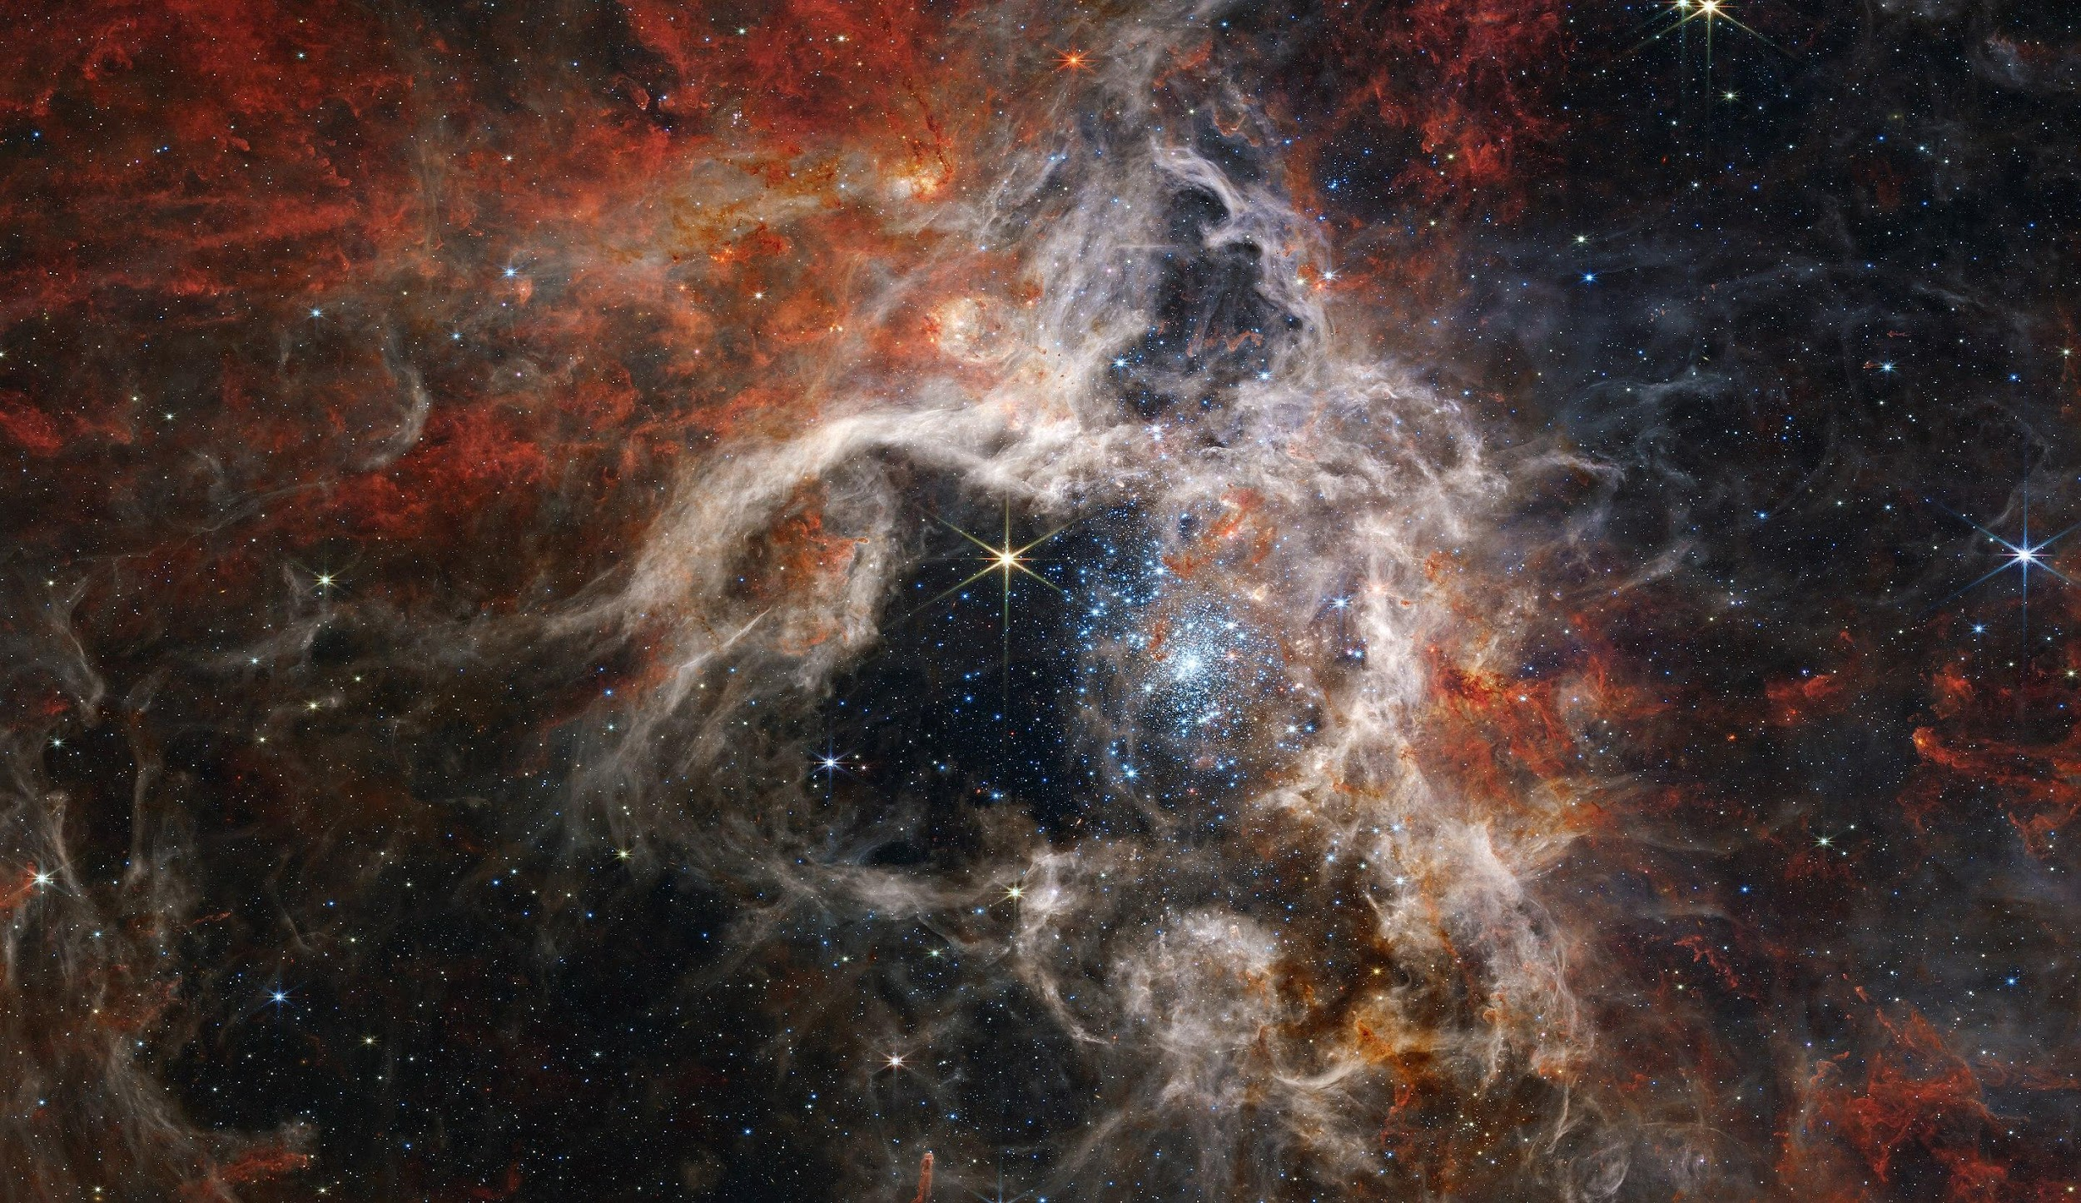
Implications of modern mass-loss rates for massive stars
JD Merritt
Ben Farr Group
University of Oregon
Notes:
tarantula nebula?

Slide 3
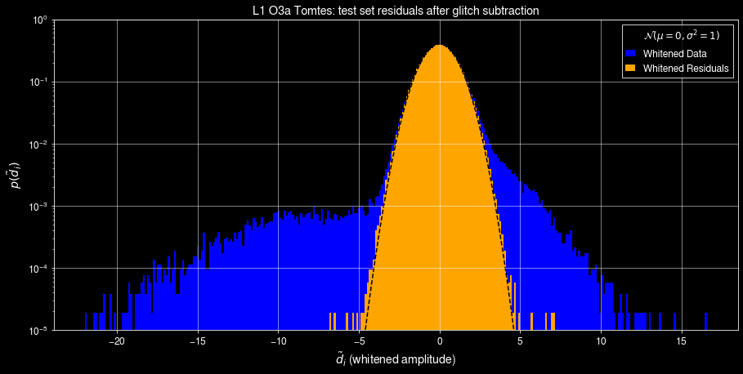
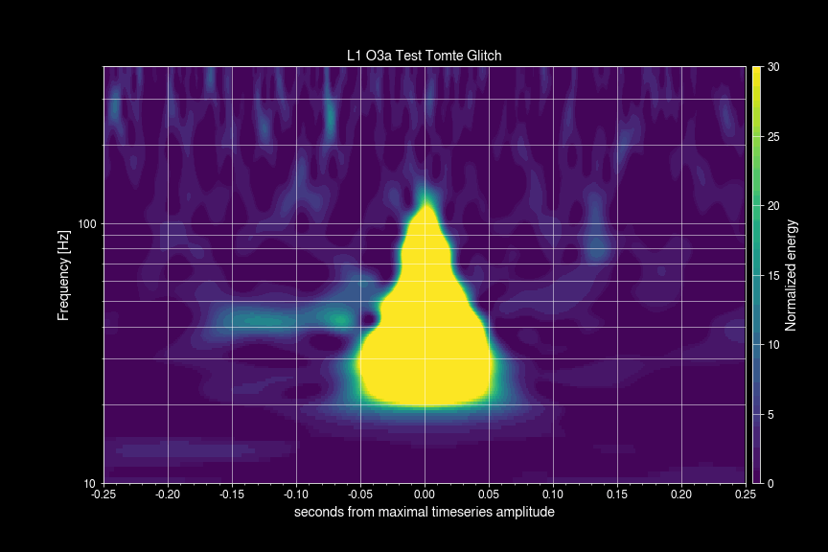
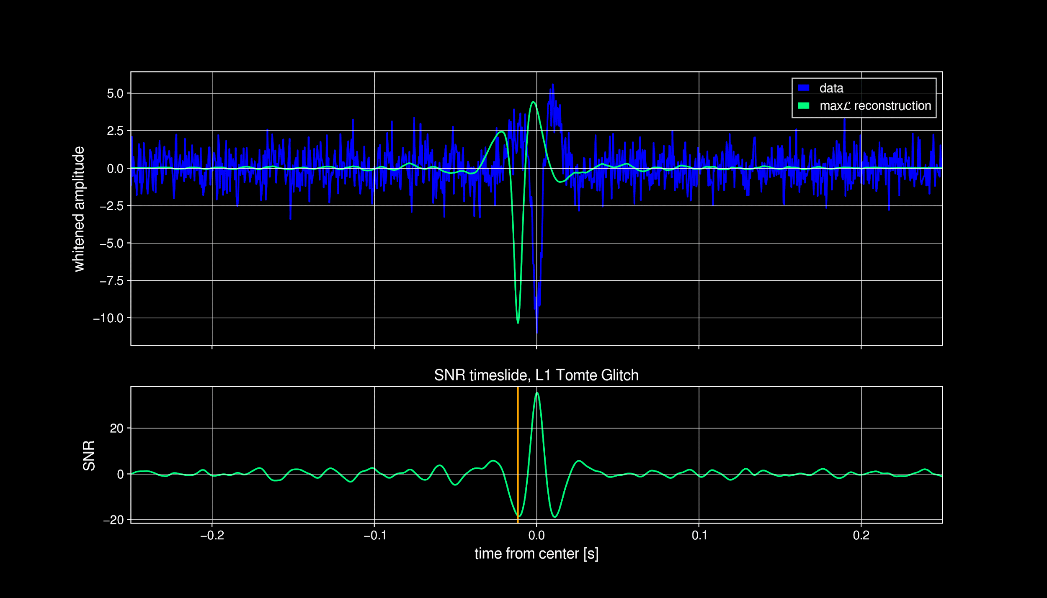
Glitschen
JD Merritt
A data-driven model for transient glitch mitigation.

Slide 4
Aims of Population Synthesis
Understand CBC formation scenarios and compare them to observation:
Synthesize a realistic population of binary or single stars
Evolve them in the isolated field scenario
Count CBCs and compare.
Notes:
In ben’s group we do alot of LVK population analyses, This is a different angle on the same problem, where does the LVK population come from?

Slide 5
Procedure of Rapid Population Synthesis
Initialize ~10⁷ systems from realistic distributions for binary evolution: SFR, redshift (z), metallicity (Z), semi-major axis (a), ZAMS mass.
Simulate relevant physics where cheap, empirically model or fit when expensive.
Evolve to obtain rates and properties of compact remnants, CBCs, SNe types, etc.

Slide 6
Why Rapid Pop Synth?
Answer questions that require universal rate comparisons of "rare" phenomena
Why do this when a drake equation would suffice?
https://arxiv.org/pdf/2107.14239 (Mandel 2021)
In practice, each term can only be estimated through some form of population synthesis, simulating a large number of binaries to find out how many pass each hurdle.
Observations are few(or zero), especially for rare or short lived events like CE.
Computational models are few and expensive, especially for SNe and CE.
NR Waveforms:Parameter Estimation::Detailed Stellar Evolution:Rapid Pop Synth

Slide 7
Why specifically?
Open Sourced
Many Collaborators, all with different backgrounds and expertise.
Fast: 20ms/binary on a laptop.
Besides winds, recent updates to tides, SNe and kicks, etc.

Slide 8
Mass Loss, and a Tour of Key Phases
The Relevant Knobs (highly uncertain):
Binary interactions:
Common Envelope
Stable Mass Transfer
Supernovae and Kicks
How much mass is retained? Is the binary disrupted?
Mass Loss
Focusing on Mass Loss, and first considering single stars:
Greater mass loss through winds leads to orbital widening to conserve momentum. (May or may not merge in a Hubble time)
Increased mass loss leads to the formation of less massive or different types of COs.
Mass loss is typically a function of L, M, R, T, Z, and sometimes more…
There are many simplifications to make
Notes:
Simplifications: these are sometimes stable, sometimes periodic/episodic, and sometimes chaotic processes. Mass loss prescriptions can be empirical, theoretical, based in simulation or based in observation.

Slide 9
Notes:
We start out on the main sequence, evolve rightward (cooler) as we burn heavier elements.

Slide 10
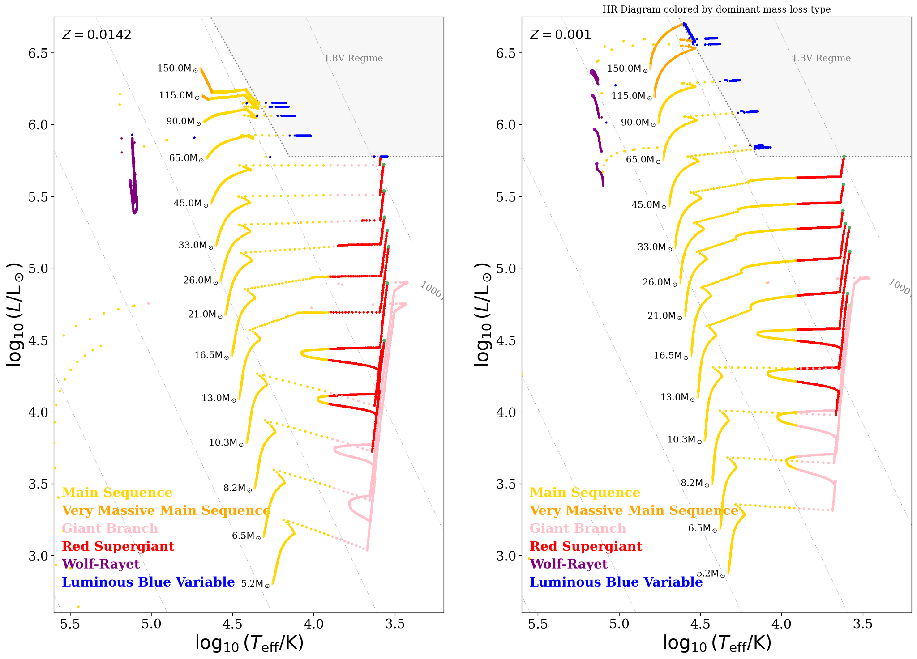

Slide 11
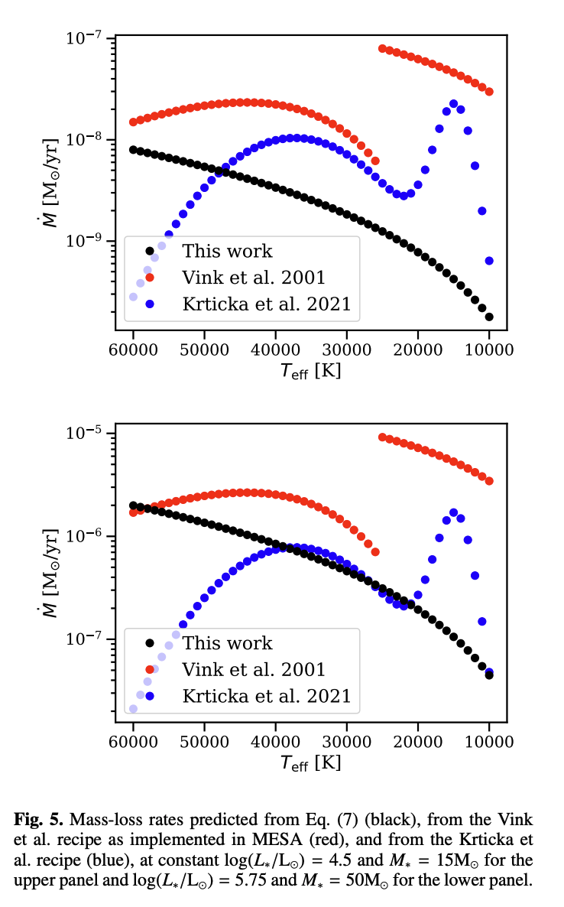
Main Sequence
Defined by H burning
Millions to Billions of years.
Appreciable (for rapid pop synth) mass loss only occurs in "massive" stars, not sunlike stars. This is enforced by a T cutoff
below 12.5kK for MS stars
Or B spectral type
Eg. "OB mass loss"
https://arxiv.org/pdf/2203.08218 Bjorklund
Notes:
Our sun at around 5kK, effectively has no winds as far as evolutionary outcomes go.

Slide 13
VMS/LBV
LBV winds occur with a check of an extreme luminosity limit(6x10⁵L☉), the same used in Startrack since 2010, and the HD limit, where we generally don't observe any stars.
VMS winds consider Gamma~0.7 and above as optically thick winds with greater efficiency.
In COMPAS we only apply these above 100M☉
Rare but significant for yields and CBC mass.
Notes:
Explain the Eddington Limit. a function of Luminosity, Mass, Composition. Describes the tipping point beyond which radiation pressure blows the star apart.
LBV mass loss is episodic, so prescriptions are typically trying to crudely time average complex behavior

Slide 14
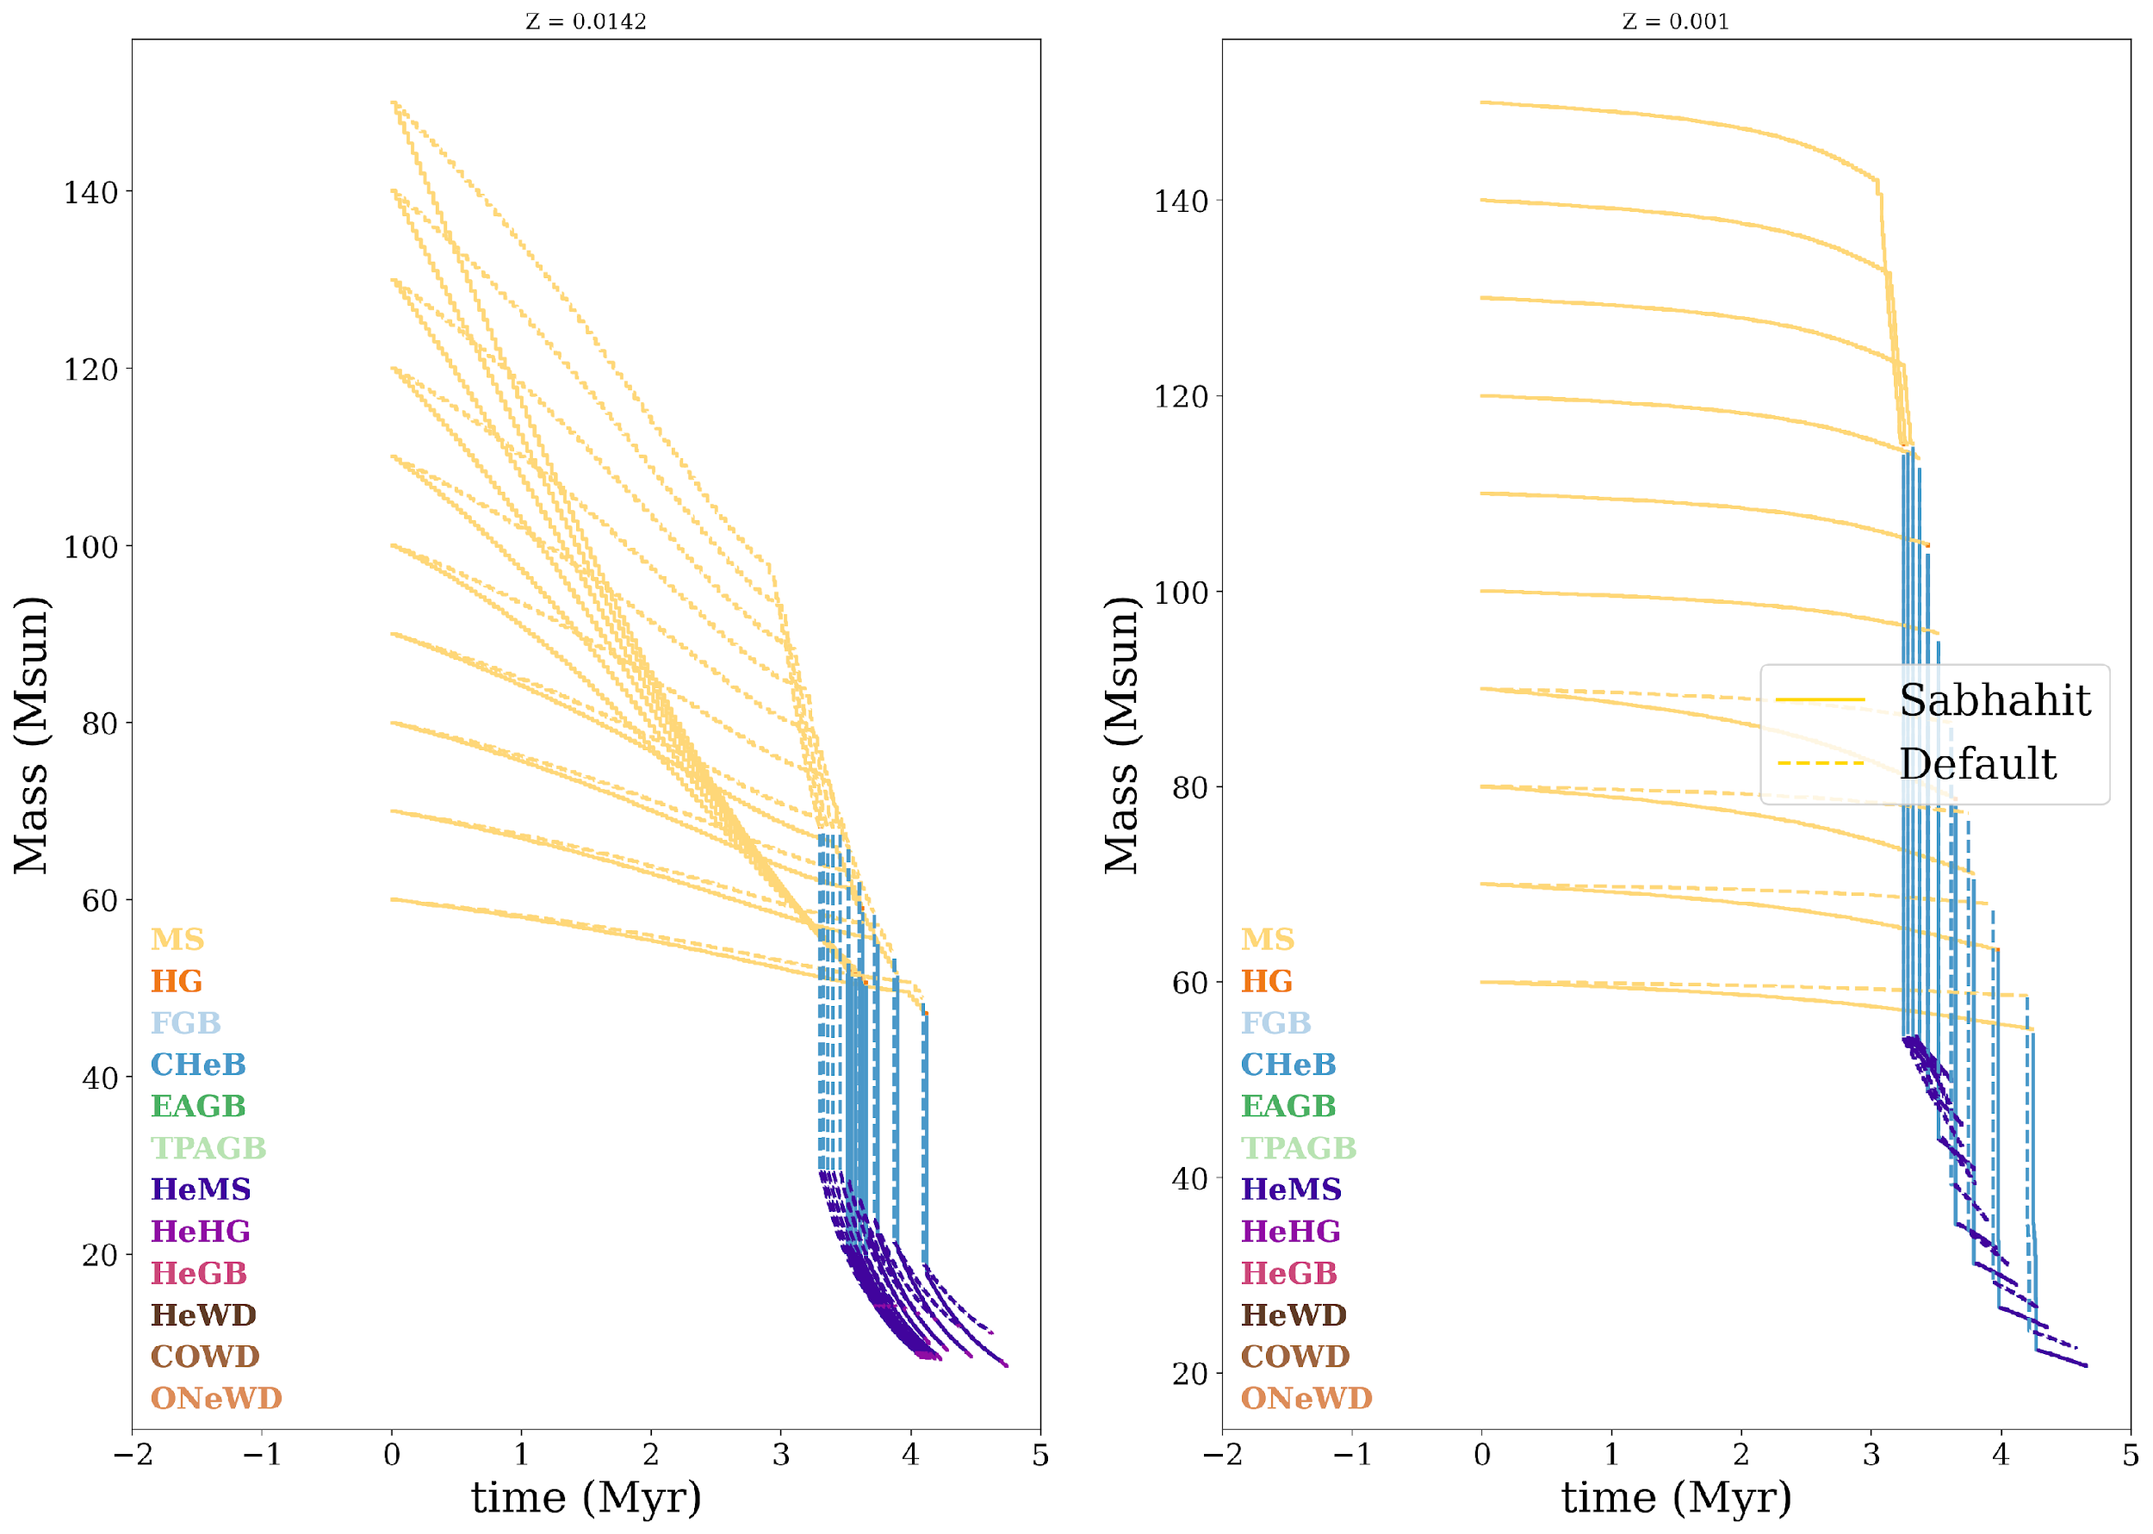

Slide 15
Notes:
If we start out at 150 solar masses, mettalicity and the wind prescription determines whether we end up at 25 solar masses, or 140 solar masses at the end of the main sequence…

Slide 16
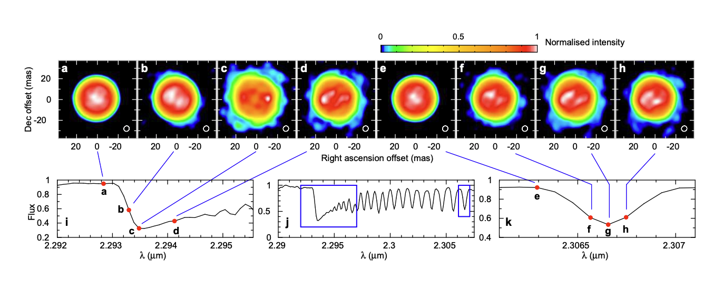
RSG
Ohnaka 2017 https://arxiv.org/pdf/1708.06372
"Evolved": burning elements He and heavier in the core.
Hotter core, looser and cooler envelope.
T: ~3500-4000K (classical RSG, up to 8000K in COMPAS)
YSG/YHG may be driven by similar mechanisms
Diffuse and loosely bound envelope
Some dust/molecular clouds
Convection driven mass loss
A small number of large convection cells
R: 100s-1500R☉
L: 1000s-10⁶R☉
M ZAMS: ~10-40Msun
In-phase lifetime: 3Myr-100kyr (for respective masses. A factor of ~10 shorter than the MS).
COMPAS criteria: T>8kK, MZAMS>8M☉, stellar type in "GIANTS"
Notes:
describe antares. The mechanisms for mass loss are fundamentally different here, with loosely bound convection granules. In the sun, the size of texas, in a RSG, the size of earth’s orbit

Slide 17
Notes:
the important thing to note here is that we vary over 8 orders of magnitude.

Slide 18
Notes:
Can avoid self-stripping and orbital widening with lower RSG mass loss rates

Slide 19
Why are Yields so sensitive to RSG winds?
It was thought that most BBH progenitors are fully self stripped or interacting, so why do RSG winds matter?
At low Z, changing RSG winds changes Yields by a factor of ~2
Envelope ejection -> Orbital Widening -> Still BBH but...
Can't merge in tH for this particular slice of the parameter space...

Slide 20
WR
Defined by H depletion: "Self Stripping"
Brightest and hottest stars observed.
Occur at high Metallicity.
T: 20,000 – 200,000K
L: 1,000s-1,000,000s of Lsol
R: 0.7-30 Rsol (dense...)
M: 10-200+ Msol
MZAMS: above 12-15Msol
Phase lifetime: 0.5Myr
He evolution.
Dominant effect at high Z

Slide 21
The Comparison Sets
16 new options total in 4 different phase-categories.

Slide 22
The Full Set
16 new options total in 4 different categories.

Slide 23
Astrophysical Qs?
Max BH mass?
Max BBH total M
DCO Yields as a function of Z
Major Observational Examples:
Cyg X-1
GW150914
Gaia BH3

Slide 25
Yields
Notes:
This is the rate of BBH formation, per star forming mass

Slide 27
Notes:
The takeaway here is the rightward shift: ie more cbc formation is possible in the local universe than previously thought. But recall that we’ve just sampled from the initial parameters: this isn’t a physically observable distribution…

Slide 29
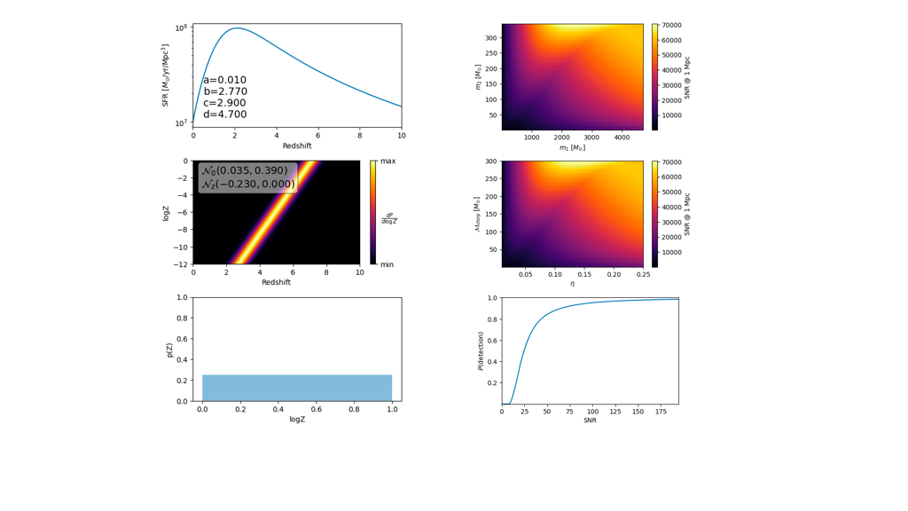

Slide 30
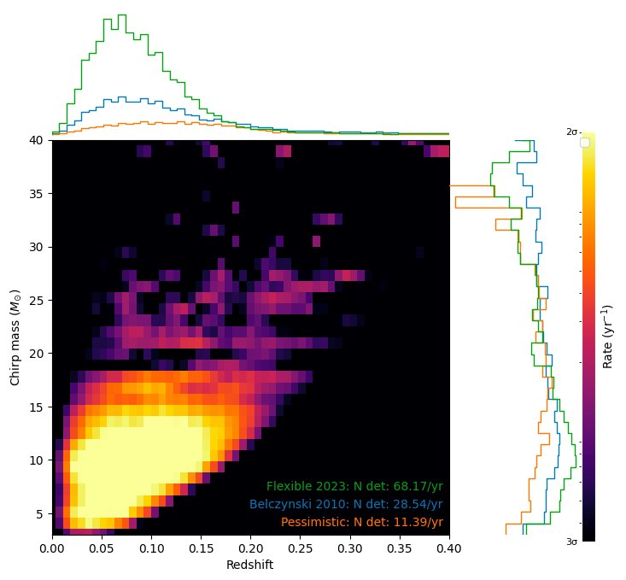
Notes:
BBHs only, O3 sensitivity, 1 year of observing time.

Slide 31
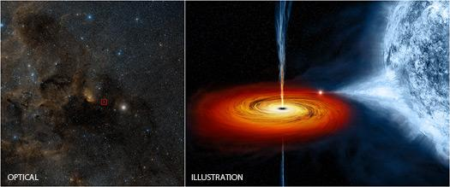
Cyg X-1
21 ± 2 M⊙ (Miller-Jones et al. 2021; Neijssel et al. 2021).

Slide 32
Notes:
Upper plateau is the onset of PPISN. Right plateau is SNe p

Slide 33
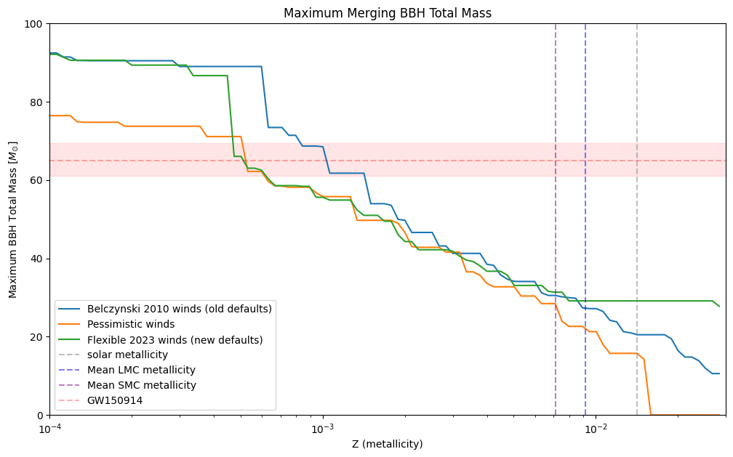
GW150914

Slide 34
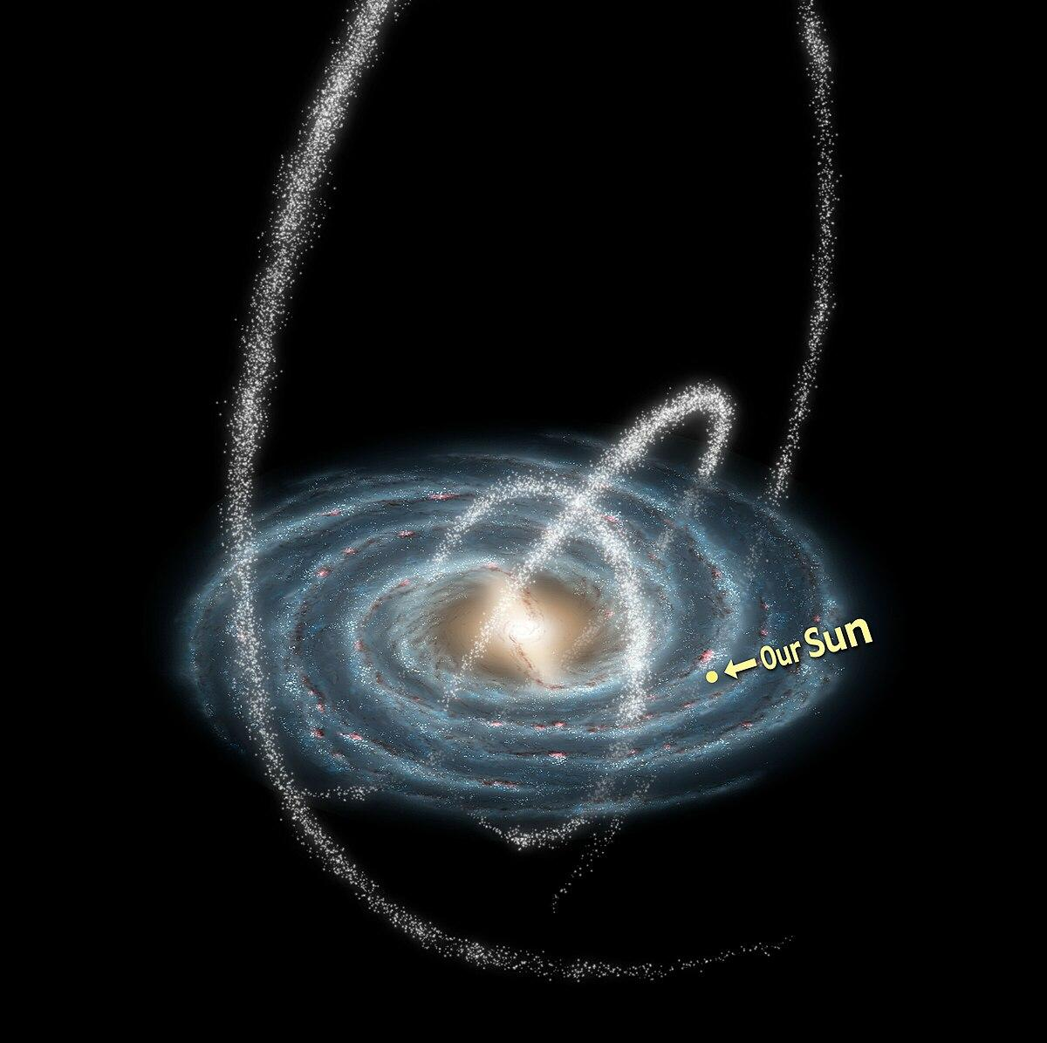
Gaia BH3
33 M☉
A metallicity estimate of –2.6 dex
Below the normal COMPAS range.

