Slide 1
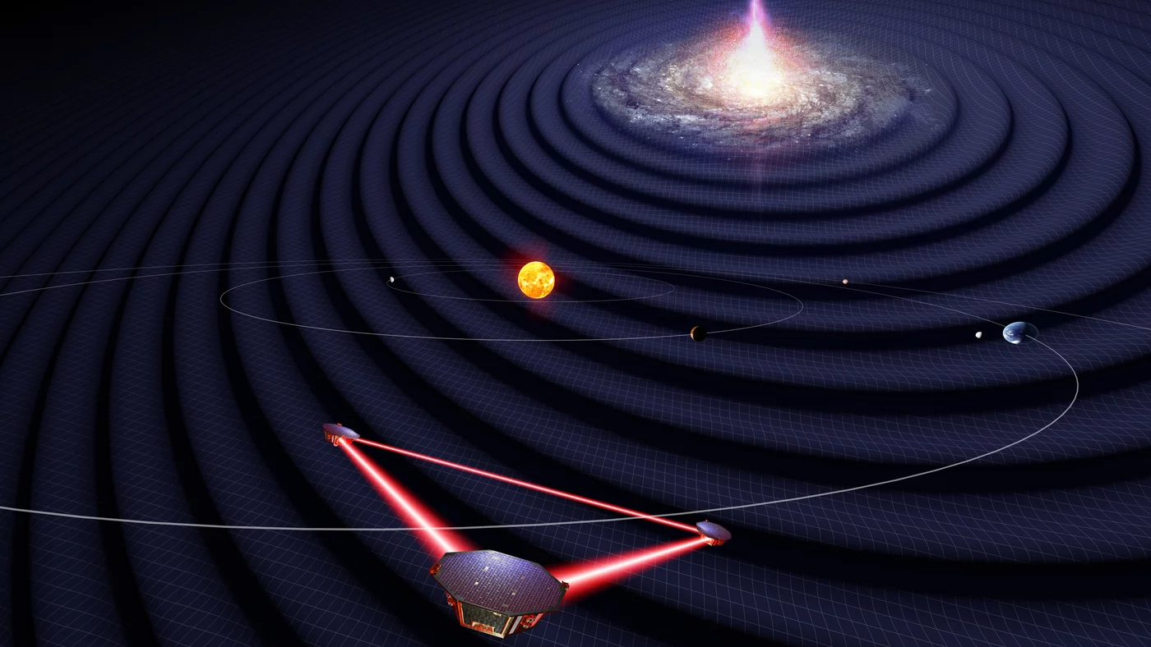
The LISA mission
Tom Wagg
University of Washington
Image: University of Florida / Simon Barke (CC BY 4.0)

Slide 2
LISA overview
What is LISA? Differences from other detectors?

Slide 4
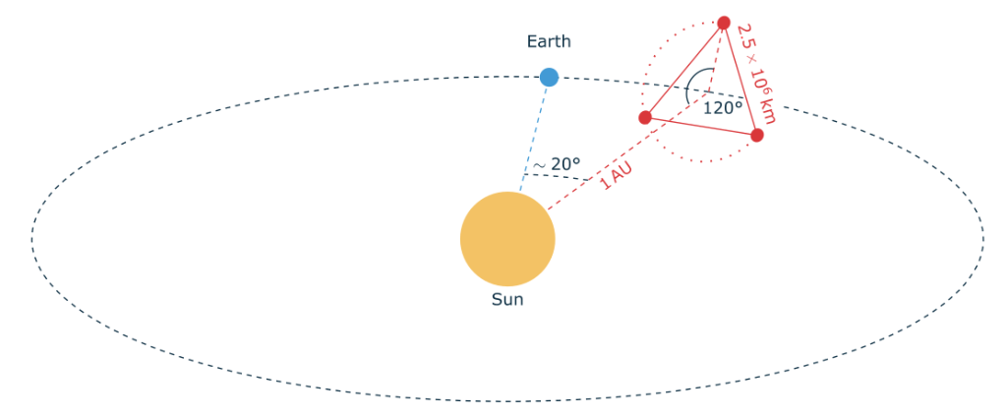
LISA mission design
Laser Interferometer Space Antenna consists of 3 spacecraft in equilateral triangle constellation, orbiting 20º behind Earth
4.5 year nominal mission lifetime
Colpi+2024 Fig 2.3

Slide 5
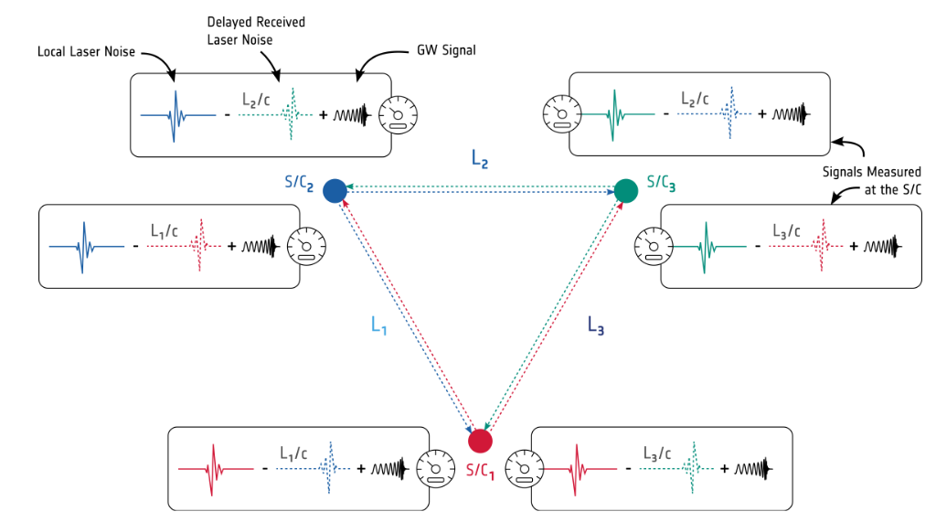
Time-Delay Interferometry setup
Each spacecraft emits and receives a beam
Pairs of lasers compared at end of each arm, can remove frequency noise
GW signals retained as different correlations between one-way measurements
Colpi+2024 Fig 2.5

Slide 6
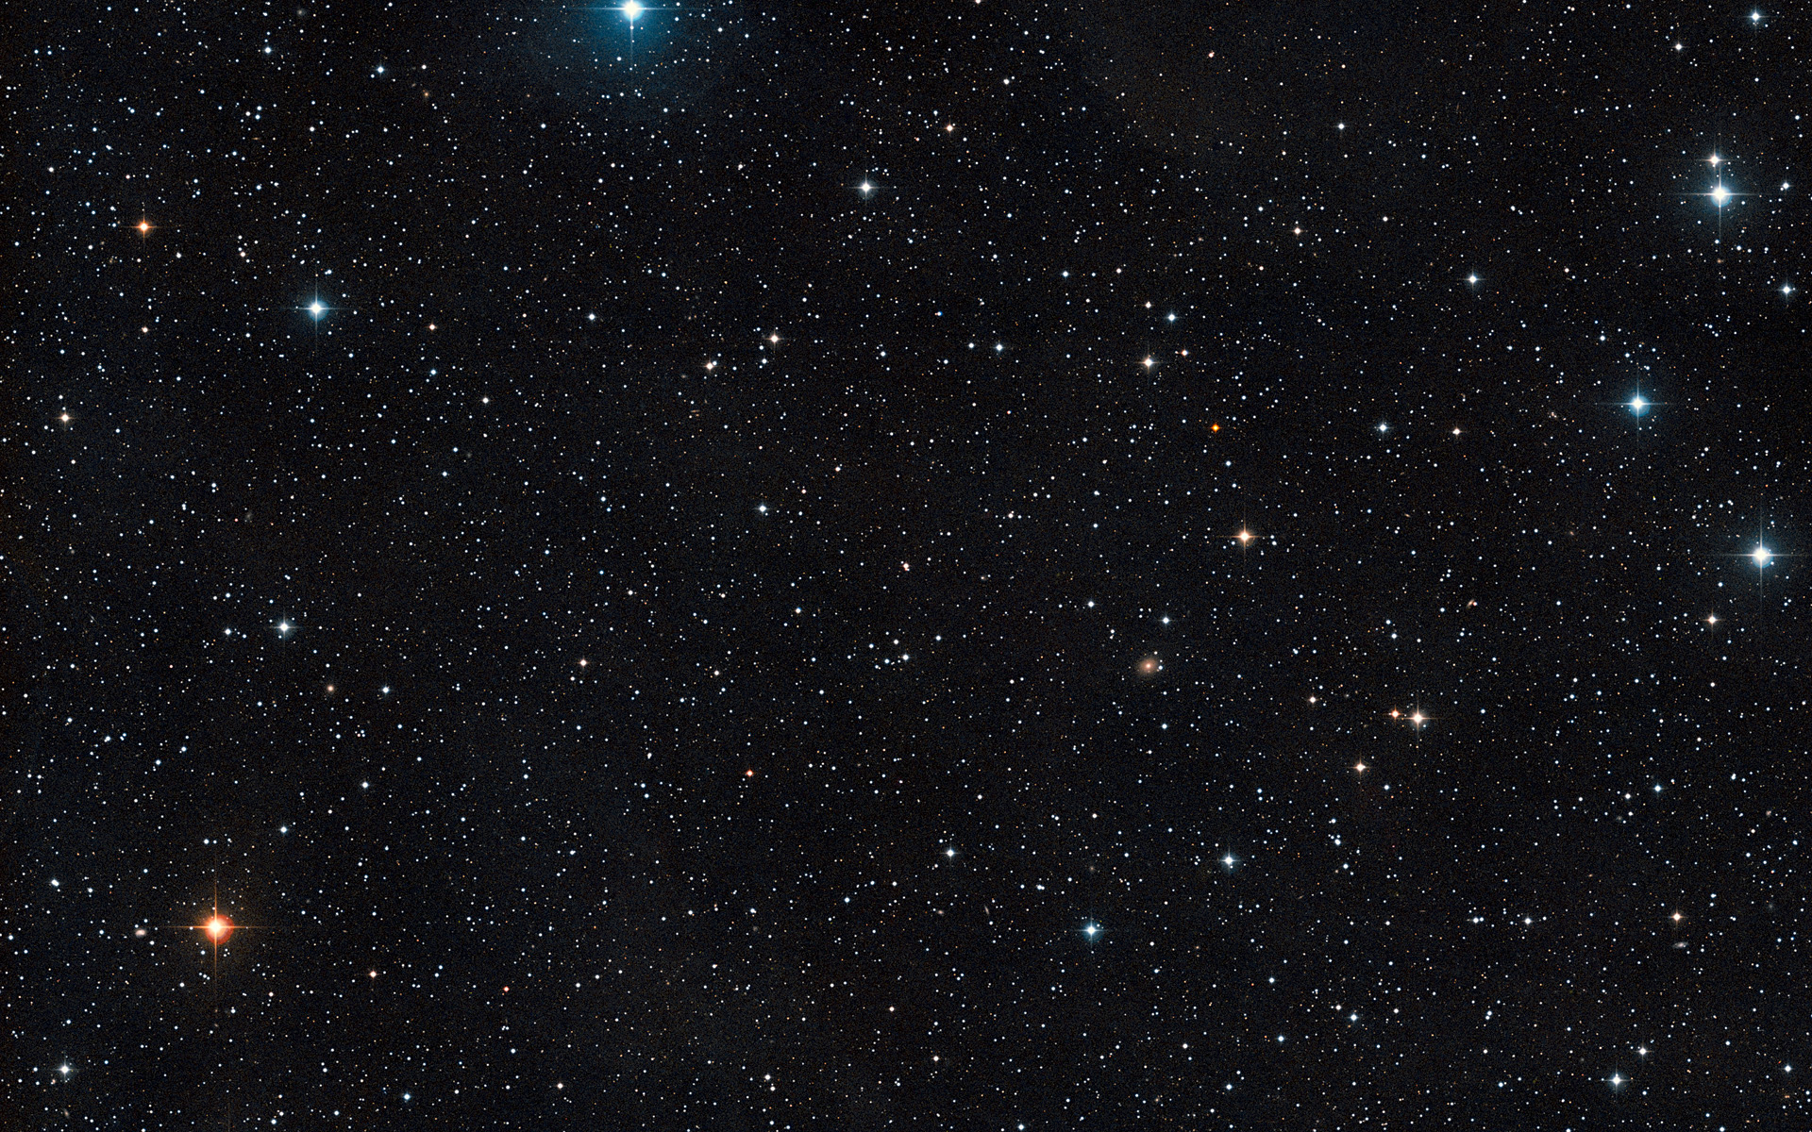
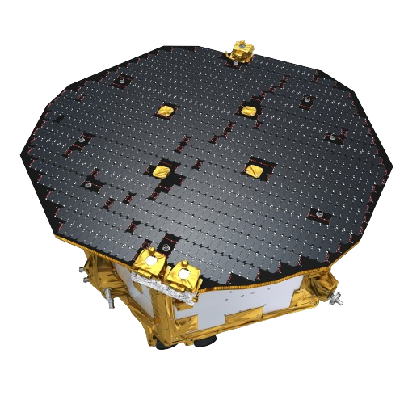
LISA is extremely sensitive
~62.5 times around the Earth
Detects shifts in separation less than the width of a human hair
2.5 million km

Slide 8
LISA focuses on millihertz gravitational waves
Colpi+2024 Fig 2.1

Slide 9
LISA focuses on millihertz gravitational waves
Colpi+2024 Fig 2.1

Slide 10
LISA detects complementary sources
Multiband detections
Some sources could be detected by LISA and other GW detectors
Different evolutionary stages
Stellar-mass binaries can be detected prior to merger
New sources
LISA can detect GWs from massive black hole binaries

Slide 11
Science Goals
(A subset of the) science enabled by LISA

Slide 12
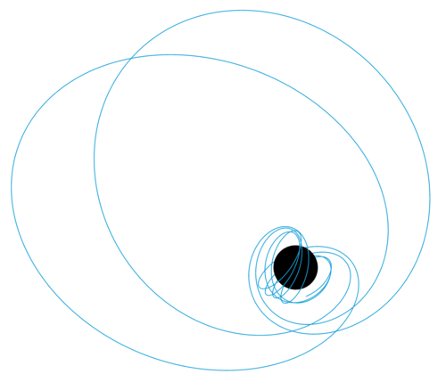
Stellar-mass binaries
Primary LISA source classes
Extreme mass-ratio inspirals (EMRIs)
Massive black holes binaries
Graphic: Benjamin Leather

Slide 13
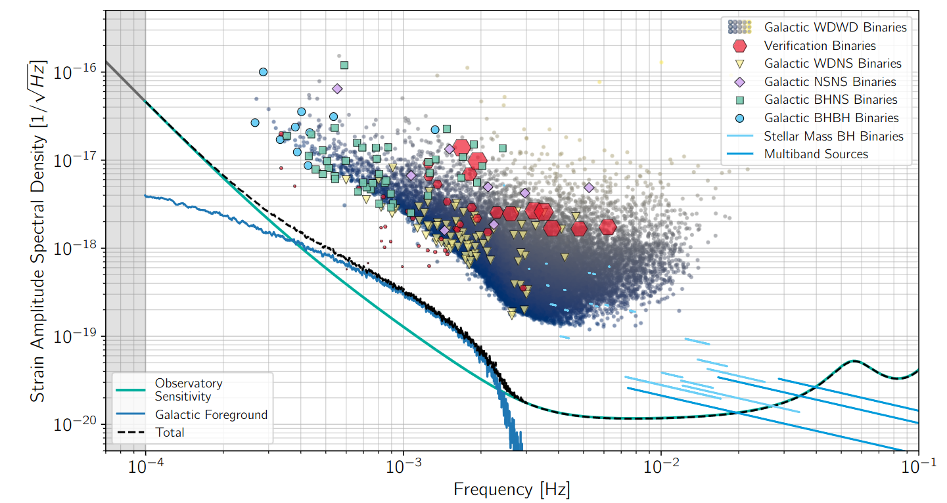
Stellar-mass binaries landscape
Unresolvable sources contribute to galactic confusion noise
~25,000 WDWDs (Korol+2017) and 10-100s more massive binaries (Toonen+2018, Wagg+2022) detected
Colpi+2024 Fig 3.1 (with data from Korol+2017, Toonen+2018, Wagg+2022)

Slide 14
Stellar-mass binaries: Understanding binary evolution
Rate and distributions of close LISA binaries constrain aspects of binary evolution (e.g. Nelemans+01, Ruiter+10, Breivik+18, Lamberts+18, Wagg+22)
Supernova natal kicks
Mass transfer
Common-envelope
Sources otherwise likely invisible to EM - can measure MW mass distribution (e.g. Korol+21, Georgousi+23)

Slide 15
Stellar-mass binaries: Understanding binary evolution
Rate and distributions of close LISA binaries constrain aspects of binary evolution (e.g. Nelemans+01, Ruiter+10, Breivik+18, Lamberts+18, Wagg+22)
Supernova natal kicks
Mass transfer
Common-envelope
More to come in my talk
about LEGWORK tomorrow!
Sources otherwise likely invisible to EM - can measure MW mass distribution (e.g. Korol+21, Georgousi+23)

Slide 16
Stellar-mass binaries: Black hole formation
LISA advantage: measures eccentricity to precision of ~10⁻³ for SNR > 8 (Nishizawa+16)
Distinguish dynamical vs. isolated binary formation with 99% confidence (Nishizawa+17)
Comparing parameters when it merges years later
LISA will identify handful of multiband sources - can predict merger location to ~few deg² and time to ~several hours (Sesana+16)
Measuring sBHs close to merger
Potential EM counterparts (Perna+16, de Mink+17, Tagawa+21) and cosmological probes (Muttoni+22, Baker+23)

Slide 17
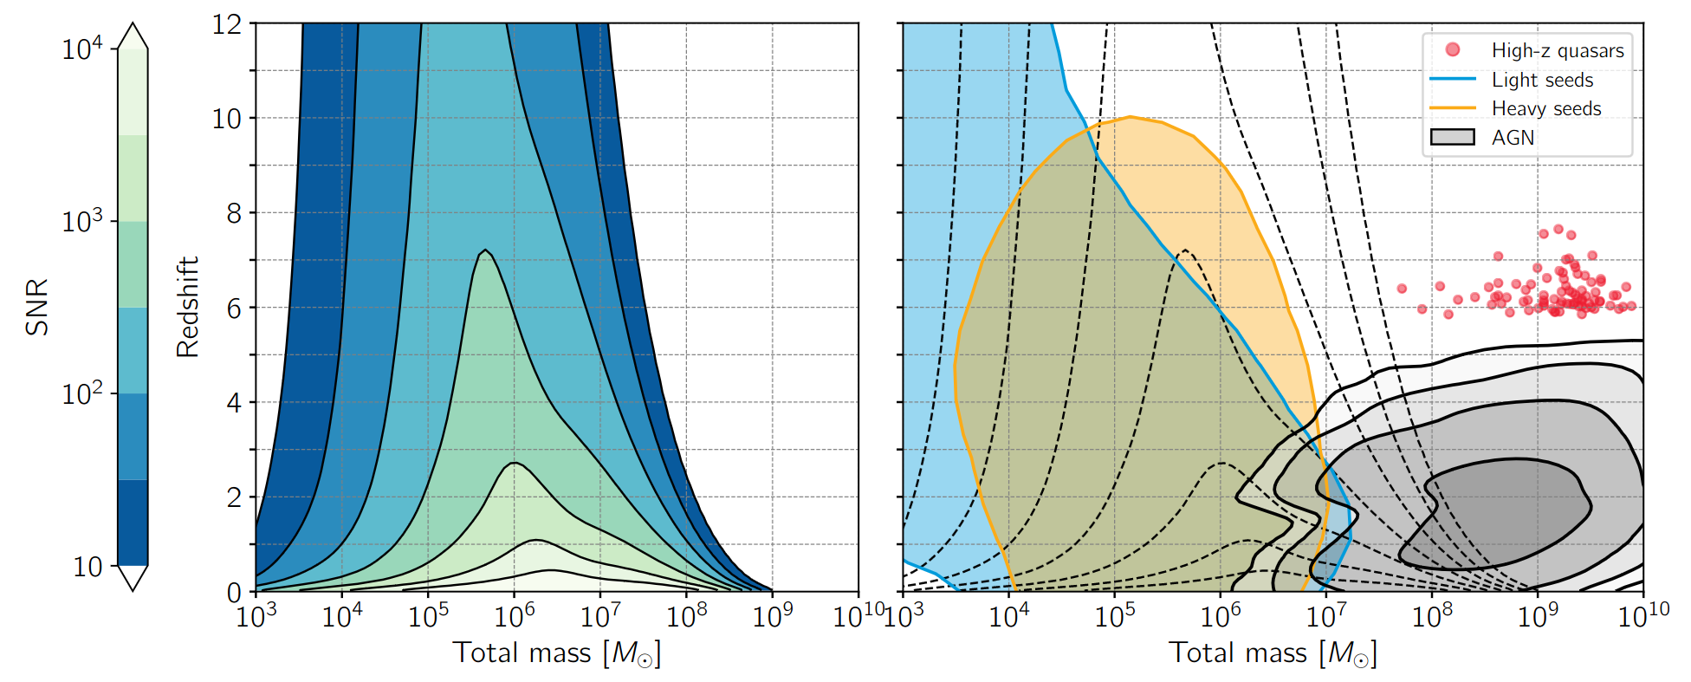
Massive black holes: Origins of SMBHs
LISA is sensitive to SMBH and IMBH binaries at high redshifts with high SNRs

Slide 18
Massive black holes: Origins of SMBHs
Bonetti+19 (seeds), Wu+2022 (AGN), Yang+21 (quasars)
Light seeds: formed from many metal-free stars (~10-100s Msol)
Heavy seeds: formed from single supermassive star (1e4-1e5 Msol)
Seed populations can be identified by LISA

Slide 19
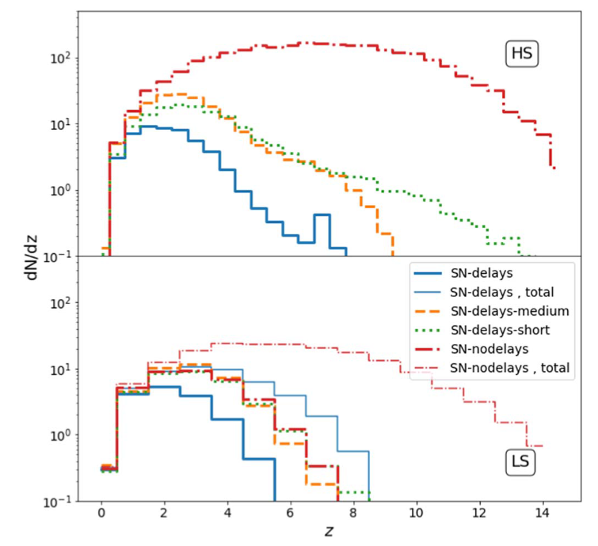
Massive black holes: Evolution
Barausse+20, Fig 1
Dual AGN discovered…but only candidate MBHBs (de Rosa+19, Bogdanović+22)
Rates + distributions inform merger histories of MBHBs and their hosts (e.g. Dayal+19)
Expect ~few-100 per year (e.g. Barausse+20)

Slide 20
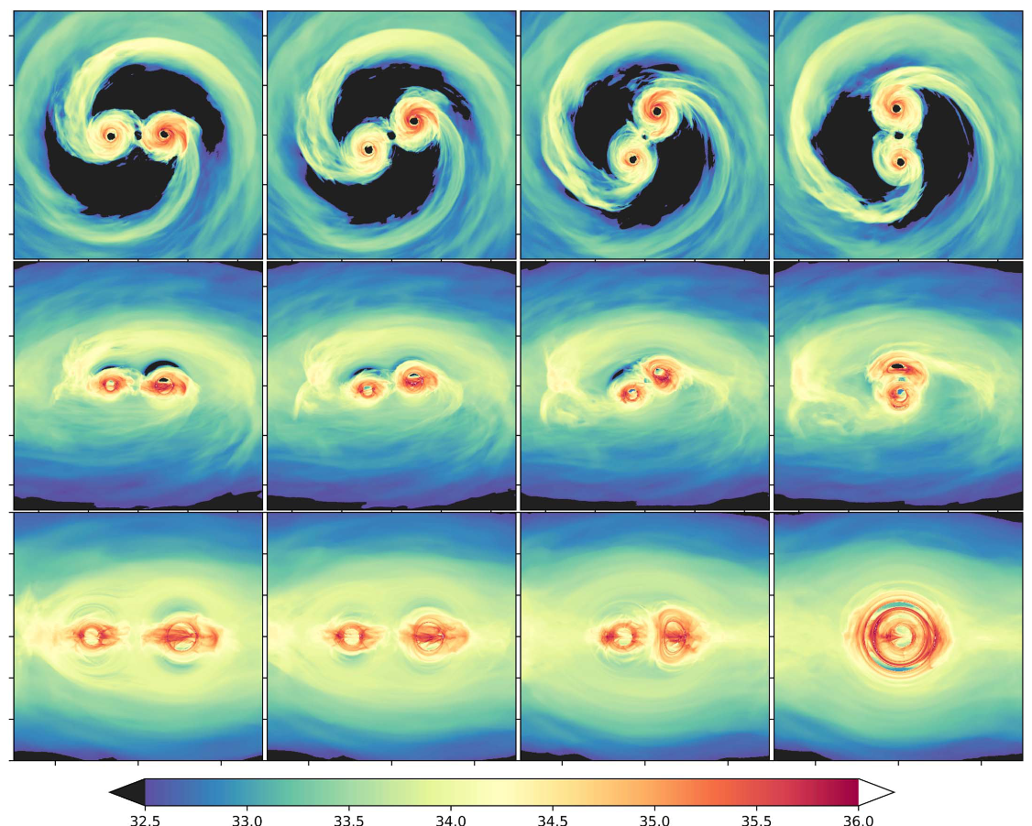
Massive black holes: Environment
EM counterparts = perfect lab for accretion & jet-launching in time-varying spacetime (e.g. d’Ascoli+19)
Consequences of merger on disc? Turn on of AGN? Multiwavelength collimated jet? Observe with multimessenger! (e.g. Corrales+10, Rossi+10, Yuan+21)
d’Ascoli+19, Fig 9

Slide 21
EMRIs (+IMRIs & XMRIs) landscape
IMRI
EMRI
XMRI
1e-3 < q < 1e-4
1e-6 < q < 1e-4
1e-6 < q
Graphic: Benjamin Leather
IMBH + something
MBH + stellar mass object
Something + brown dwarf
IMRIs up to ~few hundred (Arca Sedda+21), EMRIs ~few-several thousands (Babak+17), and ~10s of XMRIs (Berry+13)

Slide 22
EMRIs (+IMRIs & XMRIs) landscape
IMRI
EMRI
XMRI
1e-3 < q < 1e-4
1e-6 < q < 1e-4
1e-6 < q
Graphic: Benjamin Leather
IMBH + something
MBH + stellar mass object
Something + brown dwarf
IMRIs up to ~few hundred (Arca Sedda+21), EMRIs ~few-several thousands (Babak+17), and ~10s of XMRIs (Berry+13)

Slide 23
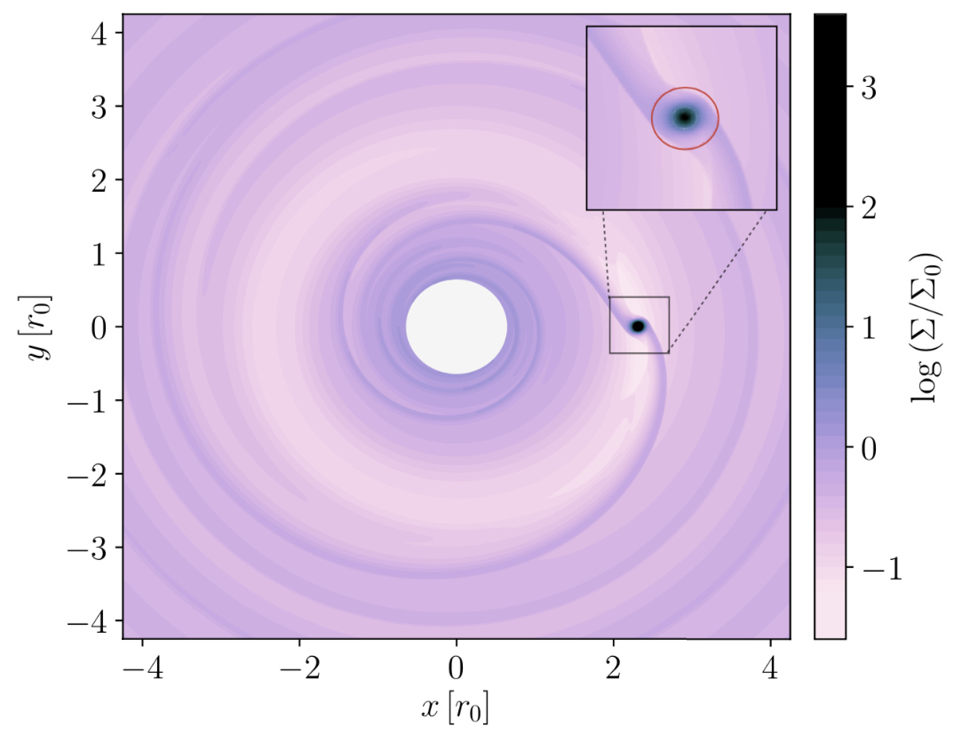
EMRIs: MBHs in quiescence
Derdzinski+21, Fig 1
Unique probes of MBHs in quiescent state (no merger or accretion) and their environment (e.g. Derdzinski+21, Zwick+22)

Slide 24
EMRIs: Tests of gravity
?
EMRIs encode detailed information about the central object’s geometry (Babak+17)
?
?
Provide constraints for deviations from Kerr and test the “no hair theorem” (Herdeiro+15)

Slide 25
And so much more!
Probe expansion rate of universe with bright/dark sirens
IMBH populations with IMRIs
Stochastic GW backgrounds
GW bursts? Unforeseen sources?
Cosmic strings??

Slide 26
Mission Status
What is LISA ✅
Why is LISA ✅
When is LISA❔

Slide 27
LISA has been adopted!
As of January 25th 2024 LISA has been officially adopted 🎉🎉🎉
Entered Phase B2 (beginning hardware implementation!!)

Slide 28
Launch aimed for 2035 on an Ariane 6
These are ESA timelines so error bars are fairly small on this date :D
There’s a stable design for the technology that’s robustly tested
Noise isolation and micronewton thrusters by LISA pathfinder - ground-based tests on the laser receiver/emitter - laser ranging with Grace Follow-On mission

Slide 29
LISA Takeaways
We’ll be inundated by a host of new sources (inspiralling sBHs, MBHBs, EMRIs and more!)
LISA will help us constrain our understanding of multitude of topics - binary stellar evolution to testing GR
LISA will open an entirely new window into gravitational waves
🤓 Set your alarms for ~10 years and get excited! 🤓

