Slide 1
Has Pulsar B Appeared Again?
An Analysis of the J0737-3039A/B Double-Pulsar System
Taylor Starkman
DCC: G2401304
1

Slide 2
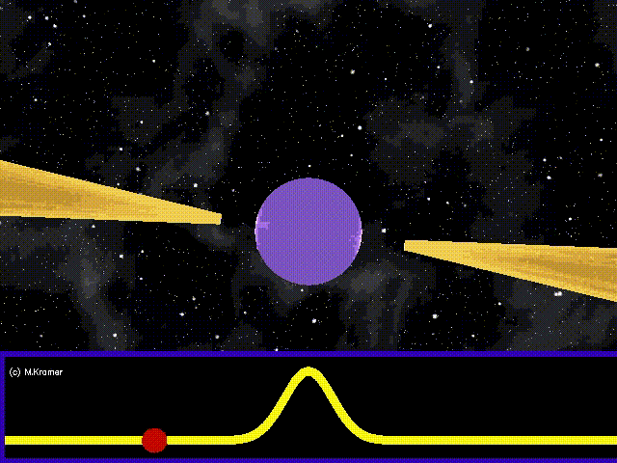
What is a Pulsar?
Bunched magnetic fields create radio beams
Periods from milliseconds to tens of seconds
Often found in binary systems
Main sequence stars and compact objects
Useful for tests of general relativity
Image credit: Michael Kramer
DCC: G2401304
2

Slide 3
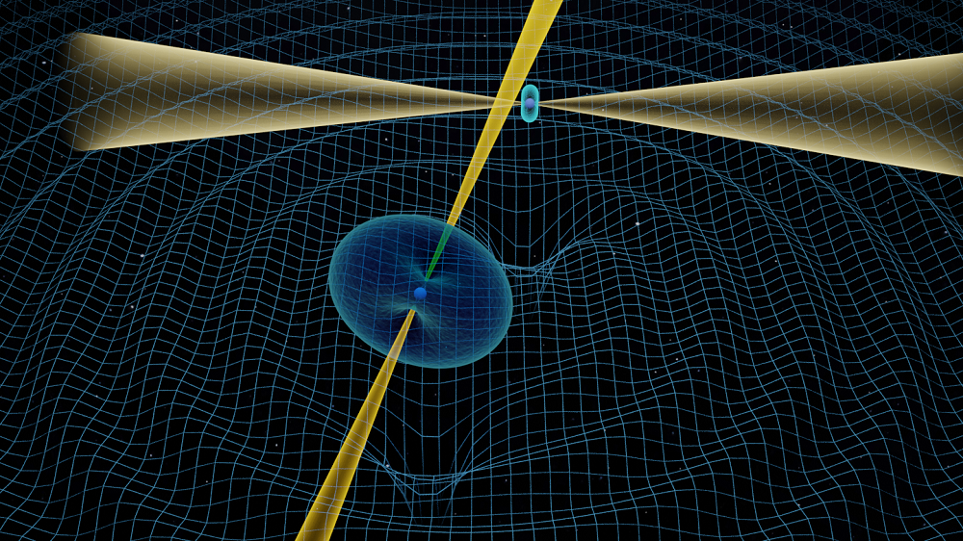
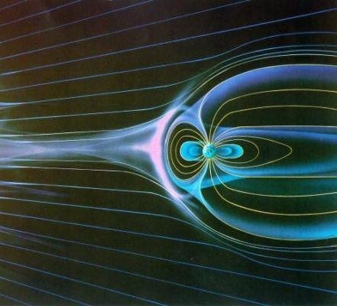
Wind from Pulsar A shapes magnetosphere of pulsar B
Eclipsing binary
Shapes beam of pulsar B?
Horseshoe shape
Presession creates a sweep of the beam
Image credit: Michael Kramer (JBCA, Unversity of Manchester).
Binary Double-Pulsar System
Orbital plane aligned with line-of-sight
Only double pulsar system
2.7 ms Pulsar A
2.8 s Pulsar B
Geodetic precession causes B to come in and out of line-of-sight
Image credit: NASA
DCC: G2401304
3

Slide 4
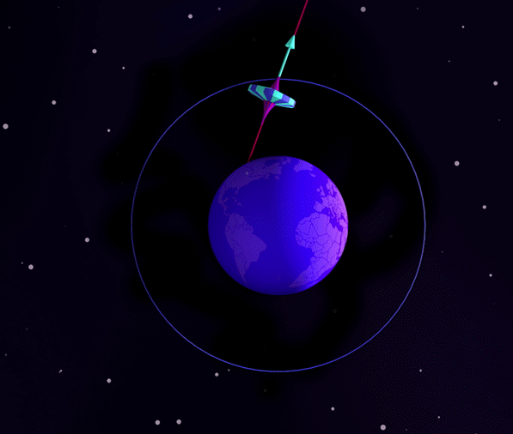
Geodetic (relativistic) precession causes the beam of Pulsar B to appear and disappear
Disappeared in 2008 (aligned with model)
Thought to appear again this year
Complete precession of rotational axis every 75 yr
Image credit: Einstein Online
DCC: G2401304
4

Slide 5
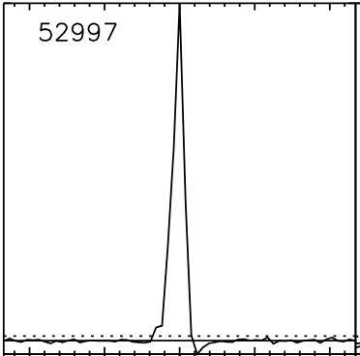
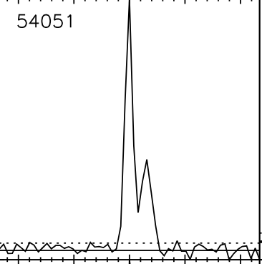
52997
54051
2003-2008
Now?
DCC: G2401304
5

Slide 6
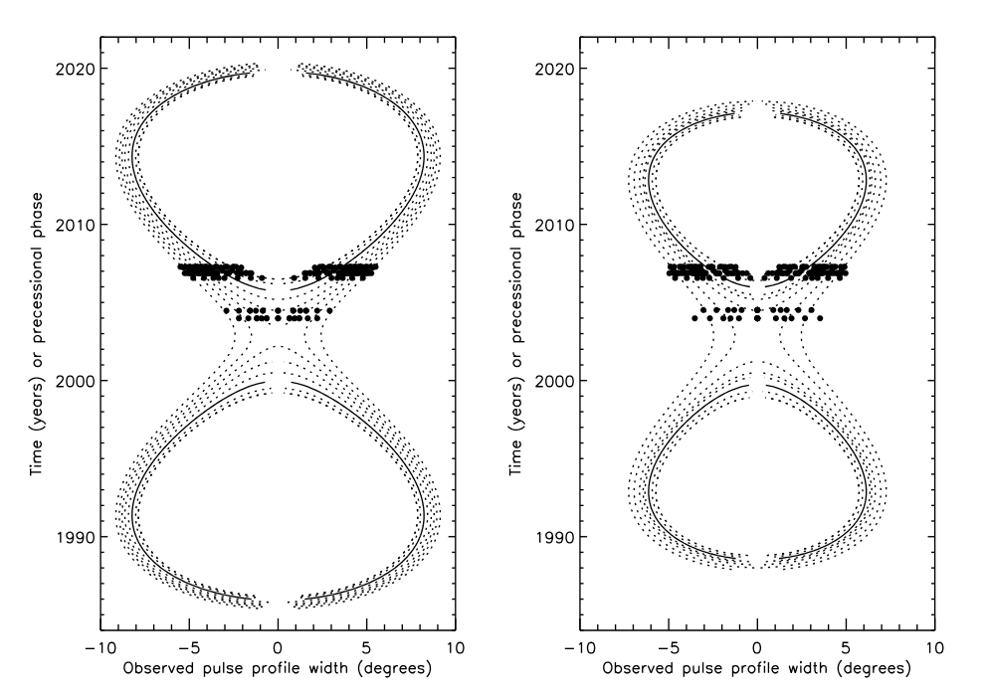
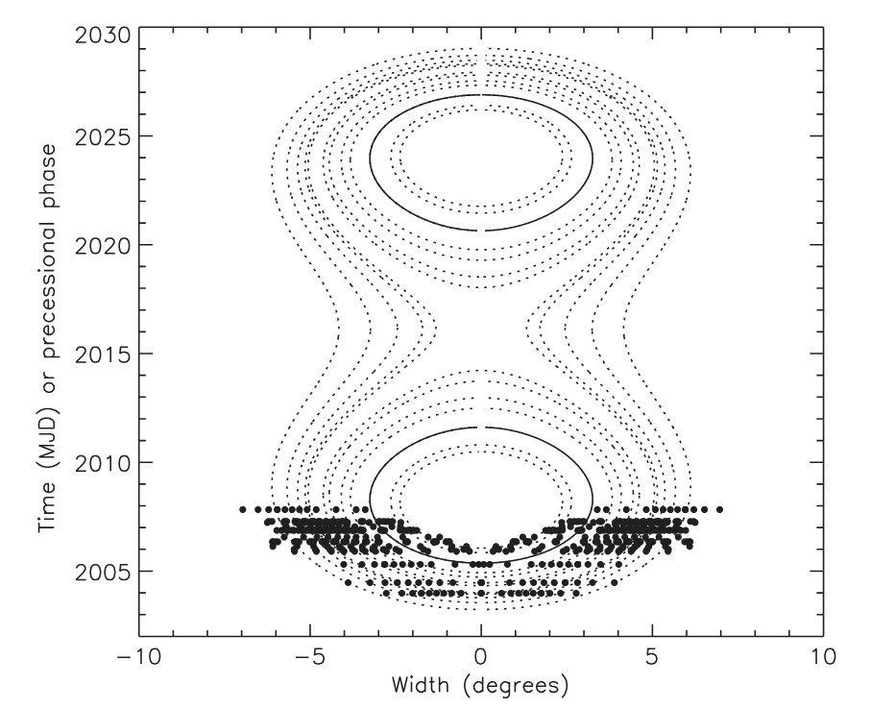
The most recent modeling (B. B. P. Perera et al 2012) suggests a reappearance in 2024
Bright Phase 1
Bright Phase 2
Now
Image credit: B. B. P. Perera et al (2010)
Previous modeling shows slight differences in beam detection for BP1 and BP2
Image credit: B. B. P. Perera et al (2012)
DCC: G2401304
6

Slide 7
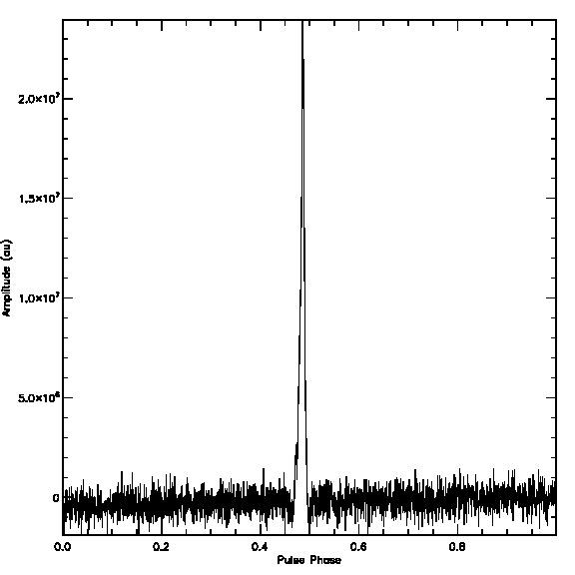
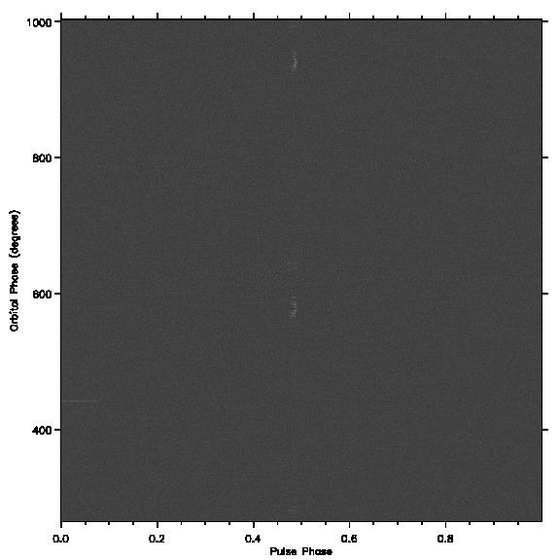
First Green Bank Telescope Observation (52997)
DCC: G2401304
7

Slide 8
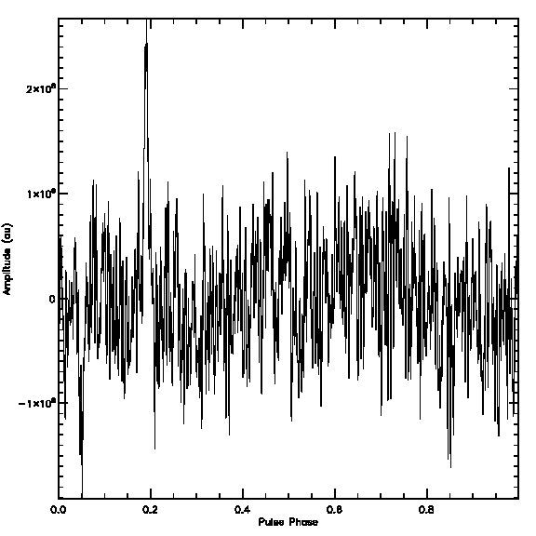
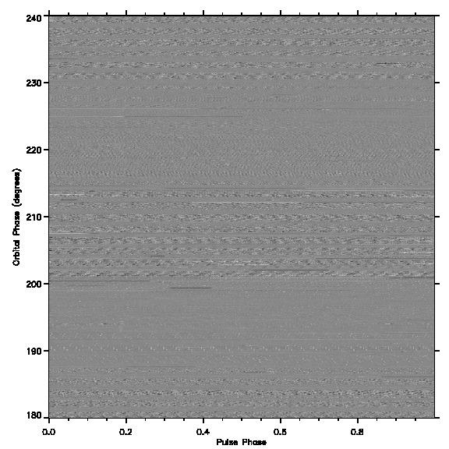
More typical observation (53175)
DCC: G2401304
8

Slide 9
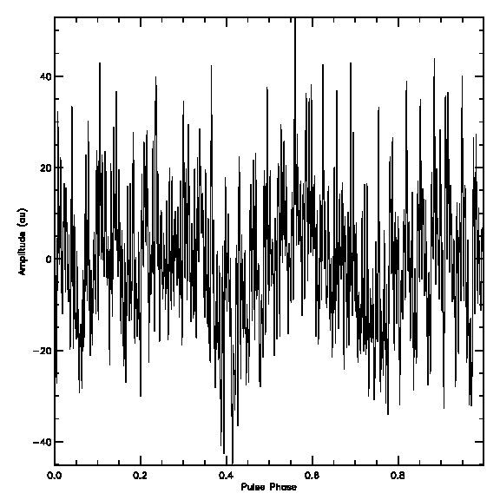
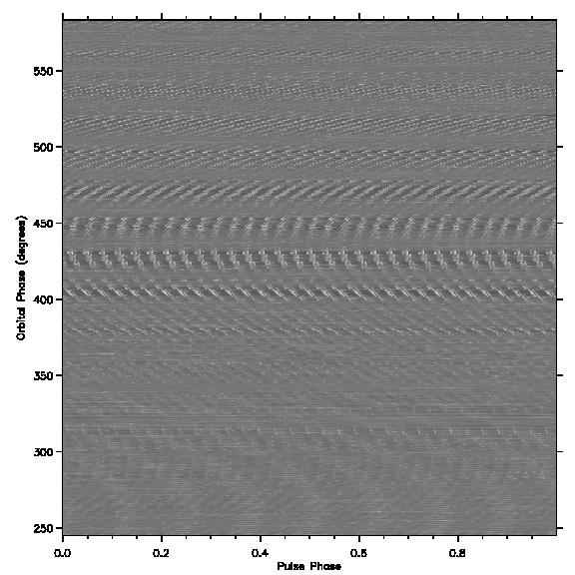
Recent Observation (no evidence of B) (59274)
DCC: G2401304
9

Slide 10
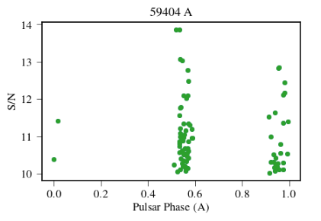
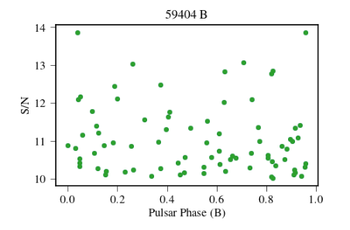
Detection Methods
Visual Analysis
Dynamic pulse vs orbital phase plots
Pulse profiles
Single pulse
S/N vs orbital phase
S/N vs rotational phase
Fast Fourier Transform (FFT)
Can detect regular bright pulses from both pulsars
No pretty pictures - sorry!
Image credit: Zachary Zelensky
DCC: G2401304
10

Slide 11
Results (so far)
We have not seen anything
To be expected because B. B. P. Perera et al predicts that B will not be visible until this year and all data was collected before December 2023
Now
DCC: G2401304
11

Slide 12
References
A. G. Lyne, A Review of the Double Pulsar - PSR J0737-3039 (Chinese Journal of Astronomy and Astrophysics, 2006)
B. B. P. Perera, et al., PSR J0737-3039B: A Probe of Radio Pulsar Emission Heights (The Astrophysical Journal, 2012)
B. B. P. Perera, et al., The evolution of PSR J0737-3039B and a model for relativistic spin precession (The Astrophysical Journal, 2010)
M. A. McLaughlin et al., The Double Pulsar System J0737-3039: Modulation of the Radio Emission From B by Radiation From A (The Astrophysical Journal, 2004)
DCC: G2401304
12

Slide 13
Acknowledgements
This research was funded by NSF NANOGrav Physics Frontier Center award #2020265 and NSF Award AST-1950617
Computational resources were provided by the Link HPC cluster and cyber-infrastructure, which is maintained by the Center for Gravitational Waves and Cosmology at West Virginia University and funded in part by NFS IIA-1458952 & NFS PHY-2020265.
Collaborators and Mentors:
Dr. Maura McLaughlin
Dr. Joey Key
Victoria Blackmon
Zachary Zelensky
Pablo Velt
DCC: G2401304
13

Slide 14
Thank you!
Questions?
Up Next: Updated Monitor for Narrow Spectral Artifacts Here at Hanford
DCC: G2401304
14

Slide 15
Updated Monitor for Narrow Spectral Artifacts at the LIGO Hanford Observatory
Taylor Starkman
DCC: G2401304
15

Slide 16
Continuous Waves
Near single frequency
Earth’s motion causes doppler shift
Likely produced by pulsars which are non-axisymmetric
Neutron stars visible as pulsars in EM, CW in GW
Image credit: Michael Kramer
DCC: G2401304
16

Slide 17
Lines
Near single frequency artifacts
Mainly electronic and instrumental sources
Cannot always be removed, so we track them
Image credit: Ansel Neunzert
Example of wide (for CW) feature (~0.026Hz wide)
Image credit: Ansel Neunzert
Example of a narrow spectral artifact (0.00028Hz wide)
DCC: G2401304
17

Slide 18
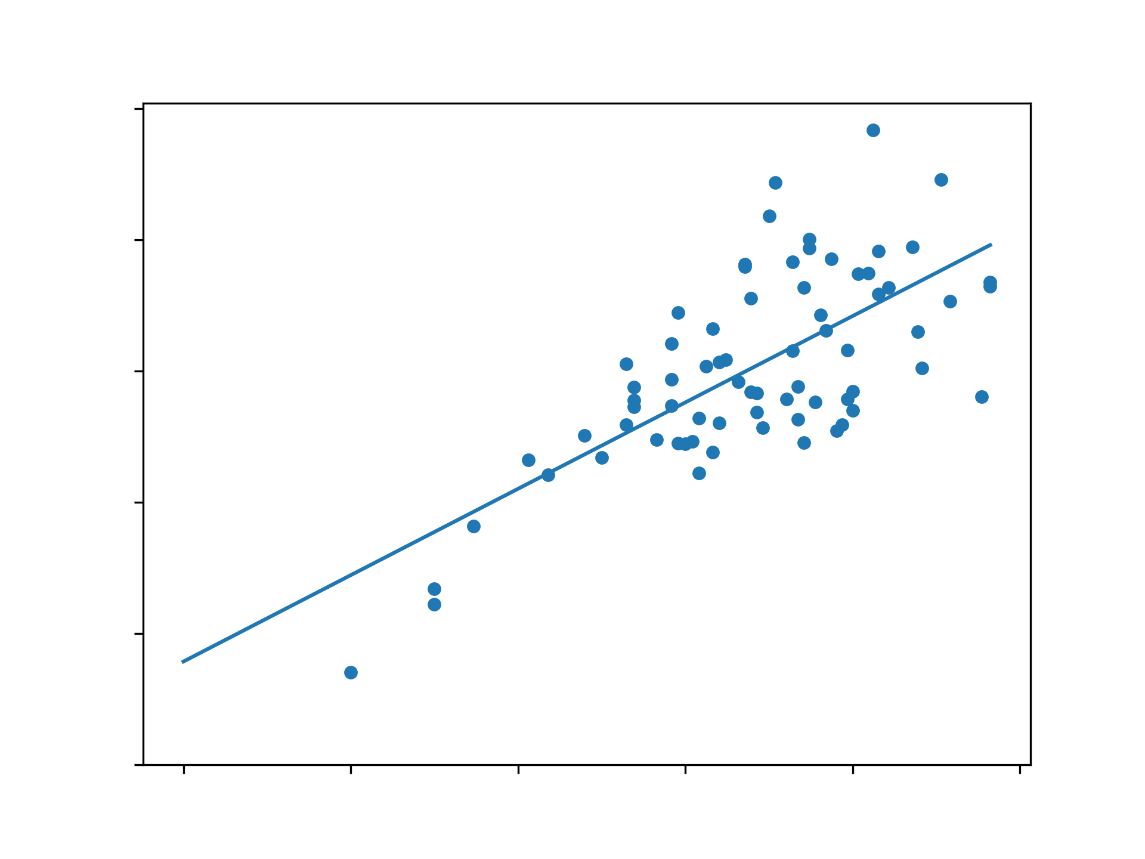
Effect of Observing Time
Signal-to-noise ratio scales with square root of observing time
Improved metric
Improving LineForest monitor
DCC: G2401304
18

Slide 19
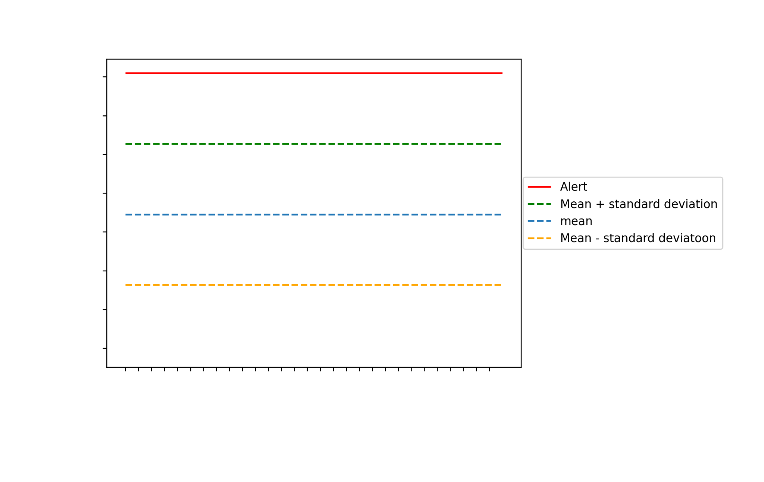
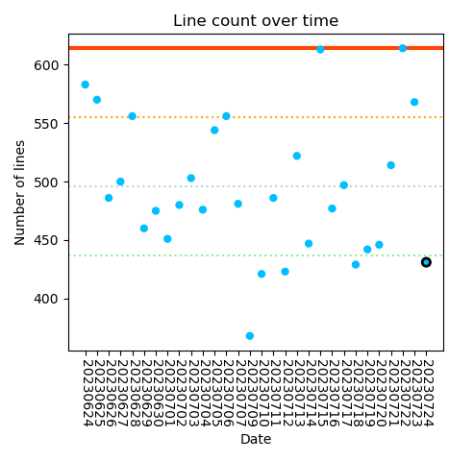
Update LineForest Monitor
DCC: G2401304
19

Slide 20
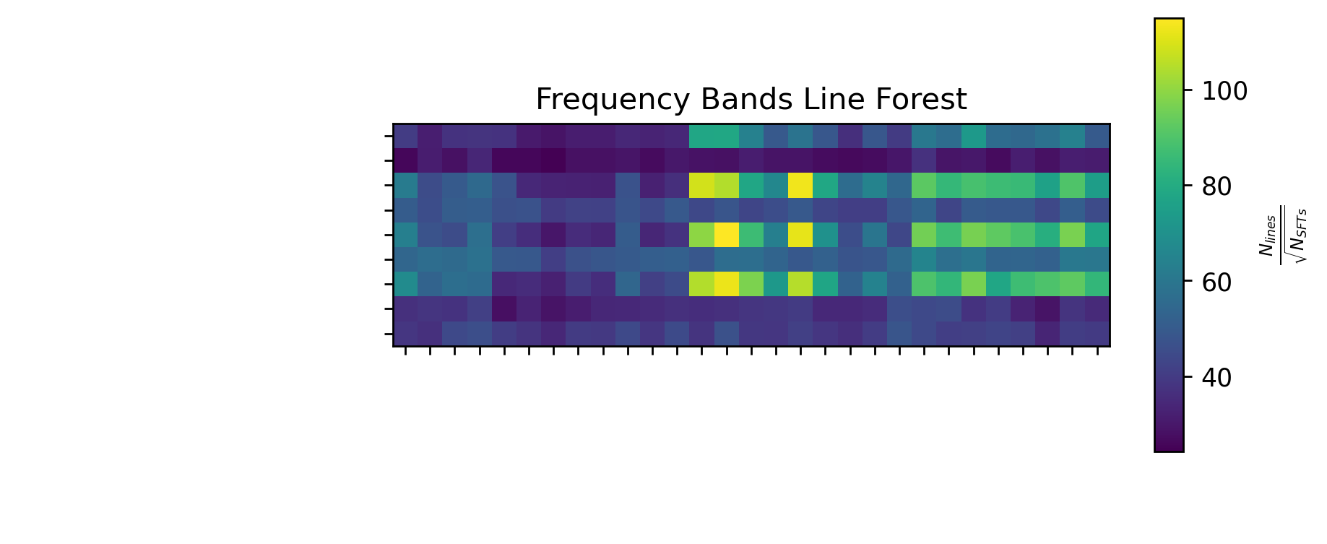
Update Line Count (All Lines)
Frequency Bands Line Forest
100
80
60
40
DCC: G2401304
20

Slide 21
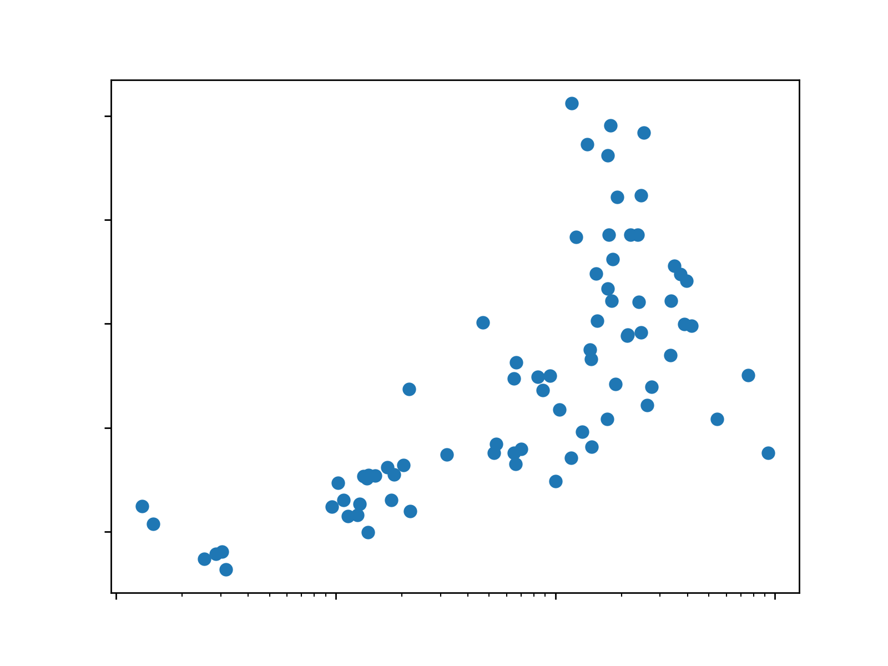
Line Contamination Around Violin Modes
Glass fibers suspending test masses resonate at 500Hz
Harmonics at 1000Hz, 1500Hz, and 2000Hz
Ring up when string is “plucked”
Increased amplitude
DCC: G2401304
21

Slide 22
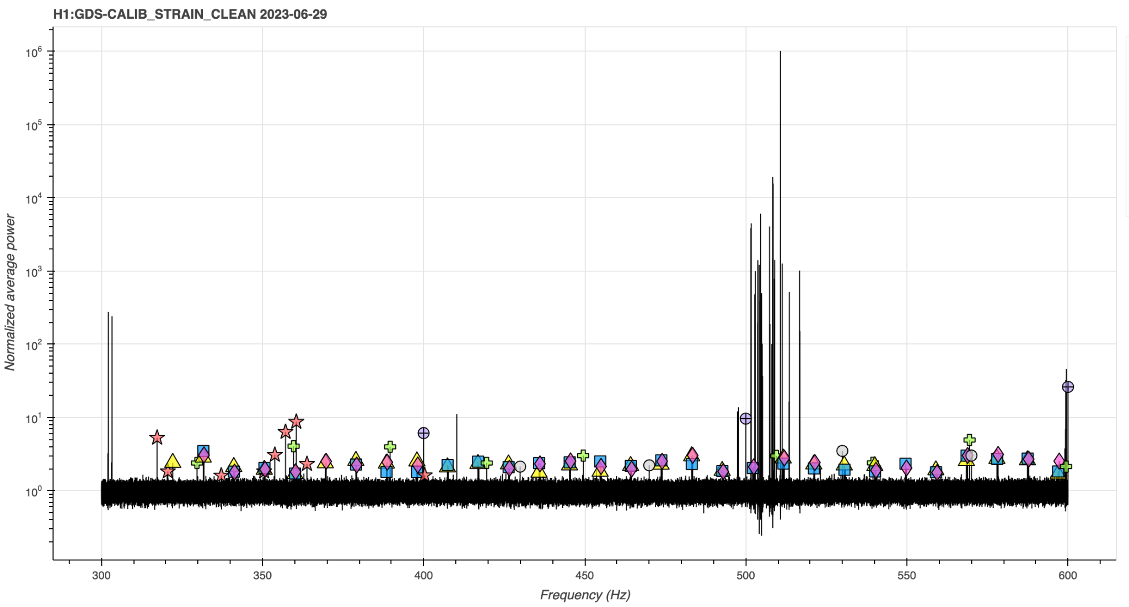
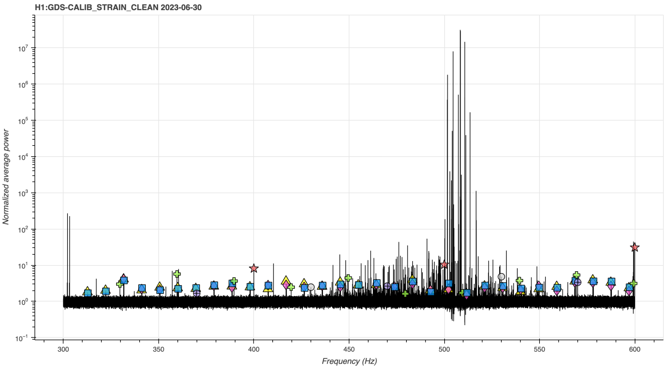
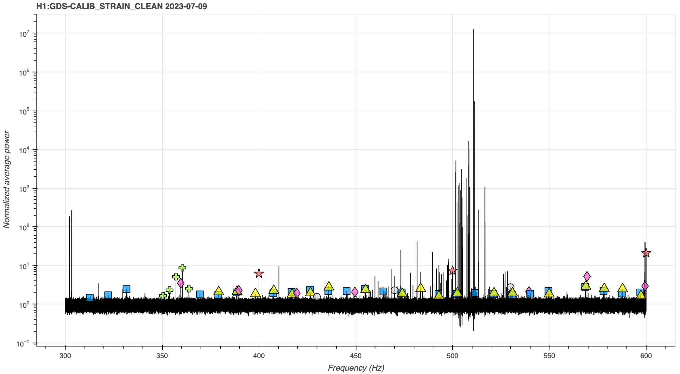
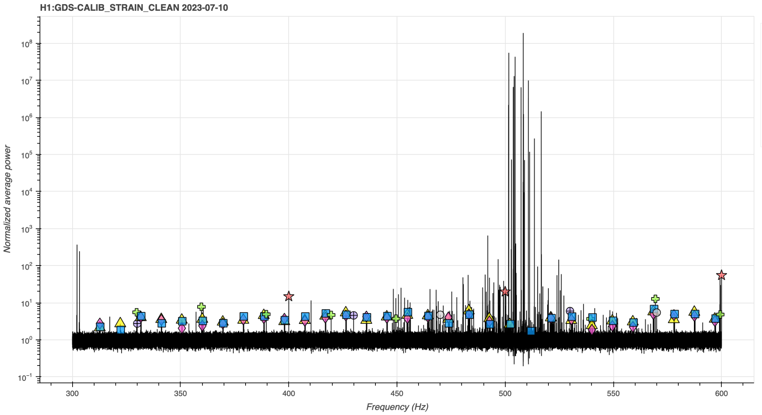
Violin Mode Line Contamination
2023-06-29
2023-06-30
Violin modes 2
Show interactives demonstrating the ring up contamination
2023-07-09
2023-07-10
alog 71501
22
DCC: G2401304

Slide 23
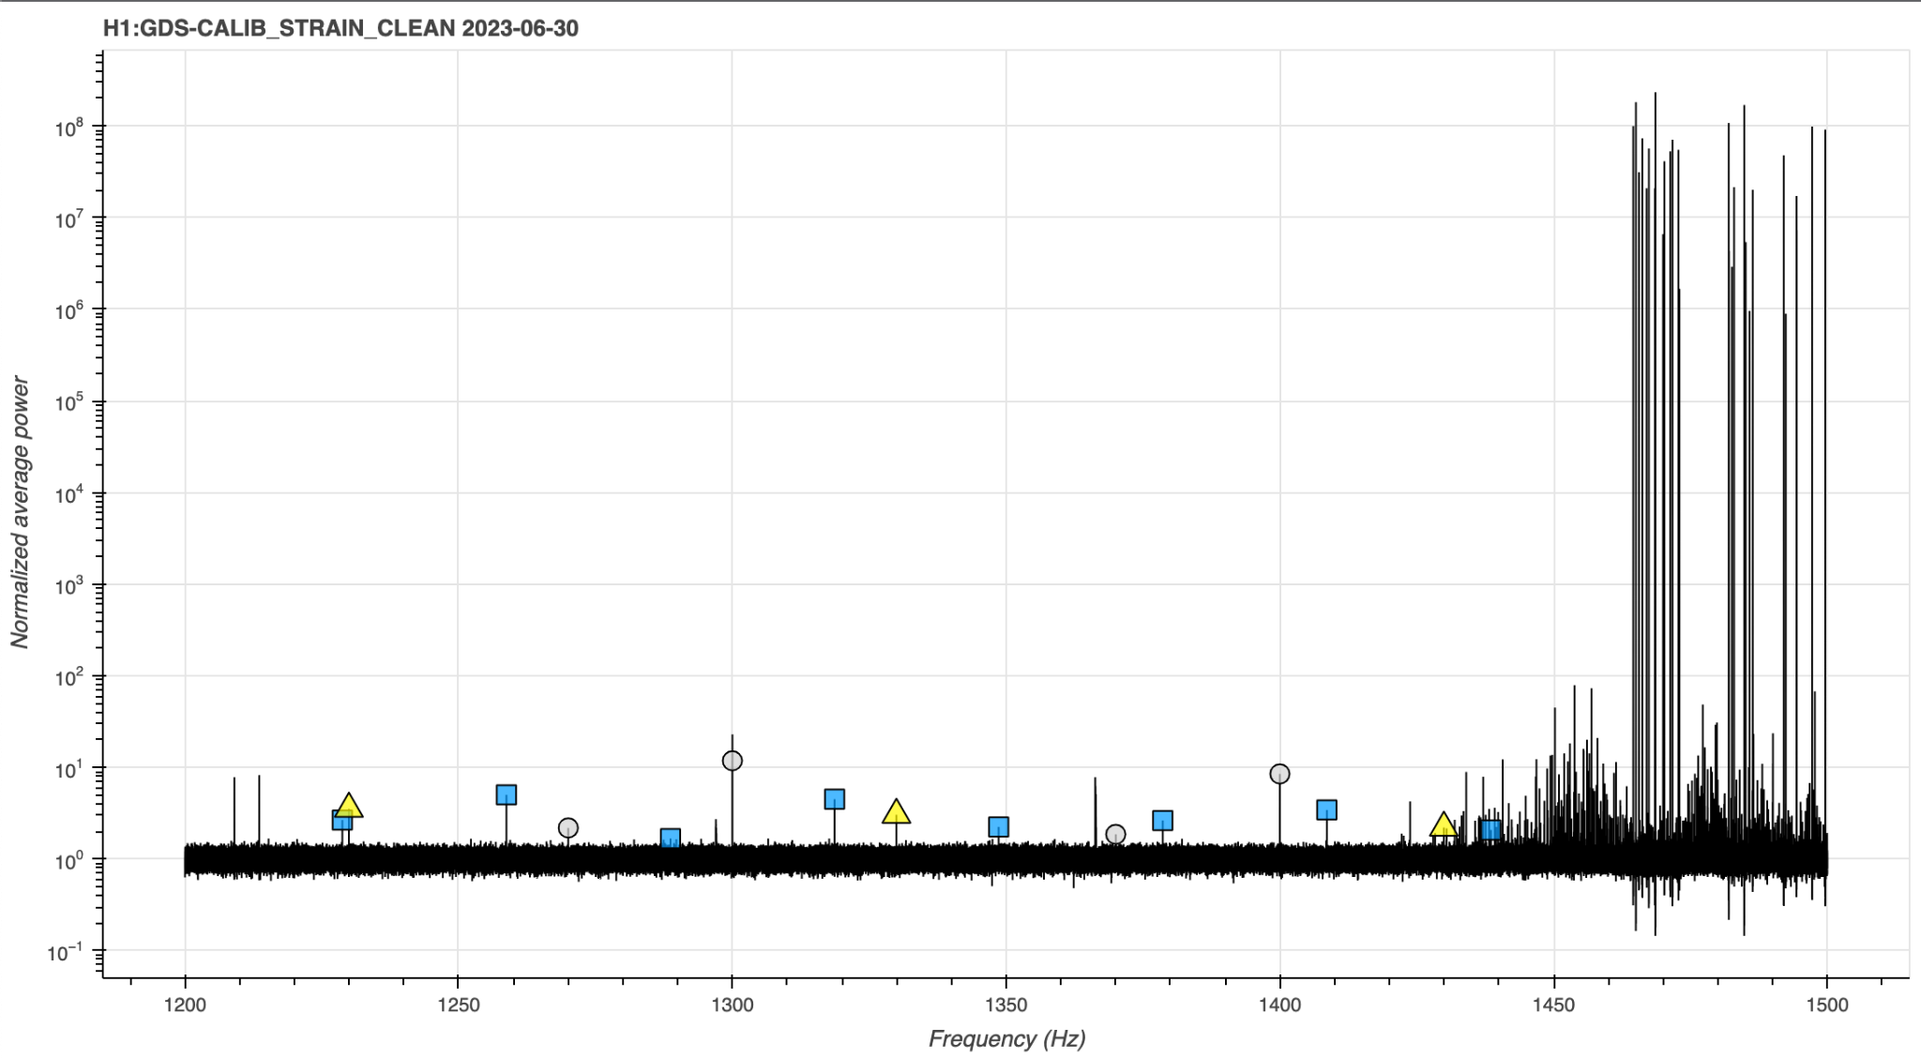
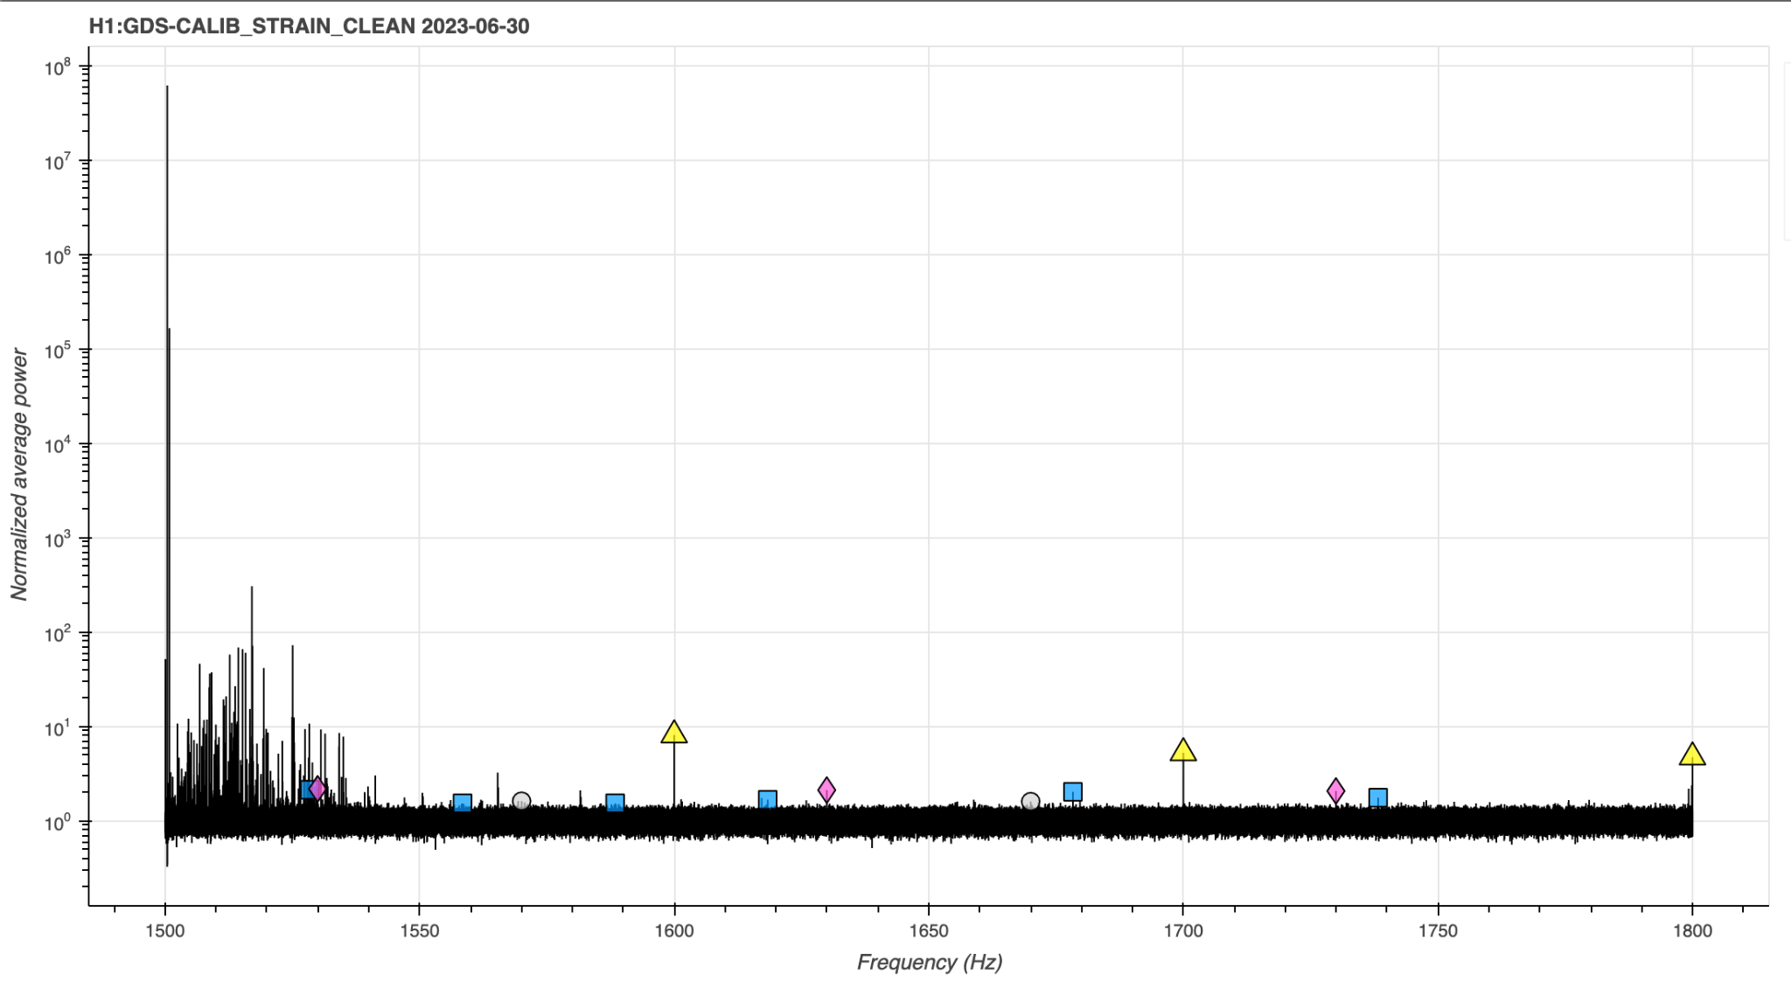
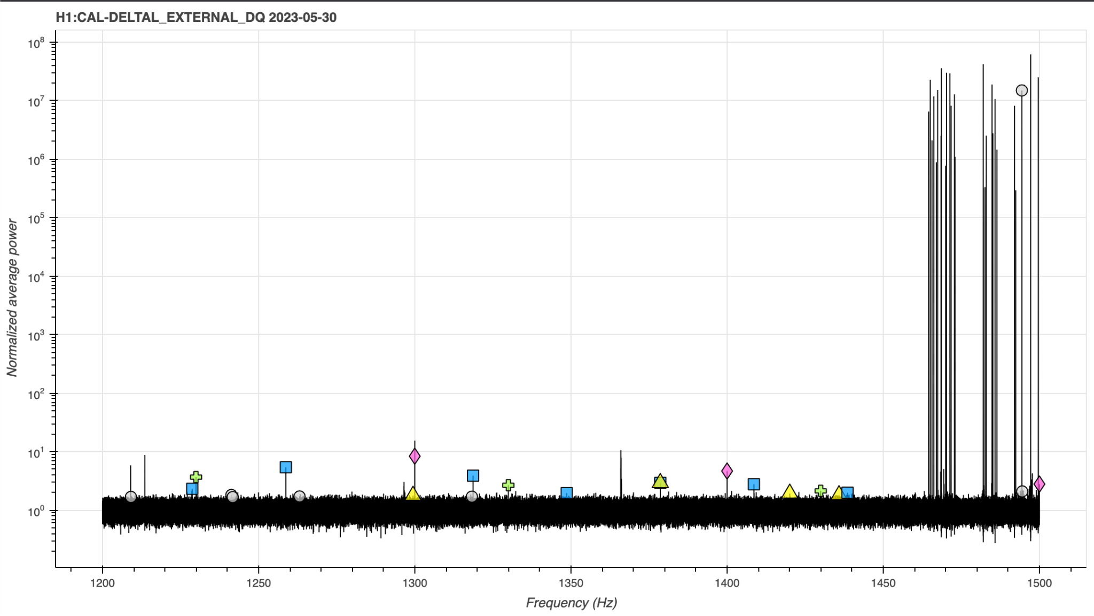
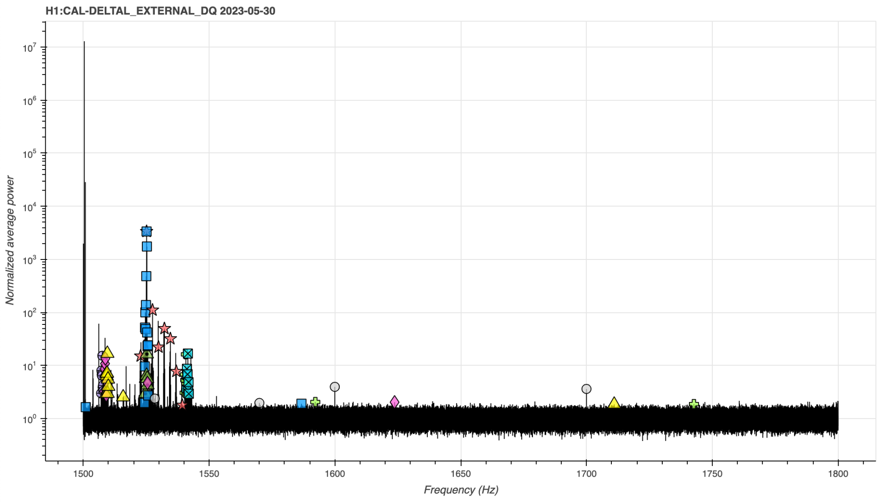
Asymmetrical Violin Mode Line Contamination
2023-06-30
-3Hz shift
2023-05-30
30Hz shift
alog 71800
23
DCC: G2401304

Slide 24
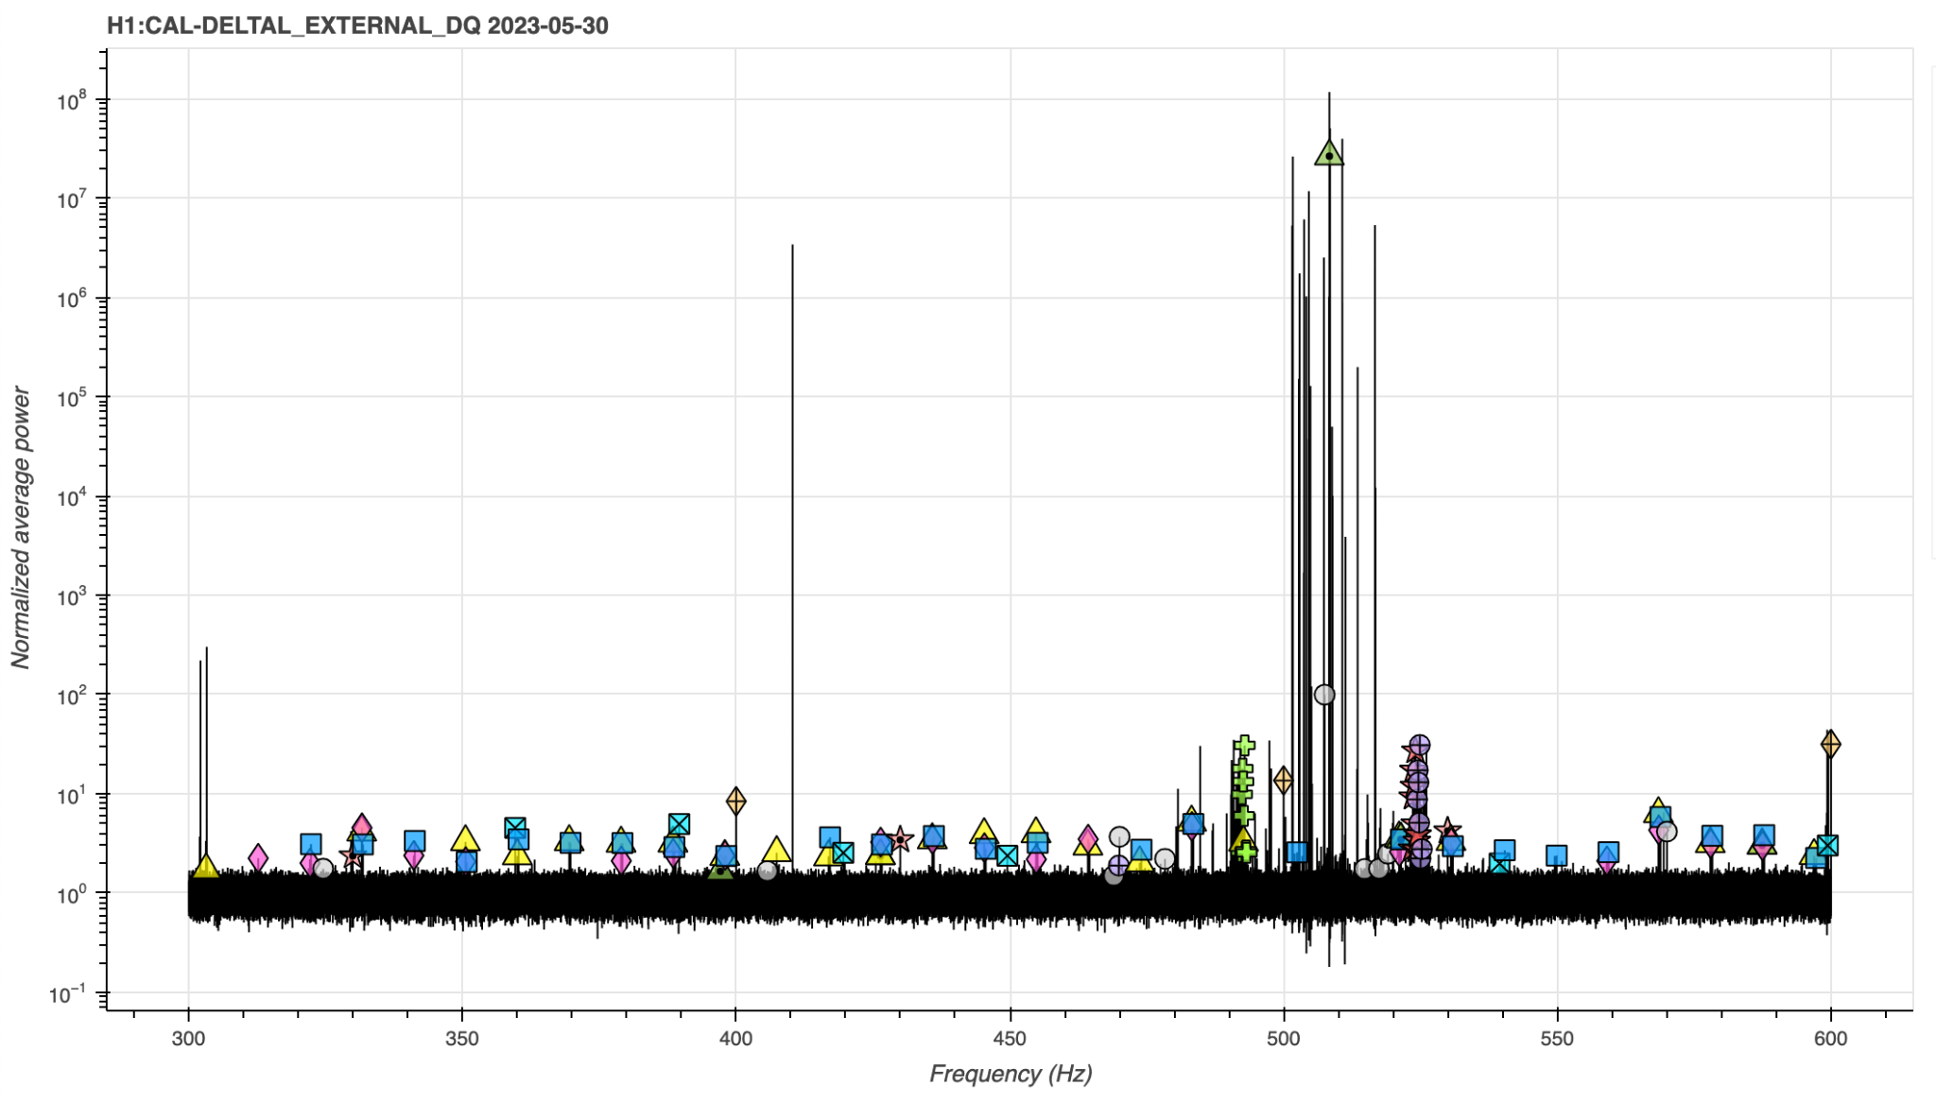
2023-06-30
-16Hz shift
2023-05-30
-3Hz shift
alog 71800
DCC: G2401304
24

Slide 25
Future Investigations
Confirmed mixing with calibration lines
All or subset?
Impact of change of ADC between O3 and O4a
Investigation led by on site commissions due to lack of visibility in data
Lack of contamination in LLO - why?
Difference in amplitude of violin modes between sites?
DCC: G2401304
25

Slide 26
Acknowledgements
This research was funded by NSF Award PHY-1944412 and NSF REU Award 2050928
DCC: G2401304
26

Slide 27
References
P. B. Covas, at el., Identification and mitigation of narrow spectral artifacts that degrade searches for persistent gravitational waves in the first two observing runs of Advanced LIGO, (Physical Review D, 2018), p. 2
K. Riles, Searches for Continuous-Wave Gravitational Radiation (Living Reviews in Relativity, 2023), p. 3-5
DCC: G2401304
27

Slide 28
Thank you!
Questions?
DCC: G2401304
28

