Slide 1
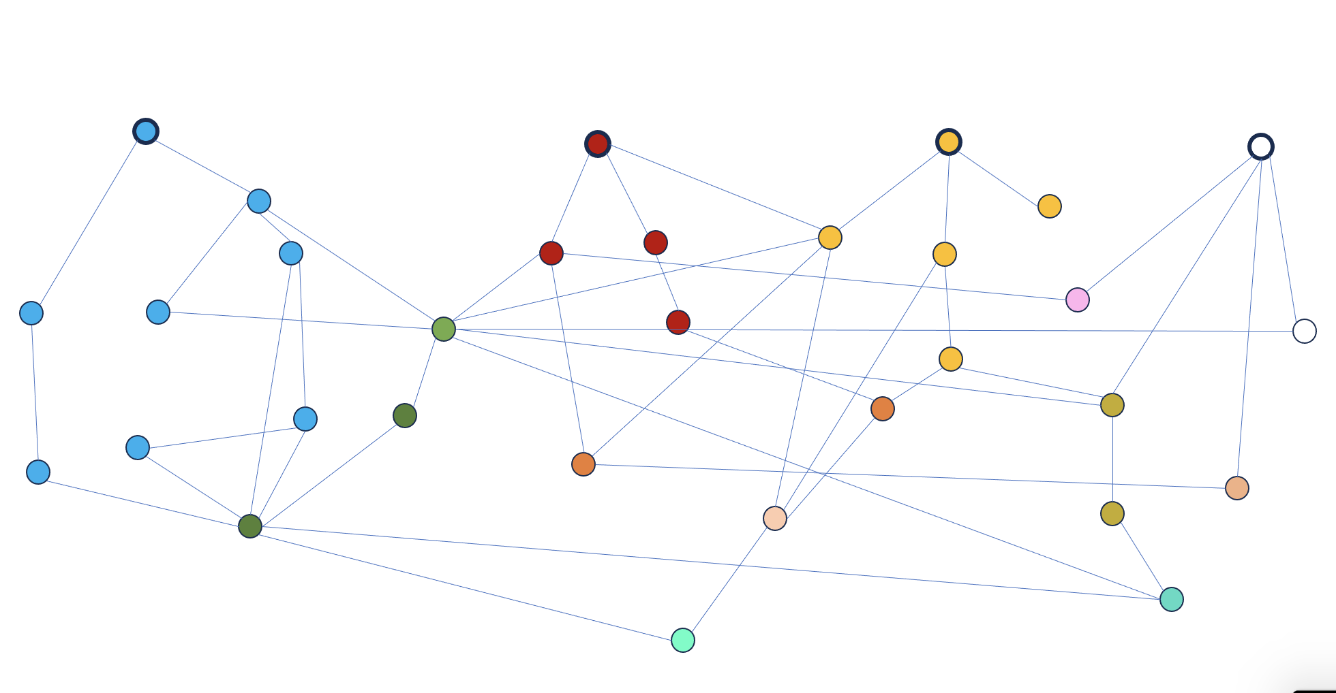
Suspending a 100kg mass (A# suspension design highlights)
Edgard Bonilla
on behalf of the Heavy SUS subgroup of the SWG

Slide 2
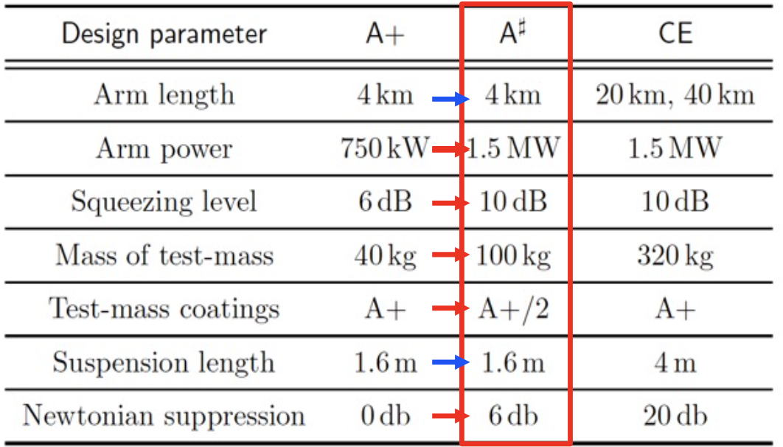
The A# upgrade:
Recommended upgrade from the LSC “Post-O5” report T2200287
Push harder on the technologies that make Advanced LIGO great!
Practice for 3G detectors!
Adapted from G2400503

Slide 3
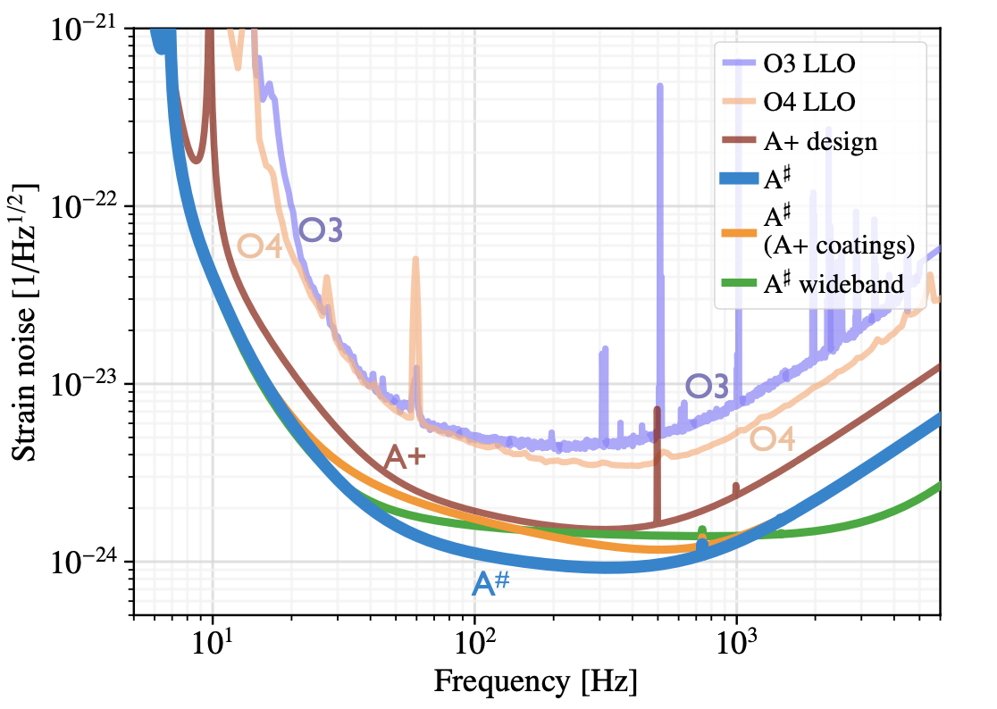
The A# upgrade:
What could it get us?
Expectations from post O5 study [T2200287]
200-700 neutron star events a year.
1000-2000 Binary Black hole events a year.
Over 6 min of early warning for prototypical Binary Neutron Star signal.

Slide 4
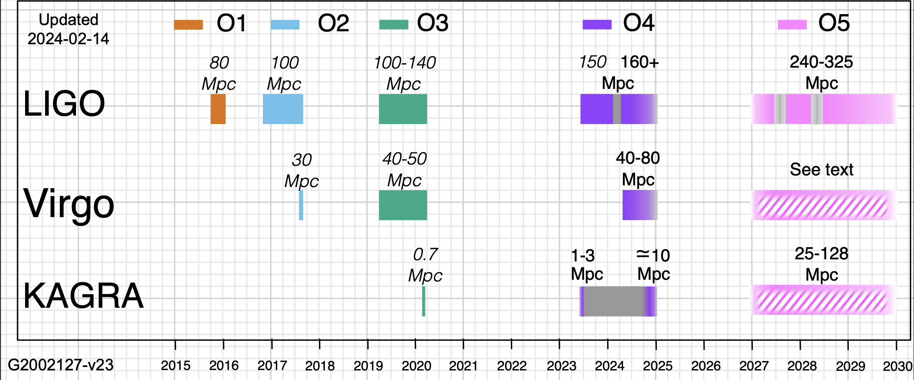
The A# upgrade:
Proposal goes here
A# starts here
We are here

Slide 5
The BSC Heavy Quadruple Suspension [BHQS]
Design description: P1200056
Great seismic isolation
Low thermal noise
40 kg test mass / 120 kg total
Cross-coupled translations and angles.
Top mass is sufficient for damping
Compact design
Augmented with high-frequency dampers
QUAD
BHQS

Slide 6
The BSC Heavy Quadruple Suspension [BHQS]
Design description: P1200056
Design procedure: T2300137
Great seismic isolation
Low thermal noise
40 kg test mass / 120 kg total
Cross-coupled translations and angles.
Top mass is sufficient for damping
Compact design
Augmented with high-frequency dampers
QUAD
BHQS
Great seismic isolation
Low thermal noise
100 kg test mass / 400 kg total
Decoupled translations and angles.
Damping with first two masses
Local Interferometric sensors
Built-in high-frequency dampers

Slide 7
The BSC Heavy Quadruple Suspension [BHQS]
Mitigate
control noise
Mitigate thermal noise
Mitigate quantum noise
Better installation/Operation
Reduce control bandwidth
Interferometric sensors
Reduce angular cross coupling
Higher stress fibers
Develop new coatings
100 kg test mass
Thermal compensation
1.5 MW laser power
10 dB squeezing
Violin mode damping
Cartridge installation
Acoustic mode dampers
Bounce-Roll dampers
BHQS

Slide 8
The BSC Heavy Quadruple Suspension [BHQS]
Angular decoupling
Interferometric sensors
Payload distribution
High stress fibers

Slide 9
The BSC Heavy Quadruple Suspension [BHQS]
High stress fibers

Slide 10
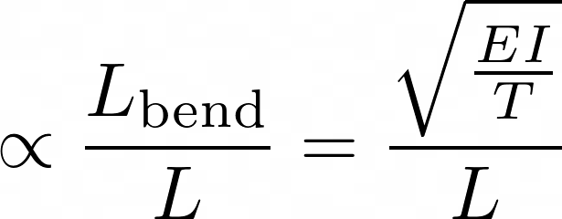
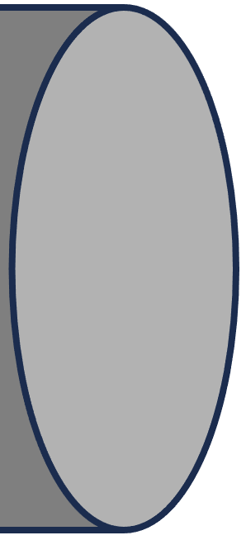
High-Stress Fibers
Benefits:
Less thermal noise from fiber bending.
Thermal Noise
: Elastic modulus
: Fiber tension
: Area moment
Goes as the fourth power of radius!
: Fiber length

Slide 11
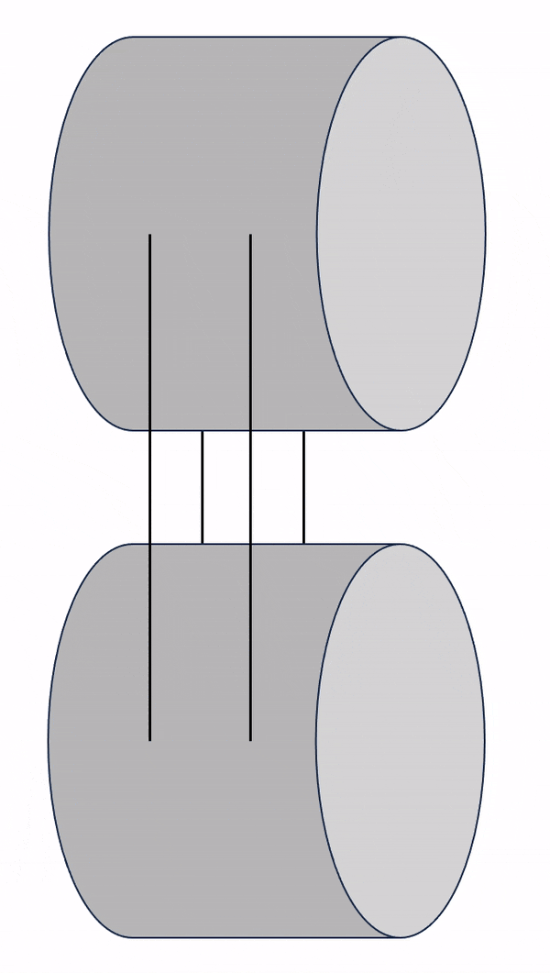
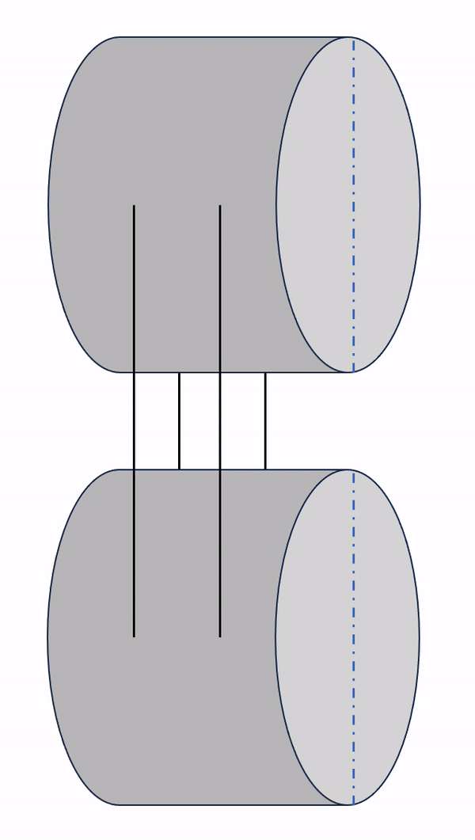
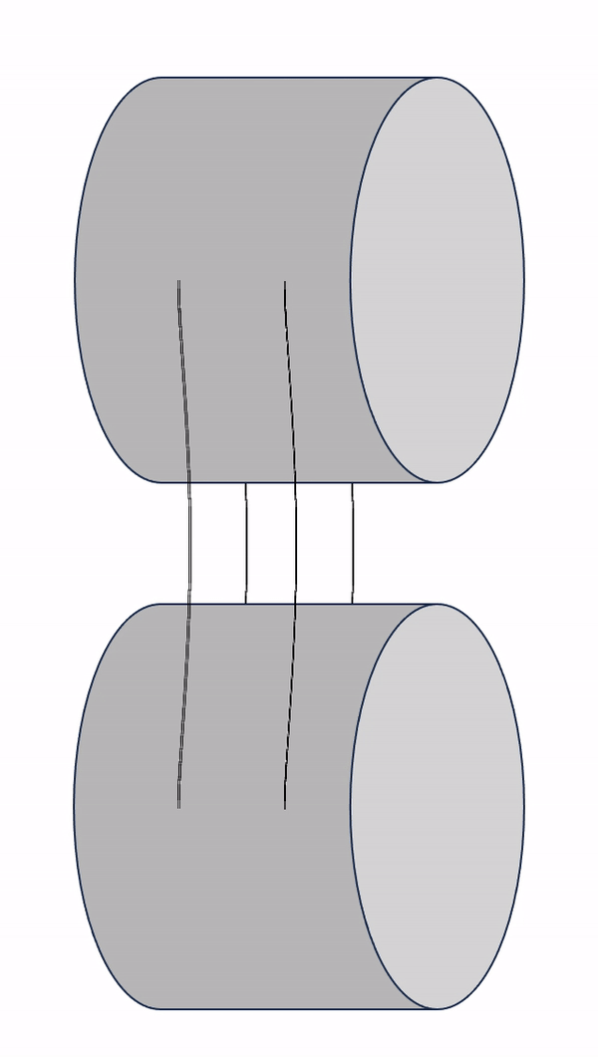
High-Stress Fibers
Benefits:
Less thermal noise from fiber bending.
Better Bounce-Roll-Violin modes
Bounce mode
Roll mode
1st Violin mode

Slide 12
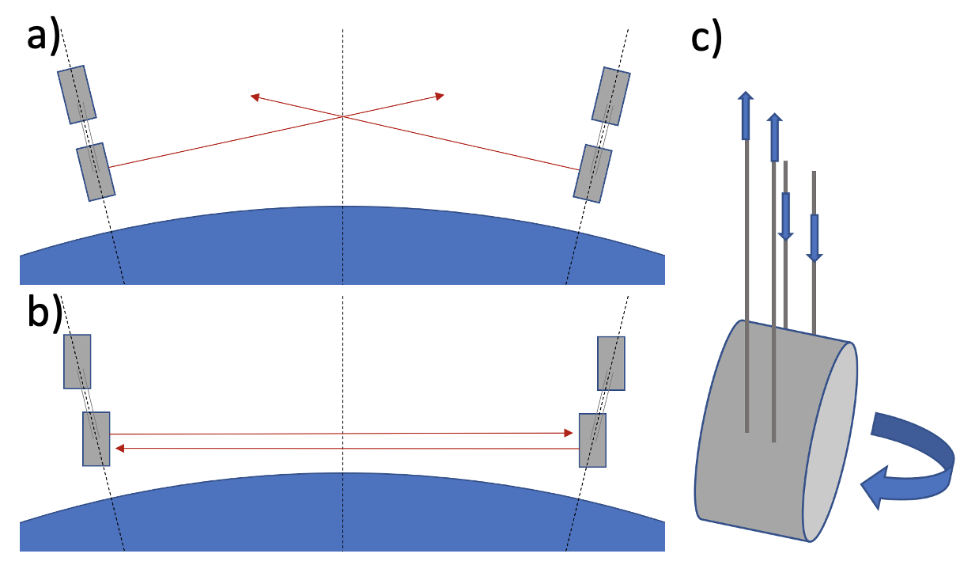
High-Stress Fibers
Benefits:
Less thermal noise from fiber bending.
Better Bounce-Roll-Violin modes
Curvature of Earth cross-couples
Vertical to Length
Roll to Yaw

Slide 13
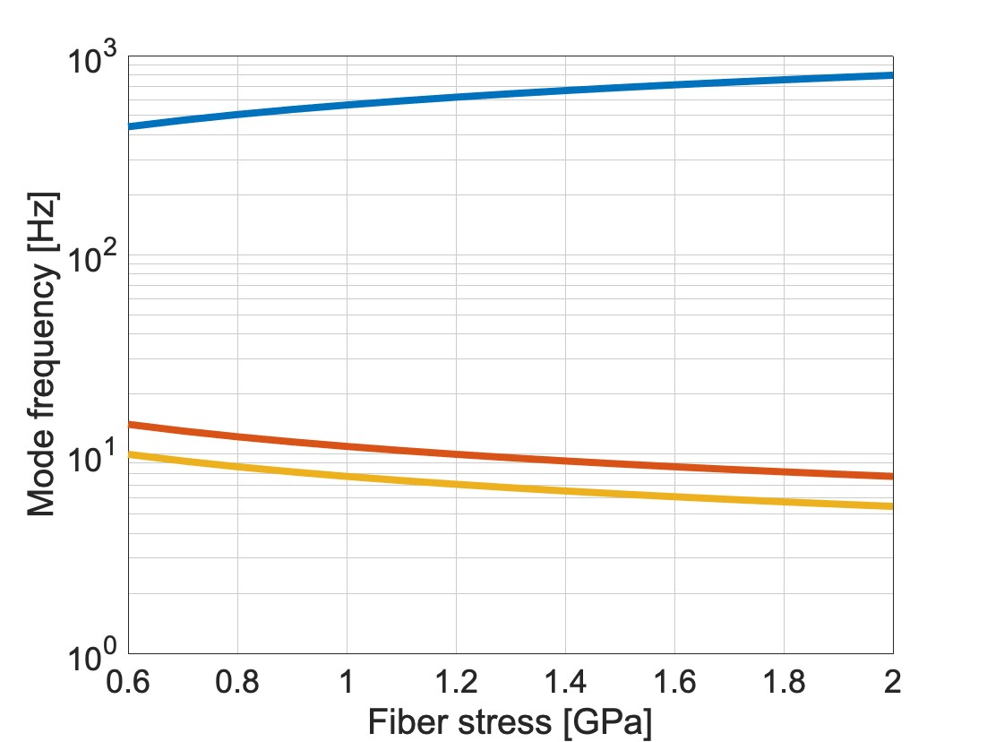
High-Stress Fibers
Benefits:
Less thermal noise from fiber bending.
Better Bounce-Roll-Violin modes
1st Violin mode
Detection band
Roll mode
Bounce mode
BHQS
Current QUAD

Slide 14
The BSC Heavy Quadruple Suspension [BHQS]
Payload distribution

Slide 15
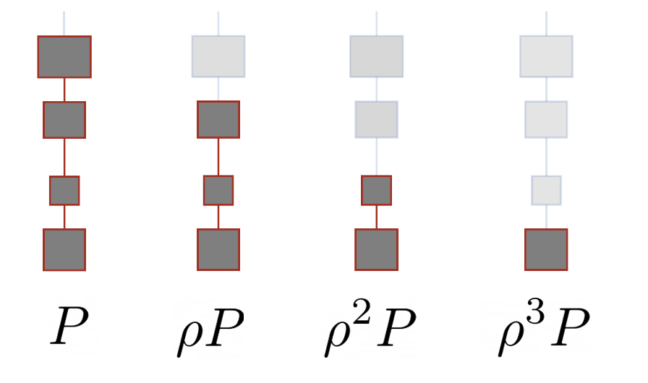
Payload distribution
‘Optimal’ Isolation insights [T2100287]:
Payloads in geometric ratios.
Equal lengths for all stages.
Maximize payload for a given mass
Final mass
Total payload

Slide 16
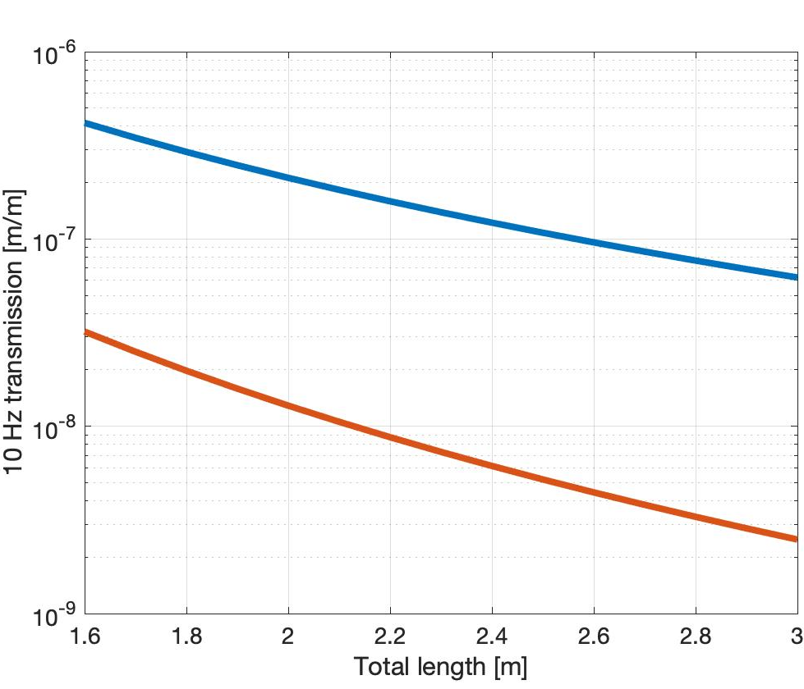
Payload distribution
Longitudinal isolation at 10 Hz
34 cm
P=400 kg
Mass ratio =1/4
Maximize total payload
117 kg
Mass distribution for isolation
Best Triple SUS
34 cm
Equal lengths for isolation
83 kg
Target suspoint Isolation
BHQS
34 cm
Same PUM as TST
100 kg
Current length
Best Quadruple SUS
Long last stage for thermal noise
60 cm
100 kg
100 kg test mass

Slide 17
The BSC Heavy Quadruple Suspension [BHQS]
Angular decoupling

Slide 18
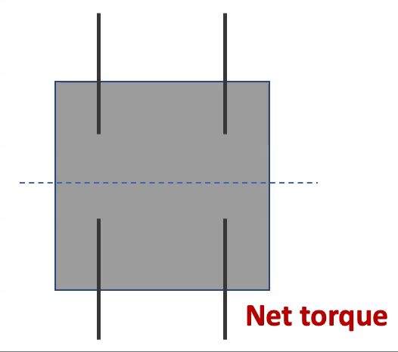
Angular Decoupling
The idea:
Attaching wires above the center of mass causes translation-to angle coupling.
Attach wires at center of mass.

Slide 19
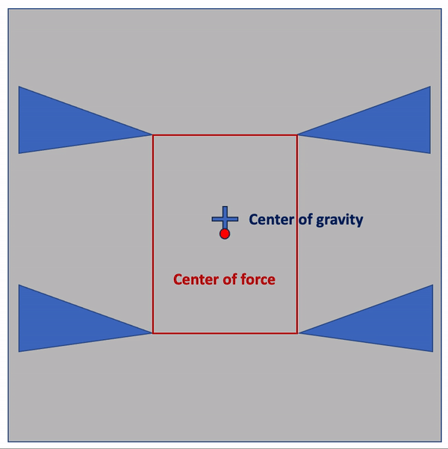
Angular Decoupling
The idea:
Attaching wires above the center of mass causes translation-to angle coupling.
Attach wires at center of mass.
Lateral compliance of blade springs creates cross-coupling
Set springs parallel to the beam direction to mitigate the effect

Slide 20
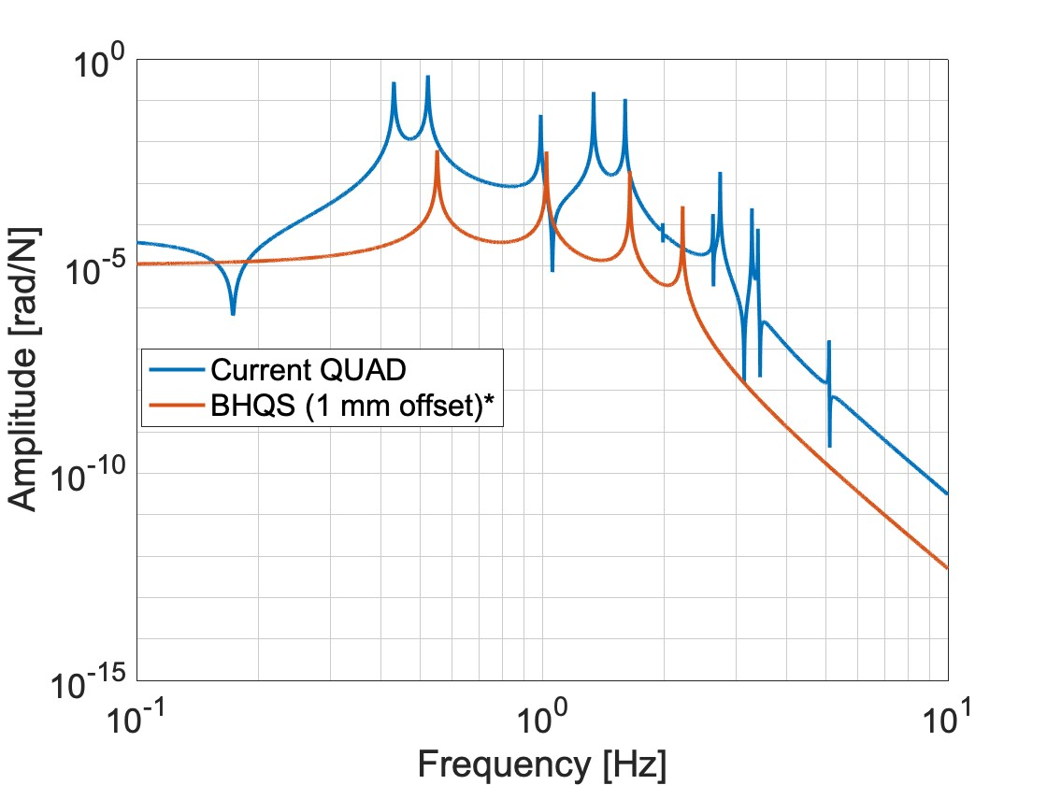
Angular Decoupling
The idea:
Attaching wires above the center of mass causes translation-to angle coupling.
Attach wires at center of mass.
Lateral compliance of blade springs creates cross-coupling
Set springs parallel to the beam direction to mitigate the effect
Large inertias and stiffnesses protect against imperfections
Top mass drive to test mass pitch coupling
*BHQS drive scaled by 4.03 (ratio of DC stiffnesses)
Realistically we should expect some imperfections!

Slide 21
The BSC Heavy Quadruple Suspension [BHQS]
Interferometric sensors

Slide 22
Interferometric Sensors

Slide 23
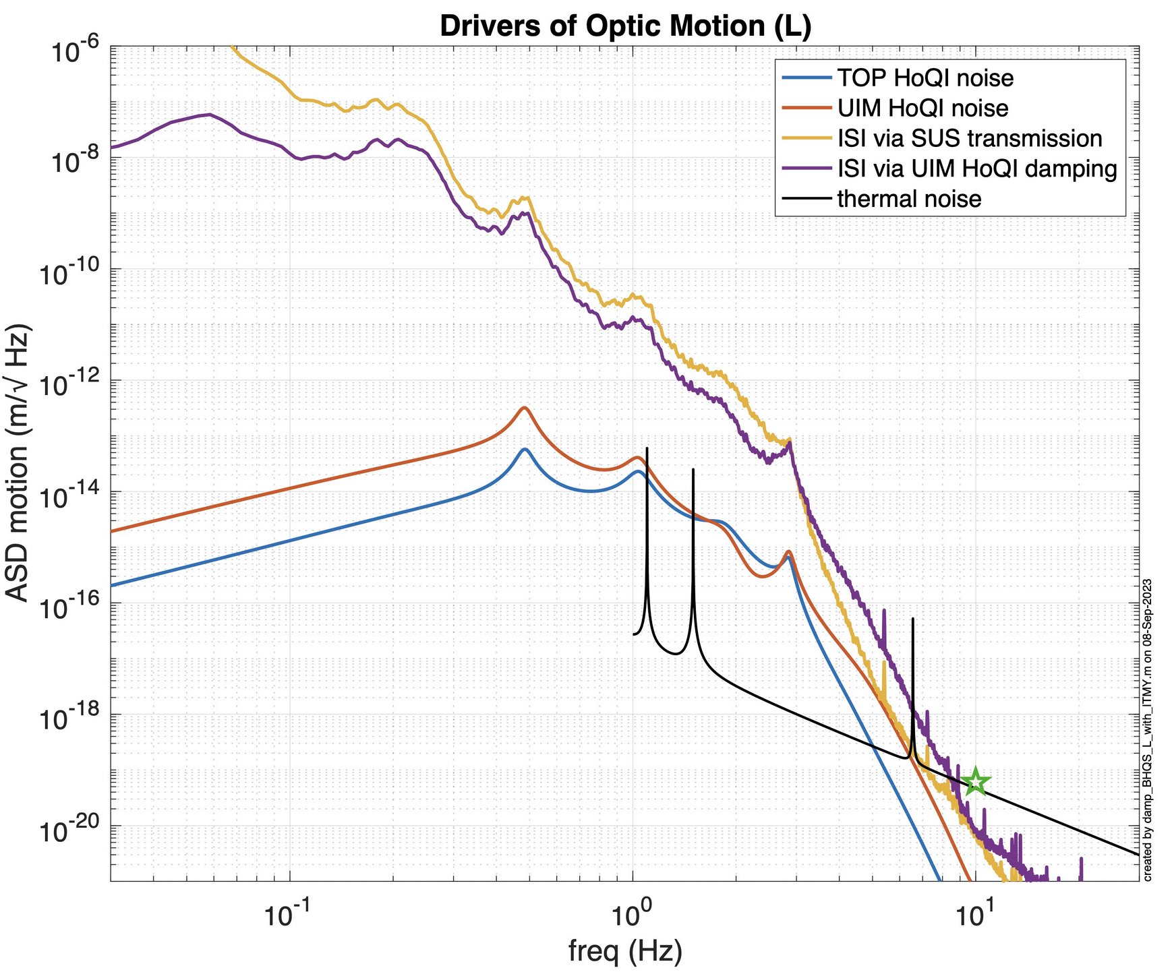
Interferometric Sensors
Noise floor is at least 1000 times lower than OSEMs above 1 Hz.
Enable active control from Top mass and UIM.
34 cm
TOP
117 kg
UIM
34 cm
83 kg
34 cm
PUM
100 kg
60 cm
TST
100 kg

Slide 24
Work in progress
Design opportunities
Hard mode visibility at the UIM.
Even higher stress fibers.
Control codesign optimization.
Cross-coupling models
FEA for cantilever springs.
Mitigation strategies for lateral blade spring compliance.
DC alignment effect on cross-coupling.
Noise estimates
Actuator noise modelling.
Realistic drive distribution for length control.
Additional design work
Reaction chain
TransMon suspension
Prototyping
First prototype under development at MIT
Want to get involved?
Contact edgard@stanford.edu
(or find me walking around at the LVK)
BHQS Parameters available on the SVN at: design_BHQS.m

Slide 25
In summary
We are preparing for the LIGO A# era.
More and earlier detections.
Testbed for 3G technology
The suspension design plan is underway.
The plan is to understand and account for as many noise sources as possible.
BHQS prototype coming soon!

Slide 26
Extra Slides!

Slide 27
Longitudinal Plant
Constraints:
60 cm last stage
100 kg test mass
Less than 400kg payload
Requirements:
6e-20 m/Hz^{1/2} at 10 Hz
Interferometric sensors enable damping of the suspension to low Q.
Thermal noise will limit the ultimate suspension performance at 10 Hz.
Improvements on the ISI infrastructure are now directly correlated with suspension performance

Slide 28
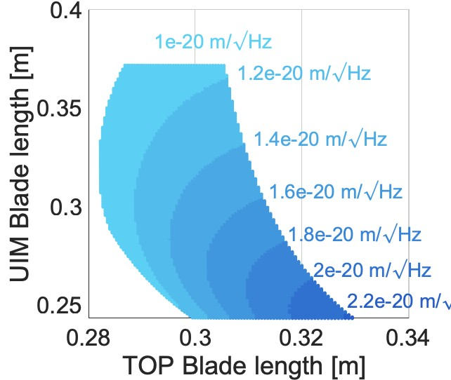
Vertical mode exploration
10 Hz motion for 3.6 Hz Vertical mode
Targets for Vertical:
Third mode at 3.6 Hz
Less than 2e-20 m/Hz^{1/2} for Length
The red circle is around where min-maxing would give us small TOP and UIM stages for this frequency.
Stiffnesses (per spring):
K_{ST2} = 3260 N/m , K_{TOP} = 4650 N/m , K_{UIM} = 2760 N/m
Current BHQS springs:

Slide 29
Vertical Plant
Constraints:
1.6 GPa fibers
Blade springs must fit
10⁻³ [m/m] coupling to Longitudinal
Requirements:
2e-17 m/Hz^{1/2} at 10 Hz
Expected test mass longitudinal motion
Only top mass damping. Easy to meet the target.
Longitudinal Transmission
Bounce mode increases the expected longitudinal motion between 4-8 Hz, but this is okay.
Current BHQS design
Current Quad
Workshop (old) BHQS
Target

Slide 30
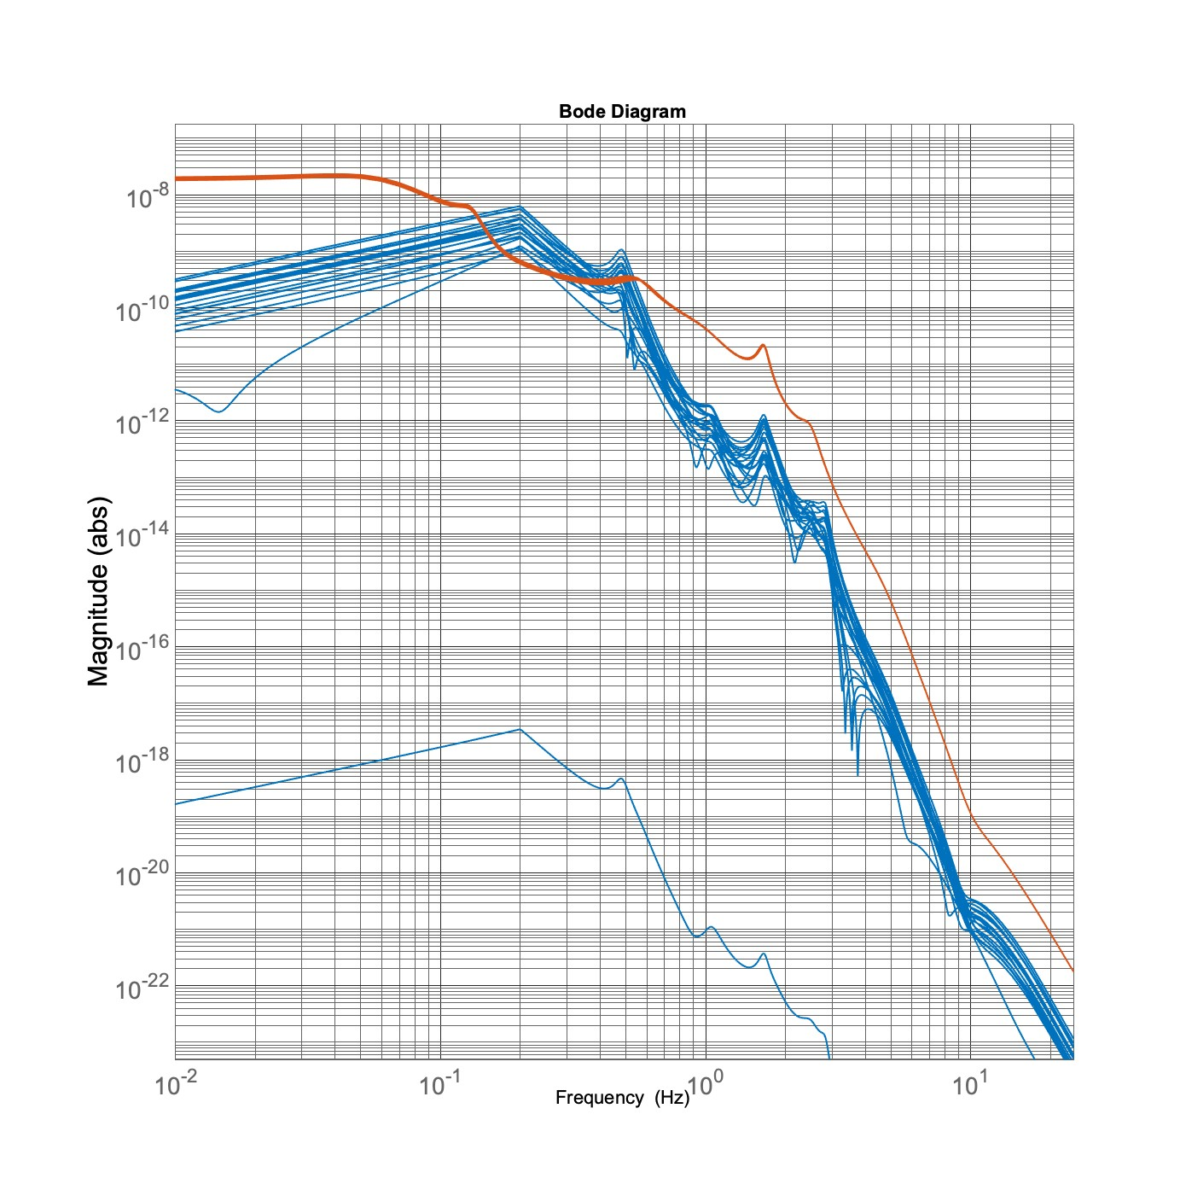
Pitch Plant
Requirements:
1e-17 rad/Hz^{1/2} 10 Hz
1 nrad RMS with IFO control
Constraints:
Test mass radius < 45 cm
10⁻³[m/rad] coupling to Longitudinal
From ISI P
The large inertia and stiffnesses limit the cross coupling even in the presence of unintended offsets
From ISI L
(± 1 mm)
Even with random offsets of up to 1 mm, the Longitudinal degree of freedom mostly does not dominate the pitch of the optic.
Test Mass Pitch [rad/Hz^{1/2}]
Target
With only local control, we expect the RMS angle of the optic to be at around 5 nrad RMS.
Frequency [Hz]

Slide 31
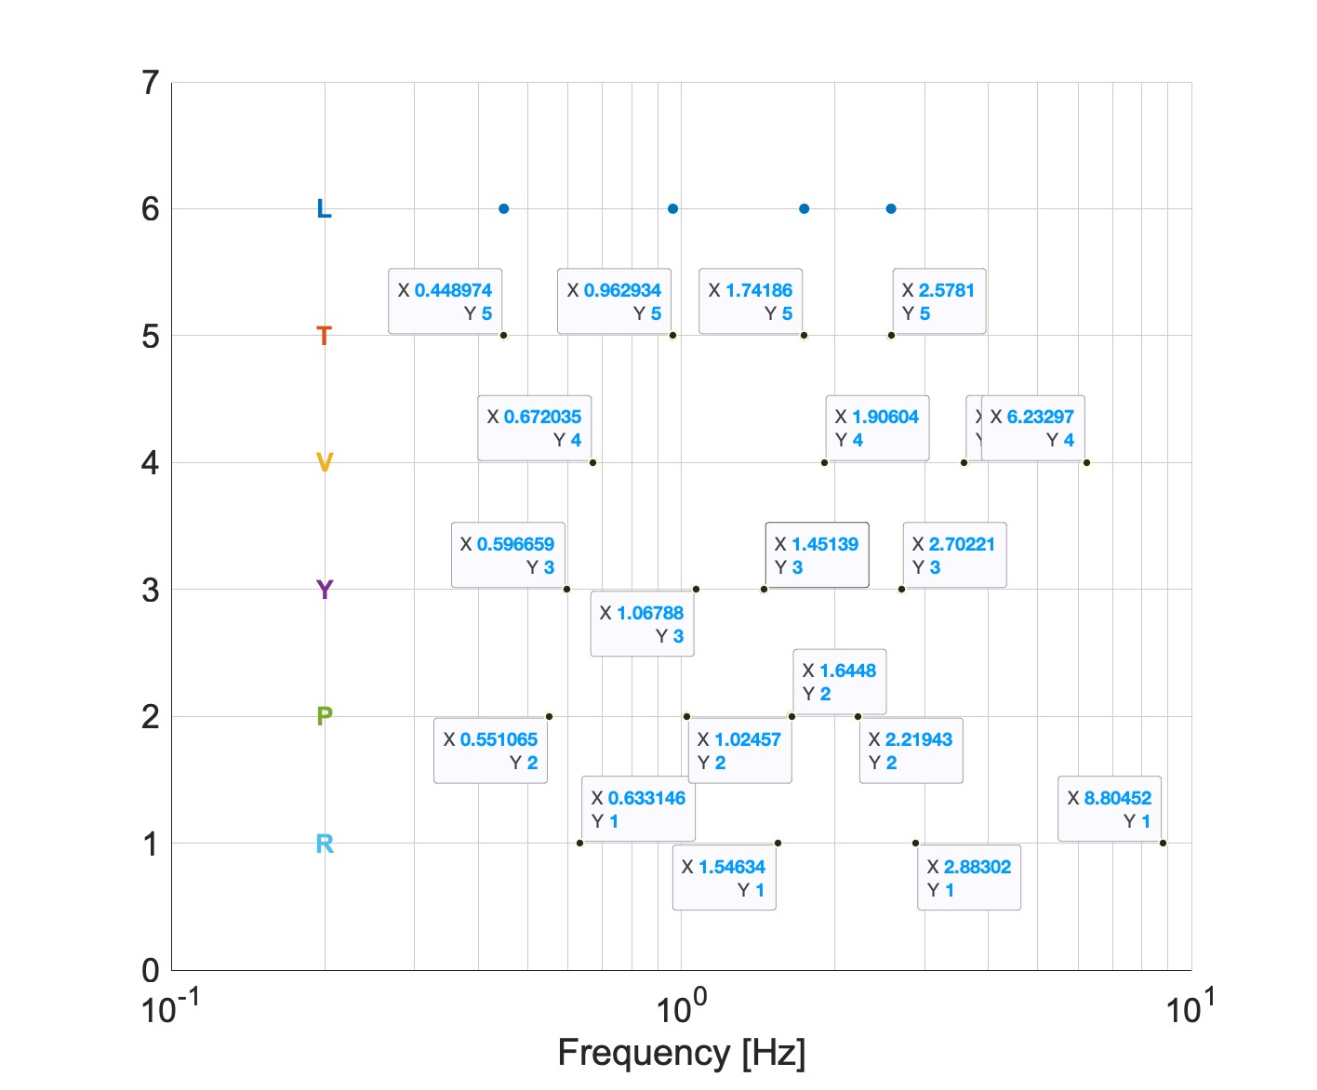
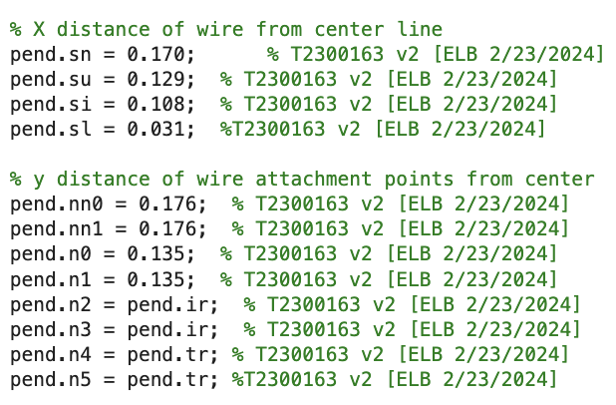
Suspension Modes
Suspension modes
Separated to an equivalent Q of 19.
Stiffer pitch plant helps with robustness

Slide 32
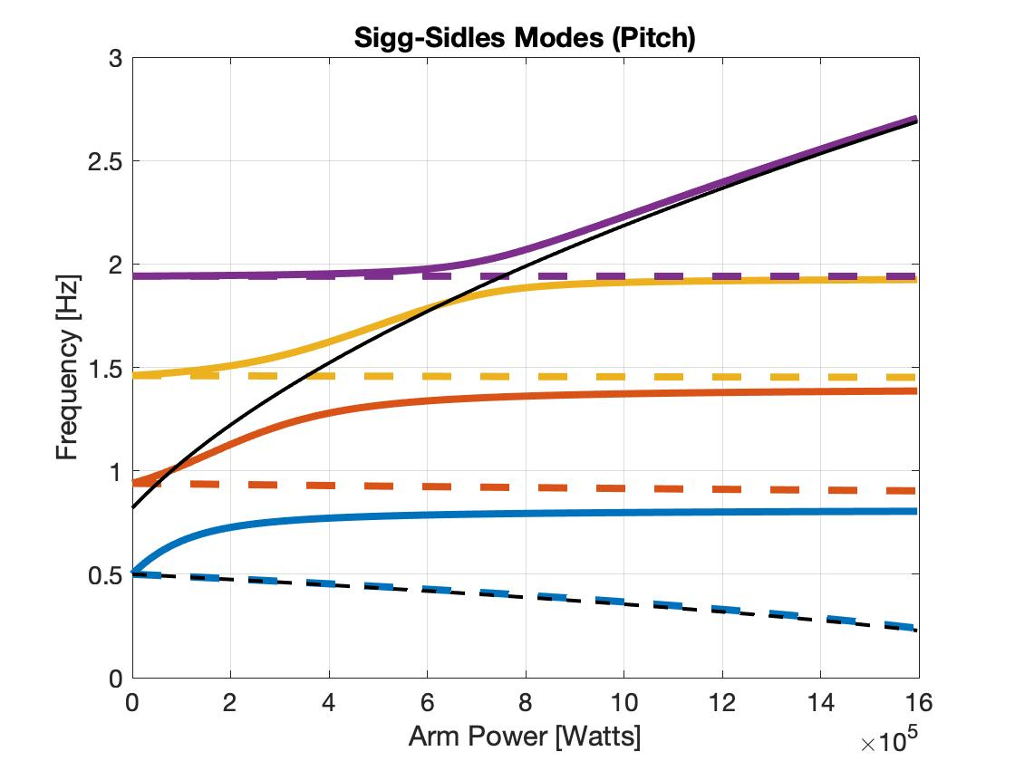
Hard/Soft modes (first order)

Slide 33
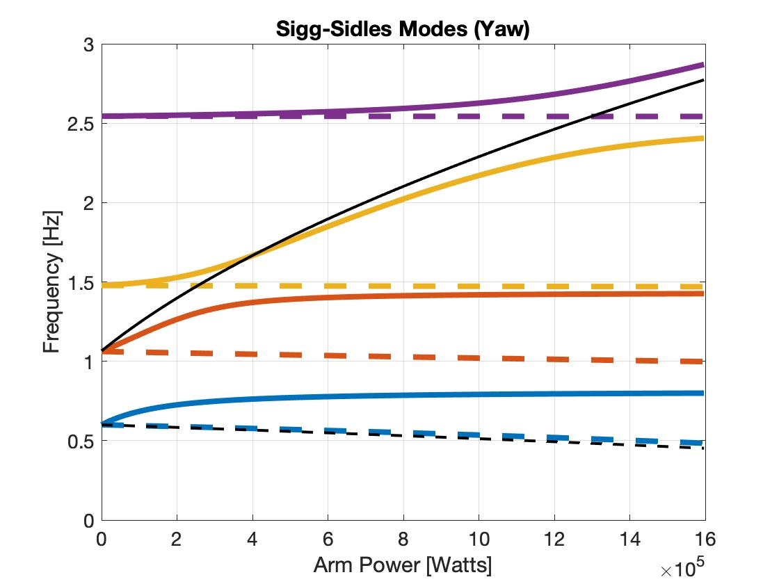
Hard/Soft modes (first order)

Slide 34
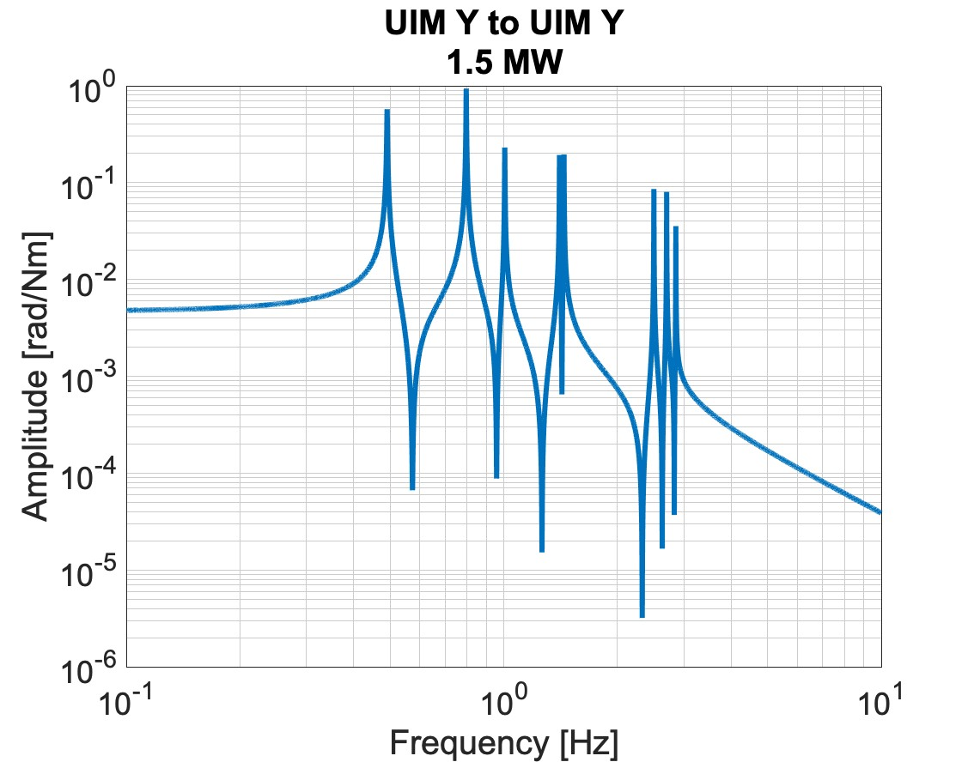
Mode visibility at the UIM
Performance is at least 1000 times better than OSEMs above 1 Hz.
Hard mode is visible at the UIM!
Enable active control from Top mass and UIM.
34 cm
TOP
117 kg
UIM
34 cm
83 kg
34 cm
PUM
100 kg
60 cm
TST
100 kg

