Slide 1
Caden Swain Demonstration of Bayesian Transfer Function Fitting Method – A Potential Tool for Estimating Interferometer Uncertainty
Mentor: Louis Dartez
LIGO SURF 2023

Slide 2
Project Goals
Primary Goal:
Analyze Bayesian transfer function fitting method (BayesianTF) and compare results to previous transfer-function-fitting method (IIRRational)
Includes testing IIRRational’s effectiveness at varying signal-to-noise ratios (SNR); predicted to be very accurate at SNR and to fail at low SNR
BayesianTF developed by Ethan Payne at Caltech
IIRRational developed by Lee McCuller at Caltech
Secondary Goals:
Characterize spare OMC DCPD whitening chassis for use in the interferometer
Generally assist with Detector Calibration

Slide 3
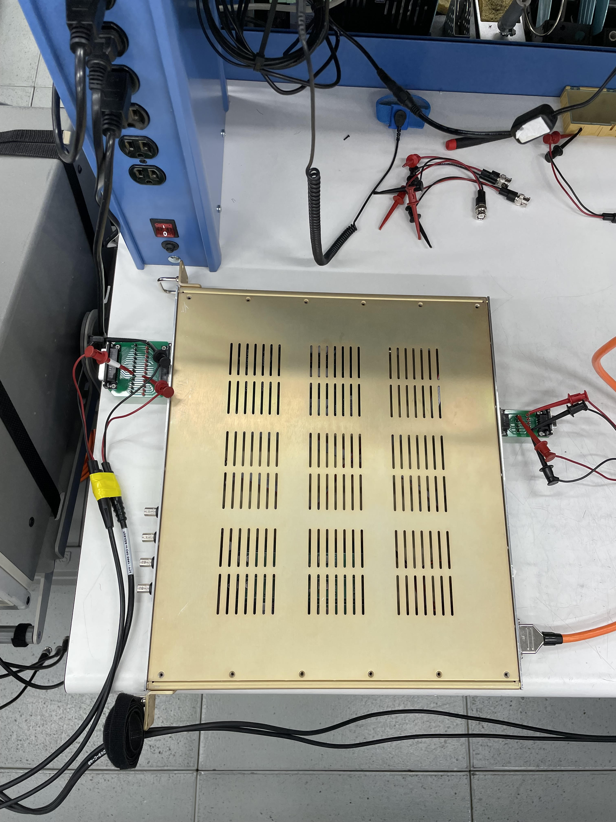
Transfer Functions
Function detailing a system’s response to an input signal
Usually for electrical systems but includes any system that can be modelled with differential equations
Ex. Electronic filters, harmonic oscillators
Frequency dependent
Complex – includes magnitude and phase
Transfer function is calculated with the ratio of the Output and Input signals
$TF=\frac{Output(f)}{Input(f)}, TF∗Input\left(f\right)=Output(f)$
To test IIRRational and BayesianTF, I gathered transfer function and noise data from a spare OMC DCPD whitening chassis

Slide 4
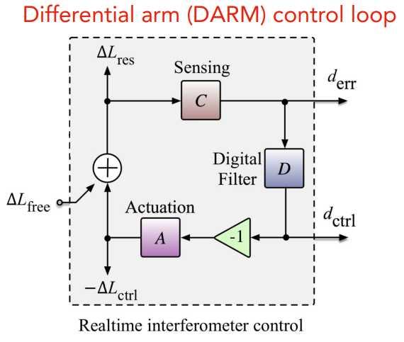
Response Function
Function of the interferometer’s response to external stimuli (Ex. Gravitational Waves)
Important because it directly propagates to the strain in the interferometer with
$$h(t)=\frac{R^{(model)}d_{err}}{L}$$
Each part of the IFO (Sensing & Actuation Functions, Digital Filter) can be modelled with transfer functions
$$R^{(model)}=\frac{1+A^{(model)}DC^{(model)}}{C^{(model)}}$$
May fit a transfer function to the Response Function as a whole

Slide 5
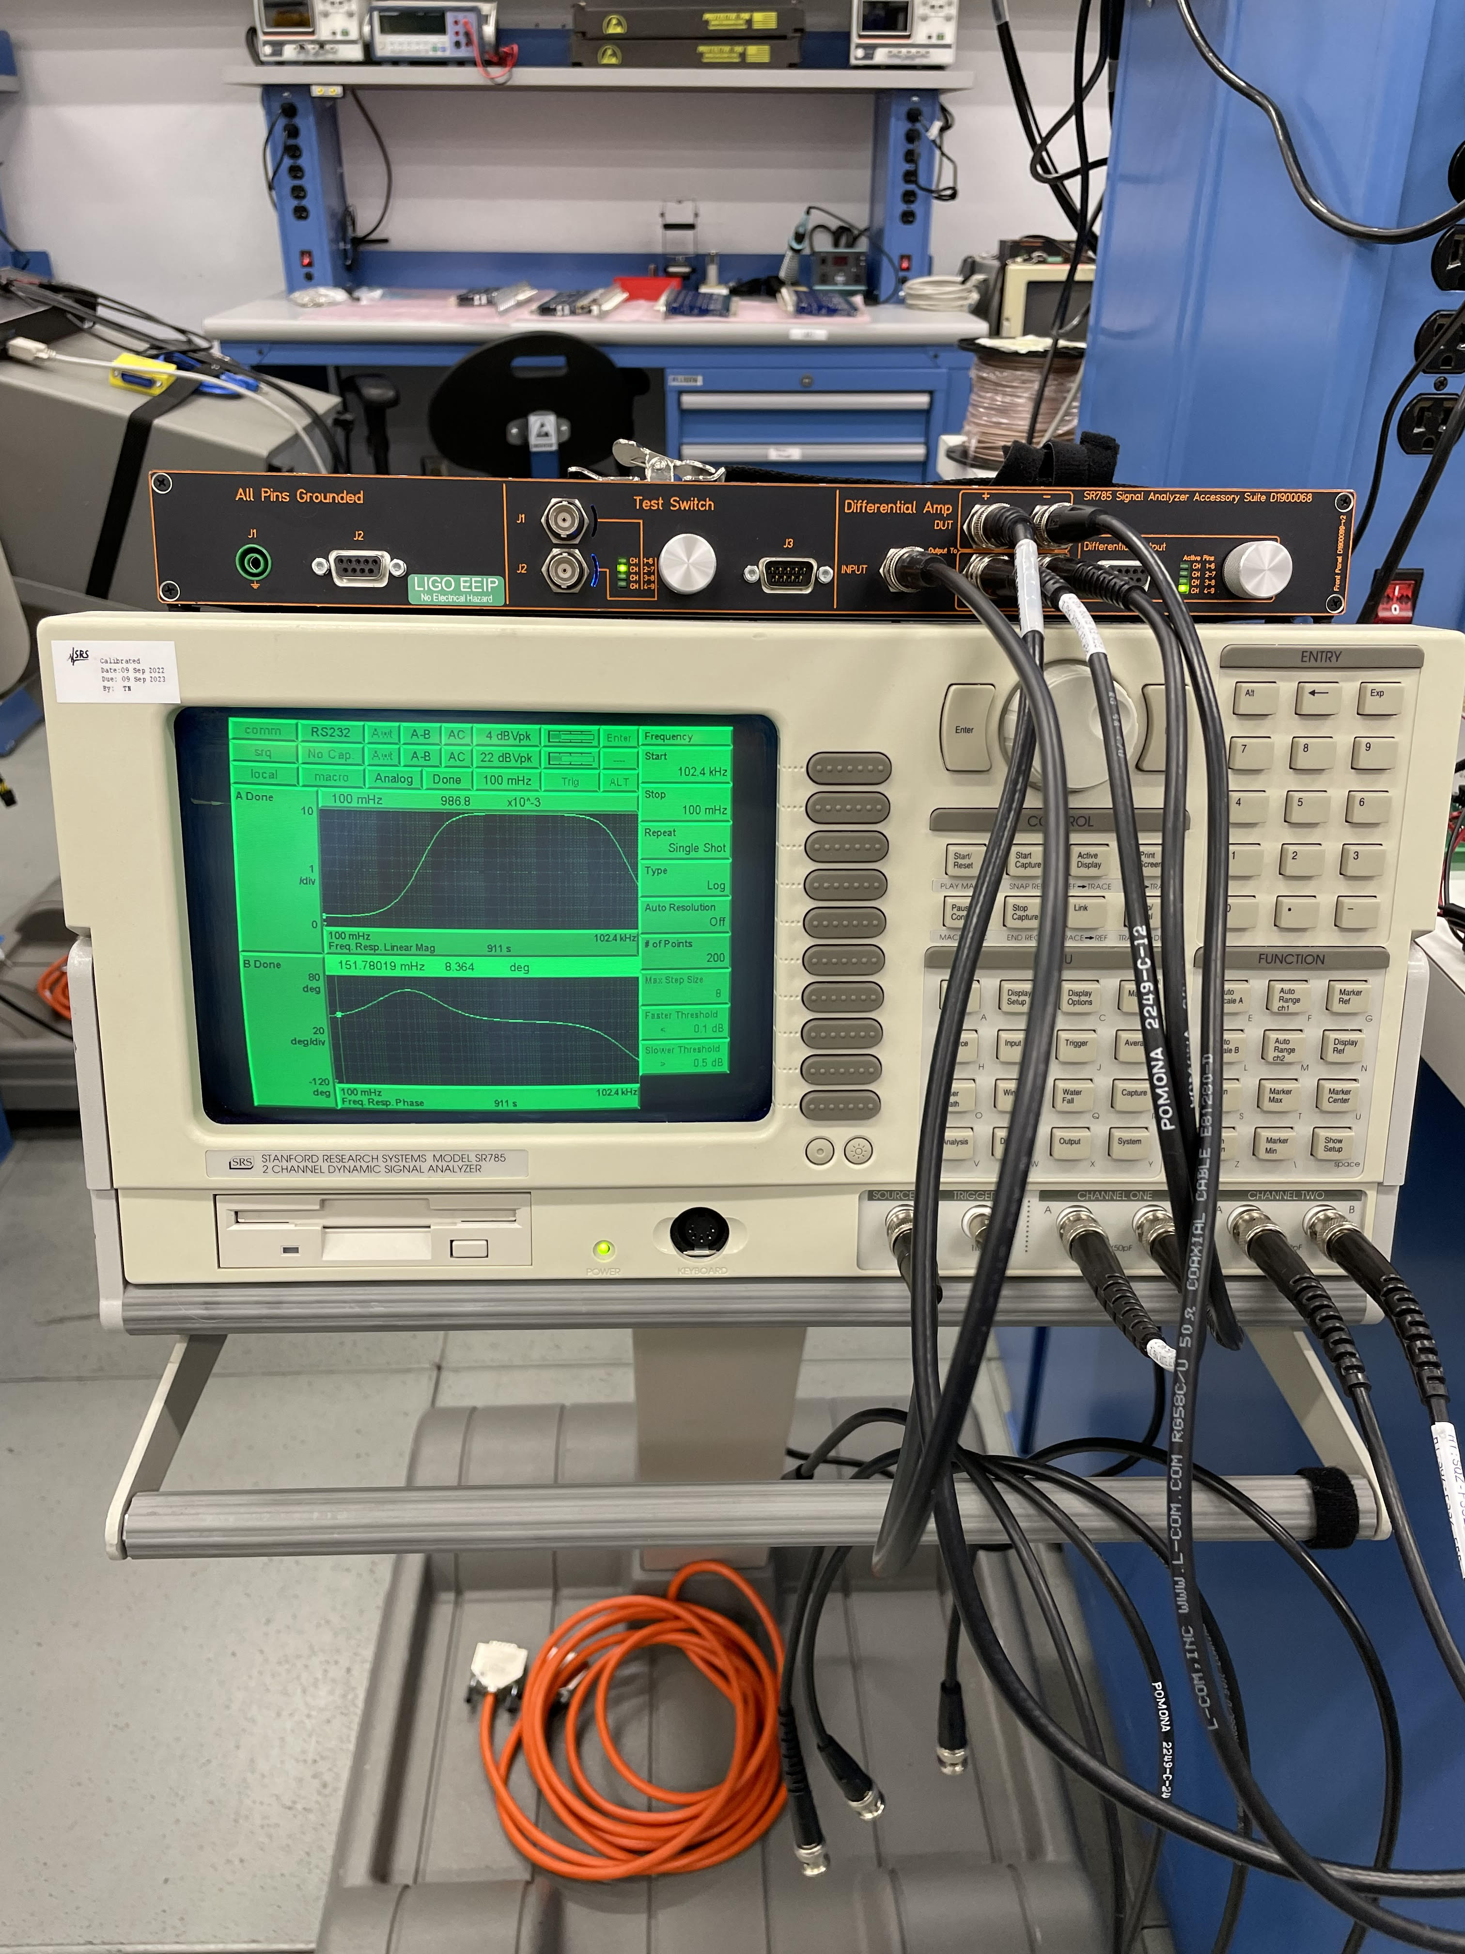
Noise Data
Gathered noise data from a spare OMC DCPD whitening chassis – S2300004 – using the SR785 Dynamic Signal Analyzer and FFT measurements
No signal was inputted, only the inherent noise of the chassis measured
Plotted and compared to Jeff Kissel’s previous noise data from S2300003 whitening chassis – noise data aligned very well – https://alog.ligo-wa.caltech.edu/aLOG/index.php?callRep=71117
Noise data is used to calculate the signal-to-noise ratio (SNR) at varying input voltages
SNR is used to calculate the coherence of the input and output signals
Coherence in turn is used to calculate uncertainty in the measurements
Measurement uncertainty required to run BayesianTF – statistics
$SNR=\frac{V_{\left(signal\right)}}{V_{\left(noise\right)}}=\frac{C\left(f\right)}{1−C\left(f\right)}$
$σ\left(f\right)=\sqrt{\frac{1−C^{2}\left(f\right)}{2N_{avg}C^{2}\left(f\right)}}$
https://arxiv.org/abs/2107.00129

Slide 6
Noise data gathered using plotted in ASD units (V/rtHz) – normalizes noise floor to a roughly flat value
Total noise calculated by multiplying ASD noise taken with FFT by the sqrt of the frequency bin width of the FFT
Varies depending on the frequency range the FFT is taken within
Total noise in my data increased as frequency increased
First measurement: 7.8mHz to 6.25mHz, 7.8mHz FFT bin width
Last measurement: 25.6kHz to 102.4kHz, 128Hz FFT bin width

Slide 7
Transfer Function Data
Gathered transfer function data from the whitening chassis at varying input voltages
Used a swept-sine measurement with the SR785 – signals are inputted over a broadband frequency range (100mHz to 102.4kHz) and the output is recorded
Measures the magnitude and phase of the transfer function
Various signal inputs (magnitude): 1V, 0.5V, 0.1V, 10mV, 1mV, 0.1mV, 0.05mV, 0.03mV, 0.01mV
Used IIRRational to characterize the analytical transfer function at high SNR / low measurement uncertainty – 1V input, SNR = 11,306,947
Calculated residual between various IIRRational transfer function models/fits at low and high measurement uncertainty – 1mV (SNR = 11,307), 0.1mV (SNR = 1131), and 0.01mV (SNR = 113)
IIRRational still very effective with all inputs above 1mV due to the high SNR / low measurement uncertainty

Slide 8
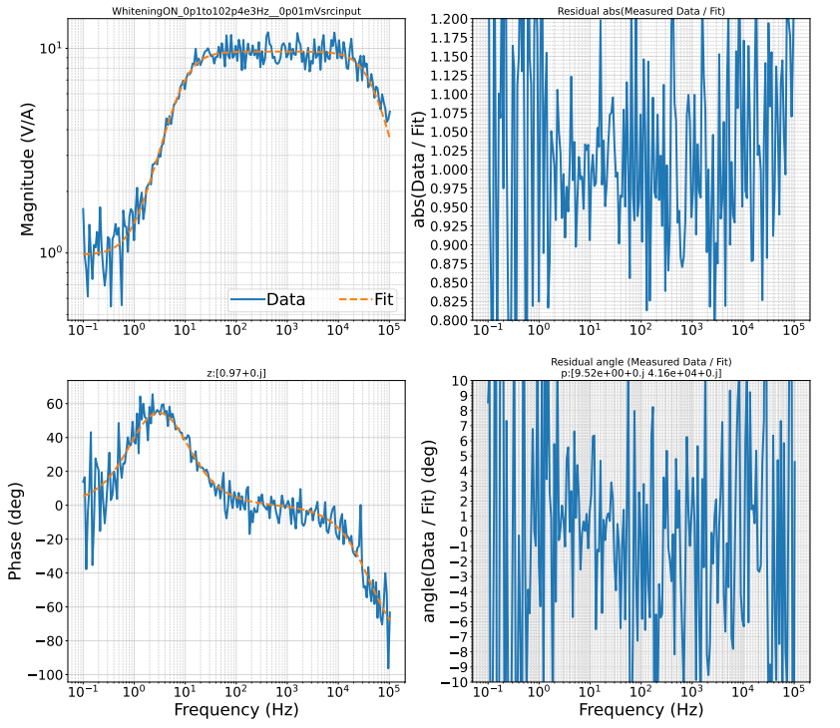
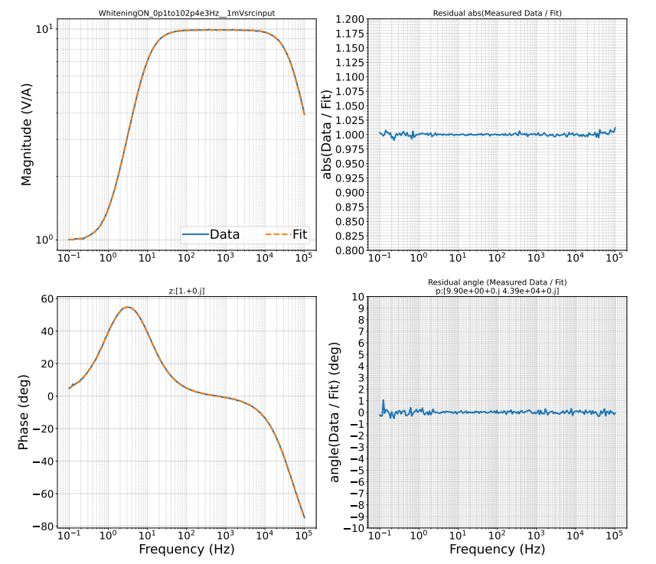
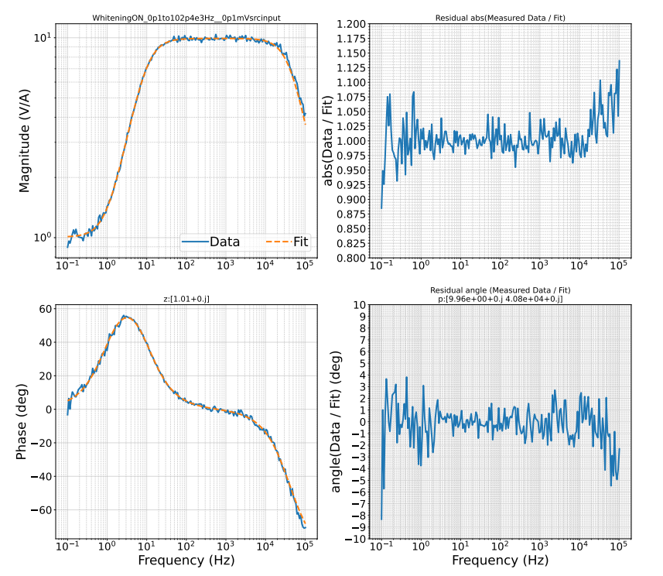
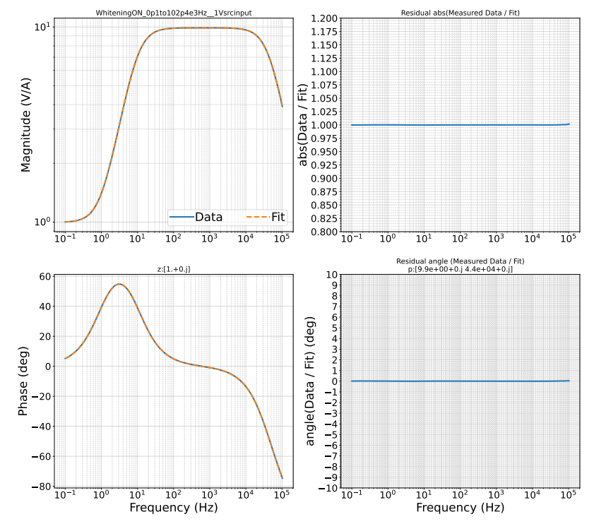
Left plots are Bode plots displaying the transfer function fits from IIRRational using the TF data from various input voltages gathered using SR785
1V (standard, lowest measurement uncertainty)
1mV
0.1mV
0.01mV
Right plots are residuals between measurement data and TF fits
Want residuals to be at unity (Magnitude=1 and Phase=0)

Slide 9
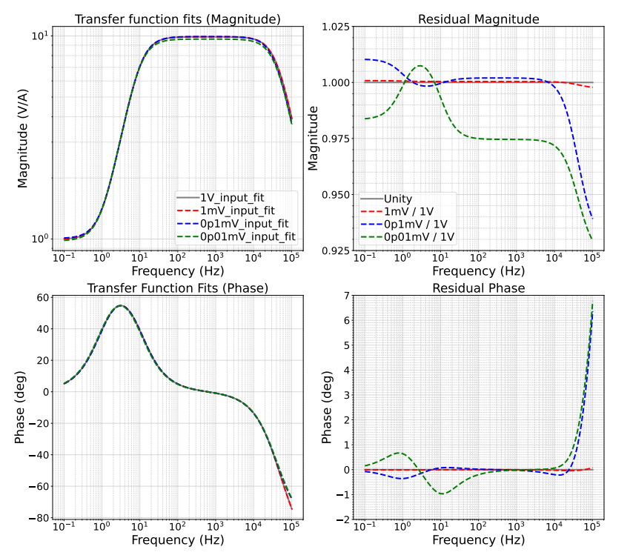
Left plots are Bode plots displaying the transfer function fits from IIRRational using the TF data from various input voltages gathered using SR785
Right plots are residuals between each of the TF fits and the standard 1V fit
Want residuals to be at unity (Magnitude=1 and Phase=0)
1mV fit accurate, other fits deviate significantly from unity
Deviation shows that IIRRational is inaccurate at low SNR / high measurement uncertainty
Heavy deviation begins somewhere between SNR ~ ${10}^{4}$ and SNR $\sim {10}^{3}$

Slide 10
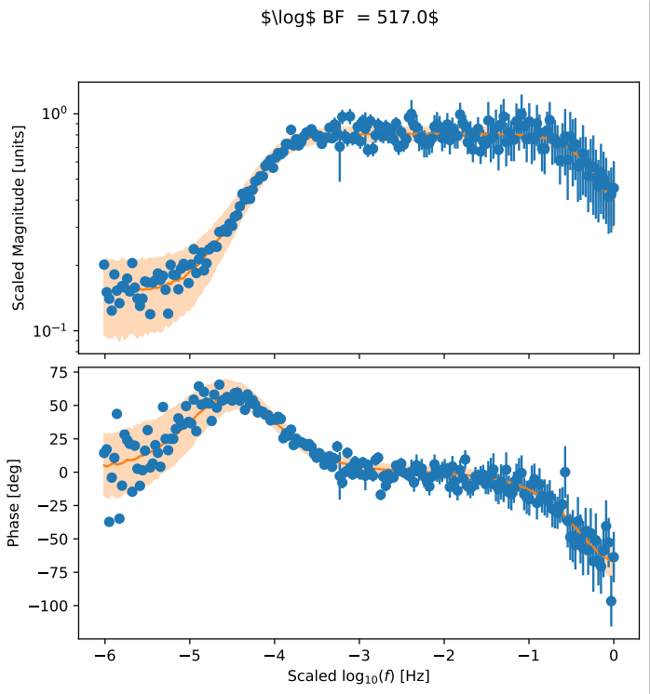
BayesianTF Results
Currently only have results for 0.01mV and 0.1mV input datasets
Limit ~ ${10}^{3}$ SNR, 0.1mV input dataset
Fails with higher SNR datasets
Takes measurement uncertainty into account – creates error bars for the fit
Very useful for application to the Response Function
IIRRational does not do this
Transfer function fit from BayesianTF
0.01mV input / ${\sim 10}^{2}$ SNR fit
Still a work in progress
Fit was just gathered two days ago
More analysis must be done

Slide 11
BayesianTF vs IIRRational
BayesianTF begins to fail around the same SNR ( ~${10}^{3} )$ as IIRRational
BayesianTF handles low SNR datasets
IIRRational handles high SNR datasets
More analysis must be done between $\sim {10}^{4}$ and ${10}^{3}$ SNR datasets to determine precise points of failure for each method
Graphical comparisons between TF fits TBD

Slide 12
Summary
Characterized a spare OMC DCPD whitening chassis with IIRRational
Gathered transfer function and noise data
Tested IIRRational’s effectiveness at varying SNR’s
Collected transfer function data at varying input voltages
Tested BayesianTF using the same datasets as used with IIRRational
Compared results between the two transfer-function-fitting methods
Graphical comparisons TBD

Slide 13
Acknowledgements
Special thanks to:
My mentor, Louis Dartez, Ethan Payne, Marc Pirello, Jeff Kissel, and Rick Savage
LHO SURF staff
LIGO
National Science Foundation
California Institute of Technology

Slide 14
About Myself
Raised in New Orleans, Louisiana
Graduated from Jesuit High School in 2020
Currently live in Los Angeles, California
Attending Loyola Marymount University (LMU)
Physics & Applied Math double major
Class of 2024 (TBD)

Slide 15
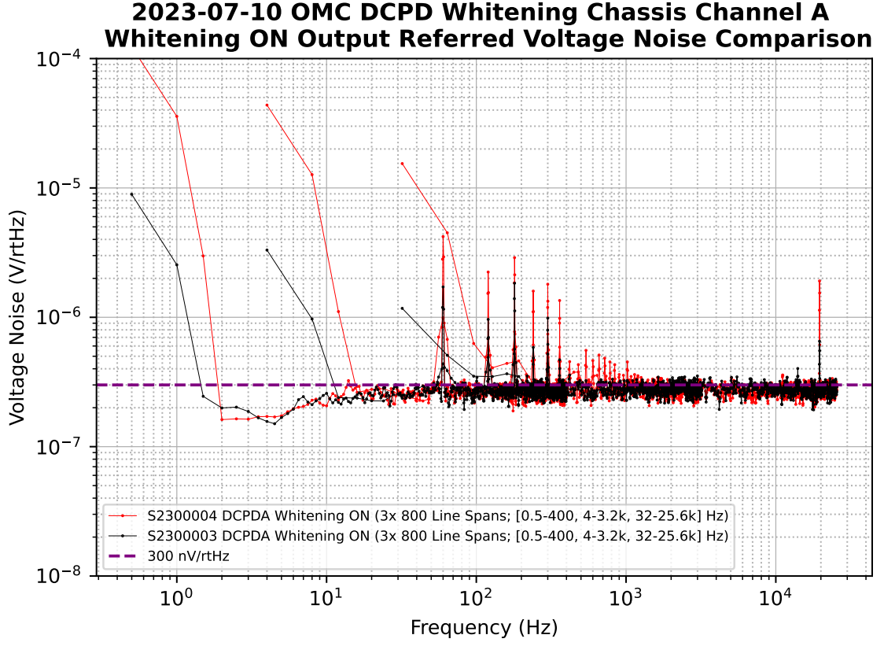
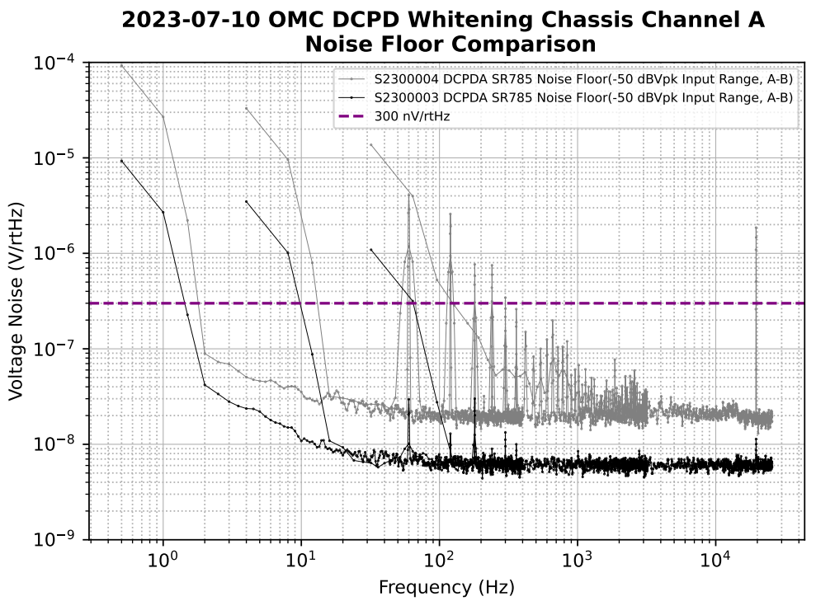
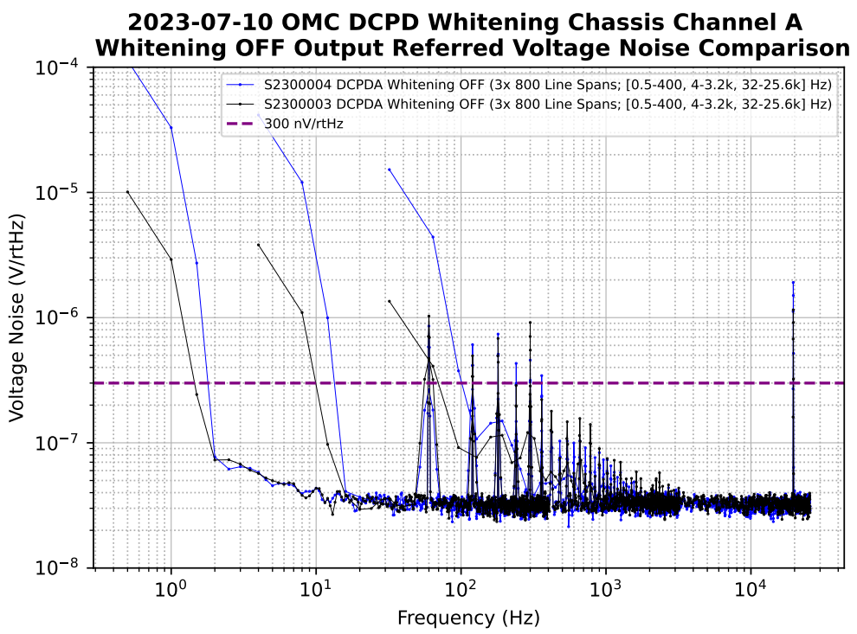

Slide 16
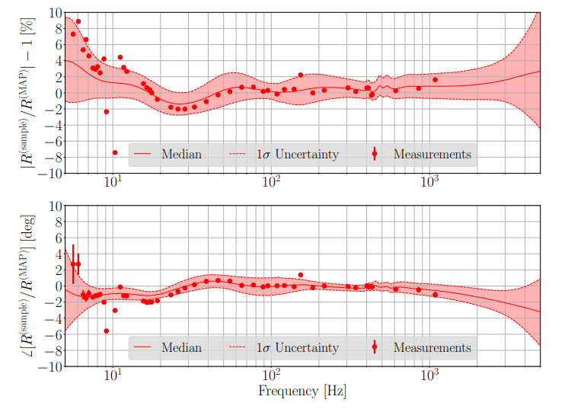
Response Function
Measured at discrete frequencies using external excitations to the IFO (Pcal system)
Uncertainty in these measurements is calculated and interpolated over a broadband frequency range using Gaussian Process Regression (GPR)
Effective, but could be improved
Another strategy: Fit an analytical transfer function to the Response Function
IIRRational – does not capture uncertainty in measurements, very accurate at high SNR/low measurement uncertainty
BayesianTF – statistical method, encapsulates measurement uncertainty, (hopefully) effective at low SNR/high measurement uncertainty
Goal: Compare results of IIRRational and BayesianTF

Slide 17
