Slide 1
Sensor Fusion for Improved Length Sensing and Control
By Deven Bowman
Mentors: Yehonathan Drori, Shruti Maliakal , Rana Adhikari

Slide 2
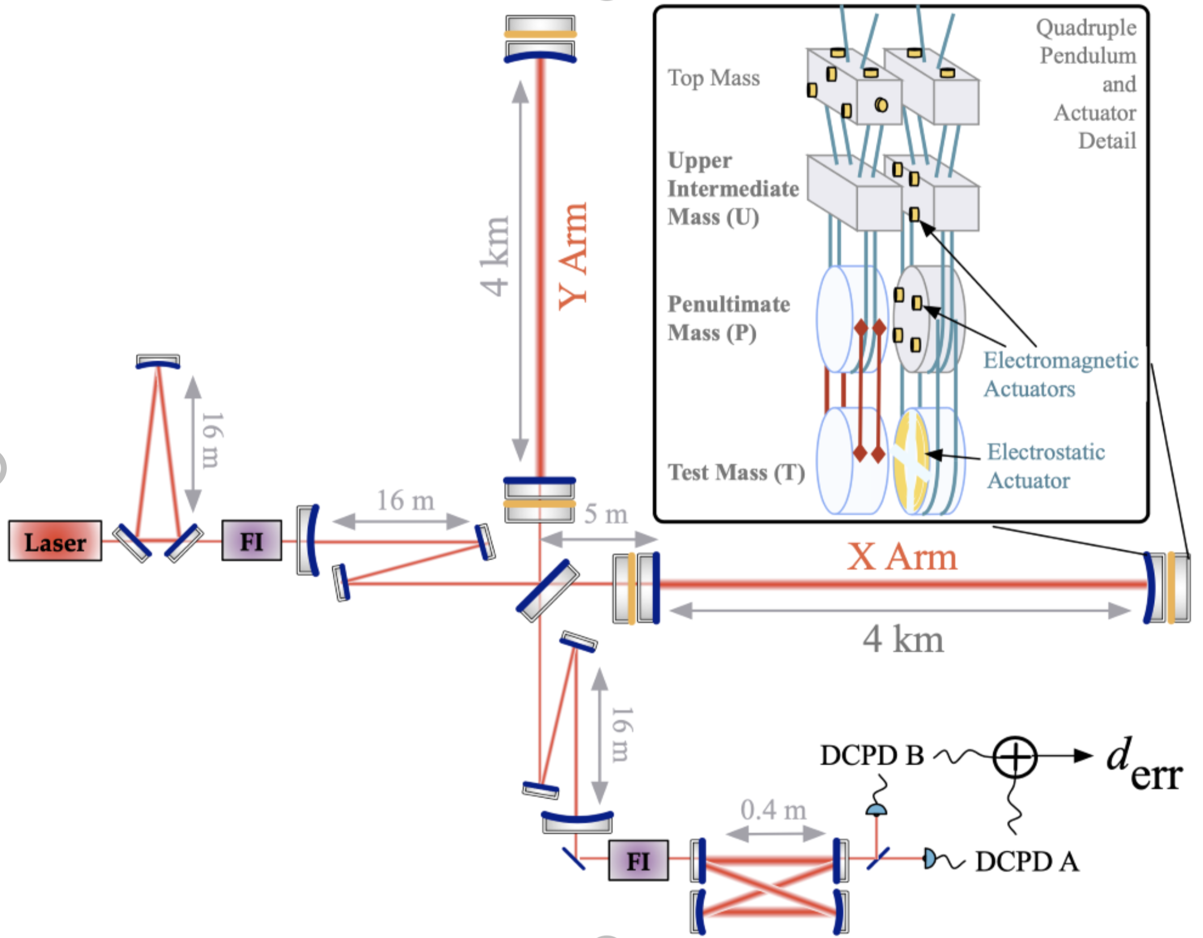
Length Sensing and Control (LSC)
LSC is crucial to maintaining linear response to GW signal through DARM
Reduces noise from auxiliary degrees to maintain high sensitivity
Notes:
Length sensing and control is an important aspect of what makes LIGO work. The people building LIGO had to get very good at generating error signals to sense changes in the internal length DoFs in order to apply control and make the whole thing work. Advance LIGO has multiple mode cleaners, a power recycling cavity, signal recycling cavity, faby-perot cavities in each arm and probably other cavities I’m even not aware of. The length of these cavities need to be controlled to maintain them on resonance with the correct laser fields. There are other DoFs like the common and differential lengths of the arms that also need to be maintained at their operating lengths. In total, LSC is keeps the detector at its operating point where it has a maximally sensitive linear signal to the GW. ASC is also important for this but that’s outside the scope of this talk.
Cite picture from reference in here: https://cga.anu.edu.au/research/projects/calibration-gravitational-wave-detectors

Slide 3
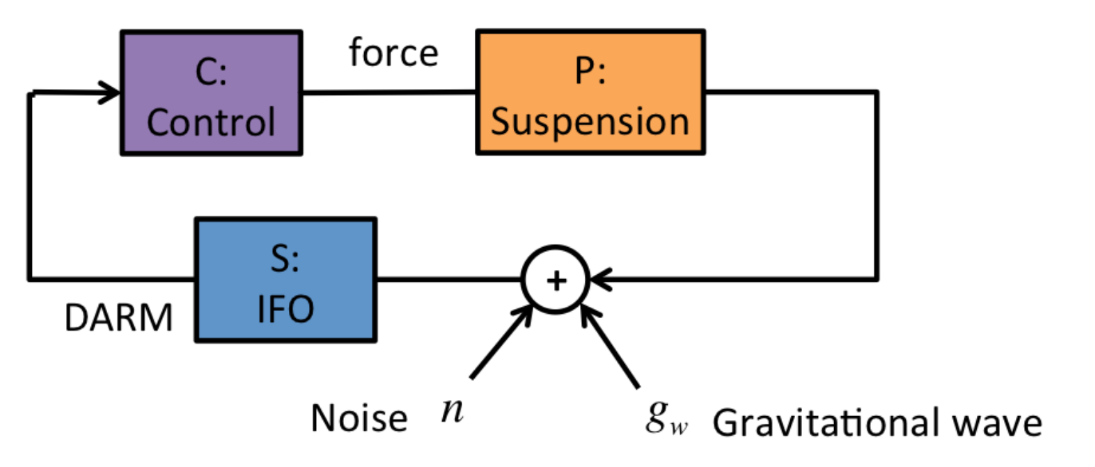
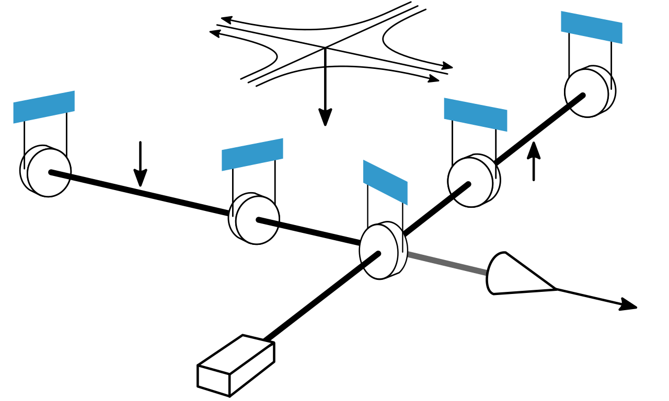
LSC for DARM
L_{x}
L_{y}
DARM : $L_{−}= \frac{L_{x}− L_{y}}{2}$
$DARM= \frac{S}{1−SPC}\left(g_{w}+n\right)$
$\hat{g_{w}}=\frac{1−SPC}{S}DARM$ = $g_{w}+n$
Notes:
*** Need to cite diagrams ****
https://en.wikipedia.org/wiki/Gravitational-wave_observatory
DARM is the DoF for the differential arm length and it is where the gravitational wave signal is derived so it is an important case to understand. Fluctuations in DARM are generated by seismic noise, radiation pressure noise, etc. These are fluctuations
Length sensing and control is an important aspect of what makes LIGO work. The people building LIGO had to get very good at generating error signals to sense changes in the internal length DoFs in order to apply control and make the whole thing work. Advance LIGO integrates optical ca
GW detectors contain many length DoFs that need to be sensed and controlled. These DoFs are re
LSC systems sense the fluctuations in the length DoFs and apply feedback to maintain them at their operating point. The most important example of this is for DARM, half the difference between the length of each interferometer arm. The gravitational wave signal modulates DARM as a function of time. The LSC

Slide 4
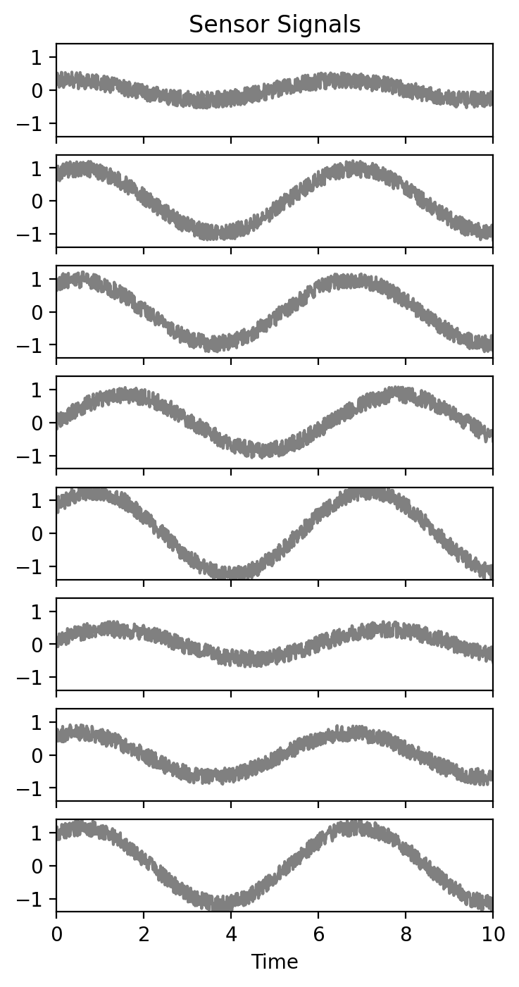
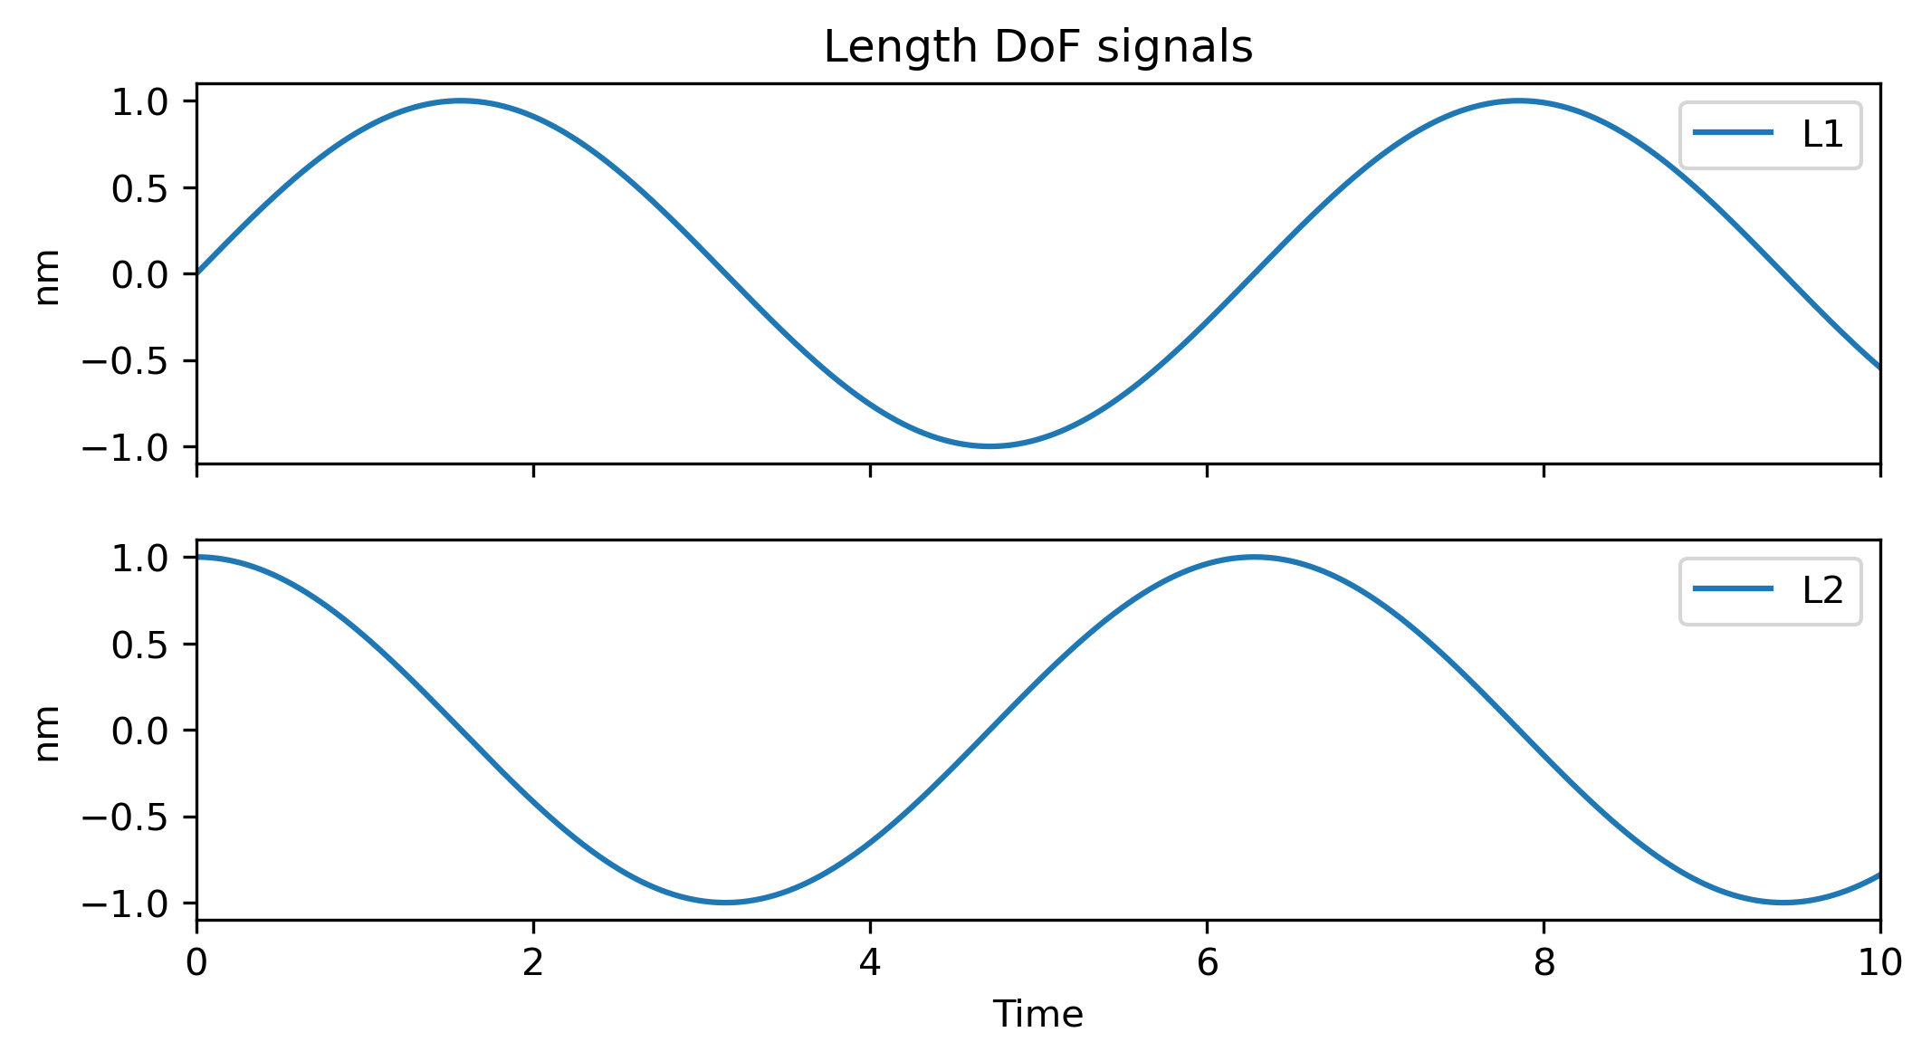
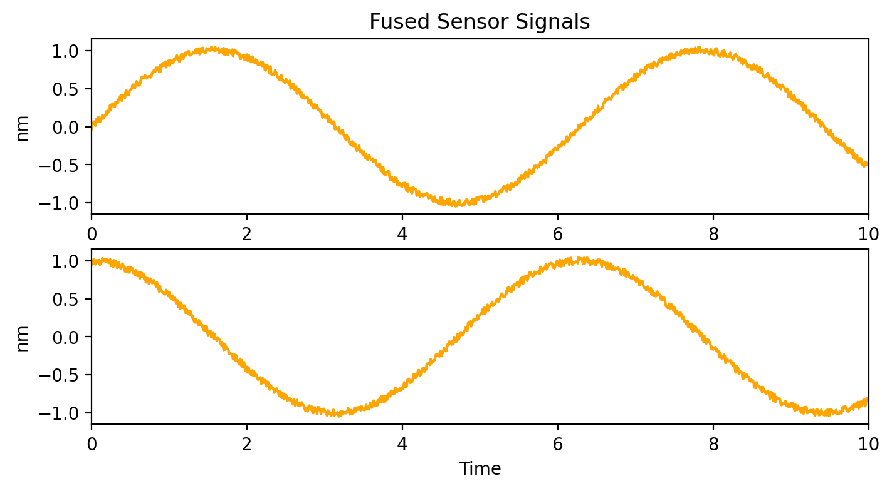
Sensor Fusion
Sensor Responses
Motion of Length DoFs
Fused Sensors
Notes:
*** Need to cite diagrams ****
https://en.wikipedia.org/wiki/Gravitational-wave_observatory
DARM is the DoF for the differential arm length and it is where the gravitational wave signal is derived so it is an important case to understand. Fluctuations in DARM are generated by seismic noise, radiation pressure noise, etc. These are fluctuations
Length sensing and control is an important aspect of what makes LIGO work. The people building LIGO had to get very good at generating error signals to sense changes in the internal length DoFs in order to apply control and make the whole thing work. Advance LIGO integrates optical ca
GW detectors contain many length DoFs that need to be sensed and controlled. These DoFs are re
LSC systems sense the fluctuations in the length DoFs and apply feedback to maintain them at their operating point. The most important example of this is for DARM, half the difference between the length of each interferometer arm. The gravitational wave signal modulates DARM as a function of time. The LSC

Slide 5
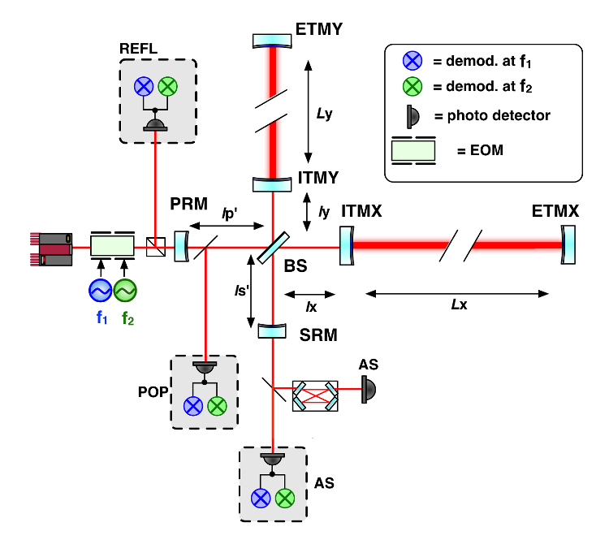
Power Recycling Michelson Interferometer at LIGO 40m
LIGO 40m is 1:100 scale prototype of the site detectors for R&D
We’ll focus on the 40m in one of the simpler configurations: PRMI

Slide 6
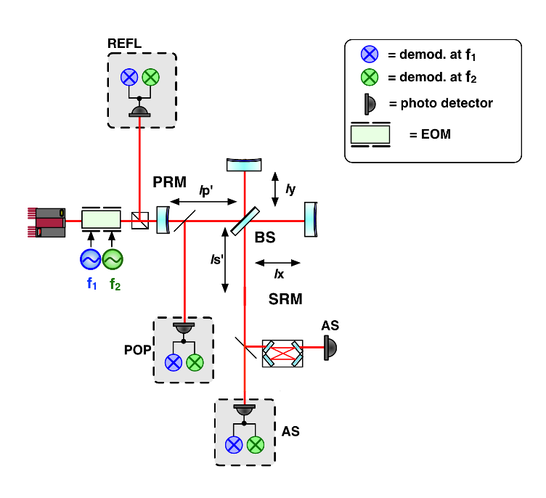
Power Recycling Michelson Interferometer at LIGO 40m
MICH: $l_{−}=\frac{l_{x}−l_{y}}{2}$
PRCL: ${l_{p}=l}_{p}^{′}+\frac{l_{x}+l_{y}}{2}$
REFL, POP and AS RF photodiodes
Multiple demodulation frequencies
I and Q demodulation phases
Sensors out number DoFs
Can we design virtual sensors for improved PRMI LSC?

Slide 7
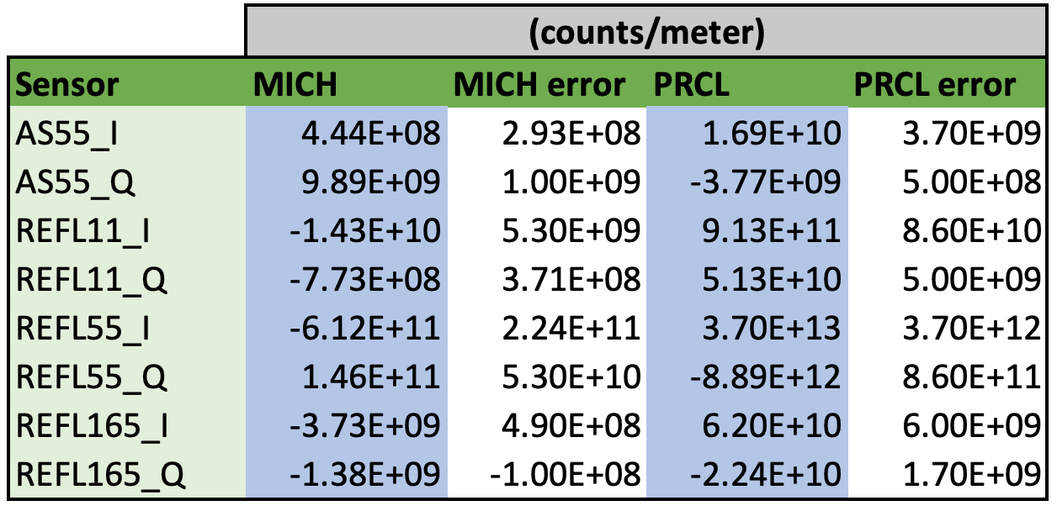
PRMI Measurements: Sensing Matrix $S$
$$g_{1}$$
$$g_{2}$$
$S:$ MICH & PRCL → Sensors
MICH and PRCL are driven response is measured in sensors
MICH @ 211.1Hz
PRCL @ 313.31Hz
PRMI has short cavities, ~1m, so sensing matrix has no relevant frequency dependence
Measured with a Yuta’s script

Slide 8
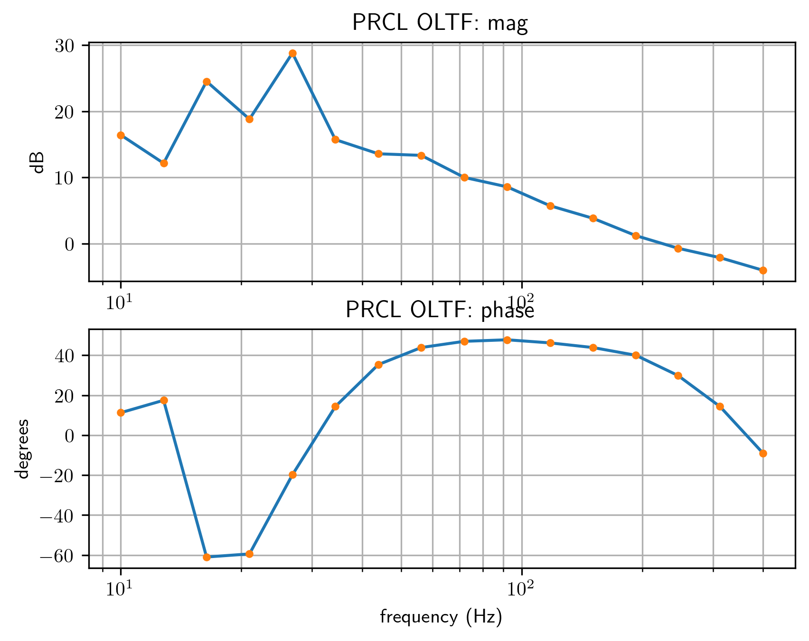
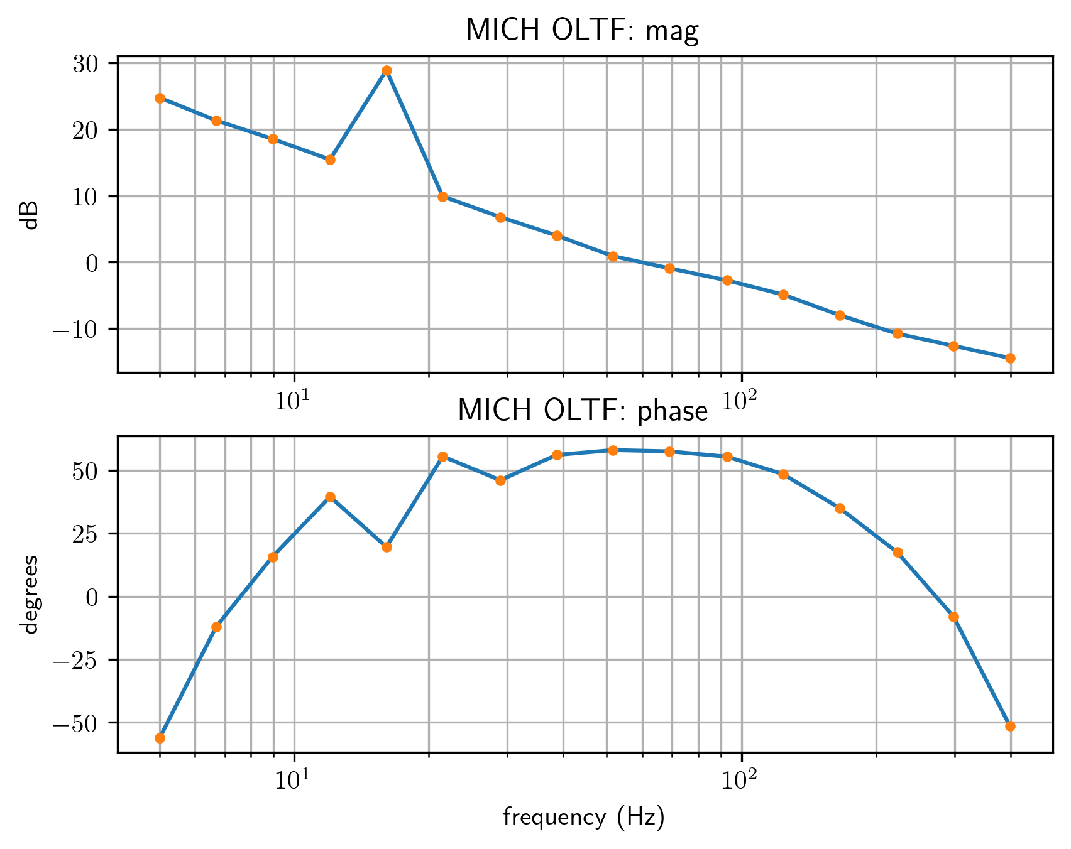
PRMI Measurements: open loop transfer functions (OLTF)

Slide 9
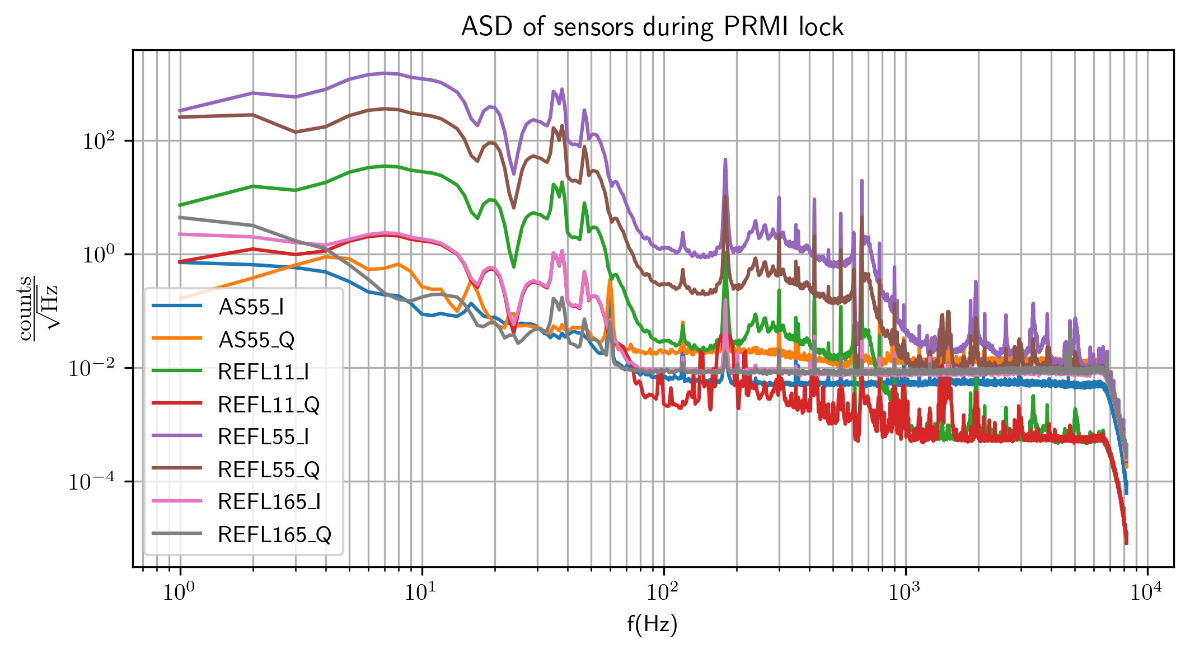
PRMI Measurements: sensor data
Time series data from 8 sensors during the PRMI lock, 80s
Calculate noise spectrum of MICH and PRCL with current sensors and theoretical fused sensors

Slide 10
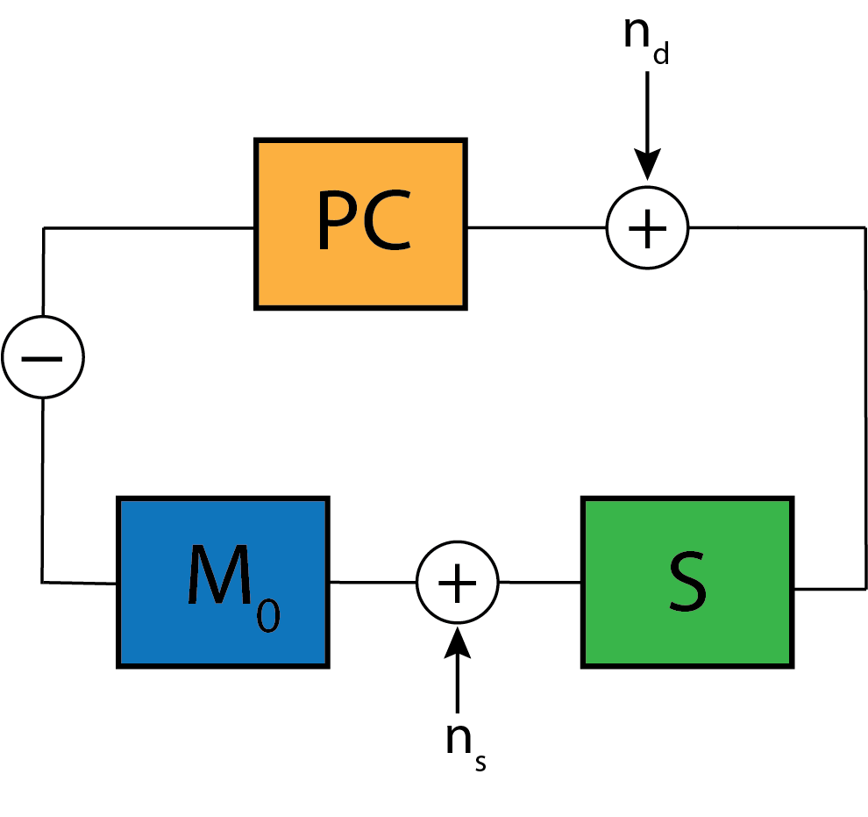
PRMI control system model
Measured Control Loop
Simulated Control Loop
$$Y_{sim}=\left[\begin{aligned}Y_{MICH} \\ Y_{PRCL}\end{aligned}\right]$$
$$Z_{sim}=\left[\begin{aligned}Z_{MICH} \\ Z_{PRCL}\end{aligned}\right]$$
$$X=\left[\begin{aligned}x_{1} \\ ⋮ \\ x_{N}\end{aligned}\right]$$
$$X_{sim}=\left[\begin{aligned}x_{1} \\ ⋮ \\ x_{N}\end{aligned}\right]$$

Slide 11
PRMI control system model
We can calculate the loop suppression to relate the sensor data to the inject noises
$$X=\left[\begin{aligned}x_{1} \\ ⋮ \\ x_{N}\end{aligned}\right]$$

Slide 12
PRMI control system model
$$Y_{sim}=\left[\begin{aligned}Y_{MICH} \\ Y_{PRCL}\end{aligned}\right]$$
Given this relation for $X$ we can proceed to simulate a loop with a new $M$
Remove loop suppression with OLTF
$$Z_{sim}=\left[\begin{aligned}Z_{MICH} \\ Z_{PRCL}\end{aligned}\right]$$
Apply loop suppression of simulated loop
$$X_{sim}=\left[\begin{aligned}x_{1} \\ ⋮ \\ x_{N}\end{aligned}\right]$$

Slide 13
PRMI control system model
$$Y_{sim}=\left[\begin{aligned}Y_{MICH} \\ Y_{PRCL}\end{aligned}\right]$$
With simulated sensor signals we calculate the simulated virtual sensors
$$Z_{sim}=\left[\begin{aligned}Z_{MICH} \\ Z_{PRCL}\end{aligned}\right]$$
Calibrate the virtual sensors to MICH and PRCL with ${(MS)}^{−1}$
$$X_{sim}=\left[\begin{aligned}x_{1} \\ ⋮ \\ x_{N}\end{aligned}\right]$$

Slide 14
Diagonalizing $MS$
We will design sensors such that $MS= \left[\begin{matrix}g_{1} & 0 \\ 0 & g_{2}\end{matrix}\right]$
Diagonal elements constrain the loop gain for MICH and PRCL
Off diagonal elements keep MICH and PRCL signals decoupled
Sensing matrix uncertainties make it hard to keep PRCL out of MICH signal
$M= \left[\begin{matrix}g_{1} & 0 \\ 0 & g_{2}\end{matrix}\right]S^{+}$, where
$S^{+}$ is the Moore-Penrose inverse of $S$

Slide 15
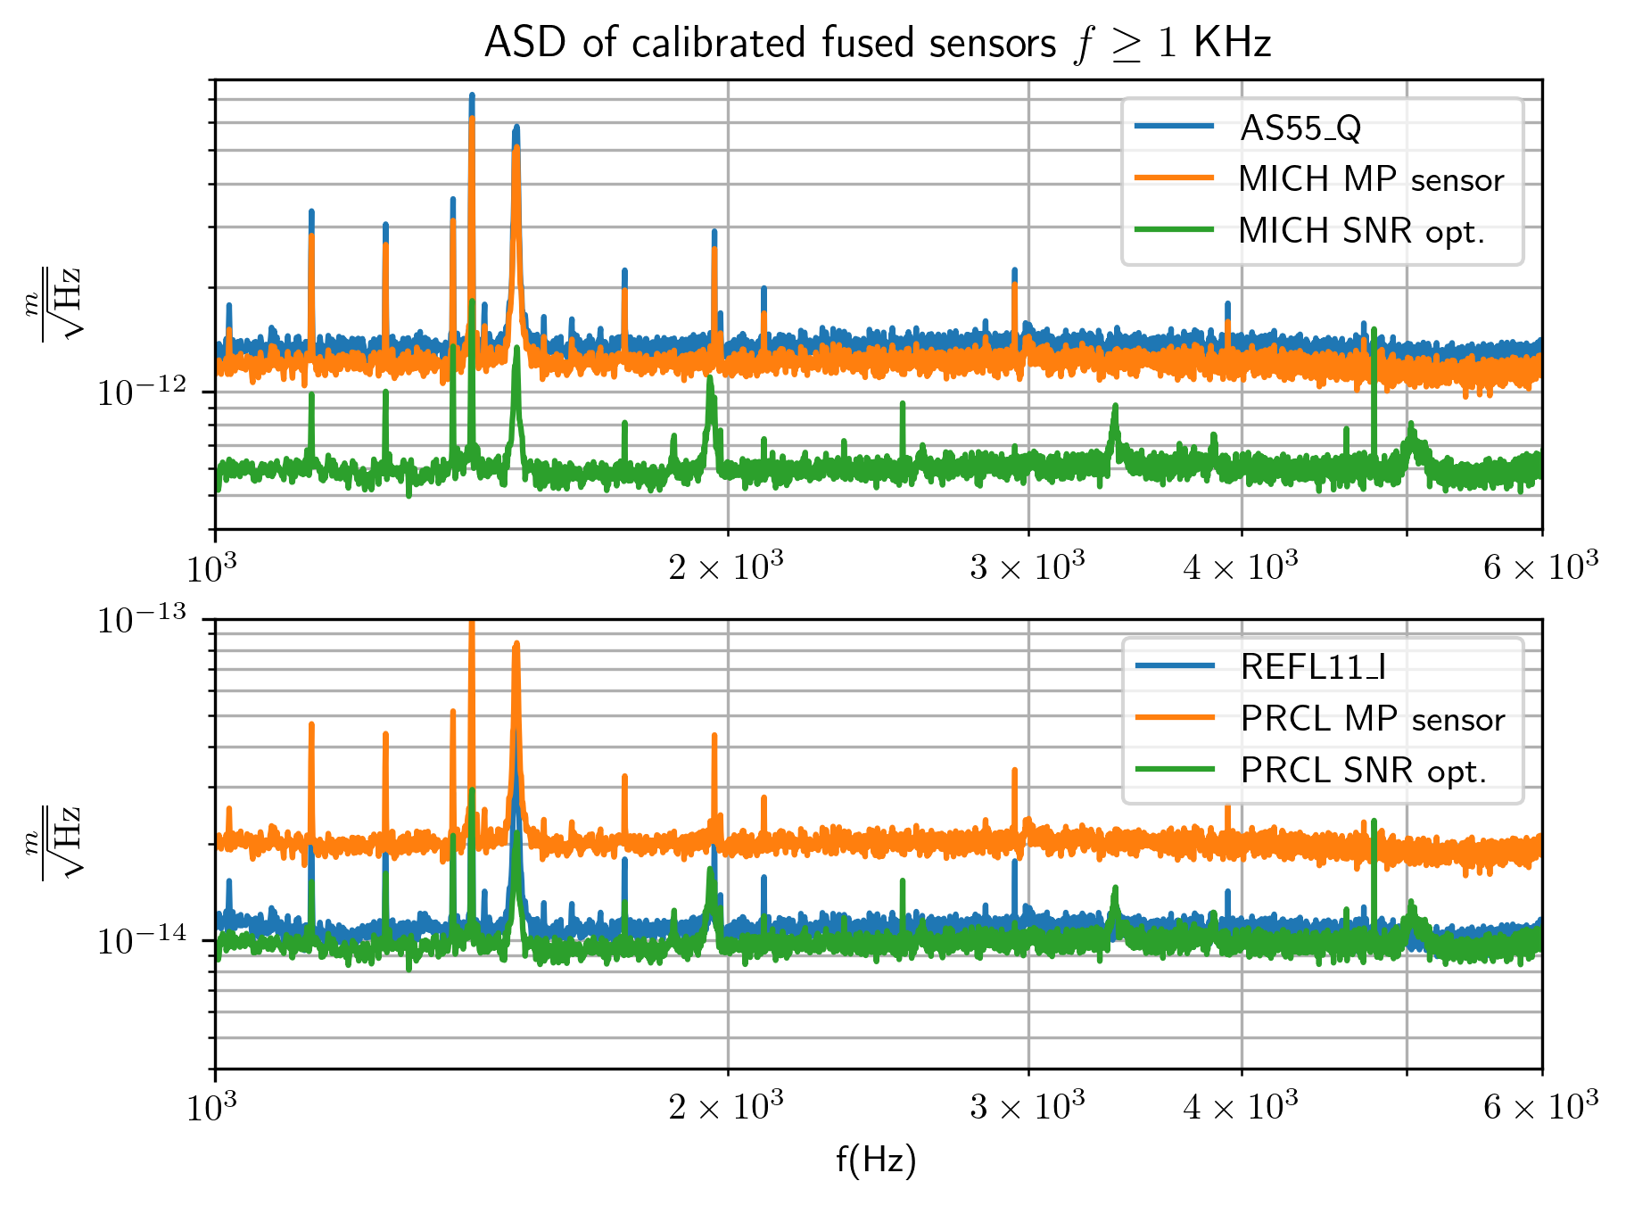
High frequency optimized SNR
The condition that $MS= \left[\begin{matrix}g_{1} & 0 \\ 0 & g_{2}\end{matrix}\right]$ leaves room for M to be optimized to a cost function
Above ~1Khz, the noise spectrum of sensors is dominated by white noise, probably dark counts in the PDs
Optimize $M$ to minimize high frequency noise
$\int_{1KHz}^{∞}{ASD\left(Z_{sim}\right)df}$

Slide 16
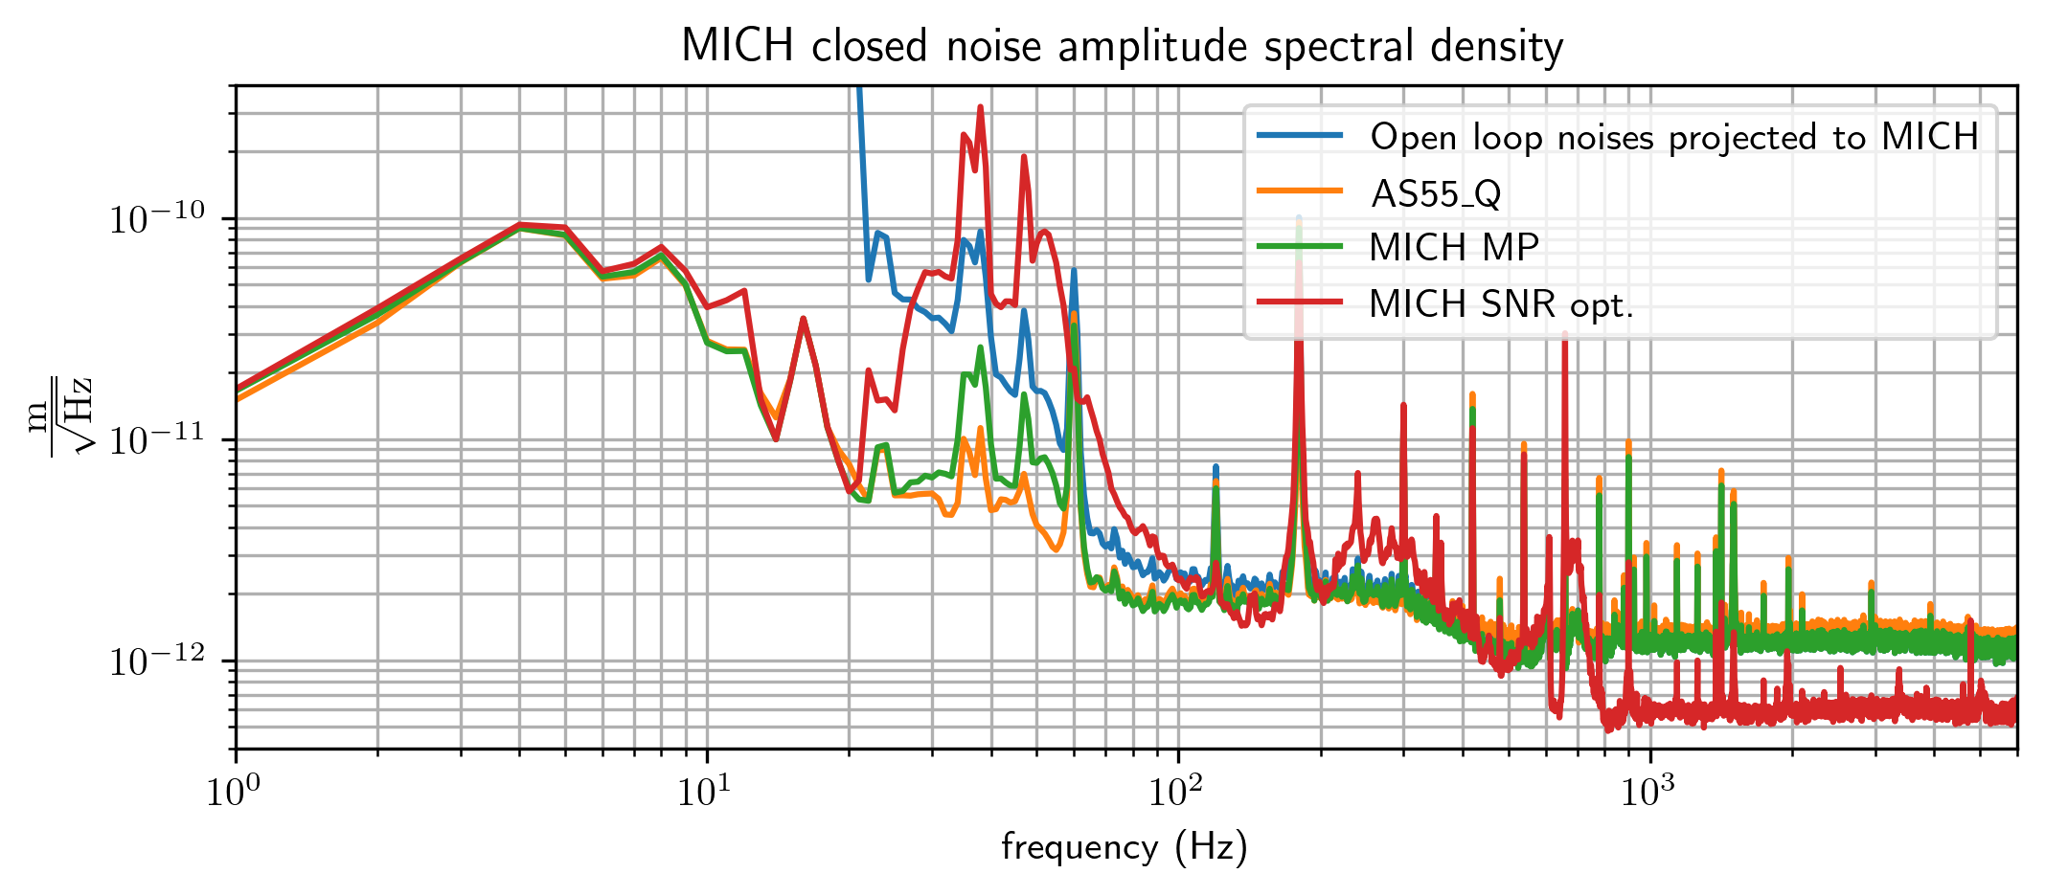
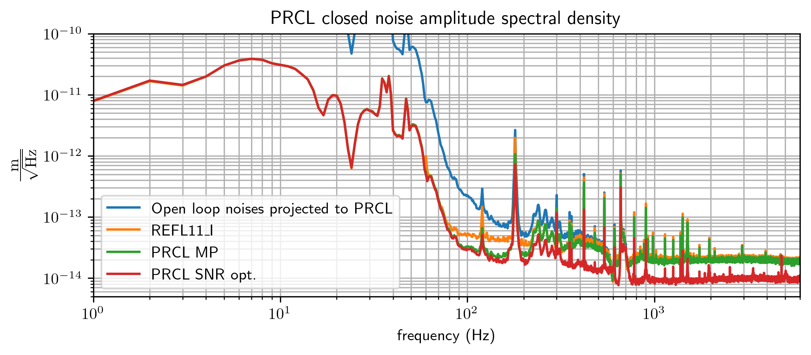
Fused Sensor Theoretical Performance
Fused sensors can be evaluated by calculated ASD of MICH and PRCL with fused sensors
Moore-Penrose inverse
High frequency SNR optimized
Sensing matrix uncertainties make delicate linear combos unlikely to perform well
Sensor fusion informed by sensors noises more likely to succeed

Slide 17
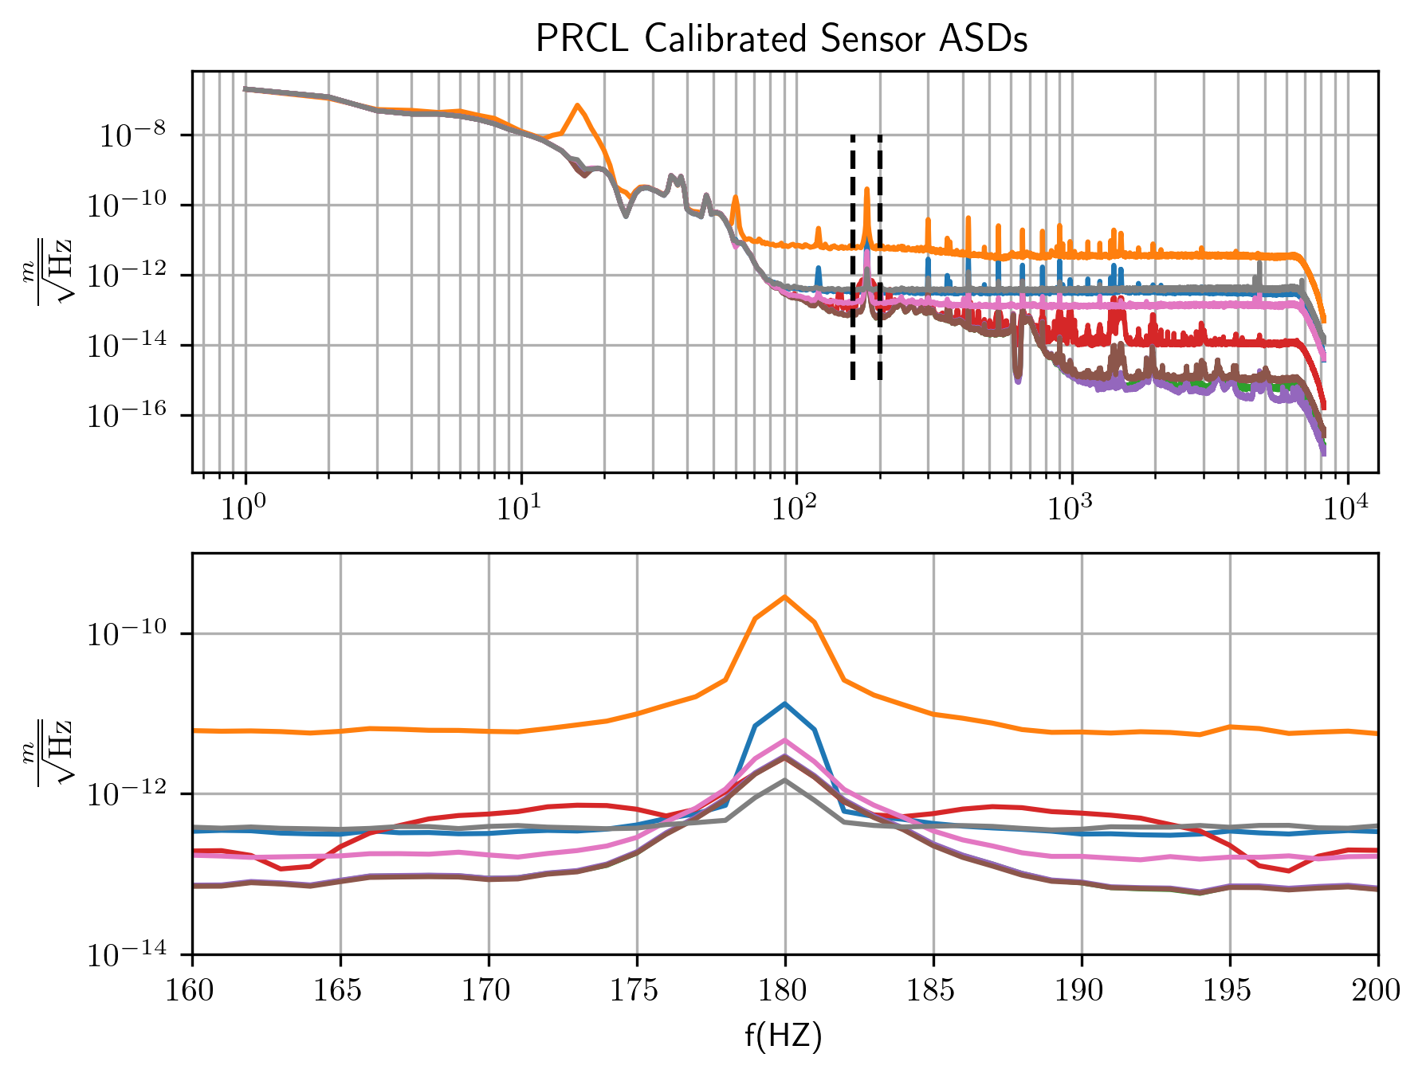
PCA for noise spikes
Sensing process:
$\left[\begin{matrix}Y_{MICH} \\ Y_{PRCL}\end{matrix}\right]→S→\left[\begin{matrix}\begin{aligned}{S_{11}Y}_{MICH}+{S_{12}Y}_{PRCL}+n_{1} \\ ⋮\end{aligned} \\ {S_{N1}Y}_{MICH}+{S_{N2}Y}_{PRCL}+n_{N}\end{matrix}\right]$
Calibration:
$X_{i}→\frac{X_{i}}{S_{i2}}$ $=Y_{PRCL}+{\frac{S_{i1}}{S_{i2}}Y}_{MICH}+n_{i}$
Peaks of noise decreasing SNR of photodiode
Understand and mitigate these spikes with PCA?

Slide 18
PCA for noise spikes
$$CSD\left(X\right)= \left[\begin{matrix}\begin{aligned}CSD\left(x_{1},x_{1}\right) \\ ⋮\end{aligned} & \begin{aligned}⋯ \\ ⋱\end{aligned} & \begin{aligned}CSD(x_{1},x_{N}) \\ ⋮\end{aligned} \\ CSD(x_{N},x_{1}) & … & CSD(x_{N},x_{N})\end{matrix}\right]$$
$X_{n}= S_{n}n$for $S_{n}$ Nx1 matrix
When this noise source dominants in a frequency range, $(f_{1 },f_{2})$
$X≈S_{n}n$
The band-limited covariance will be dominated by this signal
The band-limited covariance calculated from cross spectral density of the unsuppressed sensors

Slide 19
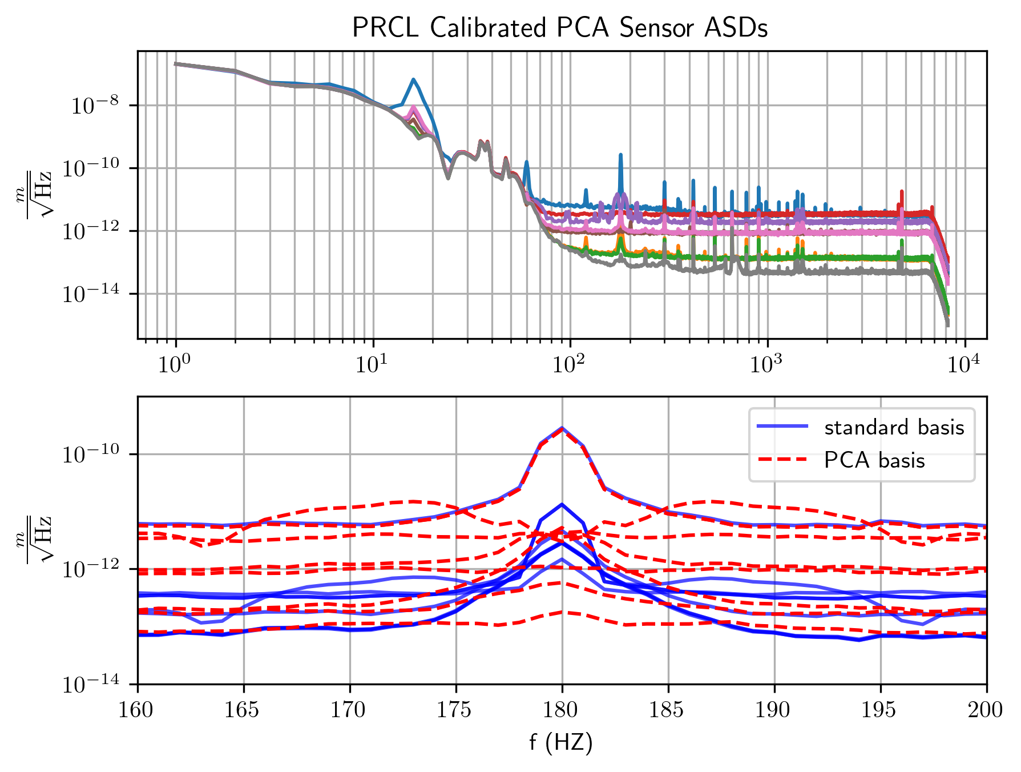
PCA for noise spikes
SVD of $S_{n}$ allows for calculation of principle components of $R_{xx}^{f_{1},f_{2}}$
$U$: Nx1 unitary
$∑$: Nx1 rectangular diagonal
$V^{T}$: 1x1 unitary
First PC, will be proportional to $S_{n}$
$U^{i}→U^{i}/\sum_{j=1}^{N}{U_{ij}}$

Slide 20
Moving Forward
Explore more sensor fusion techniques that are informed by the noises and their correlations in the sensors
Optimize w.r.t. other noise cost functions
PCA for virtual sensor design
Evaluate sensor performance with LIGO 40m prototype tests
Continue noise correlation studies to more general cavity systems with length DoFs over-sensed by RF photodiodes

Slide 21
Acknowledgements
Mentors:
Yehonathan Drori
Shruti Maliakal
Rana Adhikari
Caltech SFP
NSF

