Slide 1
Glitch Mitigated Parameter Estimation via Reweighting
Julien Kearns
Mentor: Sophie Hourihane & Katerina Chatziioannou

Slide 2
01
Background
Glitches, Spin Precession, Bayes’ Theorem

Slide 3
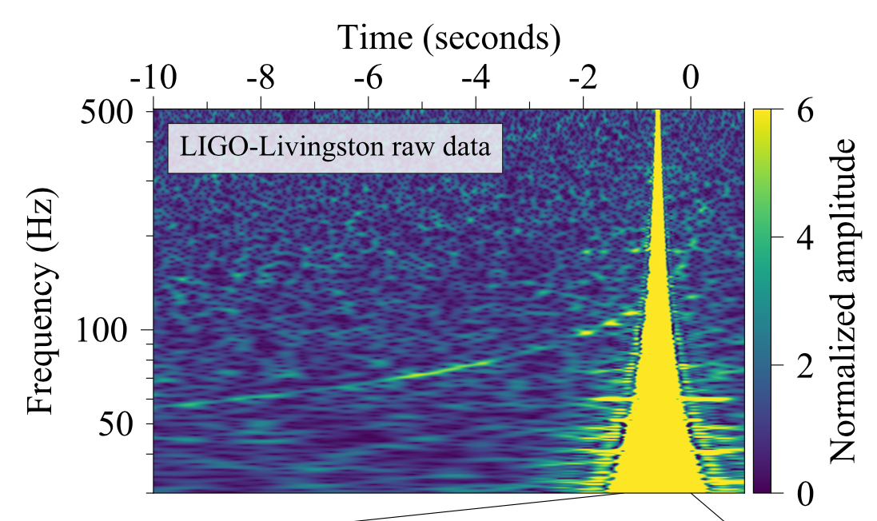
Transient Noise Artifacts - “Glitches”
Non-Gaussian
Vary in:
Sources
Frequency
Time
Duration
Strength
Interferes with Parameter Estimation
Notes:
What do we mean by non gaussian again

Slide 4
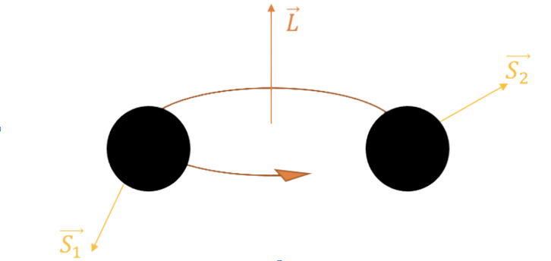
Spin Precession
Angular Momentum
Misaligned spin axes
Why do we care?
Dynamical capture
Image from Jacob Golomb
Notes:
-unlike a non precessing pair, the orbital plane of a precessing binary changes which impacts the shape of the waveform -a binary that forms together will have little to no spin precession, whereas one that was created through dynamical capture might have significant spin precession

Slide 5
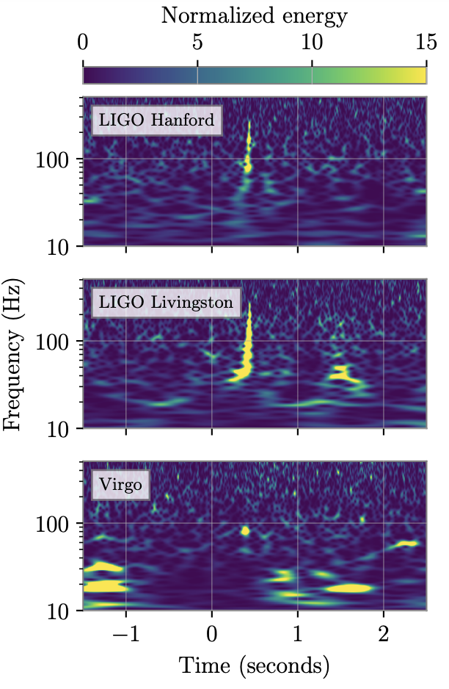
GW200129
Notes:
-The bottom left graph shows the different glitch models used for the glitch mitigation, the histogram shows reweighted distributions for the chi_p precession parameter
-In these graphs produced in a paper by my mentor and others examining the GW200129 signal we learn that estimates for the precession parameter chi_p are very dependant upon what glitch model is used for gitch mitigation

Slide 6
Slide Credit: Jonah Kanner

Slide 7
02
Objective & Method
BayesWave & Bilby, Reweighting & Efficiency

Slide 8
Bayesian Inference Algorithms
BayesWave
Both
Bilby
Glitch Subtraction? Yes!
Spin Precession? No :(
Parameter Estimation
Compact Binary Coalescence Events
Glitch Subtraction? No :(
Spin Precession? Yes!
“Any such inference [of spin precession] is contingent upon the statistical and systematic uncertainty of the glitch mitigation”
E. Payne, S. Hourihane, J. Golomb, R. Udall, R. Udall, D. Davis, and K. Chatziioannou, Phys. Rev. D 106, 104017 (2022)

Slide 9
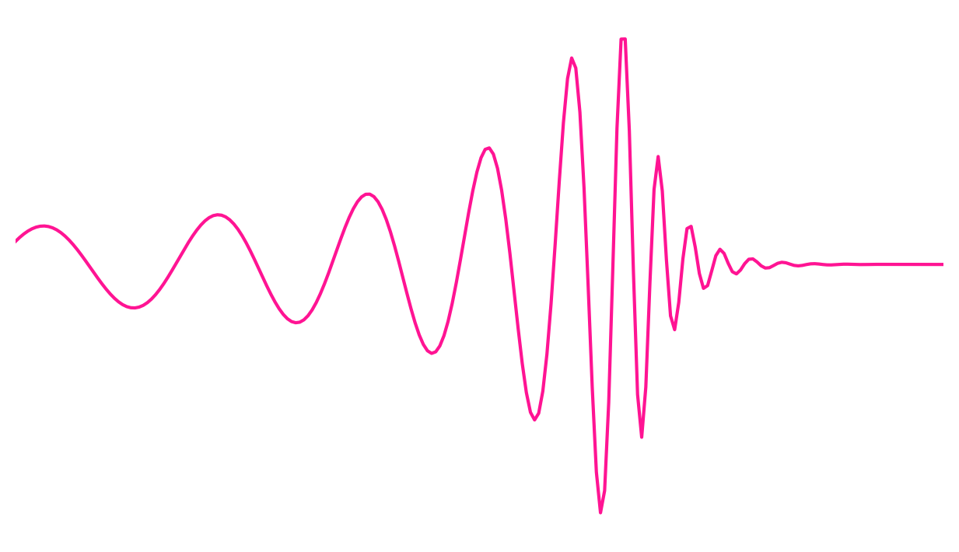
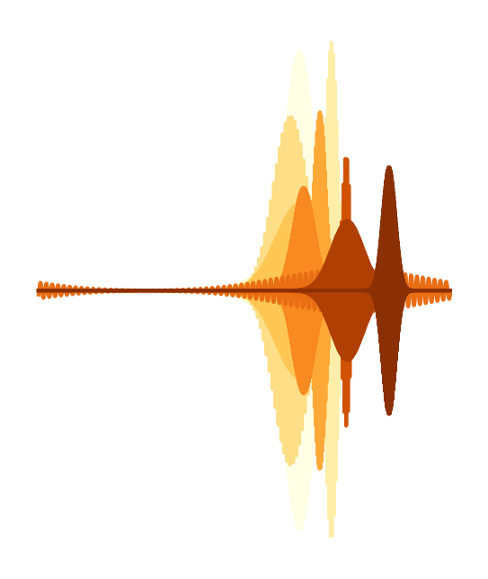
So What Do We Want?
BayesWave CBC+Glitch
Bilby θ_{p}

Slide 10
What we want

Slide 11
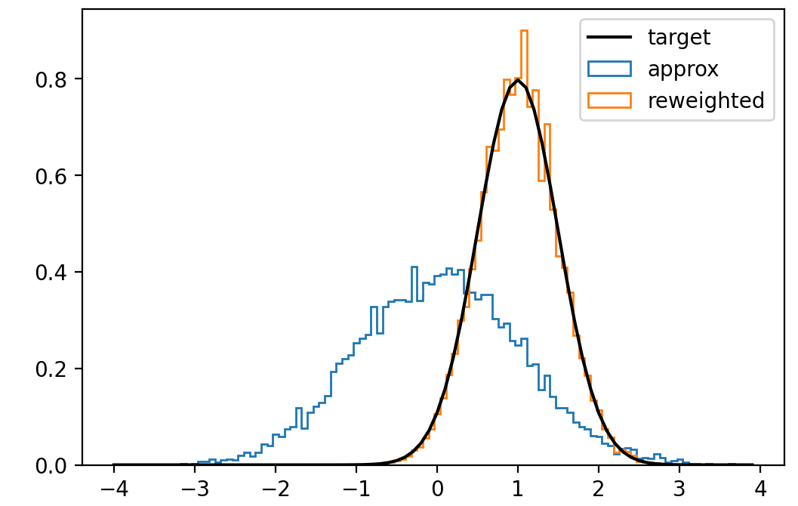
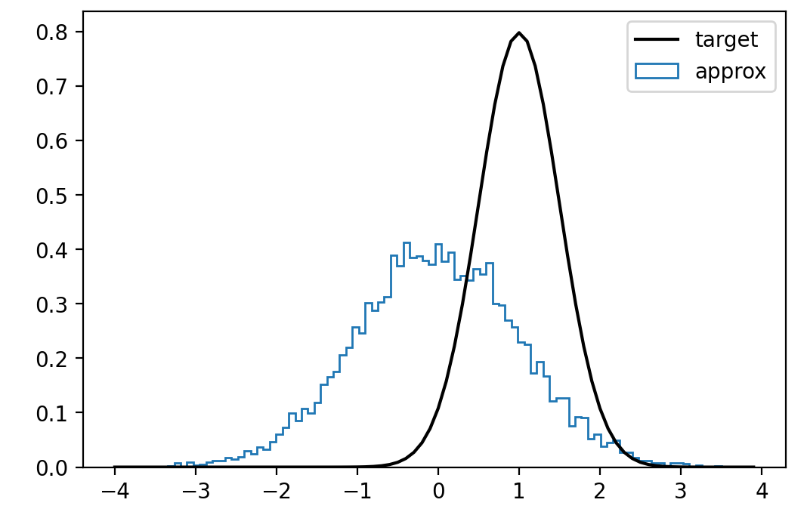
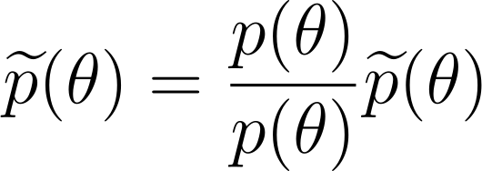
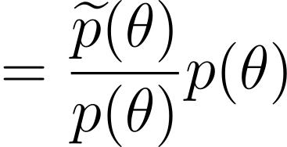
Reweighting (Same Dimension)
Reweighting
Target Distribution
Approximate distribution
Notes:
Fix animations

Slide 12
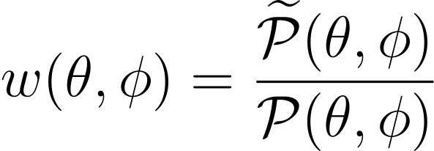
Reweighting (Added Dimension)
Original Dimension
New Dimension
New Approximate
Repeat
Target
Notes:
Top down (original, new dimension, new approximate, make weights, target)

Slide 13
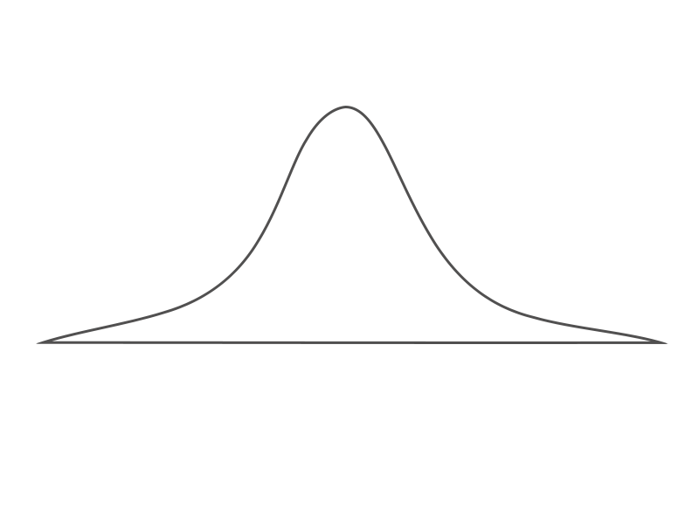
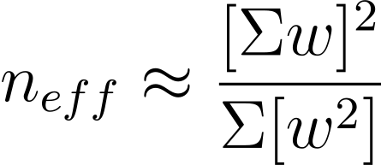
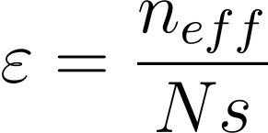
Efficiency
Effective Number of Samples
Efficiency of reweighting process
Low efficiency
Number of Samples
High efficiency
Notes:
‘if we were estimating the integral of this target using these reweighted samples, it leads to the same level of accuracy as if we drew n_effective points directly from the target distribution.
Neff is effectively how many samples we have at the end, more samples = more accurate
what the effective number of samples is saying is ‘if we were estimating the integral of this target using these reweighted samples, it leads to the same level of accuracy as if we drew n_effective points directly from the target distribution.

Slide 14
03
Simulating Glitch Parameters
Notes:
Per method: method (emphasize what we’re changing is how we make approx distribution, and specify where it’s coming from for each method, use wave pics from what we want slide) slide + results slide (waveform, corner or histogram) (make colors consistent)

Slide 15
Constructing Our Approximate
BayesWave CBC+Glitch
Bilby θ_{p}
Notes:
BW CBC+G: estimating what the glitch in the data is alongside what the cbc parameters are

Slide 16
Constructing Our Approximate
CBC
BayesWave
Glitch

Slide 17
Constructing Our Approximate
CBC
BayesWave
Glitch

Slide 18
Constructing Our Approximate
CBC
BayesWave
Glitch

Slide 19
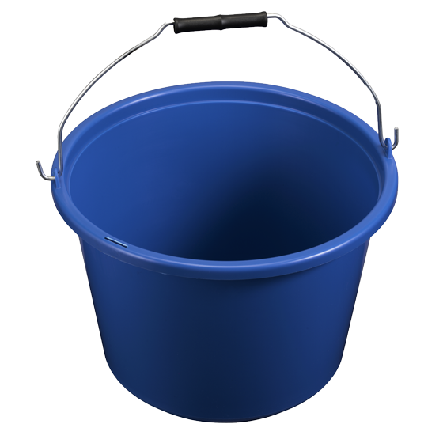
Constructing Our Approximate
Glitch

Slide 20
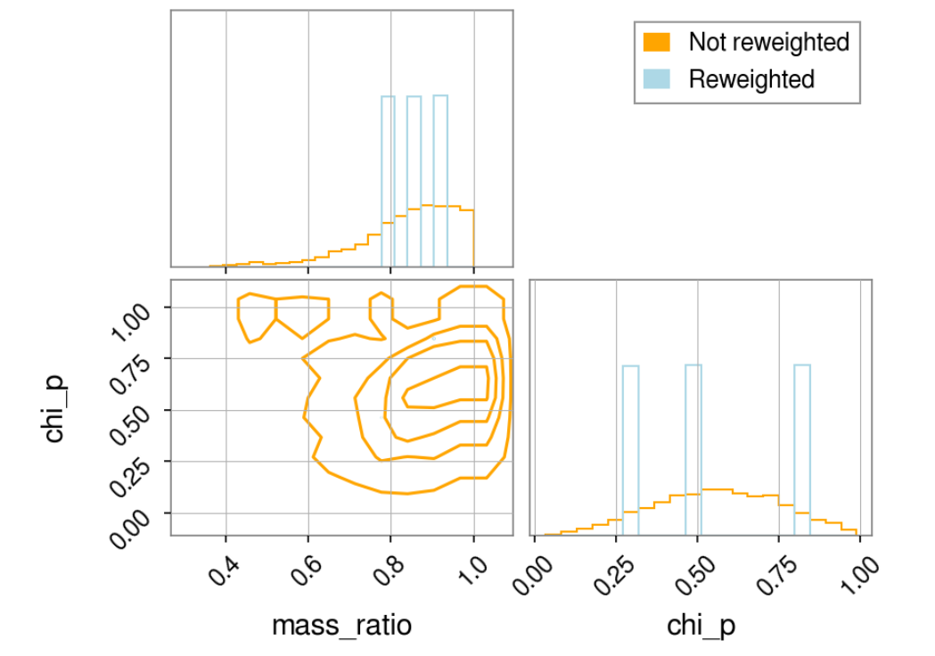
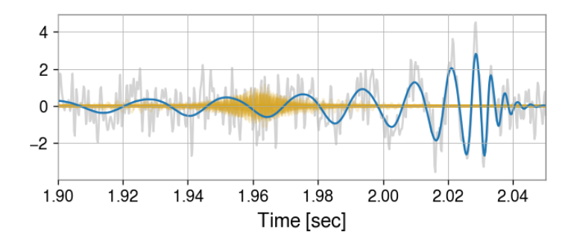
Results
Efficiency < 1%
L1

Slide 21
Revising Our Method
Take
One!

Slide 22
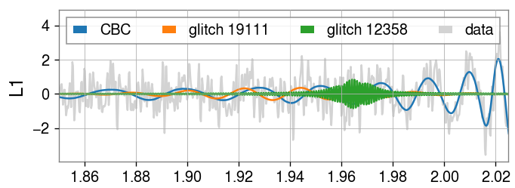
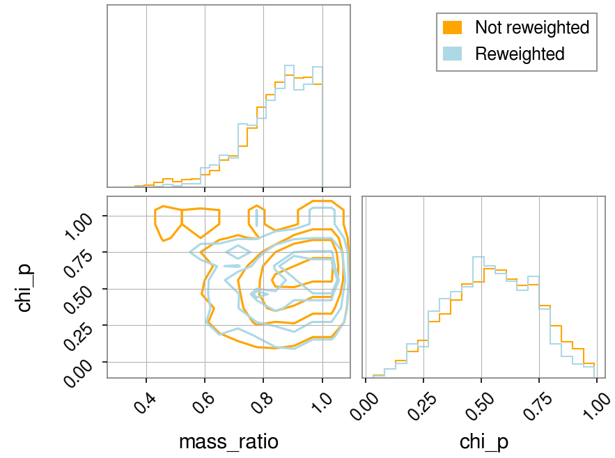
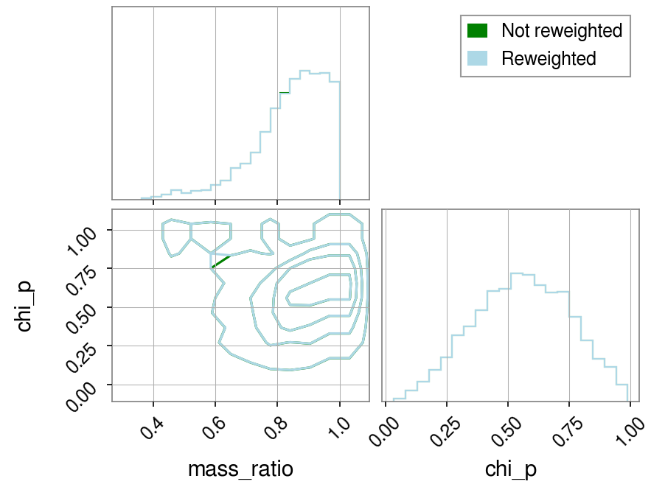
Results
Efficiency ~ 5.6%
Efficiency ~ 99.99%

Slide 23
04
Simulating Precession Parameters

Slide 24
Constructing Our Approximate
BW CBC+G
Bilby θ_{p}

Slide 25
Constructing Our Approximate
Bilby θ_{p}

Slide 26
Constructing Our Approximate
Bilby Spin Parameters Prior

Slide 27
Constructing Our Approximate
BW CBC+G

Slide 28
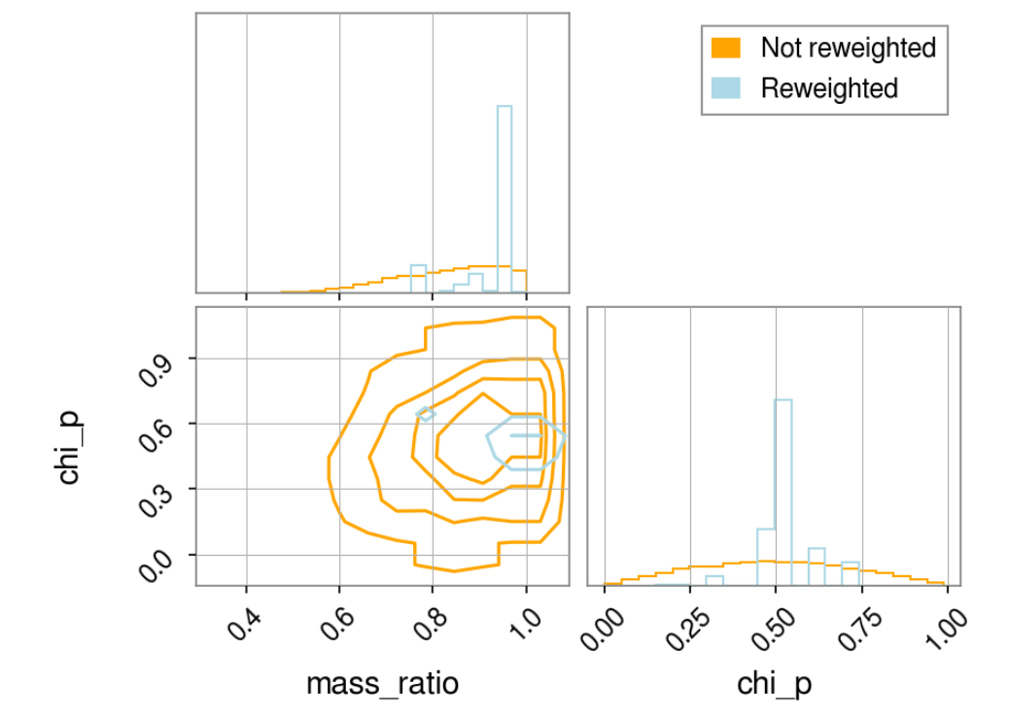
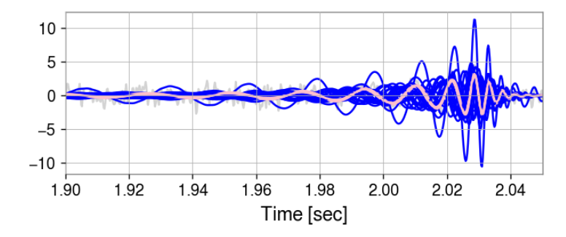
Results
Efficiency < 1%
L1
Notes:
BW: ‘imrphenomD’, Bilby: ‘nrsurrogate’, params do not match up between waveforms. BW plotted more than once with random samples

Slide 29
What Went Wrong?
Simulating Glitch Parameters
Marginalize over glitches Single glitch realization
Low efficiency
BayesWave run couldn’t confidently find glitch
Unusually High efficiency most of the time
Glitches didn’t intersect with waveform
Simulating Precession Parameters
- Low efficiency
- CBC parameters don’t translate well between ‘IMRPhenomD’ and ‘NRSur’ waveforms

Slide 30
What’s Next?
Try with simulated data
(So we know what’s right)
Try with events where BayesWave can confidently fit glitch
Try drawing from glitch prior
(Like we drew from the precession prior)

Slide 31
Thank You!
Sophie Hourihane
Katerina Chatziioannou
Alan Weinstein
Rhiannon Udall
Howard Deshong
Jacob Golomb
Simona Miller
Jonah Kanner

