Slide 1
Searching for Gravitational Waves associated with Flaring galactic Magnetars
Kara Merfeld
University of Oregon
28 April, 2023
Dissertation Committee:
Dr. Raymond Frey (Advisor)
Dr. Ben Farr (Chair)
Dr. Carol Paty
Dr. Robert Schofield
Dr. Laura Jeanty

Slide 2
Structure of Talk:
Introduction to gravitational waves and the LIGO observatories
Presentation of two of my DetChar and commissioning projects when I was an LSC Fellow, 2018-2019
Magnetars and the O3 x-ray burst GW follow-up search
The GW search over Fast Radio Bursts in O3a
Preparations for O4: a stacked analysis

Slide 3


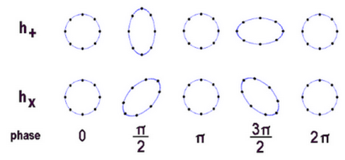
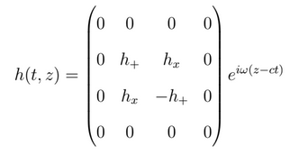
General Relativity:
In 1915, Einstein came up with General Relativity, which describes perturbations to the flat space metric as propagating waves:
The time-varying effects of a gravitational-waves on a ring of point particles:
For a plane-wave traveling in the z-direction:
https://www.johnstonsarchive.net/relativity/pictures.htm

Slide 4
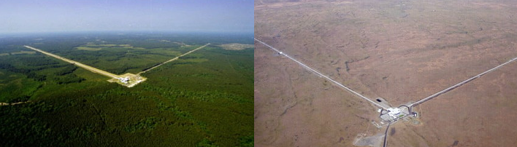
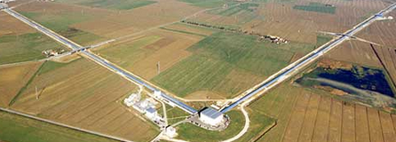
Gravitational-wave observatories:
LIGO Livingston (LA)
LIGO Hanford (WA)
Virgo Observatory, Pisa, Italy
https://www.aps.org/publications/apsnews/201710/virgo.cfm
https://www.geekwire.com/2016/hanford-ligo-scientists-spill-gravitational-wave-secrets/
https://www.ligo.caltech.edu/page/what-is-ligo

Slide 5
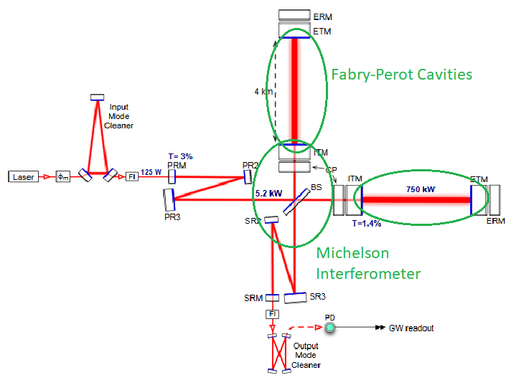
LIGO optical setup
Observatories combine a Michelson interferometer with two 4km Fabry-Perot cavities
Measures the difference in arm length (DARM) by measuring the phase difference.
Power is built up in stages before it reaches the Fabry-Perot cavities.
http://dx.doi.org/10.1088/0264-9381/32/7/074001

Slide 6
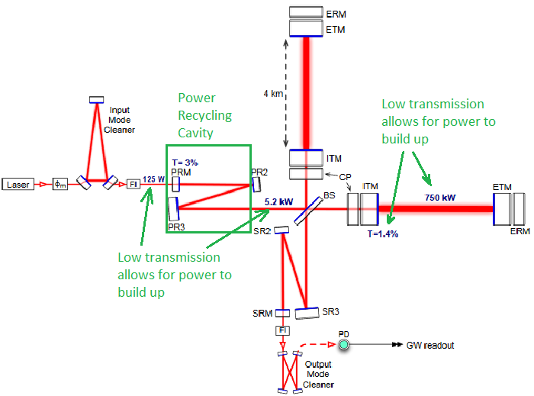
LIGO optical setup
Observatories combine a Michelson interferometer with two 4km Fabry-Perot cavities
Measures the difference in arm length (DARM) by measuring the phase difference.
Power is built up in stages before it reaches the Fabry-Perot cavities.
http://dx.doi.org/10.1088/0264-9381/32/7/074001

Slide 7
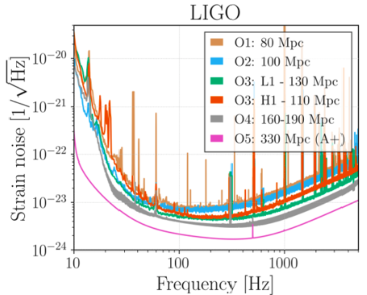
LIGO sensitivity
Frequency dependent noise floor, we lose sensitivity in the kHz region.
Vertical spikes in the spectrum are usually known noise sources (violin modes, calibration lines, etc.)
We standardize the sensitivity by the distance at which a binary neutron star merger (1.4 solar masses) can be detected with SNR = 8.
https://dcc.ligo.org/LIGO-G1901349/public

Slide 8
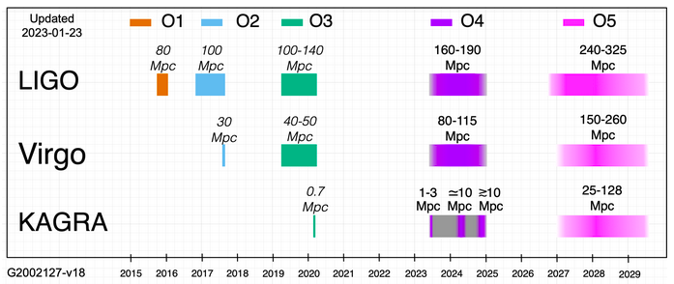
Run Sensitivities
1 parsec = 3.26 light-years
Milky Way Galaxy is ~30 kpc in diameter
https://observing.docs.ligo.org/plan/

Slide 9
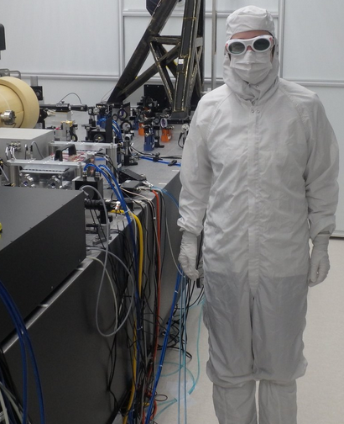
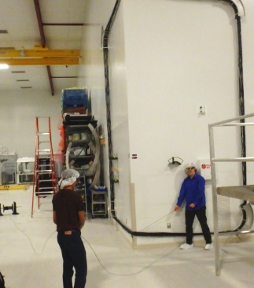
LSC Fellow work at Hanford
3 quarters; summers of 2018 and 2019, and winter of 2018.
Helped with upgrades of physical environmental monitoring channels, and injection studies
Commissioning projects aimed at maximizing the sensitivity in O3.

Slide 10
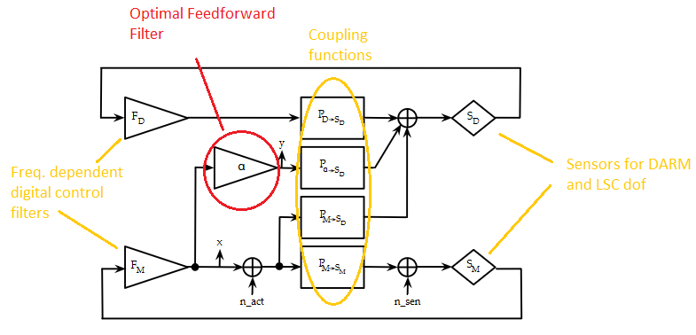

Feedforward Filters
There are 3 Length Sensing and Control (LSC) degrees of freedom, any of which could couple to DARM and add noise.
Power Recycling Cavity Length (PRCL)
Signal Recycling Cavity Length (SRCL)
Michelson length (MICH)
Goal: to design a filter, α, that allows us to actuate differentially on the ITMs and cancel out the effects of n_sen (noise of LSC dof’s)
https://dcc.ligo.org/DocDB/0139/T1600504/001/LSCfeedforward.pdf

Slide 11
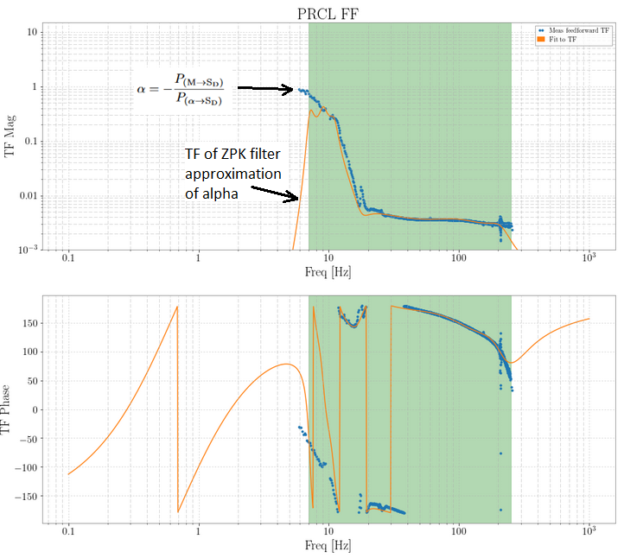
Transfer Function of Optimal Filter
The optimal alpha (blue) is measured through injections
We only care about the filter in the shaded green region, where the highest coupling is, outside of that we only care that the magnitude of the transfer function drops off to zero

Slide 12
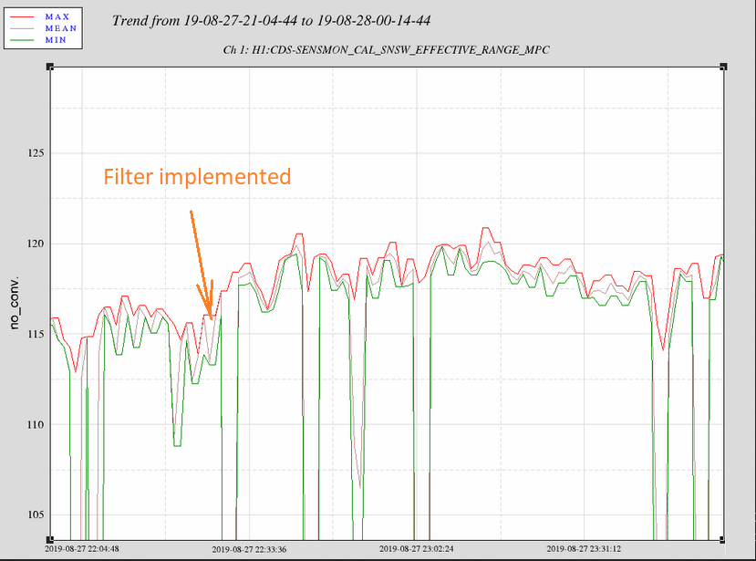
Range Increased by about 2Mpc

Slide 13
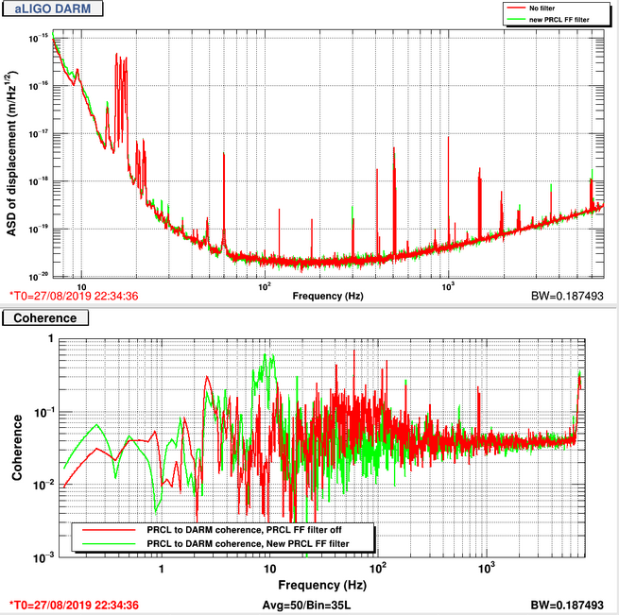
A reduction in Coherence:

Slide 14
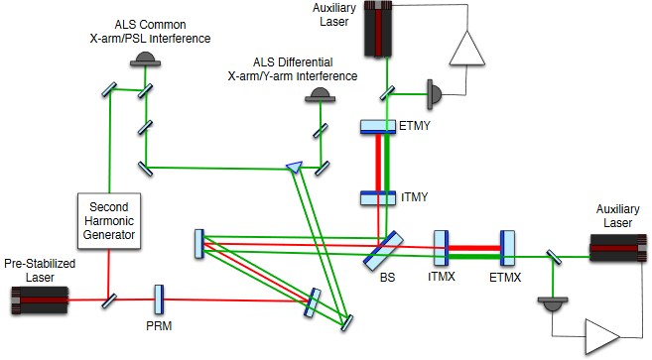
Arm Length Stabilization (ALS) Locking
Locking: the process of controlling each cavity length such that they are all resonant.
We maximize observation time by making the locking sequence more efficient.
ALS lasers locked to the cavities at wavelength 532nm.
Arm lengths measured in common and differential modes
Common and differential mode control loops used to bring the common mode frequency offset between the ALS laser and the main laser to zero.

Slide 15
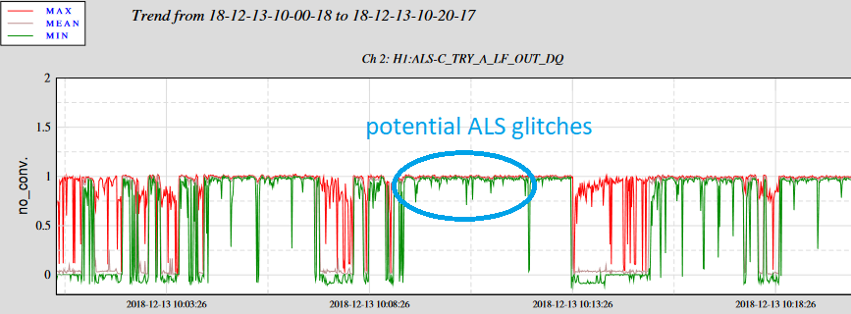
Complications in ALS feedback loops: Glitches
ALS locking was complicated by sudden, high-frequency drops in the transmission signal for both X and Y arms. The commissioners anecdotally described these being more of a problem on rainy days.
https://alog.ligo-wa.caltech.edu/aLOG/index.php?callRep=45924

Slide 16
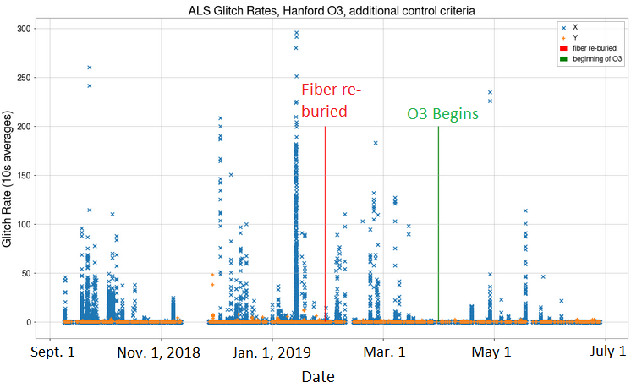
Identifying and mitigating the glitches:
I wrote code to identify the glitches, and searched for correlation with PEM channels, found none.
Found no improvement in the glitch rates when the ALS fiber was re-buried, saved the lab ~$100k on a new fiber.
Re-ran the analysis on O2, identified a start date of the glitches, and improvement when a specific flapping tag was covered. These are likely the effect of a mechanical disturbance.

Slide 17
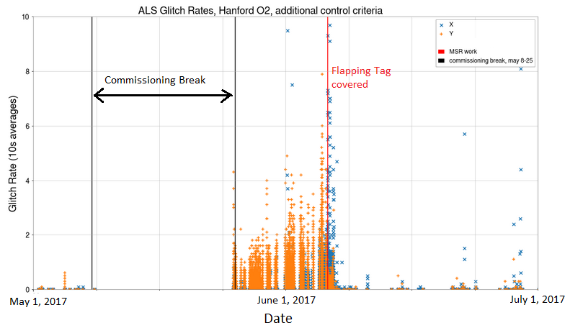
Identifying and mitigating the glitches:
I wrote code to identify the glitches, and searched for correlation with PEM channels, found none.
Found no improvement in the glitch rates when the ALS fiber was re-buried, saved the lab ~$100k on a new fiber.
Re-ran the analysis on O2, identified a start date of the glitches, and improvement when a specific flapping tag was covered. These are likely the effect of a mechanical disturbance.

Slide 18
Magnetar Overview
Neutron Stars with exceptionally strong external dipole magnetic fields, ~10¹⁴-10¹⁵ G. Potentially stronger internal toroidal magnetic fields.
Exhibit intermittent x-ray flaring activity, with energies up to ~10⁴² erg. Very rare ‘giant flares’ of energy up to ~10⁴⁶ erg. Some are known to emit in radio frequencies as well.
The flaring mechanism in a magnetar is not well understood, but theories include crust cracking, magnetic reconnection, hydrodynamic deformation, etc.
If the flare excites non-radial modes (especially f-modes), then GWs might be produced. F-modes are the fundamental pressure mode, ~1-3 kHz.
Magnetars are one of the leading progenitor models of Fast Radio Bursts (FRBs, ms duration, high-energy radio bursts from well outside our galaxy)
~30 known galactic magnetars.

Slide 19
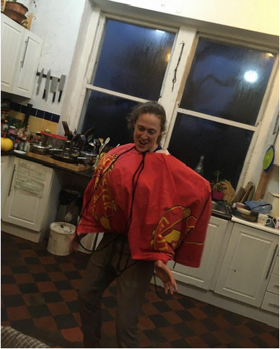
Halloween 2022:

Slide 20
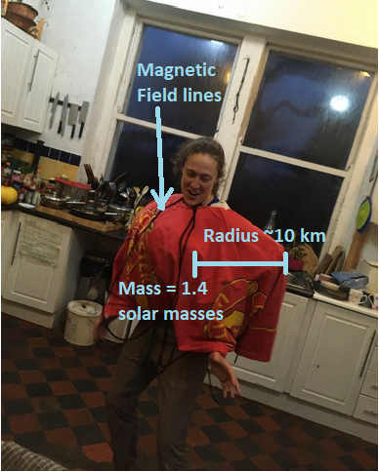
Halloween 2022:
Not pictured: a Fast Radio Burst gun.
A lot of people in Co. Mayo, Ireland, learned a little bit about something they’ll never need to know.
Co-artist:
Ruby Stunton

Slide 21
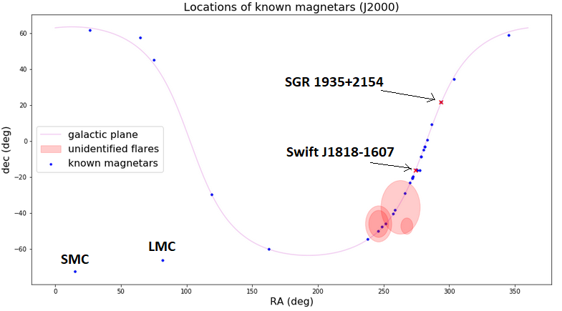
Magnetar Flares during O3
16 flares total with multiple detectors in observing mode at the time of the flare.
2 flares from newly discovered magnetar Swift J1818-1607
11 flares from SGR 1935+2154
3 flares detected by Fermi from an unknown source

Slide 22
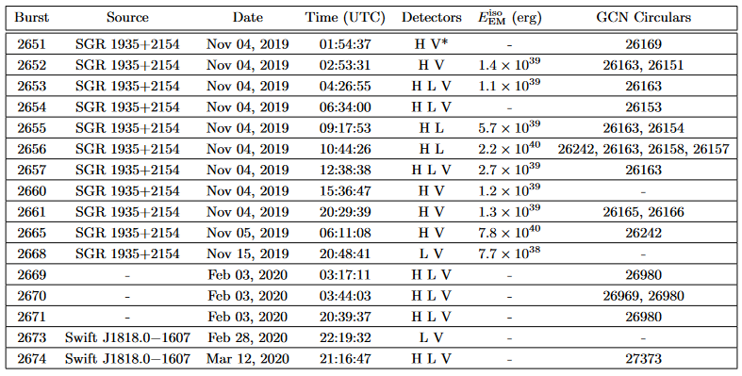
Magnetar Flares during O3
The LIGO-Virgo-KAGRA Collaboration. Search for gravitational-wave transients associated with magnetar bursts in advanced ligo and advanced virgo data from the third observing run, 2022

Slide 23
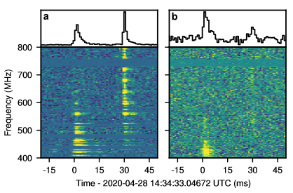
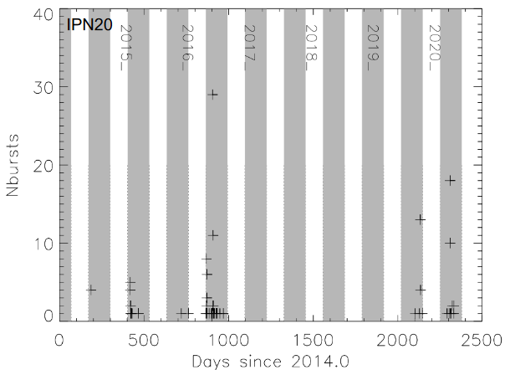
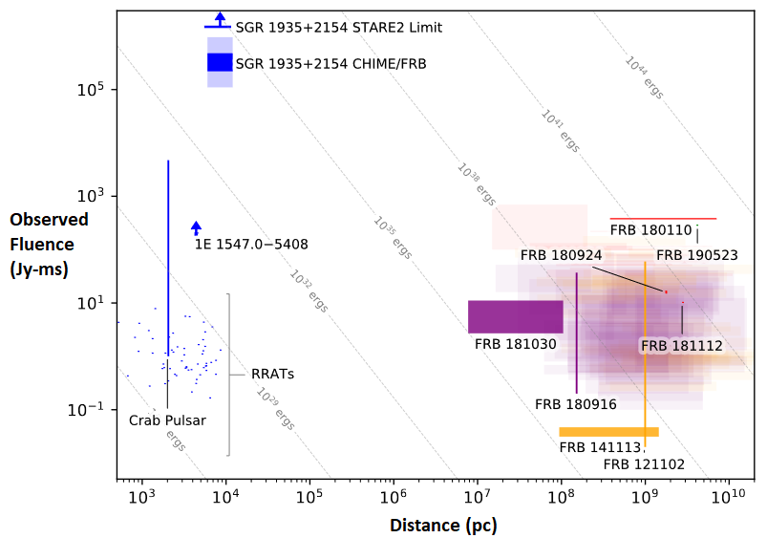
SGR 1935+2154 emitted a galactic FRB, and has displayed possible periodic windowed behavior (PWB)
Grossan, B. 2021, Publications of the Astronomical Society
of the Pacific, 133, 074202
CHIME/FRB Collaboration et al. 2020, Nature, 587, 54:

Slide 24

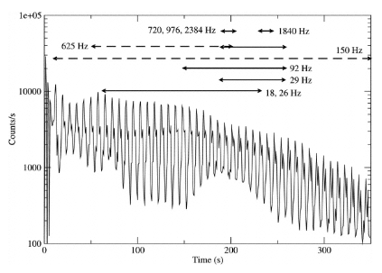
Search Structure - 2 part search
Targeted searches - we know exact points in the sky so we can gain sensitivity by coherently combining the data streams
We know the time of the flares, so we can define a time-period around that (the on-source) where we search for a GW.
Long- duration search:
Search for signals ~100s of seconds long and changing minimally in frequency
Search in [+4s, 1604s] after the flare
Motivated by the quasiperiodic oscillations observed in the tails of giant flares
Short-duration search:
Search for signals (ms to s), any frequency morphology
We search in [-4s, +4s] and [+4s,+504s] around the flare time.
Trying to detect excited f-modes both at the flare time, and during the QPOs.
  Source: Tod E. Strohmayer and Anna L. Watts 2006 ApJ 653 593

Slide 25


Search Sensitivity estimation
We standardize the sensitivity of the search by injecting waveforms into the data, and noting the root sum squared injection amplitude (h_{rss}) at which 50% are recovered (h_{rss}^{50%}).
We can approximate a corresponding gravitational-wave energy if we assume a distance to the source.
For both the short and long-duration searches, waveforms include sine-Gaussians and ringdowns. The short-duration search also includes white noise bursts.

Slide 26
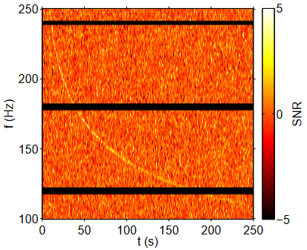
Long-Duration search
Methods:
We used the Stochastic Transient Analysis Multi-detector Pipeline (STAMP)
Data is broken into an on-source and background time-frequency maps, each pixel has an SNR
2nd order Bezier curves are generated over these TF maps, each is assigned an SNR based on the pixels it crosses.
The loudests cluster in the on-source is then compared to the loudest cluster in each background segment
Search in [+4s, +1604s] after the flare
24 Hz - 2500 Hz
We inject waveforms to determine the h_{rss} at which we recover an injection with 50% efficiency (h_{rss}^{50%}).
Thrane and Coughlin. Searching for gravitational-wave transients with a
qualitative signal model: Seedless clustering strategies

Slide 27
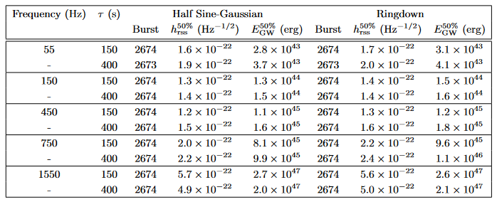
Long-Duration search results
No low p-value events
We compute the h_{rss}^{50%} for Ringdown and Half Sine-Gaussian waveforms, and the corresponding energy.
We present the most sensitive results from SGR 1818.0-1607 (assuming distance = 4.8 kPc).
The LIGO-Virgo-KAGRA Collaboration. Search for gravitational-wave transients associated with magnetar bursts in advanced ligo and advanced virgo data from the third observing run, 2022

Slide 28
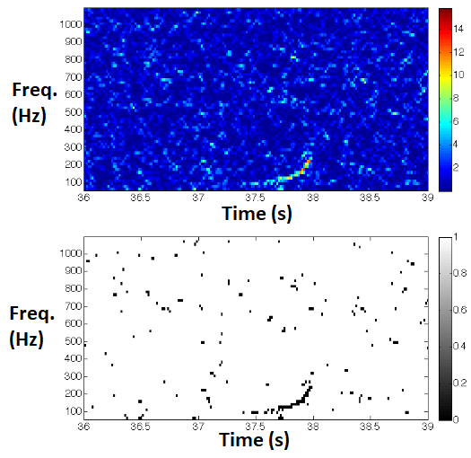
O3 Short-duration search Methods
X-pipeline: coherent search pipeline, used for short-duration (ms to s) signals, loses sensitivity to longer signals.
Combines data from all detectors into a time-frequency map, where each pixel has an associated significance
Selects out the brightest 1% of pixels, and groups neighboring pixels into clusters. Each cluster’s significance is the sum of its constituent pixels.
Each cluster in the on-source is treated as a potential gravitational-wave, and its properties compared to those in the background
50 Hz - 4000 Hz
Sutton, P. et al. X-Pipeline: an analysis package for autonomous
gravitational-wave burst searches. New Journal of Physics, 12(5):053034, May
2010. doi: 10.1088/1367-2630/12/5/053034

Slide 29
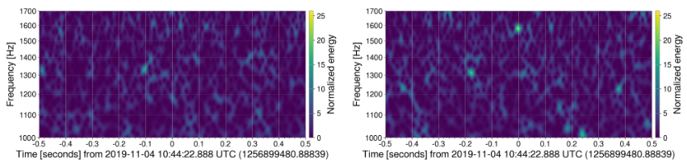
Short-Duration Search Results
Lowest p-value = 8.6x10⁻³ , f = 1560–1608 Hz, duration = 63 ms, Burst 2656 from SGR 1935+2154
Sensitivity of Burst 2656: h_{rss}^{50%}=2.1x10⁻²² Hz^{-1/2}, E_{GW}^{50%}=1.4x10⁴⁷ erg
GW/EM energy ratio = 10⁶. Injected waveforms are Ringdowns at f = 1590 Hz, duration = 100 ms.
LIGO Hanford
LIGO Livingston

Slide 30
Short-Duration Search Results
The loud event happened ~3.1 s before the x-ray burst. Inconsistent with astrophysical models.
Given the number of analyses we ran, probability of this low p-value is ~29%.
Much louder in Livingston, most likely an instrumental artifact.
LIGO Hanford
LIGO Livingston

Slide 31
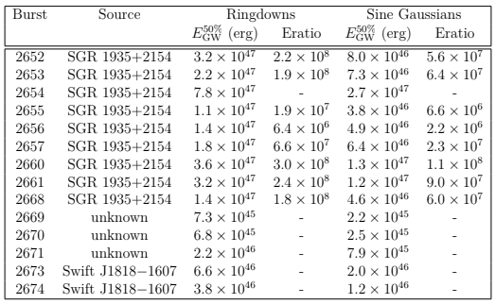
Short-Duration Search Sensitivity
Ringdowns at 1590 Hz, 100 ms
Sine Gaussians at 1600 Hz, 6.25 ms.

Slide 32
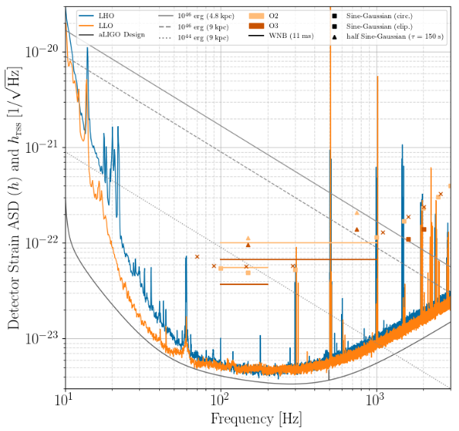
Comparing to O2 Sensitivity:
We moved the injections off of the violin mode frequencies
For the short-duration search, injections were elliptically polarized in O3, circularly polarized in O2. Circularly polarized SG’s at 1600 Hz and 2020 Hz, factors of improvement of 1.5 and 1.7 respectively

Slide 33
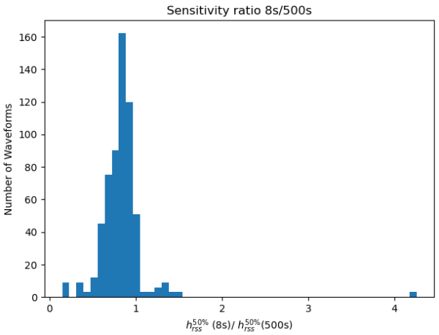
Effectiveness of two separate on-source windows
The median h_{rss}^{50%} for the 8s search is 83% that of the 500s search

Slide 34
O3a Fast Radio Burst (FRB) search
Short (ms duration) bright radio bursts with dispersion measures indicating sources well outside our galaxy
2 classes: repeaters and non-repeaters
Interesting properties - one FRB has a periodicity of ~16 days, and another has periodic windowed behavior with period=157 days.
FRB progenitors are not well known, but magnetars are a leading candidate for repeaters

Slide 35
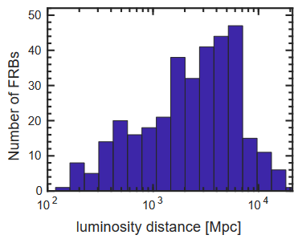
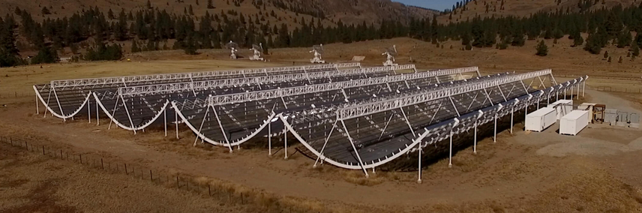
Canadian Hydrogen Intensity Mapping Experiment (CHIME)
Radio telescope, began commissioning in 2018.
200 sq. deg. field of view
Lower frequency range, 400-800 MHz.
Has made thousands of FRB detections since 2018.
Chime released information on 806 FRBs (338 from O3a) to the LVK for the O3 search.
https://chime-experiment.ca/

Slide 36
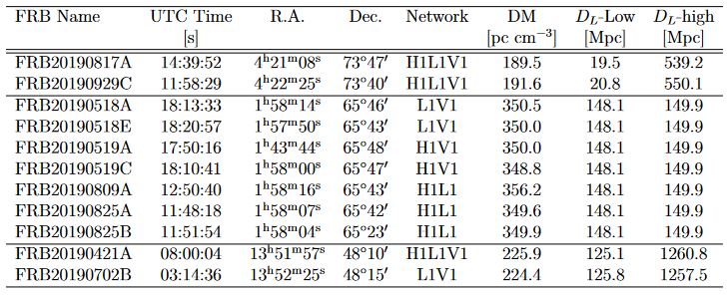
Search over repeating FRBs: x-pipeline
X-pipeline analysis was reminiscent of that of the O3 magnetar search
The distance estimates are too high to place meaningful upper limits on the gravitational-wave energy.

Slide 37
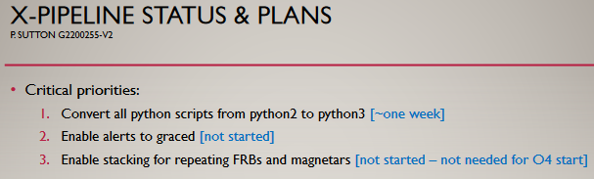
What to Expect in O4/O5:
More flares from SGR 1935+2154. (All of the flares in O3 clustered around 4 Nov. 2019).
Possibly another FRB from SGR 1935+2154 (although there is evidence for FRB/magnetar flare associations to be quite rare).
We could gain sensitivity through ‘stacking’ the triggers (from the same source), and effectively raising the SNR of the stacked GW. Tentatively in plans for O4.

Slide 38
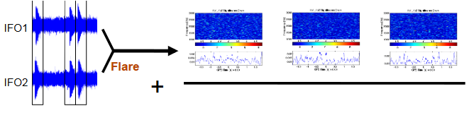
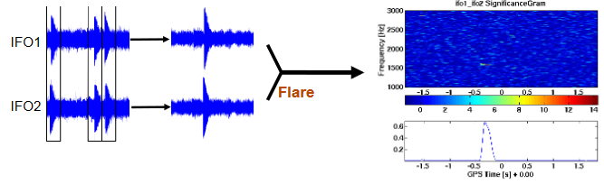
Stacked Analysis: Previous studies by Peter Kalmus (S6) in 2009
Power-Stacking:
Make 1 time-frequency map per trigger, and stack the TF maps
Sensitivity ~N^{1/4}
Allows for uncertainty in arrival times
Time-Stacking:
Combines timeseries data, makes one TF map
Greater sensitivity ~N^{1/2}
If flares are out of phase they could interfere
https://dcc.ligo.org/DocDB/0001/G090016/001/G090016-00.pdf

Slide 39
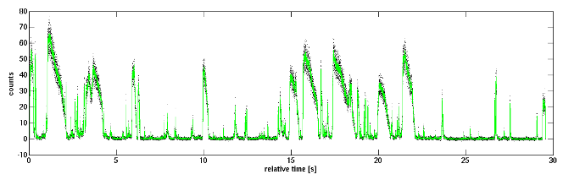
Types of Flares to Stack:
Flare Storms: ~10s of flares in minutes
SGR 1935+2154 at the time of FRB
Kalmus’s analysis handled an instance of this:
Spread Out Flares: ~10s of flares in a couple of days/weeks
SGR 1935+2154 in O3
Swift J1818.0-1607 in O3
Most repeating FRBs
Each class may or may not have the same internal driving mechanism. Our stacking method should be able to handle both together, or either one separately.

Slide 40
X-pipeline Modifications to handle Stacking:
Currently, X-pipeline runs as a 2-part search
1st stage: Identifies loud clusters and assigns each a series of properties (SNR, different measures of energy, peak time, peak frequency, etc.)
2nd stage: takes the list of loud clusters and calculates optimal cuts to make based on WFs, signal consistency, etc.
Uses these same cuts on the onsource and then looks at the most significant surviving triggers.

Slide 41
X-pipeline Modifications to handle Stacking:
Currently, X-pipeline runs as a 2-part search
1st stage: Identifies loud clusters and assigns each a series of properties (SNR, different measures of energy, peak time, peak frequency, etc.)
Extra Step here for Stacking: The onsource window is the time around each trigger (say -1s,+4s). So combine all the properties of the clusters within these times. List of offsource triggers would be generated the same way for equally spaced times in time-slid data.
2nd stage: takes the list of stacked clusters and calculates optimal cuts to make based on WFs, signal consistency, etc.
Uses these same cuts on the onsource and then looks at the most significant surviving triggers.

Slide 42

Statistics of what we actually stack:
We end up with Time-Frequency bins, each of which has as its significance (SNR) the sum of the significances of all clusters from all triggers which fell into that TF bin.
Some TF bins have a significance of 0, which is fine.
We calculate a p-value by looking at the number of TF bins louder than a specific bin
How Precise Can we get?
The limiting factor for the p-value (per frequency) is the number of time-bins available.
Standard x-pipeline run has background length 10800s, we are using 64s blockTime (which implies five 3s circular timeslides, and 138 different 32s lags)
Effective background time is 10800*138*5 = 7,452,000s. ⇒ 1,490,400 time-bins in each are 5s long.
Minimum possible p-value is P=6.7X10⁻⁷

Slide 43
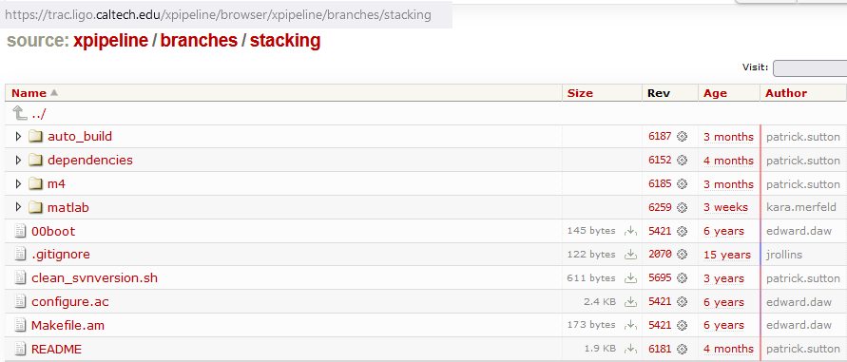
We’ve made a stacking branch of X-pipeline with the infrastructure to do the added steps before the post-processing:

Slide 44
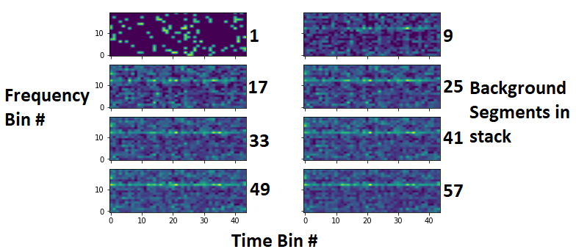
A Very Preliminary Study:
I took 57 background segments from the same trigger, pretended they were 57 different triggers, stacked them, and then plotted the energy in each Time-Frequency bin.
5s time-bins, 100Hz frequency bins (1kHz - 3kHz)
X-pipeline does whiten the data, but some frequency bins still have disproportionately many clusters
Solution:
We examine each frequency bin independently (each on-source frequency is compared to the off-source at that frequency).
This will leave us with a distribution of p-values.
X-pipeline clusters dis-proportionally grouped in certain frequency bins

Slide 45
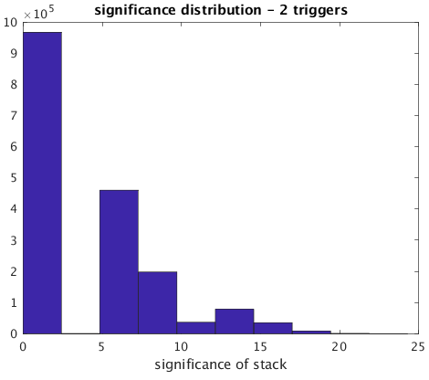
Sensitivity studies - Stacking the O3 flares from SGR 1935+2154
We search in 100Hz frequency-bins, specifically between 1500Hz - 1600Hz
5s time-bins

Slide 46
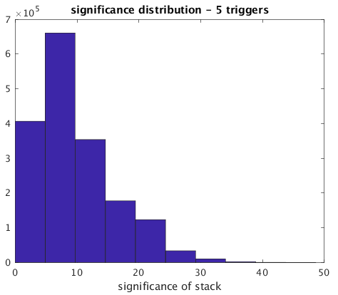
Sensitivity studies - Stacking the O3 flares from SGR 1935+2154
We search in 100Hz frequency-bins, specifically between 1500Hz - 1600Hz
5s time-bins

Slide 47
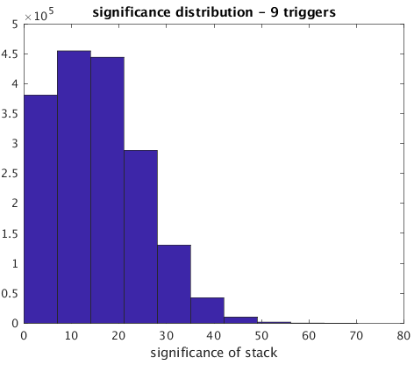
Sensitivity studies - Stacking the O3 flares from SGR 1935+2154
We search in 100Hz frequency-bins, specifically between 1500Hz - 1600Hz
5s time-bins

Slide 48
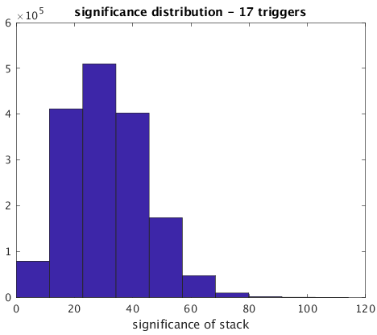
Sensitivity studies - Stacking the O3 flares from SGR 1935+2154
We search in 100Hz frequency-bins, specifically between 1500Hz - 1600Hz
5s time-bins

Slide 49
Assume that a p-value of 0.0005 constitutes an ‘interesting’ event.
We can use the significance distribution of the stacked bins to estimate the threshold significance of the stack that would yield this p-value.
Mean significance of unstacked event to give us that p-value is the threshold stacked significance/N

Slide 50
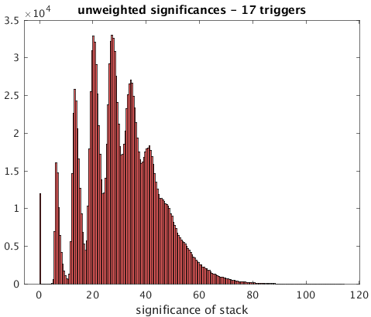
Assume that a p-value of 0.0005 constitutes an ‘interesting’ event.
We can use the significance distribution of the stacked bins to estimate the threshold significance of the stack that would yield this p-value.
Mean significance of unstacked event to give us that p-value is the threshold stacked significance/N

Slide 51
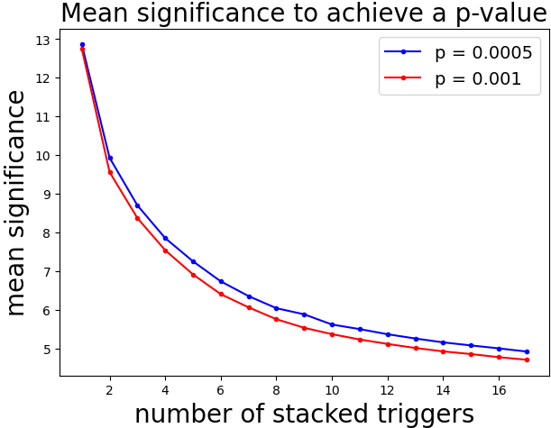
Assume that a p-value of 0.0005 constitutes an ‘interesting’ event.
We plot the mean significance needed to achieve a specific p-value, and see that we need less significance with more triggers.
The mean significance to get a specific p-value does generally drop as we stack more triggers, and falls as low as 4.9 for 17 triggers (greatly improved from 12.9 for 1 trigger!)
Value for N=1 case is taken from the distribution of standard x-pipeline outputs, without stacking

Slide 52
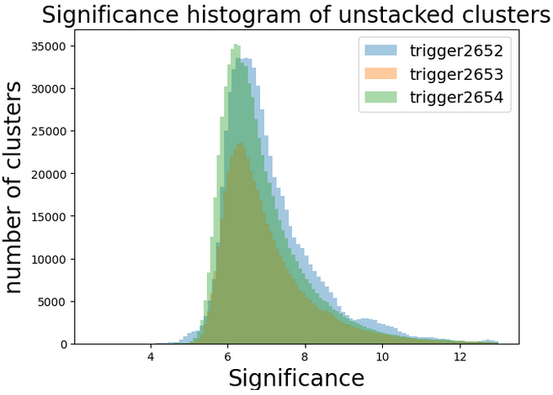
How do these significances compare to a typical unstacked box?

Slide 53
How do these significances compare to a typical unstacked box?
For N=8, mean significance = 6.04
Stacking 8 triggers allows us to detect signals which would otherwise be buried in the background, as long as they are consistently present.

Slide 54

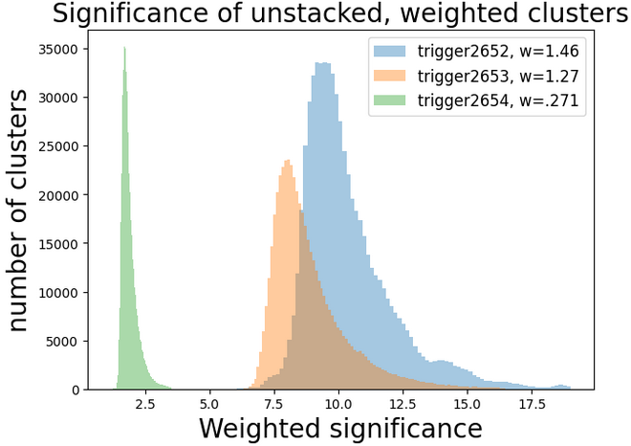

Weight the significances of each trigger
(By network sensitivity now, and EM fluence later)
We multiply the significance of each event by the weighting factor of its box. The distributions of events separate, but the mean significance across all events changes very little.
Additional Observations:
Trigger 2653 has fewer clusters. Less data available, and more of the clusters falling at frequencies outside this band.
Trigger 2652 has a population of loud cluster, significance~14, that might add noise to the stacked analysis

Slide 55

Sensitivity Weighted Stacks - Stacking the O3 flares from SGR 1935
We search in 100 Hz frequency-bins, specifically between 1500 Hz - 1600 Hz
5 s time-bins
Same analysis as previously, but with weighted clusters

Slide 56

Sensitivity Weighted Stacks - Stacking the O3 flares from SGR 1935
We search in 100 Hz frequency-bins, specifically between 1500 Hz - 1600 Hz
5 s time-bins
Same analysis as previously, but with weighted clusters

Slide 57

Sensitivity Weighted Stacks - Stacking the O3 flares from SGR 1935
We search in 100 Hz frequency-bins, specifically between 1500 Hz - 1600 Hz
5 s time-bins
Same analysis as previously, but with weighted clusters

Slide 58

Sensitivity Weighted Stacks - Stacking the O3 flares from SGR 1935
We search in 100 Hz frequency-bins, specifically between 1500 Hz - 1600 Hz
5 s time-bins
Same analysis as previously, but with weighted clusters

Slide 59

Sensitivity evolution with more stacked triggers:
We plot the weighted mean significance of the unstacked TF bins that would yield a specific p-value, given the number of triggers in each stack.
In all cases, a higher mean significance is needed when the triggers are weighted. This is consistent with the wider distribution of significances in the stacked case.

Slide 60

Histograms of the stacked significance:
Histograms of the stacked significances for both the weighted (blue) and unweighted (red) cases.
The weighted case is wider
The high-significance portions of these distributions the cutoff mean significance per trigger at which we can make a detection.
Note that the periodic spikes are gone in the weighted case.

Slide 61

Sensitivity evolution with more stacked triggers:
We plot the weighted mean significance of the unstacked TF bins that would yield a specific p-value, given the number of triggers in each stack.
We FRB runs we’ve included in this analysis were in general more sensitive than the magnetar runs. Weights spanned an entire order of magnitude.

Slide 62

Reduction in hrss50% needed for a detection
We measure the hrss of injection at which 50% are recovered at a significance such that the stacked event would have a p-value = 5X10^-4.
The hrss is decreasing with more triggers in the stack
We use a 1590 Hz ringdown waveform with 100ms duration.
Found using the post-processing of x-pipeline, inconsistently functional.

Slide 63


Quantifying the significance reduction
Equations of best fit (assuming a power law):
How many triggers can we stack?
On average, the lowest significance cluster in each box has significance of 3.19.
According to the above equations, we reach that with 93 triggers.

Slide 64
Search parameters available to tweak
Time and frequency bin sizes - these should be set by astrophysical models
The bright pixel percentage - where the initial stage of x-pipeline defines a bright pixel (1% in burst searches.
The superdecimate rate - the number of clusters per second that x-pipeline keeps (averaged over each block of time it analyzes). Standard is 1 cluster per 4 s.
The time-step dt which x-pipeline uses for the Fast Fourier Transform to make the original time-frequency maps. Standard for an x-pipeline burst search is to use powers of ½ ranging from -1 to 7. We could maybe just use lower values (we expect short-duration signals).
Weighting by electromagnetic fluence - this should be determined by astrophysical models.

Slide 65

Bright Pixel Percentage
Combined outputs of x-pipeline from triggers 2669, 2670, and 2671 run with varying bright pixel percentages.
Higher bright pixel percentage means the distributions are wider.
This could raise the number of triggers that can be stacked (currently 93).

Slide 66

Superdecimate Rate (clusters per second)
Standard x-pipeline burst searches use ¼.
For 3 out of the 4 x-pipeline runs, this parameter had minimal effect on the sensitivity.
For trigger 2652, it varied by 15%

Slide 67
Where is the benefit to stacking?
Effectively decreases the significance of an event needed to make a detection. X-pipeline records the hrss needed to recover 50% of the injections with a greater significance than the loudest background cluster, which could be as high as 13 (our cutoff). Stacking would just require the mean significance to just be as high as the mean significances calculated on the previous slide, (as low as 4.9).
This analysis is run on magnetar flares which have already been analysed individually using X and not shown evidence of a GW. So this is a way to look for lower-significance GWs.

Slide 68
Stacking Summary:
This method could obtain a p-value as low as 6.7X10⁻⁷
The mean significance necessary to achieve a p-value of .0005 can get as low as 4.9 with 17 stacked triggers.
We already have sources to run and evaluate this on including 9 flares from SGR 1935+2154, 2 from Swift J1818-1607, the 3 bursts from the unknown magnetar.
We’ve run X-pipeline on repeating FRBs as well, if we have one with many repeats this could be interesting.
We could have more sources and interesting events in O4 and beyond.

Slide 69

Publications

Slide 70




Acknowledgements
I would like to acknowledge my family and friends who have supported me throughout my graduate school career, and my collaborators for their insightful ideas and research help.
I also would like to thank the essential workers for their service during the pandemic, which allowed the rest of us to continue working from home.
I also owe my gratitude to the people I met on my travels who hosted me and welcomed me into their communities in Ireland, NI, Mozambique, Tanzania, Egypt, France, Scotland, Portugal and Greece.

Slide 71
Extra Slides

Slide 72


Slide 73


