Slide 1
Next generation Integrated package for Gravitational Wave Simulation
Simulation is not a magic stick
  It does only what you tell it to do
Simulation is a magic stick
  It does all what you tell it to do, without any compromise

Slide 2
Simulation tools in HEP
Accelerator simulations : BLAST (beam plasma & accelerator Simulation Toolkit)
  (quote from Berkeley Lab HP) Accelerators are a vital part of the DOE-supported infrastructure of discovery science. Learn how we get the most out of them by using advanced computer techniques to optimize performance, ensure cost-effectiveness, and explore new ideas. Through simulation and modeling, we can maximize performance, look for hidden trouble spots, and even find new ideas. For particle accelerators, these tools have become indispensable.
Detector simulations : GEANT4 (GEometry ANd Tracking)
  (quote from Wiki) Geant4 includes facilities for handling geometry, tracking, detector response, run management, visualization and user interface. For many physics simulations, this means less time needs to be spent on the low level details, and researchers can start immediately on the more important aspects of the simulation.
GW detector simulation is to be a combination of these two.

Slide 3
Next generation Integrated package for Gravitational Wave Simulation
Introduction
  Propaganda to make GW simulation package to the same level as HEP
  Rana > “I am a believer”. I guess that the number of optics simulation codes outnumber the controls codes by 100x. And there is basically nothing existing for mechanics. If we already had Finesse linked with our real control system, we could really understand many things. But not enough good people doing simulation.
It should be simple to study simple physics … not quite
  Field calculation as an example
Integrated package
  Obsolete e2e as a springboard for discussion to prepare for the future
Design toward future
  Need to identify what kind of framework is useful to prepare for the future
  Inputs from the end users based on commissioning and planning for the future
  What kind of time scale makes this package useful
  How to push this be realized

Slide 4
Scratch hairs before, not after, spending lots of money
Future GW simulation package to be
  Have necessary simulation components of equal qualities
  Easy integrations of components
  Getting started easily to study physics of interest
  Get the setup and modification easily
  Get complex system analysis done with reasonably rich information
    Get details of specific problems on demand
  Get long time scale analysis done in short time
  Get results with flexible formats
  …

Slide 5
Simple question, simple answer,
Simulation should take care of difficult calculations behind the scene
Scattering by mirror surface aberration
What is FP cavity loss
Researchers are interested in physics,
not how to calculate
  Mirror aberrations
    Continuous aberration
    Point absorber ~ 1cm
    Point scatterer ~ 1μm
  Many different calculations
  Millions of different mirror surface
  Cavity conditions
  Complex BRDF

Slide 6
Scattering to wide range of angle
BRDF(θ)
θ > 10⁻⁴ °
value
10¹⁰ ~ 10⁻⁶
Depends on
beam size

Slide 7
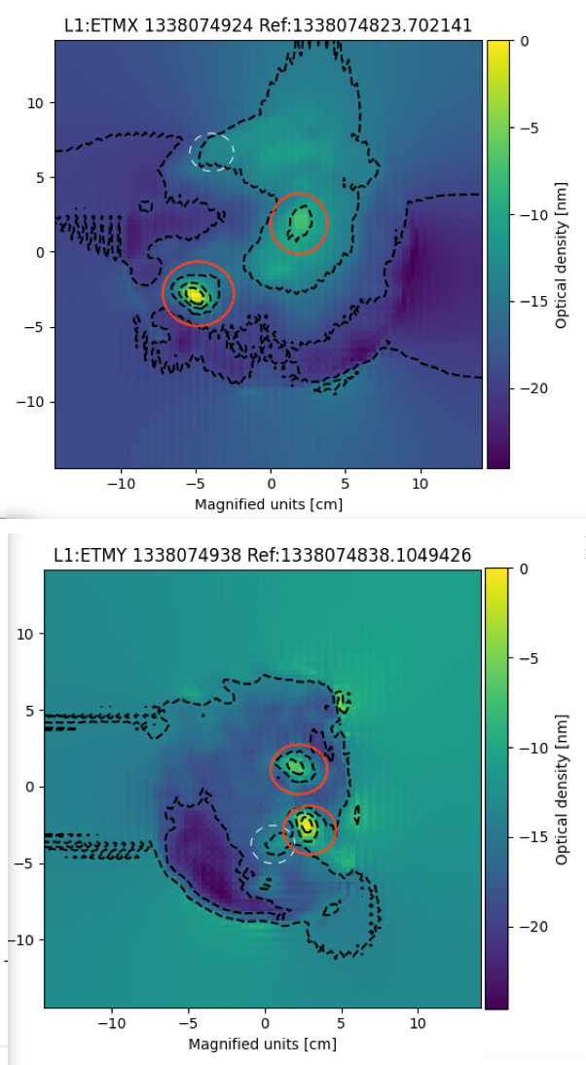
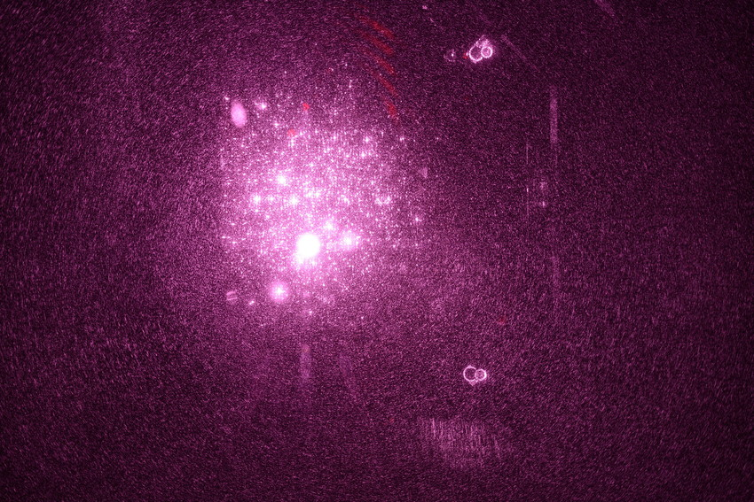
Different faces of mirror surface
~ impossible to simulate all, need to know what can be calculated and how to integrate data
1cm
1mm
Phasemap and PMM

Slide 8
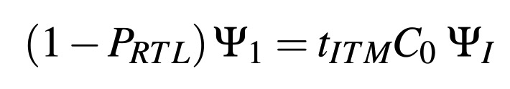
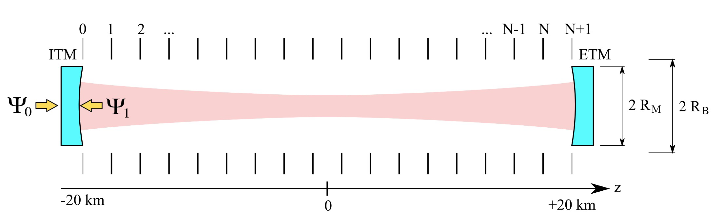
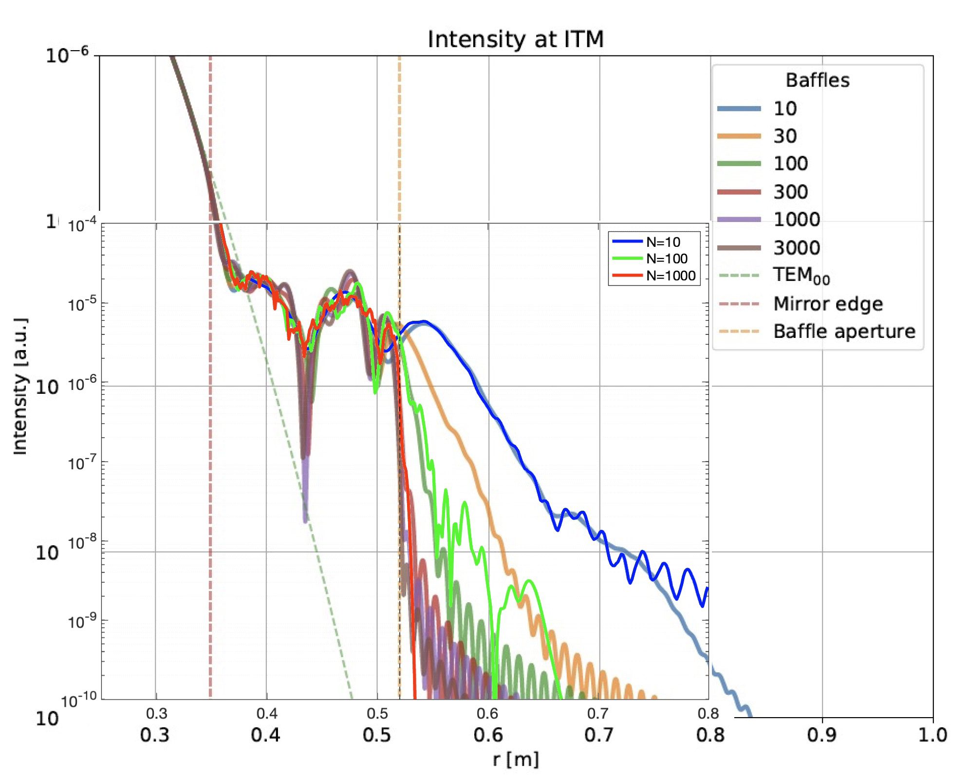
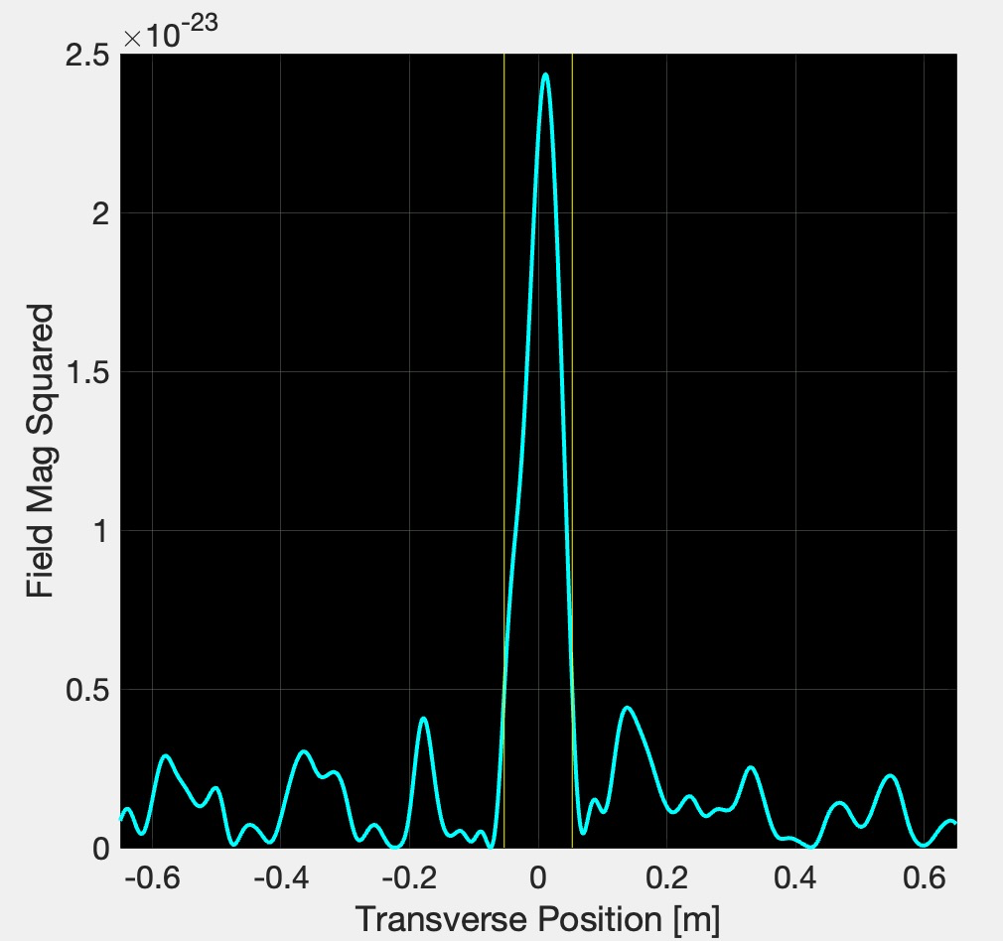
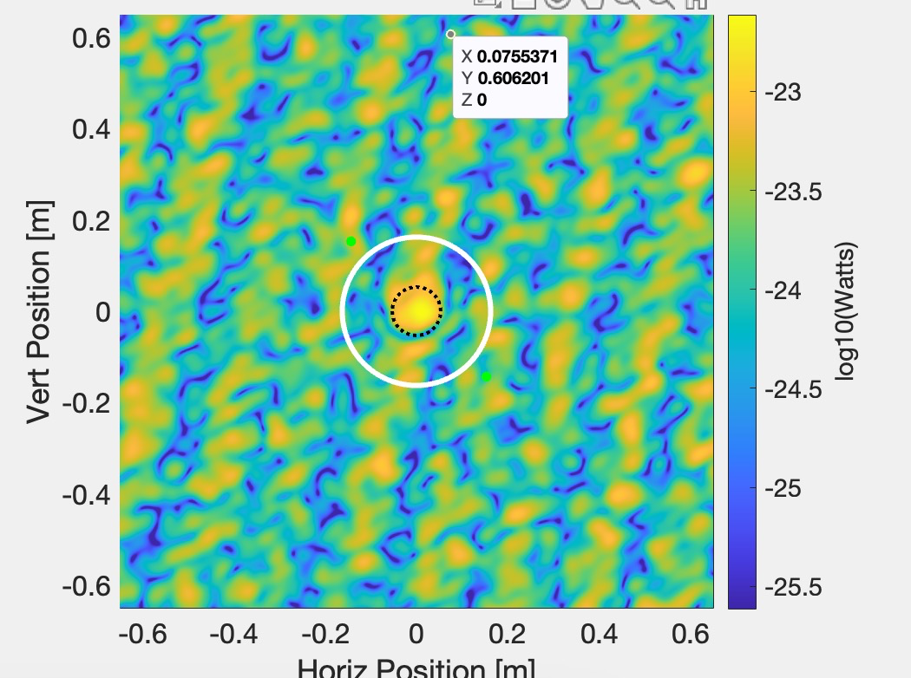
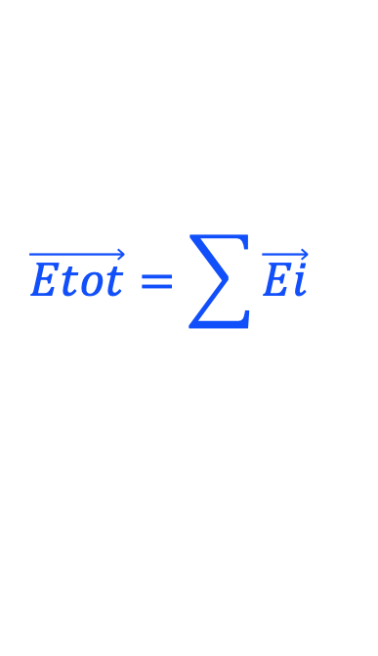


Complemental tools and calculations
Beam tube baffles
CE-T2100011 – Gabriele
Modal model using Laguerre
Axisymmetric system
Many modes needed
CE-T2300004 – Hiro
FFT
Arbitrary field shape
Notoriously slow
Serrations vs mirror aberration
Eout = fftshift( ifft2(ifftshift(
Pmap).*fft2( ifftshift(Ein))))
Power distribution by point scatterers – O(nm)
Analytic
Huygens integral
Distribution
using FFT
9k random sources, average radius of 30nm, height 0.3nm
$$\vec{E1}$$
32cm
$$\vec{Etot}=\sum{\vec{Ei}}$$
$$\vec{E2}$$

Slide 9
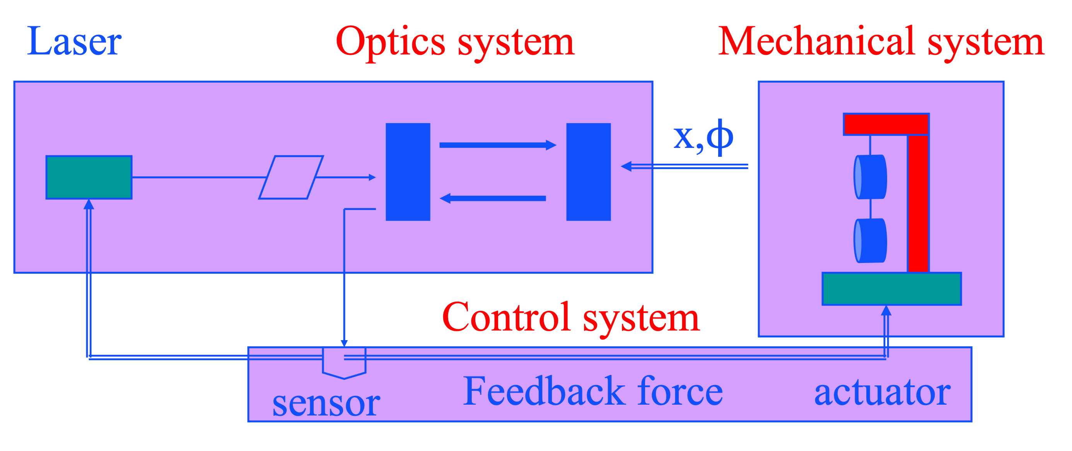
Well defined problem,
Necessary components and integration
25 years ago, iLIGO needed lock acquisition strategies
Fundamental elements to be integrated
  Seismic motion and suspension systems
  Optical systems
  Control systems
End to End model – e2e – was developed
  Object oriented concept of C++ was fully utilized to add elements easily and connect them easily, designed and developed by Matt Evans
  Simple version of these elements are embedded in this C++ framework
    Transfer functions and state space models for SUS/SEI
    low order HG model for the field calculation
    C++ codes are compiled and linked dynamically for control system design
    Mechanical Simulation Library (MSE) was developed by G.Cella (T030158)
  GUI was prepared to ease the development and simulation configuration maintenance
  Quick turn around of length sensing and control design and lock test

Slide 10
Issues
Interferometers use different locking strategies and faces different challenges
  Noise, noise, noise …, e2e helps nothing for this
  Original e2e design concept is outdated
  Details of optics and control systems need to be studied more flexibly
  Stray light simulation as a first class citizen
  Needs new framework design, based on new necessity
e2e is a realistic time domain simulation package
  It starts from an empty cavity, and one needs to lock the system to study quasi-stationary state, tedious
  Repetition of complex evolutions with time step of 10μs each, million times repetitions for 10 seconds of process, so slow
All fundamental tools in e2e are too simple and outdated
  Field – simple HG based model without maps
  Mechanical systems – simple parametrization using transfer functions and state space models
  Control systems are based on hand-made filters

Slide 11
Real challenge
Albert > You can lead a horse to water, but you cannot make it drink.
Alan > I think that constructing such a thing is a huge effort, and people will challenge the need. It would be good if you could demonstrate an important effect that needs to be understood for future detectors, that would require such a fully integrated simulation package, and would fail if we try the "piecemeal" approach of using a more targeted simulation tool like e2e or Finesse.

Slide 12
What to solve
Integration of subsystems
  Complete enough to address Noise, noise, noise … problems
  Stray light analysis
  Full simulation of the ASC system that includes realistic optics and mechanical systems
  Quantitative effects of the up-conversion effects due to non linear response
Time domain
  Study effects with long time constant, like thermal effect, in a short time
  Optimize IFO operation condition using early warning signal
  Simulated plant – imitate responses of interferometer components (G2200168, G1301255)
Flexible simulation framework – last, but not the least
  Often, interesting possibilities can be studied based on physics we understand now, but often we need to develop or customize codes to get it done. What if we can study just by connecting existing building blocks.

Slide 13
Flexible simulation Framework
What kind of flexibility is needed
What kind of questions/answers do users want
  aLIGO, AdVirgo, KAGRA commissioning experience
  CE, ET, Voyager design challenge
What kind of physics needs to be prepared
What kind of tools are best suited
  How to integrate different kinds of physics elements
  How to integrate different kinds of simulation tools with different time scale
    Time domain 10μs ~ 1s, Frequency domain, FFT, other tools
  Common front-end and/or GUI
  What environment
    Easy development and debugging

Slide 14
Time-line
After O4 starts
  Call for meetings to collect requests from the users
  Call for meetings to discuss the design of the simulation framework
  Repeat meetings with actual code / frame development
Due dates
  Make the package useful for the CE and ET design ~ 3 - 5 years
Stepwise evolution
  Each simulation tool evolves as is now, with the unified goal in mind
How to organize this effort
  HEP GEANT4 is organized by international GEANT4 collaboration
  Organize a central working group

Slide 15
Extra slides

Slide 16
mumble
Two years ago, late-Stavros suggested to make the GW simulation to the level of HEP. With my HEP background before LIGO, I could understand what he meant. I started and could not push too much. May be, I had not good enough idea of the goal and approach.
When I gave a talk about simulation at IFAE, Mario Martinez asked the question “In high energy physics, anything could be simulated by proper combination of existing simulation tools, can it be done in gravitation wave experiment?”
I said “No, we don’t have enough experience to get enough tools ready yet”.
When I visited Virgo last year, Stavros said again to push the GW simulation to be more mature as HEP. I said “we don’t have enough things in hand now”. He said “it is important to start, even with empty hand.”
I think my answer is correct as of now, but. we may need to start to think about how to make the maturity of the GW simulation toolbox to the level of HEP.
Roughly speak, GW = optics + mechanics + controls. What is important is not to simulate everything to the limit, but is to understand what are necessary ingredients and how to integrate. Tools will be numerical simulations, analytic calculations and hybrid of these two. There are experts of each part, but few people grasp the entire vision. Also, we may not understand the quality of the inputs, like optic data, so that we can use the simulation to the limit.
I hope we can start sharing ideas what do we miss now, what will be necessary and useful tools for the future. When one says "I want to do this" and if simulation package is not capable, one will say "simulation cannot do this". But if we start sharing wish lists now and start thinking what are the good ways to realize, when one says "I want to do this", there may be simulation package ready to say "go for it".
We all need to collaborate, we means “developers and users / commissioning experts”.

Slide 17
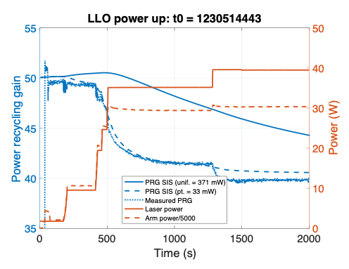
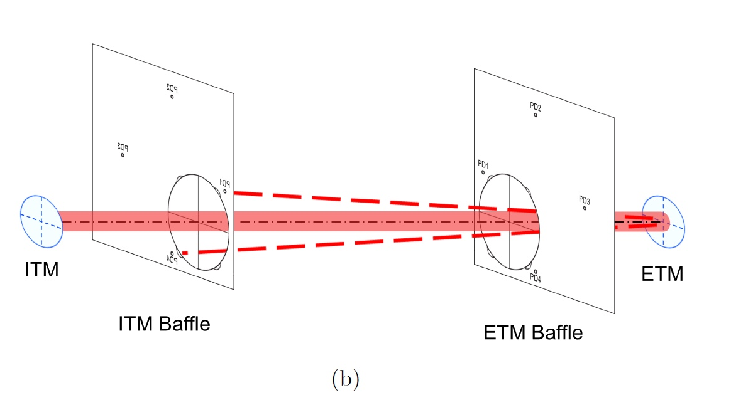
aLIGO examples
Thermal bump
Seed size ~ 10μ
Absorption ~ 10%
Bump size ~ 1cm
Beam is not gaussian
LLO : Power around test mass
Input power vs PRG
Time evolution of power recycling gain during a power-up at LLO. The laser power is shown on the left-hand axis and PRG is shown on the right-hand axis. Also shown are two SIS models of the power-recycling gain assuming surface deformation on a single ETM from uniform coating and a point absorber, respectively.

Slide 18
Sources of field loss in a cavity
~ categorize losses
Scattered fields in cavity
Scattered fields go out of cavity
Mirror finite aperture | Surface figure error | Micro roughness - PSD | Point defects
Non gaussian diffraction tail ~ θ⁻³ | Change of resonating field and larger tail | Fixed angle scattering by interference of far field | Scattering by small sources located randomly
1.9ppm for aLIGO 0.02ppm for AdVirgo | H1x:20ppm,H1y=16ppm L1x:18ppm,L1y=15ppm | 10~20ppm ? | 10~30ppm ?
Airy ring outside of mirror θ < 0.003° | λs > 5mm or θ < 0.01° | λs < 1mm or θ > 0.06°, BRDF~1/θ^{n}, n~1.5-3 | All angle, measurable at large angle ?

Slide 19
One scenario design of beam tube baffle
Input : physics specification
  specification of the FP cavity
  seismic motions
  Baffle characterization
Internal : dirty calculations and optimizations
  Resonating field in the cavity with broadening due to mirror surface aberration
  Interaction with moving baffles to calculate back scattering and diffraction
  Coupling of these noises sources to the main interferometer fields
Output : interesting outputs
  Noise spectrum with optimal baffle spacing
Support tools : make results useful
  Flexible specification of mirror surface aberration
  Flexible specification of baffles and interactions
  Data analysis tools to understand the output

Slide 20
Next generation Integrated package for Gravitational Wave Simulation
In the High Energy Physics community, there is a simulation package GEANT4, (following quote from Wiki) “which includes facilities for handling geometry, tracking, detector response, run management, visualization and user interface. For many physics simulations, this means less time needs to be spent on the low level details, and researchers can start immediately on the more important aspects of the simulation.” Last year, late-Stavros proposed to start developing simulation package of the similar quality for the gravitational wave science.
Now is a good time to start this kind of package to get ready for O4, O5 and beyond, and for the Einstein Telescope and Cosmic Explorer. There are some simulation tools for a limited purpose, like FINESSE for field calculations, but we need integrations of various elements, seismic motions and isolation, fields and optics and control systems. We have observed many unknown noises and the package needs to be prepared so that the integration is flexible enough to simulate many interesting possibilities.
This is a talk to call for to start a collaboration to develop this kind of package so that more scientists can utilize the simulation to study what they are interested in, without much bothering how to use the tool.

Slide 21
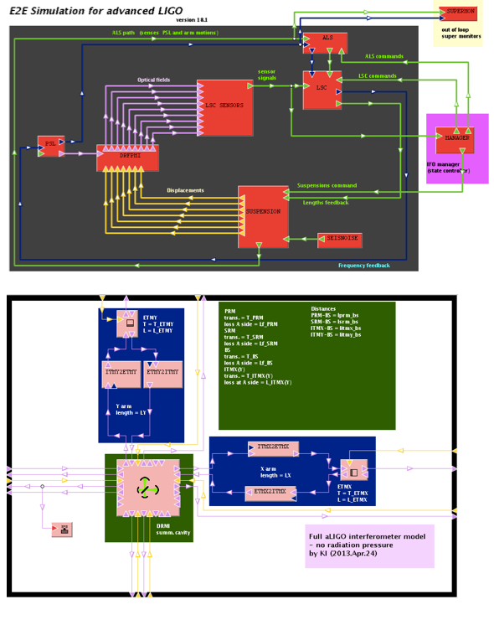
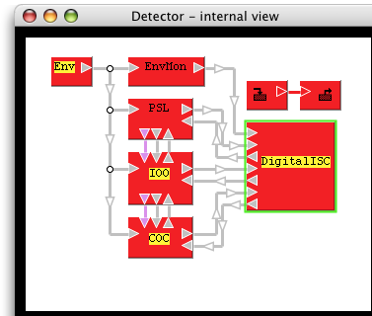
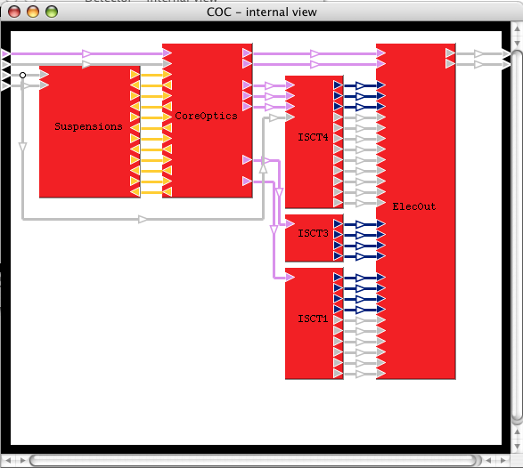
e2e simulation setups iLIGO vs aLIGO
e2e for iLIGO
e2e for aLIGO
PRM vs DRMI
Guided lock vs
ALS lock using green
Single suspension vs
triple & quad susp
Hard coded control vs
FUNCX
Necessary noises

Slide 22
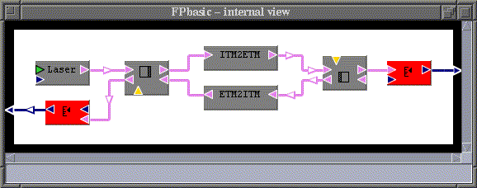
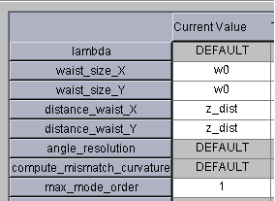
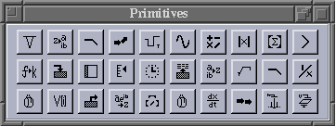
e2e Graphical Editor
Laser
mirror
mirror
Photo diode
propagator
Photo diode

Slide 23
End to End Simulation coarse view
Laser
Optics system
Mechanical system
x,ϕ
Control system
sensor
Feedback force
actuator
Time domain modal model
Objects : laser, mirror, photo diode, …
Any planar interferometer
  Fabry-Perot, Mode cleaner,LIGO I,
  Advanced LIGO,…
Transfer function using Digital filter
Single Suspended mirror
Mechanical Simulation Engine (object-oriented)

