Slide 1



LIGO: Using Quantum-Enhanced Interferometry to Observe the Most Energetic Events in the Universe
David Reitze
LIGO Laboratory
California Institute of Technology
NASA Quantum Sensing Workshop, Newport News, VA, Sept 29, 2022
LIGO-G2201708-v2
Image Credit: Aurore Simmonet/LIGO-Virgo/Sonoma State Univ.
Notes:
Thanks for the opportunity to speak about the recent GW discoveries and the role that large scientific collaborations played.

Slide 2
Overview
Gravitational Waves and Precision Interferometry for Gravitational-wave Detection…
… Enabling the Recent Gravitational-wave Astrophysics Revolution
In-depth Precision Interferometry: Understanding Noises
Quantum-engineered ‘Squeezed’ Light for LIGO: Beyond Shot Noise and Fundamental Radiation Pressure
New Horizons in Sub-quantum-limited Sensing with LIGO
Next Generation GW Observatories

Slide 3


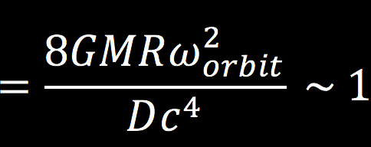
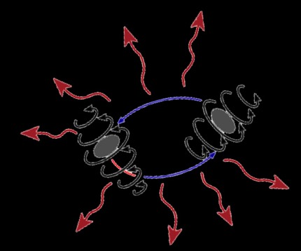
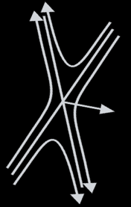


Gravitational Waves
Einstein’s General Theory of Relativity (1915) → ‘Ripples in Space-time’ (1918)
Any accelerating massive object generates gravitational waves…
... but the amplitude of those waves is exceedingly tiny.
Gravitational waves:
- are produced with detectable amplitudes by the most violent astrophysical events in the universe
- travel at the speed of light
- travel unimpeded through matter
- carry direct information about the relativistic motion of bulk matter
- propagate with amplitudes that fall off as 1/distance; they are ‘standard sirens’
Matter/Energy
Space/Time
$$G_{μν}=\frac{8πG}{c^{4}}T_{μν}$$
~ 10⁻⁴³ !!
Two merging black holes
L
Physically, amplitude →ΔL/L ~ 10⁻²¹
Notes:
GR in one slide. Start w/ field equations “space = time’ then move to GWs. Might point out that Einstein flipped flopped on GWs. Also point out that he thought them an esoteric consequence with no physical relevance. Play video. Talk about physical effect. Show coupling constant and strain

Slide 4
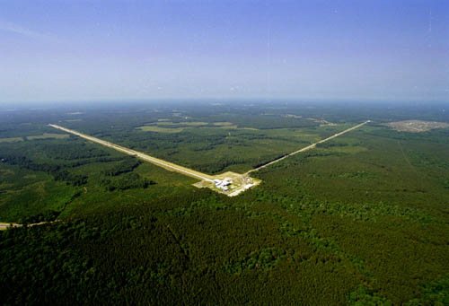
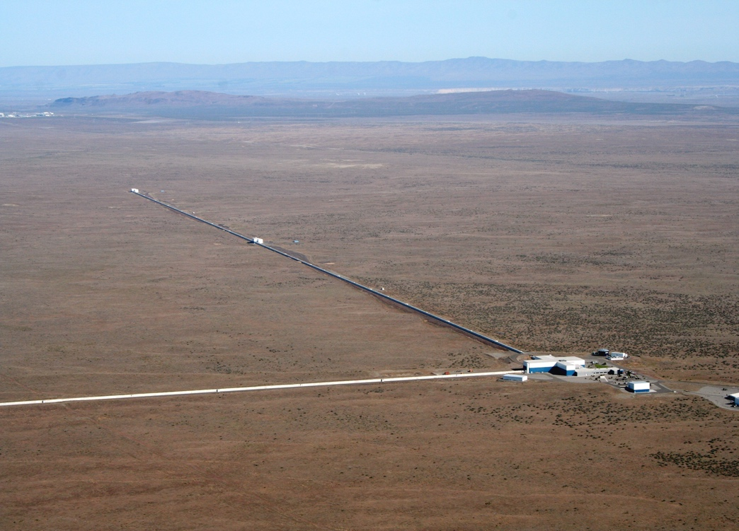
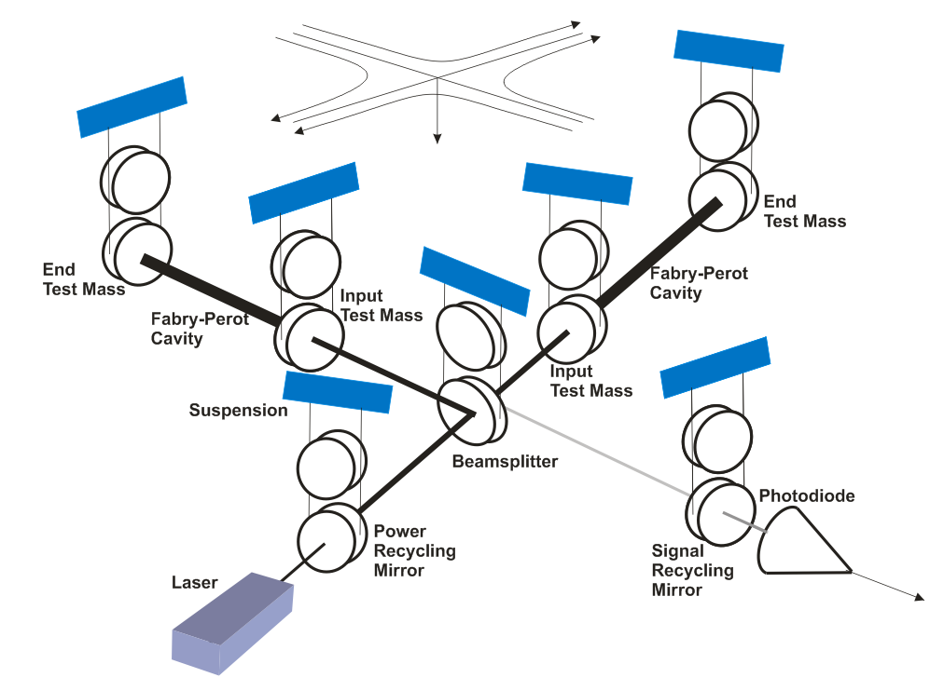
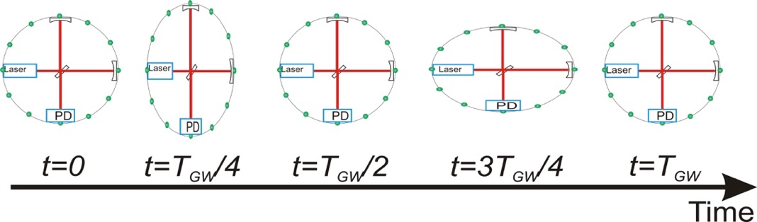
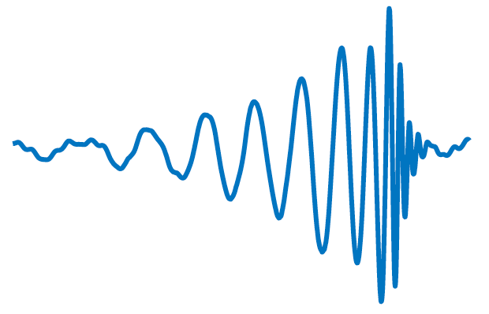
Precision Gravitational-wave Interferometry
GW interferometers use enhanced Michelson interferometry
  With suspended (‘freely falling’) mirrors
Passing GWs stretch and compress the distance between the end test mass and the beam splitter
The interferometer acts as a transducer, turning GWs into photocurrent
  A coherent detector!
LIGO Livingston Observatory
Louisiana
LIGO Hanford Observatory,
Washington
Output
Amplitude
Time
Notes:
At end of slide “Let’s examine some history”

Slide 5
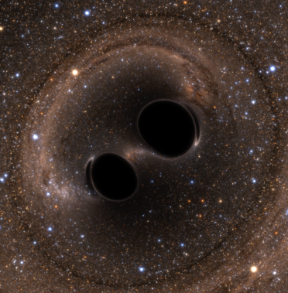
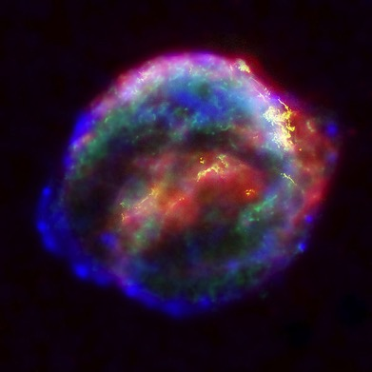
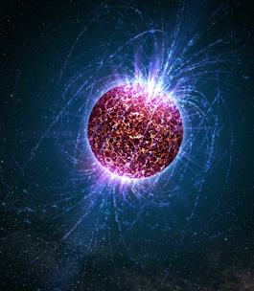
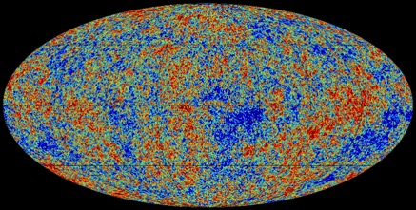
Gravitational-wave Astrophysics
Gravitational waves reveal information about the most violent and highest energy events in the Universe
The Stochastic Gravitational
Wave Background
Merging Binary Systems
Exploding Stars
Spinning Neutron Stars
Credit: Bohn, Hébert, Throwe, SXS
Credit: Chandra X-ray Observatory
Credit: Planck Collaboration
Credit: Casey Reed, Penn State
Black hole – black hole
Black hole – neutron star
Neutron star – neutron star
White dwarf binaries
Asymmetric core collapse supernovae
Neutron stars possessing ellipticity
Incoherent sum of unresolved astrophysical ‘point’ sources
Primordial GWs from the Big Bang
And possibly dark matter, dark energy, and yet to be discovered objects!

Slide 6
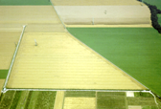
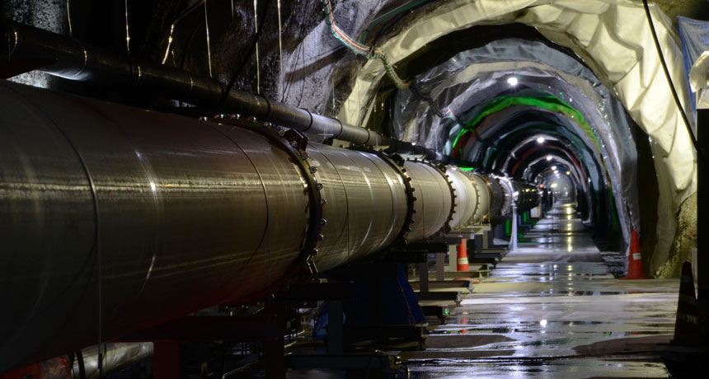
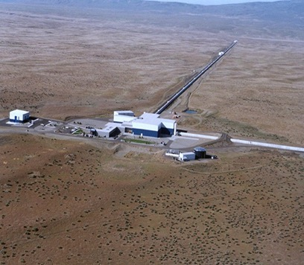
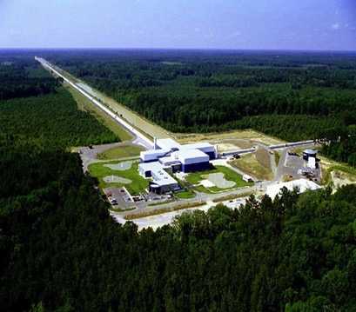
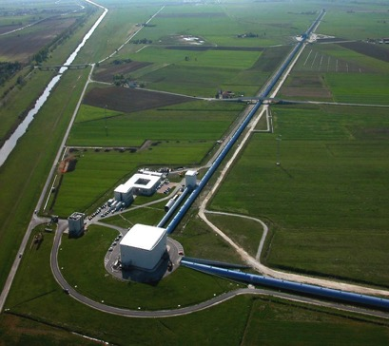
2001
2001
2001
2007
2019
~ 2028-2030

Slide 7
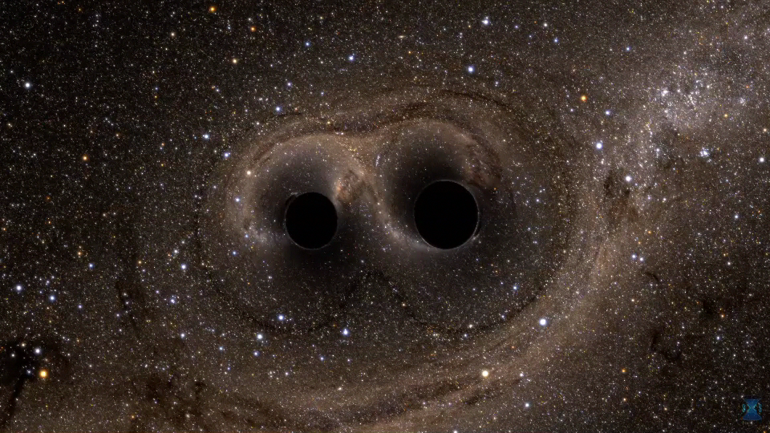
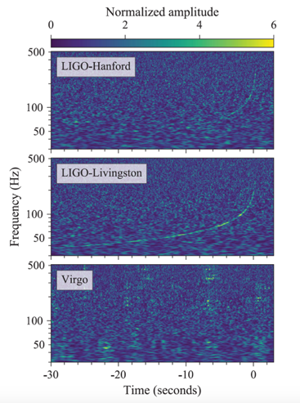
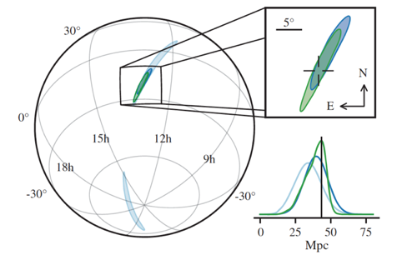
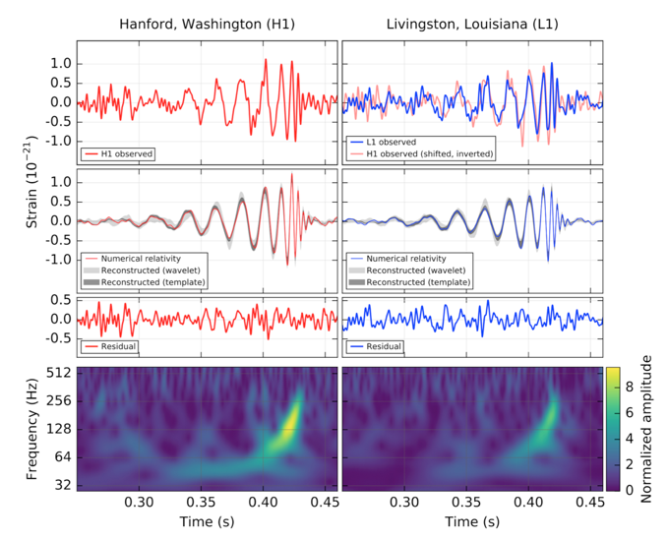
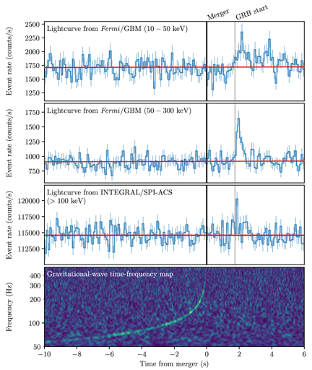
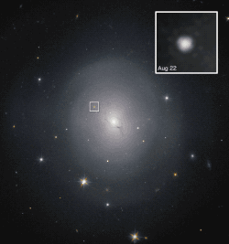
The Gravitational-Wave Universe Revealed to Date
Multi-messenger Astronomy
Binary Neutron Star Merger
Aug 17, 2017
Gravitational Waves
The First Detection:
Binary Black Hole Merger
Sept 14, 2015
Gamma Rays
Optical (Hubble Telescope)

Slide 8


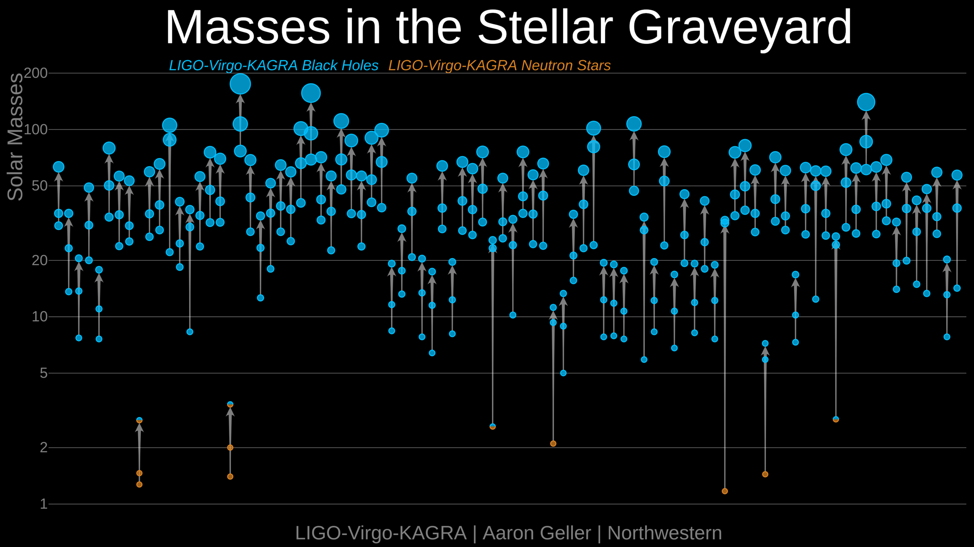


Recent LIGO-Virgo-KAGRA
Science Highlights I
qw
?
?
?
?
2016
Calendar Time
2020

Slide 9
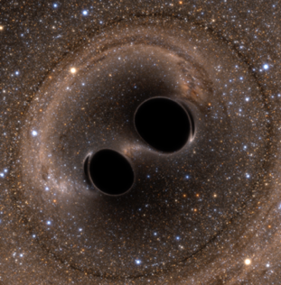
What Ground-Based Gravitational Wave Observations Have Already Taught
Us About High Energy Astrophysics, General Relativity, and Cosmology
GW150914
Gravitational waves from astrophysical sources can be directly measured!
Astrophysics: Binary black hole (BBH) systems exist.
Astrophysics: Binary neutron stars (BNS) are progenitors of short gamma ray bursts.
Astrophysics: BNS mergers produce kilonovae, which produce heavy elements.
Astrophysics: Black hole – neutron star binary systems exist.
Astrophysics: Compact objects exist in the 2 – 3 M⦿ mass range. We don’t know what they are…
Astrophysics: Black holes with masses in the (pulsational) pair instability gap between ~60 – 135 M⦿ exist.
General Relativity: Astrophysical black holes are Kerr black holes as predicted by GR.
General Relativity: The speed of gravitational waves equals the speed of light.
General Relativity: GR is valid in the high curvature, high field regime.
Cosmology: The Hubble constant can be measured using EM-bright GW ‘sirens’.
Cosmology: The Hubble constant can be measured using dark GW ‘sirens’.
GW170817/
GRB170817A
SSS17A

Slide 10
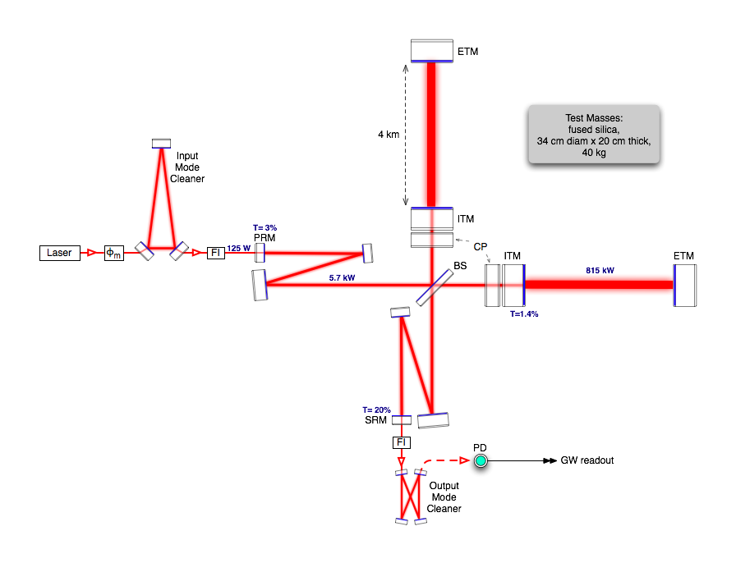
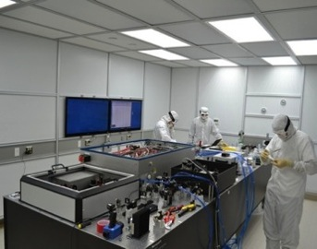
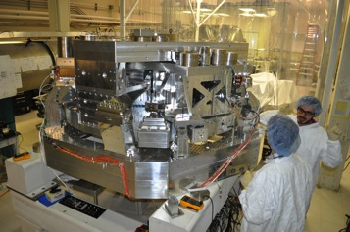
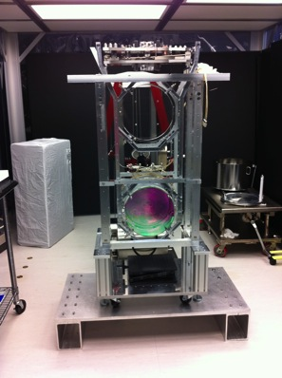
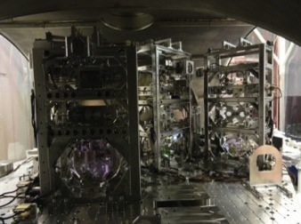
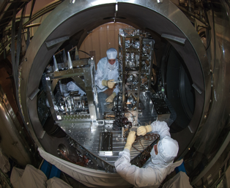
Advanced LIGO Interferometer in More Depth
Pre-stabilized Laser
70W , 1064 nm
Active Seismic Isolation
40 kg ‘Test Mass’ Mirror
4 km long Arm Cavity
140 W
100 W
3.0 kW
Power Recycling
Cavity
400 kW
Input Optics
4 km long Arm Cavity
Signal
Recycling
Cavity
Output Mode Cleaner
Auxiliary Laser
Notes:
Go through the slide from laser forward. NOTE THAT THE GW SIGNAL IS READ OUT BY INTRODUCING A ~10 pm ARMLENGTH OFFSET. THE STATIC DC FIELD IS MODULATED BY THE DIFFERENTIAL ARM LENGTH INDUCED BY THE PASSING GW.

Slide 11
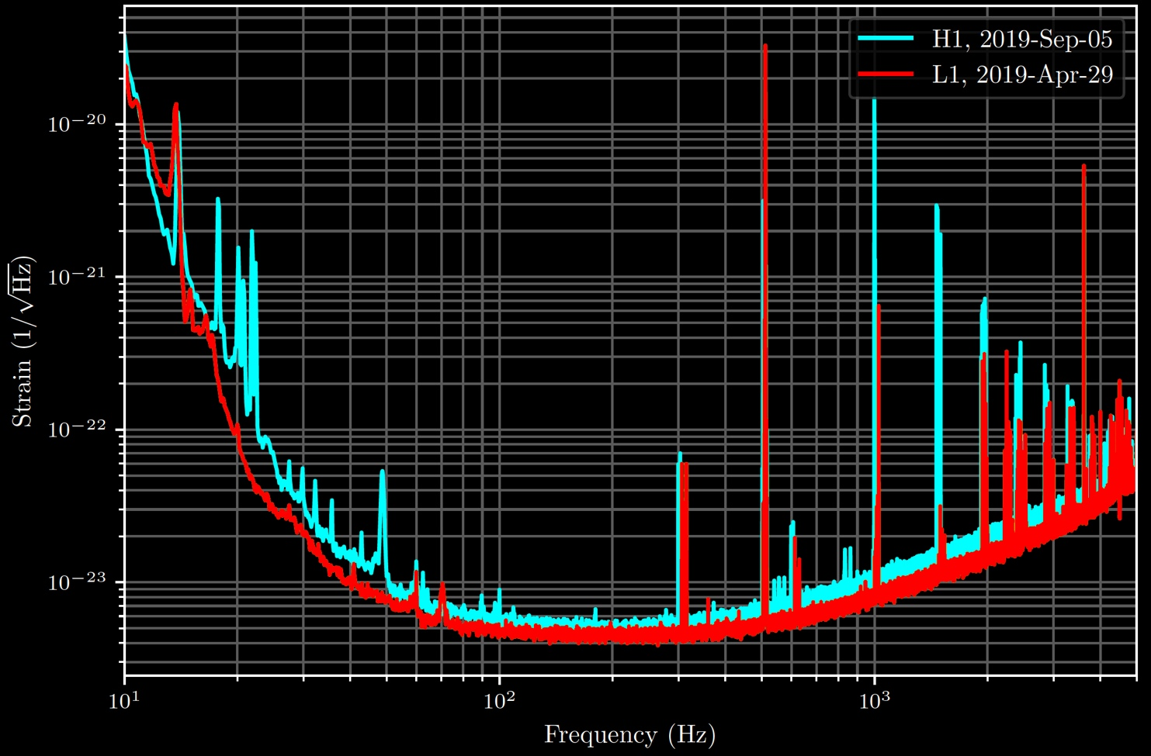
Advanced LIGO Sensitivity

Slide 12

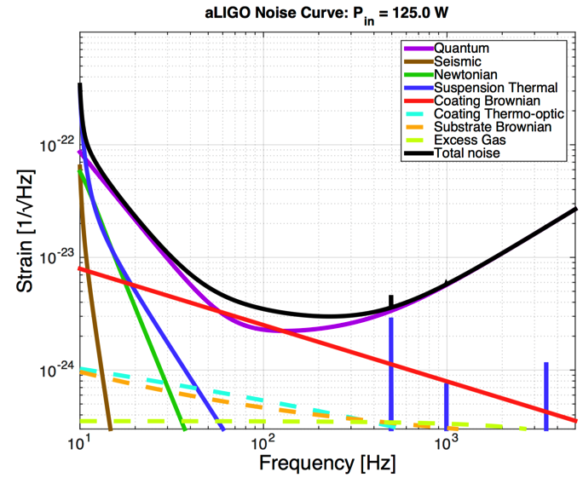
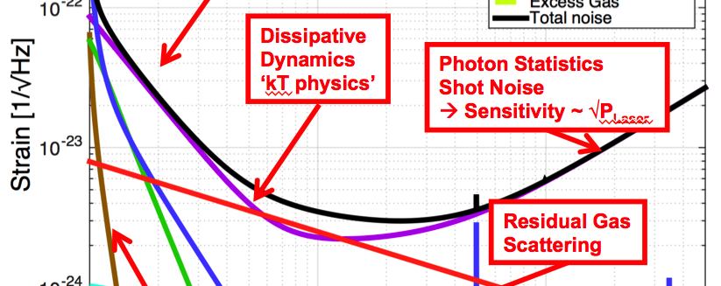
Measurement Noises
Displacement noises (ΔL_{arm}) shake the mirrors
  seismic perturbations
  quantum noise: photon pressure
  thermal noise (suspensions, mirror
  substrates, mirror coatings)
Sensing noises (Δt_{photon}) alter the arrival time of the light at the output photodetector
    quantum noise: photon arrival times
    presence of residual gas
(There are also hundreds of sources of technical noise that must be understood
and eliminated)

Slide 13



Measurement Noises
Displacement noises (ΔL_{arm}) shake mirrors
  seismic perturbations
  quantum noise: photon pressure
  thermal noise (suspensions, mirror
  substrates, mirror coatings)
Sensing noises (Δt_{photon}) alter the arrival time of the light
    quantum noise: photon arrival times
    presence of residual gas
(There are also hundreds of sources of technical noise that must be understood
and eliminated)
Quantum noise (low freq.):
photon pressure $∝$ $\sqrt{P}$_{Laser}
Quantum noise (high freq.):
photon arrival times $∝$ 1/ $\sqrt{P}$_{Laser}
Total noise

Slide 14

Coupled Quantum
“Optical Readout” Noise
Quantum Noise in Interferometers
M = 40 kg
P = 10³ W

Slide 15
Coupled Quantum
“Optical Readout” Noise
Quantum Noise in Interferometers
M = 40 kg
P = 10³ W

Slide 16
Coupled Quantum
“Optical Readout” Noise
Quantum Noise in Interferometers
M = 40 kg
P = 10⁵ W

Slide 17
Coupled Quantum
“Optical Readout” Noise
Quantum Noise in Interferometers
M = 40 kg
P = 10⁷ W
M = 40 kg
P = 10⁷ W

Slide 18

Coupled Quantum
“Optical Readout” Noise
Quantum Noise in Interferometers
M = 40 kg

Slide 19
Coupled Quantum
“Optical Readout” Noise
Quantum Noise in Interferometers
M = 400 kg

Slide 20
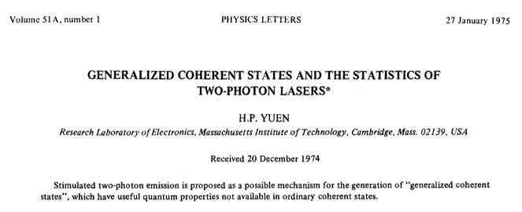
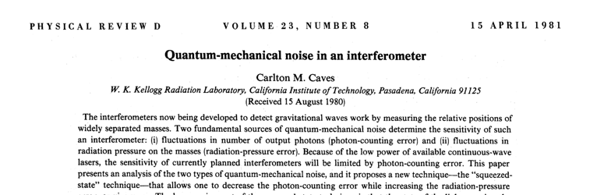
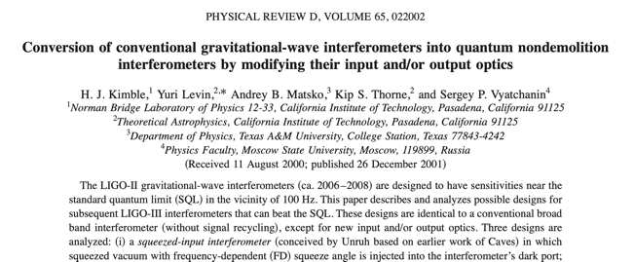

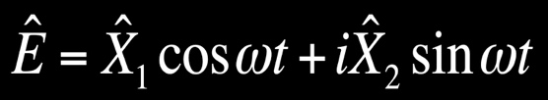


Suppressing Quantum Noise
Electromagnetic fields are quantized:
Quantum fluctuations exist in the vacuum state:
Coherent State
Vacuum State
Amplitude squeezing
│E │
Squeezed
vacuum
Phase
squeezing
ϕ

Slide 21

Controlling Quantum Noise in Interferometers
Vacuum noise naturally enters through the asymmetric (dark) port of the interferometer
Squeezed vacuum can be injected to
suppress shot noise
Main Laser
Main Laser
Symmetric port
PLL
x₂
Faraday
Isolator
Asymmetric port
Squeezed Vacuum
Source
x₁
x₂
Photodiode
x₁
Photodiode
J. Aasi, et al. (LIGO Scientific Collaboration), Nature Phot. 7, 613-619 (2013).

Slide 22
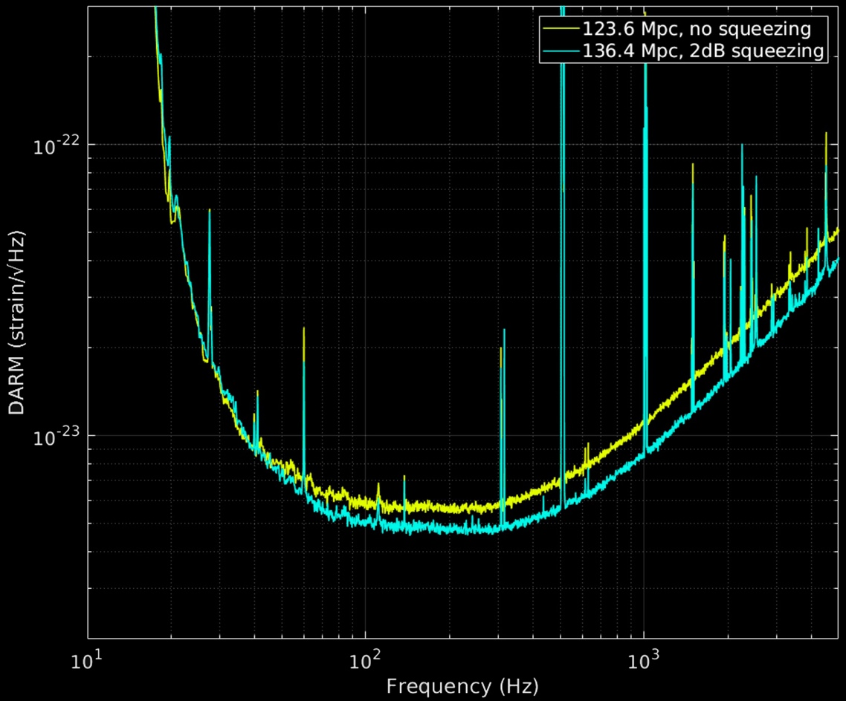
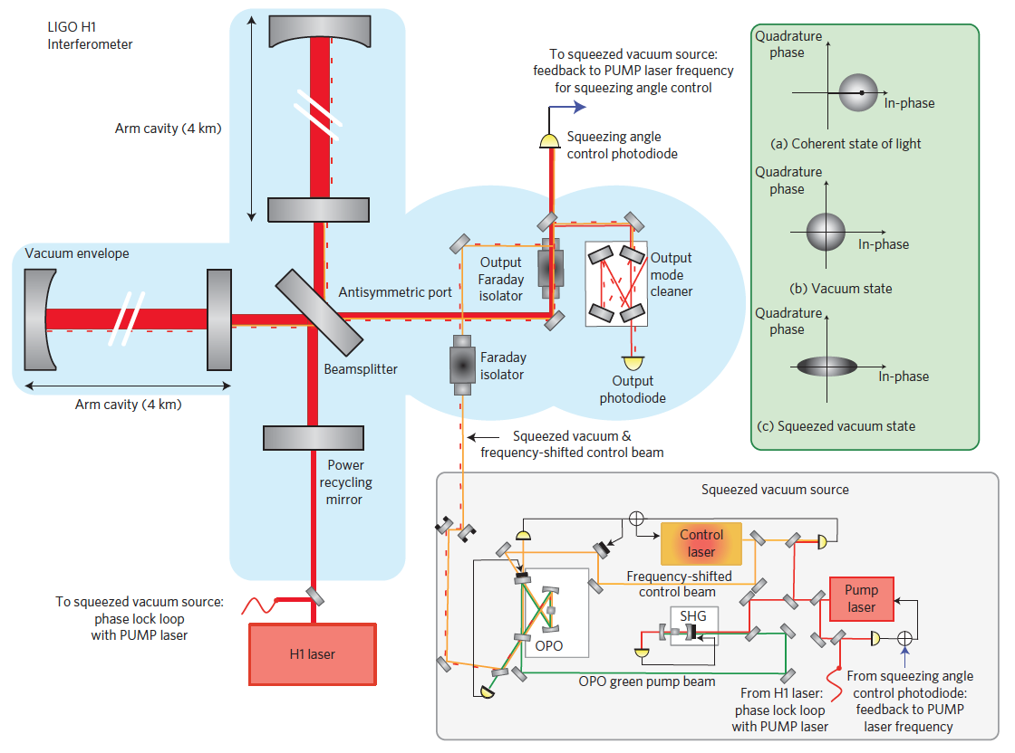
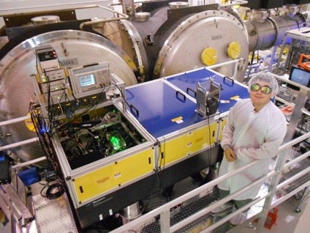
Shot Noise Suppression in the LIGO Interferometers
Binary Neutron Star Range
Frequency Independent Squeezing:
Experimental implementation at LIGO
34% increase in
rate of detected
binary neutron stars
2 dB squeezing
Shot Noise

Slide 23
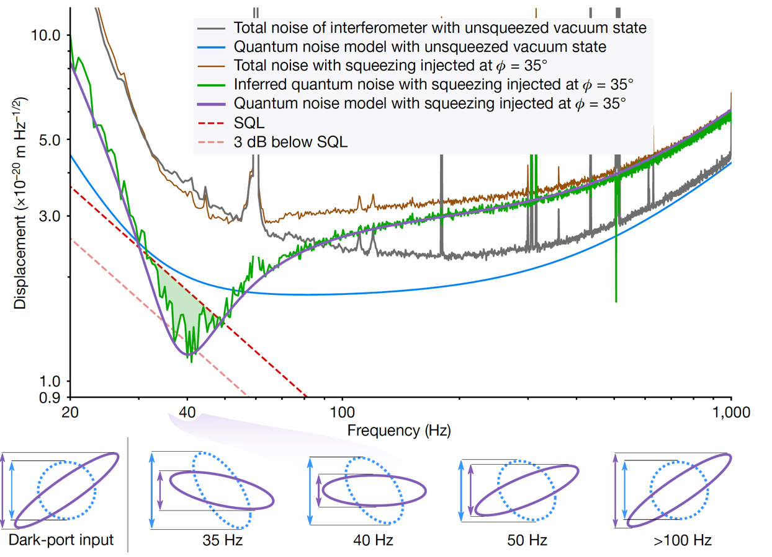
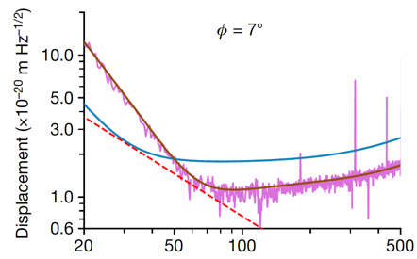


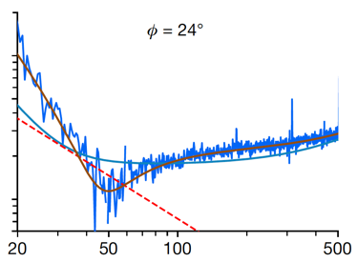
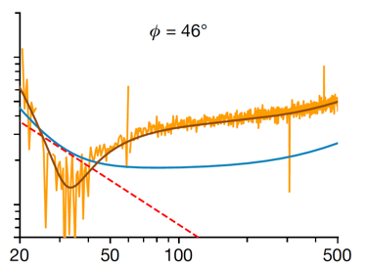
Beyond the Standard Quantum Limit:
Radiation Pressure Suppression
Ponderomotive Squeezing: the interferometer introduces correlations between the position/ momentum uncertainty of the mirrors and the photon number/phase uncertainty
By varying the squeezed quadrature field (phase) and subtracting off the classical noise, the QPR noise can be reduced below the SQL
Squeeze
angle φ
Yu, et al., “Quantum correlations between light and the kilogram-mass mirrors of LIGO” Natiure 583, 43-54 (2020).

Slide 24
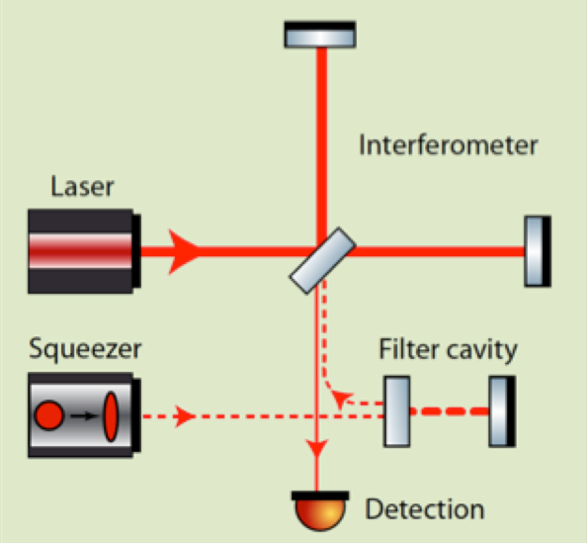
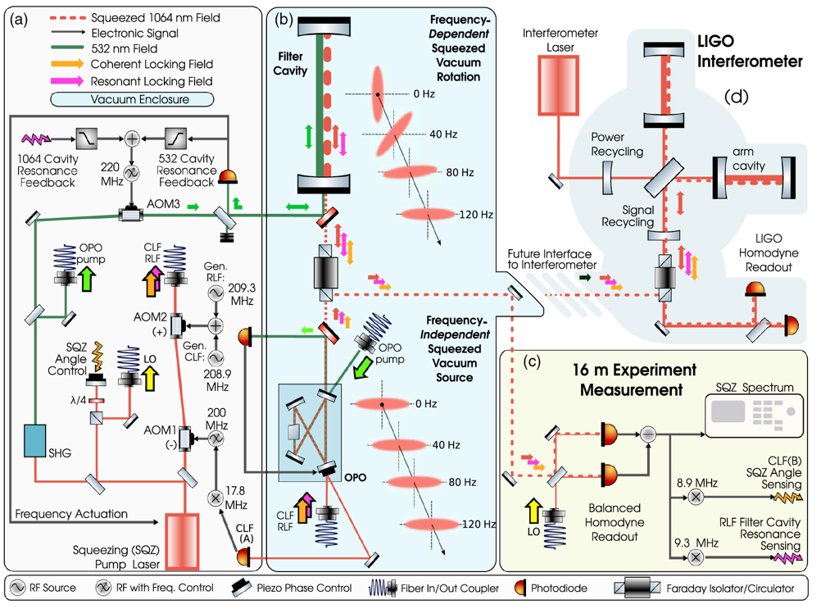
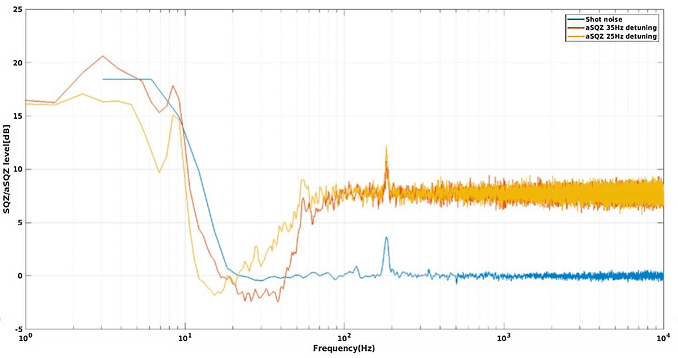
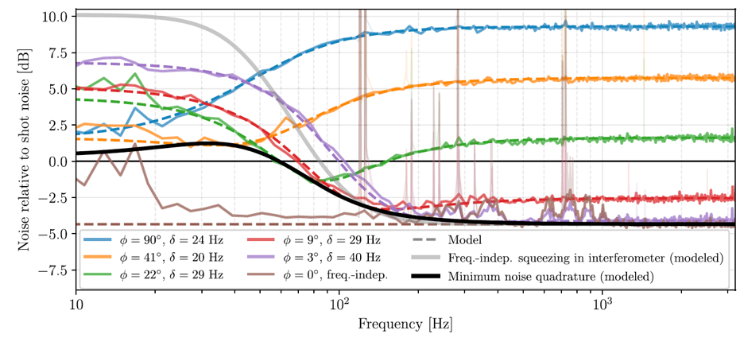
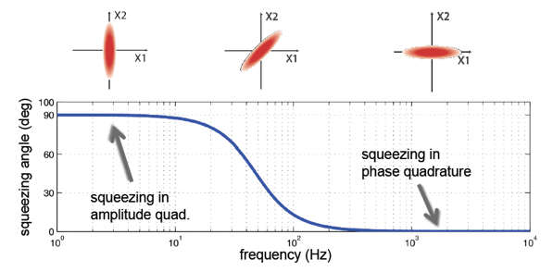
Frequency Dependent Squeezing
Demonstration on a 300 m suspended cavity
at the Virgo European Gravitational-Wave Observatory
Demonstration on a 16 m suspended cavity
at the MIT LIGO Advanced System Test Interferometer
wqe
Squeezed Light Response to Filter Cavity
Oelker, et al., “Audio-band Frequency-dependent Squeezing”, Phys. Rev. Lett. 116, 041102 (2016).
L. McCuller, et al., “Frequency-Dependent Squeezing for Advanced LIGO”, Phys. Rev. Lett. 124, 171102 (2020).
Y. Zhao, et al., “Improving the stability of frequency-dependent squeezing with bichromatic control of filter cavity length, alignment, and incident beam pointing”, Phys. Rev. D 105, 082003 (2022).

Slide 25


What’s Next for LIGO
Major Facility
Improvements
Implementation frequency-dependent squeezing in the next LIGO-Virgo-KAGRA O4 Observing Run
Improvements in the test mass mirror coatings to reduce thermal noise to be deployed for the O5 Observing Run in 2025
Filter Cavity
End Station
300 m
Filter Cavity

Slide 26
Gravitational Wave Observatories in the 2030s & 2040s:
Global Scale Detector Networks
Next Generation GW Observatory Projects in Europe and the US are gaining significant momentum
  Einstein Telescope (ET) in Europe
  Cosmic Explorer (CE) in the US
ET and CE will observe compact GW events to the edge of the star-forming universe as a global network
Europe: Einstein Telescope
10 km arm lengths
US: Cosmic Explorer
US: Cosmic Explorer
40 km arm lengths

Slide 27
Einstein Telescope
ET Design: underground, triangular, 3 detectors consisting of two interferometers (high frequency + low frequency ‘xylophone’)
  Cryogenic test masses, longer wavelengths for LF operation
  Underground infrastructure designed for future upgrades
Possible sites:
  Euregio Meuse-Rhine
  Sardinia, Italy
  (possibly) Saxony, Germany
Current envisioned timeframe:
  Construction to begin in 2026
  Science operations to begin in 2035
Status:
  ET is a fully recognized European Project on European Strategy Forum for Research Infrastructures (ESFRI) Roadmap → a key step in getting the project funding lined up.
  ET Project Organization and relevant Boards have been established
  ET Pathfinder facility in Maastricht, Netherlands under construction
  Site evaluation well underway

Slide 28
Cosmic Explorer
Detector Design: one 40 km and one 20 km L-shaped surface observatories
  Detector technology based on scaling up existing LIGO interferometer technology
Possible sites:
  No specific sites identified, however a trade study has identified candidate sites in NW and SW United States
Current envisioned timeframe:
  Construction to begin in 2029
  Science operations to begin in ~ 2037
Status:
  CE Horizon Study released in October 2022
  Currently developing proposal to enter NSF ‘Conceptual Design’ phase → this is a key step to secure construction funding
  R&D on development new lower cost ultrahigh vacuum systems underway
CE Design
Concept

Slide 29






Conclusions
The first three Advanced Detector observing runs have been a smashing success!
Upgrades are progressing toward O4 run to begin in December 2022.
Detailed plans for detector upgrades for O5 are in hand; O5 run plan coming into focus.
Planning for O6, O7, … which will carry us into the next decade are underway.
Later in the 2030s: Einstein Telescope and Cosmic Explorer will probe the compact GW sources to the nearly edge of the Universe
Acknowledgments:

Slide 30






Seismic Isolation
Force → Displacement
Transfer Function
Model vs. Measured
Concept:
Harmonic
Oscillator
4 Stage Transfer Function
Implementation:
Collaboration w/ U. Glasgow
Upper ‘ear’
Lower ‘ear’

Slide 31

Seismic Isolation
Force → Displacement
Transfer Function
Model vs. Measured
Concept:
Harmonic
Oscillator
4 Stage Transfer Function
Implementation:
Collaboration w/ U. Glasgow
Upper ‘ear’
Lower ‘ear’

Slide 32




Beyond the Standard Quantum Limit:
Quantum Radiation Pressure Suppression
Diff. displacement spectral density:
Ponderomotive coupling:
Squeeze factor:
{
{
frequency-dependent interaction between ponderomotive and injected squeezing
1) Yu, et al., “Quantum correlations between light and the kilogram-mass mirrors of LIGO” Natiure 583, 43-54 (2020).
2) A. Buonanno, A. & Y. Chen, “Quantum noise in second generation, signal-recycled laser interferometric gravitational-wave detectors” Phys. Rev. D 64, 042006 (2001).
3) H. J. Kimble, et al., "Conversion of
conventional gravitational-wave interferometers into quantum nondemolition interferometers by modifying their input and/or output optics", Phys. Rev. D 65, 022002 (2001).

Slide 33

Squeezing & Anti-squeezing
Coherent State
Amplitude squeezing
Phase Anti-squeezing
Phase
Squeezing
Amplitude Anti-squeezing
│E │
ϕ

Slide 34
Coating Thermal Noise
Advanced LIGO Test Mass Coatings
  Ion-beam sputtered (IBS) amorphous (almost) ¼ wave dielectric stack
    TiO₂:Ta₂O₅ (n_{h} = 2.07) & SiO₂ (n_{L} = 1.45)
Statistical Mechanics: kT of energy per mechanical mode, viscous damping
Loss Angle:
n_{h}
n_{L}
n_{h}
n_{L}
n_{h}
n_{L}
n_{h}
n_{L}
n_{h}
n_{L}
n_{h}
n_{L}
Measurement
Band
Low Q (BAD)
High Q (GOOD)
coating thickness
coating
elastic loss
beam radius
Compare: Bulk Silica φ ~ 10⁻⁶-10⁻⁸
Young’s modulus, coating
Y. Levin Phys. Rev. D 57 659 (1998); Harry, G.M., et al.m Class. Quantum Gravity 19 (5), 897.
Slide inspiration:
Marty Fejer, Stanford

