Slide 1
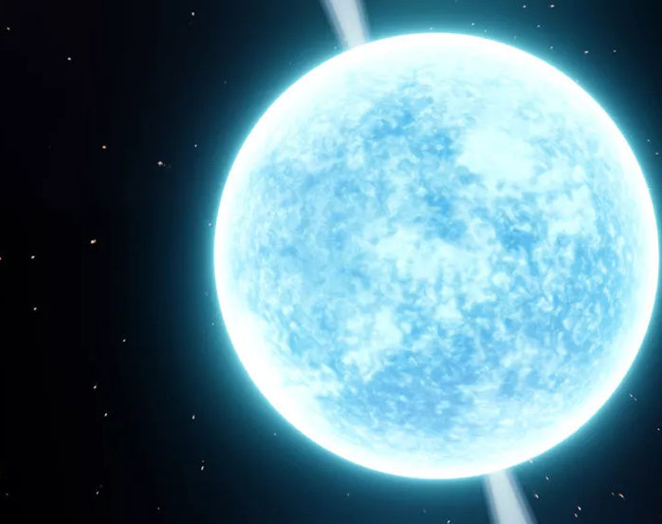
Testing Universal Relations under Non-Parametric EoS
Oscar Sy-Garcia
Mentors: Isaac Legred & Katerina Chatziioannou

Slide 2
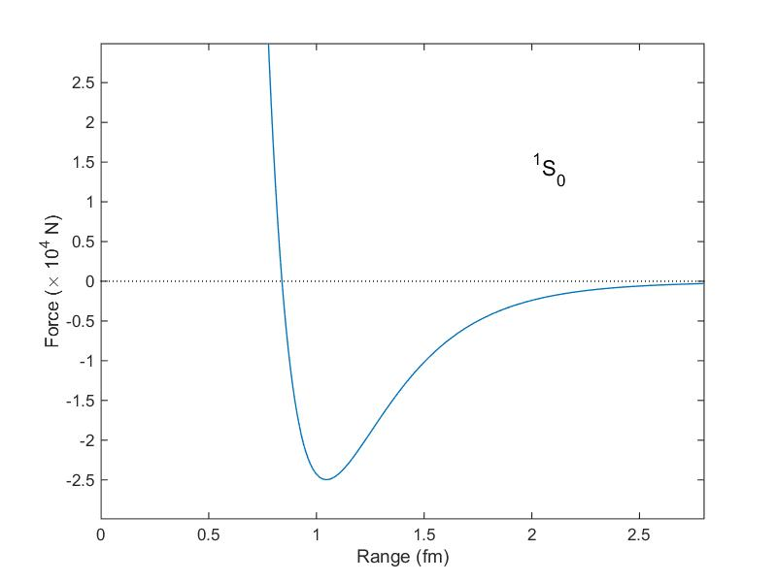
Background
Equation of State: $P=Kρ^{Γ}$
Universal Relation = EoS Independent
Equation of State
Relation Between Tidal Deformability ($Λ$)
and NS Property
Neutron Star Property!
(Mass, Moment of Inertia, etc.)

Slide 3
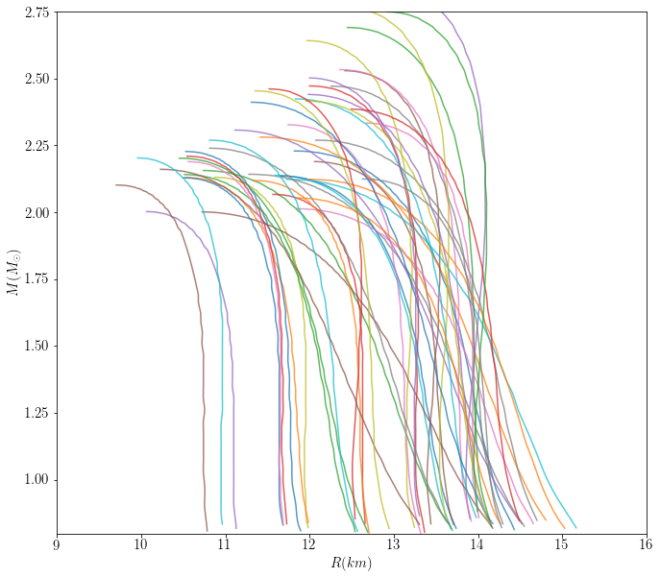
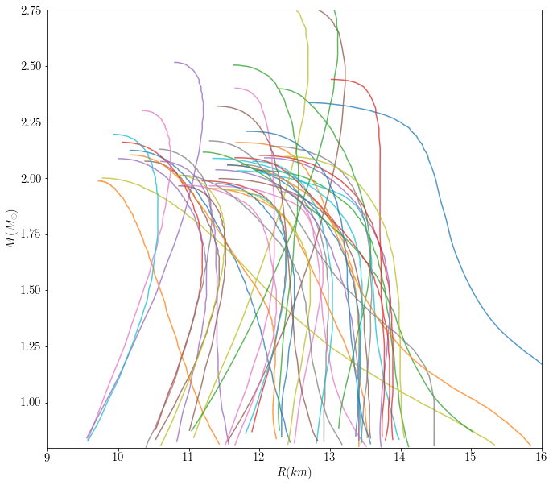
Parametric
Non-Parametric
Notes:
Inspect the universality and its origins and how it might be model-influenced

Slide 4
Methods

Slide 5
$w$ = weight
$α_{j}$ = parameters
$x_{i}$ = data points
$$χ^{2}\left(α_{j}\right)≡⟨χ^{2}\left(α_{j}\right)⟩=\sum_{EoS}{\frac{w_{EoS}}{{\sum{w}}_{EoS}}χ_{EoS}^{2}(α_{j})}$$
$$χ_{EoS}^{2}(α_{j})=\sum_{i=0}^{n}{\frac{{\left(Fit\left(x_{i}, α_{j}\right)−{Model}_{EoS}\left(x_{i}\right)\right)}^{2}}{σ_{i}^{2}}}$$

Slide 6
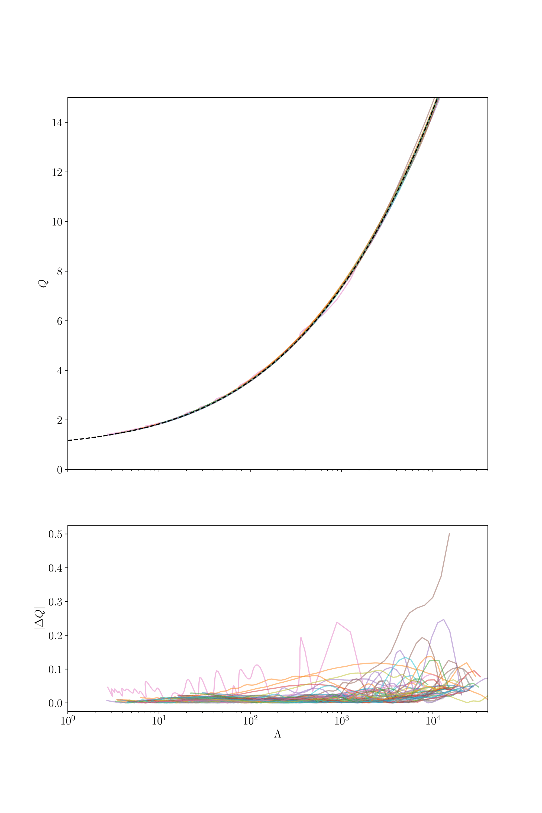
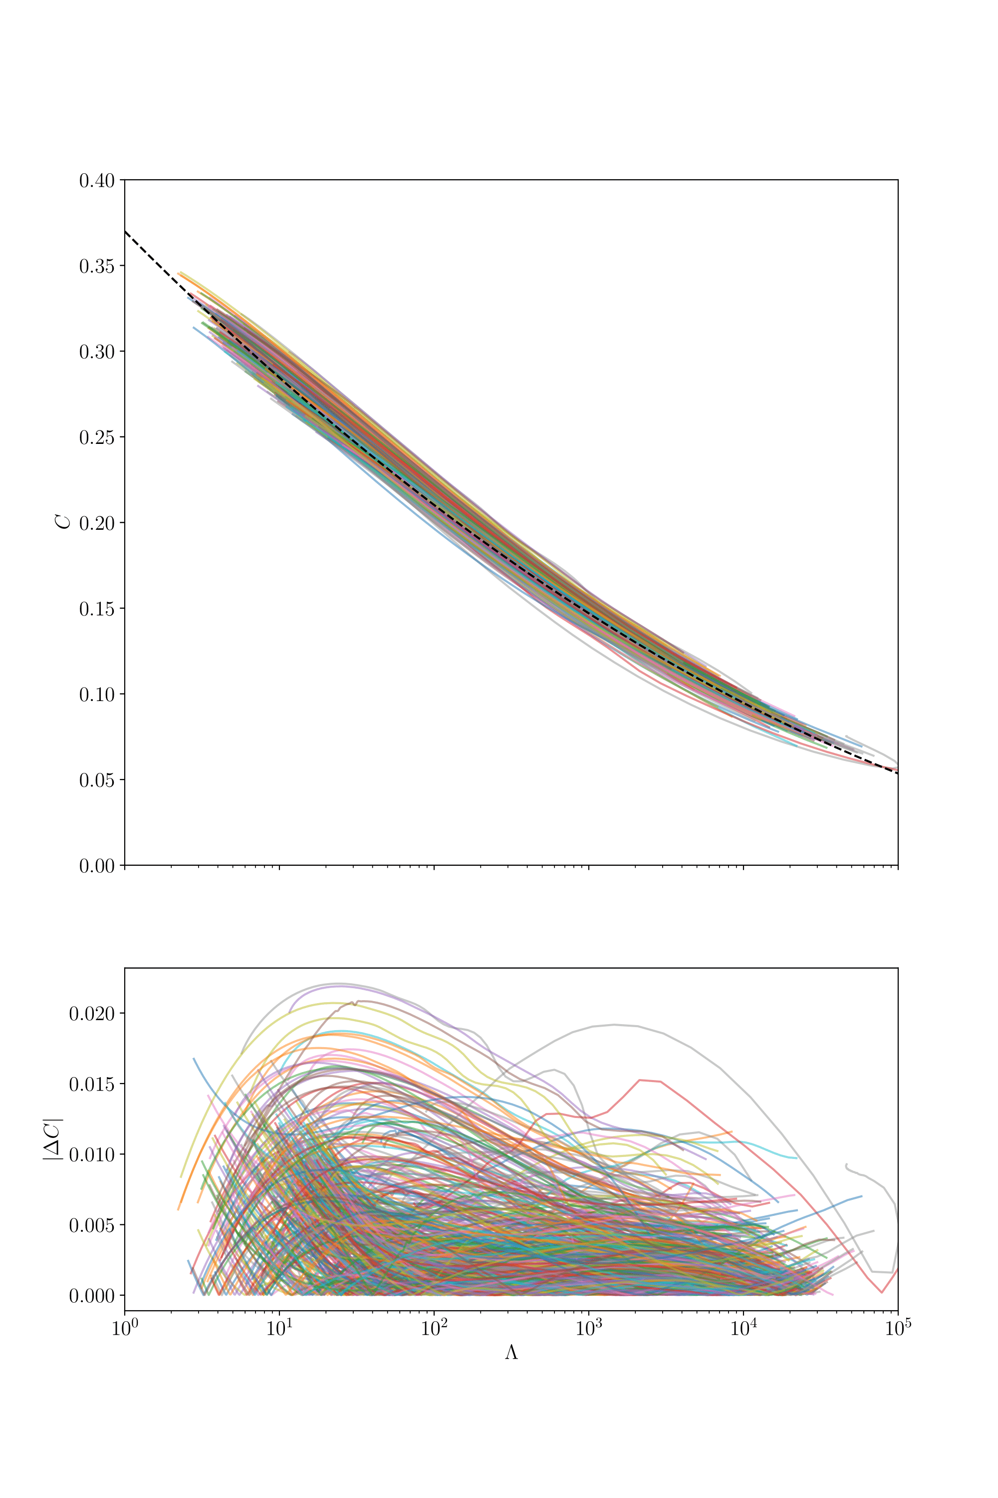
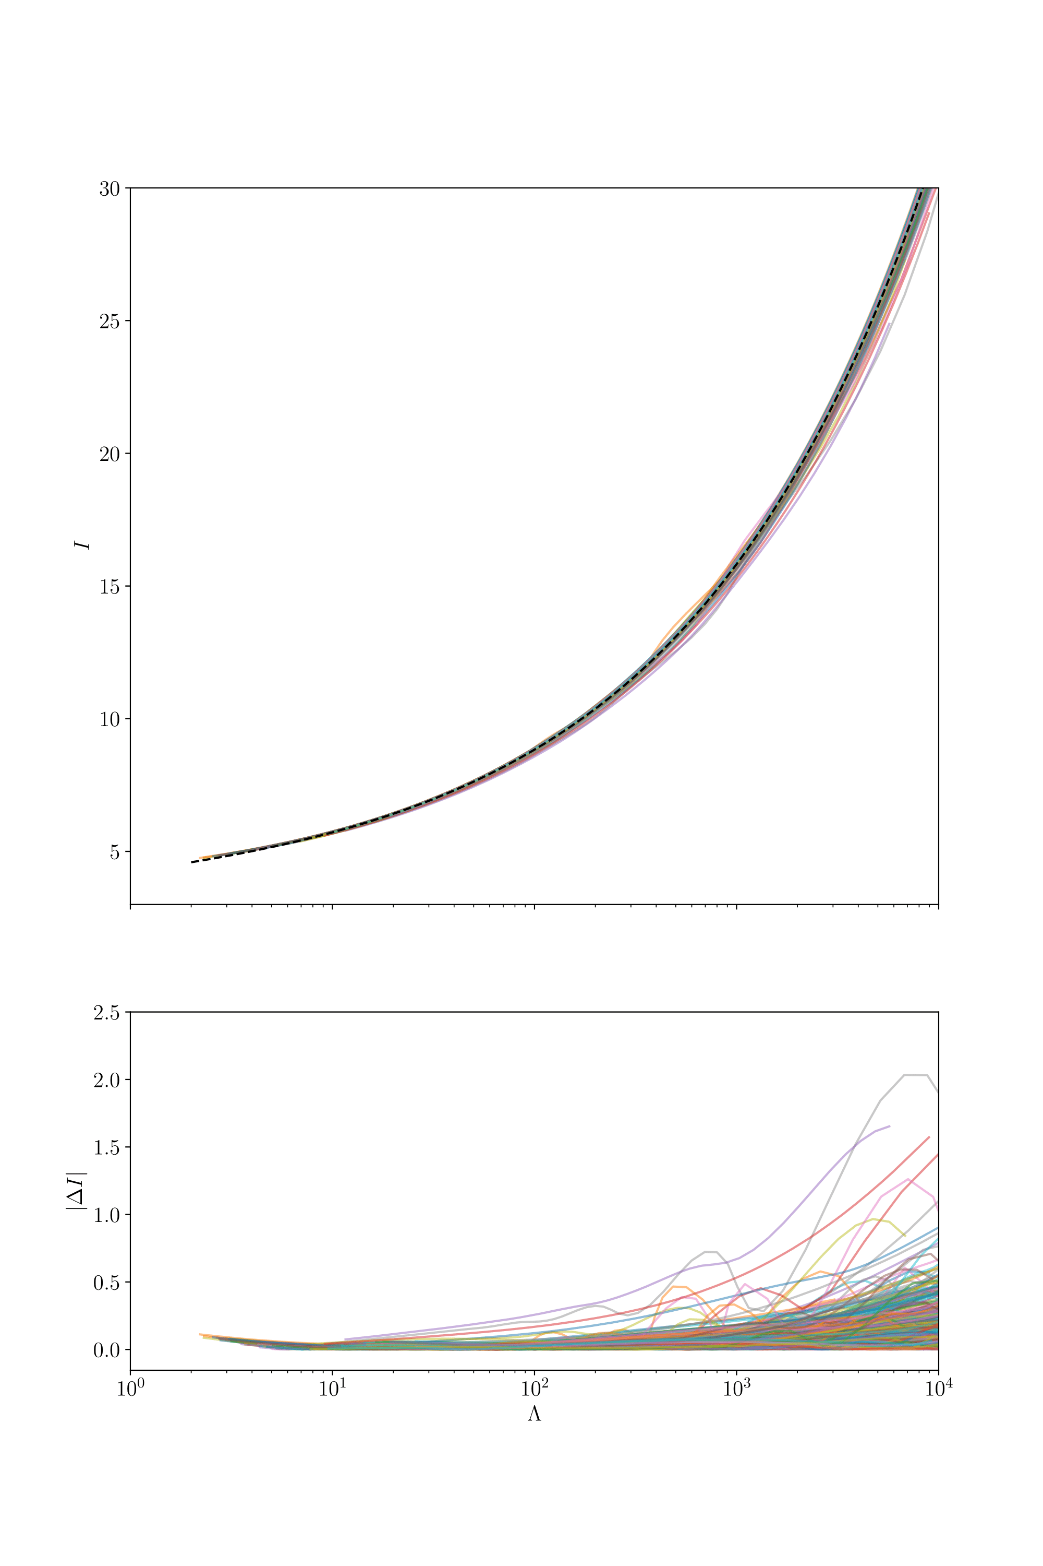
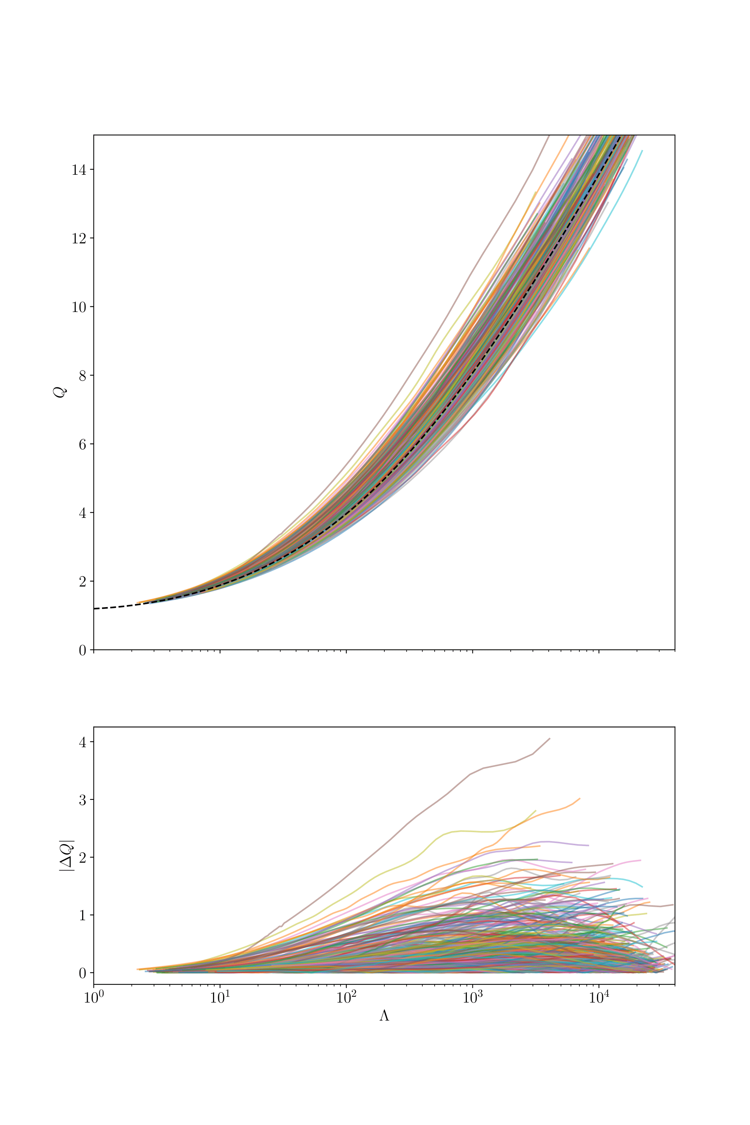
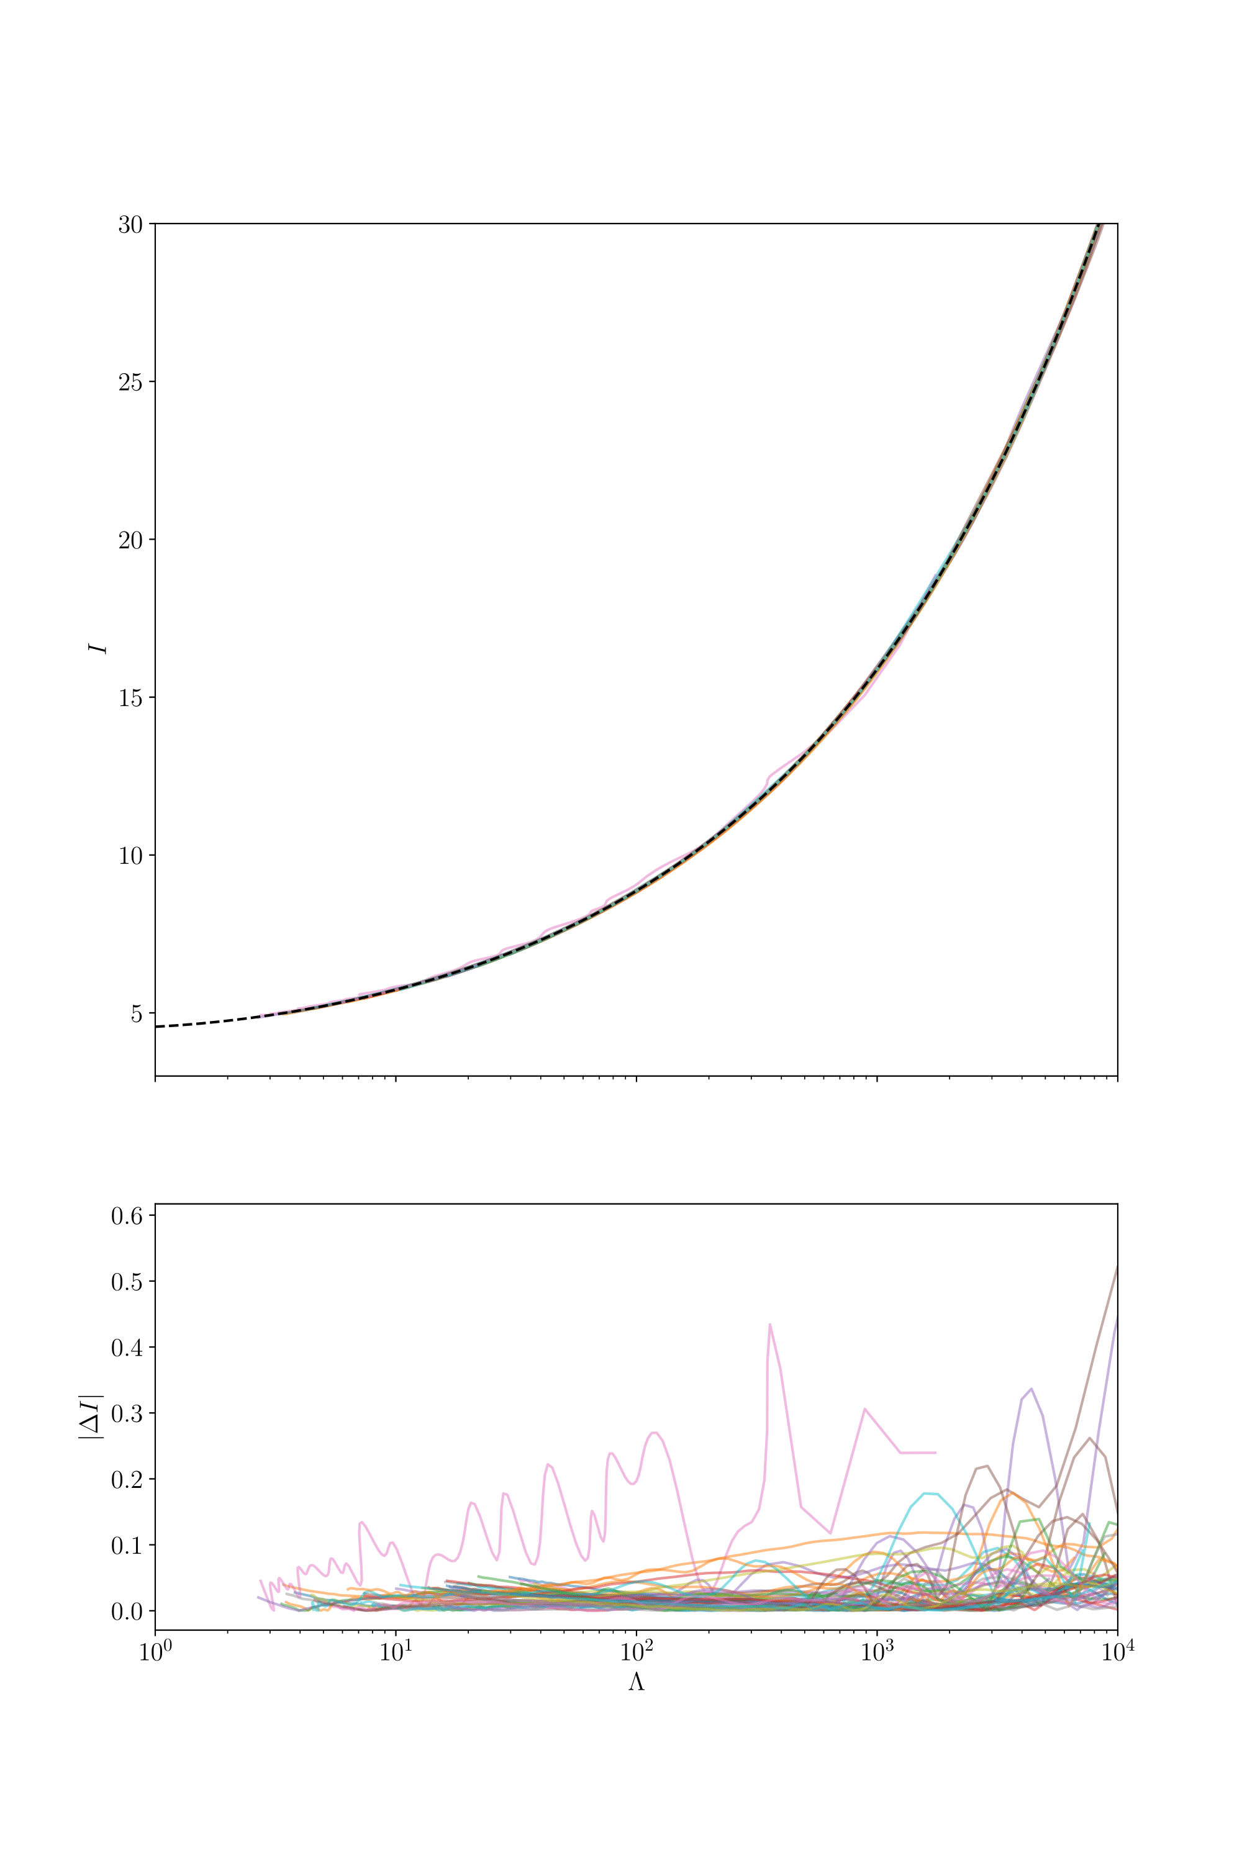
$$\frac{χ^{2}}{N_{dof}}≪1$$

Slide 7
URs to Test:
$I$ vs $Λ$ vs $Q$
“I-Love-Q”
$C$ vs $Λ$
“C-Love”
R vs $Λ$*
“R-Love”
$Λ_{a}$ vs $Λ_{s}$
“Binary Love”
$α_{c}$ vs $C$
($I$) Moment of Inertia
($Λ$) Deformability
($Q$) Quadrupole Moment
($C$) $\frac{Mass}{Radius}$
($R$)Radius
${(Λ}_{a})=\frac{Λ_{2}−Λ_{1}}{2}$
${(Λ}_{a})=\frac{Λ_{2}+Λ_{1}}{2}$
($α_{c}$) $\frac{Pressure_{core}}{Density_{core}}$
Notes:
Notice that many of these depend on Lambda, one thing we can measure

Slide 8
Results

Slide 9
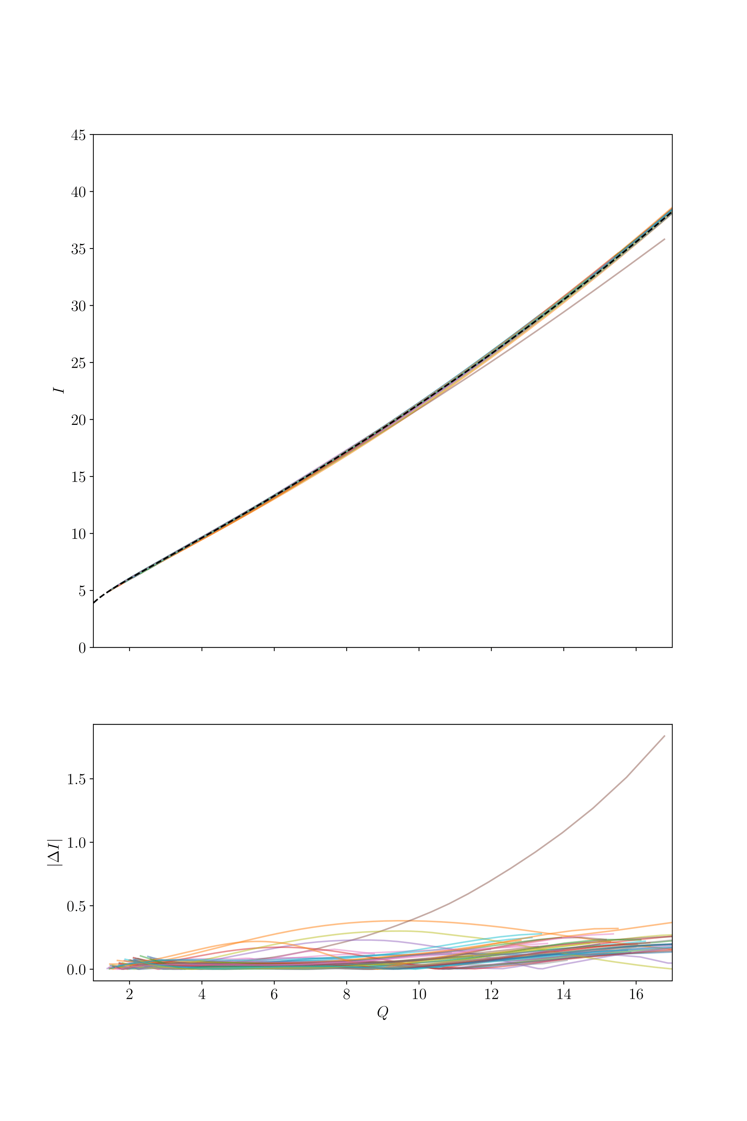

Slide 10
$$\frac{χ_{IΛ}^{2}}{N_{dof}}=1.142({10}^{−5})$$
$$\frac{χ_{QΛ}^{2}}{N_{dof}}=2.401({10}^{−6})$$
$$\frac{χ_{IQ}^{2}}{N_{dof}}=4.662({10}^{−4})$$

Slide 11
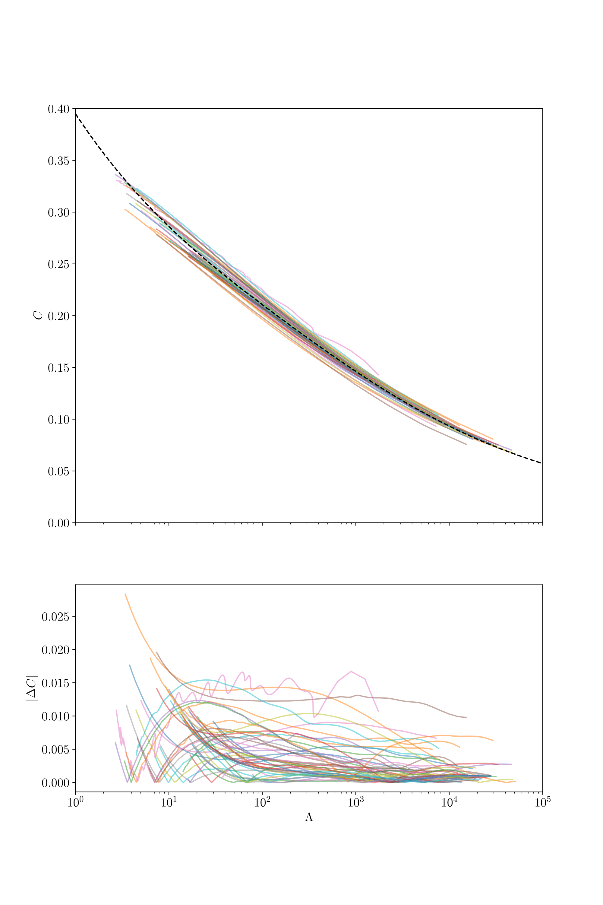
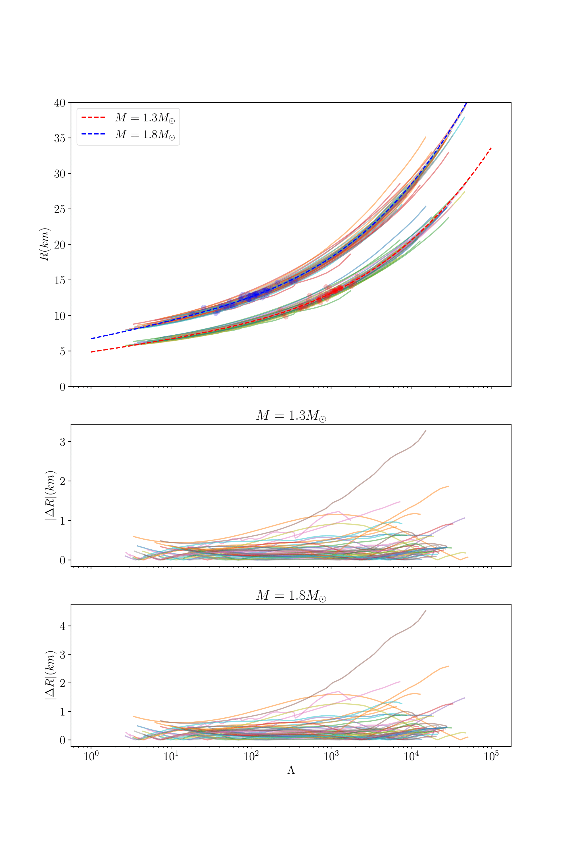

Slide 12
$$\frac{χ_{CΛ}^{2}}{N_{dof}}=0.0330536$$

Slide 13
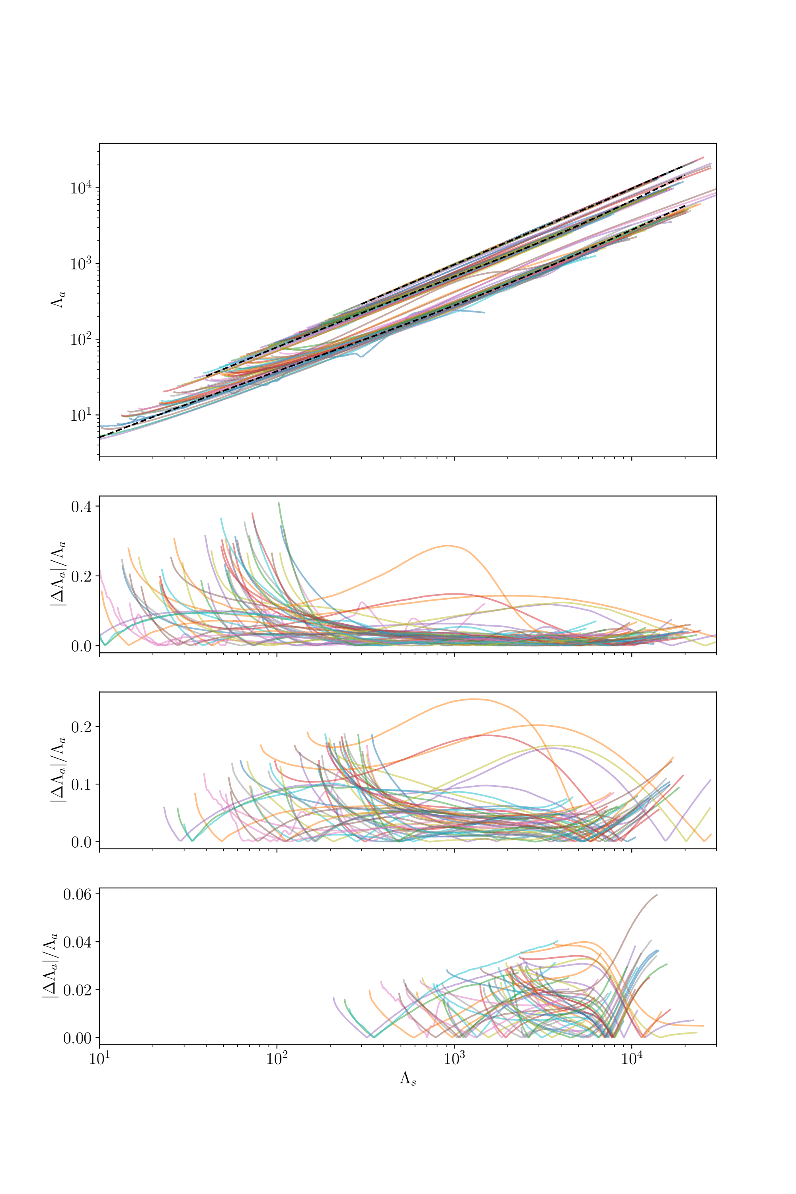
$$\frac{χ_{BΛ_{q=0.50}}^{2}}{N_{dof}}=0.001301$$
$$q=0.90$$
$$q=0.75$$
$$q=0.50$$
$$\frac{χ_{BΛ_{q=0.75}}^{2}}{N_{dof}}=0.009225$$
$$q=0.50$$
$$q=0.75$$
$$\frac{χ_{BΛ_{q=0.90}}^{2}}{N_{dof}}=0.001635$$
$$q=0.90$$

Slide 14
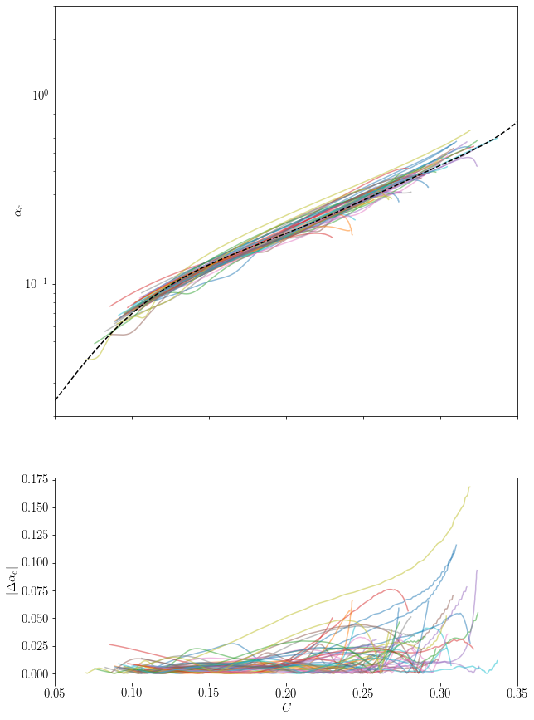
$$\frac{χ_{α_{c}C}^{2}}{N_{dof}}=0.01852$$

Slide 15
Conclusion

Slide 16
“Vanilla” EoS
I-Love-Q
C-Love
R-Love
Binary Love
$α_{c}$ vs C
Mostly…

Slide 17
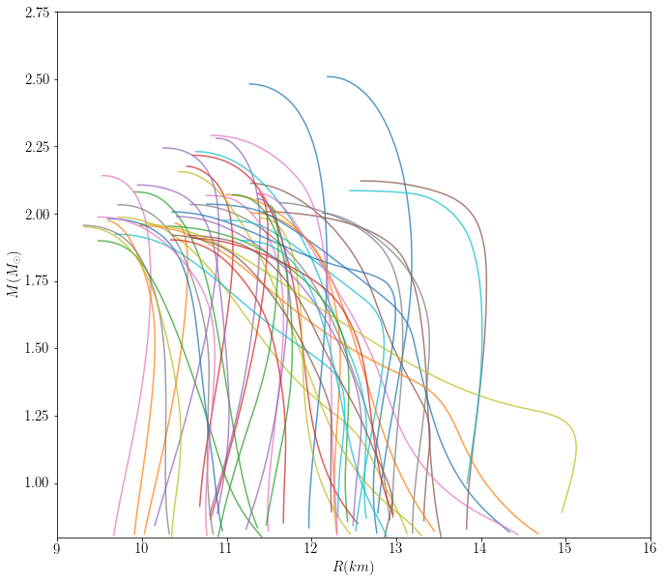
What’s Next?
Weirder EoS
Inertia Features
Hybrid EoS
Parametric comparison

Slide 18
Acknowledgments
I’d like to thank Isaac Legred and Katerina Chatziioannou for their tremendous support in this project. I also gratefully acknowledge the support from the National Science Foundation Research Experience for Undergraduates (NSF REU) program, the California Institute of Technology, and the LIGO Summer Undergraduate Research Fellowship.

Slide 19
Questions?

