Slide 1
CHARACTERISATION AND CONTROL OF THE Auxiliary laser PZT
Deeksha Sabhari

Slide 2
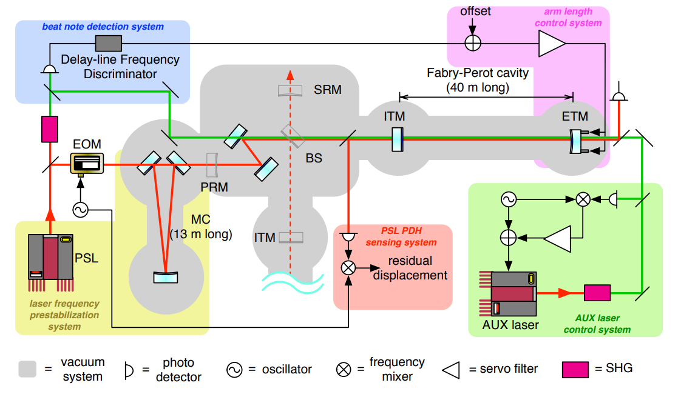
"Multicolor cavity metrology," Journal of the Optical Society of America A Vol. 29, Issue 10 (2012)

Slide 3
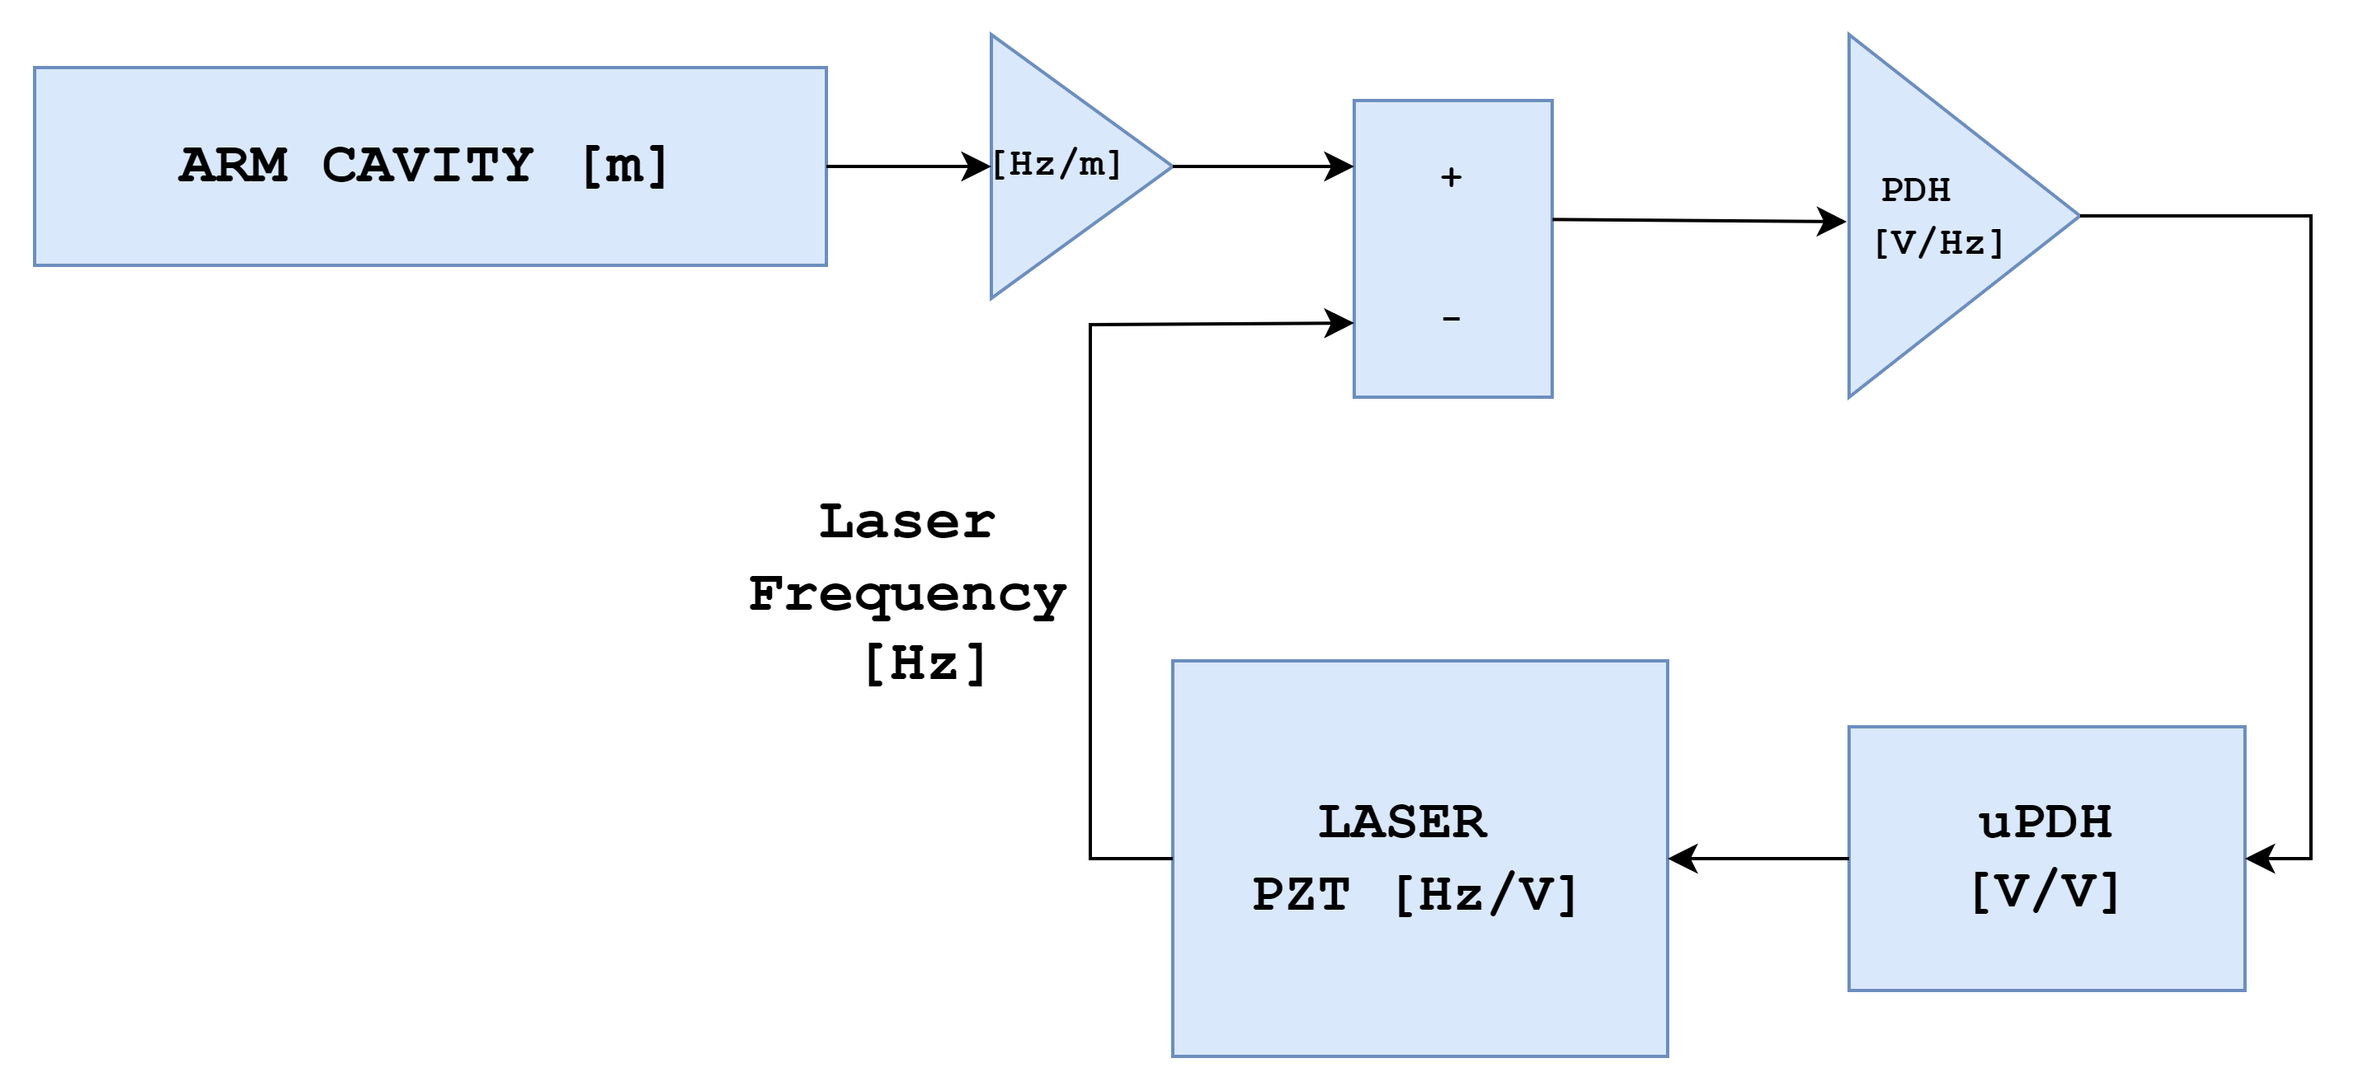
Control Loop
AUXILIARY LASER SYSTEM

Slide 4
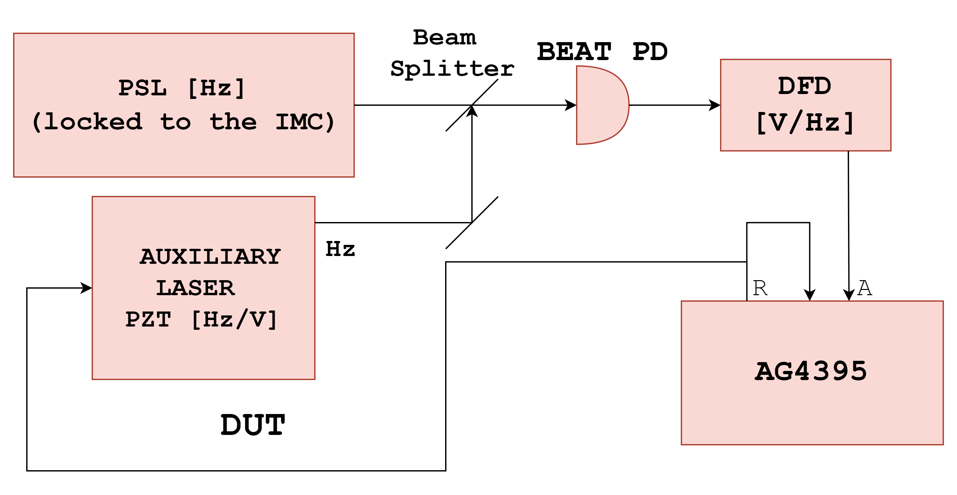
Measuring the transfer function

Slide 5
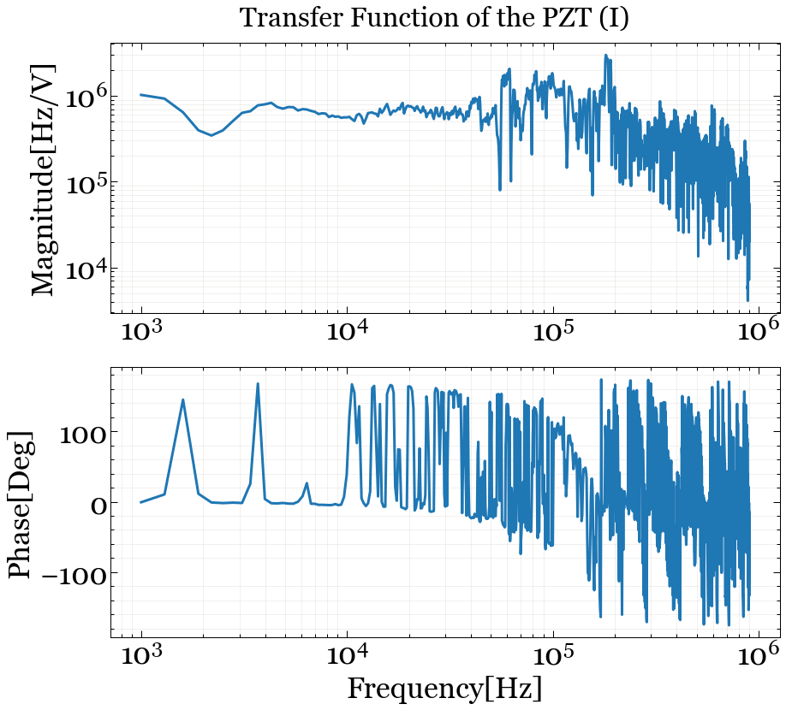
MEASUREMENTS
PZT is excited using a swept sine from the AG4395, and the beatnote of the AUX and PSL is observed

Slide 6
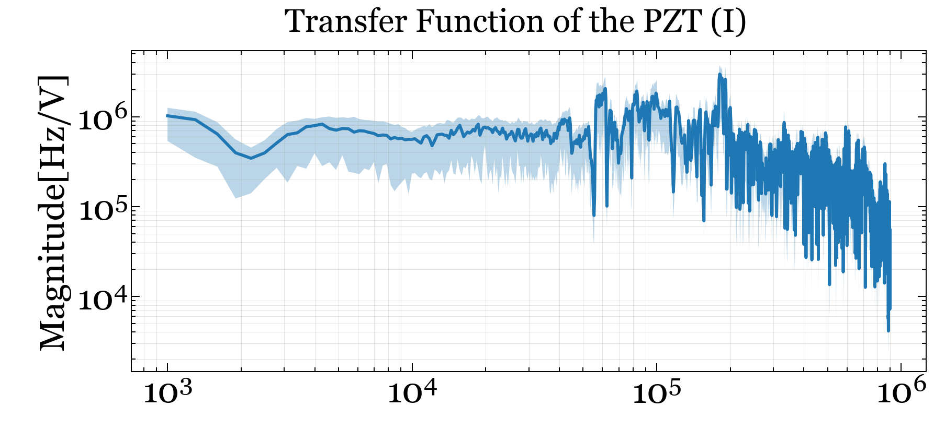
Uncertainty
PZT is excited using a swept sine from the AG4395, and the beatnote of the AUX and PSL is observed.

Slide 7
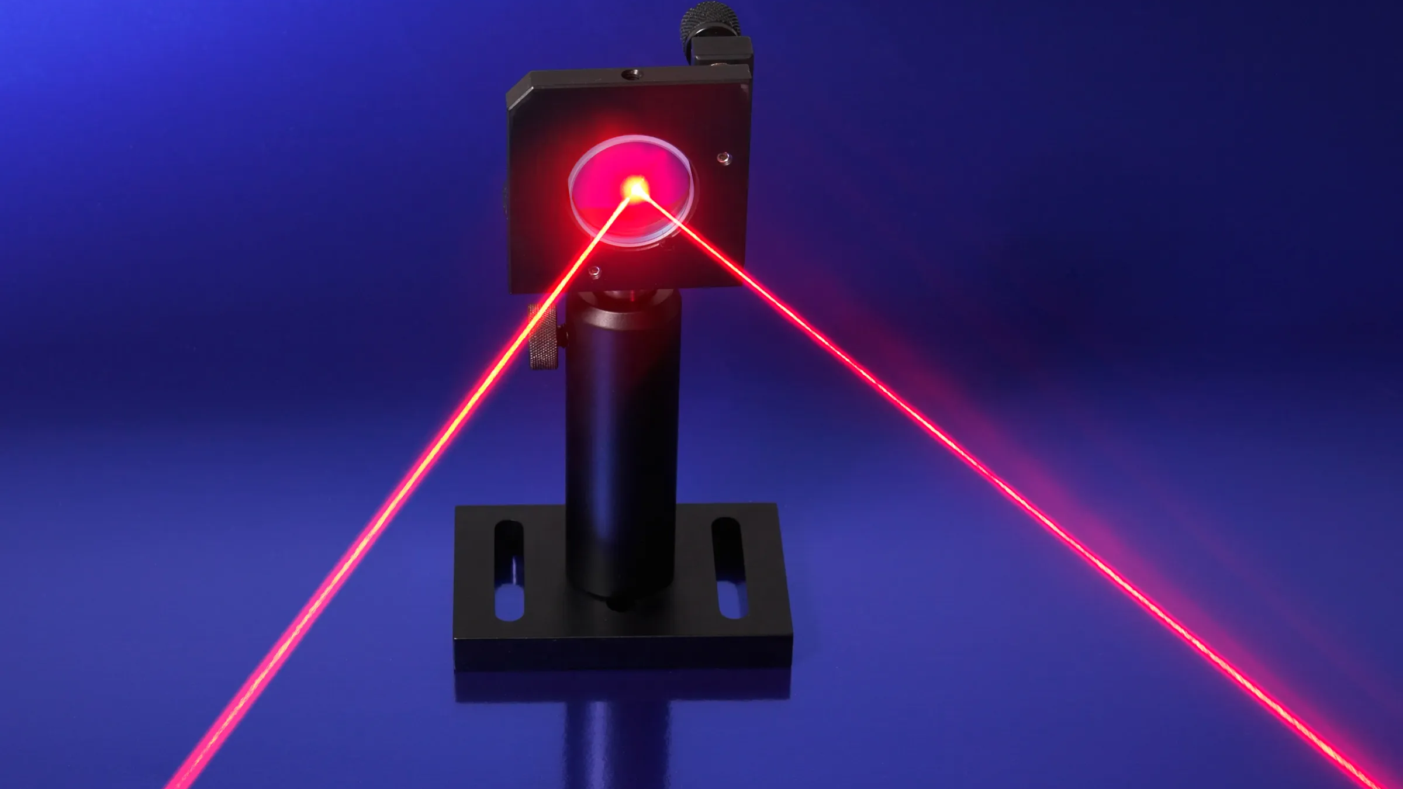
Why do we need to increase the control loop’s gain?

Slide 8
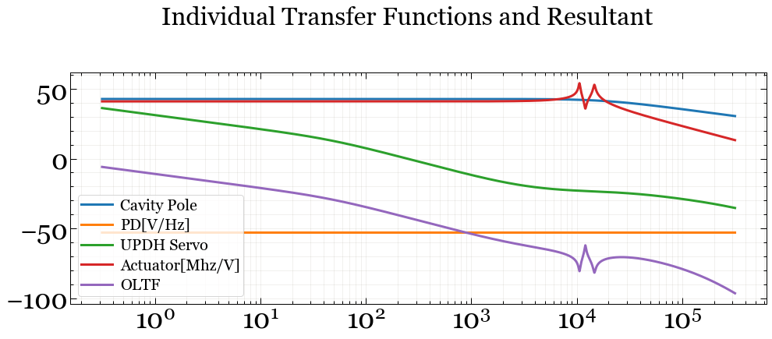
Frequency[Hz]

Slide 9
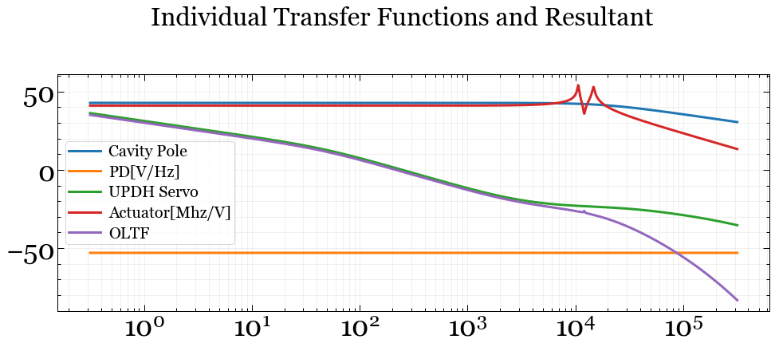
Frequency[Hz]

Slide 10
FUTURE WORK
Vectfit
Filters for control
Analysing loop stability

Slide 11
SUMMARY

Slide 12
THANK YOU
My mentors - Anchal Gupta, Francisco Salces-Carcoba, Rana Adhikari
Alan J Weinstein, LIGO and NSF
The lovely people at the 40m – Tega, Yehonathan, Yuta, and Jan Carlo!

Slide 13
References
Kiwamu Izumi, Koji Arai, Bryan Barr, Joseph Betzwieser, Aidan Brooks, Katrin Dahl, Suresh Doravari, Jennifer C. Driggers, W. Zach Korth, Haixing Miao, Jameson Rollins, Stephen Vass, David Yeaton-Massey, and Rana X. Adhikari, Multicolor cavity metrology, J. Opt. Soc. Am. A 29, 2092-2103 (2012)
Venugopalan, Gautam (2022) Prototype Interferometry in the Era of Gravitational Wave Astronomy. Dissertation (Ph.D.), California Institute of Technology. doi:10.7907/ttwp-1h12.
Karl Johan ˚Astr¨om, Richard M. Murray, Feedback Systems: An Introduction for Scientists and Engineers, Princeton University Press

