Slide 1
Gravitational-wave astronomy in the 2020s
Patrick Brady, LSC Spokesperson
University of Wisconsin-Milwaukee
EGO/Virgo
12 May 2022
https://dcc.ligo.org/G2200793
Notes:
Thank you for the invitation to give this talk. I acknowledge my collaborators in the LIGO-Virgo-KAGRA Collaboration and thank the National Science Foundation for financial support.

Slide 2
International Gravitational-Wave Observatory Network (IGWN)
The LIGO-Virgo-KAGRA Collaboration is an international team of more than 2000 scientists who work together to design, build and operate the international gravitational-wave observatory network.

Slide 3
Outline of my talk
Highlights of gravitational-wave observations 2015-2022
Detectors, sensitivity and observing runs
Compact binary detections, rates, and unique experiments
Searches for other gravitational-wave sources
The booming 20s
2022-2025
2025-2030
Next generation facilities
Einstein Telescope and Cosmic Explorer

Slide 4
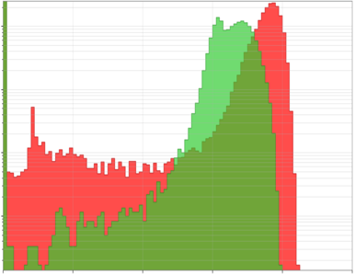
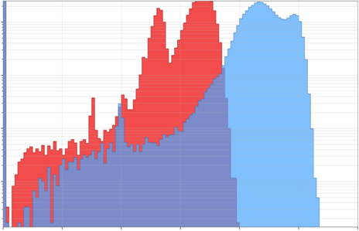
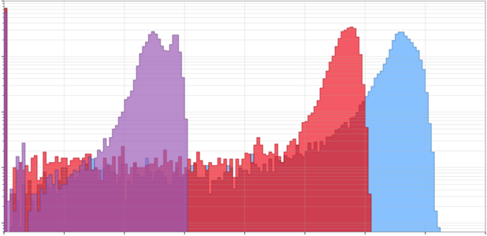
Observing runs
O1
L1
H1
H1 – LIGO Hanford
L1 – LIGO Livingston
V1 – Virgo
O2
H1
L1
Total Duration at Sensitive Distance (relative)
V1
O3
V1
H1
L1
GW170817
GW150914
Public Alerts
0
20
40
60
80
100
120
140
160
Angle Averaged Binary Neutron Star Inspiral Range

Slide 5
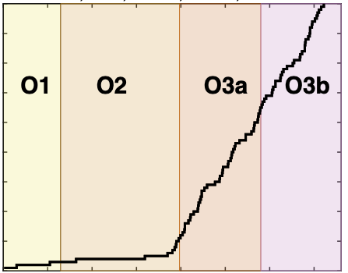
Sensitivity & detections
80
70
60
50
Credit: LIGO-Virgo-KAGRA Collaborations
(LIGO-G2102395)
Cumulative detections
40
30
20
10
100
300
500
700
Time (days)
O3 binary detection rate ~ 1 / (5 days)

Slide 6
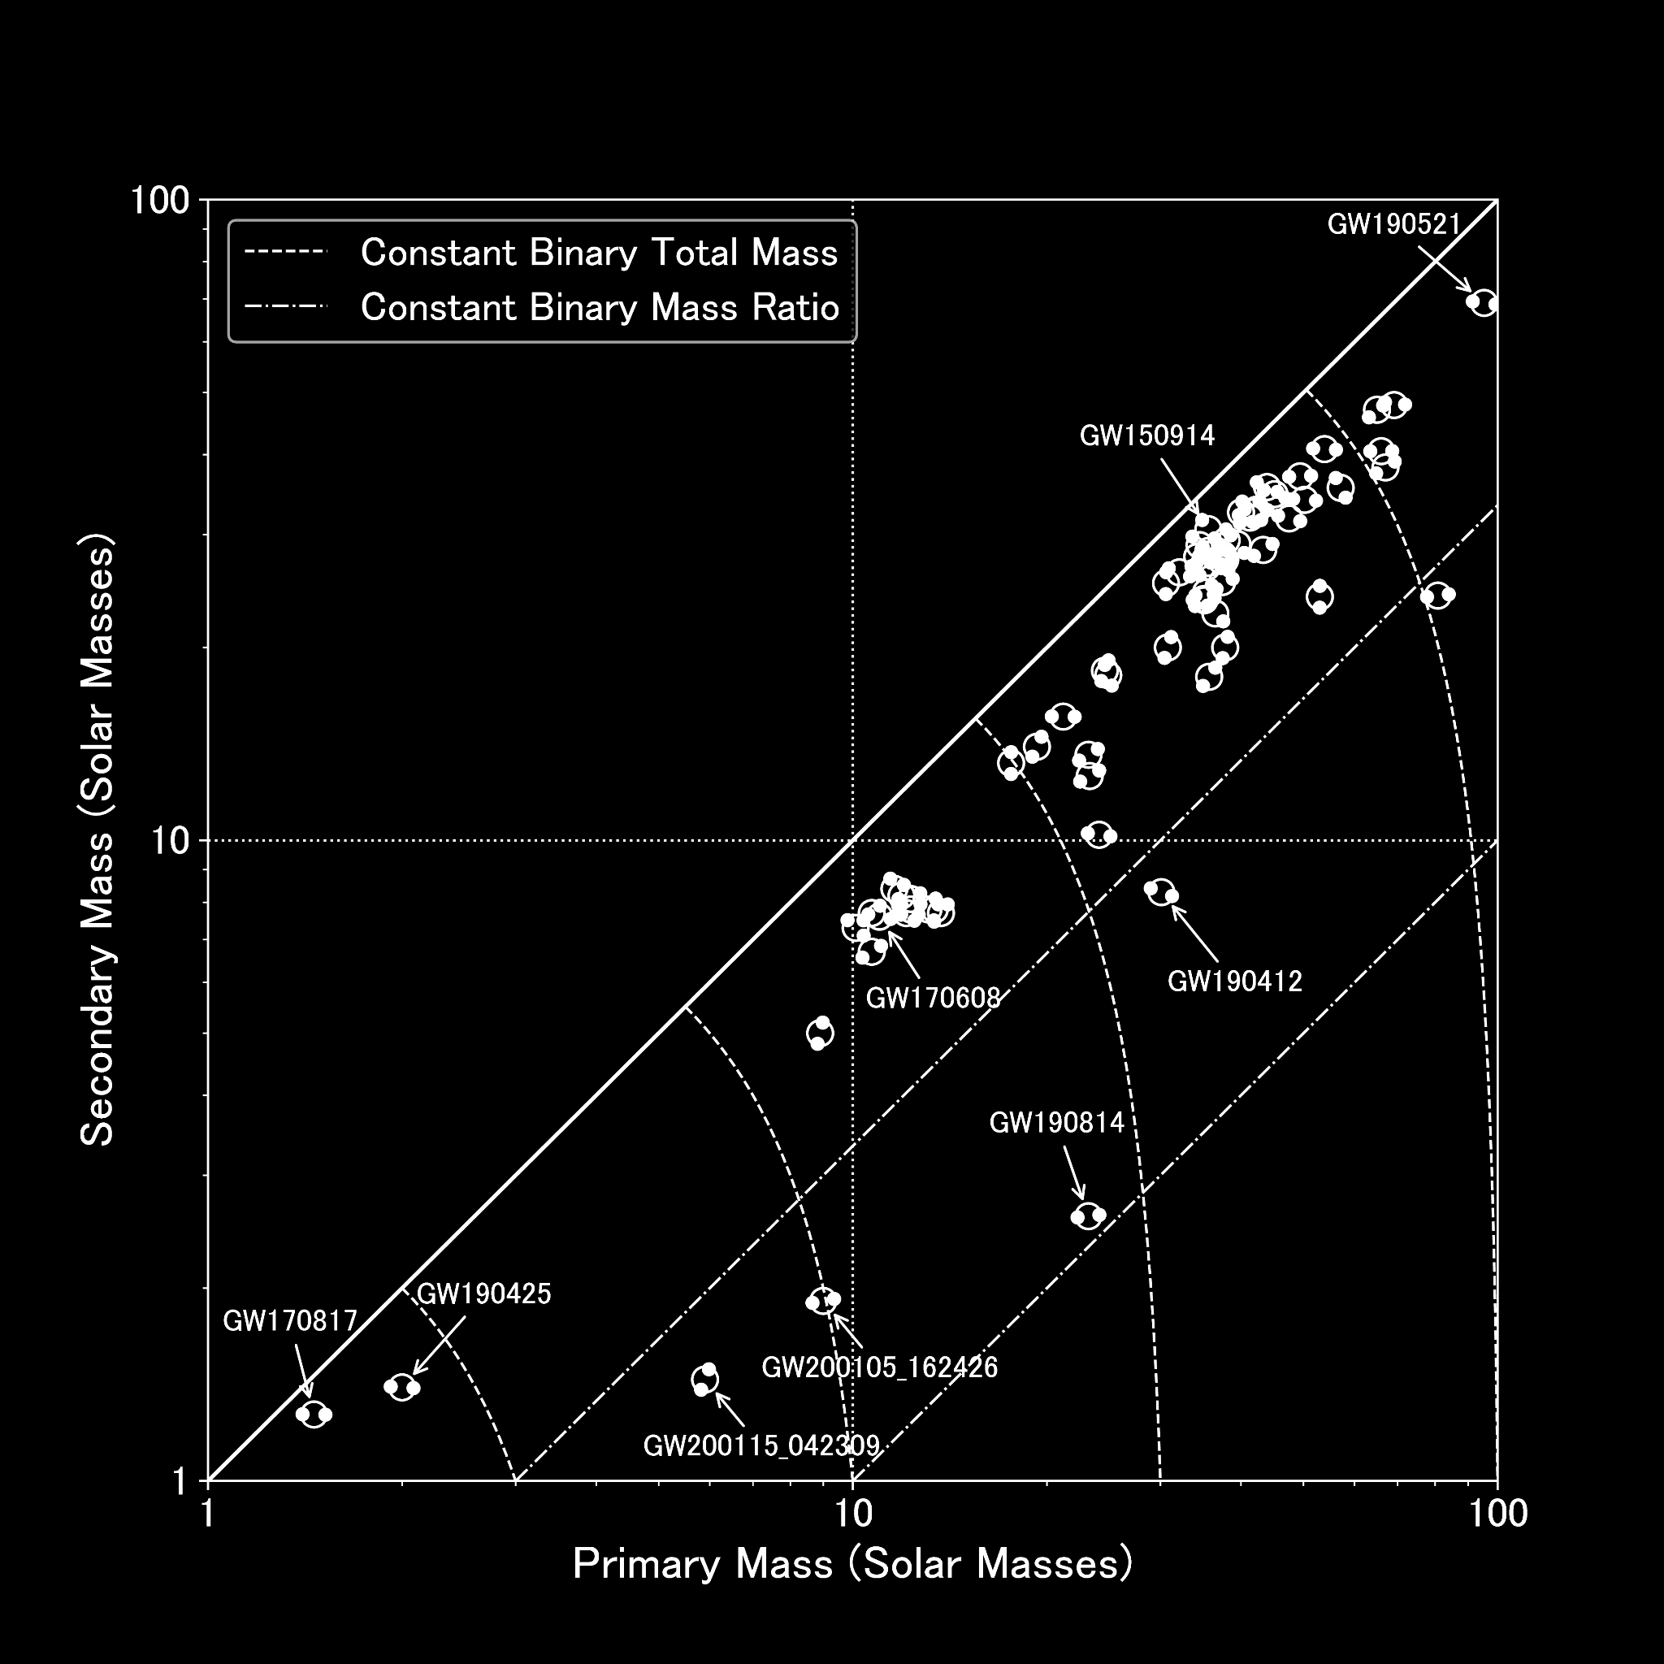
Firsts
GW150914
First astrophysical source
Binary black holes exist
GW170817
Binary neutron star mergers are gamma-ray burst progenitors
GW190521
Black holes exist in pair instability mass gap
GW190814
Compact objects exist with masses between 2-5 Msun
Credit: LIGO-Virgo-KAGRA Collaborations

Slide 7
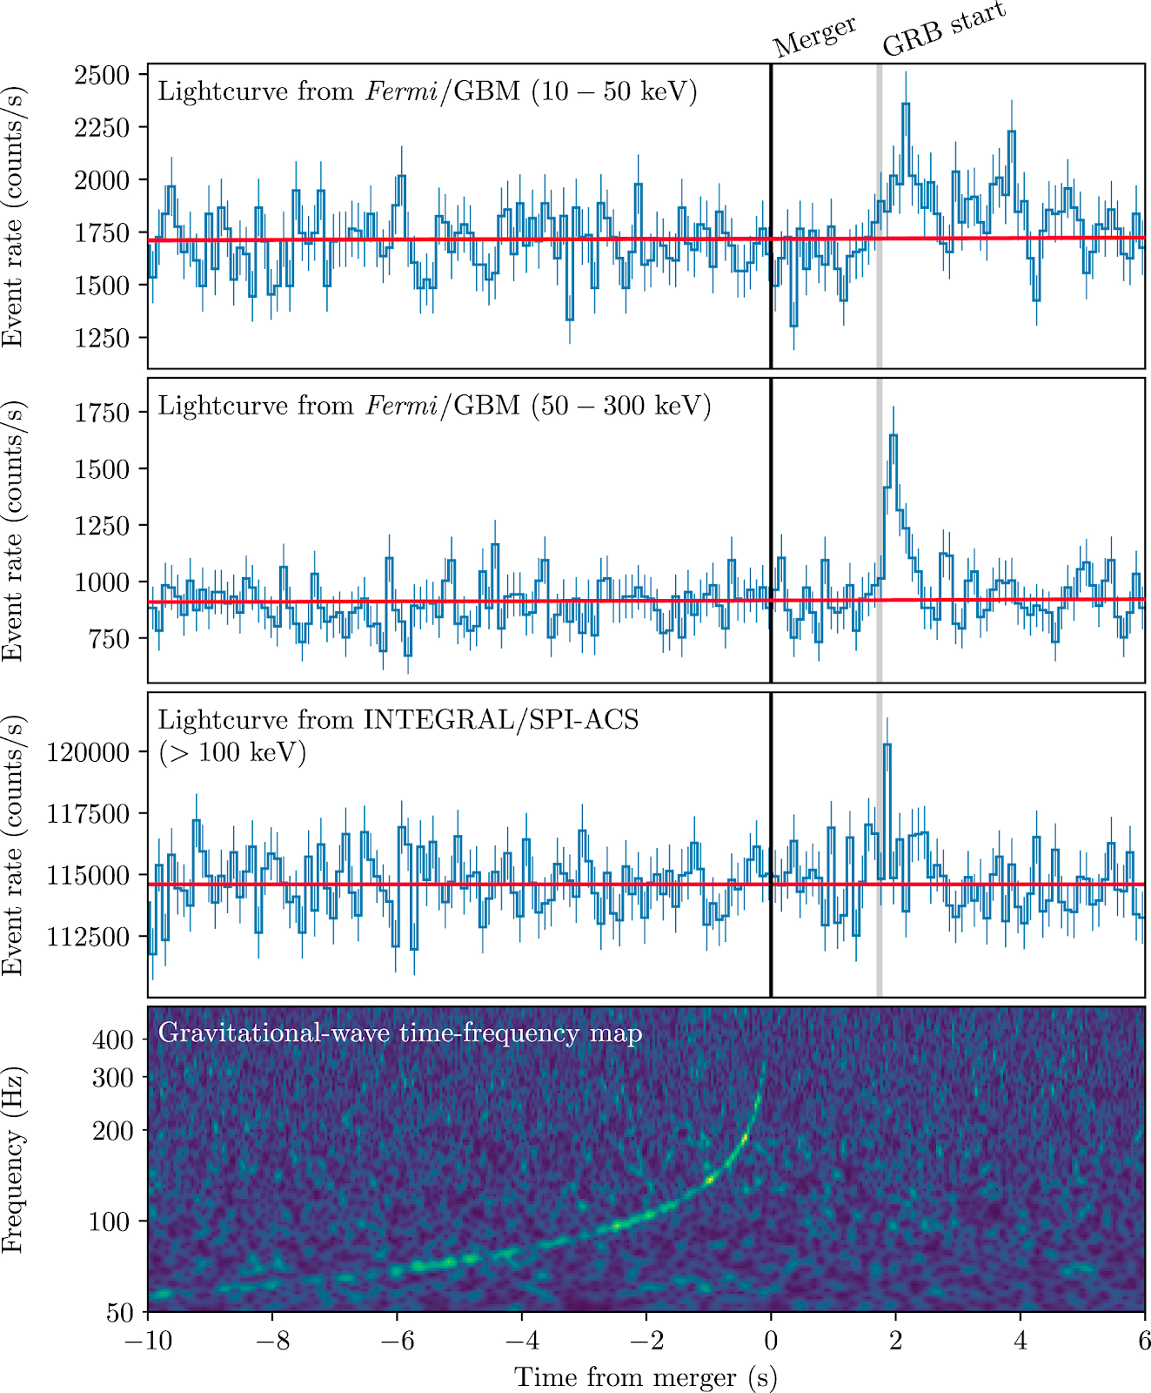
First BNS-GRB association ….
GW170817 & GRB 170817A
Fractional difference in speed of gravity and the speed of light is between -3 x 10⁻¹⁵ and 7 x 10⁻¹⁶
GW170817 & AT 2017gfo
Binary neutron star mergers produce kilonova explosions that generate heavy elements
B. P. Abbott et al 2017 ApJL 848 L13

Slide 8
First neutron-star black hole mergers
R. Abbott et al 2021 ApJL 915 L5

Slide 9
Masses in the stellar graveyard

Slide 10
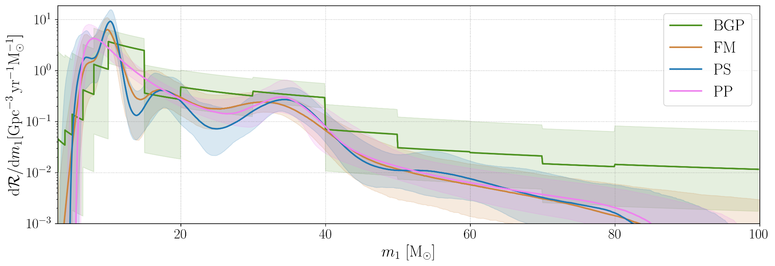
From one to many: measuring populations
R Abbott et al. https://arxiv.org/abs/2111.03634
Merger rate density as a function of primary mass using 3 non-parametric models compared to the power-law+peak (pp) model.
Notes:
Power law + peak (pp), BGP binned gaussian process, FM flexible mixtures, PS power-law + spline

Slide 11
Testing GW generation with BBH
Look for deviations in the phasing coefficients of a 3.5PN TaylorF2 phase:
B P Abbott et al. arXiv:2112.06861

Slide 12
Testing modified dispersion
Gravitational waves in GR propagate non-dispersively at the speed of light.
Some modified theories (massive graviton theories, Lorentz-violating theories) predict dispersion of GWs.
Dispersion => different frequency components of the wave travel at different speeds leading to an effective dephasing of the GW signal which can be measured
E² = p²c² + A_{j}p^{j}c^{j}
Mirshekari et al. PRD 85, 024041, 2012, Clifford. M. Will PRD 57, 2061, 1998
Bound on A₀ is equivalent to bound on the mass of the graviton.

Slide 13
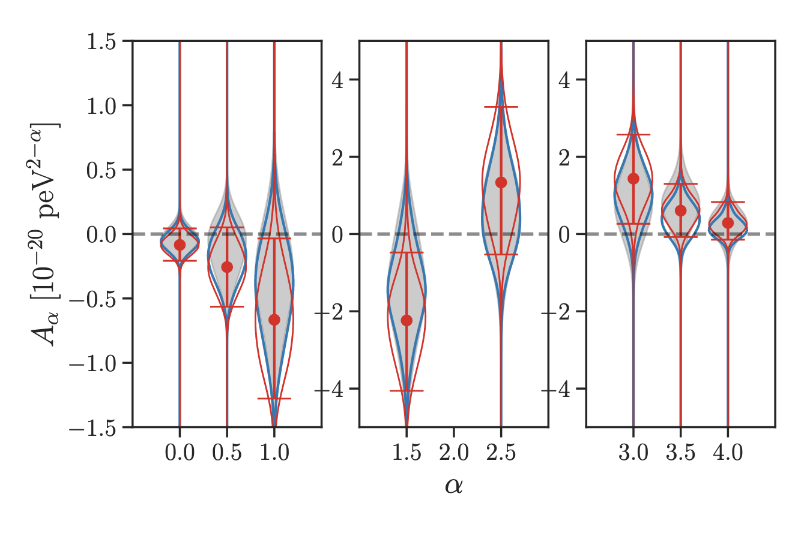
Testing modified dispersion
Red violin plots show the combined posteriors of the parameter Aɑ calculated from the GWTC-3 events
Error bars denote 90% credible intervals.
The gray shaded area are the combined posteriors corresponding to GWTC-2
B P Abbott et al. arXiv:2112.06861
Notes:
Blueafter excluding the events GW200219 094415 and
GW200225 060421 using blue violin plots.

Slide 14
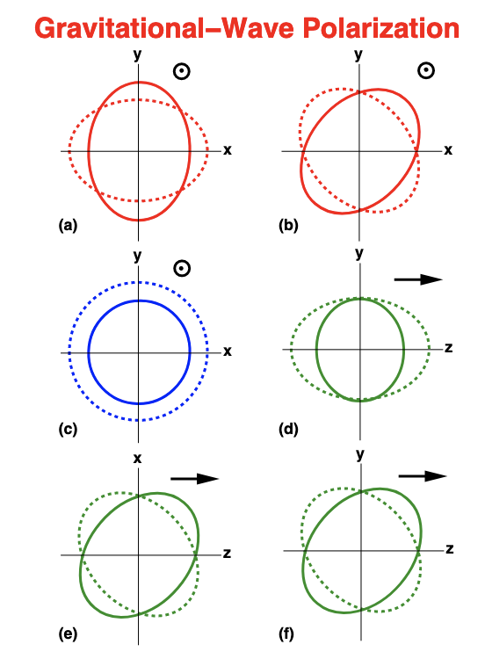
Other tests
Polarization: general metric theory allows 6 polarization modes; each detector gives one additional mode; search null-stream for residuals.
No evidence in favour of non-GR polarization hypotheses
Spin induced quadrupole: self spinning effects of compact objects lead to spin-induced deformations that imprint on the GW as 2 PN effects; search for deviations for GR for BBH
Found to be consistent with Kerr black holes for BBH candidates
B P Abbott et al. arXiv:2112.06861
C. M. Will, Living Rev. Relativity 17, 2014

Slide 15
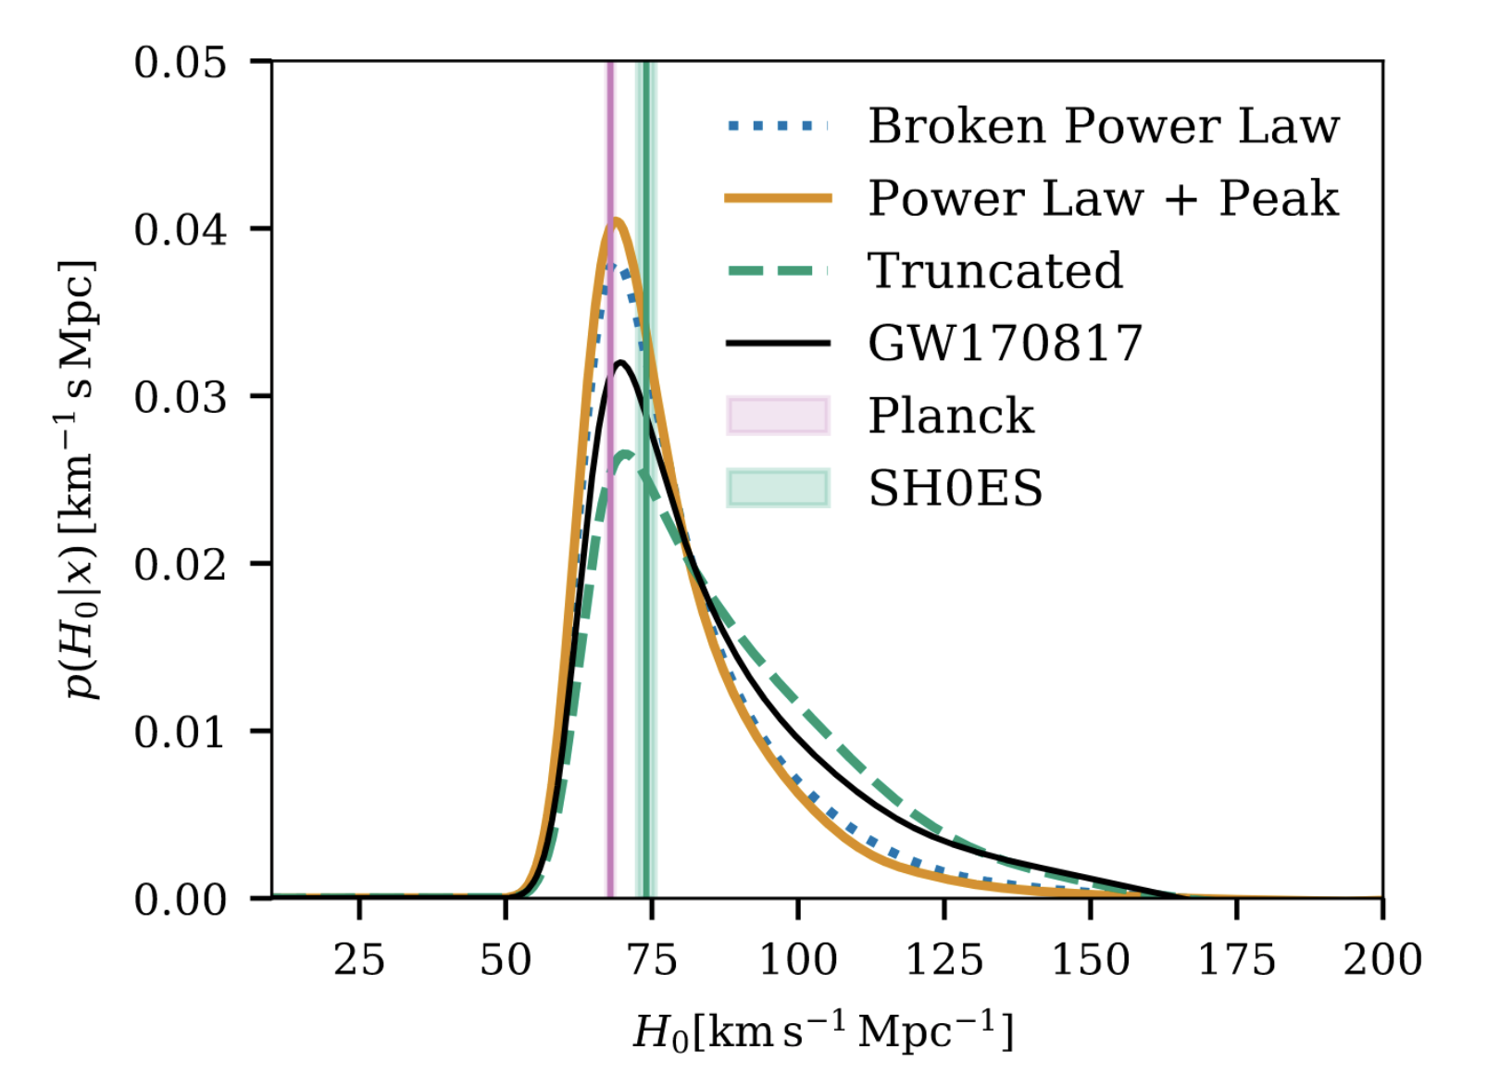
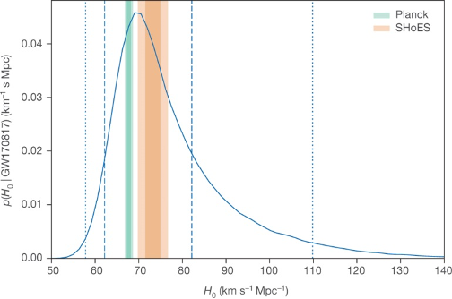
Cosmology with gravitational waves
B P Abbott et al. Nature 551, 85–88 (2017) doi:10.1038/nature24471
R Abbott et al. arXiv:2111.03604
(2021)
GW170817 + AT 2017gfo

Slide 16
Looking forward to O4
O4 expected to start 15 Dec 2022
~11 months later than expected
COVID caused delays due to site closures & supply chain issues
Weather & unanticipated problems caused further delays
Duration of O4 is under consideration
Baseline is 1 year with 1 month commissioning break
Could extend the run if scheduling makes that viable

Slide 17
Planned instrumental upgrades for O4
LIGO, Virgo and KAGRA have been doing major work
Here, I summarize the LIGO activities.
See https://youtu.be/Ut7Ef5AiA_M for more details about all of the detectors.
LIGO planned major upgrades from O3 to O4:
New laser amplifier (improve high-frequency sensitivity)
Point absorber free test masses (improve high-frequency sensitivity)
Frequency dependent squeezing (FDS) (improve broadband sensitivity)
Adaptive mode matching (improve broadband sensitivity)
Low-loss faraday isolator (improve broadband sensitivity)
Stray light baffles (improve low frequency sensitivity)
LIGO target for O4: 190Mpc BNS range
Backup plan, if necessary, is to descope FDS with target 165Mpc BNS range

Slide 18
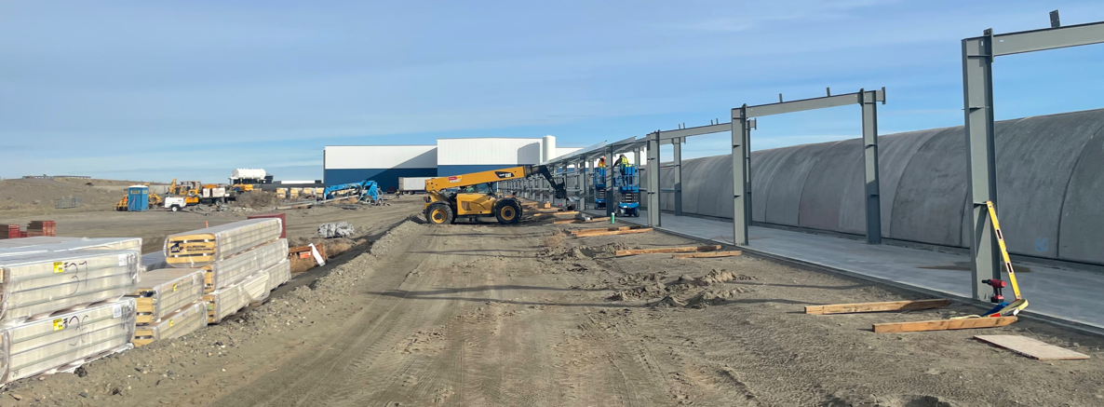
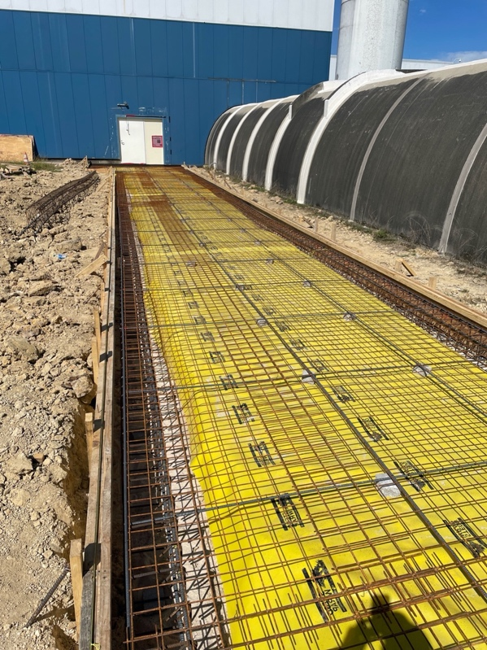
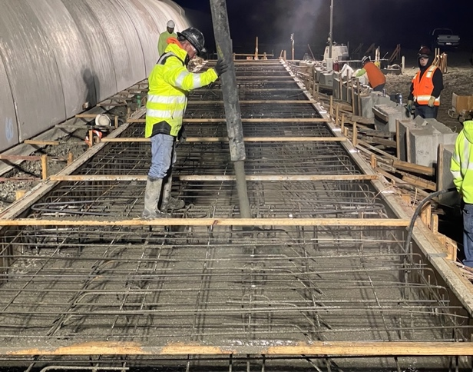
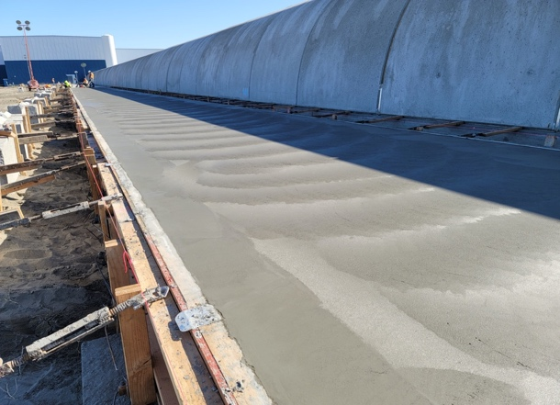
Construction for the filter cavity
Thanks to Dave Reitze, LIGO Lab

Slide 19
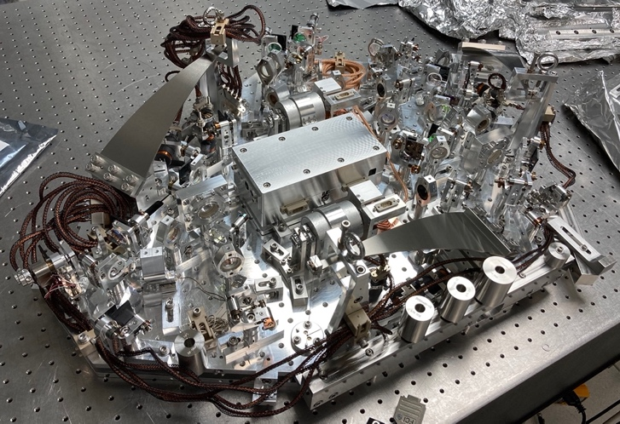
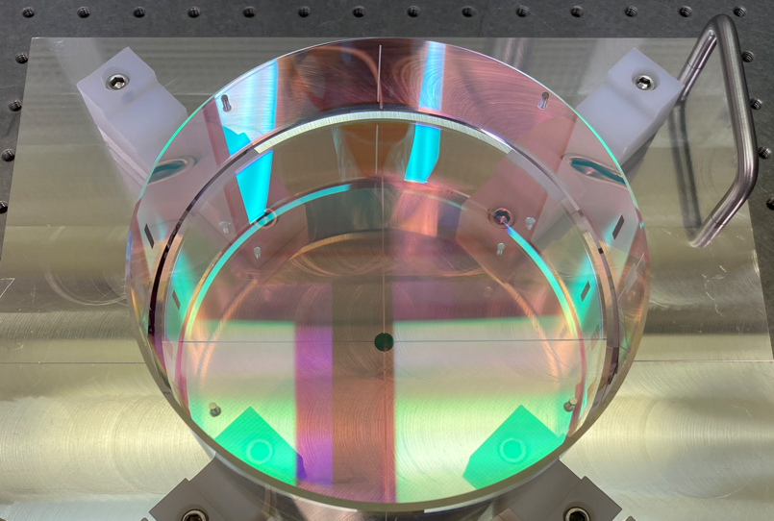
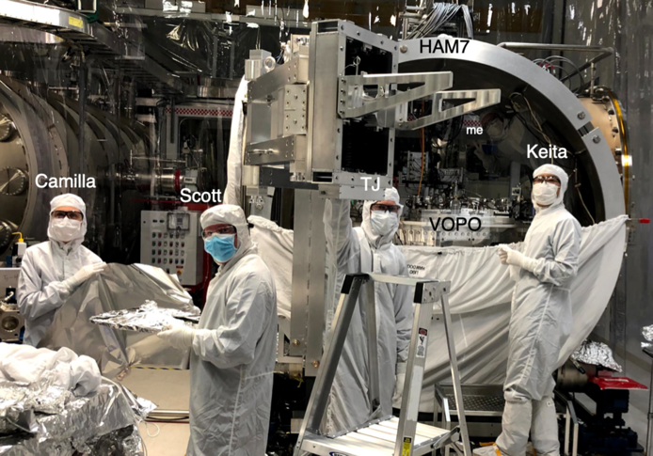
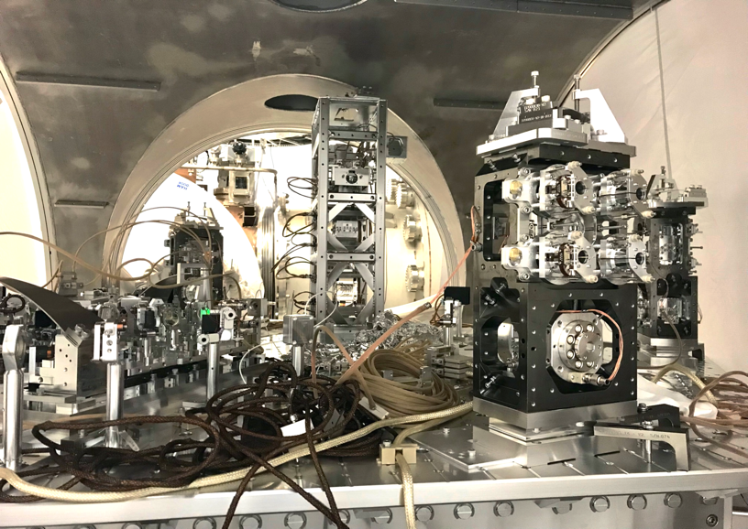
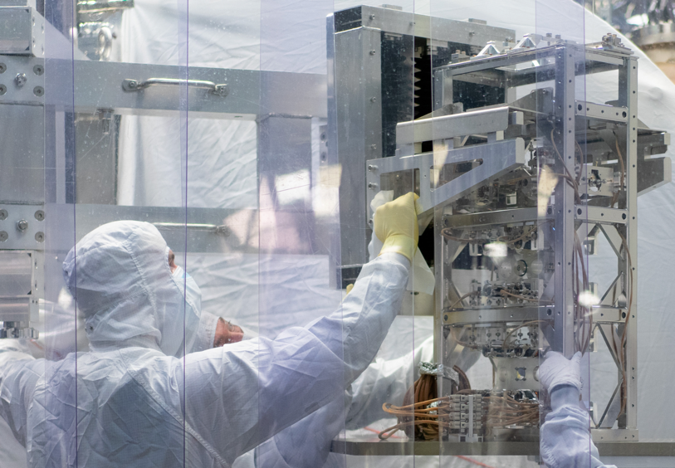
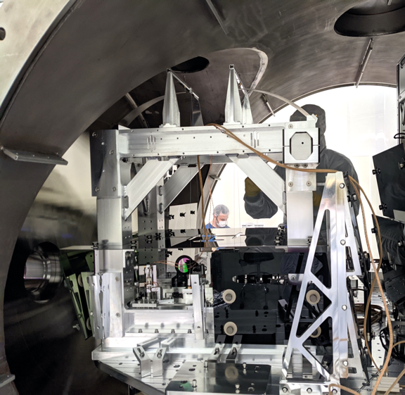
O4 LIGO detector upgrades
Thanks to Dave Reitze, LIGO Lab
wqe
Vacuum Optical Parametric
Oscillator (VOPO)
Filter Cavity Input Mirror
VOPO Installation at Hanford
Filter Cavity Injection Optics
Low Loss Faraday Isolator
Suspension Installation at Hanford

Slide 20
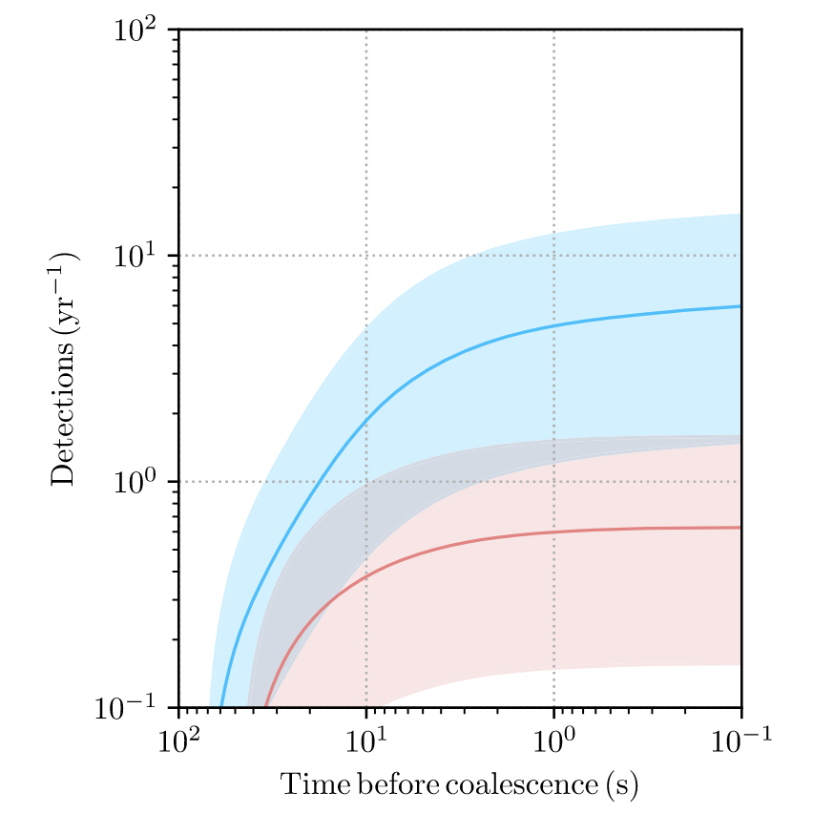
Impact of LVK upgrades on observations
Predicted O4 BNS Detections
Binary detection rates
O3 ~ 1 / 5 days
O4 ~ 1 / 2 days
Improved public alerts
Localization
Classification
Latency
Other science
Improved SNR
Discovery space
New sources?
Ryan Magee et al
2021 ApJL 910 L21

Slide 21
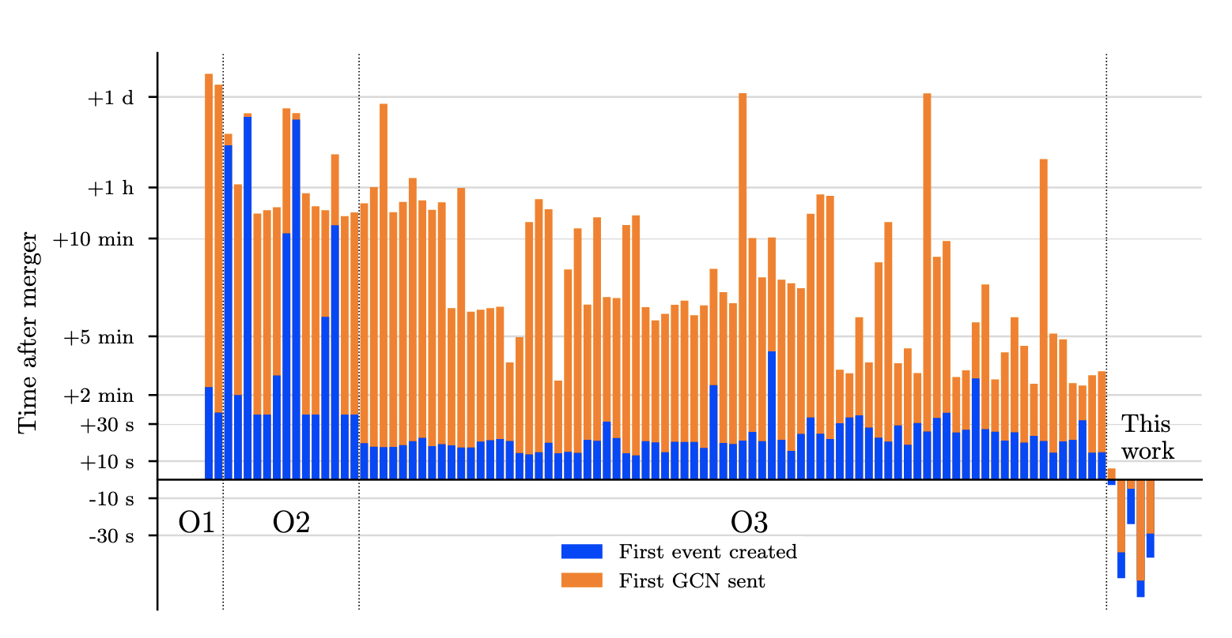
Improvements in cyberinfrastructure
Ryan Magee et al
2021 ApJL 910 L21

Slide 22
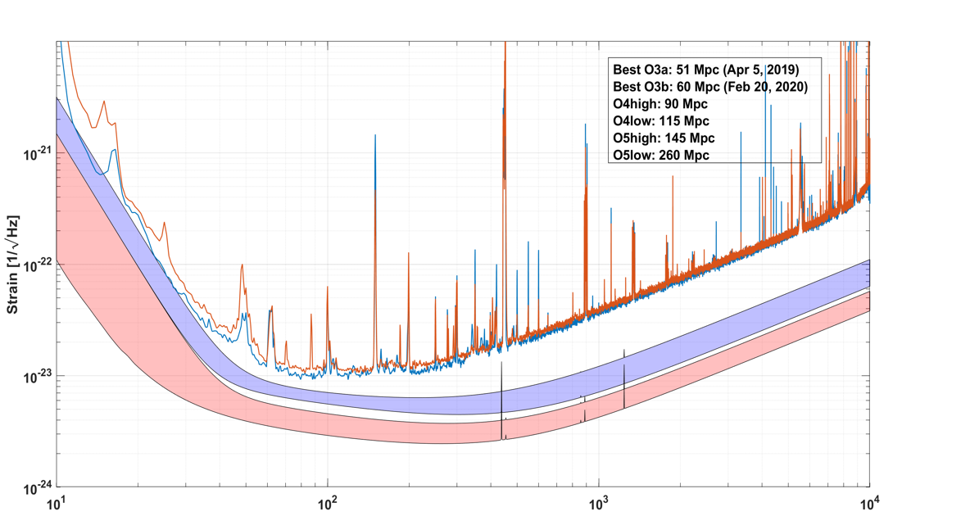
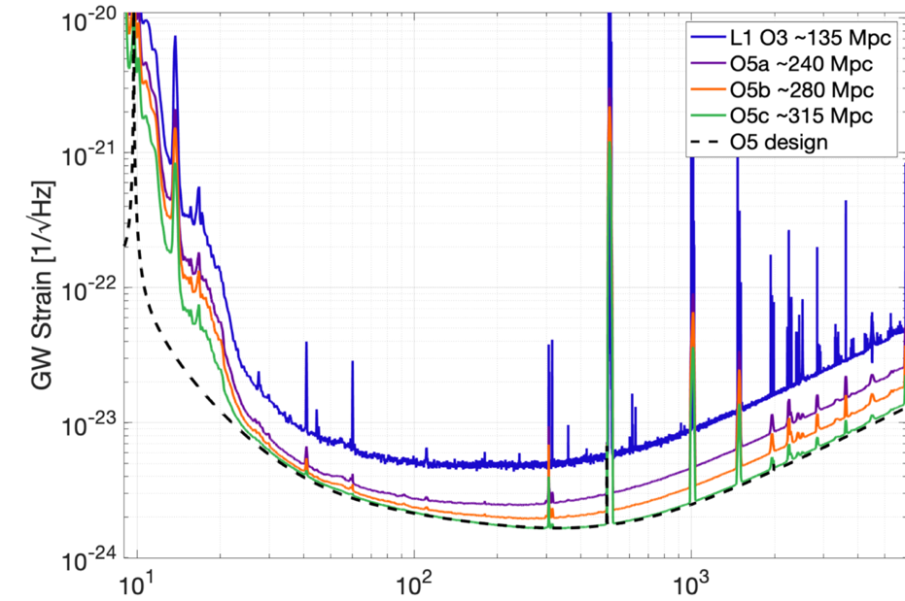
Working toward O5 sensitivity
Thanks to Dave Reitze & Giovanni Losurdo
Advanced LIGO A+
Advanced Virgo+
Frequency (Hz)
Frequency (Hz)
KAGRA will continue to work towards 130Mpc goal in O5

Slide 23
O5 Observing Run
Current thinking
Start is paced by upgrades after O4
1.5-2 years needed.
Intersperse commissioning and observations
Binary detection rates
O3 ~ 1 / 5 days
O4 ~ 1 / 2 days
O5 ~ 3 / day
Other science
Improved SNR
New sources?

Slide 24
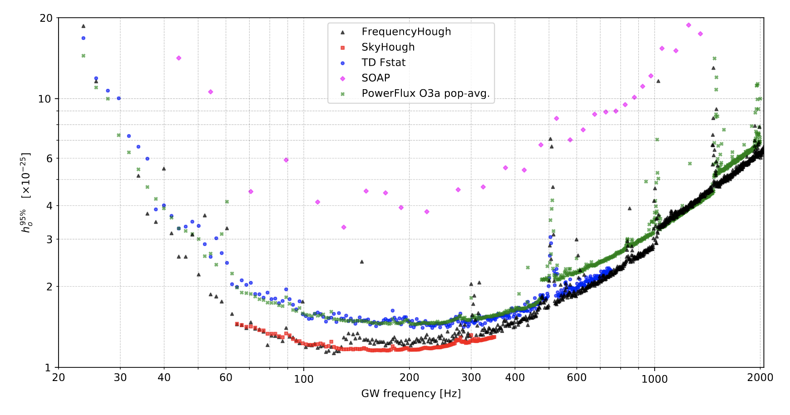
Continuous wave searches
R Abbott et al. arXiv:2201.00697 (2022)
h₀^{95%} [x 10⁻²⁵]
GW Frequency (Hz)

Slide 25
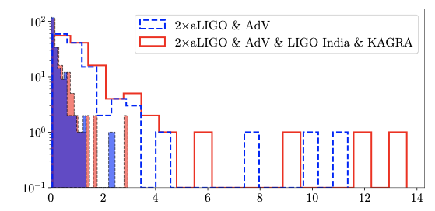
GW from pulsars
Pitkin et al, Ap. J. Lett 863, 2, L40 (2018)
SNR
Solid: ellipticity 1e-9
Empty: gravitar

Slide 26
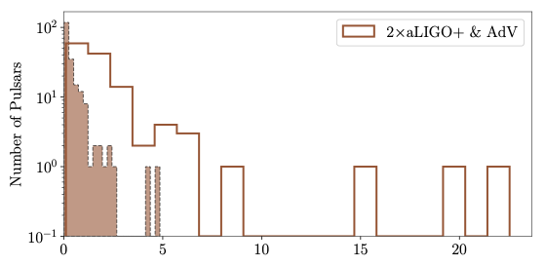
GW from pulsars
Pitkin et al, Ap. J. Lett 863, 2, L40 (2018)
SNR

Slide 27
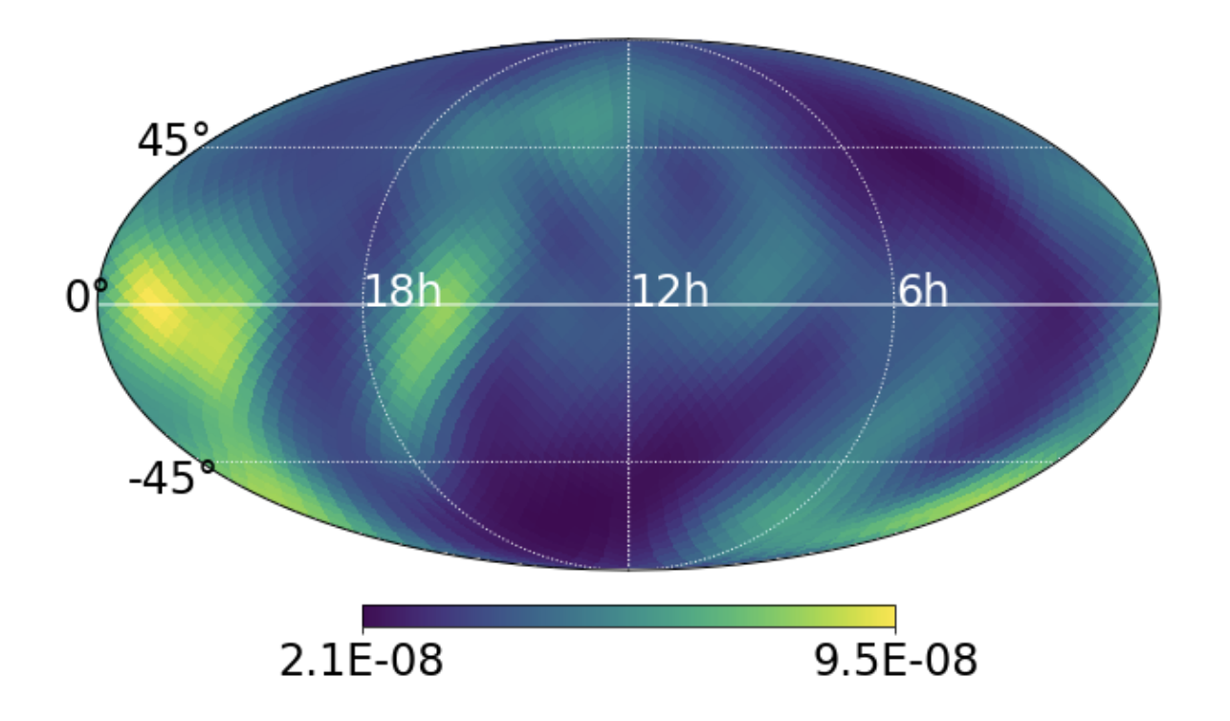
Stochastic background searches
R Abbott et al. arXiv:2110.09834 (2021)

Slide 28
Isotropic GW Background
LVC, Phys. Rev. D 104, 022004 (2021)

Slide 29
Post-O5 planning
The LVK is committed to continued observations beyond 2028 (contingent on continued funding of the observatories).
Work is underway to scope detector upgrade options and observing strategies for after O5.
Plans will be developed and refined, with community input, over the next couple of years.
LIGO is exploring:
LIGO Voyager upgrade to cryogenic detectors with silicon test masses and other modifications.
Or a path that makes a series of incremental modifications targeted to deliver specific sensitivity benefits
Considerations included readiness/technical risk, cost, impact on observing time and how the program would dovetail with the implementation of Cosmic Explorer

Slide 30
Next Generation Facilities

Slide 31
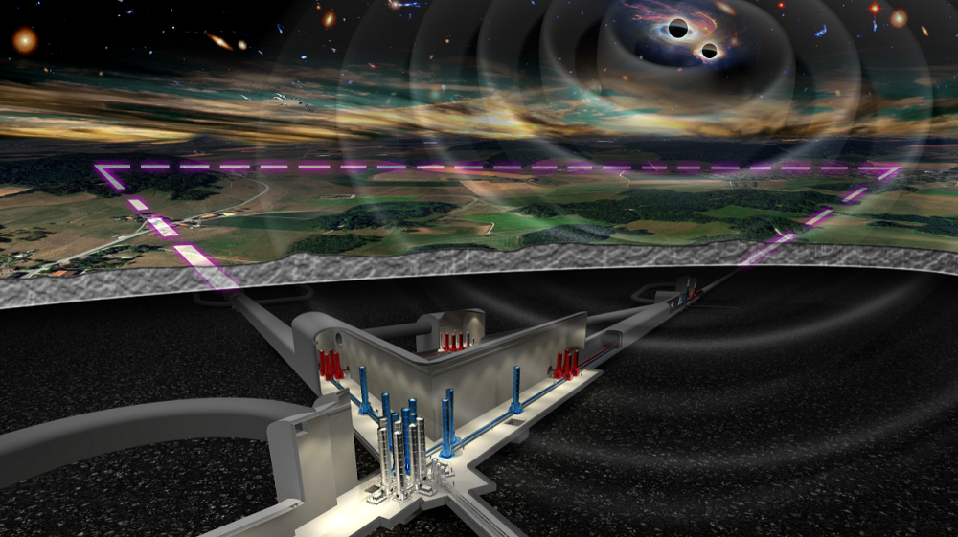
Einstein Telescope
Proposed underground facility in Europe
10km arms, cryogenic optics, triangular configuration
ET is on the European Strategy Forum on Research Infrastructures (ESFRI) 2021 roadmap

Slide 32
Cosmic Explorer
Proposed above ground facility in the US
Two 40km orthogonal arms using mature technology from current ground-based detectors
Cosmic Explorer Horizon Study
Released in October 2021
DAWN VI Workshop
“There was a consensus that Cosmic Explorer is a concept that can deliver the promised science. A strong endorsement of Cosmic Explorer, as described in the CE Horizon Study, is a primary outcome of DAWN VI."
https://arxiv.org/abs/2109.09882

Slide 33
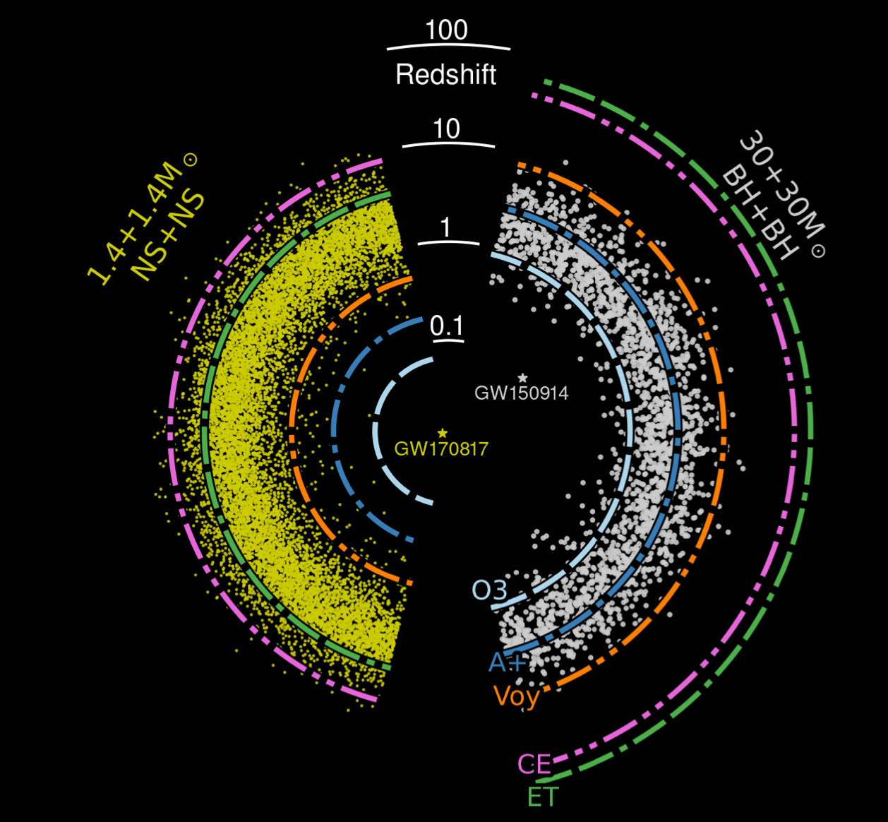
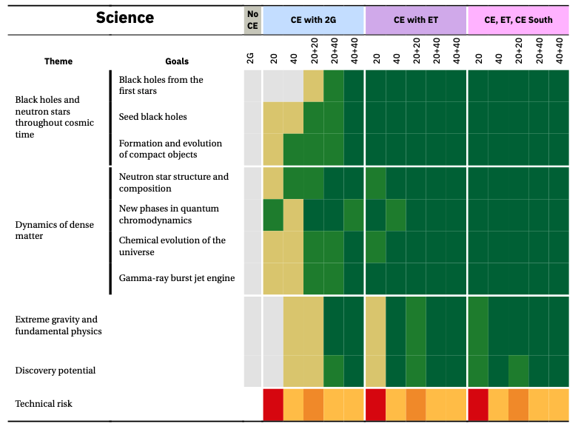
Cosmic Explorer Science Reach
A Horizon Study for Cosmic Explorer
https://arxiv.org/abs/2109.09882

Slide 34
Thank you!

