Slide 1
LVK and LHO status
Georgia Mansell
On behalf of LIGO lab and the entire LVK (!)

Slide 2
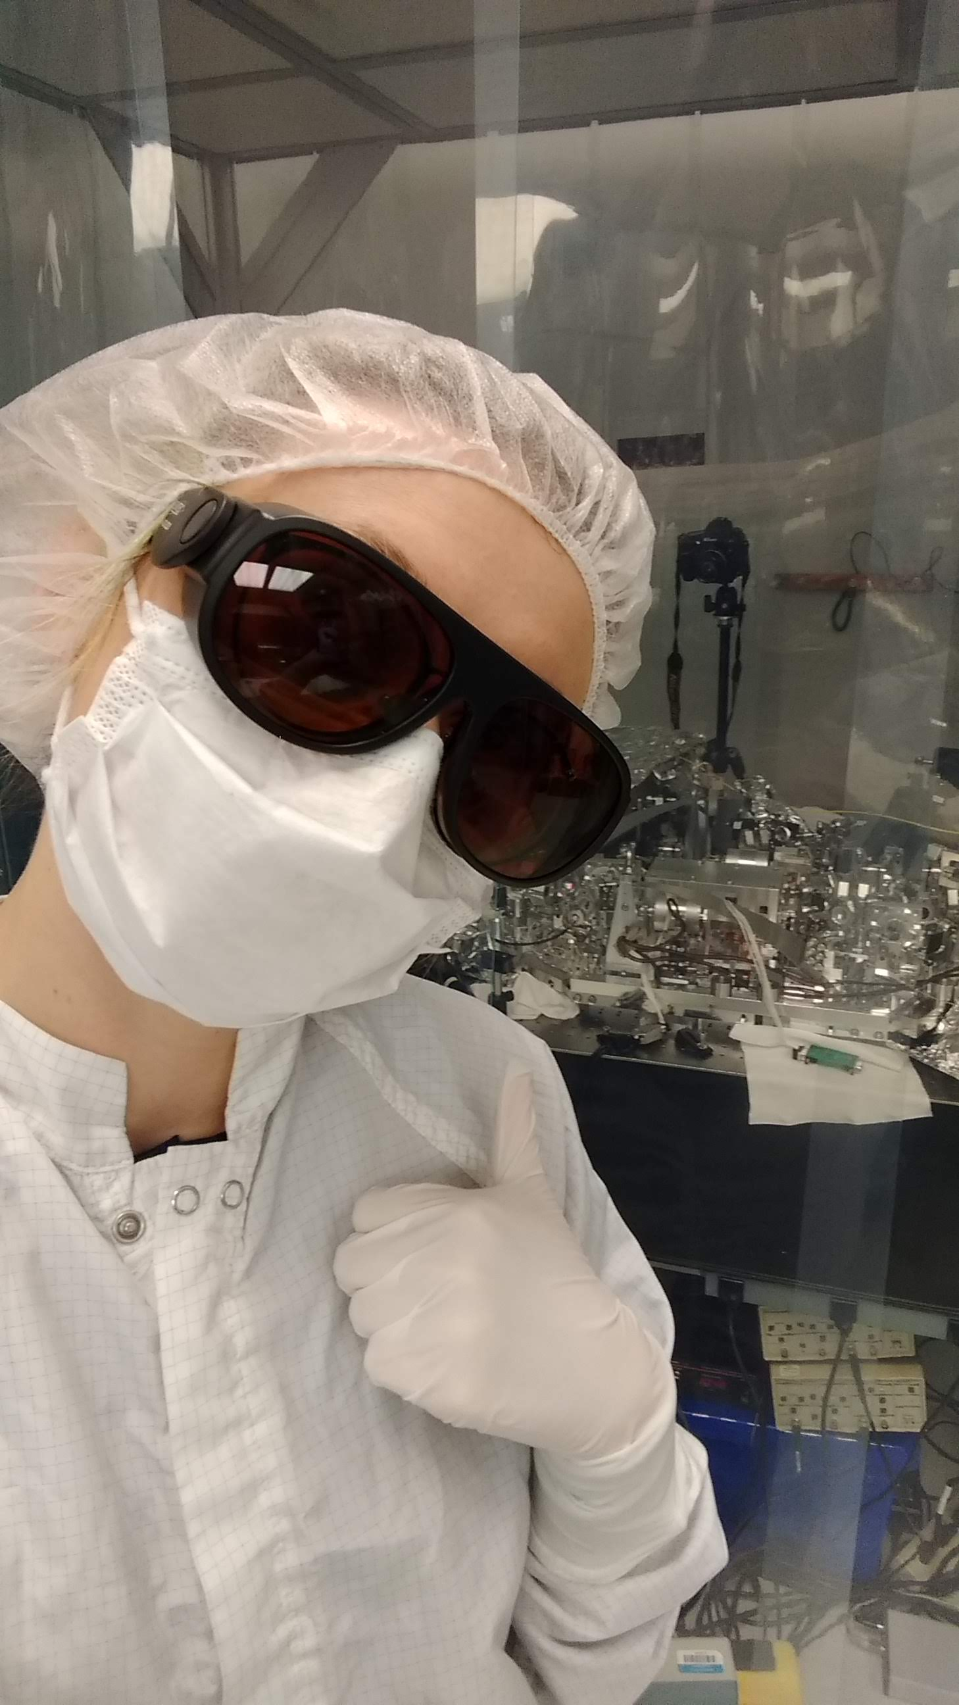
About me!
Post doc at LIGO Hanford and MIT since 2018
PhD at Australian National University in squeezed light
Undergrad at Adelaide University
My work focuses on gravitational-wave detector instrumentation
Commissioning the aLIGO detectors in the run up to observing runs
This talk will have an instrumentation focus!!

Slide 3
Overview
Recent collaboration publications
Frequency dependent squeezing!
Status of LIGO, Virgo, Kagra
New faces and farewells at LHO
LHO site status
Pre-O4 commissioning summary
LIGO-Virgo-Kagra collaboration overview
LIGO Hanford observatory overview

Slide 4
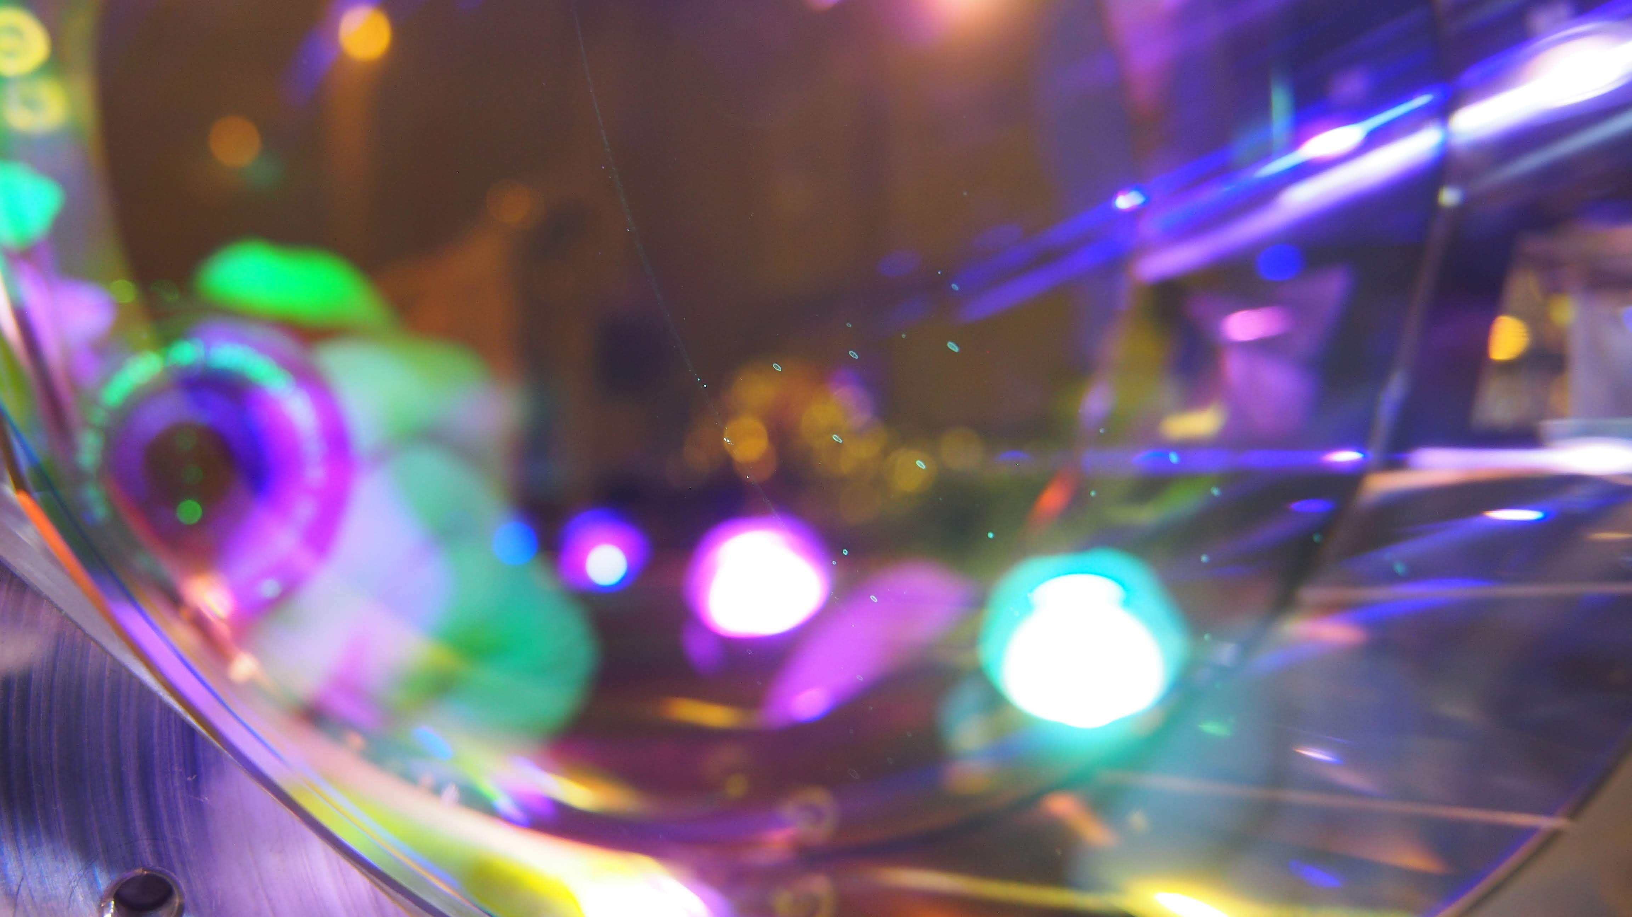
Status of the LVK
ETMY cleaning at Kagra – klog 17271

Slide 5
LVK update – recent publications
Publication list with handy science summaries https://pnp.ligo.org/ppcomm/Papers.html
Today! NSBH announcement
Two NSBH events found in the O3 data
GW200105
Signal seen in 2 detectors, lower significance
8.9 M☉ + 1.9 M☉
900 million years ago!
GW200115
Triple detector discovery, high significance
5.7 M☉ + 1.5 M☉
1 billion years ago!

Slide 6
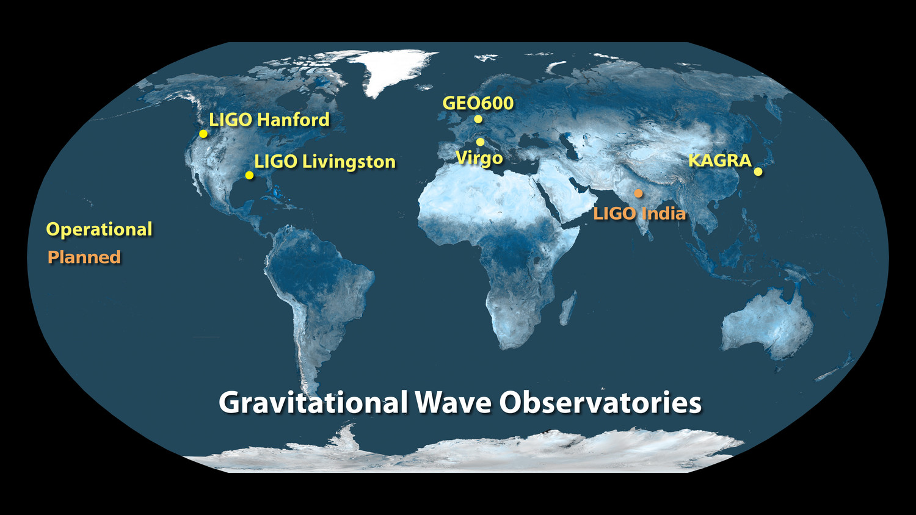
Status of LVK
Covid restrictions are lifting, and we’re preparing for O4!
O4 scheduled start date >July 2022
Aim: aLIGO 160 – 190 Mpc, AdV 90 – 120 Mpc, KAGRA 25 – 130 Mpc
Frequency-dependent squeezing install at LIGO and Virgo sites
Major facility upgrade!
New optics
Elaborate additional controls
Many many other upgrades at each site!

Slide 7
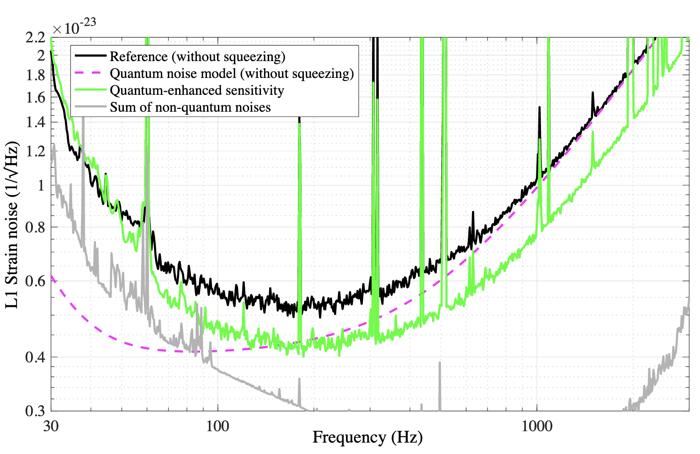
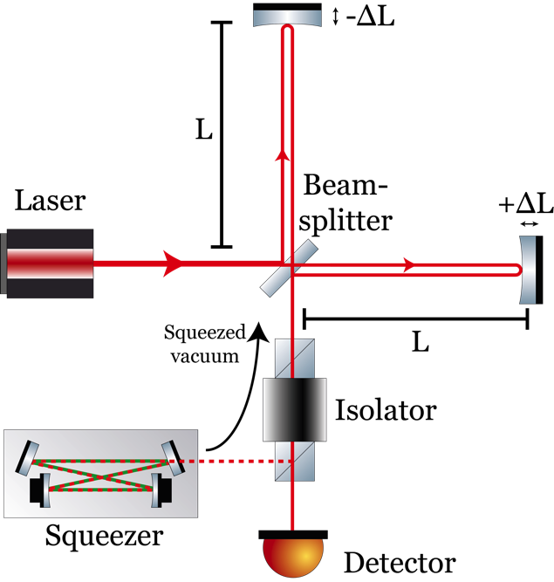
Frequency-dependent squeezing in a nutshell
Side note!
1/3
In O3 both the LIGO and Virgo detectors injected squeezed light
This made quantum noise better at high frequency and worse at low frequency
Tse, 2019, Phys. Rev. Lett. 123, 231107

Slide 8
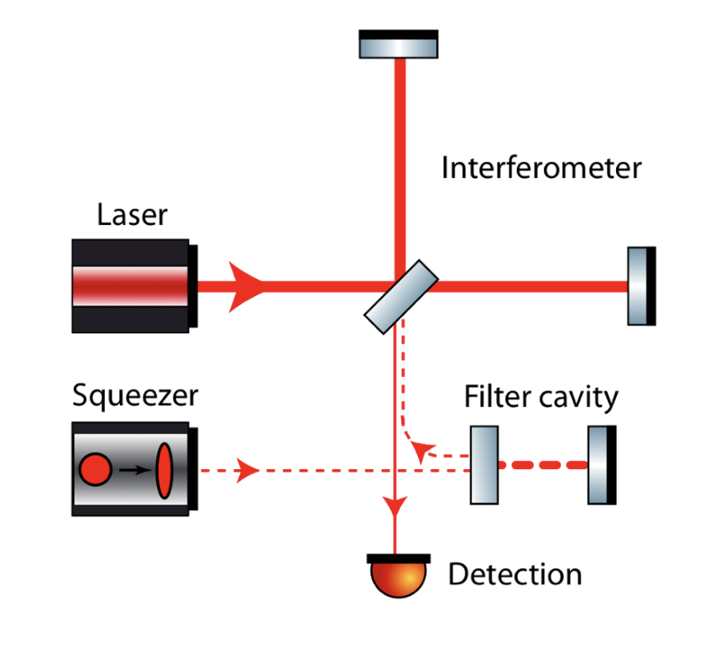
Frequency-dependent squeezing in a nutshell
Side note!
2/3
For O4 we want broadband improvement – frequency dependent squeezing
To achieve this, we need to reflect our squeezed beam off a high-finesse optical cavity before sending it into the interferometer
Isogai, G1500727

Slide 9
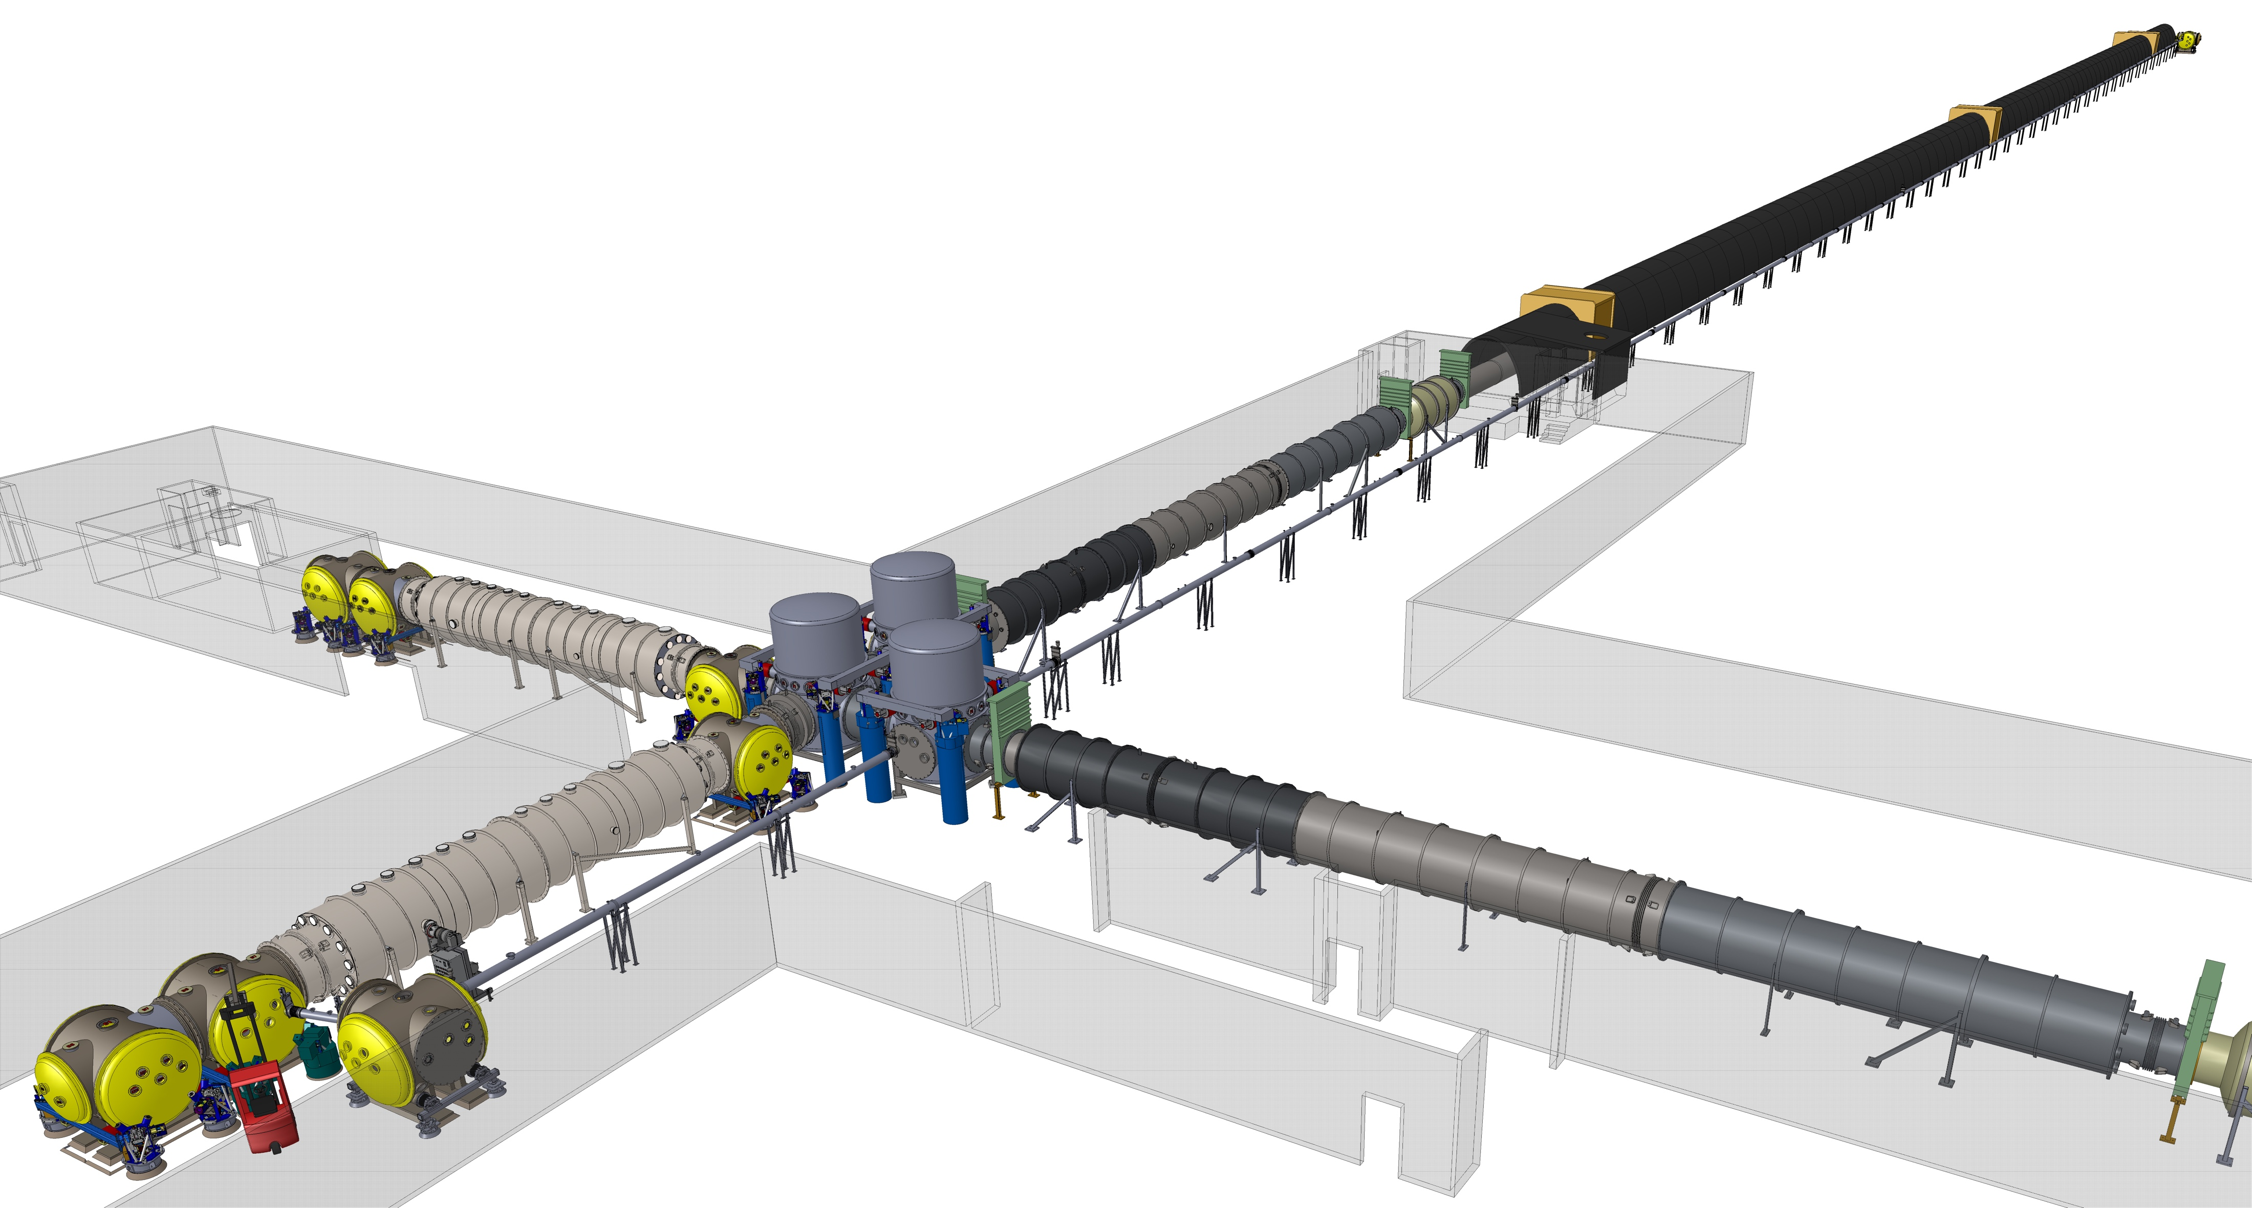
Both LIGO and Virgo are installing 300 m long filter cavities!
FC2
Y arm
Side note!
3/3
X arm
FC1
Eddie Sanchez
G1900621

Slide 10
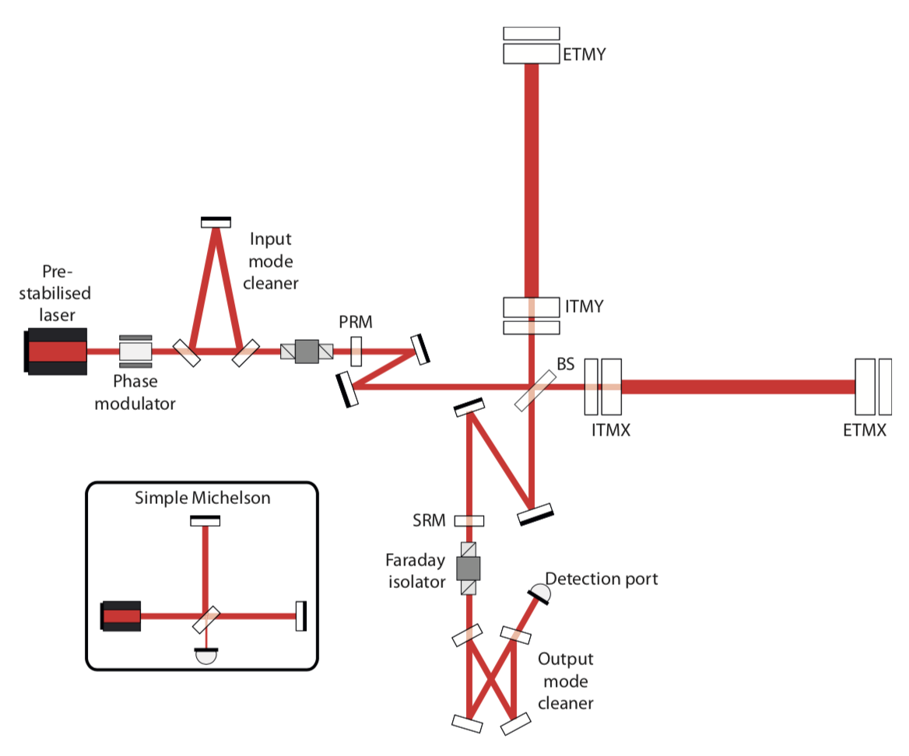
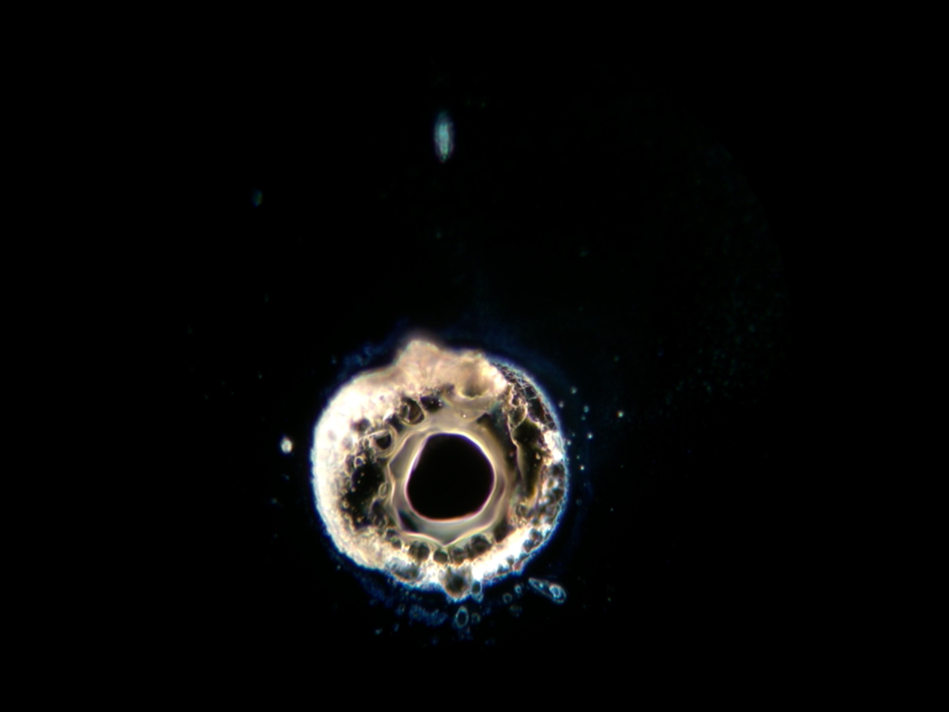
Status of LIGO
O4 sensitivity improvement plans
Improved stray light control (important <200Hz)
New higher power laser amplifier
Point absorber-free test masses
A+ project (O5, maybe ready by O4?)
High efficiency Faraday isolators
Adaptive mode matching at anti-symmetric port
Frequency-dependent squeezing!
155um
GariLynn Billingsley, G1800345

Slide 11
Status of Virgo
Slide from Giovanni Losurdo
G2100580

Slide 12
Status of Virgo
Slide from Giovanni Losurdo
G2100580

Slide 13
Slide from Yuta Michimura
G2100394

Slide 14
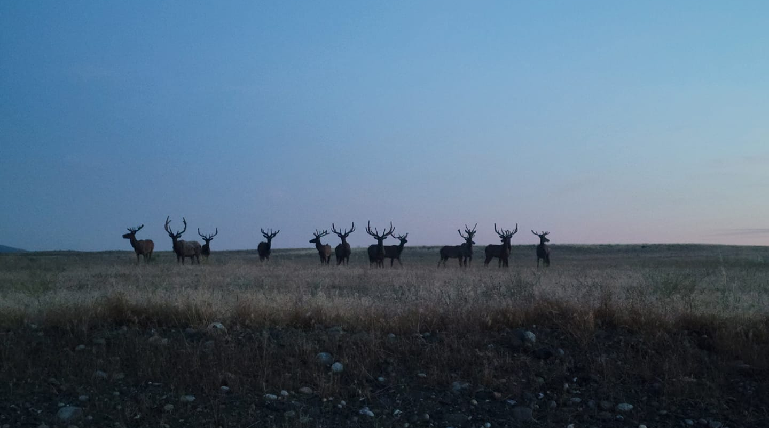
Status of LHO
Photo: Chandra Romel

Slide 15
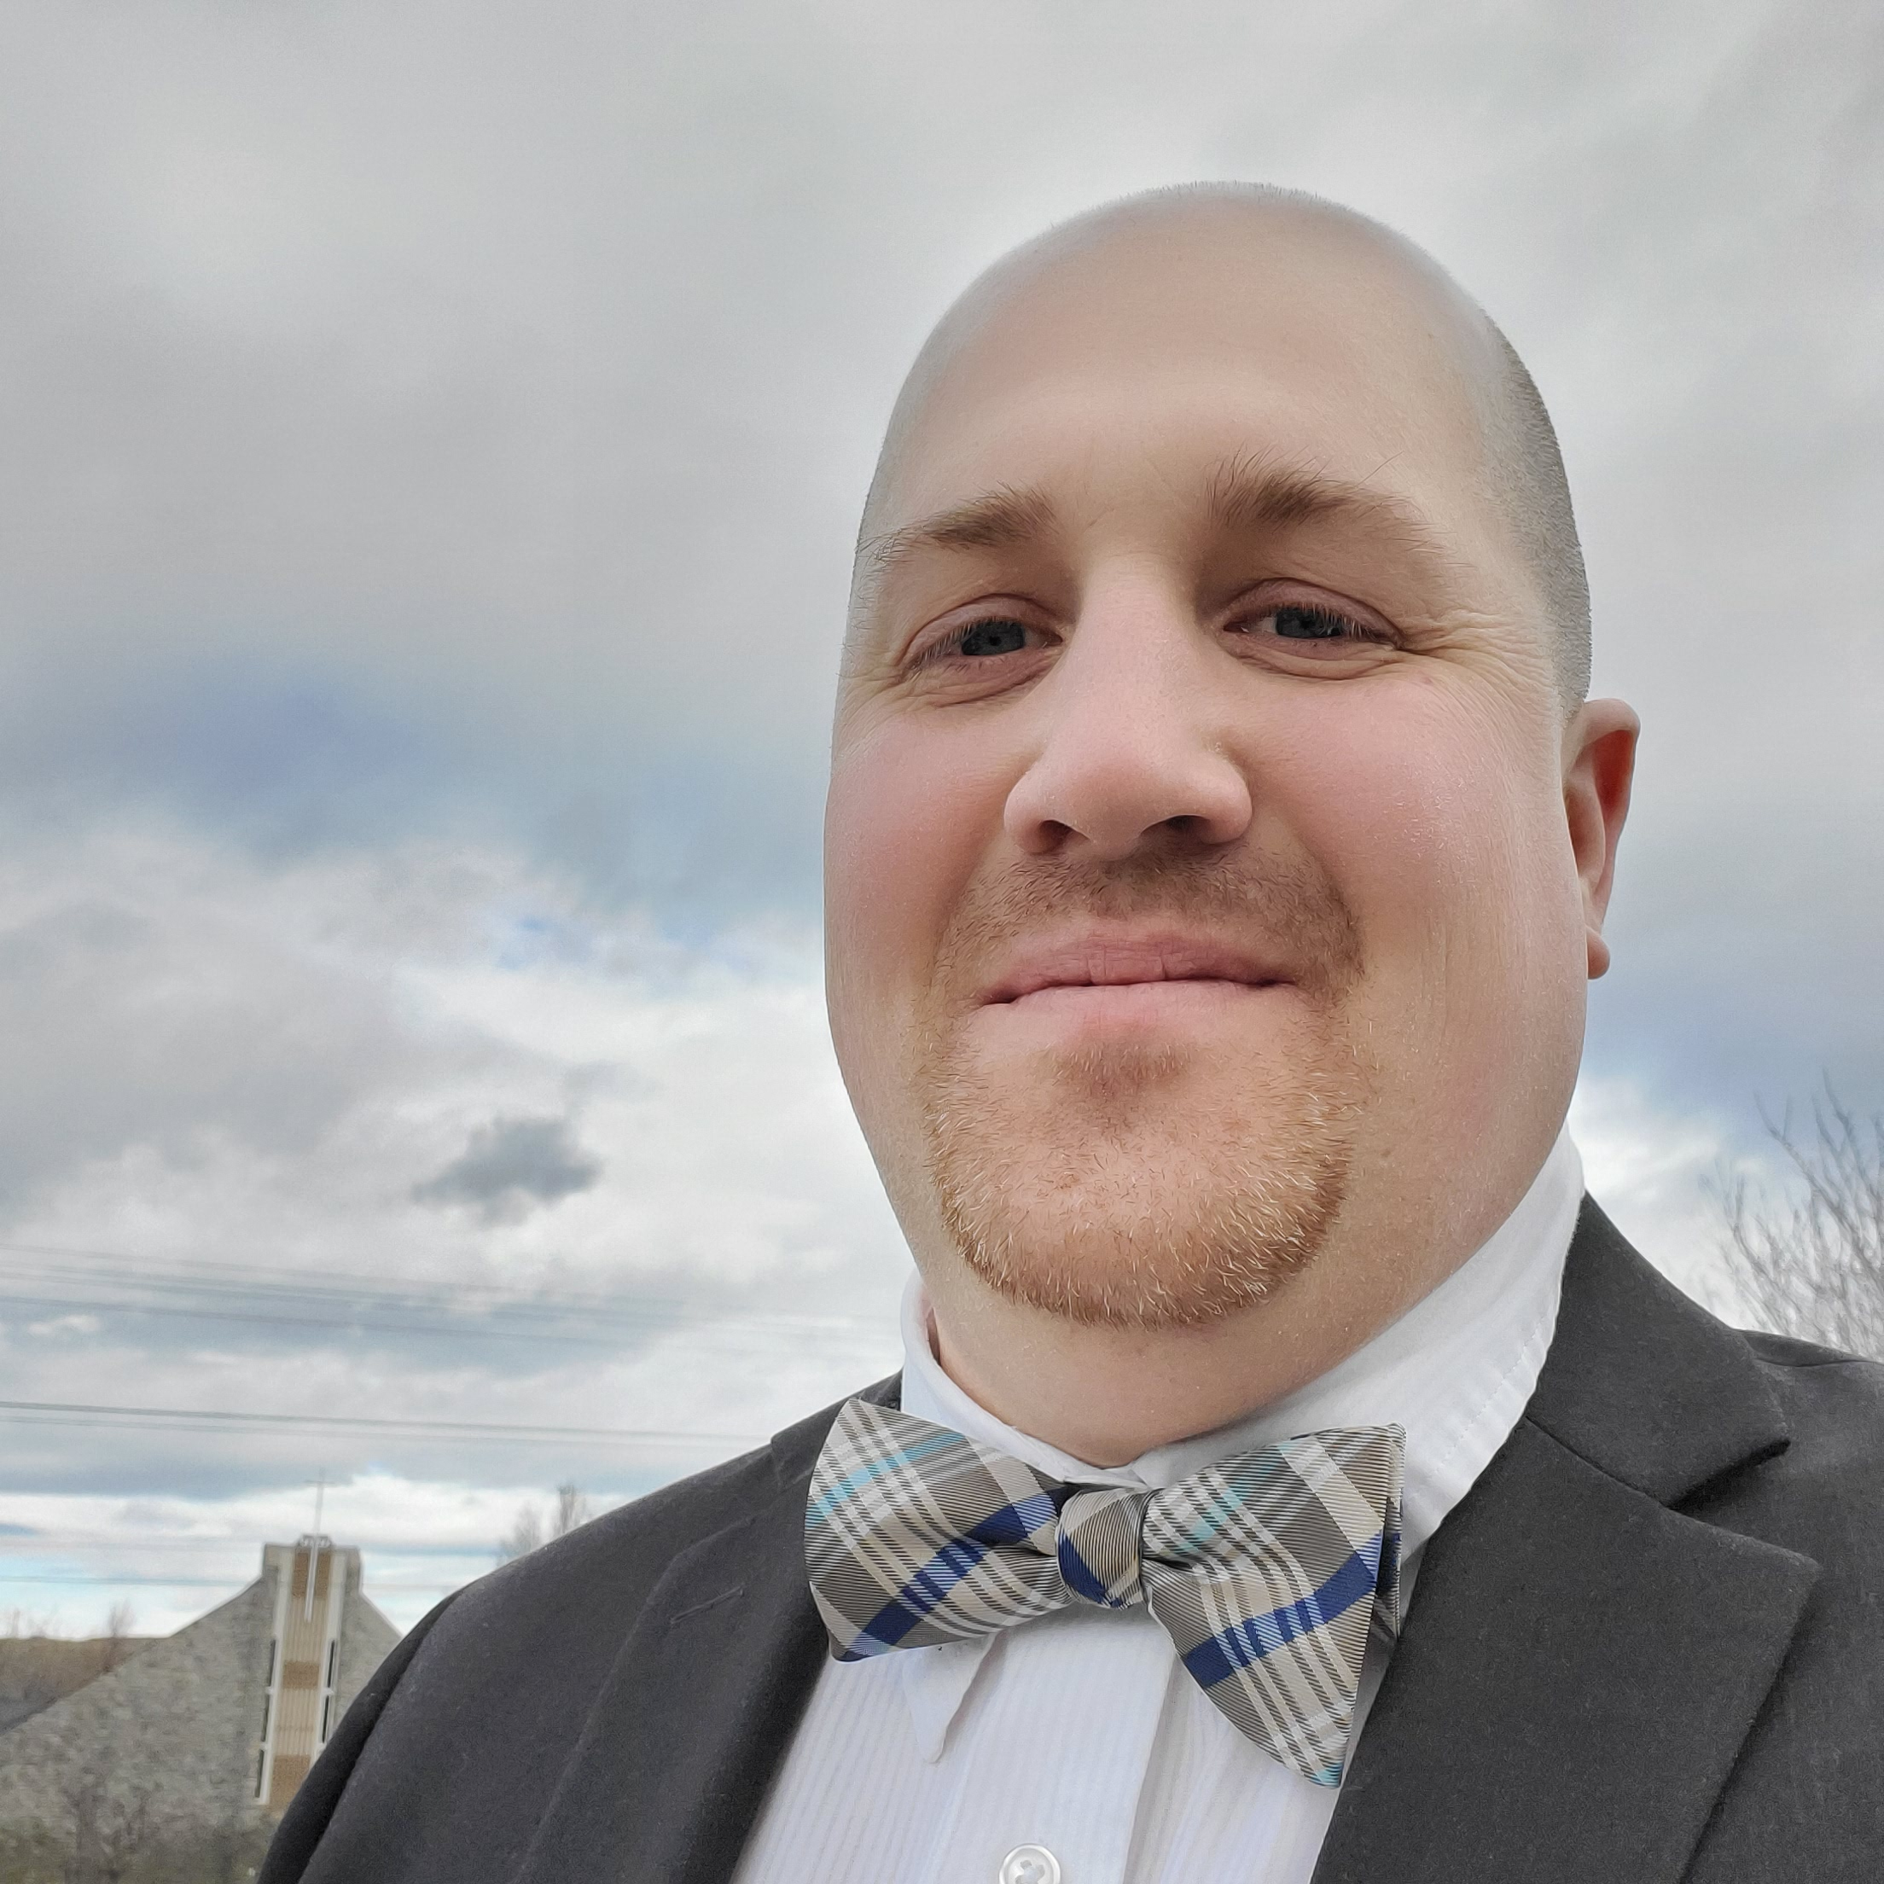
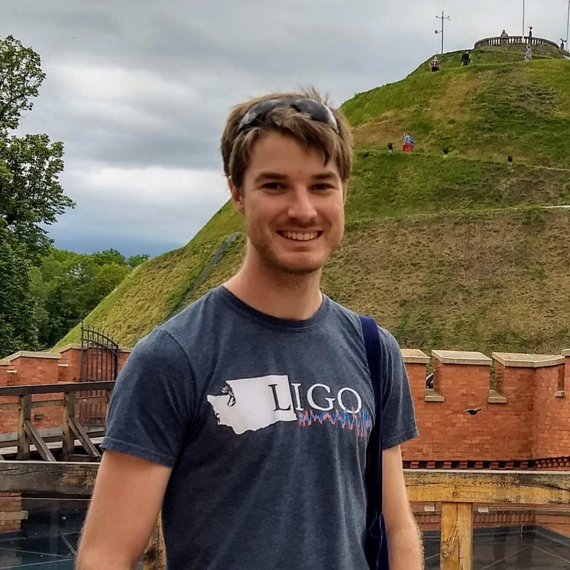
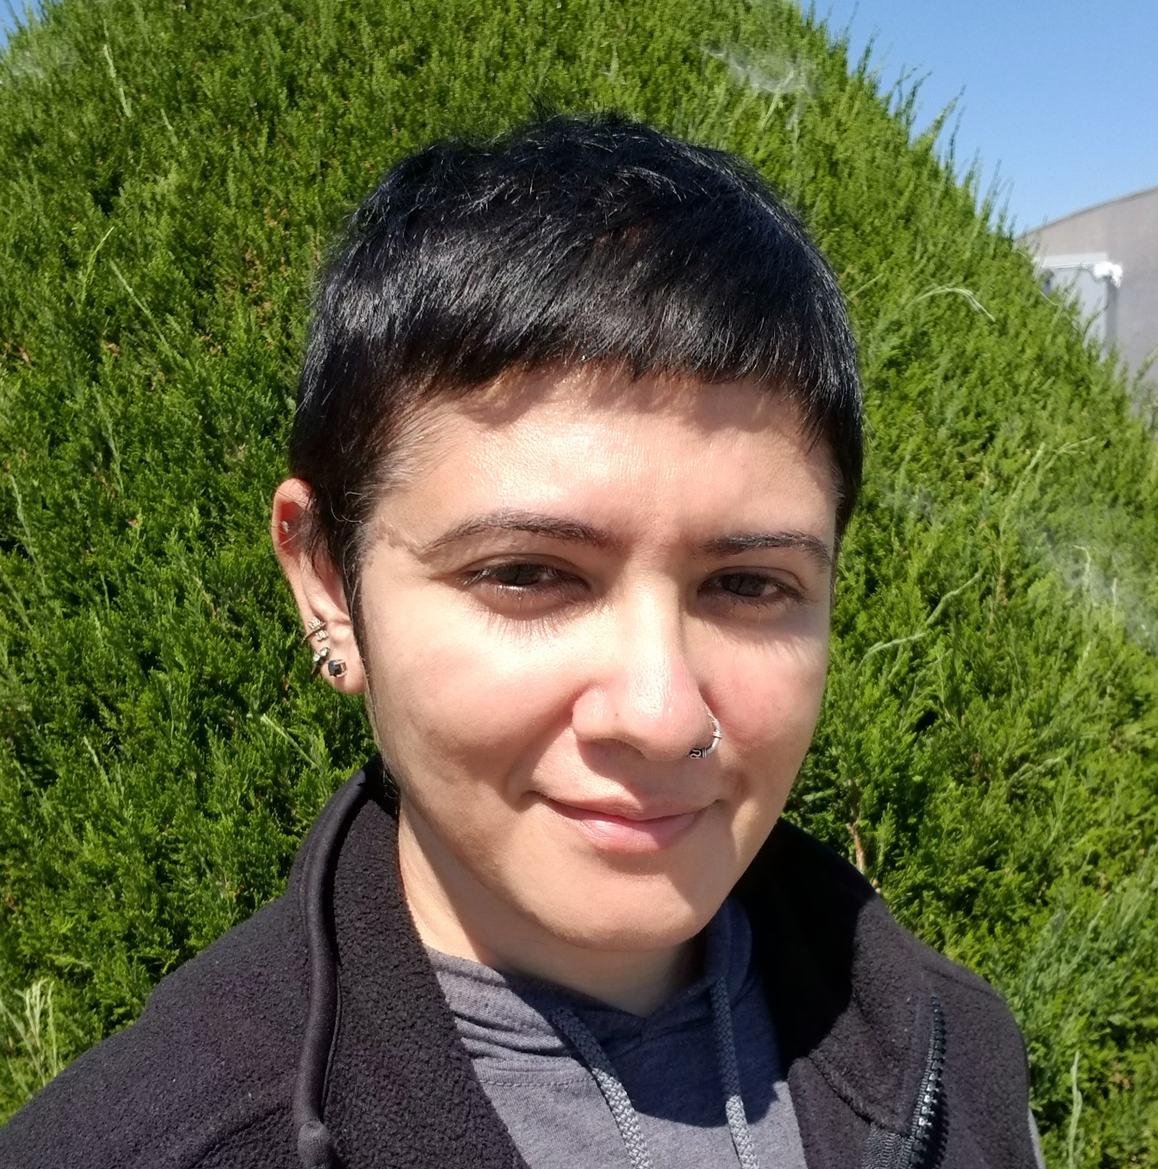
Who’s who at LHO
New faces ☺
Cory Grimmer – Site safety
Nidhi Patel – Operator
Craig Cahillane – Postdoc
Mitchell Robinson - Instrument Assembly Technician
Aurora Shaffer (c/o TJ Shaffer)
Neal Grabeel (c/o Sheila Dwyer)
Cory Grimmer
Craig Cahillane
Nidhi Patel

Slide 16
Who’s who at LHO
Some departures ☹
Hugh Radkins (seismic engineer) retired
Jeff Bartlett (operator) retired
Niko Lecoeuche (operator) now at UBC
Hugh Radkins
Niko Lecoeuche

Slide 17
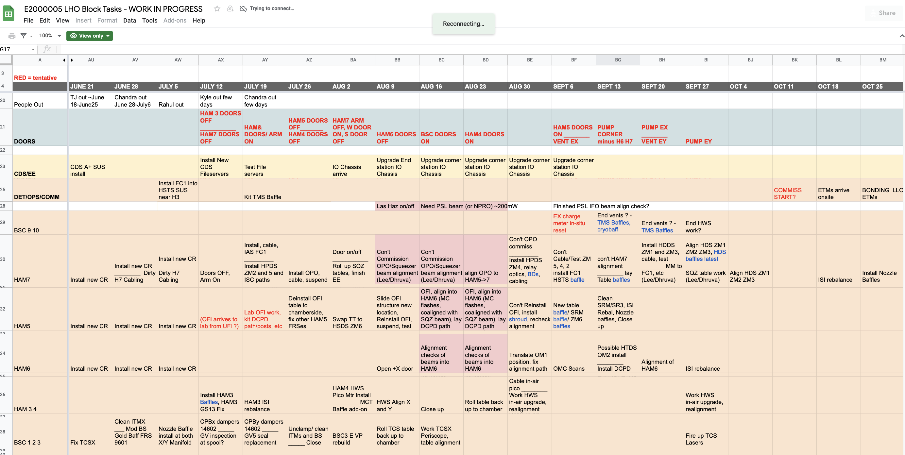
Site status – it’s complicated!

Slide 18
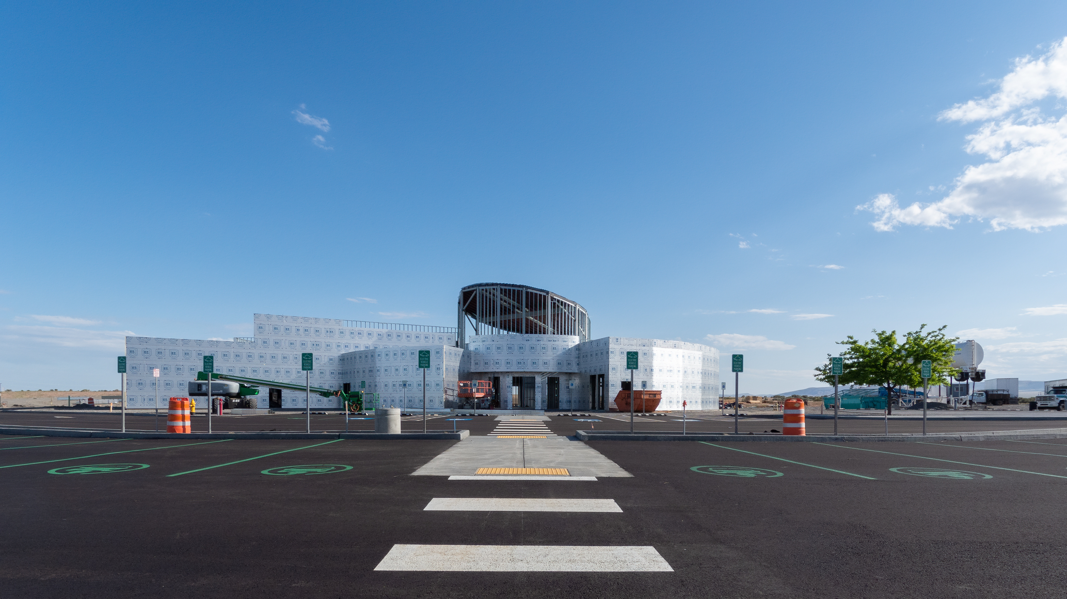
Site status (1/3)
LIGO exploration center (LExC) is under construction
New outreach center at Hanford – see discussion led by Amber at 4pm!
Photo: Keita Kawabe

Slide 19
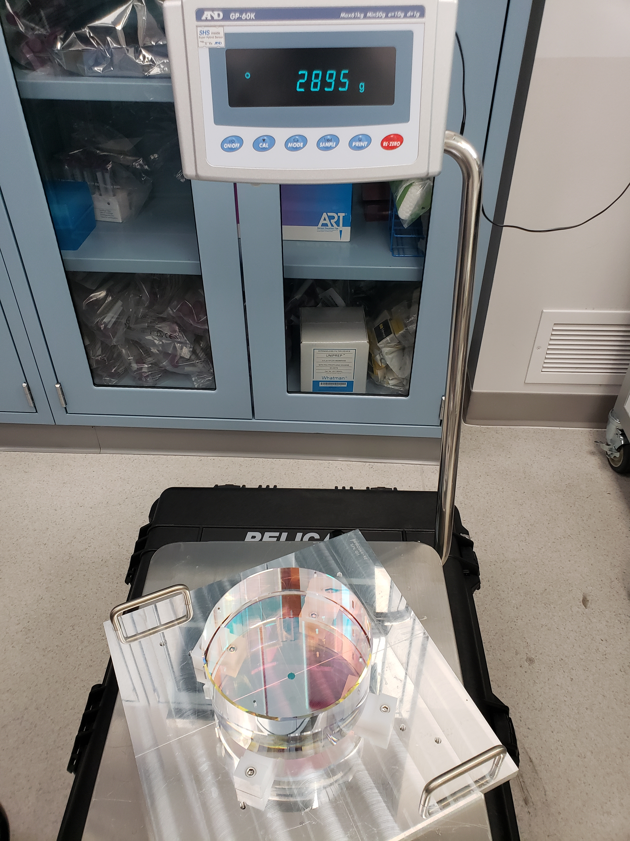
Site status - SQZ
Frequency-dependent squeezing
Massive facilities undertaking!
Two new HAMs to hold filter cavity optics
New FC “end station” – the HAM shack
New 300 m beam tube
Anticipate install of squeezer, FC optics in August– October 2021

Slide 20
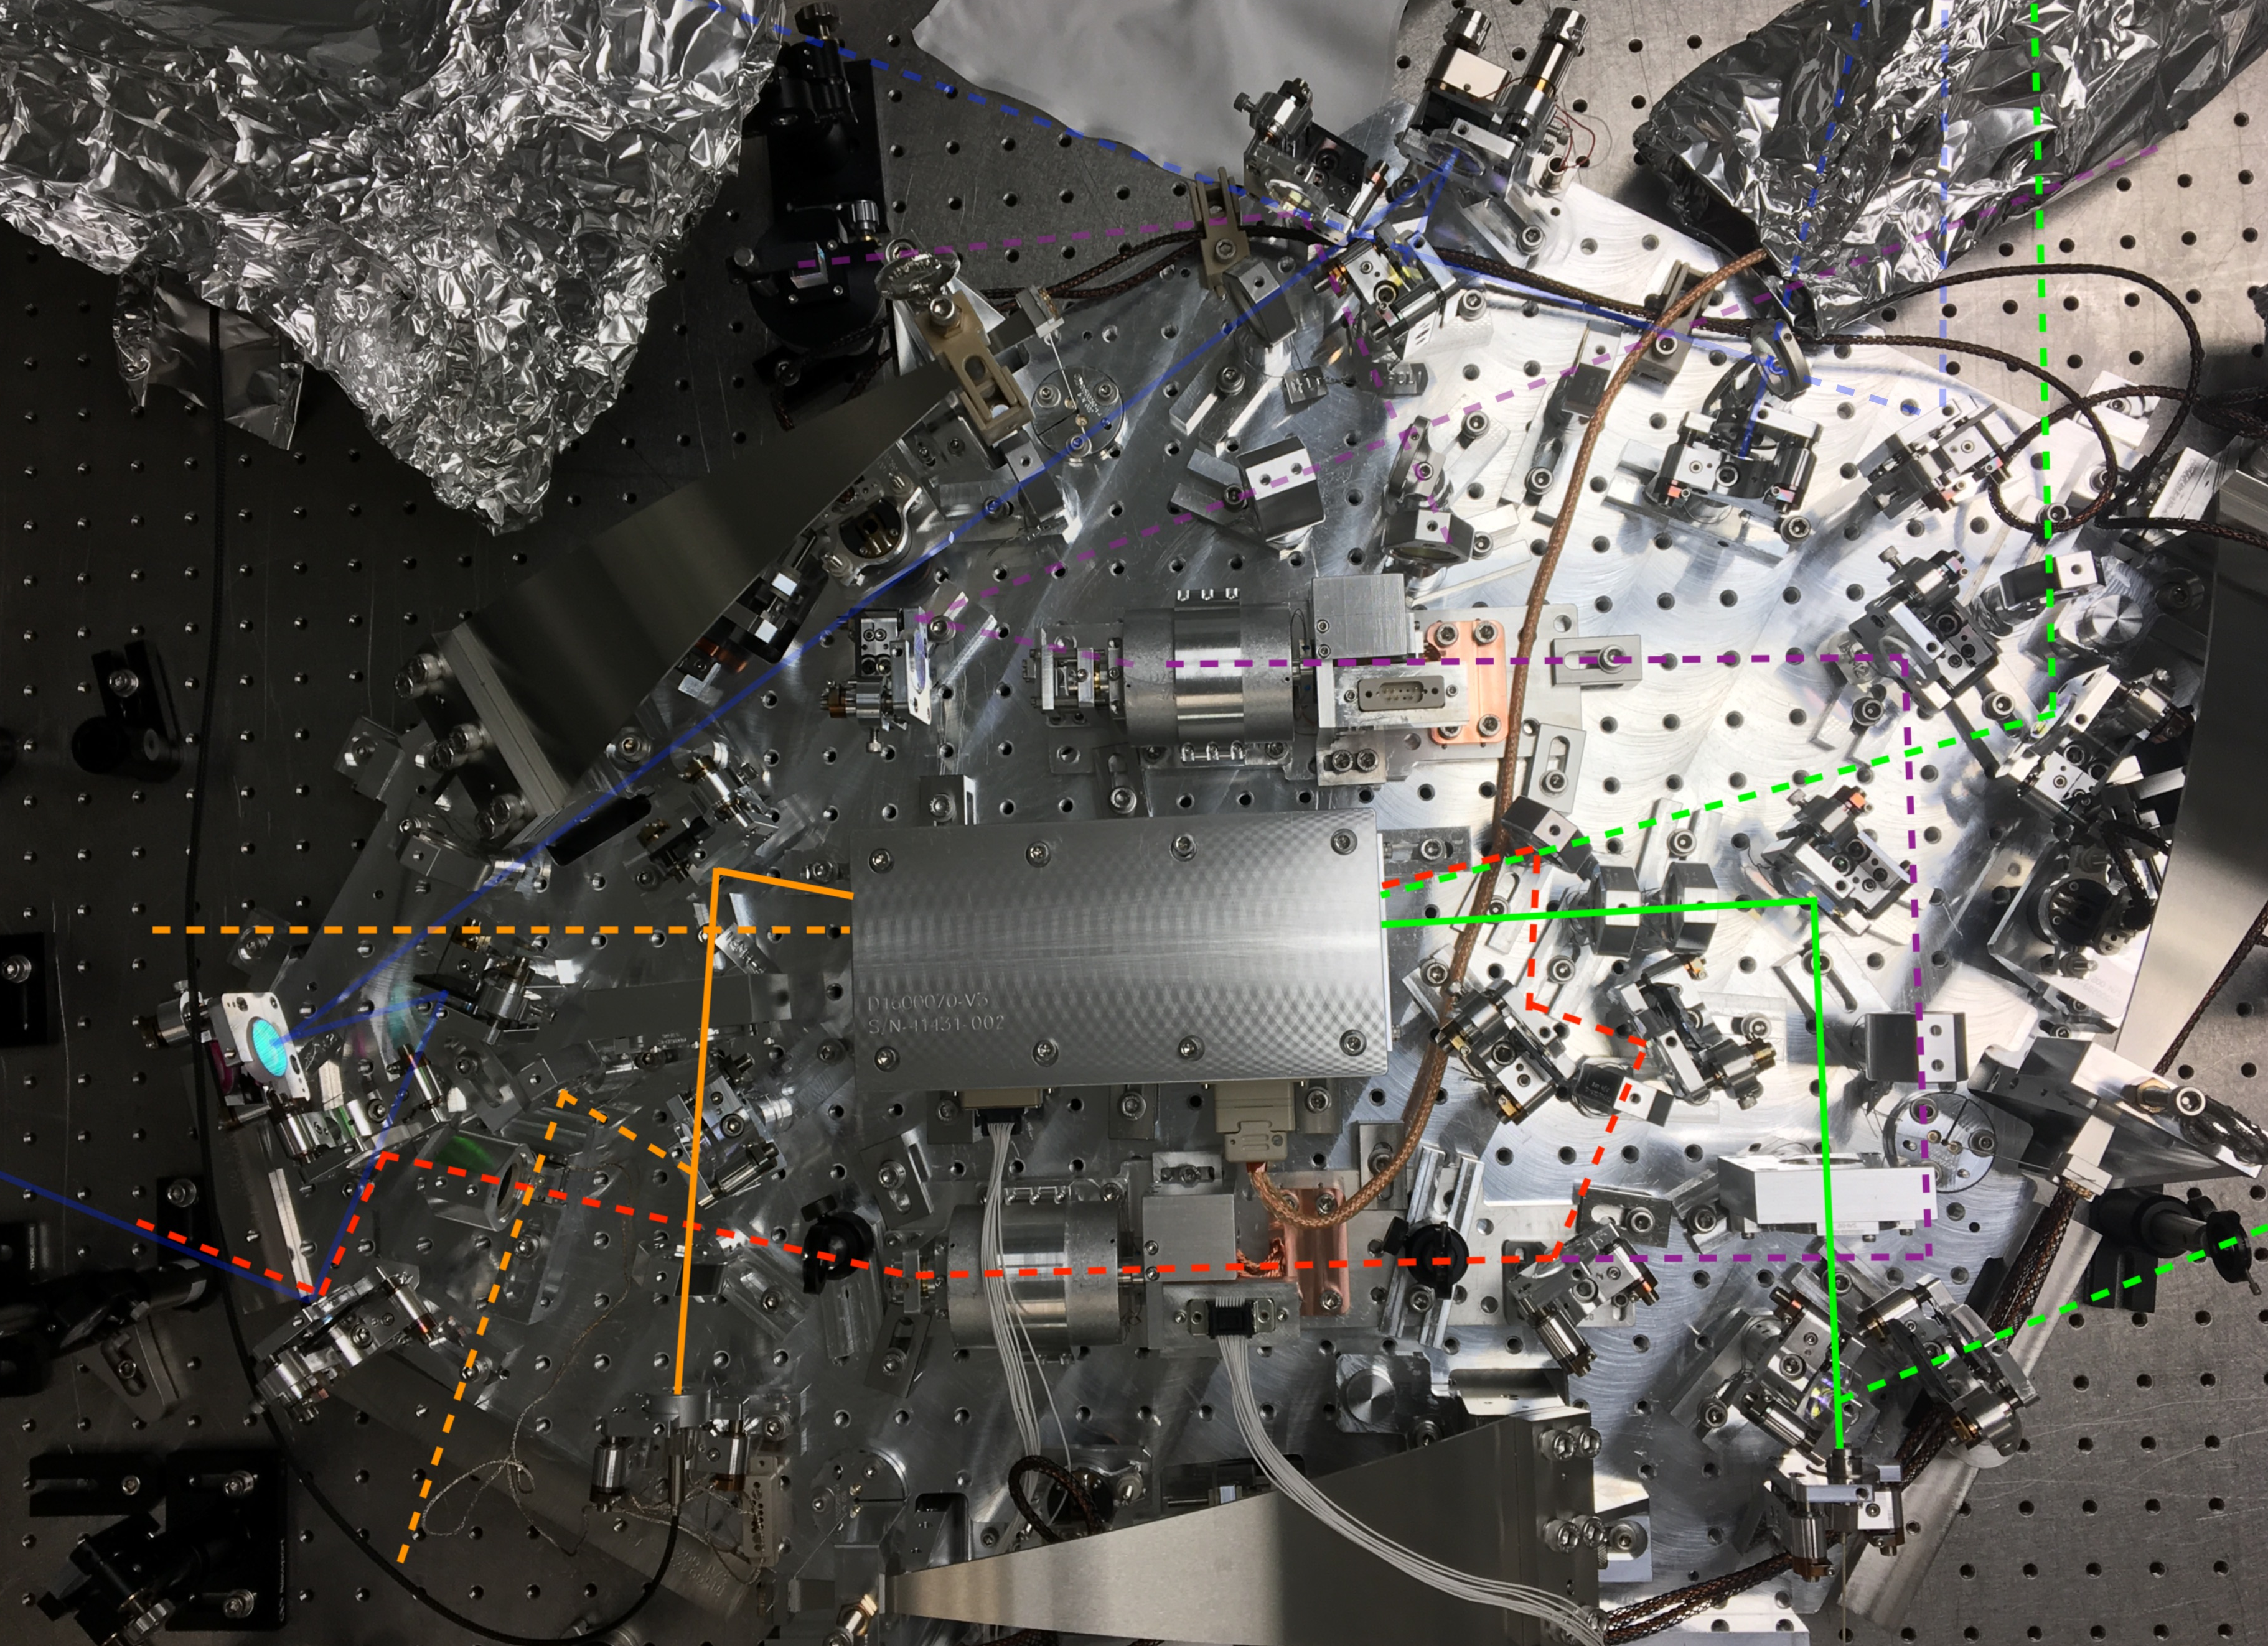
Site status - SQZ
New paths on the squeezer platform to route beam to and from filter cavity

Slide 21
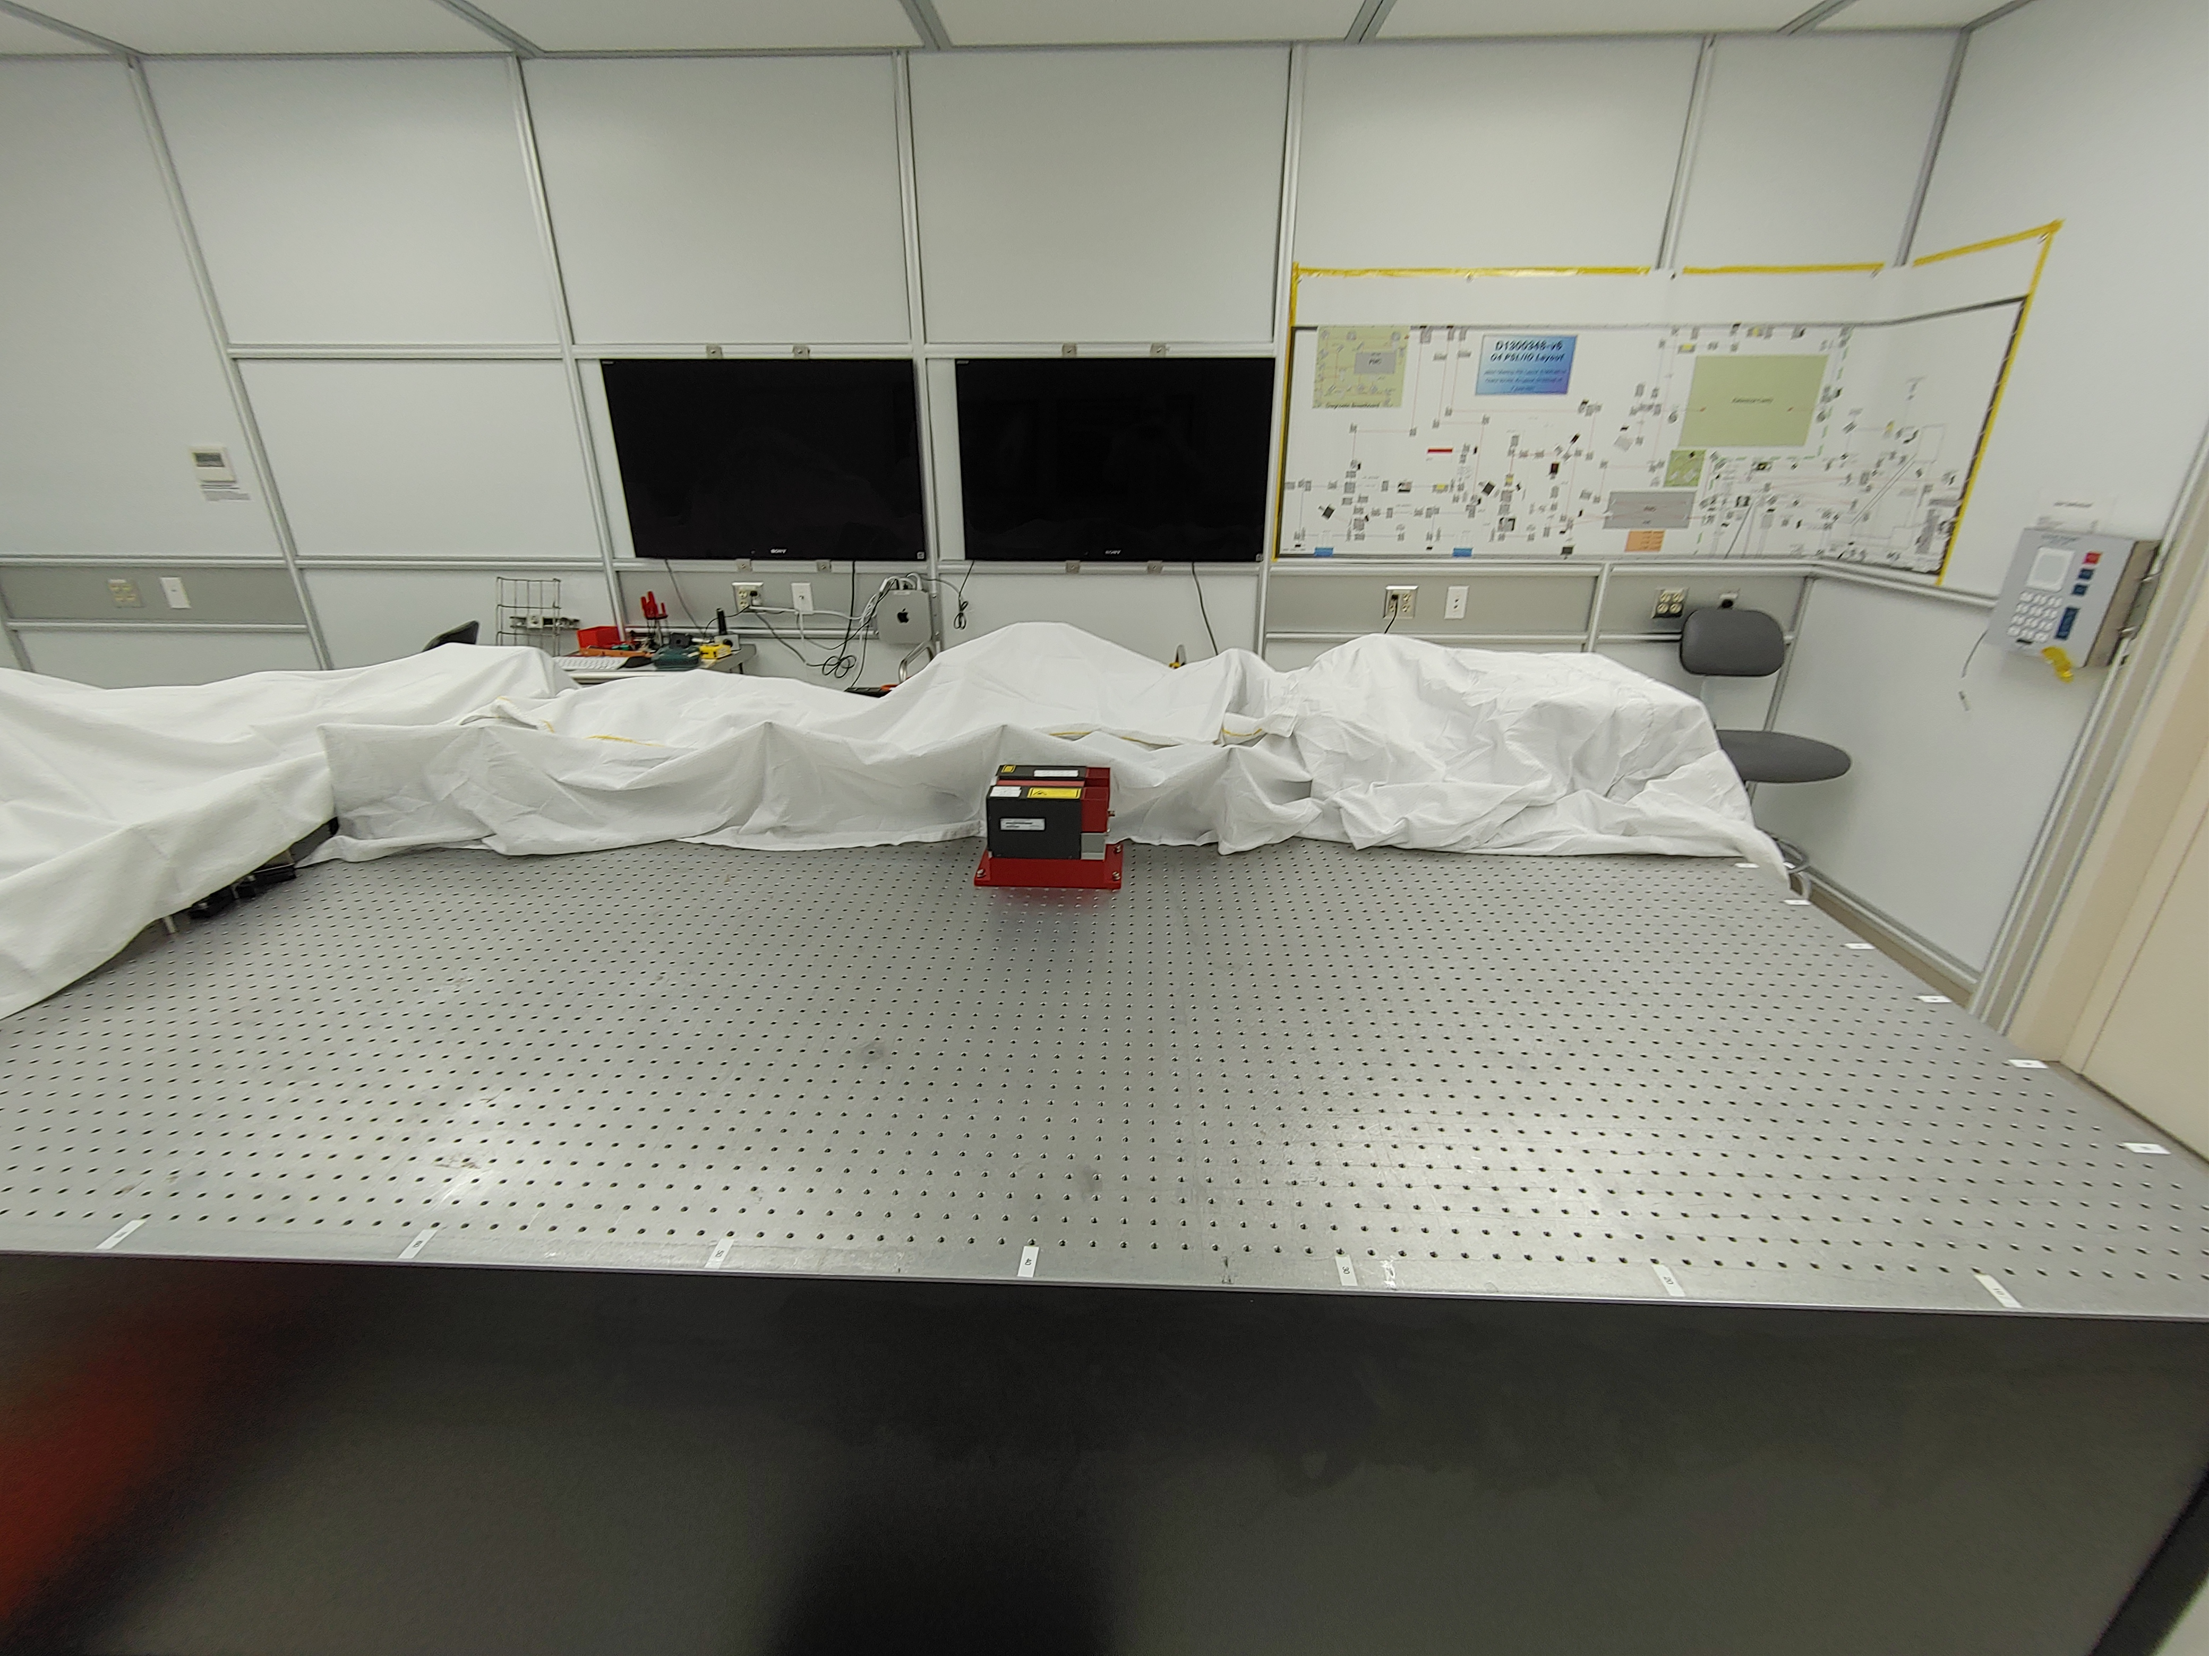
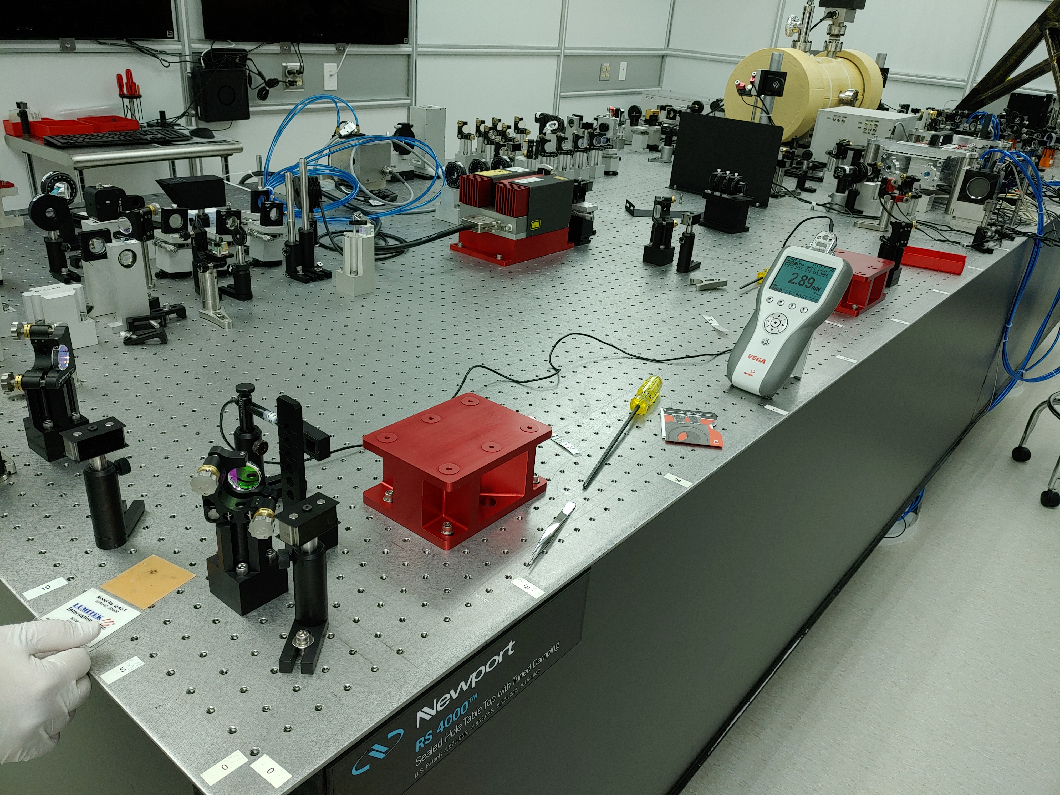
Site status - PSL
New amplifier = more power out of the pre-stabilized laser
Visual progress! Complete table re-alignment
June 9 – LHO alog 59172
June 21 – LHO alog 59251

Slide 22
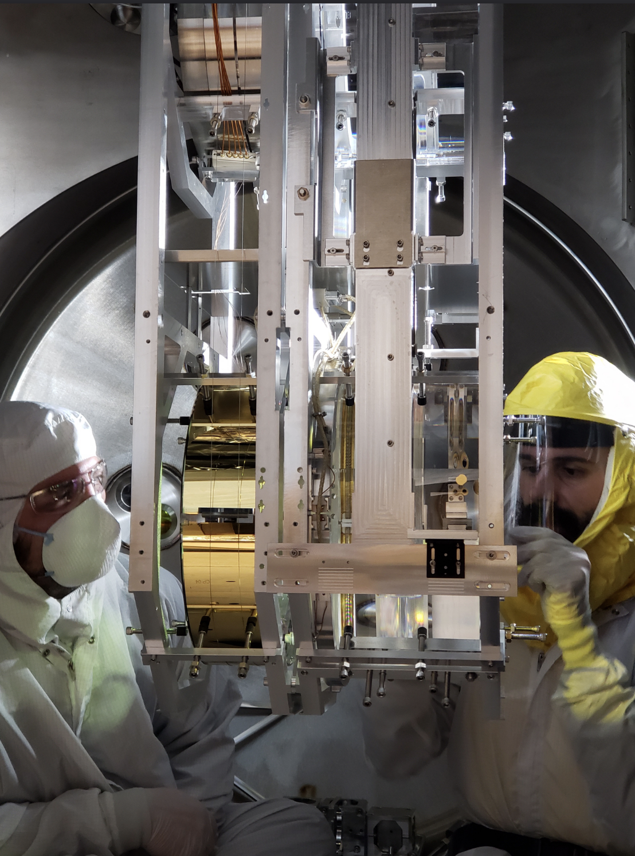
Site status – going in chamber
Many other vacuum incursions in the works!
Replaced ITMY in December 2020
Installing new stray-light baffles
Upgrading thermal compensation system
Moving the squeezer to a fresh HAM
New output Faraday isolator install
Travis Sadecki and Sebastien Biscans with new ITMY

Slide 23
Pre-O4 mini commissioning period
In March/April 2021 we had a commissioning period*
Good news: new ITMY has no significant point absorbers!
Reduced scatter coupling
Angular controls became more stable and reasonable
Powering up was easier! Reached 47W requested from PSL
Bad news: mystery noise (20-80Hz band) was consistent with O3
*vacuum envelope pumped down, commissioners “get” the interferometer, we work on acquiring lock and reaching low-noise configuration

Slide 24
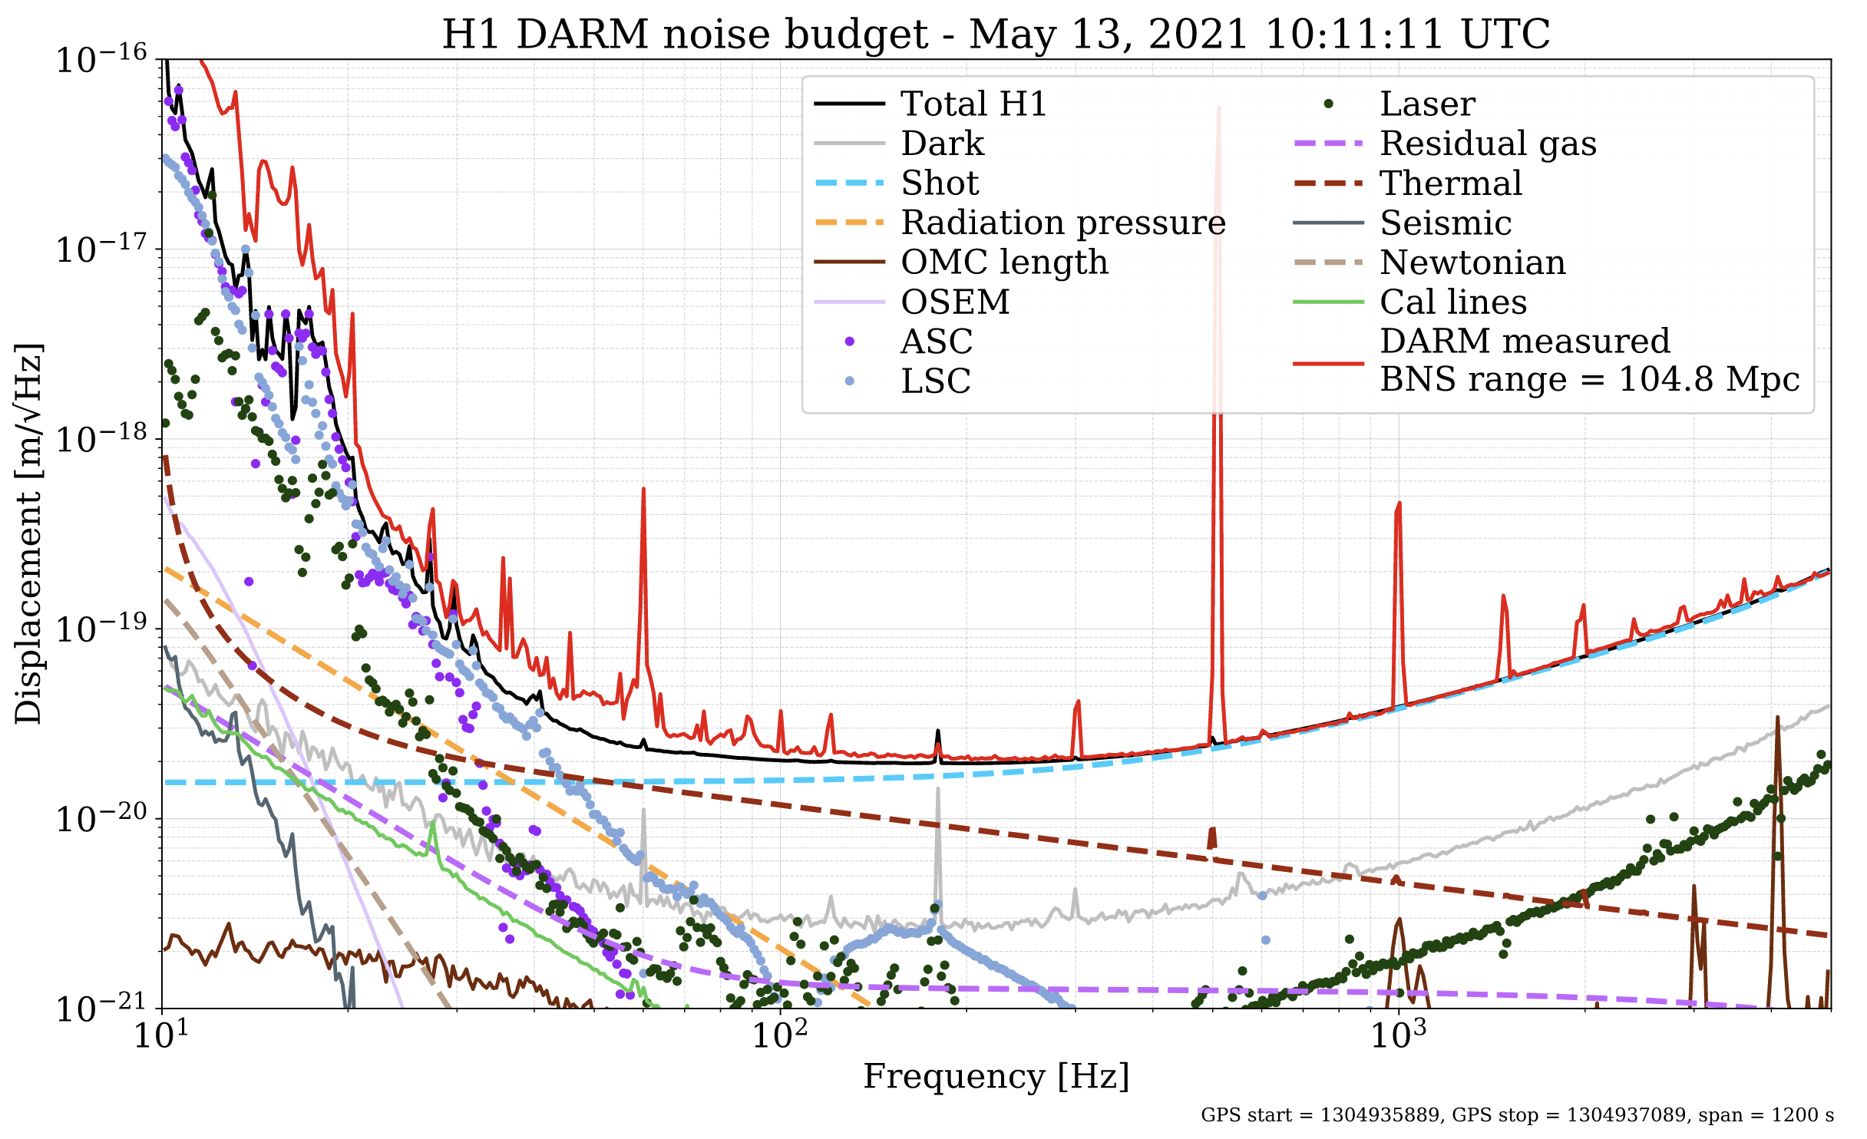

Slide 25
Conclusion
All hands on deck as we push towards O4 (and O5!)
Ambitious target sensitivity (160-190 Mpc for aLIGO), but we have some ideas of how to get there
Exciting upgrades to many systems
Expect more BBHs, BNSs, NSBHs in 2022!

Slide 27
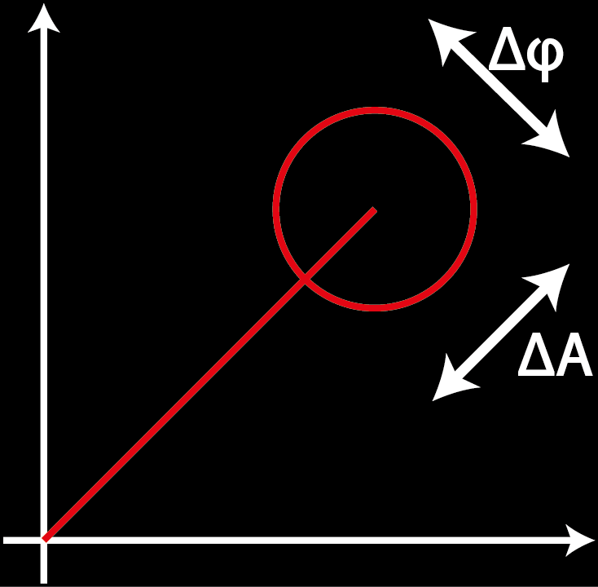
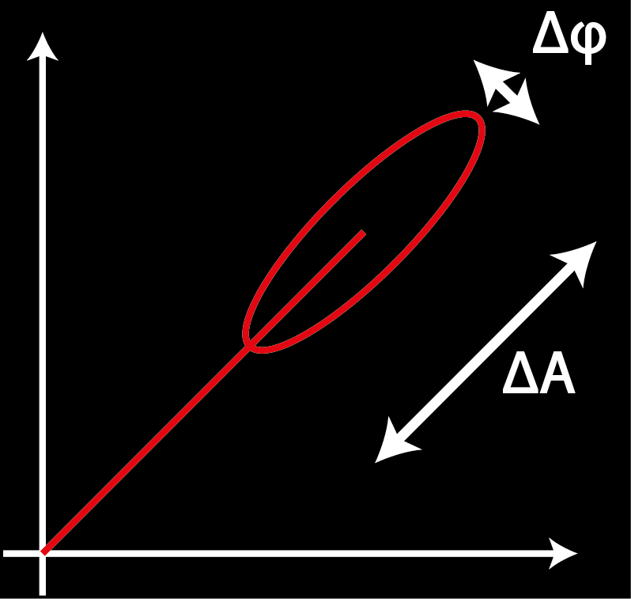
Frequency-dependent squeezing in a nutshell
Shot noise is caused by the quantum nature of light
Heisenberg uncertainty principal relates the amplitude and phase uncertainty
ΔA Δφ ≥ 1
Squeezing is reducing the noise in one quadrature at the expense of the other
Squeezing is produced in a nonlinear crystal

Slide 28
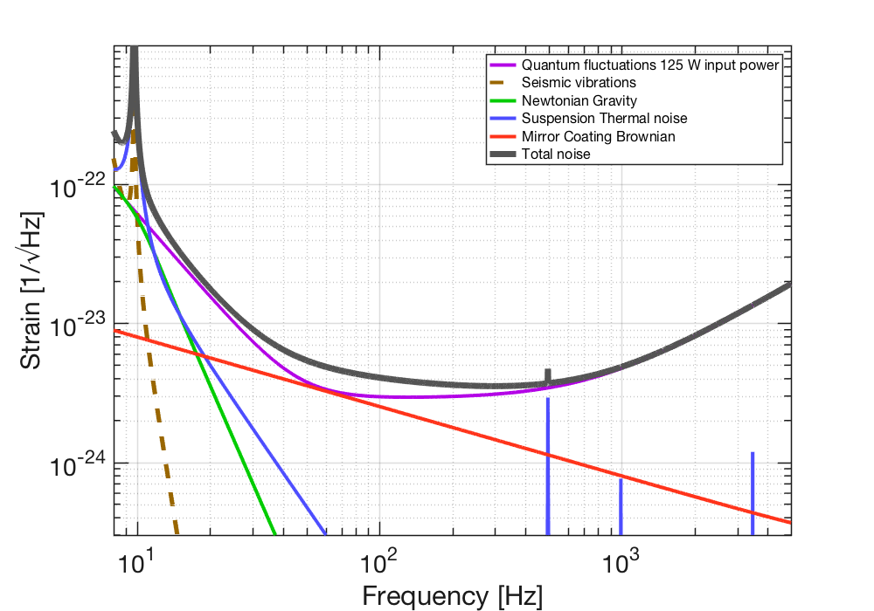
Frequency-dependent squeezing in a nutshell
Shot noise is associated with phase quadrature
Radiation pressure noise is associated with amplitude quadrature
ΔA
Δφ

Slide 29
Frequency-dependent squeezing in a nutshell
In O3 we injected phase squeezing only – improved shot noise but made radiation pressure noise worse!

