Slide 1
Data Folding for the Stochastic Gravitational Wave Pipeline
Final Presentation
Eli Wiston
Mentors: Arianna Renzini and Colm Talbot
LIGO-T2100276-v1

Slide 2
Outline
Stochastic Signals
Data folding: process and motivations
Implementation in real data: O3a Run
Results
Notes:
Begin by giving some background on stochastic signals
Next, I’ll go through how and why we implement data folding
Then, I’ll present the implementation of folding on the first half of the O3 run, breaking down data quality cuts
Finally, I’ll present my final results with the folded data

Slide 3
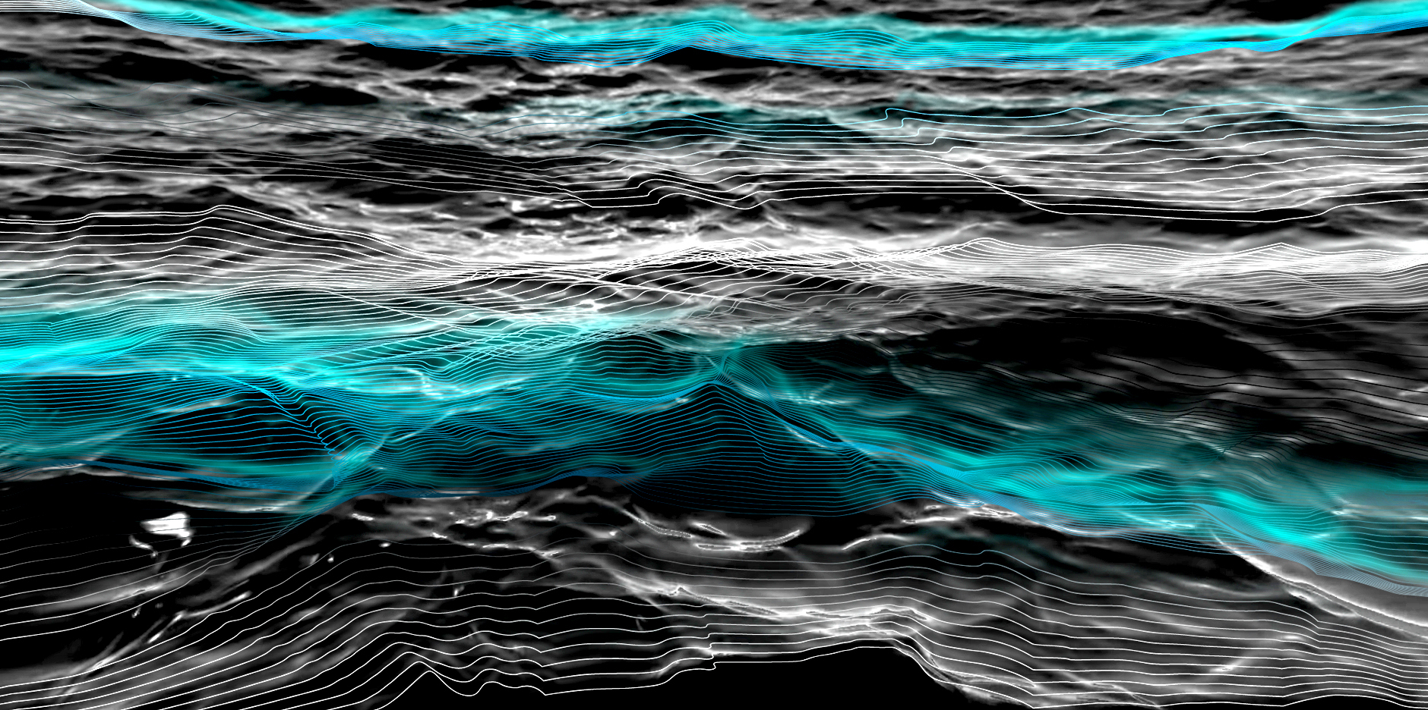
Stochastic Gravitational Wave Background
Sea of unresolved gravitational wave signals
Individually useless, collectively contain a lot of information
Notes:
A signal is classified as stochastic if it better describe by statistics then an deterministic waveform model
In typical analysis this constitutes our non-instrumental noise

Slide 4
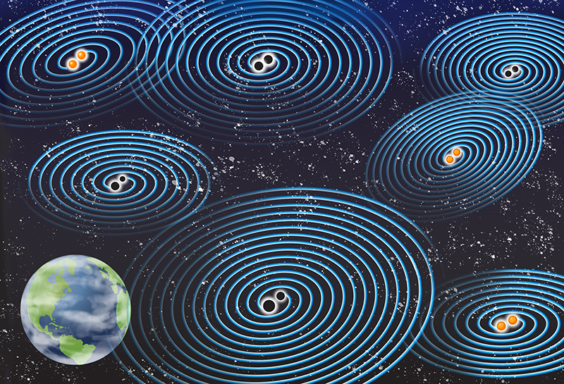
Why do we care?
There are two broad categories of stochastic signals:
A low redshift, astrophysical foreground
Measure of large-scale structure independent of EM sources
A high redshift, cosmological background
Evidence for inflation, early-universe phase transitions
Notes:
Foreground: Primarily dominated by sub-threshold Compact Binaries
Both these sources can be assumed to be stationary, with the CBCs being stationary in the limit that there are many of them

Slide 5
How do we detect weak signals?
Cross Correlation!
The stochastic signal is coherent between the two detectors, while the noise is uncorrelated
Over time, the noise will be suppressed relative to the signal
But for such weak signals, we require long stretches of time

Slide 6
Stochastic Background Detection Statistic
Assumed frequency distribution
Normalization
Overlap function
Dirty Map
CSD
PSDs
Notes:
Our key anisotropic stochastic background detection statistic is called the dirty map X. It is used in the computation of the a stochastic skymap.

Slide 7
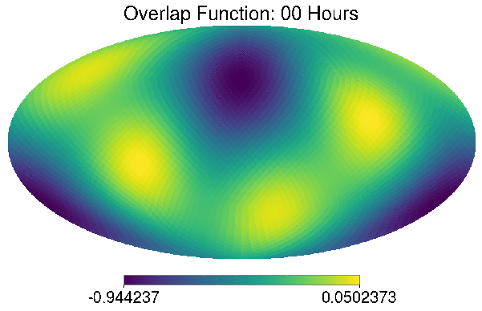
Overlap Function
The overlap function is a measure of the sensitivity of a pair of detectors to different parts of the sky.
An anisotropic, stationary background will give the same signal at each part of each sidereal day.
Notes:
Emphasize stationarity and anisotropy

Slide 8
How does folding work?
Exploiting the periodic nature of the overlap function, we can re-write these equations as:
This sum over iday is our data folding. This sum only needs to be performed once, but will speed up subsequent analysis by a factor of ~Nday.
Notes:
We can pull H(f) out as just a sum on frequency (this is where the stationarity assumption comes in), and the overlap function as a sum over frequency and t sub s, the time within each sidereal day. Our folding takes places in this final sum over i days, where big T sub s is the period of one sidereal day and t sub s is the time within each day. These time segments t sub s are how we calculate the CSD and PSDs. The segment length must be sufficiently small, so that the response, gamma and the noise levels in the detector, are stationary
For a full LIGO run, this is on the order of 100s of days. We can carry out a lot of different analyses on this folded data, including different models of H(f), the frequency distribution of the stochastic background.

Slide 9
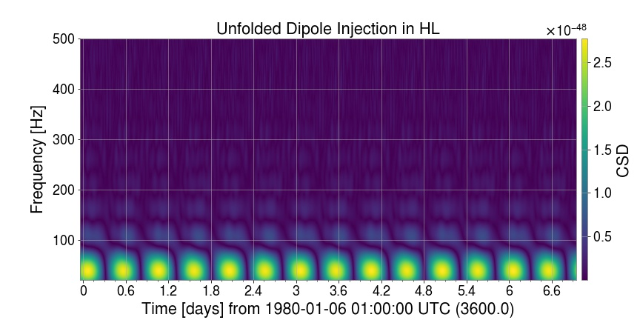
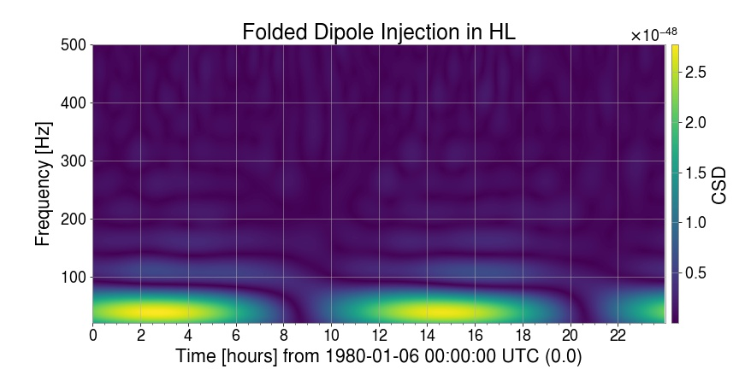
Folding on Simulated Data
Notes:
Presented here is a simulated stochastic dipole injected into the sky over one week. Because it is a dipole, the signal is periodic over half a day. That week is then folded done to the size of one day, with the signal appearing twice.

Slide 10
Mitigating Information Loss in Folding
Unfolded method:
Problem: fft lengths do not always fit evenly into one sidereal day
Method 1: Cut days short
Method 2: Keep all times
with some offset
Notes:
For a variety of reasons, researchers may select an fft length that does not evenly fit within a sidereal day. If they do, folding cannot be done perfectly, and we must select some method of folding the data that minimizes information loss.

Slide 11
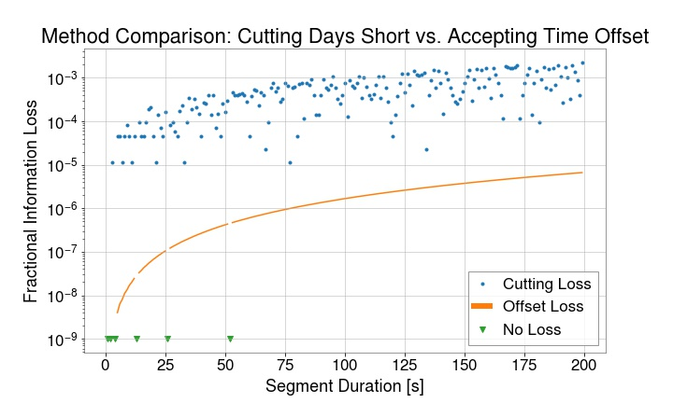
Mitigating Information Loss in Folding
Notes:
Point out no loss: when sidereal day is divisible by the segment duration
Offset is consistently at least one order of magnitude less information loss, so we moved forward with that

Slide 12
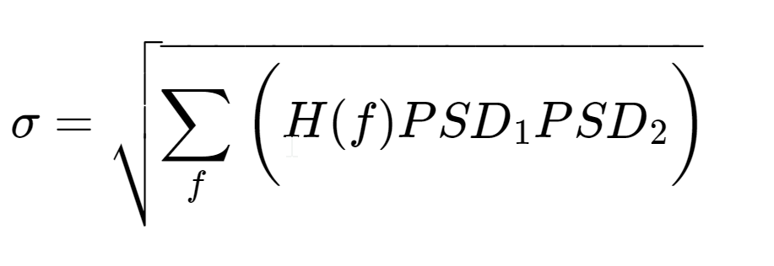
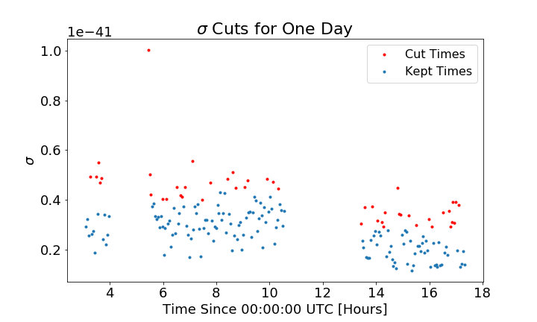
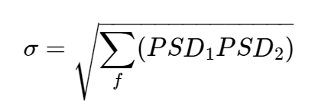
Data Quality - Delta Sigma Cuts
For H(f) = 1:
Notes:
Next, I looked at data quality cuts, in particular the delta sigma cut.

Slide 13
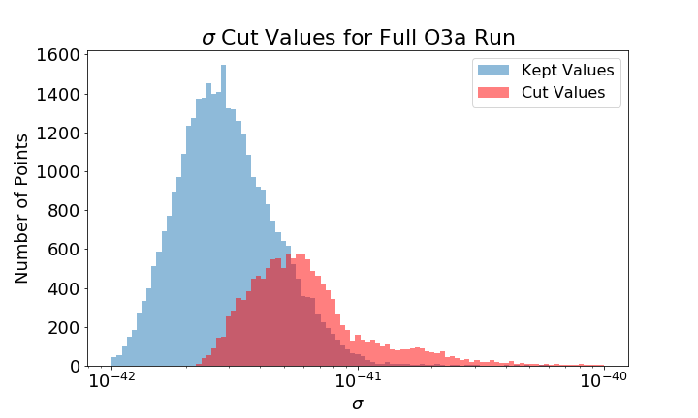
Sigma Cuts -Full O3a Dataset
28.4% of Active Times Cut
Notes:
We see that the sigma values form two populations, with the high sigma population being cut. The overlapping region is a result of the non-stationary of the noise; cuts are performed relative to surrounding times

Slide 14
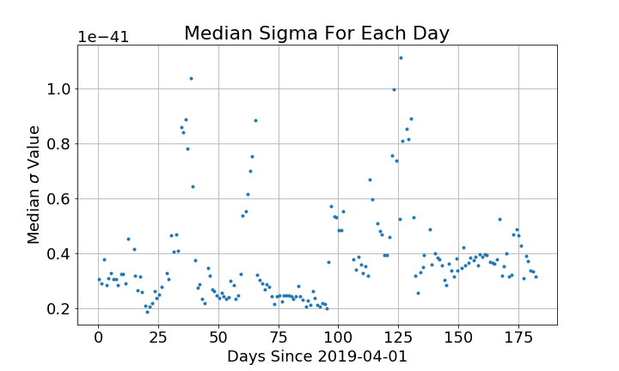
Sigma Variance Across the Run
Notes:
Here we can see the non-stationarity of detector sensitivity over the course of the run. We see significant variance over the course of the 180 day period, with a standard baseline down here and some days with poor sensitivity up here.

Slide 15
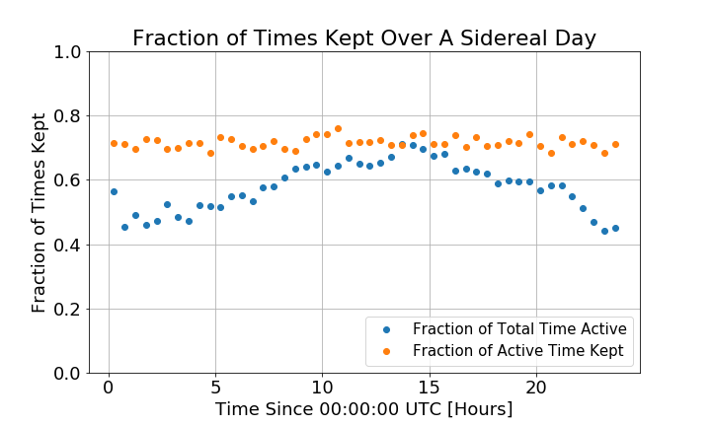
Sampling Variance Across A Sidereal Day
Notes:
Looking at the cuts made within the sidereal day. The blue points shown here represent the fraction of total time where the detectors were both actively detecting. The active times had a clear trend over the sidereal day.
The orange points represent the fraction of active times that passed the delta sigma cuts. This seems to have so connection across a day

Slide 16
Sampling Variance Across A Sidereal Day
7:00 AM in H1
9:00 AM in L1
Notes:
The peak here corresponds to 7:00 AM in Hanford and 9:00 AM in Livingston

Slide 17
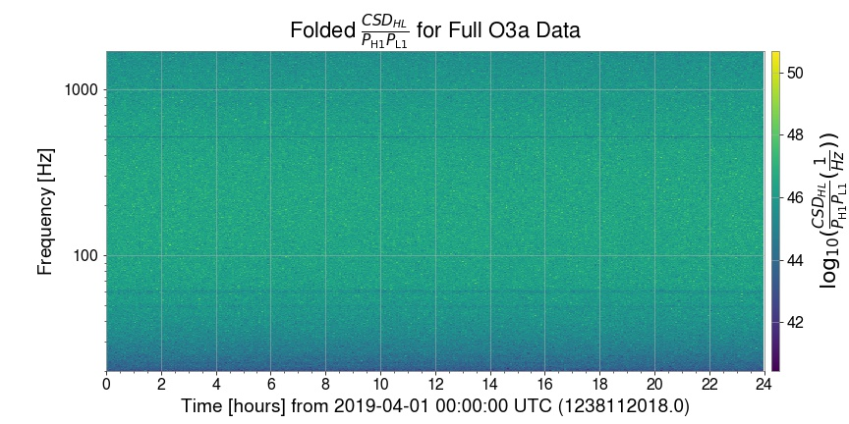
Final Folded Spectrogram
Notes:
Here we have the full folded spectrogram for the O3a. The term of interest CSD divided by PSDs is folded down to the size of one sidereal day. We see the characteristic frequency lines, present in both detectors’ PSDs reflected in the spectrogram as minima, since the term involves PSDs in the denominator

Slide 18
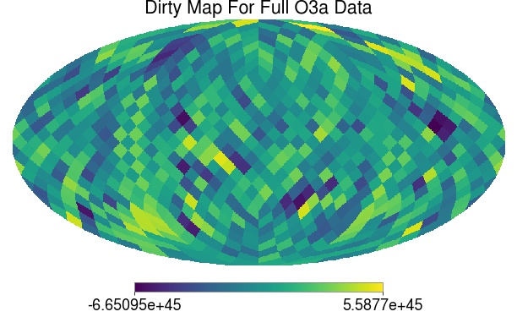
Dirty Map
Computation time on folded data: 11 hours
Estimated computation time for unfolded: 84 days
Notes:
Using the Spectrogram above, I was able to compute the dirty map for O3a. On my laptop, the computation of this map took a total of 11 hours. Since the computation scales with number of days, the estimated computation for an unfolded dataset is 84 days. If I tried to calculate this map on unfolded data on the first day of this program, it would still be 2 weeks away from completing.

Slide 19
Summary
Stochastic data can provide a range of astrophysical and cosmological insights
The periodic nature of the overlap function and assumed stationarity of the signal allow us to average the data down to the size of a sidereal day
Folding CSD/PSDs allows for efficient computation of the dirty map, our key stochastic background detection statistic

Slide 20
Acknowledgements
I’d like to thank:
My mentors, Arianna Renzini and Colm Talbot
Derek Davis
Alan Weinstein
My fellow LIGO SURFs
The NSF and LIGO Lab

Slide 21
Backup Slides

Slide 22
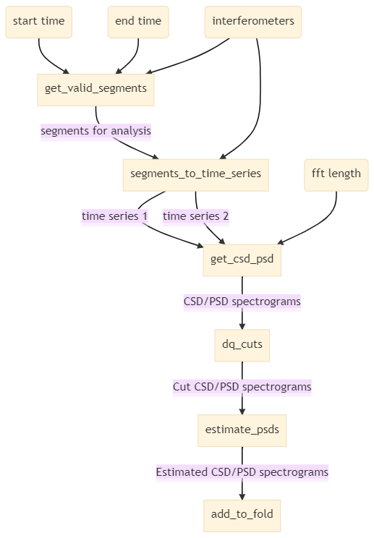
Workflow

Slide 23
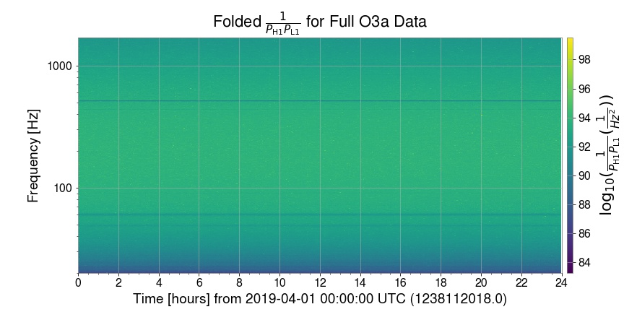
Final Spectrograms

Slide 24
Fisher Information Matrix

