Slide 1
MATLAB suspension model review
Edgard Bonilla

Slide 2
Summary
Overview.
Some things you can do with the models.
Where do the models live?
Example output.
Summary of currently supported features
Where should the suspension modelling go?

Slide 3
Overview
The Matlab models are used to generate first-principles state space models for the different advanced LIGO suspensions.
They are very useful tools for both commissioning and control design for the suspensions.
It has been used by the collaboration for years. They keep being updated with new hardware additions to the suspensions.
G2100766

Slide 4
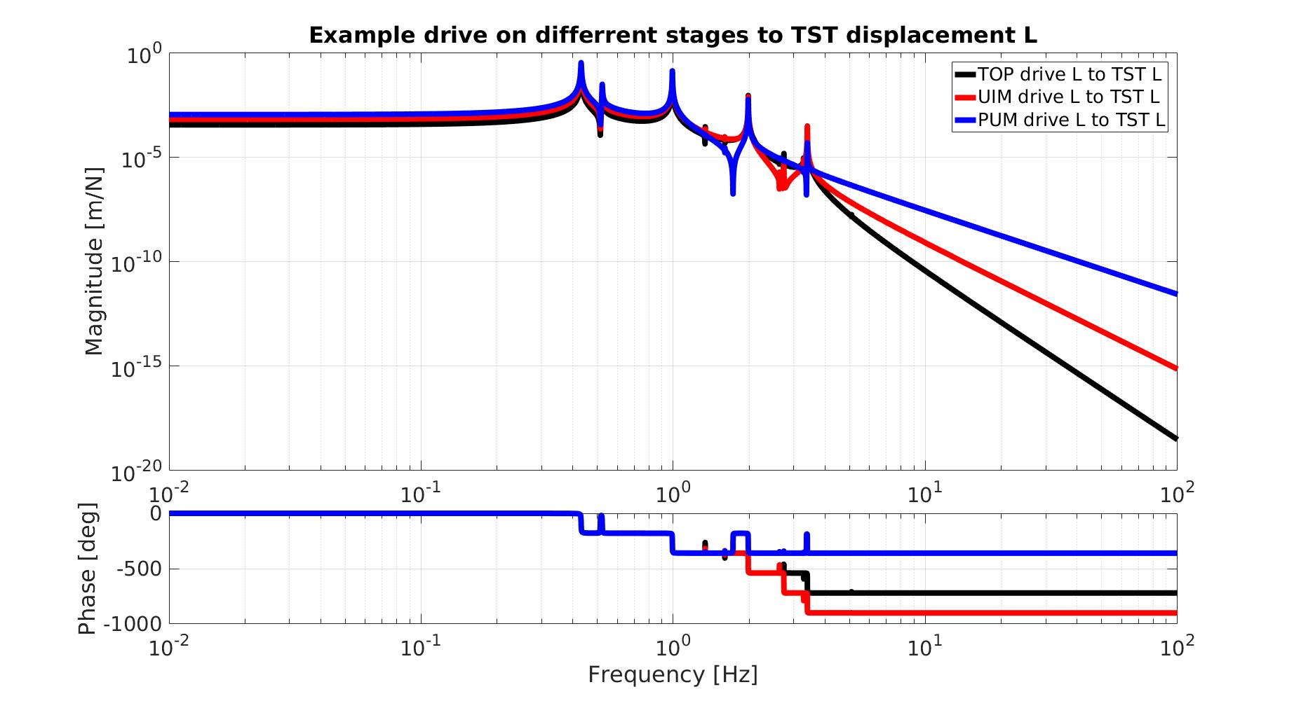
Some Features
4
G2100766

Slide 5
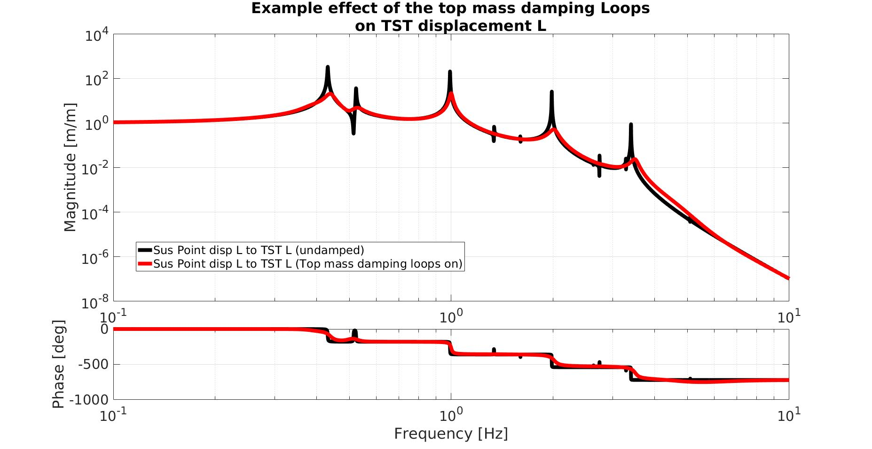
Some Features
5
G2100766

Slide 6
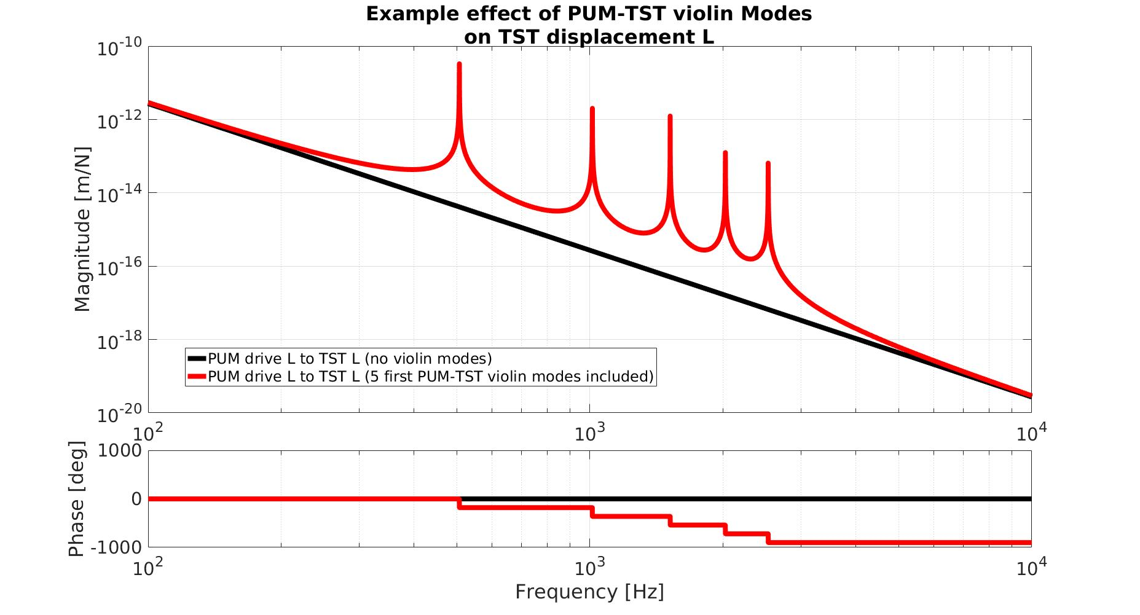
Some Features
*For a complete feature list of the QUAD Model, check G1401132.
6
G2100766

Slide 7
The builder functions:
Single: generate_Single_Model_Production.m
Double: generate_Double_Model_Production.m
Triple: generate_Triple_Model_Production.m
Quad: generate_QUAD_Model_Production.m
G2100766

Slide 8
All functions are in the SUS svn*:
Single: generate_Single_Model_Production.m
/SVNroot/sus/trunk/Common/MatlabTools/SingleModel_Production/
Double: generate_Double_Model_Production.m
/SVNroot/sus/trunk/Common/MatlabTools/DoubleModel_Production/
Triple: generate_Triple_Model_Production.m
/SVNroot/sus/trunk/Common/MatlabTools/TripleModel_Production/
Quad: generate_QUAD_Model_Production.m
/SVNroot/sus/trunk/QUAD/Common/MatlabTools/QuadModel_Production/
* “/SVNroot” refers to the svn root folder
G2100766

Slide 9
Model output:
The output is a struct with fields for the state-space model and other supporting information, which includes:
ss (dampedss): state-space model for the undamped (damped) suspension. Relates the inputs and outputs of the suspension.
in/out (dampedin/dampedout): structs with indices for the inputs and outputs of ss (dampedss). They organize the indices in a hierarchical way.
Output
Input
Test Mass
SUS point
Displacement
Displacement
Longitudinal
Longitudinal
G2100766

Slide 10
Supported features:
Single:
LPY damping.*
Violin modes (not for OPOS).
Double & Triple:
6 d.o.f. SISO damping at the top stage.*
Violin modes (last stage only).
Quad:
6 d.o.f. SISO damping at the top stage.*
Actuation against the reaction chain and OSEM readout output.
Backreaction forces to seismic table.
Violin modes in all stages, with each string modelled independently.**
ST2-Top mass feedforward.
Direct import of damping filters (using LiveParts)
Radiation pressure coupling of two quads.***
*Includes inputs to analyze OSEM noise coupling. ** With an option to use measured violin mode frequencies. *** Uses a standalone function, not part of the builder function.
G2100766

Slide 11
Questions, ideas, requests?
Include backreaction to sus tables in all models to couple with SEI models.
Python?
Simulink for the non-QUAD suspensions?

