Slide 1
Determining the Effect of Glitch Subtraction on Parameter Estimation
Lilah Mercadante
Mentors: Jonah Kanner, Alan Weinstein
1

Slide 2
Outline
Background on glitches
Motivation
Method/Research Plan
Data
Conclusions
2

Slide 3
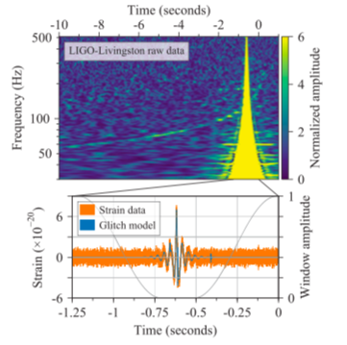
Background : What is a glitch?
High amplitude abrupt noise transient
Non-Gaussian behavior
Can be registered as false positives, weaken search sensitivity
Obscure signal
Make parameter estimation (PE) less accurate?
Source? Unknown.
Environmental disturbance, instrumental malfunction?
Image Citation: B. P. Abbott, Gw170817: Observation of gravitational
waves from a binary neutron star inspiral, Phys. Rev.
119, 1 (2017).
3

Slide 4
Background : How Do We Remove
Glitches?
BayesWave (BW) models glitches as superpositions of sine Gaussians.
Currently used by LVK to remove glitches before final publication
Being used to clean data for GWTC-2 Catalog to be published soon
Computationally intense, takes hours to run
Image Citation: B. P. Abbott, Gw170817: Observation of gravitational
waves from a binary neutron star inspiral, Phys. Rev.
119, 1 (2017).
4

Slide 5
Motivation
BayesWave glitch subtraction is a long process that requires moderate human intervention
Certain parameters set in BayesWave must be arbitrarily picked
Segment length
Upon further inspection of segment length parameter, found difficulty forming an algorithm
No direct correlation to chirp mass or glitch’s distance from signal
Do we always have to remove the glitch?
5

Slide 6
Our Question: How important is glitch subtraction to accurate PE?
Specifically: Is there a distance at which the glitch is far enough away from the signal that glitch subtraction has little/no positive impact on PE?
6

Slide 7
How Do We Test This?
Create a data sets
Simulated signal, simulated gaussian noise, and a real glitch
Inject glitch into one data set, leave the other clean
Glitch can only be in one detector
Run PE on both data sets
Run BayesWave on data with glitch to get cleaned data
Run PE on cleaned data
Compare
7

Slide 8
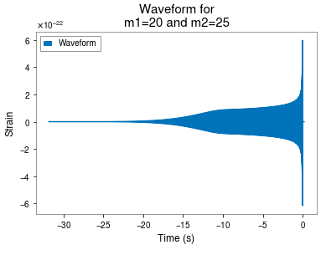
Simulated Data: The Signal
IMRPhenomD model
Tapering
We chose “common” masses
I chose masses of different size to be more realistic.
Distance = 1200 Mpc
Low freq. = 10 Hz
8

Slide 9
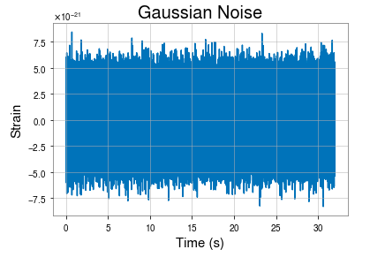
Simulated Data: Noise
9

Slide 10
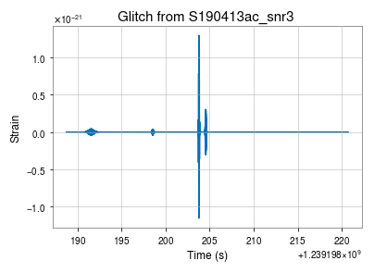
Simulated Data: The Glitch
BayesWave reconstruction of a glitch from O3a
Chosen because I already have access to this data
Plus event is in upcoming catalog
Decently loud glitch
Many small artifacts
10

Slide 11
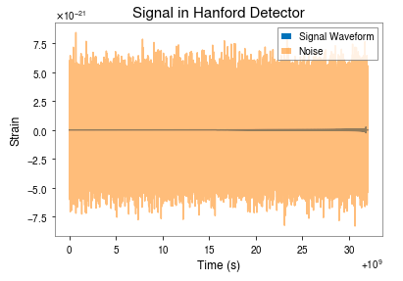
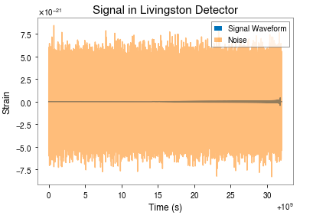
Simulated Data: Signal + Noise
11

Slide 12
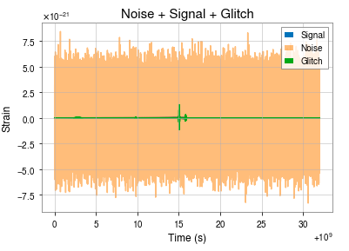
Simulated Data: Signal + Noise + Glitch
Chose Livingston detector for glitch injection
Louder signal
Set each component to have the same start time
Cyclic time shift to move signal to the middle and move glitch
Glitch is loud compared to signal in both detectors
12

Slide 13
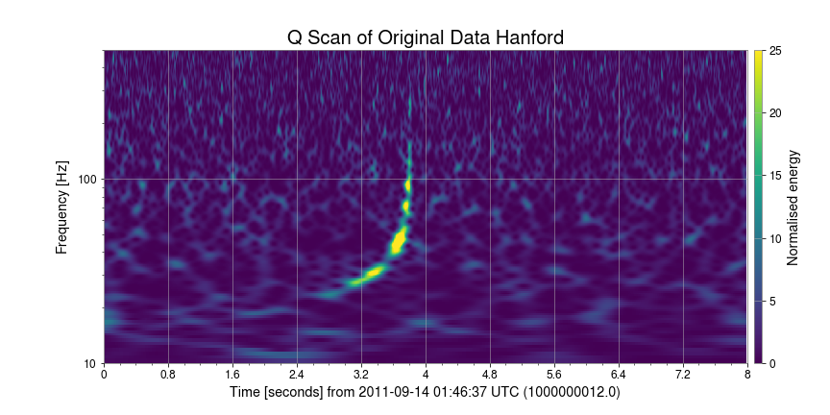
Q Scans: Original Hanford Data
13

Slide 14
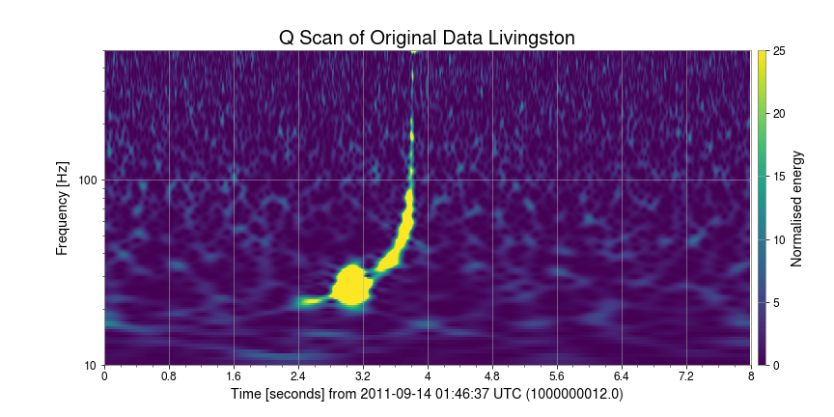
Q Scans: Original Livingston Data
14

Slide 15
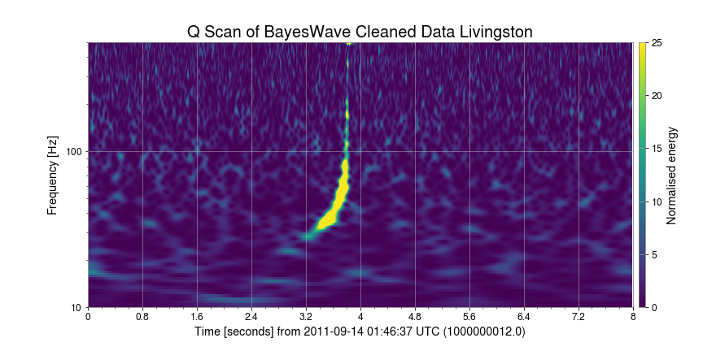
Q Scans: BW-Cleaned Livingston Data
15

Slide 16
Summary
We made simulated data and successfully ran BayesWave glitch subtraction
The PE jobs are still running, therefore we cannot yet draw conclusions or answer our project’s question
16

Slide 17
Future Work
When PE finishes we can make comparisons and draw conclusions on the effect of that one glitch on the signal
Next we can move the glitch further away and run BW and PE again to start answering our question
In the far future we could run these same tests while also varying other parameters like the masses and distances of these sources
Hope to gain a better understanding of when BW glitch removal is necessary and when it is not
17

Slide 18
Acknowledgements
National Science Foundation
National Science Foundation REU program
LIGO Laboratory
Jonah Kanner, Derek Davis, Colm Talbot, Alan Weinstein for guidance and assistance in debugging code
Tyson Littenberg for help running BayesWave and overall project guidance
Jack Kwok for help debugging code
18

Slide 19
Thank you for listening! Any questions?
19

