Slide 1
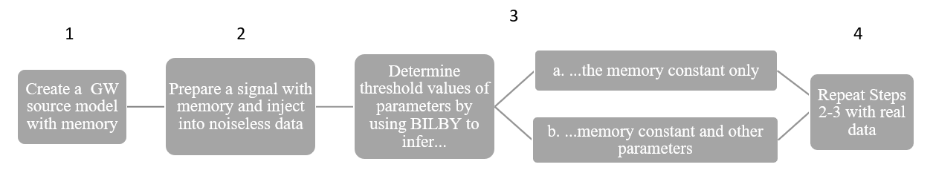

Work Flow
$$h_{tot}=h+{λ h}_{mem}$$

Slide 2
Work Flow
$$h_{tot}=h+{λ h}_{mem}$$

Slide 3
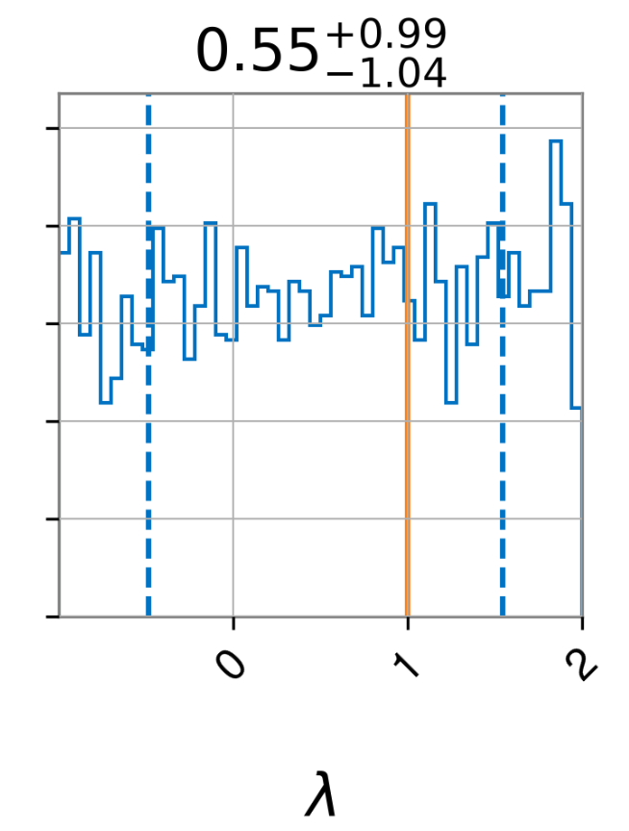
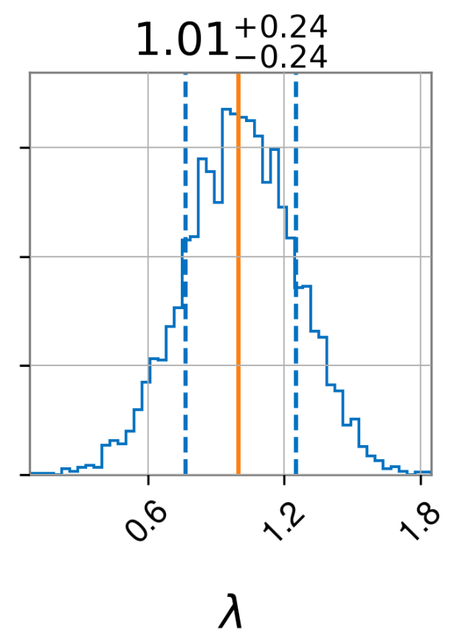
Bayes’ Rule
Prior
Data
Posterior

Slide 4
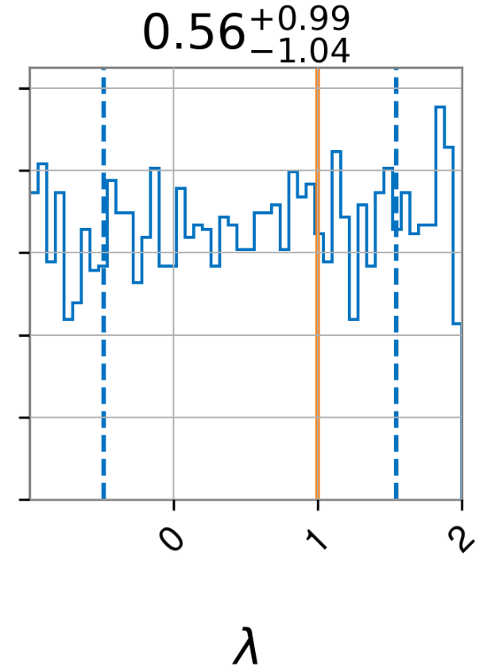
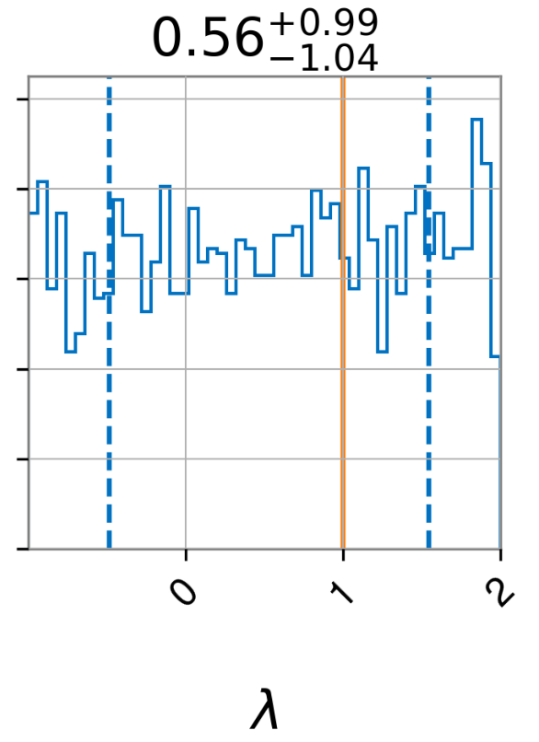
Varying Distance
Distance

Slide 5
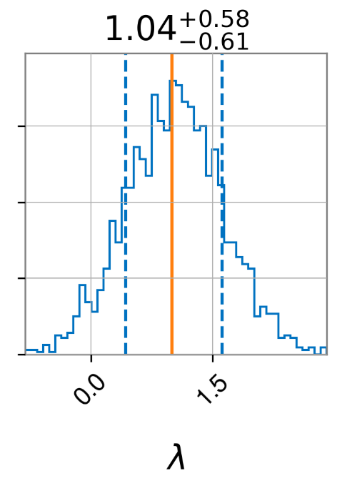
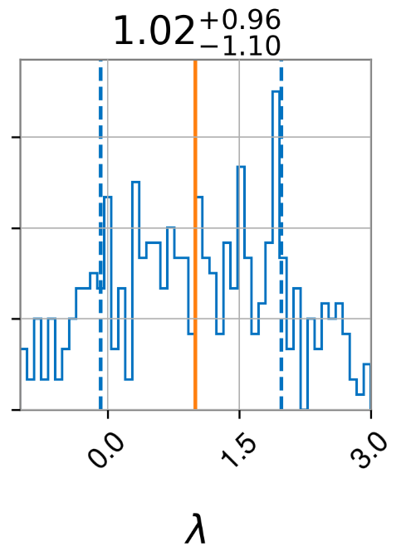
Varying Distance
Posterior
Distance

Slide 6


Bayesian vs. Frequentist
likelihood
chi square
($h+{λ h}_{m}$)

Slide 7
Bayesian vs. Frequentist
($h+{λ h}_{m}$)

Slide 8
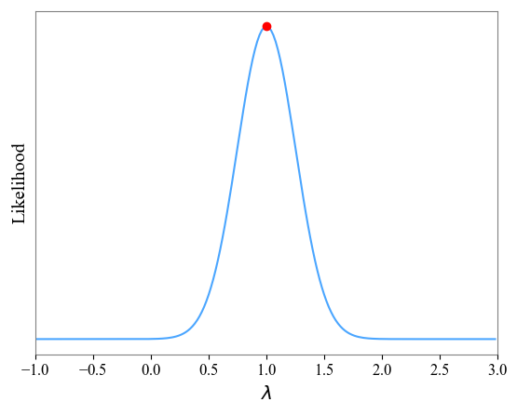
Maximizing Likelihood

