Slide 1

Detectability of Nonlinear Gravitational Wave Memory
(August 21, 2020)
Darin C. Mumma
Departments of Physics and Philosophy, Grove City College
Mentors: Alan Weinstein, Colm Talbot, Alvin K. Y. Li
LIGO Laboratory, California Institute of Technology
version 2
LIGO SURF 2020

Slide 2
Introduction
I. Background: gravitational wave (GW) memory form and types
II. Problem: can we detect GW memory?
III. Approach: Bayesian parameter estimation
IV. Results: posterior samples…and a lot of ‘em!
V. Future work: where can we go next?

Slide 3
Background

Slide 4
What is Memory?

Slide 5
What is GW Memory?

Slide 6
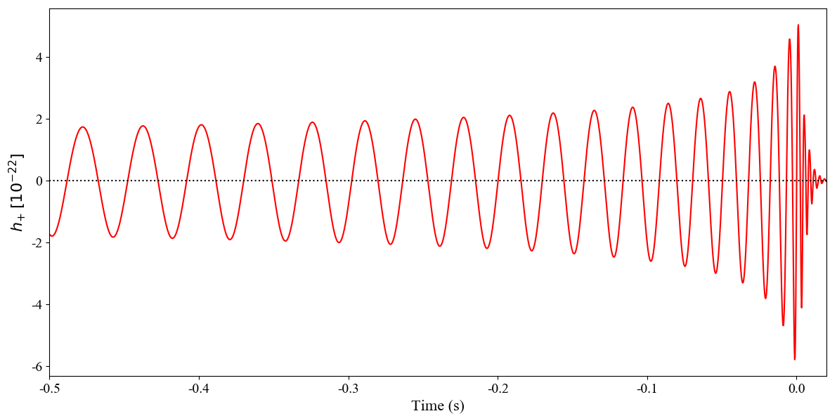

Time Domain Waveform
Figure 1. Sourced from a binary black hole (BBH) merger with non-spinning components, $M=60$M , $q=1$ and $d_{L}=600$Mpc.
$$☉$$

Slide 7
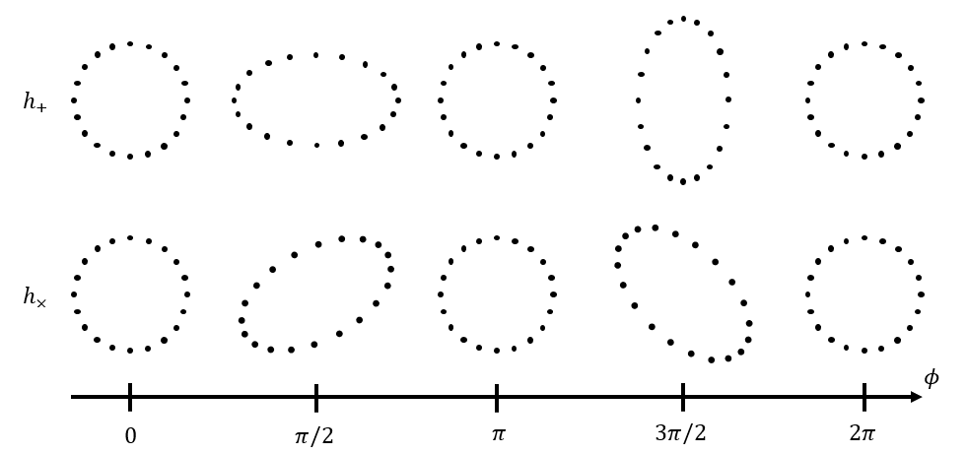

What is Memory?
GW$⊗$
d
d
d
d

Slide 8
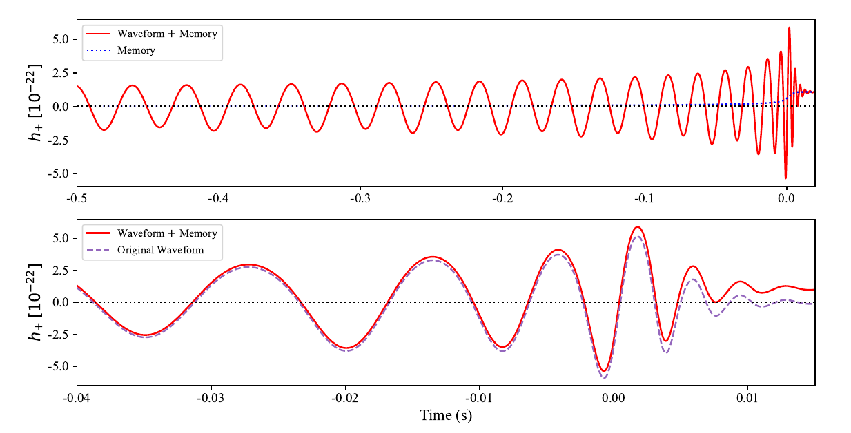


Time Domain Memory
$$h_{mem}$$
$$h_{mem}$$
Figure 2. (Top) Superposed memory and full waveform. (Bottom) Superposed oscillatory and full waveform over the LIGO band only. All waveforms were sourced from a BBH merger with non-spinning components, $M=60$M , $q=1$ and $d_{L}=600$Mpc.
$$☉$$
$$☉$$

Slide 9

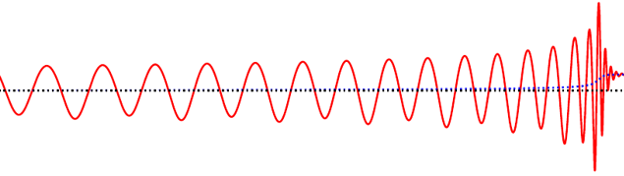
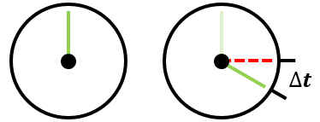

What is Memory?
Space
Time
$$\frac{1}{2}∆x$$

Slide 10
What is Memory?
Every gravitational waveform has two components: oscillatory and secular [1]
Two kinds of secular components: linear and nonlinear
oscillatory
+ secular
secular

Slide 11
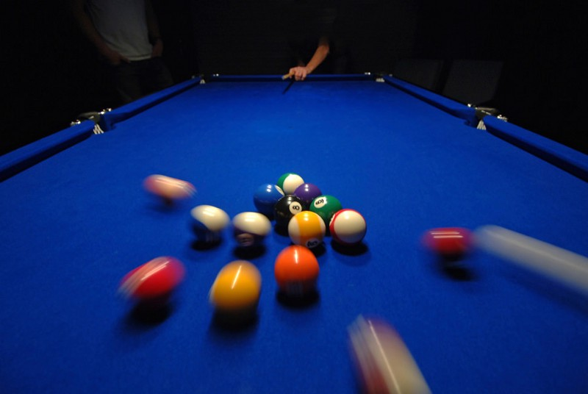
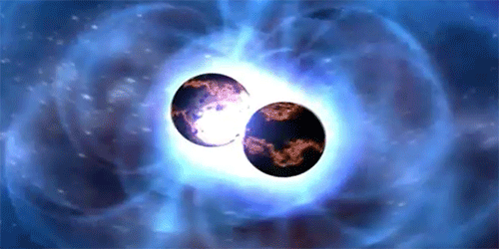
Linear Memory
Independent of source’s past motion (i.e. integrable or conservative)
Only exists alongside mass emission (e.g. neutrinos)
Too small to detect in BBH mergers [2, 3]
neutrinos
(Courtesy of Lea [4] and LIGO Caltech [5])

Slide 12

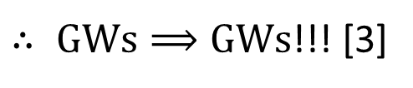



Nonlinear Memory
$$1. accelerating masses⟹GWs$$
$$2. mass∝energy$$
$$3. GWs=energy$$
gravitons
$∴ GWs⟹GWs$!!! [3]

Slide 13
Nonlinear Memory
Depends on entire past motion of source
(i.e. hereditary, nonintegrable, or nonconservative)
More prominent than linear memory in BBHs [1, 2]
Typically 10 times weaker than oscillatory component [3]

Slide 14
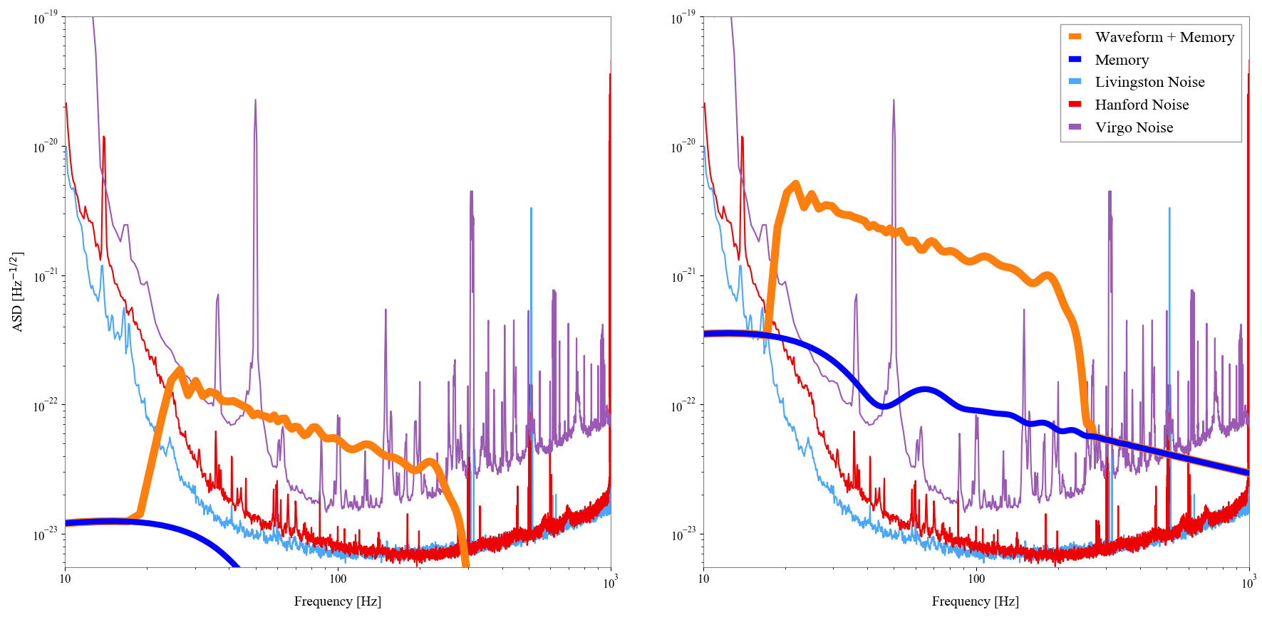


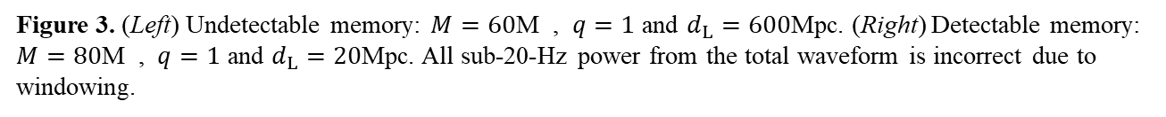
Frequency Domain Memory
Figure 3. (Left) Undetectable memory: $M=60$M , $q=1$ and $d_{L}=600$Mpc. (Right) Detectable memory: $M=80$M , $q=1$ and $d_{L}=20$Mpc. All sub-20-Hz power from the total waveform is incorrect due to windowing.
$$☉$$
$$☉$$

Slide 15
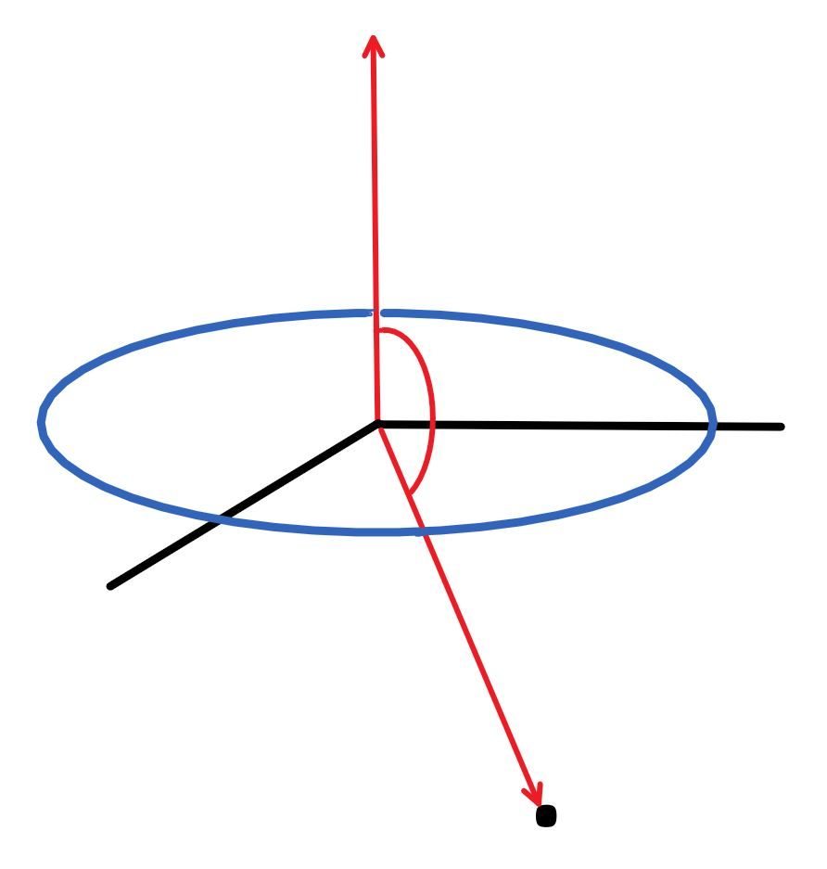








Estimating Memory
Nonlinear GW memory is given by:
$h_{mem}≈\frac{5}{14c^{2}}$ $\frac{E}{r}$ $\sin^{2}ι$ (1)
where E $≡$ total radiated energy of GW source,
c $≡$ vacuum speed of light
r $≡$ distance between source and detector,
$ι$ $≡$ inclination angle $≡$ angle between $\vec{L}$ and $\vec{r}$.
Let’s use GW150914 as an example:
$E=3.0M ⋅c^{2}$, $r=410$Mpc, and $ι={150}^{\text{◦}}$.
Thus,
$h_{mem}$ $≈3.0×{10}^{−23}.$ (2)
For reference,
$h_{max}$ $≈1.0×{10}^{−21}$.
$$z$$
$$\vec{L}$$
binary orbit
$$ι$$
$$y$$
$$☉$$
$$x$$
$$\vec{r}$$
detector
(Courtesy of Garfinkle [6])

Slide 16
Problem

Slide 17
Can we detect memory?

Slide 18
Under what circumstances can we detect memory?

Slide 19
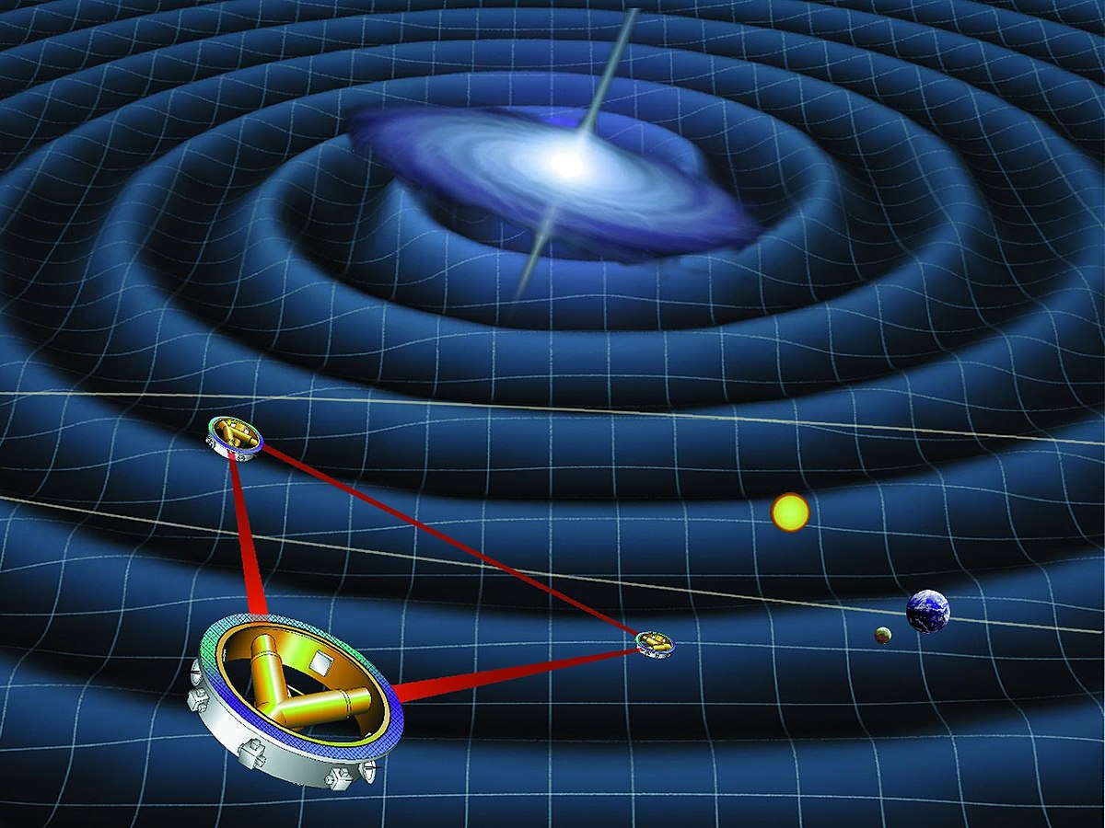
Importance
Verification of General Relativity
But, why now?
MANY new and exciting events [7]
More detectors than ever
Higher sensitivity per detector
Later…
LISA [1]
(Courtesy of NASA [8])

Slide 20
Approach

Slide 21

Model with Memory
memory constant
$$h_{tot}=h+{λ h}_{mem}$$

Slide 22
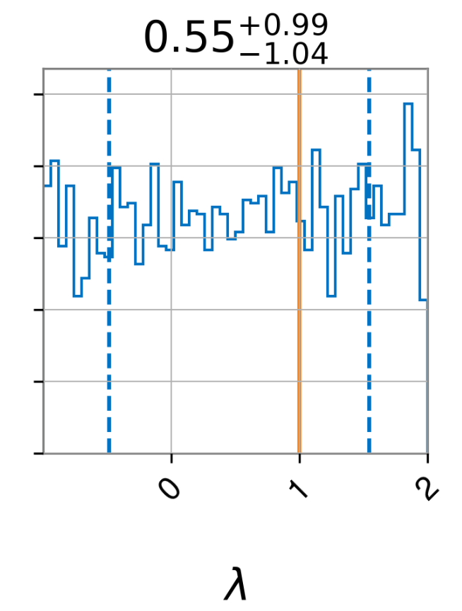
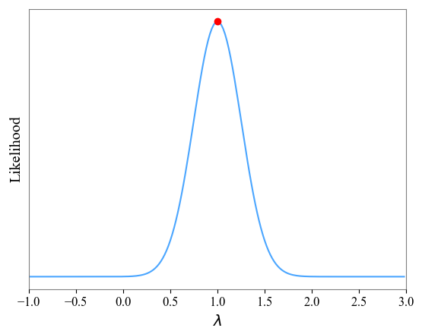
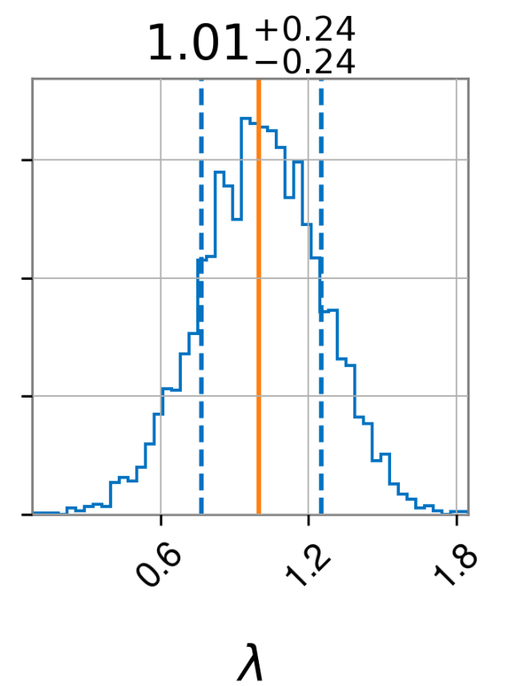
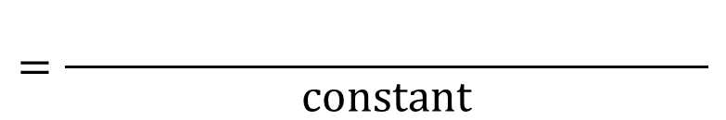

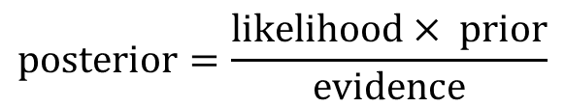

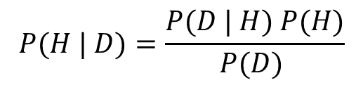
Bayes’ Theorem
FOR MATHEMATICIANS
FOR THEORISTS
$$P(H | D)=\frac{P(D | H) P(H)}{P(D) }$$
$$posterior=\frac{likelihood× prior}{evidence}$$
FOR LIGO SCIENTISTS
Likelihood
$$×$$
Prior
Posterior
$$=\frac{ylfkglfkfkglfkglfgkgflgkflk}{constant}$$
$$λ$$

Slide 23
Bayes’ Theorem
Prior
Data
Posterior

Slide 24
Results

Slide 25
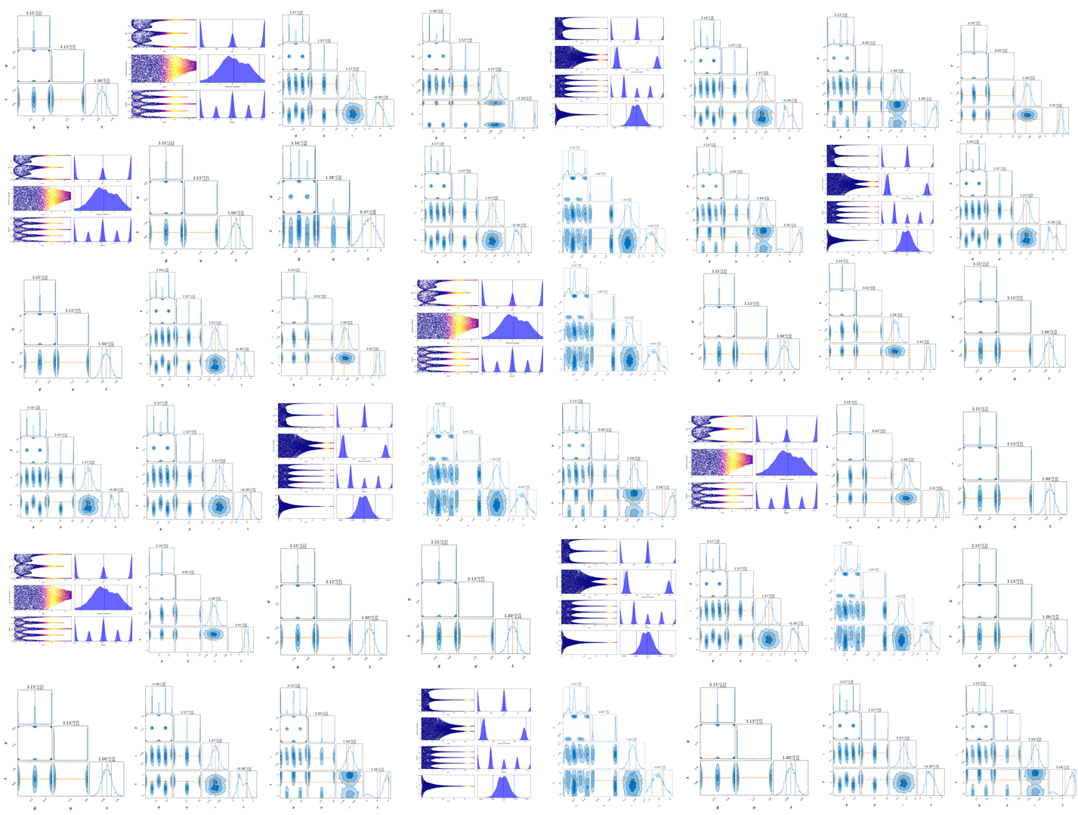

Slide 26
Questions?

Slide 27
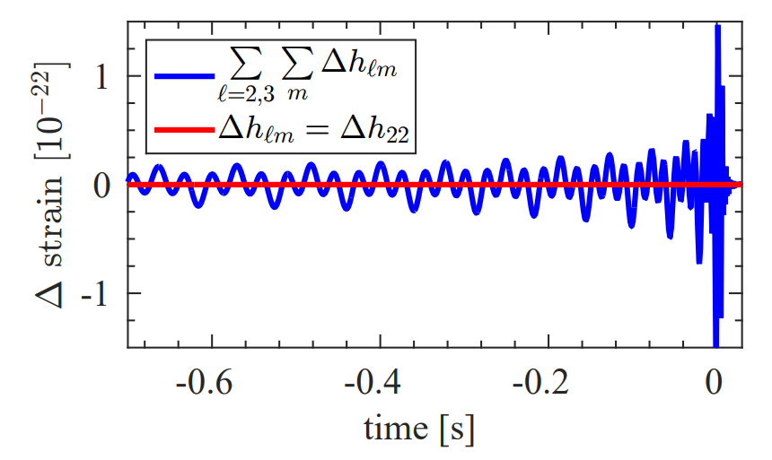


Degeneracy
Under the transformation
($ψ→ψ+π/2$, $φ_{c}→φ_{c}+π/2$)…
Oscillatory part remains the same
Memory swaps sign
…but only if we are looking at the (2, 2)-mode alone.
Figure 4. Time series plot of the difference between $h_{lm}$ $\left(ψ, { φ}_{c}\right)$ and $h_{lm}(ψ+π/2,{ φ}_{c}+ π/2)$. (Red) (2, 2)-mode only and (Blue) higher-order modes only. The injected waveform used to generate these posterior distributions is sourced by a system with the following parameters: $M=70.4$solar masses, $q=1.1$, $d_{L}=\text{342.2}$Mpc, $ι=$ 2.5, $α=$ $δ=1.2$ (Courtesy of Lasky et al. [])

Slide 28
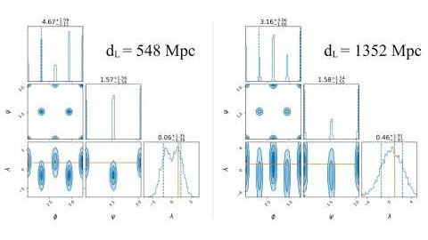
(2, 2)-mode only
Higher-order modes
Figure 5. (Left) (2, 2) mode only and (Right) all modes included. The injected waveform used to generate these posterior distributions is sourced by non-spinning components with $M_{tot}=60$solar masses, $q=1$, $ι=π/2$, $ψ=0, φ_{c}=0, α=0$, $δ=0$.

Slide 29
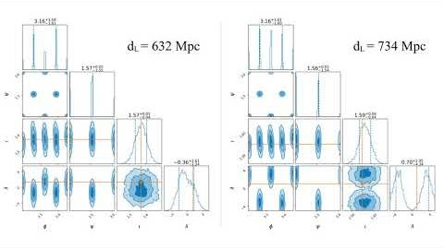
Noiseless
Noisy
Figure 6. (2, 2)-mode degeneracy. (Left) noiseless and (Right) with noise. The injected waveform used to generate these posterior distributions is sourced by non-spinning components with $M_{tot}=60$solar masses, $q=1$, $ι=π/2$, $ψ=0, φ_{c}=0, α=0$, $δ=0$.

Slide 30
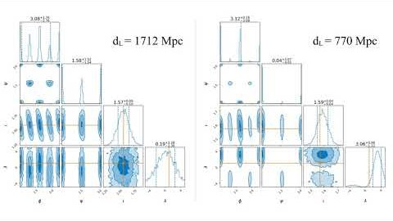
Noiseless
Noisy
Figure 7. (Left) Noiseless signal with all modes included and (Right) noisy signal with all modes included. The injected waveform used to generate these posterior distributions is sourced by non-spinning components with $M_{tot}=60$solar masses, $q=1$, $ι=π/2$, $ψ=0, φ_{c}=0$, $α=0$, $δ=0$.

Slide 31
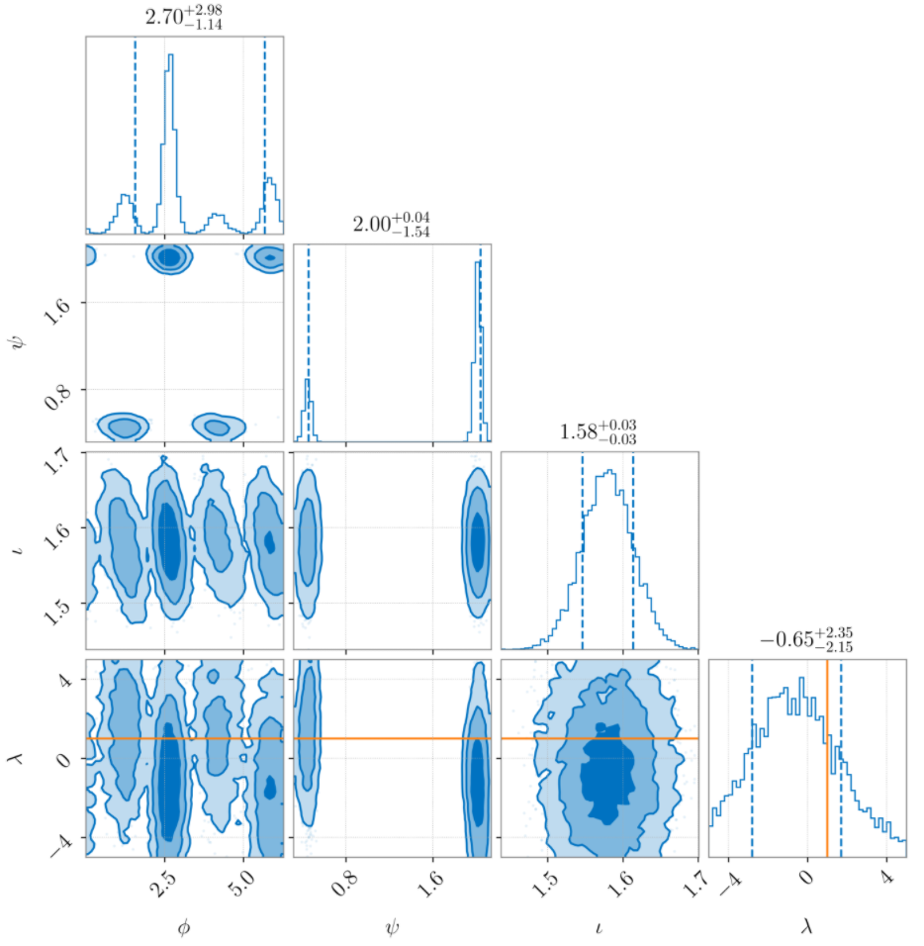
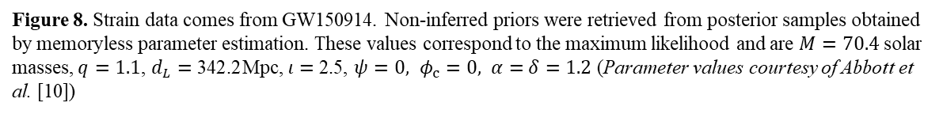
The Real Deal!!!
Figure 8. Strain data comes from GW150914. Non-inferred priors were retrieved from posterior samples obtained by memoryless parameter estimation. These values correspond to the maximum likelihood and are $M=70.4$solar masses, $q=1.1$, $d_{L}=\text{342.2}$Mpc, $ι=$ 2.5, $ψ=0, φ_{c}=0, α=$ $δ=1.2$ (Parameter values courtesy of Abbott et al. [10])

Slide 32
Future Work

Slide 33
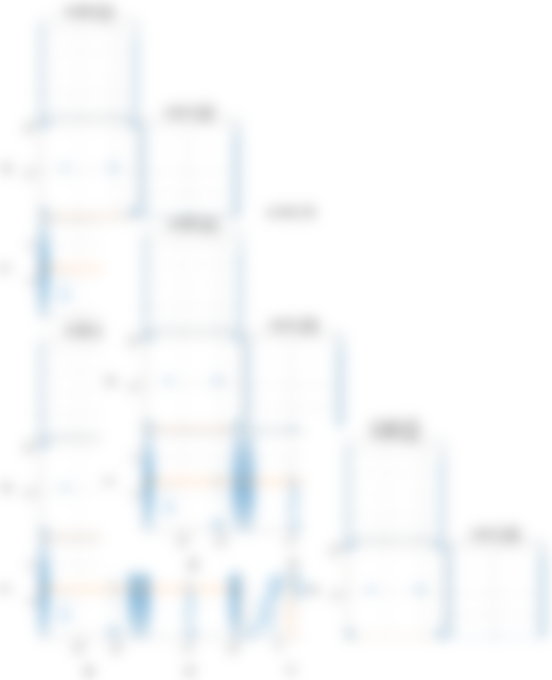
Future Work
Analyze remaining events
Explore higher dimensional
parameter spaces
Incorporate full posterior samples for
physical events
Later…
Event stacking
?

Slide 34


Acknowledgements
Mentors
LIGO Laboratory
Caltech SURF
National Science Foundation (NSF)
LIGO SURF 2020

Slide 35
References
[1] M. Favata. “The gravitational-wave memory effect.” Classical Quantum Gravity, 27(8): 2010.
[2] C. Talbot et al. “Gravitational-wave memory: waveforms and phenomenology.” Phys. Rev. D, 98(6): 2018.
[3] K. Thorne. “Gravitational-wave bursts with memory: The Christodoulou effect.” Phys. Rev. D, 45(2): 520- 24: 1992.
[4] R. Lea. DOI: https://sciscomedia.co.uk/reverse-time.
[5] LIGO Caltech. DOI: https://www.ligo.caltech.edu/video/BNS-merge.
[6] D. Garfinkle. “A Simple Estimate of Gravitational Wave Memory in Binary Black Hole Systems.” Classical Quantum Gravity, 33(17): 2016.
[7] B. P. Abbott et al. Astrophys. J. Lett., 892(L3): 2020.
[8] NASA. DOI: lisa.jpl.nasa.gov/gallery/lisa-waves.
[9] P. D. Lasky et al. “Detecting Gravitational-Wave Memory with LIGO: Implications of GW150914.” Phys. Rev. Lett., 117(6): 2016.
[10] B. P. Abbott et al. “GWTC-1: A Gravitational-Wave Transient Catalog of Compact Binary Mergers Observed by LIGO and Virgo During the First and Second Observing Runs.” Phys. Rev. X, 9(3): 2019.
[11] C. M. Biwer et al. “PyCBC Inference: A Python-based parameter estimation toolkit for compact binary coalescence signals.” PASP, 131(996): 2019.
[12] C. Talbot. “GWMemory.” DOI: github.com/colmtalbot/gwmemory.
[13] G. Ashton. “BILBY.” DOI: lscsoft.docs.ligo.org/bilby/index.

Slide 36
Questions?

