Slide 1
SIS20 Primer
Hiro Yamamoto / LIGO
Introduction
  Real world vs simulation
Simple system
  FP
    Field, power distribution, etc
  FP with maps and point absorber
    Round trip loss, modes, mirror surface, etc
LLO
  DRFPI with point absorber
  Round trip loss, PRG, etc
1

Slide 2
real hardware vs SIS
 | Real HW | Simulation
Building block | Laser, Mirror, Cavity | IFOBuilder : tool package FFTIFO (base class), LaserObj, MirrorObj, PropObj
IFO | 40m, iLIGO, aLIGO | DRFPM, FP, Mirror (derived class of FFTIFO using objects defined in IFOBuilder)
Operation | Laser on, locking | lock, calc (calculate fields with / without cavity locking)
Analysis | Measure error signal, modes in cavity, power on baffle | demod, power, gaussFit (FFT fields) HGPower, mainLGs (HG and LG mode analysis) PointScatter, getField (large angle scattering)

Slide 3
FFT Basic :
Field on optics + propagation

Slide 4
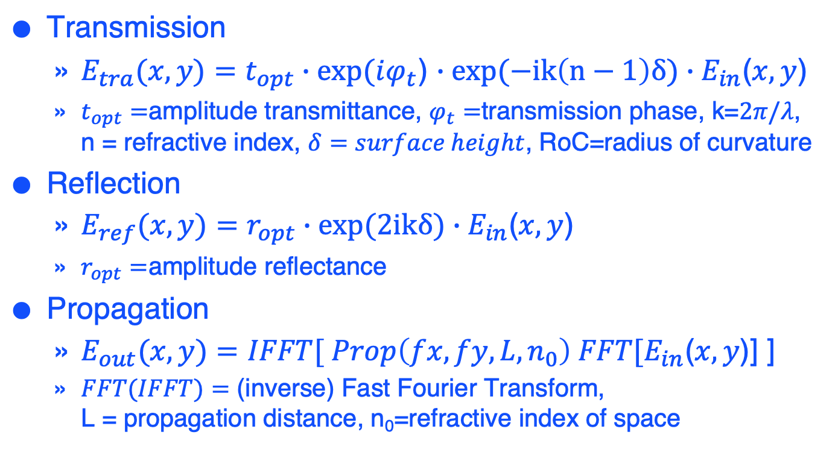
Three basic formulas
Transmission
  $E_{tra}(x,y)=t_{opt}∙exp⁡(iφ_{t}$) $∙exp(−ik\left(n−1\right)δ)∙E_{in}$($x,y$)
  $t_{opt}=$amplitude transmittance, $φ_{t}=$transmission phase, k=$2π/λ$,
  n = refractive index, $δ=surface height$, RoC=radius of curvature
Reflection
  $E_{ref}(x,y)=r_{opt}∙exp(2ikδ)∙E_{in}$($x,y$)
  $r_{opt}=$amplitude reflectance
Propagation
  $E_{out}(x,y)=IFFT[ Prop\left(fx,fy,L,n_{0}\right) FFT[E_{in}$($x,y$)] ]
  $FFT(IFFT)=$ (inverse) Fast Fourier Transform,
  L = propagation distance, n₀=refractive index of space

Slide 5
Simple FP simulation
FPIFO0.m
classdef FPIFO0 < FFTIFOAcc
methods
function obj = FPIFO0( varargin )
obj@FFTIFOAcc( varargin{:} );
end
function defineIFO( obj, varargin )
%% add optics
% laser source
obj.addLaser( 'laser' );
% ITM
obj.addMirror( 'ITM', 'invRoC', 1/1934, 'Aperture', 0.34, 'T', 0.014, 'Thick', 0.2 );
% ETM
obj.addMirror( 'ETM', 'invRoC', 1/2245, 'Aperture', 0.34, 'T', 5e-6 );
%% define connections among optics
obj.addProp( '', 'laser', 'ITM-AR' );
obj.addProp( 'FPprop', 'ITM-HR', 'ETM-HR', 4000);
end
end
End

Slide 6
Examine FP cavity same procedure for any
* Build an IFO
fp = FPbasic; % define FP
* Lock the cavity
fp.lock; % lock FP
* Study system
fp.power('ITM-HR-o'); % power of outgioing field from ITM HR
fp.roundtripLoss(‘ITM-HR-o’); % round trip loss
fp.gaussFit('ITM-HR-o') % gaussfit of a field
fp.HGCoef('ITM-HR-o',0:1,0:1) % HG(0,0), (1,0), (0,1), (1,1) amplitude
fp.printAll % print all information about fp
% field of incoming field to ETM HR
% E(j,i) is the amplitude of the field at (x,y) = (x(i), x(j))
[E,x,y] = fp.getField('ETM-HR-i');
semilogy( x.^2, abs(E(end/2,:)).^2 )

Slide 7
Outputs
fp = FPbasic; (the mode is defined using FP cavity RoCs and length)
Cavity mode defined using field 'ITM-HR-o' with w = 0.0534211, RoC = -1934
fp.lock;
1 (FFT 8) : 'ITM-HR-o' Pwr= 2.832e+02, Err= 9.930e-01, …
(change cavity length until converges)
9 (FFT 72) : 'ITM-HR-o' Pwr= 2.835e+02, Err= 8.077e-07, … delL=-3.376e-16
fp.roundtripLoss(‘ITM-HR-o’)
6.9348e-07
fp.gaussFit(‘ITM-HR-o’) : (gauss fit of the field)
'(x,y) = (1.79476e-08, -1.80293e-08), w = 0.05342810192, R = -1934.086631
fp.HGCoef('ITM-HR-o',0:1,0:1) % HG(0,0), (0,1); (1,0), (1,1) amplitude
1.6837e+01 + 3.1260e-03i 2.7750e-10 - 1.9355e-10i
6.3478e-11 + 1.8906e-10i 2.0643e-11 - 1.3251e-11i

Slide 8
fp.printAll outputs
=== Information about fields ===
3) name: ITM-HR-i ==== Power = 283.481, E(analytic) = -16.8377, [status = 1024]
RoC = 1934, w = 0.0534211, z = 1837.22, z0 = 421.68, 1/phiCorr = 1844.22
q = 1837.22 + i 421.68, 1/q = 0.000517063 - i 0.000118677
=== Information about optics ===
2) name: 'ITM', Wfft = 0.854768, Nfft = 256
inPorts = [ 3 4 ] loss for each input port = [ 2.10749e-07 1.66283e-09 ]
outPorts = [ 5 6 ]
loss 3.91984e-05 in 'ITM-HR-i'+'ITM-AR-i'->'ITM-HR-i'+'ITM-AR-i'
R = 0.986, T = 0.014, L = 0
Roc(HR) = 1934, Aperture = 0.340000, Thickness = 0.200000, n = 1.449630, …
=== Information about propagators ===
3) name: FPprop prop loss = 4.85674e-07
Prop from 'ITM-HR-o'[5] to 'ETM-HR-i'[7]
L0 = 4000, propL0 = 4000, delL = 4.61187e-07, lockPhase/pi = 0, gouy00 = 2.72342
nRef = 1, ratio = -1.16894, CLa = -0.00046387, (-k*L+(1+n+m)gouy00)/pi = 1.83876e-08

Slide 9
FP with surface aberration
FPwMaps.m
Variables can be set at run time
  fp = FPwMaps('ITMID', 4, 'ETMID', 10, 'xPoE', 0.02, 'pointPwrE', 0.03);
Mirrors can be specified by ID
  Data files should be in ./Data0/
Simple ring heater
Thermal distortions by coating absorption
Point absorbers at multiple locations
Spatial resolution can be specified if you need fine structure
Poorman’s WFS
Support tools
  Mode analysis
  Inspection of surface map

Slide 10
Implementing surface aberration
% dat = calcThermal( elph, r, Psub, Pcoat, w, thickness, radius )
% thermal deformation by absorption using Hello-Vinet formula
%
% del = pointAbs( x, y, x0, y0, Pabs, absRadius )
% parametrization of surface aberration by point absorber
% (x0, y0) : location of point absorber in m
% Pabs : amount of absorption in W
% multiple absorbers : x0 = [0.02, 0.03], y0 = [-0.01, 0.02],
% Pabs = [0.04, 0.02]
% ITM HR surface
obj.setHRfiles( 'ITM', ITMmap, ...
'map + rsq*delRoCI/2 + calcThermal(0, r, 0, PcoatI, wI, 0.2, 0.175 )
+ pointAbs(x,y,xPoI, yPoI, pointPwrI)', ...
0.16, ITMRoC, 0, ...
'delRoCI', delRoCI, 'PcoatI', PcoatI, 'wI', 0.053,
'xPoI', xPoI, 'yPoI', yPoI, 'pointPwrI', pointPwrI );

Slide 11
LLO simulation
LLODRFPMAcc.m
Dual recycled FP Michelson with LLO maps
  Stable power recycling and signal recycling cavities
All the map aberrations in FPwMaps are included for both arms
  Effects of point absorbers
Beam off-centering in the arm – tricky way
Misc
  Extra arm loss of 30ppm added by hand to make the PRG to be 50

Slide 12
LLO runs with point absorber
llo = LLODRFPMAcc; llo.lock(‘errorLimit’,1e-3)
: 'PRM-HR-o' Pwr= 5.186e+01, Err= 2.278e-04, delL=-1.231e-12
: 'SRM-HR-o' Pwr= 5.986e-02, Err= 2.950e-04, delL=-1.203e-11
: 'ITMX-HR-o' Pwr= 6.948e+03, Err= 7.878e-04, delL= 1.626e-15
: 'ITMY-HR-o' Pwr= 6.785e+03, Err= 7.715e-04, delL= 1.577e-15
llo.roundtripLoss('ITMX-HR-o’) : 5.315445166031996e-05
llo.roundtripLoss('ITMY-HR-o’) : 5.931360270183816e-05
% with point absorber on ETMY
llo = LLODRFPMAcc('xPoY', 0.02, 'yPoY', 0, 'PpointEY', 0.05 );
: 'PRM-HR-o' Pwr= 3.013e+01, Err= 7.783e-05, delL= 2.503e-12
: 'SRM-HR-o' Pwr= 9.942e-02, Err= 3.720e-04, delL= 2.699e-11
: 'ITMX-HR-o' Pwr= 3.996e+03, Err= 8.830e-04, delL=-3.660e-17
: 'ITMY-HR-o' Pwr= 3.932e+03, Err= 9.296e-04, delL=-4.301e-15
llo.roundtripLoss('ITMX-HR-o’) : 5.317286612804839e-05
llo.roundtripLoss('ITMY-HR-o’) : 1.597188171539310e-04

Slide 13
LLO beam tilt
llo = LLODRFPMAcc('res', 2e-3, 'armPower', 0,
'xPoY', 0.02, 'yPoY', 0, 'PpointEY', 0.05,
'posEYX', -0.02);
No thermal by coating absorption
Point absorber on ETMY at (2cm,0) 50mW
Beam on ETMY at (-2cm,0)

Slide 14
PRG and arm loss
Point absorber on ETMY | Beam center on ETMY | PRG | X arm loss | Y arm loss
none | (0,0) | 51.0 | 53 ppm | 59 ppm
(2cm,0) 50mW | (0,0) | 29.1 | 53 ppm | 160 ppm
(2cm,0) 50mW | (-2cm,0) | 32.8 | 53 ppm | 108 ppm
(2cm,0) 50mW | (2cm,0) | 33.5 | 53 ppm | 141 ppm
(2cm,-1cm) 30mW (0,-1cm) 50mW | (2cm,0) | 28.2 | 53 ppm | 155 ppm

