Slide 1
SN1549 images after precision RTS scan after micromachining (laser ablation)
G. Billingsley

Slide 2
Previous work on this sample
LIGO-G1902383: Absorption Test and microscopy of witness sample SN1549 ITM03/11 HR
LIGO-G2000212: Second tests of Laser Micromachining LIGO Mirrors
LIGO-T1900901: Post-Ablation absorption testing of ITM03/11 HT Witness Sample SN1549
LIGO-T2000125: Post-Ablation high resolution absorption testing of ITM03/11 HT Witness Sample SN1549
Main Filecard for this sample
LIGO-E2000051: Advanced LIGO Core Optic coating witness sample ITM 03/11 HR SN1549

Slide 3
T2000125 snapshot This high resolution absorption scan is done near the estimated laser ablation position. The scan is 4 mm in diameter at about the same intensity (~25 W/mm^2) as aLIGO. Five points are confirmed absorbers as they do not change after a drag wipe. None of these points were found in the gentle absorption scan T1900901 The point e location was adjusted manually to obtain the maximum absorption signal. This point showed the brightest scatter from the probe beam, and so is presumed to be the location of the laser ablation described in G2000212

Slide 4
Point e location relative to ink at RTS

Slide 5
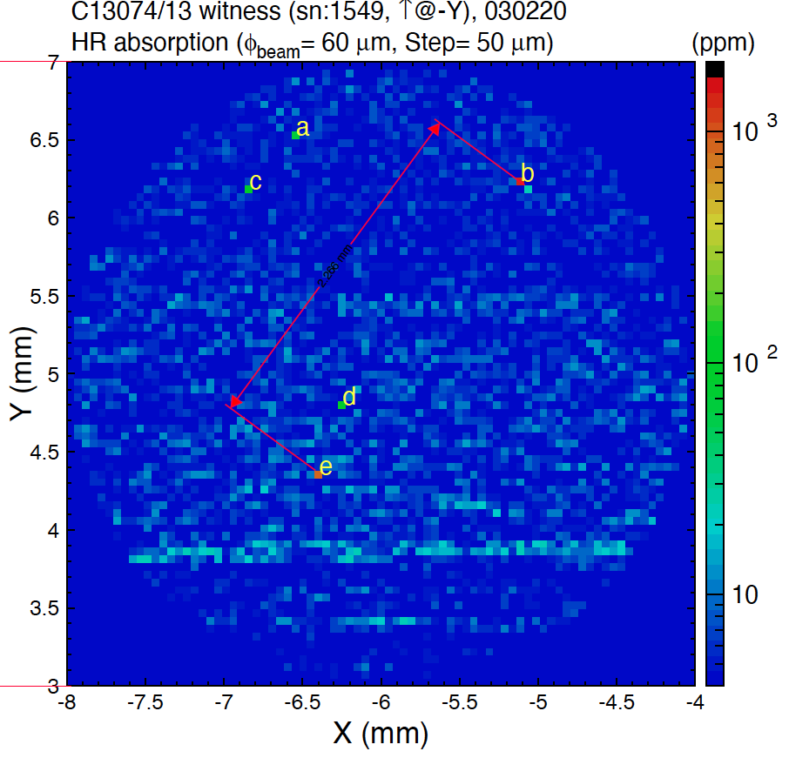
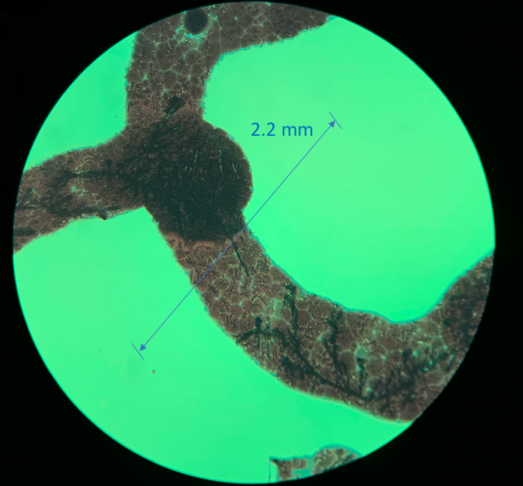
Tie RTS location to microscope image 2.25 mm measured between point b2 and the ablated spot using the microscope.
2.266 mm distance between point b and e as scaled in acrobat.

Slide 6
Area b overview Assume that b2 is the absorber found by RTS

Slide 7
Point b2, about 5 µm long

Slide 8
Point e – no apparent damage from scan
As received After RTS scan (~25 W/mm^2)

Slide 9
Also of interest: a retroreflection in the ablation system? ~425 µm separation.

Slide 10
Super clean T2000149
Cleaning This scan was performed after the sample was Wrapped in an alpha wipe placed in a small beaker the beaker was filled with isopropyl alcohol The beaker was placed in water in an ultrasonic cleaner for 10 minutes The sample was removed and drag-wiped with acetone using berkshire paper lens tissue.
Motivation We know that first contact can be absorbing, we want to be sure the absorption measured at the ablation spot is not because of some embedded first contact.
Damage There was some damage of the sample during the latest scan, this does not interfere with the ablation test site, they are separated by ~ 1.5 mm see T2000149
The point e location was adjusted manually to obtain the maximum absorption signal. This point showed the brightest scatter from the probe beam, and so is presumed to be the location of the laser ablation described in G2000212

