Slide 1
IFO Performance During Earthquakes
Eyal Schwartz 04/08/2020
Arnaud Pele, Jim Warner, Brian Lantz, Kate Dooley
On behalf of LIGO seismic team and many others at the sites
DCC paper: LIGO-P2000072

Slide 2
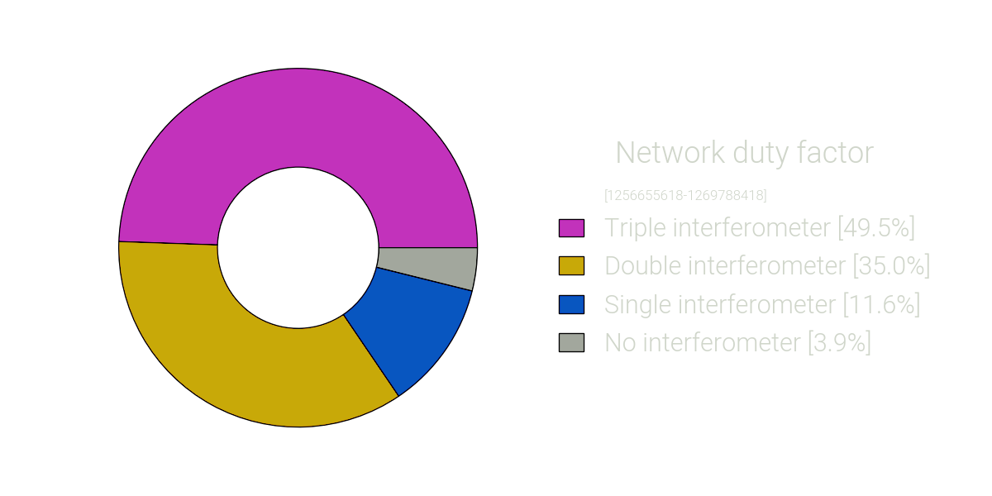
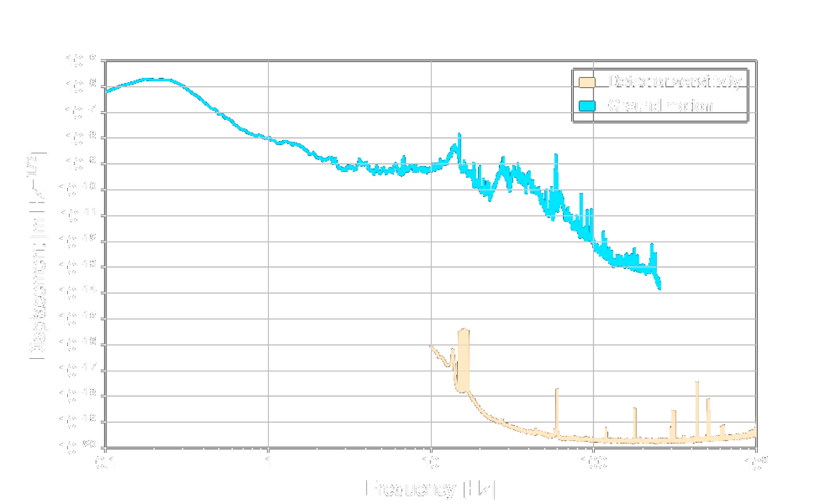
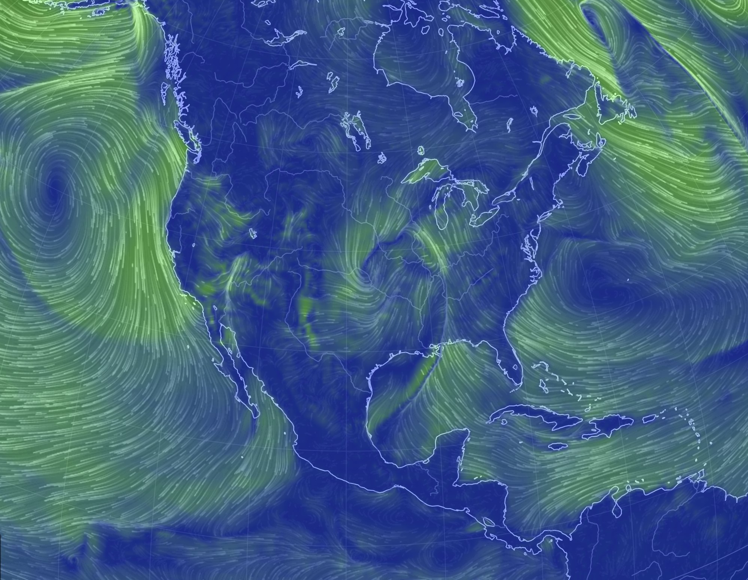
Why seismic isolation: sensitivity and duty cycle
10 orders of magnitude
Vajente, G1900851
Pele, G2000186
https://earth.nullschool.net/
Notes:
We use seismometers placed on the slab at different locations of the detector to measure the ground motion of the sites. We typically split the ground motion in separate frequency bands for different type of vibrations source. The first band, below 0.1Hz is sensitive to teleseismic earthquakes. It is also sensitive to wind which tilts the building and create a fake signal in our instruments. The second band covers the useism frequencies, between 0.1 and 1Hz, where the noise is generated by movement of the ocean waves.
The other frequency band, above 1Hz, is dominated by noise caused by human activities : cars, trucks, trains, heavy machinery.
This spectra shows the variation of the ground motion over few days in 2015, while a storm was passing in the gulf. We can see the variation of the motion in the useism band, increasing by more than a factor of 10 over a day.

Slide 3
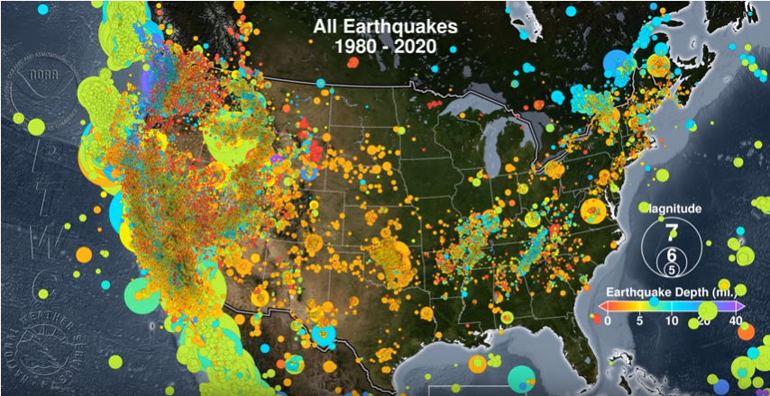
So what is the problem???
Well…. One of many….
https://youtu.be/sv7JwrWURyQ

Slide 4
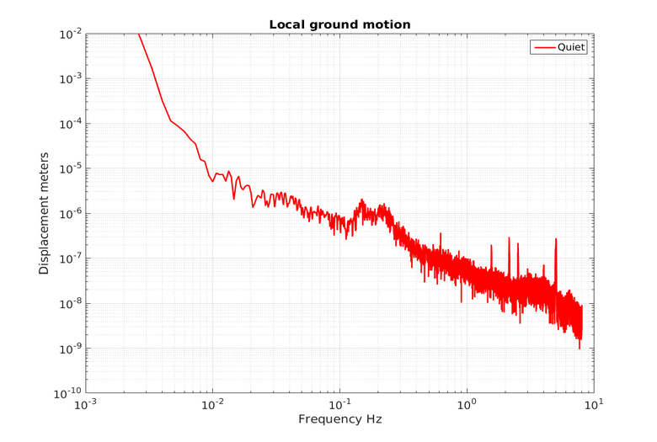
So what is the problem???
anthropogenic
Earthquake
Wind
useism

Slide 5
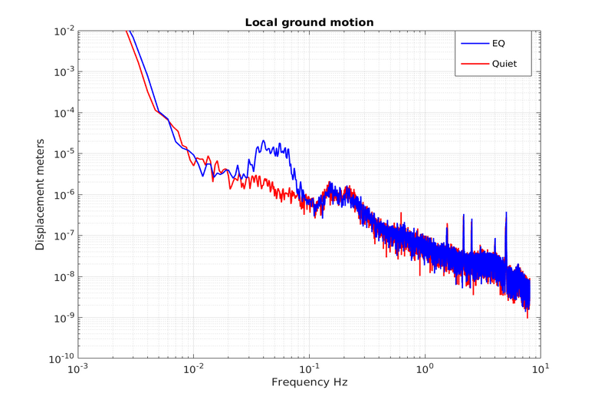
So what is the problem???
anthropogenic
anthropogenic
Earthquake
Wind
Earthquake
Wind
useism
useism

Slide 6
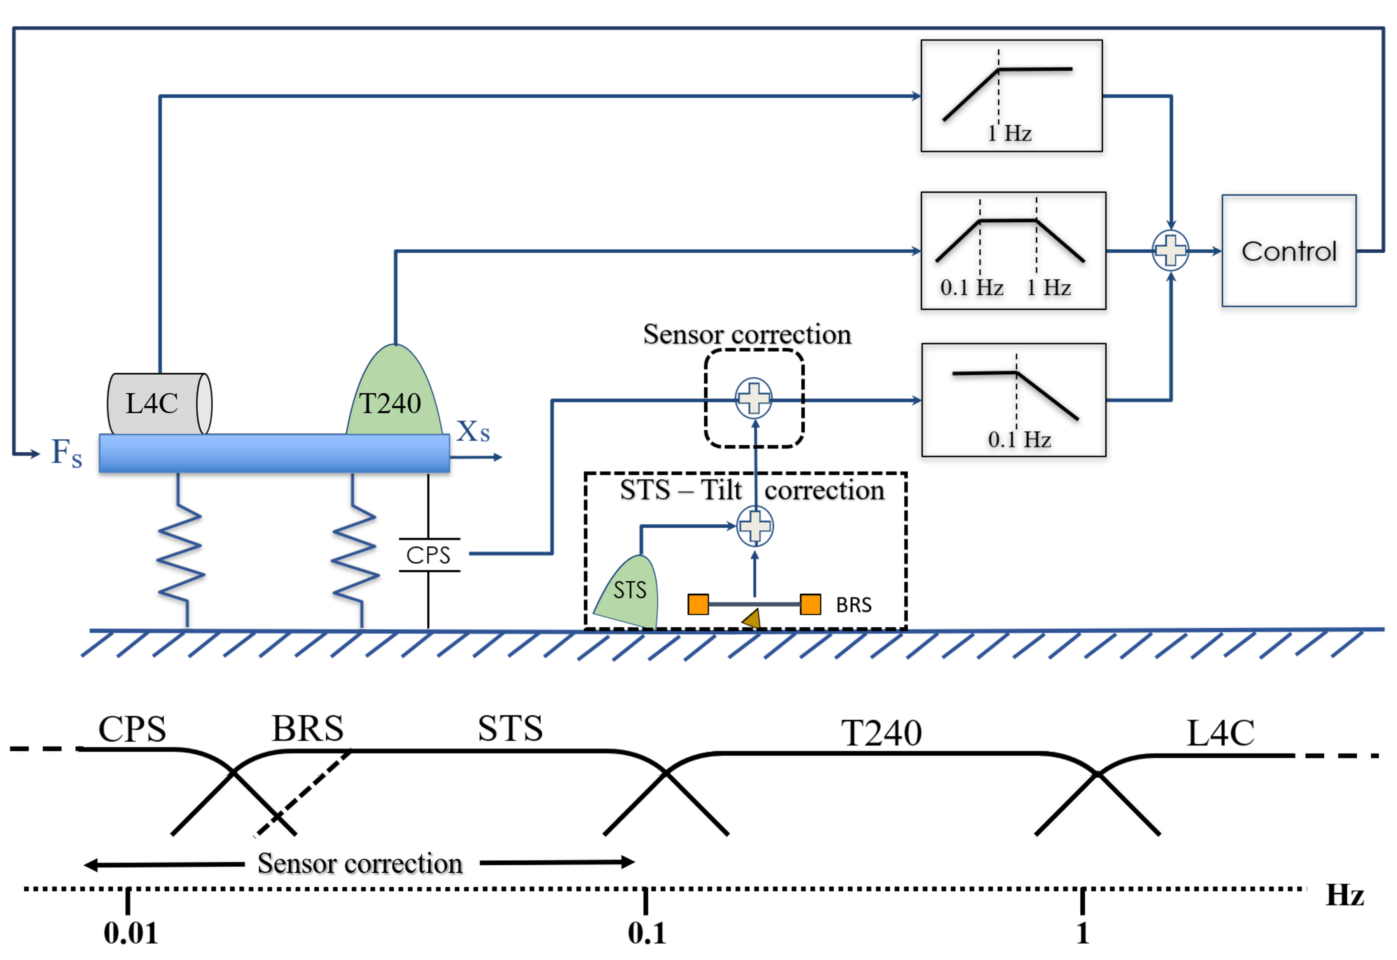
Active isolation, general control scheme
Sensor correction 101
Feedforward:
Ground seismometer
feeds to CPS path to
make it "inertial"

Slide 7
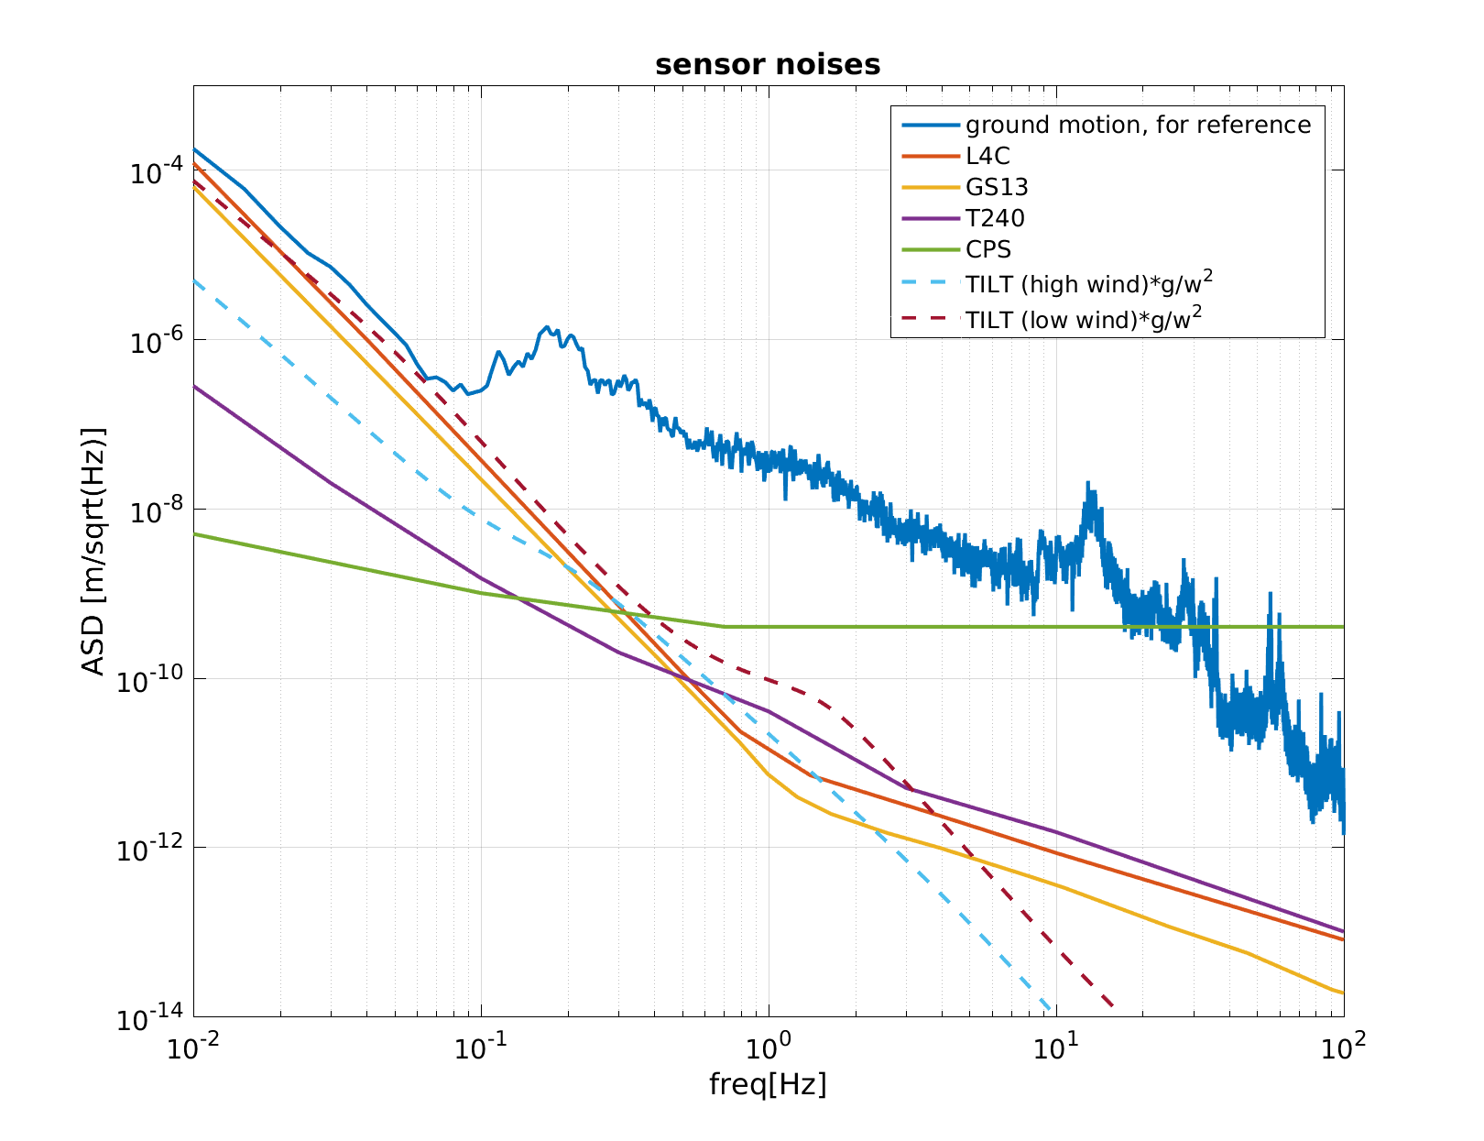
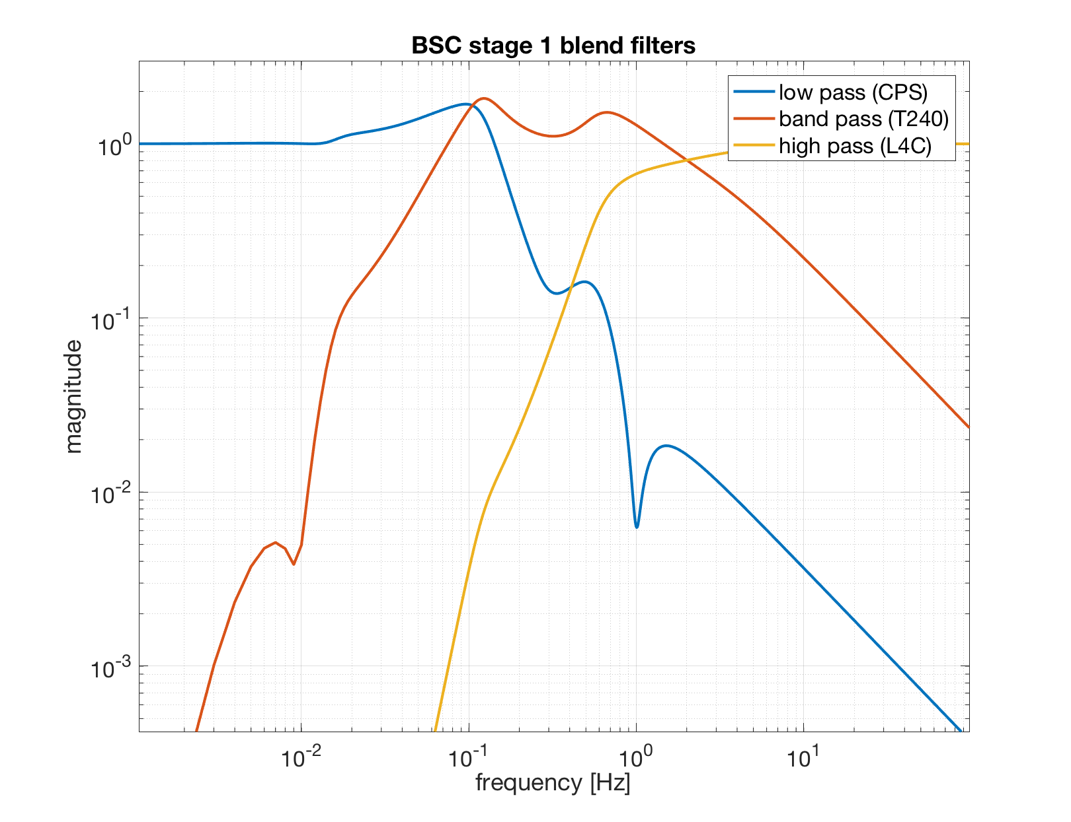
Blend for virtual inertial sensor
Pele, G2000186

Slide 8
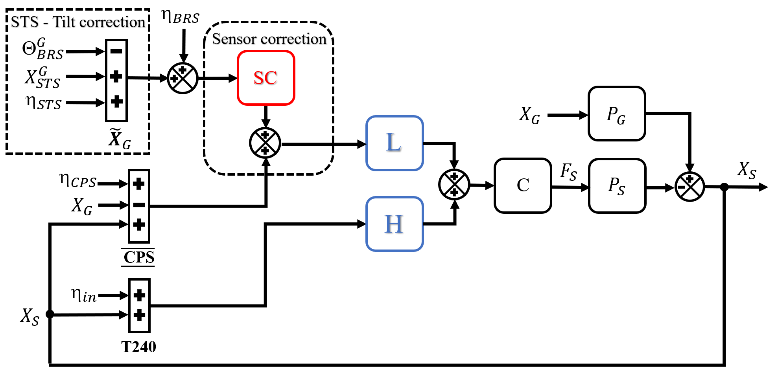
Sensor correction 101
Ground $=X_{STS}^{G}+\frac{g}{ω^{2}}∗tilt − Θ_{BRS}^{G}∗\frac{g}{ω^{2}}+η_{STS}+η_{BRS}$
Venkateswara, P1800038

Slide 9
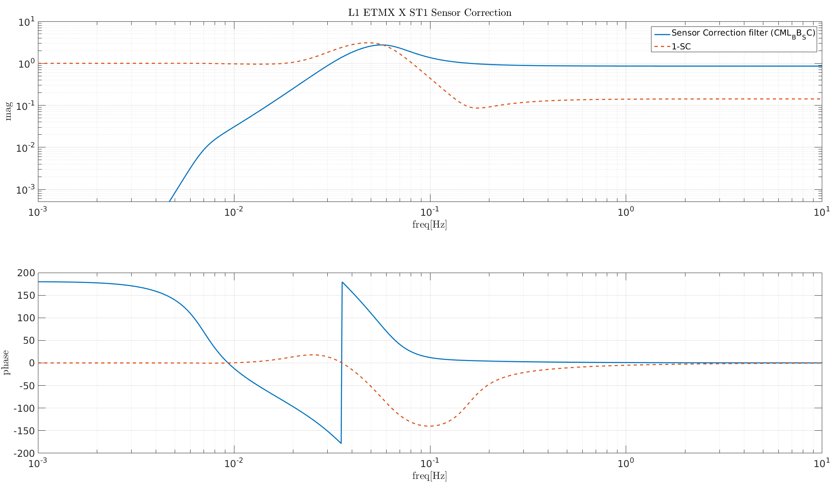
Sensor correction 101
GROUND AMPLIFICATION
GROUND REJECTION
Pele, G2000186
GROUND TILT REJECTION
MAXIMUM GROUND REJECTION WHEN GAIN = 1 AND PHASE =0

Slide 10
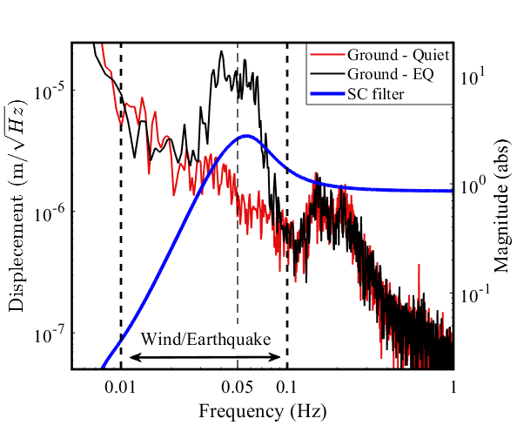
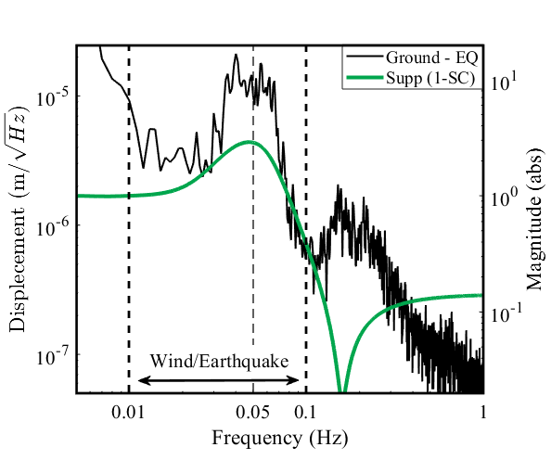
Sensor correction 101
SC Filter
Suppression (1-SC)

Slide 11
Problem:
We get hit right where it hurts… Gain peaking at 50-80 mHz.
Why we lose lock??

Slide 12
What can we do to deal with this?
Better predictions for earthquakes arrival time and magnitude.
Optimize IFO seismic state for earthquake passing.
Transition safely between states during lock.
Understand the local and global behavior.

Slide 13
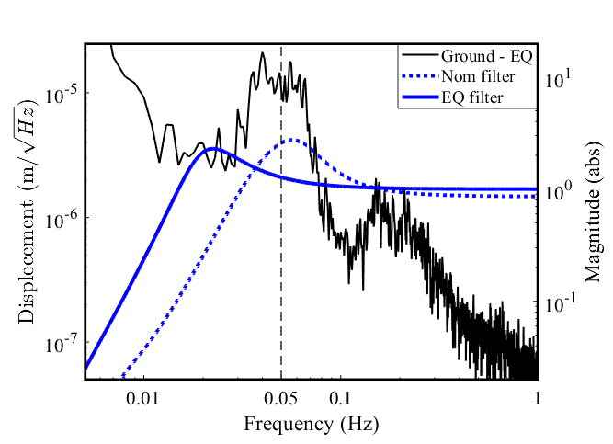
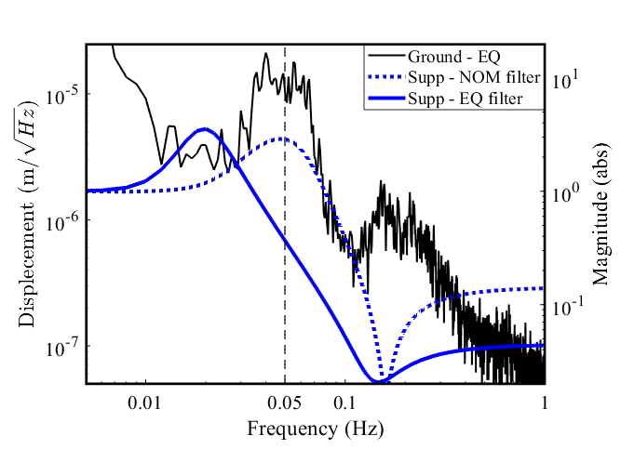
Sensor correction 102?
SC Filter
Suppression (1-SC)
Seismic Optimization

Slide 14
Goals
REDUCE local platform motion & drive - Local
REDUCE differential motion of arm – Global
Keep stability of IFO lock.

Slide 15
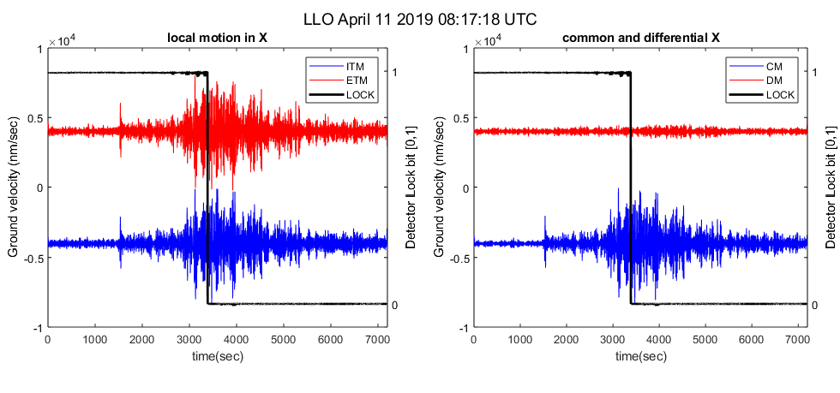
Lets look at ground motion during earthquake:

Slide 16
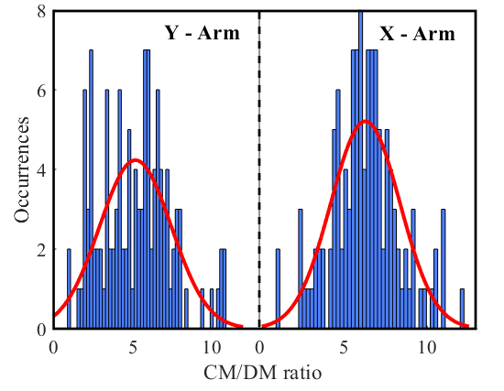
Common mode is dominating – lets take it out!
CM/DM ~ 5-6

Slide 17
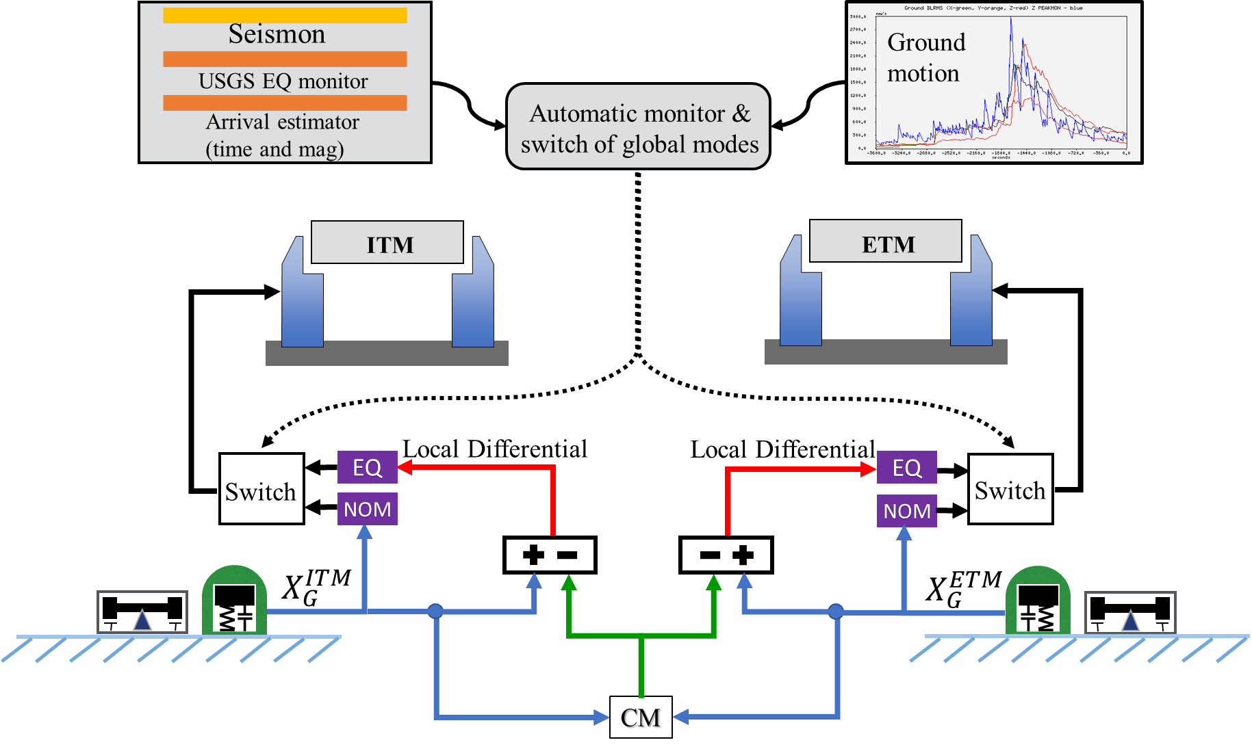
The new control scheme for earthquakes
CM$=\frac{ITM+ETM}{2}$
DM$=\frac{ITM−ETM}{2}$
Lantz, G1800399

Slide 18
Goals
REDUCE local platform motion and drive
REDUCE differential motion of arm
How?
Remove Common motion at earthquake band.
Design different sensor correction filter.

Slide 19
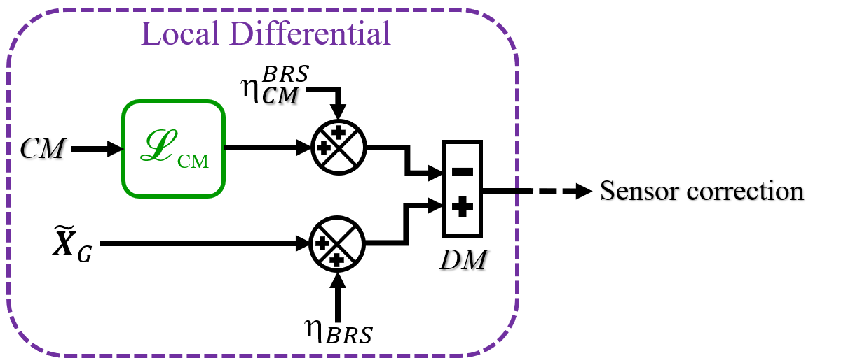
Sensor correction 102?

Slide 20
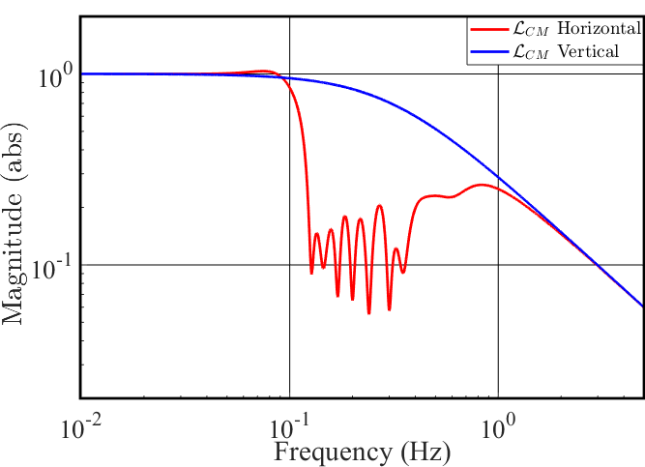
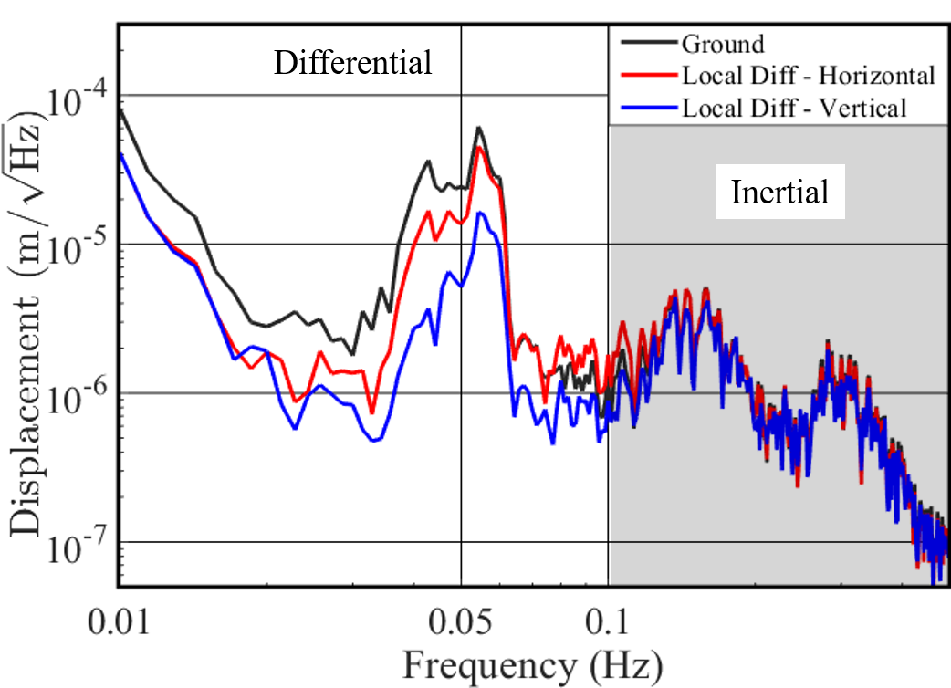
CM filter
Seismic Optimization

Slide 21
coupling!
Differential platforms motion
Coupling to other DOF – this is just weird…
SEI log: 1568

Slide 22
Global controls - Automation
EQ Guardian
SEI Guardian
Ground seismometers
EQ controls
Seismic controls
Alerts
Prepare
Seismon
EQ here
EQ ON
EQ Passed
EQ OFF

Slide 23
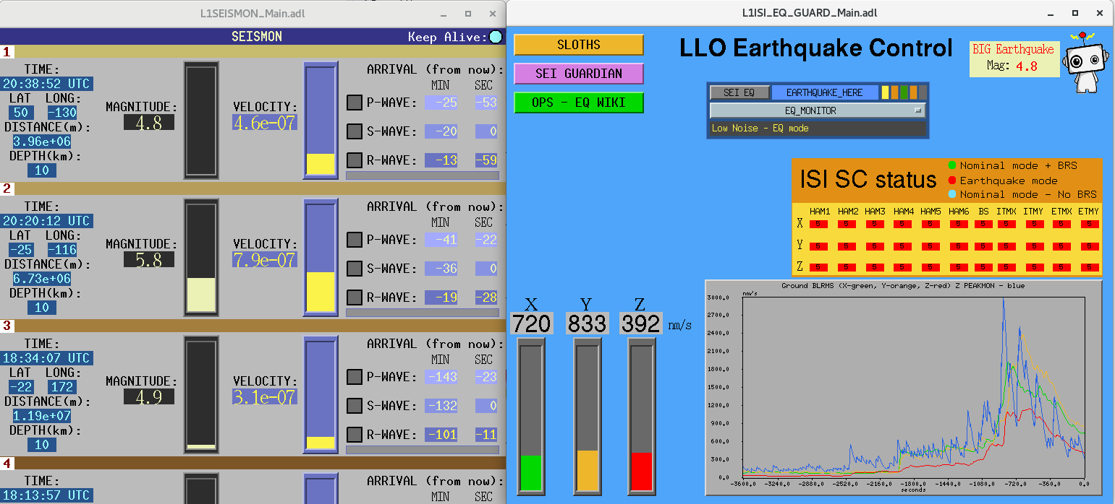
Global controls - Automation
EQ Guardian
SEI Guardian
Ground seismometers
EQ controls
Seismic controls
Alerts
Prepare
Seismon
EQ here
EQ ON
EQ Passed
EQ OFF
Mukund G1800118

Slide 24
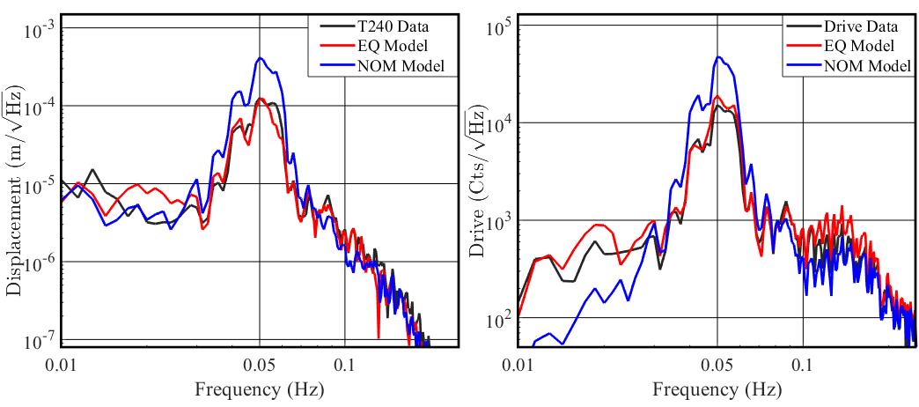
Results!
Local platform motion and drive

Slide 25
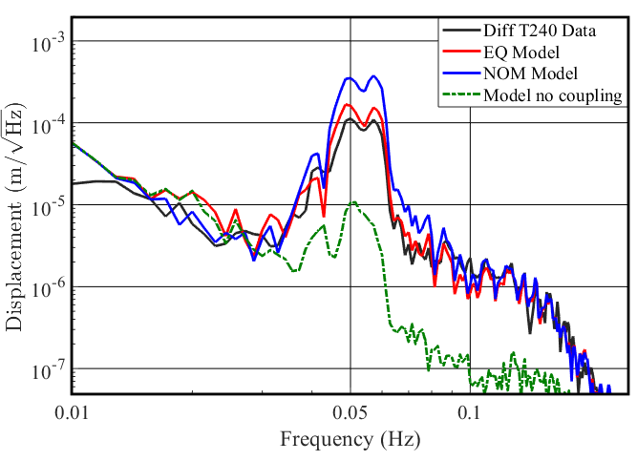
Results!
Differential platforms motion
$+$ O(Sensor noises)

Slide 26
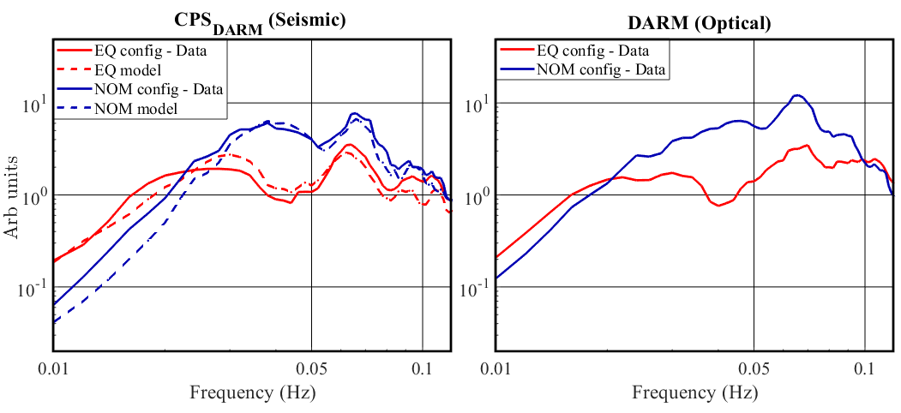
Results!
DARM controls
IFO Optimization!

Slide 27
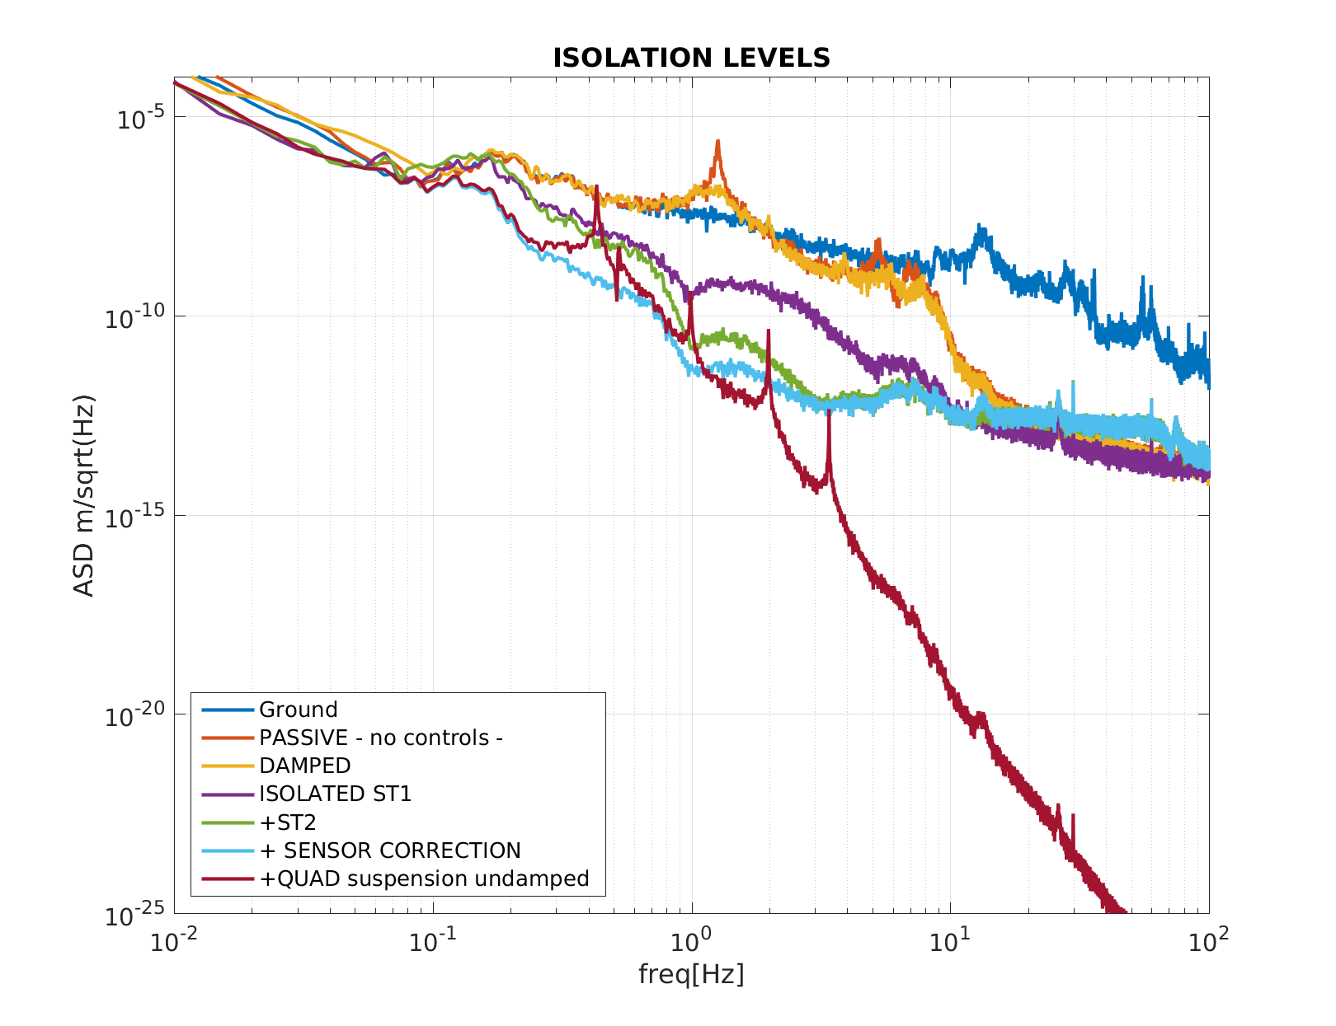
Optical controls
High Q resonances
Pele G2000186

Slide 28
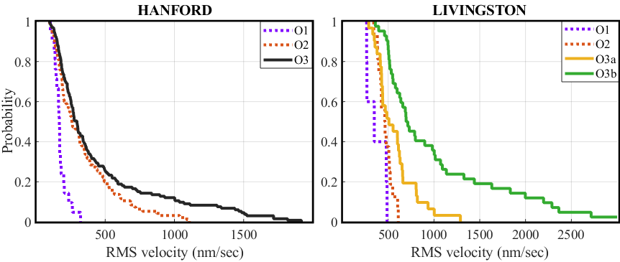
Results - Statistics

Slide 29
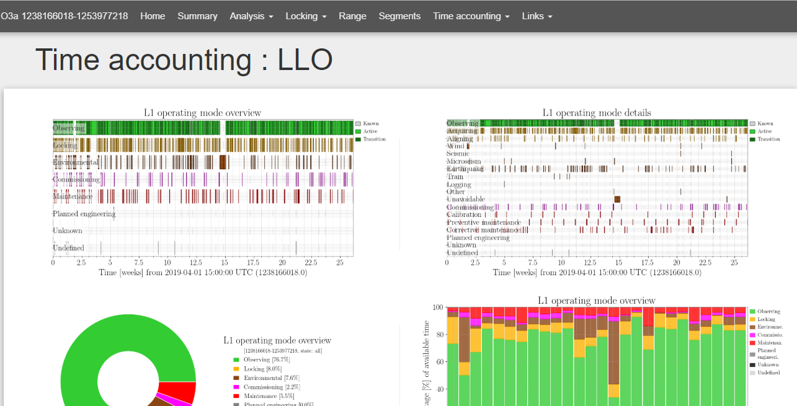
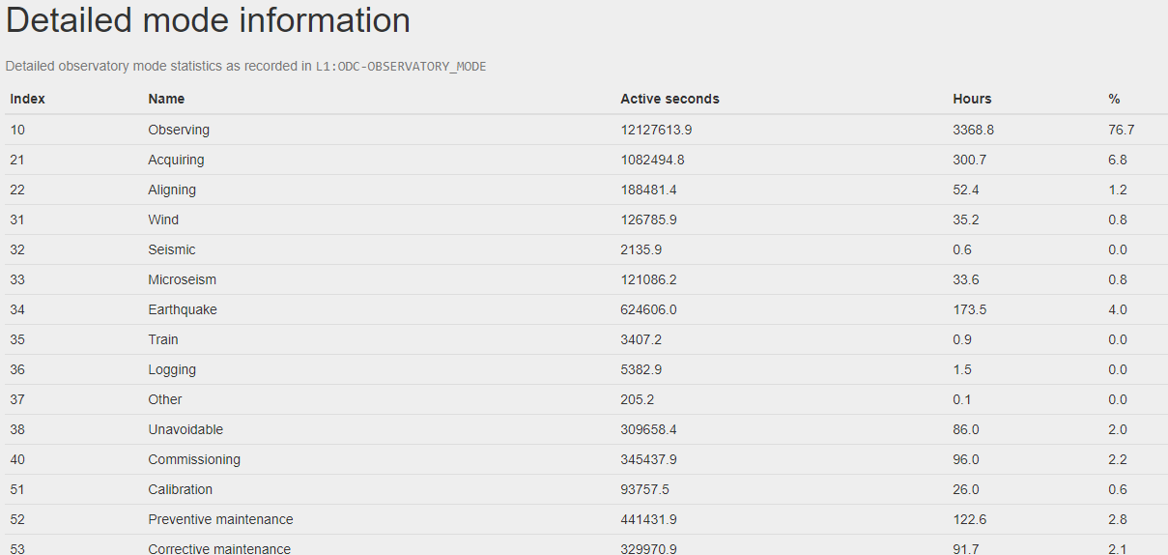
Earthquakes are annoying

Slide 30
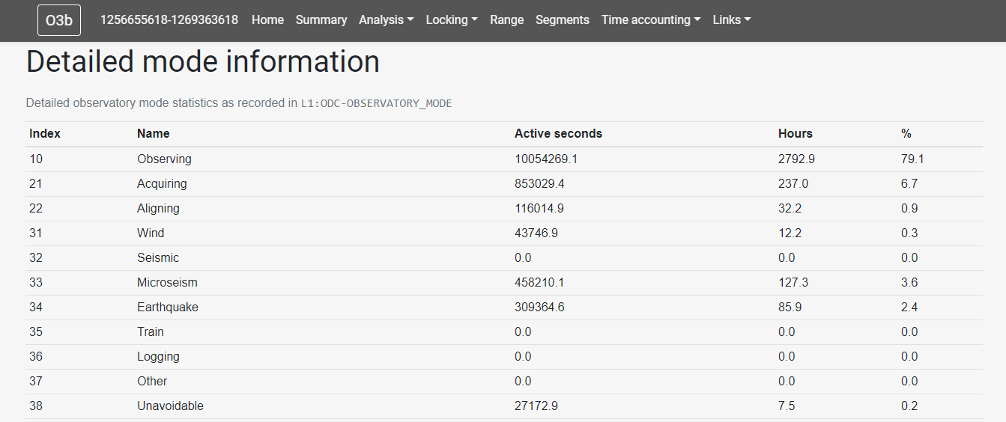
Earthquakes are a bit less annoying

Slide 31
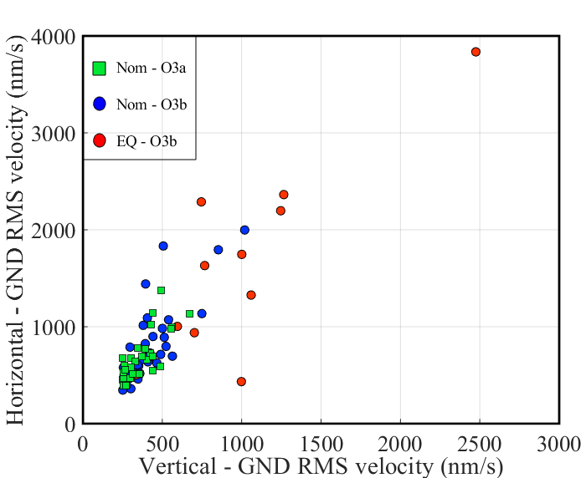
In action during O3a/b

Slide 32
Summary and what’s next?
We are getting a suppression factor of 3-4 for differential motion and 2-3 for platform motion and drive at EQ band.
We reduce optical control signals during EQ and can use CPS to optimize the performance in low frequencies.
Increased duty cycle of interferometers.

Slide 33
Summary and what’s next?
Earthquakes predictions. Seismon, picket fence.
Multi-scenario optimization – SC & CM filters, blends.
Optimize for multi-frequency band excitations.
Understand cross-couplings from all DOF - Tilt.
Optimize performance of IFO based on seismic at low frequencies.
Automation, automation, automation….

