Slide 1
O3 October Commissioning Break Update
Keita Kawabe, Brian O’Reilly, Alessio Rocchi, Matteo Tacca

Slide 2
October 2019 Commissioning Break
Oct. 1 2019 15:00:00 UTC to Nov. 1 2019 15:00:00 UTC.
Both LHO and LLO are done with installations essential for the rest of O3 except for LHO’s wind fence.
We’ve been pumping down the “corner” volume, but we plan to open the gate valve today to start relocking the detectors.
Retuning, noise mitigation, calibration etc. until we resume the observation in November.
No delays except H1 wind fence which won’t be available until mid-Nov. Impact on the observation projected to be less than 8 hours.
Virgo already locked their instrument with higher power stably, fine tuning is ongoing.

Slide 3
LIGO Commissioning break
Category | Specific task(s) | Motivation
In-vac scattering mitigation (both) | H1: In-vac window swap. L1: More in-vac baffles. | Smaller scattered light noise.
Squeezing improvement (H1 only) | Replace damaged fiber. | Smaller shot noise via more pump power into in-vac squeezer.
Vacuum (both) | L1: X-arm accumulation test, identify (and fix) the leak. H1: Swap aging equipments. | Reduced residual gas effect for L1. Risk mitigation for H1.
Environment (H1 only) | Wind fence. | Better duty factor, possibly reduced glitches, when windy.
Seismic isolation (H1 only) | Thermal control of tilt sensor. | More robust control.
LIGO activities, no significant delay as of now.
There are other “me too” activities that are not essential for O3b (but may be essential for O4).

Slide 4
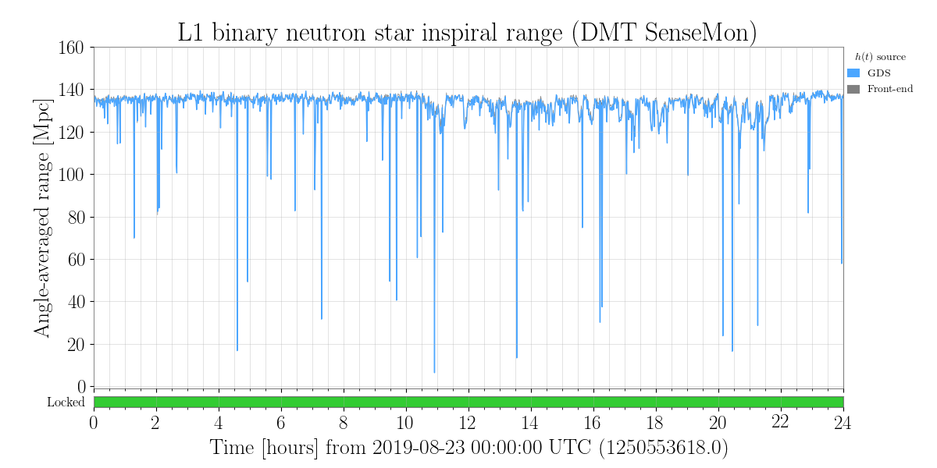
L1 Scattering Mitigation: A focus in this commissioning break.
Range varies when anthropogenic ground motion increase during the day (0600 – 1700 local time)

Slide 5
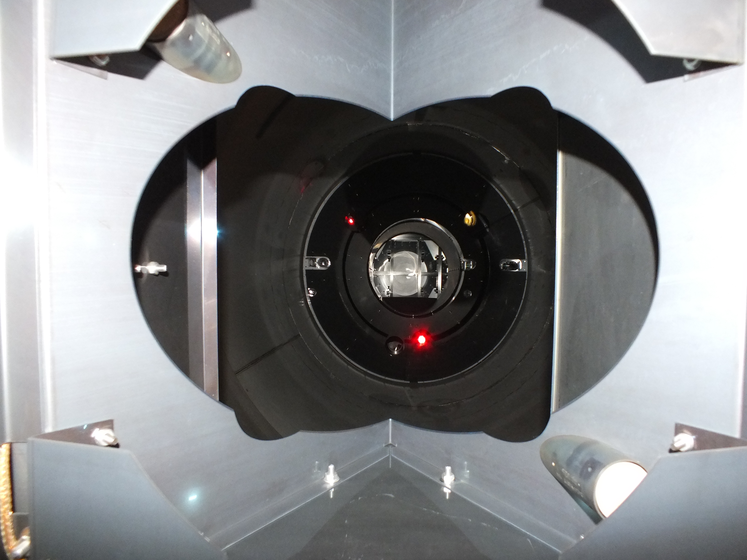
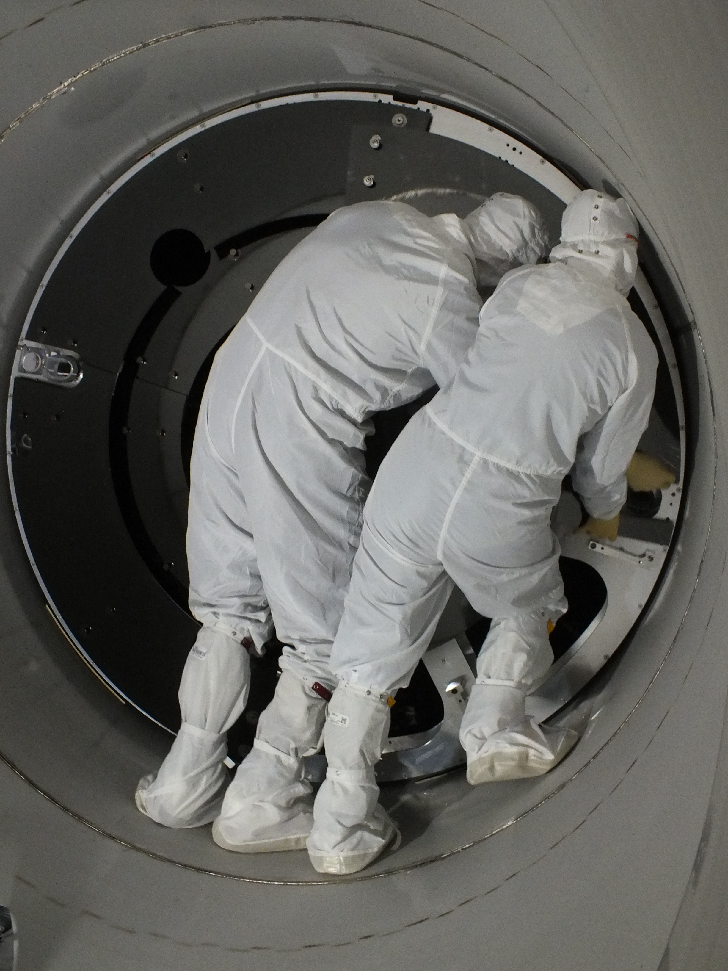
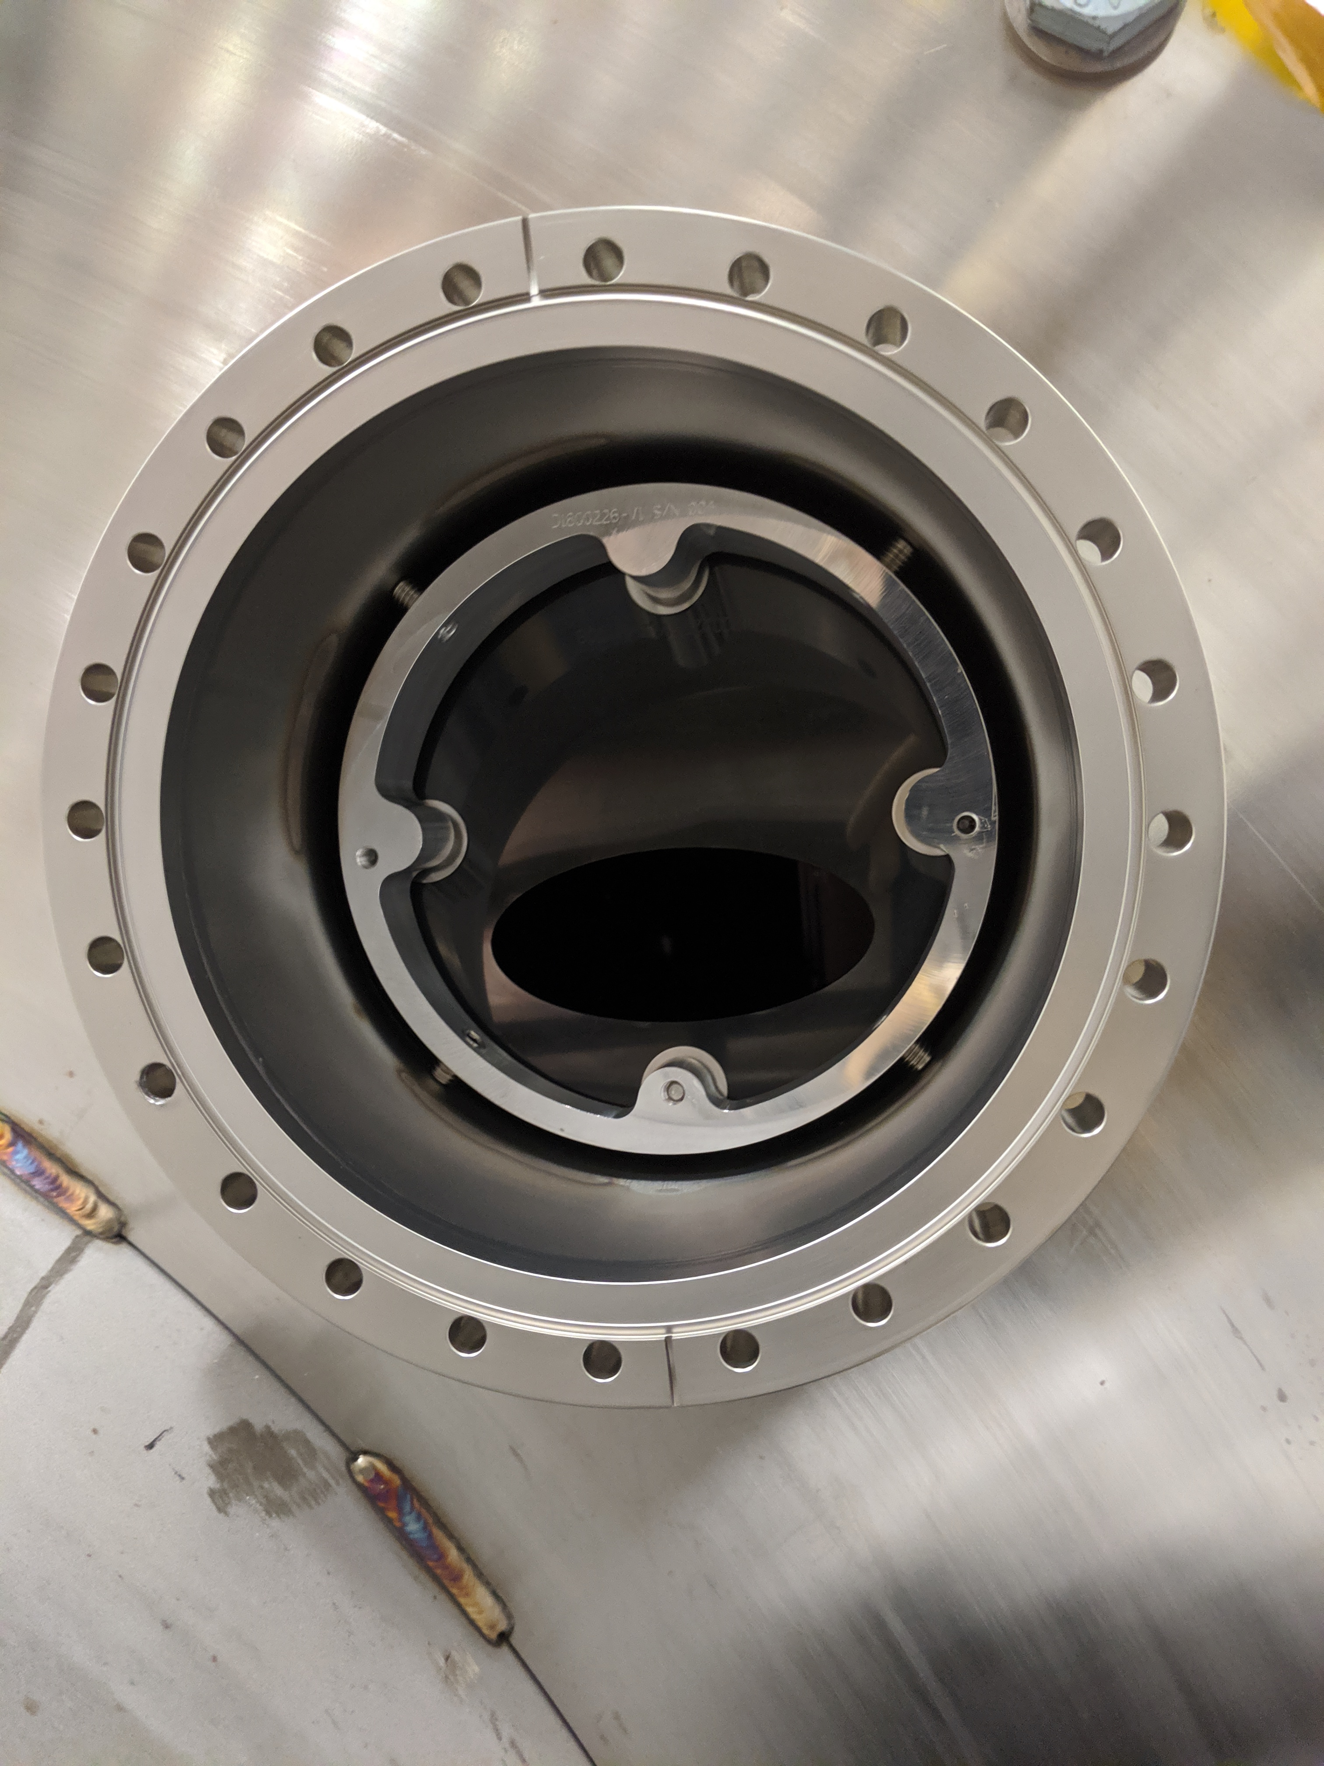
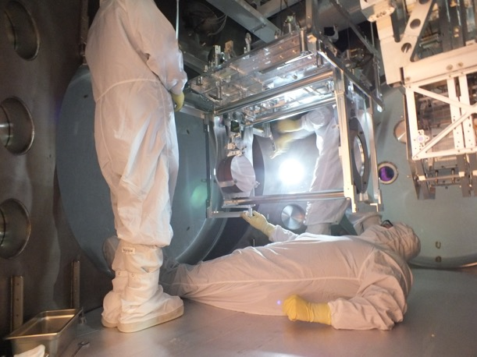
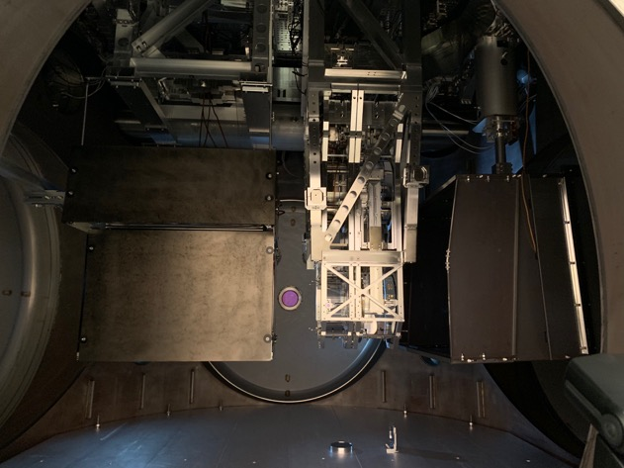
View from ETM
Installing big (and small) ones near ETM
Looking at the small one on the viewport from outside
ETM transmission monitor before (left), after (right)

Slide 6
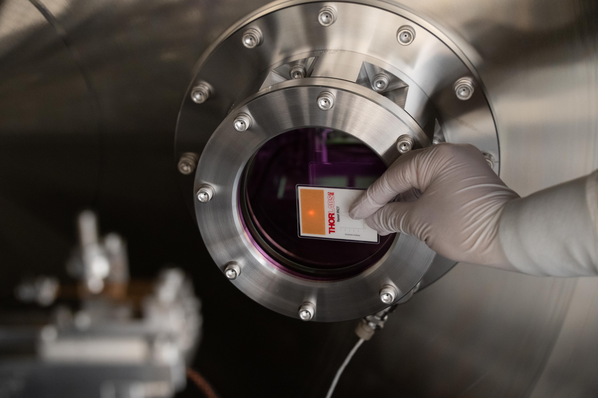
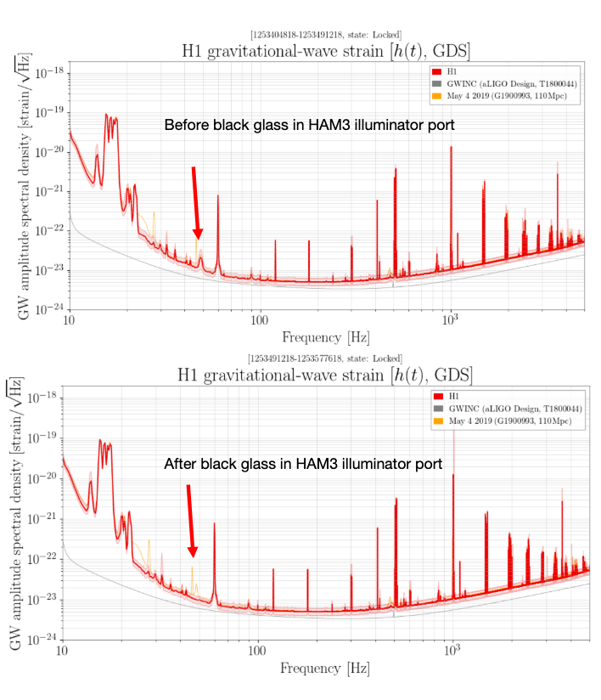
H1 scattering mitigation: Targeting corner station
H1 scattering in the input chain causing non-stationary 48Hz bump (mitigated/eliminated during O3a).
New H1 in-vac viewport with
a larger incident angle in the output chain

Slide 7
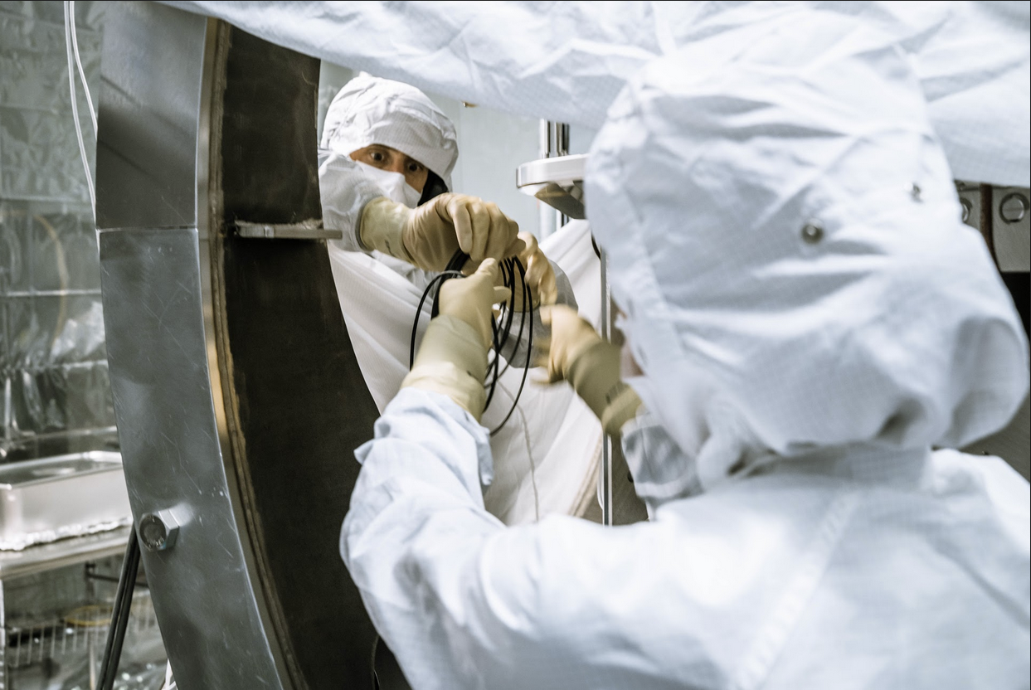
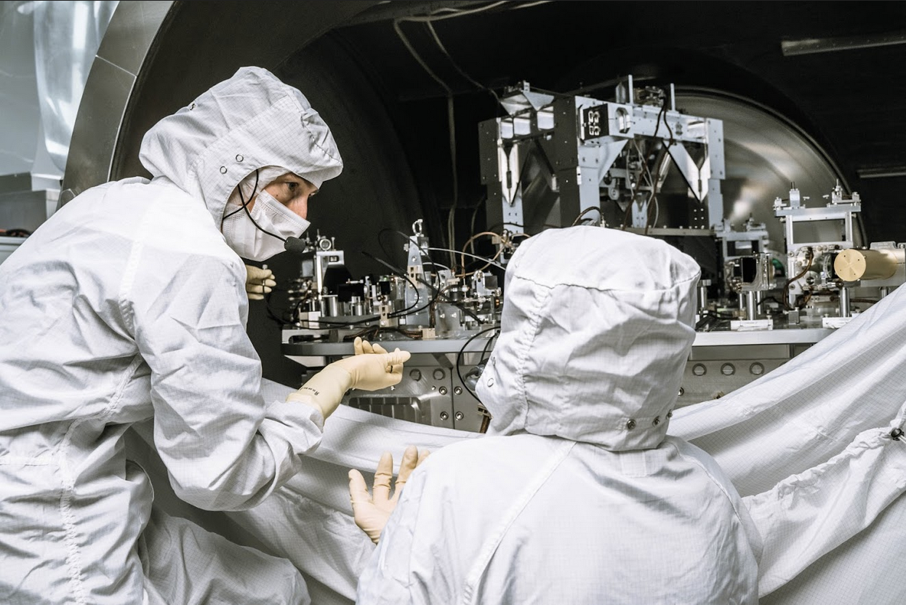
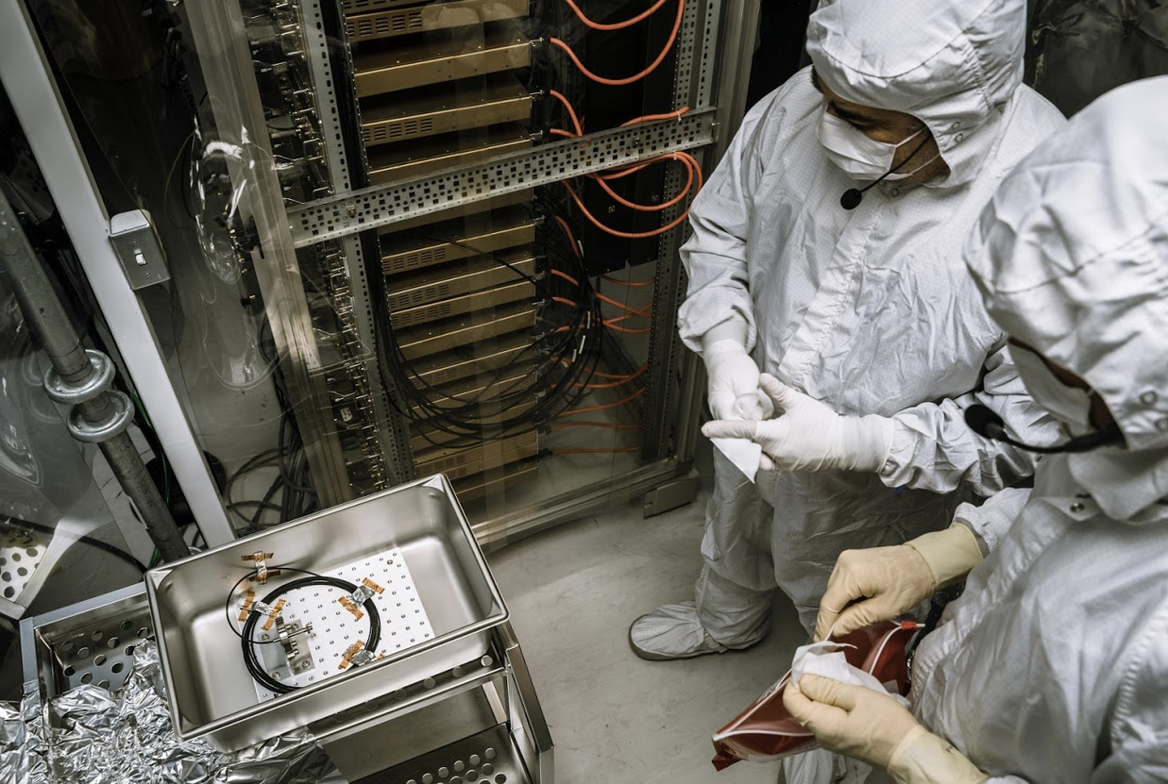
H1: Swapping degraded in-vac fiber for SQZ system

Slide 8
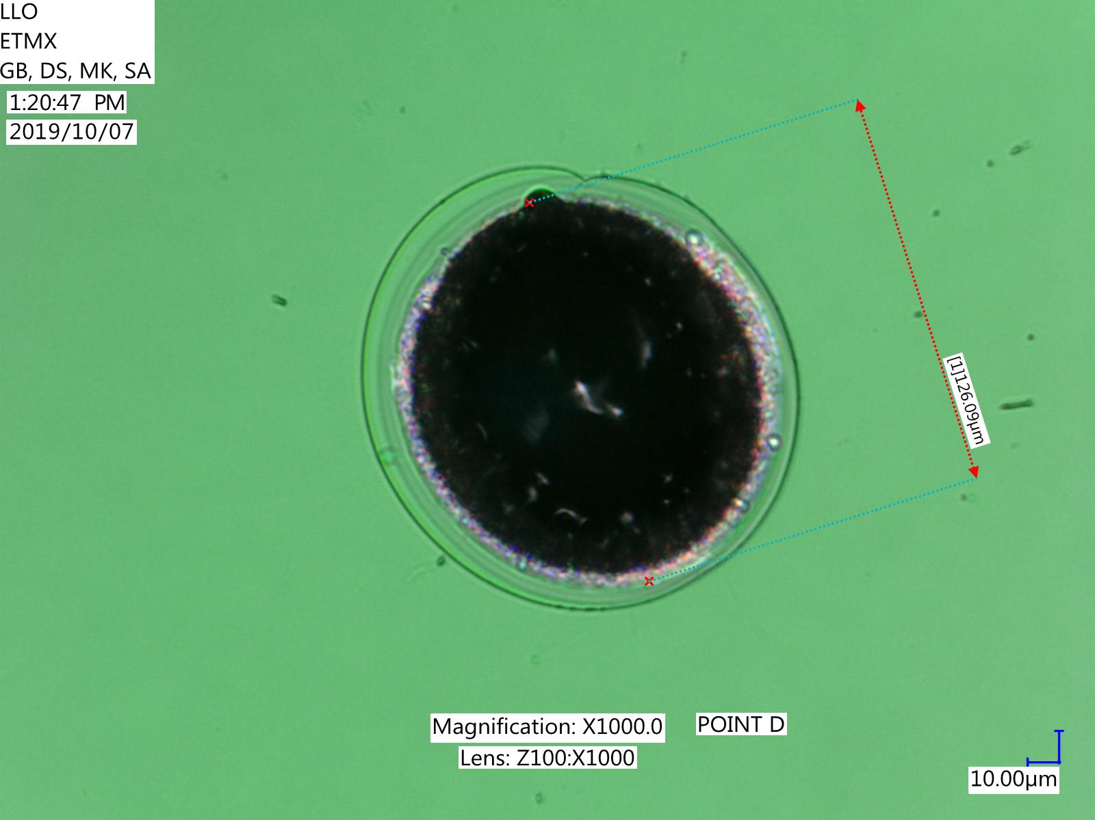
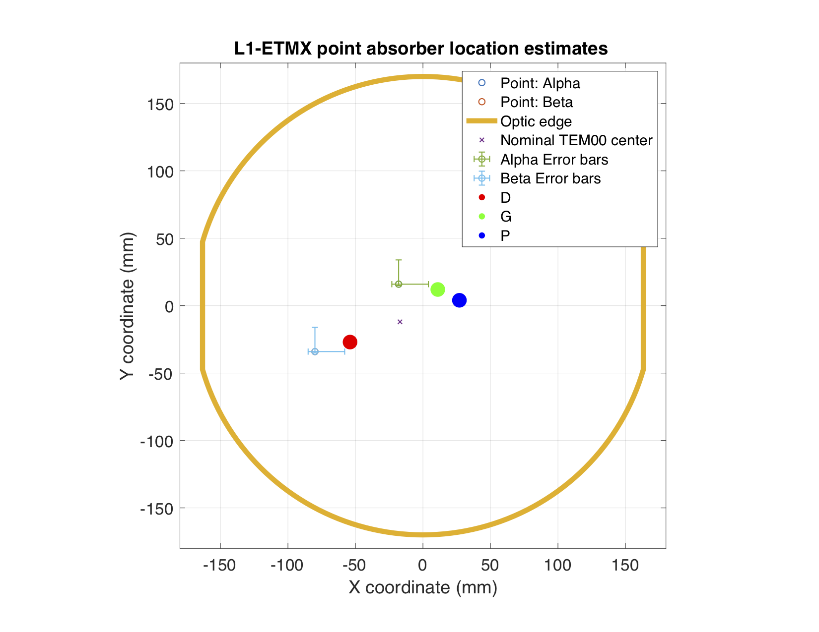
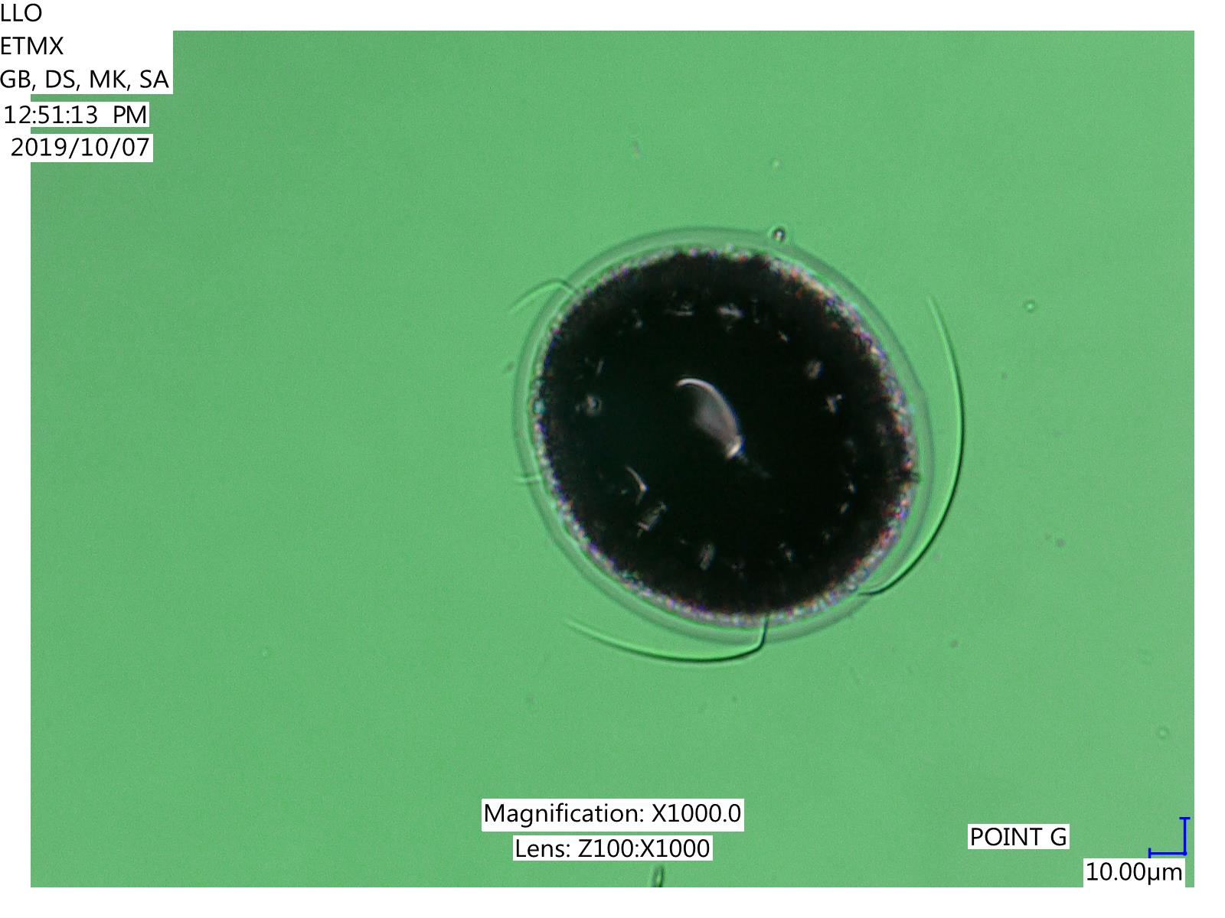
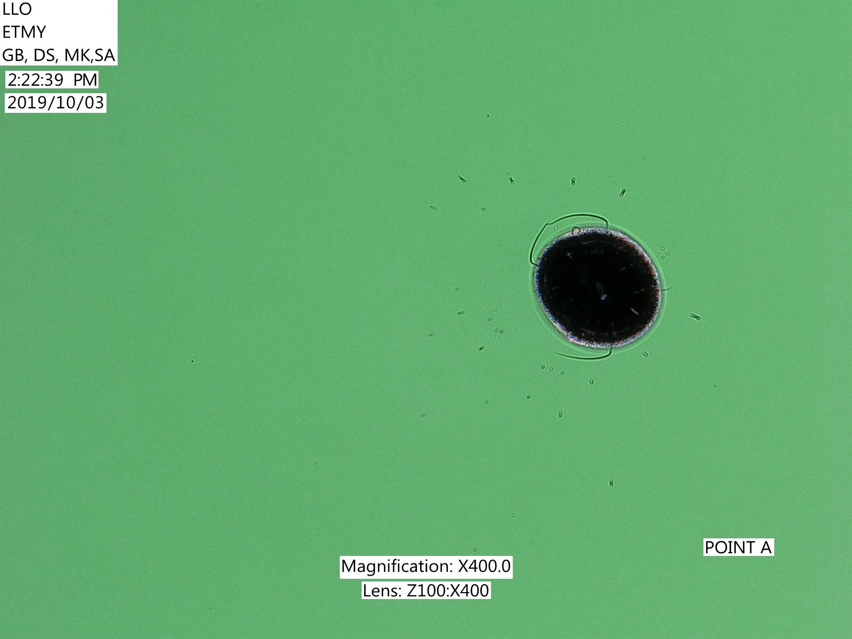
During the break: L1 EX spot absorbers in-situ pictures

Slide 9
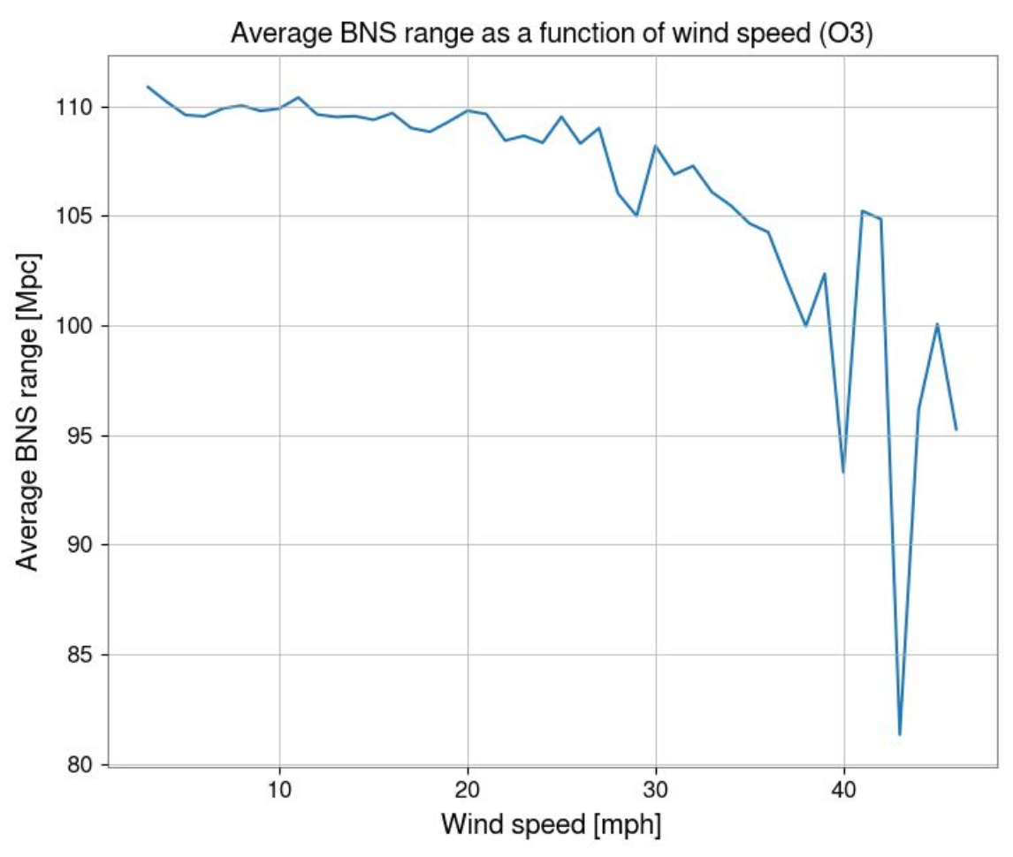
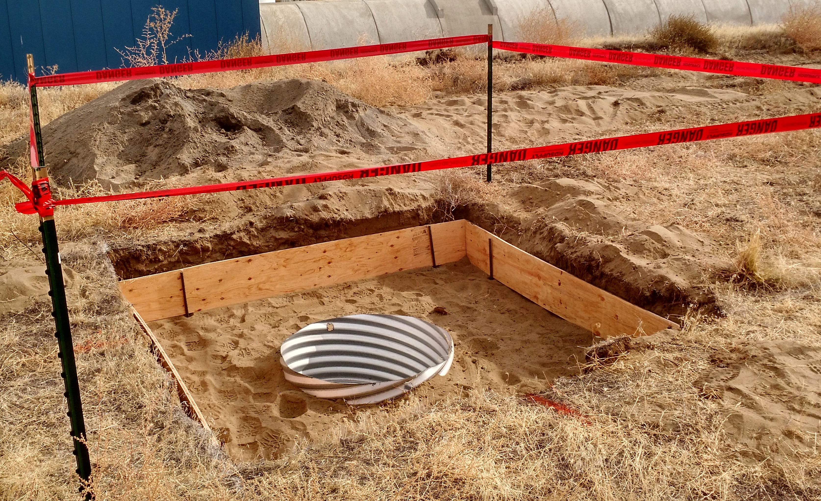
H1 Wind Fence
Wind has an impact on duty factor as well as noise at Hanford.
“Baseball net”-type wind mitigation.
Installation ongoing.
Not operational until mid-Nov.
Minimal (projected less than 8 hours) of impact on the run.
Hole for one of H1 wind-fence posts.

Slide 10
Virgo commissioning break
Category | Specific task(s) | Motivation
Increase Power to 25W | Retune all the interferometer at higher power (ISC working points and loops, TCS working points, etc) | Small increase in the sensitivity, learn how to handle higher power
Scattered light investigation | Cure the scattered light on the external input optics bench (known issue). Tests along in-vacuum beam path to better identify the source of scattering (and possibly cure them) | Better sensitivity Better control signals
“Flat noise” investigation | Sensitivity in the mid-frequency range is limited by the unknown “flat noise”. Test the hypothesis that it’s RFAM for sidebands picked up and imprinted on the carrier by ISS as per Virgo log 47080. | Better sensitivity
Virgo activities, no significant delay as of now.

Slide 13
(Working on temp. stabilization)

Slide 14
Relocked with 26W on Oct 22!
Stable operation.
No SQZ, no fine tuning of things (yet).
But you can already see an improvement between 50 and 80 Hz!

Slide 15
Schedule
Relocking, retuning, characterization in the last week of this month.
No known delay (yet).
Nov 01 1500 UTC: Nominal start of O2b. Back to regular observation schedule.
LHO wind fence installation continues in Nov, but they’re mostly quiet background work (e.g. waiting for the concrete to cure). Projected impact on the observation is less than 8 hours.
Will be functional in mid-Nov, observe w/o wind fence until then.
No planned break during holidays.
End of the run is shifted by a month due to this. Committed to one year of observation.
Eagerly waiting to see the benefits of the commissioning break as well as welcoming KAGRA later this year for O3b!

