Slide 1
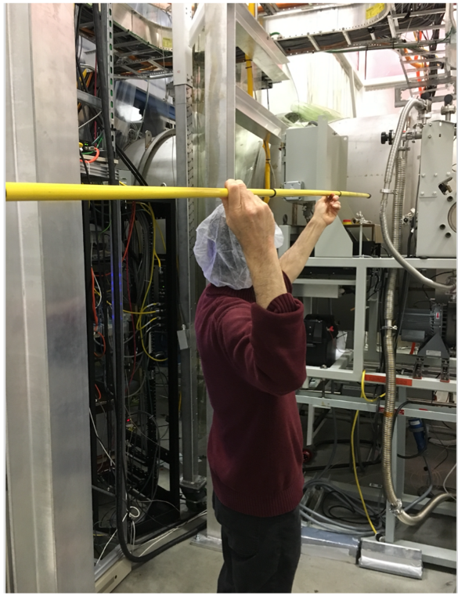
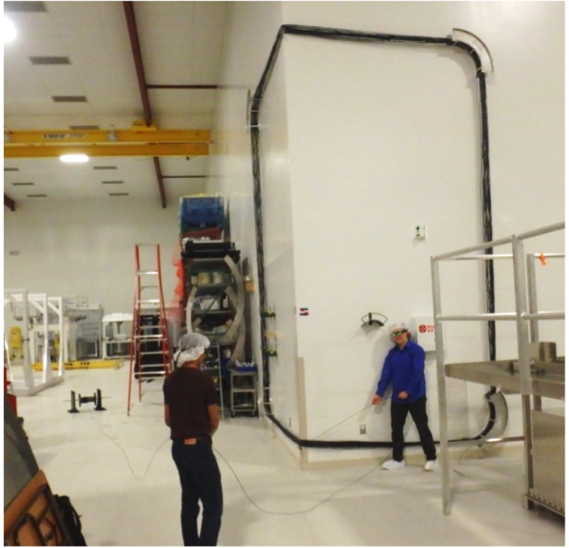
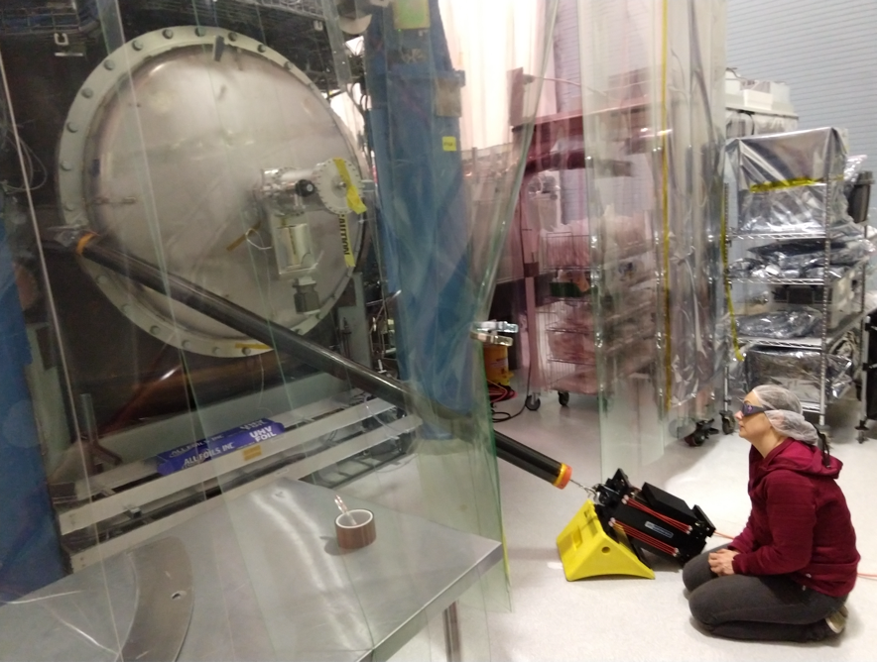
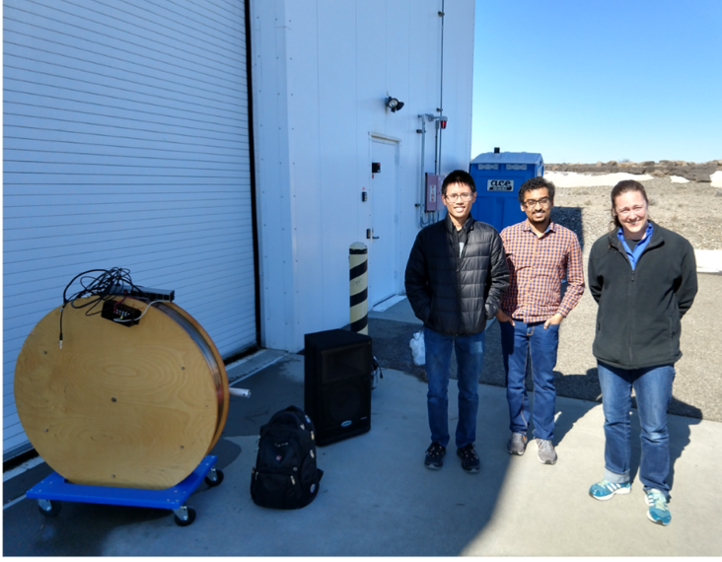
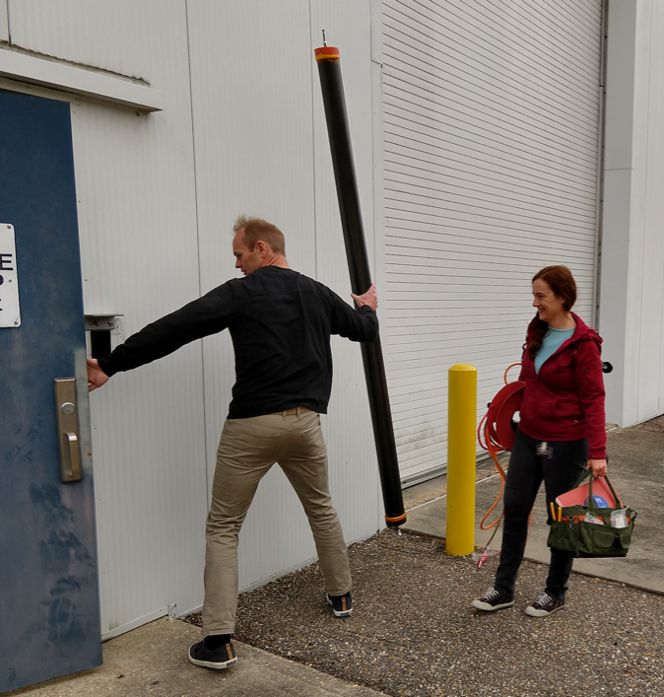
a
August 2019 PEM update and new techniques for localizing scattering
Robert Schofield, Philippe Nguyen, Sharan Banagiri, Corey Austin, Kara Merfeld, Anamaria Effler, David Shoemaker, Siddharth Soni, Adrian Helmling-Cornell, Matthew Ball, DetChar

Slide 2
a
Results from the pre-run PEM injection program
Vibration
RF
Site activities
Magnetic
Big coils and magnetic monitoring program
Tests of coupling factors for thunder coupling etc.
Two new techniques for localizing vacuum enclosure coupling sites
Impulse propagation delay, amplitude, & frequency structure
Beating injections with location-dependent phase of envelope
Worst coupling sites and mitigation plans
TMSX, LLO
EY, LLO
HAM5,6 LHO, LLO
48 Hz LHO
IO Jitter, LHO, LLO

Slide 3
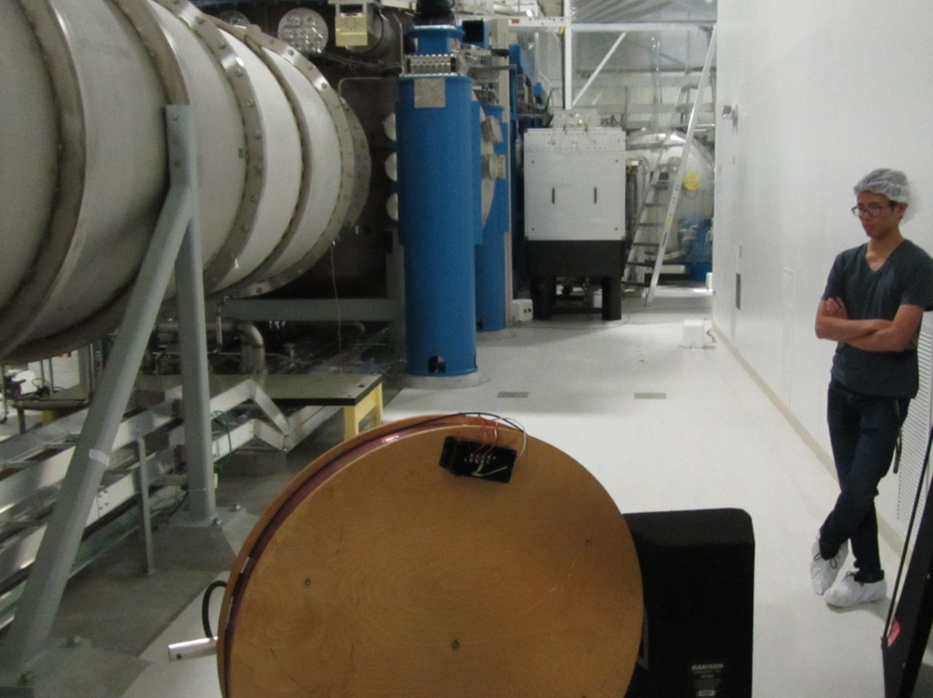
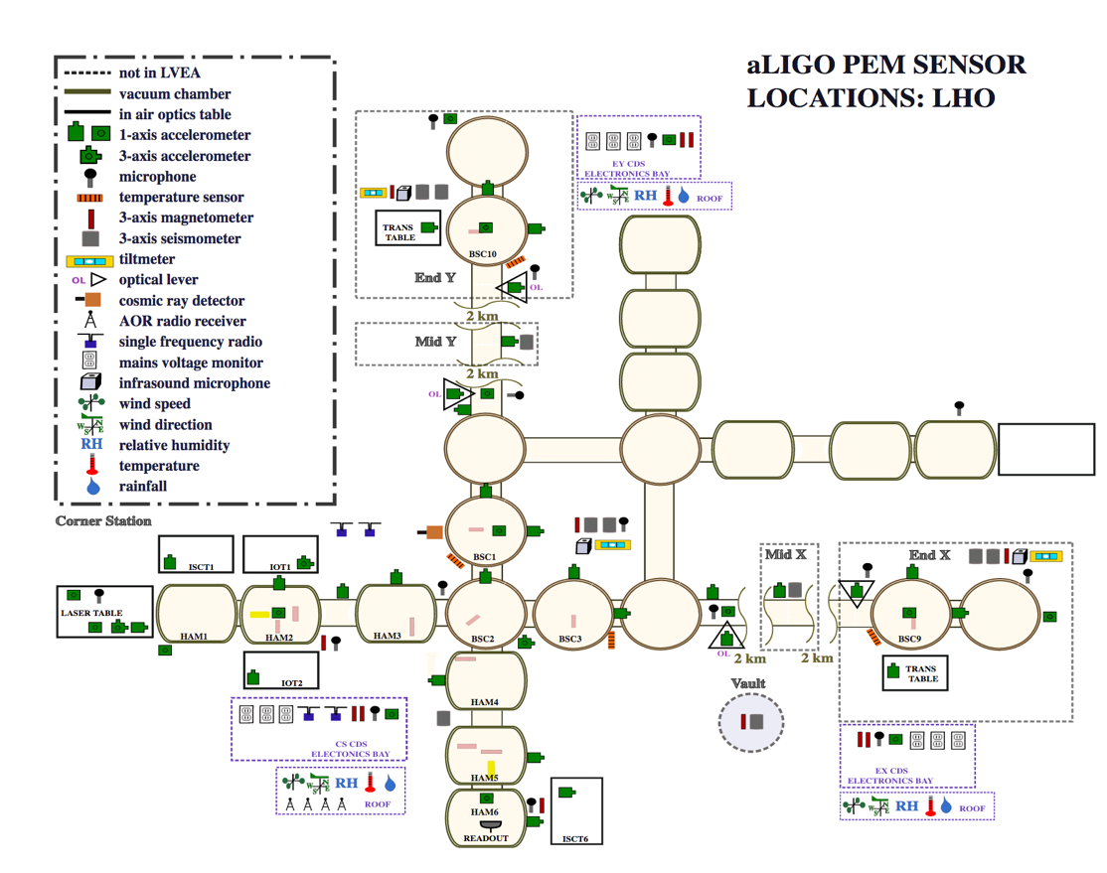
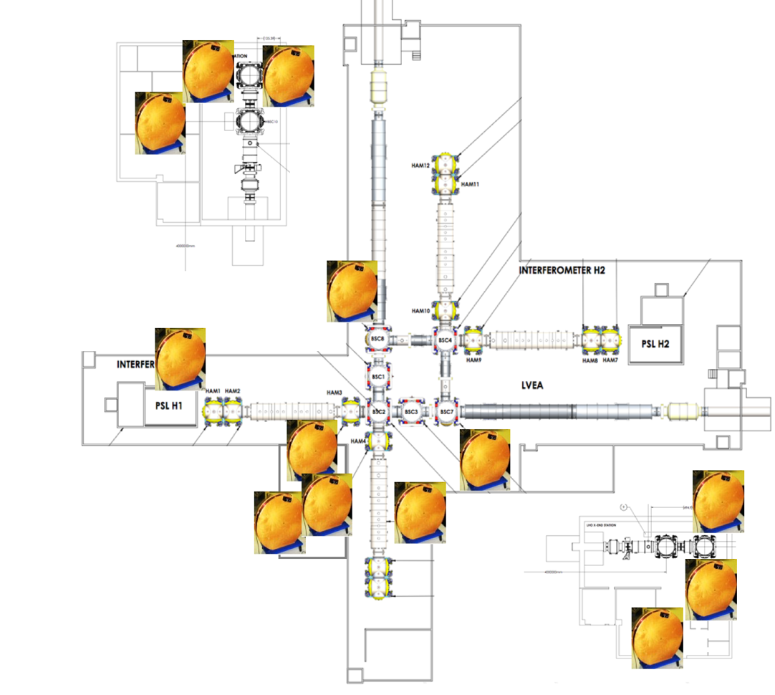
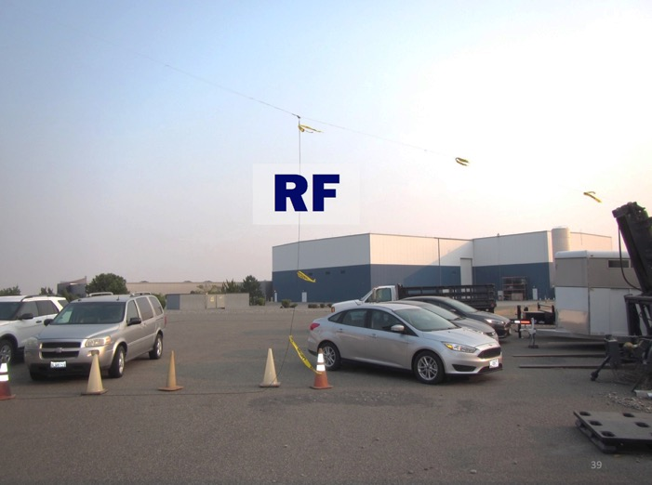
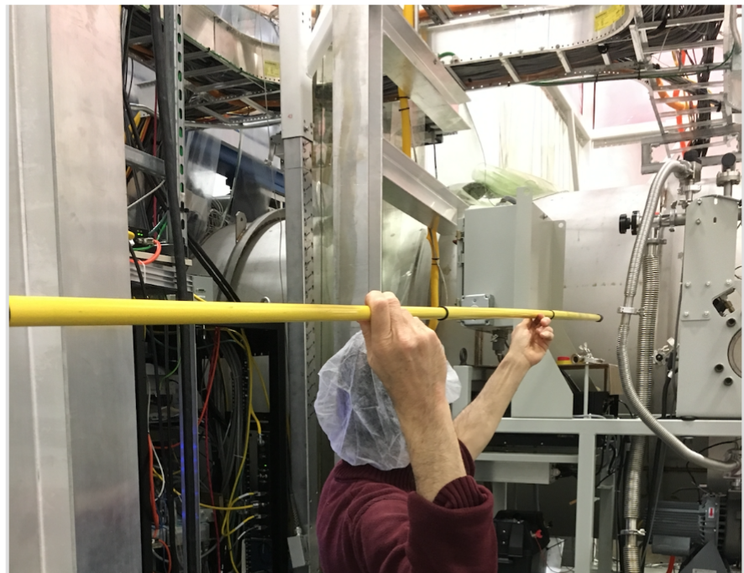
PEM Injection Program
Acoustic
Magnetic
Shaker
Radio
Impulse
5

Slide 4
a
Results from the pre-run PEM injection program
Vibration
RF
Site activities
Magnetic
Big coils and magnetic monitoring program
Tests of coupling factors for thunder coupling etc.
Two new techniques for localizing vacuum enclosure coupling sites
Impulse propagation delay, amplitude, & frequency structure
Beating injections with location-dependent phase of envelope
Worst coupling sites and mitigation plans
TMSX, LLO
EY, LLO
HAM5,6 LHO, LLO
48 Hz LHO
IO Jitter, LHO, LLO

Slide 5
Results at: PEM.LIGO.ORG

Slide 6
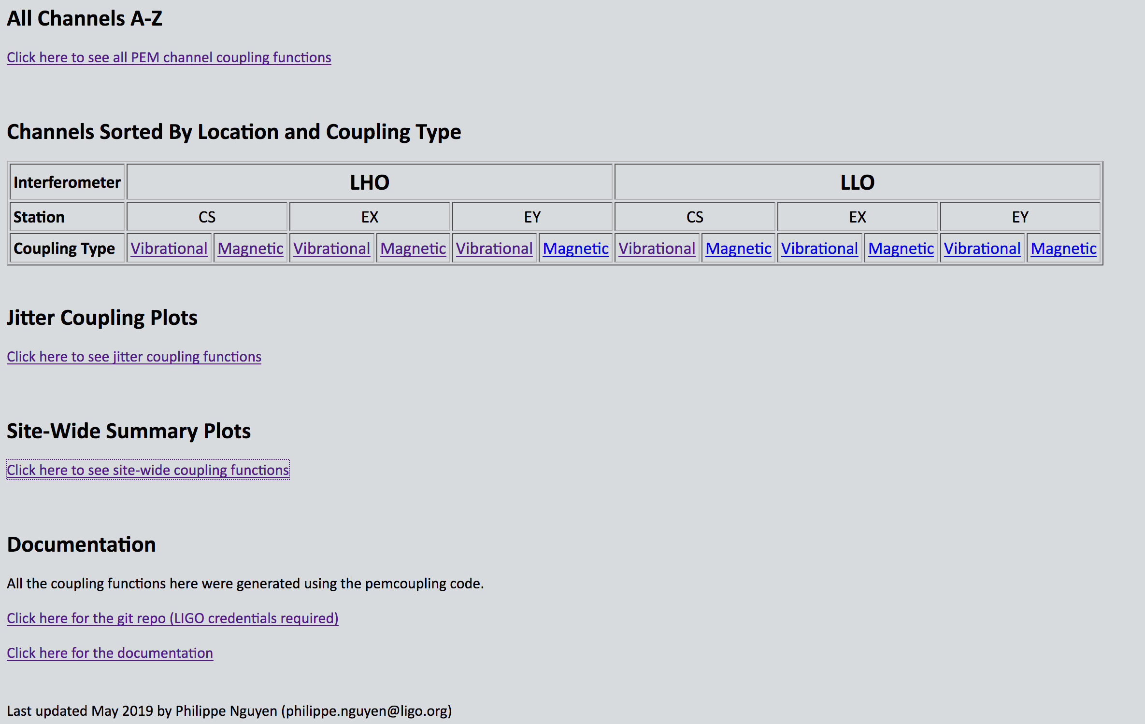
Count coupling functions for easy estimate of signal in DARM
Physics units coupling functions
Site-wide summary

Slide 8
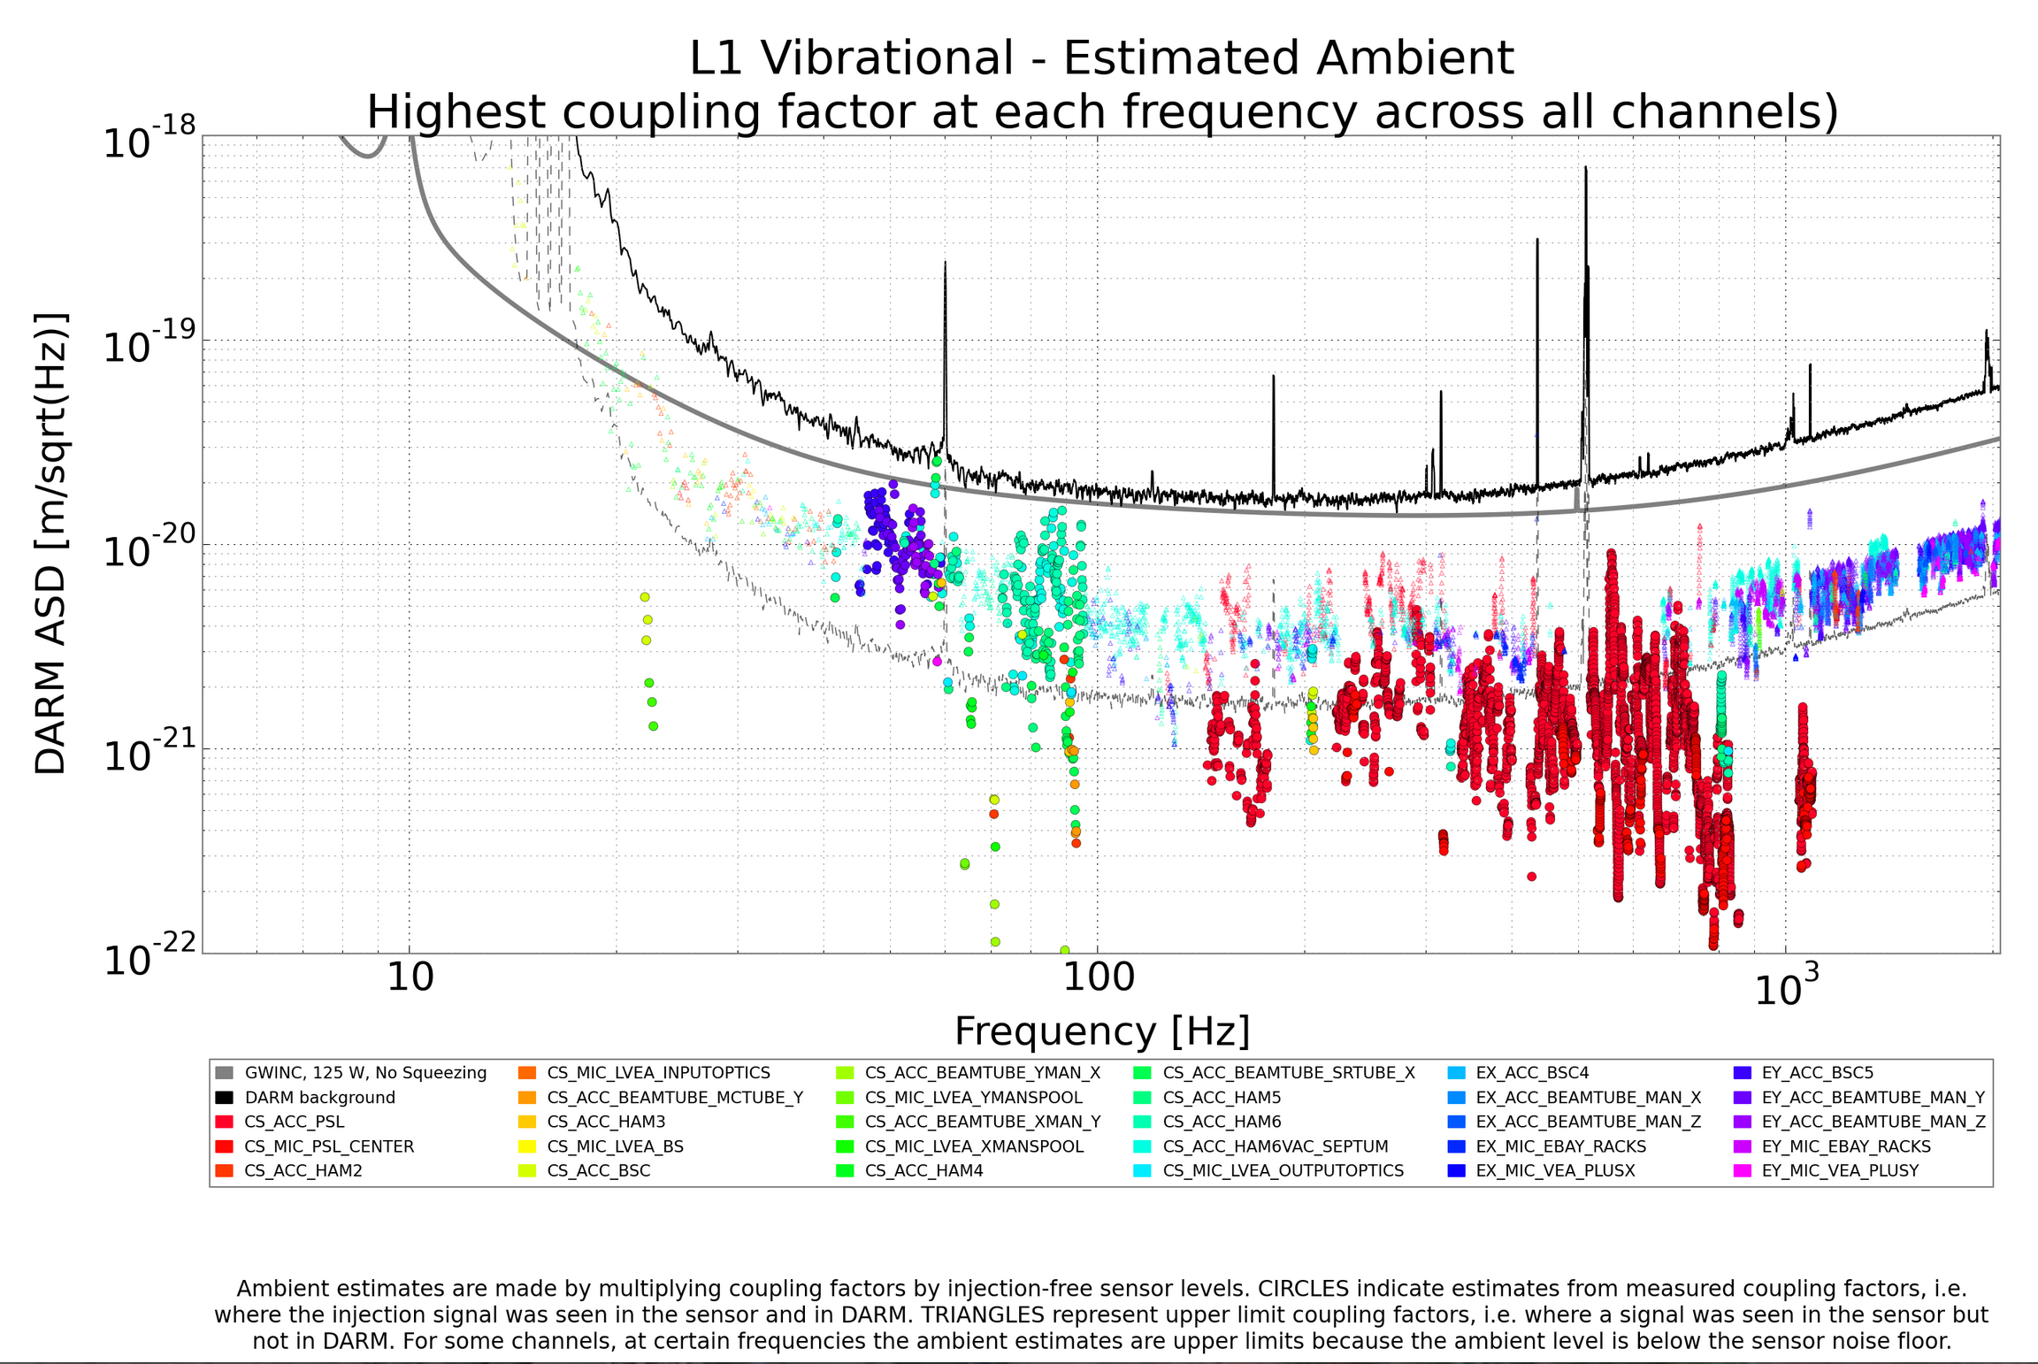

Slide 9
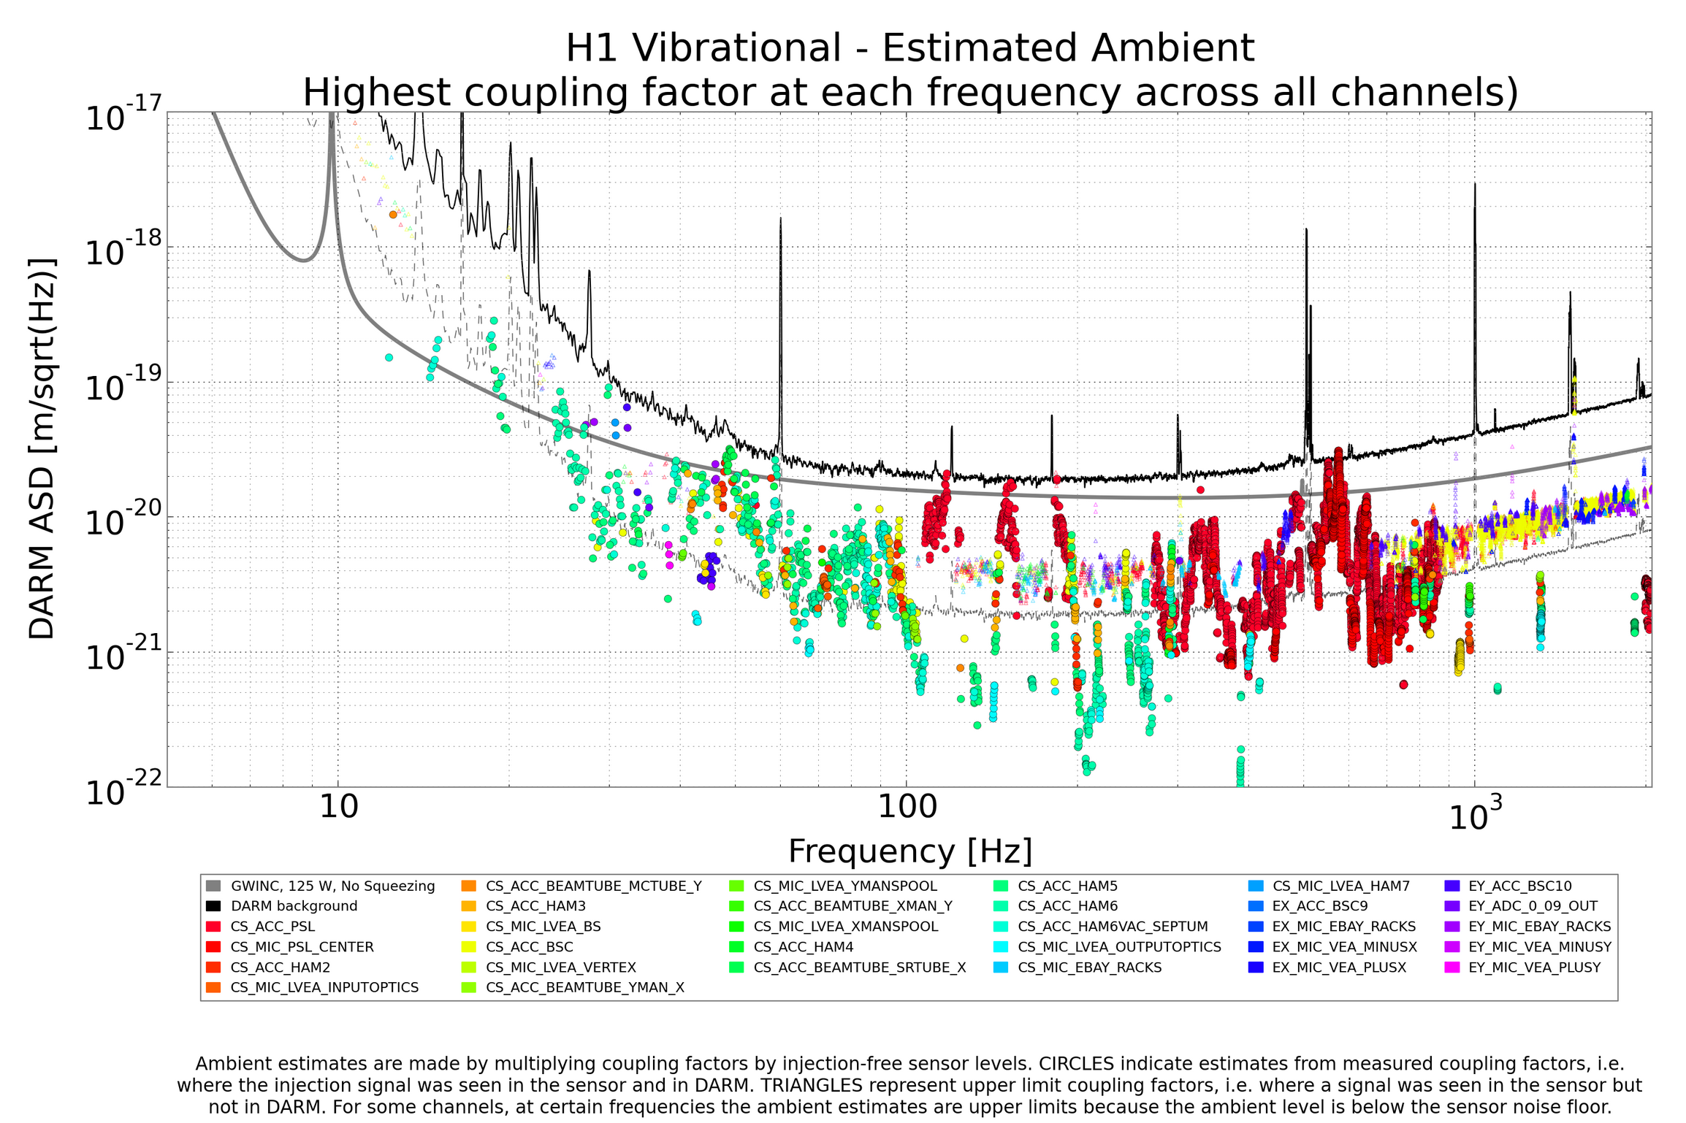

Slide 10
a
Results from the pre-run PEM injection program
Vibration
RF
Site activities
Magnetic
Big coils and magnetic monitoring program
Tests of coupling factors for thunder coupling etc.
Two new techniques for localizing vacuum enclosure coupling sites
Impulse propagation delay, amplitude, & frequency structure
Beating injections with location-dependent phase of envelope
Worst coupling sites and mitigation plans
TMSX, LLO
EY, LLO
HAM5,6 LHO, LLO
48 Hz LHO
IO Jitter, LHO, LLO

Slide 11
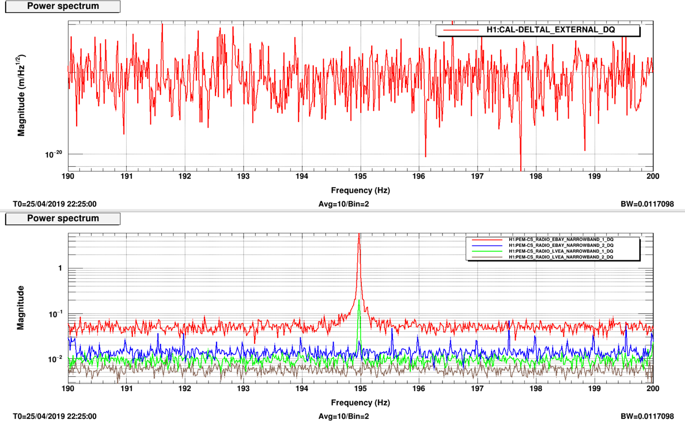
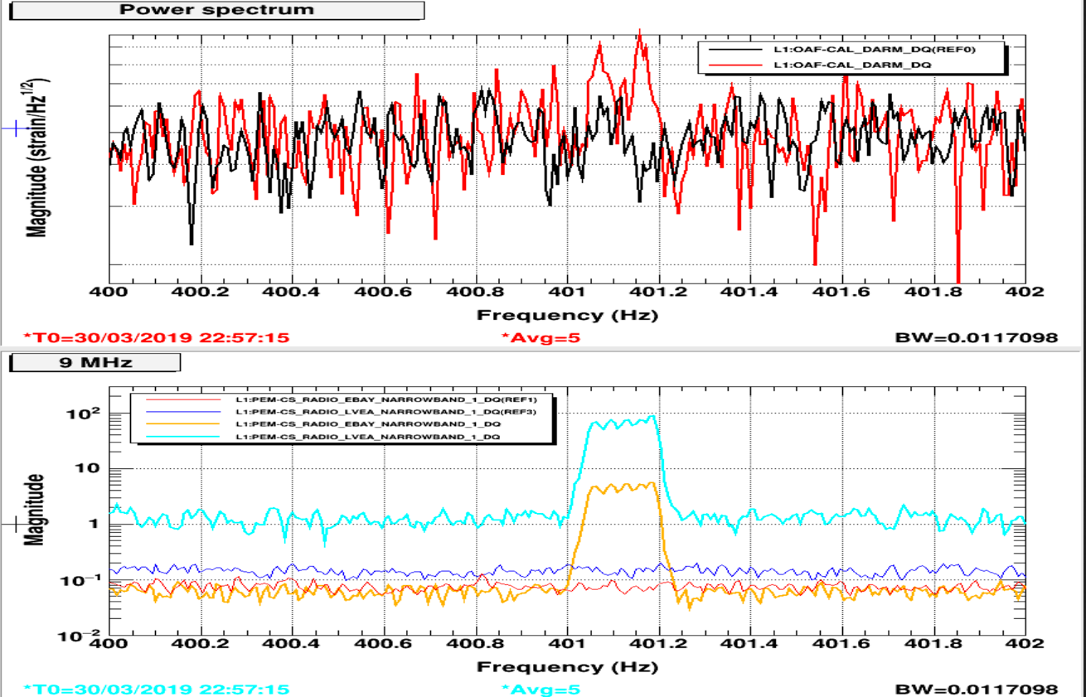
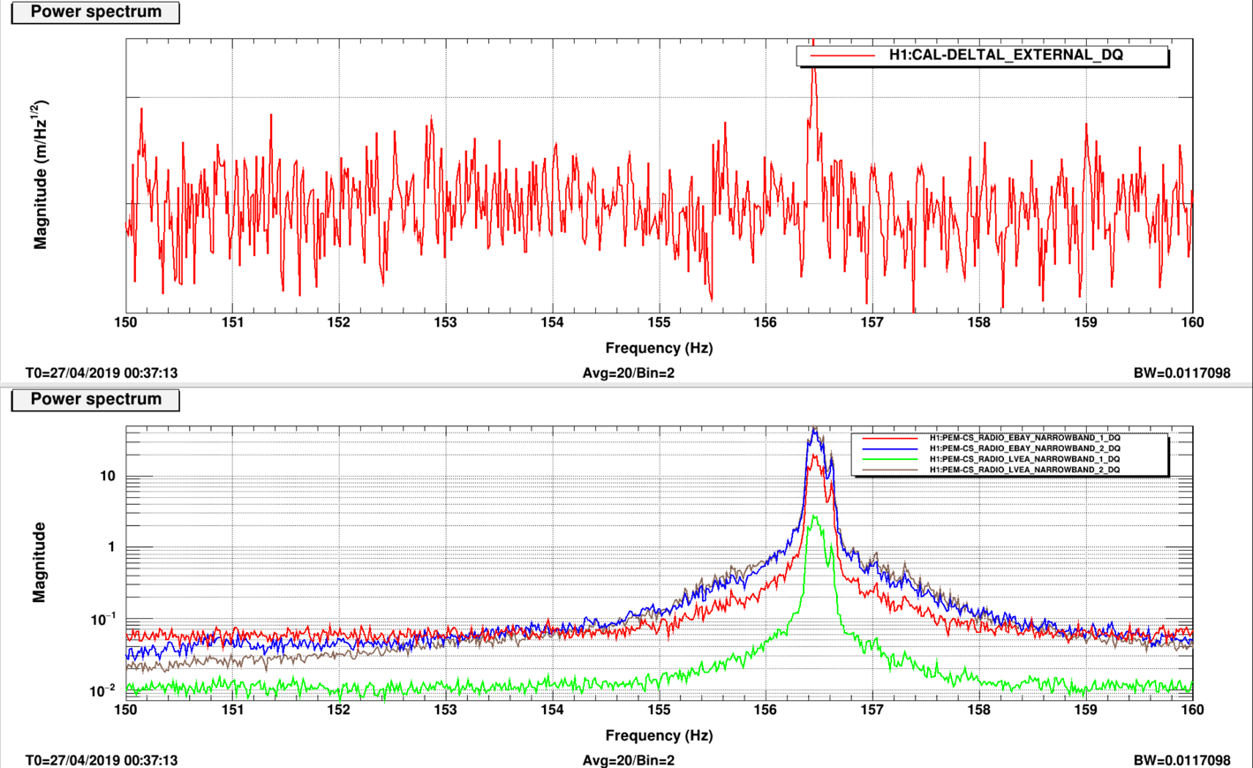
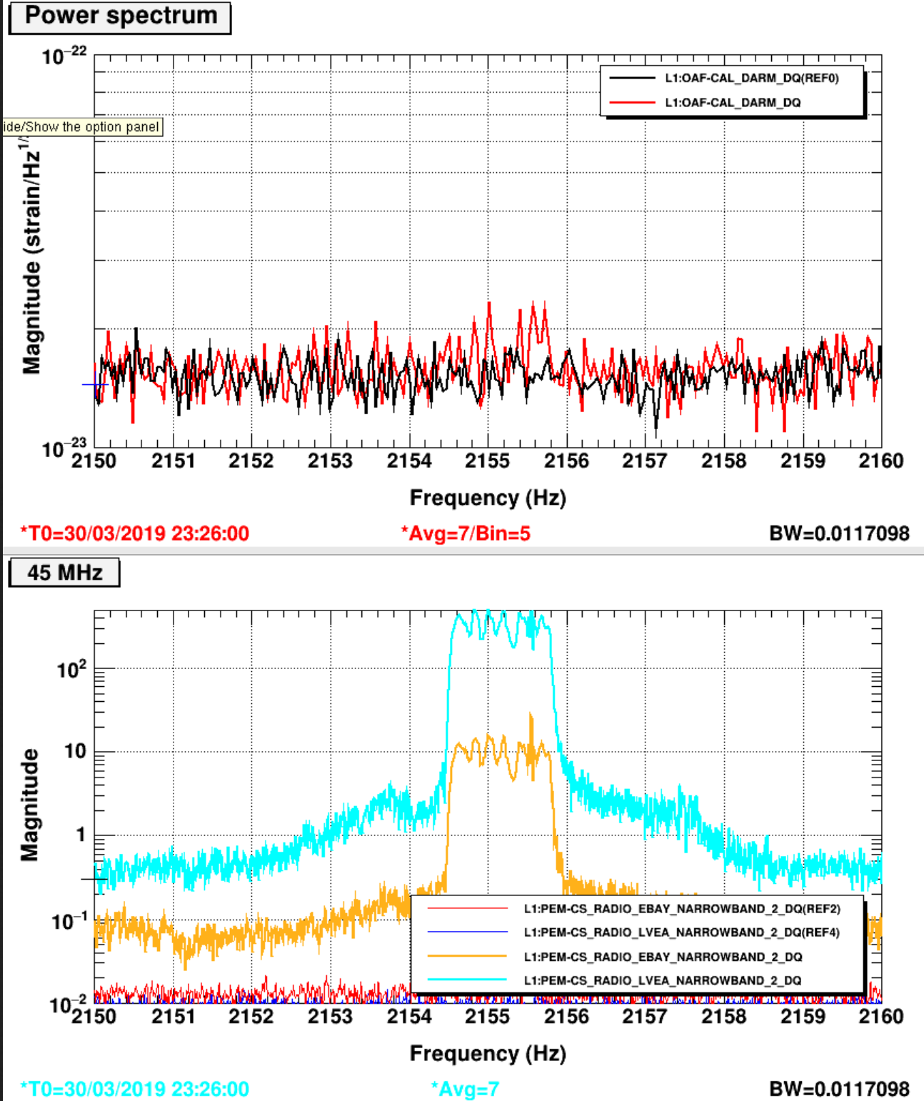
Radio channels detect external 9 & 45 MHz RF with at least 100 times SNR of DARM
LHO
LLO
9 MHz
45 MHz

Slide 12
a
Results from the pre-run PEM injection program
Vibration
RF
Site activities
Magnetic
Big coils and magnetic monitoring program
Tests of coupling factors for thunder coupling etc.
Two new techniques for localizing vacuum enclosure coupling sites
Impulse propagation delay, amplitude, & frequency structure
Beating injections with location-dependent phase of envelope
Worst coupling sites and mitigation plans
TMSX, LLO
EY, LLO
HAM5,6 LHO, LLO
48 Hz LHO
IO Jitter, LHO, LLO

Slide 13
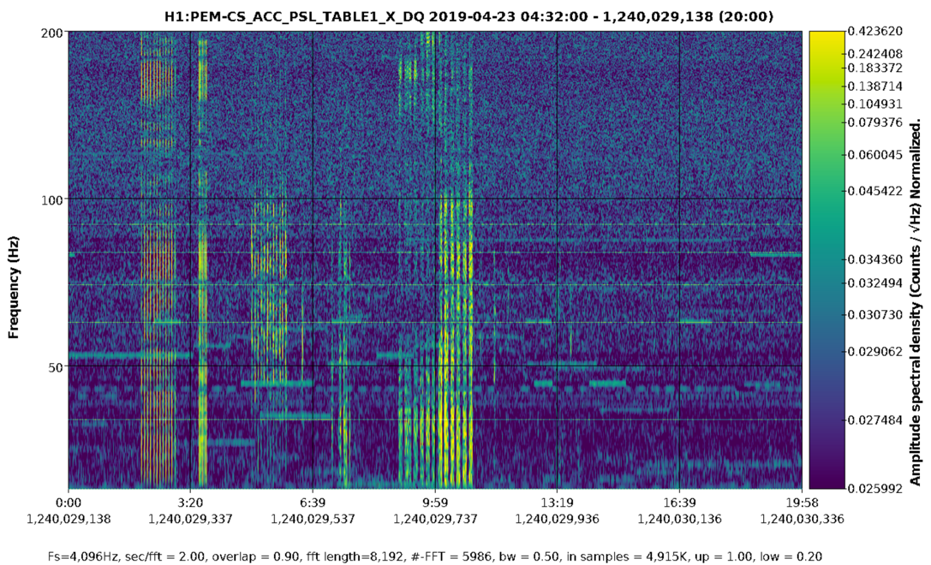
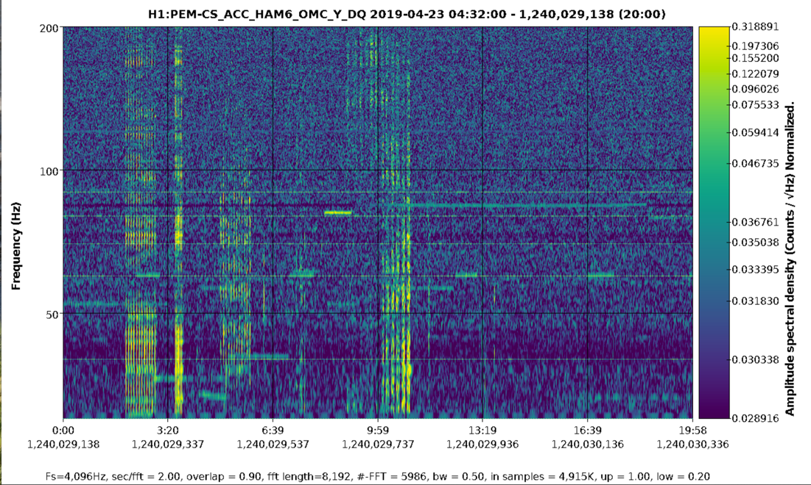
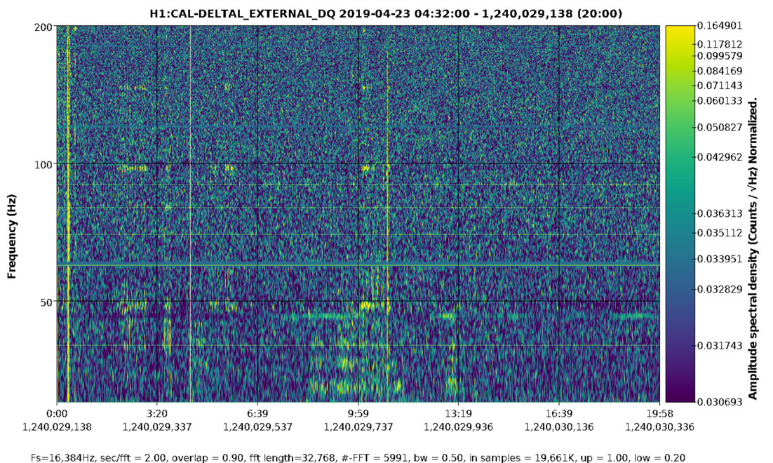
Heavy stepping tours, rolling chairs in control room, dropping a few pounds, show in H1 DARM
Mass (large super ball) dropped from about 4 ft. in control room
chair with person rolling across control room
4 people walking to imitate animated crowd (not jumping).
hallway outside control room
control room
HAM5/6 area accelerometer
PSL accelerometer
DARM
DARM (copy)

Slide 14
a
Results from the pre-run PEM injection program
Vibration
RF
Site activities
Magnetic
Big coils and magnetic monitoring program
Tests of coupling factors for thunder coupling etc.
Two new techniques for localizing vacuum enclosure coupling sites
Impulse propagation delay, amplitude, & frequency structure
Beating injections with location-dependent phase of envelope
Worst coupling sites and mitigation plans
TMSX, LLO
EY, LLO
HAM5,6 LHO, LLO
48 Hz LHO
IO Jitter, LHO, LLO

Slide 16
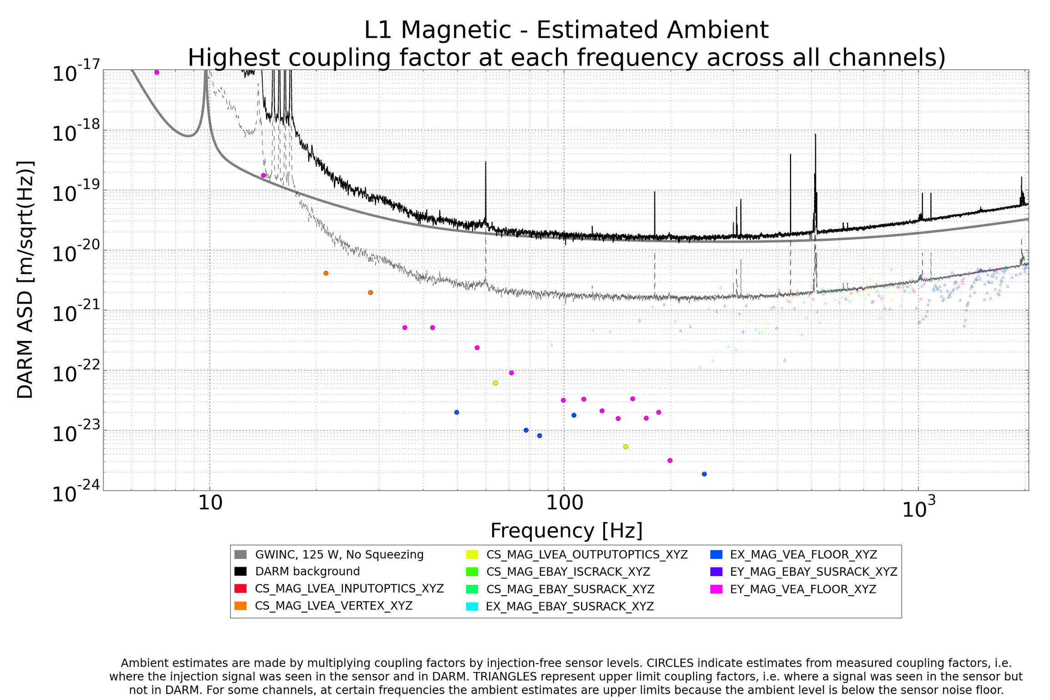

Slide 17
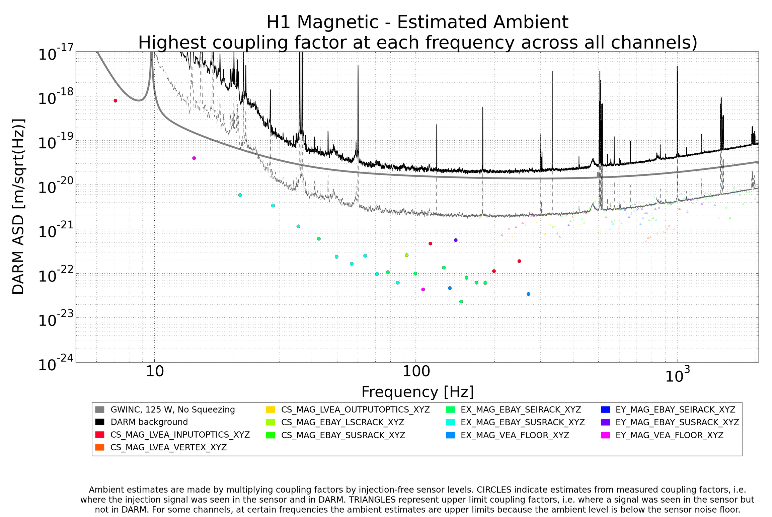

Slide 18
a
Results from the pre-run PEM injection program
Vibration
RF
Site activities
Magnetic
Big coils and magnetic monitoring program
Tests of coupling factors for thunder coupling etc.
Two new techniques for localizing vacuum enclosure coupling sites
Impulse propagation delay, amplitude, & frequency structure
Beating injections with location-dependent phase of envelope
Worst coupling sites and mitigation plans
TMSX, LLO
EY, LLO
HAM5,6 LHO, LLO
48 Hz LHO
IO Jitter, LHO, LLO

Slide 19
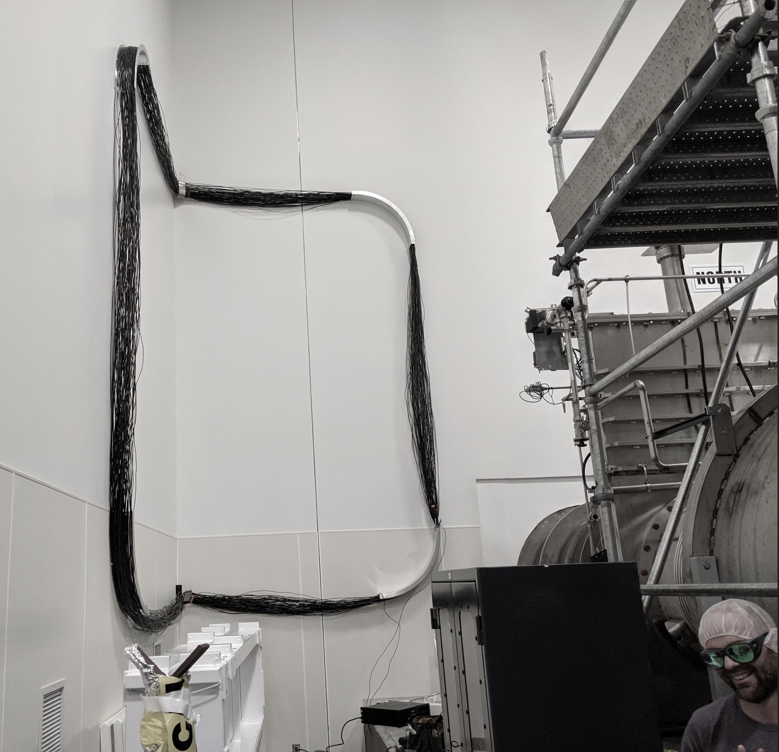
First coils at LHO & LLO
LHO CS
LLO EX

Slide 20
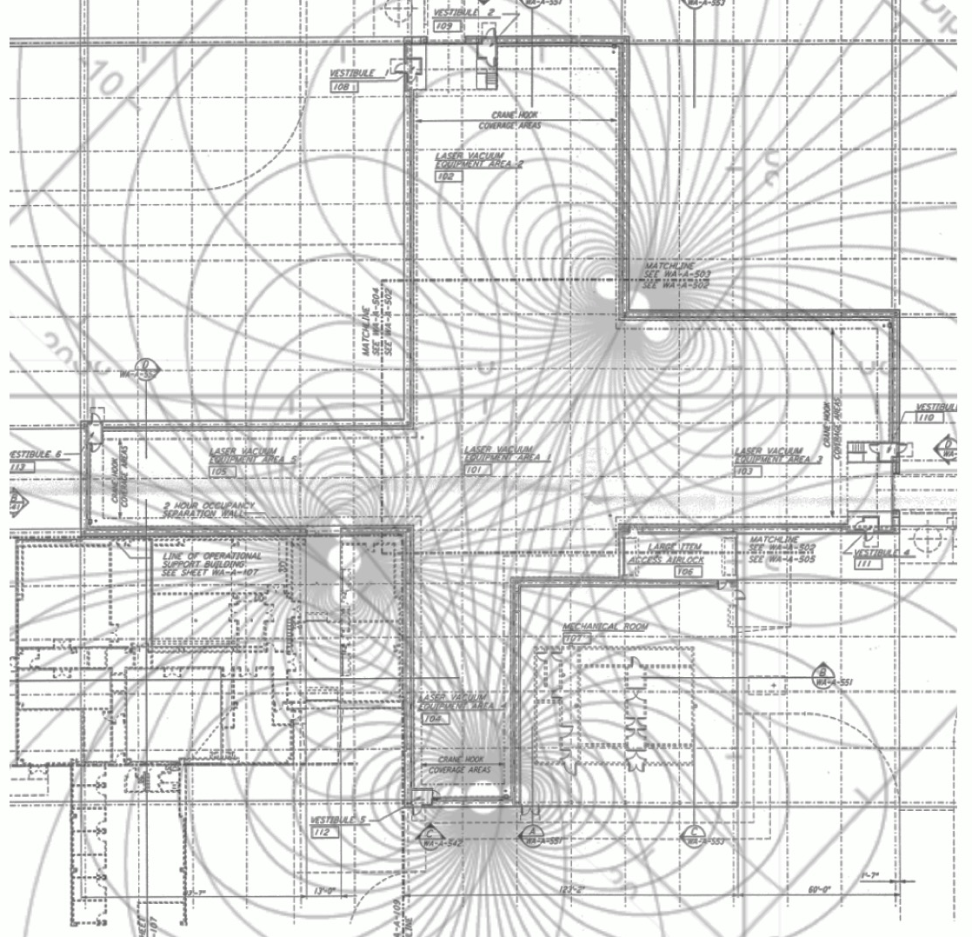
Proposed coil locations
CS
EY
EX

Slide 21
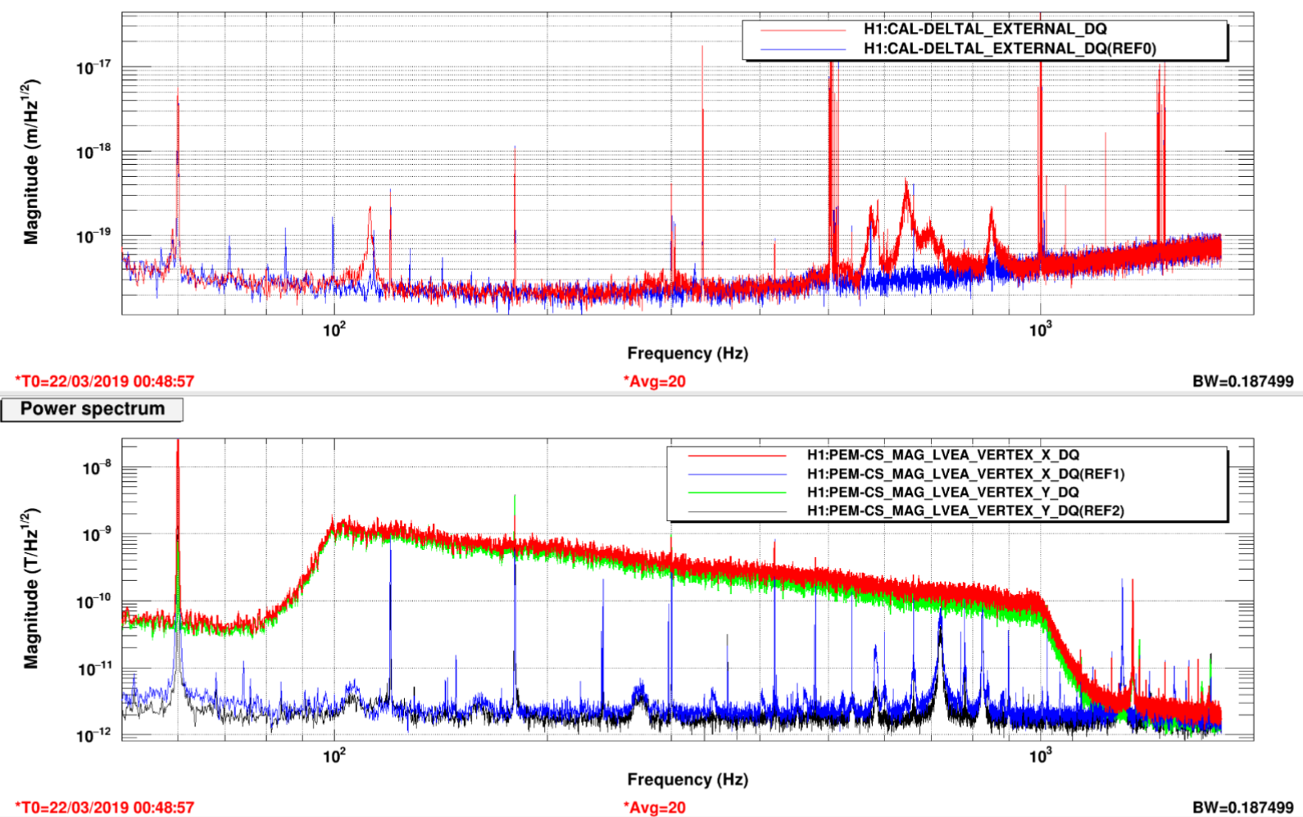
Broad band injection shows magnetic resonances
DARM
Magnetometer

Slide 22
Weekly magnetic injection results (Philippe N.)

Slide 23
Weekly magnetic injection

Slide 24
I.
LLO

Slide 25
a
Results from the pre-run PEM injection program
Vibration
RF
Site activities
Magnetic
Big coils and magnetic monitoring program
Tests of coupling factors for thunder coupling etc.
Two new techniques for localizing vacuum enclosure coupling sites
Impulse propagation delay, amplitude, & frequency structure
Beating injections with location-dependent phase of envelope
Worst coupling sites and mitigation plans
TMSX, LLO
EY, LLO
HAM5,6 LHO, LLO
48 Hz LHO
IO Jitter, LHO, LLO

Slide 26
Effects of environment on DARM are consistent with PEM coupling functions
Range reduction from LHO HVAC is roughly predicted from estimates for HAM5/6.
Range reduction from rain at LHO is roughly consistent with PEM coupling functions, though underestimated by 2 at 48 Hz
Range reduction from wind at LHO is roughly consistent with PEM coupling functions.
LLO DARM glitch from thunder near S190510g is correctly predicted from PEM injection coupling functions.

Slide 27
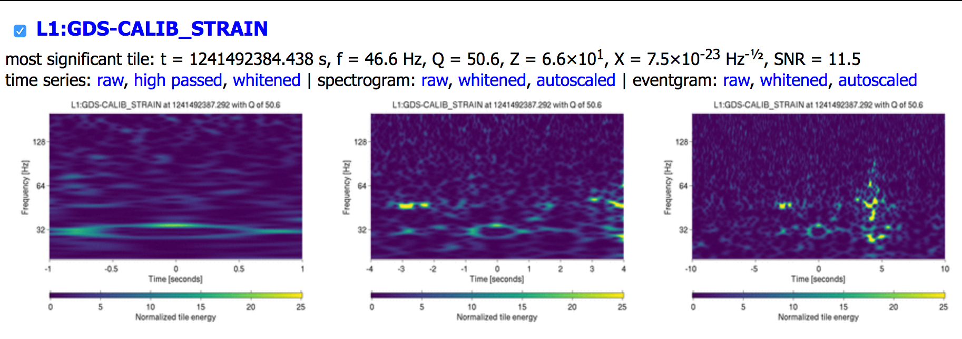
Thunder associated with S190510g in DARM and accelerometer

Slide 28
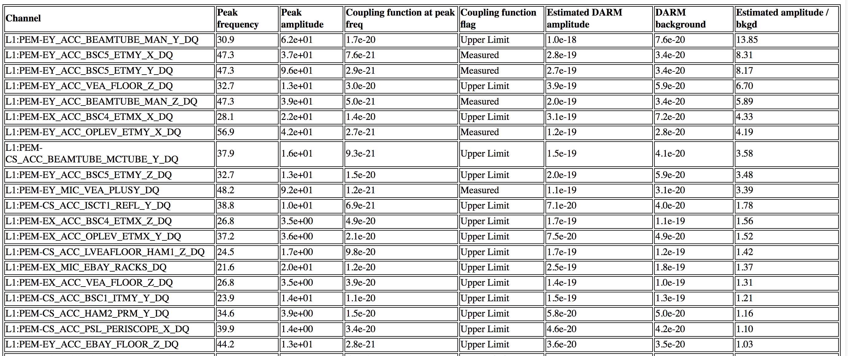
Automated DQR results: signal in DARM is well predicted
Similar automated calculations are made for every PEM trigger around candidates

Slide 29
a
Results from the pre-run PEM injection program
Vibration
RF
Site activities
Magnetic
Big coils and magnetic monitoring program
Tests of coupling factors for thunder coupling etc.
New techniques for localizing vacuum enclosure coupling sites
Impulse propagation delay, amplitude, & frequency structure
Beating injections with location-dependent phase of envelope
Worst coupling sites and mitigation plans
TMSX, LLO
EY, LLO
HAM5,6 LHO, LLO
48 Hz LHO
IO Jitter, LHO, LLO

Slide 30
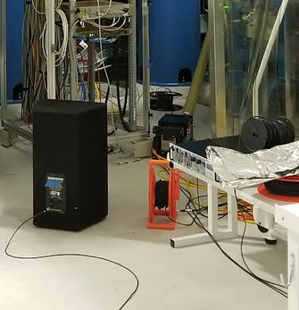
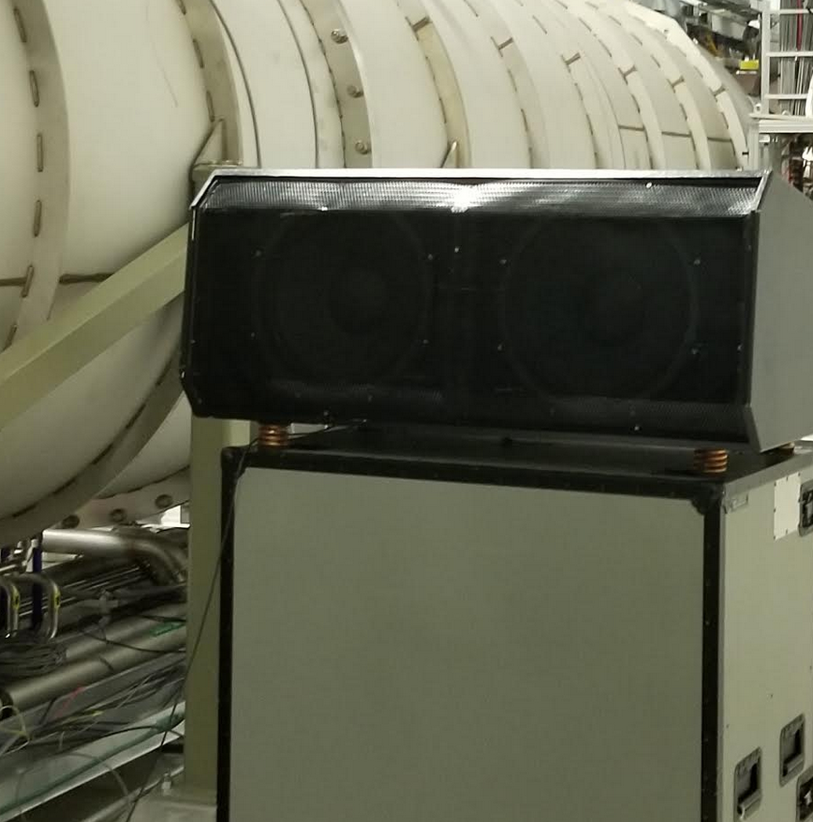
I. New techniques for localizing vacuum enclosure coupling
When you shake HAM5, HAM6 and other places shake also, so other techniques are needed to narrow potential coupling sites
1. Impulse injections at multiple sites, monitor DARM and accelerometers for consistency of propagation delays, amplitude ratios, and resonance structure.
2. Beating injections producing location-dependent phase of beat-envelope. Coupling site is near accelerometer that best matches phase of beat-envelope in DARM. Better for narrow-band coupling

Slide 31
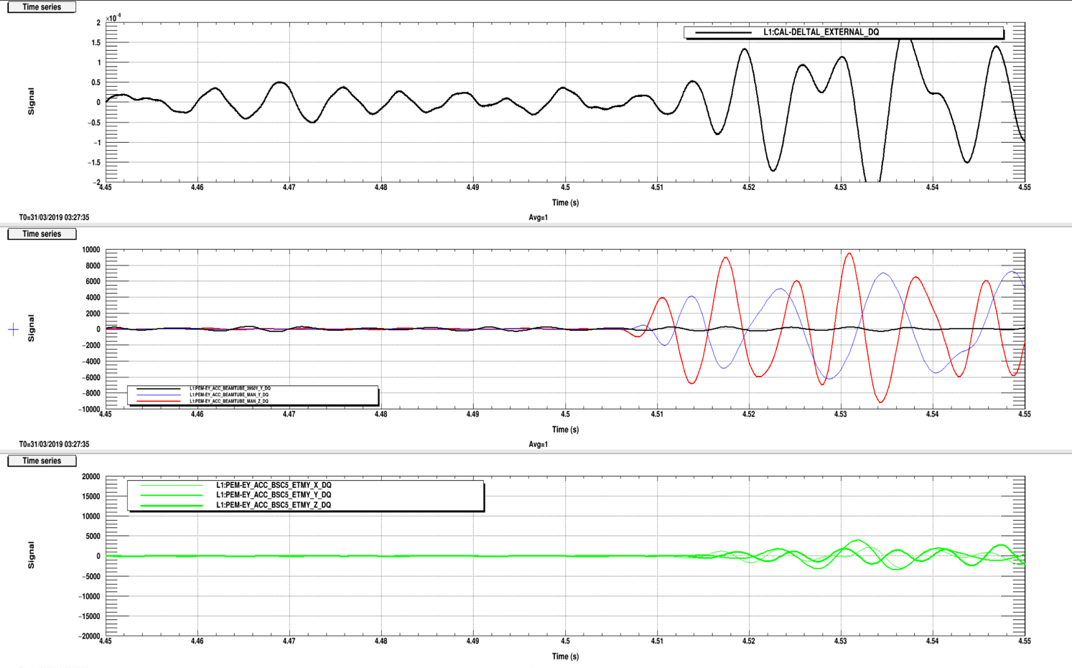
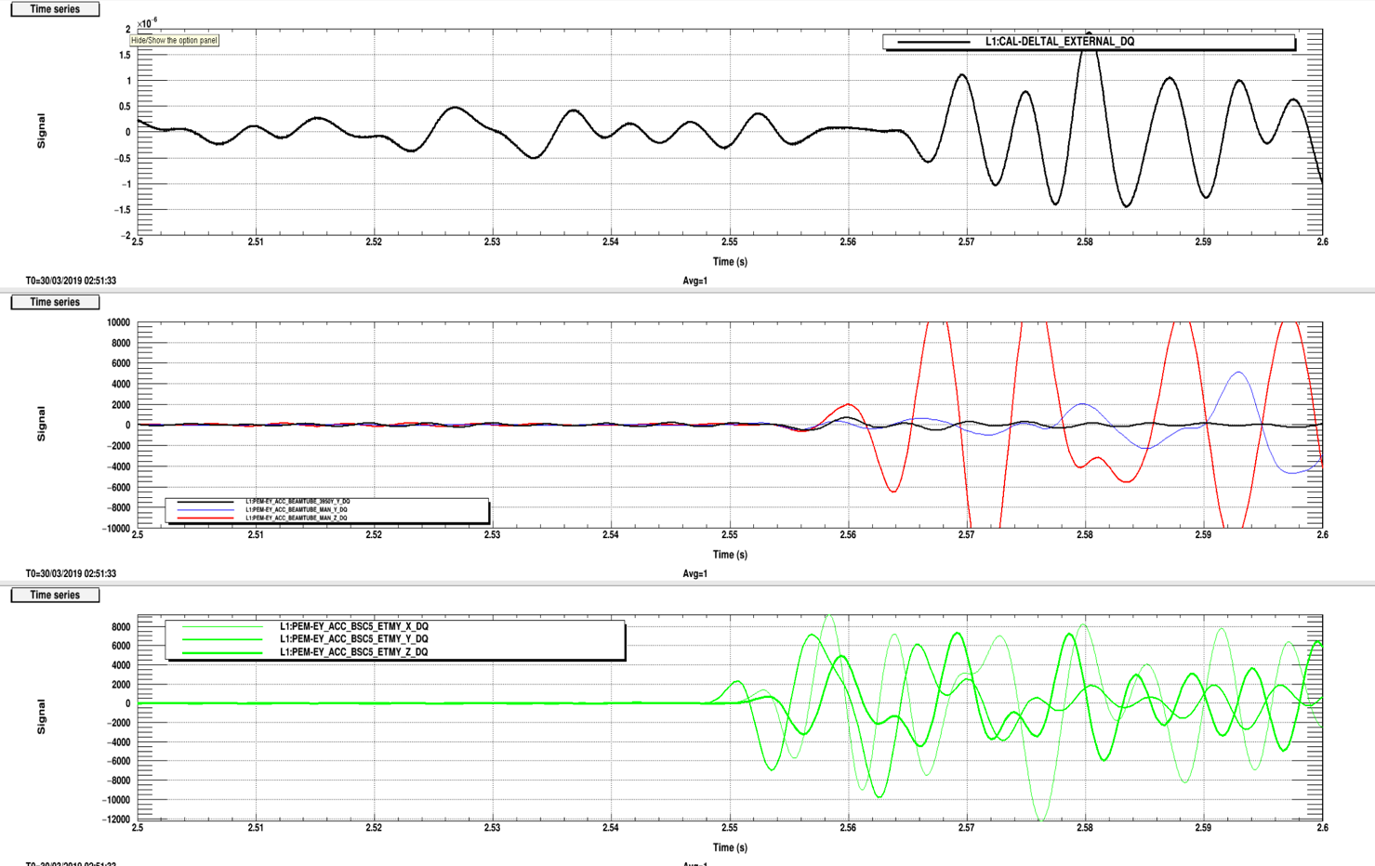
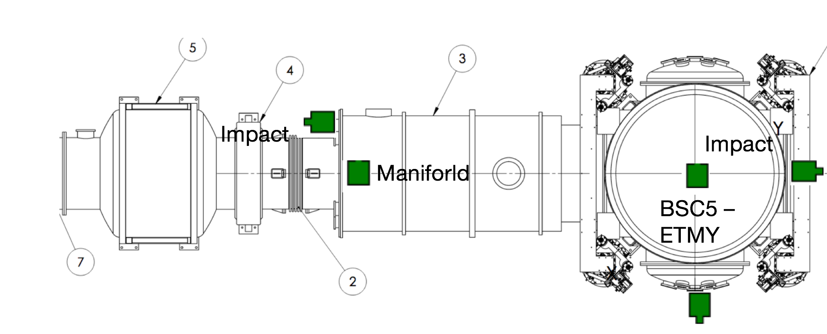
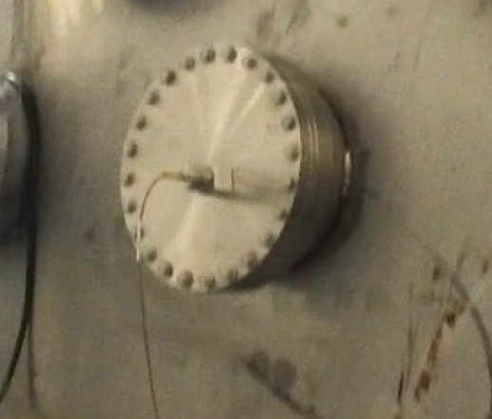
1. Impulse injected onto vacuum enclosure at multiple sites
consistency between accelerometer and DARM arrival times
consistency between accelerometer/DARM amplitude ratios
consistency between accelerometer and DARM frequency structure
Soft hammer strike on -Y reduction flange, 70-200 Hz band
Soft hammer strike on end cap, 70-200 Hz band
DARM
1
Red and Blue: manifold accelerometers
2
2
BSC 5 accelerometers
Impulses propagate at 100s of meters per second

Slide 32
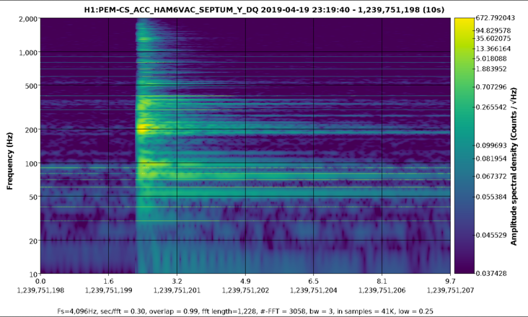
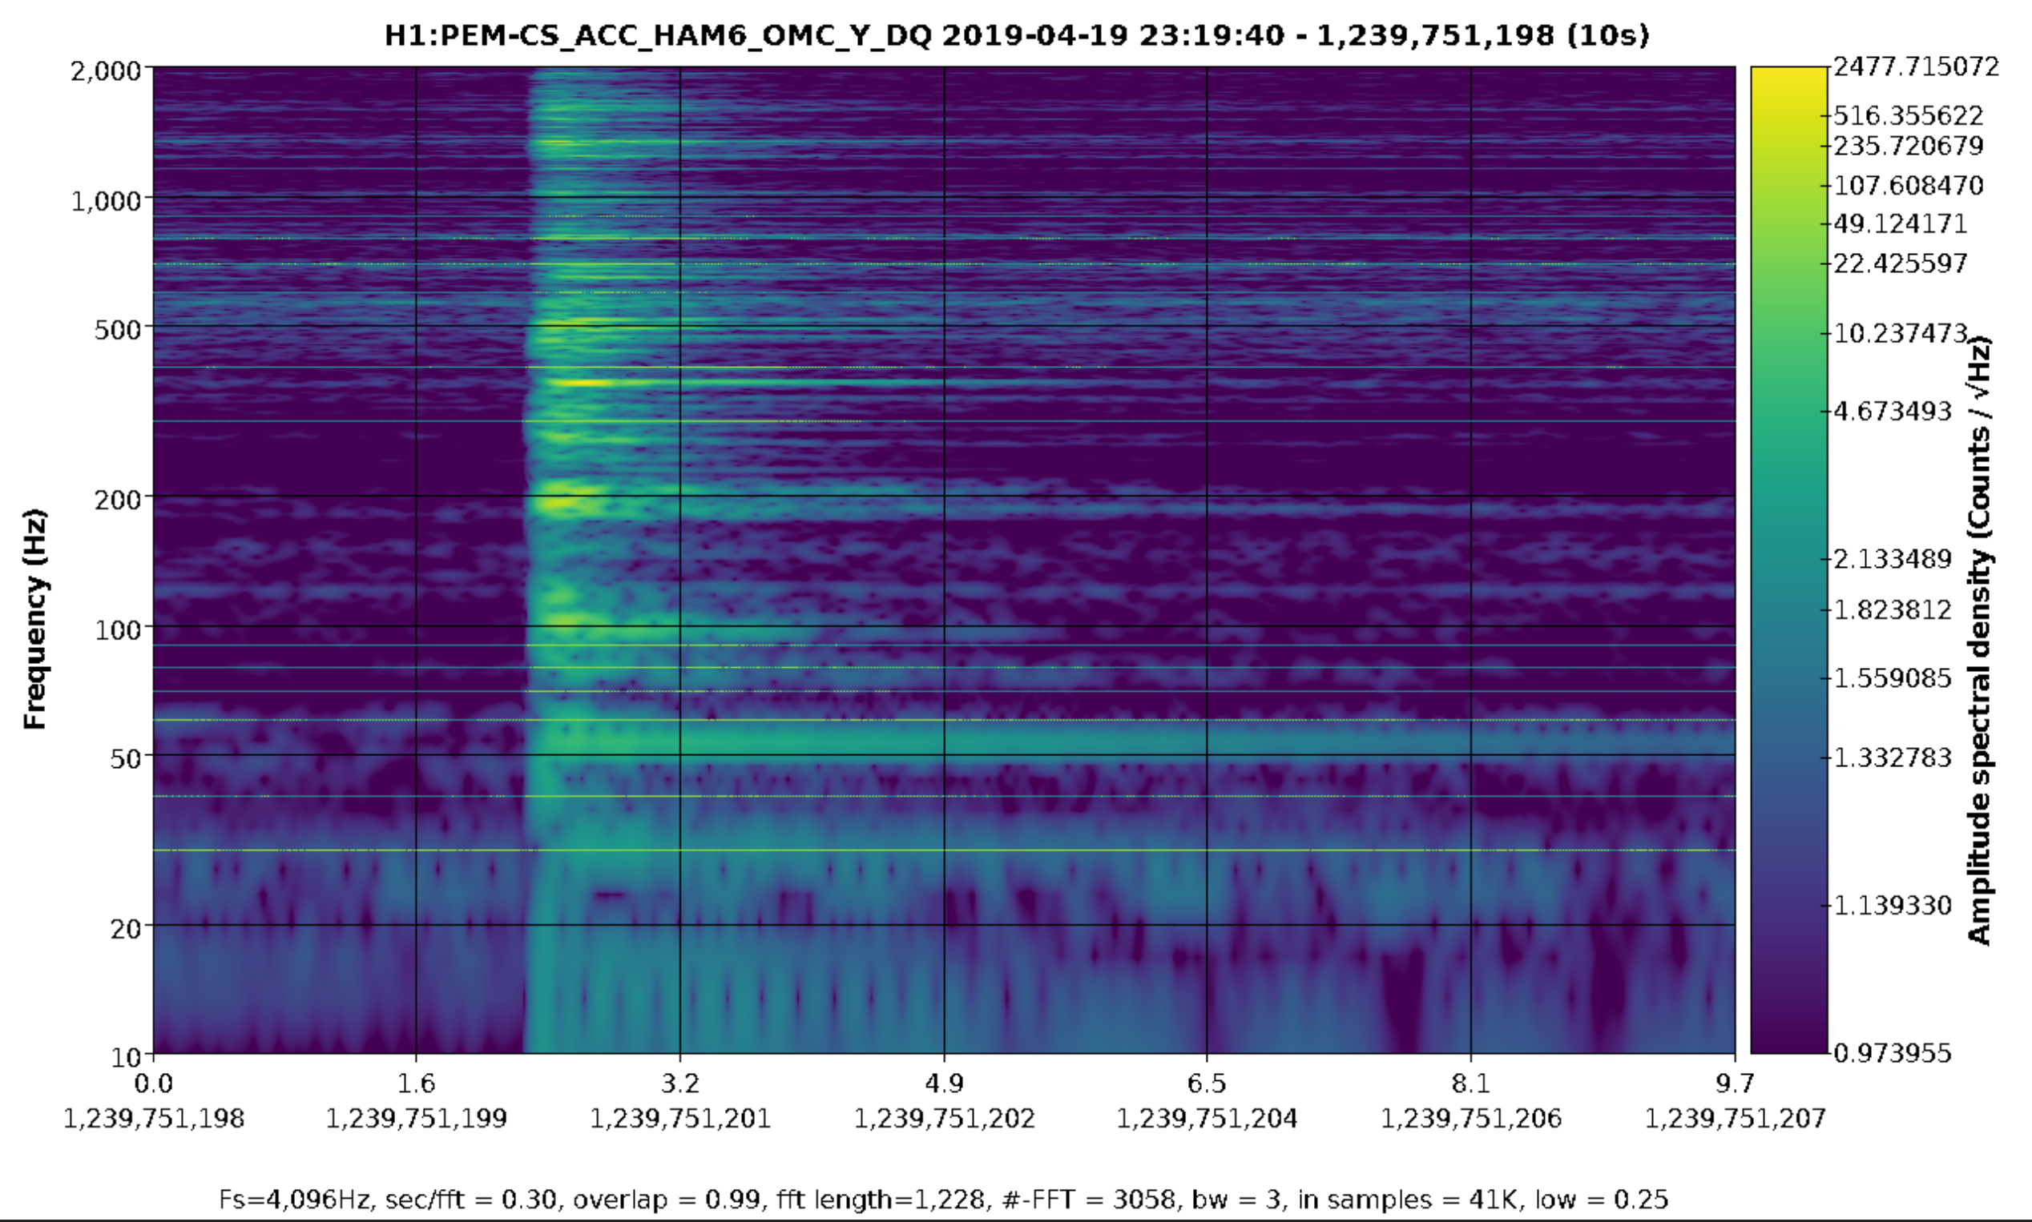
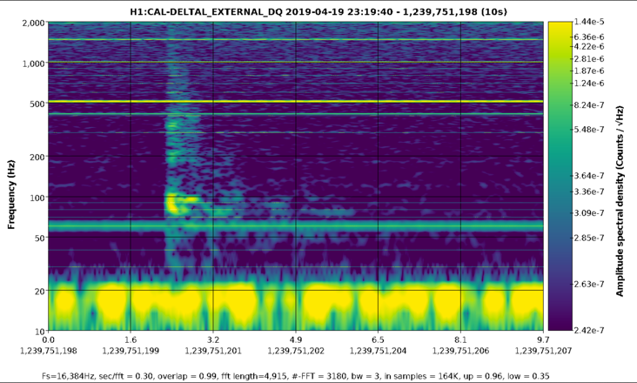
1. Impulse injected onto vacuum enclosure at multiple sites
consistency between accelerometer and DARM arrival times
consistency between accelerometer/DARM amplitude ratios
consistency between accelerometer and DARM frequency structure
DARM
Good Accelerometer match
Poor match

Slide 33
2. Separated beating injections to produce location-dependent beat-envelope phase
Accelerometer and DARM consistency for acoustic injections
Accelerometer and DARM consistency for vacuum enclosure shaking
Strips of spectrograms with 20s 50, 50.05 Hz beats followed by 50, 50.01 Hz 100s beats
BSC3 Y
DARM
HAM6 S
BSC3 accelerometer doesn’t match DARM envelope but HAM6 septum does

Slide 34
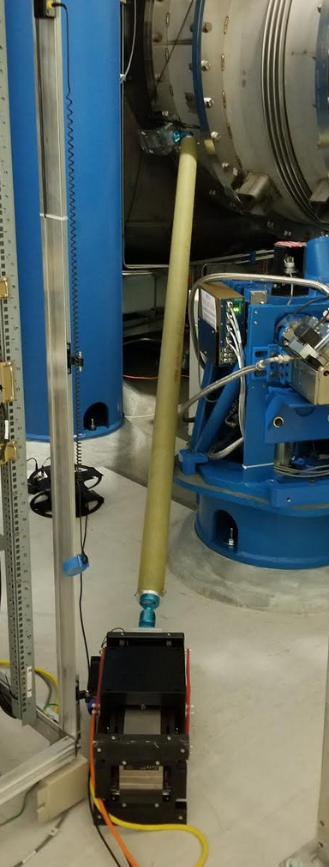
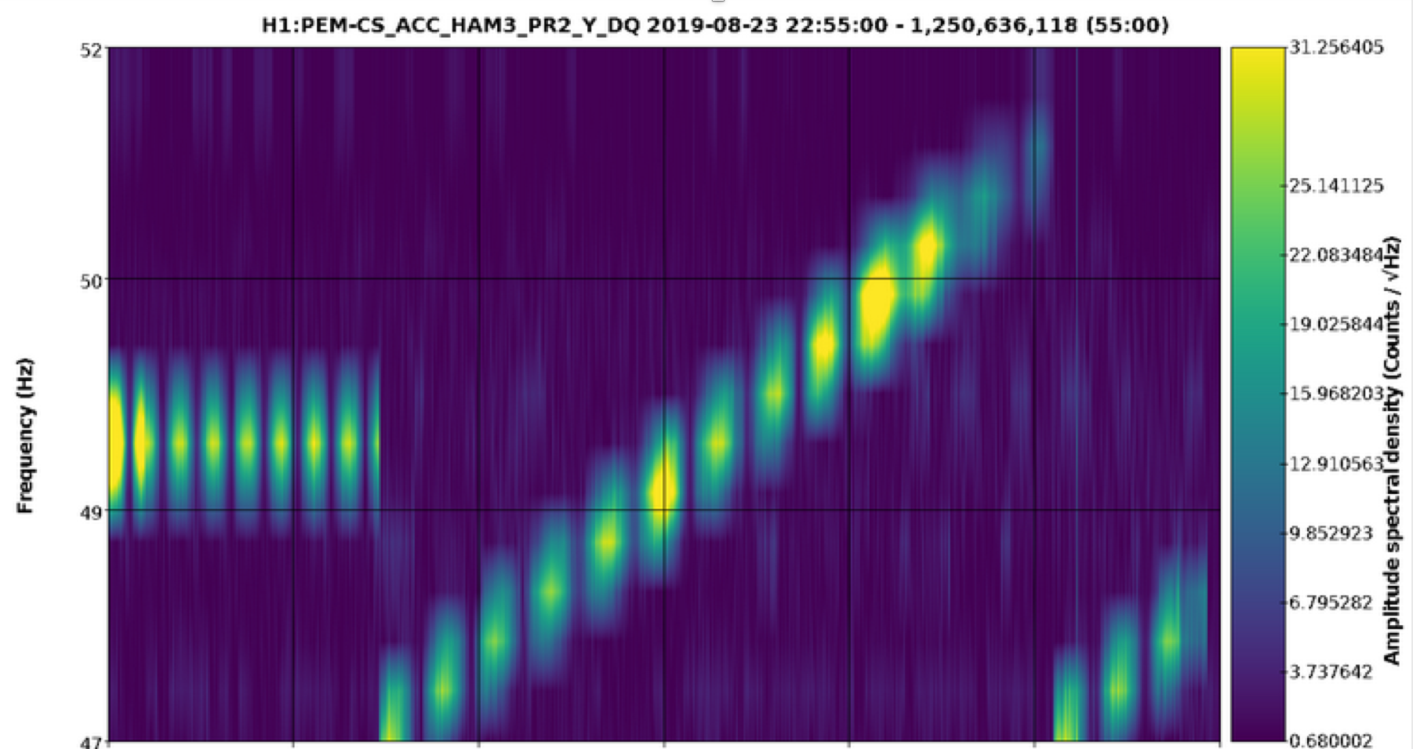
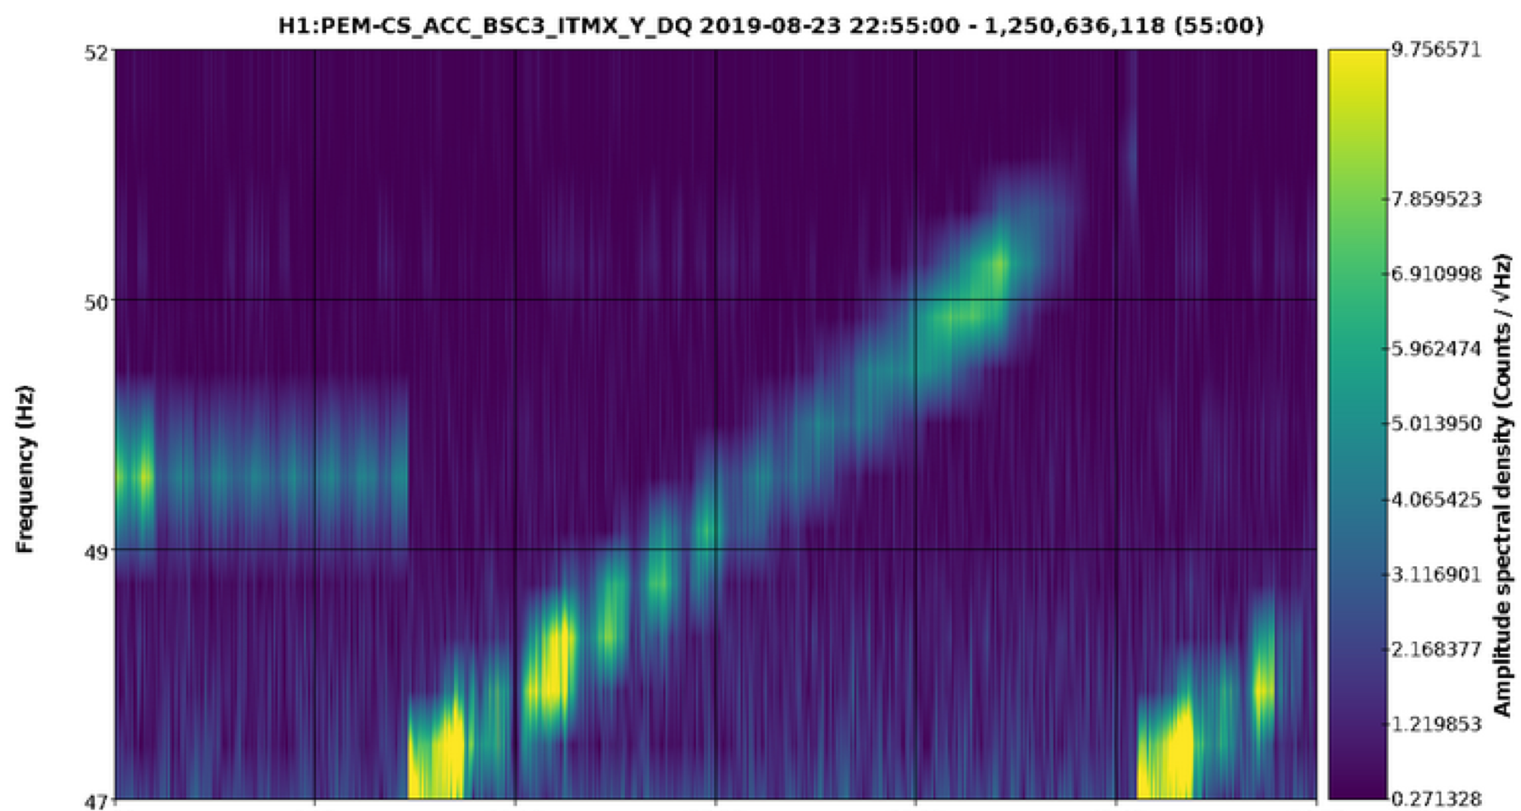
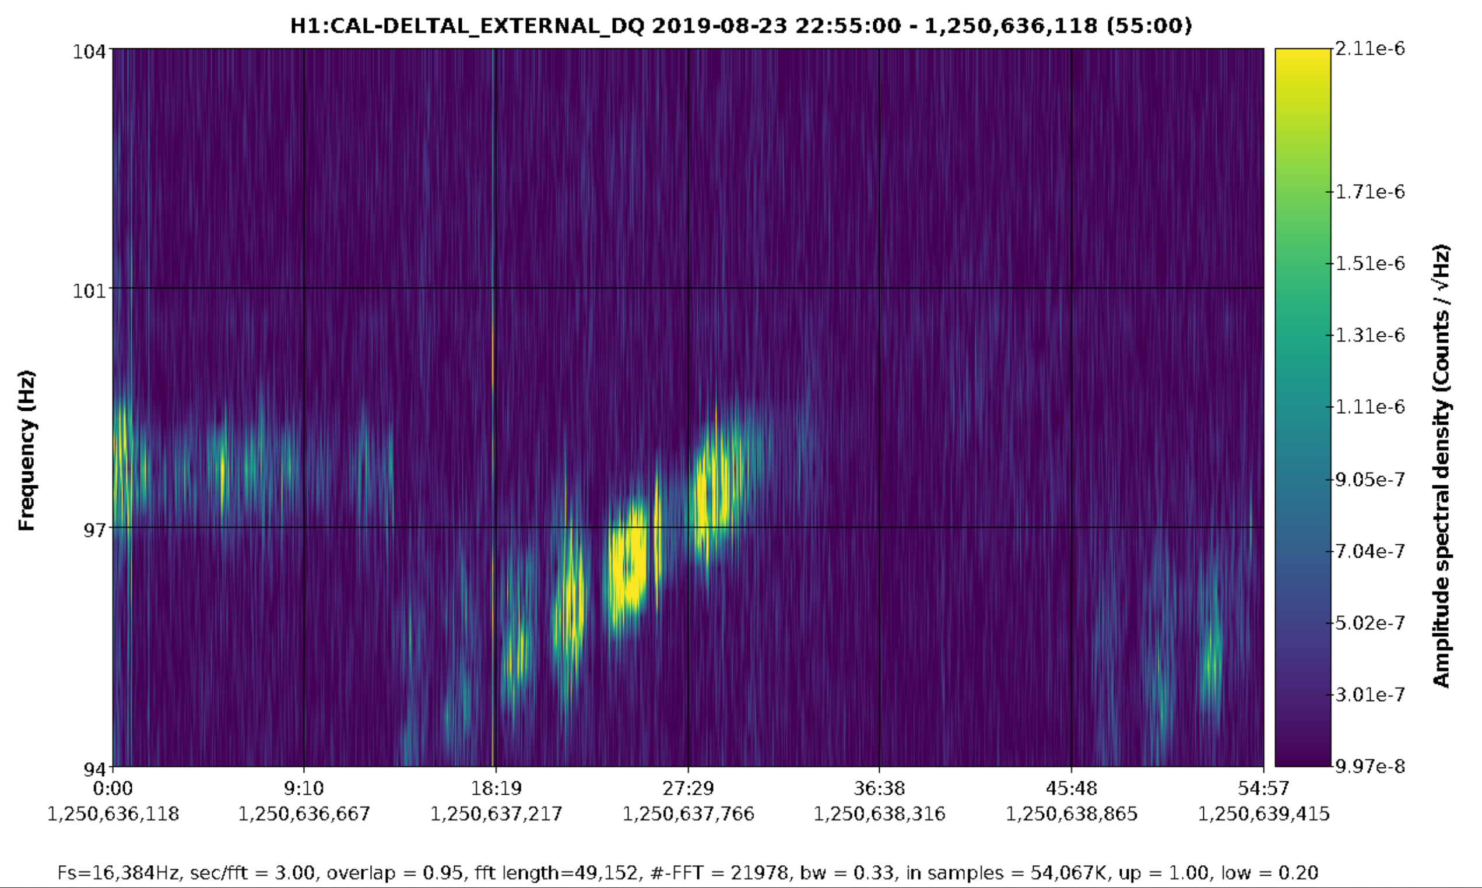
2. Double injections to produce location-dependent beat-envelope phase
Accelerometer and DARM consistency for acoustic injections
Accelerometer and DARM consistency for vacuum enclosure shaking
Frequency sweep to reduce chance of accidental alignment for non-coupling locations

Slide 35
a
Results from the pre-run PEM injection program
Vibration
RF
Site activities
Magnetic
Big coils and magnetic monitoring program
Tests of coupling factors for thunder coupling etc.
Two new techniques for localizing vacuum enclosure coupling sites
Impulse propagation delay, amplitude, & frequency structure
Beating injections with location-dependent phase of envelope
Worst coupling sites and mitigation plans
TMSX, LLO
EY, LLO
HAM5,6 LHO, LLO
48 Hz LHO
IO Jitter, LHO, LLO

Slide 36
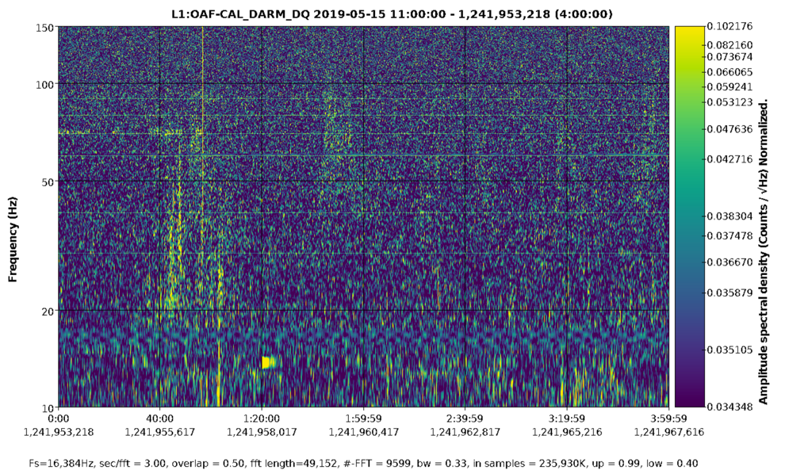
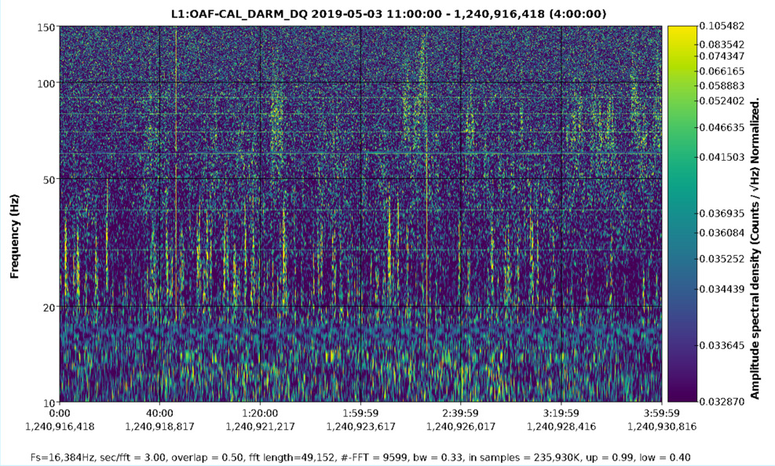
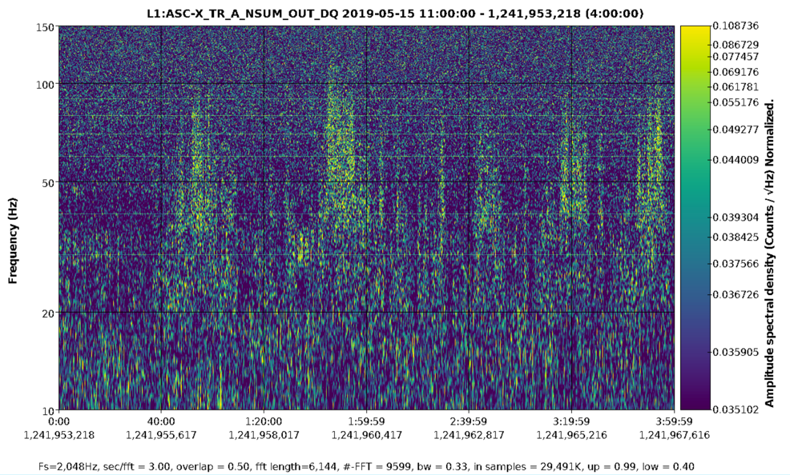
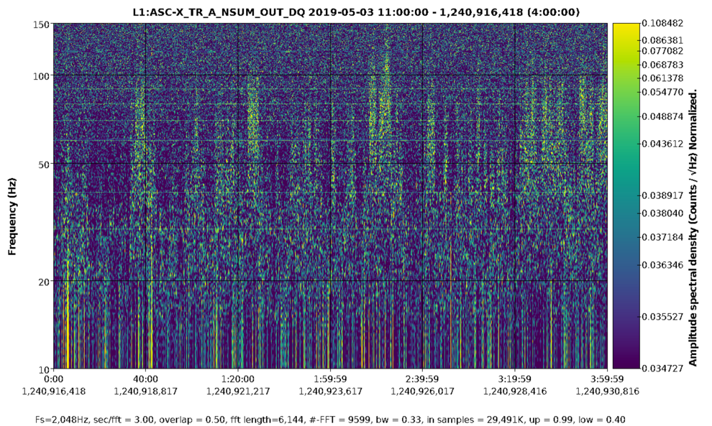
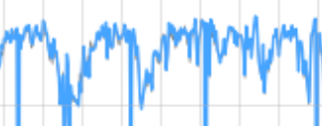
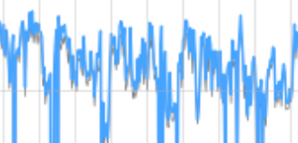
Worst source of range drops: TMSX noise at EX at LLO
May 15
May 3
TMX noise
TMX noise
L1 DARM
4 hours
Arch scattering noise, possibly from EY
Arch scattering noise, possibly from EY
TMX noise: L1 X_TR_A_NSUM
signal from transmission monitor quad photodiode
L1 range

Slide 37
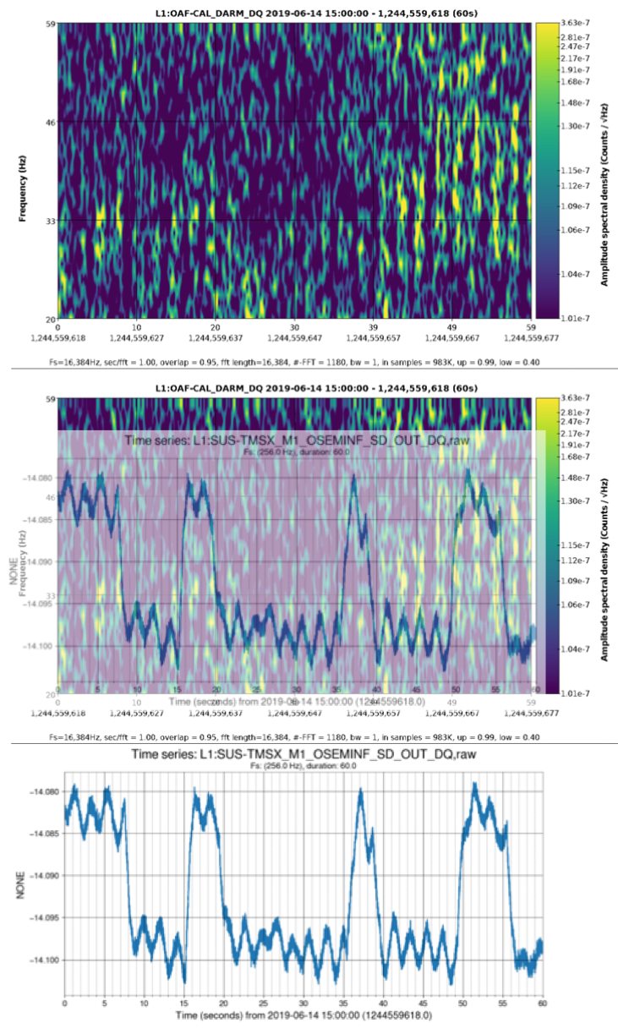
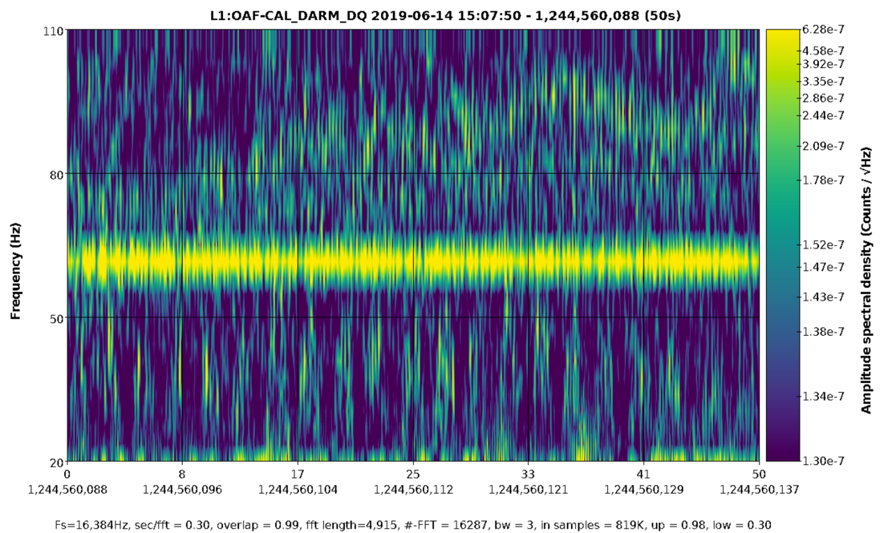
Noise in DARM modulated at TMSX suspension frequencies
DARM
3.8 Hz
0.48 Hz
0.48 Hz
overlap
Angular motion of the TMSX could produce high frequencies in DARM if the scattered light only couples back into the arm cavity over a couple of percent of the angular range (i.e. intensity noise from varying mode matching).
TMSX beam-axis OSEM (SD)
Test Mass
Anamaria Effler

Slide 38
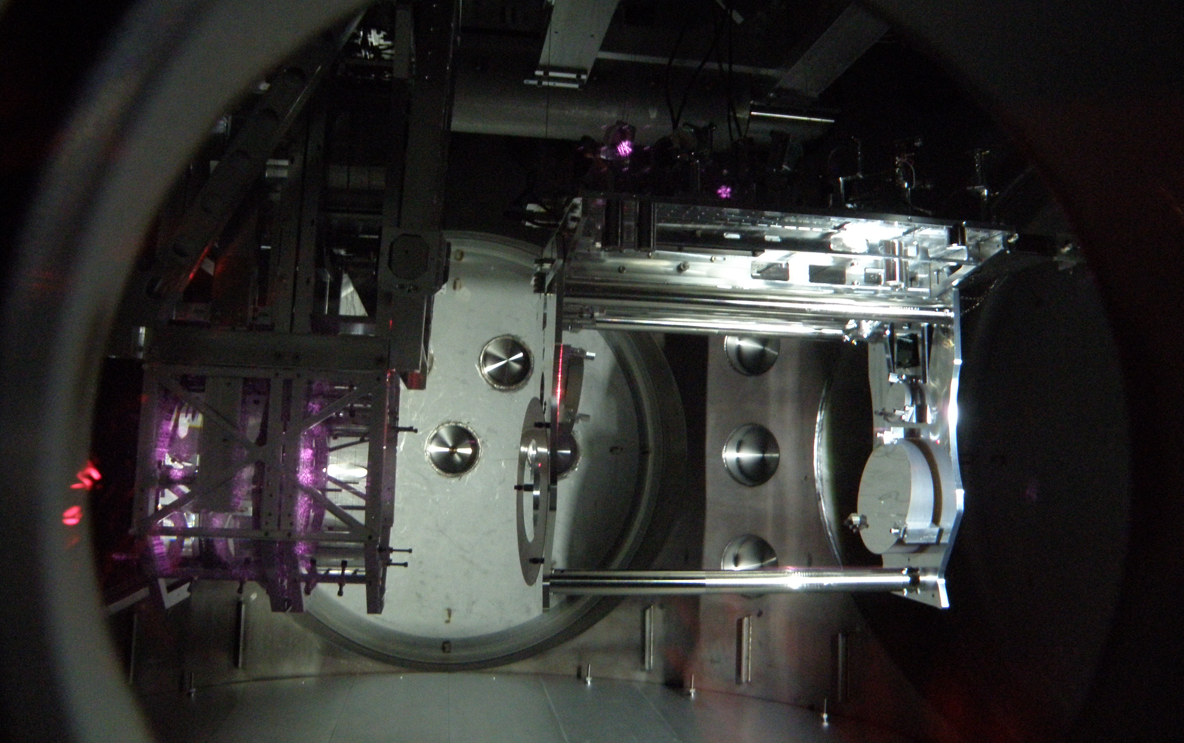
Transmission monitor during lock
Test Mass
Transmission monitor
Anamaria Effler

Slide 39
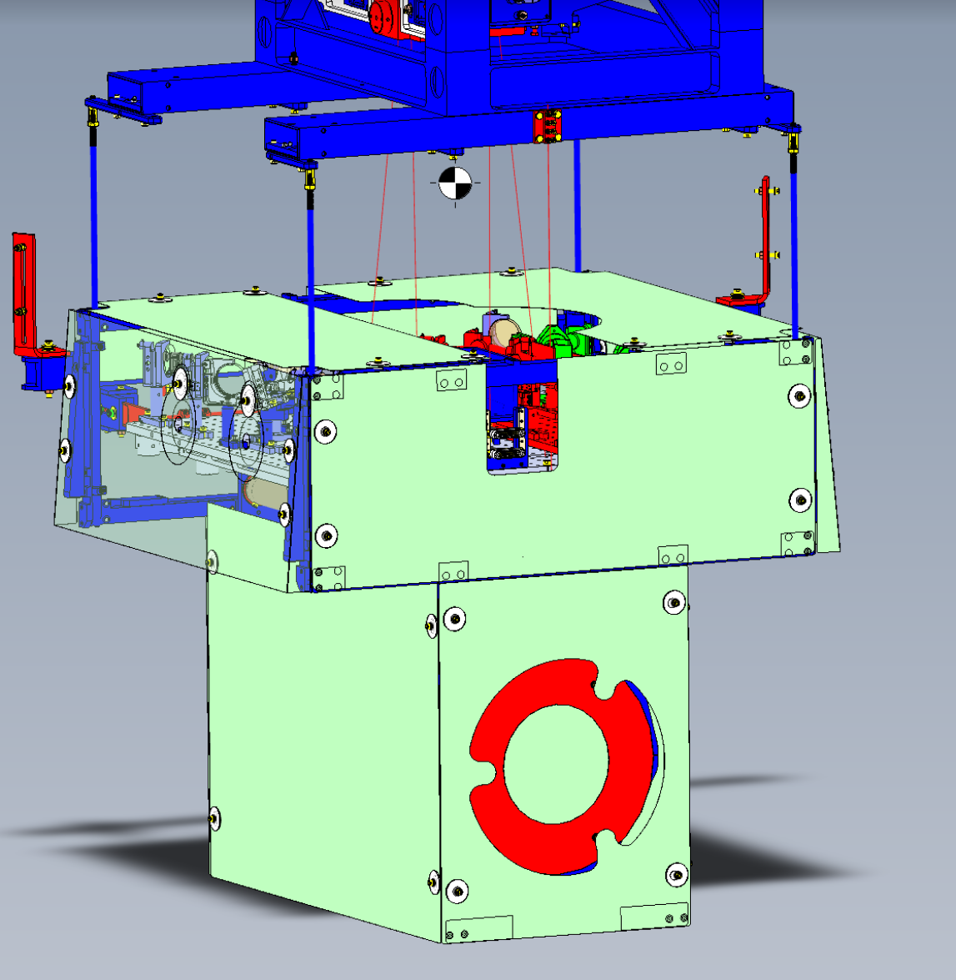
TMS shroud
Alena Ananyeva, Eduardo Sanchez and the SLiC group

Slide 40
a
Results from the pre-run PEM injection program
Vibration
RF
Site activities
Magnetic
Big coils and magnetic monitoring program
Tests of coupling factors for thunder coupling etc.
Two new techniques for localizing vacuum enclosure coupling sites
Impulse propagation delay, amplitude, & frequency structure
Beating injections with location-dependent phase of envelope
Worst coupling sites and mitigation plans
TMSX, LLO
EY, LLO
HAM5,6 LHO, LLO
48 Hz LHO
IO Jitter, LHO, LLO

Slide 41
Impulse injections suggest EY coupling site is in manifold near P-cal periscope
Figure 1b. LLO EY: accelerometer signals are most consistent with coupling site in manifold
Soft hammer strike on -Y reduction flange, 70-200 Hz band
Soft hammer strike on end cap, 70-200 Hz band
DARM
1
1
1
Red and Blue: manifold accelerometers
2
2
2
2
BSC 5 accelerometers
1
DARM time and amplitude are consistent with red and blue manifold accelerometers: DARM crosses 1 about the same time red or blue cross 8000 for these and other impulses
Green BSC chamber accelerometers are not consistent in time or amplitude with DARM signal
Impact
Impact
Manifold
BSC5 –ETMY
2

Slide 42
Plans: complete P-cal periscope baffling
Alena Ananyeva, Eduardo Sanchez and the SLiC group

Slide 43
Nozzle baffles
Alena Ananyeva, Eduardo Sanchez and the SLiC group

Slide 44
But reflections from LLO EY periscope are not unique
LLO EY (2 views)
LHO EY (2 views)
LHO EX (2 views)
Fairly bright retro reflections from back ring of periscope at LLO-EY (yellow arrows)
Similar glints can be seen at LHO EY
LHO EX has similar glints, without the coupling to DARM.
gate valve
(gets pulled up))

Slide 45
Angle P-cal beam windows so they won’t retro-reflect
Alena Ananyeva, Eduardo Sanchez and the SLiC group

Slide 46
a
Results from the pre-run PEM injection program
Vibration
RF
Site activities
Magnetic
Big coils and magnetic monitoring program
Tests of coupling factors for thunder coupling etc.
Two new techniques for localizing vacuum enclosure coupling sites
Impulse propagation delay, amplitude, & frequency structure
Beating injections with location-dependent phase of envelope
Worst coupling sites and mitigation plans
TMSX, LLO
EY, LLO
HAM5,6 LHO, LLO
48 Hz LHO
IO Jitter, LHO, LLO

Slide 47
Impulse injections suggest coupling at LLO & LHO HAM5/6 septum
Figure 1a. L1 coupling time and amplitude consistent with septum or HAM5 walls, not HAM6 walls or ISI tables
Soft hammer strike on HAM6 end cap, 70 – 200 Hz band
Soft hammer strike on SRTube by HAM5, 70-200 Hz band
DARM
1
1
HAM5 (Red)
HAM6 (Blue) accelerometers
2
2
Septum accelerometers
3
ISI GS13s
1
Blue HAM 6 accelerometers are not consistent in amplitude or time with effect in DARM, while HAM5 and septum accelerometers are.
For example, DARM (top trace) crosses 1 about the same time as The green septum accelerometers cross 15 for these and other impulses.
Late arrival of signal on ISI GS13s indicates that the effect in DARM is associated with the vacuum enclosure, not motion of table.
Septum
HAM6
HAM5
2
Bellows
3

Slide 48
Impulse injection resonance structure suggest coupling at LHO HAM5/6 septum
Impulse signal in H1 DARM generated by tapping HAM 5 +X reduction flange
For comparison, impulse signal in DARM (first white arrow) is pasted just before signal in accelerometer (second white arrow). This HAM5 accelerometer is not a good match
Not best match
H1
Not best match
The best match to the resonance structure in H1 DARM is with this beam-line axis HAM5/6 septum accelerometer, suggesting that the septum vibration is the source of the DARM noise.
Not best match
Not best match

Slide 49
Impulse injection resonance structure suggest coupling at LLO HAM5/6 septum
Impulse signal in L1 DARM
For comparison, impulse signal in DARM (first white arrow) is pasted just before signal in accelerometer (second white arrow). This HAM6 accelerometer is not a good match
Not best match
L1
Not best match
The best match to the resonance structure in L1 DARM is with this beam-line axis HAM5/6 septum accelerometer, suggesting that the septum beam-line motion is the source of the DARM noise.
Not best match
Not best match
Not best match
Not best match

Slide 50
HAM5/6 coupling at the septum window? Scatter from beam spot seen at LHO but not LLO

Slide 51
Angled septum ports to be installed in October vent
Alena Ananyeva, Eduardo Sanchez and the SLiC group

Slide 52
a
Results from the pre-run PEM injection program
Vibration
RF
Site activities
Magnetic
Big coils and magnetic monitoring program
Tests of coupling factors for thunder coupling etc.
Two new techniques for localizing vacuum enclosure coupling sites
Impulse propagation delay, amplitude, & frequency structure
Beating injections with location-dependent phase of envelope
Worst coupling sites and mitigation plans
TMSX, LLO
EY, LLO
HAM5,6 LHO, LLO
48 Hz LHO
IO Jitter, LHO, LLO

Slide 53
LHO 48 Hz peak

Slide 54
LHO 48 Hz peak
Shaker injections: some sensitivity at BSC2
Impulse injections: point towards vertex, but hard to tell because too short
Beating shaker injections: HAM3 area most consistent with DARM
Frequency sweep to reduce chance of accidental alignment for non-coupling locations

Slide 55
Scattering from HAM3?
Bellows?
Door nozzles and windows (door removed here)?
Looking into HAM3 from Beamsplitter

Slide 56
a
Results from the pre-run PEM injection program
Vibration
RF
Site activities
Magnetic
Big coils and magnetic monitoring program
Tests of coupling factors for thunder coupling etc.
Two new techniques for localizing vacuum enclosure coupling sites
Impulse propagation delay, amplitude, & frequency structure
Beating injections with location-dependent phase of envelope
Worst coupling sites and mitigation plans
TMSX, LLO
EY, LLO
HAM5,6 LHO, LLO
48 Hz LHO
IO Jitter, LHO, LLO

Slide 57
Reduction in jitter mainly due to reduced cooling water, some from optic damping
O2
O3

Slide 58
Identifying sources of jitter peaks

Slide 59
5 minute optic damping system

Slide 60
Optic damping difference

Slide 61
Current LLO jitter noise
L1

Slide 62
Current LHO jitter noise

Slide 63
a
Results from the pre-run PEM injection program
Vibration
RF
Site activities
Magnetic
Big coils and magnetic monitoring program
Tests of coupling factors for thunder coupling etc.
Two new techniques for localizing vacuum enclosure coupling sites
Impulse propagation delay, amplitude, & frequency structure
Beating injections with location-dependent phase of envelope
Worst coupling sites and mitigation plans
TMSX, LLO
EY, LLO
HAM5,6 LHO, LLO
48 Hz LHO
IO Jitter, LHO, LLO

