Slide 1
O3 LIGO-Virgo-KAGRA update, July 18 2019
Keita Kawabe, Shinji Miyoki,
Brian O’Reilly, Matteo Tacca

Slide 2
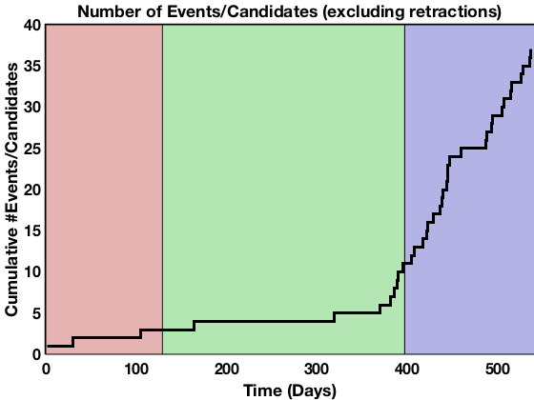
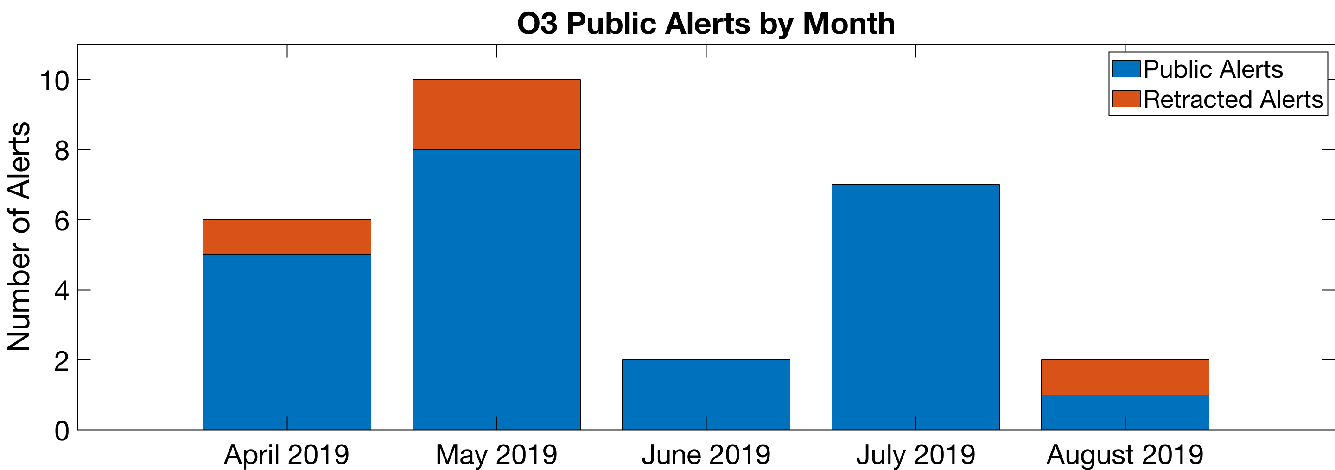
27 Alerts so far in O3, 5 retractions.

Slide 3
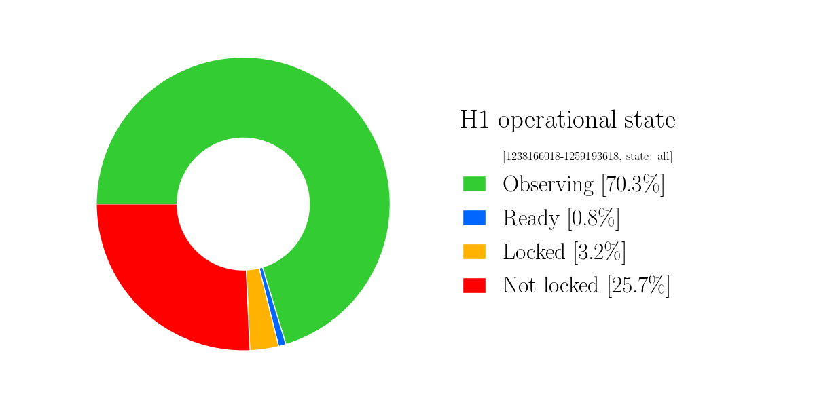
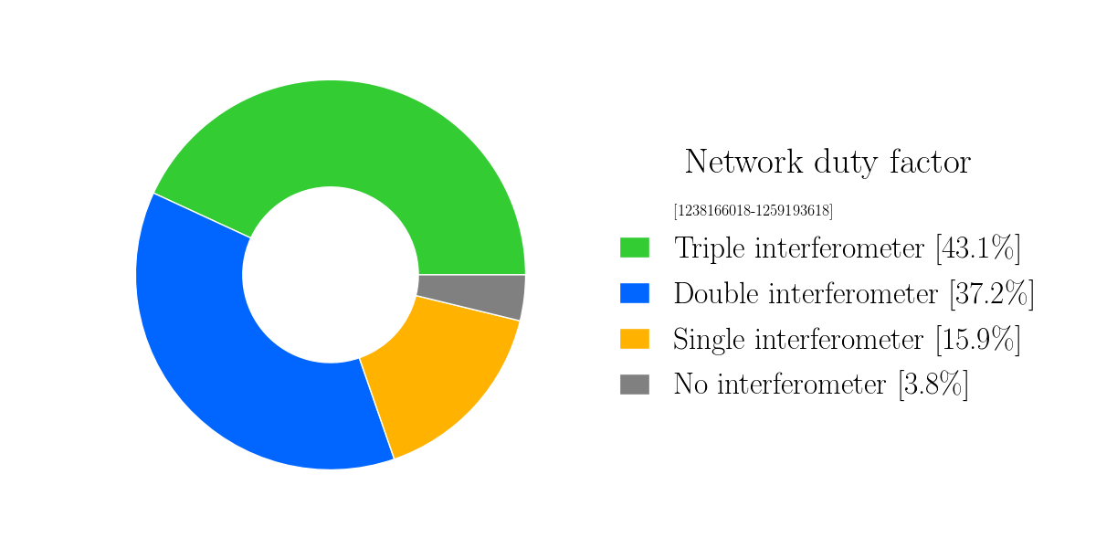
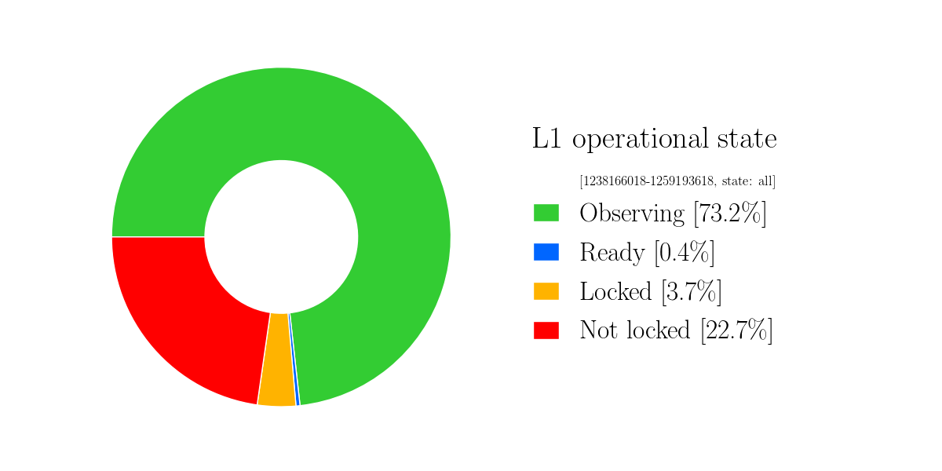
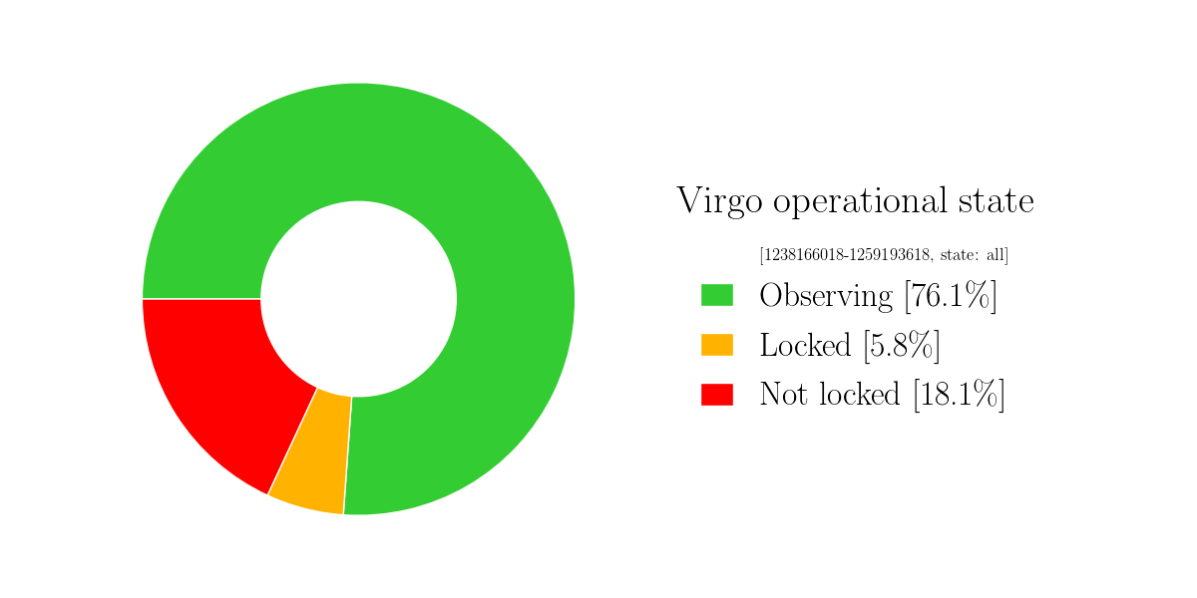
Detector Performance: O3 Cumulative Duty Factor
Numbers essentially the same as July.
Downtime includes everything, including but not limited to maintenance.

Slide 5
26 Alerts so far in O3, 4 retractions.
S190718y : FAR = 1/10 months, P_{terrestrial} = 98%, HasNS,HasRemnant>99%
S190720a : FAR = 1/8 yrs, P_{BBH} = 99%
S190727h : FAR = 1/100 yrs, P_{BBH}=92% (initial skymap and P_astro were corrected)
S190728q : FAR = 1/1e15 yrs, P_{BBH} = 34%, P_{massgap} = 52%, P_{NSBH} = 15%
S190808ae: FAR = 1/1 yrs, P_{terrestrial} = 57%, P_{BNS} = 43%
After removing some instrumental artifacts and reanalysis the FAR for this candidate increased above our threshold for public alerts. The candidate was retracted.
S190814bv: FAR = 1/1e+25 yrs, P_{massgap}=100%

Slide 6
Commissioning Break 1st to 31st Oct 2019
Expect no observation by LIGO/Virgo: 1/Oct/2019 1500 UTC - 1/Nov/2019 1500 UTC.
New end date planned to be April 30 2020 to preserve 1 year observation.

Slide 7
Status and Milestones of KAGRA Commissioning
Plan on 6th May
We are here
2019 | Jan | Feb | Mar | Apr | May | Jun | Jul | Aug | Sep | Oct | Nov | Dec
O3start
M
M
M
Beam align
Pumping
Machine health check
Pumping
DRFPMI ASC/Laser power up
Post COM.
Noise hunting
P
R
M
I
Yarm
FPMI
DRMI
DRFPMI
Current schedule plan
Mid-size
Baffle
Join O3
Y-TMS
VIS
ETMX WAB
Payload
control
Cooling
ETMX
Weekend run
Weekend run
Weekend
FPMI run
Cooling 3 TMs
Data Process Rehearsal (DPR) with IFO
ASC: Alignment Sensing Control
Working on handing-off from green to IR for mass lock of arm cavities was done
Fiber noise cancellation system for green is done.
DRMI trial (by the end of August) will be continued.
ITMs Polarization issues.
Reflection from each ITMs has ~5-10 % P-polarization. We will estimate the impact on sensitivity.
Go back to FPMI or keep DRMI ? -> under discussion
Frosting issues on Cryogenic Mirrors.
Each mirror encountered frosting problem due to molecule gas adsorption around 25K. The frosting can be recovered by warming up mirrors around 30K~ 80K.
PEM and Detchar preparation tasks are smoothly going.
Notes:
This slide shows outline of 2019 schedules. Upper panel shows schedule plan presented in the last PAB. Lower panel shows the current plan. I like to explain important difference between them.
This slide shows the schedule outline based on the Gantt chart.
Installation works, such as ...
ETMX WAB means installation of baffles in Xend. During this periods, we can not use ETMX. Major installation works complete in the next March.
We start beam alignment works for Xarm commissioning from September. The Xarm commissioning continues early December. From the end of November, we start beam alignment works for Yarm and DRMI commissioning. When ETMX is ready, we start commissioning of full interferometer. In this periods the full interferometer is FPMI.
After FPMI, we will proceed DRFPMI or FPMI.
In the case of DRFPMI, we start commissioning with low laser power. After then we construct alignment sensing control system with laser power increase. Then we do post commissioning and installation of baffles. I will explain later.
In the case of FPMI, we construct ASC system and then we do post com and baffle installation.

Slide 8
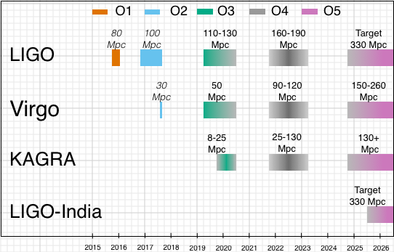
For your longer term planning: P1900218, our best estimate LIGO-Virgo-KAGRA plan as of now
https://dcc.ligo.org/public/0161/P1900218/002/SummaryForObservers.pdf
Full update to “Observing Scenarios” paper is in final internal circulation.

