Slide 1
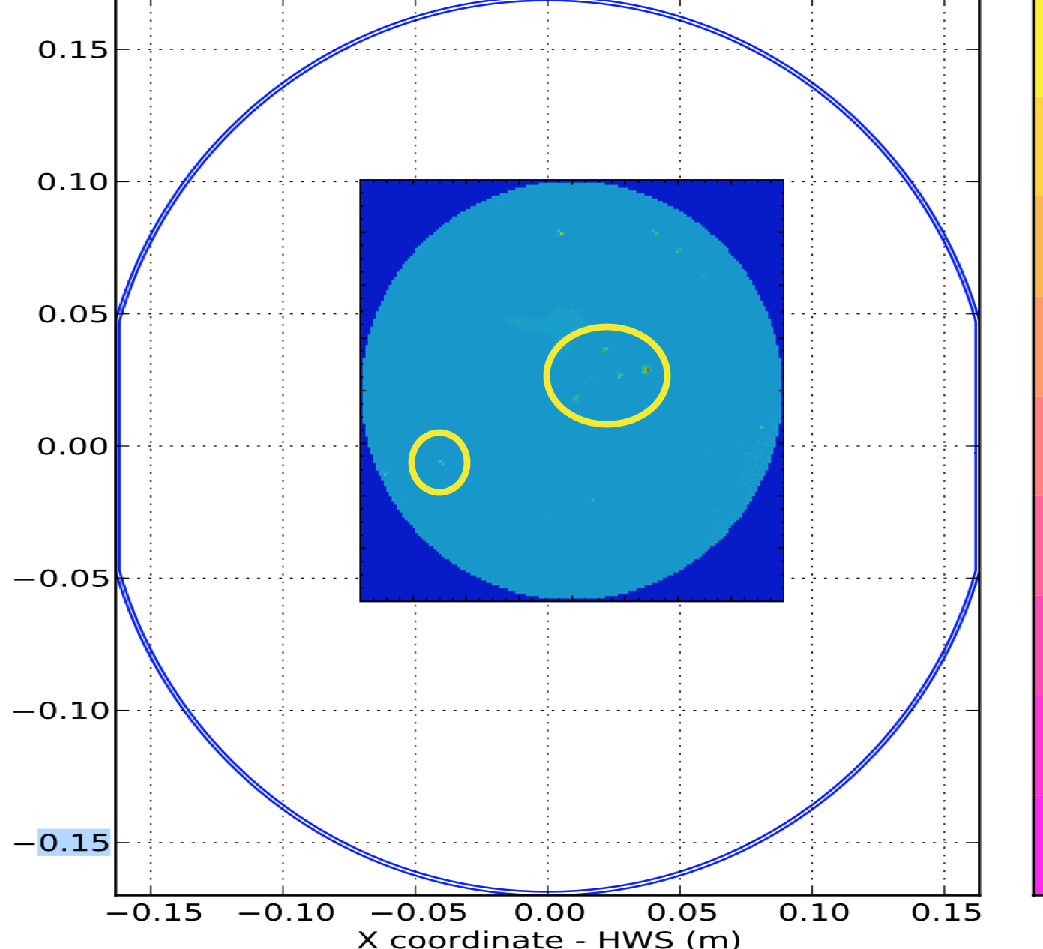
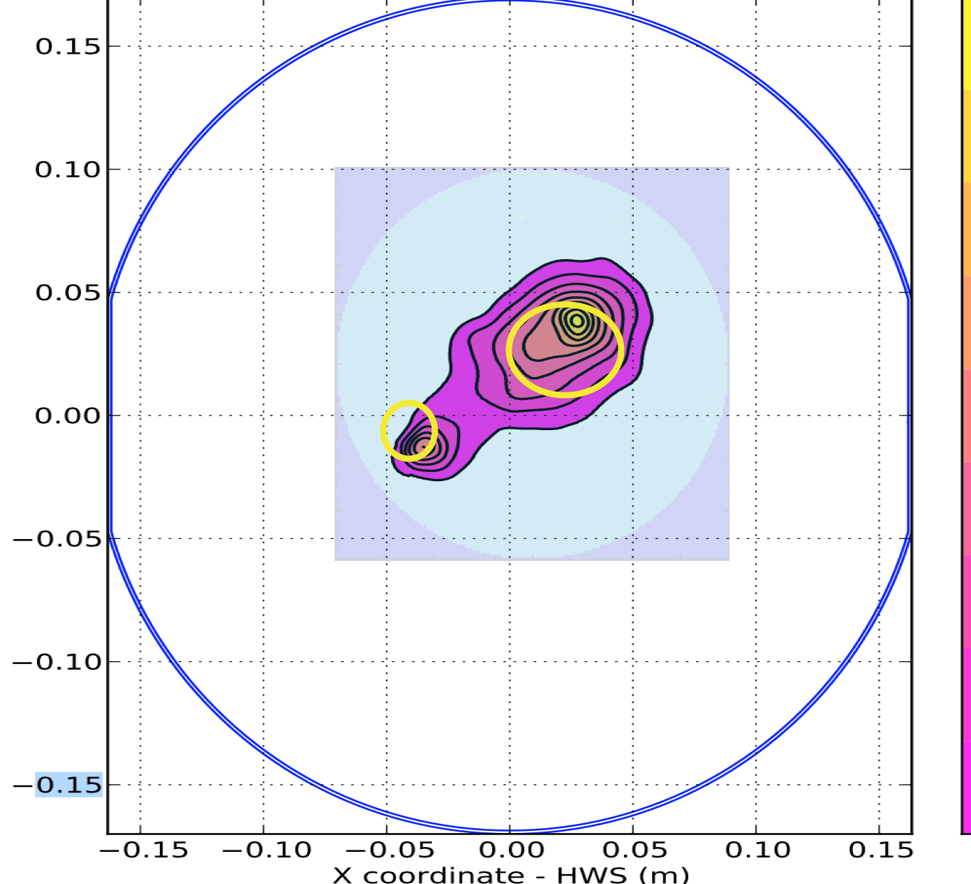
Compare HWS measurements of current optics to transmission maps
Correlation between the transmission map and the HWS absorption map has been noted on ETM10, O3 LLO ETMx
The blue TM outline on the HWS data is approximate in all cases
  HWS maps stolen from G1900203
  Transmission maps cite DCC#
G. Billingsley, A. Brooks, L. Zhang

Slide 2
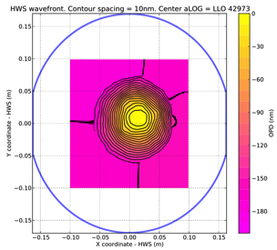
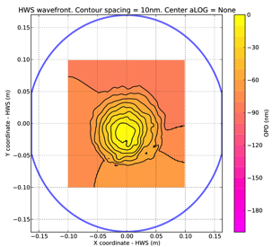
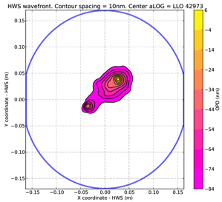
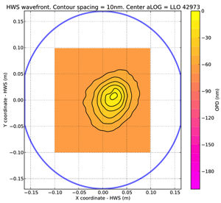
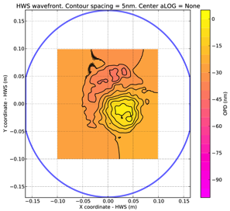
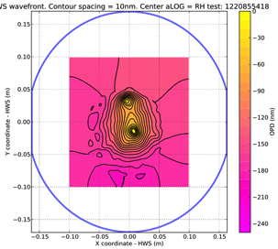
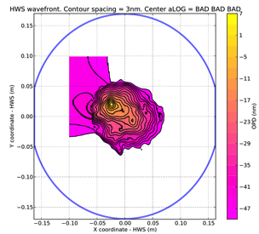
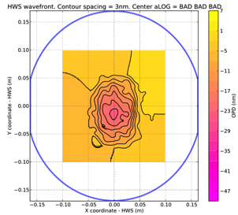
Compare HWS measurements of current optics to transmission maps
 | ITMX | ITMY | ETMX | ETMY
L1 – abs status HWS Abs value Optic SN Trans. Map link | Uniform [0.6ppm] ITM04 https://dcc.ligo.org/E1200702 | Uniform [0.7-0.8ppm] ITM08 https://dcc.ligo.org/E1200575 | Point [0.1ppm] ETM10 https://dcc.ligo.org/E1500299 | Points 0.14 or 0.35ppm* ETM15 https://dcc.ligo.org/E1500301
H1 – abs status HWS Abs value Optic SN Trans. Map link | Uniform? [0.2-0.3ppm] ITM07 https://dcc.ligo.org/E1700232 | Point [0.26-0.36ppm] ITM11 https://dcc.ligo.org/E1400042 | Point [~0.25ppm] ETM13 https://dcc.ligo.org/E1500300 | Inconclusive [violates conservation of energy] ETM16 https://dcc.ligo.org/E1500302
L1
H1
[Credit: LLO & LHO TCS teams]
https://ldas-jobs.ligo.caltech.edu/~aidan.brooks/
https://awiki.ligo-wa.caltech.edu/wiki/Auxillary_Optics_Stuff/TCSComponents/PreO3_Absorption_measurements

Slide 3
L1-ETMY surface deformation
[scaled to same incident power]

Slide 4
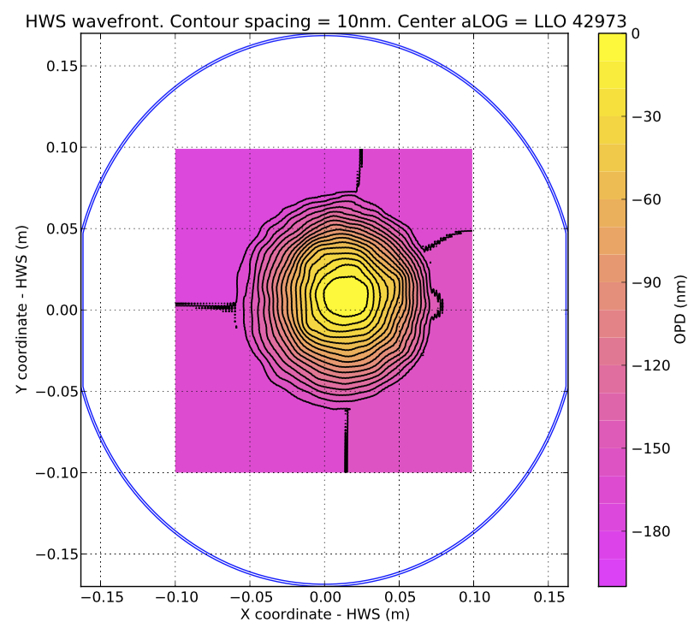
ITM04, O1, O2, O3 L1 ITMX

Slide 5
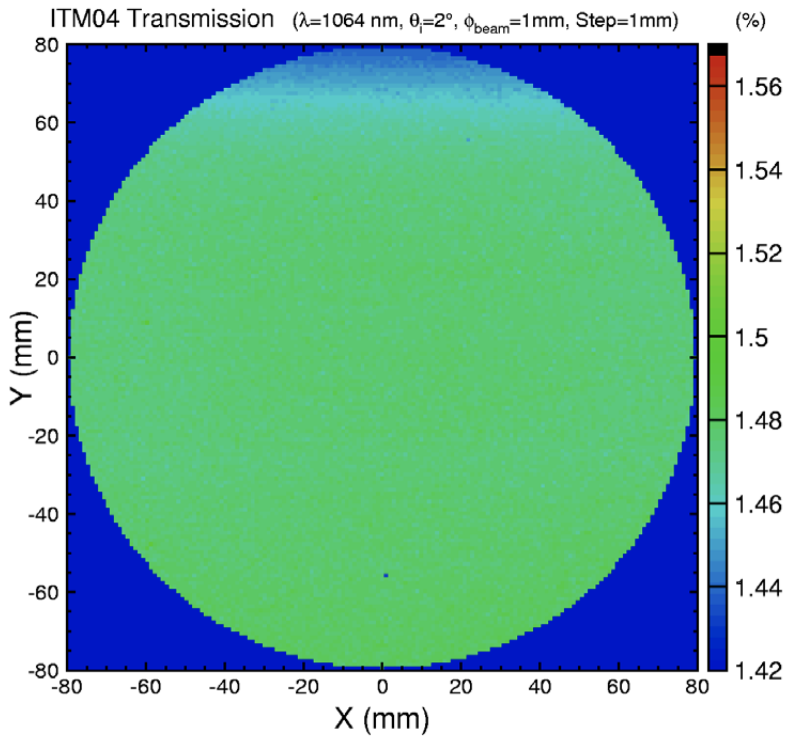

Slide 6
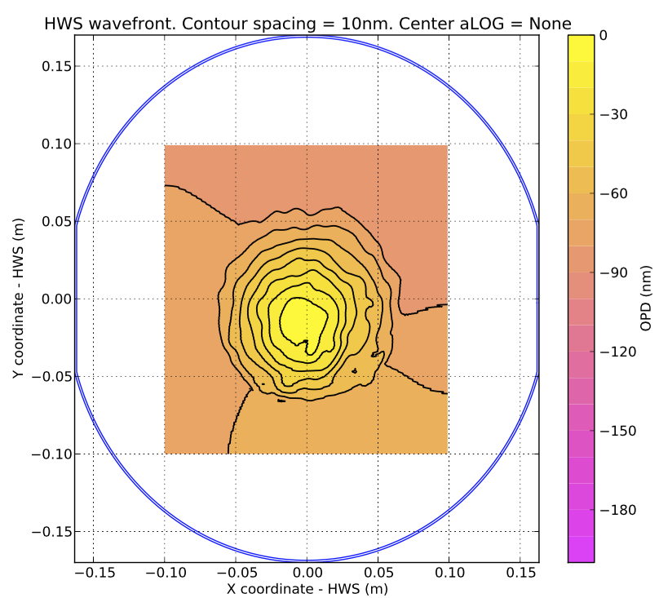
ITM08, O1, O2, O3 L1 ITMY

Slide 7
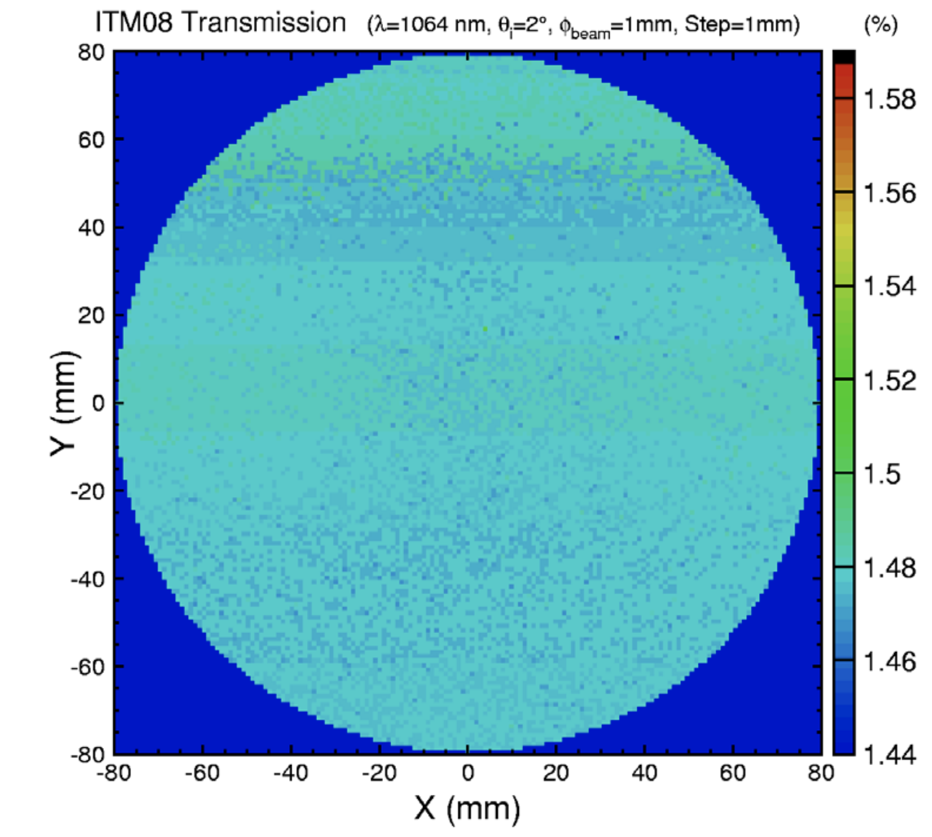

Slide 8
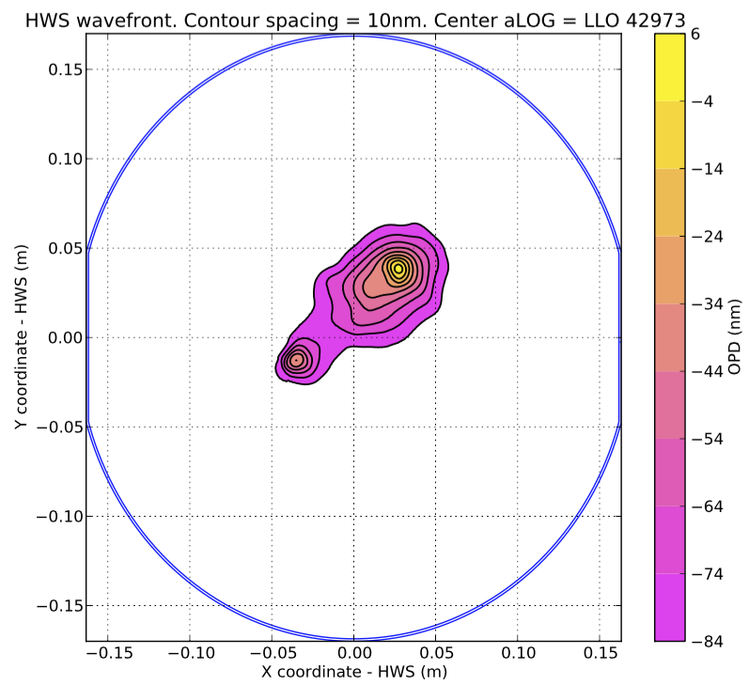
ETM10, O3 L1 ETMX

Slide 9
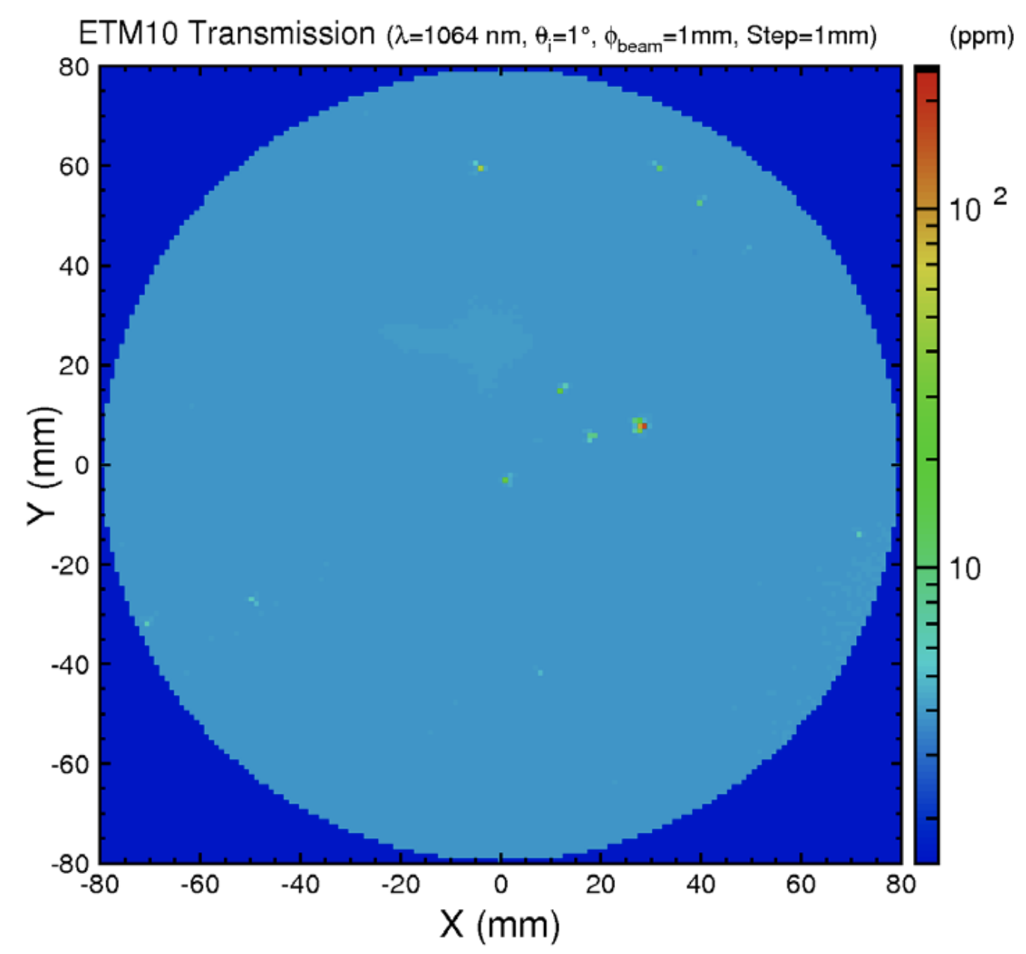

Slide 10
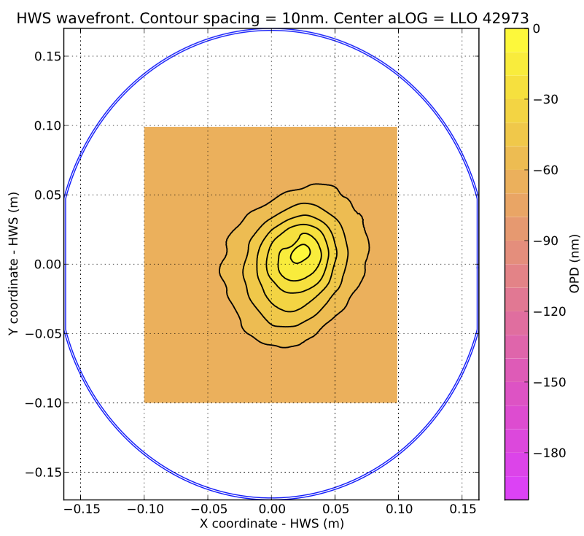
L1 ETMY-ETM15

Slide 11
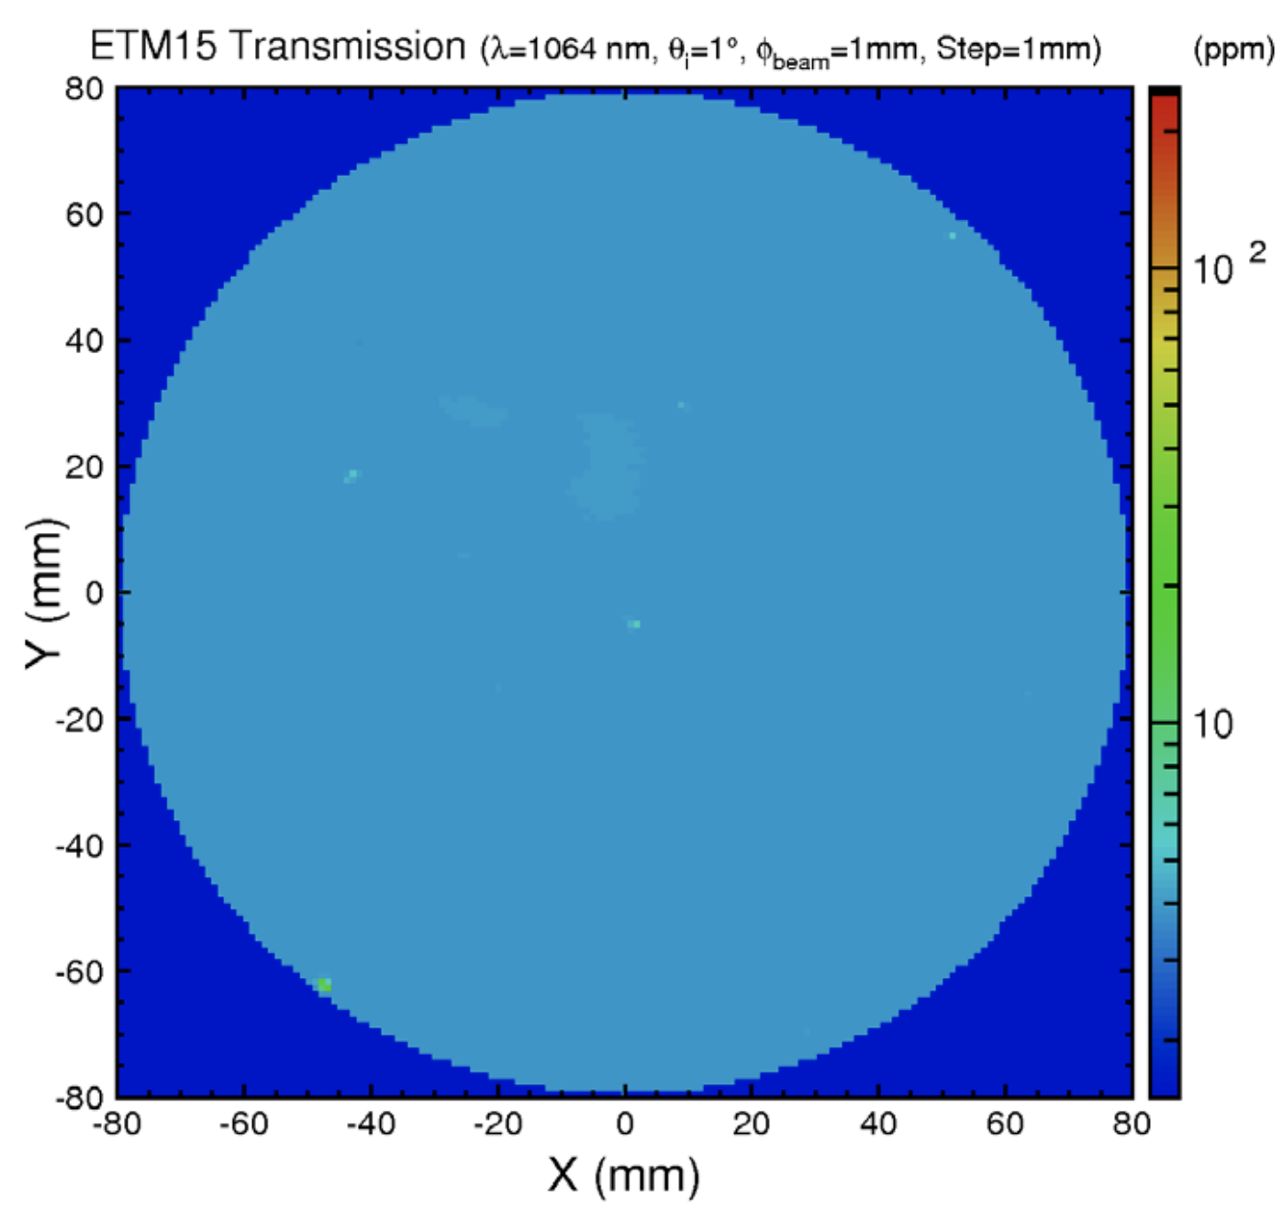

Slide 12
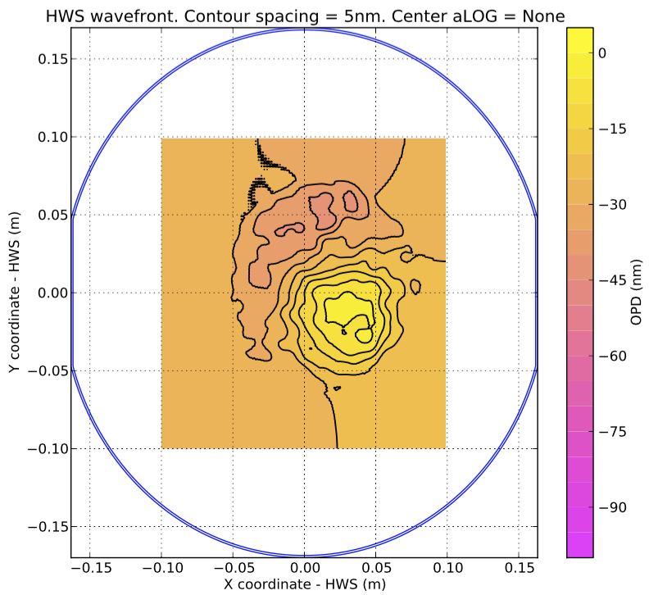
ITM07 O2partial, O3 H1 ITMX

Slide 13
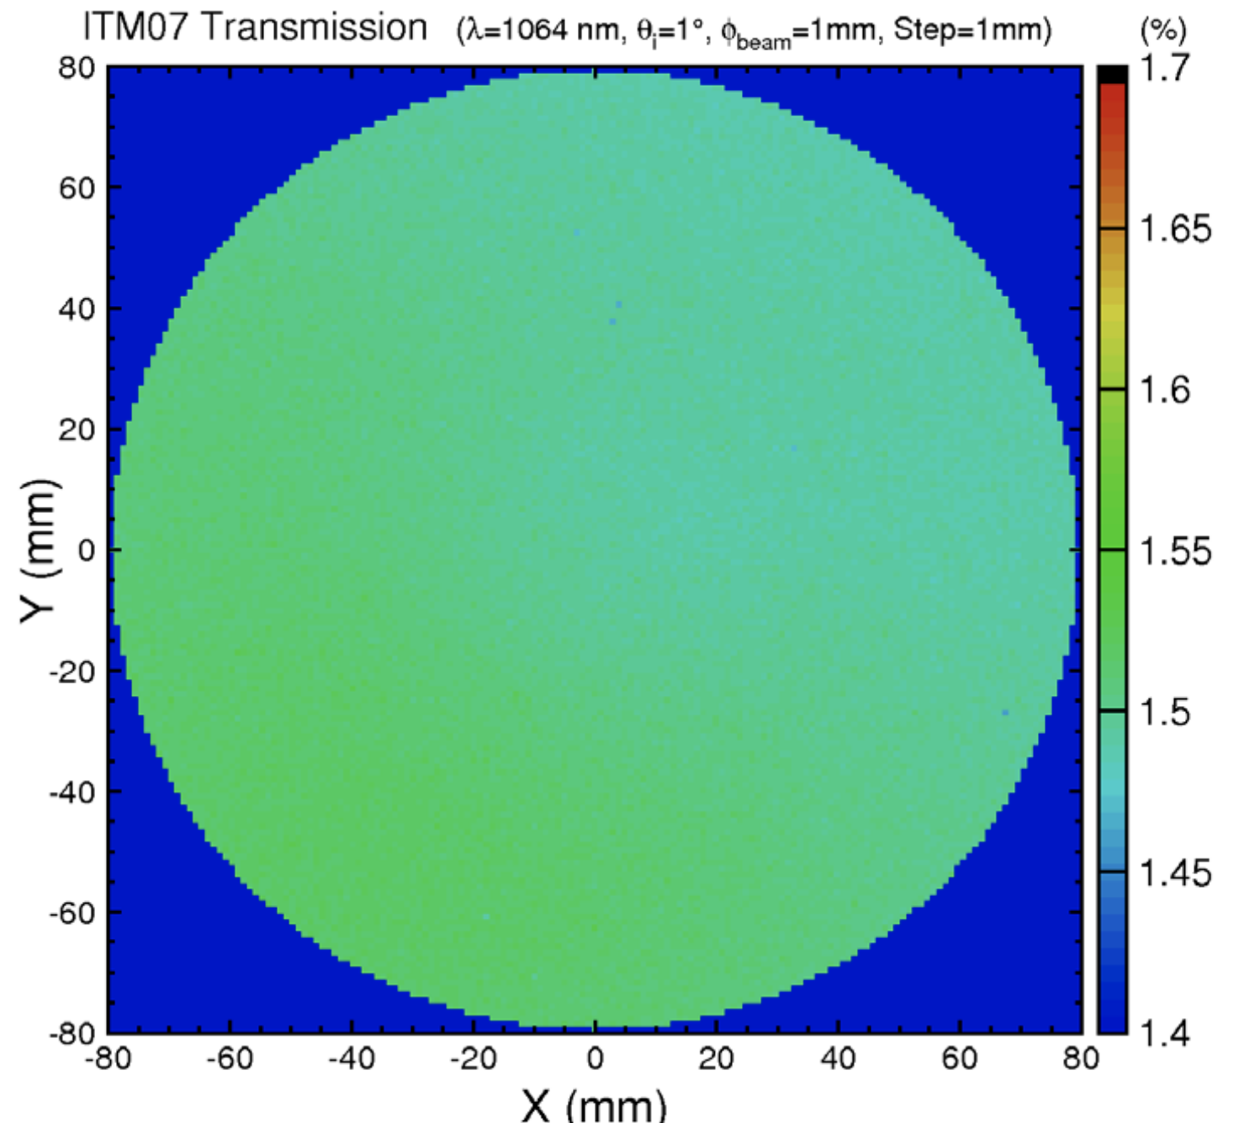

Slide 14

ITM11, O1, O2, O3 H1 ITMY

Slide 15
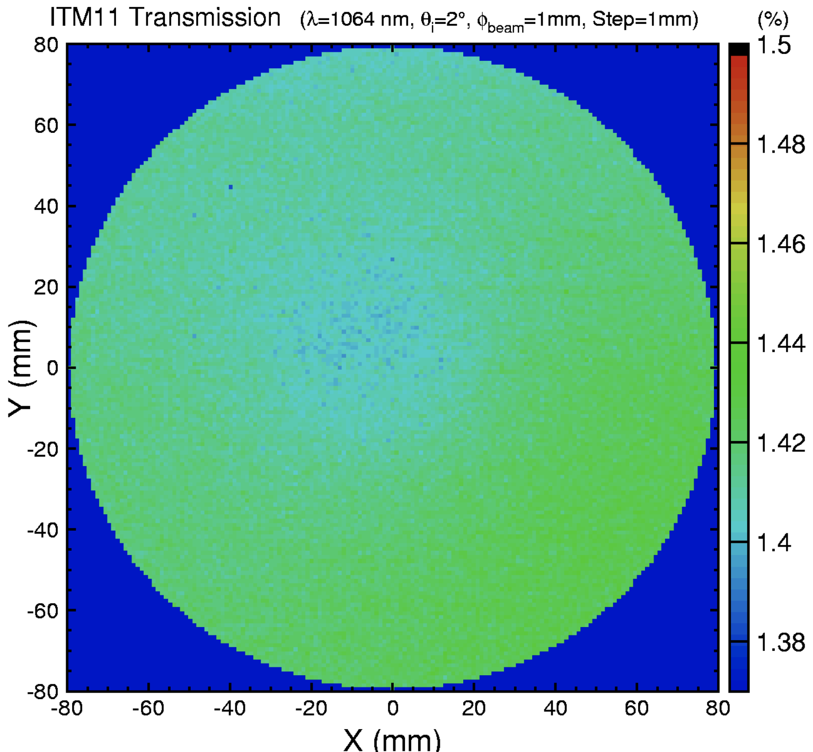

Slide 16

H1 ETMX – ETM13

Slide 17
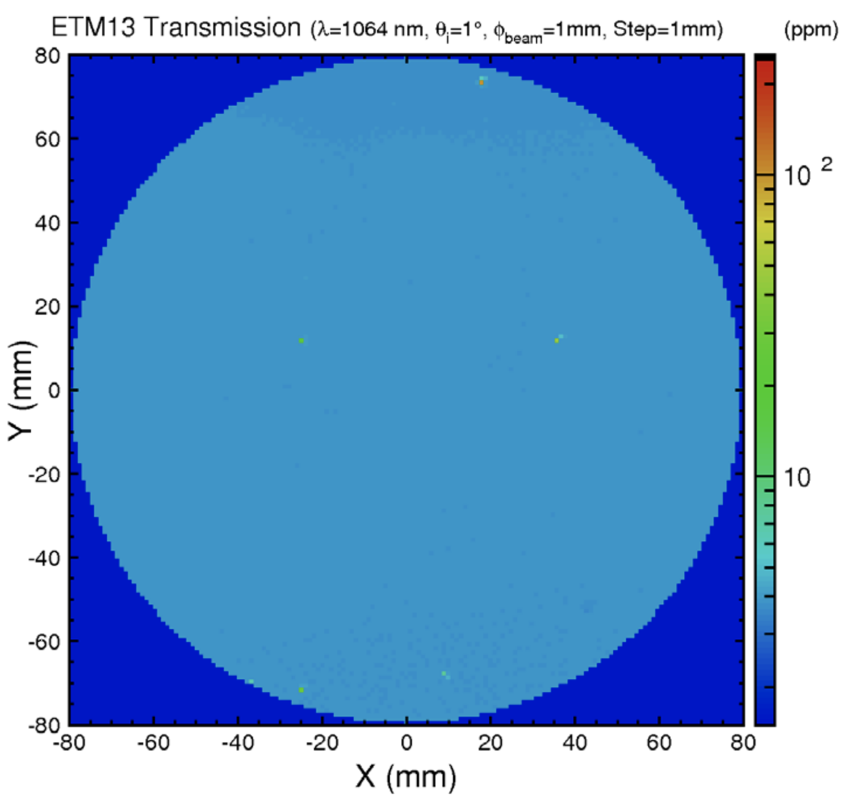

Slide 18
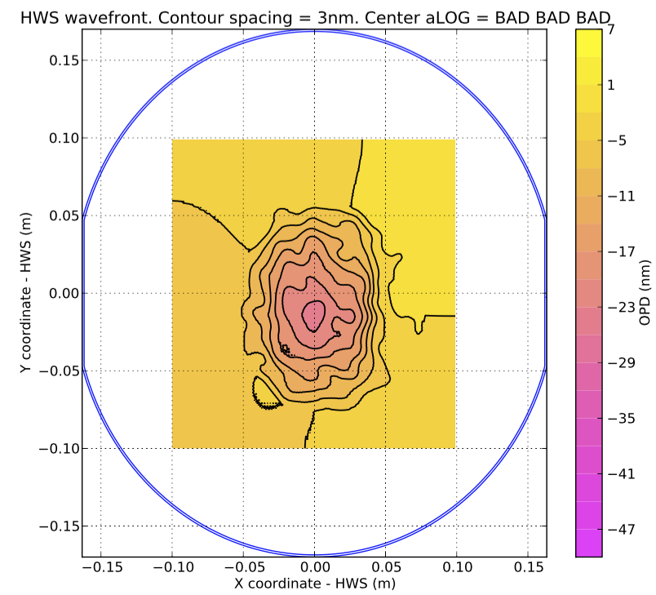
H1 ETMY-ETM16

Slide 19
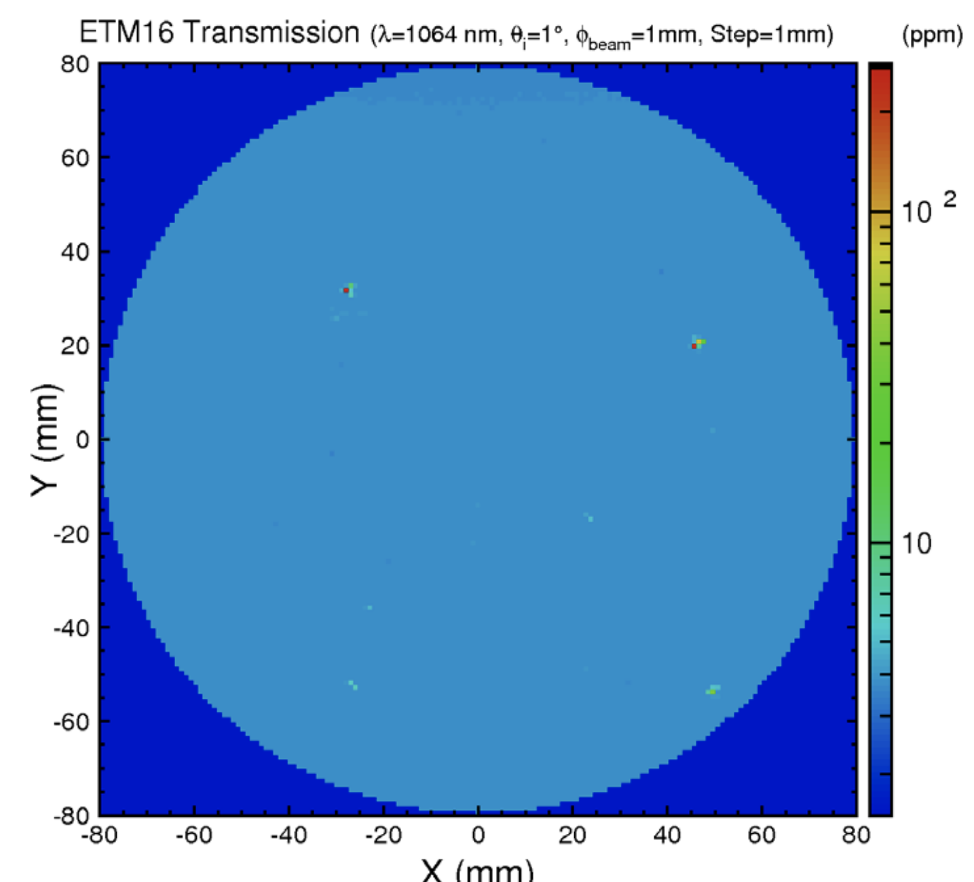

Slide 20
First observation: ITM03, 01,02 partial H1-ITMX
Removed after O2
Sent to CIT for forensics

Slide 21
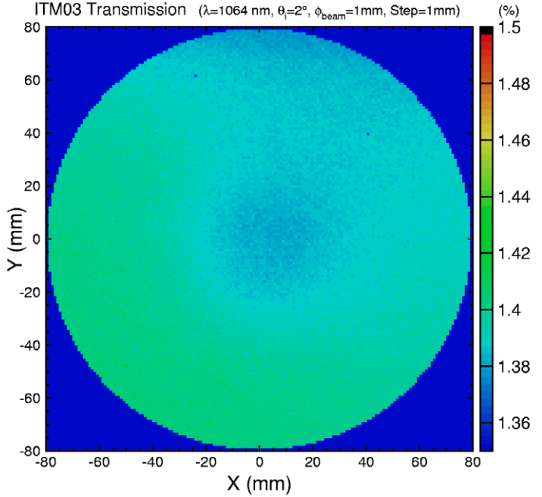
https://dcc.ligo.org/LIGO-E1400008

