Slide 1

Toward the Next Generation of Standards for Laser Power Measurements
Michelle Stephens, Nathan Tomlin, Chris Yung, Ivan Ryger, Malcolm White, John Lehman
March 15, 2019

Slide 2
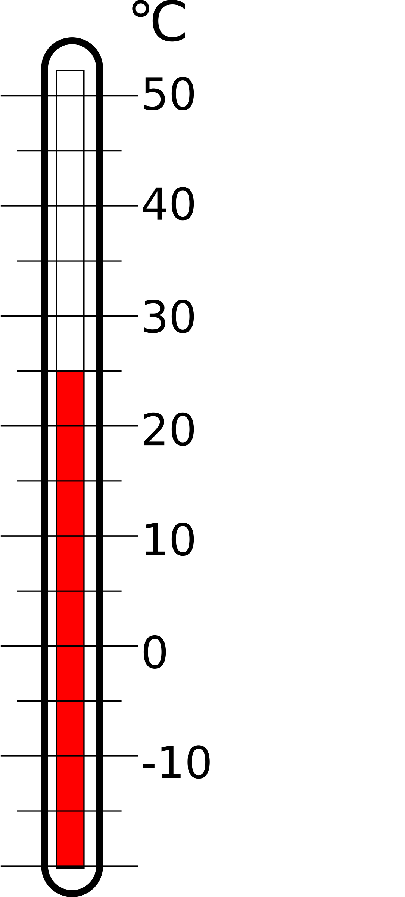
Electrical Substitution Radiometer (ESR)
Temperature
sensor (T)
electrical heater
Absorber = cavity
incident radiation
Heat Link (W/K)
thermal bath (T₀)

Slide 3
Existing CW Laser Power Standards (C-series)
electrical heater
Temperature
sensor (T)
5 cm
Absorber = cavity
incident radiation
conductance (G)
thermal bath (T₀)

Slide 4
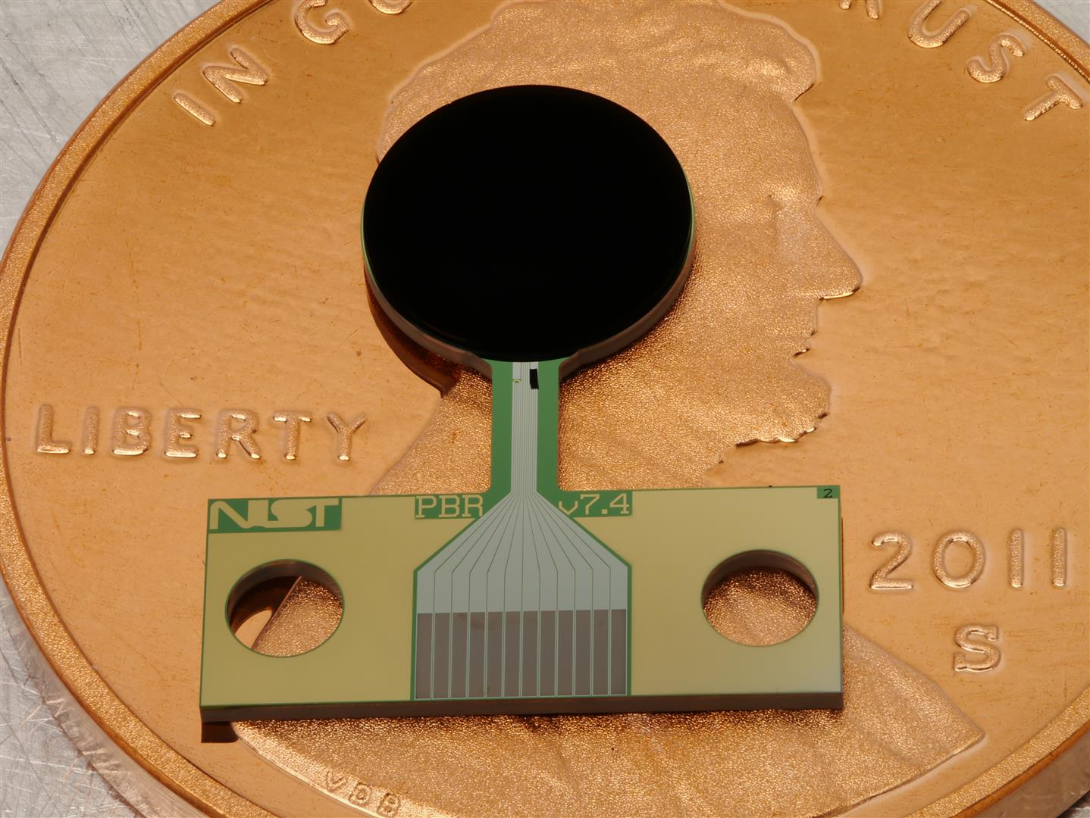
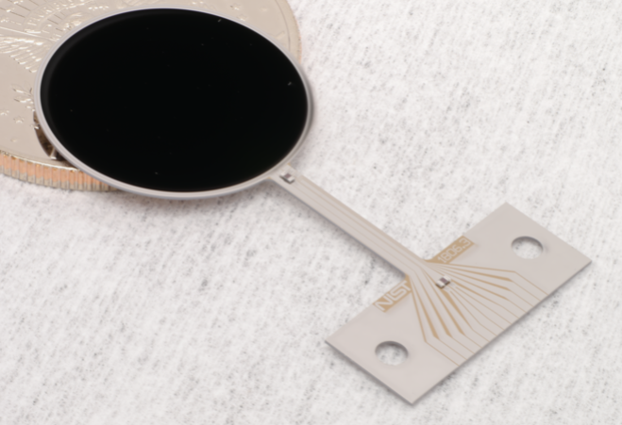
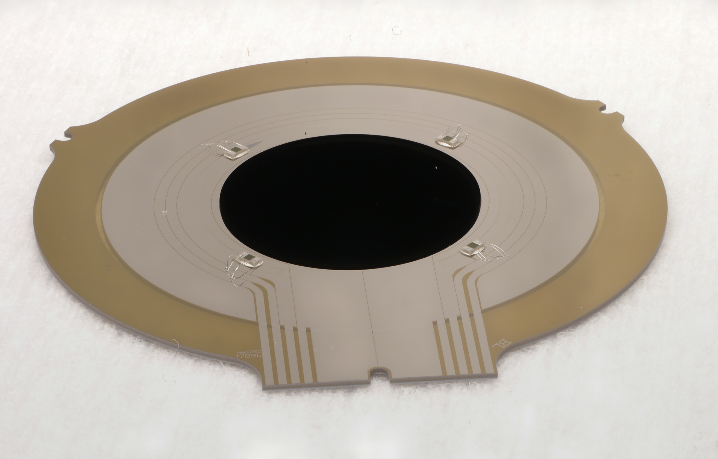
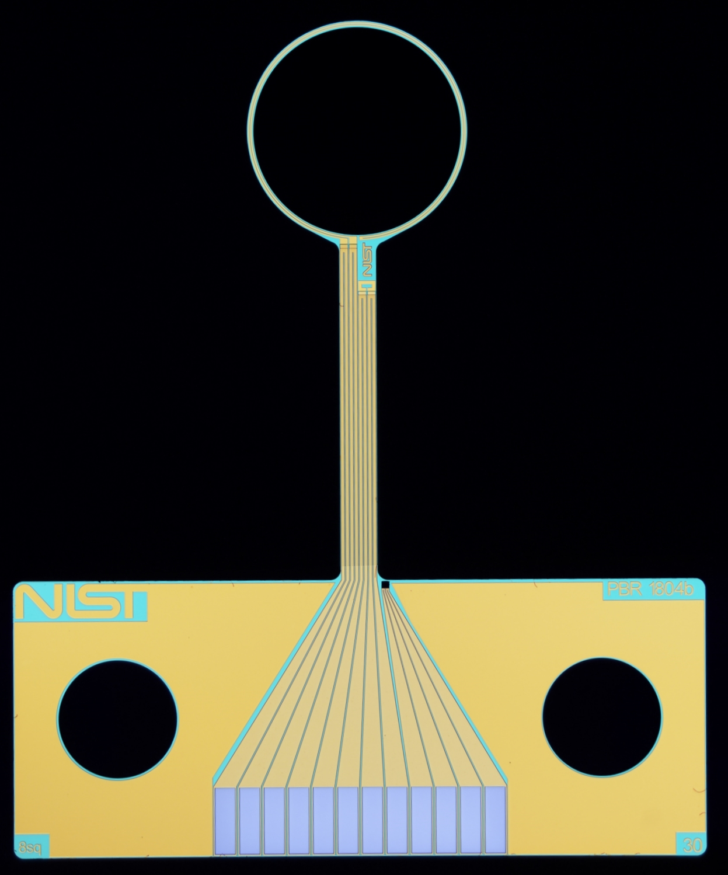
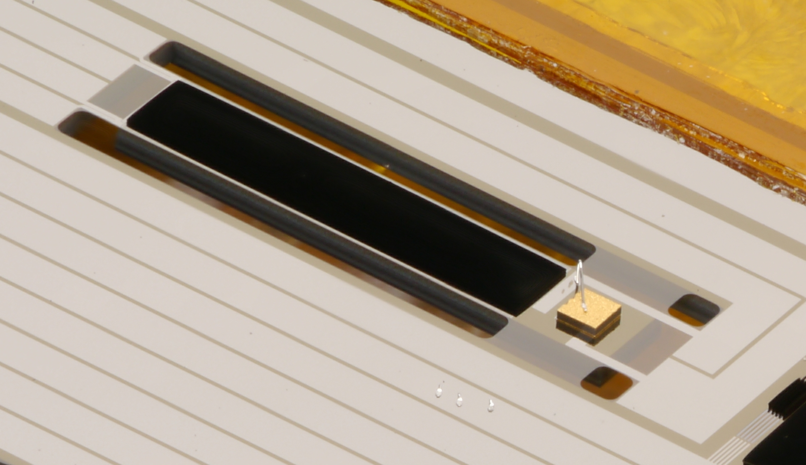
The Next Generation of Standards
Cryogenic
Space Applications
Room Temperature
W Heater
COTS thermistors
Absorber
5 mm
Heater
20 mm
Heat Link
Absorber
Heat Link
10 mm
Absorber
Heater
Thermistors
Transition Edge Sensor
Link
Cryogenic Optical Fiber Power Meter
Compact Total Irradiance Monitor
3 mm
W Heater
Si substrate
W heater around perimeter
Vertically aligned carbon nanotube (VACNT) absorber
Superconducting or W
Transition edge sensor (TES) or commercial off-the-shelf (COTS) thermistor or thin-film VOx for temperature measurement
Absorber
1 mm
Heater
Heat Link
Absorber
Transition Edge Sensor
5 mm
Link
COTS thermistor
Fast Far Infrared Bolometer
Compact Spectral Irradiance Monitor
Credit: Nathan Tomlin/ Chris Yung

Slide 5
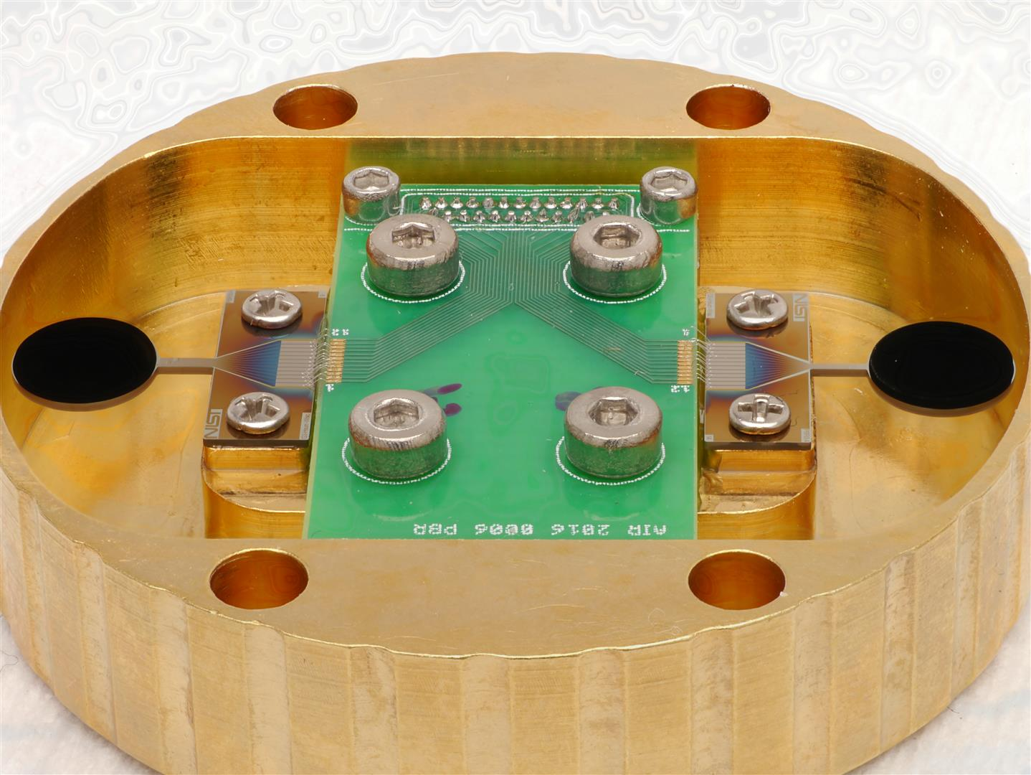
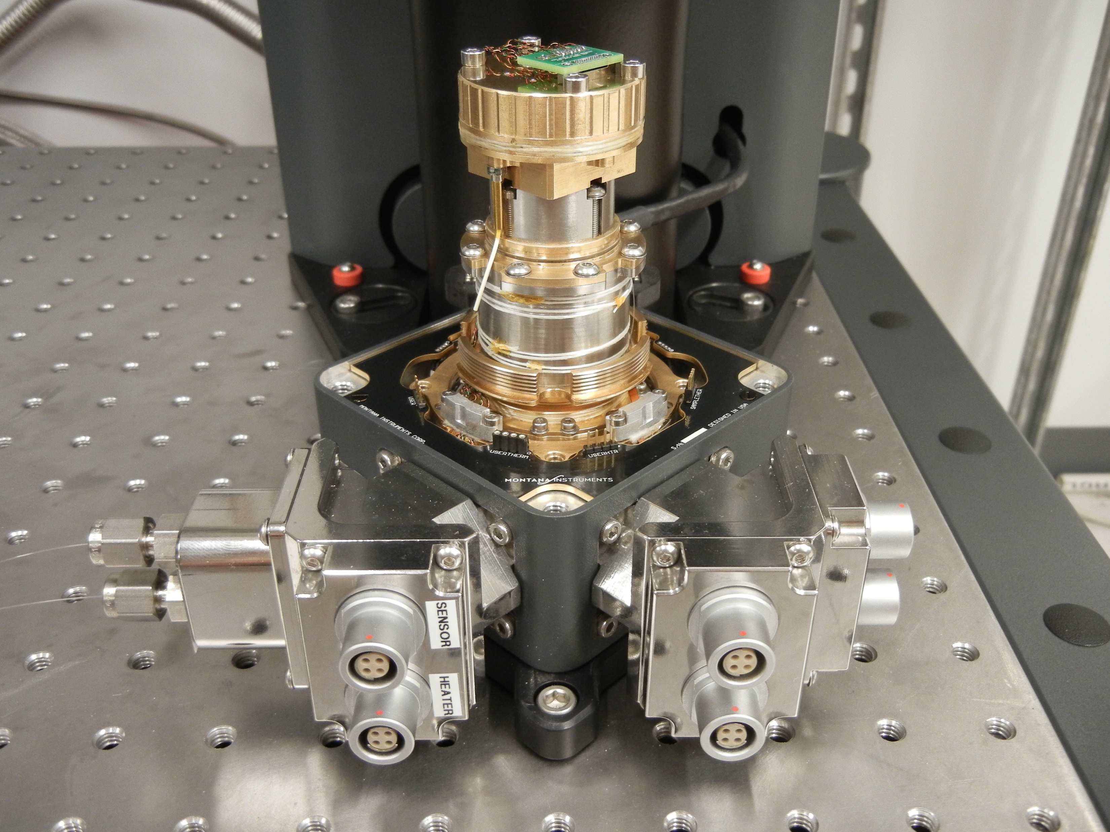
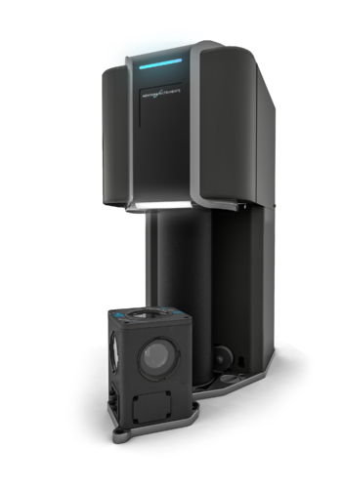
Cryogenic Optical Fiber Power Meter
Operation at 300 μW, 2 mm beam diameter
850 nm
1310, 1550 nm
Uncertainty 0.4%, k=2
  Dominated by optical fiber beamsplitter
Detectors at 4 K
Optical Fibers

Slide 6
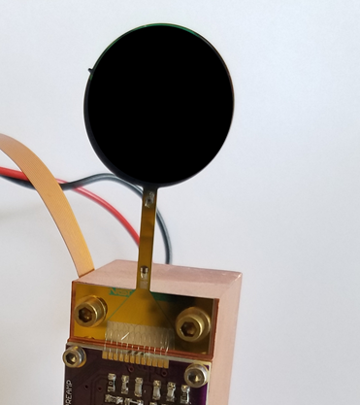
Performance Requirements
Heater
Absorber
20 mm
Thermometers
Link
Current standard
Next-Gen C
2 cm beam diameter
100 μW – 100 mW
325 nm – 1.93 μm
15 minute
All custom
0.6 – 0.9% accuracy, k = 2
2 cm beam diameter
100 μW – 100 mW
325 nm – 1.93 μm
2 minute
Mostly off-the-shelf
0.1% accuracy, k = 2

Slide 7
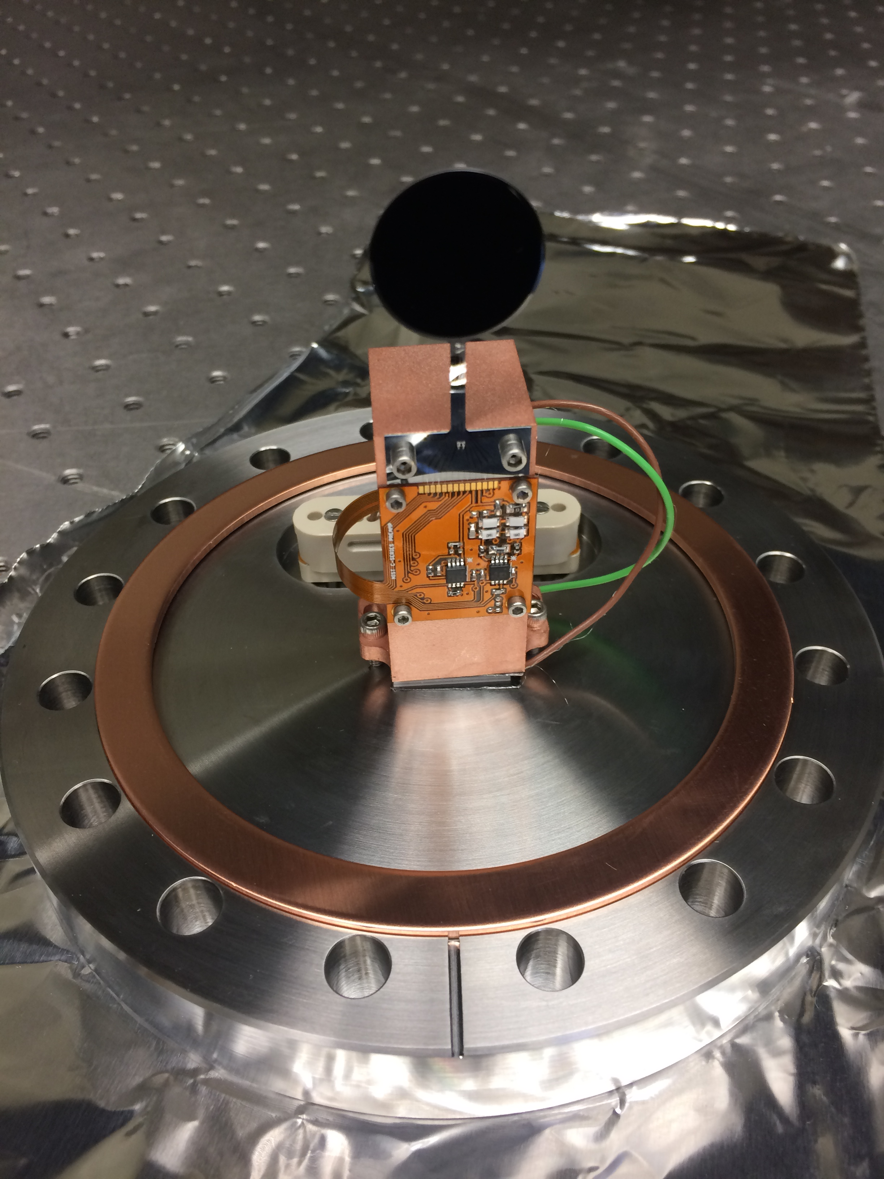
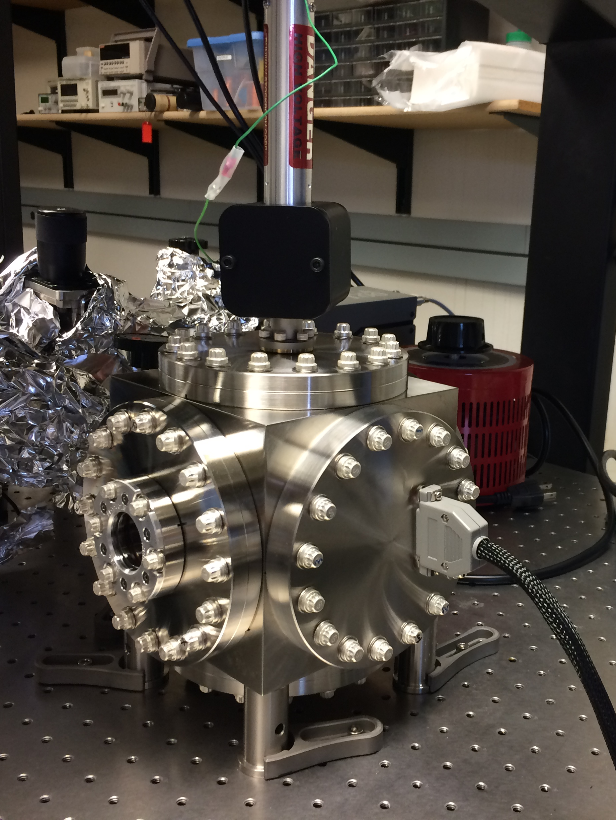
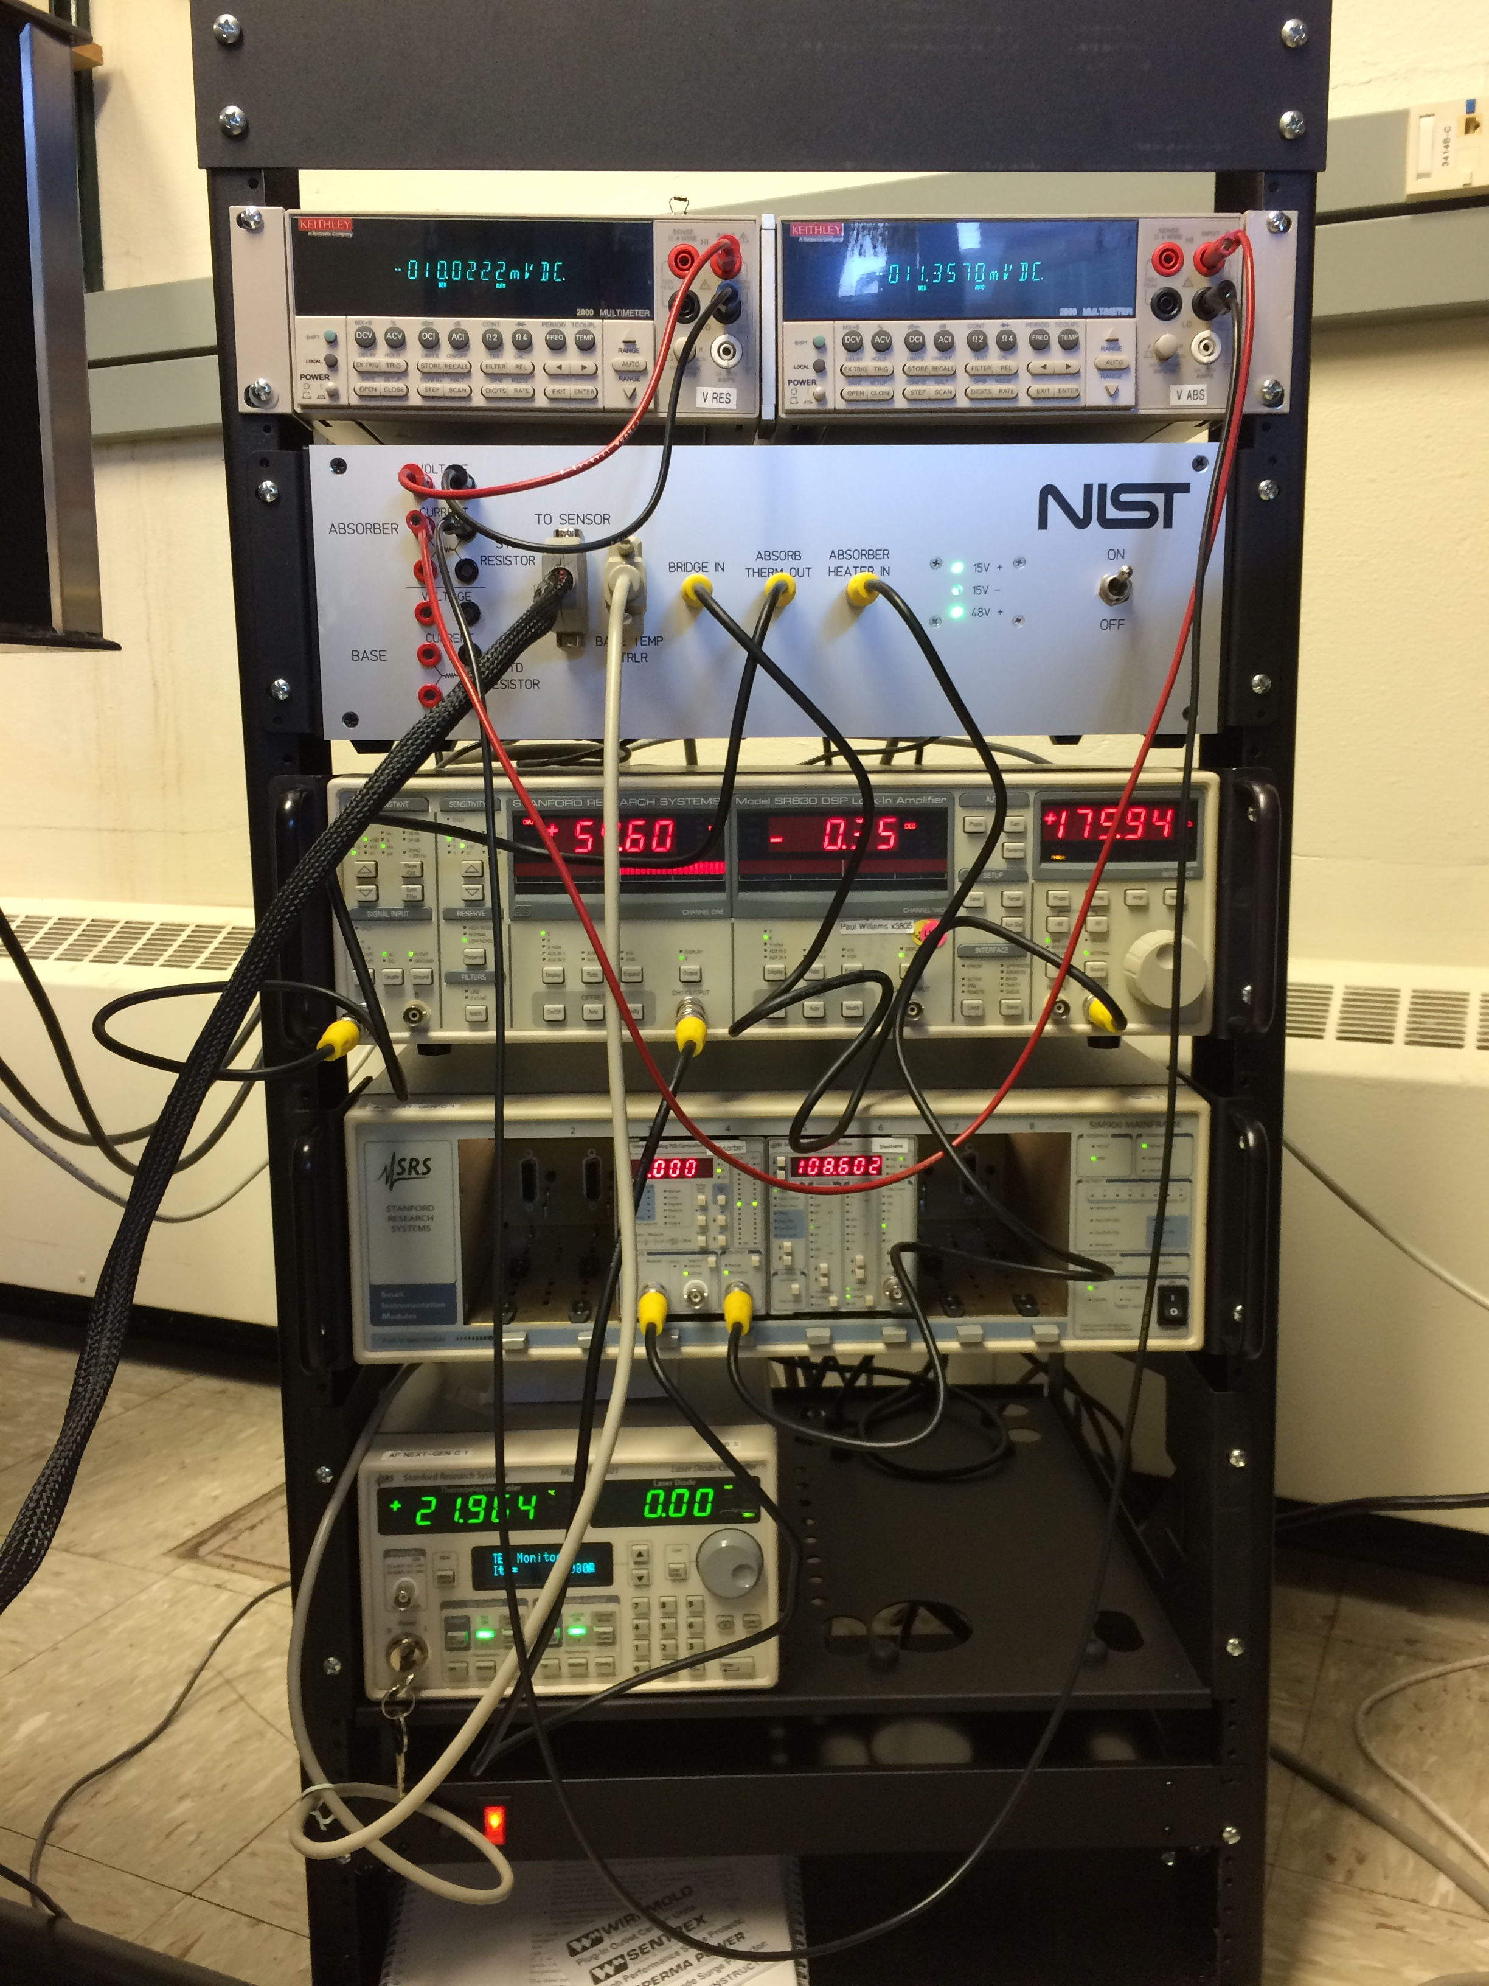
Components of Next-Gen C Standard
Bolometer with Peltier Cooler and bridge circuit
Voltmeters
Vacuum
Lock-in
PID controller
TEC Controller

Slide 8
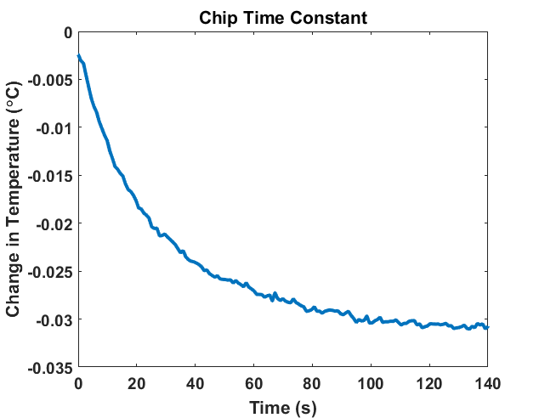
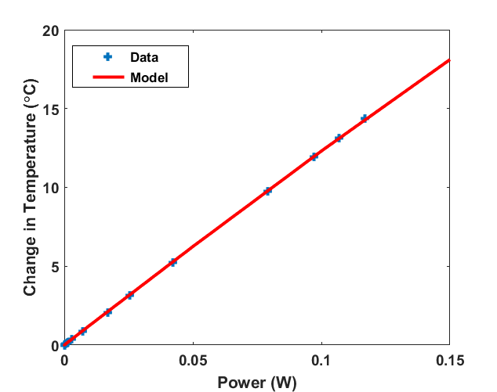
Characterization
Bolometer time constant in vacuum, 23 s
(21 s predicted)
Heat link G in vacuum, 0.0081 W/K
Closed loop power measurement, 8 mW 633 nm

Slide 9
Sensitivity to Room Temperature

Slide 10
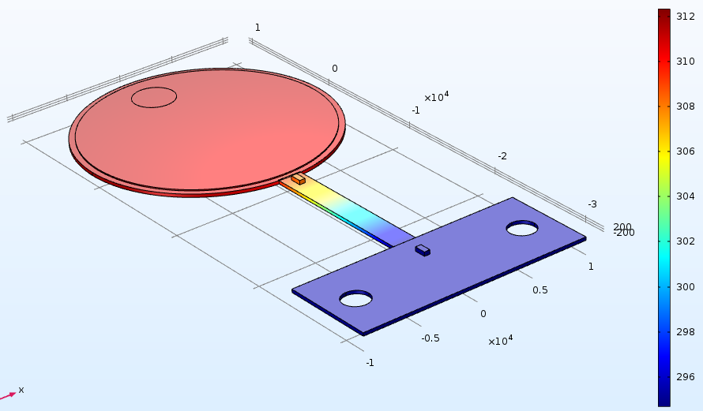
Position Dependent Response
Credit: Florian Stuker
Measured Laser Power vs. Position on Detector
Blue = Middle of Chip
Green = Bottom, 7 mm offset from middle, closer to heat link
Pink = Top, 7 mm offset from middle, farther from heat link

Slide 11
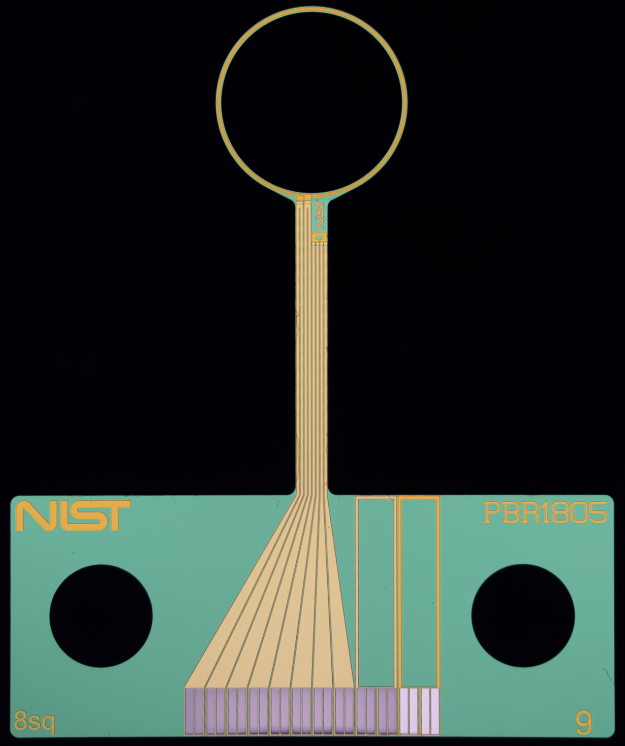
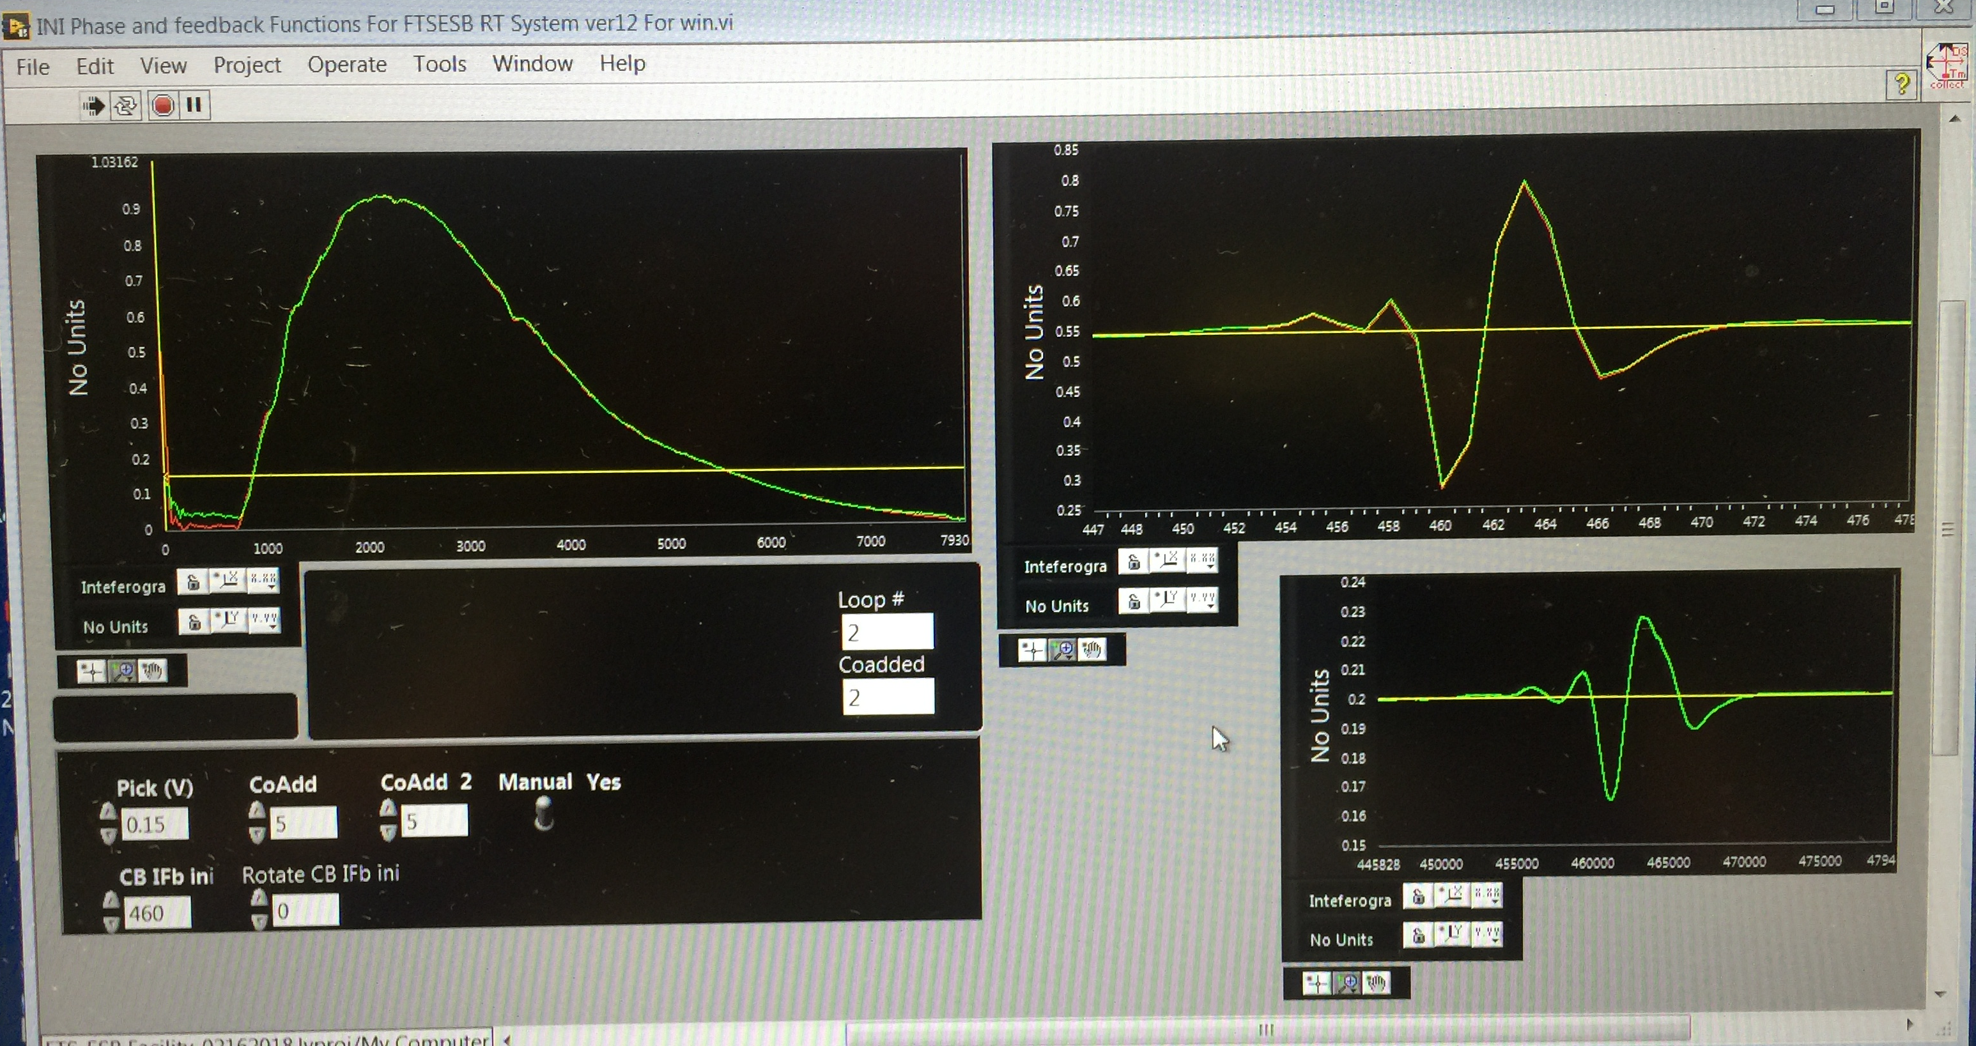
Fast Far-Infrared Bolometer
Electrical Substitution Fourier Transfer Spectroscopy
(collaboration with Solomon Woods, NIST, Gaithersburg)
VACNT
absorber
(3 mm dia.)
W heater
Nb TES
Optical signal cancelled with heat pulse
(red-optical, green – electrical)
Measurements from 1 Hz to 50 Hz

Slide 12
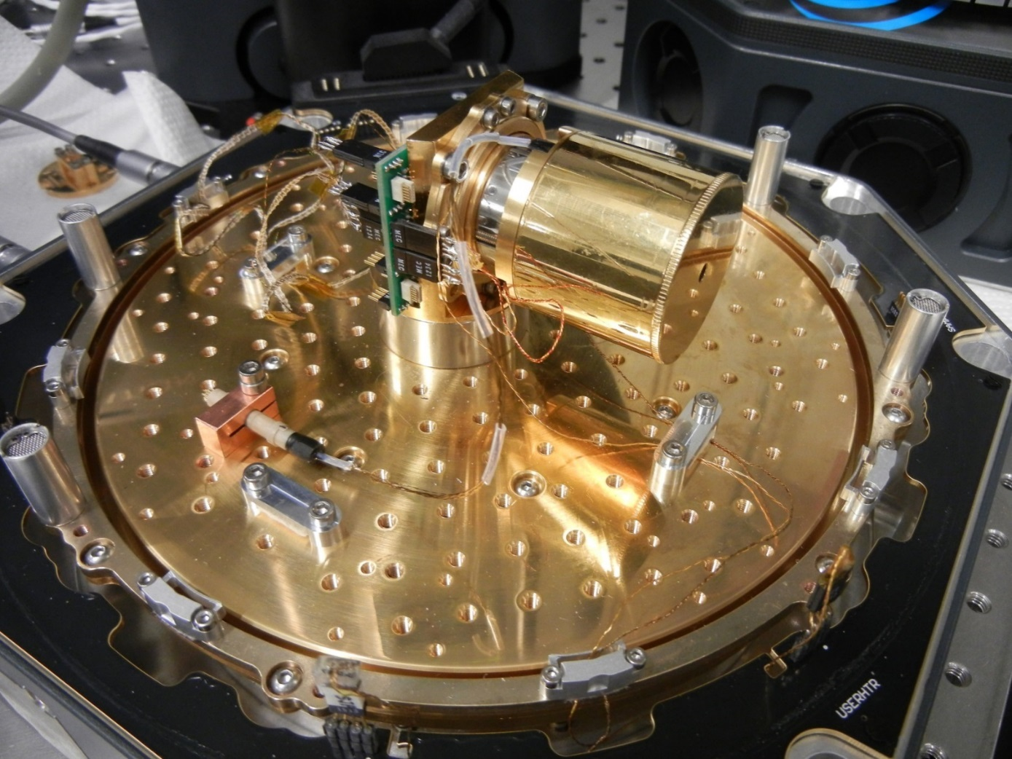
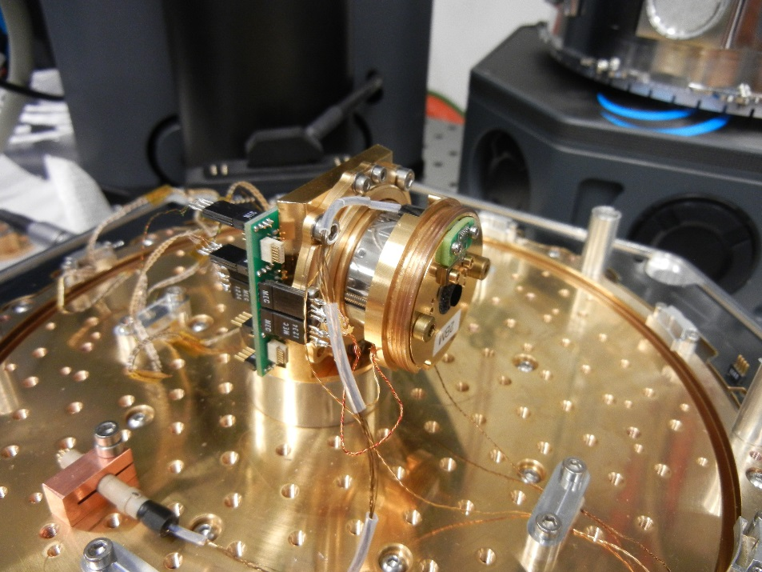
300 mW, modulated
Free space cryogenic bolometer with heat link and heater configuration specifically designed for LIGO power and beam diameter
Brewster window
Closed loop operation for speed
Cryostat exists
Electronics for fast closed-loop operation are under development
Bolometer prototypes fabricated

