Slide 1
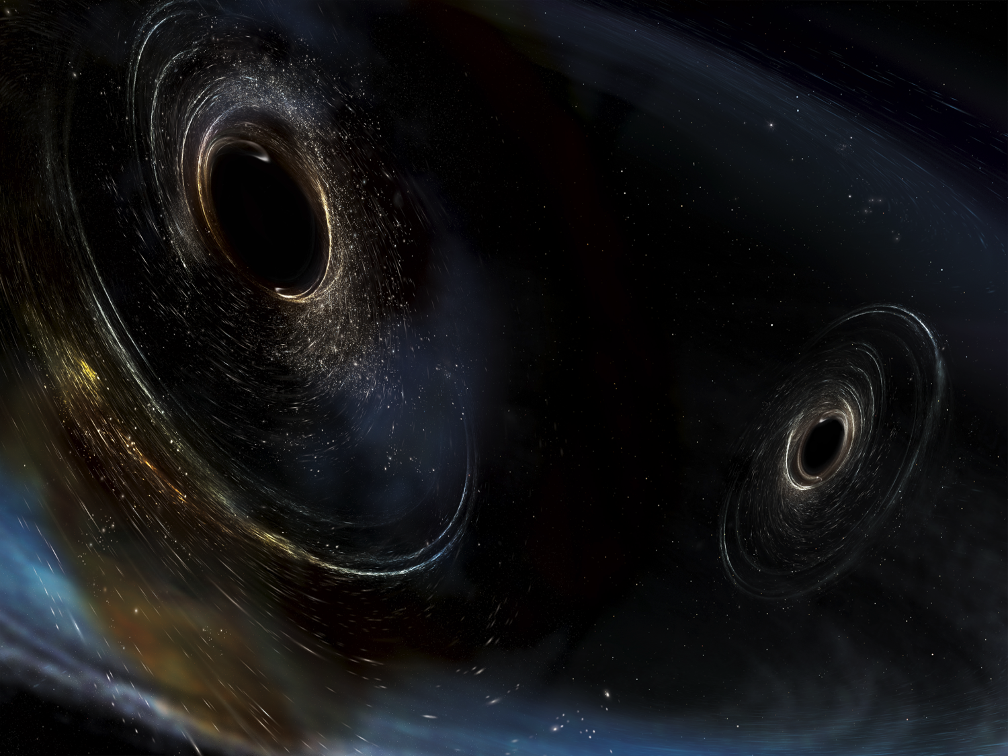



Multi-messenger Astronomy in the Era of LIGO-India, Khandala Jan 15-18, 2019
Gravitational-wave Observatories in the Multi-messenger Astronomy Era:
LIGO’s plans into the 2020s and Beyond
David Reitze
LIGO Laboratory
California Institute of Technology
For the LIGO Scientific Collaboration and the Virgo Collaboration
LIGO-G1900067-v2
Image Credit: Aurore Simmonet/SSU

Slide 2
Talk Roadmap
Preview: Highlights of results from LIGO, Virgo O1 and O2 observation runs
  You will hear more in later talks at this meeting
Near term (~ 5 year) plans for the ground-based GW detector network
  A+ is coming!
Longer term planning for new ‘3rd generation’ GW observatories

Slide 3
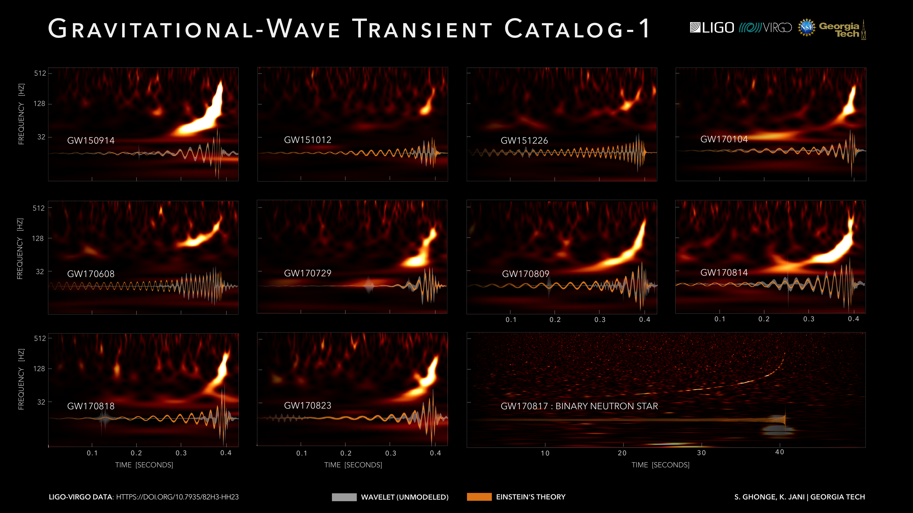
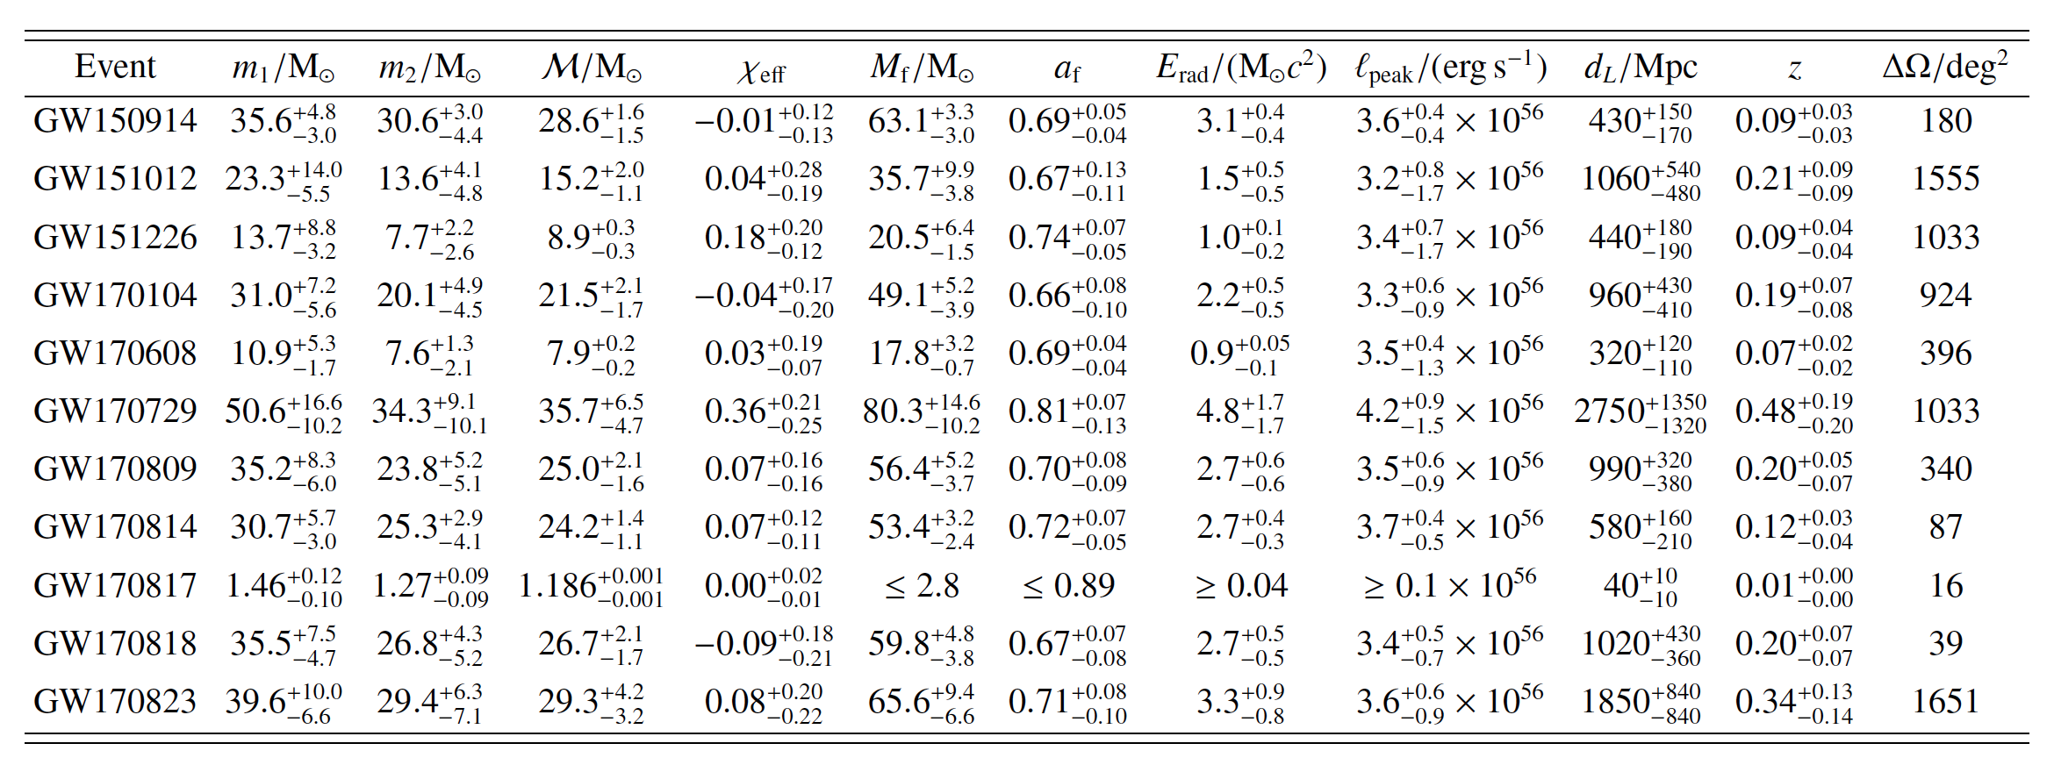
Just released: GWTC-1 GW Catalog!
qwe
B. P. Abbott, et al., (LIGO Virgo Collaboration), “GWTC-1: A Gravitational-Wave Transient Catalog of Compact Binary Mergers Observed by LIGO and Virgo during the First and Second Observing Runs” , https://arxiv.org/abs/1811.12907
B. P. Abbott, et al., (LIGO Virgo Collaboration), “GWTC-1: A Gravitational-Wave Transient Catalog of Compact Binary Mergers Observed by LIGO and Virgo during the First and Second Observing Runs” , https://arxiv.org/abs/1811.12907

Slide 4
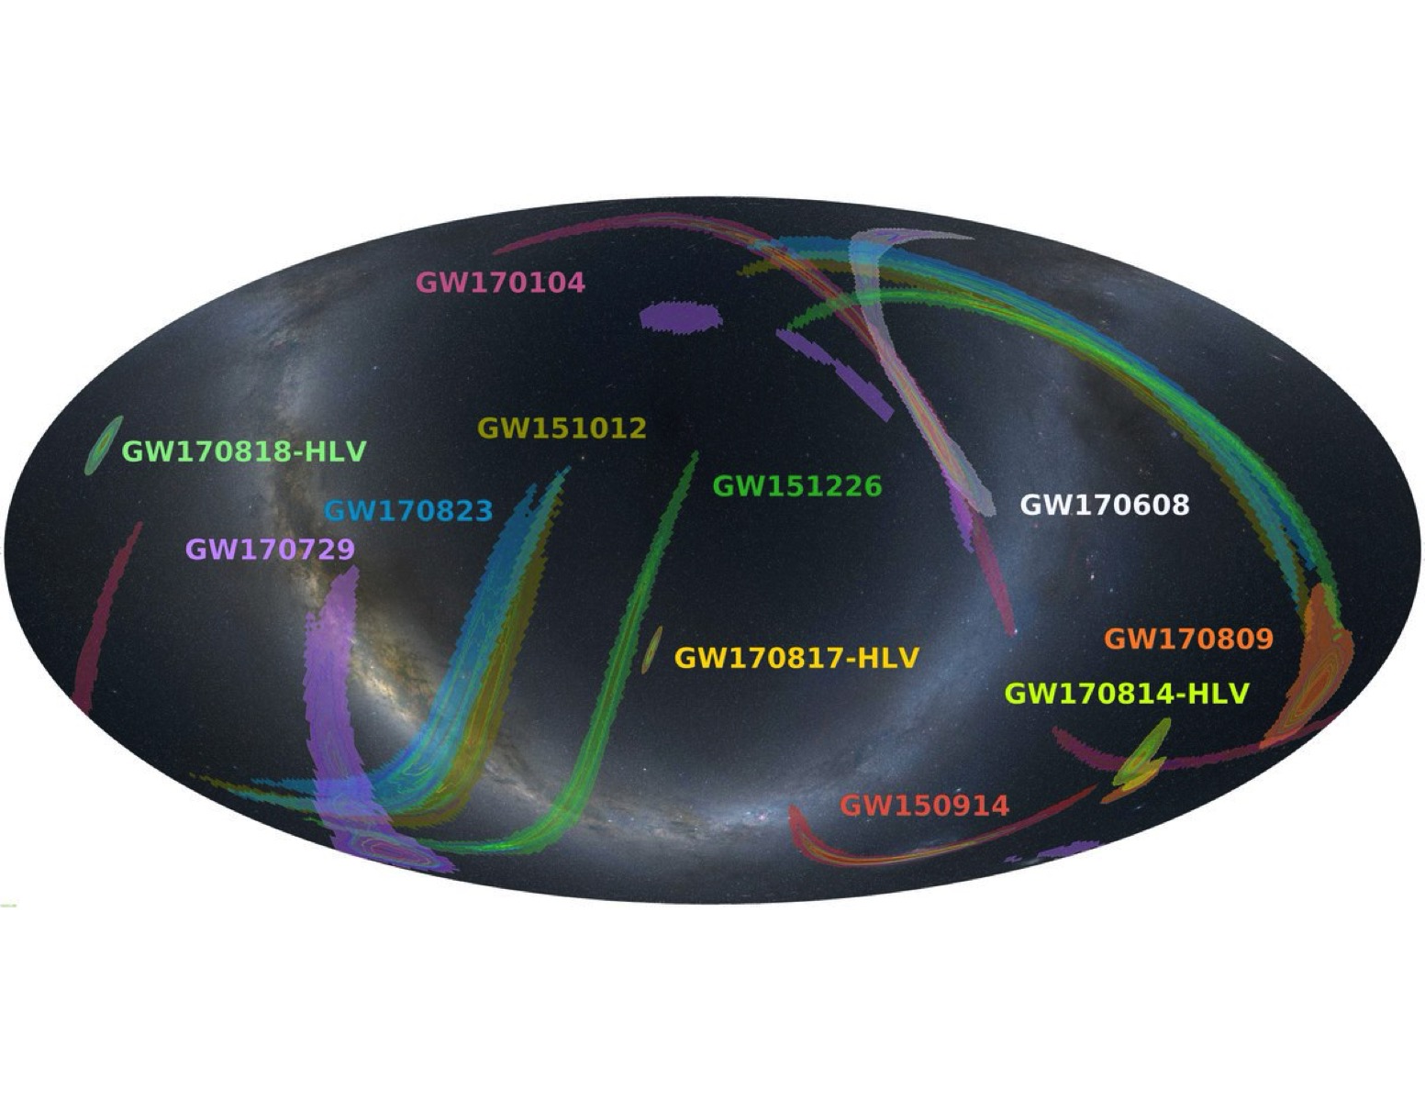
Skymaps of LIGO-Virgo’s
Detections
Abbott, et al, (LIGO Virgo Collaboration "Low-Latency Gravitational Wave Alerts for Multi-Messenger Astronomy During the Second Advanced LIGO and Virgo Observing Run", https://arxiv.org/abs/1901.03310

Slide 5
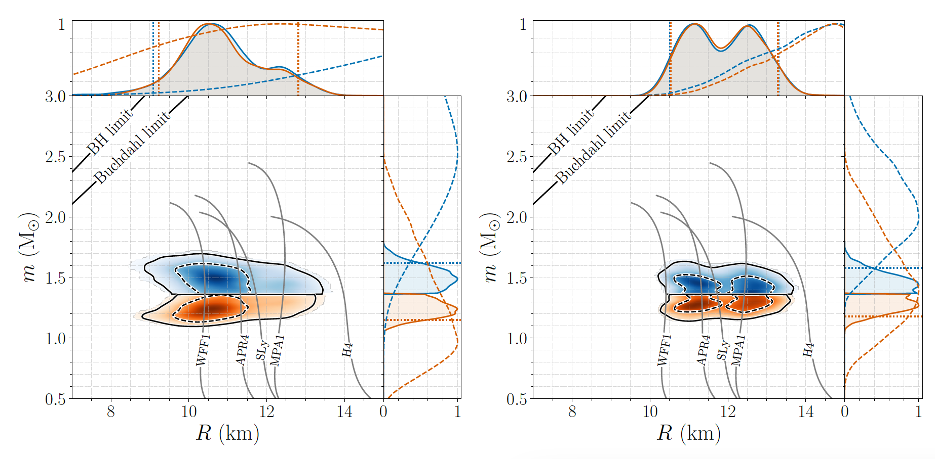
Measurements of the GW170817
BNS Radii and EoS
Reanalysis of LIGO-Virgo data assuming components were NSs described by single EOS and consistent with EM observations
  R = 11.9 km +/- 1.4 km
Also constrain NS pressure-density relationship
→ p @ 2X nuclear saturation density = 3.5x10³⁴ dyn/cm²
Abbott, et al., LIGO-Virgo Collaboration, “GW170817: Measurements of neutron star radii and equation of state”, Phys. Rev. Lett. 121, 161101

Slide 6
Near Term:
Plans for Observing and Upgrades in the Next Five Years

Slide 7
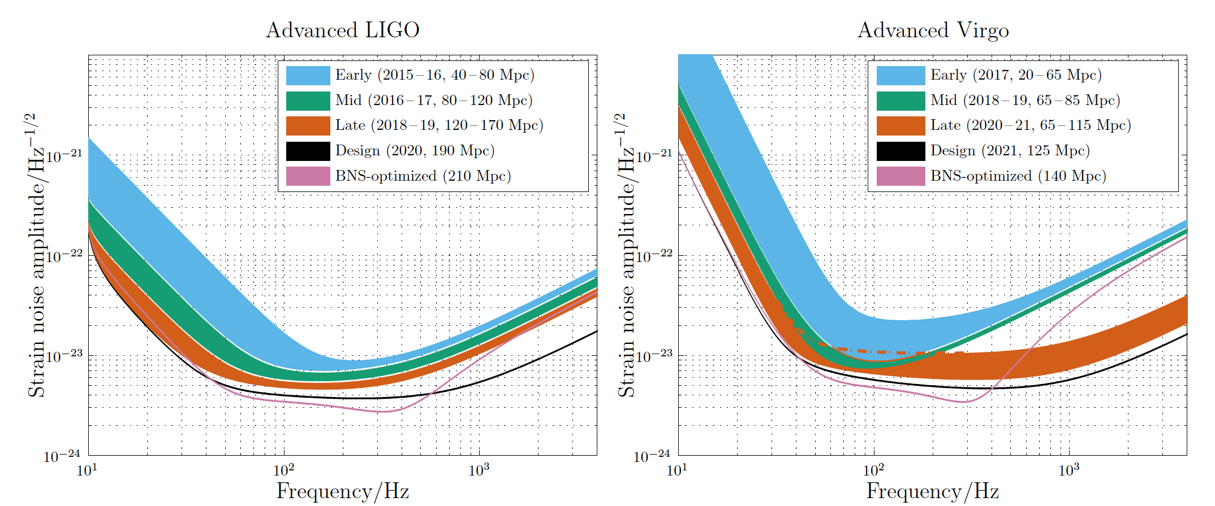
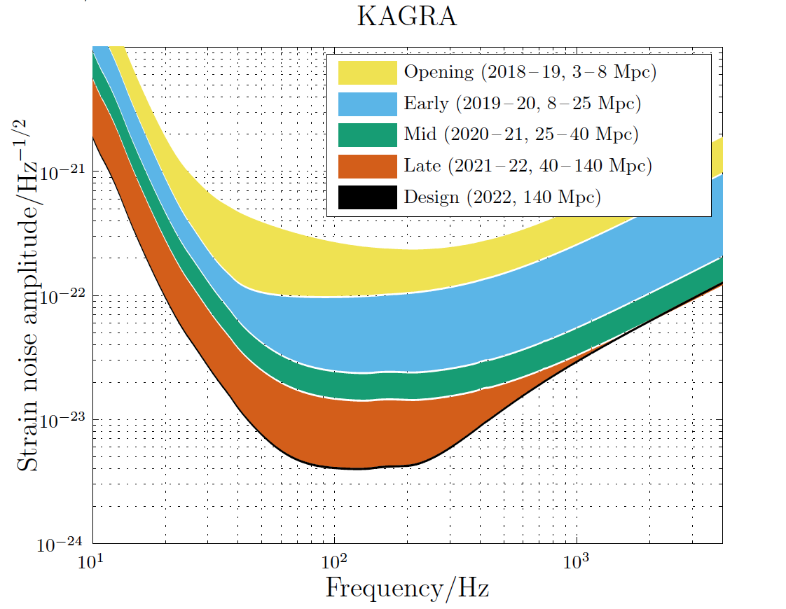
Estimated Sensitivity Evolution:
LIGO, Virgo, KAGRA
KAGRA currently undergoing commissioning,
intends to join the O3 run in 2020
Abbott, B. P. et al. (KAGRA Collaboration, LIGO Scientific Collaboration and Virgo Collaboration), "Prospects for Observing and Localizing Gravitational-Wave Transients with Advanced LIGO, Advanced Virgo and KAGRA", Living Rev. Relativity (2018) 21:3
LIGO-India planning to come online in 2025

Slide 8
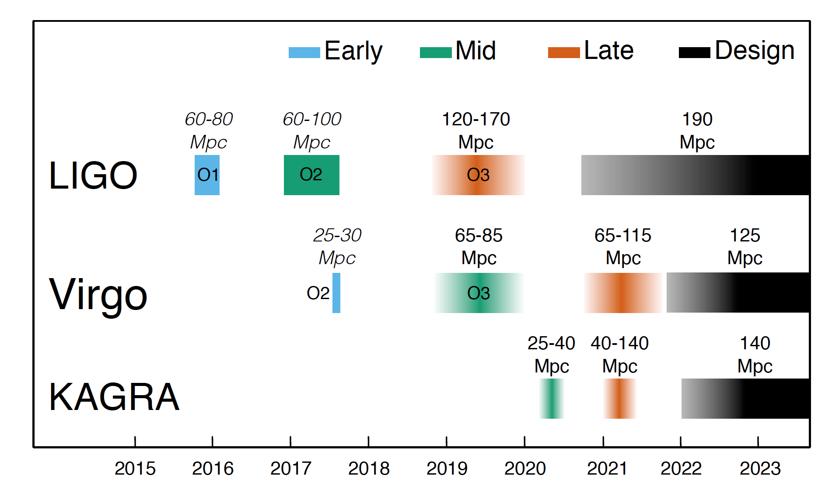
Coordinated Observations with the GW Network
  w
173
Abbott, B. P. et al. (KAGRA Collaboration, LIGO Scientific Collaboration and Virgo Collaboration), "Prospects for Observing and Localizing Gravitational-Wave Transients with Advanced LIGO, Advanced Virgo and KAGRA", Living Rev. Relativity (2018) 21:3

Slide 9
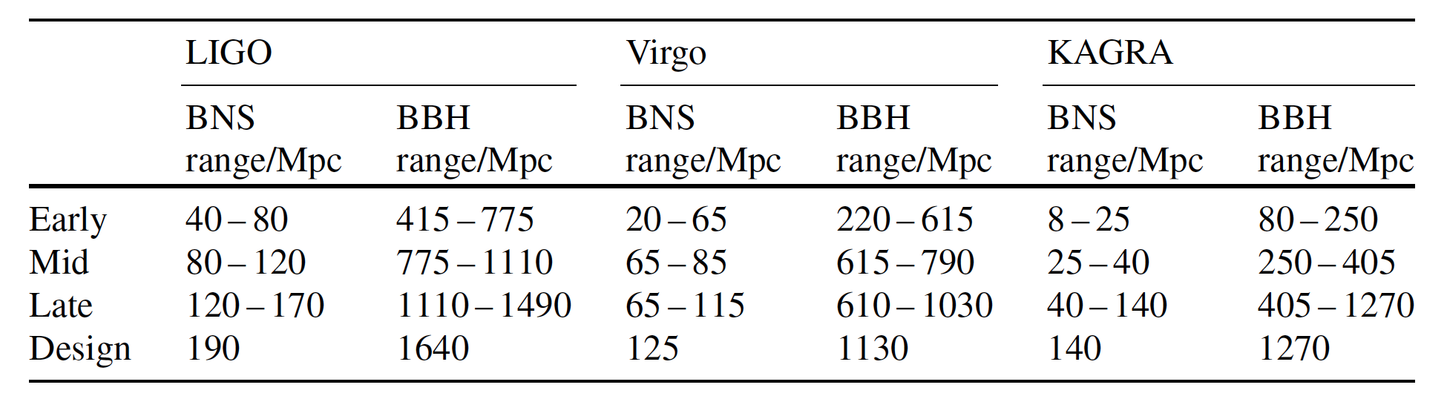
Estimated Inspiral Ranges for
LIGO, Virgo, KAGRA
‘Seeing’ distance (averaged over all sky and binary orientations) to binary neutron star (1.4 M-1.4 M) and binary black hole (30 M-30 M) for SNR = 8
Note: Horizon distance ≈ 2.25 x average distance
O3
O3
O3
Abbott, B. P. et al. (KAGRA Collaboration, LIGO Scientific Collaboration and Virgo Collaboration), "Prospects for Observing and Localizing Gravitational-Wave Transients with Advanced LIGO, Advanced Virgo and KAGRA", Living Rev. Relativity (2018) 21:3

Slide 10
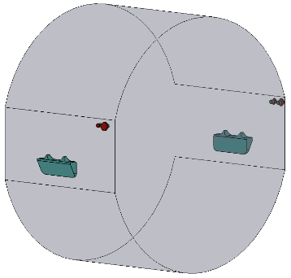
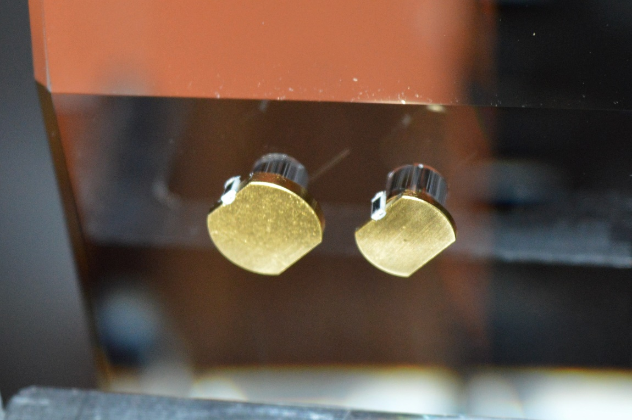
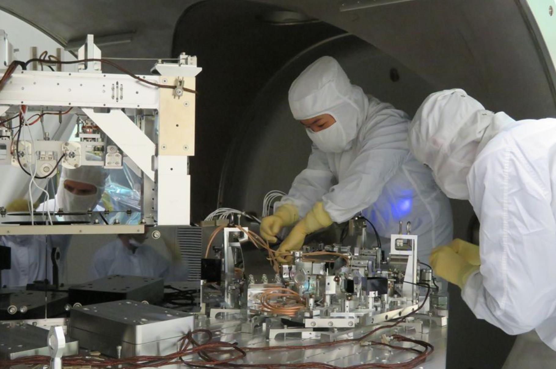
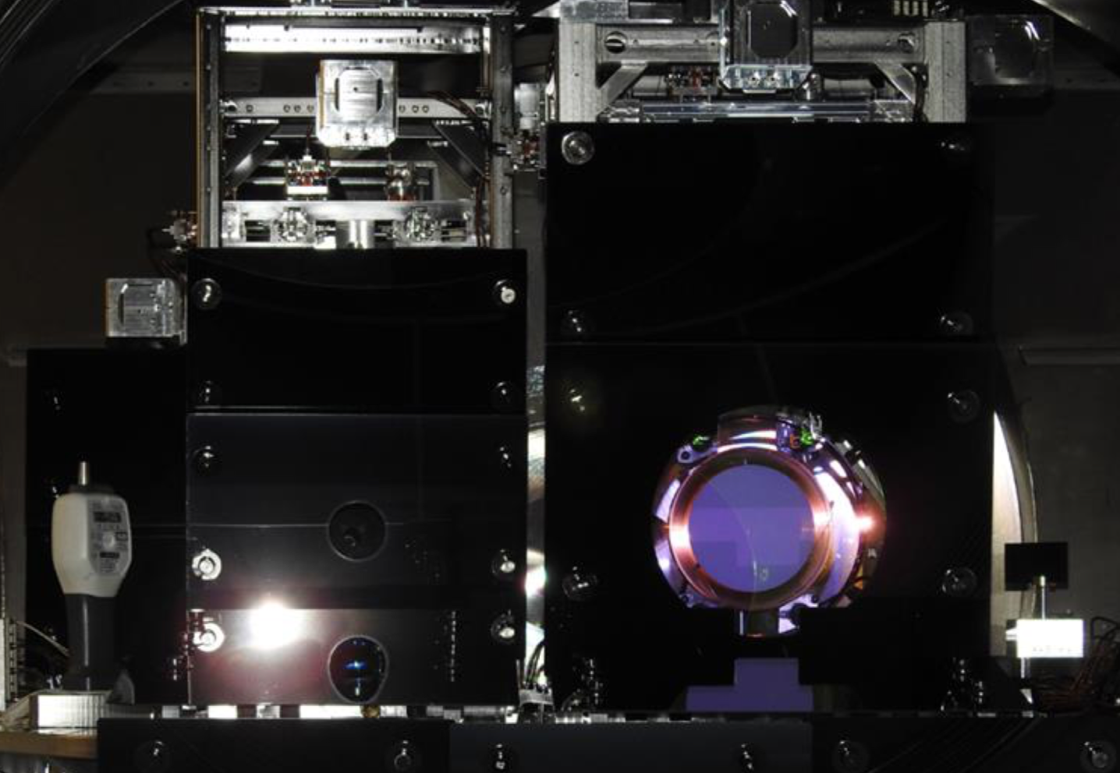
Major LIGO Detector Improvements for O3
Squeezed light injection
  Goal is 3 dB noise reduction; have seen 2+ dB
Replaced all end test masses, added annular end reaction masses
Vastly improved interferometer stray light control
New robust 70W laser amplifiers → 50 W into interferometers
Installation of acoustic mass dampers on all test masses
  Parametric instability suppression → shouldn’t be a problem for O4!
New monolithic Signal Recycling Cavity mirrors, new 118 MHz SRC modulation sideband control scheme
Replace Output Faraday Isolators
Electric field meters installed in one end station for H1 and L1
Acoustic Mass
Dampers
Installing in-vacuum squeezer
on L1
Stray light control

Slide 11
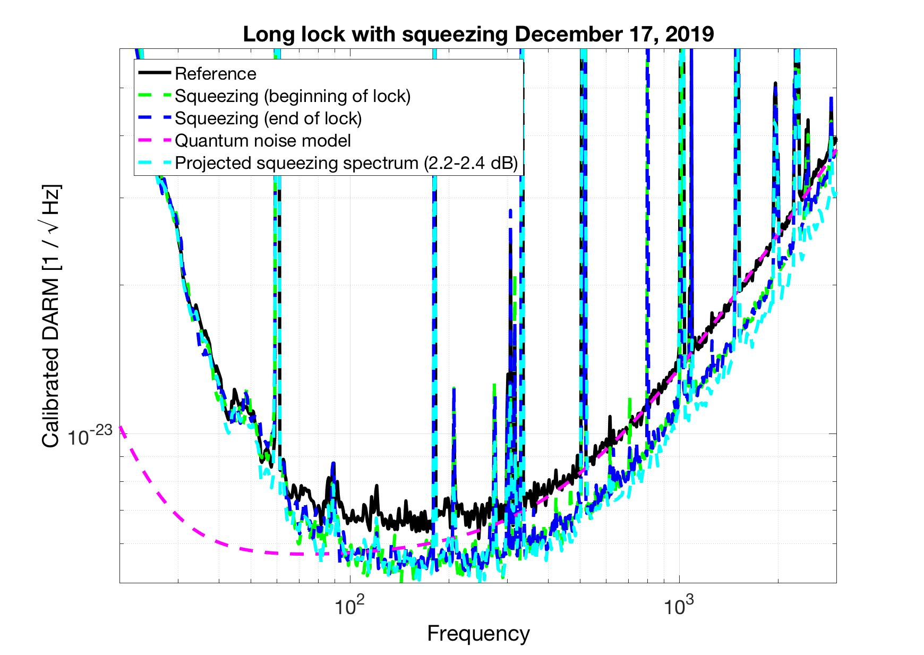
LIGO Progress toward O3
LIGO Livingston L1 interferometer: Squeezed

Slide 12
What remains to be done before O3
Problems encountered and overcome (or worked around...)
  Several fiber breaks during installation of new test masses
  Livingston vacuum system – major problems with gate valve ‘GV11’
Current status of LIGO interferometers
  Livingston L1 interferometer has achieved ~115 Mpc BNS inspiral range (w/ squeezing)
  Hanford H1 interferometer has achieved ~ 90 Mpc BNS inspiral range (no squeezing yet)
Still to be done to achieve O3 desired sensitivity target
  Inject and characterize squeezing on H1
  Improve squeezing and reduce losses on L1 and H1
  Push injected power to 50 W on L1 and H1
    H1 @ 25W
    L1 @ 35 – 40W
  Continued noise hunting: Identify and improve low frequency noise on L1 and H1
    LF noise not completely understood; excess noise on L1 and even more excess noise on H1
O3 scheduled to begin in April 2019

Slide 13
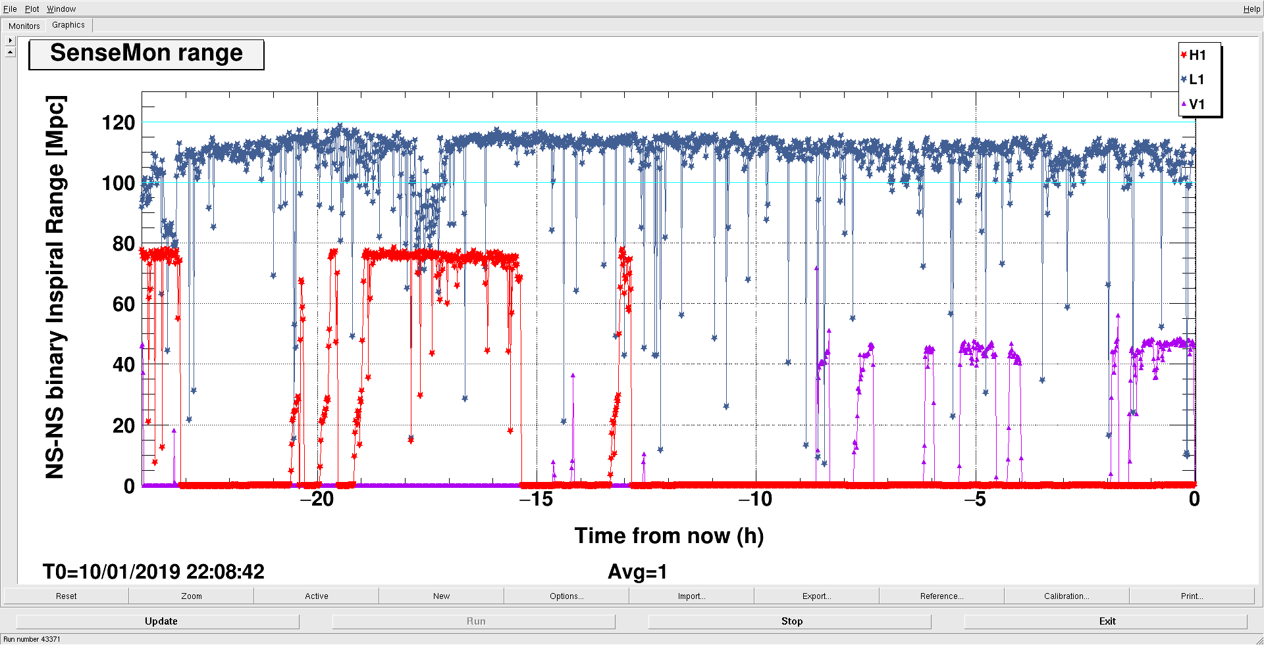
Latest From the Observatories
H1, L1 Goal
V1 Goal

Slide 14
Advanced LIGO ‘A+’:
A Mid-scale Upgrade to Advanced LIGO

Slide 15
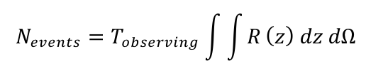
GW Science is Sensitivity Driven!
Rates:
2) Many sources require higher SNR to uncover new astrophysics!!
tidal disruption in BNS mergers
tests of alternative theories of gravity
Black hole ringdowns
Stochastic background
Isolated neutron stars
Galactic supernova
Surprises!
Binary Neutron Stars
825X
230X
120X
45X
LIGO-India
LSST Survey

Slide 16
2024: Advanced LIGO ‘A+’
‘Mid-scale’ upgrade of the Advanced LIGO interferometers
Sensitivity improvement over ALIGO:
  1.4/1.4 M BNS inspiral range by ~ 1.9 to 325 Mpc
  30/30 M binary black hole inspiral range by ~1.6 to > 2.5 Gpc
Greater event rate than Advanced LIGO
Higher SNR CBC events
Employs frequency-dependent squeezing & lower thermal noise mirror coatings
Currently planning for a 1.5-2 year run duration beginning mid 2024 or early 2025
LIGO-India planned to come online in the A+ configuration in 2025
O2
aLIGO design
A+
BNS: 325 Mpc
BBH: 2563 Mpc
BNS: 173 Mpc
BBH: 1607 Mpc

Slide 17
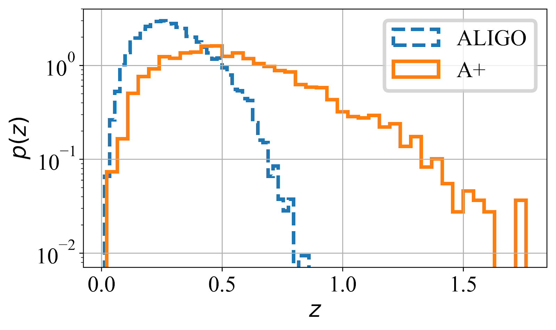
A+ Enabled Science
BBH rate 4.1x aLIGO ➔17-300 BBH/month
Off-axis observations ➔ BH component spins
BH Spins ➔ Origins of stellar-mass BH
Z_{max} ~ 1.5 ➔ BBH cosmological evolution
SNR ~ 100 events ➔ Ultra-precision tests of GR
BNS rate 6.7x aLIGO ➔ 1-13 BNS/month
(2-11 BNS x SGRB coincidences/year)*
Multimessenger coincidences ➔ precision H₀ measurement, kilonovae, etc.
High inspiral SNR ➔BNS tidal deformation
BNS remnant “ringdown” ➔NS matter equation of state
*(or more, if GW170817 represents hidden sub-threshold SGRB population)
Redshift Distribution of BBH sources detectable with SNR >10
Post- BNS merger signals vs detector
sensitivity for some speculative
neutron-star EOS

Slide 18
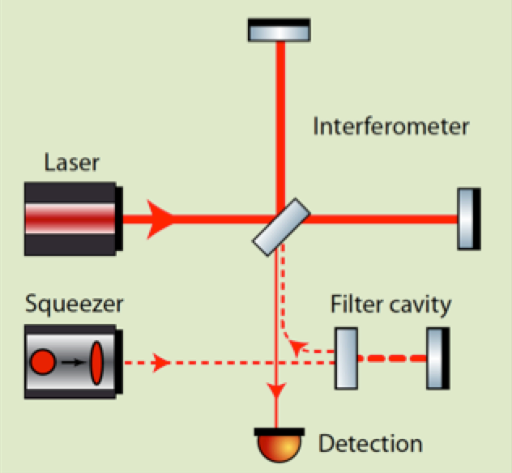
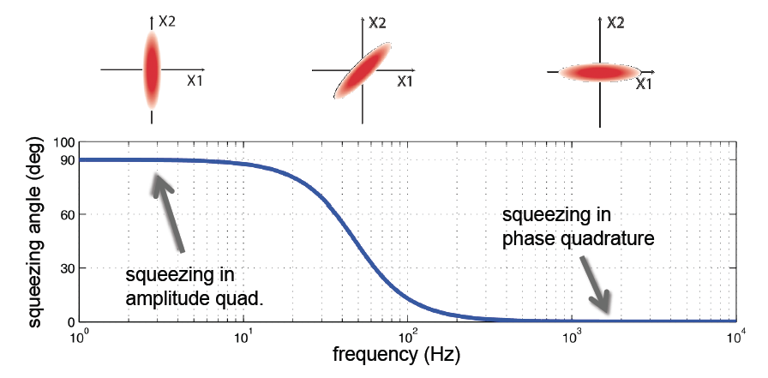
A+: Frequency-Dependent Squeezing
Optical “filter cavity” (FC)
Rotates squeezing phase to both improve radiation pressure at LF and phase noise at HF
Low-loss, high finesse cavity with bandwidth ~100 Hz
Sensitive to optical losses, scattering and mirror motion
Requires seismic isolation and quiet mirror suspension
Requires high-quality FC mirrors
Requires L_{FC} ~ 300 m
Oelker, et al., “Audio-band Frequency-dependent Squeezing”, Phys. Rev. Lett. 116, 041102 (2016).

Slide 19
Balanced Homodyne Readout (UK)
Reduced dark-port loss
Improved backscatter immunity
Improved phase tuning flexibility
Enhanced readout dynamic range
P. Fritschel, M. Evans, V. Frolov, "Balanced Homodyne Readout for Quantum Limited Gravitational Wave Detectors", Opt. Exp. 22, 4224-4234 (2014).

Slide 20
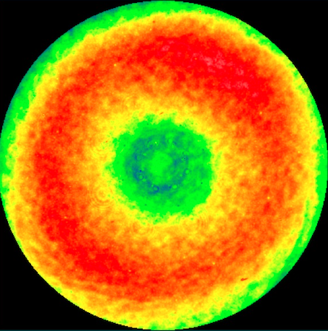
A+: Improved
Test Mass Mirror Coatings
Elastic loss angle goal of φ < 9 x 10⁻⁵
  Compare: aLIGO φ = 3.6 x 10⁻⁴
UK, European and US Center for Coatings Research initiative to select best low-loss coating design in about 2 years
  Current R&D on small samples
A+ Coating Pathfinder program will spin up industrial vendor(s) and qualify full-aperture coatings for production
Replacement core optics delivered for final phase of A+ installation (mid-FY23)
aLIGO ETM figure map
6.5 Å_{RMS} over
central 160 mm
(LIGO Lab/G. Billingsley)
Current aLIGO
Coating Loss
S. Gras & M. Evans, Direct Measurement of Coating Thermal Noise in Optical Resonators, Phys. Rev. D 98, 122001 (2018)
A+ goal

Slide 21
Longer Term:
Facility-limited ‘2.5 Generation’ Detectors
New ‘3rd Generation’ Gravitational-wave Observatories

Slide 22
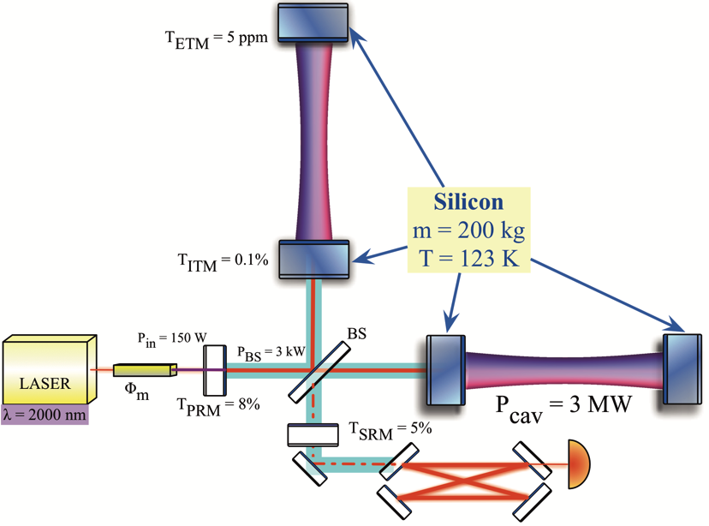
Voyager: The Ultimate
LIGO Detector
Voyager Key Technologies
  Silicon Mirrors: 200 kg, 45 cm dia., mCZ process
  Mirror Coatings: 𝛂-Si/SiO2 (𝛂-Si: ~lossless thin film)
  Cryogenics: 123 K (zero CTE), radiative (non-contact) cooling
  Lasers (2000 nm): P~ 180 W, PARM ~ 2800 kW
  Wavefront Compensation: thermally adjustable lenses only (no actuation of test mass)
  Photodiode Quantum Efficiency: 80 -> 99% for 2 micron
Effort Led by R. Adhikari

Slide 23
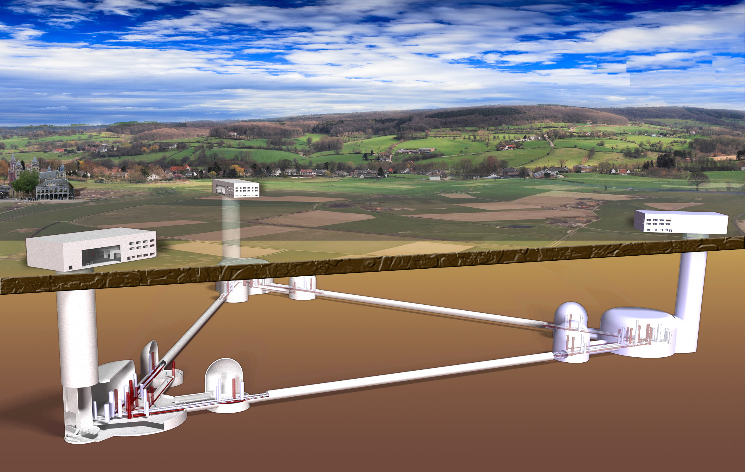
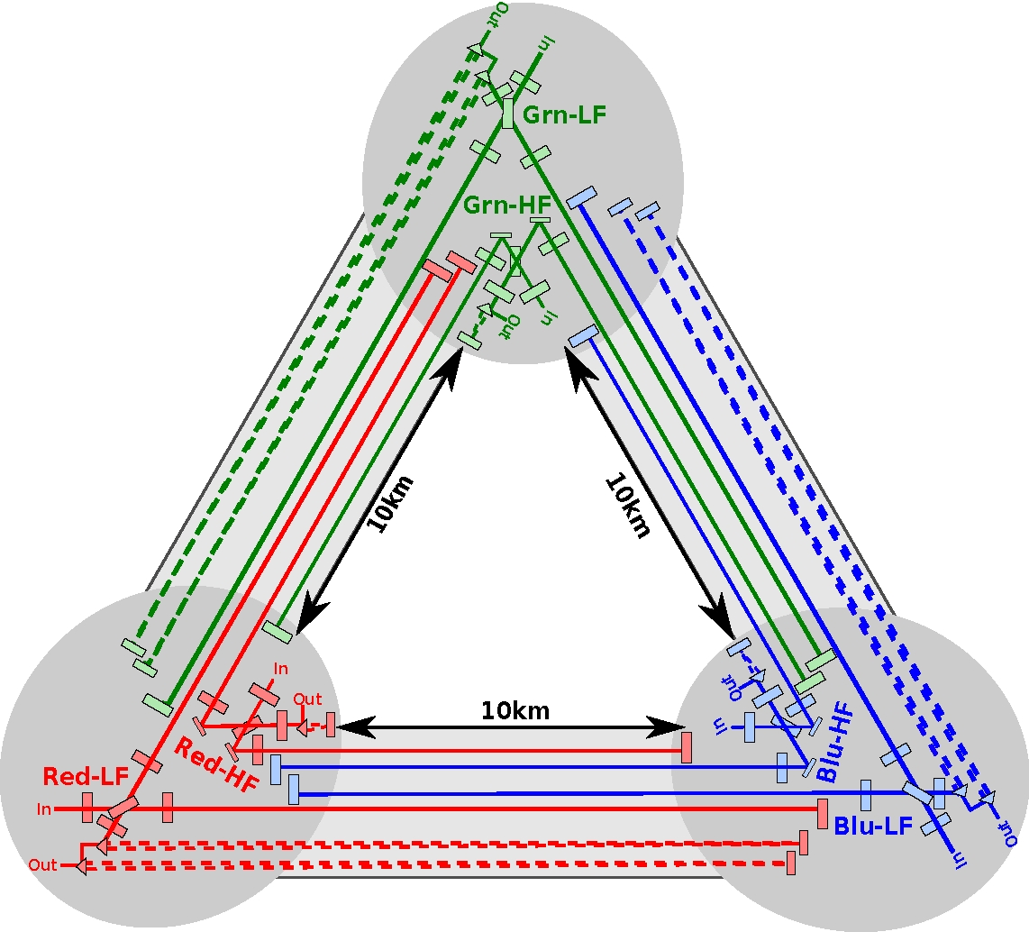
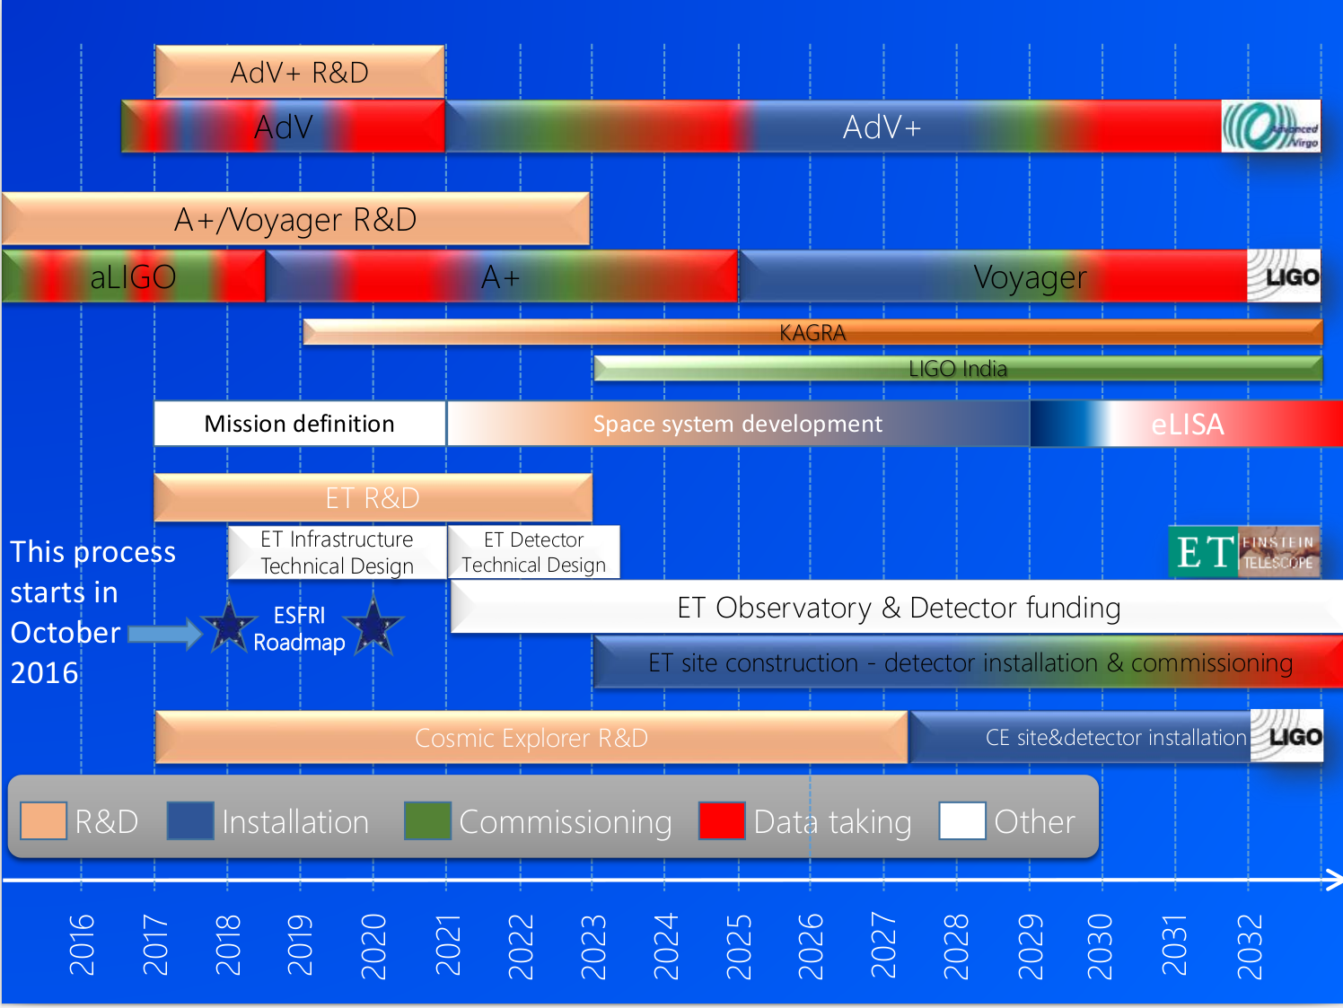
Einstein Telescope (Europe)
Third-generation GW observatory
Target sensitivity for ET a factor of ten improvement in comparison to current advanced detectors
10 km long, Underground
Xylophone configuration, 6 interferometers
Formal Design Study completed in 2011:
http://www.et-gw.eu/etdsdocument
Slide Credit:
Vaishali Adya, AEI

Slide 24
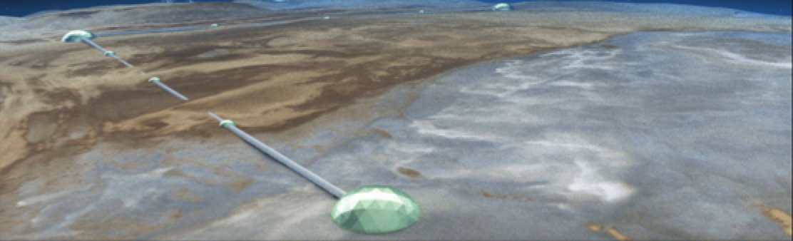
Cosmic Explorer (US)
Third-generation GW observatory
Target sensitivity a factor of > 10 improvement in comparison to current advanced detectors
Above ground, 40 km arm length, L configuration
Formal design study under way (M. Evans, MIT, lead PI)
cosmicexplorer.org
First Stars Formed

Slide 25

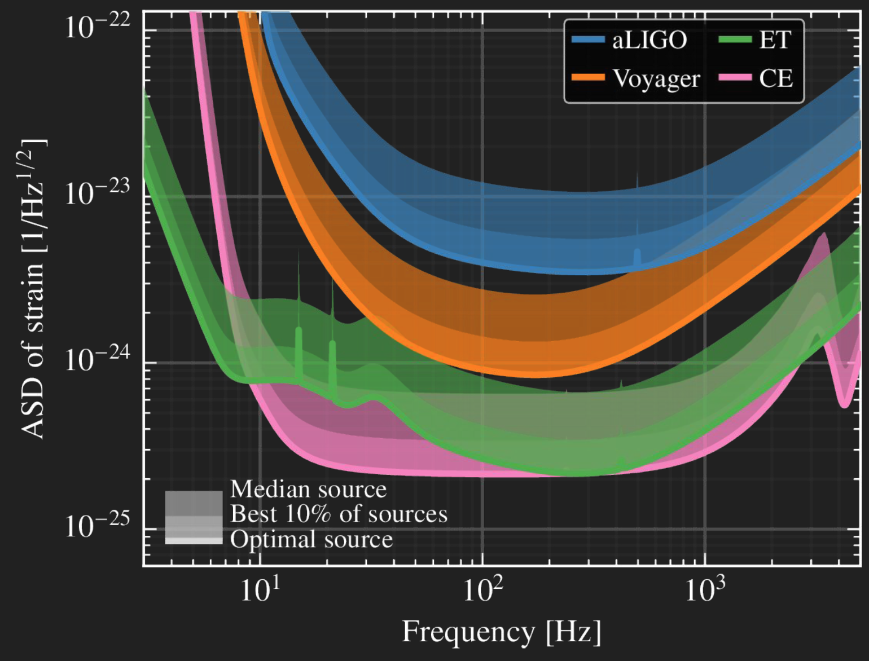

Detector Sensitivities

Slide 26
wq

Slide 27
How to Get From Here to 3G?
GWIC (Gravitational Wave International Committee)
Body formed in 1997 to facilitate international collaboration and cooperation in the construction, operation and use of the major gravitational wave detection facilities world-wide
Affiliated with the International Union of Pure and Applied Physics
  From 1999 until 2011, GWIC was recognized as a subpanel of PaNAGIC (IUPAP WG.4).
  In 2011, GWIC was accepted by IUPAP as a separate Working Group (WG.11).
Formally linked to the:
International Astronomical Union (IAU)
International Society for General Relativity and Gravitation (ISGRG)

Slide 28
Who is GWIC?
The membership of GWIC represents all of the world’s active gravitational wave projects*, as well as other relevant communities, covering gravitational wave frequencies from nanohertz to kilohertz. Each project has either one, two, or four members on GWIC depending on size.
OzGrav: Matthew Bailes (PPTA); David McClelland (ground-based interferometers)
Einstein Telescope: Michele Punturo
European Pulsar Timing Array: Michael Kramer
GEO 600: Karsten Danzmann, Sheila Rowan (Chair)
IndIGO: Bala Iyer, Somak Raychaudhury
KAGRA: Yoshio Saito, Takaaki Kajita
LIGO: Dave Reitze, David Shoemaker
LISA: Neil Cornish, Bernard Schutz,
Ira Thorpe, Stefano Vitale
NANOGrav: Maura McLaughlin
Theory Community: Luis Lehner
Virgo: Jo Van den Brand, Fulvio Ricci
IUPAP AC2 (ISGRG): Beverly Berger
IAU D1: Marica Branchesi
Executive secretary : David Shoemaker
Co- secretary: Stan Whitcomb
*no CMB community membership

Slide 29


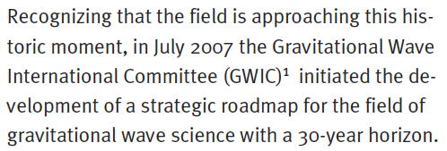
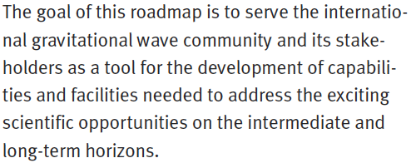
https://gwic.ligo.org/roadmap/Roadmap_110726_WEB.pdf

Slide 30

GWIC’s role in 3G detector development
At its meeting in New York, 2016, GWIC agreed to form a subcommittee to look at the 3G detector landscape
  Co‐chairs: Dave Reitze, Michele Punturo
The subcommittee, with the involvement of the community, will provide a final report and set of proposed actions/recommendations to GWIC no later than the 2019 GWIC meeting.
GWIC 3G subcommittee mandate:
“Examining the path to a future network of observatories / facilities, specifically”:
1. Science Drivers for 3G detectors
Commission a study of ground-based gravitational wave science from the global scientific community, investigating potential science vs architecture vs. network configuration vs. cost trade-offs, recognizing and taking into account existing studies for 3G projects (such as ET) as well as science overlap with the larger gravitational-wave spectrum.
Working Group Chairs:
V. Kalogera
B. Sathyaprakash

Slide 31
2. Coordination of the Ground-based GW Community:
Develop and facilitate coordination mechanisms among the current and future planned and anticipated ground-based GW projects, including identification of common technologies and R&D activities as well as comparison of the specific technical approaches to 3G detectors. Possible support for coordination of 2G observing and 3G construction schedules.
3. Networking among Ground-based GW Community:
Organize and facilitate links between planned global 3G projects and other relevant scientific communities
4. Funding agency interfacing and advocacy:
Identify and establish a communication channel with funding agencies who currently or may in the future support ground-based GW detectors
5. Investigate 3G detector governance schemes
By applying knowledge of the diverse structures of the global GW community, propose a sustainable governance model for the management of detector construction and joint working, to support planning of 3rd generation observatories.
6. Computing
Computing to survey what kinds of global computing models would be most efficient for 3G science goals and identify appropriate pathways towards a sustainable 3G computing cyberinfrastructure model
WG Chairs:
H. Lueck
D. McClelland
J van den Brand
GWIC Chair, Secretariat
GWIC Chair, Secretariat
WG Chairs:
S. Katsanevas
G. Sanders
WG Chairs:
I. Bird
P. Couvares
E. Porter

Slide 32
The 3G subcommittee, with the involvement of the community, will provide a final report and set of proposed actions/recommendations to GWIC at the 2019 GWIC meeting (July 7, 2019, Valencia, Spain)
  Preliminary report will be circulated publicly in April 2019
To learn more:
https://gwic.ligo.org/3Gsubcomm/

Slide 33
Conclusions
Preparations are in full swing for O3 run to begin in April 2019
  Numerous improvements to LIGO interferometers
  L1 has almost achieved its O3 sensitivity goal; H1 and Virgo are making good progress
A+ upgrade underway
  Sensitivity goals: 325 Mpc BNS range, 2.5 Gpc BBH range (30/30 M)
  Target observing date of mid-2024
  LIGO-India planning to join in A+ configuration in 2025
Longer Term
  Serious planning efforts have begun for a new generation of GW observatories to being operations in the 2030s
  The future for GW science is quite bright. And LIGO-India will be a big part of that future!
  Acknowledgments: LIGO Lab, LSC, Virgo, NSF

Slide 34
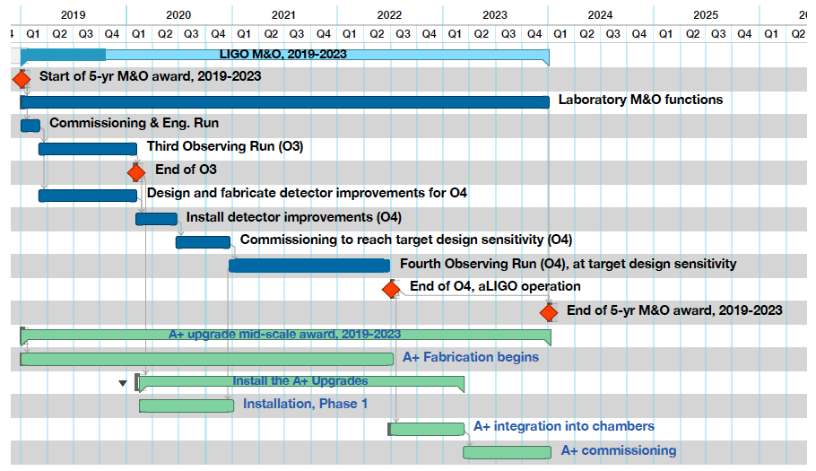
Overview of LIGO
Operations Plan 2019-2023
Top level schedule for LIGO Operations in 2019-2023
O3 currently planned to being in April 2019
A+ project begins in Oct 2018 (accelerated from original plan!)
A+ midscale upgrade

Slide 35
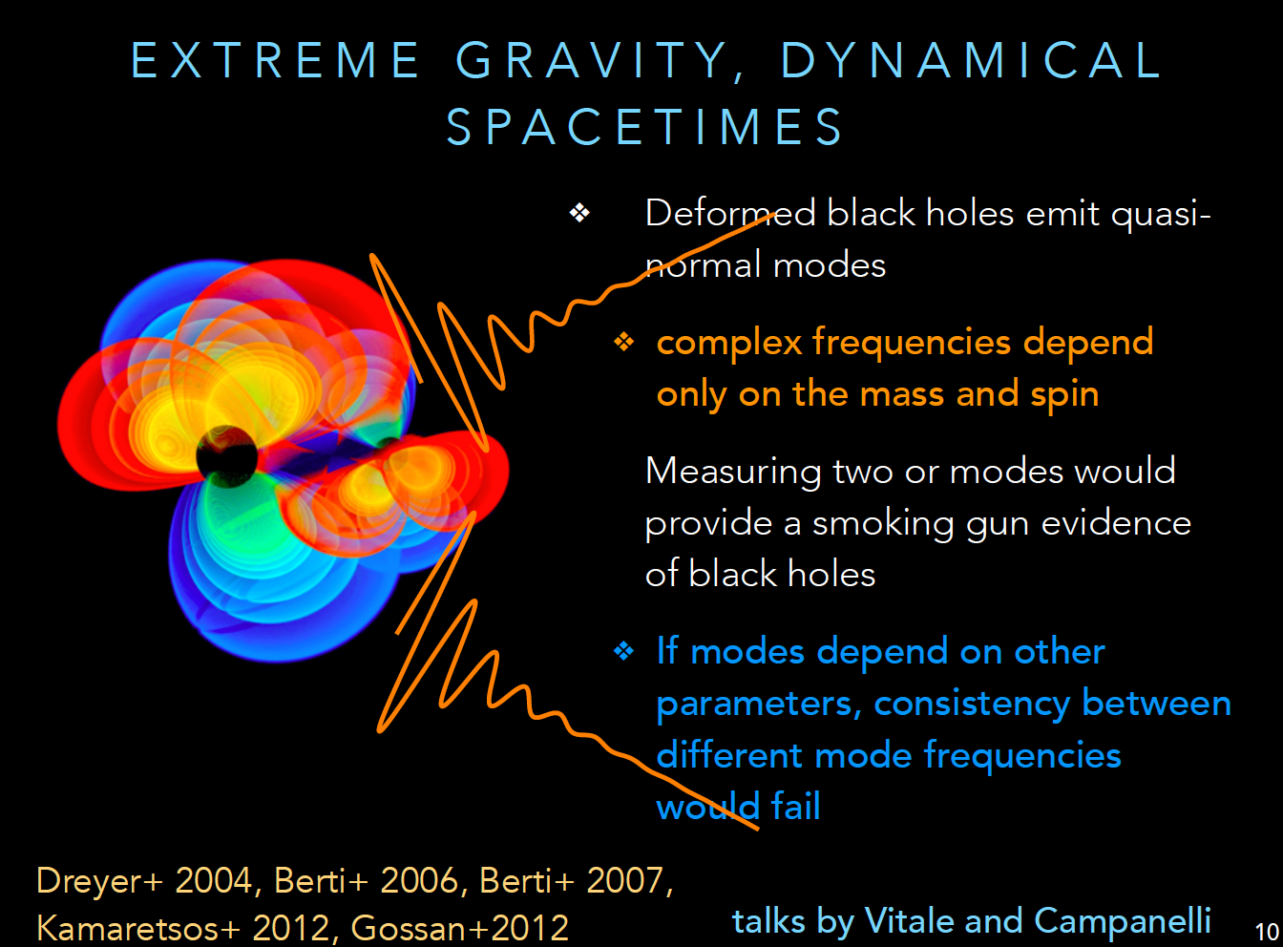
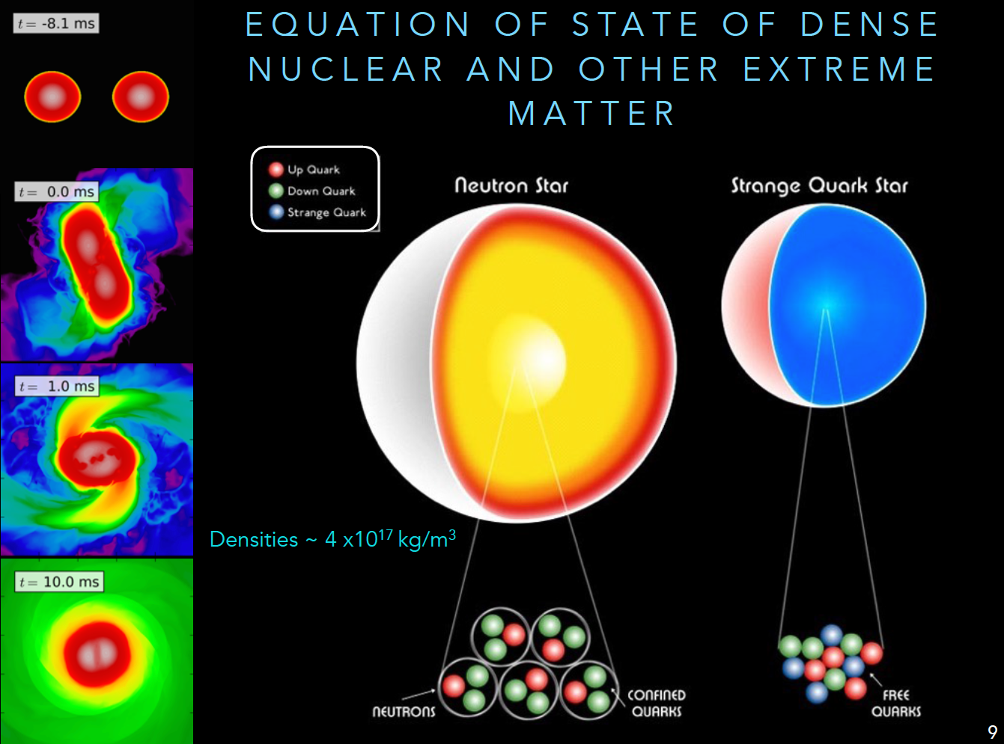
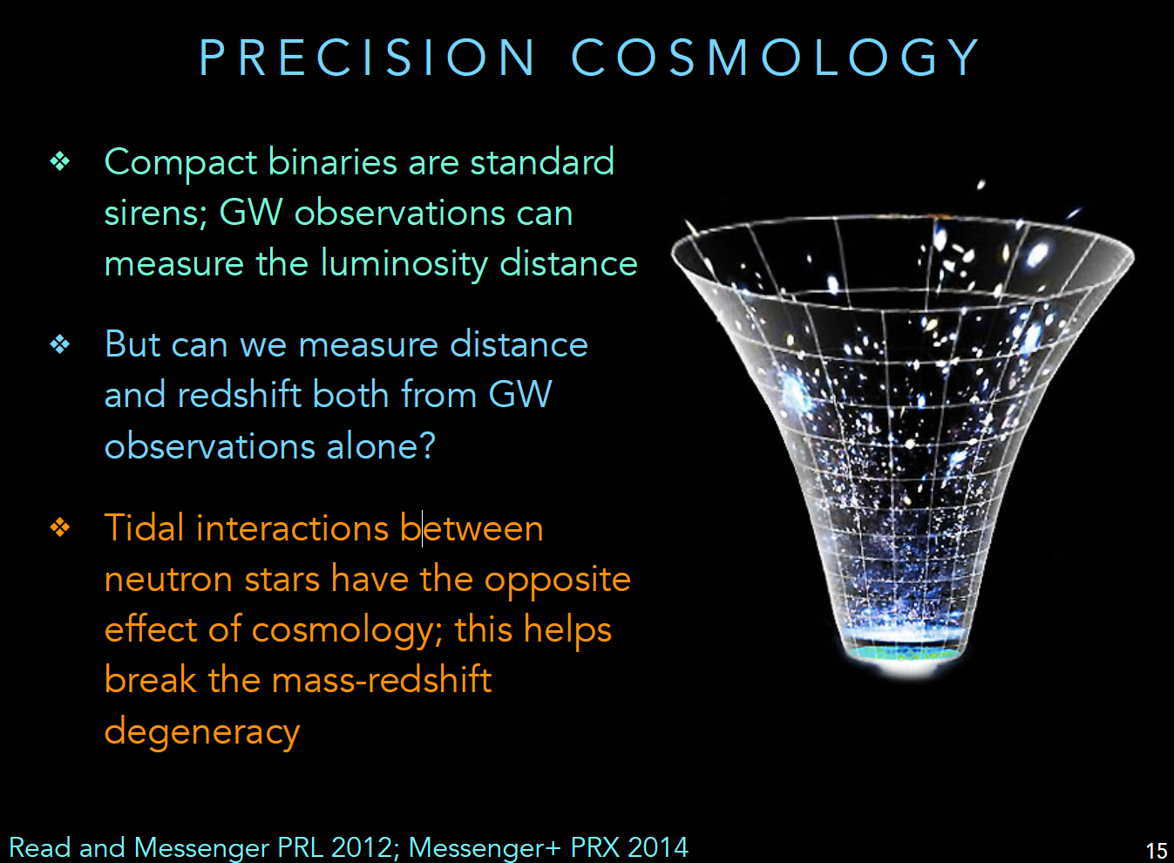
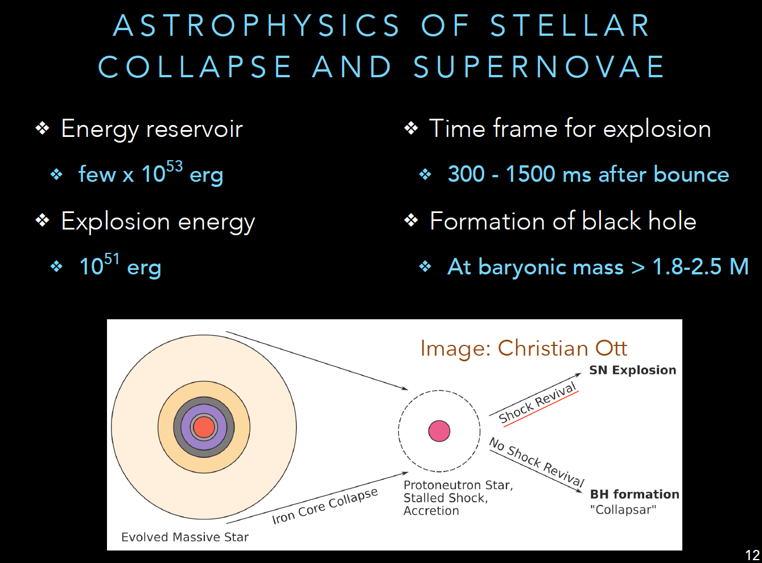
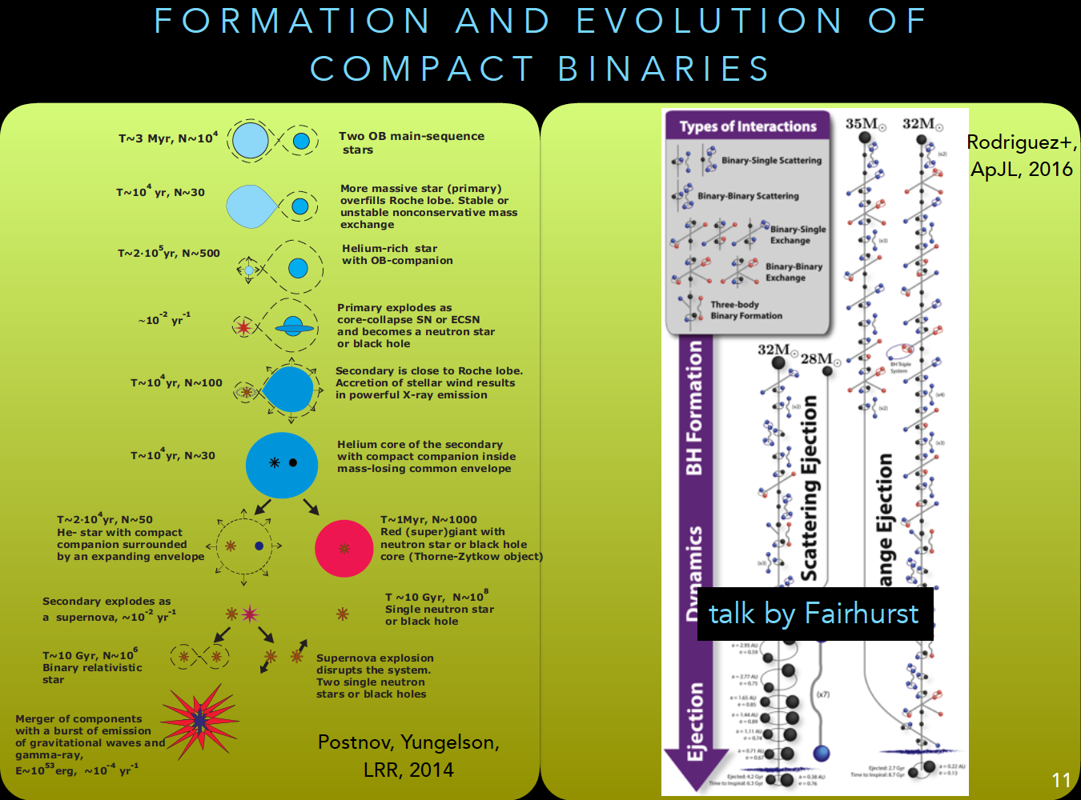
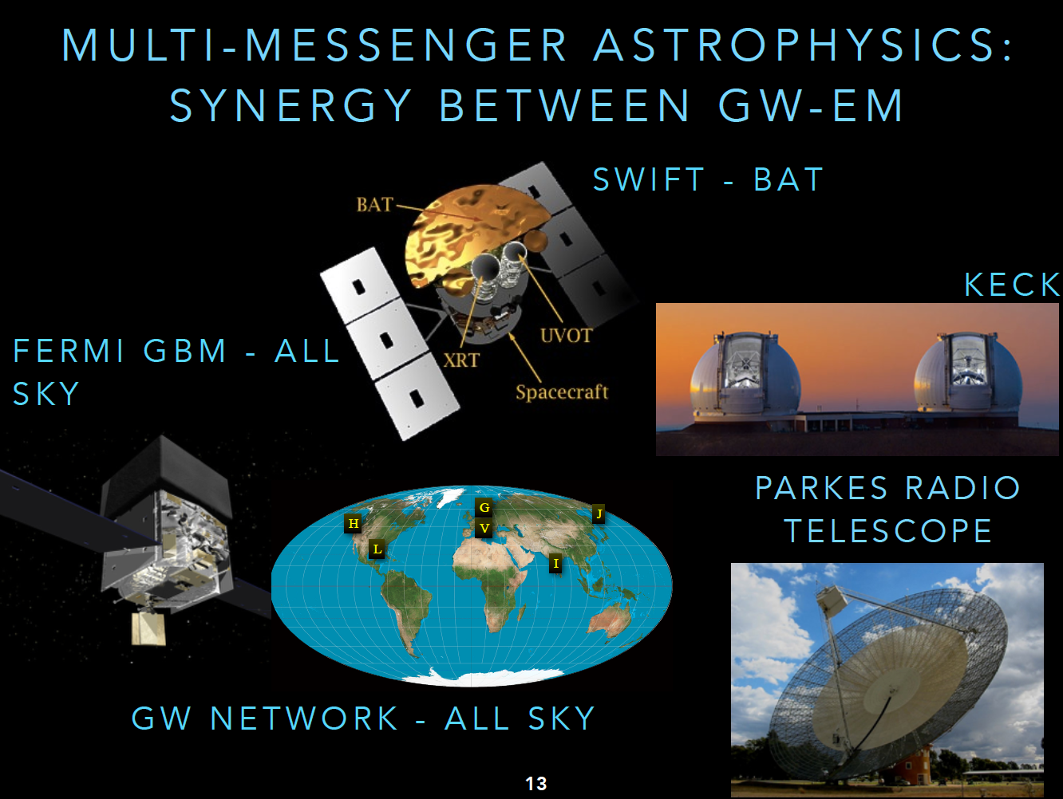
Third Gen Science Targets
The 3G Gravitational Wave
Ground-based Network
Credit: B. Sathyaprakash, Dawn III Workshop,
https://wiki.ligo.org/LSC/LIGOworkshop2017/WebHome

