Slide 1
Status of Beam Rotation Sensors at LLO
Krishna Venkateswara
for
Michael Ross , Arnaud Pele, Jim Warner, Camillo Cocchierri, Eyal Schwartz, TJ Shaffer, LLO Staff, Team SEI, Jens Gundlach
LIGO-G1802012

Slide 2
Content
Introduction
Brief Installation History
Noise and SEI Impact
Current Status
Future Plans

Slide 3
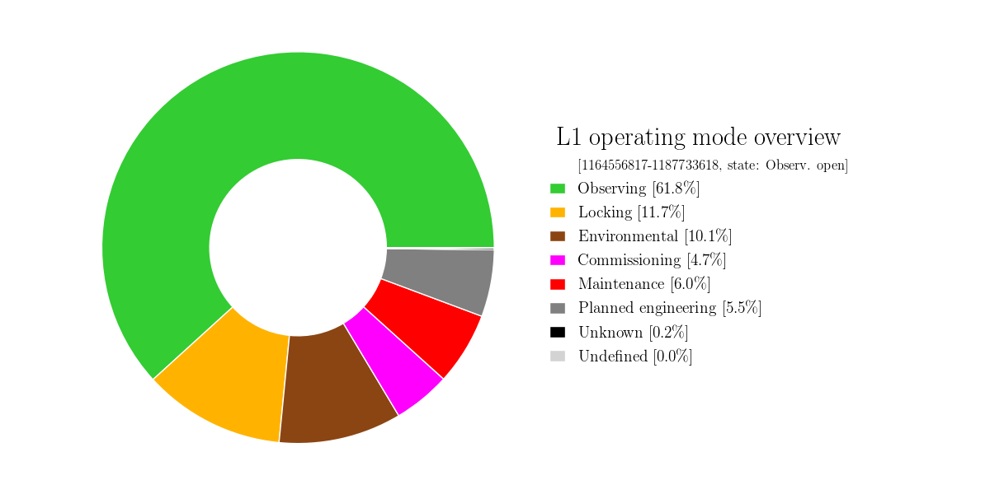
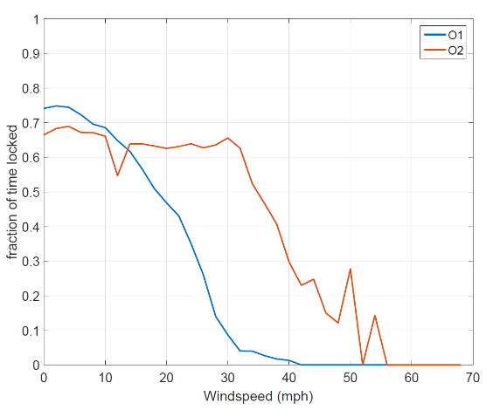
Introduction
Wind-induced tilt, Microseism and Earthquakes limit Gravitational-wave observation time.
Quick explanation
Seismometer signals are often dominated by wind-induced tilt < 0.1 Hz and show peak translation between 0.1-0.5 Hz (from microseism).
Required x10 isolation from microseism leads to excess low-frequency motion of SEI platforms during high-winds.
Solution: Use a rotation-sensor to get a tilt-free ground translation signal and use it for sensor-correction.
O2 Time Accounting at LLO
Details:
Windproofing LIGO: P1800038
Talk by A. Pele: G1801687
Improved duty cycle at LHO in O2, enabled by tilt-subtraction

Slide 4
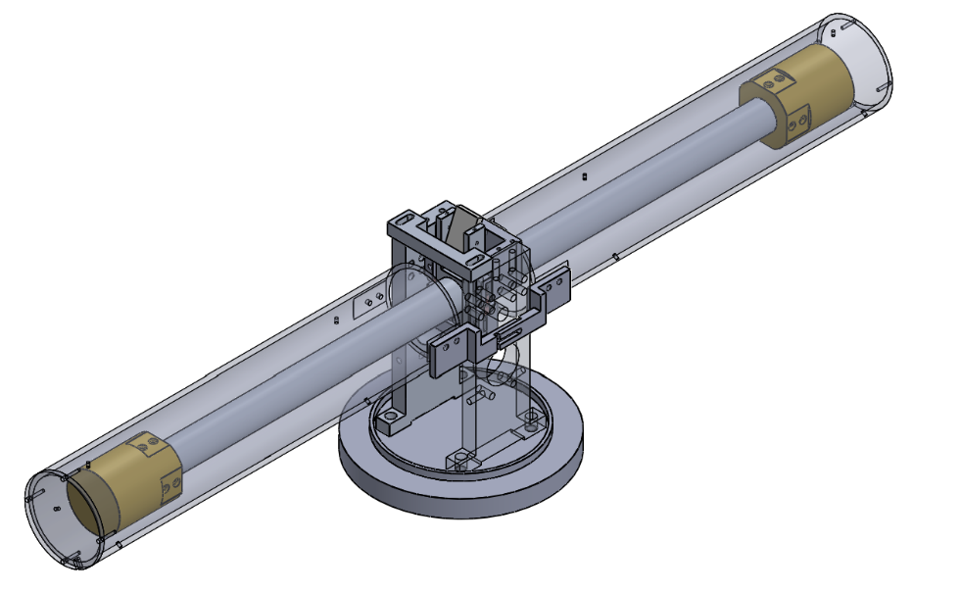
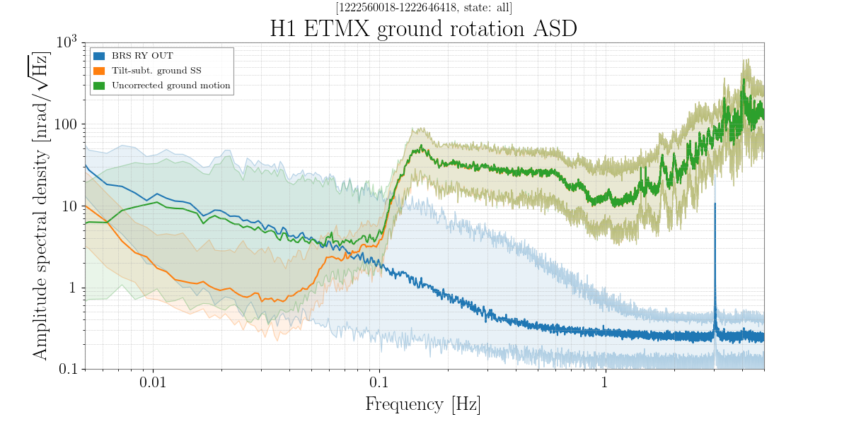
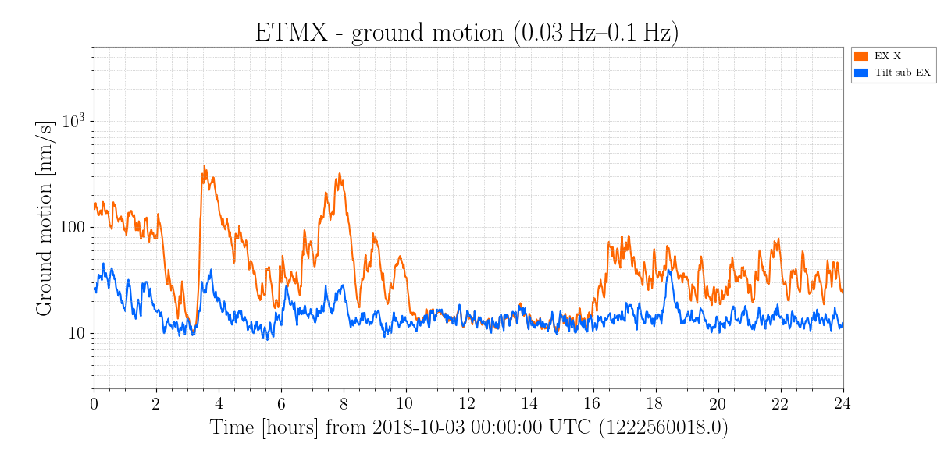
BRS Basics
Beam-balance:
0.9-m-long, 4.5-kg-active mass
10-15-μm-thick flexures (Cu-BE)
3-8 mHz resonance
Autocollimator Readout
~0.15 nrad/√Hz
Capacitive Active Dampers
Vacuum maintained by ion pump

Slide 5
Installation history
Sub-award to install four BRS at LLO approved ~ Dec 1, 2017.
Machined and partially-assembled components shipped from UW on Feb 14, 2018.
Assembly/Commissioning began Feb 24th, 2018, and nominally finished by end of May 2018.
Notable issues during installation
A critical part found to be machined incorrectly (at UW). One was fixed at LLO and the rest were shipped back to UW and fixed. Led to a few days delay, but likely no impact on end-product.
First beam-balance assembly went according to plan. For the remaining three, center of mass of beam (as assembled) found to be well above suspension point. Required addition of extra mass below center to compensate and led to a delay by 1-2 weeks to diagnose and fix. Cause of mismatch remains unknown. No long term impact observed.
Made the additional design change of placing the ground seismometer on the BRS platform, to improve coherence.

Slide 6
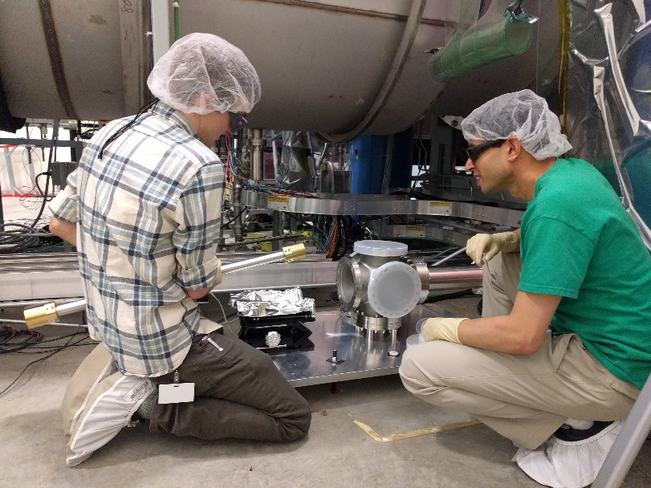
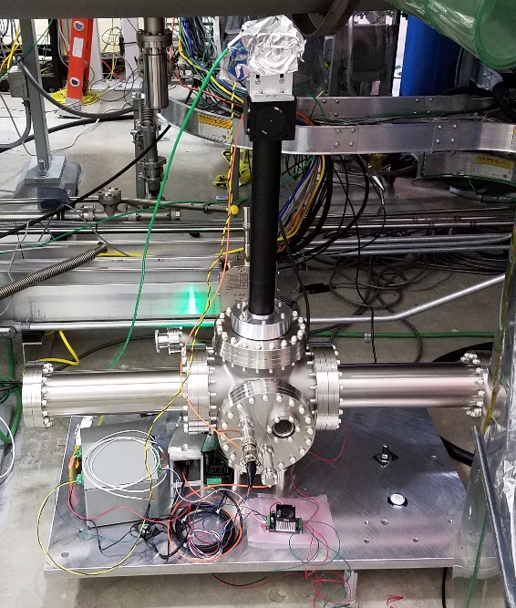
Assembly Photos

Slide 7
Alogs of Note
Seismometers on BRS platform rotated to improve coherence with the ISI seismometers (39478).
Corner station ISI models modified (39529).
First online tilt-subtraction at the corner station (39626).
First BRS spectra (39639).
All four BRS’ working and subtracting tilt (40707).
Low-frequency performance was limited by temperature noise ⇒ was addressed by improving thermal shielding and adding gel-pads (thanks to Stuart A. and Gary T.!) (40819, 41088).
The lower BRS resonance frequencies at LLO, along with time-varying temperature gradients in the VEA cause the BRS drift out of readout range more often than at LHO ⇒ being addressed by using external heaters by Eyal and Arnaud (41036).

Slide 8
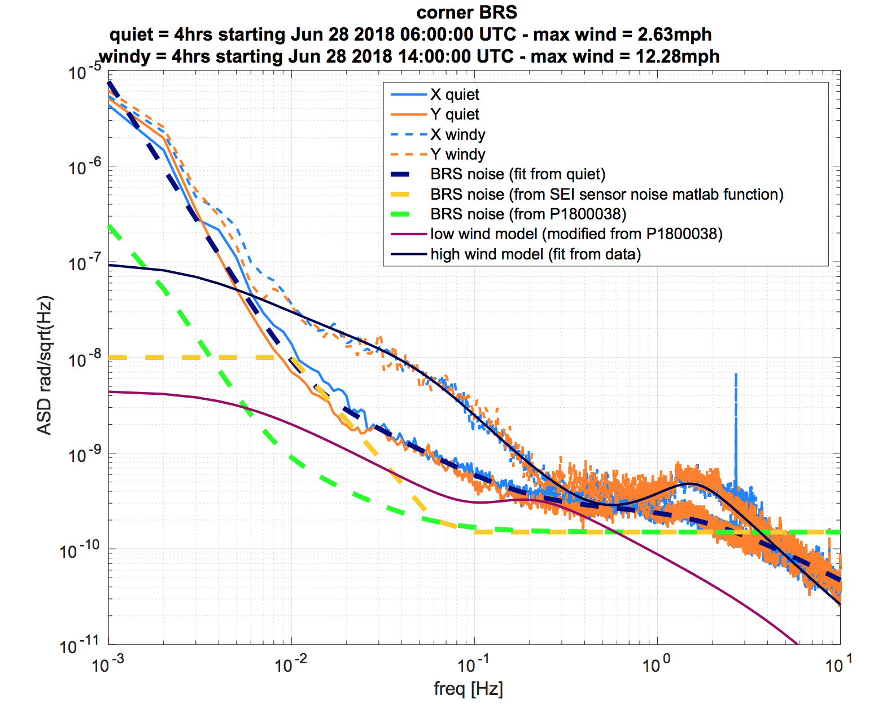
LLO-BRS first spectrum
Source: A. Pele, https://alog.ligo-la.caltech.edu/aLOG/index.php?callRep=39639

Slide 9
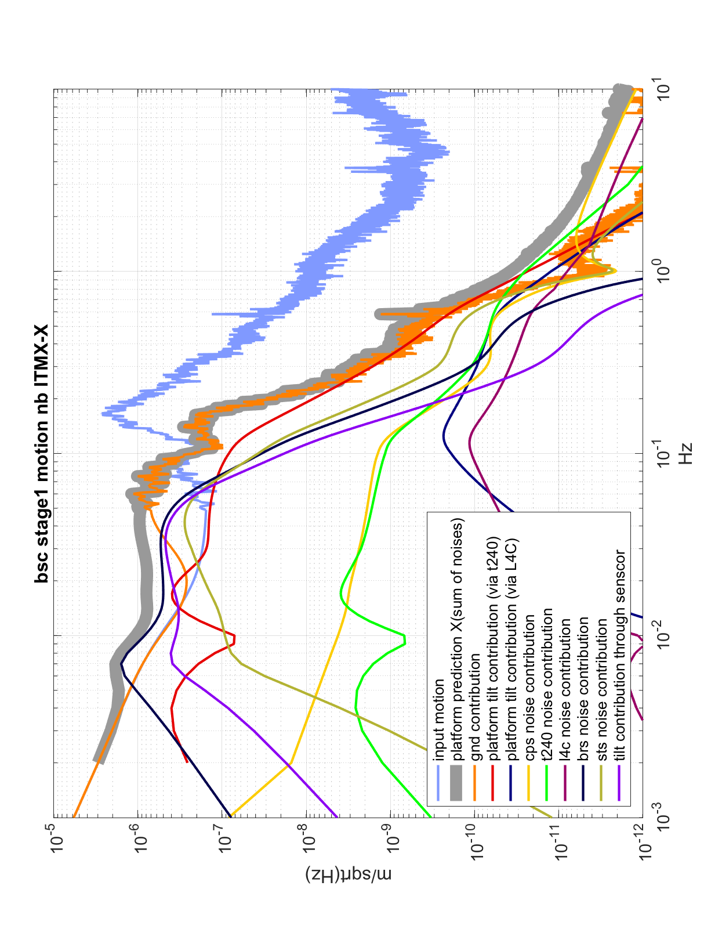
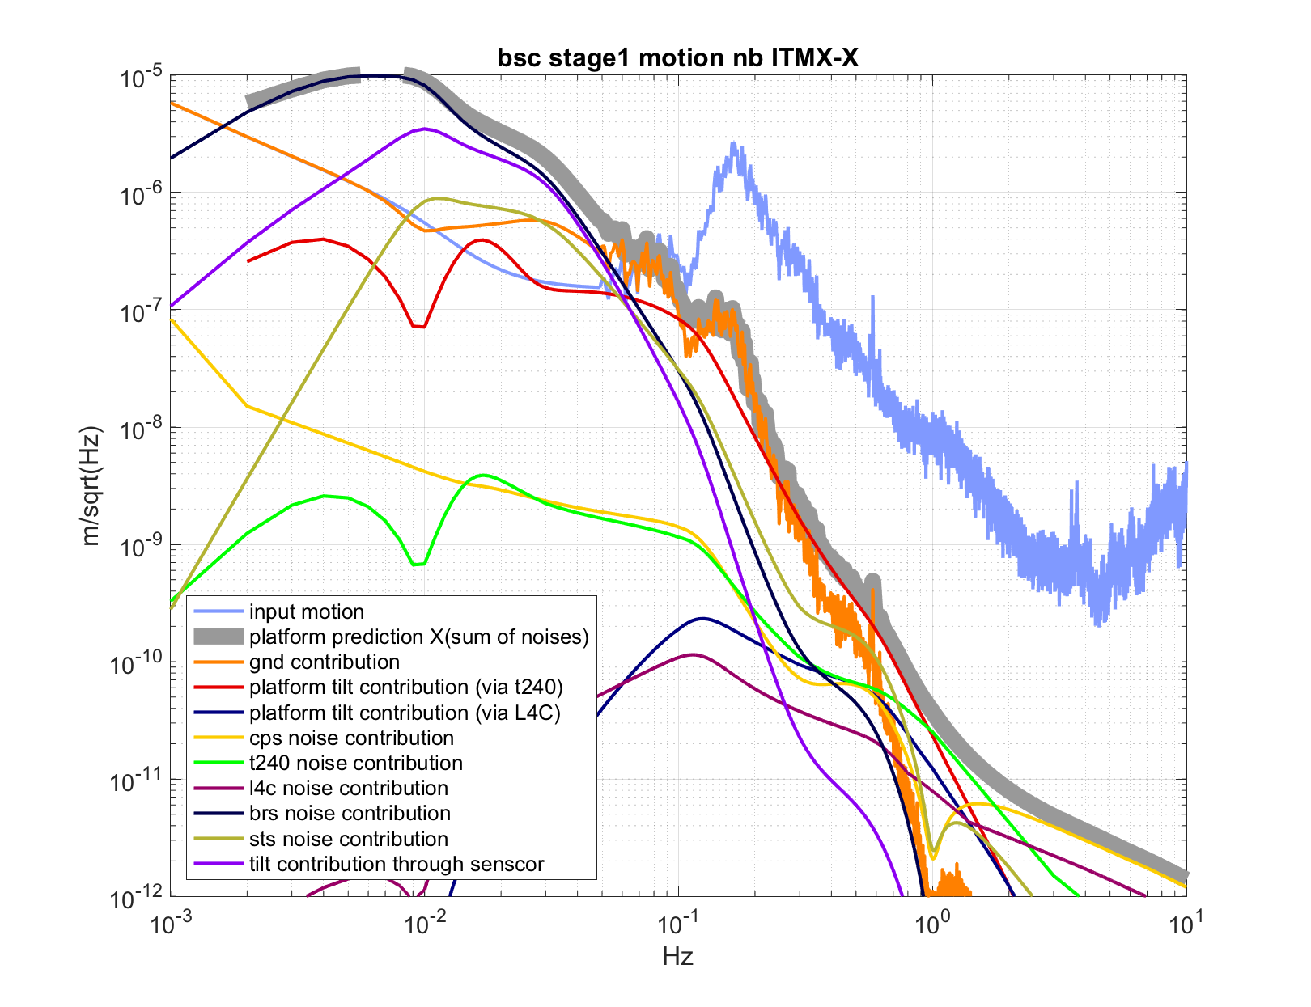
ISI Stage 1 Noise Budget
In high microseism+wind, and
current sensor correction
Noise re-injection
2X suppression
More aggressive sensor correction
Source: A. Pele, G1801687

Slide 10
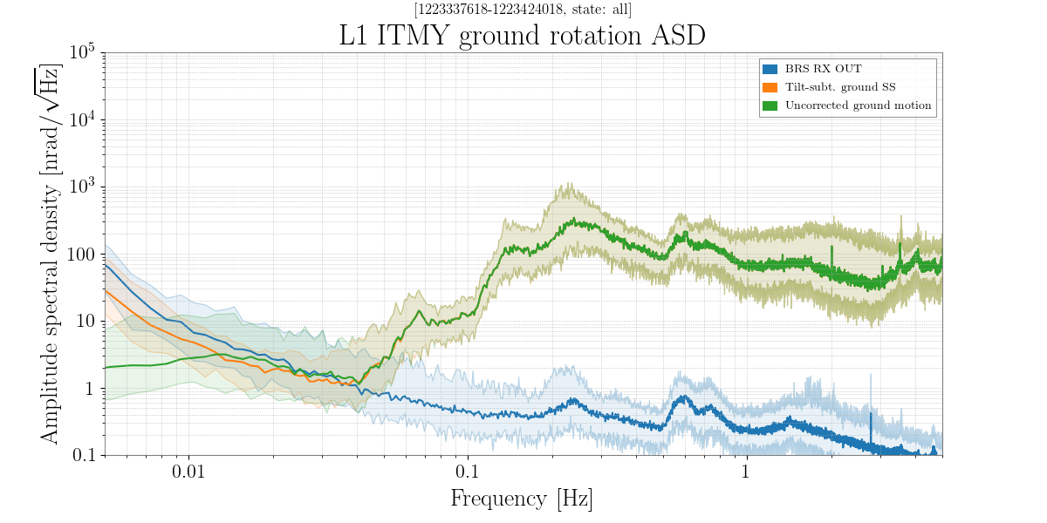
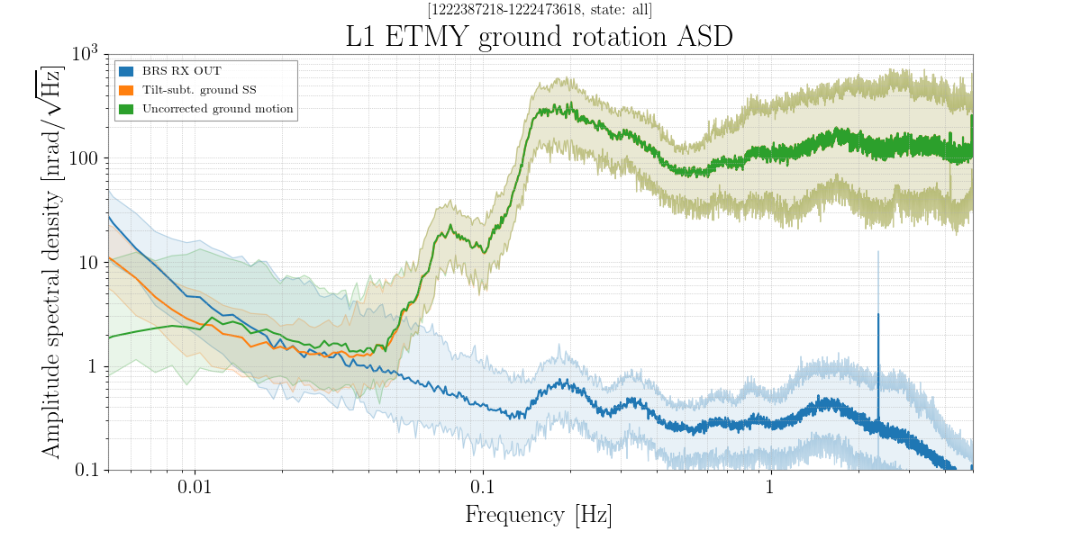
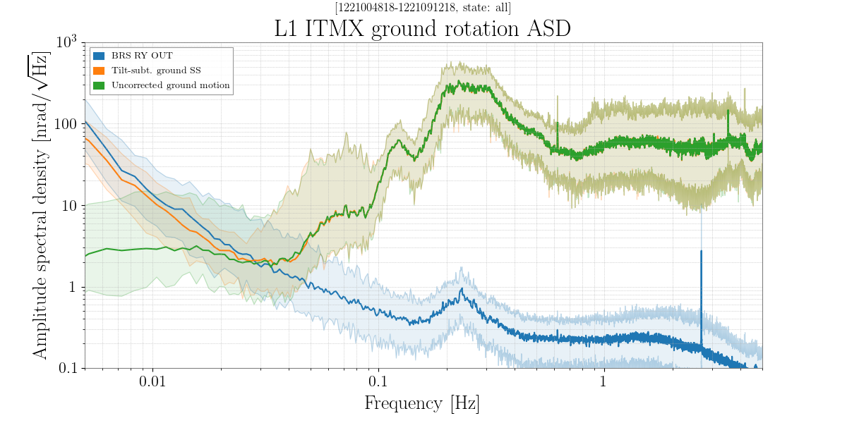
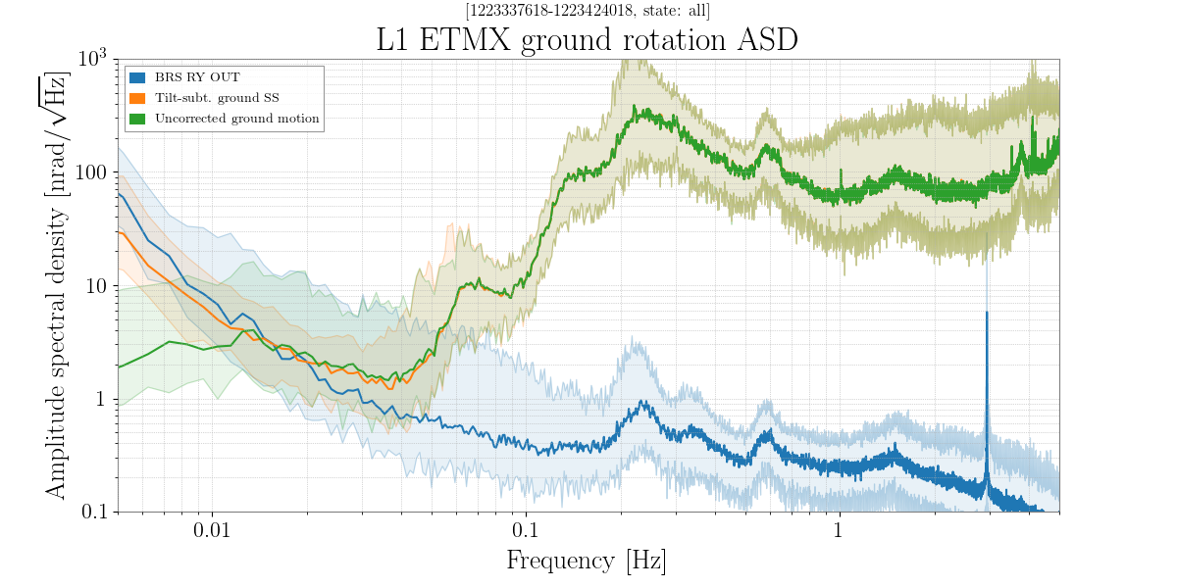
Current Status
https://ldas-jobs.ligo-la.caltech.edu/~detchar/summary/day/20181011/sei/brs_etm/
https://ldas-jobs.ligo-la.caltech.edu/~detchar/summary/day/20181011/sei/brs_itm/
In range
In range
Out of range
In range

Slide 11
Future Plan
We are discussing design changes needed for improved BRS Drift Control at LLO. Will submit an ECR with design outline soon. Option 1: Use a Beckhoff relay to have an on-off control of a heater.
Develop/Test new sensor-correction filters to take advantage of the improved low-f noise and try more aggressive microseism isolation.
Do full on-off tests with IFO when possible.

