Slide 1
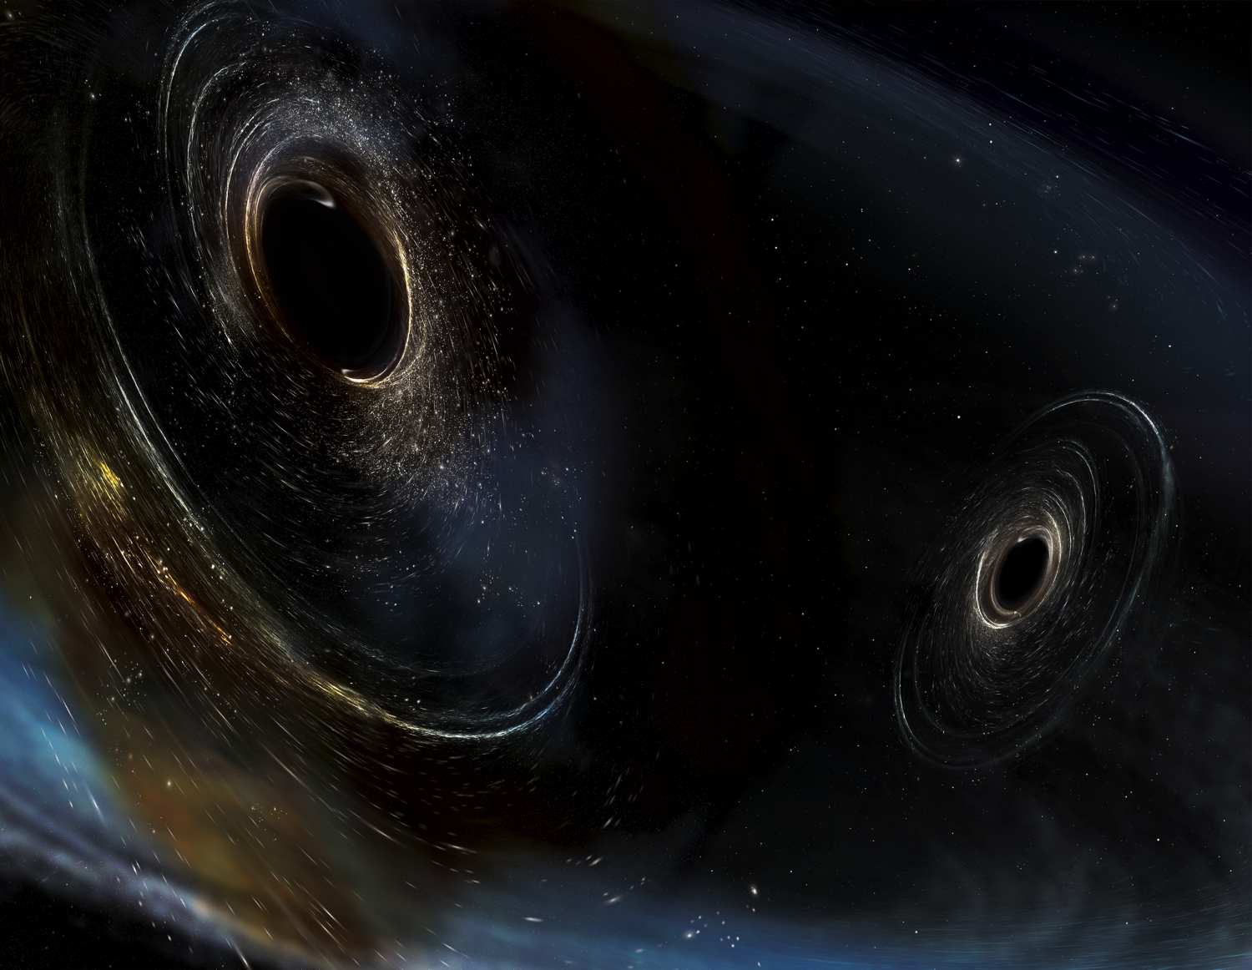



Alignment of the
LIGO Detectors
Calum Torrie, LIGO Laboratory
California Institute of Technology
International Workshop on Accelerator Alignment (IWAA) 2018
Image Credit: Aurore Simmonet/SSU

Slide 2














































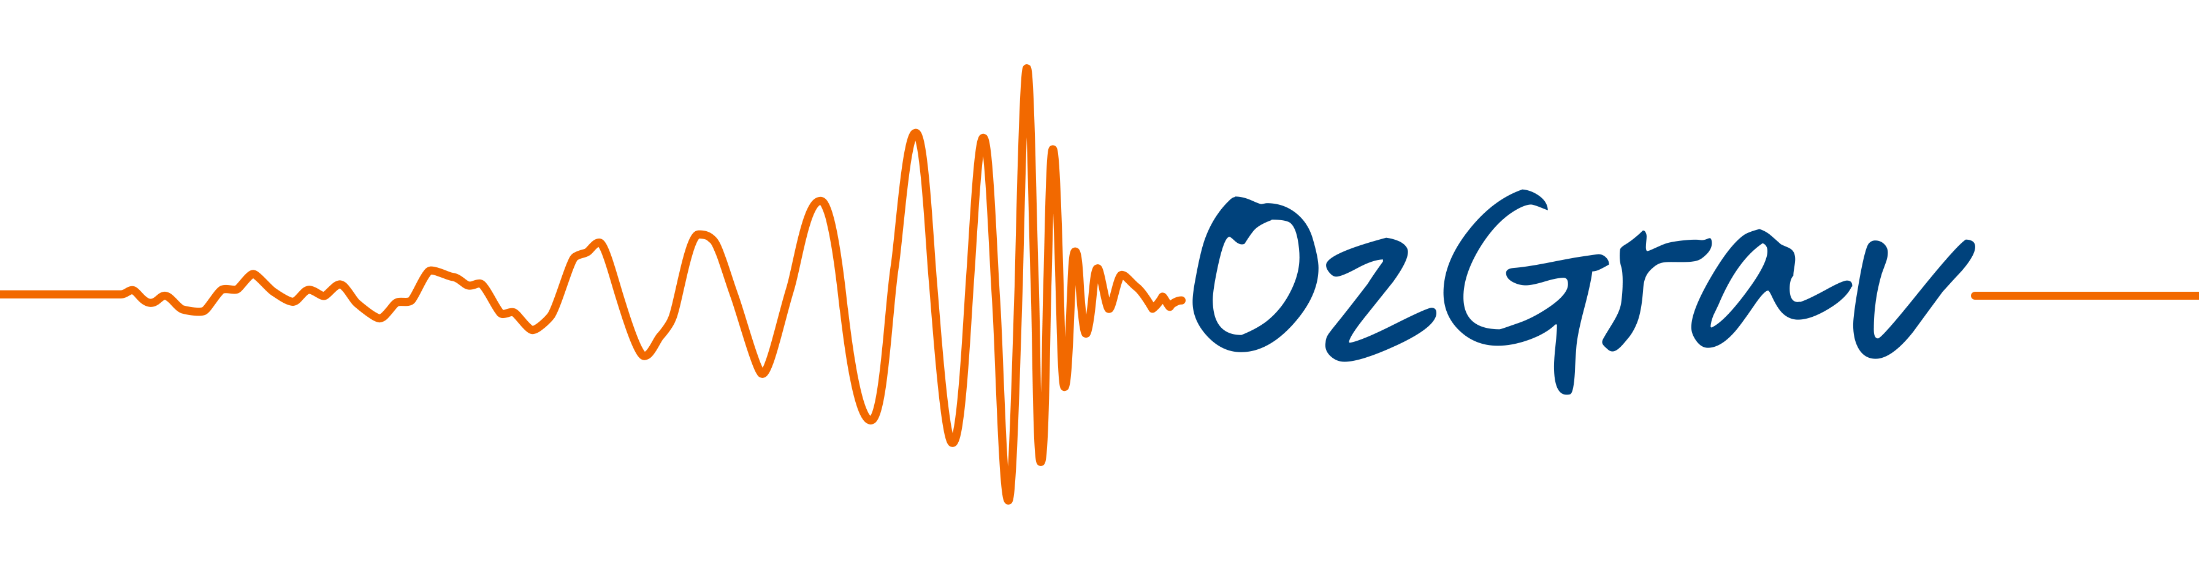
























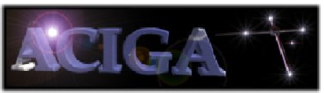































Credit to the LIGO Scientific
Collaboration
Abilene Christian University
Albert-Einstein-Institut
American University
Andrews University
Bellevue College
California Institute of Technology
California State Univ., Fullerton
California State Univ., Los Angeles
Canadian Inst. Th. Astrophysics
Carleton College
Chinese University of Hong Kong
College of William and Mary
Colorado State University
Columbia U. in the City of New York
Cornell University
Embry-Riddle Aeronautical Univ.
Eötvös Loránd University
Georgia Institute of Technology
Goddard Space Flight Center
GW-INPE, Sao Jose Brasil
Hillsdale College
Hobart & William Smith Colleges
IAP – Nizhny Novogorod
IIP-UFRN
Kenyon College
Korean Gravitational-Wave Group
Louisiana State University
Marshall Space Flight Center
Montana State University
Montclair State University
Moscow State University
National Tsing Hua University
NCSARG – Univ. of Illinois,
Urbana-Champaign
Northwestern University
Penn State University
Rochester Institute of Technology
Sonoma State University
Southern University
Stanford University
Syracuse University
Texas Tech University
Trinity University
Tsinghua University
U. Montreal / Polytechnique
Université Libre de Bruxelles
University of Chicago
University of Florida
University of Maryland
University of Michigan
University of Minnesota
University of Mississippi
University of Oregon
University of Sannio
University of Szeged
University of Texas Rio Grande Valley
University of the Balearic Islands
University of Tokyo
University of Washington
University of Washington Bothell
University of Wisconsin – Milwaukee
USC – Information Sciences Institute
Villanova University
Washington State University – Pullman
West Virginia University
Whitman College
LIGO Laboratory: California Institute of Technology; Massachusetts Institute of Technology;
LIGO Hanford Observatory; LIGO Livingston Observatory
Australian Consortium for Interferometric Gravitational Astronomy (ACIGA):
Australian National University; Charles Sturt University; Monash University; Swinburne University; University of Adelaide; University of Melbourne; University of Western Australia
German/British Collaboration for the Detection of Gravitational Waves (GEO600):
Albert-Einstein-Institut, Hannover; Cardiff University; King's College, University of London; Leibniz Universität, Hannover; University of Birmingham; University of Cambridge;
University of Glasgow; University of Hamburg; University of Sheffield; University of Southampton; University of Strathclyde; University of the West of Scotland; University of Zurich
Indian Initiative in Gravitational-Wave Observations (IndIGO):
Chennai Mathematical Institute; ICTS-TIFR Bangalore; IISER Pune; IISER Kolkata; IISER-TVM Thiruvananthapuram; IIT Madras, Chennai; IIT Kanpur;
IIT Gandhinagar; IPR Bhatt; IUCAA Pune; RRCAT Indore; University of Delhi

Slide 3
Topics
Gravitational Waves
Precision Measurement
Discoveries
Focus on Alignment

Slide 4

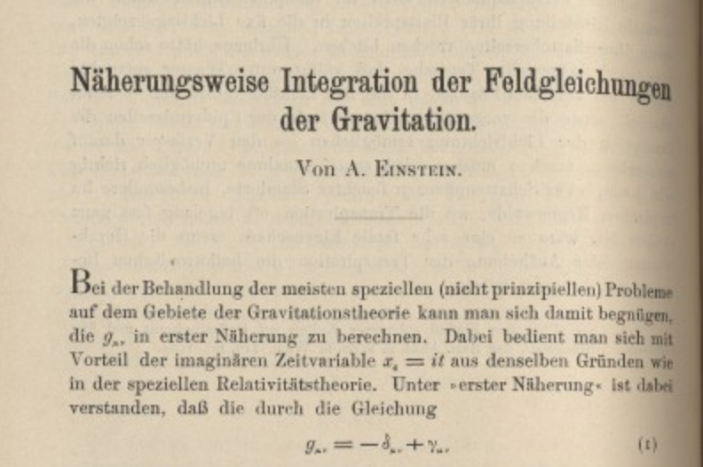
General Relativity and Gravitational Waves
2016 was the centenary of Einstein’s General Relativity
A geometric theory:
  Gravitation arises from curvature of space-time
  Curvature arises from matter, energy
Bizarre, but so far completely successful, predictions:
  Perihelion shift, bending of light, frame dragging, gravitational redshift, gravitational lensing, black holes,…
One key prediction remained elusive until September 14th 2015:
Gravitational Waves
A. Einstein, Näherungsweise Integration der Feldgleichungen der Gravitation, 1916

Slide 5
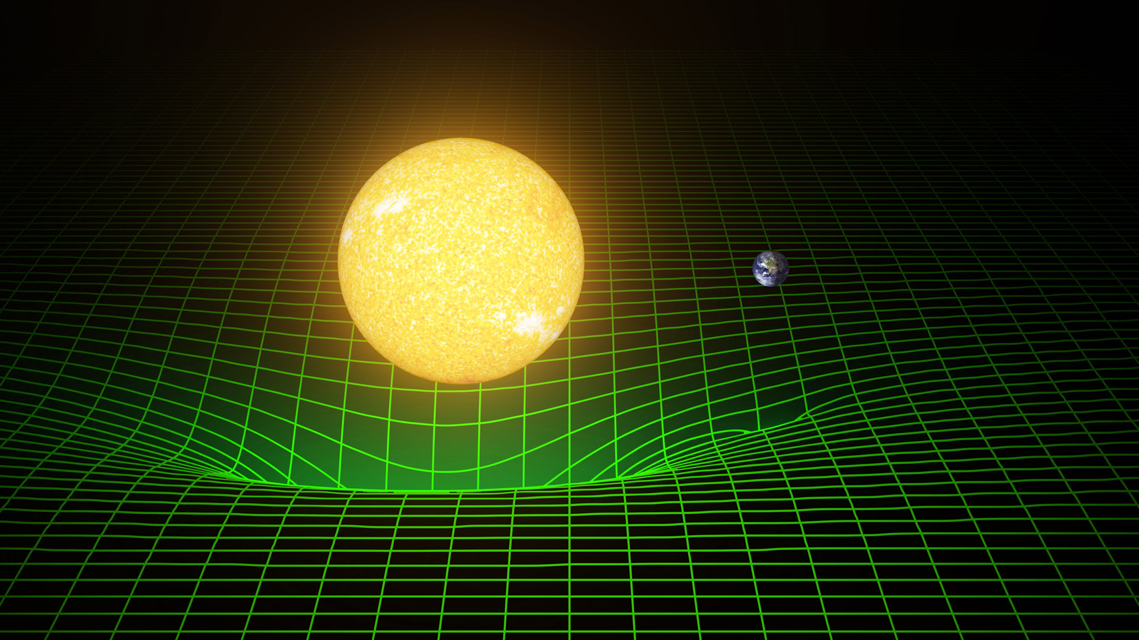
Gravity & Curved Space-time

Slide 6
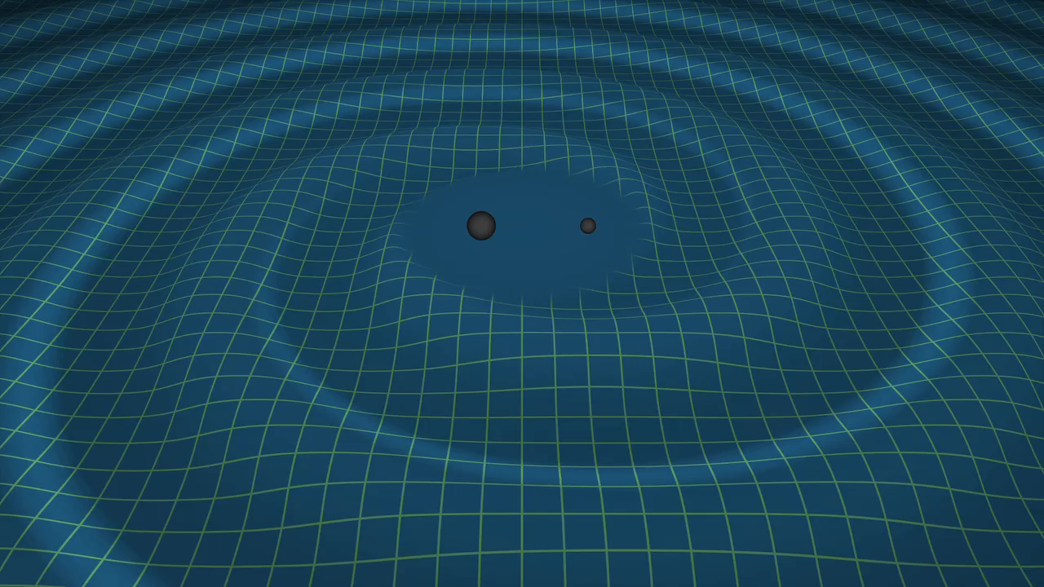
Gravitational Waves
Credit: LIGO/Tim Pyle

Slide 7

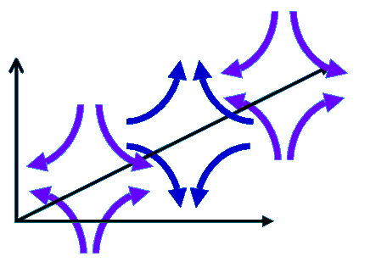
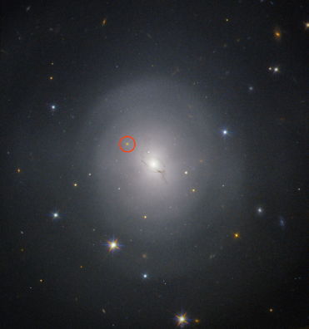
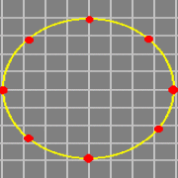
Detecting the effects
GW’s produce time-varying transverse strain in space
→ Monitor separations of free test particles
(Earth)
In a galaxy far far away…
NGC4993
European Southern Observatory
Very Large Telescope

Slide 8

Michelson interferometer
Graphic: M. Evans, MIT
Inertial test body
Inertial test body
L_{y}
L_{x}
LASER
Beamsplitter
Photodetector

Slide 9
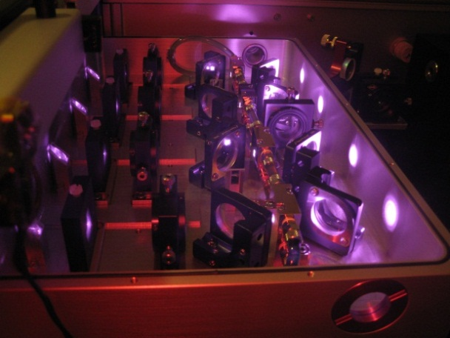
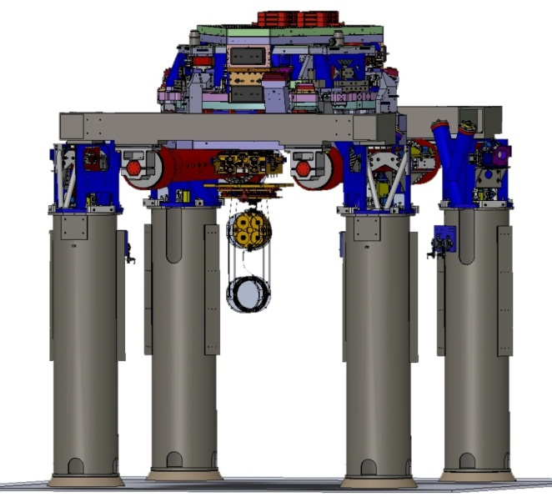
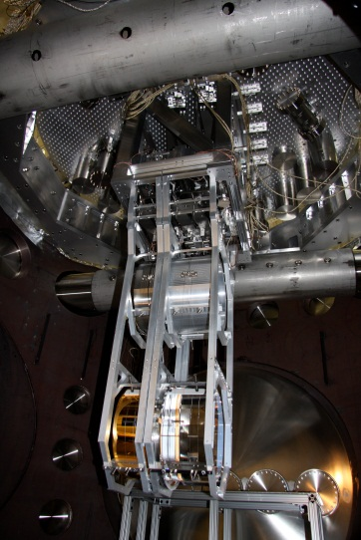
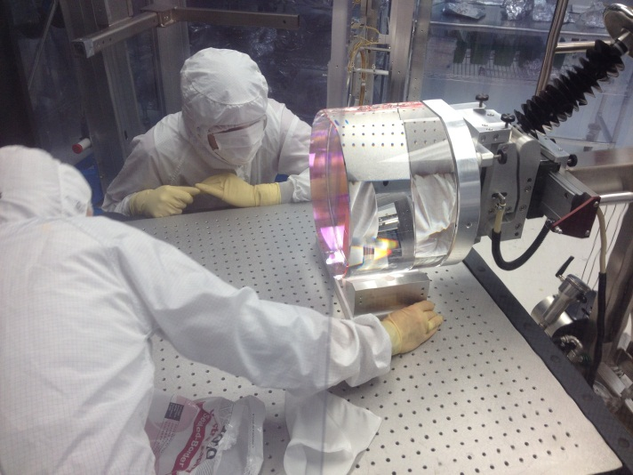
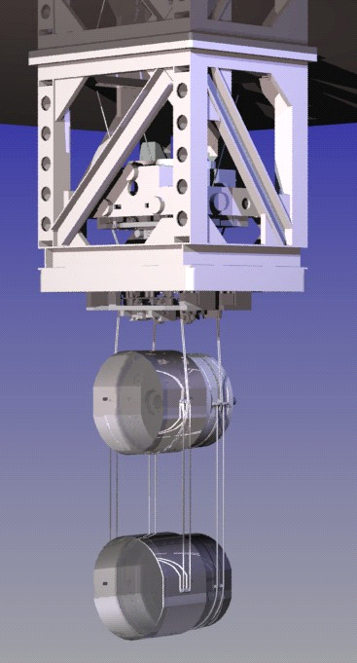
LIGO’s Interferometer
The interferometer core optics are suspended so that they are vibrationally isolated and free to respond to the passing GW
Powerful lasers (200W)
Each core optic is actively controlled in longitudinal position and tip & tilt
In order to reduce in band injection of noise the core optic actuation is limited in range, so initial alignment must be accurate
Large 40 kg mirrors with highly reflecting coatings
Notes:
1064 nm CW Laser

Slide 10
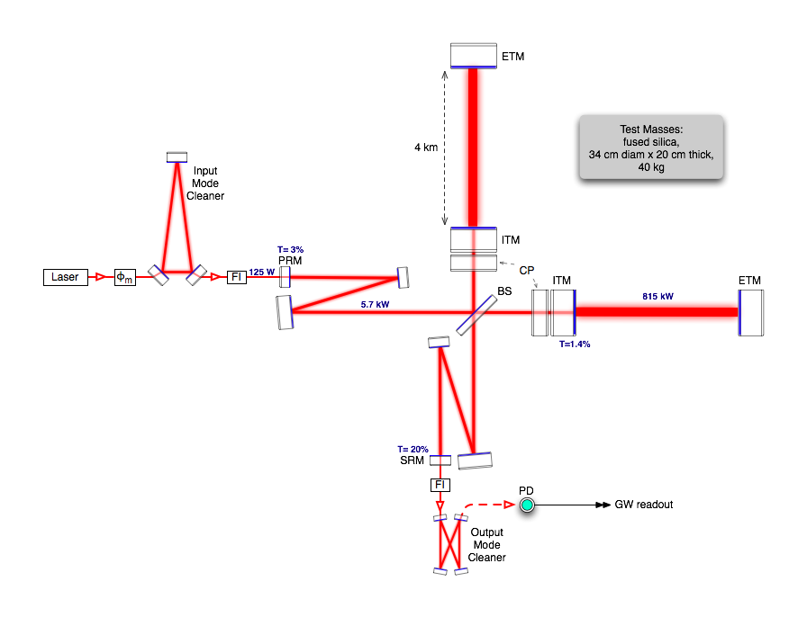
LIGO’s Optical Configuration
Graphic: M. Evans, MIT
Coupled Optical Cavities:
  Power Recycling Cavity (PRC)
  Signal Recycling Cavity (SRC)
  Arm Cavities
Y-ARM
PRC
X-ARM
SRC
The actuation allows for fine alignment to correct for initial alignment errors & drift
Will come back to optic alignment at a later slide …
Once the interferometer is "locked" on an optical cavity resonance, wavefront sensors can measure tip/tilt errors relative to the optical cavity axis for feedback control
The LIGO Scientific Collaboration: B. Abbott, et al
General Relativity and Quantum Cosmology
https://arxiv.org/abs/0711.3041
Notes:
4 km of beamtube in each arm
11 Chambers each with many optics / isolation platforms
Laser in mode-cleaner 1-2 mm beam radius 2 kW/mm^2 power density
Laser in arms 6cm beam radius 96 W/mm^2 power density

Slide 11
A “small” problem…
A wave’s strength is measured by the strain induced in the detector,
We can calculate expected strain at Earth;
If we make our interferometer arms 4,000 meters long,
!!
A ten-thousandth the size of an atomic nucleus

Slide 12
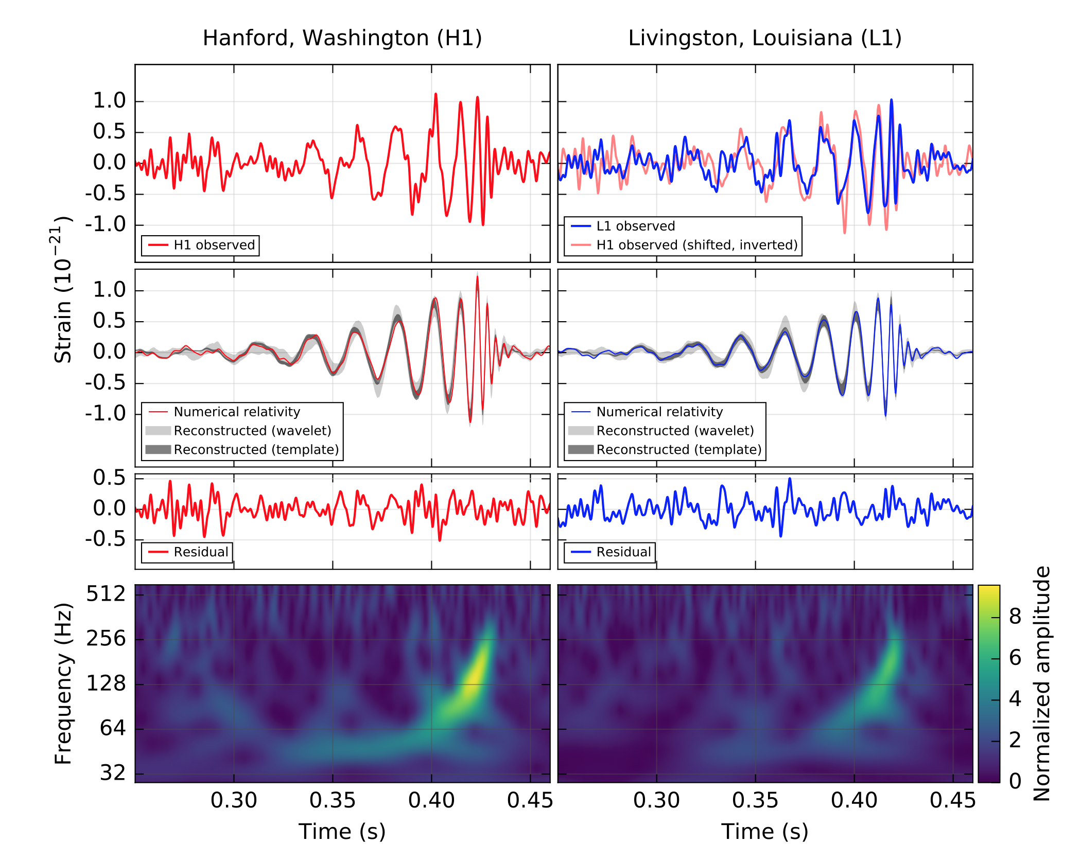
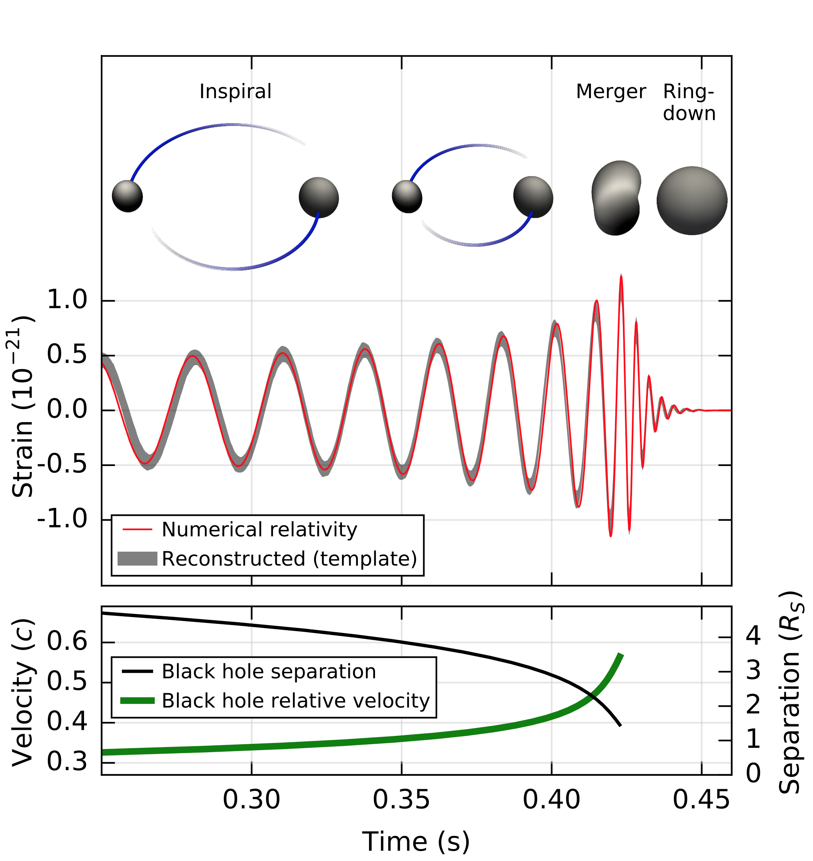
First direct detection of the inspiral and coalescence of a Black Hole Pair
(14 Sep 2015) GW150914
29M and 36M black holes 1.3 billion light years away inspiral and merge, emitting 3M of gravitational wave energy and briefly “outshining” the entire universe
Time resolution of event is ~0.1 ms
Abbott et al Phys. Rev. Lett. 116 (2016) 061102

Slide 13
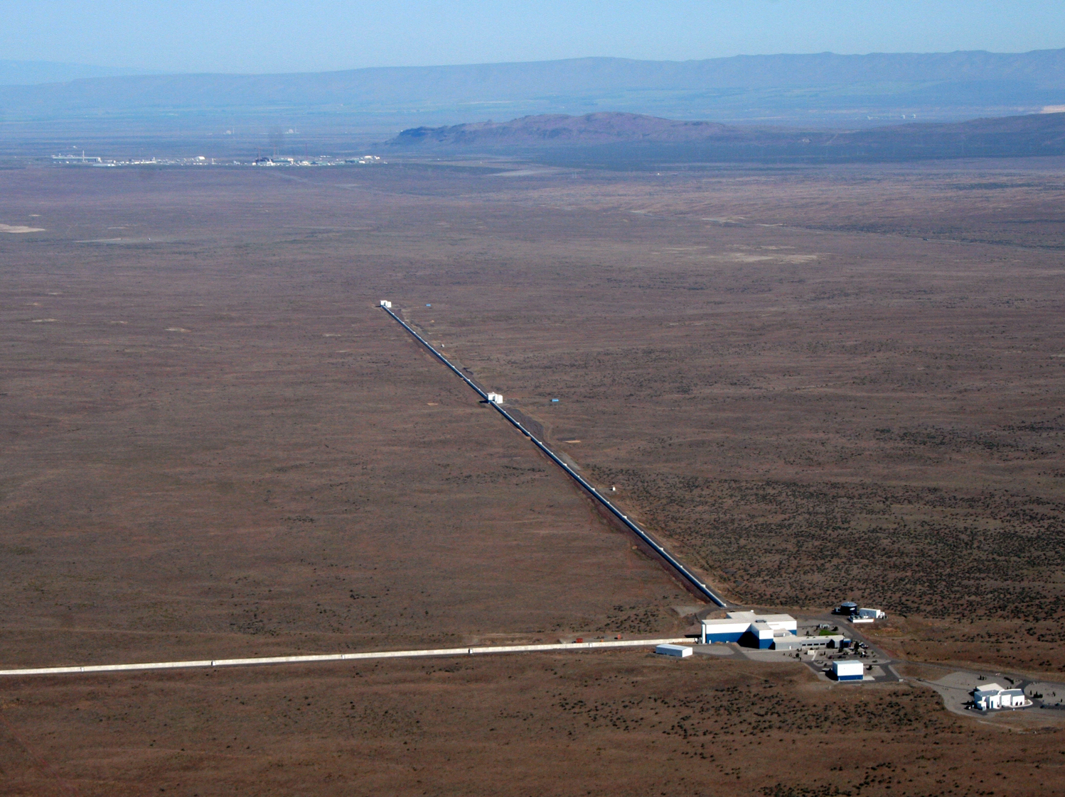
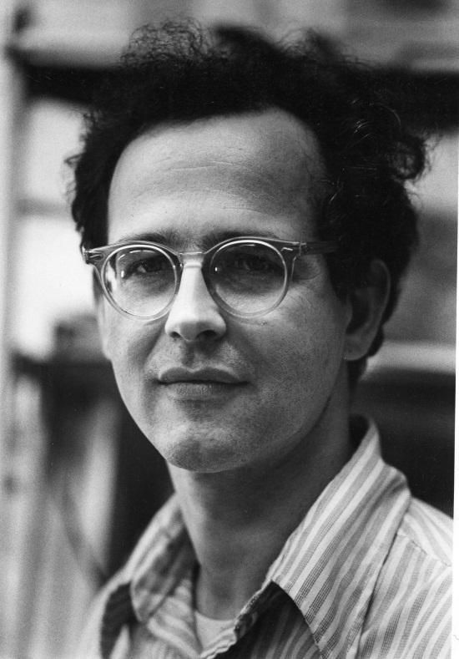
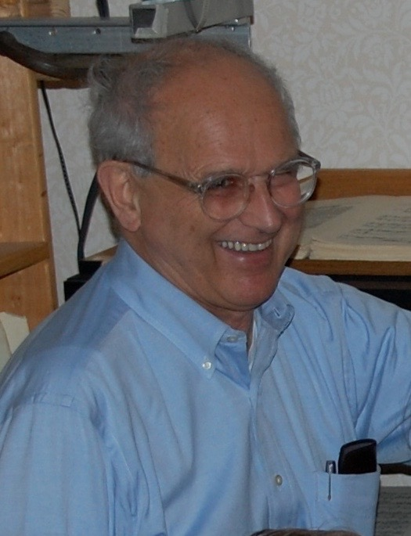



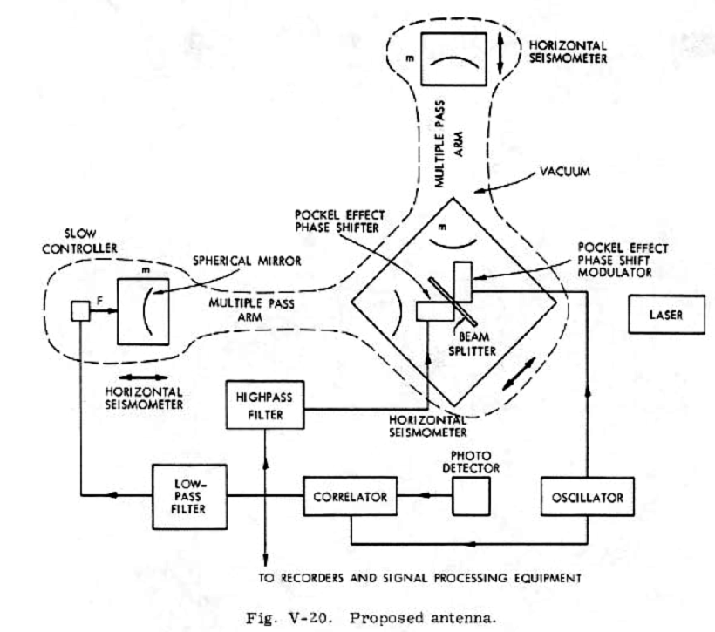

Interferometric GW Detection
the LASER Interferometer Gravitational-wave Observatory
Rai Weiss, MIT
LIGO Proposal to the NSF 1989, https://dcc.ligo.org/LIGO-M890001/public

Slide 14
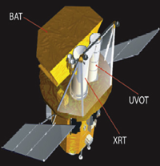
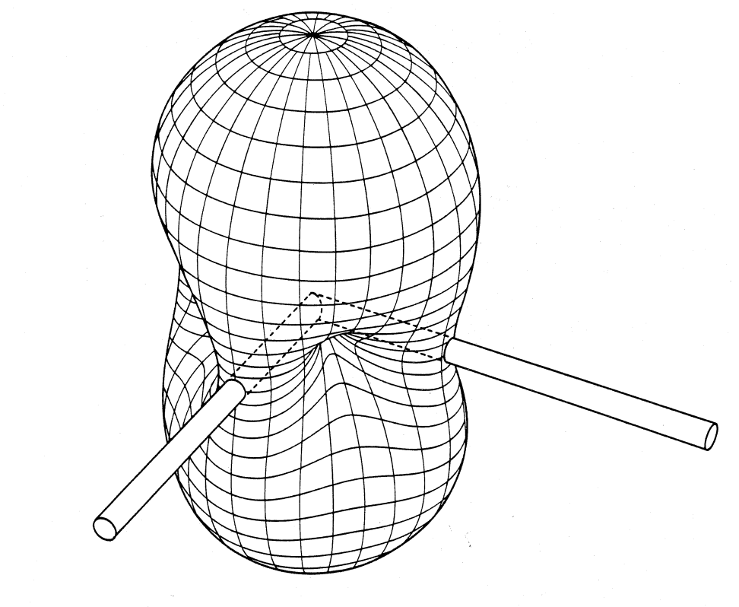
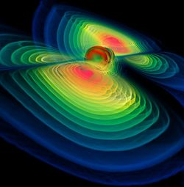
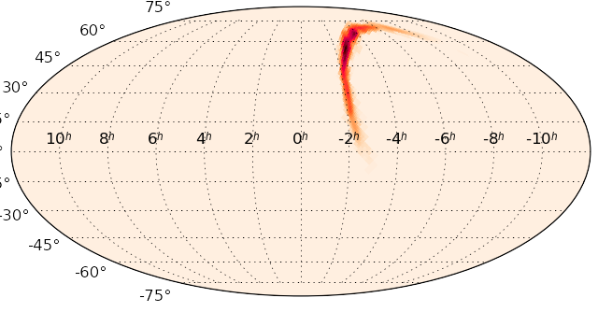

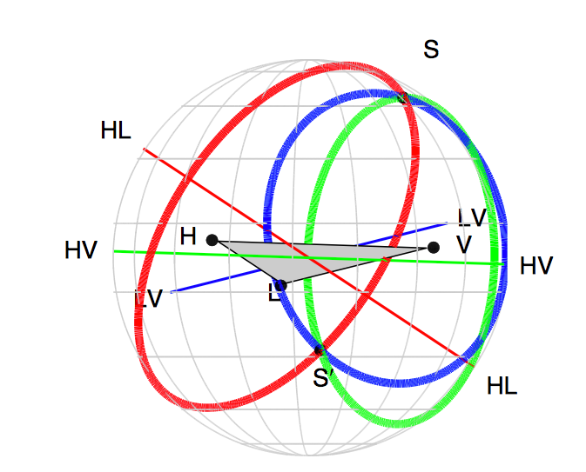
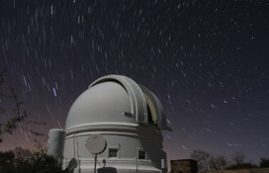
Network Aperture Synthesis and EM Source Follow-up
Image: W. Benger
Swift
Satellite
Sky map
X-ray, γ-ray
follow-up
Each detector is
~omnidirectional
LIGO
Hanford
Virgo
Arrival time
triangulation
Optical
follow-up
LIGO
Livingston
Palomar Transient
Factory
http://earthobservatory.nasa.gov/
(t_{L},t_{H},t_{V})
Notes:
Each Detector is ~ omnidirectional.
"With this triangulation, we can locate the source that is emitting these gravitational waves, and this is important because we expect that many such merger events emit other messengers, such as light, x-rays, radio waves, neutrinos, or other sub-atomic particles. These can be studied by both astronomers and astroparticle scientists.“

Slide 15
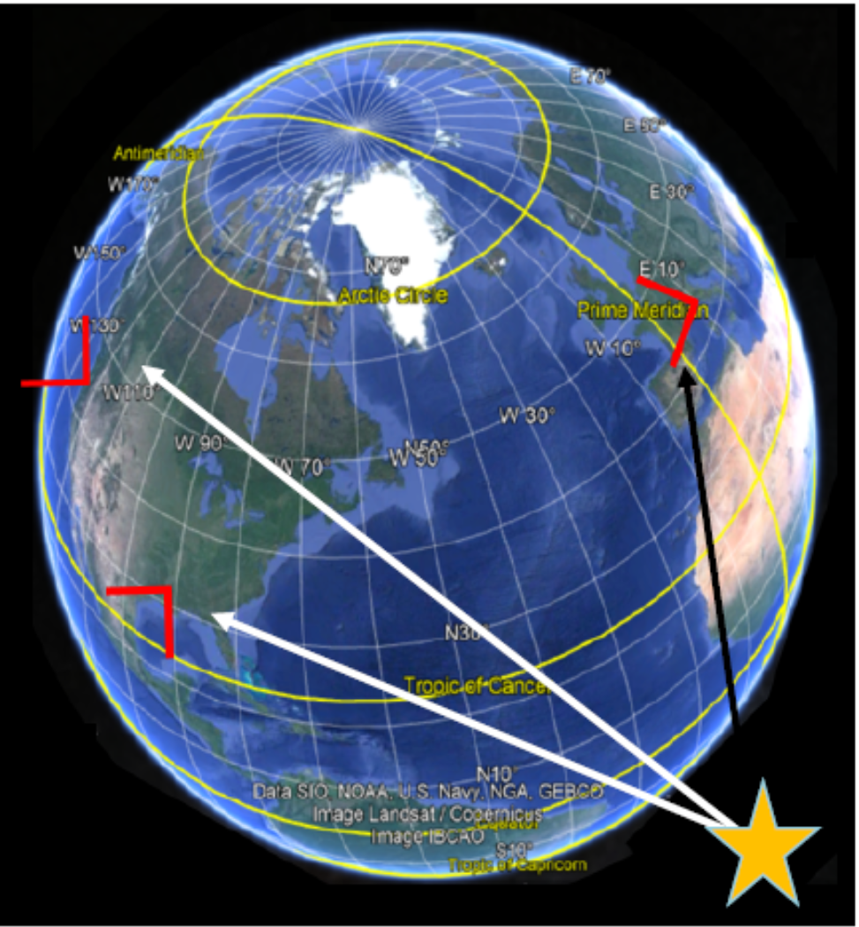
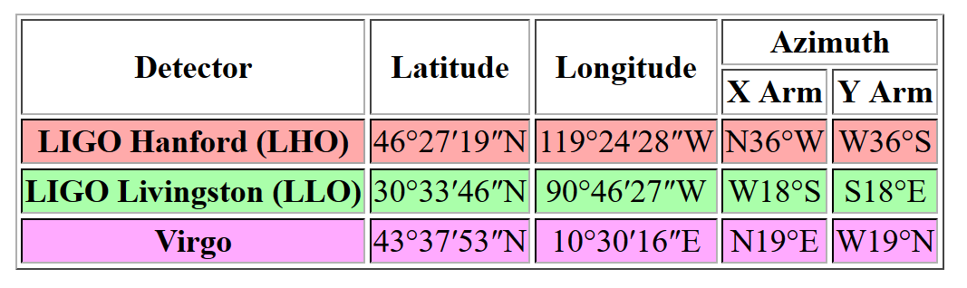
Source “Triangulation”
Indicates the direction of the arms relative to local north.
Each detector is
~omnidirectional
Arrival time
triangulation
Interferometer Angular Orientation
  Sensitivity changes only in 2nd order to arm deviation from orthogonality
  Coincident sensitivity changes only in 2nd order relative to angular misalignments
  0.5 deg error in either arm orthogonality or relative orientation between the observatories results in only a ~10 ppm sensitivity decrease
  Not just “triangulation” – also use two waveform polarizations and astrophysical constraints
Notes:
In addition to better localizing the gravitational wave source, the participation of Virgo means that the polarization of the waves can be studied. Like other kinds of waves, gravitational waves oscillate in specific directions. Both of LIGO’s detectors are oriented in similar ways, so they were unable to sense the oscillation direction. Virgo is oriented in a way complementary to LIGO, so analysis of signals from the three detectors can reveal information about the polarization. With this information, even more stringent tests of general relativity should become possible.

Slide 16
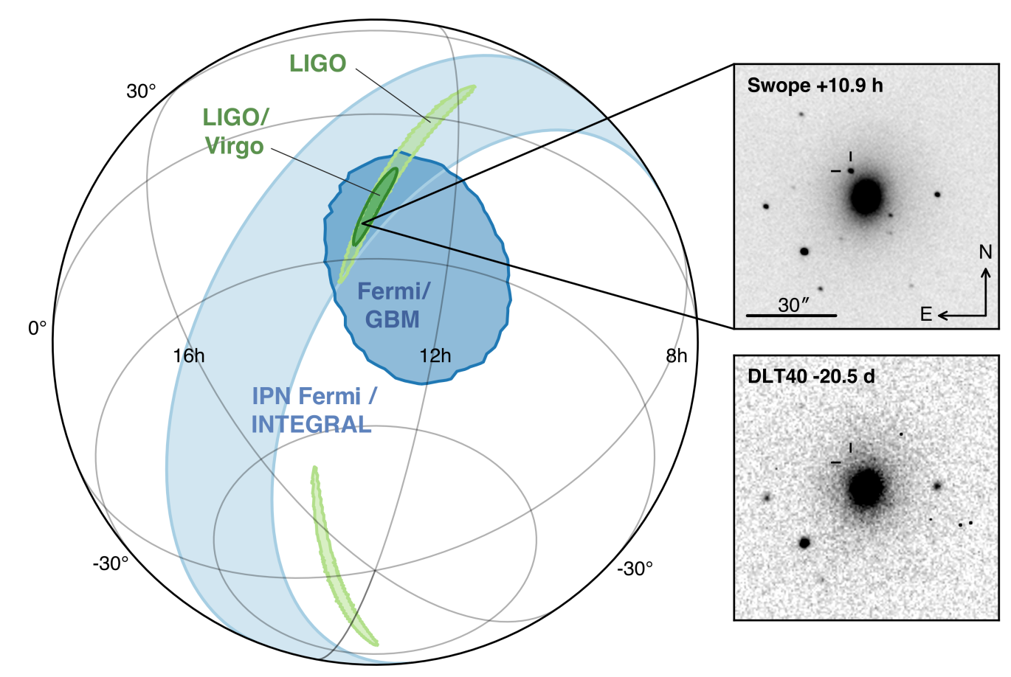
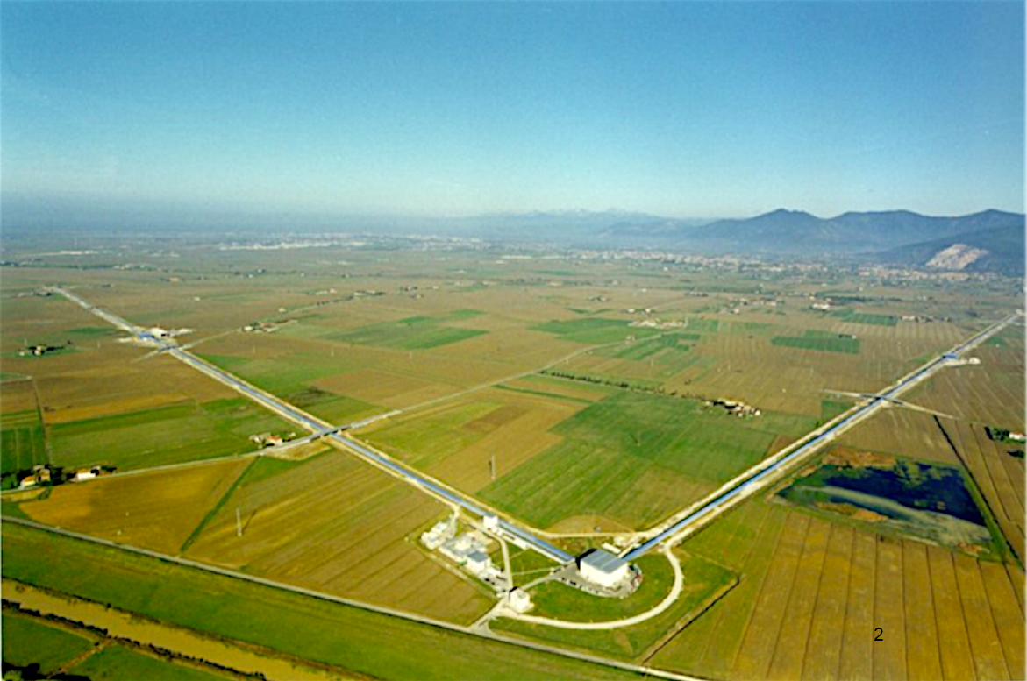
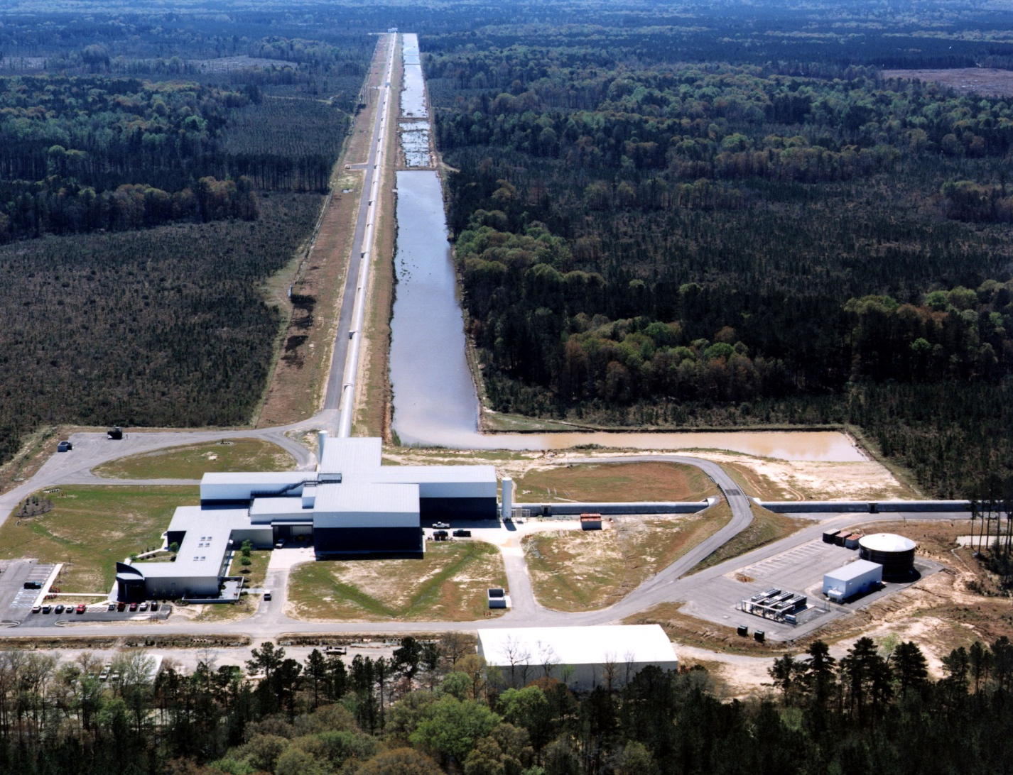
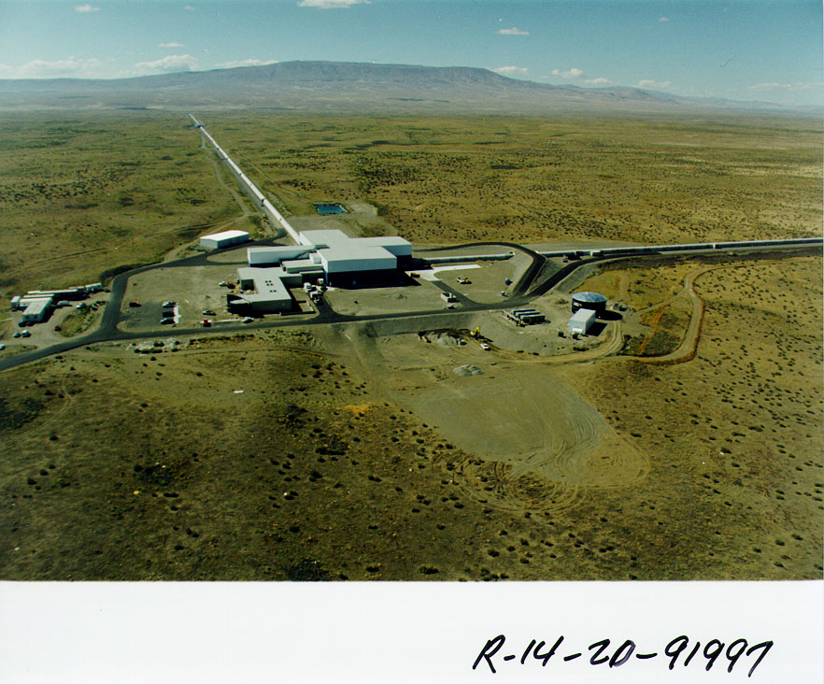
Source “Triangulation”
LIGO
Livingston, LA
Virgo
Cascina, Italy
7900 km (25 ms)
8200 km (27 ms)
3000 km (11 ms)
Abbott et al. Ap. J. Lett., 848:2 (2017)
LIGO
Hanford, WA
Observatory-to-Observatory baseline distance accuracy
  Data timing accuracy (1 usec, derived from GPS, checked by atomic clock) x Light Speed = ~300 m
  Actual waveform (signal) timing accuracy is ~0.1 ms (SNR = 10)
  GPS provides baseline accuracy (~5 m) << required

Slide 17

Beam Tube Alignment
  Requirement to maintain a 1m clear aperture through the 4 km long arms
  A straight line in space varies in ellipsoidal height by 1.25 m over a 4km baseline
A maximum deviation from straightness in inertial space of 5 mm rms
An orthogonality between arm pairs of better than 5 mrad
This quality of alignment comfortably meets LIGO requirements
Notes:
The interferometer plane was chosen to minimize construction costs determined by the local topography such that the global coordinate system lies in a plane locally tangent to the WGS-84 model within the triangle defined by the 4 km arms. Deviations between the local zenith and z_{G} up to 0.63x10⁻³ rad.

Slide 18
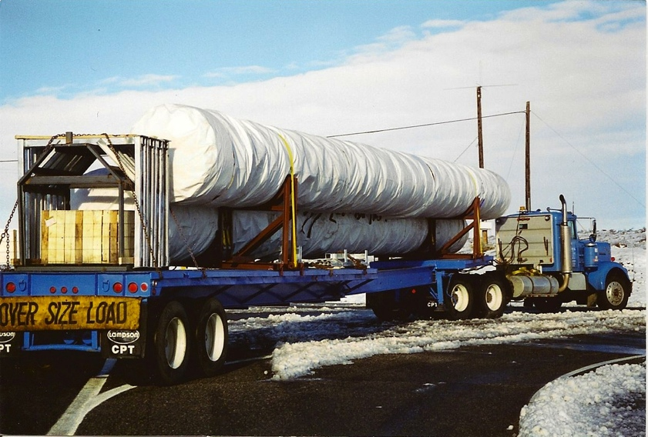
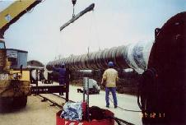
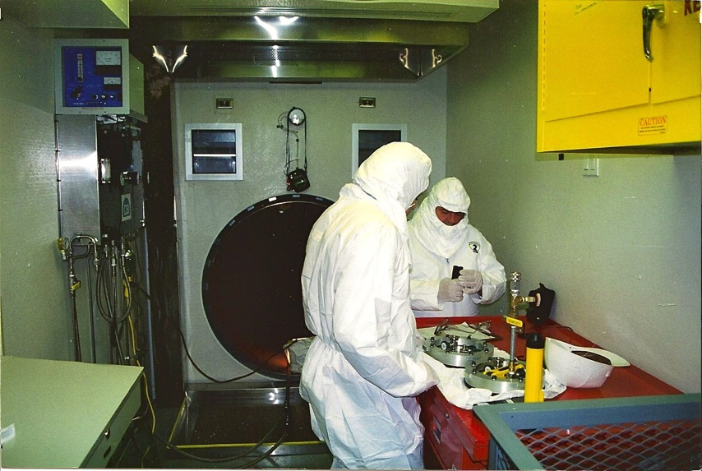
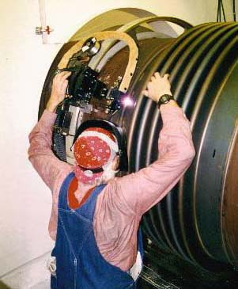
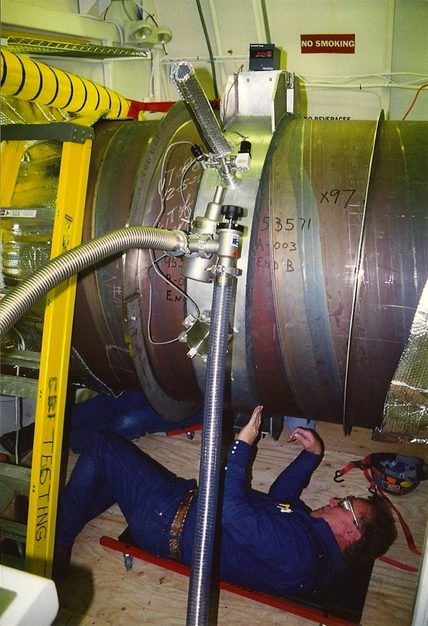
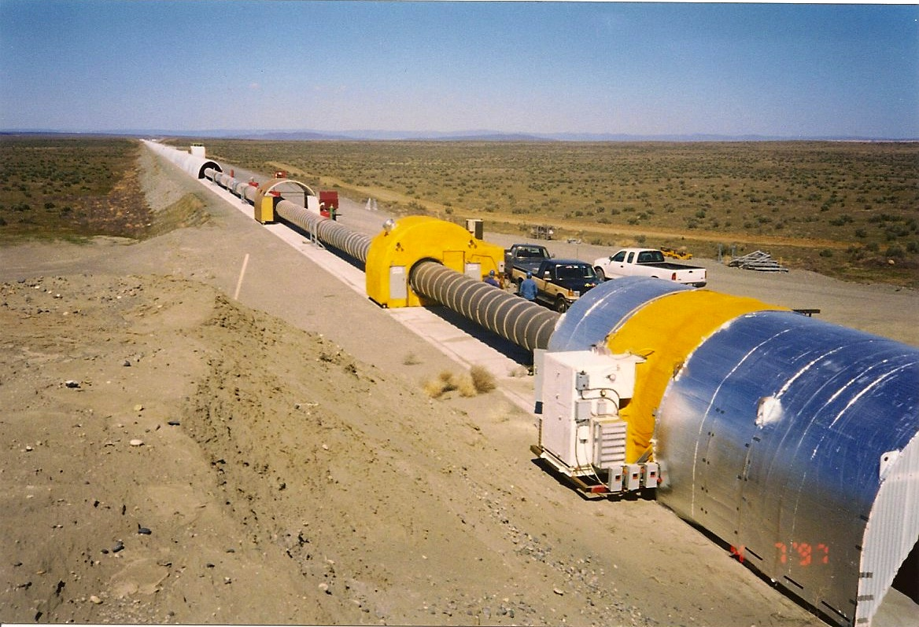
Field assembly of the beam tubes
The alignment of the LIGO system was done using dual-frequency differential GPS
The BT’s are fabricated from 3 mm thick, spirally welded 304L stainless steel in 20 m sections.
4x controlled interface points were defined along each arm.
These points were identified by monuments having measured geodetic coordinates.
Beam tubes were aligned using dual-frequency differential GPS, 5 mm/4 km straightness*
See Rev. Sci. Instr. V 72, No. 7 p 3086, July 2001.
Position
Transport
Position
Transport
Field fitup
Field
Add next section
Butt weld
Leak check
Add next section

Slide 19
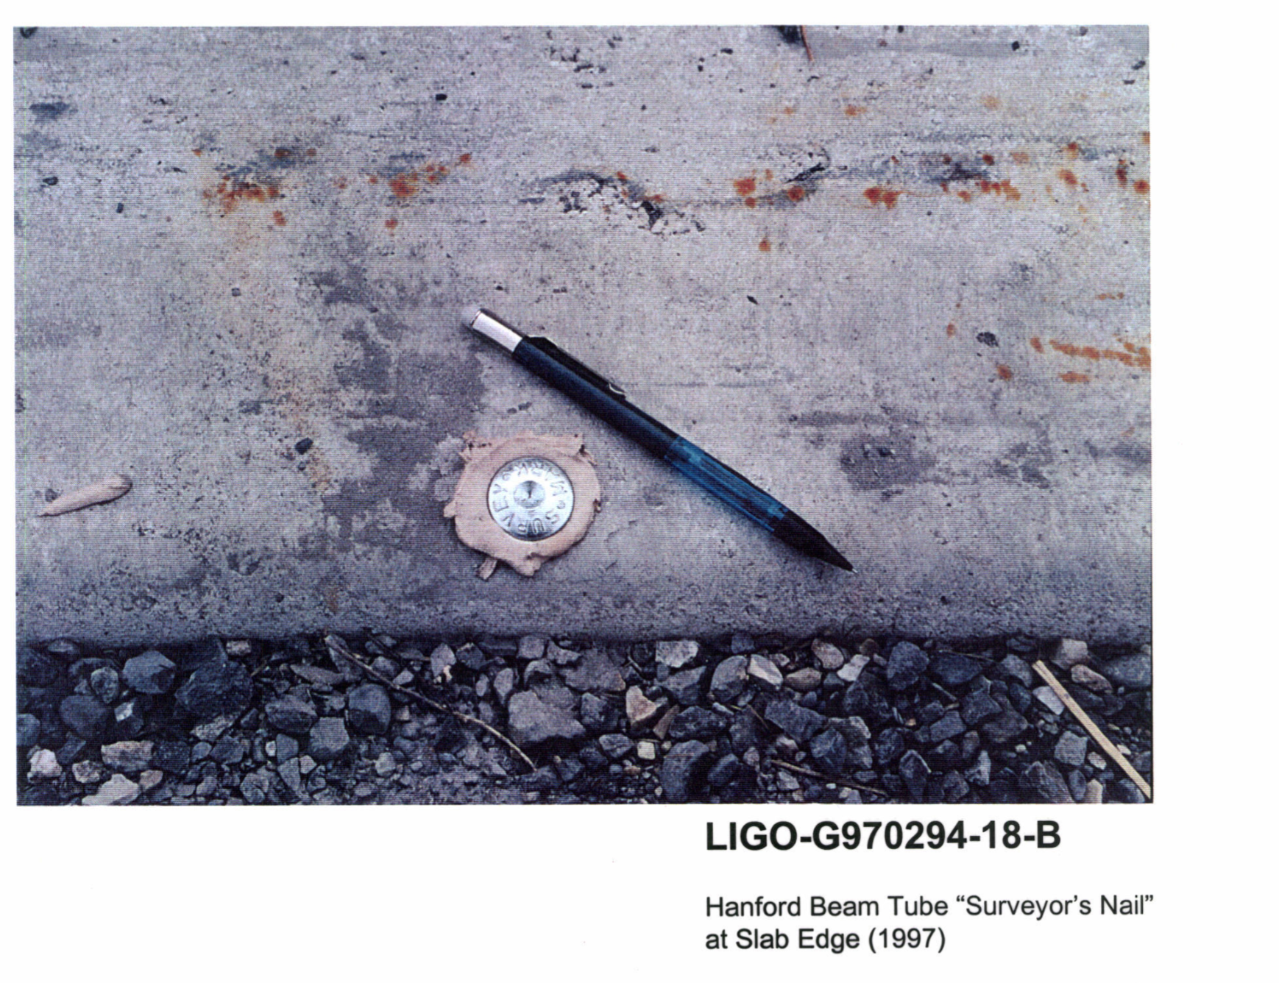
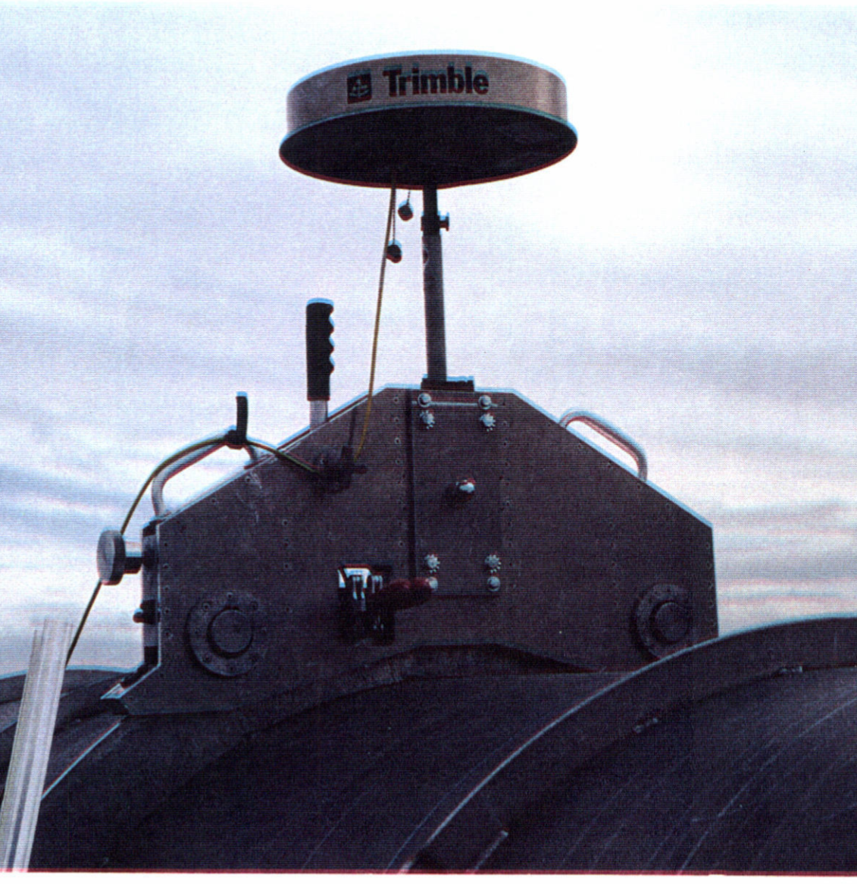
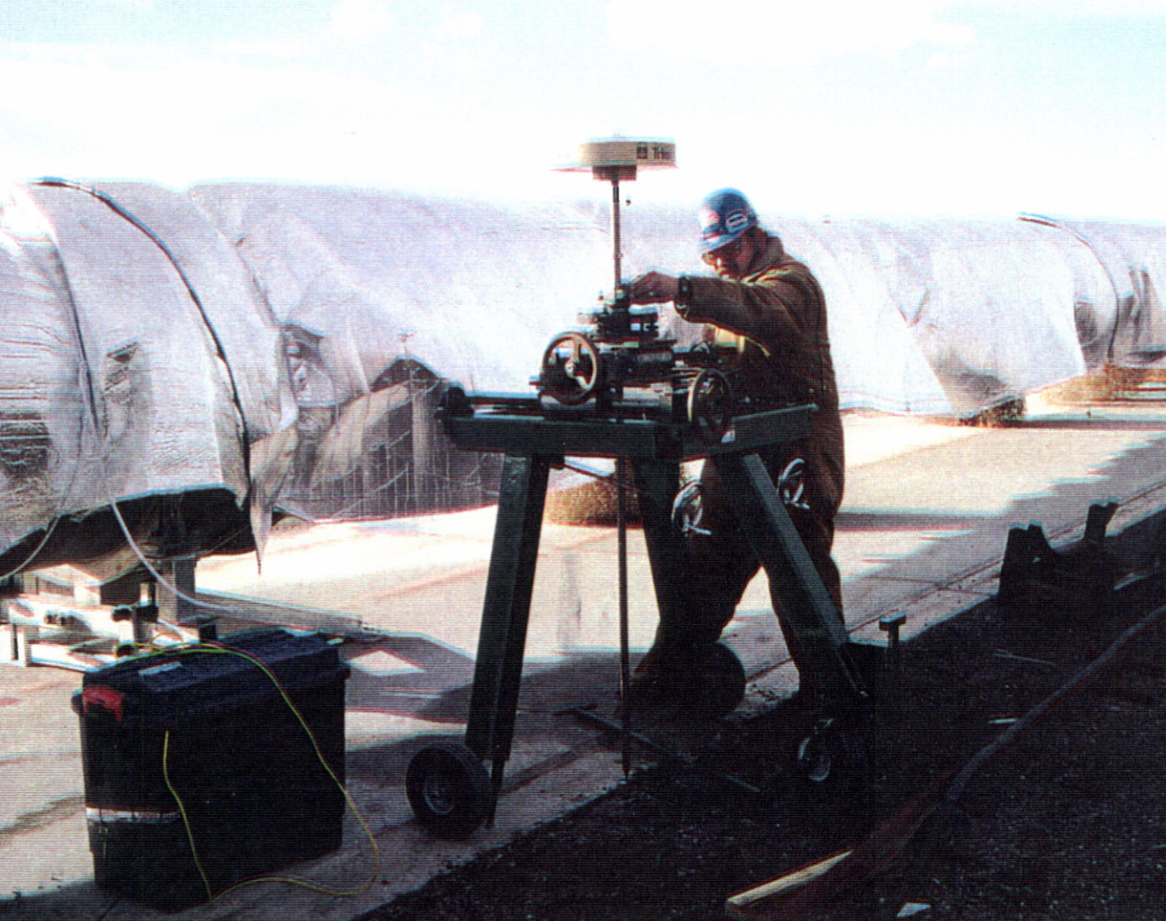
Beam Tube Alignment
Final Alignment (images from)
GPS Antenna Mounted on the Beam Tube Support Ring
GPS Antenna Cart (equipped with linear bearings & a plumb alignment with a fixed height antenna rod) checking Position of Beam Tube "Surveyor's Nail
GPS Antenna Mounted on Beam Tube Support Ring (1997)
GPS Antenna Cart (equipped with linear bearings & a plumb alignment with a fixed height antenna rod) checking Position of Beam Tube "Surveyor's Nail“.
Notes:
Surveyor’s nail or PK nail – shanked nail with indentation in the middle of the head, driven into the ground to mark a position precisely.

Slide 20
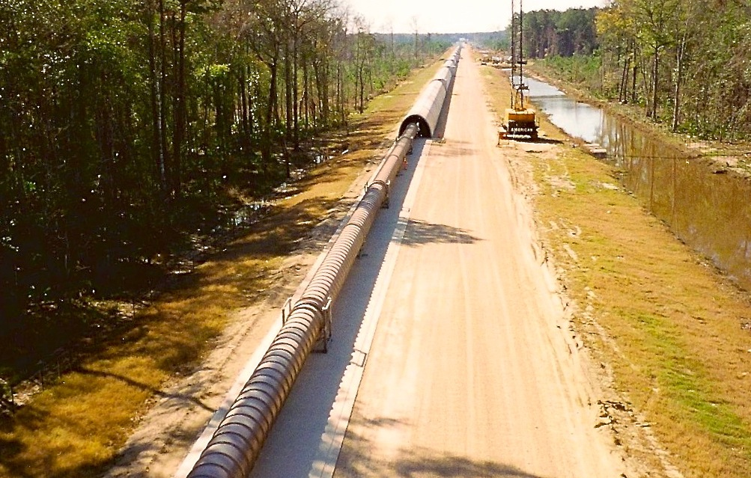
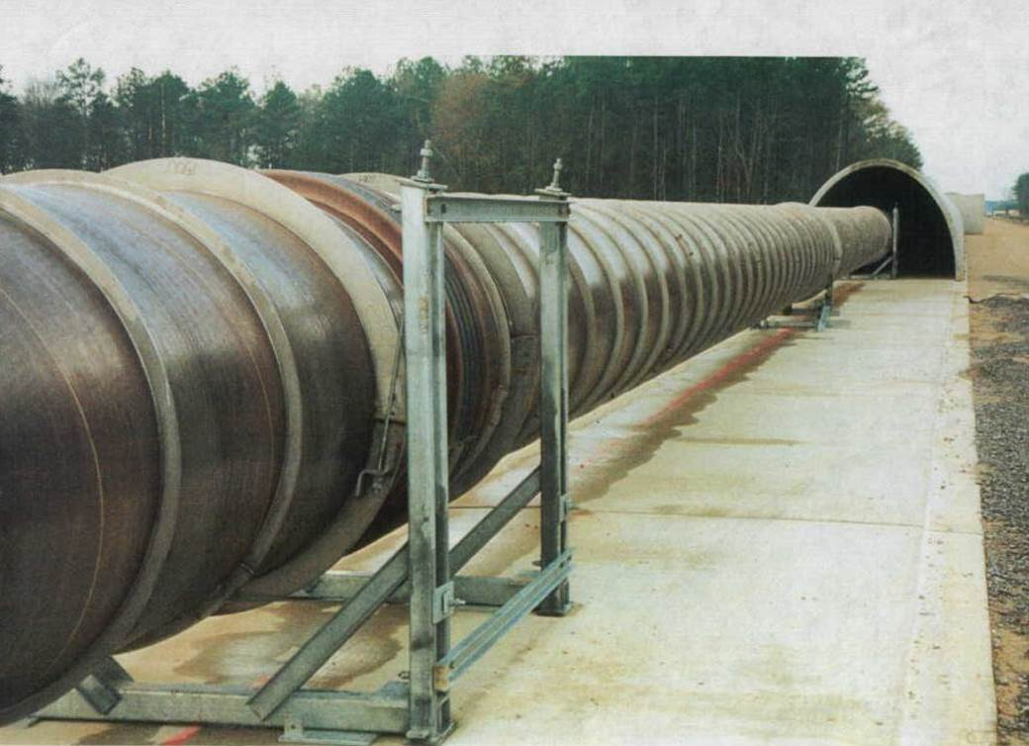
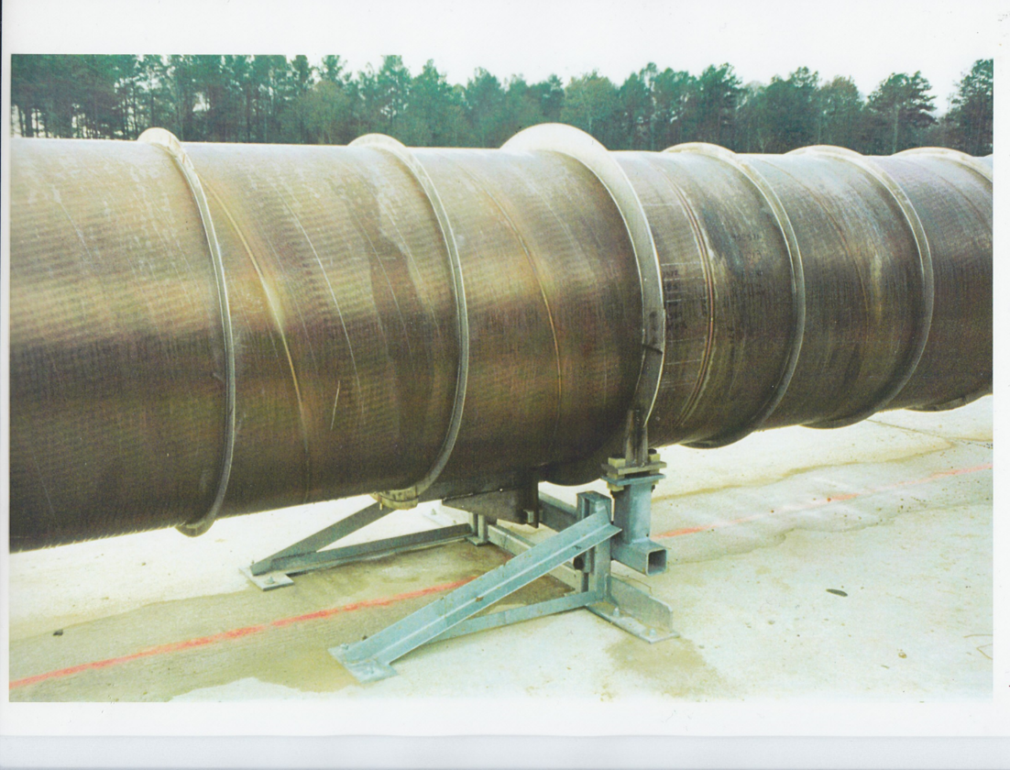
Beam Tube Alignment
Beam Tube Support
Final Alignment
Supports were aligned for the final time after installation had proceeded for three to four sections, i.e., 80 m from the installation activity.
This was just before the beam tube became covered by cement enclosures.
Beam Tube Support
Notes:
LIGO beam tubes
9000 m³ volume
30000 m² surface area
50000 m of spiral welds
~10⁻⁹ Torr operating pressure

Slide 21
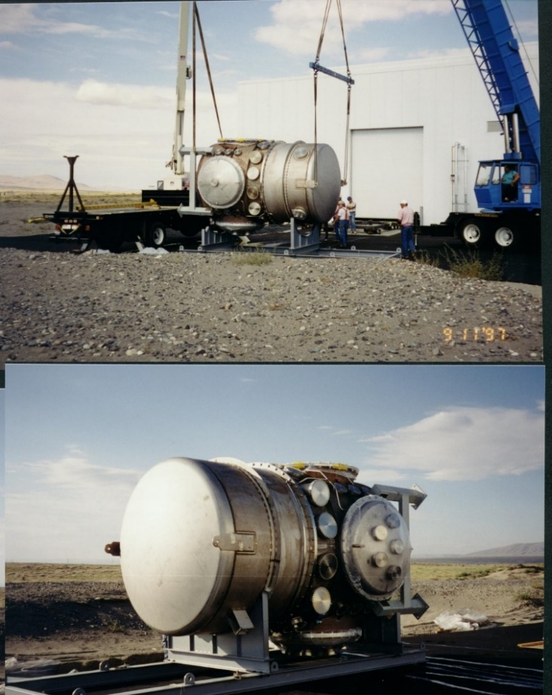
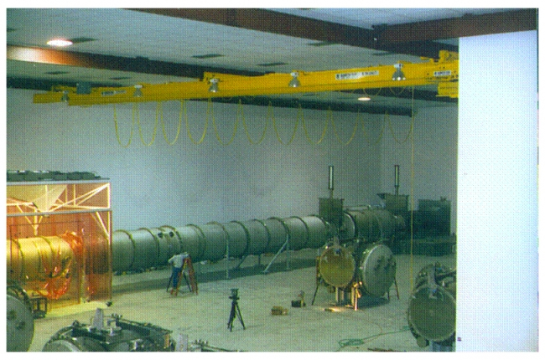
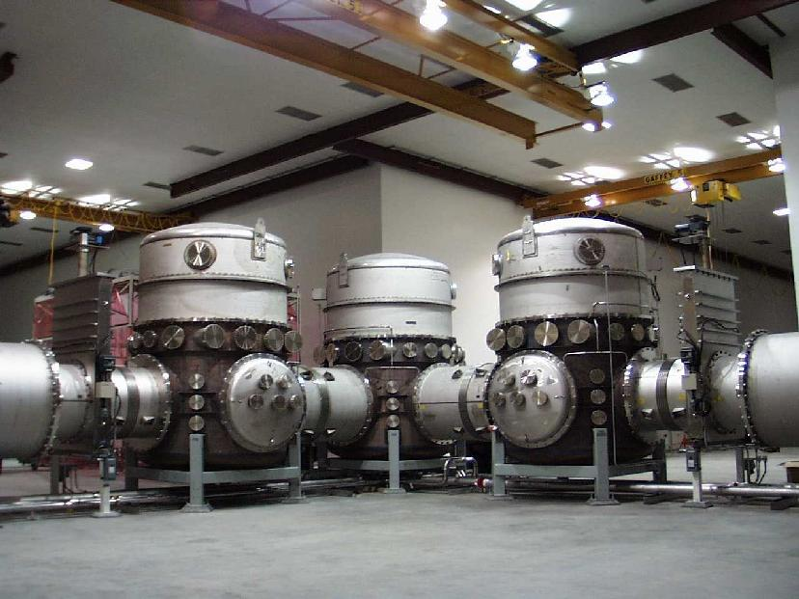
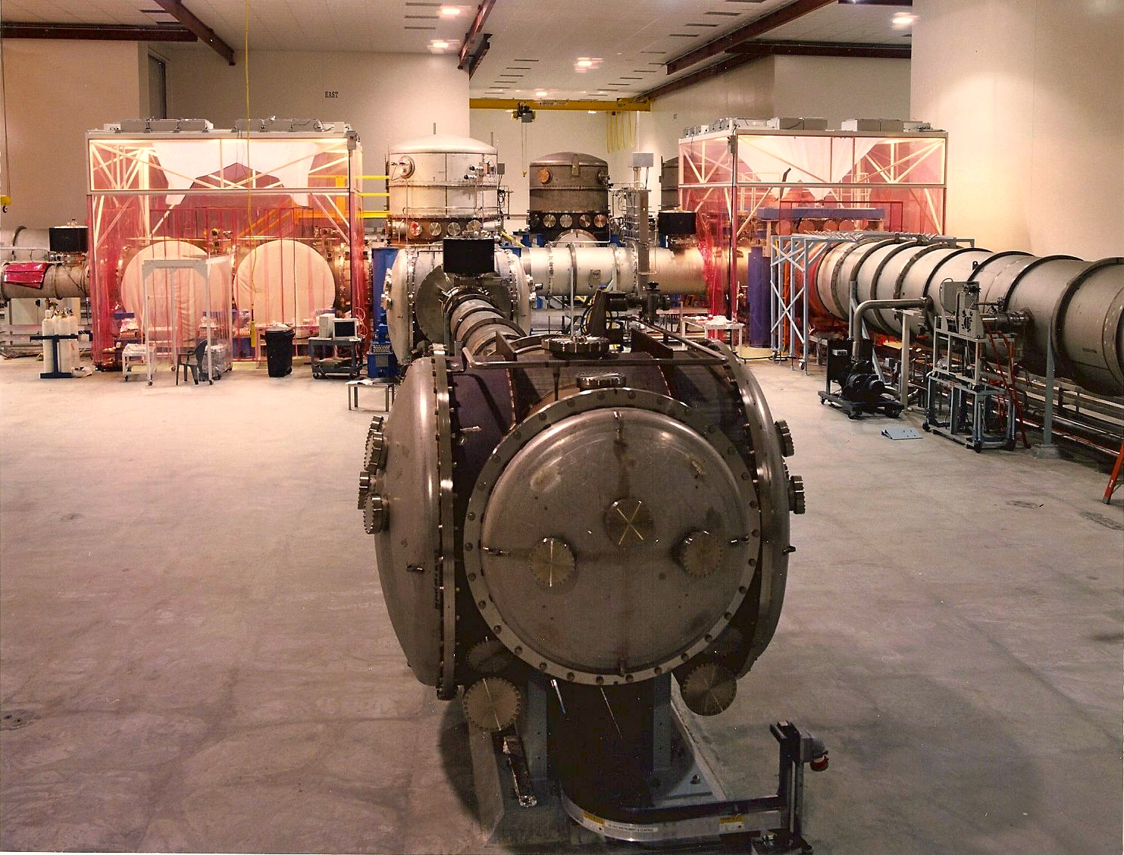
Chamber Alignment
Chambers house complex primary as well as input/output optic suspension systems / fixed mirrors
X and Y – Azimuth “Offset” monuments were established from the existing monuments used to position the beam tubes.
These axial and transverse positional coordinates are referenced to the global coordinates set, by conventional optical survey techniques
HAM Chambers
BSC Chambers at the Vertex

Slide 22
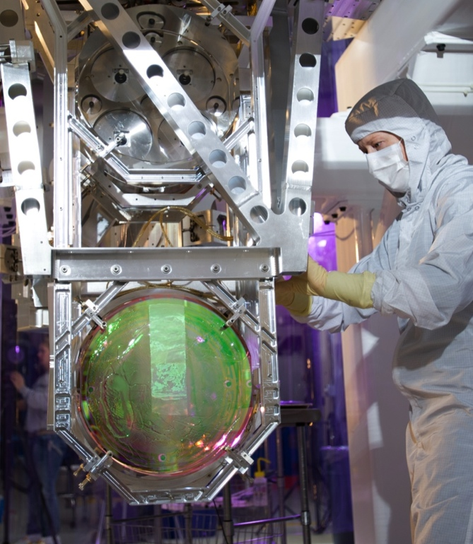
IFO Alignment: Modes of Operation
Initial Alignment Mode
Adjust input beam direction to go down the beamtubes and be centered on the optics
Pre-align (“dead reckon”) main optics without optic actuation based on optical survey (100 µ rad)
Static initial alignment of main optics using actuation (acquisition tolerance 0.5 µ rad)
Acquisition Alignment Mode (allows IFO locking)
Holding mode: main optics are held within the acquisition alignment tolerance continuously during the lock acquisition procedure
Detection Mode
sense and control alignment of the IFO (3 nrad rms)
sense and control centering of the beams of the main optics
Diagnostic / Calibration Mode
provide diagnostic capability of performance
provide calibration procedures
The optics are freely suspended, must position to a small fraction of a wavelength of main laser light (1064nm) in order to enable active, linear, servo-control.
Initial Alignment Plan Dwyer et al. https://dcc.ligo.org/LIGO-G1400193
Footnote explaining the dual use of the term "initial alignment": LIGO commissioners co-opted the term "initial alignment". They mean it in a different sense than is used for the "Initial Alignment System (IAS)". In G1400193, IAS is referred to as "coarse alignment".

Slide 23

Interferometer Components/Optics Initial Alignment
Primary Optic placement and alignment tolerances
  Axial positioning within ± 3 mm
  Transverse position within ± 1 mm vertically and ± 2 mm (depending on optic)
  Angular pointing to within 10% of the actuator dynamic range, which corresponds to ± ~100µrad generally

Slide 24









Chamber and Interferometer Components Alignment
3. Zemax OpticStudio used for Ray Trace
1. Additional monuments placed with view of optics
2. Tables positioned and aligned using “Total” Station” Theodolite & Optical Level
4. Co-ordinates transferred in 3D CAD (SolidWorks)
6. Approximate Alignment using Templates
7. On table monuments also used for Approximate Alignment
5. Then once layout complete checked with rays
8. Precise alignment: in situ using retro-reflectors with attached target and a laser autocollimator mounted on the Total Station
9. Integrated Alignment check: Using PSL beam in low power mode projecting through particular group of optics
Notes:
Additional monuments are established from the existing monuments placed to permit convenient sighting and measurement of primary optics.
The heights of the chambers and the SEI optics tables are adjusted so as to be locally level but at the proper position relative to the projected BT axes at their centers.
The Seismic (ISI) optic tables: Table coordinates and angles are aligned first (with a substitute payload ) set using a “Total Station” Theodolite and optical level
Ray Trace performed in Zemax’s Optical Studio ---
Using co-ordinates transferred in into CAD (SolidWorks)
then once 3D CAD model completed another translation from Zemax (with rays)
Approximate Alignment: Using Templates (cookie cutters) to “dead reckon” suspension positions on HAM and BSC tables
Precise alignment: in situ using specialized survey equipment.
Integrated alignment check: Once the optical elements have each been aligned based on survey monuments, we check and adjust the optics relative to one another (using PSL beam) projecting though each particular group of elements)

Slide 25






Key Equipment Used by LIGO
Full details at https://dcc.ligo.org/LIGO-T1000230/public
Optical level (Sokkia B2o AutoLevel)
Optical Transit Square (Brunson model 75-H)
Visible Laser Autocollimator (Newport LDS vector) with custom periscope.
Total Station (Sokkia Set2BII and SetX1)
Infrared Laser Autocollimator (4W fiber coupled laser and Davidson D-271-106)
Lateral Transfer Retroeflectors (PLX)
Coordinate Measuring Machine (Romer)

Slide 26



LIGO: Optical Levers
https://dcc.ligo.org/LIGO-T1000517/public
Optical Levers in aLIGO
Serve as optical alignment references to 1 micro radian over a time span of one hour
To keep the interferometer aligned until lock is acquired and the interferometer’s angular feedback system can take over.
Also very useful in case where lock is lost, can go back and look at last position of optical levers as starting point.
Cartoon of Optical Lever system
Side view of end station at LHO with Optical Levers shown
Close-up of instrumentation used in Optical Lever system

Slide 27


Arm Length Stablisiation
Arm Length Stabilization (ALS)
Alignment is facilitated by locking the Fabry-Perot arm cavities independent of the rest of the interferometer with auxiliary low finesse 532 nm (doubled frequency) lasers.
First the light of each auxiliary laser is made to resonate within each respective arm.
Next the feedback is handed off to the cavity length actuators, so that the cavity length follows the laser frequency.
The auxiliary lasers are then phase locked to the main science laser, so that the cavities can be tuned on and off resonance with the main laser beam.
The cavities are only tuned onto resonance with the main beam once the rest of the interferometer is locked.
Finally the feedback is switched from the auxiliary laser to the main laser.
Simplified schematic of the ALS system for LIGO
A Staley et al Achieving resonance in the Advanced LIGO gravitational-wave interferometer
Classical and Quantum Gravity, Volume 31, Number 24
Notes:
These auxiliary lasers will produce light with a wavelength of 532nm, which is half that of the main science laser at 1064nm, so as to avoid interference with the rest of the interferometer.

Slide 28


Alignment Sensing & Control (ASC)
Requirement is to suppress the angular motion of the mirrors without reintroducing noise in the gravitational-wave signal
The angular motion has two fundamental contributors:
  seismic noise transmitted to the mirrors via their suspension systems and
  shot noise of the sensors transmitted to the mirrors via the control system itself
Sensing in LIGO
  Quadrant Photo-Diodes (QPD)
    Relative position → pitch & yaw
  Wavefront Sensors (WFS)
    RF QPD yields In-Phase and Quadrature Phase pitch & yaw
    References the optical axis of the cavity
26 degrees-of-freedom
  Input beam (pos + angle)
  11 optics form the PRC, SRC, FP arm cavities (yaw, pitch)
From Input Mode Cleaner (IMC) cavity
PR3
SENSORS
SR3
INPUT MATRIX
DOF
Input & Output Matrices are used to project the sensing to the controlled degrees-of-freedom (dofs)
Alignment Sensing and Control in Adv. LIGO, LIGO-P0900258, Class. Quantum Grav. 27 (2010) 084026 Advanced LIGO Angular Control System (ASC), LIGO-G1500923
Notes:
, which is extracted at the asymmetric port of the IFO into the differential arm length signal (DARM).
two Quadrant Photo-Diodes QPDs in transmission of each arm cavity in order to sense the dc position of the transmitted beam.
Moreover, at least two WFSs will be located at each port of the IFO from which alignment RF error signals are planned to be extracted

Slide 29
What next?
Alignment technology played a key role in opening a revolutionary new window on the Universe
This is a new field- we’ve just scratched the surface. We have plans for increasing sensitivity to sample 100x greater volume of space.
Beyond that, we are developing concepts for bigger instruments, up to 40km in size, that can map the entire universe in gravitational waves
Leading to New alignment challenges

Slide 30


Thank you
T. A. Callister, M. W. Coughlin, and J. B. Kanne
Gravitational-Wave Geodesy: A New Tool for Validating Detection of the Stochastic Gravitational-Wave Background, Accepted for publication. Coming soon.
Trig Pillar from near my home Island of Islay, Scotland

