Slide 1
Basic concepts for
3rd generation detectors
Lisa Barsotti
(LIGO-MIT)

Slide 2
The GW world-wide network
The present (2G):
Advanced LIGO (4km), Advanced Virgo (3km), GEO HF (600m)
The near future:
  KAGRA (coming online 2019-2020): a 3km 2G detector, pioneering 3G technologies (underground, cryogenic)
  LIGO A+, adVirgo+, .. (2024): improved detectors in current facilities: same materials, laser wavelength, better coatings, broadband squeezing
  LIGO-INDIA (~2025): it will be a 4km LIGO A+ instrument
Longer term future in current facilities (like LIGO Voyager):
  3G technologies in 2G facilities
  Length and shape constrained by existing facilities
New detectors in new facilities (3G)
  Einstein Telescope project, Cosmic Explorer concept
  Longer than 2G detectors (10-40km), more than x10 better sensitivity

Slide 3
Concept Roadmap
Ultimate R&D (ET, CE)
3G detectors in
New Facilities
Other wavelengths, cryogenics
Voyager – Current Facilities
Coatings, squeezing
A+, adVirgo+, ..
2G Advanced Detectors
Now
Early 2020s
Late 2020s
Mid 2030s

Slide 4
Ingredients to go beyond current 2G detectors
More of the same, but even better: more power, bigger/heavier masses, lower loss mirror coatings, better suspensions, …
New technologies: broadband squeezed light, alternative wavelengths + cryogenics, alternative optical configurations, ..
Make it longer: take advantage of scaling of noises with arm length
Go Underground: access low frequencies
New concepts: triangular shape, xylophone, ..
ONLY FOR NEW FACILITIES

Slide 5
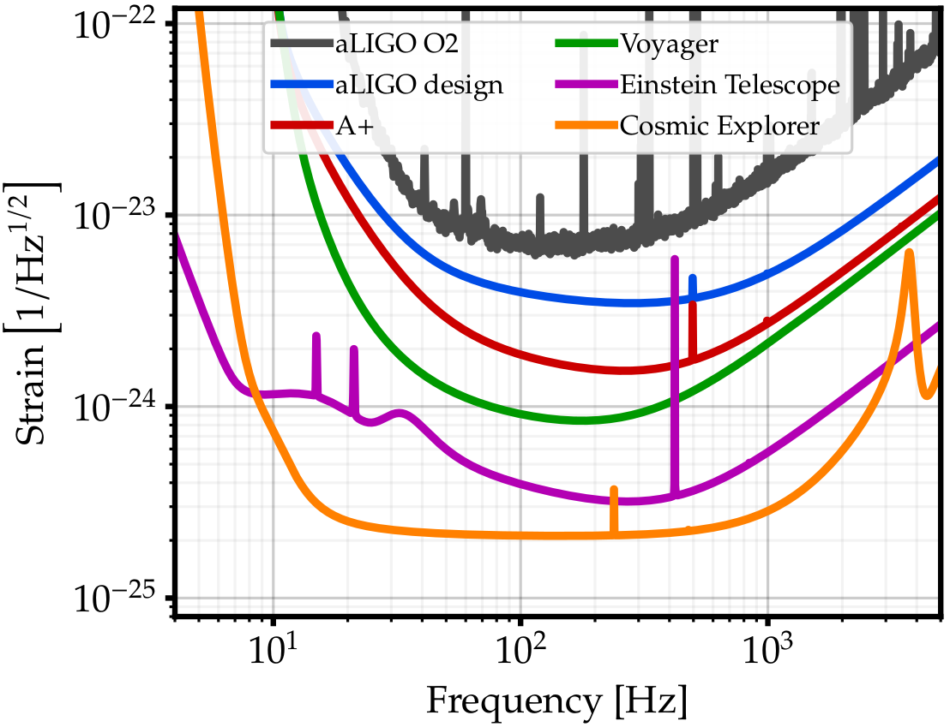
From 2G to 3G:
Example of Sensitivity Progression
Better
Exploring the sensitivity of next generation gravitational wave detectors (2017) CQG 34, 044001
Longer

Slide 6
BBH and BNS from the entire Universe
PBH?
First Stars Formed
BNS
BBH
Credit: Evan Hall

Slide 7
High SNR signals
Credit: Evan Hall

Slide 8

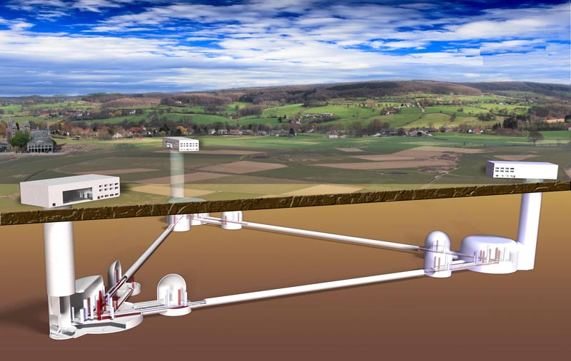
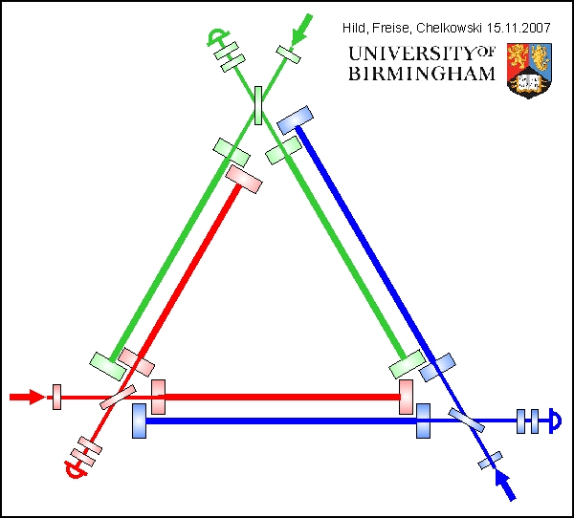
et-gw.eu
Original design: Underground, triangular, 10km on a side, 6 interferometers

Slide 9
ET: Why Triangular?
Best science with a single 3G detector (polarization information)
Concept compatible with construction in Europe: underground
Excavation cost also favors a triangular configuration
Facility able to support further detector improvements

Slide 10
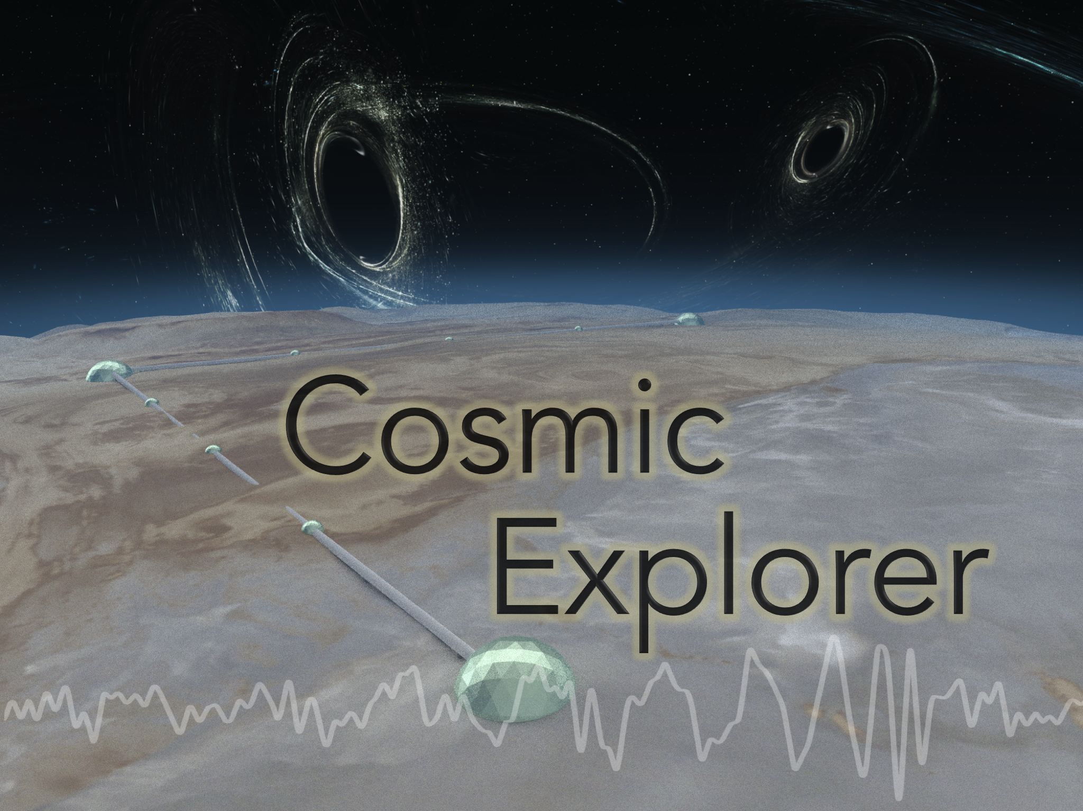
Cosmic Explorer
cosmicexplorer.org
Surface, right-angle, 40km on a side, 1 interferometer

Slide 11
CE: Why L-shaped?
CE concept developed assuming ET is operational:
  CE is the optimal design scale for our astrophysical targets (BNS mergers, core collapse supernovae, ...)
  best way to expand 3G science

Slide 12
CE: Why 40km?
Fundamental noises scale with length, but not as 1/L as one might guess from h = ΔL/L
  40 km is a nearly optimal choice

Slide 13
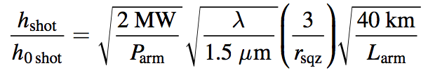
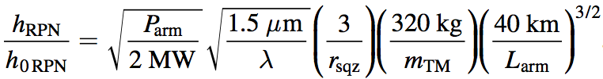
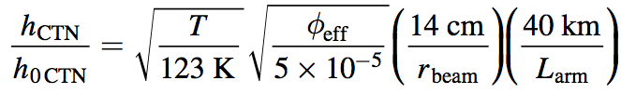

How do fundamental noises scale?
Shot Noise
while maintaining bandwidth
Radiation Pressure Noise
while maintaining bandwidth
Coating Thermal Noise
constant loss angle…
Residual Gas Noise
facility limit…

Slide 14
How do fundamental noises scale?
Shot Noise
while maintaining bandwidth
Radiation Pressure Noise
while maintaining bandwidth
Coating Thermal Noise
constant loss angle…
Residual Gas Noise
facility limit…

Slide 15
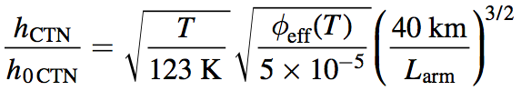
How do fundamental noises scale?
Shot Noise
while maintaining bandwidth
Radiation Pressure Noise
while maintaining bandwidth
Coating Thermal Noise
loss angle dependence?
Residual Gas Noise
facility limit…

Slide 16
CE: Why 40km?
Fundamental noises scale with length, but not as 1/L as one might guess from h = ΔL/L
  40 km is a nearly optimal choice
Free-Spectral-Range for a 40km detector is 3.75kHz, going beyond 40km would reduce the interferometer bandwidth and compromise its scientific potential (like neutron-star merger and supernovae)

Slide 17
Conclusions
ET original triangular design, and CE L-shaped, 40km concept are the natural choices given constraints and historical development
GWIC-3G science team will influence ET and CE final design choices
A third 3G detector could draw from both ET and CE designs to complement and complete a network capable of precision pointing
More about enabling technologies and governance in Michele’s talk

