Slide 1
Dawn IV, Aug 30, 31, 2018 Amsterdam
Gravitational-wave Detectors:
The US Landscape 2020–2030 and Beyond
(A Personal Perspective)
Dave Reitze
LIGO Laboratory

Slide 2
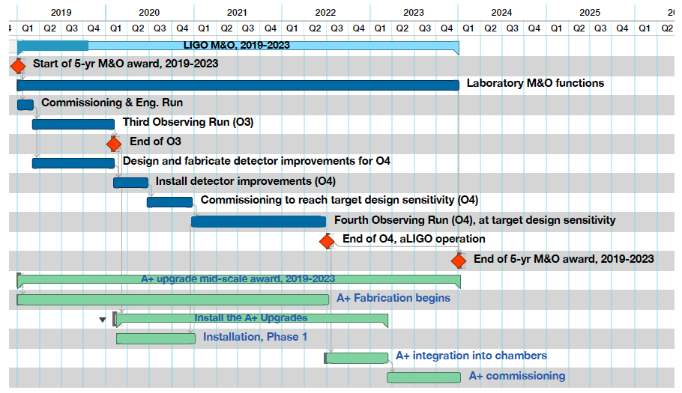
LIGO Laboratory Operations
Plan for 2019-2023
Plan lays out envisioned run schedules and upgrade/commissioning periods for coming 5 years
Caveats which could impact this plan: i) A+ Project detailed planning not done, ii) joint run planning with Virgo and KAGRA
A+ midscale upgrade

Slide 3
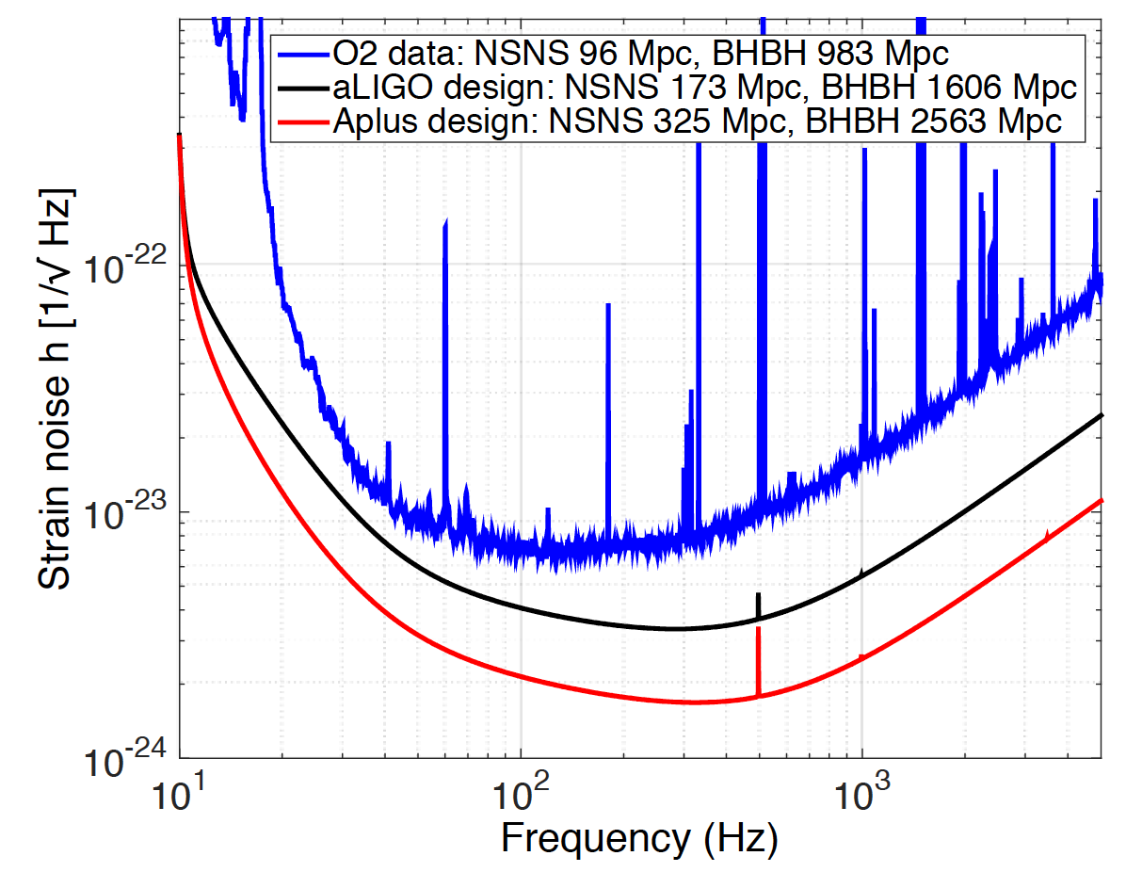
A+ Advanced LIGO
Upgrade 2019-2026(+)
Mid-scale upgrade of the Advanced LIGO interferometers
  Improves binary neutron star inspiral range by ~ 1.9; 30/30 M binary black hole inspiral range by ~1.6
  Frequency dependent squeezing + better coatings w/ lower thermal noise
US-UK-Australia international collaboration
Project Status:
  US: $20.5M awarded by NSF to begin Oct 1, 2018
  UK: ~ £10M requested by STFC; under review
  Australia: funded by ARC, have received deliverables
Construction Project Schedule: 2019-2023
  Fabrication/facility modifications/installation/integration: 2019-2022
  Commissioning: 2023
Operation: currently envision a 1.5-2 year run durations in 2024-2026, perhaps 2027

Slide 4
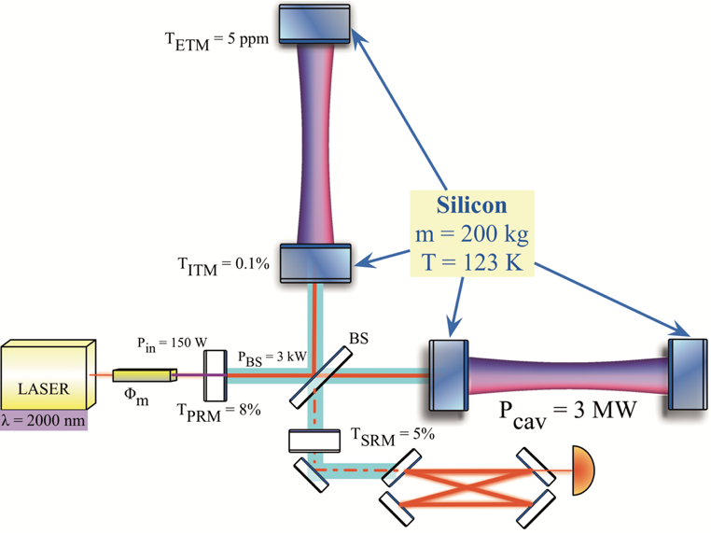
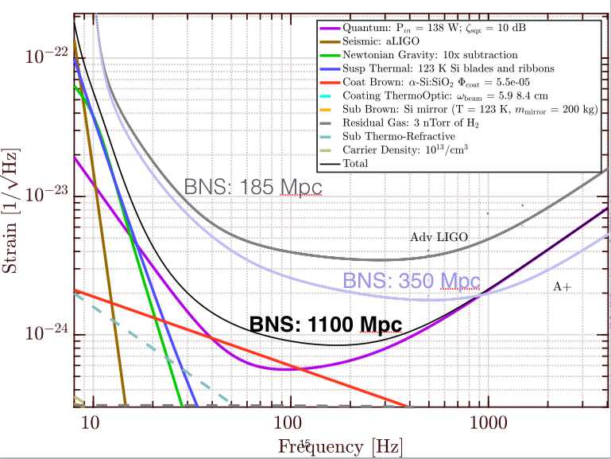
Longer Term I: Voyager
A 4 km design to exploit the LIGO Observatory facilities limits
  Ultimately determined by arm length and vacuum base pressure
Uses new technologies …
  Silicon test masses
  123 K operating temperature
  2 μm 150 W laser, higher quantum efficiency photodiodes
... but reuses key Advanced LIGO components
  Vacuum system
  Seismic isolation
Prototyping effort
  40 m interferometer at Caltech; pending funding
Cost: O($10⁸M)
Time Scale: ? (but not before late 2020s)
Shapiro, Brett, et al. "Cryogenically cooled ultra low vibration silicon mirrors for gravitational wave observatories." Cryogenics 81 (2017): 83-92.

Slide 5
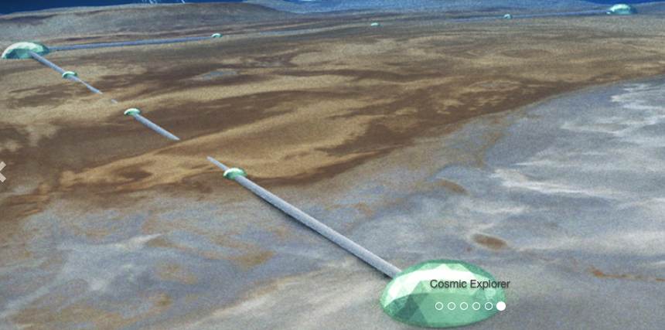
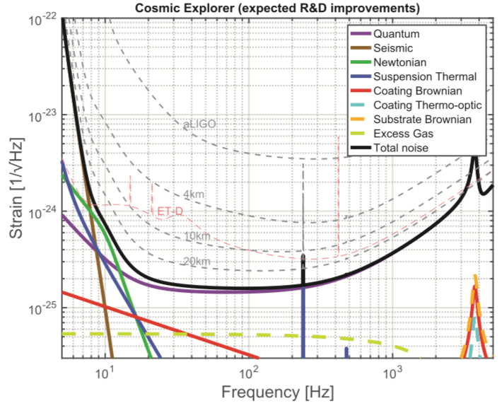
Longer Term II: Cosmic Explorer
40 km L-shaped interferometer design
A key node of the 3rd generation detector network
Sensitivity can benefit from new technologies (a la Voyager), but could also use existing 2G technology, appropriately scaled up:
  Large aperture, 320 kg silica test masses, higher arm powers
Design effort formally underway
  Recently funded by NSF, 3 year study
  Matt Evans (MIT) leading, participation by other US institutions
Cost: O($10⁹)
Time scale for realization: ?, but not before 2030
B. P. Abbott, et al., (LIGO Scientific Collaboration), “Exploring the sensitivity of next generation gravitational wave detectors”, Class. Quantum Grav. 34, 044001 (2017).

Slide 6
The Path to 3G in the US
Possible paths
Field-Specific National Academies Studies
  Commissioned by funding agencies
  Studies are both comprehensive and intensive
    10-15 study members, membership is a mix of scientists from within the community and objective outsiders
    Resulting report and recommendations undergo stringent review
OR
Astro2020 Decadal Survey
  Astronomy and various fields of Physics conduct Decadal Surveys
    Initial LIGO was endorsed in a 1986 study
  Chartered by US agencies (NASA, NSF, DOE)
  (Complex) Process involves surveying relevant communities and issue report ranking large and mid-scale projects
  Unclear if ground-based GW will be included for ranking
Astro2020 call for science papers:
  http://sites.nationalacademies.org/cs/groups/ssbsite/documents/webpage/ssb_187932.pdf
  Due by Jan 18, 2019
More on Astro2020
this afternoon

