Slide 1
Noises in gravitational wave detectors
LIGO-G1801355-v1
Koji Arai – LIGO Laboratory / Caltech

Slide 2
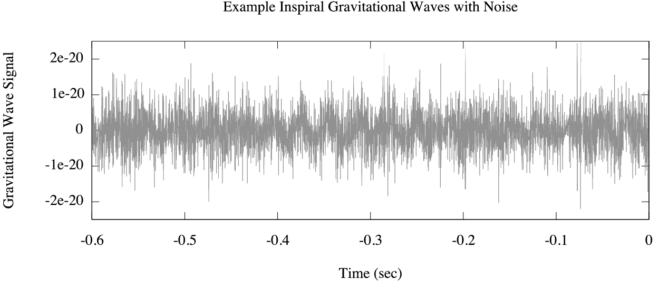
Detector output signal
h(t) = differential arm strain signal
Single time series data

Slide 3
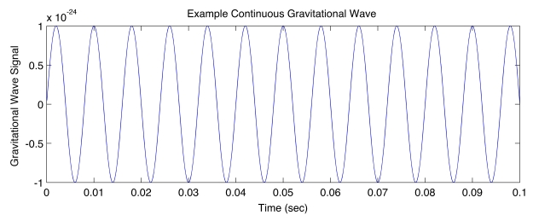
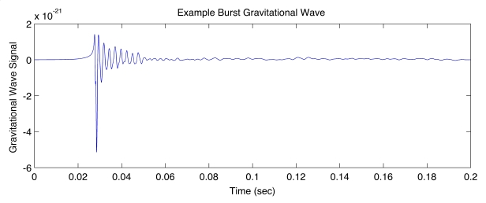
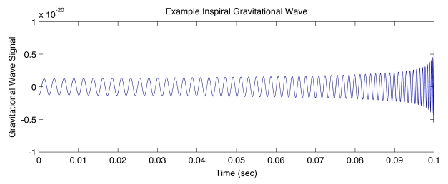
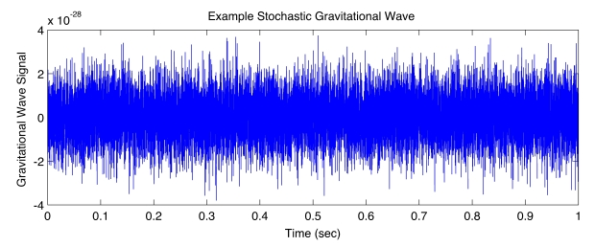
Signal vs Noise
Waveform of GW signals
Continuous
Compact Binary Coalescence
Burst (unpredictable w.f.)
Stochastic

Slide 4
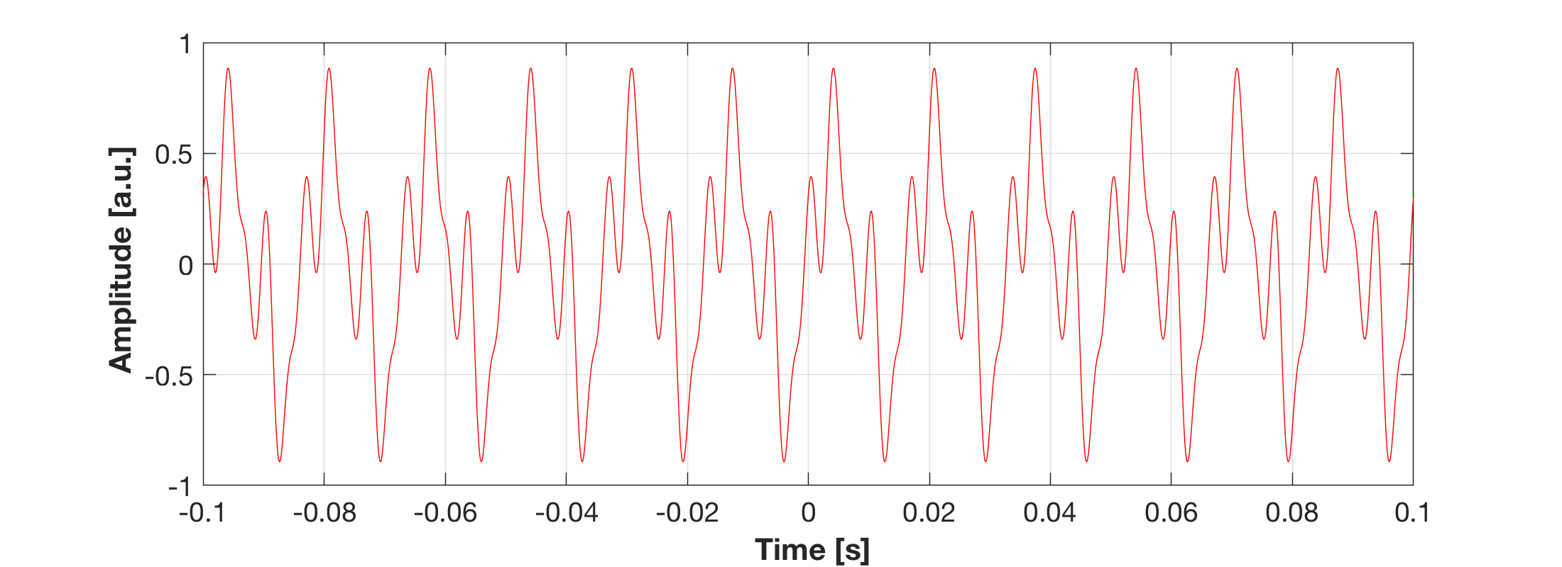
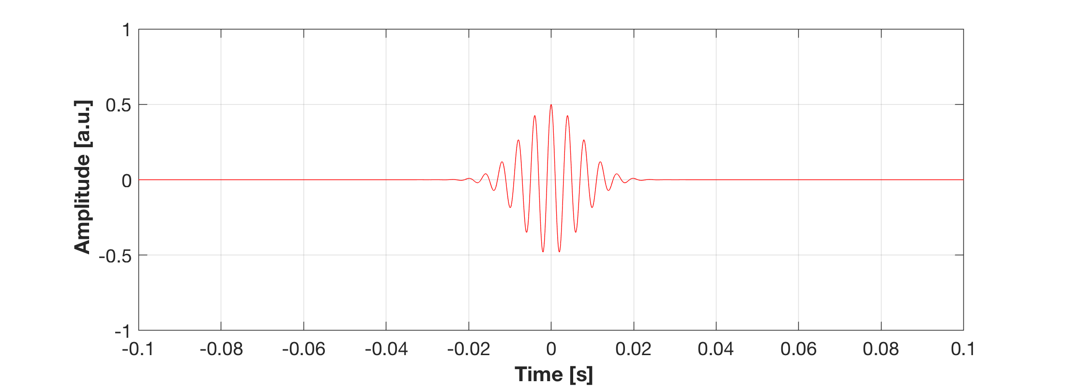
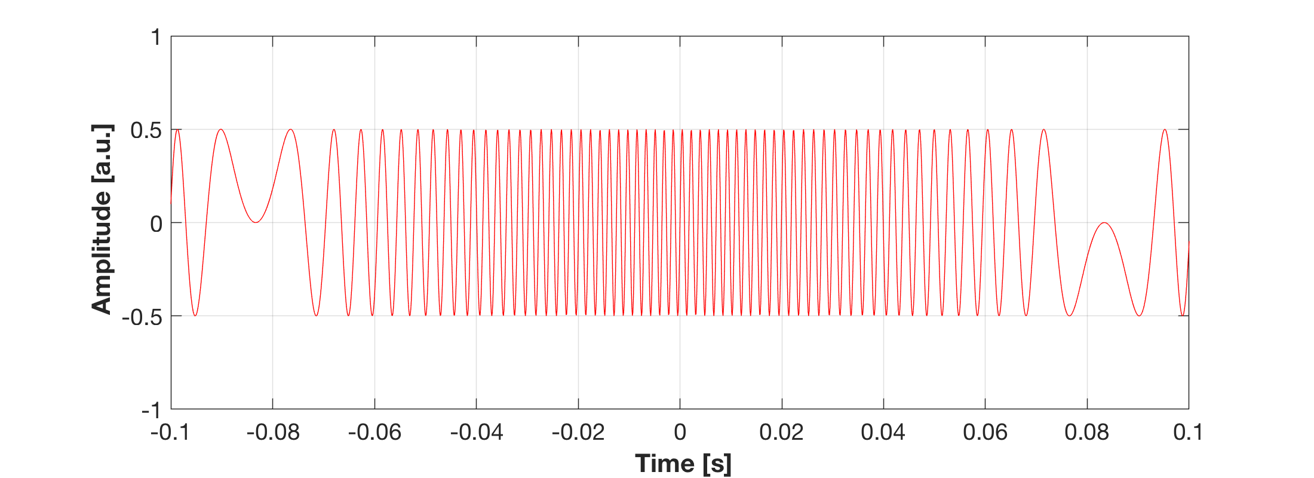
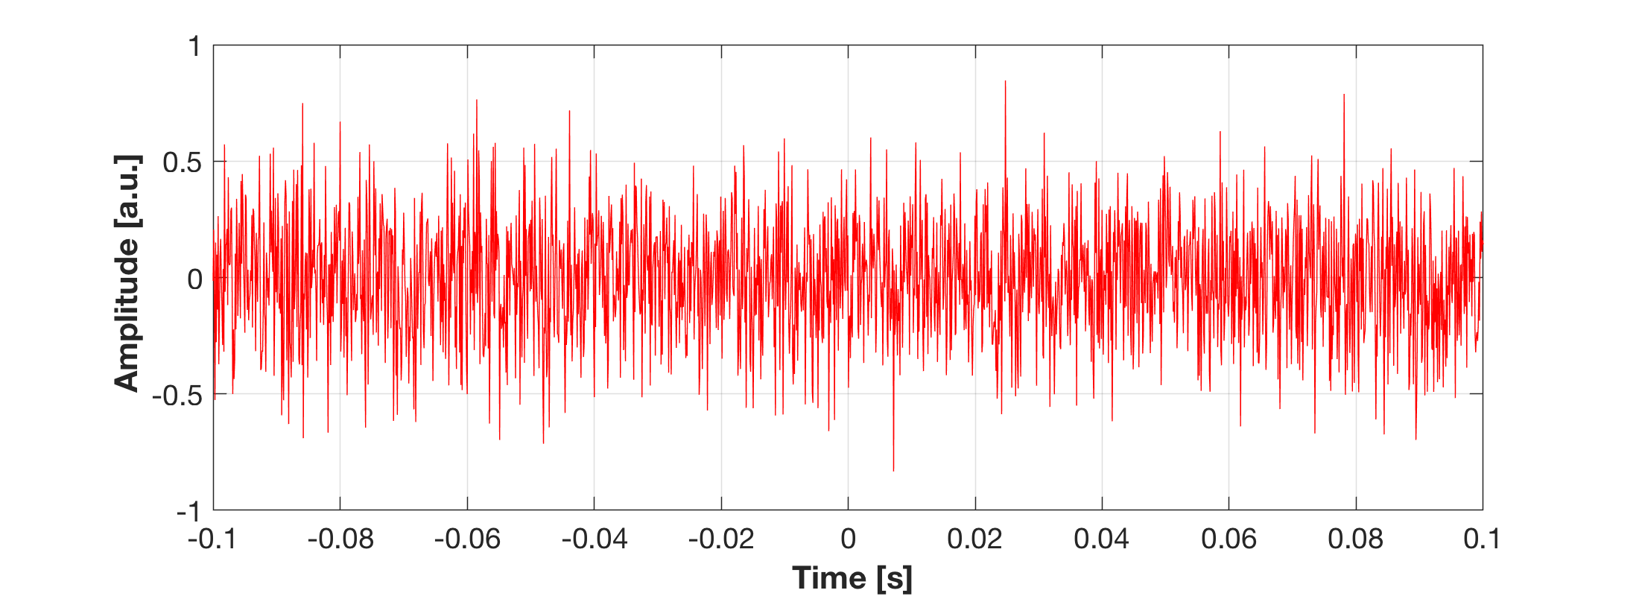
Signal vs Noise
Waveform of GW signals
Continuous
Compact Binary Coalescence
vs noises
Burst (unpredictable w.f.)
Stochastic
Line noise
Transient noise
Scattered light noise
broadband noise

Slide 5
Characterization of time-series data
Amplitude
Line noise
Transient noise
?
?
Scattered light noise
broadband noise
???
Notes:
x_{\rm RMS} = \sqrt{\frac{1}{T} \int_{T_1}^{T_2} \left[x(t)\right]^2 dt}

Slide 6
Characterization of time-series data
RMS (Root Mean Square)
Line noise
Transient noise
? ->RSS
Scattered light noise
broadband noise
Notes:
x_{\rm RMS} = \sqrt{\frac{1}{T} \int_{T_1}^{T_2} \left[x(t)\right]^2 dt}

Slide 7
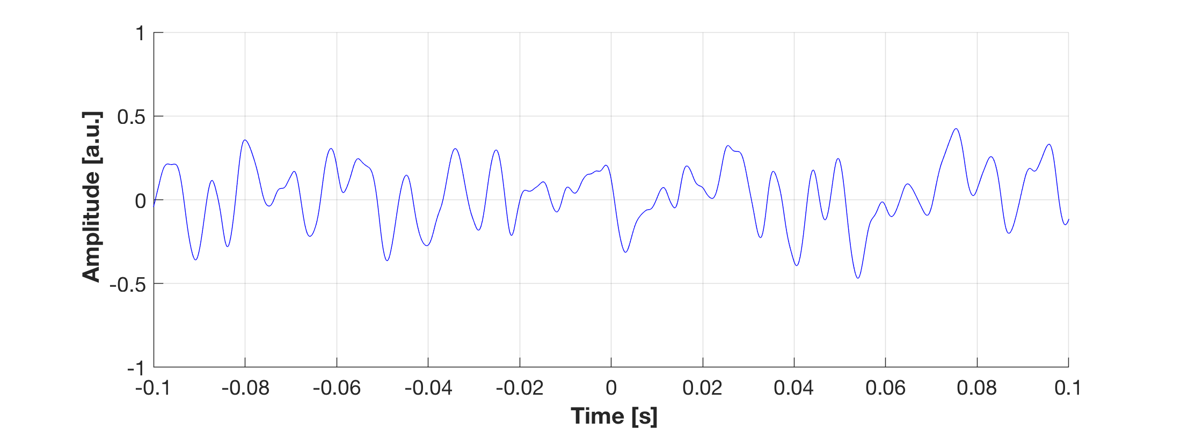
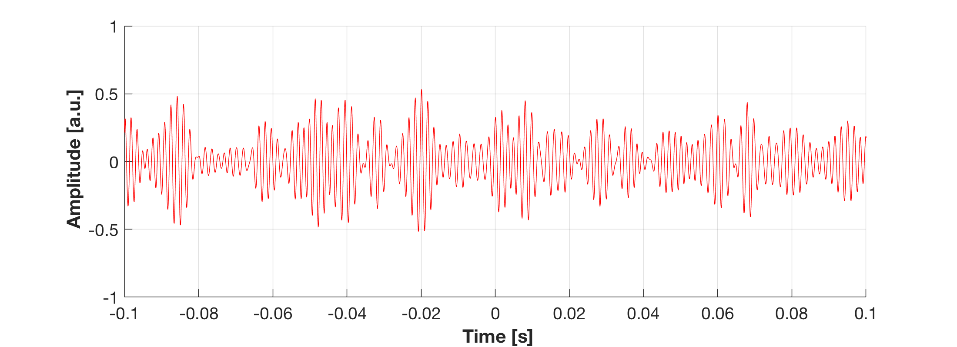
Characterization of time-series data
Same RMS (~0.2), but they look different
Waveform 1
Waveform 2
Notes:
x_{\rm RMS} = \sqrt{\frac{1}{T} \int_{T_1}^{T_2} \left[x(t)\right]^2 dt}

Slide 8
Freq domain: Power Spectral Density
Double sided PSD (-Infinity < f < Infinity)
Single sided PSD (0 <= f < Infinity)
[x_{unit}² / Hz]
Linearized PSD:
[x_{unit}/ sqrtHz]

Slide 9
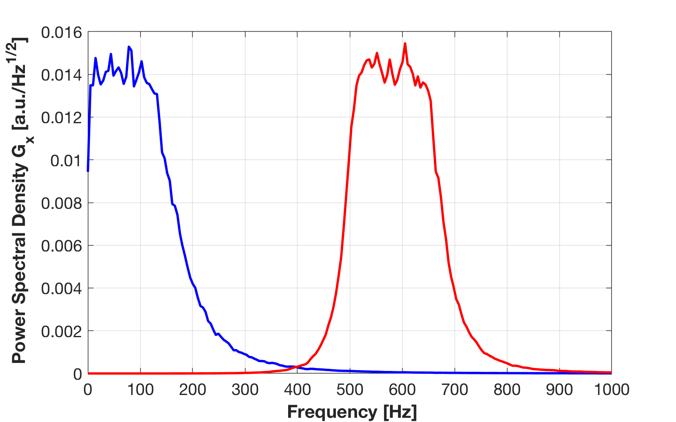
Characterization of time-series data
Same RMS (~0.2), but they look different
Waveform 1
Waveform 2
Frequency Domain
Notes:
x_{\rm RMS} = \sqrt{\frac{1}{T} \int_{T_1}^{T_2} \left[x(t)\right]^2 dt}

Slide 10
PSD <-> RMS
Parseval’s Theorem for signal RMS and PSD
Root Mean of x(t):
average signal power density (per sec)
(cf. variance, std deviation)
PSD Sx(f):
power density per frequency (per sec)

Slide 11
PSD <-> RMS
Same RMS (~0.2), but they look different
Waveform 1: RMS~0.18
Waveform 2: RMS~0.18
Frequency Domain
Sqrt(0.014² * 150)
=~0.17
→150Hz←
→150Hz←
Notes:
x_{\rm RMS} = \sqrt{\frac{1}{T} \int_{T_1}^{T_2} \left[x(t)\right]^2 dt}

Slide 12
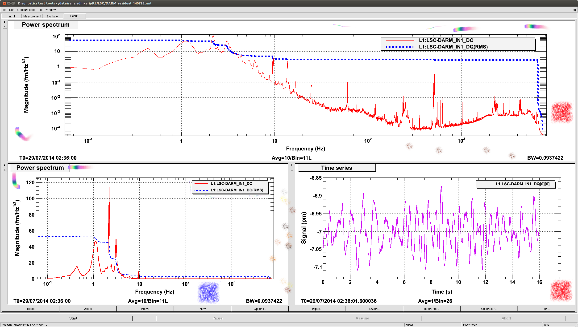
Time series, PSD, and RMS
Example
PSD [fm/sqrtHz] in log-log scale,
PSD [fm/sqrtHz] in log-lin scale
RMS [fm] ~ 50fm = 0.05pm
Time series [pm]
Notes:
x_{\rm RMS}(f) = \sqrt{\int_f^{\infty} S_x(f) df}

Slide 13
Time domain vs frequency domain
Time domain vs frequency domain
Noise
Reduction
Time domain: transient noises
Frequency domain: stationary noises

Slide 14
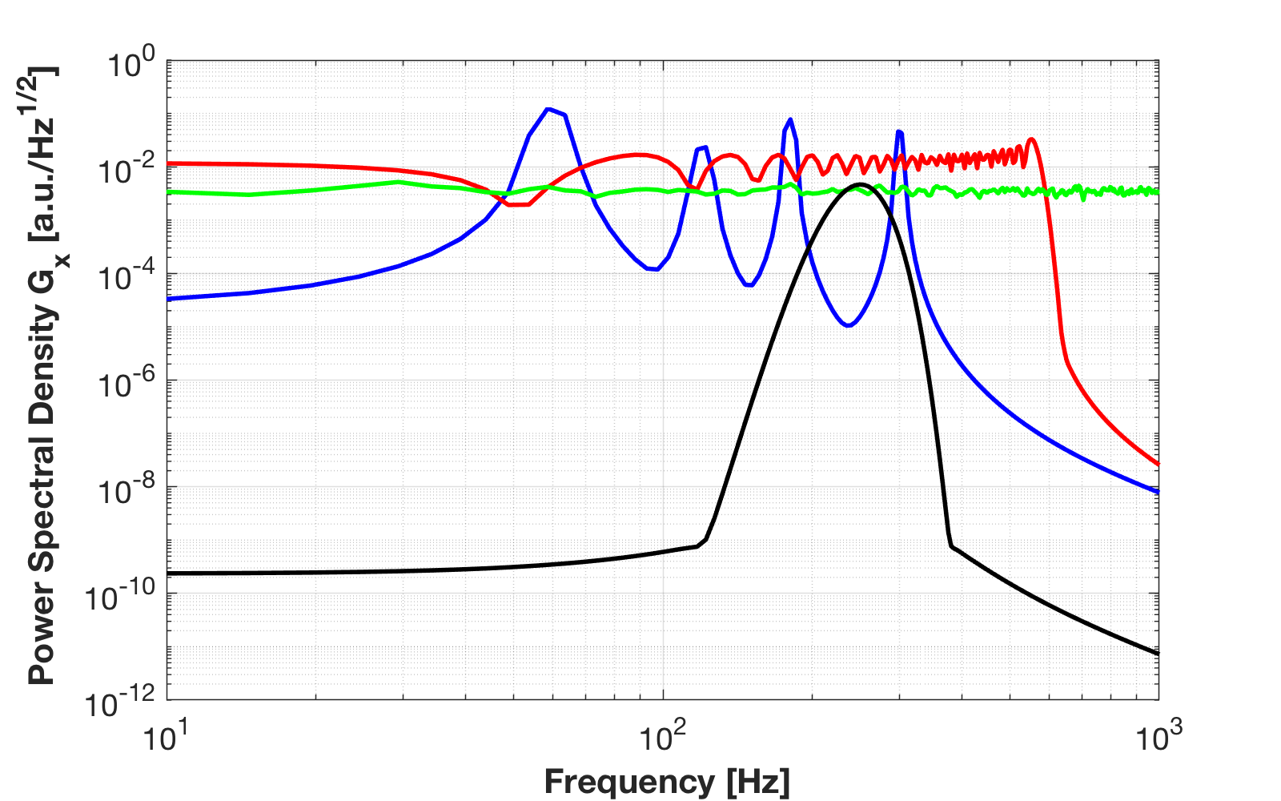
Time domain vs frequency domain
Line noise *
Transient noise *
Scattered
light noise *
Broadband
noise
Notes:
x_{\rm RMS} = \sqrt{\frac{1}{T} \int_{T_1}^{T_2} \left[x(t)\right]^2 dt}

Slide 15
Sensitivity and noise
Sensitivity (=noise level) of Advanced LIGO
Current sensitivity
h= 8x10⁻²⁴ /rtHz
RMS?

Slide 16
Actual GW detector
4km FP arm cavities
Mode
Cleaner
Vacuum Envelope
Seismic Attenuation
Recycling
Mirrors
Analog Electronics
Digital Control
Mirror Suspension
(Quad Pendulum)
High
Power Laser
Data Analysis
Signal
Readout
Scheme
Data Storage
Mirror & Coating
Fused Silica fiber

Slide 17
Components of the interferometer
3 elements of a GW detector
  Mechanics
  Optics
  Electronics

Slide 18
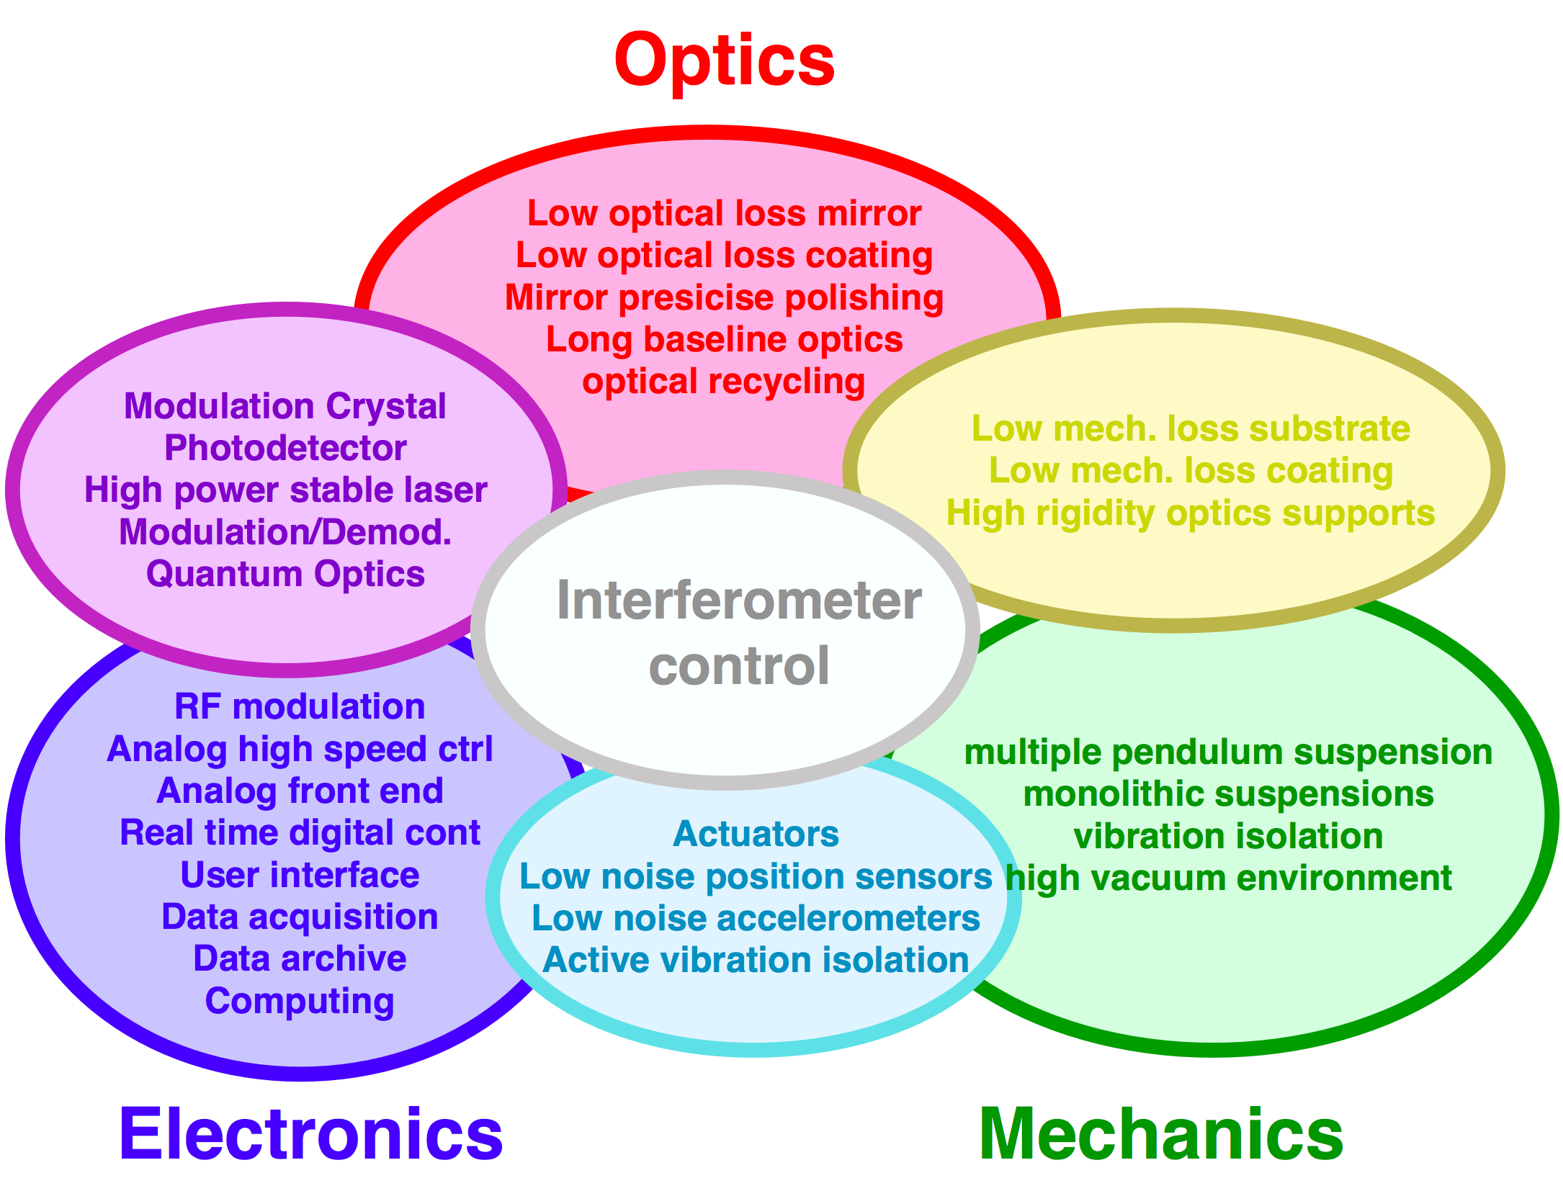
Components of the interferometer
3 elements of a GW detector
  Mechanics
  Optics
  Electronics

Slide 19
Noise categories
3 fundamentals of the GW detector
Mechanics -> Displacement noises
Optics -> Optical noises
Electronics -> Electrical noises
Displacement
Optical
Optical
Displacement
Electrical
Electrical
Electrical

Slide 20
Sensitivity and noise
Sensitivity (=noise level) of Advanced LIGO
Design

Slide 21
Noise coupling to the GW channel
Noise coupling
model
Make the noise (dx) small
Make the coupling (𝜀) small
It is simple... isn’t it?
GW
Noise
Coupling
GW channel

Slide 22
Noise coupling to the GW channel
Noise source measurement
Use a sensor that is specifically sensitive to dx.
This measurement itself is often difficult.
Sensor
Output
Noise
Sensor

Slide 23
Noise coupling to the GW channel
Coupling measurement
dH = 𝜀 dN.
The system should be designed to allow the excitation.
Noise
Coupling
GW channel
Noise Excitation

Slide 24
Noise coupling to the GW channel
Noise budget
Noise measurement
Artificial Excitation
GW channel

Slide 25
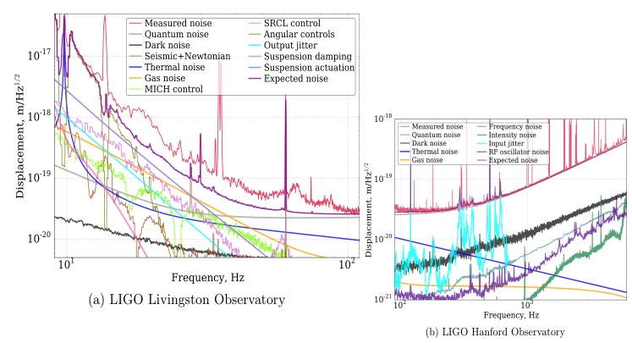
Sensitivity and noise
Sensitivity (=noise level) of Advanced LIGO
Noise budget
h= 2x10⁻²³ /rtHz

Slide 26
Displacement noises

Slide 27
Displacement noise
Mechanical displacement sensed
by a laser interferometer
The longer the arm length,
the smaller the strain noise
  Seismic noise
  Thermal noise
  Newtonian Gravity noise

Slide 28
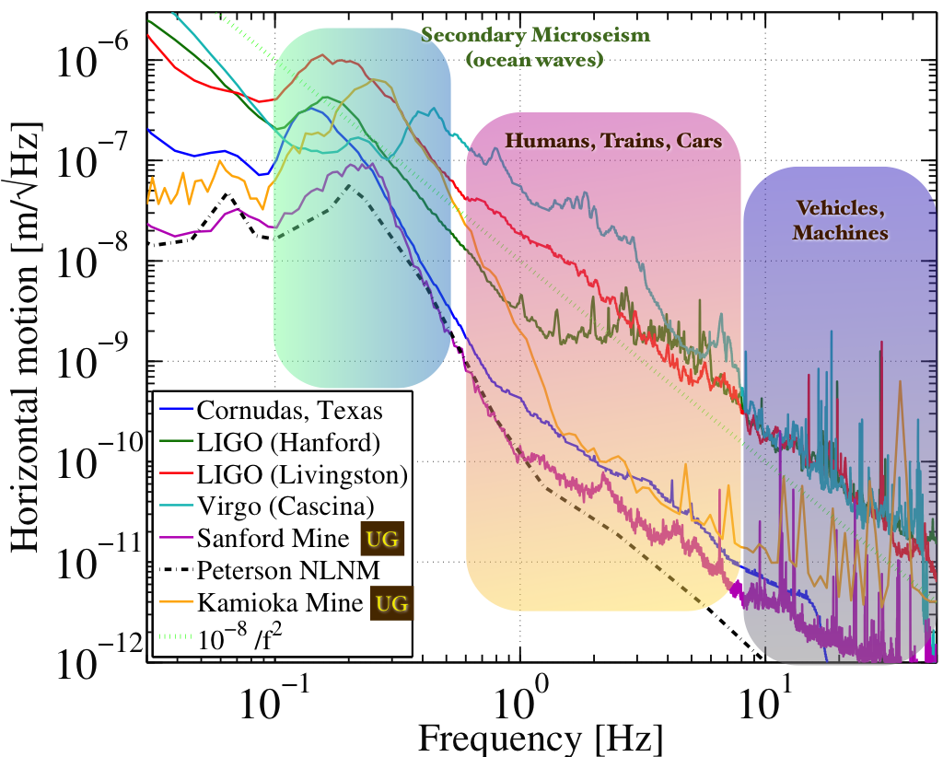
Displacement noise
Seismic noise
  Even when there is no noticeable earth quake…
Target
disp. noise
10⁻²⁰m/rtHz
http://link.aps.org/doi/10.1103/RevModPhys.86.121 (http://arxiv.org/abs/1305.5188)

Slide 29
Displacement noise
Vibration isolation ~ utilize a harmonic oscillator
  A harmonic oscillator provides vibration isolation
  above its resonant frequency
w0=1Hz
|x/X|~1/1000@30Hz

Slide 30
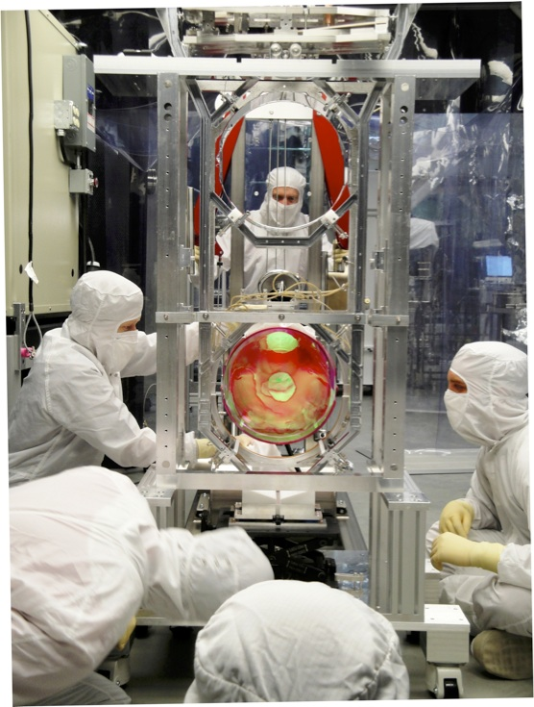
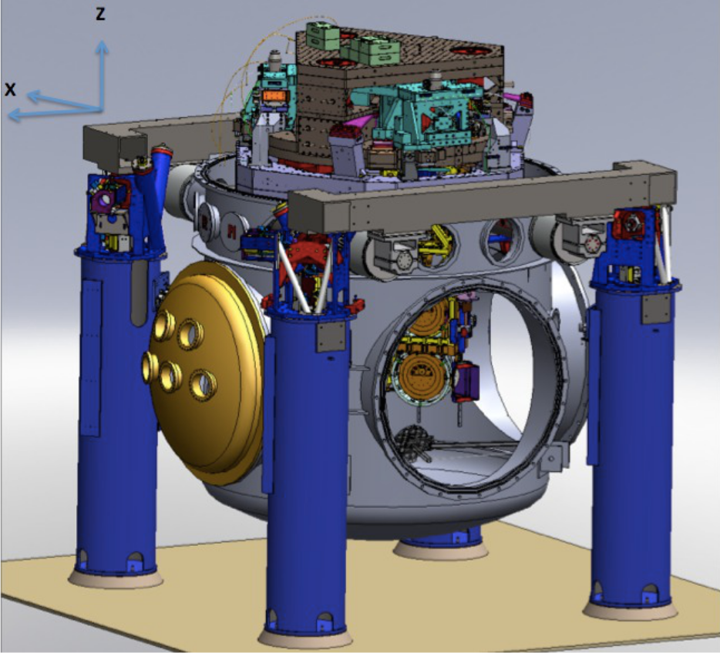
Displacement noise
aLIGO vibration isolation
Hydraulic active isolation / Invacuum Active Isolation Platforms / Multiple Pendulum

Slide 31
Displacement noise
http://link.aps.org/doi/10.1103/RevModPhys.86.121 (http://arxiv.org/abs/1305.5188)

Slide 32
Displacement noise
Thermal noise:
System in thermal equilibrium
  the system can dissipate its energy to the heat bath
  the system is thermally excited by thermal fluctuation
  The level of thermal excitation can be evaluated using the energy dissipation of the system (e.g. friction, resistance)
  “Fluctuation Dissipation Theorem”

Slide 33
Displacement noise
Equipartition Theorem
In thermal equilibrium, each d.o.f. has the energy of
Johnson noise

Slide 34
Displacement noise
Mechanical resonance
Quality factor Q
High Q
=> most of the kBT/2 energy
contained in the resonant freq
=> Lower thermal motion
at off-resonance
High Q
Low Q

Slide 35
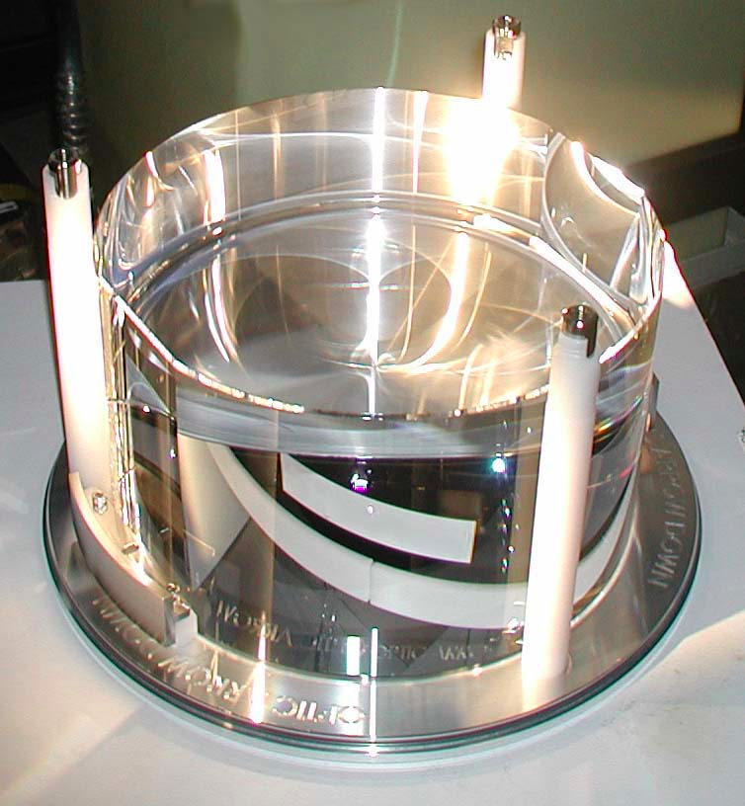
Displacement noise
Mirror substrate thermal noise
  Brownian motion
  Mechanical loss associated
  with the internal friction
  ⬄Thermally excited body modes
  Optical coating (higher mech. loss)
  will be limiting noise source in aLIGO
  Thermo elastic noise
  Elastic strain & thermal expansion coefficient
  => cause heat distribution & flow in the substrate
  ⬄Temperature fluctuation causes mirror displacement
  Thermo-refractive noise
  ⬄Temp. fluctuation causes fluctuation of refractive index
We don’t need to
know Z(w)!

Slide 36
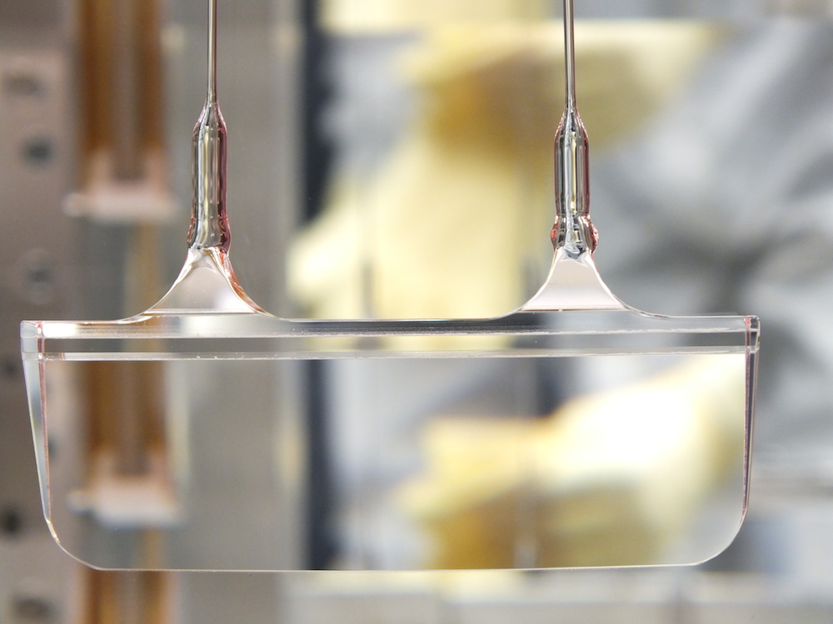
Displacement noise
Suspension thermal noise
  Brownian motion
  Mechanical loss of the suspension fiber
  ⬄Thermally excited pendulum modes
  Thermo elastic noise
  Elastic strain of the fiber & thermal expansion coefficient
  => cause heat distribution & flow in the fiber
  ⬄Temperature fluctuation causes mirror motion
<- Monolithic suspension
for high pendulum Q
We don’t need to
know Z(w)!

Slide 37
Displacement noise
Newtonian Gravity noise
  Mass density fluctuations around the test masses
  => test mass motion via gravitational coupling
  Dominant source of Newtonian noise
  = Seismic surface wave
  Mitigation
  1) Going to quiet place (underground)
  2) Feedforward subtraction
  3) Passive reduction by shaping
  local topography
NN
aLIGO
sensitivity
J Driggers, et al, PRD 86, 102001 (2012)
J Harms, et al, Class. Quantum Grav. 31 185011 (2014)

Slide 38
Optical noises

Slide 39
Optical noises
Noises that contaminate the readout signal
  Quantum noises (shot noise, radiation pressure noise)
  Laser technical noises (frequency/intensity noise)
  Modulation noises
  Scattered light noise
Optical
Optical

Slide 40
Optical noises
Quantum noises: Shot noise
  Noise due to photon counting statistics
  N detected photon => standard deviation √N
  Increasing the incident power P_{in},
  => The shot noise is increased by √P_{in}
  => The signal amplitude is increased by P_{in}
  In total, the signal-to-noise ratio is improved by

Slide 41
Optical noises
Quantum noises ~ Radiation pressure noise
  Photon number fluctuation in the arm cavity
  => Fluctuation of the back action force
  Quantum noise of the input laser
  => Common noise for two arms
  => cancelled and does not appear in the signal
  Vacuum fluctuation injected
  from the dark port
  => Differentially power fluctuation
  => Cause the noise in the GW signal

Slide 42
Optical noises
Quantum noises
  Standard Quantum Limit (SQL)
- Trade-off Between Shot Noise and Radiation-Pressure Noise
- Uncertainty of the test mass position due to observation

Slide 43
Optical noises
Laser frequency noise
  Laser wavelength (λ = c / ν)
  = reference for the displacement measurement
  Optical phase 𝜙 = 2 pi ν L / c
  d𝜙 = 2 pi / c (L dν + ν dL) <= indistinguishable
  dL/L target 10⁻²⁴
  => dν = 10⁻²⁴ x 300 THz (1064nmYAG laser)
  = 3 x 10⁻¹⁰ Hz/rtHz

Slide 44
Optical noises
Laser frequency noise
  Target: dν_{eff} = 3 x 10⁻¹⁰ Hz/rtHz
  Laser stability
  dν = 10~100 Hz/rtHz @100Hz
iLIGO
3-stage cascaded
laser frequency stabilization
  Michelson’s differential sensitivity provides
  Frequency noise cancellation of 1/100~1/1000
  “Common Mode Rejection”

Slide 45
Optical noises
Laser intensity noise
  Relative Intensity Noise (RIN): dP/P
  Sensor output V = P x
  => dV = P dx + x dP <= indistinguishable
  Requirement: RIN = 10⁻⁹ 1/√Hz
  x_{ofs}=10e-12 (DC Readout)
  => dx=1e-20 m/√Hz

Slide 46
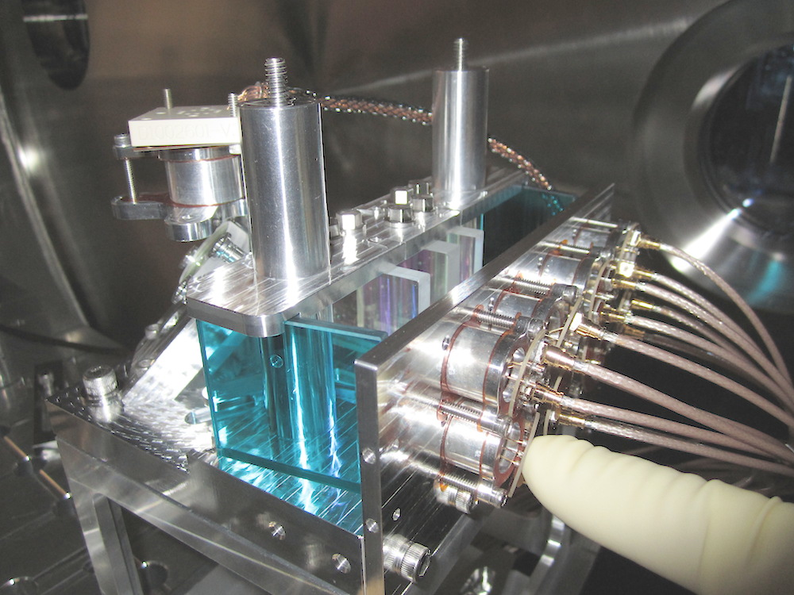
Optical noises
Laser intensity noise ~ intensity stabiliaztion
  Requirement: RIN = 10⁻⁹ 1/√Hz
  2-stage cascaded intensity stabilization control
  Challenge: requires 300mA of photodetection
  Shot noise limited RIN
  In-vacuum 8-branch
  Photodiode array
P. Kwee et al,
Optics Express 20 10617-10634 (2012)

Slide 47
Optical noises
Scattered light noise
  Scattered light recouples to the interferometer beam
  with an arbitrary phase
  => causes amplitude and phase fluctuation
  Two effects:
  1. Small motion regime: linear coupling of the phase fluctuation
  2. Large motion regime: low freq large motion of the scattering object => upconversion via fringe wrapping
  Mitigation
    Reduce scattered light
    Vibration isolation
    of the scattering object

Slide 48
Electrical noises

Slide 49
General rules for electrical noises
Low noise amplification at the beginning
Give necessary gain as early as possible
Don’t attenuate (and amplify again)
input noise: v1
input noise: v2
output noise Vout:
Sqrt[(v1 G1 G2)²+(V2 G2) ²]
Signal
Gain G1
Gain G2
Input equivalent noise
Vout / (G1 G2)
= Sqrt[v1²+(v2/G1) ²]
output noise: v1 G1
Lessons
  The input referred noise is determined by v1
  It won’t become better by the later stages
  If G1 is big enough, we can ignore the noise of later stages

Slide 50
Digitization (Quantization) noise
Analog signals (~+/-10V) -> Digital signal
  Digitized to a discrete N bit integer number
  Quantization causes a white noise
  e.g. +/-10V 16bit => Δ = 0.3mV => Vn ~ 100 μV/sqrtHz
  cf. Input noise of a typical analog circuit 10nV/sqrtHz
quantization error
quantization
http://www.analog.com/static/imported-files/tutorials/MT-229.pdf

Slide 51
Digitization (Quantization) noise
Whitening
  Amplify a signal in the freq band where the signal is weak
Dewhitening
  Amplify a signal in the freq band where the signal is weak

Slide 52
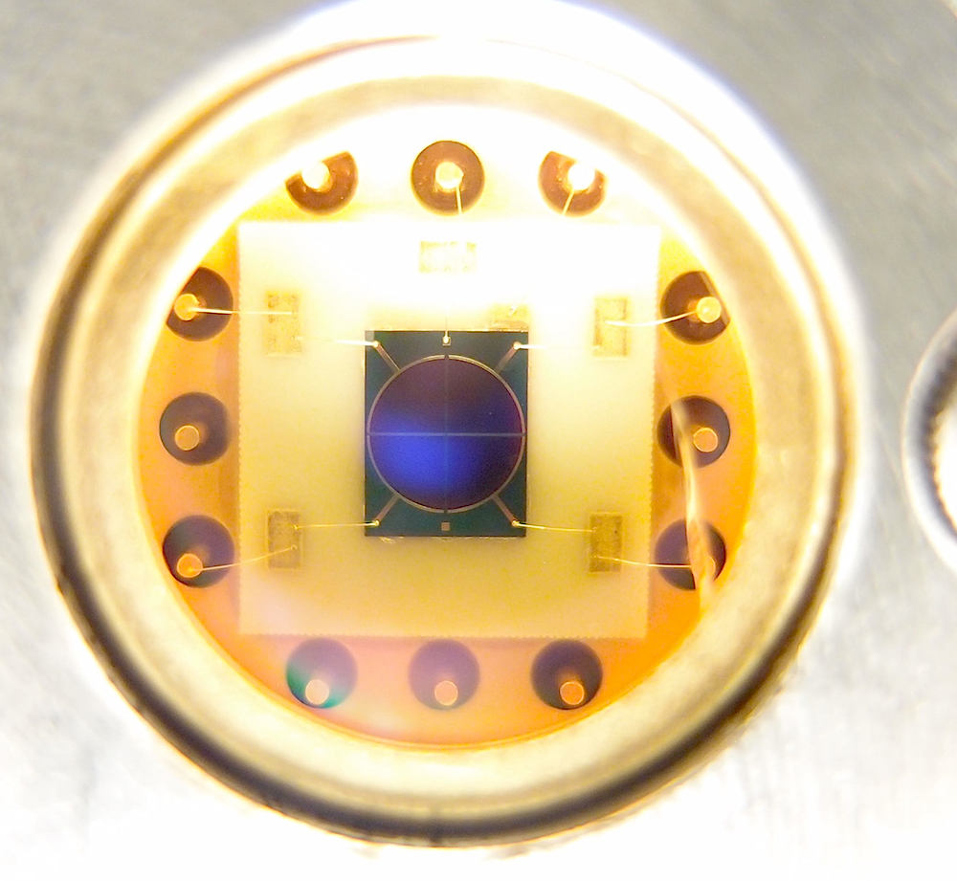
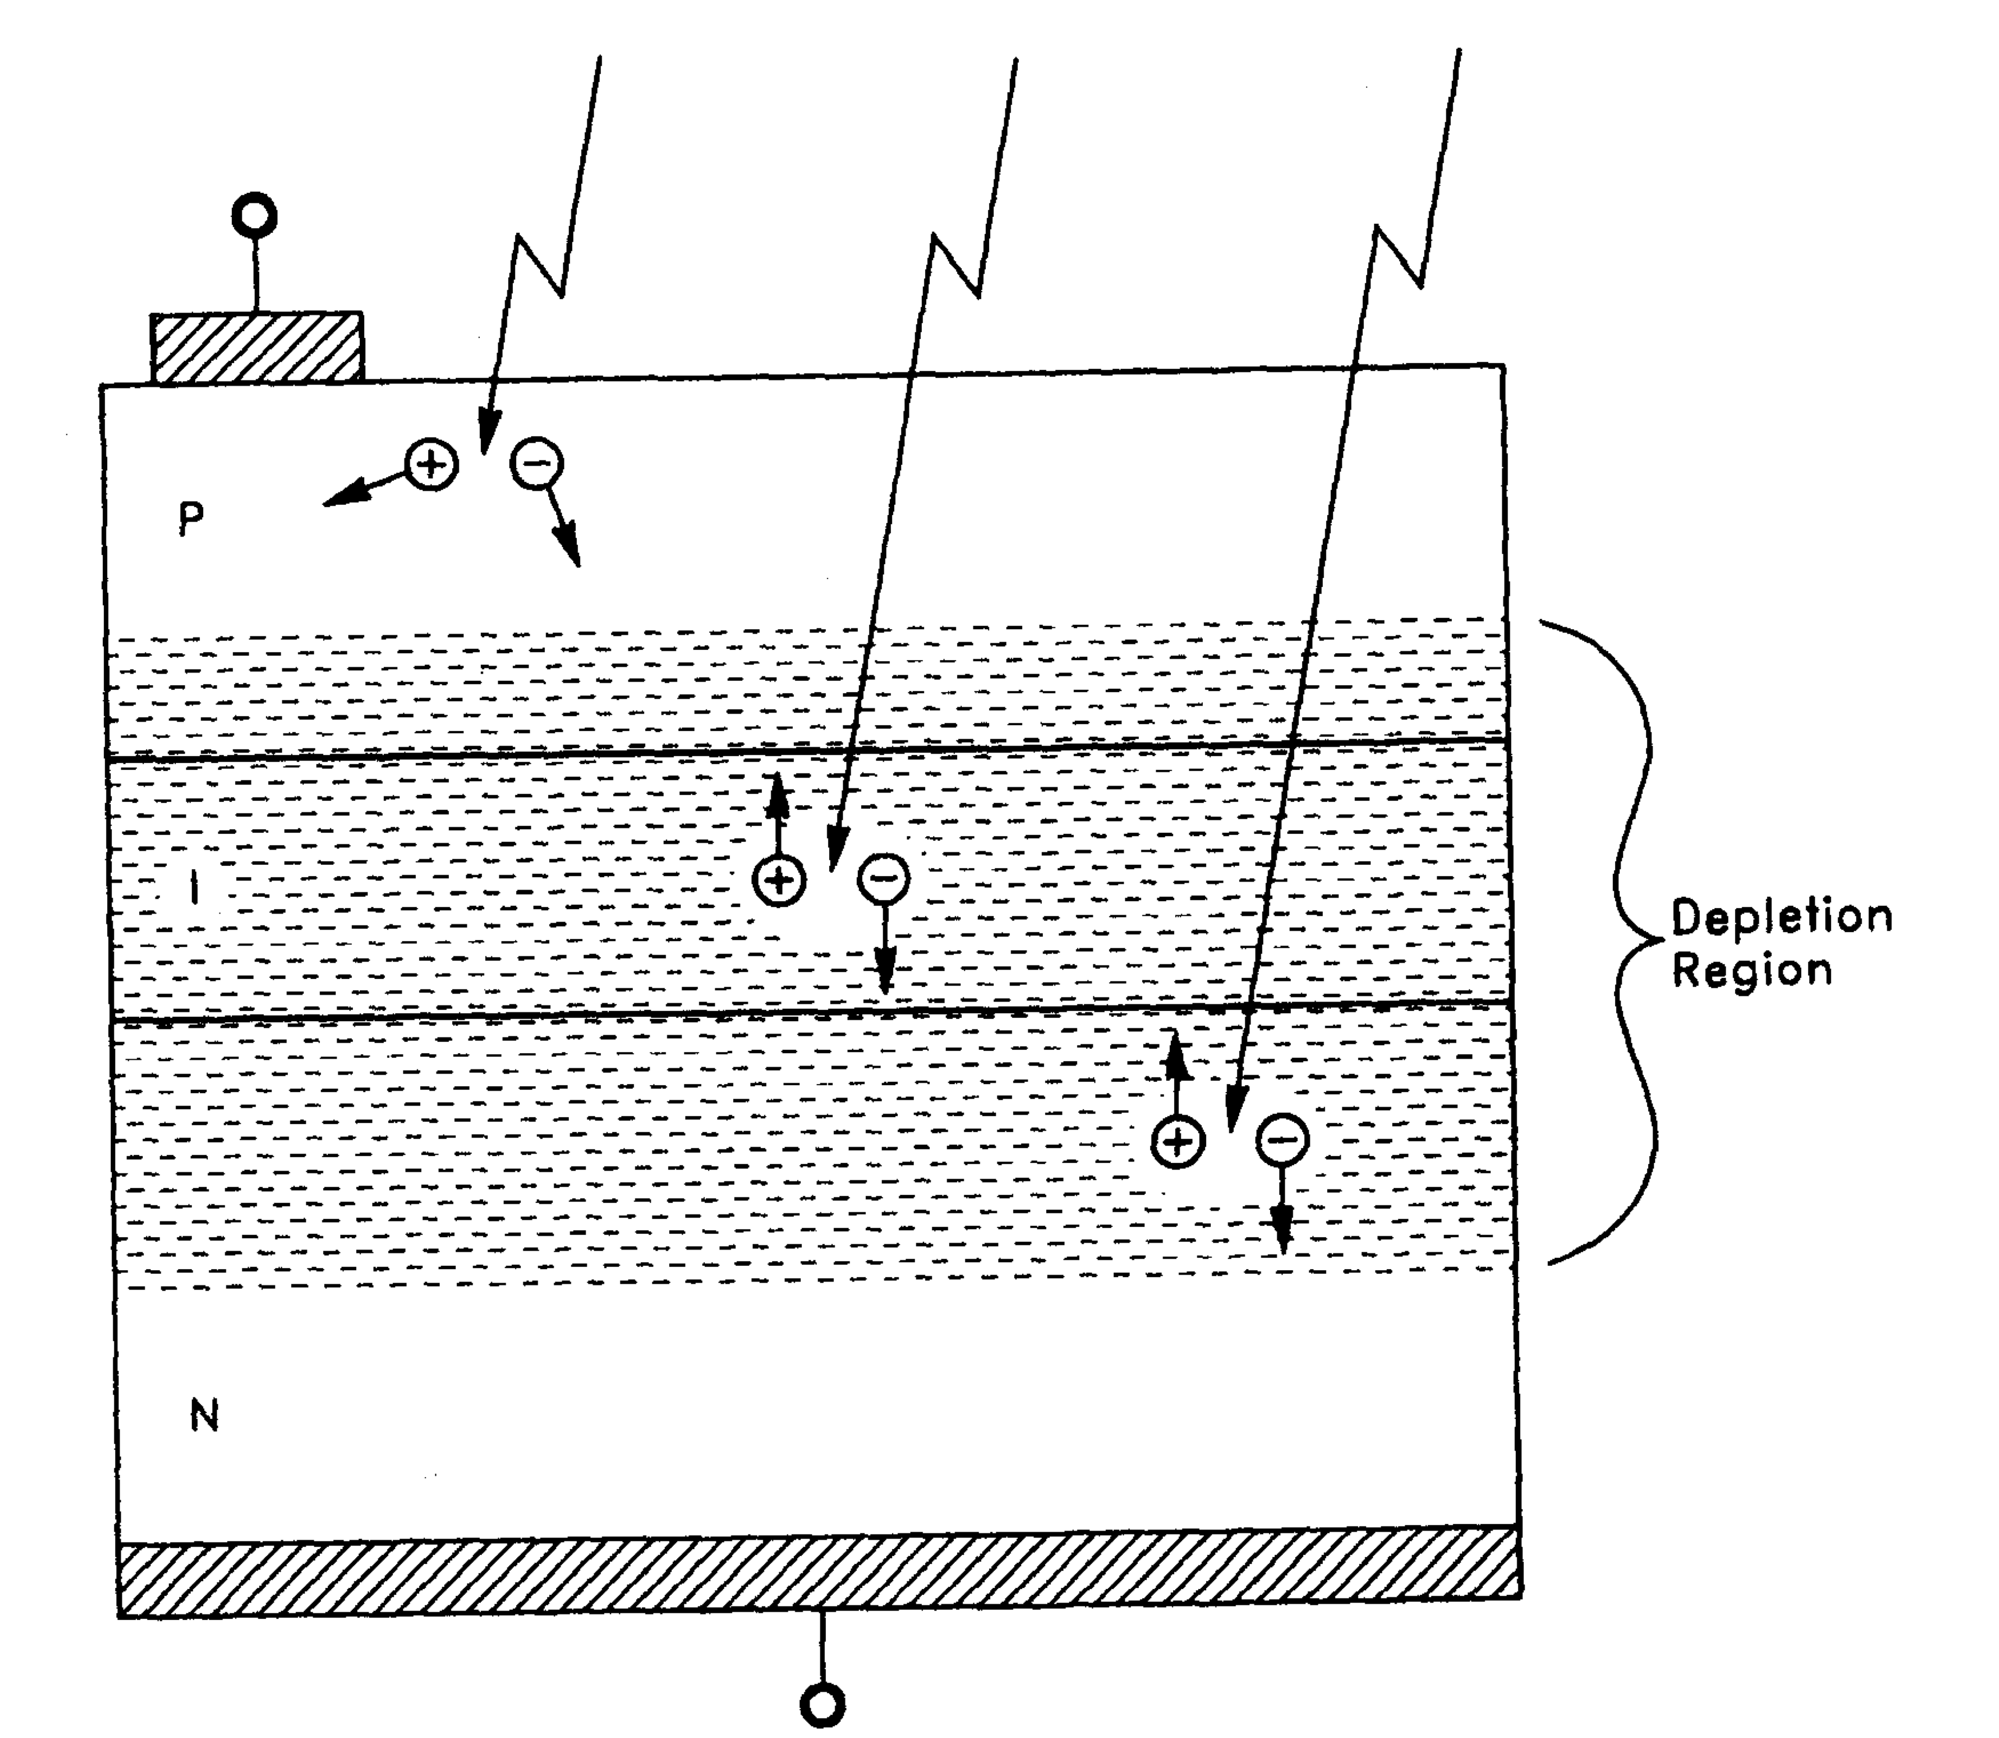
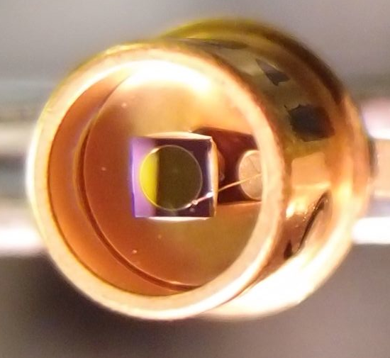
Noise in photodetectors
Photodiodes
  PIN photodiodes
  (InGaAs for near IR, Si for visible)
    Good linearity
    Low noise
    High Quantum Efficiency (>90%)
InGaAs Quadrant PD
(𝜙3mm)
Anode
InGaAs PD (𝜙1mm)
P-layer
I-layer
N-layer
Photocurrent
Cathode
“Photodiode Amplifiers”, J. Graeme (McGrawHill 1995)

Slide 53
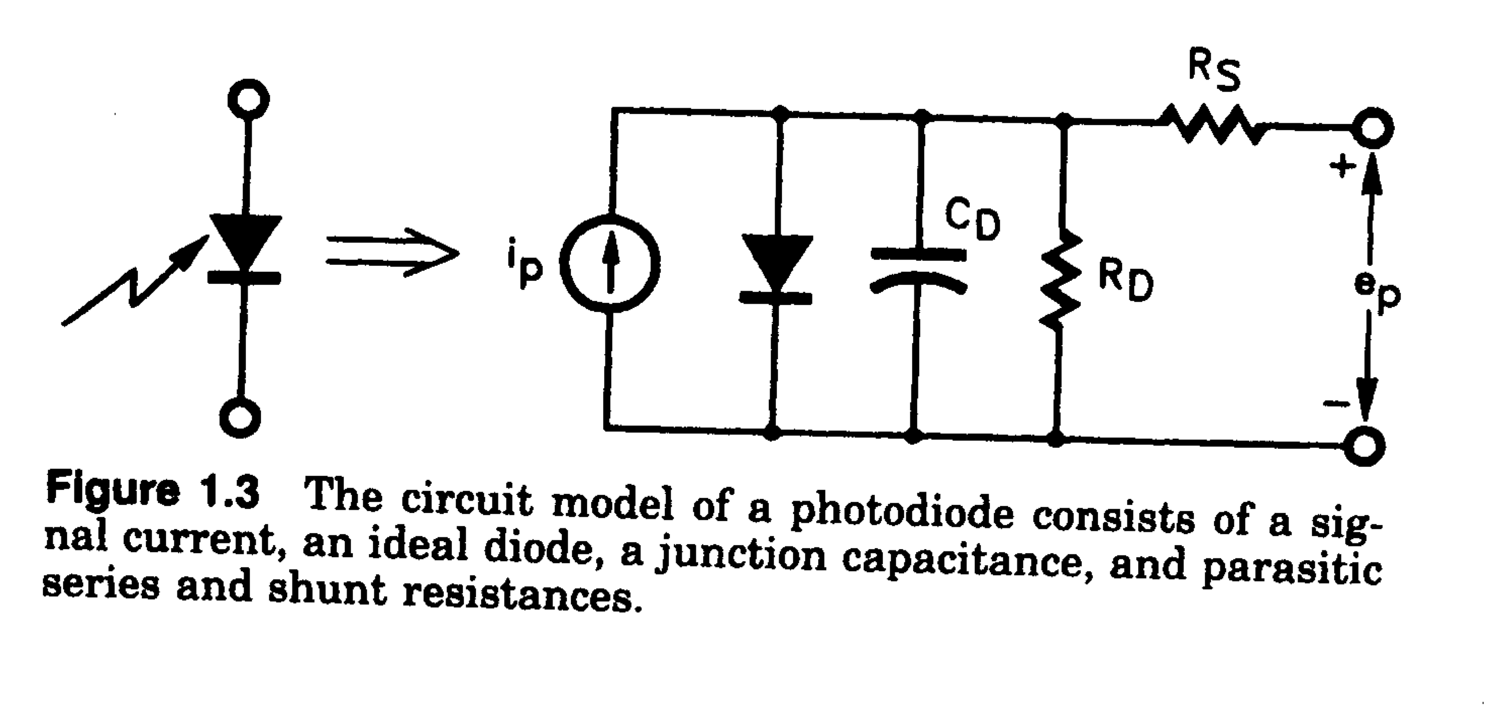
Noise in photodetectors
Noise in photodiodes
  Photodiode equivalent circuit
    Shunt Capacitance R_{D} (~100MΩ) Usually not a problem
    Junction Capacitance C_{D} (1pF~1nF)
    Series Resistance R_{S} (1Ω~100Ω)
input referred noise current
  The diode aperture size needs to be ~mm => Cd tends to be big.
  2mm InGaAs PD: Rs~10Ω, Cd~100pF
  => i_Rs = 20 pA/sqrtHz @100MHz
  (equivalent to the shot noise of 1mA light ~ 1.3mW@1064nm)

Slide 54
Summary

Slide 55
Summary
Summary
  There are such large number of noises
  They are quite omnidisciplinary
  Only one untamed noise can ruin GW detection
  GW detection will be achieved by
    Careful design / knowledge / experience
    Logical, but inspirational trouble shooting
  Noise “hunting”
    Systematic approach: noise budget

