Slide 1
Gravitational wave detection with laser interferometers
LIGO-G1801277-v1
Koji Arai – LIGO Laboratory / Caltech

Slide 2
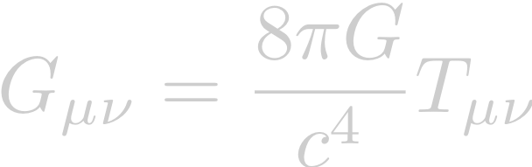
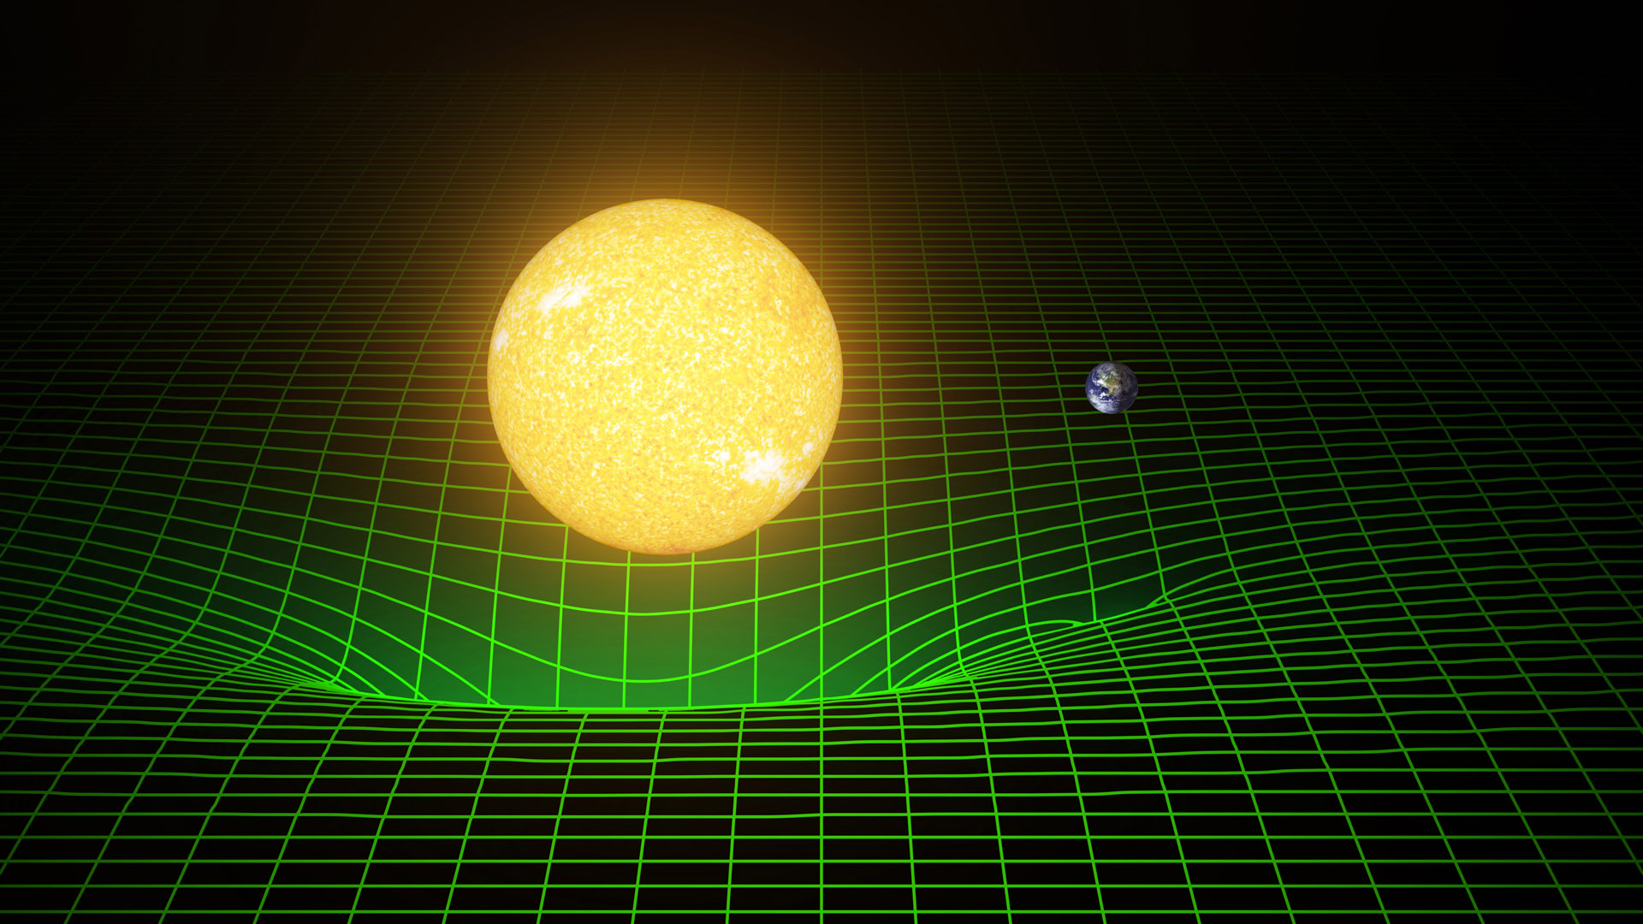
Gravity = Spacetime curvature
Albert Einstein: General Relativity
spacetime
curvature
energy density
(e.g. mass)
Credit: Caltech/MIT/LIGO Lab

Slide 3


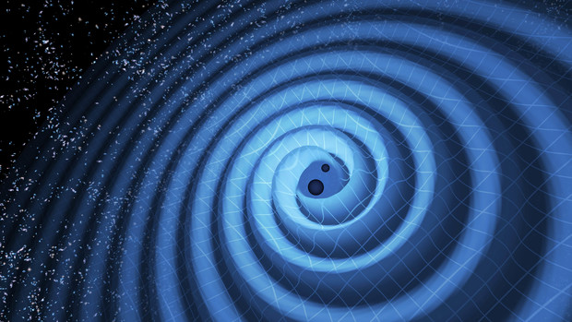
Gravitational waves
Small perturbation of the spacetime
Ripples
in specetime
spacetime
metric
flat
spacetime
perturbation
wave equation
Image credit: LIGO/T. Pyle
Notes:
Gmunu definition / Einstein tensor = function of g / EM wave / ds^2 =

Slide 4
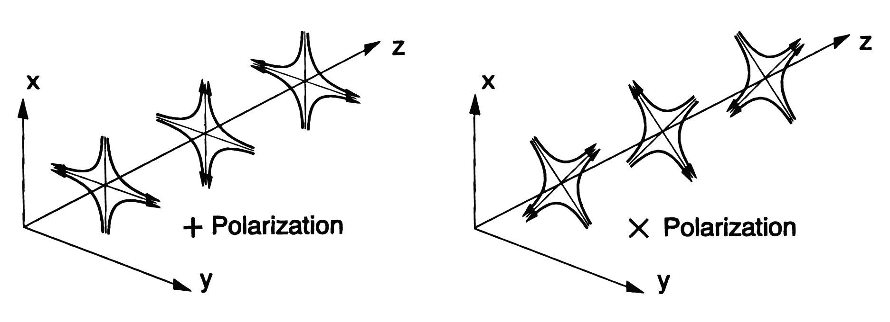
Two modes of gravitational waves
spacetime
metric
flat
spacetime
perturbation
wave equation
Quadrupole strain pattern
Notes:
Gmunu definition / Einstein tensor = function of g / EM wave / ds^2 =

Slide 5
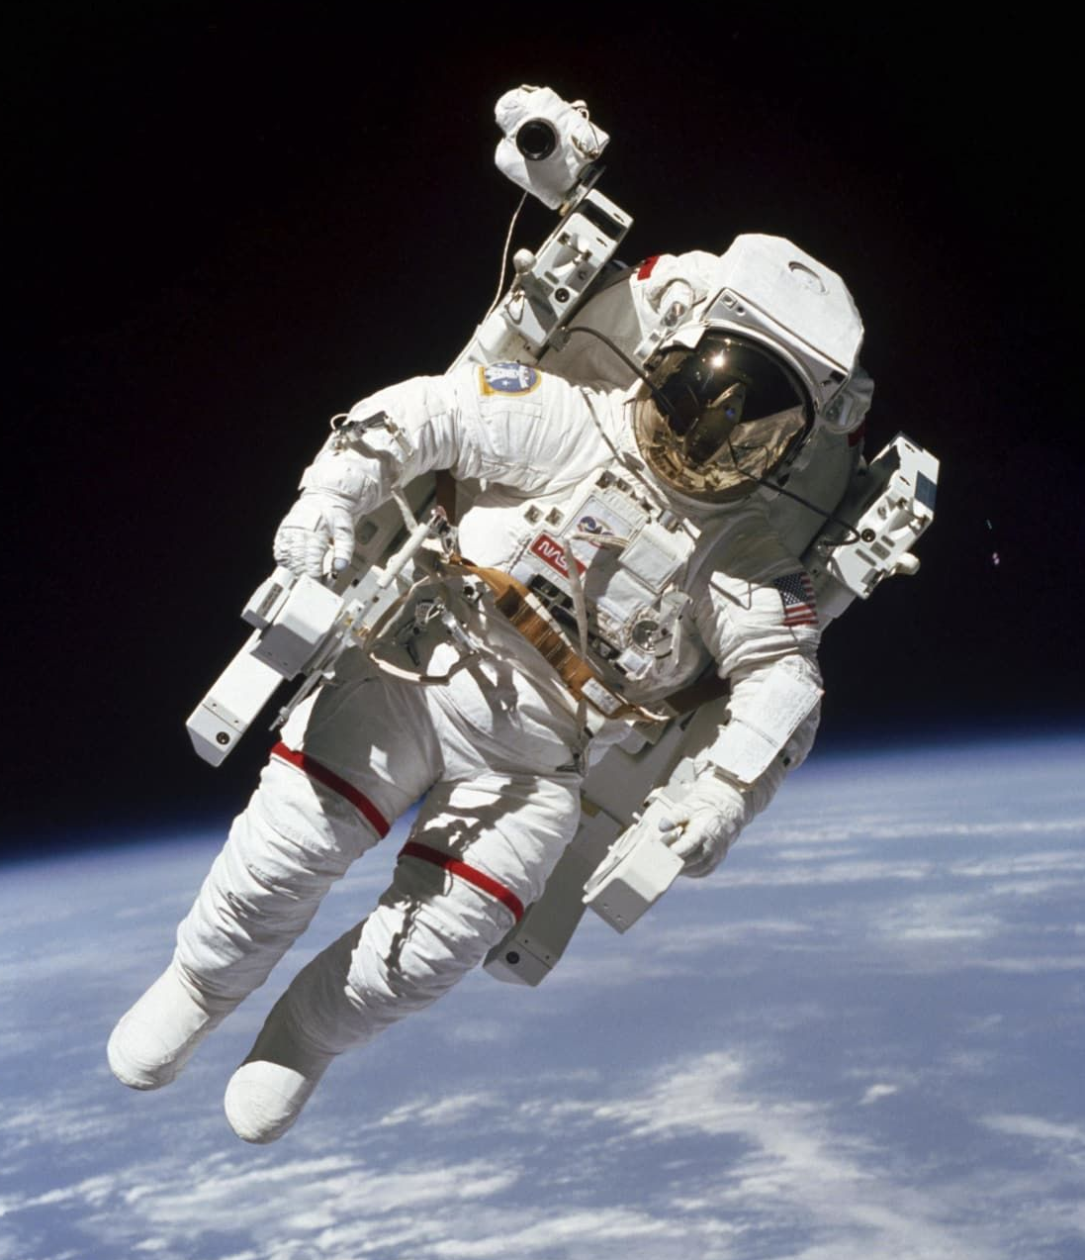
GW Detection
Two free-falling masses
Free fall? Free mass?
  => Equivance principle

Slide 6
GW Detection
Optically measure strain between free masses
  GWs do not appear in the local motions
  The effect appears in the optical distance between the masses
GW
L->L (1+h/2)

Slide 7
GW Detection
Measure strain between free masses
  GW does not appear in the local motion
  Changes optical distance between the masses
Longer the baseline, the bigger change
  (displacement dx) = (Strain h) x (baseline L)
GW
L->L (1+h/2)

Slide 8
GW Detection
Q: What happens if
  The mirrors are not free-falling
  The distance is measured with a tape measure with infinite precision
GW
L

Slide 9
GW detection with a laser interferometer
Michelson-type interferometer
  With suspended mirrors
End Mirror
Photodetector
Beamsplitter
Laser
End Mirror

Slide 10
GW detection with a laser interferometer
Q: Why is the Michelson interferometer suitable for GW detection?
End Mirror
Photodetector
Beamsplitter
Laser
End Mirror

Slide 11
GW detection with a laser interferometer
Michelson interferometer =
Optical phase meter
sensitive to differential arm displacement
  The effect of GWs have the nature of differential strain
  Insensitive to the wavelength (=frequency) change of the laser
  Laser interferometry allows us to read the phase of the light
  Laser beams can be propagated long distance without power loss

Slide 12
GW detection with a laser interferometer
Michelson-type interferometer
  With suspended mirrors
Differential path length change
  Intensity change at the output
The longer the arms, the better!
h
-> dx
Path length
change
Arm
length
GW
strain
L

Slide 13
GW detection with a laser interferometer
Q: Why are the mirrors suspended?
End Mirror
Photodetector
Beamsplitter
Laser
End Mirror

Slide 14
GW detection with a laser interferometer
Why are the mirrors suspended?
Above the resonant (pendulum) frequency,
a suspended mirror behaves as a free mass
At least in horizontal directions.
Notes:
&m \ddot{x} = - \frac{m g}{l} x + F_{\rm ext}\\
({\rm F.T.}) \Rightarrow &- \omega^2 \tilde{x} = - \omega_0^2 \tilde{x} + \tilde{F}_{\rm ext}/m\\
&\,\,\,\,\,\,(\omega_0 = \sqrt{g/l})\\
\Rightarrow &\frac{\tilde{x}}{\tilde{F}_{\rm ext}} = \frac{1}{m (\omega_0^2-\omega^2)}

Slide 15
GW detection with a laser interferometer
Plane light wave & propagation
  In a scaler model, the light field of a laser beam
  can be assumed as plane waves.

Slide 16
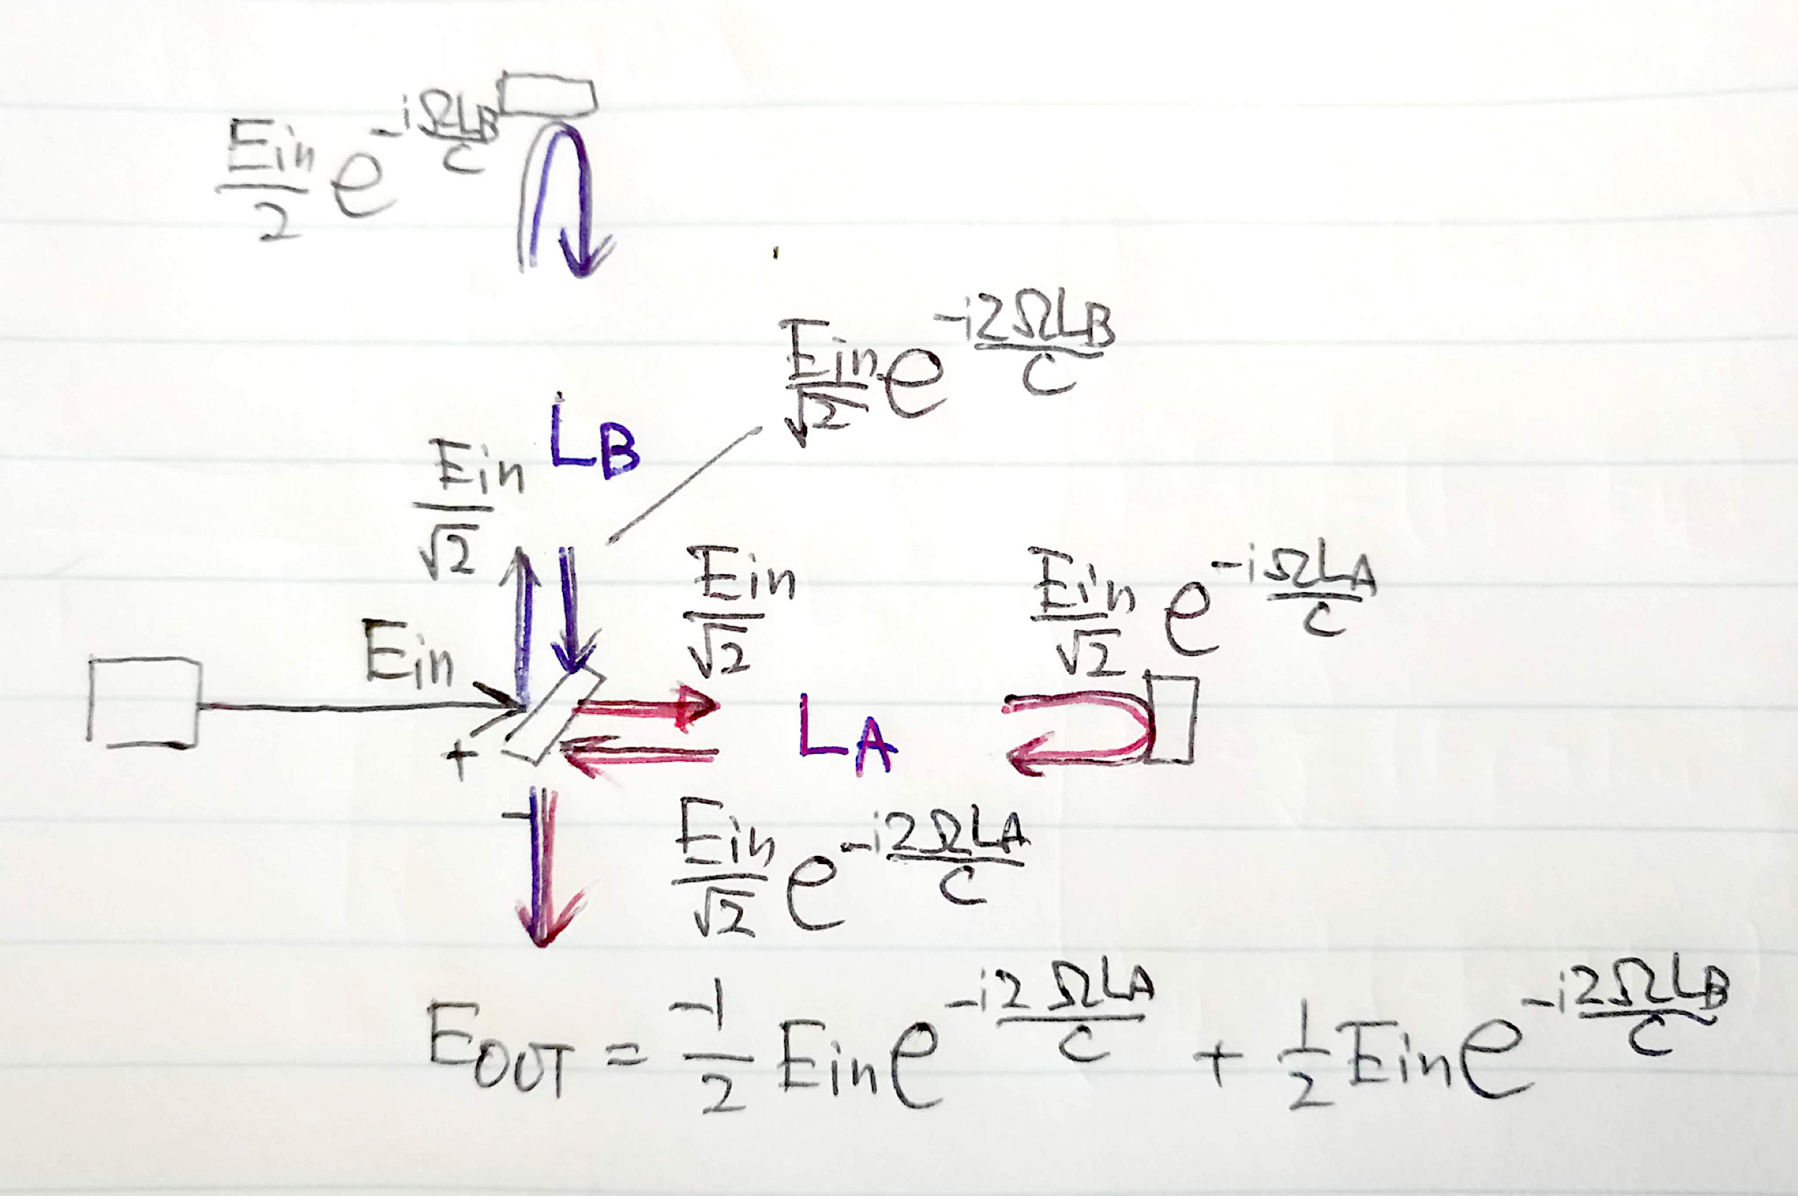
Michelson interferometer
Electric field in a Michelson interferometer

Slide 17
Michelson interferometer
Light intensity at the output port
  Difference of the electric fields from the arms
  Output intensity is sensitive
  to the differential phase

Slide 18
Michelson interferometer
Frequency response of the Michelson to GWs
Frequency response
of the Michelson interferometer
Ω: optical angular frequency, λ_{OPT} laser wavelength
ω: angular frequency of GW, λ_{GW} wavelength of GW
Jean-Yves Vinet,et al
Phys. Rev. D 38, 433 (1988)

Slide 19
Michelson interferometer
Frequency response of the Michelson to GWs
Cut off freq
longer -> lower
DC Response
longer -> larger
Notch freq
f = n c / (2 L)
  Michelson arm length optimized for 1kHz GW
  -> 75km, too long! => Fabry-Perot cavity

Slide 20
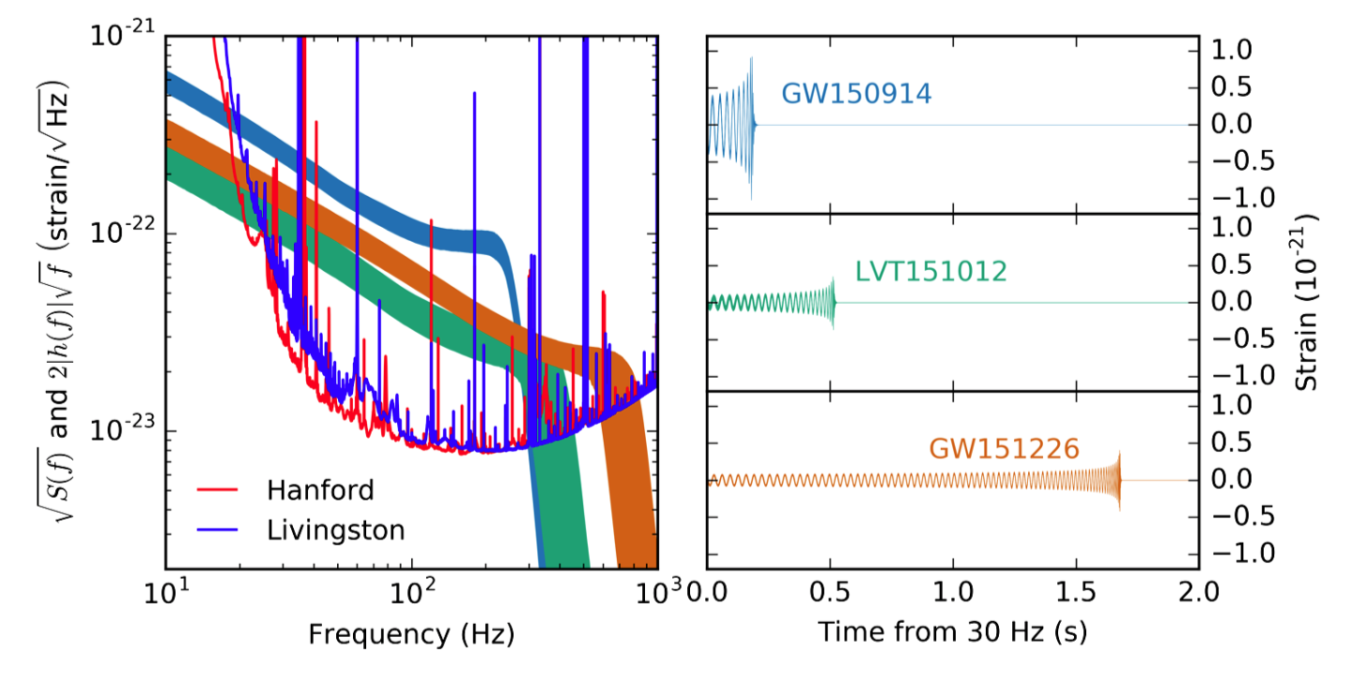
Comparison:
Michelson sensitivity and GW amplitudes
From Phys. Rev. X 6, 041015
Michelson sensitivity (4km 1W ): h ≈ 1.3×10⁻²⁰ /√Hz
Not enough at all!! What to do? (talk about it later)

Slide 21
Antenna pattern of a Michelson interferometer
Q: How does a Michelson interferometer reacts
to GWs coming from various directions?
End Mirror
Photodetector
Beamsplitter
Laser
End Mirror

Slide 22
Antenna pattern of a Michelson interferometer
Q: How does a Michelson interferometer reacts
to GWs coming from various directions?
End Mirror
Photodetector
Beamsplitter
Laser
End Mirror

Slide 23
Antenna pattern of a Michelson interferometer
Response of the interferometer to GWs
with + and x polarizations from various directions
+ x sqrt(“+”² +“x”²)
Directivity is very mild
➔ Need multiple detectors for source identification

Slide 24
Antenna pattern of a Michelson interferometer
Source identification with multiple detectors
Use difference of the signal arrival time
to triangulate the source direction
Two detectors are not enough
Need three or more.
GW
dt

Slide 25
Advanced topics
Angular & frequency response of an arbitrary optical path
  Draw an arbitrary optical path.
  What is the angular and frequency
  response of such a path?
  Can we use numerical “optimization”
  for certain criteria?
  e.g.
  better sky coverage, directive beaming,
  for certain source frequency, etc…
GW
GW
GW

Slide 26
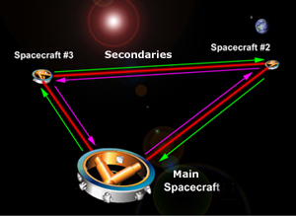
Advanced topics
Angular and frequency response of LISA
  R. Schilling, Class. Quantum Grav. 14 (1997) 1513-1519
Arm length 2.5Gm

Slide 27
Fabry-Perot Michelson Interferometer
Arms are too short
Use Fabry-Perot cavities in the arms
to store the light longer
Basic form of the modern interferometer GW detector

Slide 28
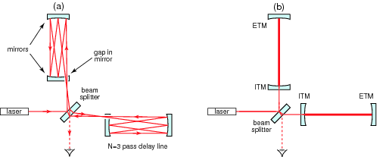
Fabry-Perot Michelson Interferometer
In the past, a delay line arm was considered
(easier to understand)
A FP arm is similar but use a single optical path

Slide 29
Fabry-Perot optical resonator
Storing light in an optical cavity
  Field equations
Very fast phase response

Slide 30
Fabry-Perot optical resonator
Storing light in an optical cavity
Finesse
Cutoff freq “Cavity pole”
DC Response
amplification
  1. FP increases stored power in the arm
  2. FP increases accumulation time of the signal
  => Above the roll-off, increasing F does not improve the response

Slide 31
Dual recycling
Even more mirrors for more light and signals
Power
recycling
mirror
Advanced LIGO
Dual-Recycled Fabry-Perot Michelson Interferometer
Signal
extraction
mirror
These recycling mirrors allows us to control the power increase in the arm and the signal storage time independently

Slide 32
GW telescope?
A continuous signal stream from an interferometer
Find GW signals in the sea of noise
  Detector noises produce fake detections
Reduce noises!
  Obs. distance is inv-proportional to noise level
  x10 better => x10 farther => x1000 more galaxies

Slide 33
GW telescope?
Noises & the signal
Noise = Background

Slide 34
Actual GW detector
4km FP arm cavities
Mode
Cleaner
Vacuum Envelope
Seismic Attenuation
Recycling
Mirrors
Analog Electronics
Digital Control
Mirror Suspension
(Quad Pendulum)
High
Power Laser
Data Analysis
Signal
Readout
Scheme
Data Storage
Mirror & Coating
Fused Silica fiber

Slide 35
Technologies of the GW detectors
3 elements of a laser GW detector
  Mechanics
  Optics
  Electronics

Slide 36
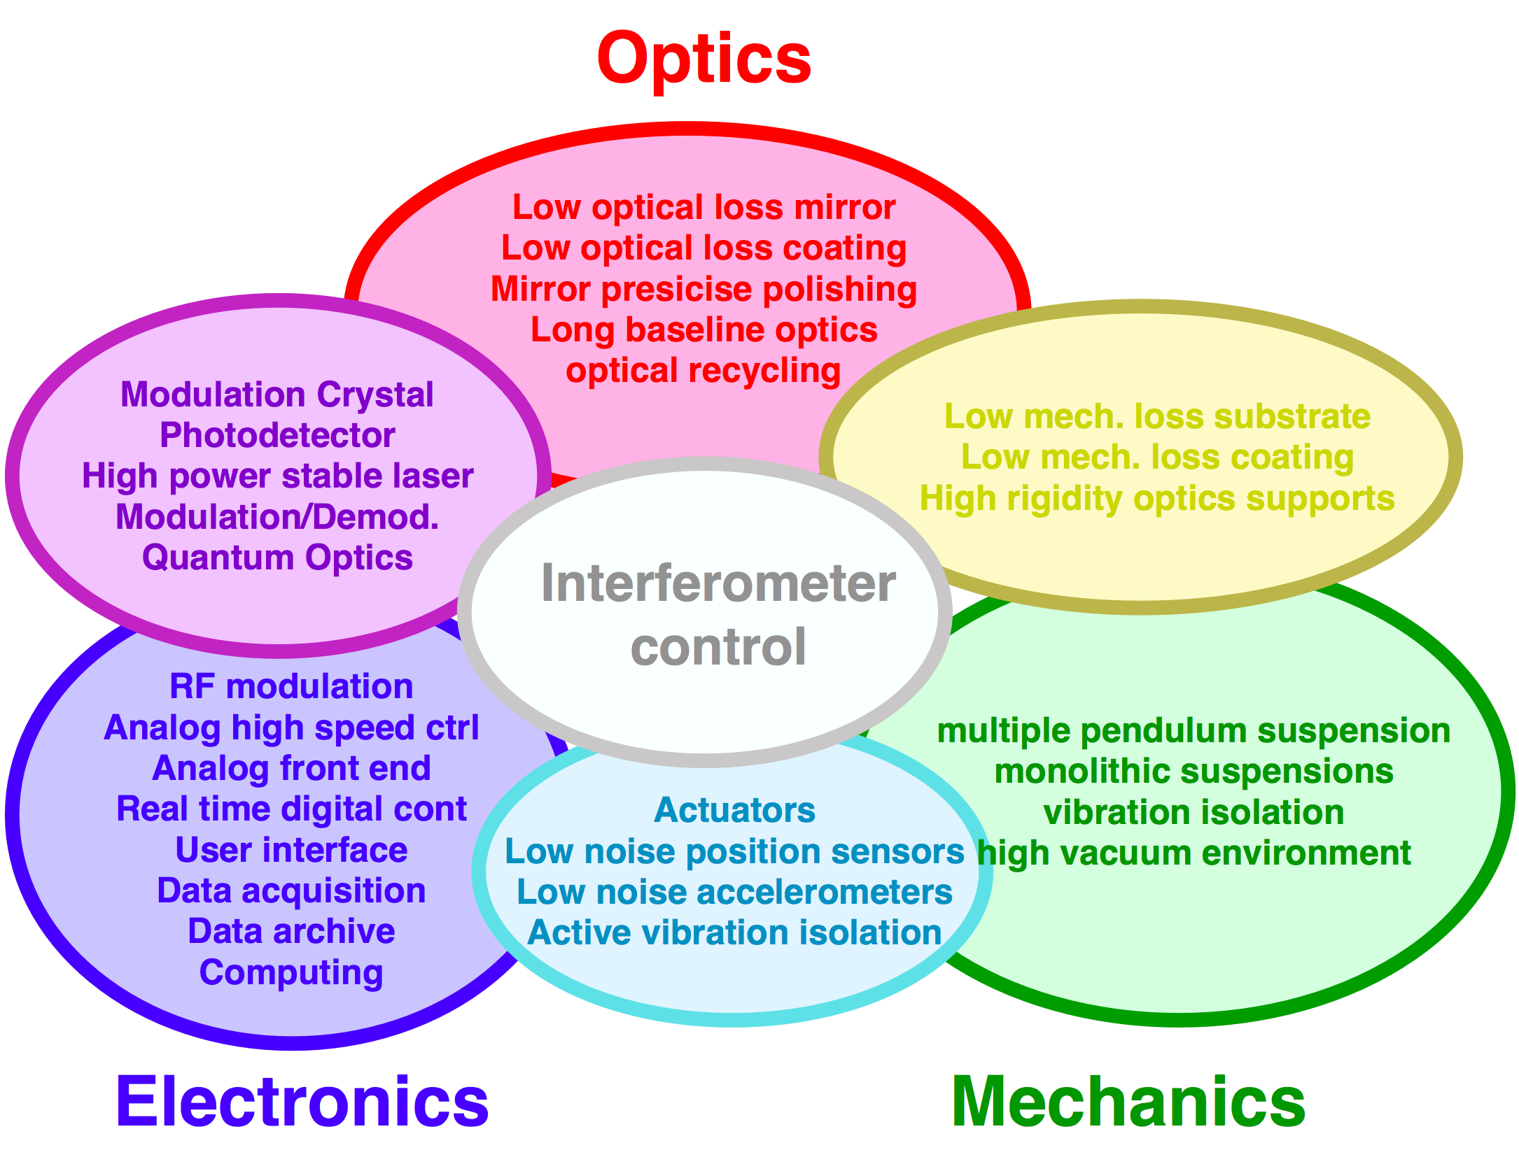
Technologies of the GW detectors
3 elements of a GW detector
  Mechanics
  Optics
  Electronics

Slide 37
Sensitivity and noise
Sensitivity (=noise level) of Advanced LIGO
Design

Slide 38
Sensitivity and noise
Sensitivity (=noise level) of Advanced LIGO
Current sensitivity
h= 8x10⁻²⁴ /rtHz

Slide 39
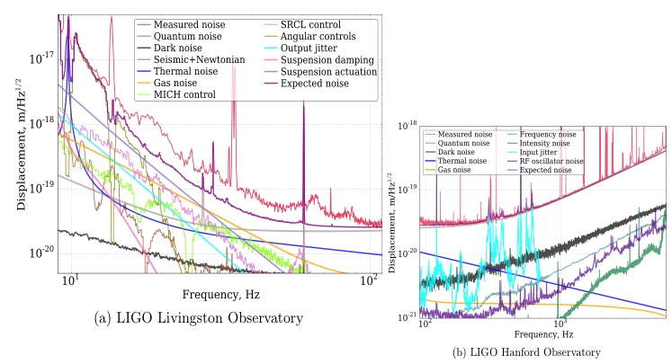
Sensitivity and noise
Sensitivity (=noise level) of Advanced LIGO
Noise budget
h= 2x10⁻²³ /rtHz

Slide 40
Summary
Interferometric GW detector
  GWs: Spacetime strain with quadrupole patterns
  Laser interferometry: Michelson type interferometer
  Multiple detectors: Triangulation for source identification
  Optical resonators: Fabry-Perot cavity and recycling
  Technologies: All for noise reduction

