Slide 1
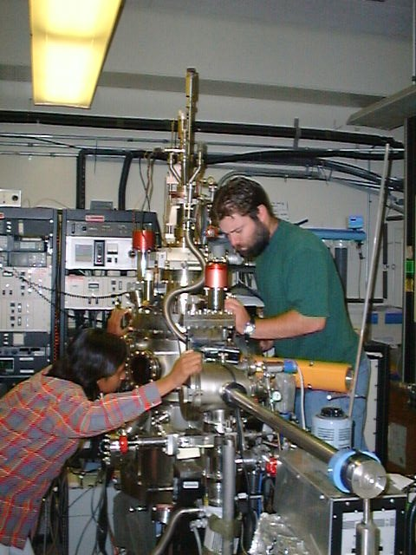
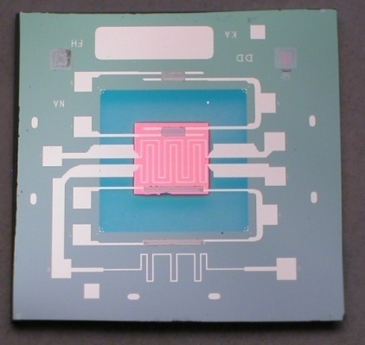
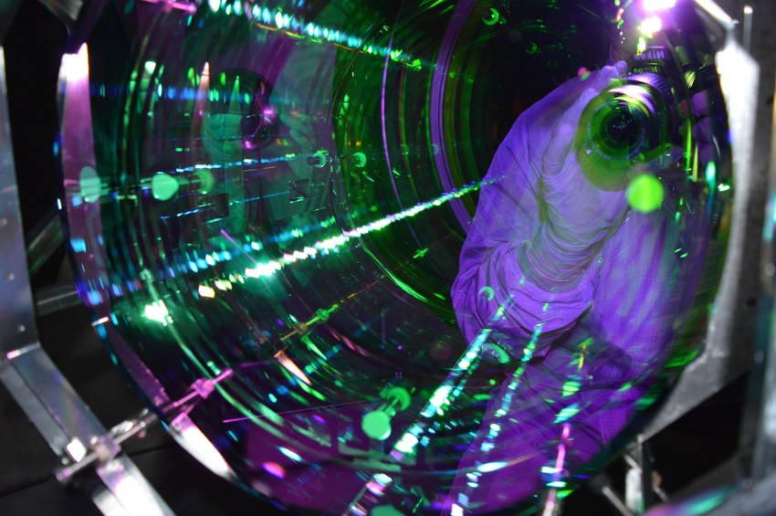


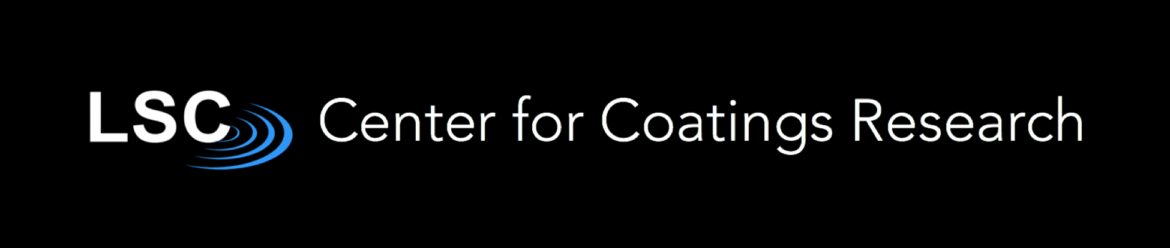
Two level systems and thermal noise why do coatings have this noise and how do we reduce it
Frances Hellman
University of California, Berkeley
New LIGO Coatings group member
Nanocalorimeters: Si micromachined chips for thin film heat capacity
UHV growth chambers for prototyping materials
Image credit: LIGO/Joe Hanson

Slide 2
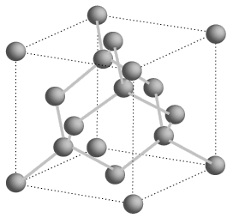
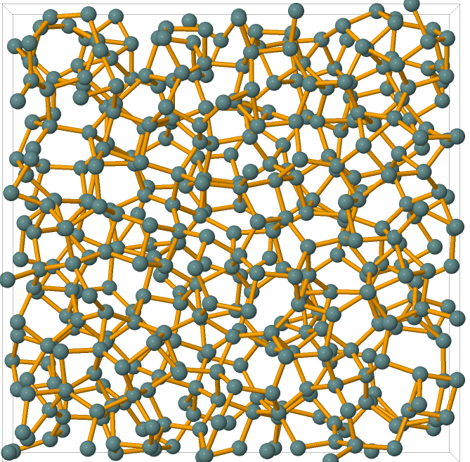
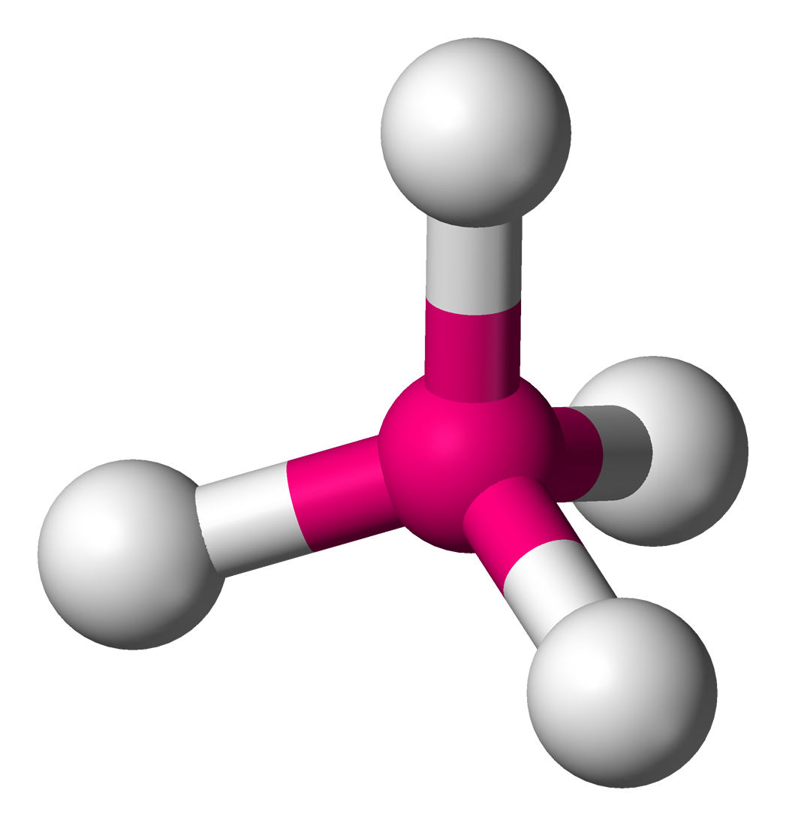
Traditionally, glasses quenched from liquid
Also can be made by vapor deposition
Structure of Silicon
Current mirror coatings are amorphous (=non-crystalline)
No long range structural order, but have short range order
Amorphous Si: still has tetrahedral coordination
109.5˚
SiO₂
Xtal Si: diamond structure
Image credit: Kiran Prasai
O-Si-O bonds are fixed angle but Si-O-Si angle is quite floppy –different energy scales
Si: Tetrahedrally-bonded (both xtal and “glass” = amorphous)
2

Slide 3
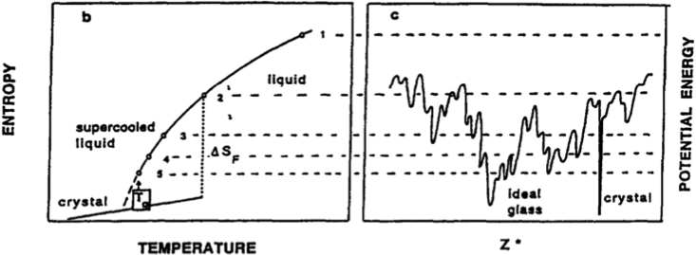
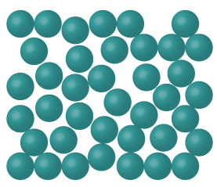
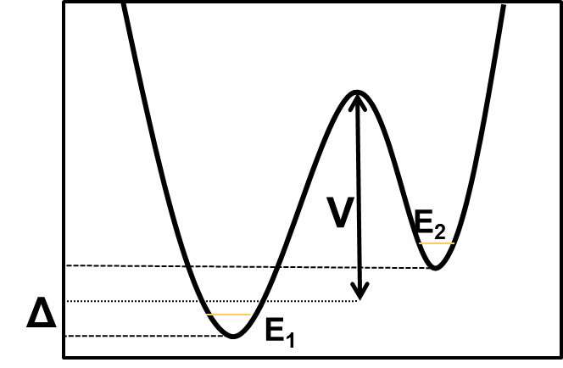
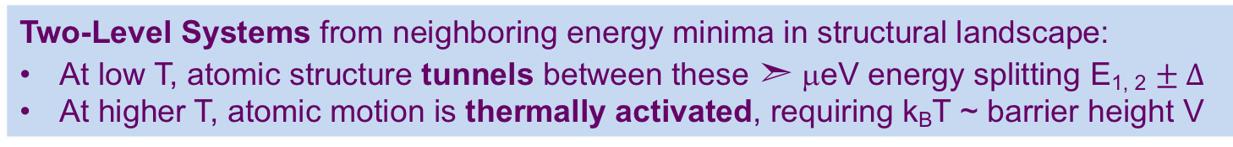
Energy landscape of configurations: “nearby” minima lead to tunneling or thermally-activated motion of groups of atoms
Anderson, et al., Philos. Mag., 25 1 (1972)
Phillips, J. Low. Temp. Phys., 7 3-4 (1972)
C.A. Angell, Physica D 107, 122 (1997)
τ(T)
Two-Level Systems from neighboring energy minima in structural landscape:
At low T, atomic structure tunnels between these ➣ μeV energy splitting E_{1, 2} $± Δ$
At higher T, atomic motion is thermally activated, requiring k_{B}T ~ barrier height V
In both cases, atomic motion leads to dissipation (thermal noise)
For a single V, dissipation at frequency ω will have a peak at temperature T
at 1 kHz, 0.5 eV barrier heights has a peak ~ room temperature
50 meV barrier heights has a peak ~ 30K
A distribution of μeV tunneling-induced energy splitting leads to T-independent losses
Ideality & tunneling level systems in thin film a-Si
APS March meeting 5/16/18
3
Notes:
Heat capacity of glasses
- Zeller and Pohl demonstrated that a wide range of glasses have a heat capacity that is remarkably different than their crystalline counter parts.
- The low temperature linear heat capacity has been explained by the phenomenological Two Level Systems (TLS) model
- This model proposes that single atoms or groups of atoms are in a local energy minima but that there are nearby minima due to other structural configurations that could have been frozen in at the glass transition.
- The finite overlap of the ground state wave functions of the minima leads to a splitting of the ground state energy and this is the source of the low energy excitaitons.
Excess heat capacity of dangling bonds
- The heat capacity of dangling bonds has been measured in e-beam a-Si
- The lifting of the spin degeneracy leads to a Schottky anamoly below 1K
Return to Internal friction
- The IF of a-Si:H is constant from 0.3K to 100K as is seen in other glasses where structural configurations lead to TLS
- The IF of e-beam a-Si shows no magnetic field dependence and nothing that would correspond to the Schottky anomaly seen by Lohneysen.
- This would indicate that the TLS in a-Si and a-Si:H are structural in nature and not electronic.
- Additionally, the dark recovery time for light induced TLS in the internal friction is similar to the electronic recovery time for the photoconductivity
Our question: How does the light soaking effect seen in a-Si:H relate the TLS model of glasses to the Staebler-Wronski Effect? Is there a structural component to this effect?

Slide 4
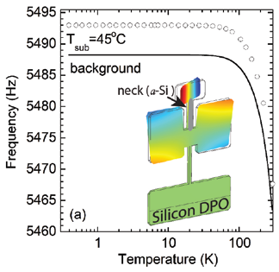
Internal friction to measure losses
Measure resonant frequency and internal friction (damping) Q⁻¹ of a xtal Si double paddle oscillator (DPO) or cantilever as a function of T before and after depositing a film, or a silica disk at room temperature using GeNS (gentle nodal suspension)
X. Liu and R.O. Pohl, Phys. Rev. B 58, 9067 (1998)
Q⁻¹ vs T before and after a-Si sample
Internal friction Q⁻¹(T) has a low T plateau due to tunneling two level system (TLS)-phonon interactions
  Q_{o}⁻¹ proportional to P (density of TLS) with a poorly understoood TLS – phonon coupling parameter γ , also called the deformation potential
Q₀⁻¹ = πPγ²/2ρv²
ρ is density, and v is sound velocity
a-Si
-
Annealed a-Si
-
4
Notes:
Internal friction
- Internal Friction (acoustic attenuation) measures the interaction between the TLS and the acoustic waves.
- The magnitude of the IF is proportional to the density of TLS.
a-Si less than a-SiO2 and other bulk glasses (range shown with arrow)
a) paddle, paddle + c-Si (same); paddle +e-beam a-Si, and again after annealing. b) paddle (background) subtracted)

Slide 5
“Universal” mechanical losses at low T (tunneling)
Higher T more variable, including peaks (thermally activated)
bulk a-SiO₂ and other glasses
large variety of glasses
have similar cryo behavior
SiO₂ R.T. dip
K.A. Topp, Z. Physik B Condensed Matter 101 235–45 (1996)
5
Notes:
the "big dip" might be attributable to the strong covalent network of silica and the fact that there are some low-energy, short-range excitations, and then no other structural motif is really available to contribute to the loss until temperatures that are quite a bit higher.

Slide 6
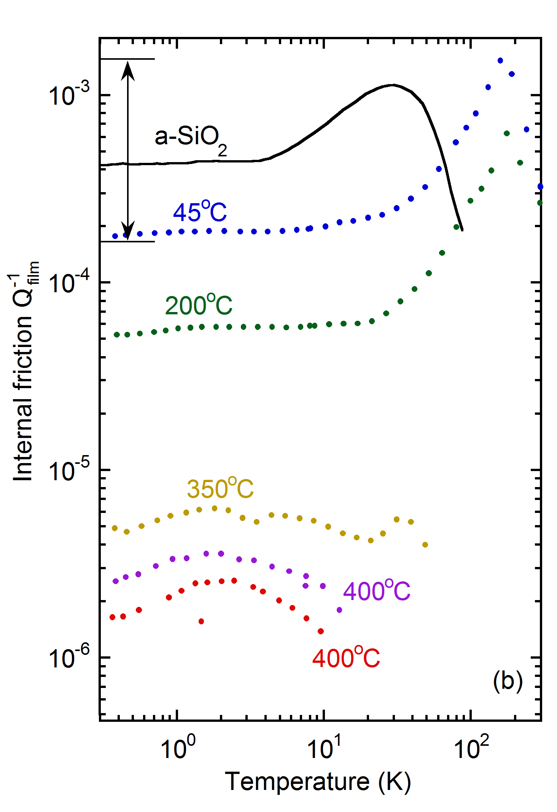
Thin film amorphous Silicon: internal friction Q⁻¹ (and excess heat capacity) is strongly reduced (decades) by increased growth T_{s}
a-Si films grown at lower T_{s} have typical (high) Q⁻¹ (like a-SiO₂)
a-Si films grown at 400°C have very low Q⁻¹ at low T (perhaps good for LIGO Voyager); (at RT better but only 4x)
BUT, large absorption – likely need H to eliminate dangling bonds in a-Si
a-Si:H has low Q⁻¹ (although peaks not well understood) BUT has high excess low T heat capacity indicating local structures that cause loss are present, just not coupling to acoustic waves – why and what does this do to higher temp loss???
Internal friction Q⁻¹ _{film}
a-Si:H
a-Si grown at higher T_{s}
D. R. Queen, X. Liu, J. Karel, T.H. Metcalf, F. Hellman, Phys. Rev. Lett. 110, 135901 (2013).
X. Liu, D. R. Queen, T. H. Metcalf, J. E. Karel, F. Hellman, Phys. Rev. Lett. 113, 025503 (2014).
D.R. Queen, X. Liu, J. Karel, Q. Wang, R.S. Crandall, T.H. Metcalf, F. Hellman, Eur. Phys. Lett. 112, 26001 (2015).
M. Molina-Ruiz, H. C. Jacks, D.R. Queen, T. Metcalf, X. Liu, Q. Wang, R. S. Crandall, F. Hellman, in preparation
6
Notes:
On the right I show our “phase diagram” and on the left is a plot of C/T^3 versus T plotted on a log-log scale. Let me walk you through this starting with vitreous silica at the top of the phase diagram. This sample is in the “glassy regime” and is what we would associate with universal behavior. On the left this is the solid black line with the TLS upturn below 1K and Boson peak around 20K. Moving down to the e-beam evaporated silicon, we see the heat capacity increase at the Boson peak and the low temperature heat capacity is Debye like.
Now, the amorphous silicon nitride, which we get from our addenda measurement, shows a Boson peak at 100K and a large upturn in the heat capacity well above 1K. Similarly, the HWCVD a-Si:H films, which are not expected to have any TLS, have a large up-turn on this plot starting near the Boson peak.
This is completely unexpected if you just look at the internal friction data as plotted on our phase diagram. The internal friction tells us that we should not see any density of TLS in these films and the TLS model says that we should not see any TLS because of the over-constrained tetrahedral bonding. One obvious candidate is hydrogen but we do not see any appreciable difference between 4 and 8 at. % H films. Another obvious candidate is dangling bonds which are know to strongly influence the optical and electronic properties of a-Si. But e-beam a-Si is known to have 10¹⁹ cm⁻³ dangling bonds while device quality a-Si:H has 10¹⁵ – 10¹⁶ cm⁻³ dangling bonds. Light soaking these films will increase this dangling bond density by an order of magnitude and this has been shown to increase the internal friction.

Slide 7
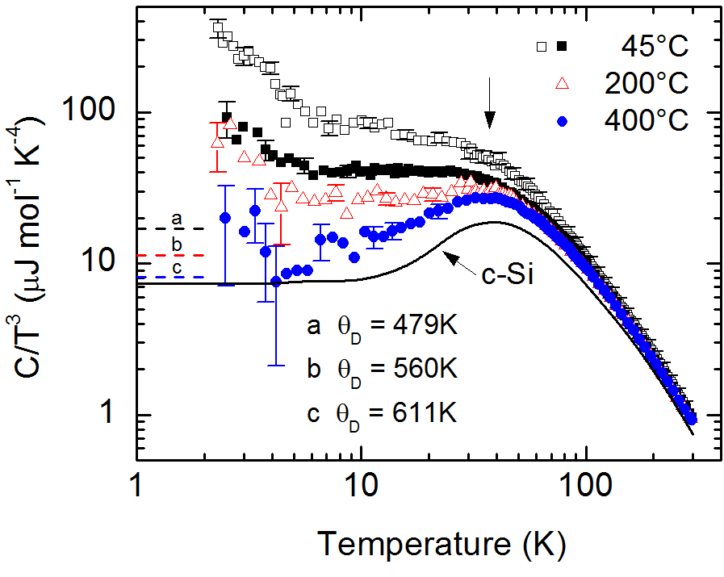
Variable TLS in a-Si also in specific heat C: excess C at low T
Linear term in C: c₁ ~ n₀
Excess T³ term (c_{ex})
θ_{D}=645K
Films grown at 400°C have C(T) only a little above c-Si; small n₀ and small c_{ex}
(Also, thermal conductivity shows no plateau)
Films grown at lower T_{s} have excess Q⁻¹ and C(T) above Debye value (from transverse and longitudinal sound velocity measurements)
Fit low T C(T) to c₁T + C₃T³; both n₀ and c_{ex} depend on T_{s} and on film thickness
Sound velocity, bond angle distribution, nanovoid size depend on T_{s} & not thickness
7
Notes:
Heat capacity: Upturn in C/T³ typical of TLS in amorphous materials
Large T³ term
Internal friction: Shows plateau that is typical of TLS
Both C_{P} and Q⁻¹ are independent of field indicating not electronic states of dangling bonds

Slide 8
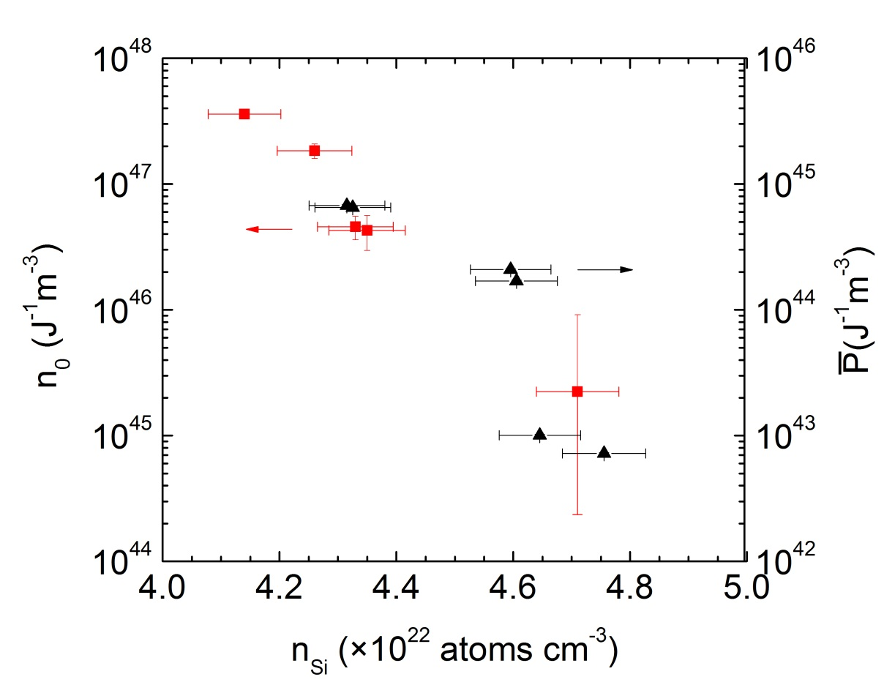
TLS density from specific heat and internal friction are proportional to each other, and depend on film density
Crystalline Silicon:
n_{Si}=5×10²² cm⁻³
_
n_{o} and P vanish as n_{Si} → n_{crystalline Si}
n₀/P ~ 8 – similar to other glasses. n_{o} and P proportional in usual TLS model
TLS vanish with increasing n_{Si} – associated with low density regions/nanovoids??
Correlation is over nearly 3 decades
_
_
8
Notes:
Comparison of n₀ and P with material parameters show that the TLS density is largest in low density films.
Suggests that TLS occur in low density regions of the film such as microvoids. Similar result found in the thermal conductivity of a-Ge.
Film density depends on growth temperature and film thickness.
n₀/P~100 which suggests that all the TLS relax on the 1ms time scale of the measurement. Typical bulk measurement time constants are 10s. This result constrains the long time tails of the TLS distribution by four orders of magnitude.
c_{ex} also shows a density dependence suggesting that the T³ term has a common origin with the TLS. This origin is not addressed in the standard tunneling model.
Models such as the soft potential model try to capture this but so far we have formulated the model in such a way to capture this behavior.

Slide 9
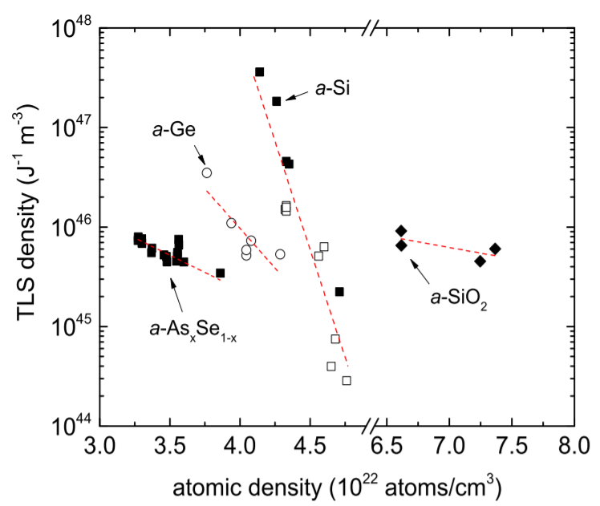
TLS (either n_{o} or P) dependence on atomic density seen in a range of amorphous materials
_
From D.R. Queen et al., JNCS 426 (2015), 19-24
9
Notes:
Comparison of n₀ and P with material parameters show that the TLS density is largest in low density films.
Suggests that TLS occur in low density regions of the film such as microvoids. Similar result found in the thermal conductivity of a-Ge.
Film density depends on growth temperature and film thickness.
n₀/P~100 which suggests that all the TLS relax on the 1ms time scale of the measurement. Typical bulk measurement time constants are 10s. This result constrains the long time tails of the TLS distribution by four orders of magnitude.
c_{ex} also shows a density dependence suggesting that the T³ term has a common origin with the TLS. This origin is not addressed in the standard tunneling model.
Models such as the soft potential model try to capture this but so far we have formulated the model in such a way to capture this behavior.

Slide 10
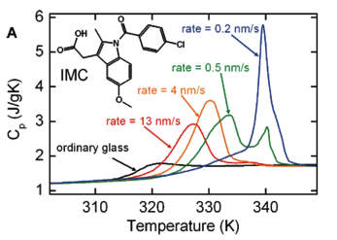
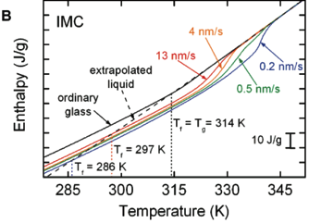
Vapor deposited films of indomethacin (IMC); ultrastable glasses with low TLS grown at T_{s} < glass transition T_{g}
Heat capacities and enthalpies for vapor deposited glasses of indomethacin (IMC) with decreasing deposition rates; grown at “magic” T_{s} ~ 0.8 T_{g}. As rates are lowered, T_{f} decreases, as does enthalpy, indicating a more stable glass. Similar effects seen with growth T.
These films also have low TLS!!
T. Perez-Castaneda, C. Rodriguez-Tinoco, J. Rodriguez-Viejo, M.A. Ramos, “Suppression of tunneling two-level systems in ultrastable glasses of indomethacin,” PNAS 111(31), 11275 (2014)
M.D. Ediger, “Vapor-deposited glasses provide clearer view of two-level systems,” PNAS 111(31), 11232 (2014).
10

Slide 11
Hypotheses re vapor deposited a-Si
Vapor deposited films of covalent materials such as a-Si or a-SiO_{x} (or Alumina or SiNx or Tantala) have to date not been probed for ideality/ultrastability
The glass transition of a-Si has never been measured (because it can’t be quenched) but theory suggests 850K (C.R. Miranda and A. Antonelli, J. Chem Phys 120, 11672 (2004).
Our growth T to get low TLS is 673K ~ 0.8 T_{g}!! (similar to IMC work)
We have also seen effects of deposition rate and thickness on density and TLS, similar to IMC work; TLS measurements in progress on these other films
11

Slide 12
Connection between energy landscape, entropy, and TLS
C.A. Angell, Physica D 107, 122 (1997)
TLS
X
No TLS
T_{Kauzmann} where (extrapolated) entropy of supercooled liquid crosses crystal!
The energy landscape (right) as related to the glass transition of a liquid (left). Glasses falling out of the equilibrium supercooled liquid at a given dashed line correspond to configurations in the energy landscape.
Hypothesis: vapor deposition offers a way to directly access low lying (ideal) glass state
Due to high atomic mobility at film growth surface despite being at low T.
Hypothesis: Ideal glass has no nearby energy minima, so no TLS, unlike most other states
12

Slide 13
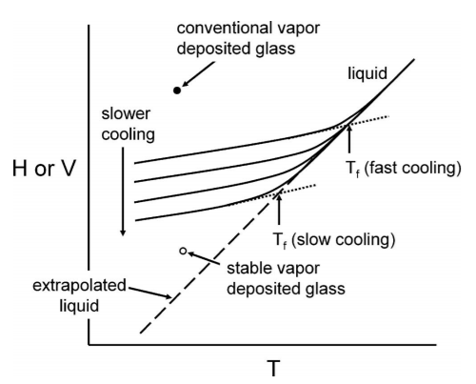
Enthalpy or Volume (density) as a function of T starting from liquid
Vapor deposited compared to liquid quenching of amorphous material
High loss
H and V based on simulations of atoms with simple bonds (Lennard- Jones). Kiran Prasan will talk about a-Si.
Kearns, Swallow, Ediger, J. Chem. Phys. 127, 154702 (2007)
Low loss
Could this apply to vapor deposited amorphous SiO₂?
Does this lower losses at all T, some T, for all materials?
13

Slide 14
Comments and Open questions
Random first order transition (RFOT) theory of glass transition predicts divergence of correlation length ξ of supercooled liquid as T➔T_{K}
Also predicts TLS density ~ ξ⁻³ , supporting the hypothesis that TLS density is highly suppressed for deposition T near T_{K}
But, surface diffusion needs to be fast near T_{K} , argues T_{K} needs to be ~T_{g}, (which means “fragile” glasses like a-Si and indomethacin, not a-SiO₂)
But, a-SiO₂ has a high density of low energy floppy modes, so perhaps
OPEN QUESTIONS
Is low TLS related to growth near T_{K}? (If (and only if) surface mobility during growth is high). Fragile glasses have T_{K} near T_{g}, where mobility is high, so low TLS would be correlated with fragility
Or is low TLS related to nature of bonding: overconstrained (tetrahedral Si) versus underconstrained (Si-O-Si bonds in SiO₂)
Test with amorphous SiO₂, Ta₂O₅, Al₂O₃, and Se_{x}Ge_{1-x} alloys!!
What is the relationship to density in the IBS overdense films, which could be higher in the energy landscape with higher TLS.
14

Slide 15
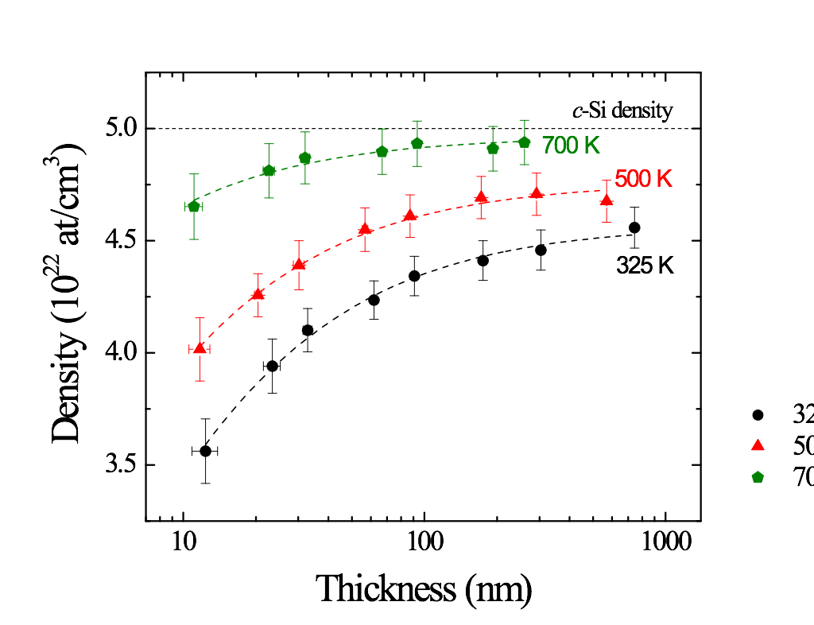
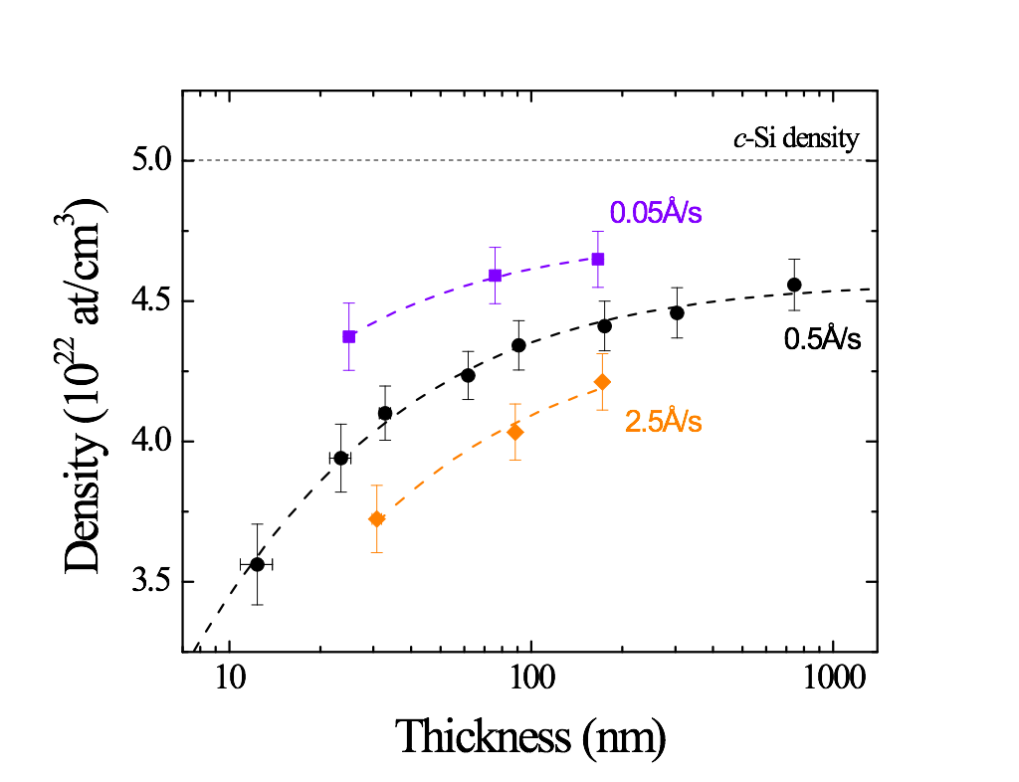
Growth parameters substantially modify amorphous Si film density and some measures of structure
0.5Å/s
325K
Thickness, growth temperature T_{g}, and growth rate affect film density and roughness; room T growth flattest for all thicknesses; higher T_{g} thin is flat, roughens with thickness (1.5 nm RMS at 300 nm)
Thinner, low growth T, high growth rate films are less dense
On what length scale(s) do density changes occur? Little variation in dangling bond density or macroscale structure
Variations in bond angle disorder, medium range order, nanovoid size and number
(Raman, Fluctuation Electron Microscopy, positron doppler broadening spectroscopy)
Which of these matter to TLS? Structural work (Kiran Prasai and Hai-Ping Cheng)
15

Slide 16
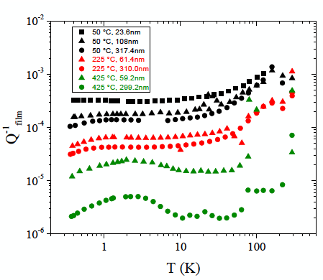
Amorphous Silicon losses: thickness also matters
Thin films are more lossy than thick films (not per volume, absolute)
Correlates with atomic density differences (thick films are denser)
Annealing reduces loss, but not much (at low T) compared to growth T effects
Grown room temp
Incr. thickness
Grown 225 C
Grown 425 C
16

Slide 17
More recent data on internal friction (IF) derived TLS density (specific heat still in progress)
Low density plateau in P shows that IF-derived TLS do not continue to increase with lower density samples
Two possible conclusions:
Larger nanovoids in the lower density (thinner, faster growth rate, lower growth temperature) do not create more TLS (then specific heat n₀ would also plateau)
TLS decouple from phonons in lower density films (then specific heat n₀ would continue to increase) – one data point suggests this low γ idea
17

Slide 18
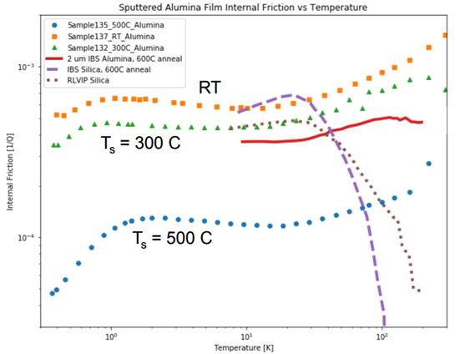
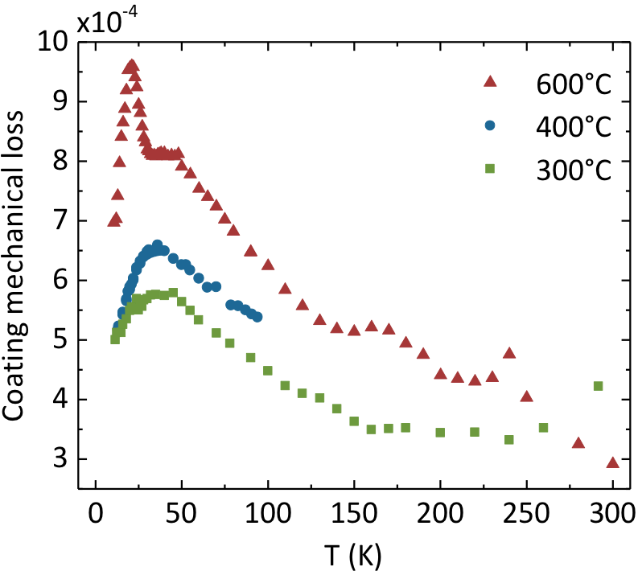
Other current materials in LIGO coatings:
Magnetron sputtered
Al₂O₃ (Abernathy, NRL)
LIGO-G1800418
Alumina (amorphous Al₂O₃) has reduced losses (at all T) when grown at elevated T_{s}
10⁻³
Amorphous Si₃N₄ – grown by LPCVD, at elevated T. Losses <1x10⁻⁴ at all T
Jessica, Glasgow, LVC G1800585-1
10⁻⁴
I W Martin et al, Class. Quant. Grav. 27 225020, 2010; CQG 35 075001
Discussed in next talk Kiran Prasai
Tantala (Ta₂O₅): annealing more effective, growth T less effective – why?
Elevated temperature growth of IBS tantala: T_{s} up to 400 C) reduces RT loss
RT loss decreases with T_{anneal} until limited by crystallization
Annealing improves loss at 300K, increases it at low T
18

Slide 19
Overview and future LIGO- specific directions
Room T: Tantala is improving! Have ~1x10⁻⁴ loss materials via annealing & doping
  Understand better the structural causes of loss to enable further improvements (Kieran Prasai talk)
  Look for a different high index material that has bond energies like a-SiO₂ with really low losses. The key seems to be separation of bond energy scales
  Look for a narrow gap (high index) fragile glass like a-Si with higher band gap
Low T: Amorphous silicon is a promising high index material (for long λ) below 50K, with low losses (absorption still needs improvement); losses not yet known at 123K
What about the low index material?
Silica ≈ 1x10⁻⁴ at 123K – ok; 5x10⁻⁴ at 10 K – pretty high (although there is a T in the S(f,T) so maybe good enough)
  In many cases annealing improves high temperature loss, but worsens low temperature loss. Strengthening some bonds, weakening others.
  Perhaps vapor deposition at elevated temperatures can access an ideal glass, low loss at low T state in SiO₂ that is inaccessible by liquid quenching or annealing! (in progress)
Al₂O₃ and SiN are alternative good low index candidates with low loss
  May not be necessary to achieve low TLS; it may be enough to have low coupling constant γ! (already have seen this effect in a-SiNx, also low density a-Si and a-Si:H)
19

