Slide 1
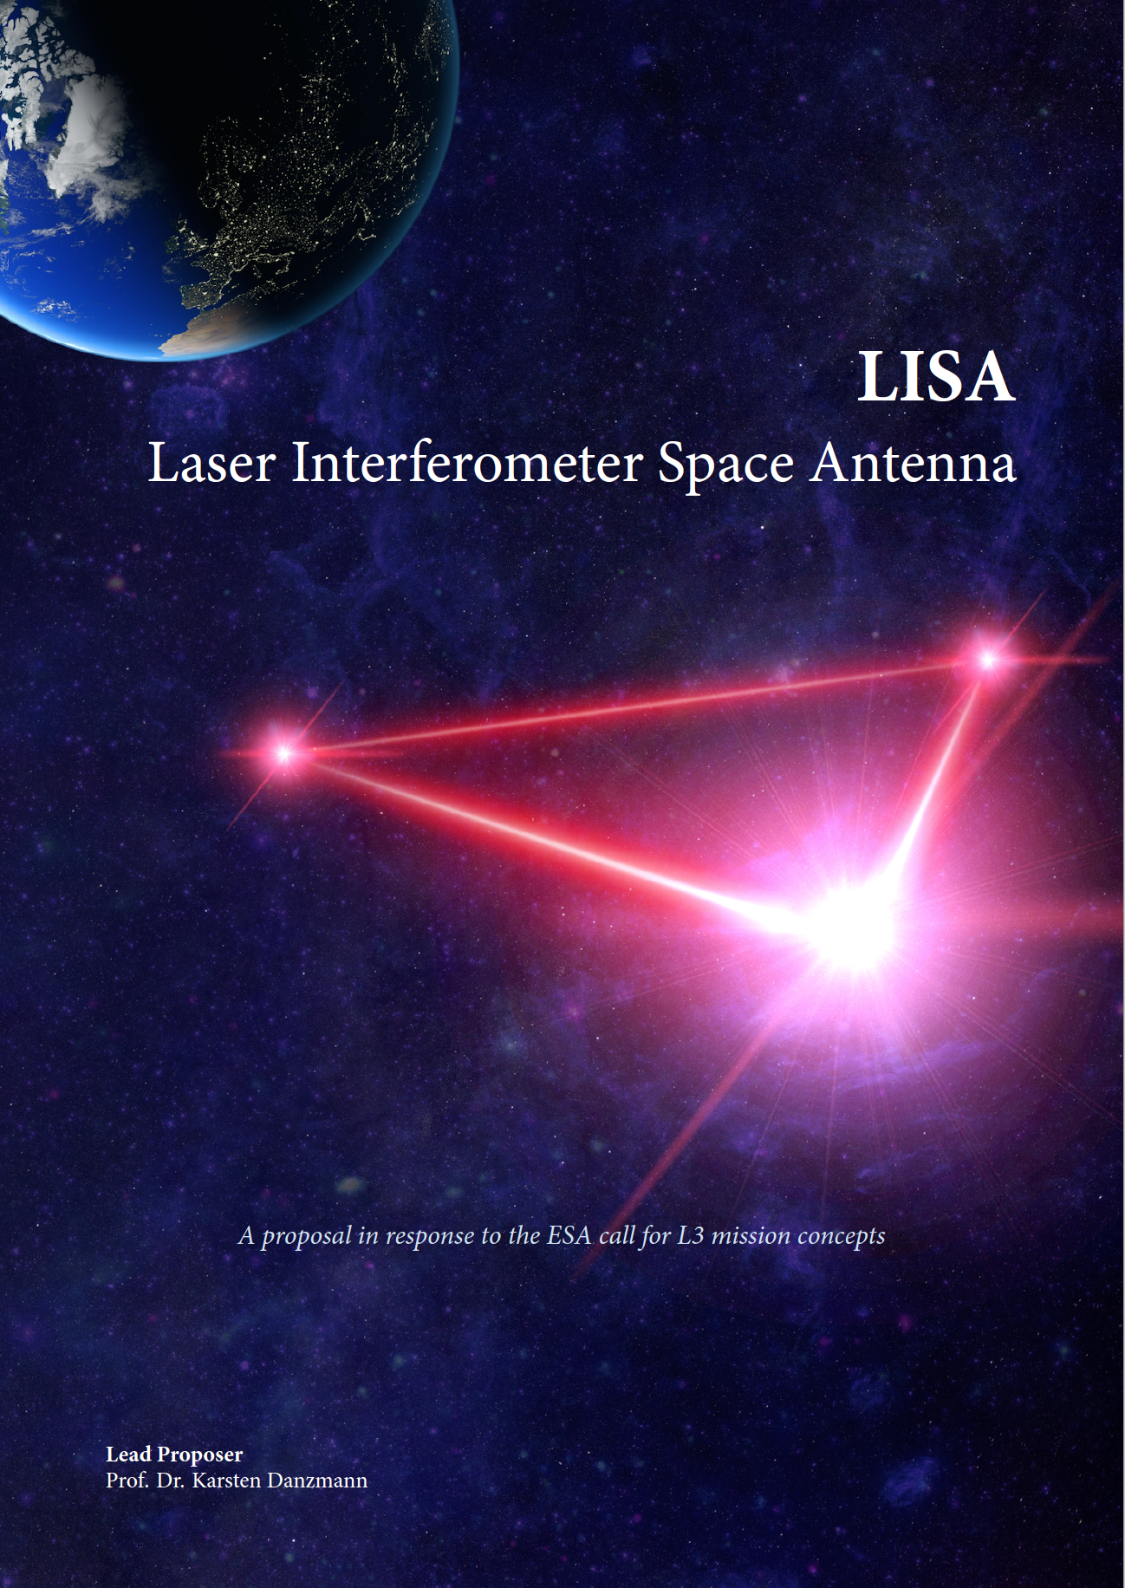
D. Shoemaker
for the LISA Consortium
GWADW
11 May 2018
Based on materials from Martin Hewitson and other LISA Colleagues
LIGO DCC G1800974

Slide 2
Contents
Mission constraints and design
LISA Pathfinder Heritage
The path to launch
Science from Kelly, John

Slide 3
GW Spectrum
http://rhcole.com/apps/GWplotter/
huge
big
small
>10⁹ M☉
10⁶ M☉
10 M☉

Slide 4
The LISA Concept
Probe the change in proper time between pairs of free-falling test masses caused by GWs
Free-falling test masses are housed in drag-free spacecraft separated by a few million km
Proper time is inferred by the time of flight of photons exchanged between the satellites
We have multiple transponder links from which we can form Michelson-like signals

Slide 5
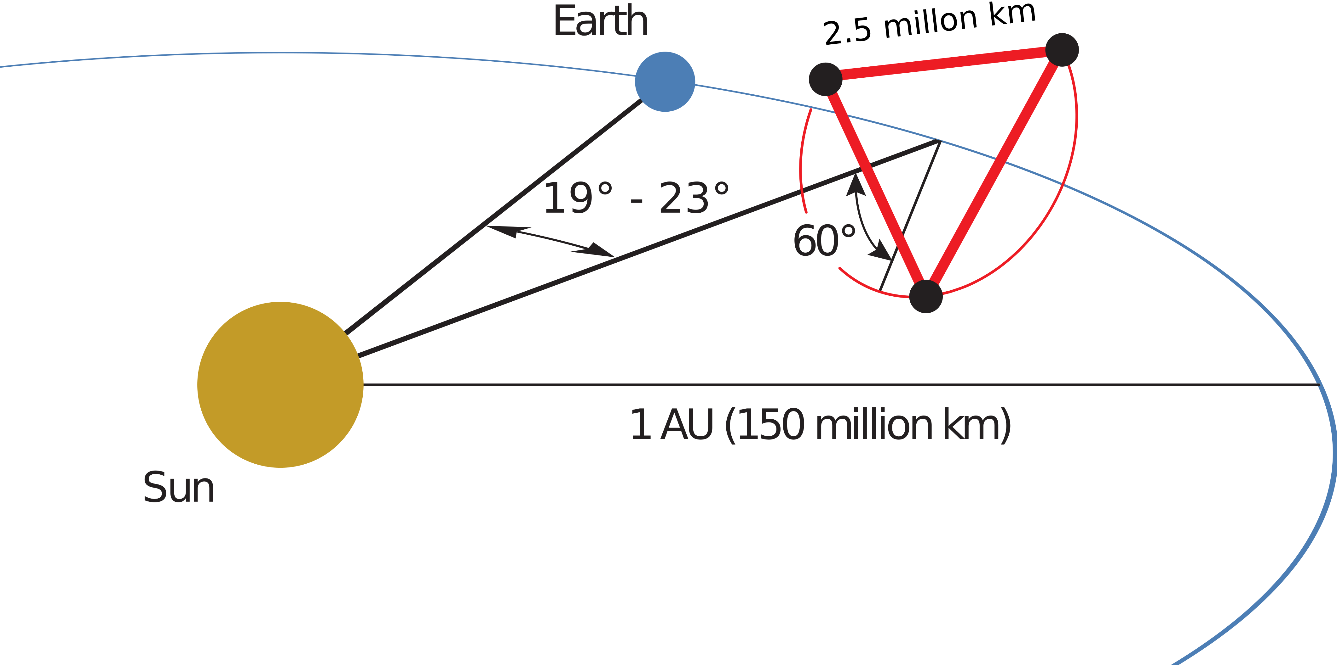
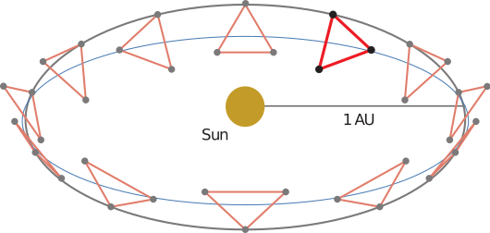
A constellation of three satellites
60 million km to earth
(~3 minutes)

Slide 6
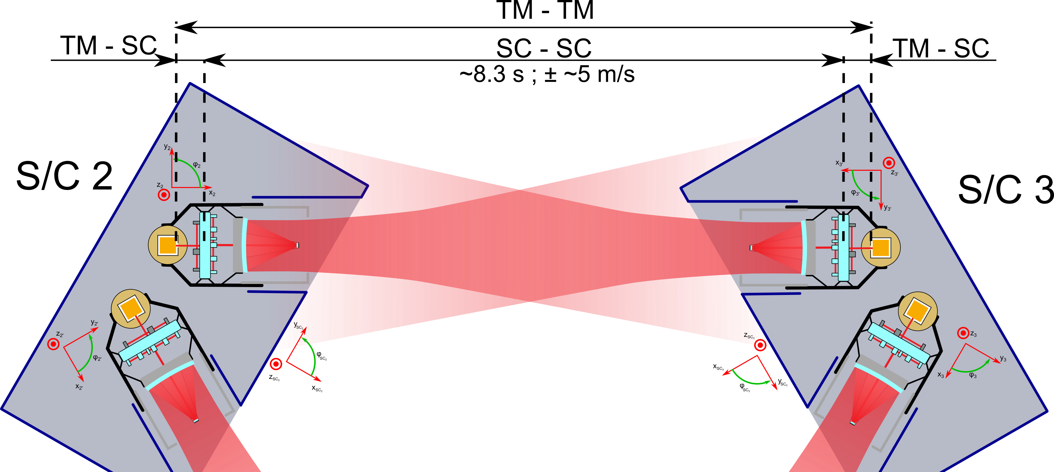
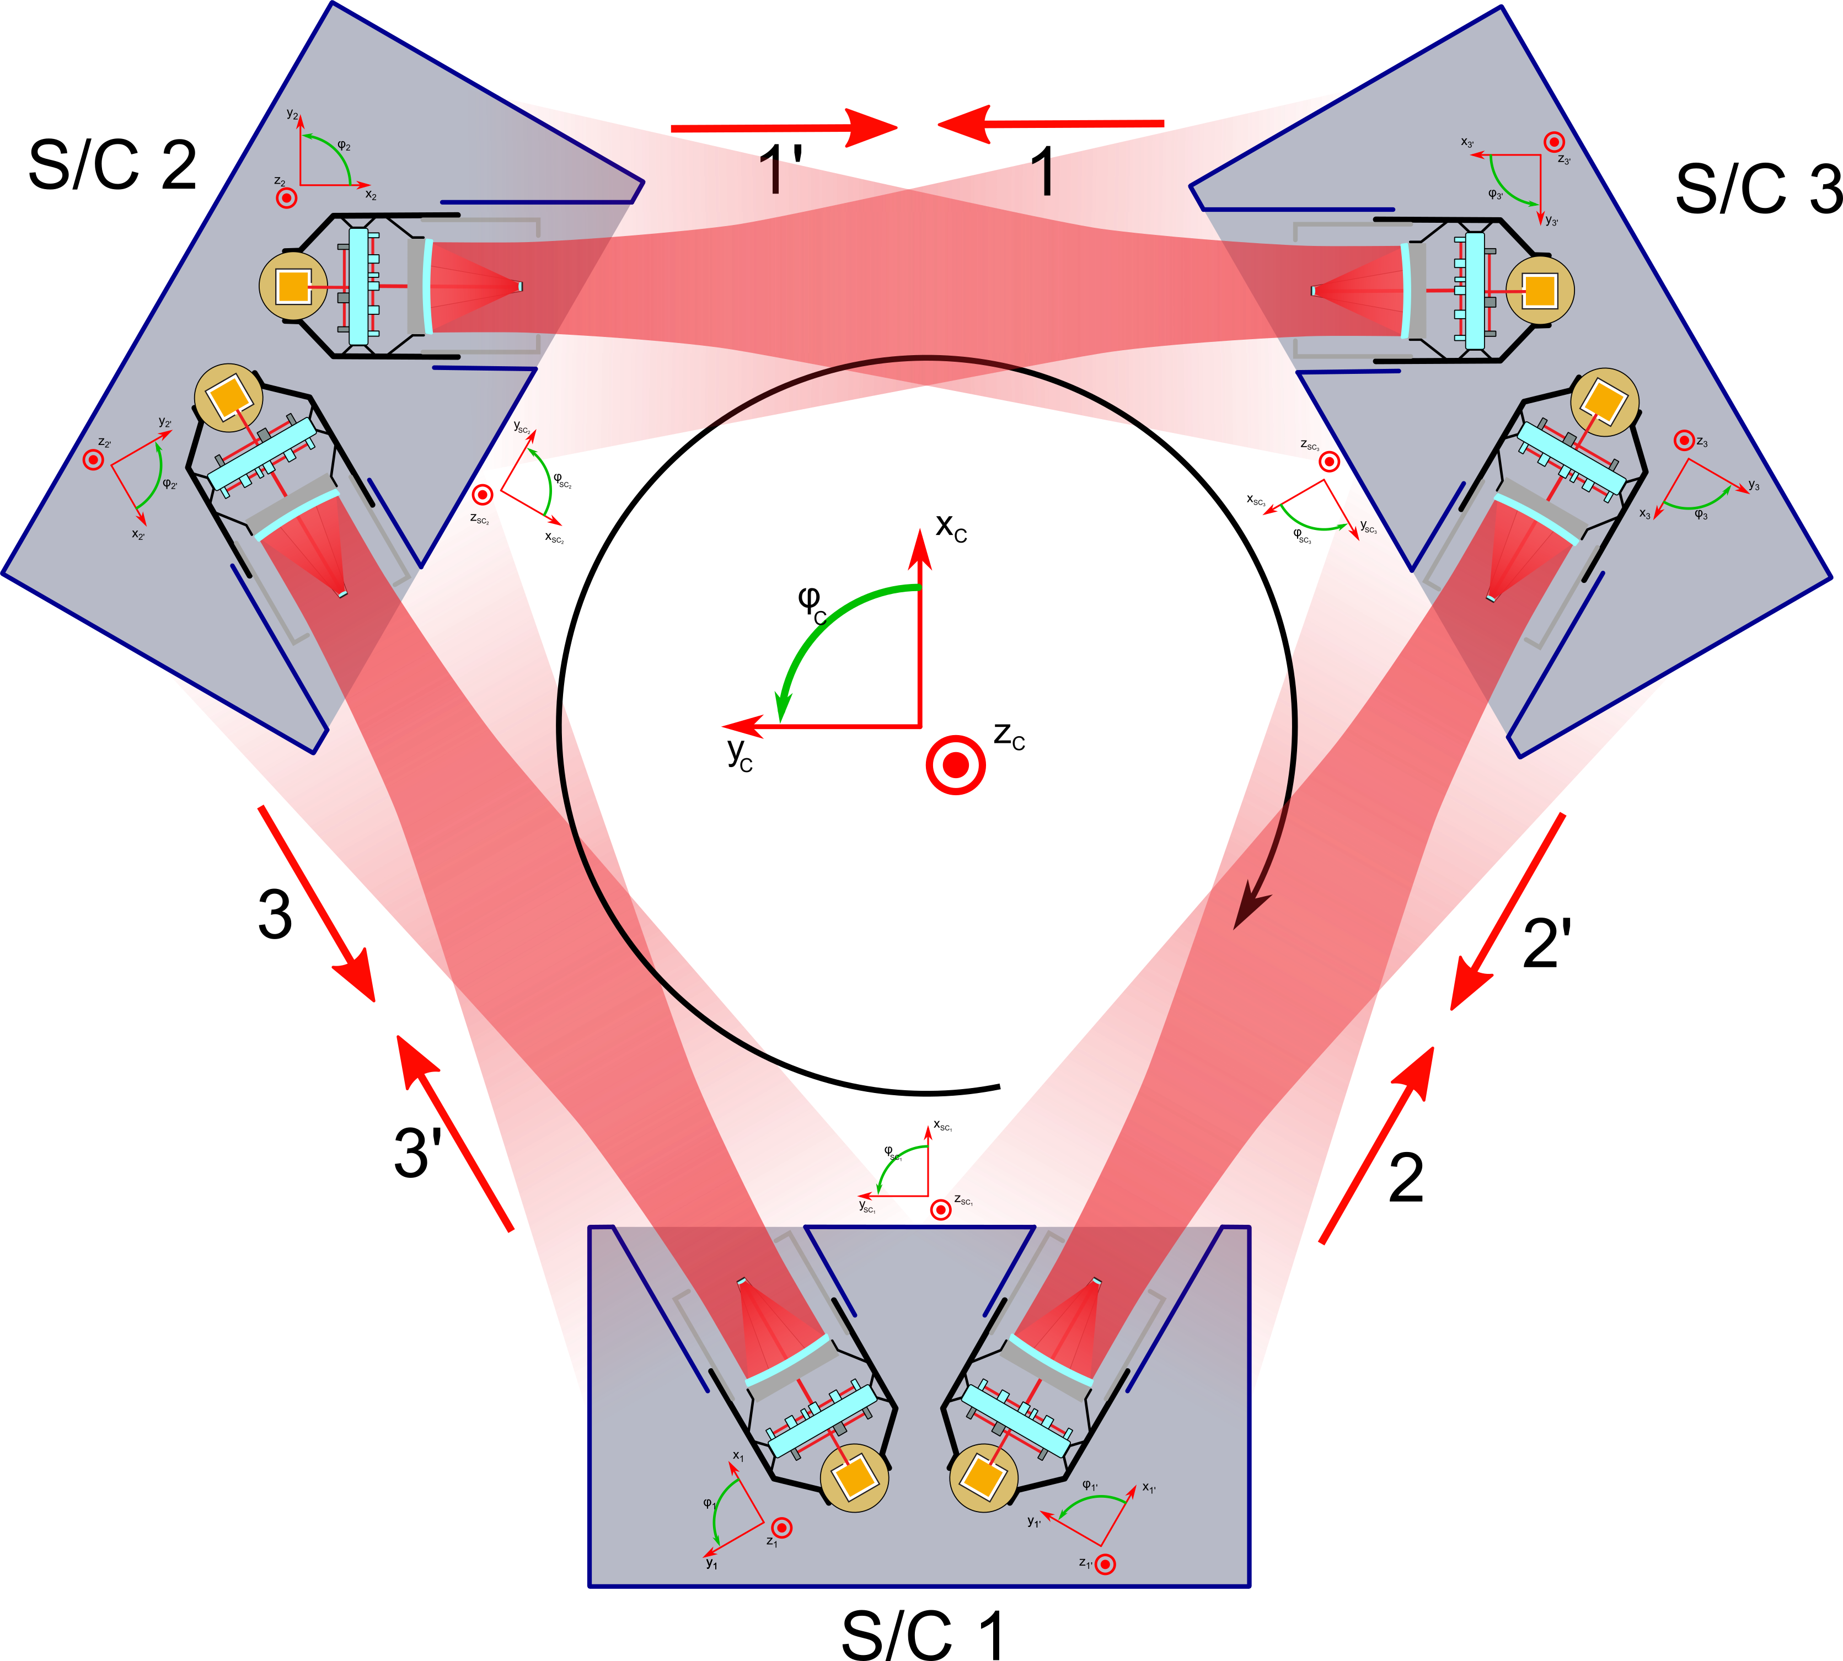
The measurement concept
test-mass to test-mass measurement is synthesised from:
test-mass to SC
SC to SC
SC to test-mass
2 W broadcast, 10⁻¹⁰ W received
Combine 6 links on ground
Time Delay Interferometry

Slide 7
Process of setting requirements
Determine practical (cost, space readiness) limits for sensing system and spacecraft key parameters:
Laser power
Telescope size
Photodetector and phasemeter performance
Lifetime, mass, ESA cost cap
Use detailed models to calculate sensitivity in high-frequency regime
Use LISA Pathfinder results to define low-frequency sensitivity
Feed to Science Team; use detailed models to calculate what can be seen with that instrument
Sanity check: Is this a great mission? Yes!
‘Flow down’ from Science to the mission specifications

Slide 8
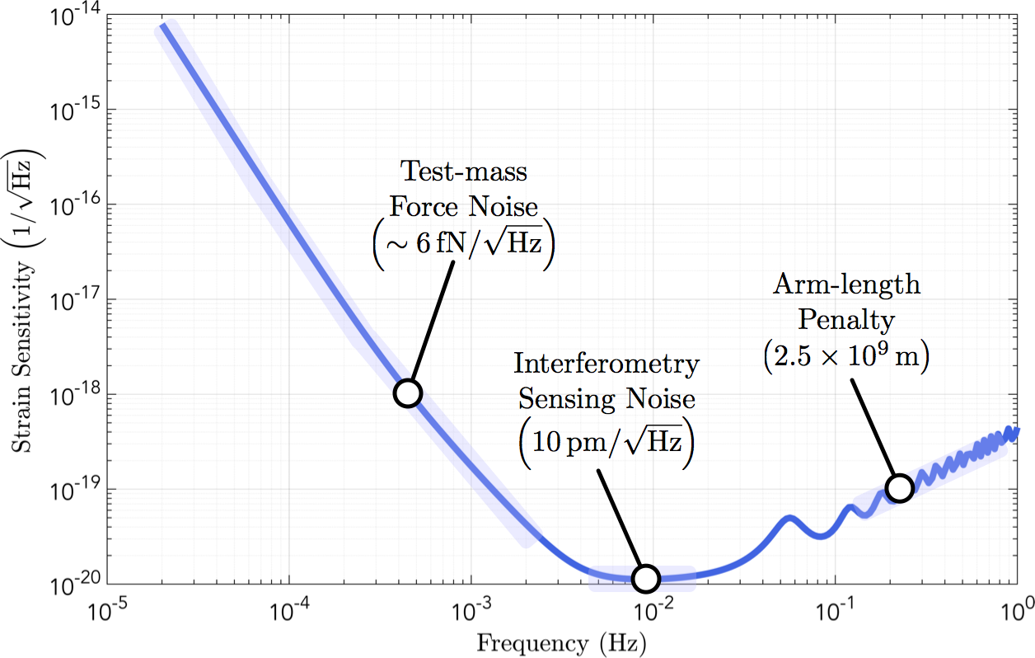
LISA limiting noise sources

Slide 9
Science Objectives
Science case is composed from a number of Science Objectives (SO)
Each SO is broken up into Science Investigations (SI)
From each SI we derive Measurement Requirements (MR)

Slide 10
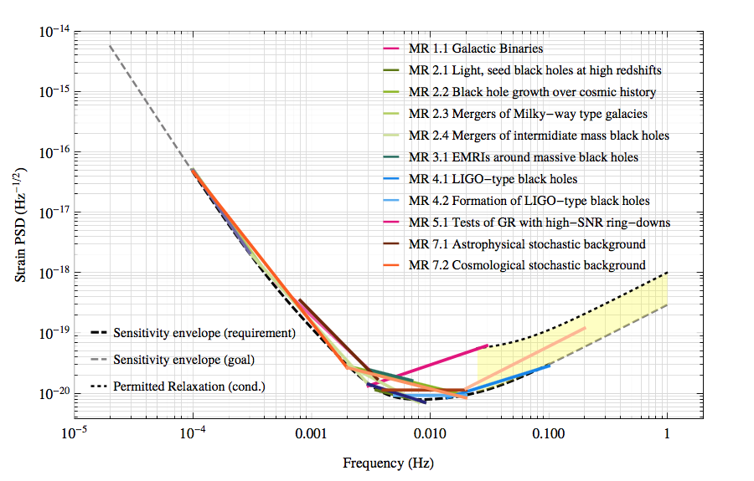
Sensitivity Envelope

Slide 11
LISA Pathfinder
Test most of the LISA performance budget
all relevant local test mass disturbance forces
local interferometry
And much of the critical technology
drag-free control
test mass charge control
gravitational balancing
SC environment control (thermal, magnetic)

Slide 12
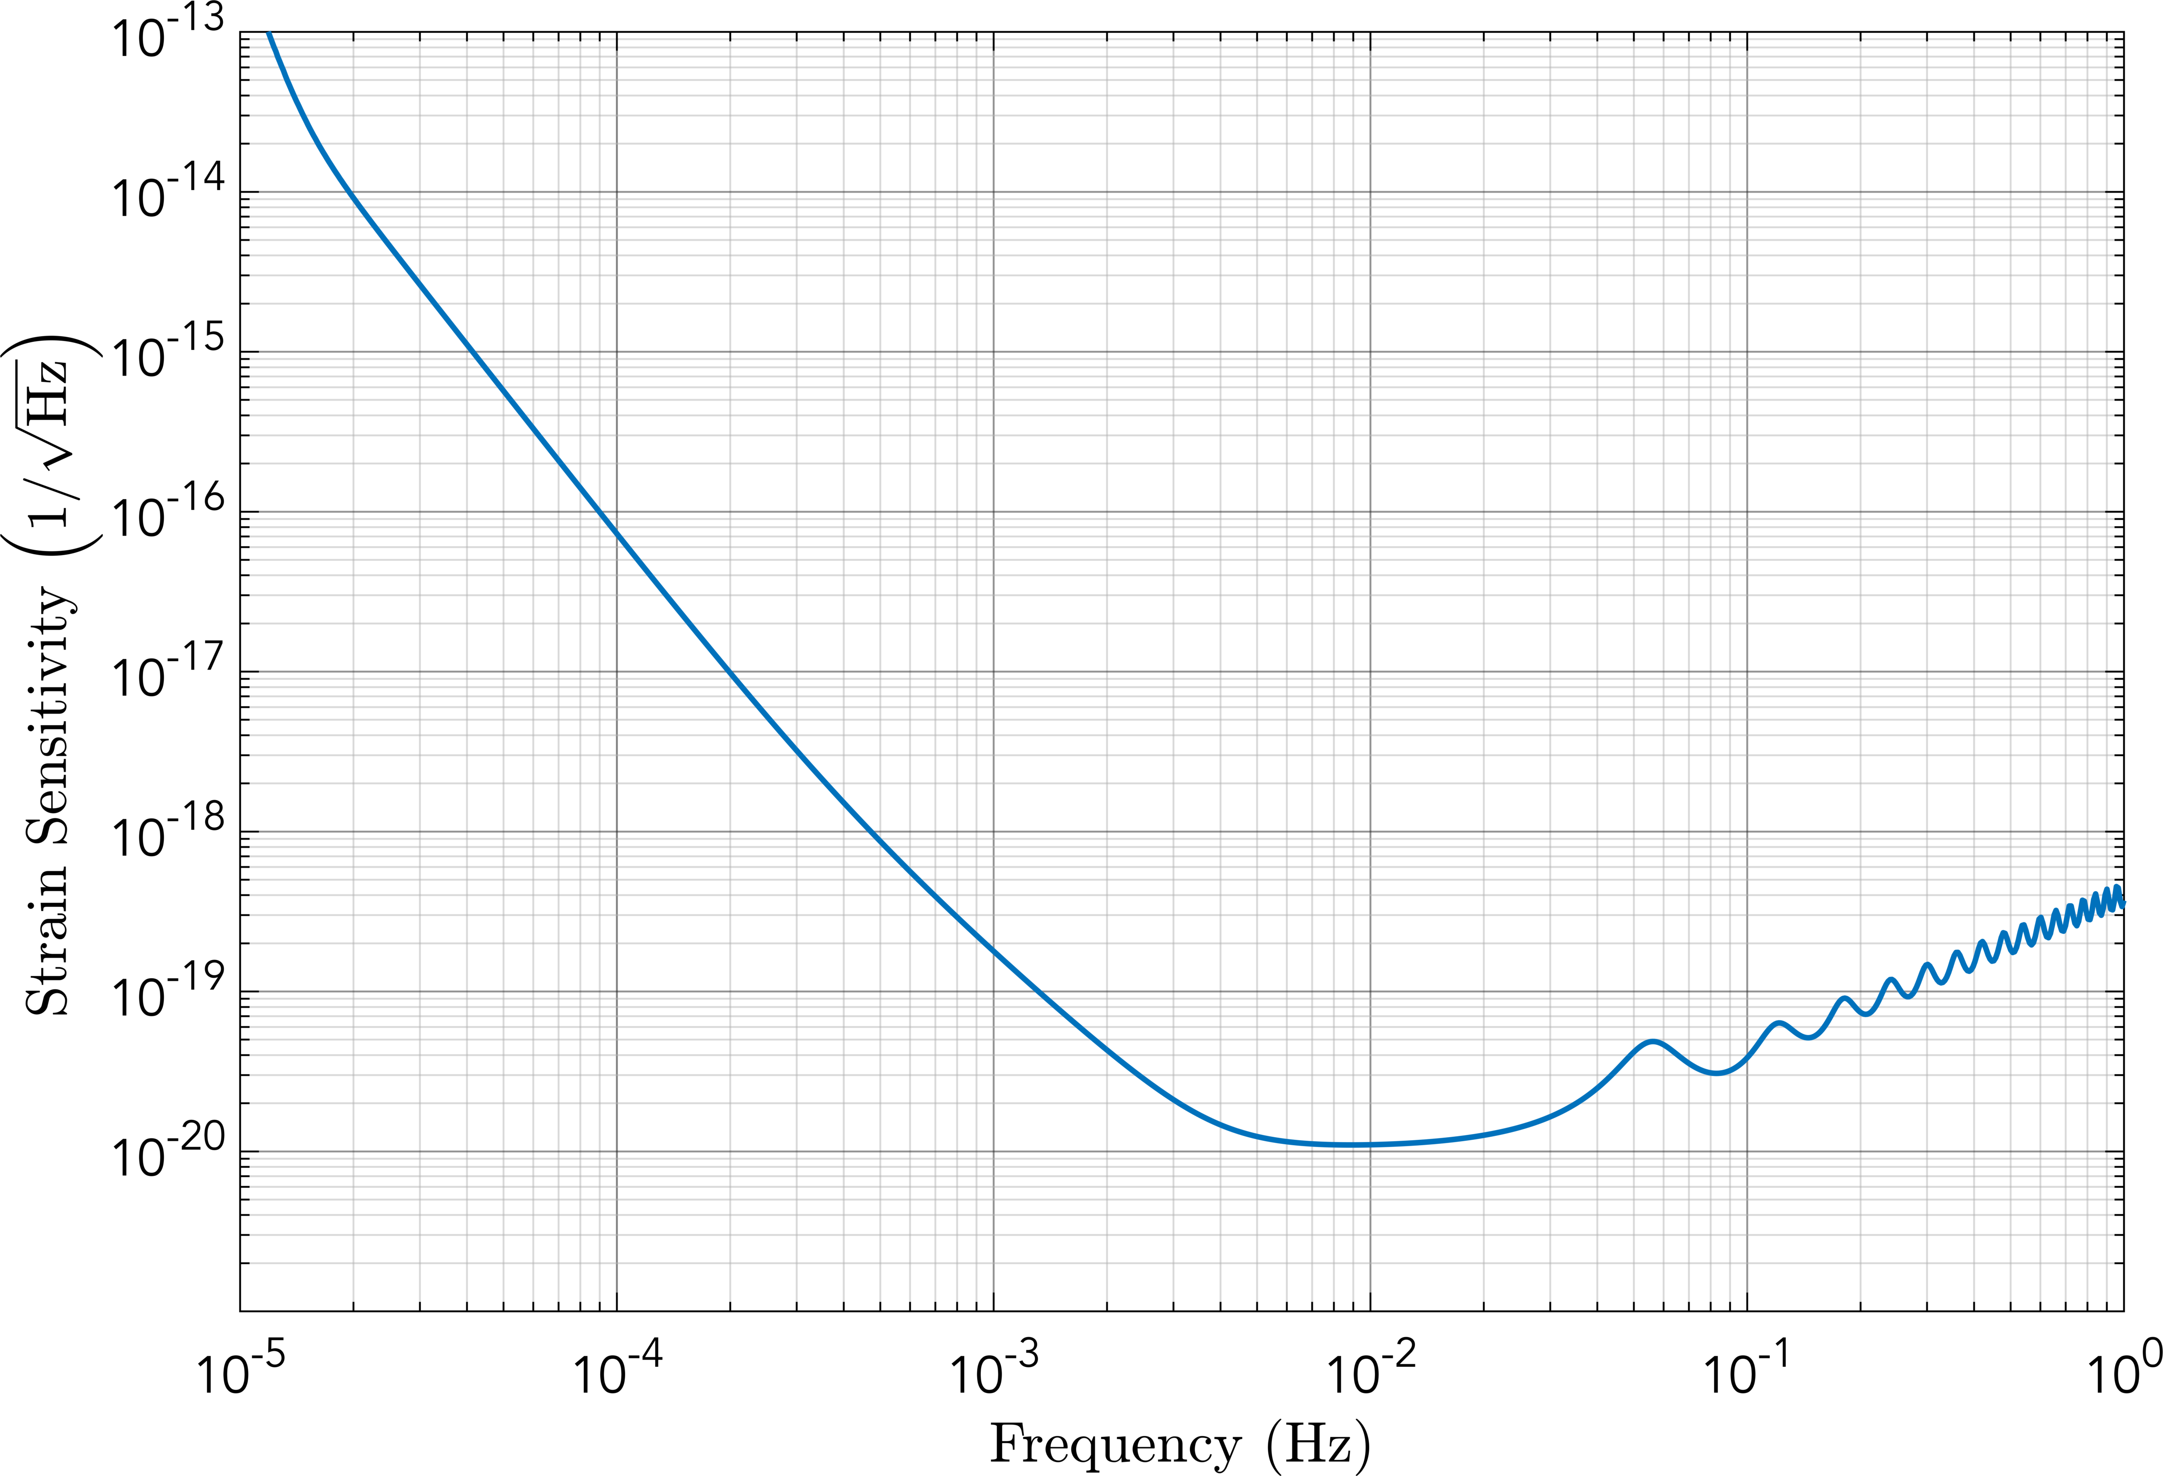
The LPF test
Can we put test masses in quiet enough free-fall?
LPF tests this

Slide 13
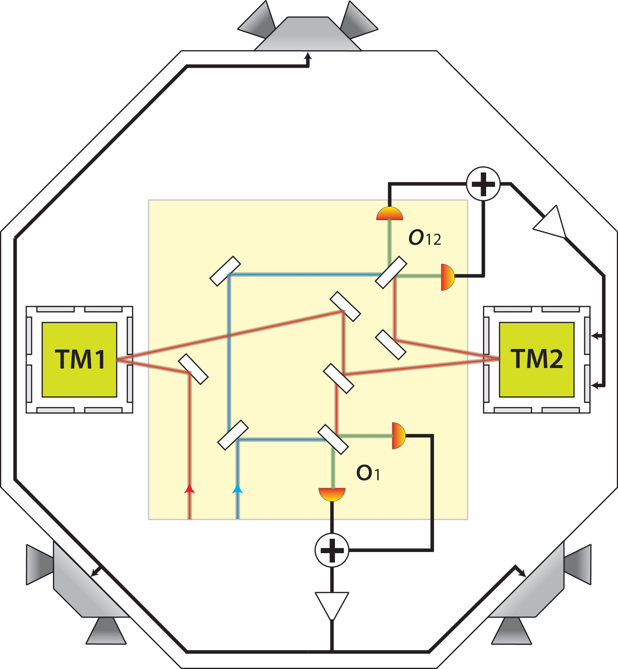
LPF Concept
Free-falling test mass
Drag-free satellite
Suspended witness mass
Suspension
Drag-free

Slide 14
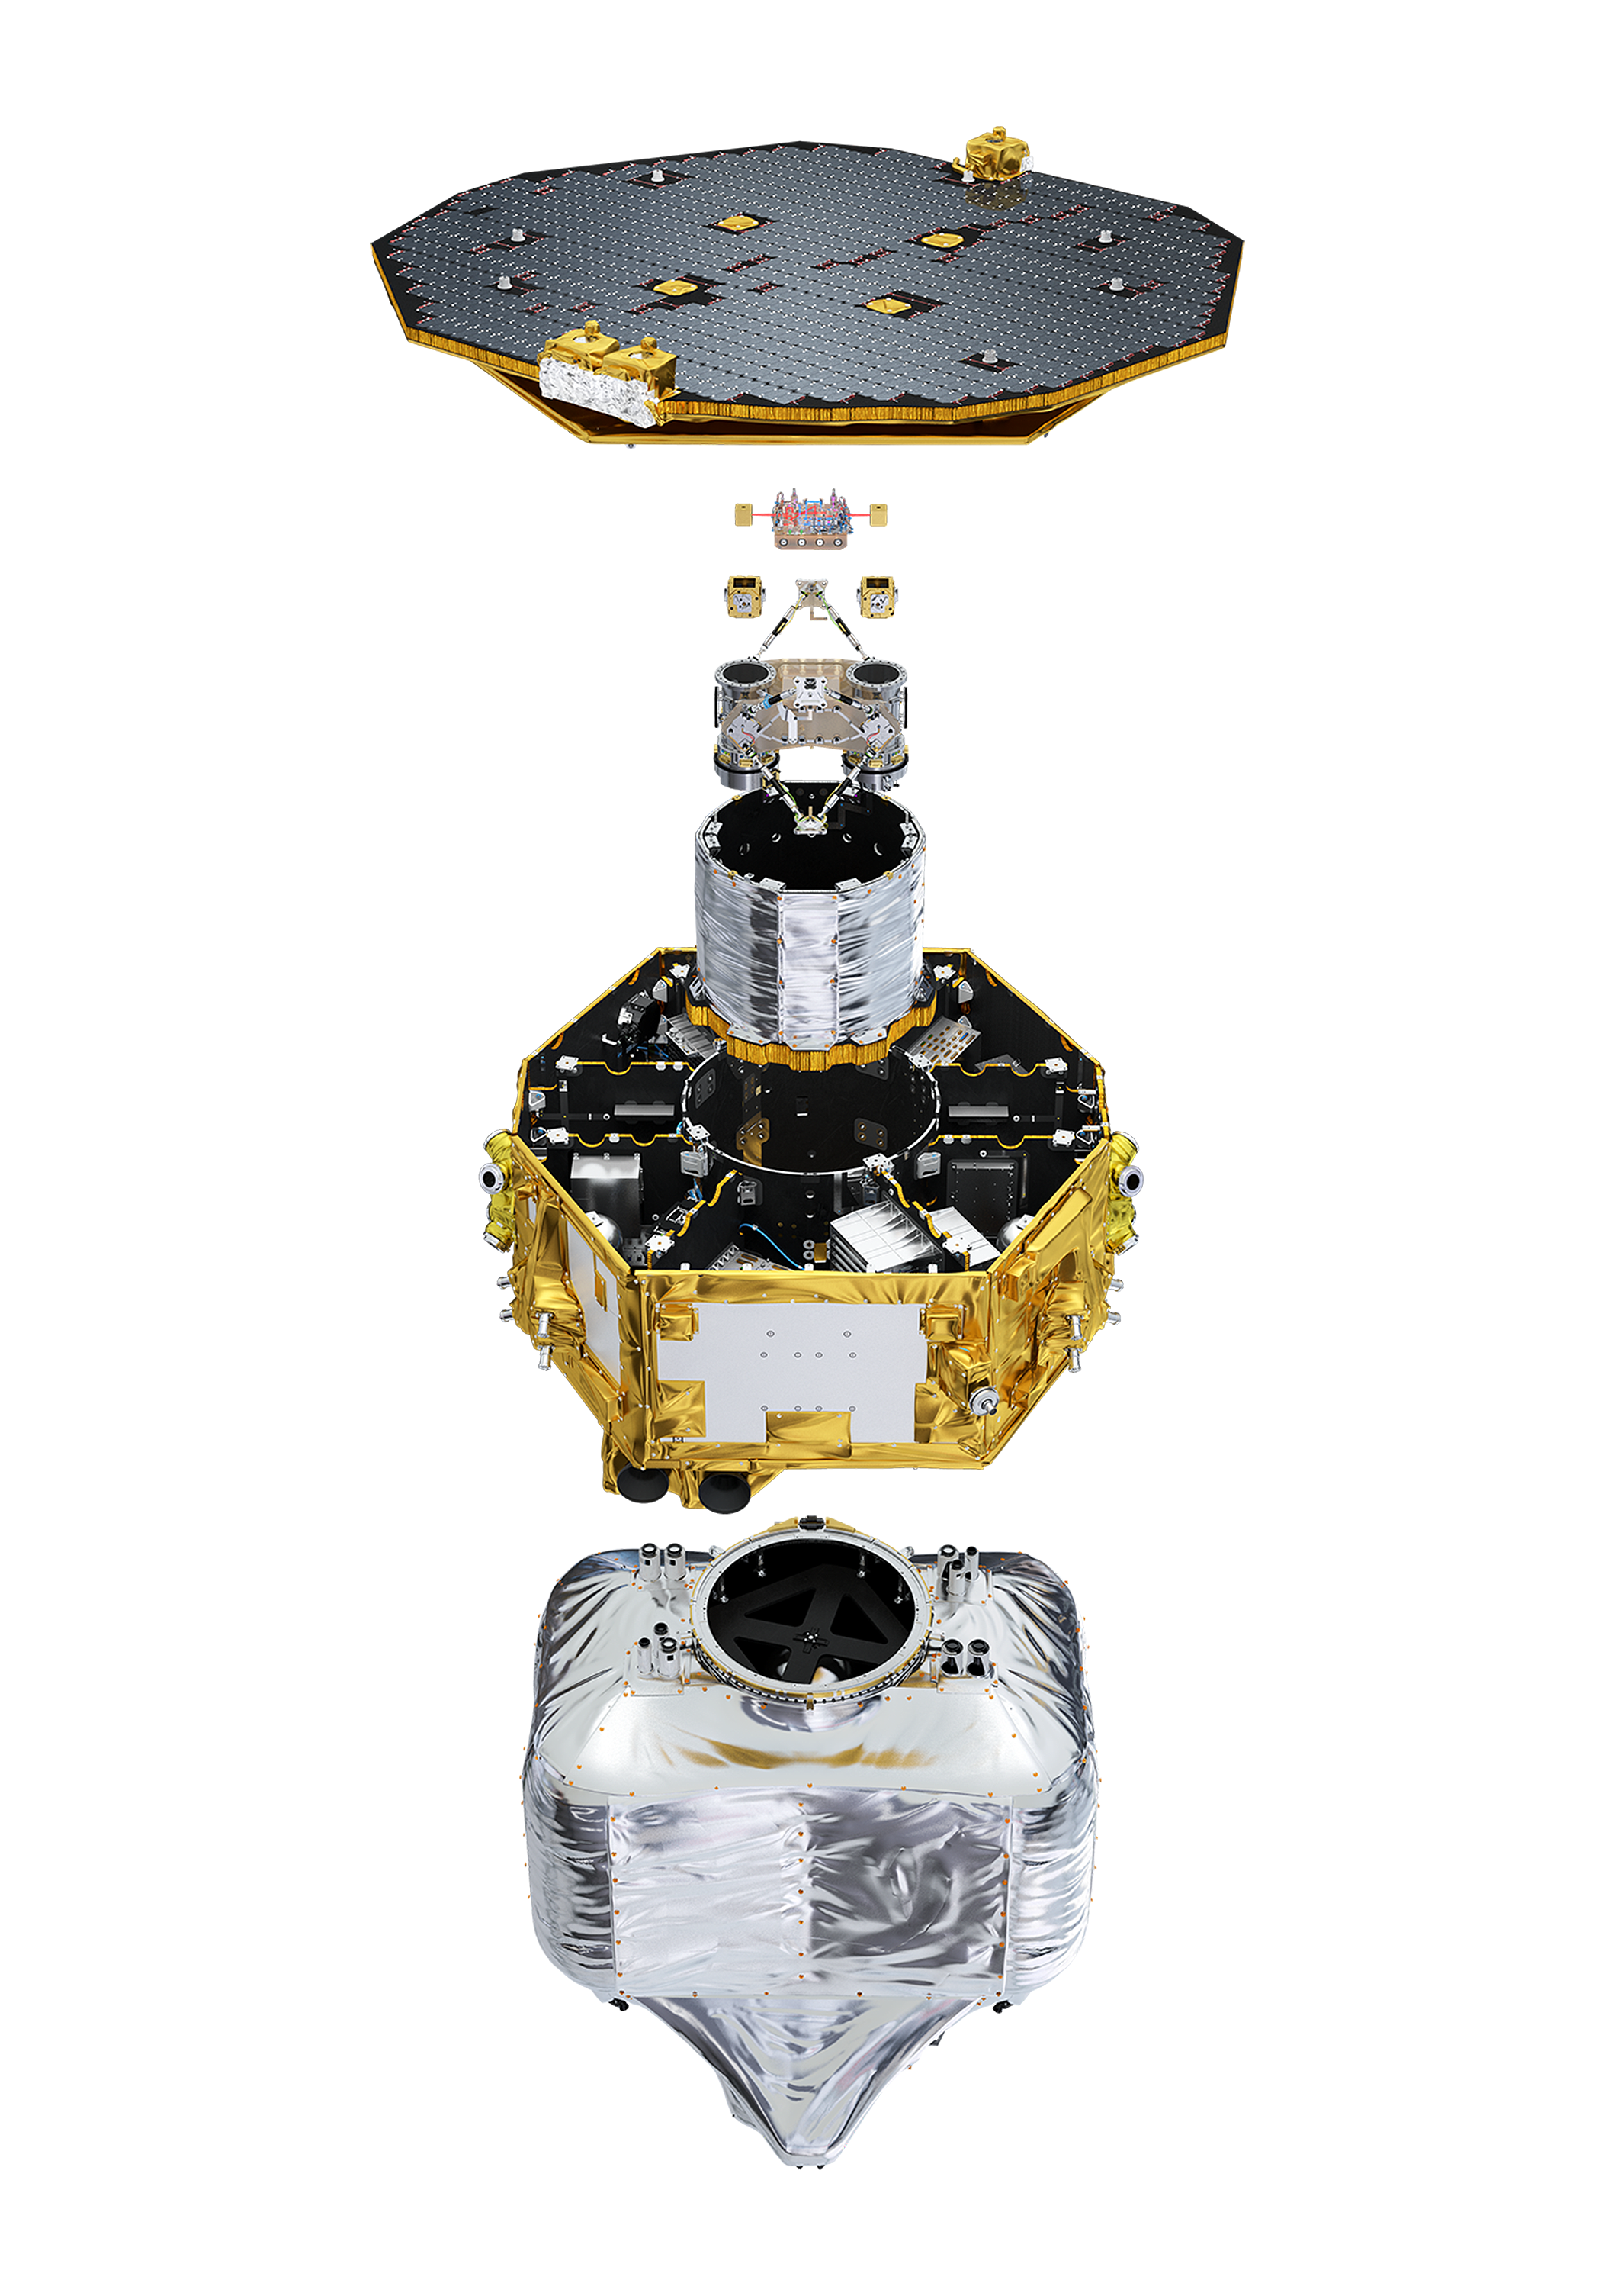
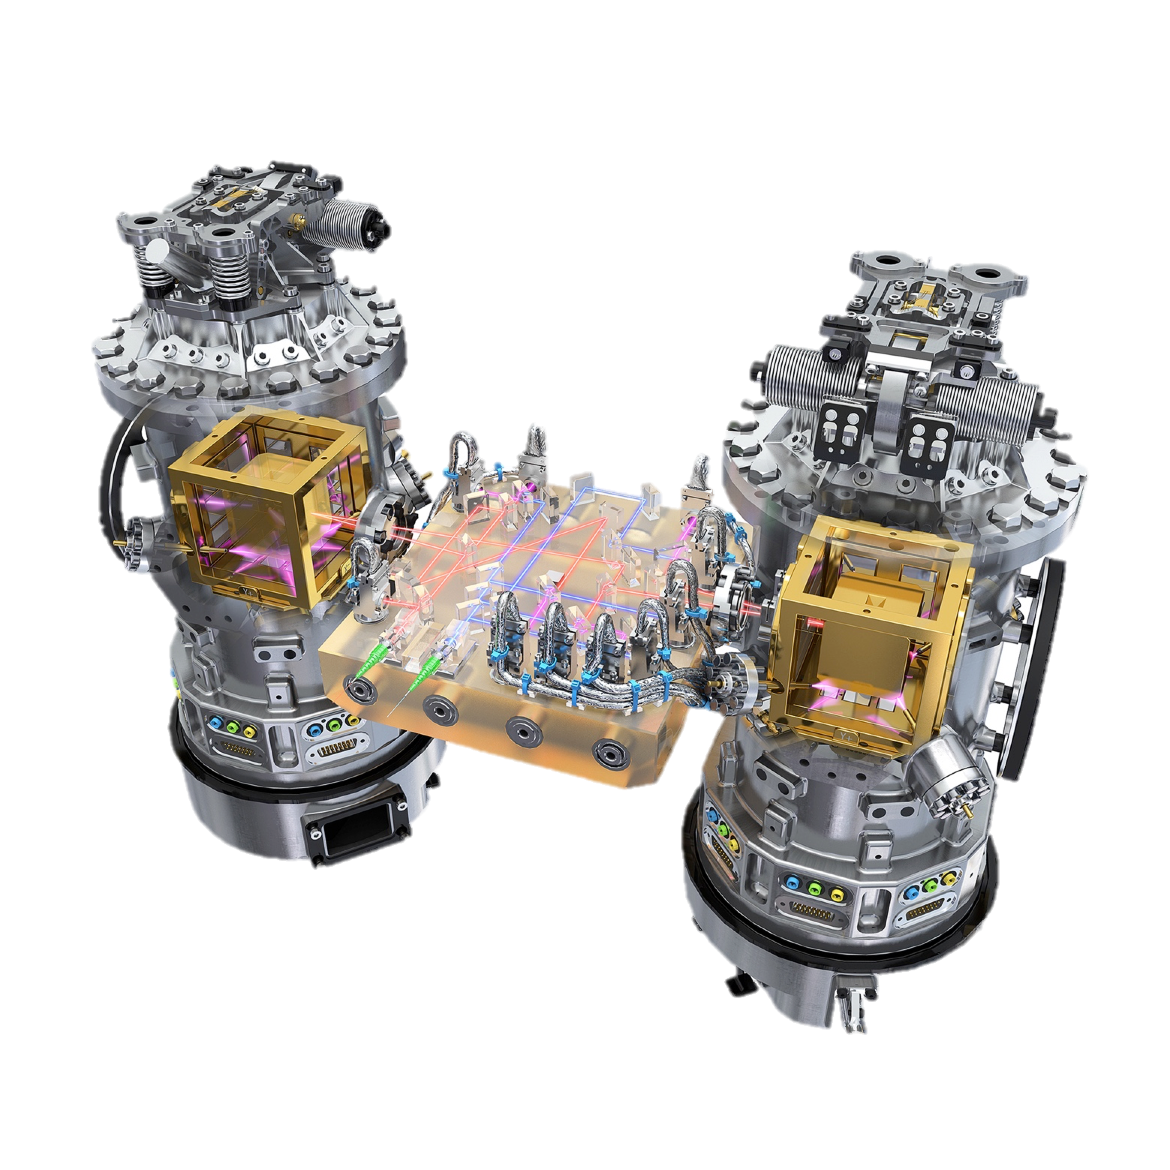
LPF Realization
Magnetic Coils
Motion
Sensors
Heaters
UV Lamps
Motion
Actuators

Slide 15
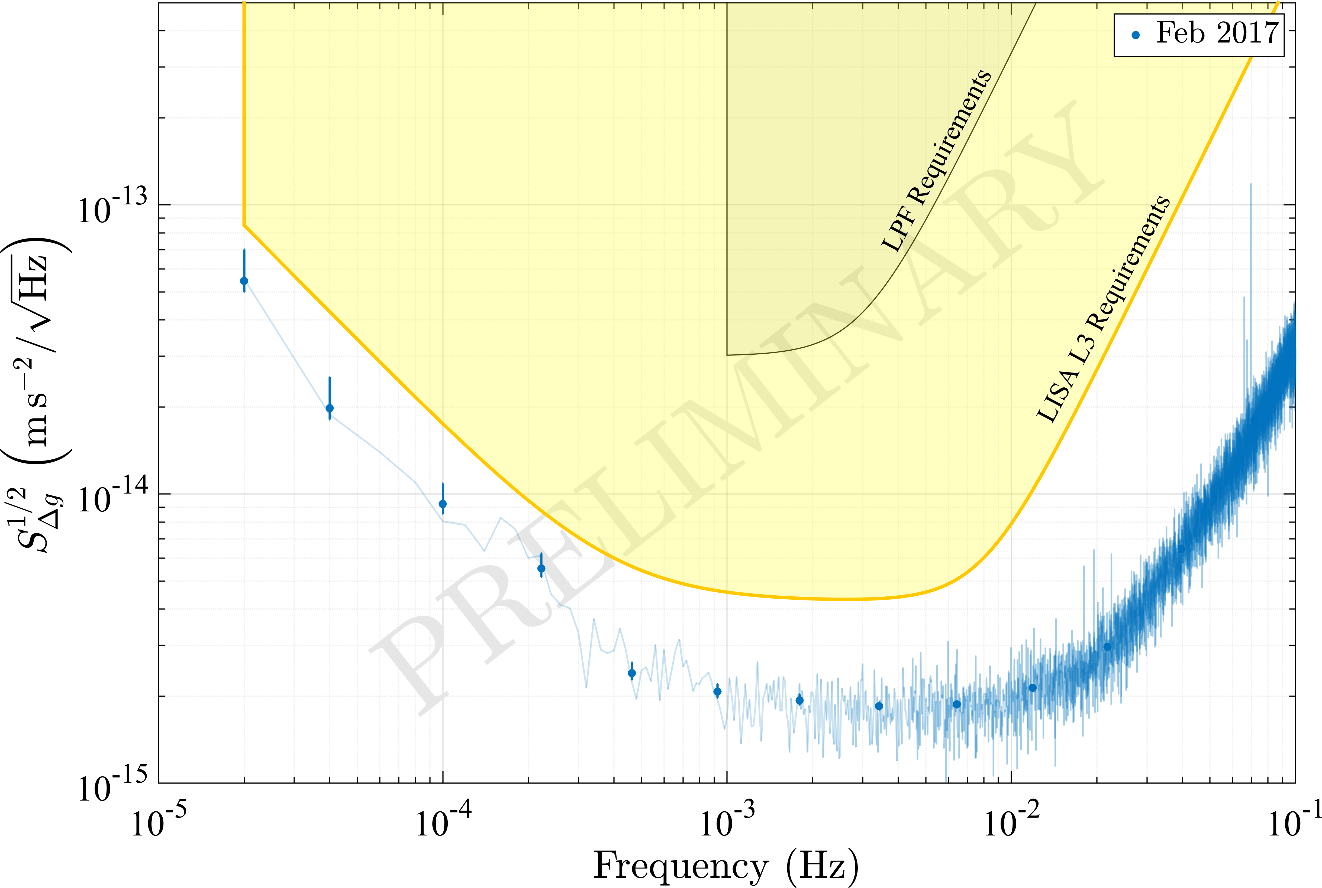
What do we know now?
Interferometer sensing noise
100x better than on ground
actuation noise, radiation pressure, etc + 50% something unknown
Brownian force noise due to residual gas around test masses

Slide 16
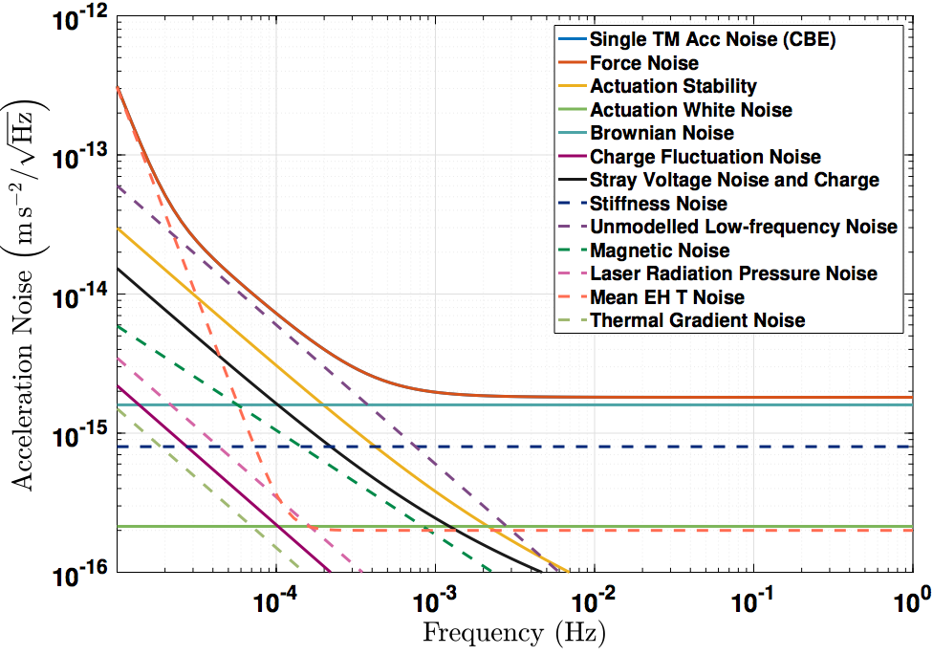
Acceleration noise in LISA
Un-modelled noise to reflect uncertainty in LPF measurement
LPF
extrapolation
estimates from LPF

Slide 17
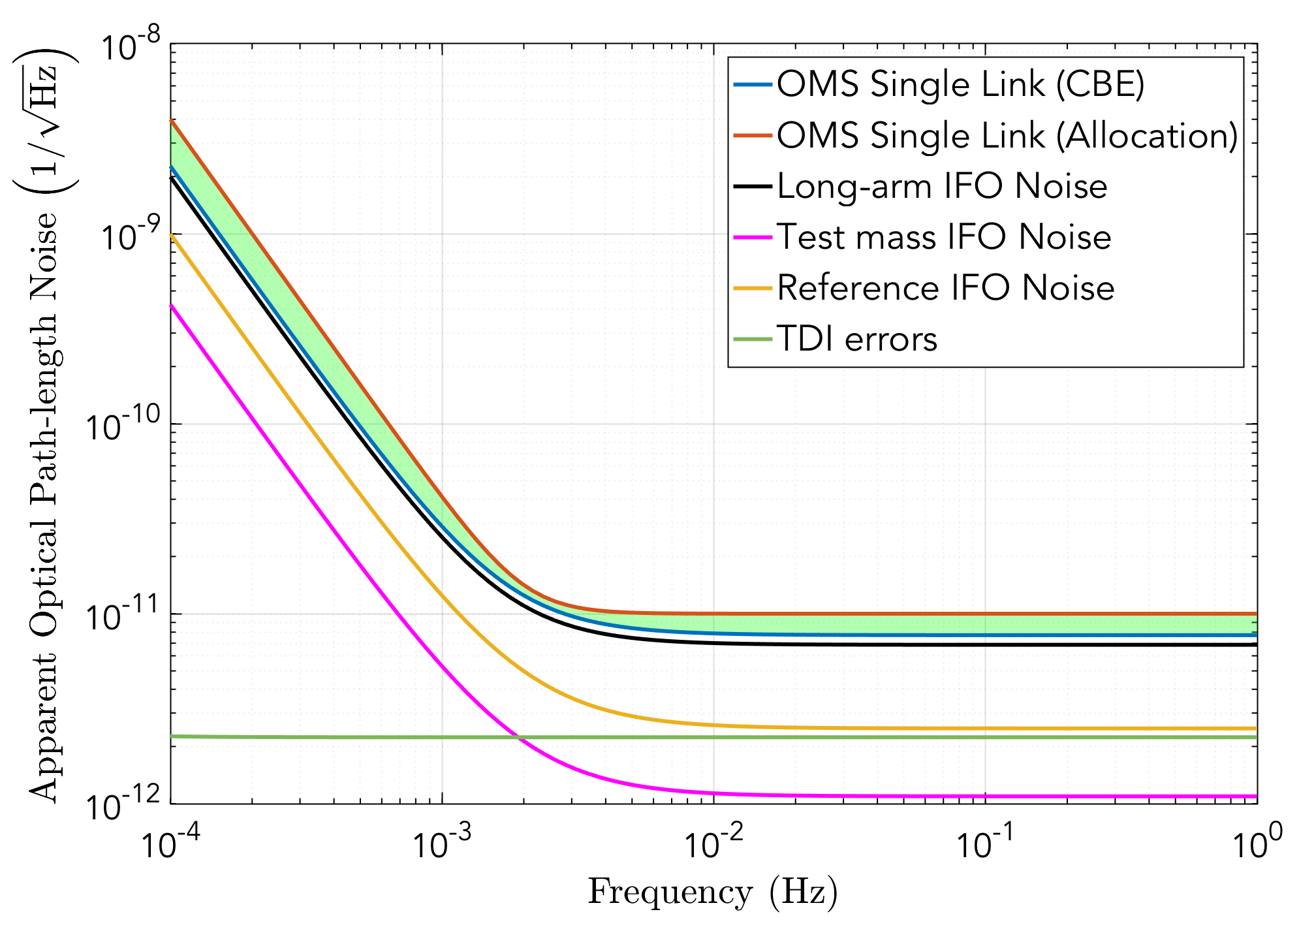
Optical Metrology Noise in LISA
Bottom up approach of best estimates
Added:
a little margin for un-modelled phase noise effects
relaxation to low frequency to ease testing

Slide 18
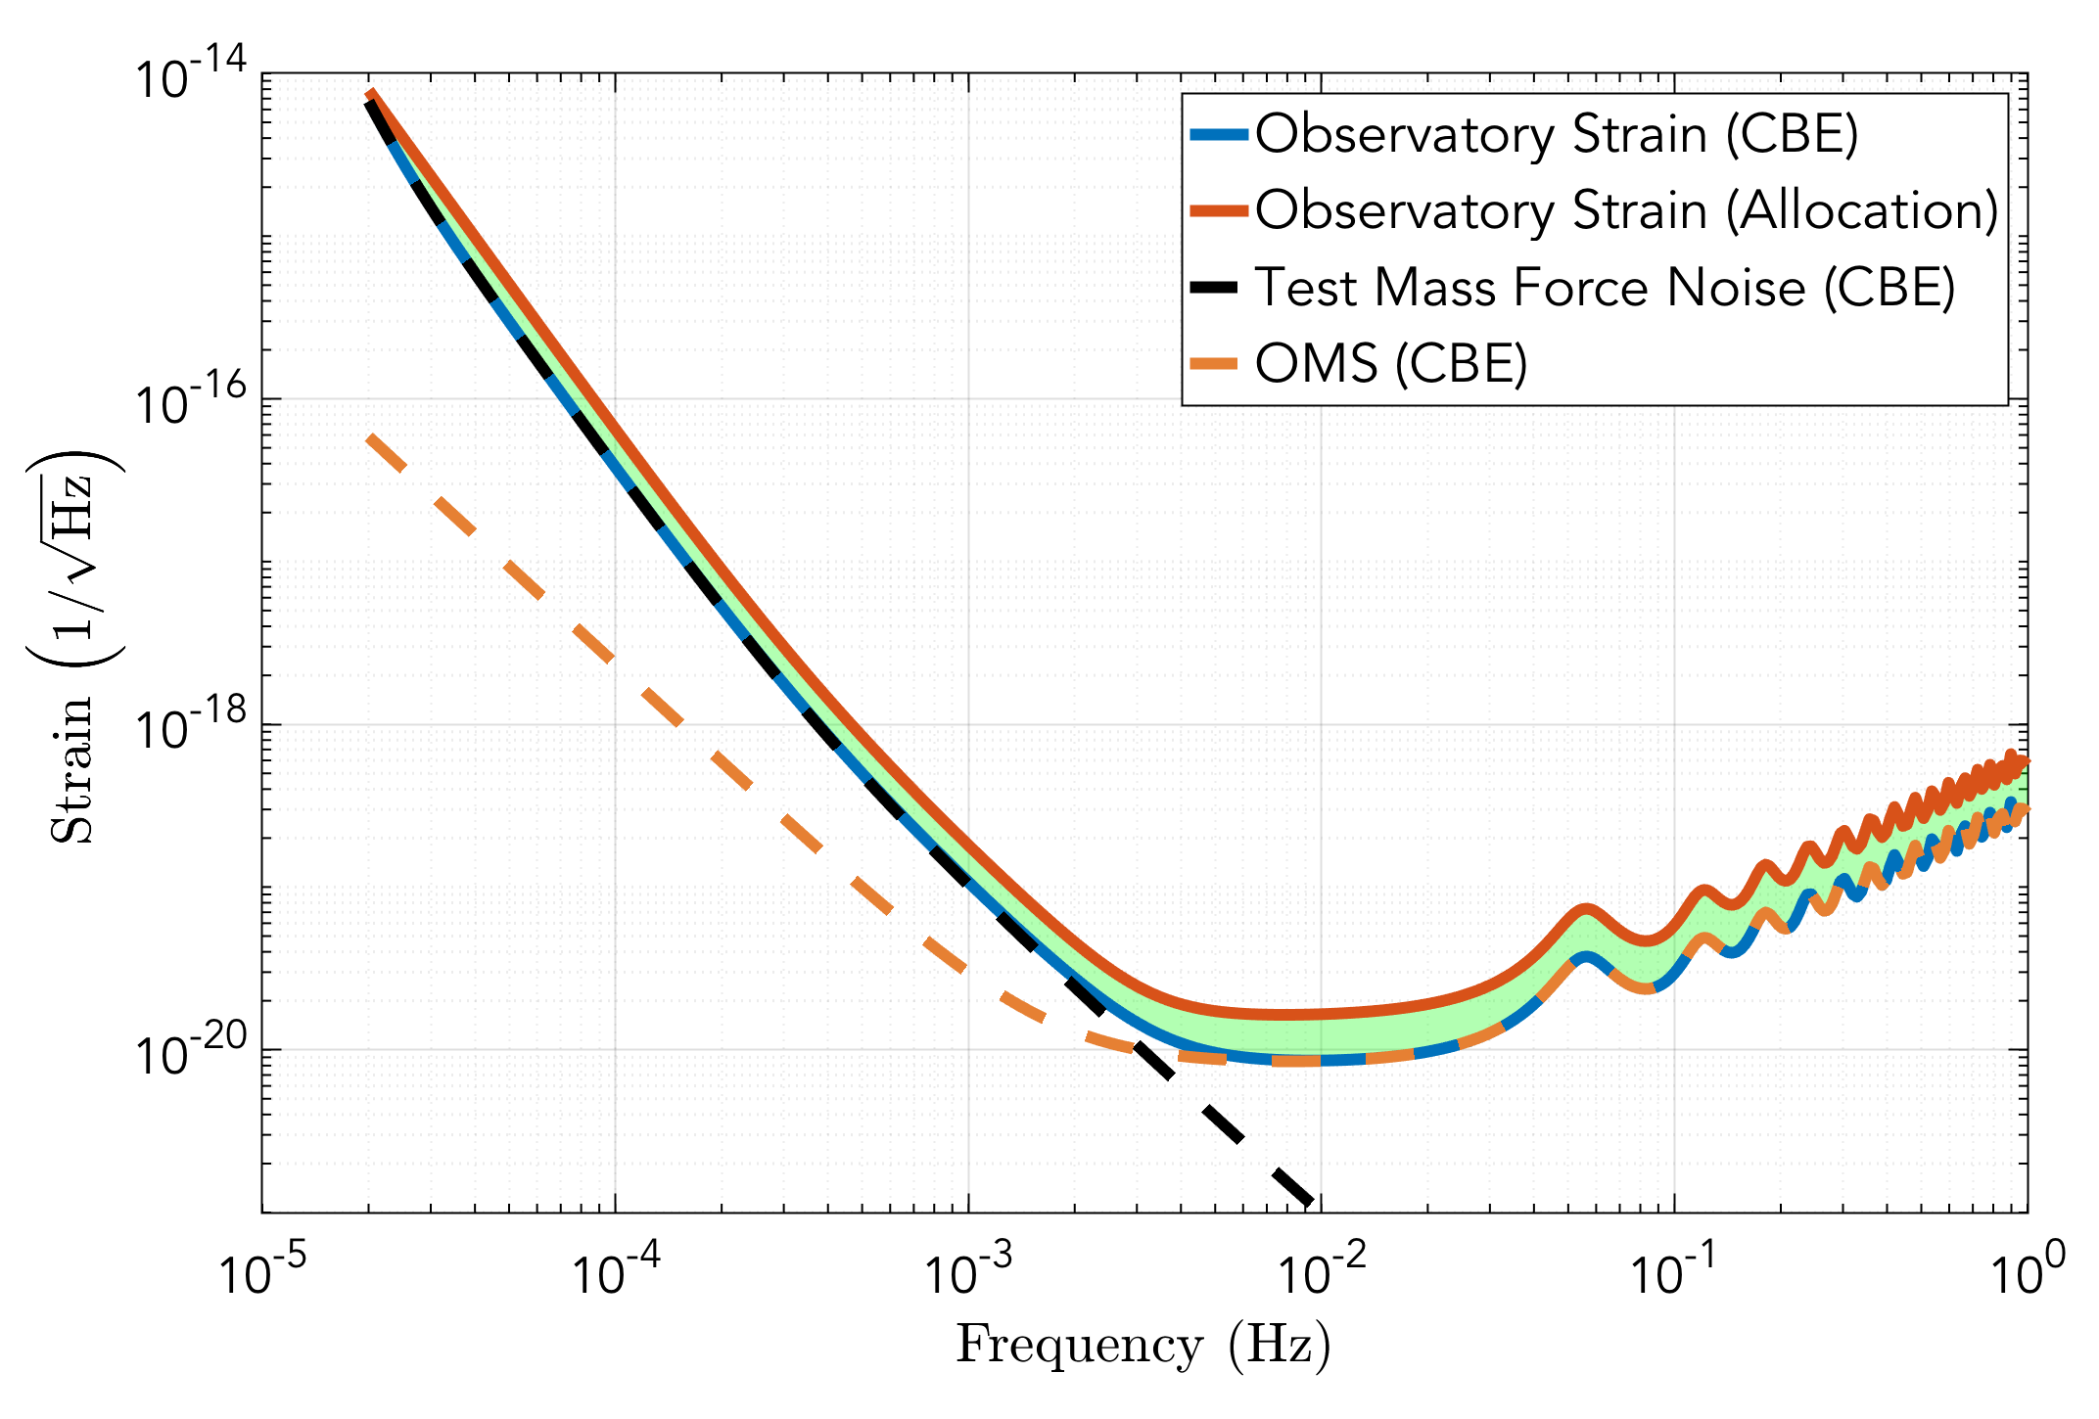
Full observatory break-down
LPF-like TM force noise limits at low frequency
OMS Noise limits above few mHz

Slide 19
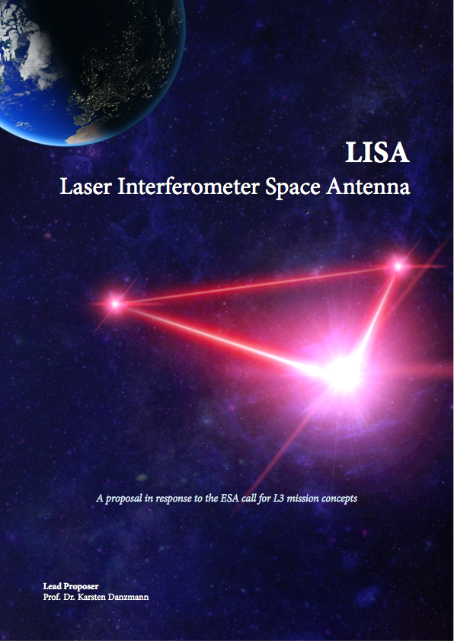
LISA Selected for ESA’s L3 mission slot
www.lisamission.org
https://arxiv.org/abs/1702.00786

Slide 20
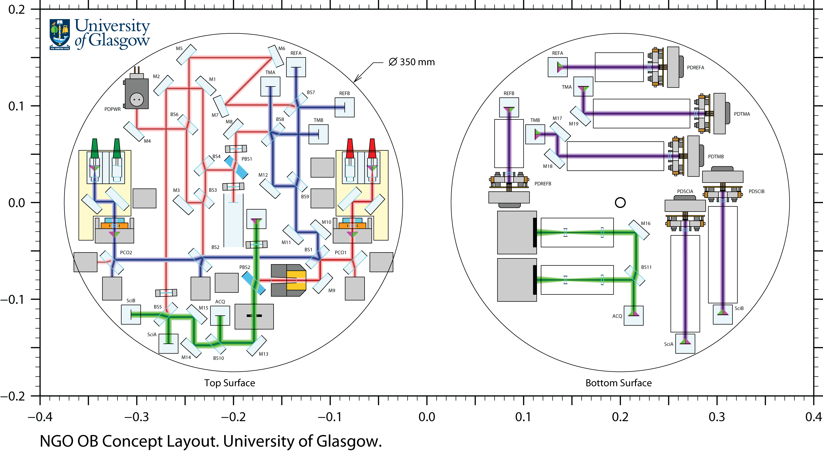
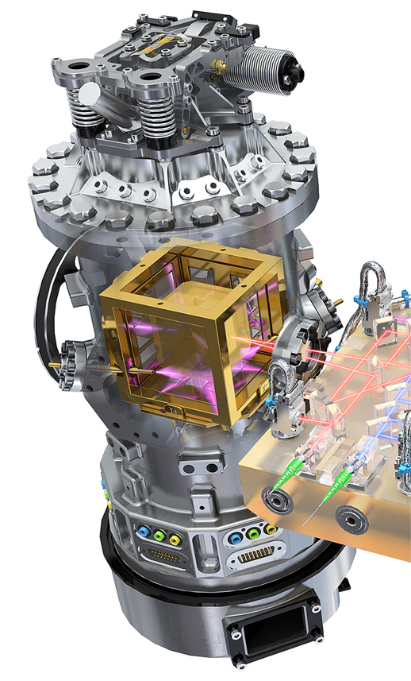
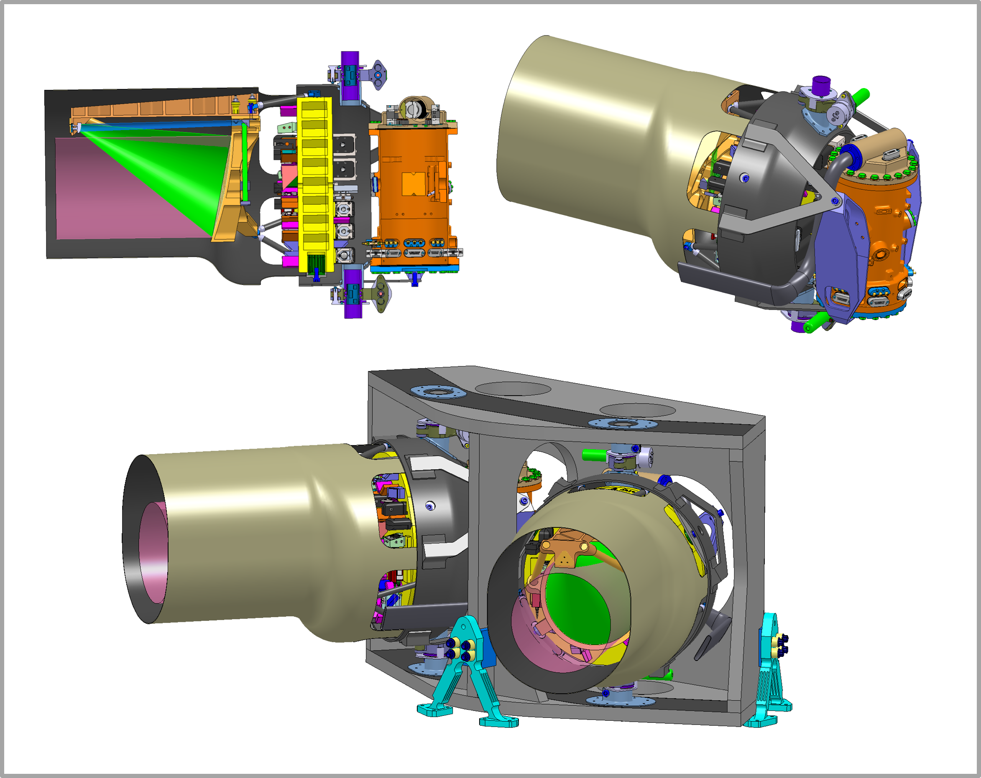
Payload concept (per S/C)
2 LPF Gravitational Reference Sensors
TM, EH, FEE, caging mechanism, discharge system
2 Optical Benches
imaging of received light, local and science IFOs, back-link/phase reference
2 Telescopes and mounting structures
Telescope breathing mechanism
Images courtesy of Airbus D&S GmbH,
Friedrichshafen

Slide 21
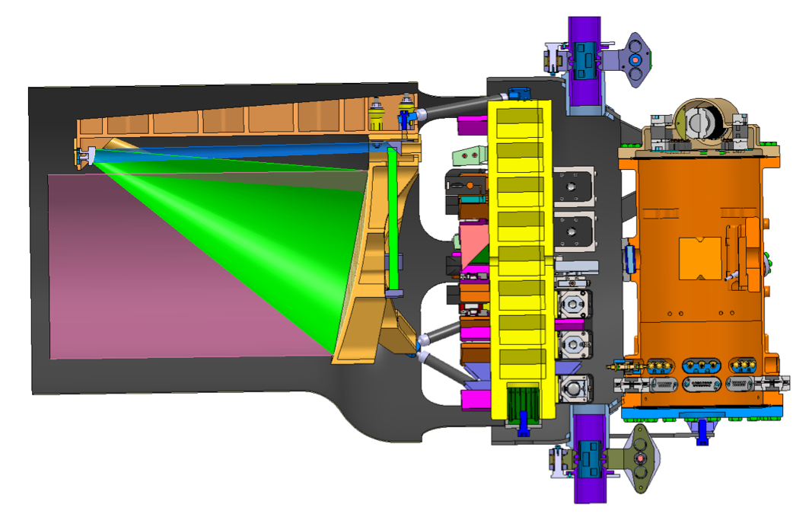
Payload concept (per S/C)
Probably
NASA Provided
Consortium Provided

Slide 22
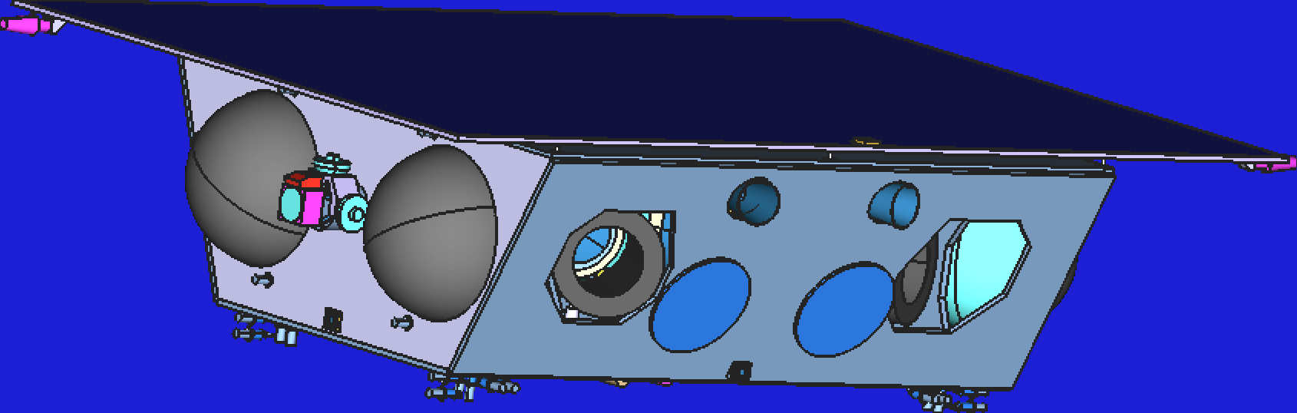
S/C after Phase 0
Cold-gas
Tanks
Solar Array
Star
Cameras
Transfer
Thruster
Cold-gas
Thrusters
Telescopes

Slide 23
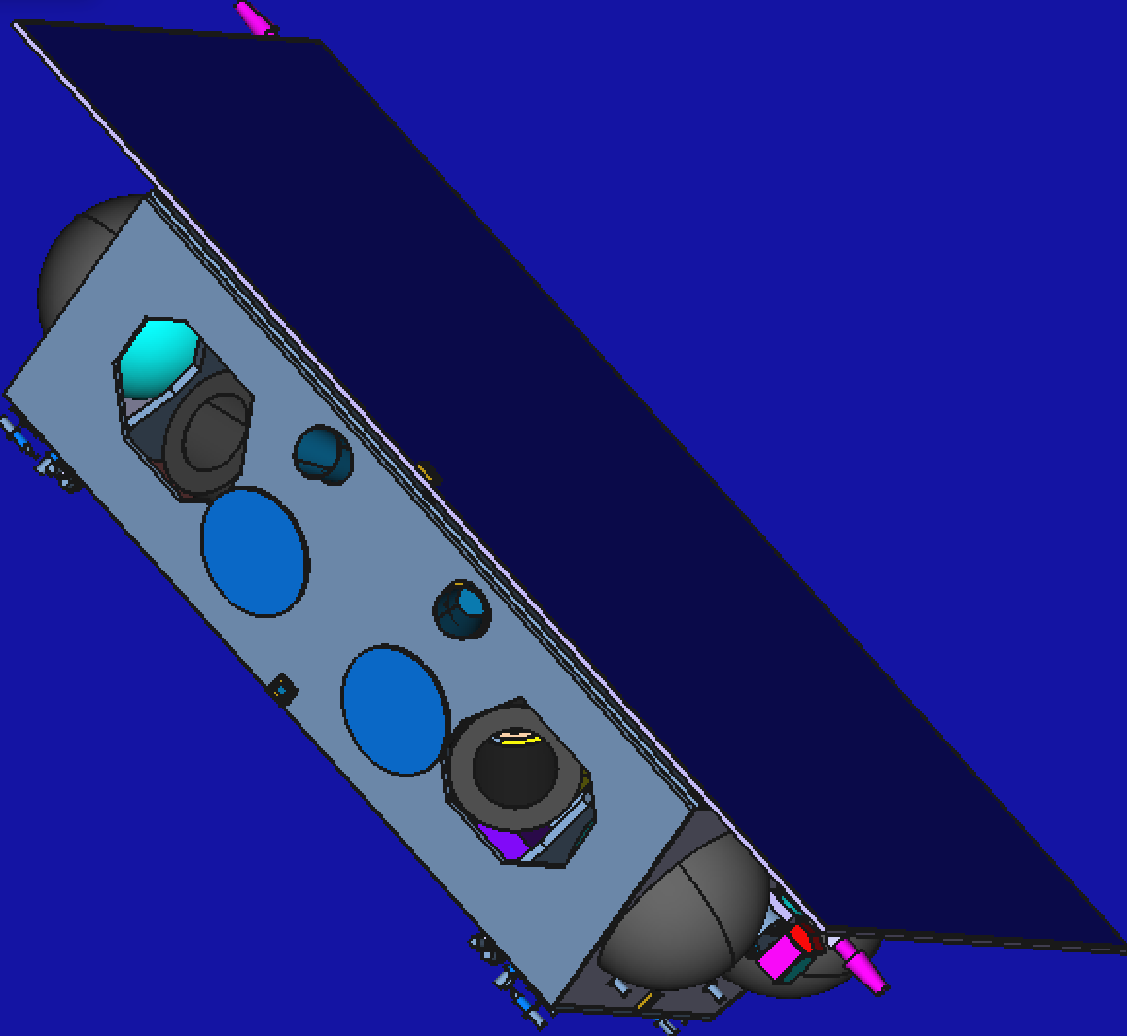
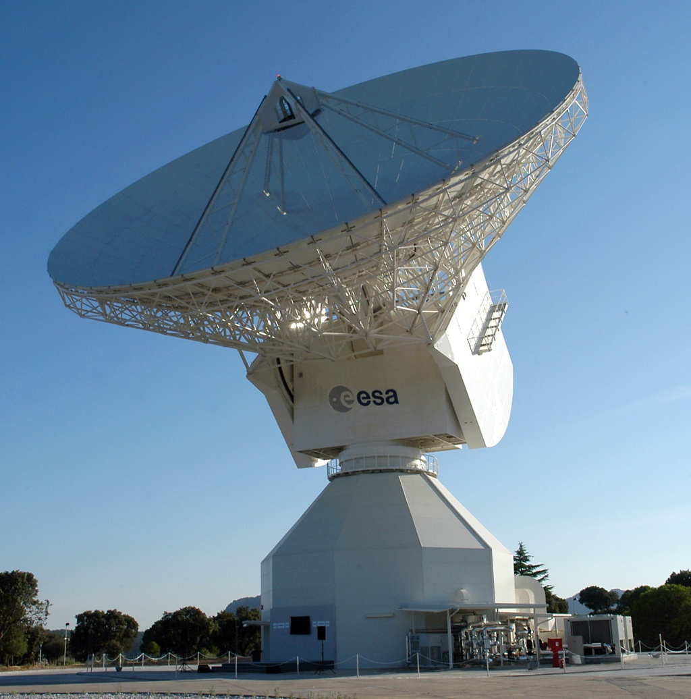
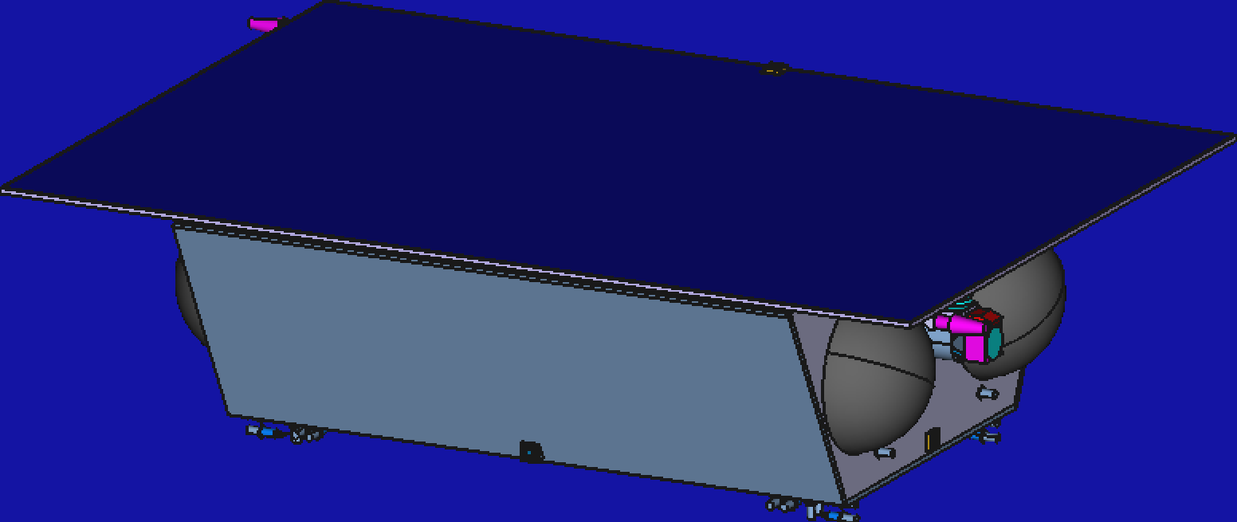
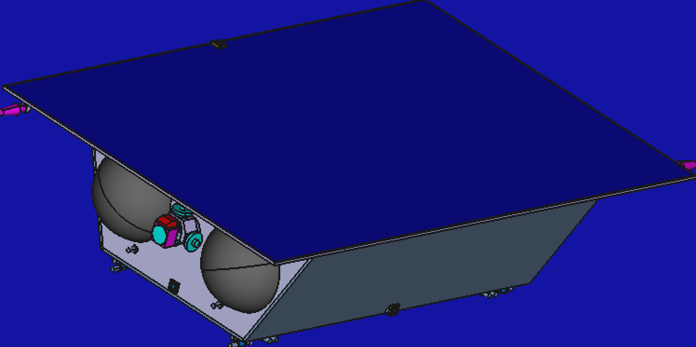
Data Processing
Calibration
Preprocessing
Source Catalogues
Astrophysics DA
TDI Processing

Slide 24
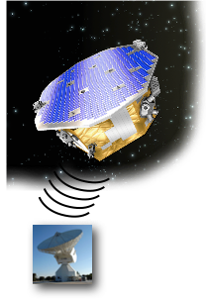
Raising alerts
SOC
Preprocessing
TDI
Issue Alert
MOC
Depacketising
DPC
low-latency
analysis
Generate Alert
Rich science available in joint EM+GW observations of events

Slide 25
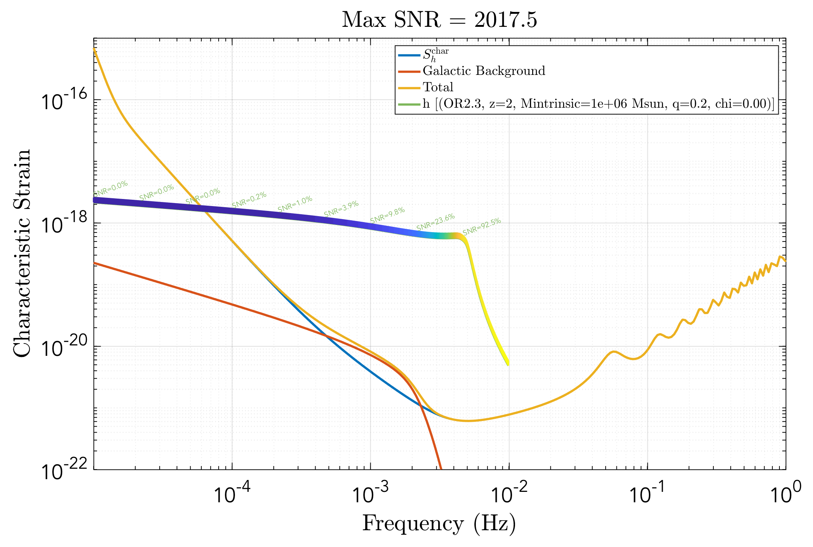
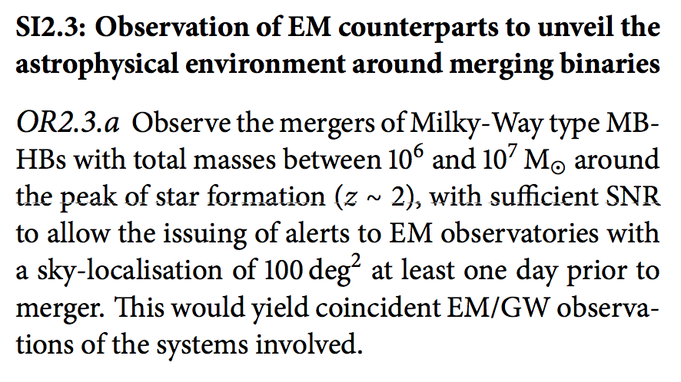
An alert example
Edge case:
Total mass 10⁶ M☉
z = 2
most of the SNR from merger and ring down in the last hours

Slide 26
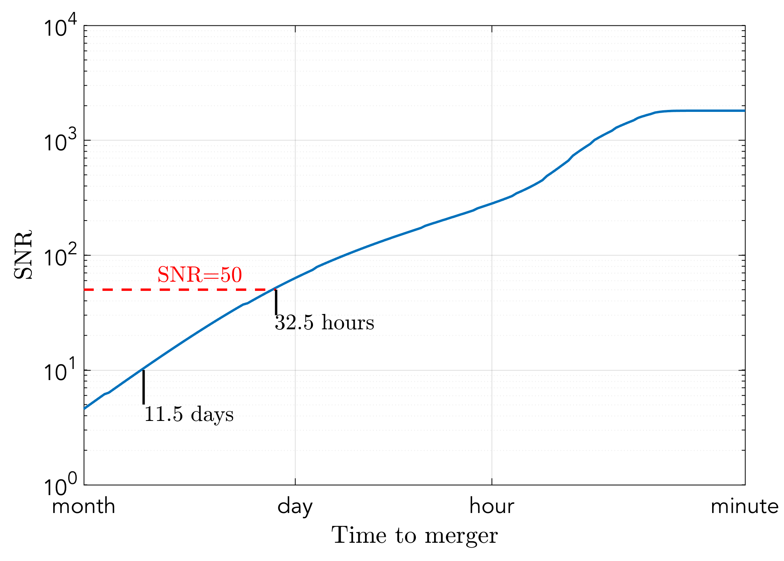
Detection and localisation
need SNR > 50 for good source localisation
Sources more massive and/or closer give
earlier detection
earlier and/or more accurate localisation
need SNR > 10 for detection

Slide 27
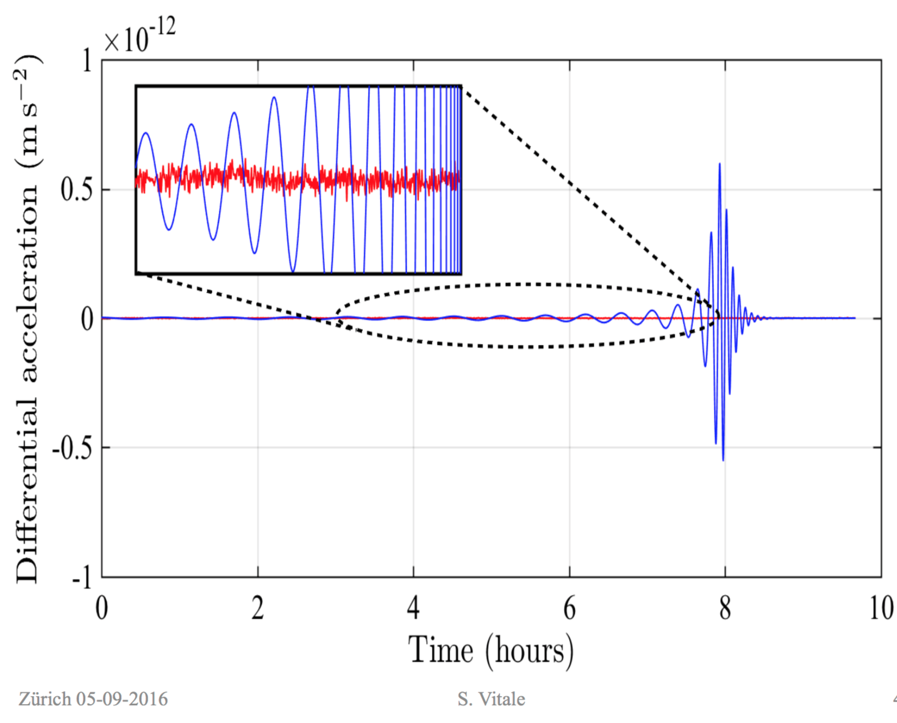
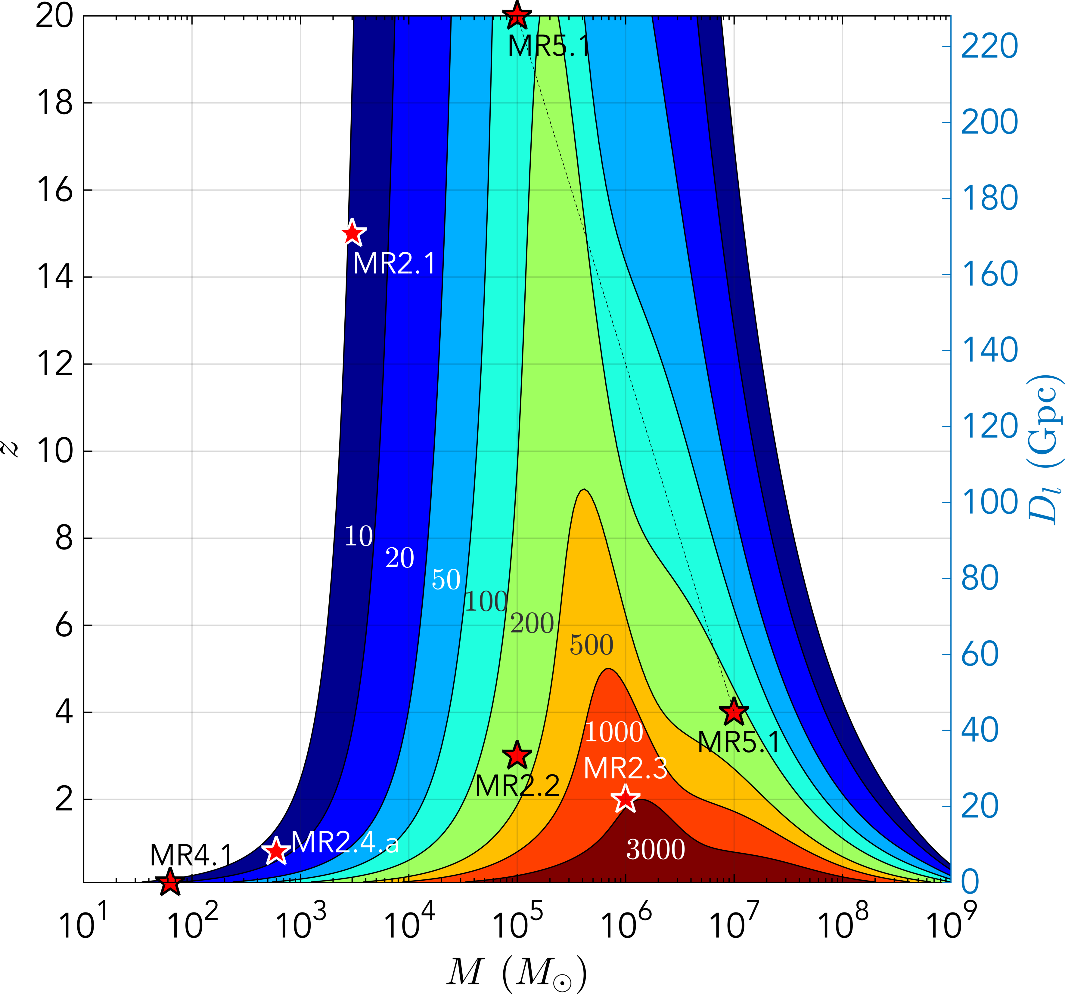
High SNR!
Blue: Simulated signal for inspiral of two 5x10⁵ Black Holes inspiraling at z=5
Red: LISA Pathfinder interferometer performance

Slide 28
The challenge of LISA data analysis
Multiple signals are always present in the LISA data
Need to disentangle all those signals to extract information about the sources
Mock LISA Data Challenges
international community working on the problem

Slide 29
Mission: Organization
ESA is the lead organization
€1.05Bn Euro for launch, spacecraft
LISA Consortium is an umbrella for instrument, data, and science community
European nation LISA Consortium members to deliver instrument to ESA
NASA a ~20% partner
Probable contributions: Telescopes, Lasers, Charge Management, Colloidal Thrusters, Phasemeter parts
Goddard, JPL; ‘Nasa LISA Study Team’

Slide 30
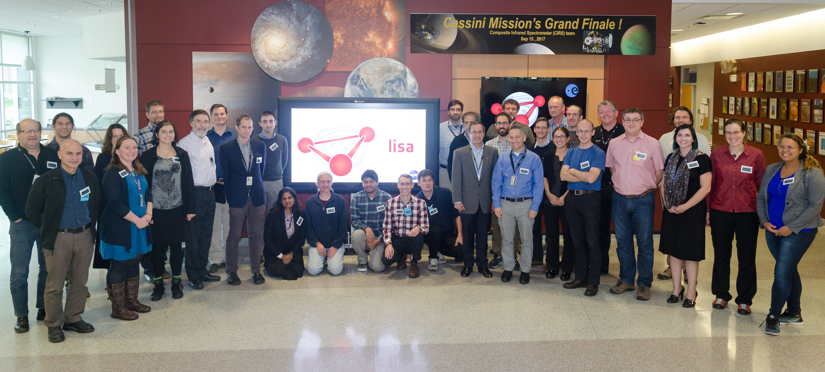
NASA LISA Study Team
Kelly Holley-Bockelmann, Chair
k.holley@vanderbilt.edu

Slide 31
NASA LISA
Study Team
Jillian Bellovary | CUNY, Queensborough
Pete Bender | University of Colorado
Emanuele Berti | University of Mississippi
Warren Brown | Harvard-Smithsonian Center for Astrophysics
Robert Caldwell | Dartmouth College
Neil Cornish | Montana State University
Mike Eracleous | Penn State University
Craig Hogan | Fermilab
Kelly Holley-Bockelmann | Vanderbilt
Brittany Kamai | CalTech
Joey Key-Shapiro | University of Washington, Bothel
Shane Larson | Northwestern
Sean McWilliams | West Virginia Unversity
Guido Mueller | University of Florida
Priya Natarajan | Yale
David Shoemaker | MIT
Deirdre Shoemaker | Georgia Tech
Tuck Stebbins | University of Colorado
Science Team
independent scientists

Slide 32
NASA LISA
Study Team
John Baker | NASA Goddard Space Flight Center
Jordan Camp | NASA Goddard Space Flight Center
John Conklin | University of Florida
Curt Cutler | NASA Jet Propulsion Laboratory
Ryan DeRosa | NASA Goddard Space Flight Center
William Klipstein | NASA Jet Propulsion Laboratory
Tyson Littenberg | NASA Marshall Space Flight Center
Jeff Livas | NASA Goddard Space Flight Center
Kirk McKenzie | NASA Jet Propulsion Laboratory
Michele Vallisneri | NASA Jet Propulsion Laboratory
John Ziemer | NASA Jet Propulsion Laboratory
Core Team
folks paid by NASA

Slide 33
NASA LISA
Study Team
Ira Thorpe | NASA Goddard Space Flight Center
Ann Hornschemeier | NASA Goddard Space Flight Center
Rita Sambruna | NASA Headquarters
Terri Brandt | NASA PCOS Program Office
Paul McNamara (ESA Observer) | European Space Technology Centre
Martin Hewitson (Euro-Community Observer) | Albert Einstein Institut/ Leibniz Universität Hannover
Ex-Officio and Observers
people with power

Slide 34
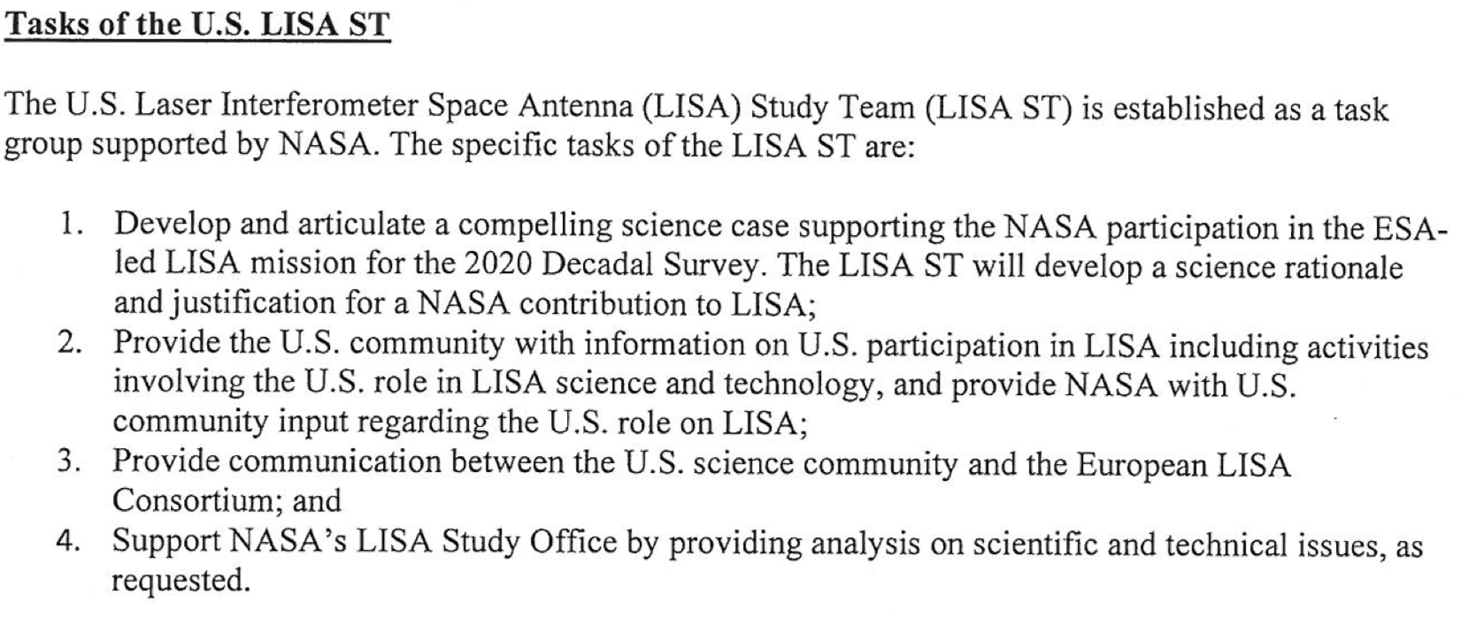
Key NLST
Reasons
for Existing:
The US 2020 Decadal Survey
Placing well in the 2020 US Astronomy Decadal Survey will protect LISA from budget cuts, cost overruns, the winds of change…
‘Advoreach’ (advocacy+ outreach)
To get the most science out of LISA, we need to build capacity in the new field of gravitational wave astronomy. This requires a huge, formal, and persistent effort to train scientists at all levels, from senior faculty to undergraduates.

Slide 35
Path to launch
Mission
Consolidation
Review
Mission
Selection
Review
Mission
Definition
Review
Proposal
Selection
Mission
Phase 0
Payload
Phase 0
Competitive Industrial Phase A studies
2017
2018
2019
2020
Mission
Adoption
Launch
Implementation Phase (B2/C/D)
2024
2026
2028
2030
2032
2034

Slide 36
Post launch
Launch
Transfer & Commissioning
Operations
Mission Extension
2034
2036
2040
2046

Slide 37
Summary
LISA L3 proposal has been selected!
Scramble now to
Deliver required documentation for industrial contractors
Develop hardware designs to required readiness
Refining Science, developing analysis techniques
Developing community
In US, focused effort to inform Decadal Survey
Launch scheduled for 2034;
…Possible as early as 2028

