Slide 1
Summary of the Town Hall meeting and next steps
David Shoemaker for LSC and Virgo
OpenLVEM Town Hall Meeting Amsterdam, 13 April 2018
LIGO-G1800782-v1
GOES-8 image produced by M. Jentoft-Nilsen, F. Hasler, D. Chesters (NASA/Goddard) and T. Nielsen (Univ. of Hawaii)
LIGO-G1600320-v10

Slide 2
Goals of the Meeting
To share LVC’s expectations for how the GW detectors will operate during the O3 run
And what it implies about expected event rates
To talk about the new direction we are going with the follow-up program for O3 and beyond
Open Public Alerts: long promised, now will be the norm!
Philosophy and mechanics of selecting event candidates and sharing information about them
Preliminary (un-vetted) GCN Notices; GCN Circulars & Notices after vetting
To allow observers to discuss plans for taking advantage of this
Acting on low-latency alerts
Doing science with multi-messenger observations
To discuss whether some science investigations will require more
Active collaboration, joint papers, exchange of additional information, and/or lower-confidence event candidates

Slide 3
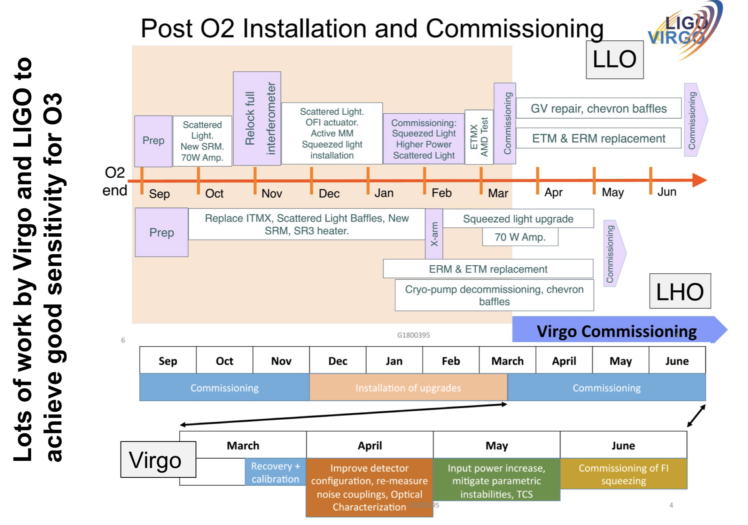
LIGO/Virgo instrument status & timeline

Slide 4
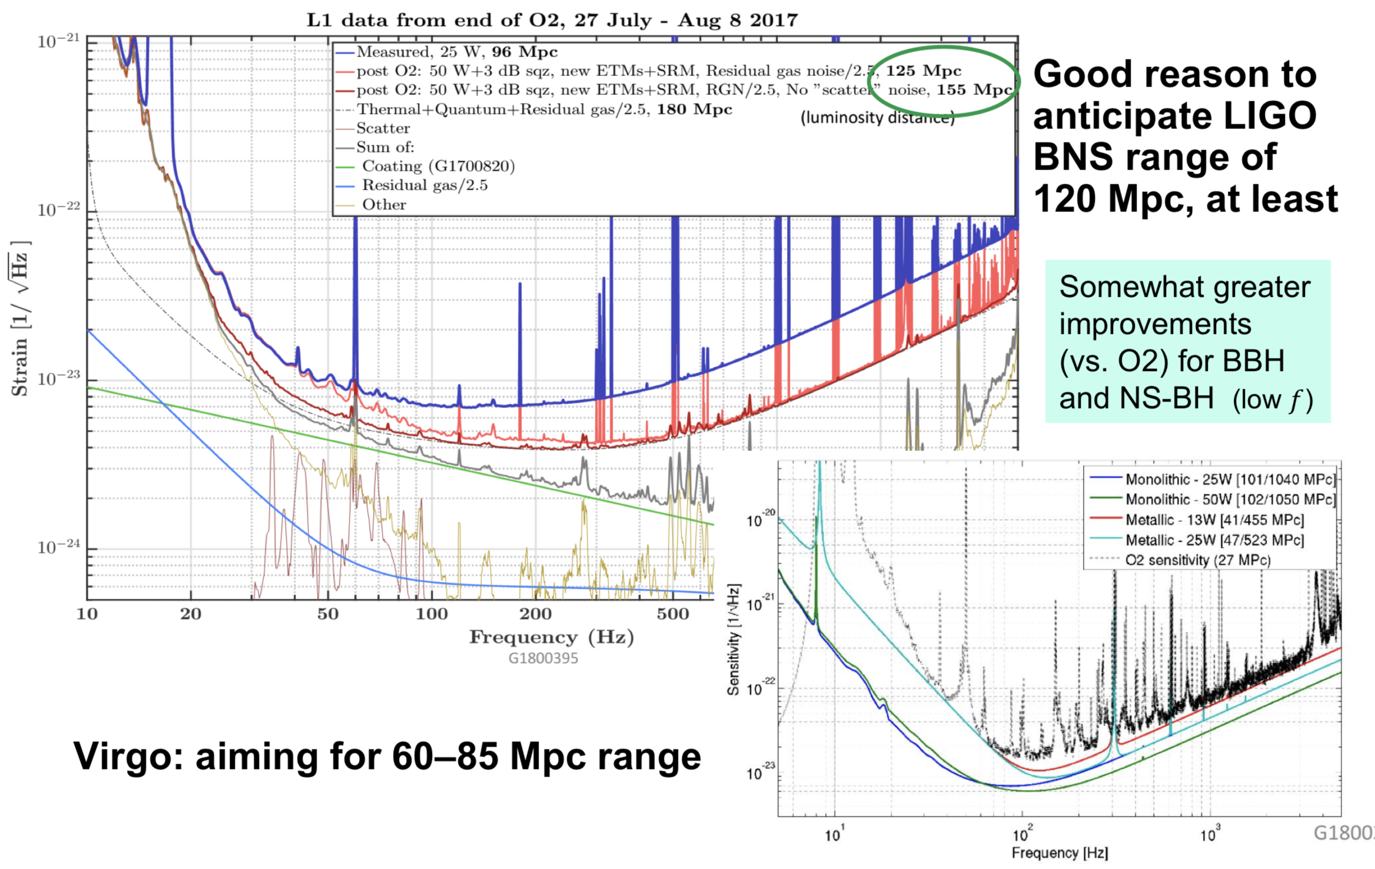
Sensitivity

Slide 5
Timing
Virgo should make significant contributions to detection and localization of events
KAGRA now aims to join near the end of the run, but it’s not yet known if their sensitivity will be sufficient to have a scientific impact
Date of beginning O3 run is not fixed; lots of commissioning to to do
Current expectation: early 2019
Plan to have a one-month engineering run leading into O3 Time for shaking down systems; may issue (open) alerts on best-effort basis Need to be clear about when we may send alerts – status display / API ?

Slide 6
Rates

Slide 7
Rates
Those estimates are for 3-detector events; will also have some 2- detector events (and potentially 1-detector, if validated by a counterpart)
Handling these rates will present challenges
Will you still follow up on all the BBHs you can?
There will be times with more than one event “in play” – we will need to keep the identities clear
Unlikely (not impossible) to get another BNS event as close as GW170817
Nearby core-collapse supernova? Better be ready for one
Publishing schedule?
Notable individual events will still be published individually, including at least the next few BNS
Expect to publish “routine” events periodically in catalog papers; maybe 6-month cadence, but this is under discussion. Could coordinate.
Issue: delay in getting parameter results out could negatively impact EM observers publishing about the event

Slide 8
Open Public Alerts
LIGO-Virgo alerts in O3 will all be public
We will set CBC FAR threshold to try to get an overall purity of 90%
We will tell you the FAR so that you can be more selective if you want
CBC alerts will include type classification
We’ll issue an alert for a sufficiently high-confidence GW burst detection
We will “promote” a weaker event to a public alert if it is compellingly associated with a multimessenger signal – but may take weeks
Alerts will be communicated using (regular) GCN Notices and Circulars, starting with one or more Preliminary Notices before vetting
→ Users should be prepared to handle Retraction Notices too
LIGO/Virgo are looking forward to seeing the fruits of open alerts
This plan for the program was the result of extended discussions, endorsed by votes of the LSC Council and Virgo Steering Committee

Slide 9
Notes
Rich real-time Communication is of high value, esp. If we have difficulties with the data. Not asking for more insider information, but anything we can say about the quality and certainty of the data
DQ flag planned, but maybe a bit more info behind it
A ‘quality factor’ to come with the data
Time scales for refined data
Interest in getting projections for the further future latencies for e.g., sky maps
Work underway on speeding up at least the non-human part of the calculations/evaluations. 10^7 waveforms
Help offered to work on the calculations/computation
Interest in understanding the localization potential
For 3 and 2 detector detections
For different SNRs

Slide 10
Notes
BHBH are still interesting to look for, and there is interest to have the info as rapidly as possible
May want to poll for the intervals which would be best, but understand that the LVC may be limited by personpower
Trades needed -- not all triggers can be followed up. Any additional information to be used to select?
Models -- e.g., a cut on mass
Additional data from LVC -- e.g., high mass or low mass

Slide 11
Notes
Request for more information on say strongest signals to help choose how to spend telescope time
Masses for example
Maybe a flag that gives some semi-quantitative information -- classes of masses, e.g., to aid in making triage in observing
Want clarification on the NS probability criterion --- 0 or 1, or is it continuous variable? (Pannarale and Ohme 2014)
Spin also interesting for observers (although sub-dominant in our waveforms; no ‘smoking guns’ seen to date)
Science-specific MoUs are an opportunity to look more deeply at the initial data
Also: specific requests make it easier to craft means to release additional information

Slide 12
Notes
We confirm that there is no need to keep any of the telescope observing data private if triggered by the Open Public Alerts
Science-based MoUs could bring in exceptions
OPA contents will be finalized and put in a public place to allow e.g., automated reading of the alerts
LVC data become public
Upon publication: 1 hr of data used in papers, plot data, full posteriors
No longer than 18 months after a 6 month ‘chunk’ -- might be shorter for O3 (e.g., 12 months) if we are ready
Coordination of EM observers could be useful to ensure that all events get some attention
Do astronomers want to create an organization for this? Global ENGRAVE?
Asterics Horizon 2020 is pursuing this sort of coordination in Europe
To discuss: A further meeting (or session at a meeting) to coordinate

Slide 13
Opportunities for science-driven collaboration

Slide 14
Collaboration
Desire to do all possible science enabled by GW and other observations, and to do it optimally
Desire to get credit for doing / contributing to good science
versus
Effort required to make and fulfill commitments
LVC having to pay attention to many different projects
LVC is looking for the right balance.

Slide 15
Collaborative Projects
BBH to contribute to H_{o}?
Galaxy surveys focused on areas of interest maybe --- and/or an assessment of the current catalogs
Combining EM and GW distance measures
May improve accuracy
Inclination via afterglow analysis
Or inform modeling of afterglow with GW
The physical systems are complicated!
Better GW waveforms and SNR may help; least sensitive detector dominates
Localization
Share richer information from LVC modeling
Joint modeling projects?
KAGRA might join end-O3

Slide 16
Collaborative Projects
Subthreshold events
Background grows very very rapidly
Requires more modeling to see if there is benefit
Rich data sets exist
Common working group and tools
Asterics a European path; efforts starting to make a long term and more global endeavor.
AMON an possibility
Supernovæ
12 hour cadence EM observation at this time – shorter feasible?
Neutrinos a reliable trigger for Galactic SN
GW sensitivity probably limited to Galaxy
Open Call
LVC to think about what we have heard; invite further input
Then define the process

Slide 17
Next steps
LVC: Implement new low-latency event handling infrastructure
Testing
Will distribute test Notices, including Retraction Notices
Engineering runs to be scheduled; updates to EM Community on what to expect and how to participate
Communication, communication, communication

Slide 18
The Last Page
Get in touch with any of us with questions and ideas
Thanks to EM Community for participating
Thanks to Marica and Jo

