Slide 1
Initial Investigation of Damping using ANSYS
Eduardo Plascencia
G-1800233-v3
06/08/2018
Can be accessed on computer m49

Slide 2
Outline
Undamped Cantilever with hole, modal analysis
Damped Cantilever with hole, modal analysis
Harmonic Analysis of damped cantilever
$b=\left\{0, 0.546, 2.73\right\}\frac{N∗s}{m}$
Damping as a function of cantilever mass
Future steps (vibration absorber parameters)

Slide 3
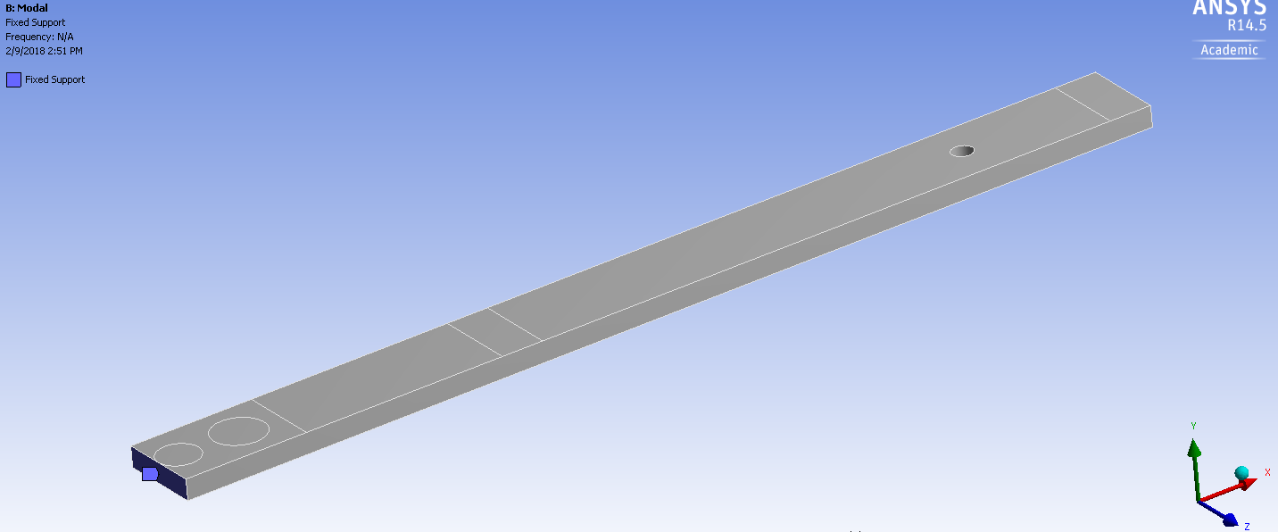
Individual Analysis of the Cantilever
Modal Analysis setup
Note the fixed supports, these were used on all implementations of the cantilever.
Cantilever mass = 0.384 kg
Credit to Cormac for slide.

Slide 4
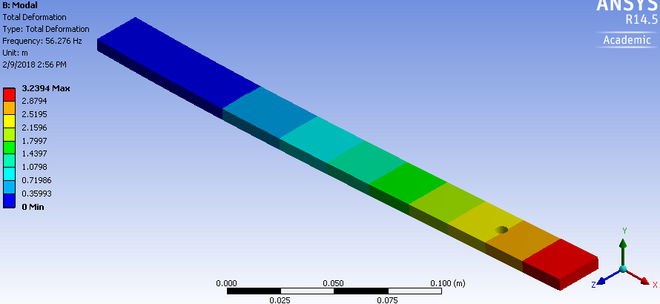
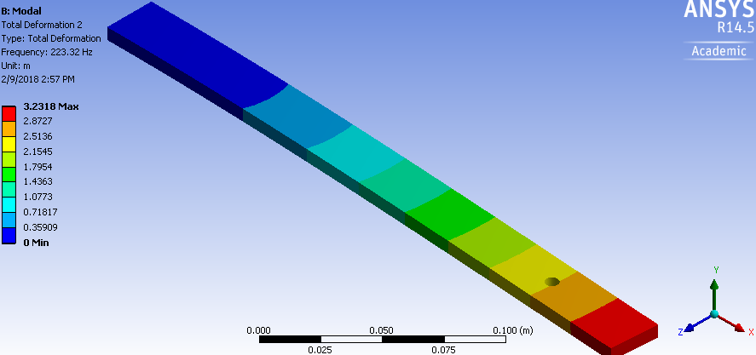
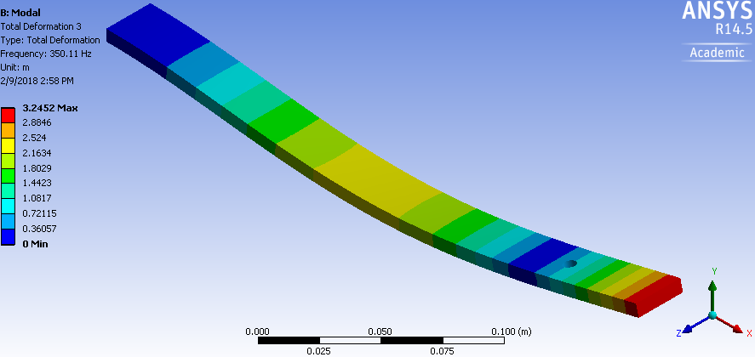
Modes: Undamped Cantilever with Hole

Slide 5
Modes: Undamped Cantilever with Hole
Mode # | Frequency [Hz] | Motion
1 | 56.27 | Y-direction
2 | 223.32 | Z-direction
3 | 350.11 | Y-direction

Slide 6
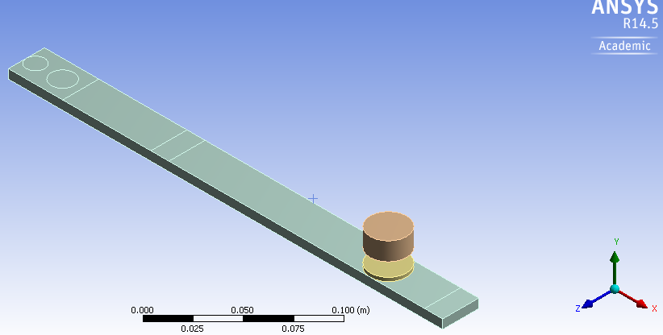
Individual Analysis of the Cantilever w/ Damper
Second Modal Analysis setup
Fixed Support the same as before
Damper mass = 0.060 kg
Total mass = 0.444 kg

Slide 7
Modes: Cantilever w/Hole and Damper
Mode # | Frequency [Hz] | Motion
1 | 29.3 | Y-direction (symmetric)
2 | 58.2 | Y-direction (anti)
3 | 216.6 | Z-direction
Note: “symmetric” and “anti-symmetric” occur with respect to the cantilever beam and damper unit motion.

Slide 8
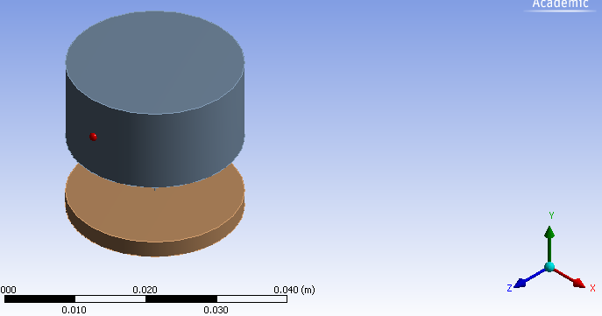
Modal Analysis: Damper Only
Damper unit only, mass = 0.0606 kg
Resonance at $f_{0}=31.19 Hz$
In $y$-direction

Slide 9
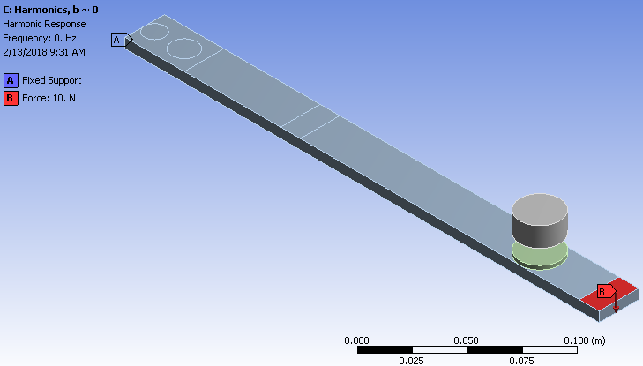
Harmonic Analysis Setup: Cantilever w/ Damper
Cantilever with damper subject to harmonic analysis
Note fixed support at back (same as before) and applied force

Slide 10
Harmonic Analysis Setup: Cantilever w/ Damper
Three test cases:
$b \sim 0\frac{N∗s}{m} →Q →Infinity$
$b=0.546\frac{N∗s}{m} →Q=50$
$b=2.73\frac{N∗s}{m} →Q=10$
$b=\frac{\sqrt{m∗k}}{Q}$; altered Q w.r.t. bar mass to arrive at initial $b$ values
All other variables constant; $k=1942\frac{N}{m}$ (taken from prior analysis by Cormac O’Neill, G-1701054)
Full solution model used to perform analysis

Slide 11
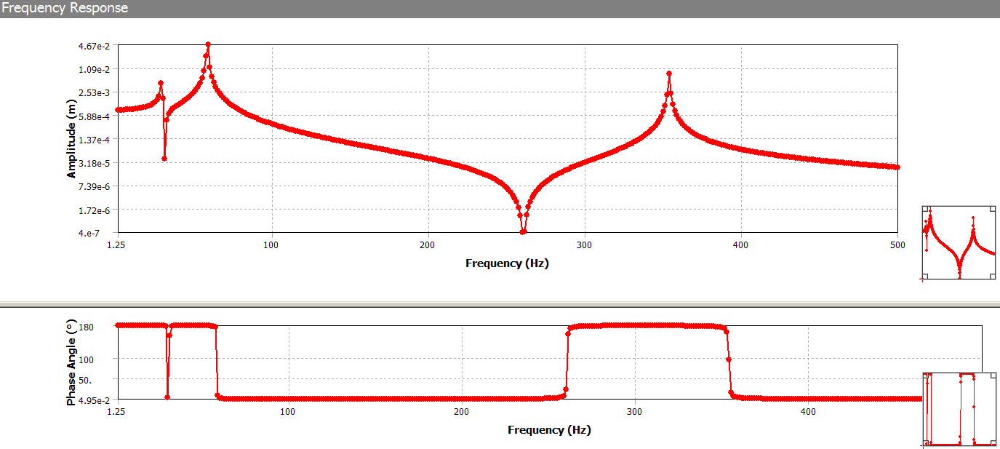
Results, $b\sim 0\frac{N∗s}{m}$

Slide 12
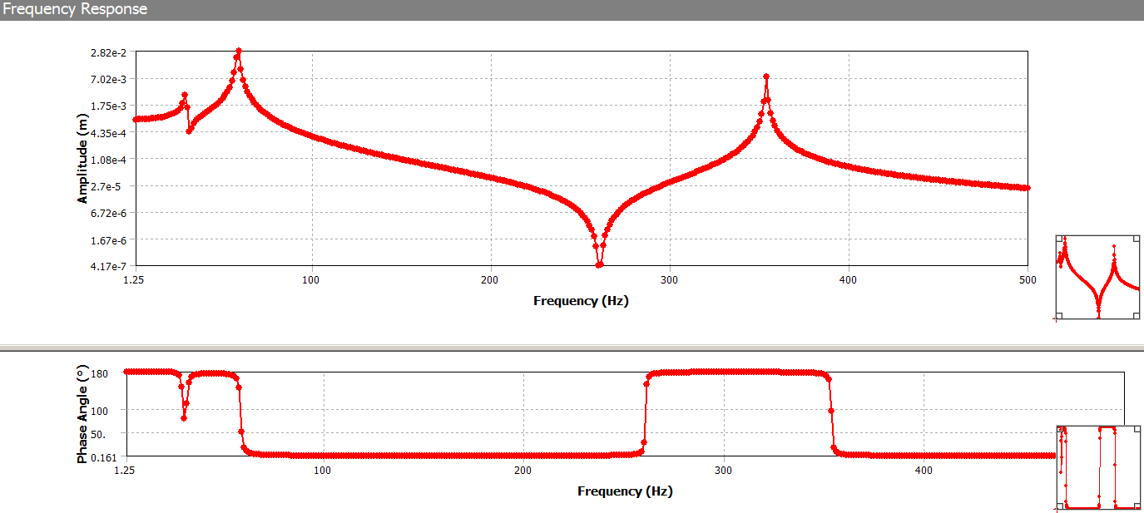
Results, $b=0.546\frac{N∗s}{m}$

Slide 13
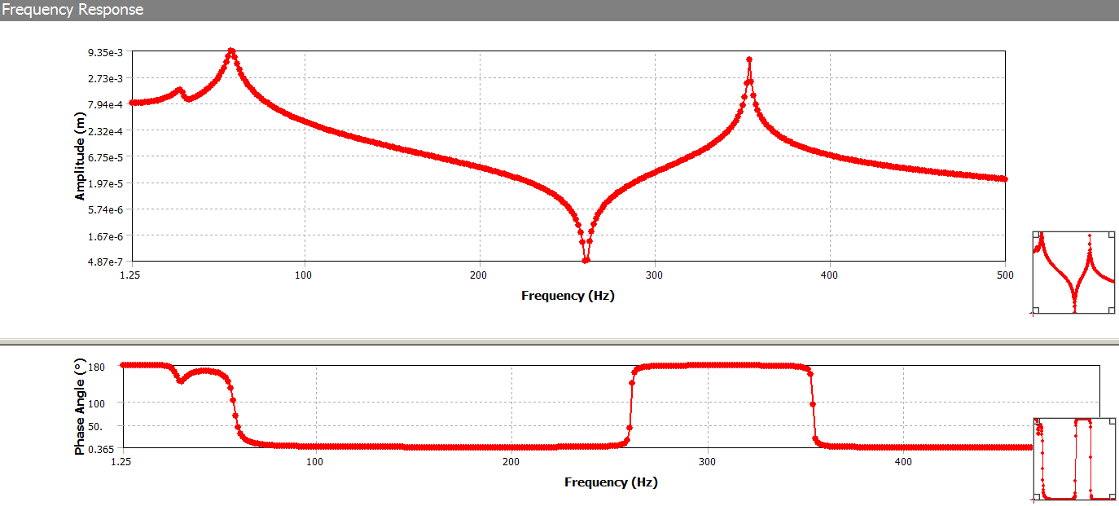
Results, $b=2.73\frac{N∗s}{m}$

Slide 14
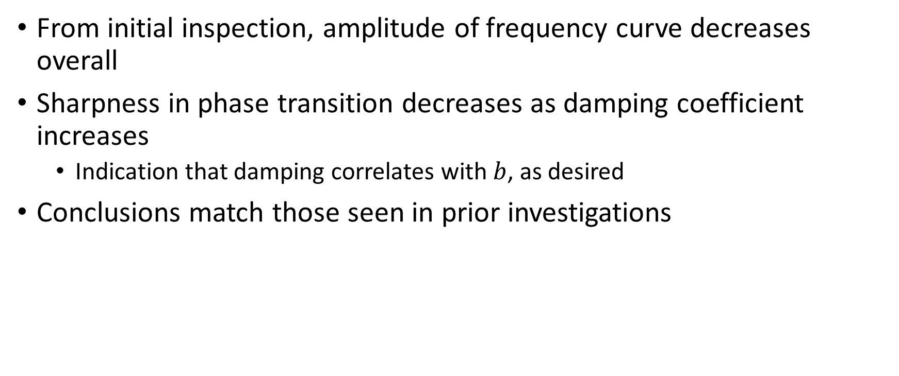
Conclusions: Harmonic Analysis
From initial inspection, amplitude of frequency curve decreases overall
Sharpness in phase transition decreases as damping coefficient increases
Indication that damping correlates with $b$, as desired
Conclusions match those seen in prior investigations

Slide 15
Damping as a Function of Cantilever Mass
Mass of cantilever changed by varying its density
Predefined b = $0.421\frac{N∗s}{m}$, k = $1942\frac{N}{m}$
Legacy numbers used for consistency, but strong evidence that these may not be accurate
Parameters specified such that Q = 25 at damper resonance

Slide 16
Damping w.r.t. Cantilever Mass: Amplitudes
Damper frequency $f_{d}=31.19 Hz$. Low peaks (20-30 Hz) correspond to cantilever frequency; high peaks to damper frequency. Lines correspond to varying mass of cantilever (in kg).

Slide 17
Damping as a Function of Mass
Original cantilever mass $m_{0}=0.384 kg$ and mass of damper $m_{d}=0.06 kg$; simulation ranged from $0.75∗m_{0}$ to $30∗m_{0}$. Resonant frequency of damper $f_{d}=31.19 Hz.$

Slide 18
Conclusions: Damping as a Function of Cantilever Mass
Varying cantilever mass with constant damper mass led to inconclusive results
Damper mass in close proximity to cantilever mass introduced coupling effects, seen in amplitude graph – damper peaks were much higher than expected when the ratio of cantilever:damper mass was small (~3-10).
Damper performance decreased as ratio of cantilever:damper mass increased
Damper and cantilever mode frequencies were adjacent at small cantilever mass (due to geometry of cantilever), so Q was smaller than designed-for ($Q_{damper}$ = 25).

Slide 19
Current: Adding Vibration Absorber Parameters to Toy Damper
Currently attempting to “scale up” (increase dimensions) of toy cantilever-damper model
Increasing (and altering) dimensions of cantilever done to change resonant frequency with goal of targeting ~60 Hz first mode for cantilever model
Damper model designed to mimic vibration absorber properties as determined through testing and documentation
Start initial simulations with damper model designed for primary frequency $f_{0}=100 Hz$ and $Q=1.5$

Slide 20
Future Steps
Vibration absorber parameters can be applied to the damper in the current cantilever-damper system to provide a reasonable analogue to the system of interest
Cantilever design has been scaled up to create appropriate first frequency of ~ 57 Hz
Damper should be scaled up to match vibration absorber parameters more closely
Even using parameters mimicking vibration absorber performance (per previous slide), ANSYS mass-spring toy damper model as currently designed (taken from previous work) did not appreciably damp up-scaled cantilever
May potentially be solved by scaling up damper model to match mass of vibration absorber
Current work under “Cantilever_VaryingDamperMass.wbpj” ANSYS Workbench file on computer m49

