Slide 1
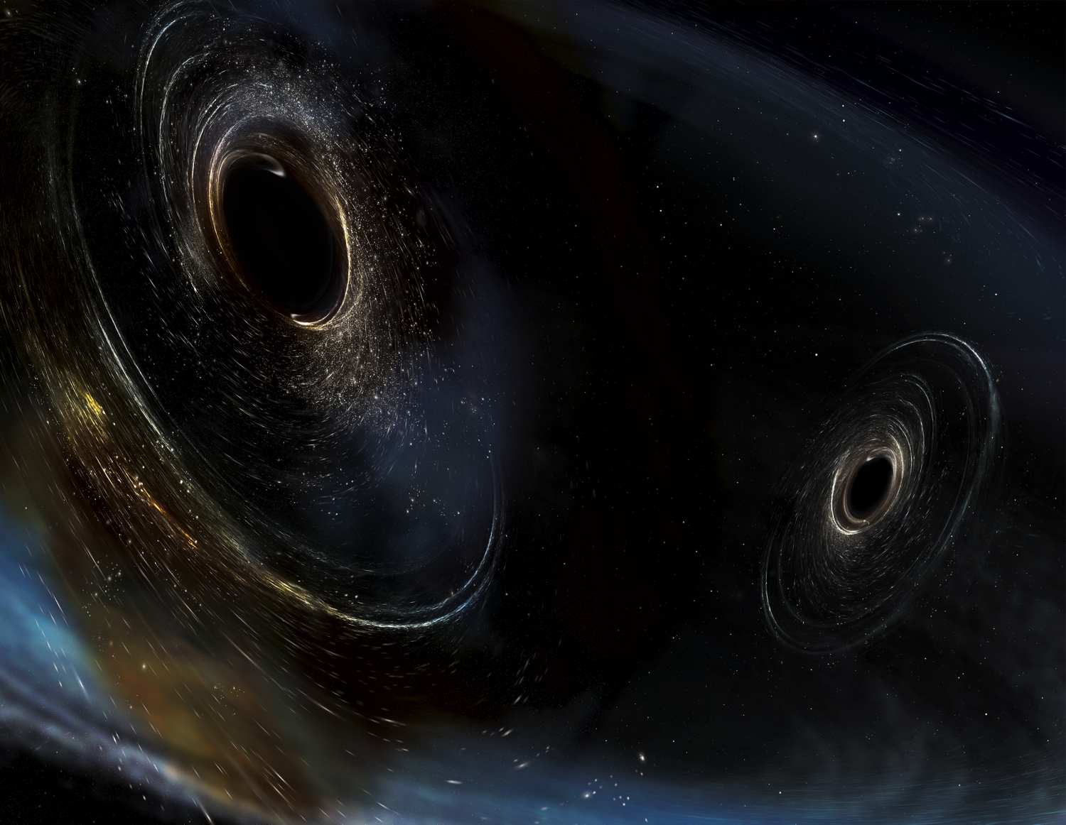


CERN Colloquium, CERN, August 29, 2017
Gravitational Waves:
An Entirely New Window on to the Cosmos
David Reitze
LIGO Laboratory
California Institute of Technology
For the LIGO Scientific Collaboration and the Virgo Collaboration
LIGO-G1701533-v2
Image Credit: Aurore Simmonet/SSU

Slide 2
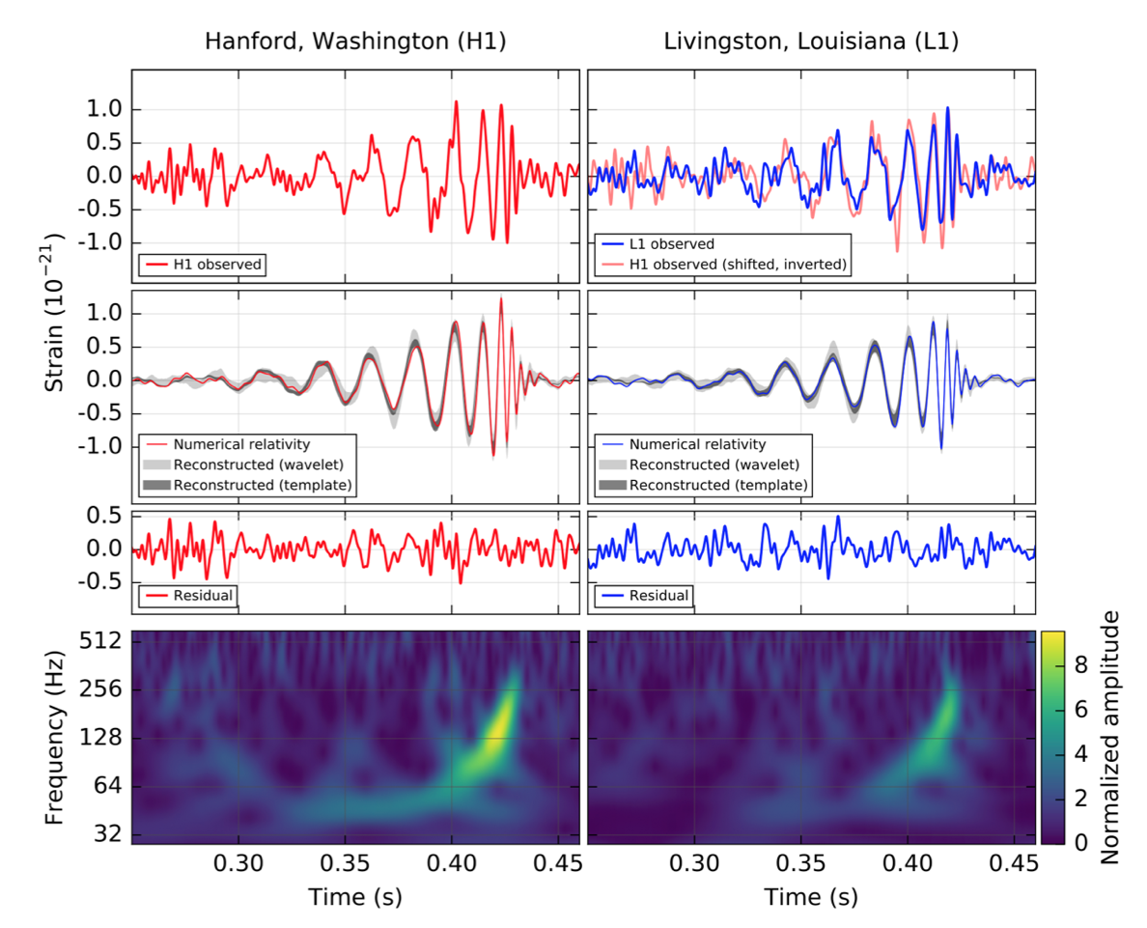
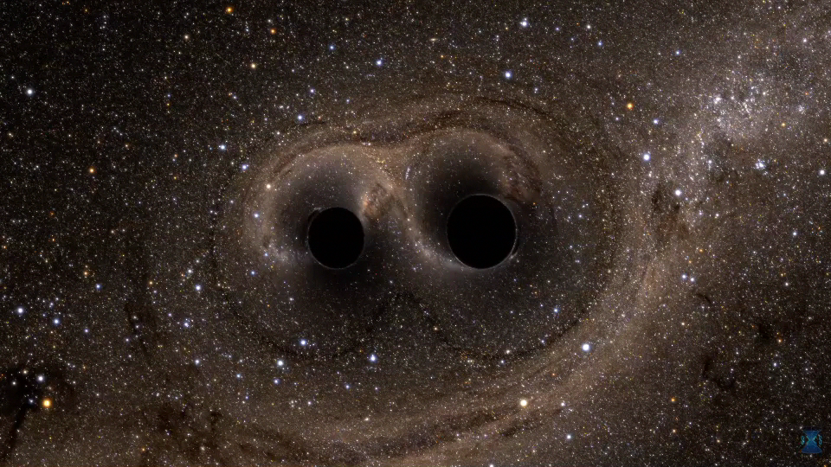
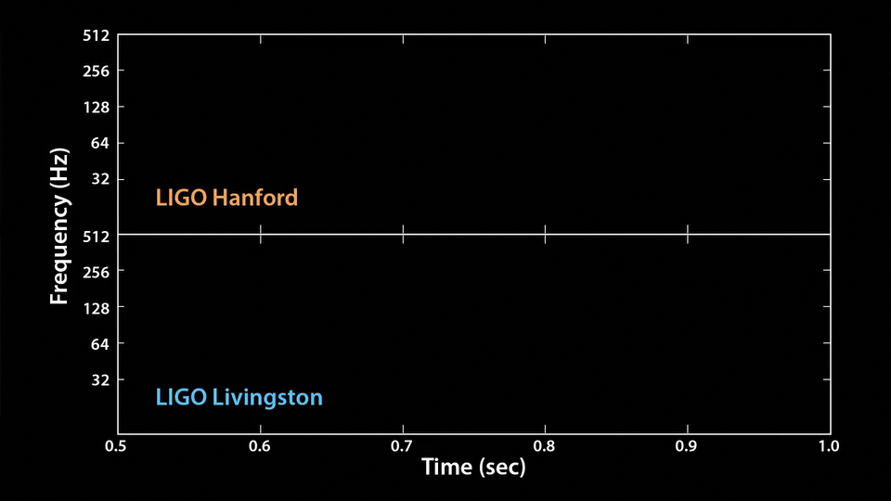
GW150914: The First Binary Black Hole Merger
Andy Bohn, François Hébert, and William Throwe, SXS Collaboration
Abbott, et al. ,LIGO Scientific Collaboration and Virgo Collaboration, “Observation of Gravitational Waves from a Binary Black Hole Merger” Phys. Rev. Lett. 116, 061102 (2016)
Notes:
I think everyone here is familiar with this data (a landmark in physics and astronomy), and perhaps you’ve seen the movie and even heard the GW. But because this is such an amazing discovery, let me start my talk by reminding you again.

Slide 3
Outline
Gravitational Waves and GW Astrophysics
LIGO/Virgo Detectors
Gravitational Waves from Binary Black Hole Mergers
  Detection Confidence
  Astrophysics
Multi-messenger Astronomy with Gravitational Waves

Slide 4
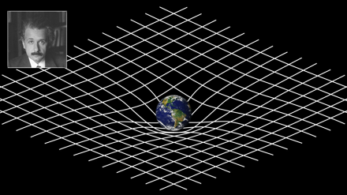
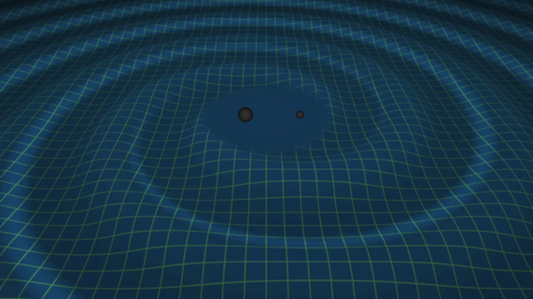
General Relativity and Gravitational Waves
General Relativity:
Einstein Field Equations
Weak field approximation --
space-time is slightly
perturbed from flat space-time:
Free Space:
T_{μν} = 0
~ 10⁻⁴³
Wave equation for h_{μν} !
Notes:
Mention
GR == Space tells matter how to move and matter tells space how to curve
GWs travel at the speed of light
Coupling is small; experiments to detect GWs are hard

Slide 5
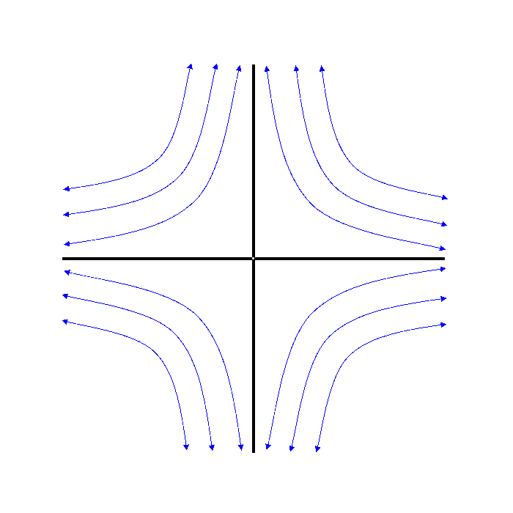
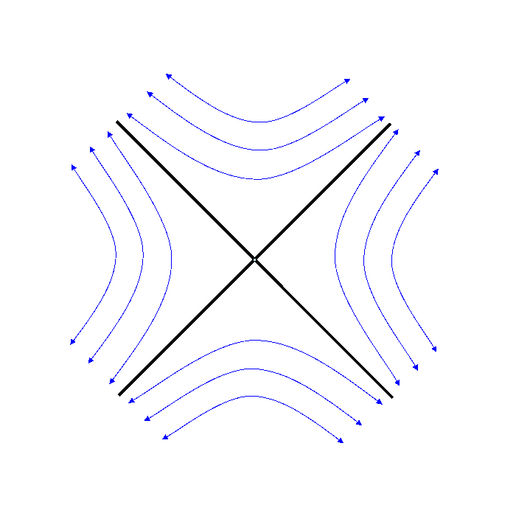
Gravitational Waves
Physically, h is a strain: ΔL/L
transverse to the propagation direction of the gravitational wave
10M Binary Black Hole System
ω_{orb}
h₊
h_{x}
M
R

Slide 6
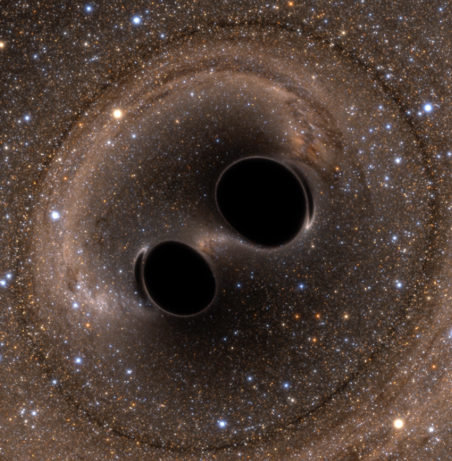
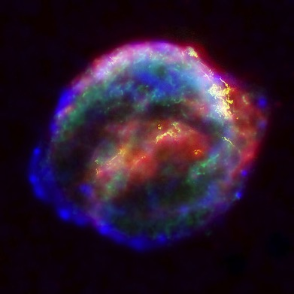
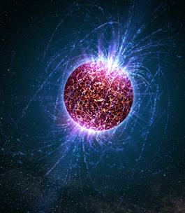
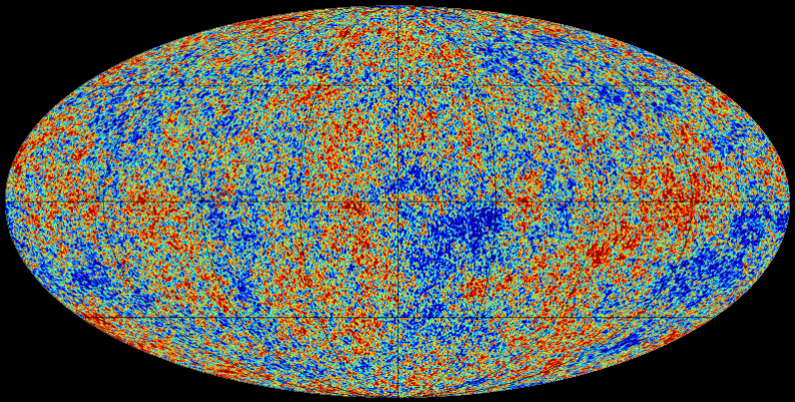
The Astrophysical
Gravitational-Wave Source Catalog
Coalescing Binary Systems
Black hole – black hole
Black hole – neutron star
Neutron star – neutron star
modeled waveform
Transient‘Burst’Sources
asymmetric core collapse supernovae
cosmic strings
???
Unmodeled waveform
Credit: Bohn, Hébert, Throwe, SXS
Credit: Chandra X-ray Observatory
Cosmic GW Background
residue of the Big Bang
probes back to < 10⁻¹⁵ s
stochastic, incoherent background
Difficult (impossible?) for LIGO-Virgo to detect
Continuous Sources
Spinning neutron stars
monotone waveform
Credit: Planck Collaboration
Credit: Casey Reed, Penn State
Notes:
LIGO is designed to be an observatory, not a one-off proof that GWs exist. What do we look for?
There are number of predicted astrophysical sources of gravitational radiation, and most of them involve cataclysmic events.
Binary systems – NSs and BHs, most likely source, theoretically well understood with known waveforms
Bursts – GW emissions that are not well modeled or understood. These include asymmetrically core collapse supernova, cosmic strings, and perhaps unknown sources
The residual GW background
Continuously emitting sources such as spinning neutron stars, which have a pure monotone emission.

Slide 7
Gravitational Wave Detectors:
LIGO and Virgo

Slide 8
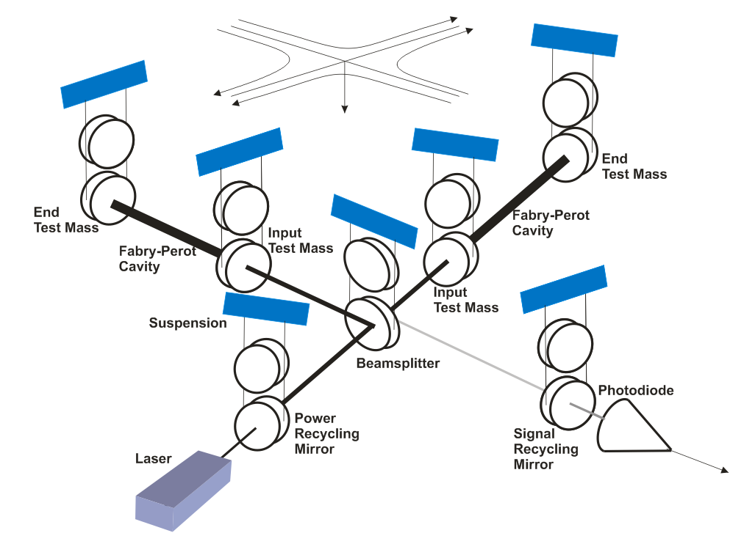
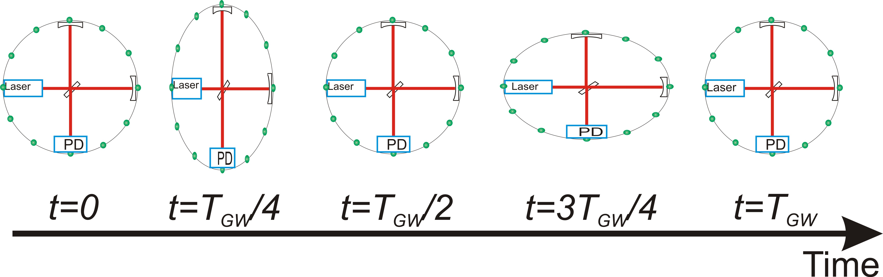
Precision Gravitational-wave Interferometry
Advanced LIGO
LIGO uses enhanced Michelson interferometry
  With suspended (‘freely falling’) mirrors
Passing GWs stretch and compress the distance between the end test mass and the beam splitter
The interferometer acts as a transducer, turning GWs into photocurrent
  A coherent detector!
Notes:
At end of slide “Let’s examine some history”

Slide 9
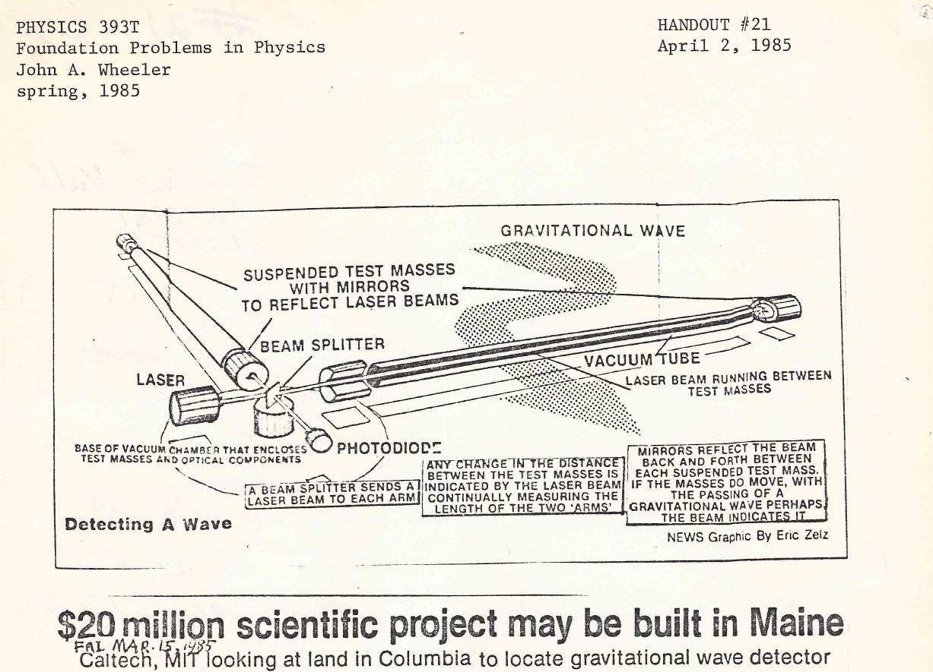

Slide 10
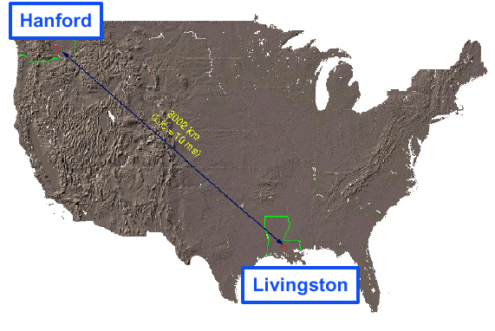
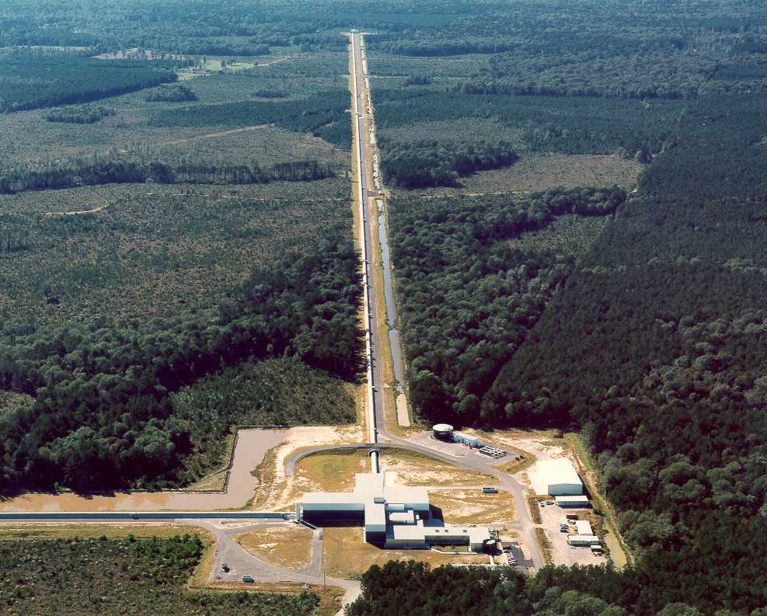
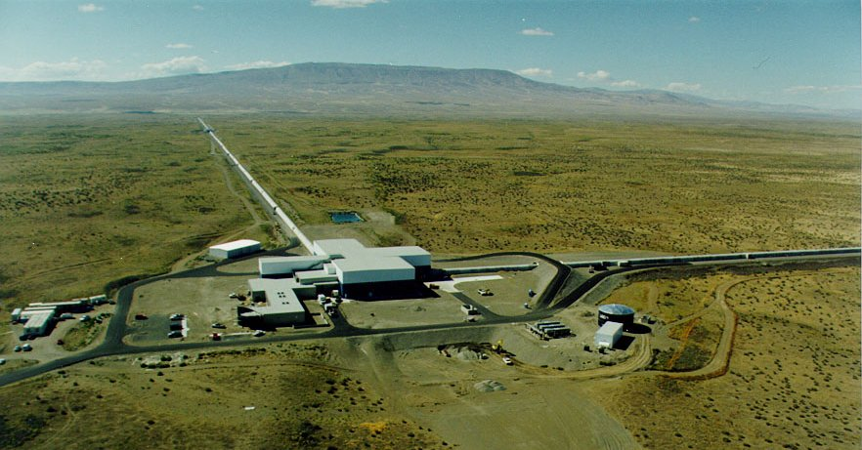
LIGO
Funding
1984 LIGO founded as a Caltech/MIT project
1990: LIGO Construction Project approved by NSF
1992: LIGO Construction Project funded by NSF
1992 --1995: Site selection, vacuum prototyping
1995 – 1999: LIGO facilities construction at
Hanford and Livingston
1998 – 2002: Installation/integration of initial LIGO
interferometers
2002 - 2005: Interferometer commissioning
interleaved with science runs (S1-S4)
Nov 4, 2005 – Sept 31, 2007: S5 science run
  Design sensitivity reached
  15 Mpc range; > 1 year of triple coincidence data
2007 – 2009: Enhanced LIGO instrument upgrade
  Tests key Advanced LIGO technologies
July 7, 2009 – Oct 20, 2010: S6 science run
  18 Mpc range to merging binary neutron stars
April 2008: Advanced LIGO Construction begins
Dec 2011 – Advanced LIGO detector installation
begins
Mar 2015 - Advanced LIGO Construction complete
Sept 2015 – First Advanced LIGO Observing
Run ‘O1’
Sept 14, 2015 – First binary black hole detection
Nov 2016 – Advanced LIGO O2 run
Hanford, WA
LIGO Livingston
Construction
LIGO Hanford
Initial LIGO
LIGO Hanford Observatory
Livingston, LA
LIGO Laboratory:
180 staff located at Caltech, MIT, Hanford, Livingston
LIGO Scientific Collaboration:
~ 1200 scientists, ~100 institutions, 16 countries
Advanced LIGO
Notes:
The real history; four epochs, today

Slide 11

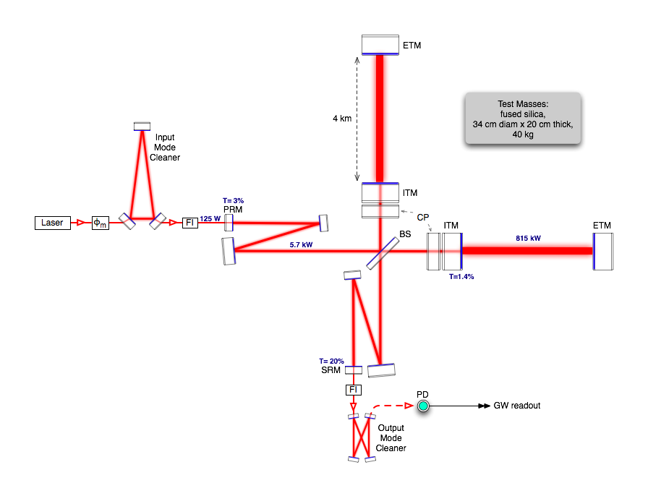
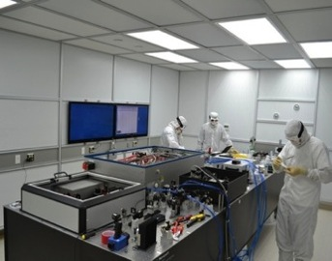
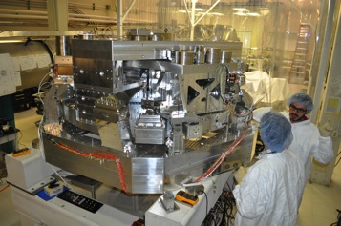
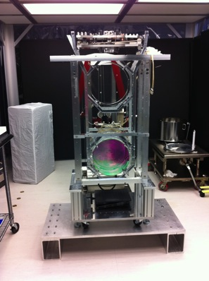
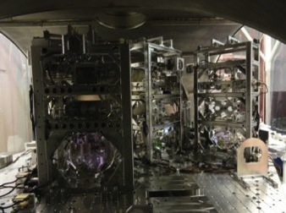
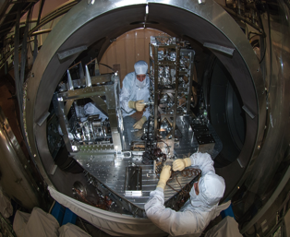
Advanced LIGO Interferometer
Pre-stabilized Laser
200W , 1064 nm
Active Seismic Isolation
40 kg ‘Test Mass’ Mirror
Input Optics
Output Mode Cleaner
Auxiliary Laser
Notes:
Go through the slide from laser forward

Slide 12
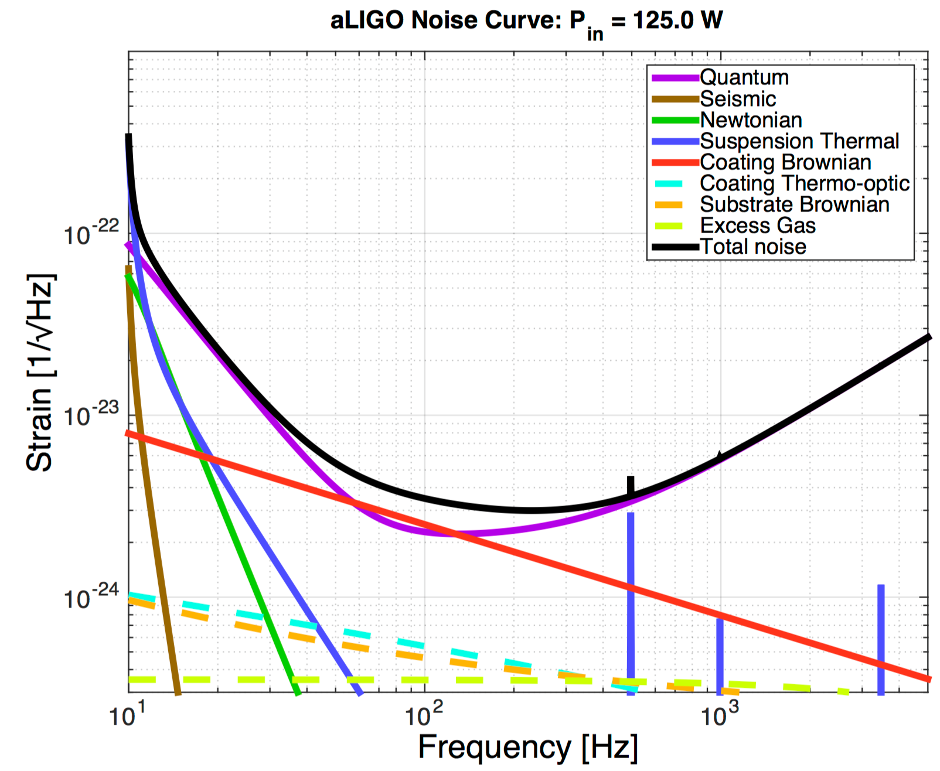
Precision Interferometry = Understanding Measurement Noises
Fundamental Noises:
Displacement Noises
→ ΔL(f)
  Seismic noise
  Radiation Pressure
  Thermal noise
    Suspensions
    Optics
II. Sensing Noises
→ Δt_{photon}(f)
    Shot Noise
    Residual Gas
Technical Noises:
Advanced LIGO Design Noise Budget
Photon Statistics
Radiation Pressure
Sensitivity ~ 1/√P_{Laser}
Dissipative
Dynamics
‘kT physics’
Photon Statistics
Shot Noise
→ Sensitivity ~ √P_{Laser}
Residual Gas
Scattering
→ Hundreds of them…
Seismic Motion
Notes:
Explain top level three noise sources
Do animation explaining limitations and as a way of previewing next slides

Slide 13
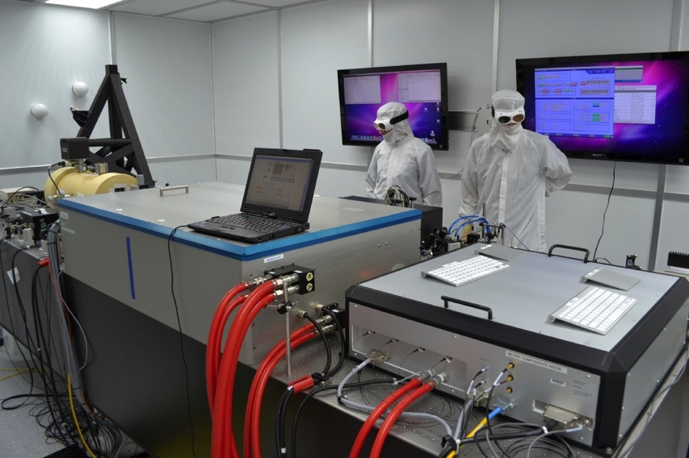
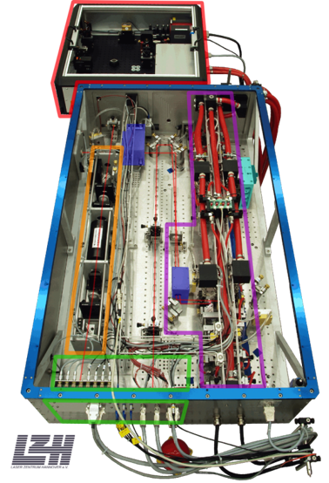
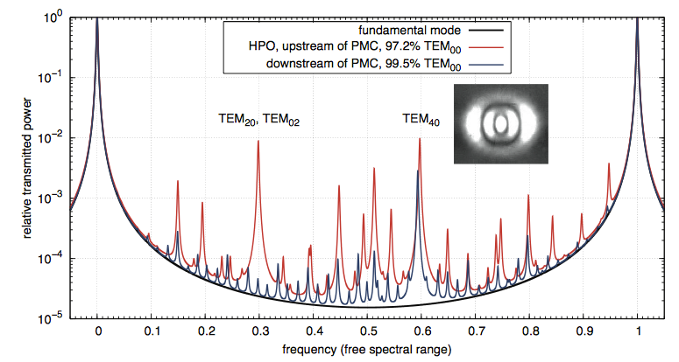
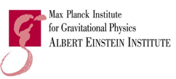
Advanced LIGO Front-end Stabilized
200W Laser
Stabilized in power and frequency – using techniques developed for time references
Uses a Nd:YAG monolithic master oscillator followed by two-stage amplification
  35W Nd:YVO₄ MOPA
  200 W injection-locked Nd:YAG rod ring amplifier
Collaboration w/
MPG Albert Einstein Institute;
Laser Zentrum Hannover
P. Kwee,et al., Opt. Exp. 20, 10617-10634 (2012).
Notes:
Quckly go over

Slide 14
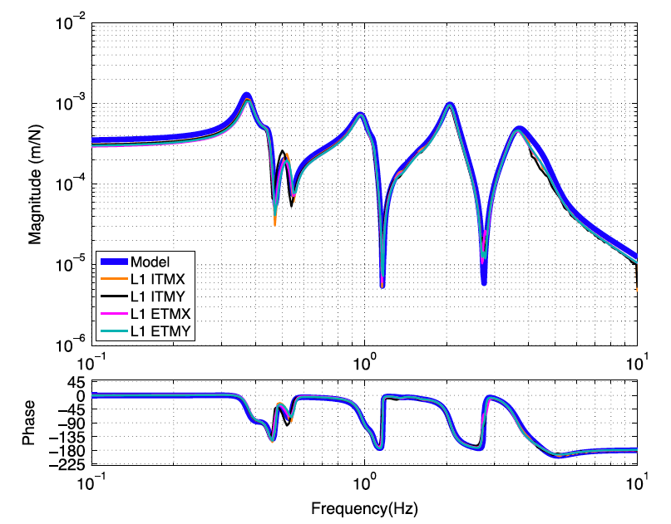

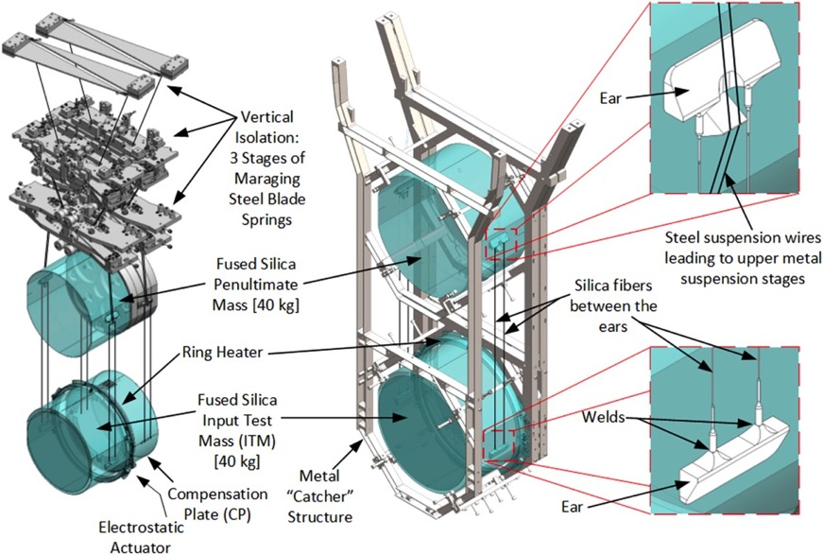
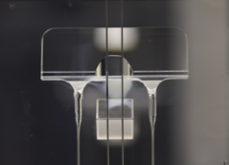
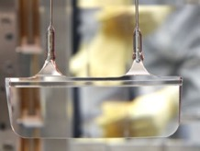
Advanced LIGO Suspensions
Force → Displacement
Transfer Function
Model vs. Measured
Concept:
Implementation:
Collaboration w/ U. Glasgow
Upper ‘ear’
Lower ‘ear’

Slide 15
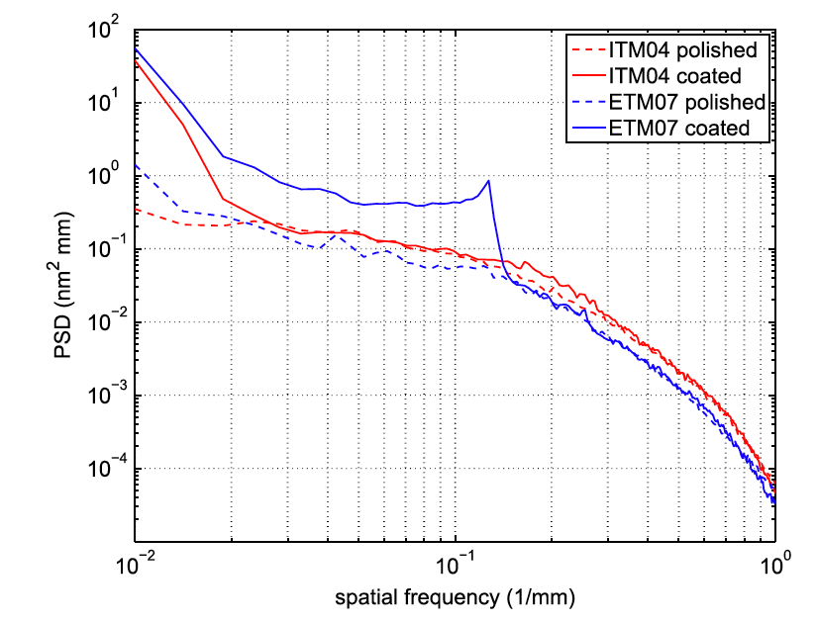
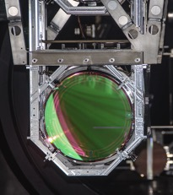
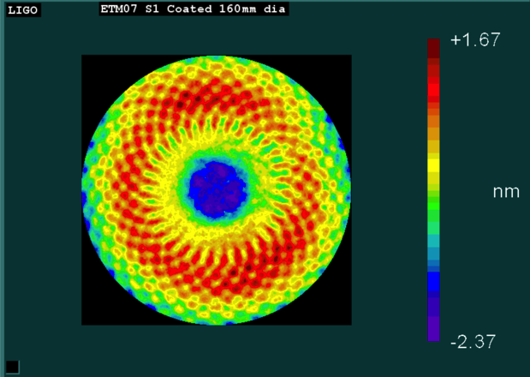
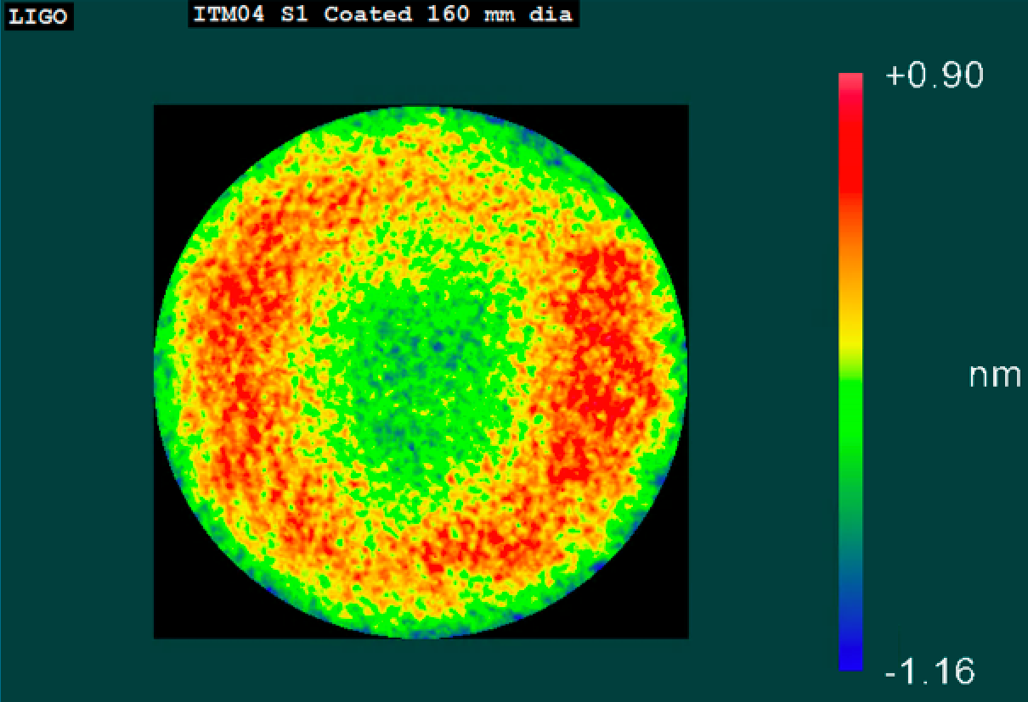
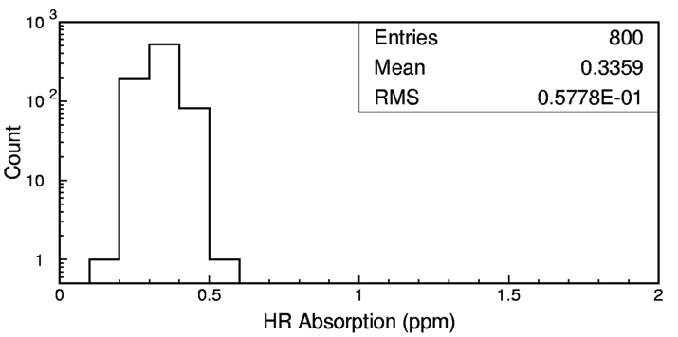
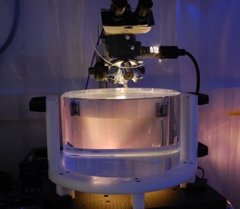
Advanced LIGO ‘Test Mass’ Mirrors
Truly the ‘crown jewels’ of the detector
Physical specifications:
  Ultra-pure, ultra-homogeneous Hereaus Suprasil fused silica
  340 mm diameter, 200 mm thick, 40 kg mass
Surface figure: super-polish followed by ion beam sputtering
  < 0.15 nm RMS deviation from sphere
Coatings: TiO₂-doped Ta₂O₅/SiO₂
  Reflectivity depends upon type of mirror
  Ultralow absorption (< 0.5 ppm)

Slide 16
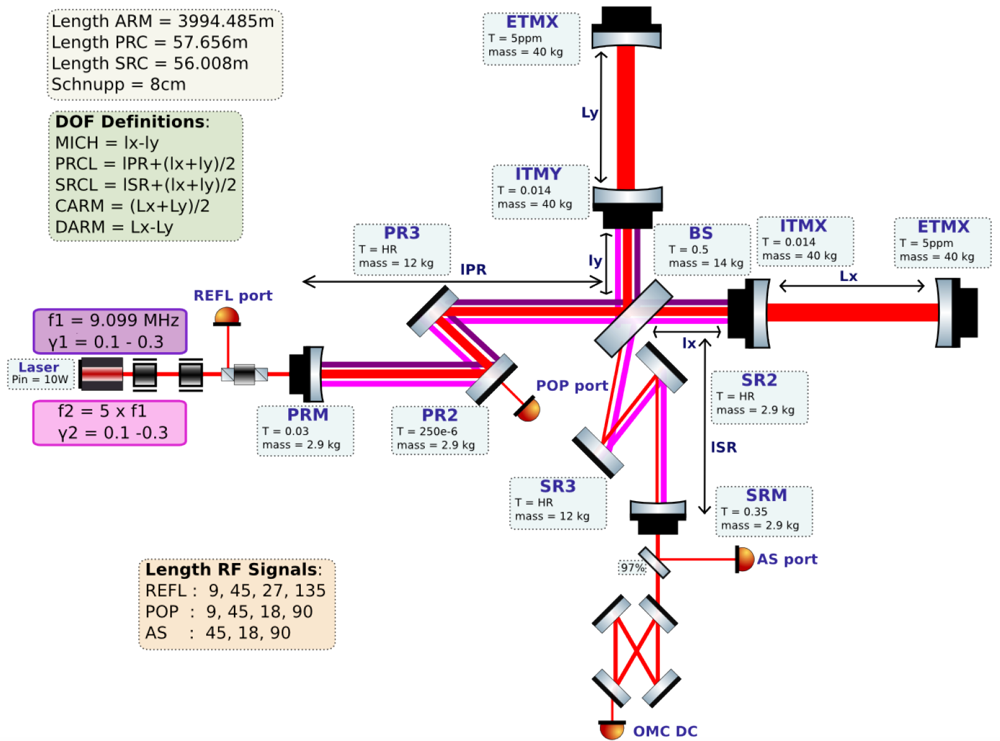
Advanced LIGO = Servo Control
Gravitational Wave!
Slide: Anamaria Effler, LIGO Livingston

Slide 17
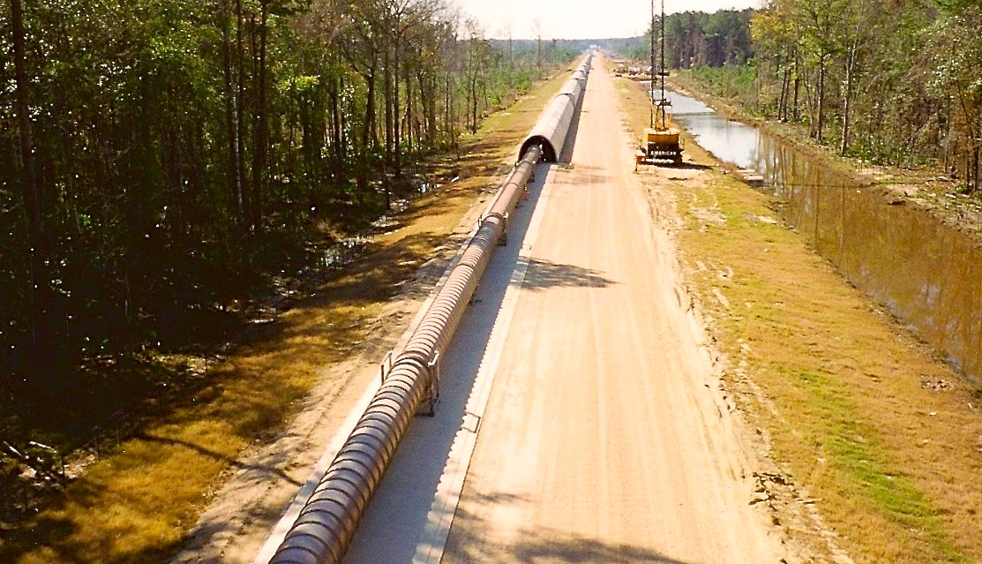
The LIGO Vacuum System
Consists of:
  9000 m³ volume
  30000 m² surface area
  50000 m of spiral welds
  10⁻⁸ - 10⁻⁹ torr
At each observatory

Slide 18
LIGO Livingston Performance
70.6 Mpc BNS Range)
175
Notes:
Point out
What BNS range means
Curves look similar, but BNS range benefits from low frequency senstivity

Slide 19
LIGO Hanford Performance
175

Slide 20
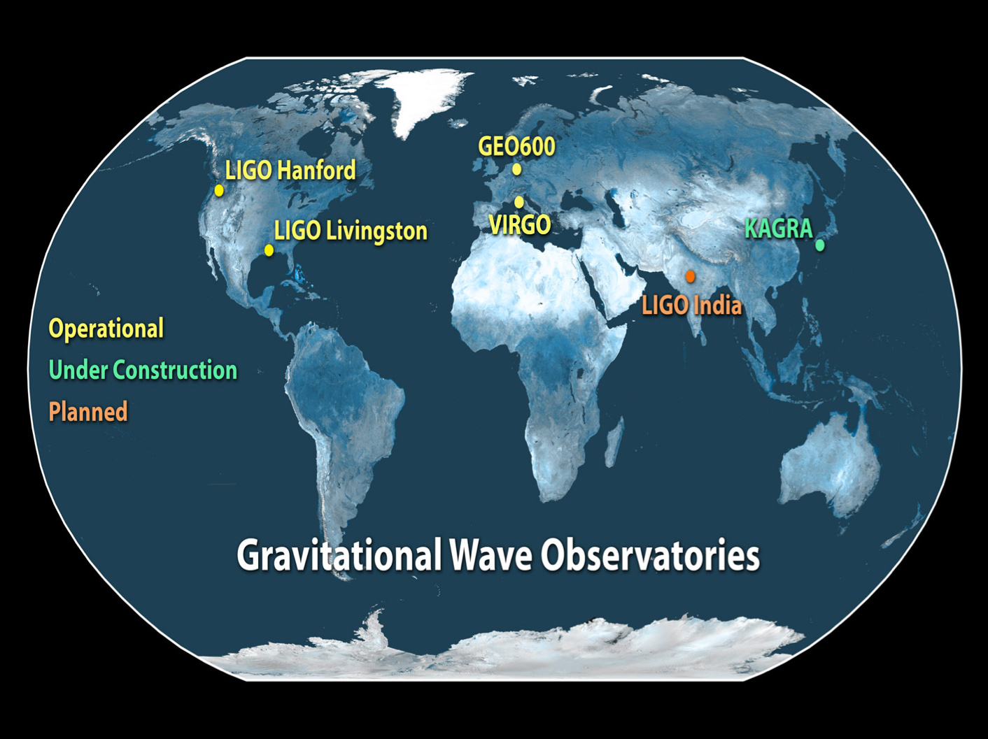

Slide 21
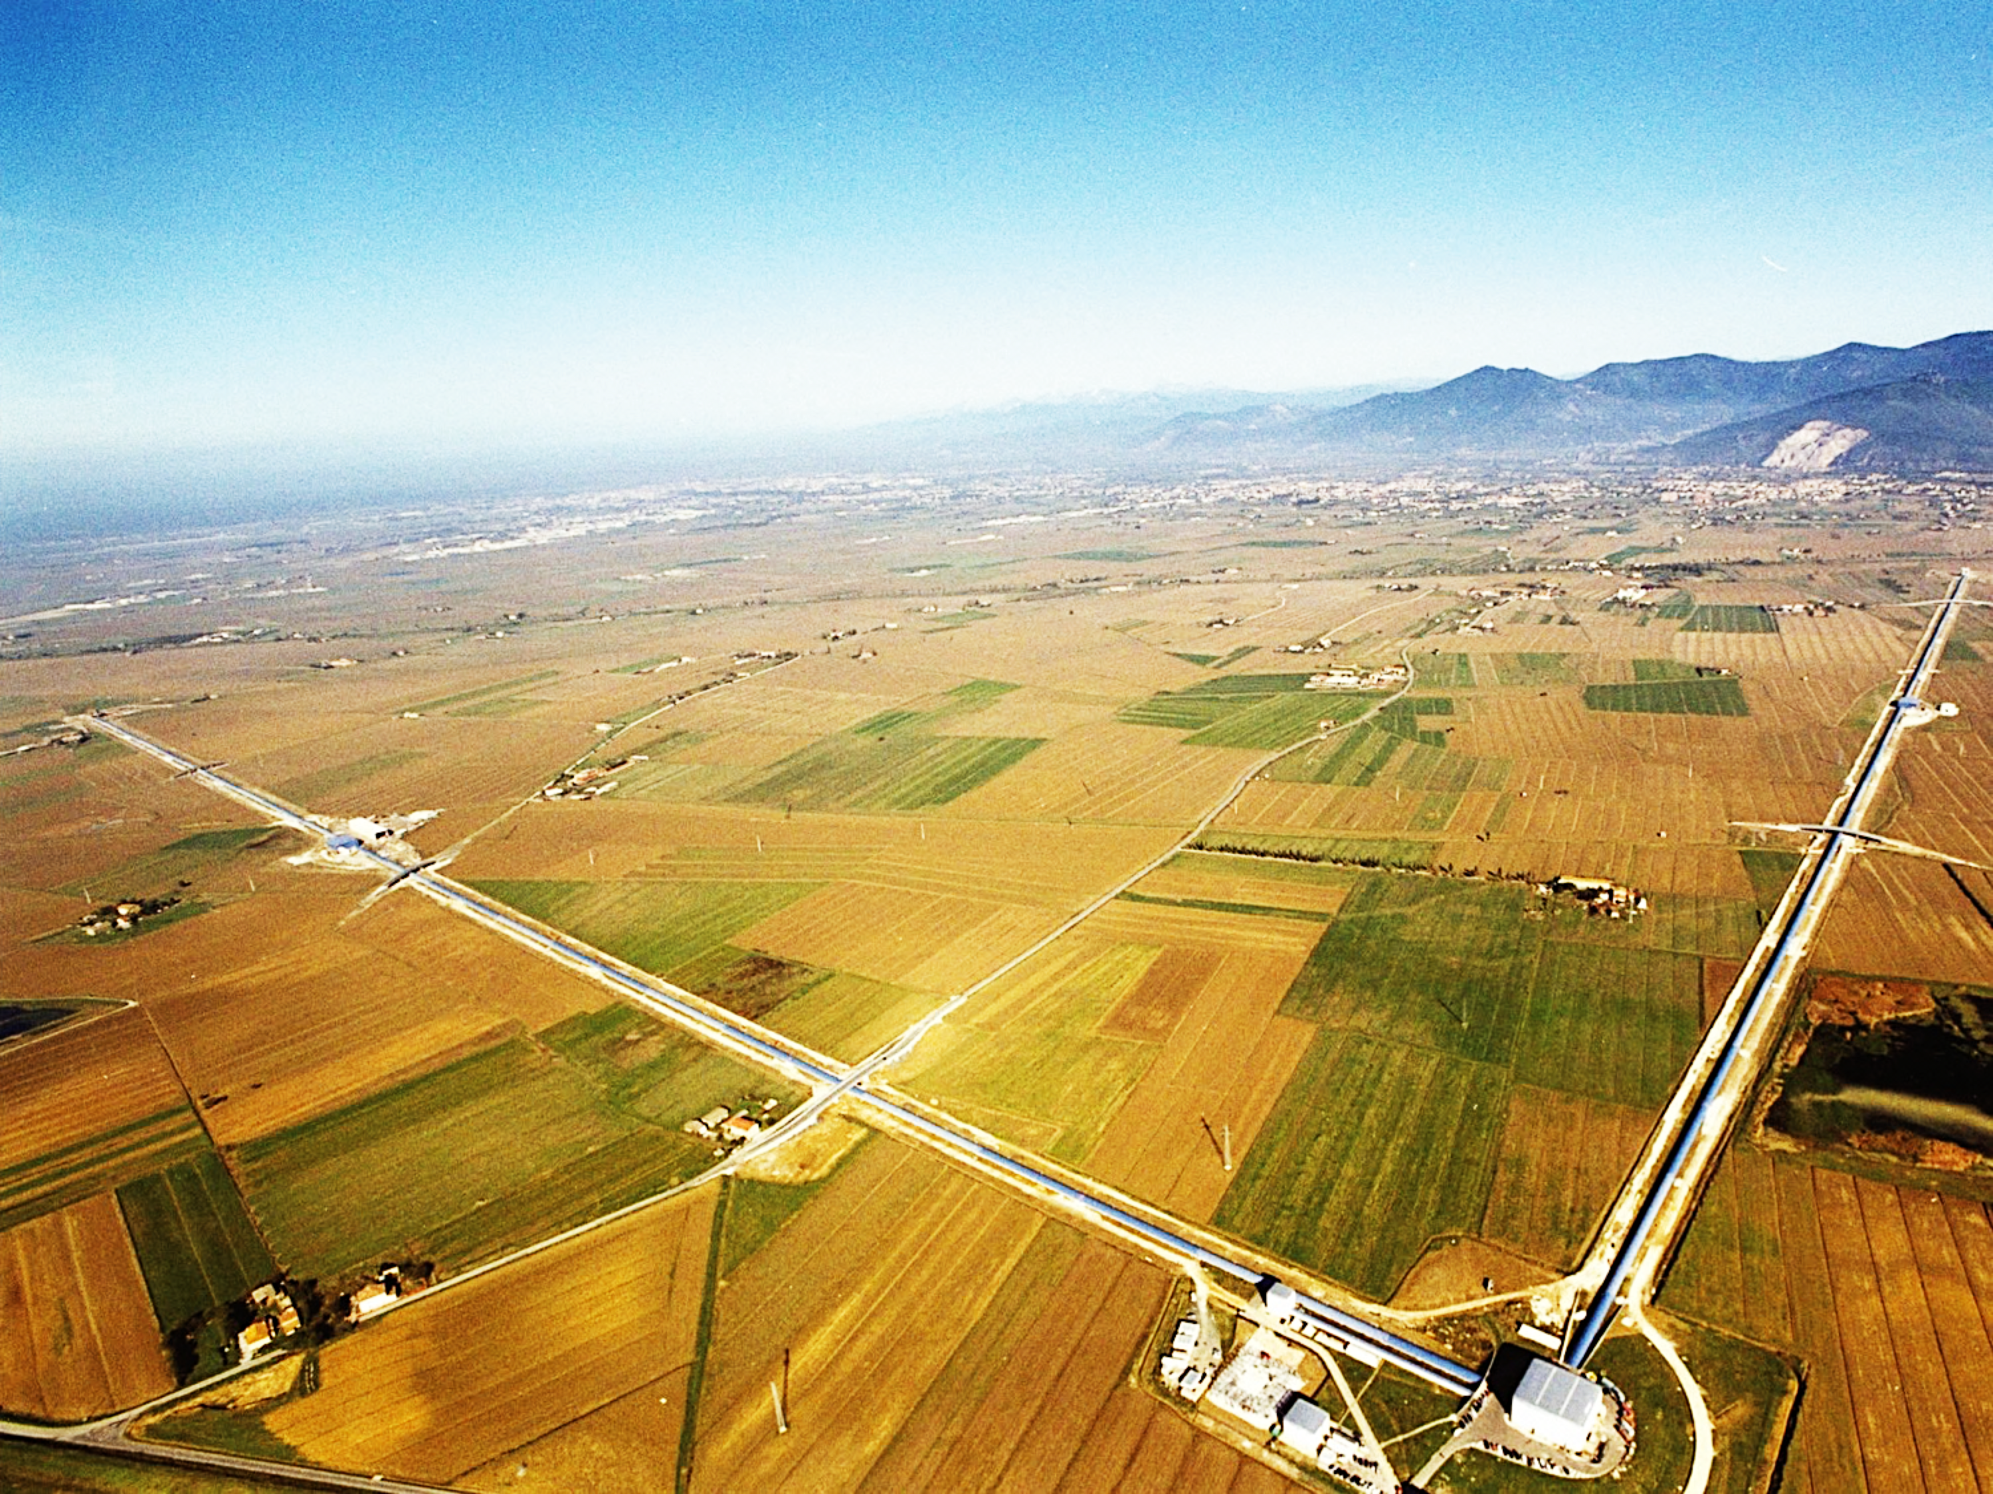
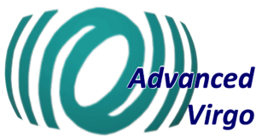






ADVANCED VIRGO
6 EU countries: France, Hungary, Italy, Poland, Spain, and The Netherlands
20 labs, ~280 authors
APC Paris
ARTEMIS Nice
EGO Cascina
INFN Firenze-Urbino
INFN Genova
INFN Napoli
INFN Perugia
INFN Pisa
INFN Roma La Sapienza
INFN Roma Tor Vergata
INFN Trento-Padova
LAL Orsay – ESPCI Paris
LAPP Annecy
LKB Paris
LMA Lyon
NIKHEF Amsterdam
POLGRAW(Poland)
RADBOUD Uni. Nijmegen
RMKI Budapest
University of Valencia

Slide 22
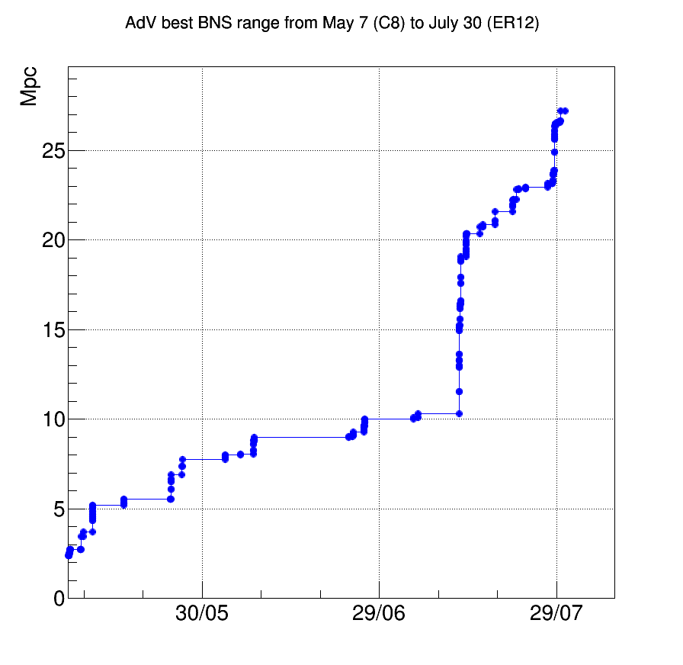
Advanced Virgo Progress
Advanced Virgo integration completed in late 2016, followed by commissioning period
First project milestone (1h stable lock) reached in March 2017
First commissioning run (C8) in May 2017
Sensitivity exceed that of Virgo+ in July, 2017
Weekend run on May 27 to 29 to test long-term stability, and effectiveness of automation.
Longest stable lock stretch was 69 hours
Binary neutron star range up to 28 Mpc
Joined O2 on August 1, 2017
Virgo science duty cycle was more than 80% (over last four weeks of O2)
Binary Neutron Star Range
Date

Slide 23
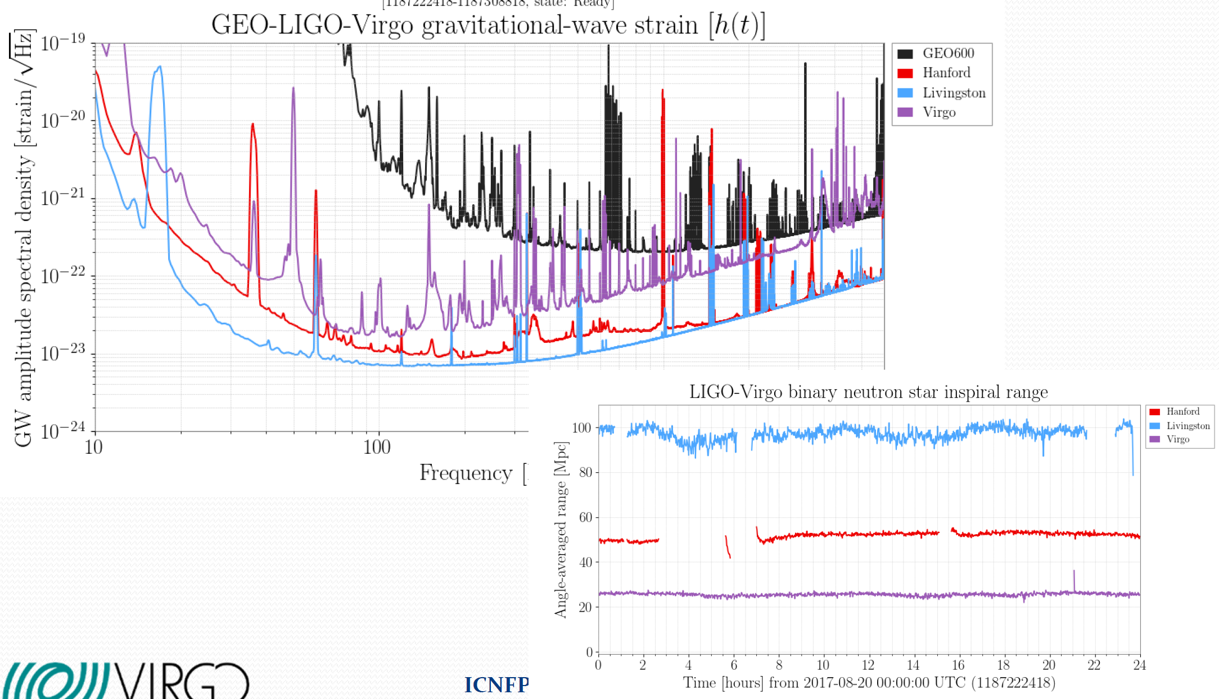
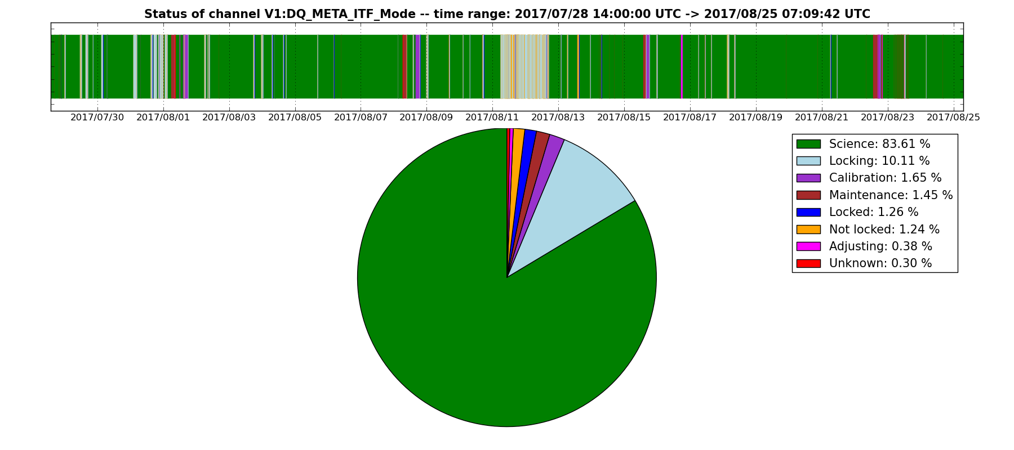
Advanced Virgo Performance

Slide 24
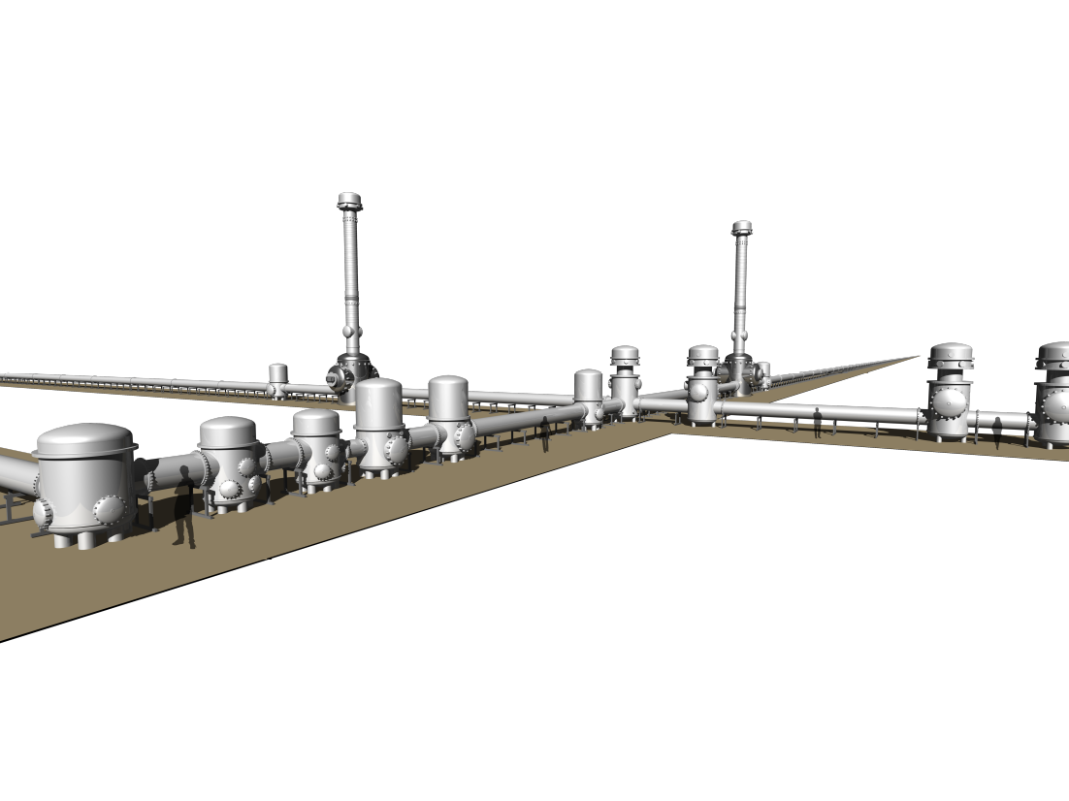

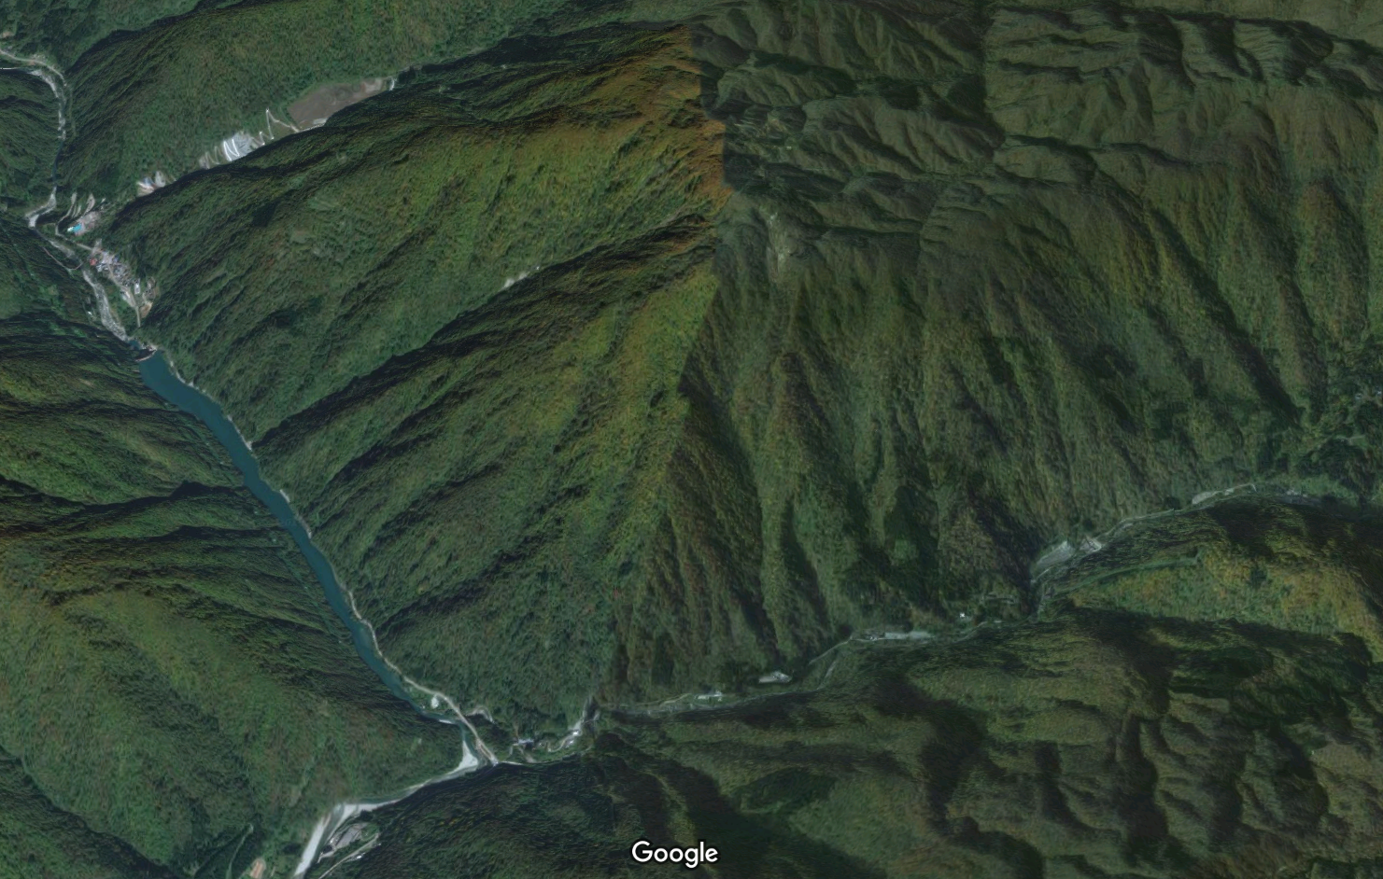

The KAGRA Project
About 300 collaborators
Over 30 Japanese institutes, over 40 international institutes

Slide 25
The First Gravitational Wave Detections: Binary Black Holes

Slide 26
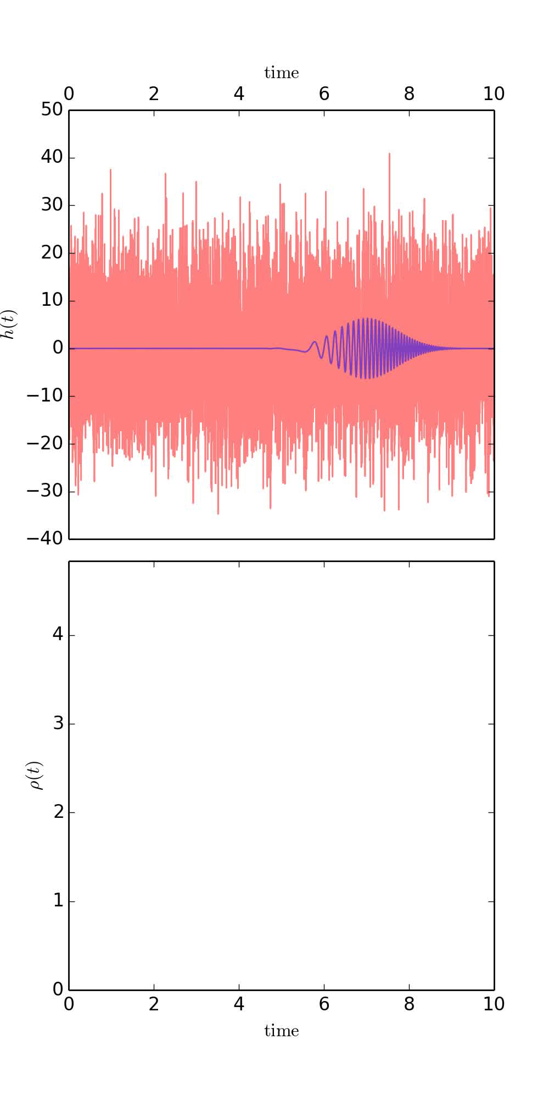



Assessing Statistical Significance: Modeled Search
Matched filter search: X-correlation of L1, H1 data streams
Background computed from time-shifting coincident data in 100 ms steps
  For GW150914, 51.5 days → 5x10⁶ years
Simulation: Reed Essick, LIGO MIT
Abbott, et al., LIGO Scientific Collaboration and Virgo Collaboration, “Binary Black Hole Mergers in the first Advanced LIGO Observing Run”, Phys. Rev. X 6, 041015 (2016).
Notes:
Explain template-based search
Show animation
Explain background generation

Slide 27

Assessing Statistical Significance: Modeled Search
Abbott, et al., LIGO Scientific Collaboration and Virgo Collaboration, “Binary Black Hole Mergers in the first Advanced LIGO Observing Run”, Phys. Rev. X 6, 041015 (2016).

Slide 28

Assessing Statistical Significance: Unmodeled Search
Pipelines look for excess power in time-frequency domain
  e.g. wavelet basis
  More sensitive to generic sources, but also to noise transients in the interferometers
Simulation: Reed Essick, LIGO MIT

Slide 29

Extracting Astrophysical Parameters from GW Waveforms I
Compact object parameters encoded in the waveforms:
  Constituent masses, constituent spins, sky location, luminosity distance, orbital inclination, time of arrival
Intrinsic degeneracies make parameter estimation difficult!
  E.g., luminosity distance vs. inclination angle
The SNR of the waveform matters
  often buried in detector noise; lower SNR obscures parameter estimation
Inspiral Merger Ringdown
LIGO Scientific Collaboration and Virgo Collaboration, “Parameter estimation for compact binary coalescence signals with the first generation gravitational wave detector network” Phys. Rev. D 88(2013) 062001

Slide 30









Extracting Astrophysical
Parameters from Waveforms II
Total Mass:
Mass ratio:
Chirp Mass:
Black Hole Spins:
Spin component aligned with orbital angular momentum:
Effective spin parameter:
Luminosity Distance D_{L}
Bayesian computation of posterior PDFs
  Markov chain Monte Carlo
  Nested Sampling
Abbott, et al., LIGO Scientific Collaboration and Virgo Collaboration, “Binary Black Hole Mergers in the first Advanced LIGO Observing Run”, Phys. Rev. X 6, 041015 (2016).

Slide 31



Astrophysical Parameters of the
Detected BBH Mergers
GW170104

Slide 32



Gravitational Waves in
Pop Culture
From The Guardian, Feb 12 2016

Slide 33
What These GW Detections Tell Us
About Black Holes, Merger Rates, and General Relativity

Slide 34


Black Holes Detected By LIGO
Credit: Robert Hurt/Caltech, Aurore Simmonet, SSU

Slide 35


Estimating Binary Black Hole Merger Rates
With four detections, we can infer BBH merger rates
under different assumptions
  Flat mass spectrum
  Power law:
  Event-based (match properties of observed events)
Merger rate of stellar mass BBHs implied by the detections: 12 – 213 per Gpc³ per yr
Corresponds to one per ~ day to one per few weeks at Advanced LIGO design sensitivity!
R = N/<VT>
Abbott, et al., LIGO Scientific Collaboration and Virgo Collaboration, “Binary Black Hole Mergers in the first Advanced LIGO Observing Run”, Phys. Rev. X 6, 041015 (2016).
Abbott, et al. ,LIGO Scientific Collaboration and Virgo Collaboration, “GW170104: Observation of a 50-Solar-Mass Binary Black Hole Coalescence at Redshift 0.2”, Phys. Rev. Lett. 118, 221101 (2017).

Slide 36


Tests of General Relativity in the Strong Field Regime I
The first binary black hole mergers provide the best test of GR in the strong field, dynamical, nonlinear regime
By comparing experimental waveform with GR, can look for deviations in phase due to finite graviton mass
  Compton wavelength of the graviton:
No deviations from General Relativity observed.
eV/c²
Compton Wavelength of the Graviton
Abbott, et al. ,LIGO Scientific Collaboration and Virgo Collaboration, “GW170104: Observation of a 50-Solar-Mass Binary Black Hole Coalescence at Redshift 0.2”, Phys. Rev. Lett. 118, 221101 (2017).
Abbott, et al. ,LIGO Scientific Collaboration and Virgo Collaboration, “Tests of general relativity with GW150914”, Phys. Rev. Lett. 116, 221101 (2016).

Slide 37

What the LIGO Detections Tell Us About Black Holes, Binary Formation
Stellar mass binary black hole systems exist!
Stellar mass binary black hole systems can merge in less than a Hubble time!
First observation of ‘heavy’ stellar mass (> 25 M) black holes
Heavy mass BBH system most likely formed in a low-metallicity environment: < ½-¼ Z
In the future:
  Determine mass and spin spectrum of black holes
  Determine preferred formation channels: isolated binary evolution vs dynamical capture in dense stellar environments
Abbott, et al. ,LIGO Scientific Collaboration and Virgo Collaboration, “Astrophysical Implications of the Binary Black-Hole Merger GW150914”, ApJL, 818, L22, 2016 ;”The Rate of Binary Black Hole Mergers Inferred from Advanced LIGO Observations Surrounding GW150914”, arXiv:1602.03842

Slide 38
The Future:
1) Multi-messenger Astronomy With Gravitational Waves
&
2) More Sensitive Gravitational-wave Detectors

Slide 39







Multi-messenger Astronomy with Gravitational Waves
Binary Neutron Star Merger
X-rays/Gamma-rays
Gravitational Waves
Visible/Infrared Light
Neutrinos
Radio Waves

Slide 40





Enabling multi-messenger astronomy with gravitational waves
Swift
Interferometers are ‘omni-directional
microphones’!!
Swift
Polarization-averaged antenna pattern
for an interferometer
Limit:
LIGO
Hanford
t₁
Coherent
Detector
Network
t₂
Virgo
t₃
LIGO
Livingston
Image:
http://earthobservatory.nasa.gov/
Abadie, et al, (LSC & Virgo Collaborations) Astron. Astrophys. 541 (2012) A155.

Slide 41

GW150914 EM Follow Up
Follow-up observations reported by 25 teams via private Gamma-ray Coordinates Network (GCN) Circulars
Abbott, et al. ,LIGO Scientific Collaboration and Virgo Collaboration, “Localization and Broadband Follow-Up of the Gravitational-Wave Transient GW150914”, Ap. J. Lett, 826:L13, 2016.

Slide 42

Event Sky Location
With 2 detectors can only limit location to annulus on the sky
  Preferential angles from interferometer antenna patterns
90% credible regions:
  GW150914: 230 deg²
  GW151226: 850 deg²
  LVT151012: 1600 deg²
  (GW170104: 1200 deg²)

Slide 43
Event Sky Location
With 2 detectors can only limit location to annulus on the sky
  Preferential angles from interferometer antenna patterns
90% credible regions:
  GW150914: 230 deg²
  GW151226: 850 deg²
  LVT151012: 1600 deg²
  (GW170104: 1200 deg²)
With Virgo, 90% credible regions decrease
by approximately 2 – 6 times:
Assuming Equal LIGO sensitivities; Virgo 1/3 as sensitive
Also depends on duty cycle and sky location

Slide 44

‘A+’ Advanced LIGO
Mid-scale Upgrade
An upgrade to aLIGO that leverages existing technology and infrastructure, with minimal new investment and moderate risk
Target: average 1.7 increase in range over aLIGO
~ 5 greater event rate than Advanced LIGO; ~ 40 times better than current Advanced LIGO sensitivity
Stepping stone to future detector technologies
Two year down time; back online by 2023 with funding in FY’19
  Funding model based on successful Advanced LIGO model using international partners
A+ key parameters: 12dB injected squeezing
15% readout loss
100 m filter cavity (FC)
20 ppm round trip FC loss
Coating Thermal Noise half of aLIGO

Slide 45



Further on: Voyager,
Einstein Telescope, Cosmic Explorer
LIGO Voyager – exploiting
the LIGO Observatory facility
limits
Longer Arm Length Interferometers
Einstein Telescope
A future GW observatory in the EU
λ = 2 μm
Cosmic Explorer – A future
GW Observatory in the US

Slide 46

Conclusions
LIGO-Virgo has made first measurements of gravitational wave amplitude and phase
Merging binary black hole systems have been observed for the first time!
Plans are underway to improve LIGO’s sensitivity for O3 and beyond
LIGO-Virgo O2 run completed on August 25
Stay Tuned…

Slide 47












































































LIGO Scientific Collaboration

Slide 48








Acknowledgments
LIGO Livingston Observatory
LIGO Hanford Observatory
Thanks to:
ligo.caltech.edu
www.ligo.org
Support: National Science Foundation
LIGO Caltech
LIGO Caltech
LIGO MIT
LSC

