Slide 1
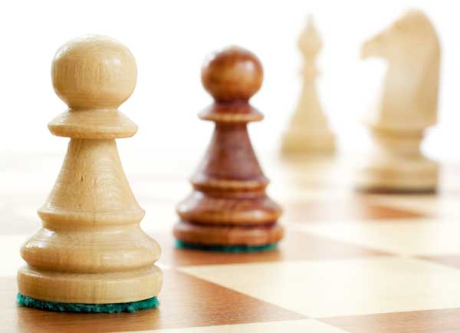
DAWN III Workshop:
What’s Next for Gravitational Wave Astronomy?
Barry C Barish
LIGO Laboratory
6-July-2017
Strategic Issues

Slide 2
Context of G3: Where will we be?

Slide 3
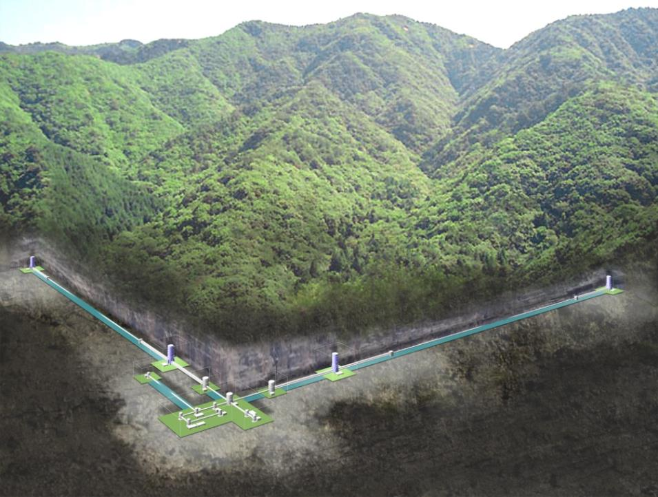
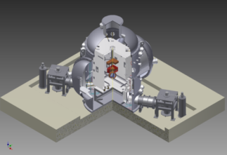
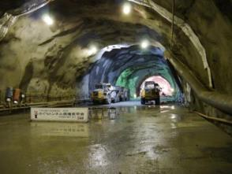
Context of G3: Where will we be?
Cryogenic Mirror
KAGRA
Kamioka Mine
Underground
Technologies crucial for next-generation detectors;
KAGRA can be regarded as a 2.5-generation detector.

Slide 4
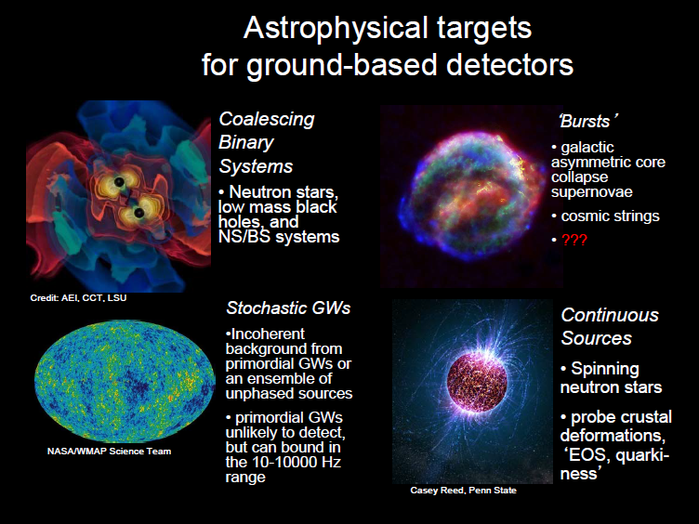
Context of G3: Where will we be?

Slide 5


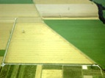

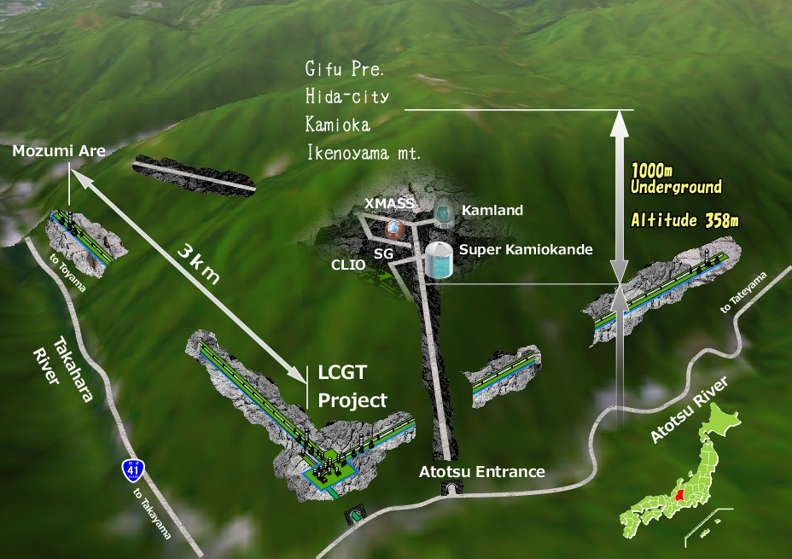



The advanced GW detector network:
2015-2025
Context of G3: Where will we be?
Advanced LIGO
Hanford
2015
GEO600 (HF)
2011
KAGRA
2017
Advanced LIGO
Livingston
2015
Advanced
Virgo
2016
LIGO-India
2022
5
5

Slide 6
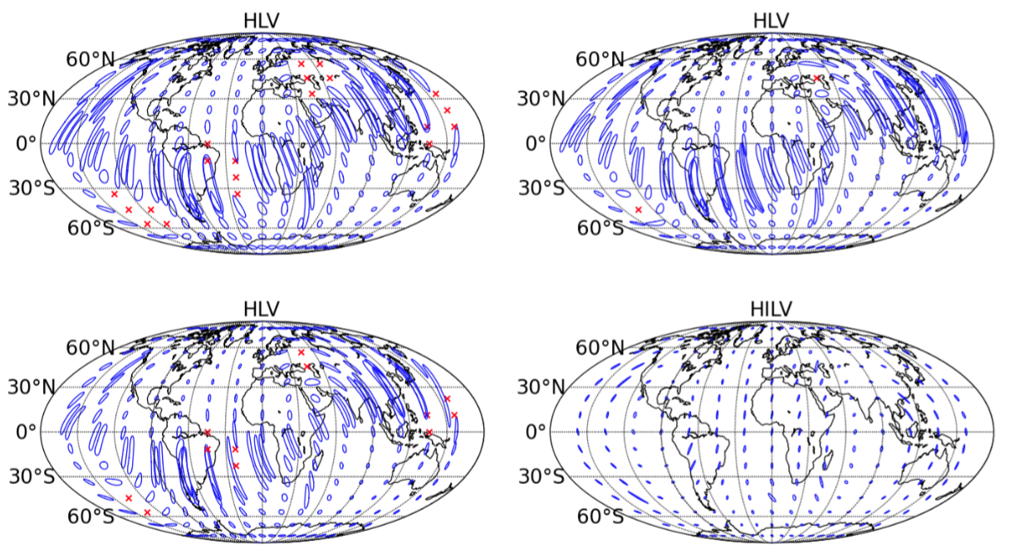
Localization of the Source future: more precise
Context of G3: Where will we be?
2016-17
2017-18
2019+
2022+
Adding Virgo will break the annulus
As sensitivity progresses, so does the localization. In the design LIGO-Virgo network, GW150914 could have been localized to less than 20 deg²
LIGO India will lead to a further impressive improvement

Slide 7
G3: Some Big Issues
Science Motivations and Goals
  GWIC Committee (must be done in the context of projected G2)
Science Goals → Technical Performance
  Frequency vs Sensitivity Goals?
  Network Performance Goals (e.g. Pointing Accuracy)?
Strategic Issues
  How many G3 Detectors are required?
  G3 Detectors: Identical or Different?
  How Internationally Organized/Funded/Implemented?
    Present GW Model: “Collaboration of Collaborations?”
    Globally Organized, like ILC, SKA?
    Global w/ Strong Host, like CERN LHC, DUNE?
    ‘Limited’ Partnerships, like ALMA, LSST, TMT?

