Slide 1
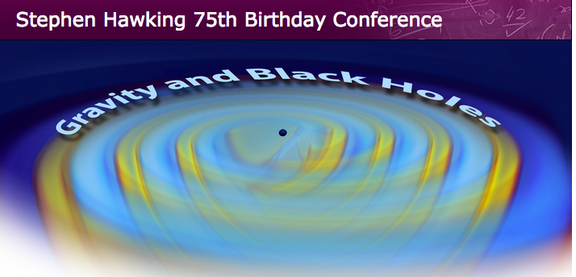
How to hear black holes and other cosmic sounds
Gabriela González
Louisiana State University
For the LIGO Scientific Collaboration and
the Virgo Collaboration
LIGO Livingston Observatory,
Louisiana, USA

Slide 2























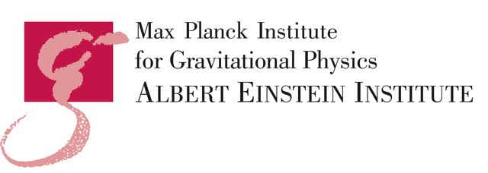





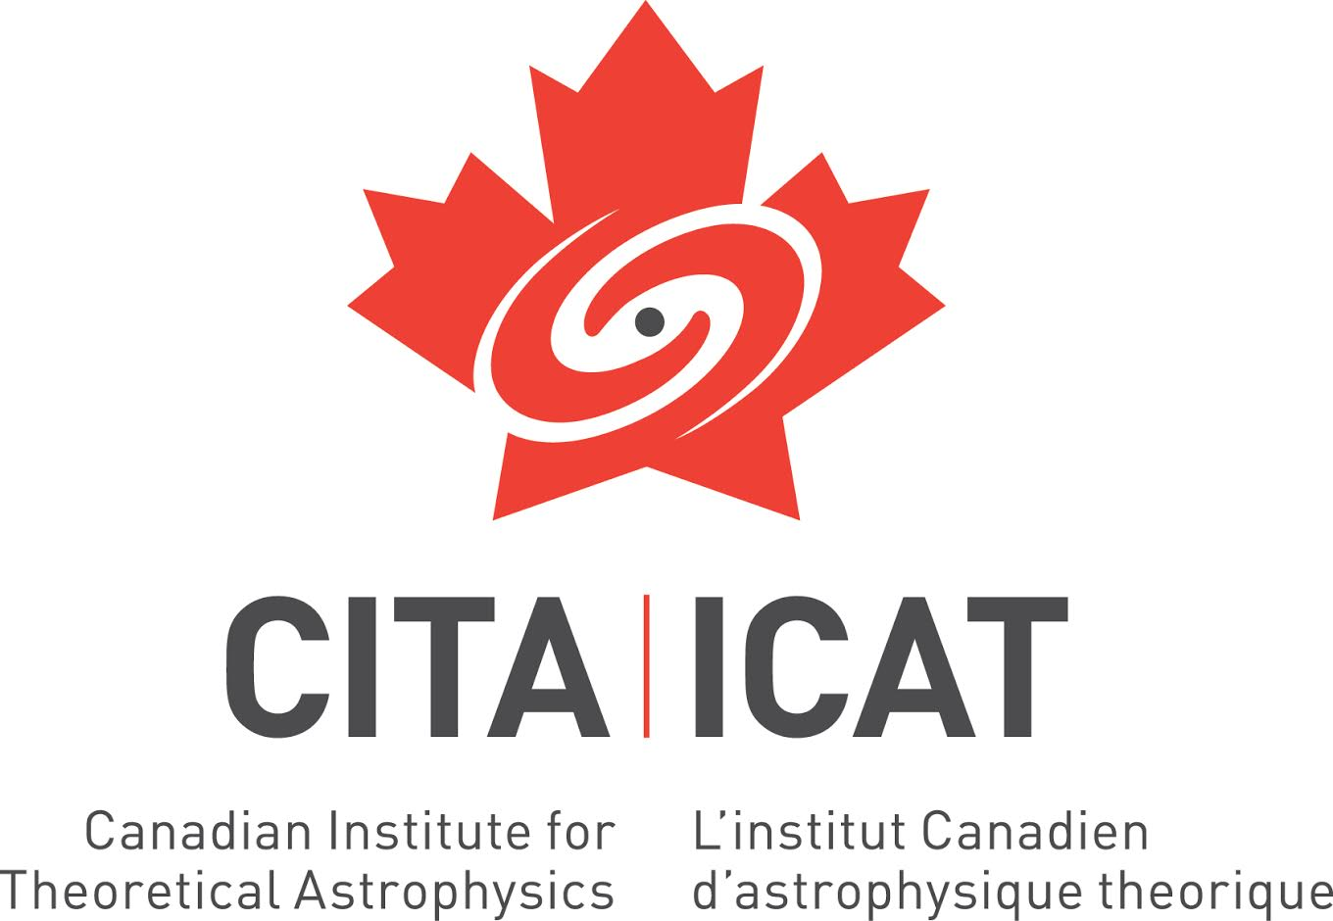




















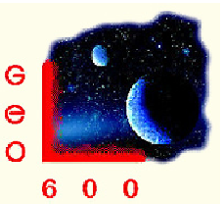




















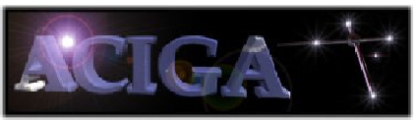







“We” = LIGO Scientific Collaboration
(and Virgo Collaboration)

Slide 3
Initial (2001-2010) and advanced (2015+) LIGO
Better
Seismic
Isolation
15-20 Mpc BNS
inspiral range;
Ended 2010
Reduced
Brownian
Noise
Reduced Quantum Noise
200 Mpc BNS
inspiral range;
Circa 2019
3

Slide 4
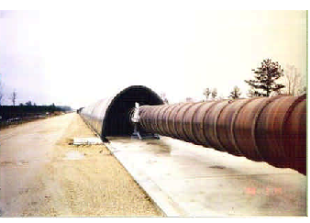
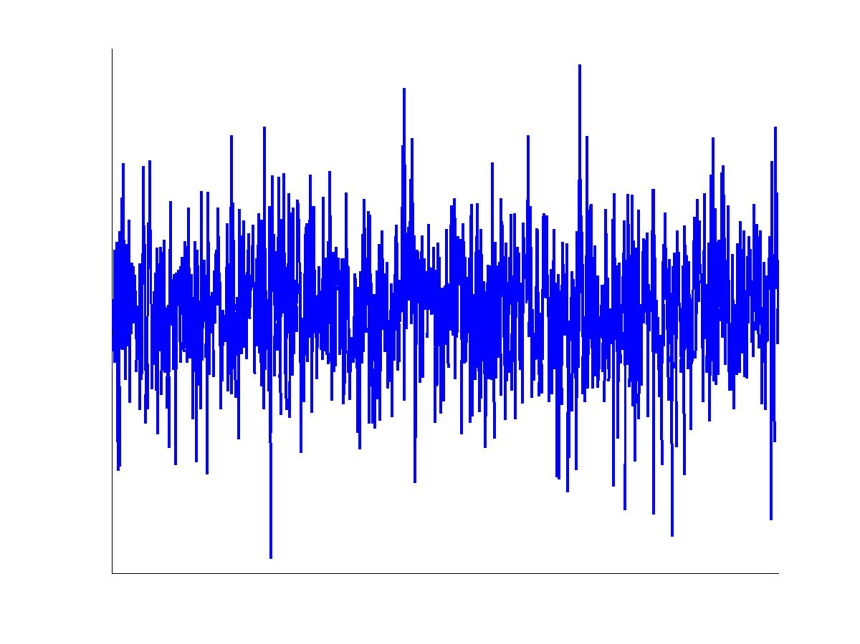
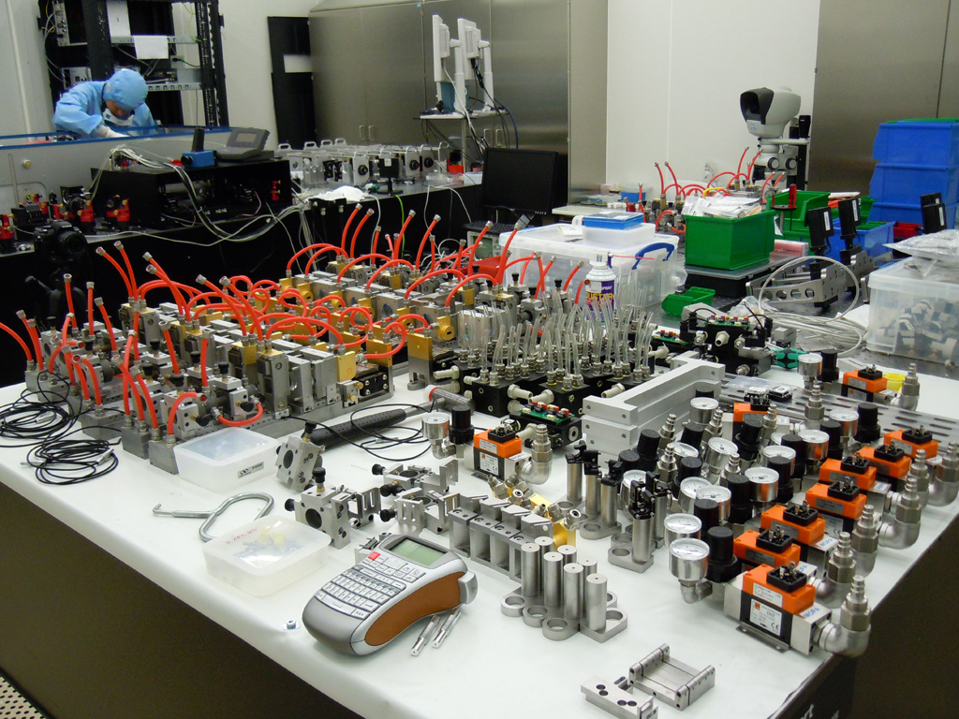
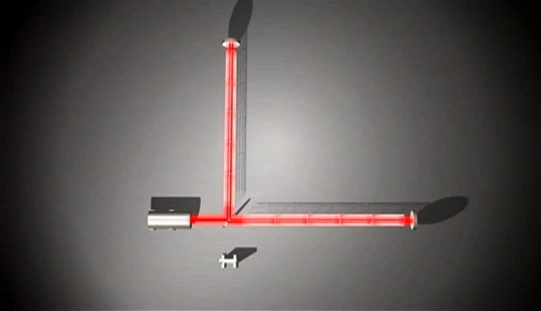


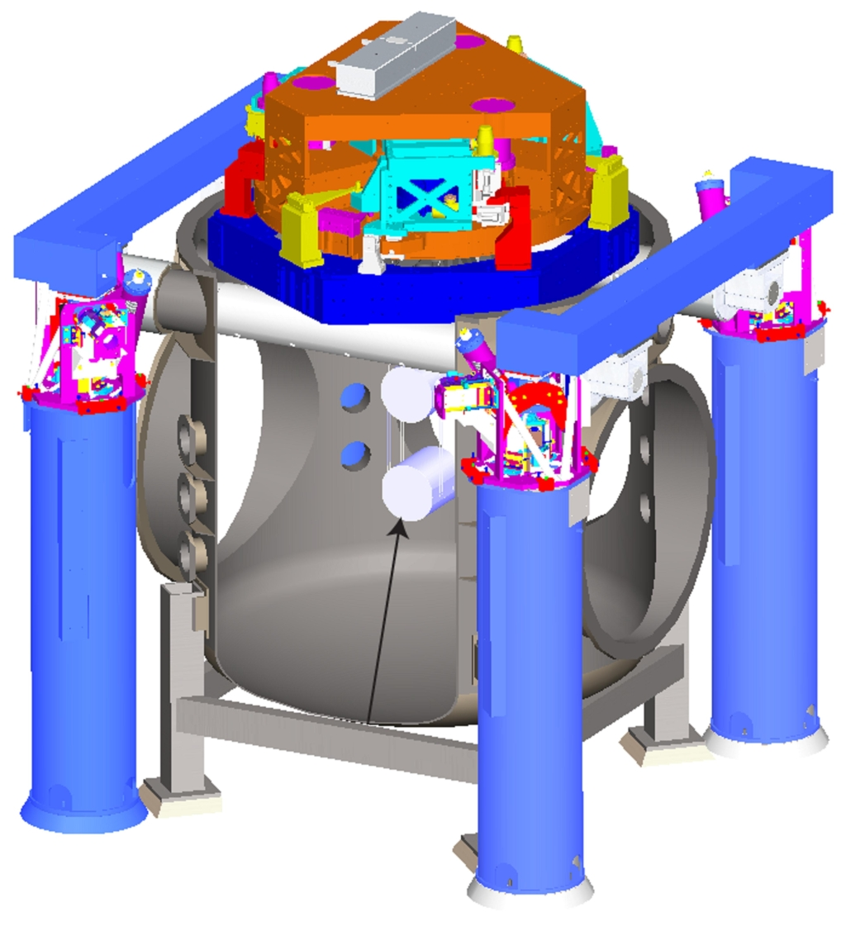
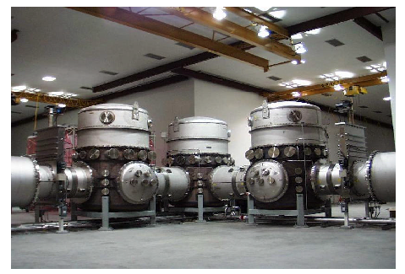
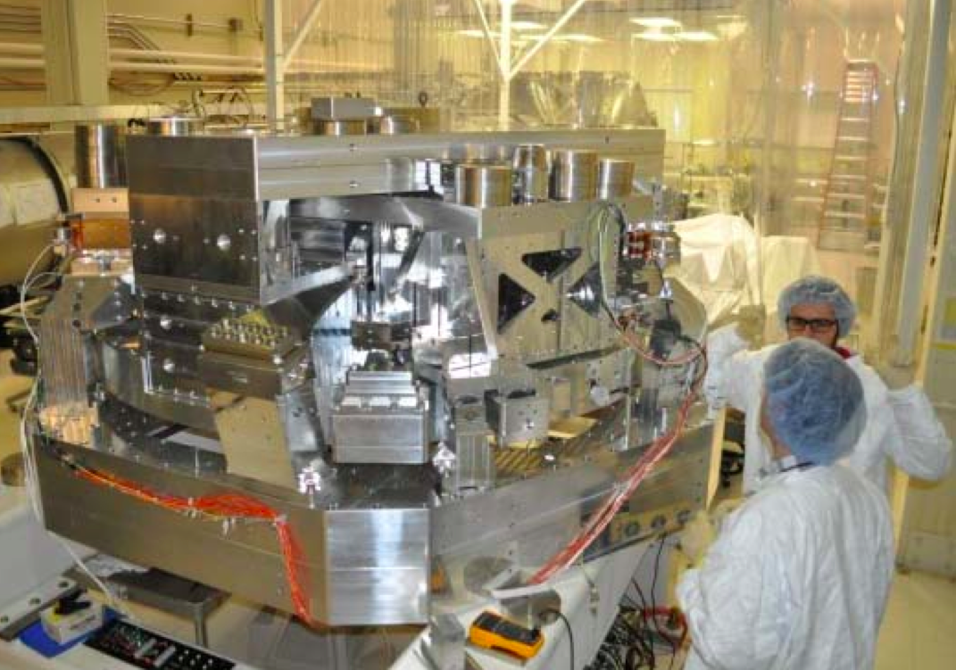

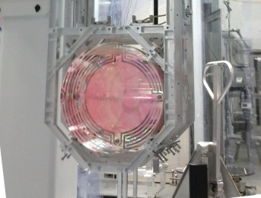

2008+:
Advanced LIGO detectors

Slide 5
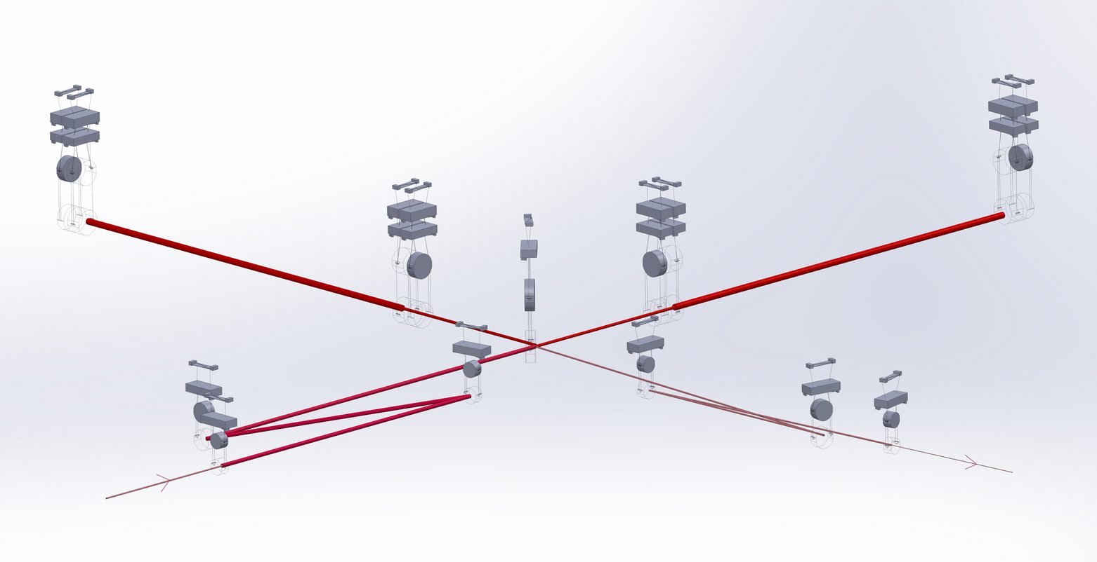
Advanced LIGO detectors

Slide 6
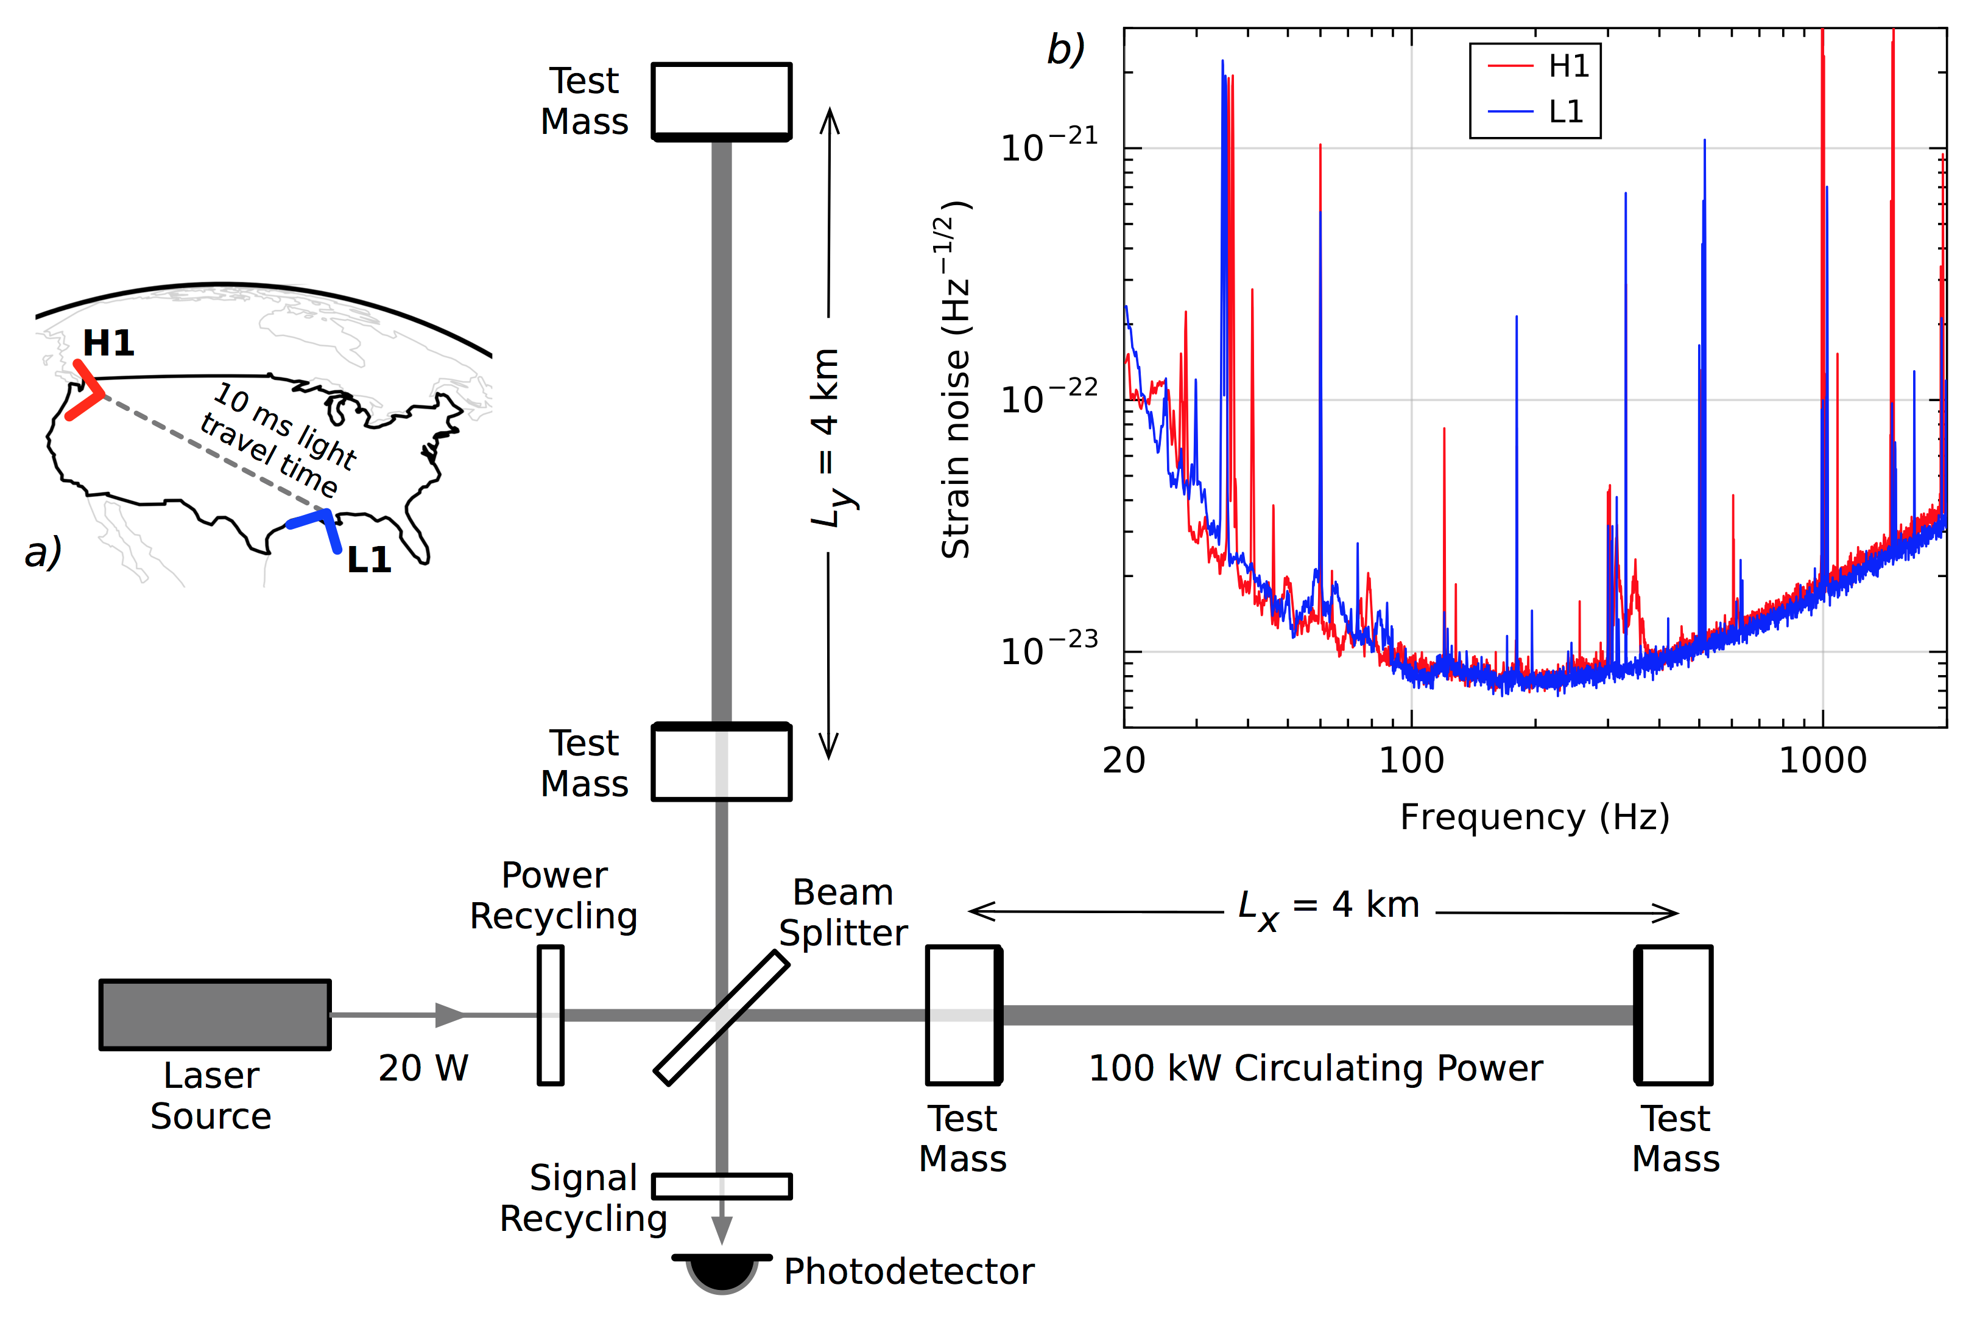
Advanced LIGO detectors
September 2015
PRL 116, 061102 (2016)

Slide 7
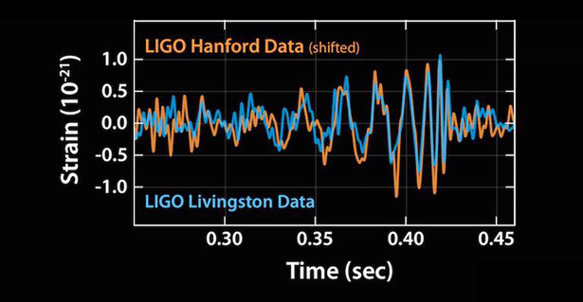
On Sept 14 2015…
Image Credit: Caltech/MIT/LIGO Lab
Notes:
The observed signals matched beautifully the predicted waveform for the motion of a pair of black holes and vibration of the resulting single black hole. From the frequency of the signals, we can tell the masses of each initial black hole and the mass of the final black LIGO has made the first-ever detection of two black holes merging into one, proving that binary black holes are more common in the universe than most scientists earlier thought.

Slide 8
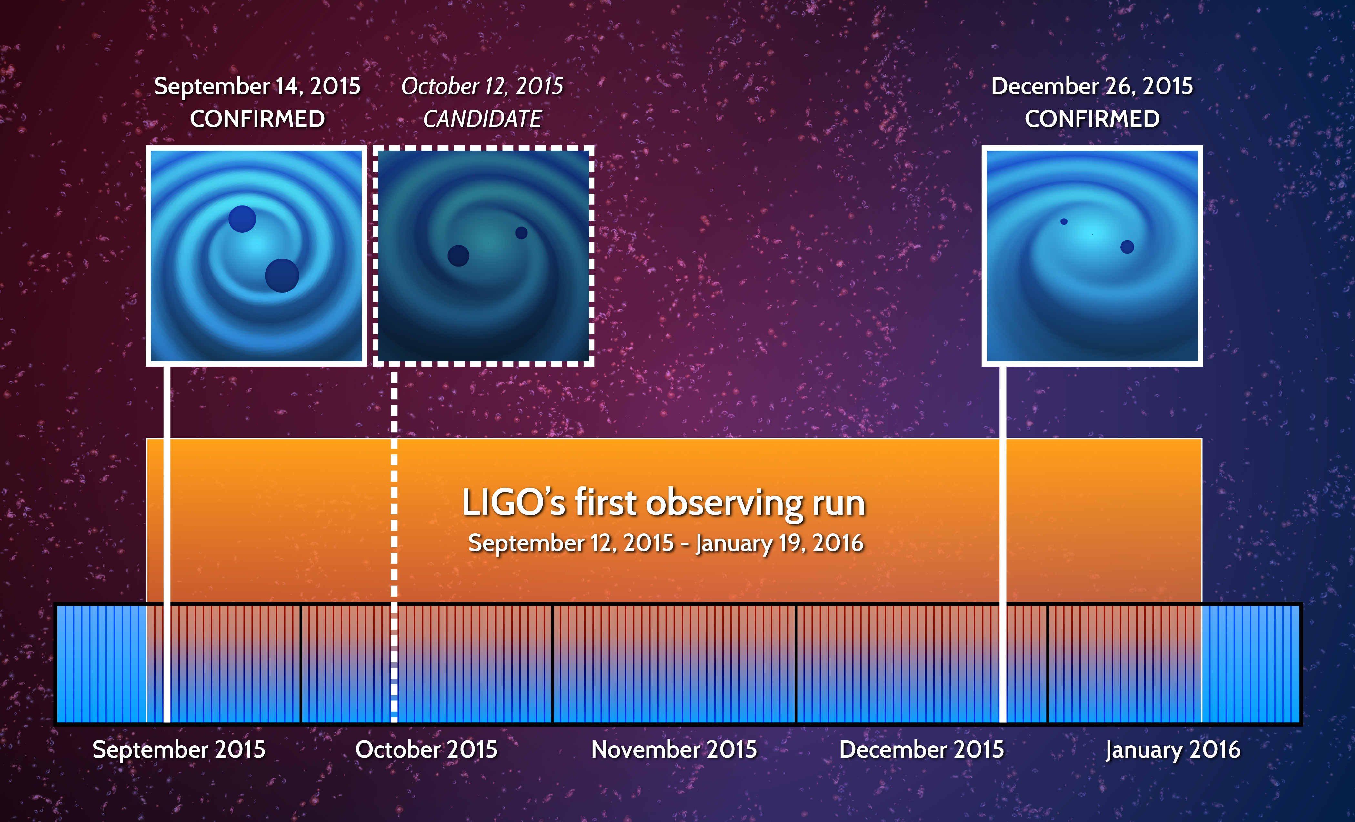
Image credit: LIGO

Slide 9
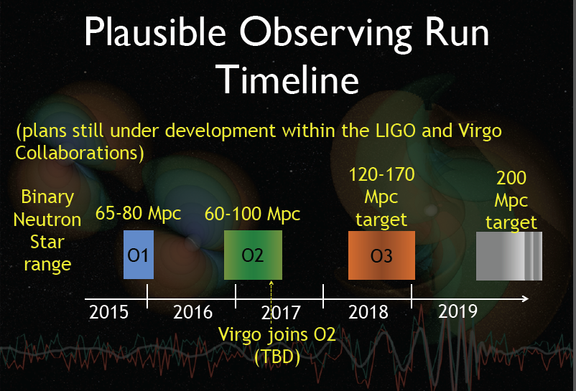
What happened since 2016?

Slide 10
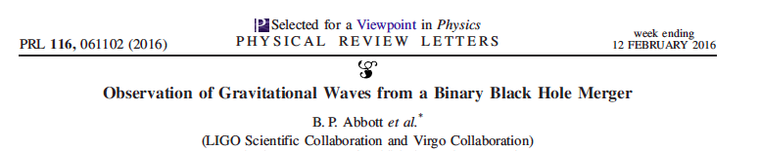
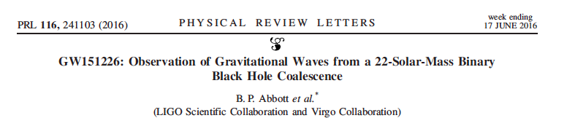
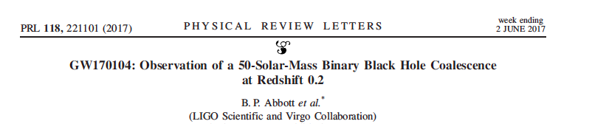

Slide 11
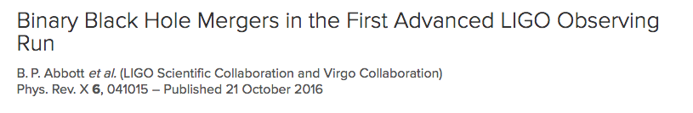
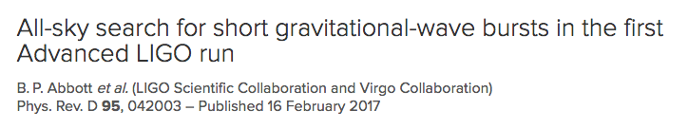
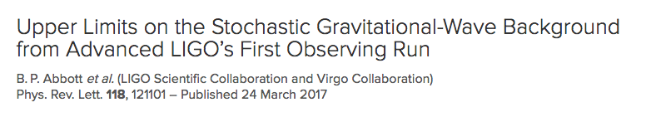
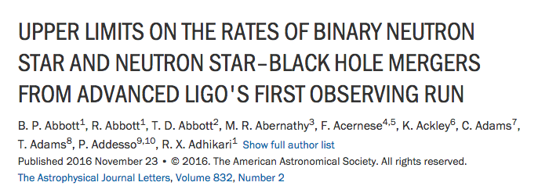
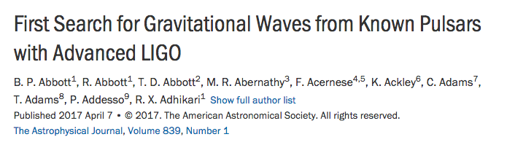

Slide 12
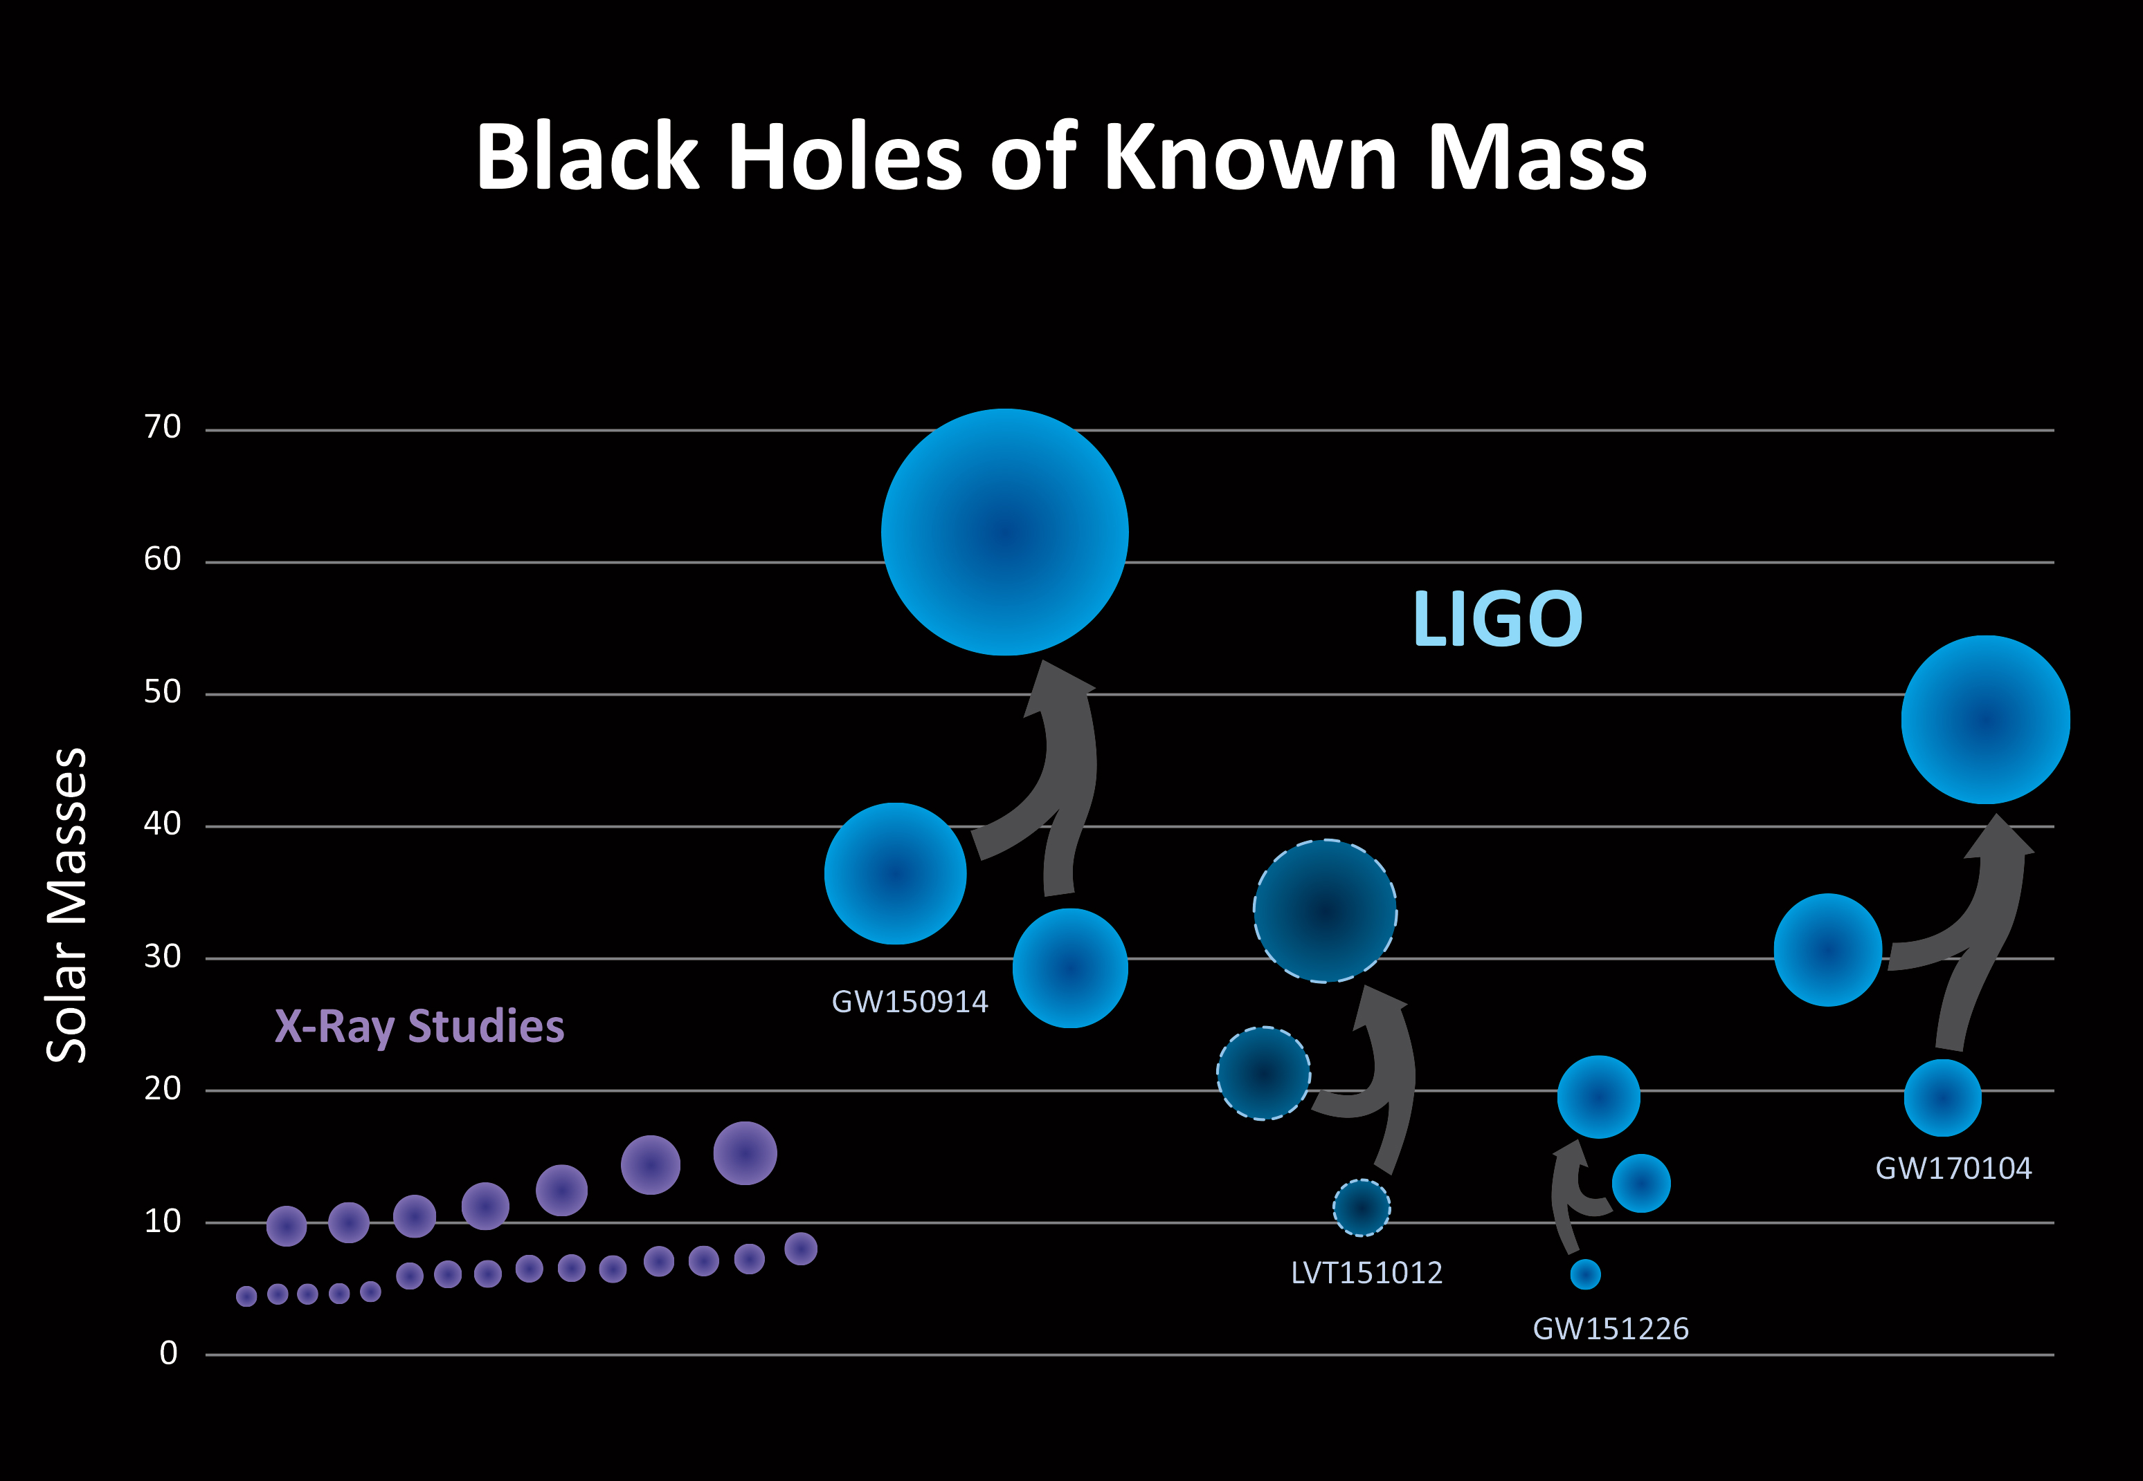
Filling in the black hole catalog
Image credit: LIGO
Credit: LSC/Sonoma State University/Aurore Simonnet

Slide 13
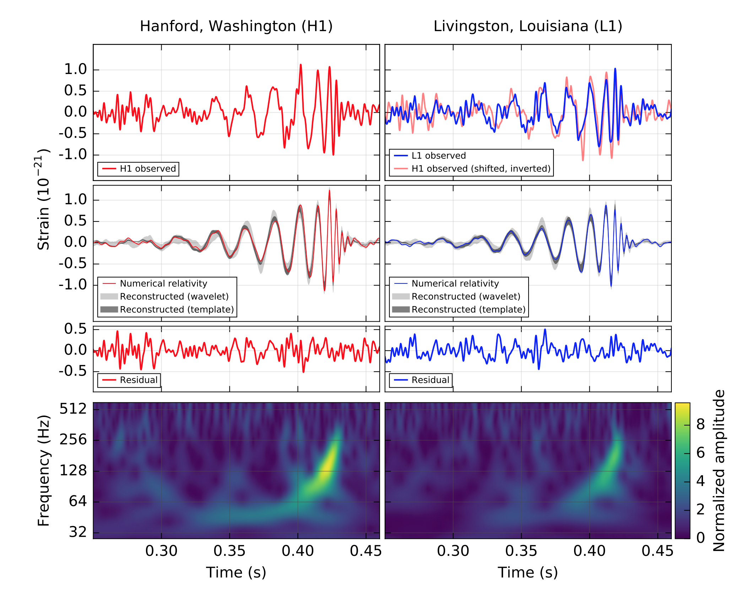
PRL 116, 061102 (2016)

Slide 14
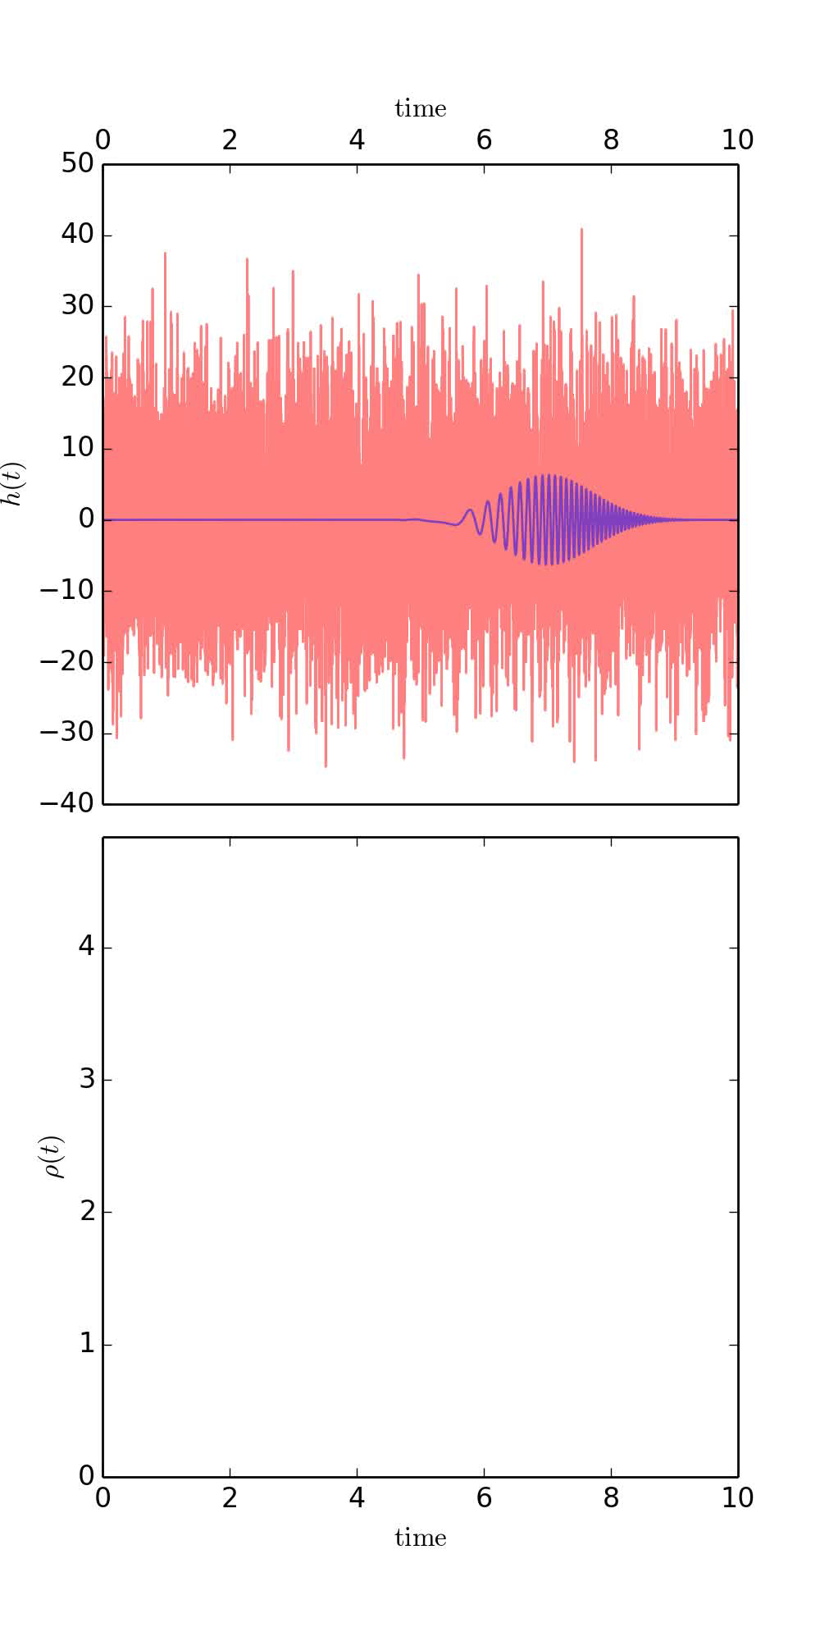
Searching for a specific waveform: matched filtering

Slide 15
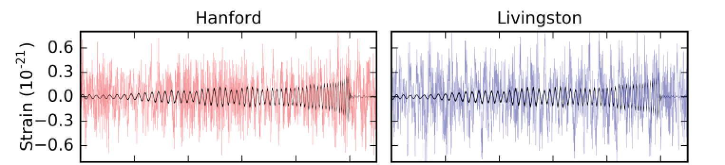
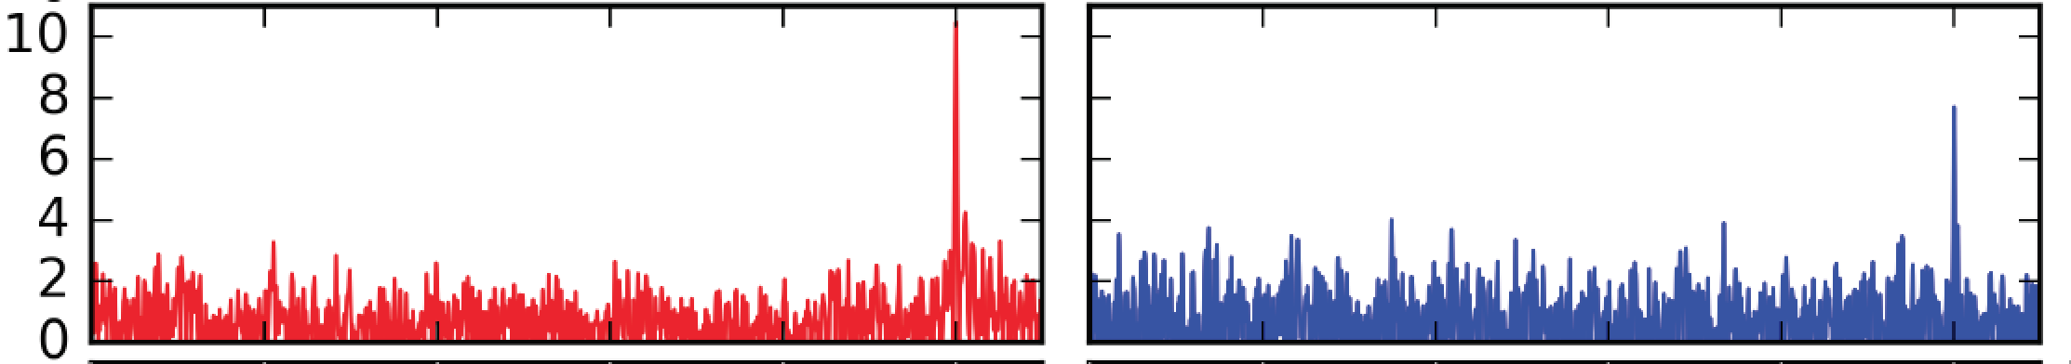
GW151226
Filtered detector output and filtered best matching waveform
Signal-to-noise (SNR) when best template matches at coalescence time
Phys. Rev. Lett. 116, 241103 (2016)
Notes:
The LIGO detectors saw the last 55 cycles of the black hole dance before merger, lasting about a second.
Although the signal seems smaller than the noise in the detector, it can be easily pulled out with analysis methods: the “signal to noise ratio” in the detectors was 11 and 8.
Highlight peaks.

Slide 16
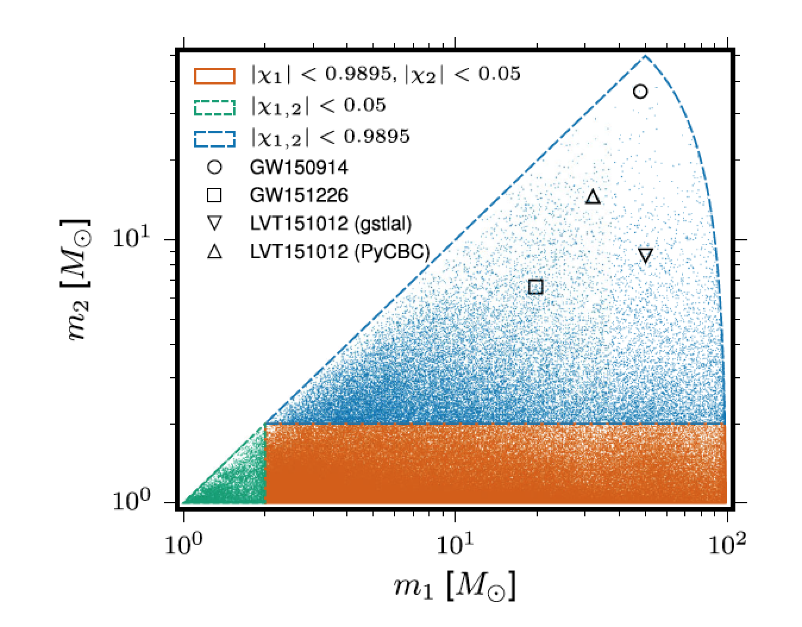
Searching and finding waveforms
Phys. Rev. X 6, 041015 (2016) )

Slide 17
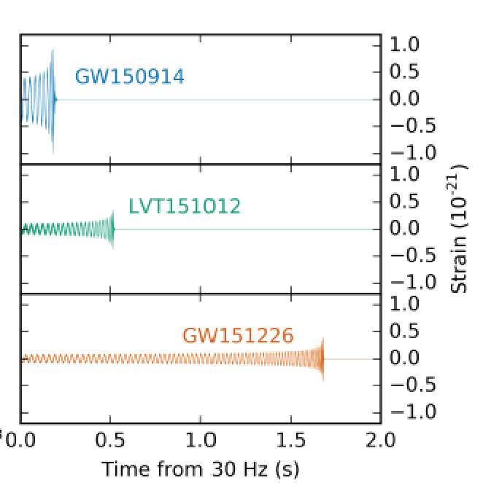
O1 BBH search
Significance of the three signals
Search for binary black holes systems with black holes larger than 2 M and total mass less than 100 M, in O1 (Sep 12, 2015-Jan 19, 2016, ~48 days of coincident data)
LVT151012
GW151226
Phys. Rev. X 6, 041015 (2016) )

Slide 18
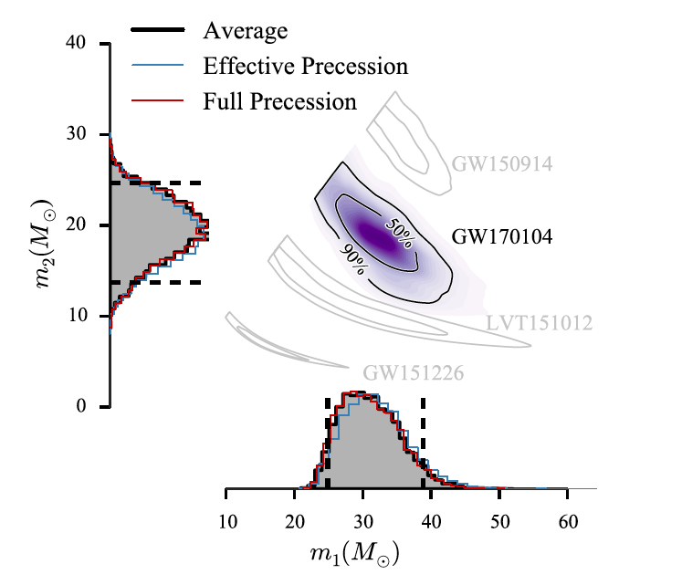
Finding parameters: masses
Phys. Rev. Lett. 118, 221101

Slide 19
Finding parameters: GW150914
Phys. Rev. Lett. 116, 241102 (2016)

Slide 20
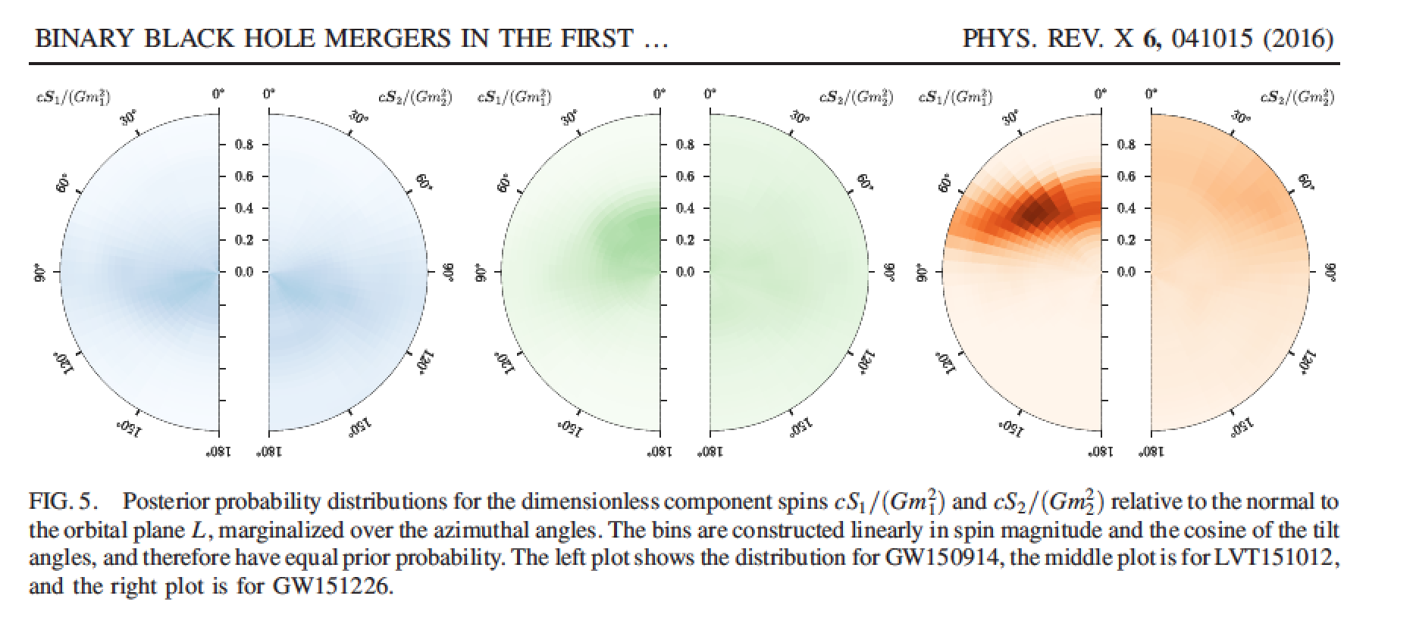
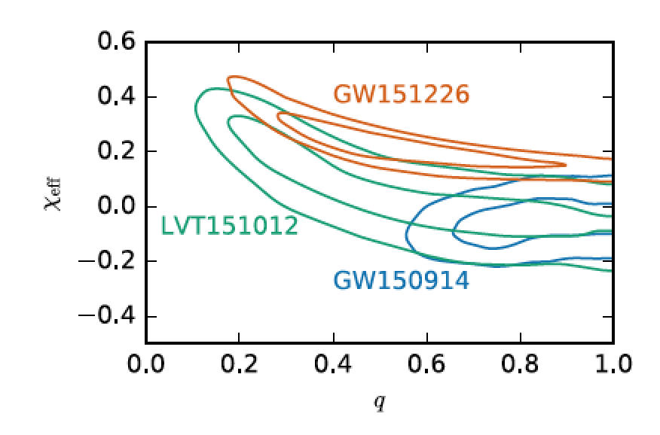
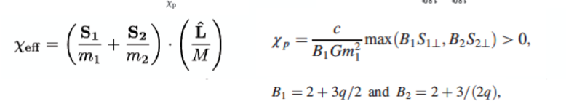

Slide 21
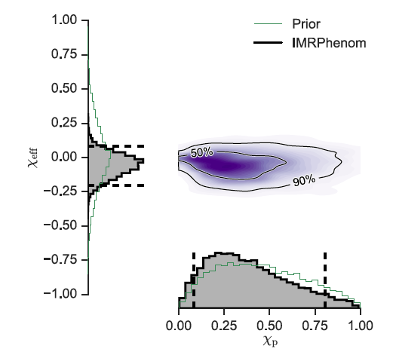
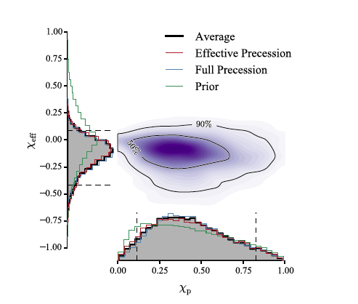
Black hole spins
GW150914
Phys. Rev. Lett. 116, 241102
GW170104
Phys.Rev.Lett 118, 221101 (2017)

Slide 22
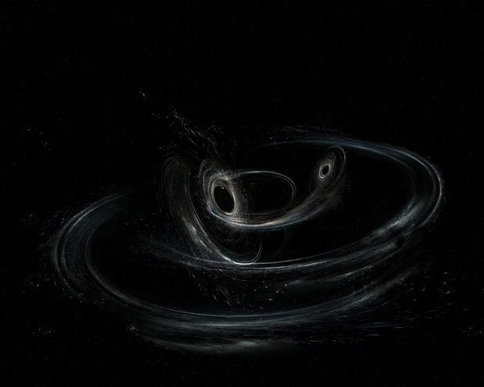
Black hole spins
Aurore Simonnet , SSU
Aurore Simonnet , SSU
GW170104
Phys.Rev.Lett 118, 221101 (2017)

Slide 23
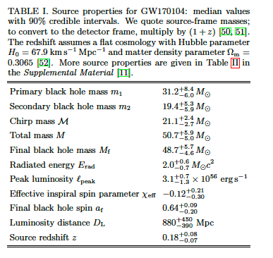

Slide 24
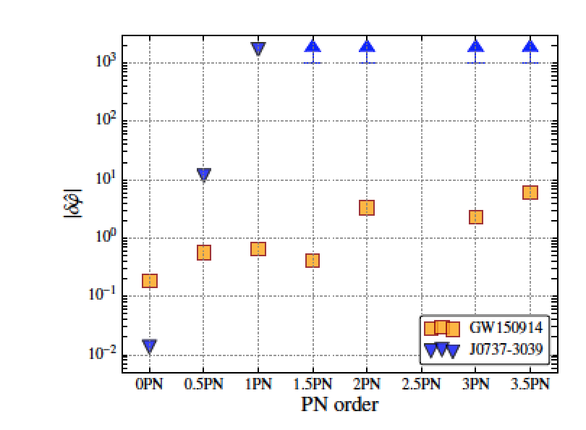
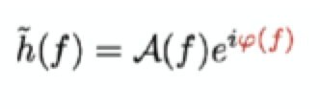
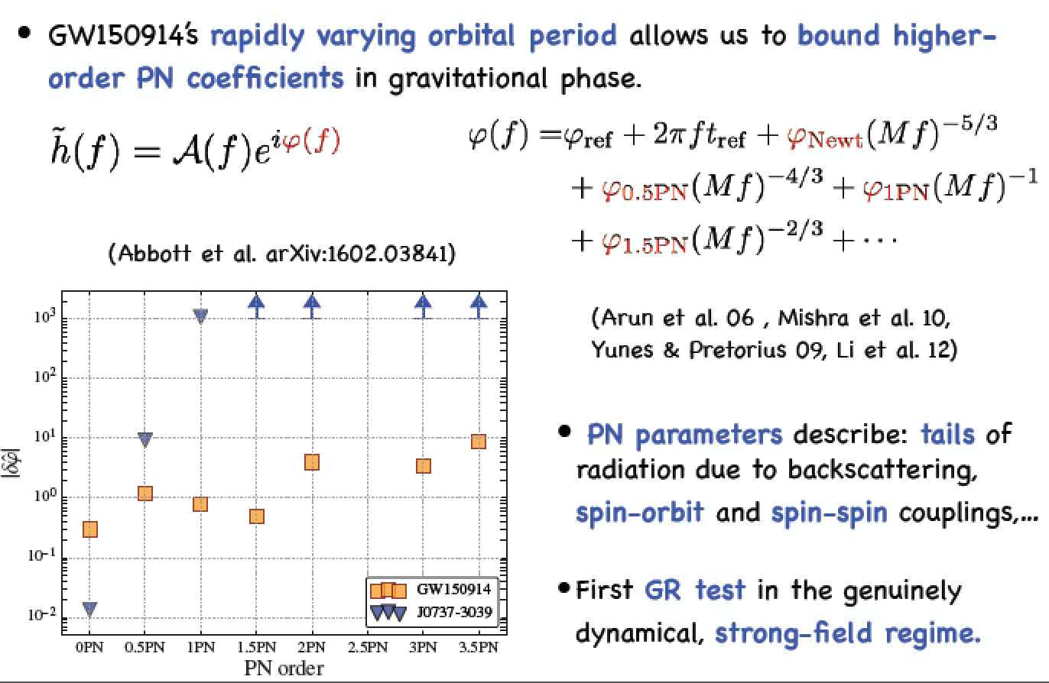
Testing General Relativity
Binary pulsars tests:
BBH coalescence:
Fractional deviation from GR
Phys. Rev. Lett. 116, 221101 (2016)

Slide 25
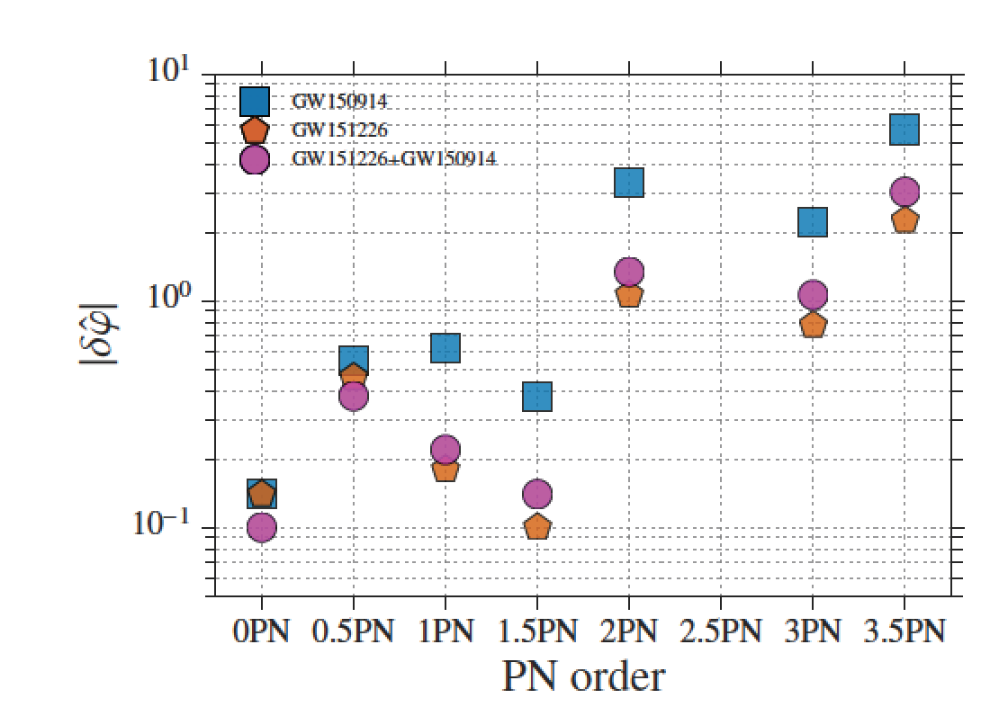
Testing General Relativity
Fractional deviation from GR
Phys. Rev. X 6, 041015 (2016) )

Slide 26
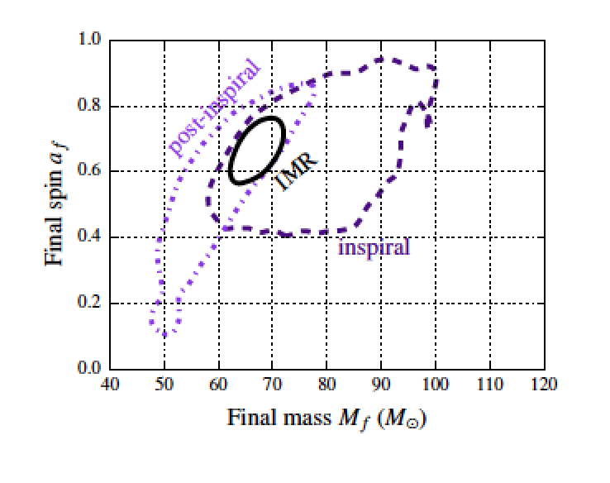
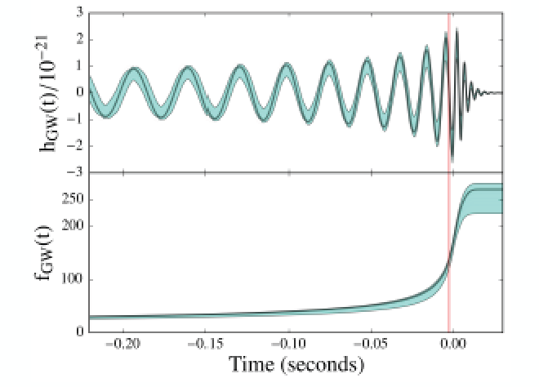
Inspiral vs merger-ringdown
Phys. Rev. Lett. 116, 221101 (2016)
Test done in frequency domain with
approximations of GR waveforms

Slide 27
What happened since 2016?
What will happen in the next few years?

Slide 28
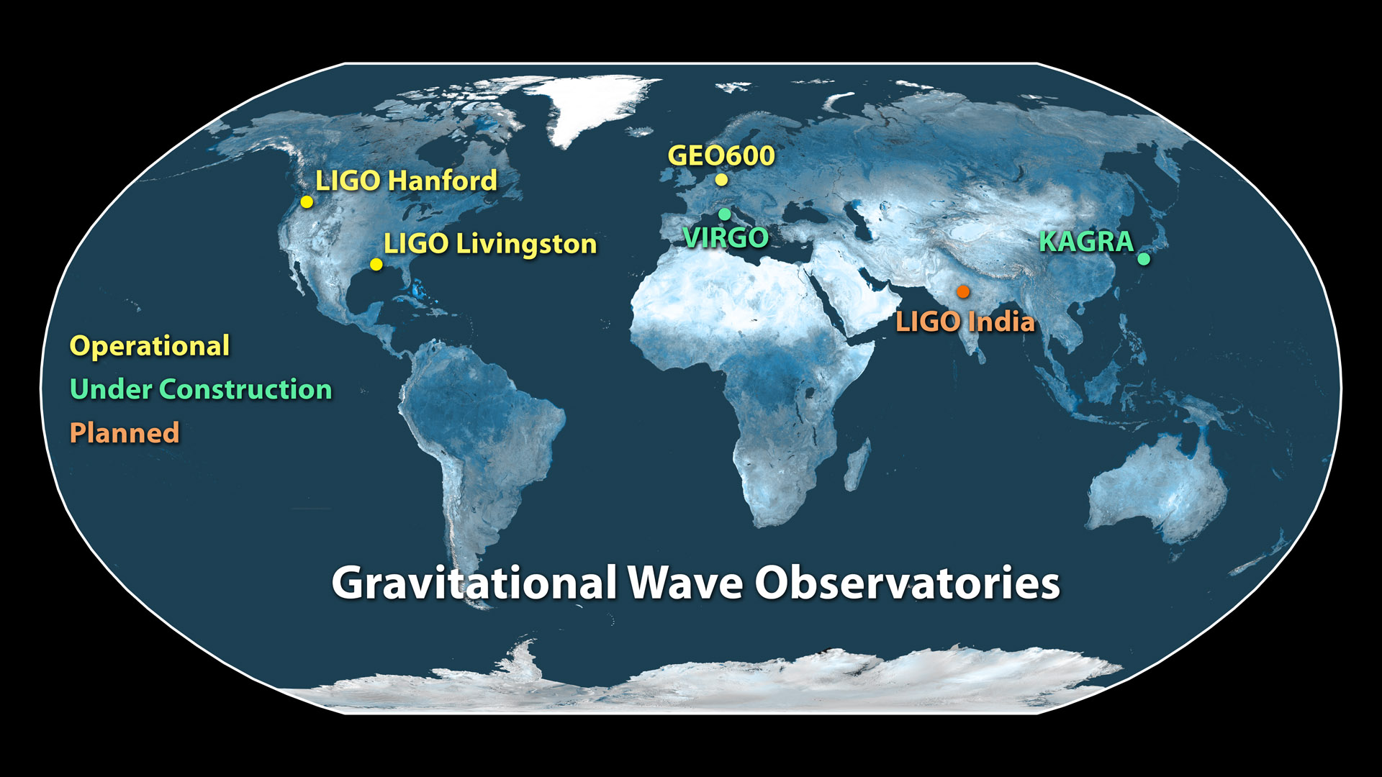
Approved!
Image Credit: Caltech/MIT/LIGO Lab
Notes:
Having three or more detectors will help us narrow down the location of the gravitational signals even more: You need at least two ears to know where a sound comes in a plane, but having more ears you can localize the source much better. We have more detectors in the near future: The Virgo detector will joining the gravitational wave network later this year – and we expect more detectors to join in Japan and perhaps India.
We have opened the era of gravitational wave astronomy, and expect to learn much astrophysics from the many detections to come. This is the end of a long quest, but more than that it’s the beginning of a new era. To quote one of our young scientists: we’ll never stop listening to gravitational waves now!
I have the honor to let now Rai Weiss, one of the founders of LIGO, tell you more about the history and technology involved in these amazing instruments.

Slide 29
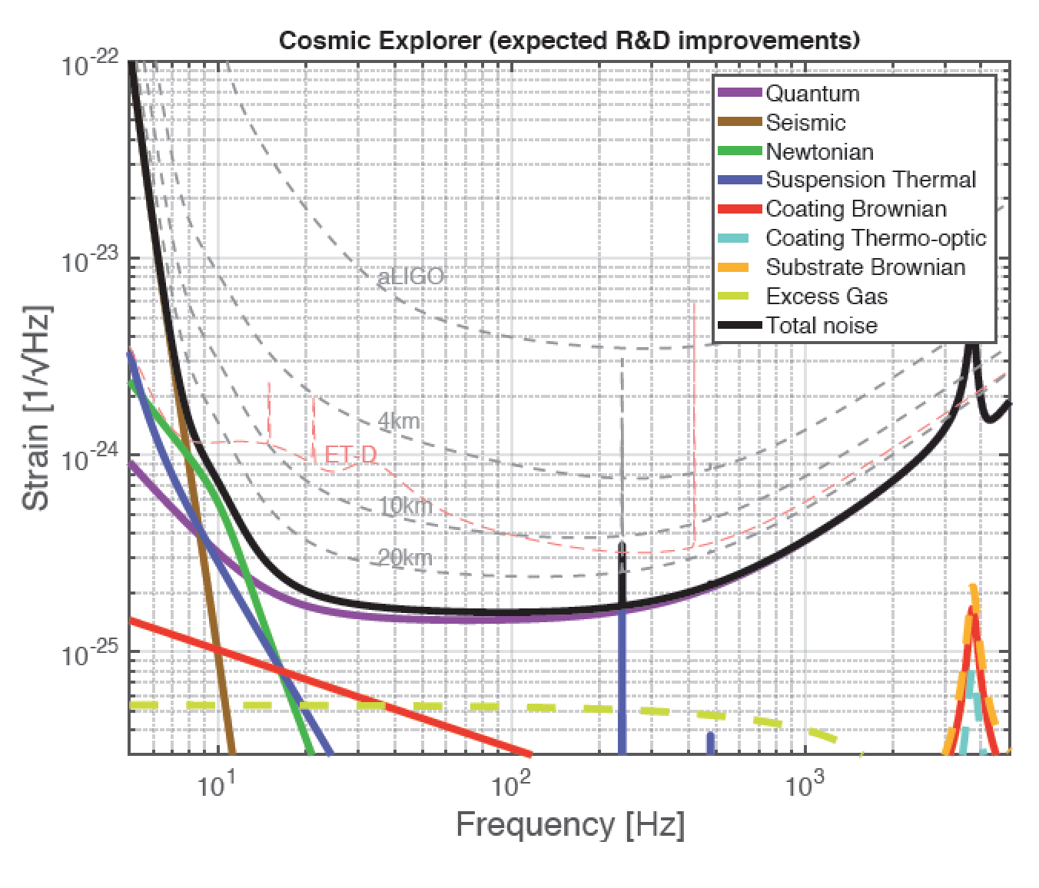
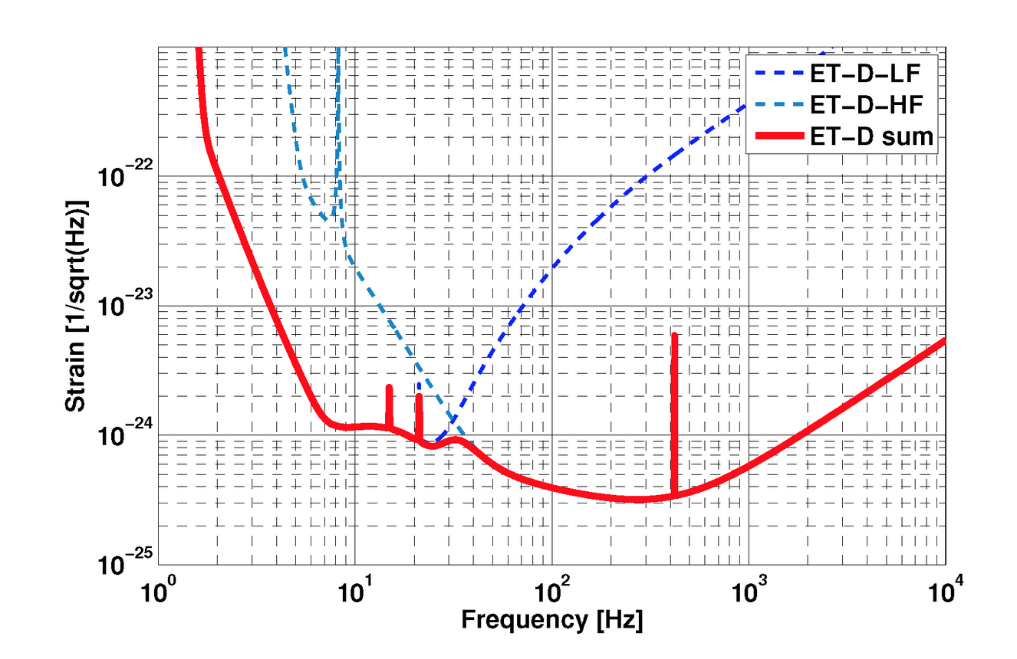

The future:
3rd generation detectors
Einstein Telescope
S.Hild et al., Classical and Quantum Gravity, 28 094013, 2011
arXiv:1607.08697
http://www.et-gw.eu/

Slide 30

Gravity’s symphony: first two notes
Credit: LIGO

Slide 31


Sources of gravitational waves: not just black holes!
Astrophysical or

Slide 32


Slide 33

Gravitational-wave astronomy: this is just the beginning!
Happy Birthday
www.ligo.org

