Slide 1
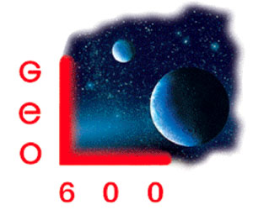
Optical properties of SIlicon for cryogenic Gw detectors
Zeno Tornasi
11/07/2017 - Hilton hotel, Pasadena, ca, U.S.A.
R. Adhikari¹, A. Bell², R. Birney³, M. Fejer⁴, D. Gibson³, E. Gustafson¹, J. Hough², A. Markosyan⁴, I. W. Martin², J. Steinlechner^{2,5}, S. Reid³, S. Rowan², S. Sproules²
¹Caltech, ²UofG, ³UWS, ⁴Stanford, ⁵Hamburg
LIGO-G1700998

Slide 2
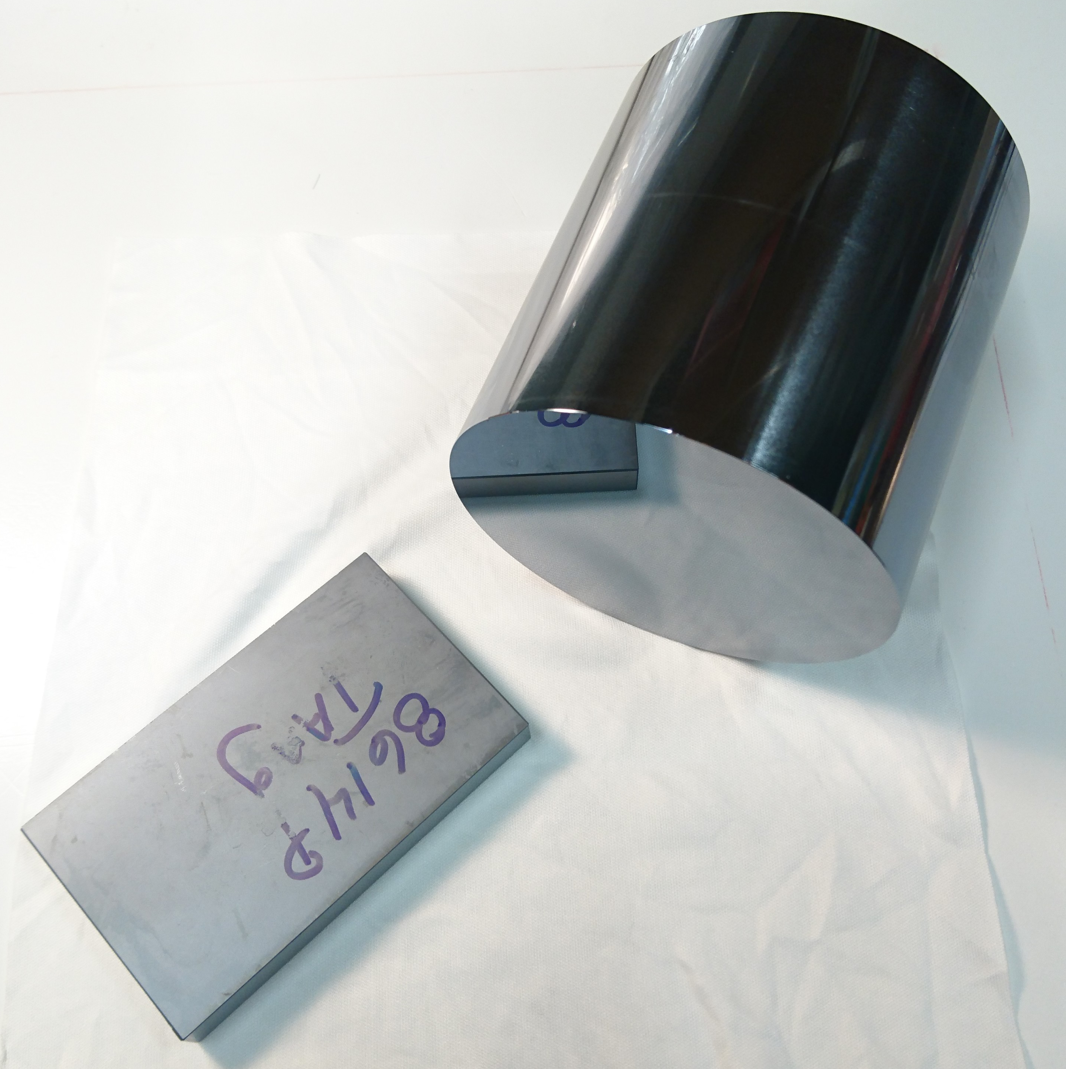
Crystalline silicon
Optical scattering
Amorphous silicon coatings
Optical absorption
Topics

Slide 3
Why silicon?
Introduction

Slide 4
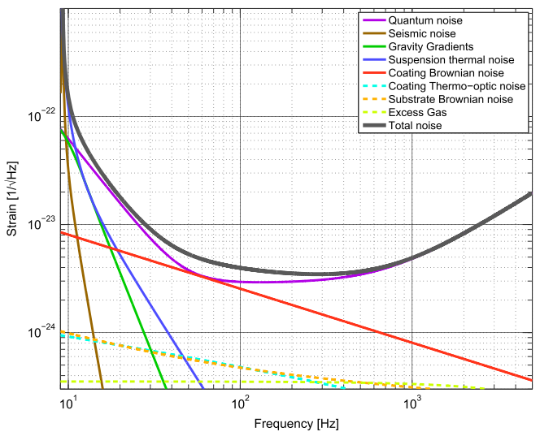
The LIGO Collaboration, Class. Quantum Grav. 32 (2015) 074001
Noise in a gravitational wave detector

Slide 5
Coating Brownian noise
The LIGO Collaboration, Class. Quantum Grav. 32 (2015) 074001
Noise in a gravitational wave detector

Slide 6
Coating Brownian noise
The LIGO Collaboration, Class. Quantum Grav. 32 (2015) 074001
Noise in a gravitational wave detector

Slide 7
$$S_{x}\left(f\right)∝\frac{T φ d}{f Y w^{2}}$$
Temperature
Mechanical loss
Coating thickness
Young’s modulus
Beam width
Coating Brownian noise (similar idea for substrates)

Slide 8
$$S_{x}\left(f\right)∝\frac{T φ d}{f Y w^{2}}$$
Temperature
Mechanical loss
Coating thickness
Young’s modulus
Beam width
Limited room for improvement
Substrate engineering constraints
Coating Brownian noise (similar idea for substrates)

Slide 9
$$S_{x}\left(f\right)∝\frac{T φ d}{f Y w^{2}}$$
Temperature
Mechanical loss
Coating thickness
Young’s modulus
Beam width
Property of the coating material
Not much to do about it
Coating Brownian noise (similar idea for substrates)

Slide 10
$$S_{x}\left(f\right)∝\frac{T φ d}{f Y w^{2}}$$
Temperature
Mechanical loss
Coating thickness
Young’s modulus
Beam width
High refractive index materials
Coating Brownian noise (similar idea for substrates)

Slide 11
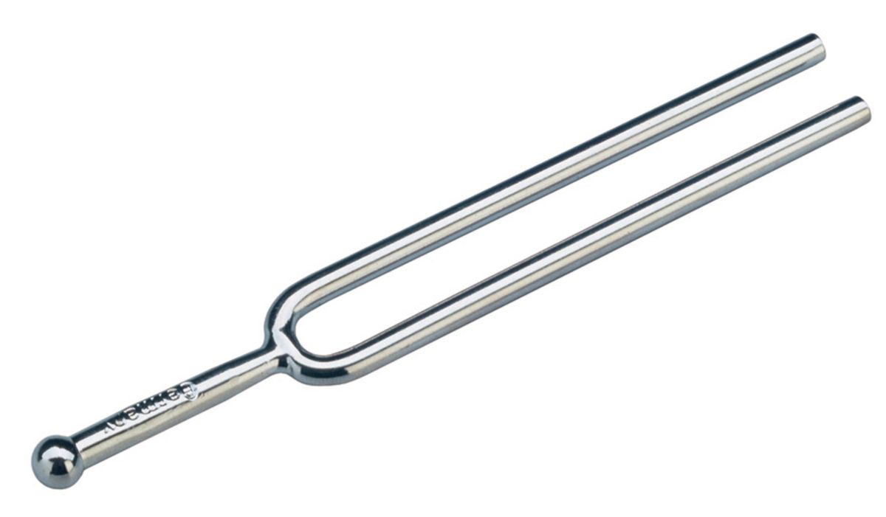
$$S_{x}\left(f\right)∝\frac{T φ d}{f Y w^{2}}$$
Temperature
Mechanical loss
Coating thickness
Young’s modulus
Beam width
Property of the material
Can vary by orders of magnitude
Can be engineered to some extent
Coating Brownian noise (similar idea for substrates)

Slide 12
$$S_{x}\left(f\right)∝\frac{T φ d}{f Y w^{2}}$$
Temperature
Mechanical loss
Coating thickness
Young’s modulus
Beam width
Current detectors operate at room T
Can we just go cryogenic then? Not yet…
Coating Brownian noise (similar idea for substrates)

Slide 13
In general
$$S_{x}\left(f\right)∝\frac{T φ d}{f Y w^{2}}$$
Fused silica has a high mechanical loss at low T

Slide 14
In general
$$S_{x}\left(f\right)∝\frac{T φ(T) d}{f Y w^{2}}$$
Fused silica has a high mechanical loss at low T

Slide 15
In general
$$S_{x}\left(f\right)∝\frac{T φ(T) d}{f Y w^{2}}$$
Currently LIGO optics are made of fused SiO₂
Fused silica has a high mechanical loss at low T

Slide 16
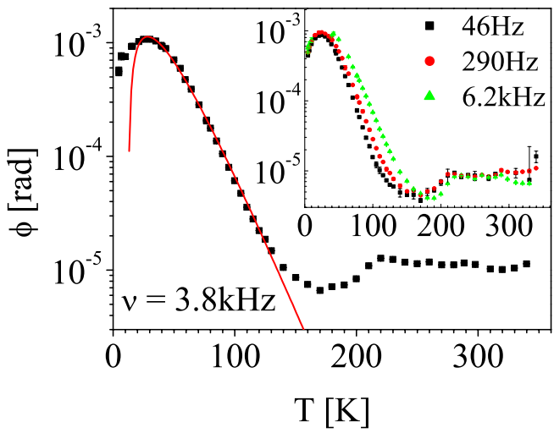
In general
$$S_{x}\left(f\right)∝\frac{T φ(T) d}{f Y w^{2}}$$
Currently LIGO optics are made of fused SiO₂
Since the ’50s we know that mechanical loss in SiO₂ goes like →→
Travasso F. et al. (2007) Europhys. Lett. 80 50008
Fused silica has a high mechanical loss at low T

Slide 17
Fused silica is used
As a substrate
As a coating
With tantala (also lossy at low T)
What do we use instead?
THE PROBLEM

Slide 18
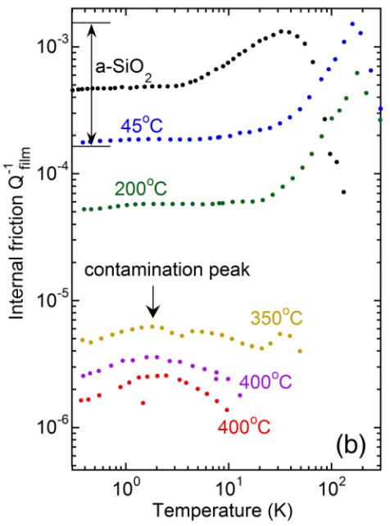
SiO₂
aSi
X. Liu, F. Hellman, et al, PRL 113, 025503 (2014)
Coatings: Amorphous silicon looks promising

Slide 19
SiO₂
Bonus
High refractive index
n = 3.47 @ 1550 nm helps reducing thickness
aSi
X. Liu, F. Hellman, et al, PRL 113, 025503 (2014)
Coatings: Amorphous silicon looks promising

Slide 20
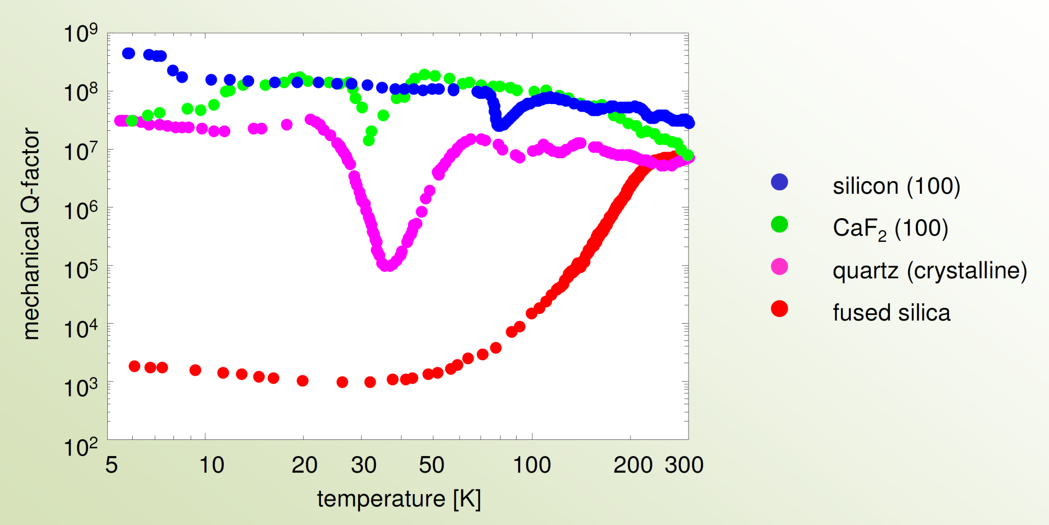
Christopher Wipf / LIGO-G1700602
We know since the ‘70s that cSi has very low mechanical loss at low temperature.
Credits: Ronny Nawrodt
Substrates: Crystalline silicon looks great too

Slide 21
Both cSi and aSi have low mechanical loss at low temperature
But what about optical properties?
 | cSi (bulk) | cSi (surface) | aSi
Absorption | Bell, A. Markosyan | Ongoing (A. Bell) | This work
Scattering | This work | Future work? | Future work
Recap

Slide 22
Crystalline silicon

Slide 23
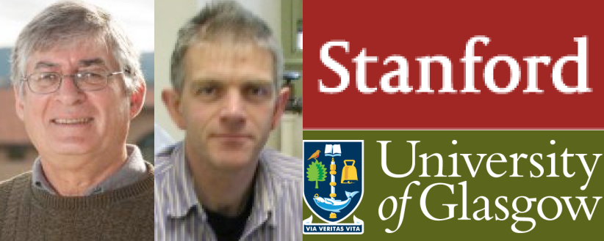
Standard Czochralski grown silicon (Cz Si)
Too impure for application in GW detectors
because of high optical absorption
Float-zone silicon (FZ Si)
Very pure and low absorbing: 2 ppm/cm @ 1550 nm
Available in crystals of maximum diameter 20 cm
Magnetic field-grown Czochralski silicon (MCz Si)
Available up to 45 cm in diameter
Bulk absorption can be as low as 5 ppm/cm @ 1550 nm, albeit inhomogeneous
A. Markosyan, A. Bell / LIGO-G1700480
Surface absorption is a different beast
A. Bell / LIGO-P1700134
Crystalline silicon bulk absorption

Slide 24
Photons scattered
off axis
Add phase noise if they are reflected back in the system by the environment
Contribute to cavity round trip loss
Easily disrupt squeezed states
Why scattering matters

Slide 25
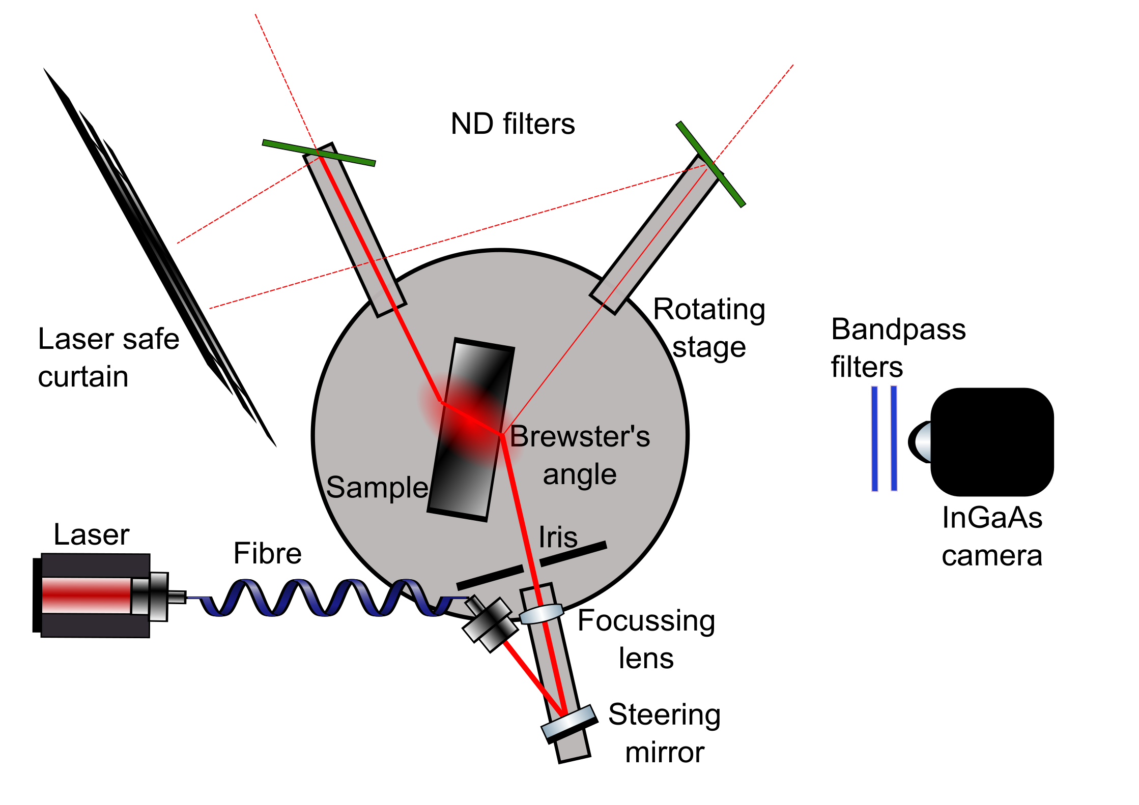
Polariser
The Glasgow scatterometer

Slide 26
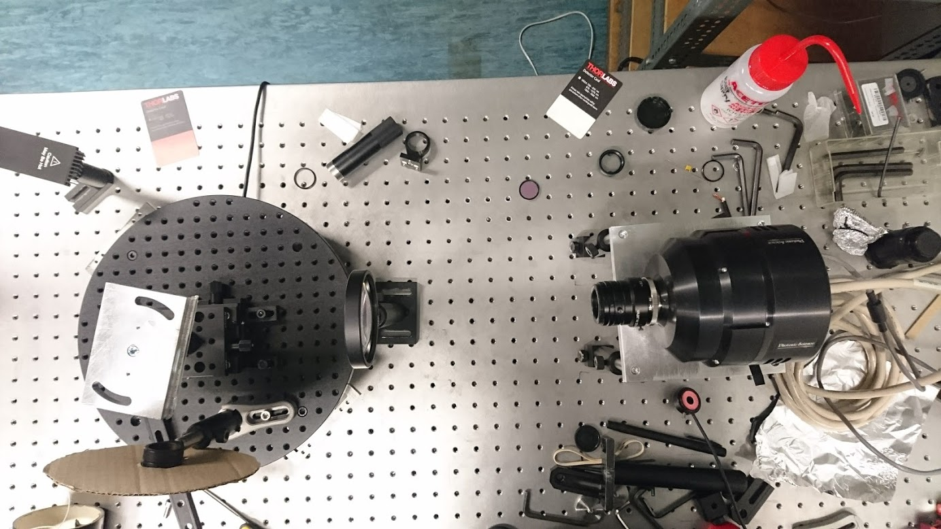
Polariser
The Glasgow scatterometer

Slide 27
Polariser
Direct calibration attempted shining the laser itself at the camera
The Glasgow scatterometer

Slide 28
“Engineering run 1”: looking at CCl₄

Slide 29
“Engineering run 1”: looking at CCl₄

Slide 30
“Engineering run 1”: looking at CCl₄

Slide 31
2.6x10⁵
“Engineering run 1”: looking at CCl₄

Slide 32
Very lumpy beam despite centrifuging and filtering through 0.2 μm filters
The peaks sit on a baseline
Obtained scattering ratio 3.5x larger than the value in literature
2.6x10⁵
“Engineering run 1”: looking at CCl₄

Slide 33
Heraeus Suprasil 3001
fused silica cylinder
(same silica used in aLIGO)
“Engineering run 2”: fused silica

Slide 34
Bulk silica cylinder viewed face-on
Beam in the medium and its reflections
Heraeus Suprasil 3001
fused silica cylinder
(same silica used in aLIGO)
“Engineering run 2”: fused silica

Slide 35
Difference between direct calibration and CCl4
Scattering ratio obtained is 2.16x larger than literature, according to my direct calibration
Or it’s 0.6x literature, taking CCl4 as a reference
Bulk silica cylinder viewed face-on
Beam in the medium and its reflections
Heraeus Suprasil 3001
fused silica cylinder
(same silica used in aLIGO)
“Engineering run 2”: fused silica

Slide 36
Difference between direct calibration and CCl4
Scattering ratio obtained is 2.16x larger than literature, according to my direct calibration
Or it’s 0.6x literature, taking CCl4 as a reference
Bulk silica cylinder viewed face-on
Take away message
Still “commissioning” the scatterometer, plenty of things to understand better
BUT
2. It’s NOT off by orders of magnitude!
Beam in the medium and its reflections
Heraeus Suprasil 3001
fused silica cylinder
(same silica used in aLIGO)
“Engineering run 2”: fused silica

Slide 37
Bulk MCz slab viewed face-on
Beam in the medium and its reflections
Magnetic Czochralski silicon slab
“O1”: magnetic Czochralski silicon

Slide 38
Difficult to isolate the main beam from the many strong reflections (high refr. index, small polished sample)
Images 10 times brighter than fused silica under similar conditions.
Bulk MCz slab viewed face-on
Beam in the medium and its reflections
Magnetic Czochralski silicon slab
“O1”: magnetic Czochralski silicon

Slide 39
Difficult to isolate the main beam from the many strong reflections (high refr. index, small polished sample)
Images 10 times brighter than fused silica under similar conditions.
Bulk MCz slab viewed face-on
MCz Si scatters
at 1550 nm, at 16° observation angle:
0.11 - 0.17 ppm cm⁻¹ sr⁻¹
0.99 - 1.6 ppm cm⁻¹
Beam in the medium and its reflections
Magnetic Czochralski silicon slab
“O1”: magnetic Czochralski silicon

Slide 40
Difficult to isolate the main beam from the many strong reflections (high refr. index, small polished sample)
Images 10 times brighter than fused silica under similar conditions.
Bulk MCz slab viewed face-on
MCz Si scatters
at 1550 nm, at 16° observation angle:
0.11 - 0.17 ppm cm⁻¹ sr⁻¹
0.99 - 1.6 ppm cm⁻¹
Beam in the medium and its reflections
Magnetic Czochralski silicon slab
45-74 ppm bulk scatter for a 46 cm thick test mass
No requirement in ET design document
Could be dominated by coating scattering*finesse
“O1”: magnetic Czochralski silicon

Slide 41
Difficult to isolate the main beam from the many strong reflections (high refr. index, small polished sample)
Images 10 times brighter than fused silica under similar conditions.
Bulk MCz slab viewed face-on
LIGO Core Optics Components Design Requirements Document
MCz Si scatters
at 1550 nm, at 16° observation angle:
0.11 - 0.17 ppm cm⁻¹ sr⁻¹
0.99 - 1.6 ppm cm⁻¹
Beam in the medium and its reflections
Magnetic Czochralski silicon slab
45-74 ppm bulk scatter for a 46 cm thick test mass
No requirement in ET design document
Could be dominated by coating scattering*finesse
“O1”: magnetic Czochralski silicon

Slide 42
Amorphous silicon

Slide 43
Slides courtesy of prof. Stuart Reid
Heat deposited aSi films made at UWS

Slide 44
First coatings: 20 ppm/QWL
Very hard to reproduce!
Slides courtesy of prof. Stuart Reid
Heat deposited aSi films made at UWS

Slide 45
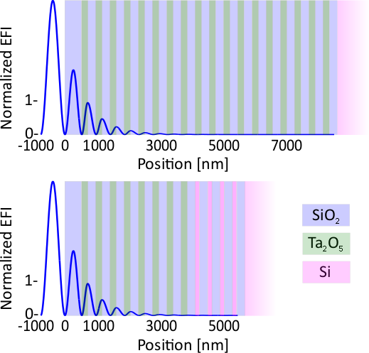
Description
Assuming aSi absorption 20 ppm/QWL at 1550nm
We need 5 bilayers of SiO₂ and Ta₂O₅ to reduce the laser power
For an ITM with T= 6000 ppm we need 2 bilayers of SiO₂ and aSi
For an ETM with T = 6 ppm we need 5 bilayers of SiO₂ and aSi
Thermal noise improvement* compared to a pure SiO₂ and Ta₂O₅ coating:
120 K 20 K ITM: -21% -20% ETM: -38% -36% total: -32% -31%
*Loss for aSi: values from commercial coatings; no cryogenic measurements on UWS coatings
Simulations: J. Steinlechner
Multimaterial coating with aSi

Slide 46
Room temperature
deposition
Dangling bonds - absorption correlation

Slide 47
200 °C deposition
Dangling bonds - absorption correlation

Slide 48
Dangling bonds - absorption correlation

Slide 49
Dangling bonds - absorption correlation

Slide 50
400 °C – 3 hours
Dangling bonds - absorption correlation

Slide 51
Dangling bonds - absorption correlation

Slide 52
Deposition temperature - absorption correlation

Slide 53
Silicon is a promising material for cryogenic GW core optics.
It has low mechanical loss at low temperature, zeros of expansion coefficient, high refractive index
In Glasgow a scatterometer is active
It is able to take measurements to better than order of magnitude level but we’re working hard towards a fully reliable instrument
Preliminary measurement of MCz Si bulk scattering suggests that might be compatible with use in ET -- 45-74 ppm bulk scatter for a 46 cm thick test mass could be just as high as we can afford
Heat deposited aSi coatings show absorption comparable with annealed ones (but better mechanical loss).
A clear link has been established between absorption and dangling bonds, and absorption and deposition temperature.
Conclusions

Slide 54
Thank you!

Slide 55
Optimise the scatterometer, understand its noise sources and discrepancies with literature
Carry out systematic angle-dependent measurements to verify to which extent the scattering observed is really only Rayleigh
Find a way to reliably calibrate the system
Work towards understanding surface absorption (not discussed here)
Integrate the aSi coatings study with other analyses such as Raman spectroscopy
Future

Slide 56
Photothermal common-path interferometry (PCI)

Slide 57
EPR – Courtesy of Stephen Sproules

Slide 58
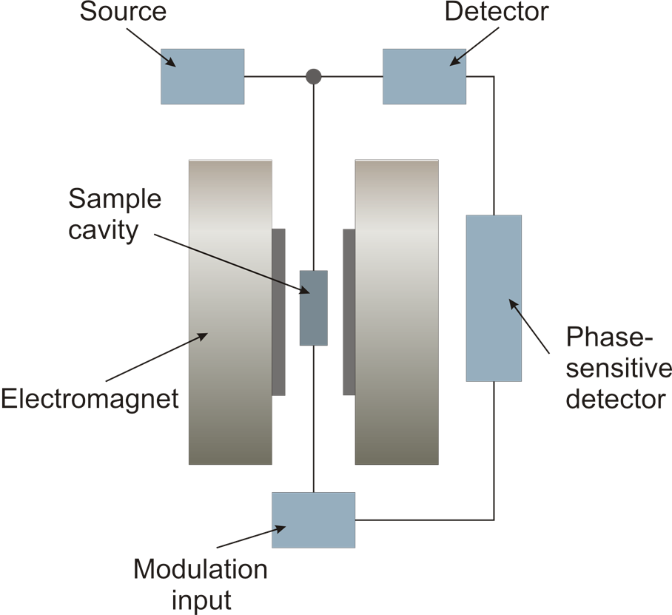
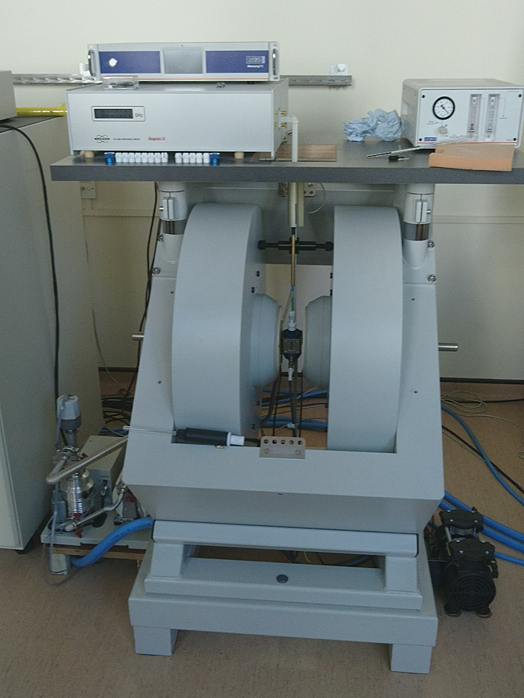
EPR – Courtesy of Stephen Sproules

Slide 59
Description
At 1064 nm RT:
We need 8 bilayers of SiO₂ and Ta₂O₅ to reduce the laser power
For an ITM with T= 1.4% we can’t improve the coating using aSi in lower layers
For an ETM with T = 6 ppm we need 4 bilayers of SiO₂ and aSi
Thermal noise improvement* compared to a pure SiO₂/Ta₂O₅ coating:
Room temperature: ITM: - 0% ETM: - 28% total: -22%
Almost no improvement by reducing mechanical loss further (limited by silica loss and ITM thermal noise)
*Loss for aSi: values from commercial coatings; no cryogenic measurements on UWS coatings
Simulations: J. Steinlechner
EPR – Courtesy of Stephen Sproules
Notes:
Jessica and Iain multimaterial idea

