Slide 1
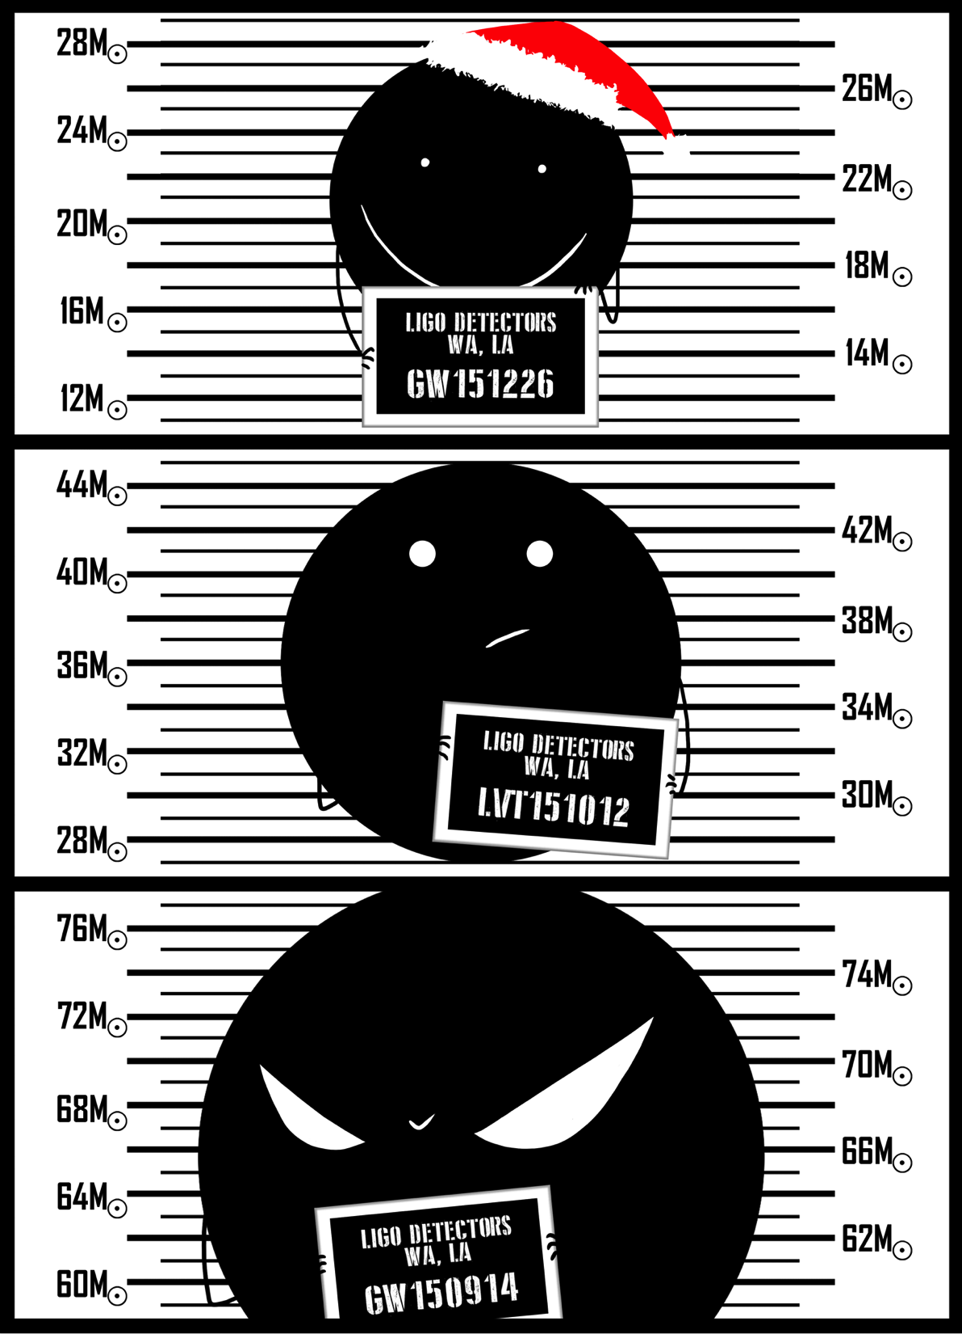
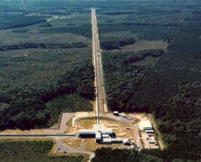
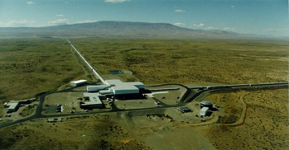



Gravitational Waves
Observed by LIGO
Alan J Weinstein
LIGO Laboratory, Caltech
LIGO Scientific Collaboration
Aspen 2017 Winter Conference
"From the LHC to Dark Matter and Beyond"
March 22, 2017
LIGO Livingston
Observatory
LIGO Hanford Observatory
LIGO Laboratory, Caltech
N. Kijbunchoo, LIGO
LIGO-G1700584

Slide 2
Outline
Gravitational waves
LIGO detectors and the global network
Astrophysical sources
Compact Binary Coalescence
CBC searches
Results from O1:
BBH events observed
Event properties
Tests of General Relativity
Astrophysical population properties
Astrophysical formation scenarios
Binary neutron stars
Nuclear equation of state
Summary and Future

Slide 3
Outline
Gravitational waves
LIGO detectors and the global network
Astrophysical sources
Compact Binary Coalescence
CBC searches
Results from O1:
BBH events observed
Event properties
Tests of General Relativity
Astrophysical population properties
Astrophysical formation scenarios
Binary neutron stars
Nuclear equation of state
Summary and Future

Slide 4
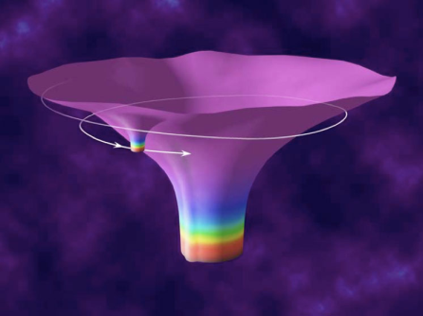
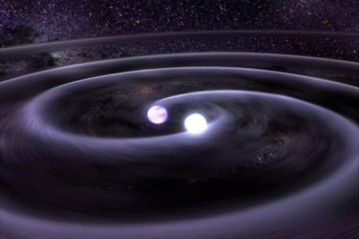

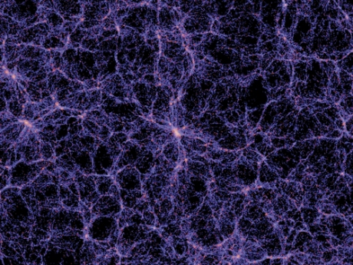

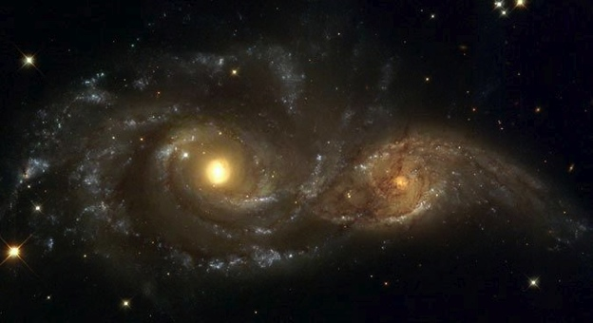
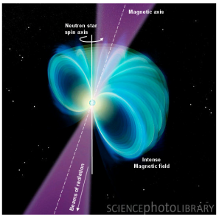

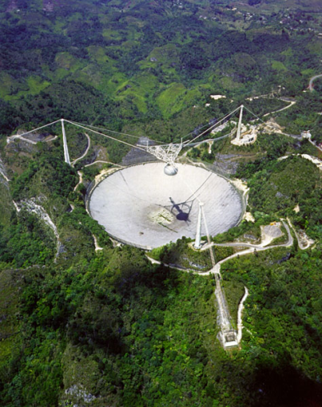
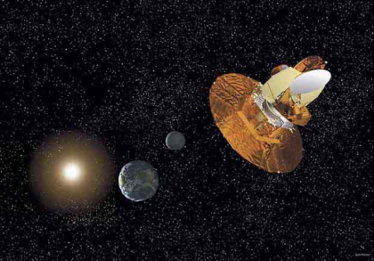
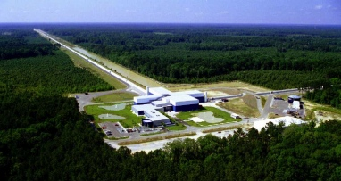
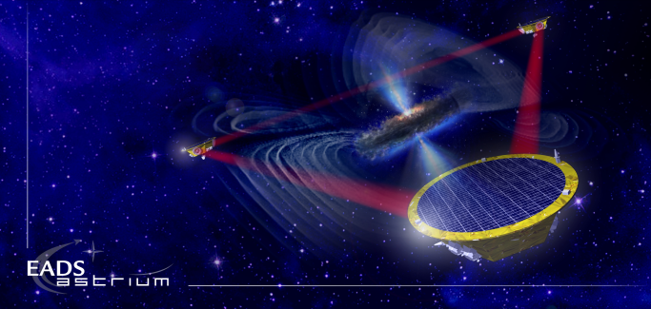
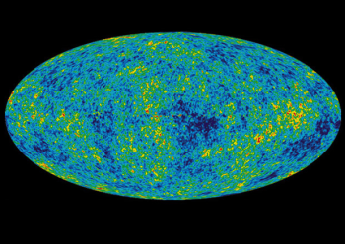
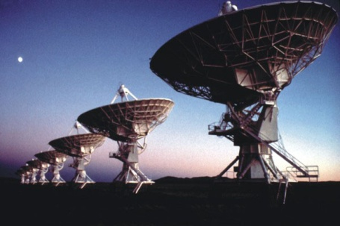
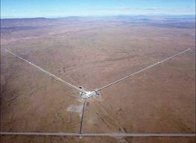
The GW Spectrum
BH and NS Binaries
Supernovae
Cosmic Strings
Relic radiation
Extreme Mass Ratio
Inspirals
Spinning NS
Supermassive BH Binaries
Binary coalescences
10⁻¹⁶ Hz
10⁻⁹ Hz
10⁻⁴ Hz
10⁰ Hz
10³ Hz
Inflation Probe
Pulsar timing
Space detectors
Ground interferometers

Slide 5
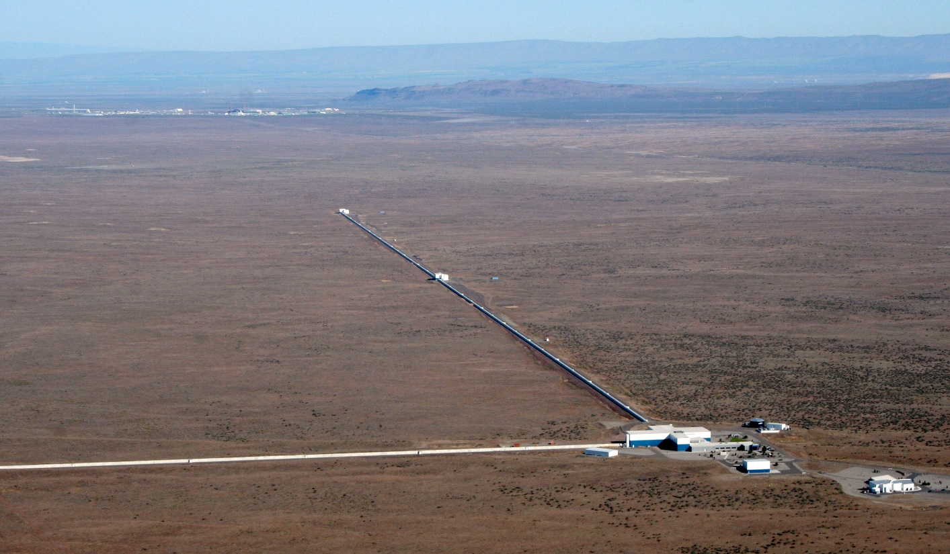
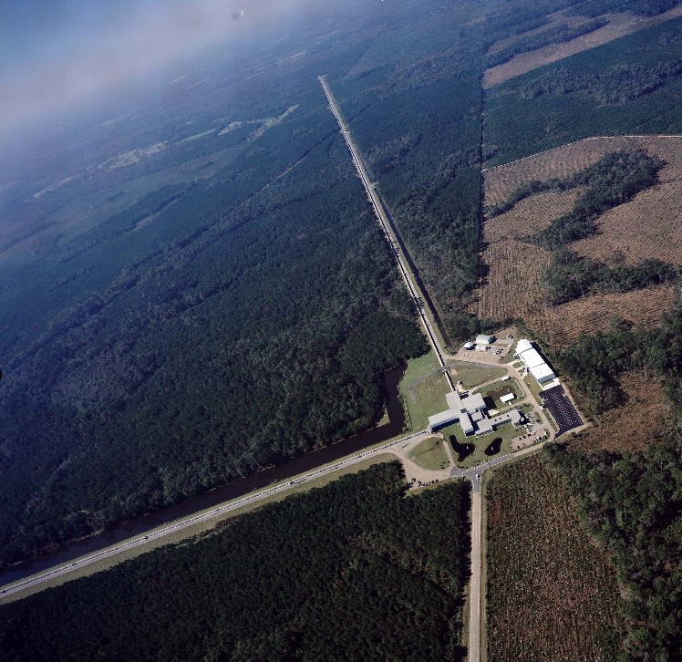
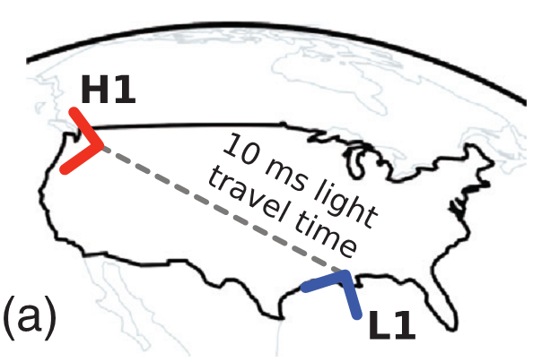
The LIGO* Observatories
* LIGO = Laser Interferometer Gravitational-wave Observatory
4km
LIGO Hanford
LIGO Livingston

Slide 6
The Advanced LIGO detectors
10⁻¹⁹ m Hz^{-1/2}
Abbott, et al., LVC,Phys. Rev. X 6, 041015 (2016)
Notes:
detection https://dcc.ligo.org/LIGO-P150914

Slide 7
Initial LIGO → Enhanced LIGO
→ Advanced LIGO
Initial LIGO
Enhanced LIGO
Advanced LIGO
’05
’06
’07
’08
’09
’10
’11
’12
’13
’14
’15
’16
Installation & commissioning
(the “Dark Ages”)
S4
S5
AstroWatch
S6
O1
O2
Engineering runs 6, 7, 8
NOW

Slide 8








The emerging Advanced
GW Detector Network
2015
~2019
GEO-HF
2011
LIGO Hanford
600 m
4 km
3 km
3 km
4 km
~2024
4 km
LIGO Livingston
(pending)
2015
Virgo
2017
3 separate collaborations working together

Slide 9
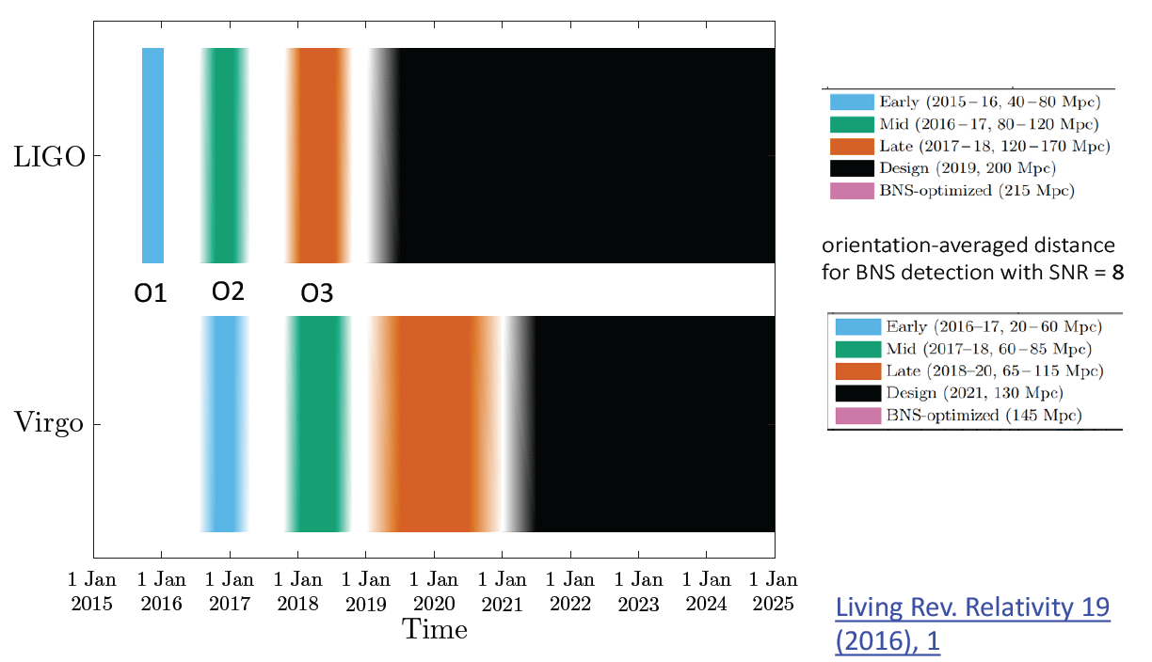
Near-term observing plan,
LIGO and Virgo

Slide 10

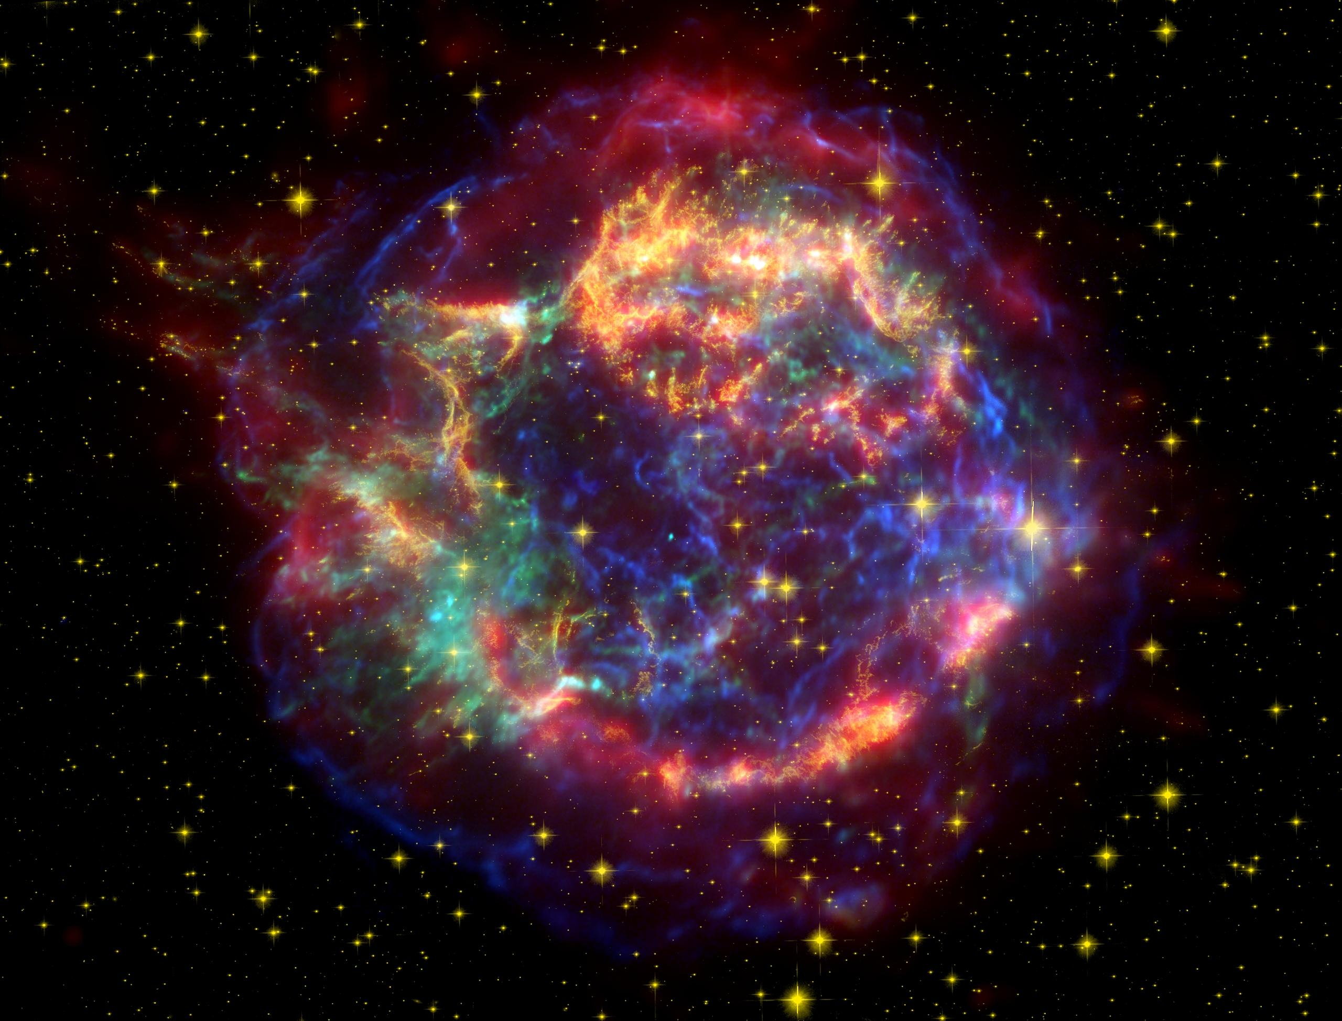

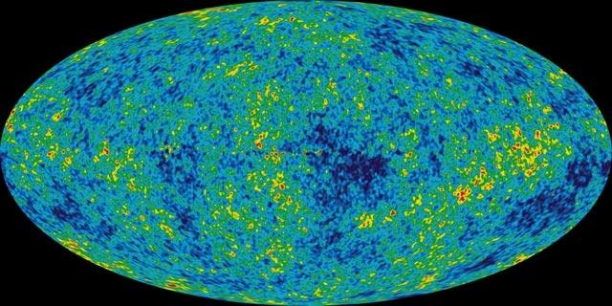
GW sources for ground-based detectors:
The most energetic processes in the universe
Coalescing Compact Binary Systems: Neutron Star-NS, Black Hole-NS, BH-BH
- Strong emitters, well-modeled,
- (effectively) transient
Asymmetric Core Collapse Supernovae
- Weak emitters, not well-modeled (‘bursts’), transient
- Cosmic strings, soft gamma repeaters, pulsar glitches also in ‘burst’ class
Credit: AEI, CCT, LSU
Spitzer, HST, Chandra
Spinning neutron stars
- (effectively) monotonic waveform
- Long duration
Cosmic Gravitational-wave Background
- Residue of the Big Bang, long duration
- Long duration, stochastic background
NASA/WMAP Science Team
Casey Reed, Penn State
Notes:
LIGO is designed to be an observatory, not a one-off proof that GWs exist. What do we look for?
There are number of predicted astrophysical sources of gravitational radiation, and most of them involve cataclysmic events.
Binary systems – NSs and BHs, most likely source, theoretically well understood with known waveforms
Bursts – GW emissions that are not well modeled or understood. These include asymmetrically core collapse supernova, cosmic strings, and perhaps unknown sources
The residual GW background
Continuously emitting sources such as spinning neutron stars, which have a pure monotone emission.

Slide 11
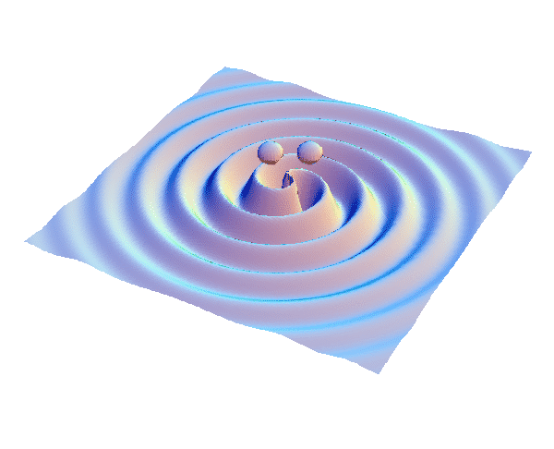
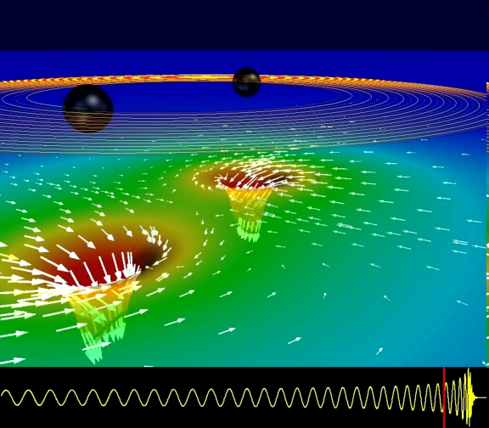
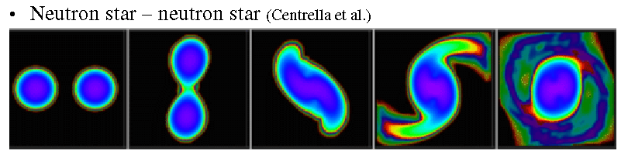
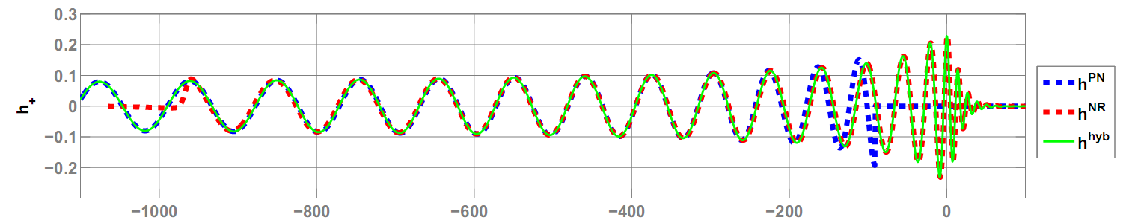
GWs from coalescing compact binaries (NS/NS, BH/BH, NS/BH)
Tidal disruption of neutron star
A unique and powerful laboratory to study
strong-field, highly dynamical gravity
and the structure of nuclear matter
in the most extreme conditions
Gravitational waveform: inspiral merger BH-ringdown
Waveform carries lots of information about binary masses, orbit, merger

Slide 12
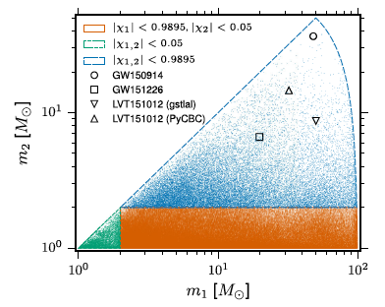
Template-based searches
GW150914
> 900 Mpc
BBH
BNS
NSBH
Masses and (aligned) spins
Templates spaced for < 3%
loss of SNR: 250K templates.
Sensitive distance in Mpc
Abbott, et al., LVC, “Binary Black Hole Mergers in the first Advanced LIGO Observing Run”, Phys. Rev. X 6, 041015 (2016)
Notes:
https://dcc.ligo.org/P1500269/

Slide 13
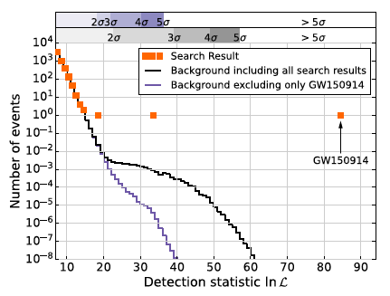
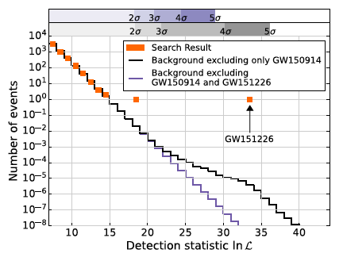
Search results
Advanced LIGO Observing Run O1
LVT151012
Three events above the estimated “background”
from accidental coincidence of noise fluctuation triggers.
Two have high significance (> 5σ).
Abbott, et al., LVC, “Binary Black Hole Mergers in the first Advanced LIGO Observing Run”, Phys. Rev. X 6, 041015 (2016)
Notes:
https://dcc.ligo.org/P1500269/

Slide 14
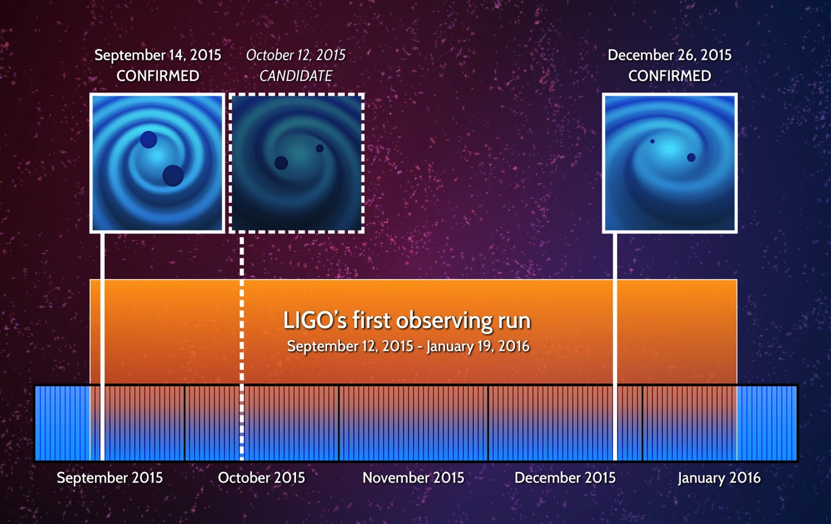
Search results
Advanced LIGO Observing Run O1
Notes:
https://dcc.ligo.org/P1500269/

Slide 15
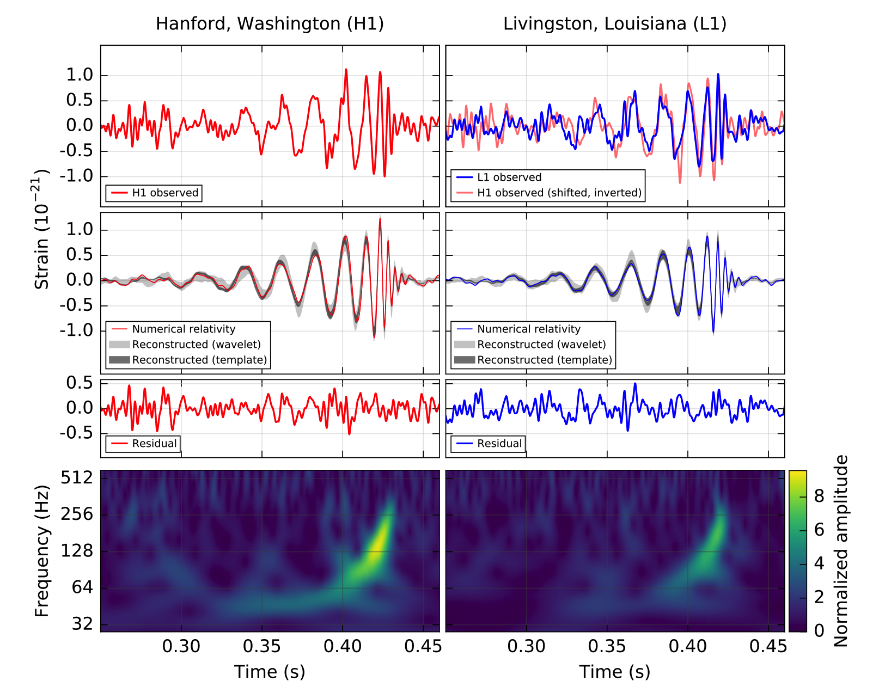
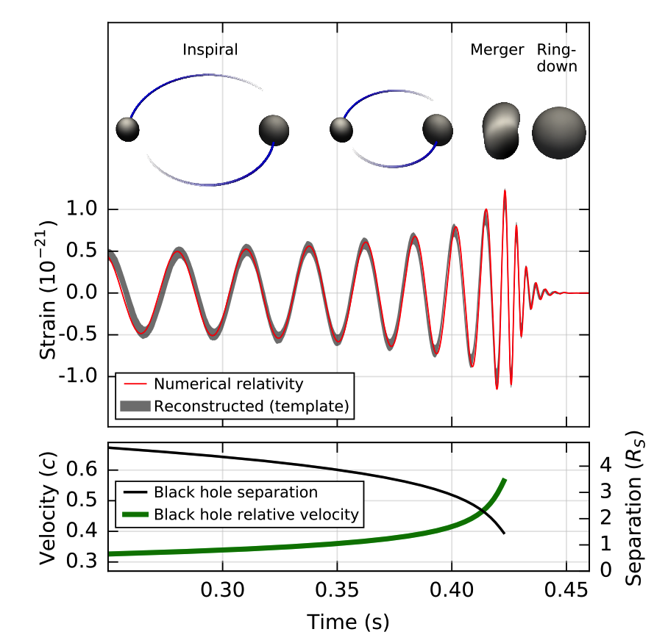

GW150914
Phys. Rev. Lett. 116, 061102 – Published 11 February 2016
Reconstructed
(no whitening)
Audio:
filtered data
freq-shifted data
reconstructed & shifted
Whitened and band-passed [40-300] Hz
Notes:
detection https://dcc.ligo.org/LIGO-P150914

Slide 16
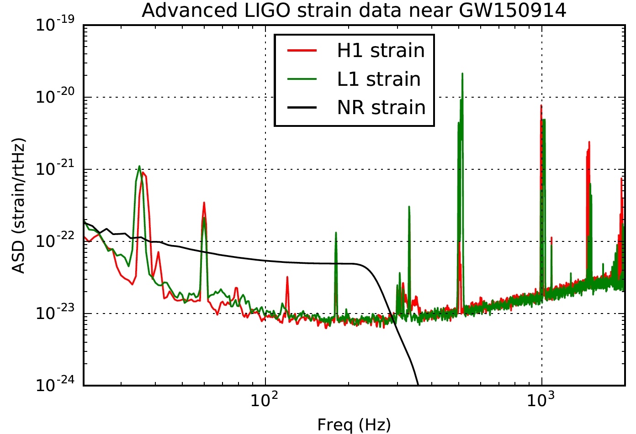
GW150914 in the frequency domain
inspiral
merger
ringdown
Made with data from the
LIGO Open Science Center, losc.ligo.org

Slide 17
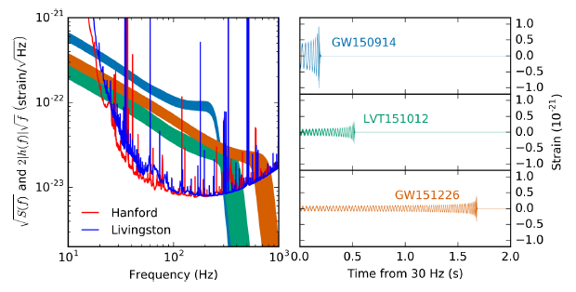
Three BBH events, compared
inspiral
merger
ringdown
Abbott, et al., LVC, “Binary Black Hole Mergers in the first Advanced LIGO Observing Run”, Phys. Rev. X 6, 041015 (2016)

Slide 18
What can we learn from a few events?
Such high frequency chirps require extremely compact orbiting objects of ~ stellar mass.
Black holes (strongly-curved spacetime with event horizons) EXIST, and emit waves of curved spacetime when perturbed.
  Previously, observations of high energy radiation from
  in-falling matter only told us that compact objects with strong gravity (and perhaps, with event horizons) were present.
Binary black holes exist! Formation scenarios involving common evolution require the binary to survive two
core-collapse supernovas.
Other formation scenarios may be important!
Two black holes merge into one, which rings down,
consistent with black hole perturbation theory.
Excellent consistency between the observed waveform and the prediction from GR (numerical relativity) tell us that we are seeing the inspiral of two black holes moving at 0.5c, merging into one BH, which subsequently rings down.
GR is tested, for the first time, in the strong (non-linear) and highly dynamical regime.
Masses, spins, sky location, rates, formation mechanisms…
Notes:
detection https://dcc.ligo.org/LIGO-P150914

Slide 19
Exploring the Properties of GW150914
Bayesian parameter estimation: Adjust physical parameters of waveform model to see what fits the data from both detectors well
➔ Get ranges of likely (“credible”) parameter values
Illustration by N. Cornish and T. Littenberg

Slide 20
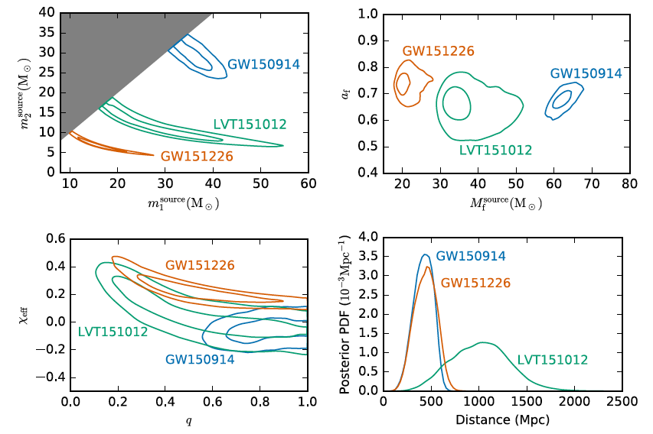
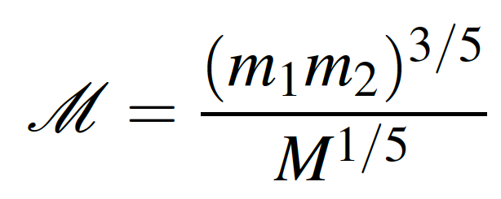
Three BBH events, black hole masses
For the higher mass systems,
we see the merger,
measure M_{tot} = m₁+m₂
For lower mass systems,
we see the inspiral,
measure the “chirp mass”
Source masses are redshifted!
These masses are surprisingly large!
Abbott, et al., LVC, “Binary Black Hole Mergers in the first Advanced LIGO Observing Run”, Phys. Rev. X 6, 041015 (2016)

Slide 21
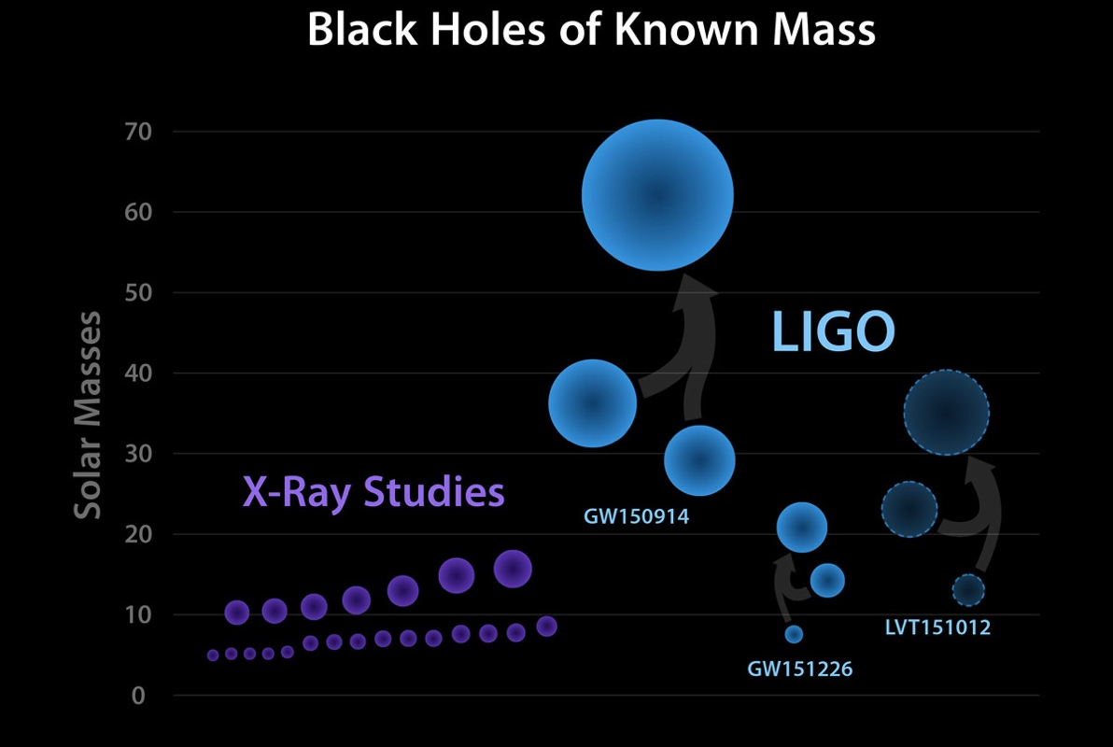
The Black Hole Mass Menagerie
4 Months of Gravitational-wave Astronomy
40 Years of X-ray
Astronomy

Slide 22
These are big black holes

Slide 23
Three BBH events, distances
It’s hard to measure distances
in astronomy!
(few “standard candles”)
BBH events are
“standardizable sirens”
(need to know their masses,
orbital orientation, etc).
Distances measured poorly
with only two detectors.
Our two loud events are far away!
(400 Mpc ~ 1.3 Gly) – merged 1.3 By ago!
Abbott, et al., LVC, “Binary Black Hole Mergers in the first Advanced LIGO Observing Run”, Phys. Rev. X 6, 041015 (2016)

Slide 24
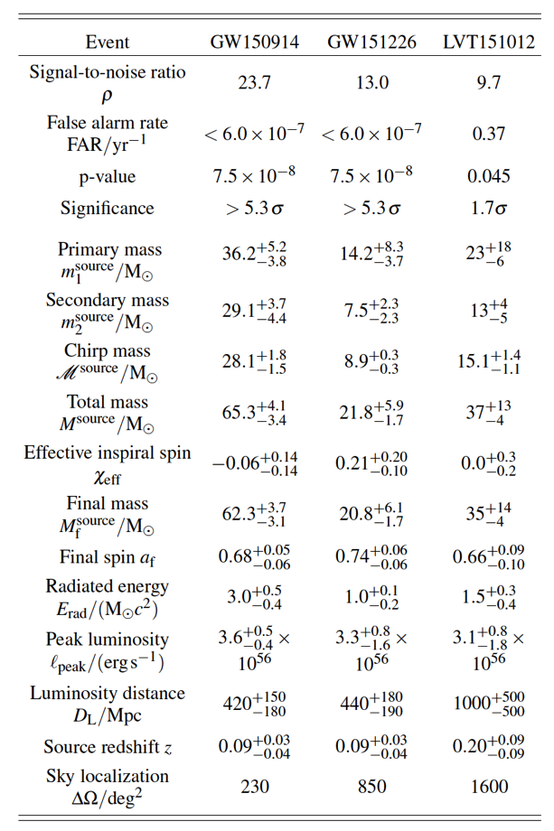
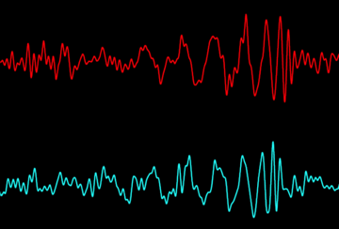
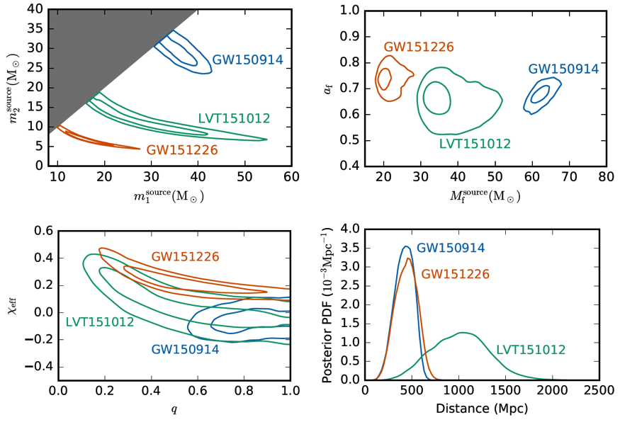
Extracting Astrophysical
Parameters from Detections
Hanford
Livingston
Abbott, et al., LVC, “Binary Black Hole Mergers in the first Advanced LIGO Observing Run”, Phys. Rev. X 6, 041015 (2016)

Slide 25
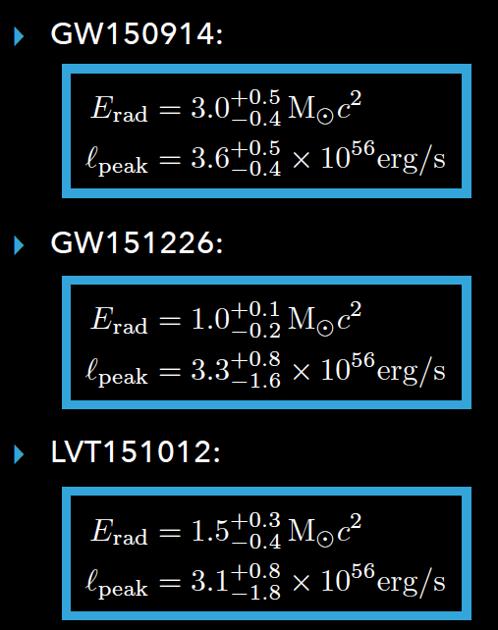
Radiated energy & luminosity
GW150914: E_{GW} ≈ 3 Mc², or ~4.5% of the total mass-energy of the system.
Roughly 10⁸⁰ gravitons.
Peak luminosity L_{GW} ~ 3.6×10⁵⁴ erg/s, briefly outshining the EM energy output of all the stars in the observable universe (by a factor > 20).
Notes:
https://dcc.ligo.org/P1500218/

Slide 26
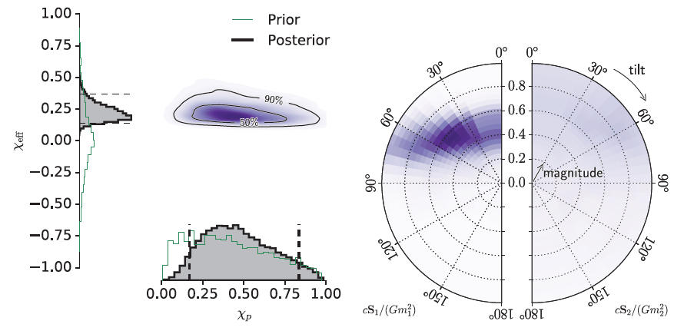
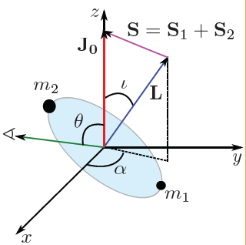
BH spins – aligned with orbital angular momentum, and precessing spin
The component BH spins measurably modulate the
inspiral frequency evolution.
Spin-orbit couplings cause the orbital plane to precess,
producing amplitude modulation
at the detectors.
Parameterize with aligned spin
χ_{eff} and “precessing” spin χ_{P}
GW150914
GW151226
Notes:
https://dcc.ligo.org/P1500218/

Slide 27
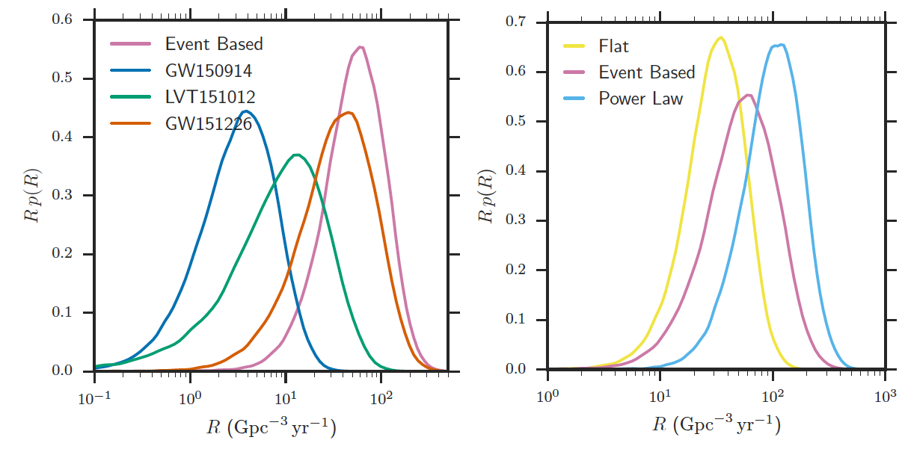
Astrophysical rate density
Roughly consistent with astrophysical expectations from:
Core collapse supernova rate
Short GRB rate
Astrophysical modeling of compact binary formation (“population synthesis”)
A half-dozen BNS systems in our galaxy (including Hulse-Taylor)
Notes:
https://dcc.ligo.org/P1500218/

Slide 28
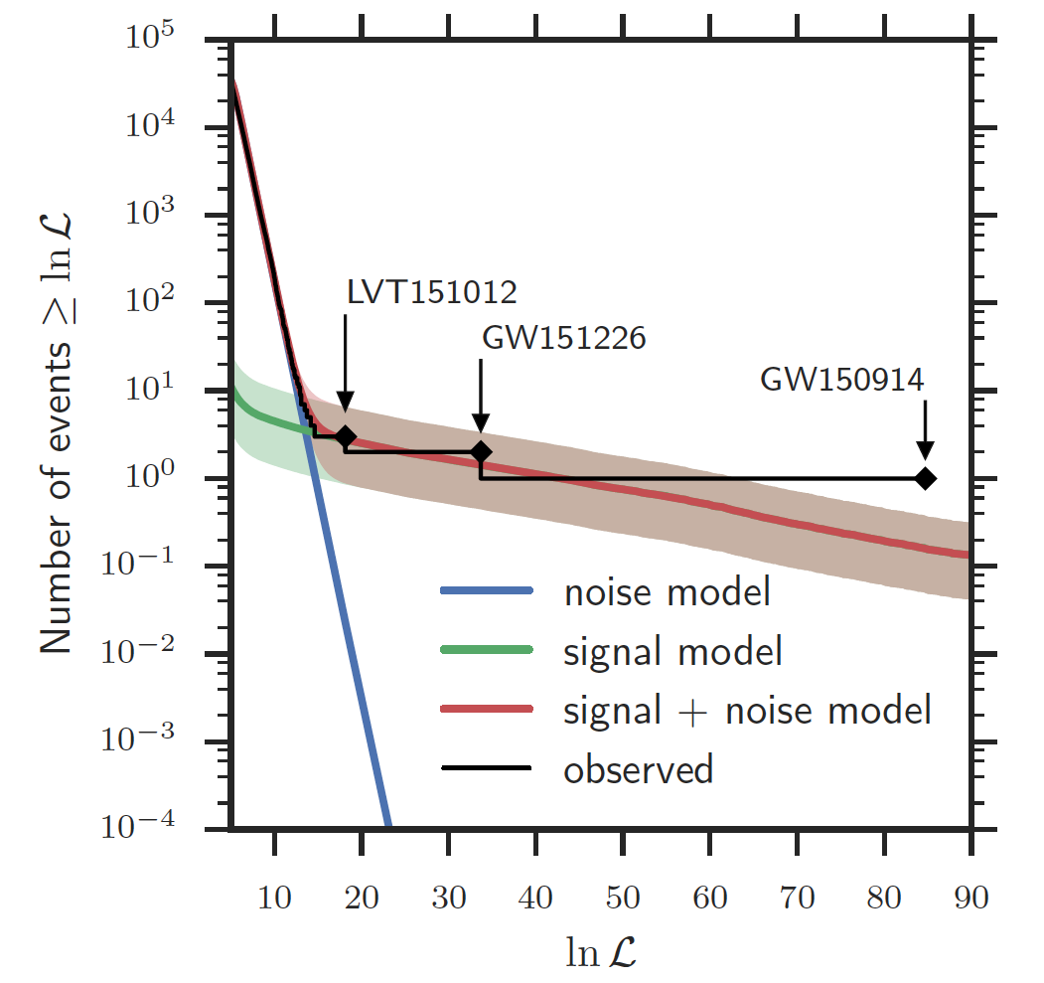
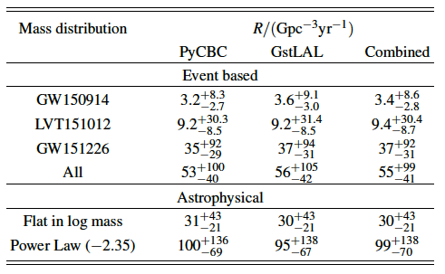
Observed BBH merger rate
Abbott, et al., LVC, “Binary Black Hole Mergers in the first Advanced LIGO Observing Run”, Phys. Rev. X 6, 041015 (2016)
The observed BBH merger rate
(comoving frame) from these three events,
in number / Gpc³ / yr
Event-based:
Astrophysically motivated:
LVT151012
Same ballpark as population synthesis models, CCSN rate, etc
iLIGO+eLIGO BBH rate upper limit: ~< 420 Gpc⁻³ yr⁻¹
Aasi, J. et al. 2013, Phys. Rev. D, 87, 022002, arXiv:1209.6533
Notes:
Rates - - https://dcc.ligo.org/P1500217/

Slide 29
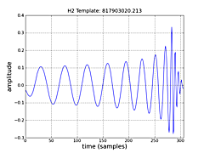

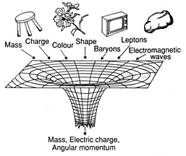
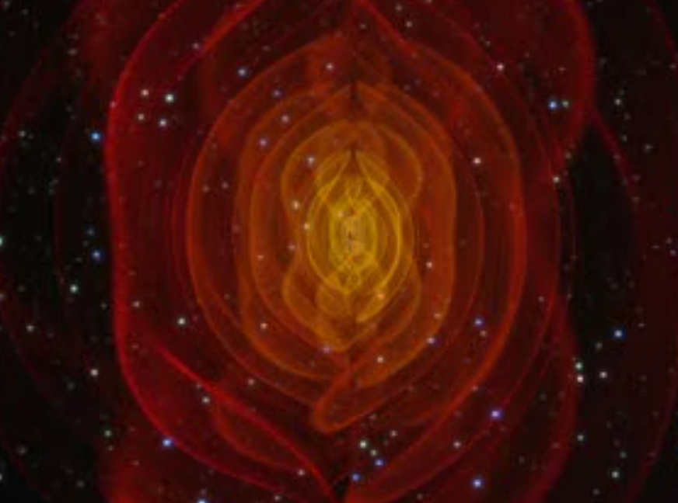
Testing General Relativity in the strong-field, dynamical regime
Test post-Newtonian expansion of inspiral phase.
Test Numerical Relativity waveform prediction
for merger phase.
Test association of inspiral and ringdown phases:
BH perturbation theory, no-hair theorem.
EOB-NR
www.black-holes.org
nonlocal.com/hbar/blackholes.html

Slide 30
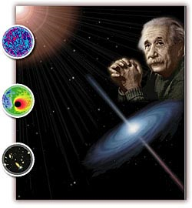
Testing beyond-GR in wave generation and propagation
We can test GR in the new regime of strong-field,
highly dynamical gravity!
Gravitational lensing & multiple “images”
(not beyond GR!)
Constrain “parameterized post-Einsteinian framework”
(Yunes & Pretorius, 2009)
Directly measure speed of gravitational waves (c_{GW} ≠ c_{light}),
constrain (or measure) the mass of the graviton.
Constrain (or measure) longitudinal (vector, scalar) polarizations.
Constrain (or measure) Lorentz violating effects.
Constrain (or measure) cosmic anisotropies.
Constrain (or measure) parity-violating effects.
Constrain (or measure) dissipative gravity effects.
Test specifically for scalar-tensor and other alt-gravity theories
Beyond Einstein

Slide 31
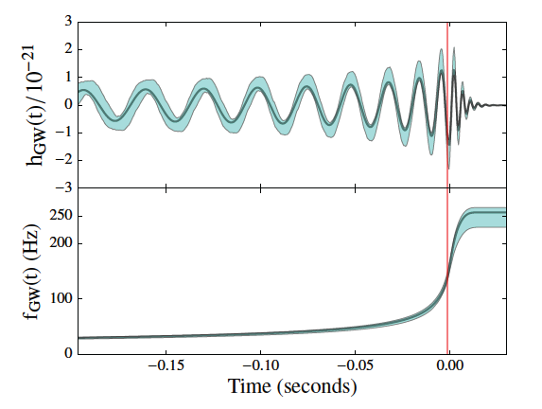

Tests of consistency with predictions from General Relativity
From the inspiral phase evolution, determine initial masses and spins
In GR, the mass and spin of the remnant BH is determined from the initial ones and the orbital dynamics
Predict final mass and spin from the “inspiral” using NR formulae
Measure directly from the “merger ringdown” (post-inspiral)
Consistency test on the waveform and thus, on the corresponding GR solution
No evidence for violations of GR
Tests of General Relativity with GW150914
Phys. Rev. Lett. 116, 221101 (2016)

Slide 32

Ringdown in GW150914
Ringdowns of perturbed (newly formed) BHs are predicted from BH perturbation theory.
Expect a spectrum of ringdown quasi-normal modes (QNMs) with predictable frequencies and decay times.
GW150914 was not loud enough to detect more than one ringdown mode (and that, just barely).
The measured frequency and decay time for the least damped QNM are consistent with IMR waveforms from numerical relativity simulations.
We can “stack” multiple events to test for deviations from GR predictions.

Slide 33






Mass of the graviton
A propagating graviton with mass m_{g}
and associated Compton wavelength
results in frequency-dependent velocity
and dispersion causes distortion of the phase evolution of the waveform
(wrt massless theory)
Agreement of observed waveform with theory allows us to set the bound:
> 10¹³ km
Tests of General Relativity with GW150914
Phys. Rev. Lett. 116, 221101 (2016)

Slide 34


What if GR black holes … aren’t?
“Echoes from the abyss”
When is a BH not a BH?
Planck-scale departures from GR (firewalls, fuzzballs, gravastars) near the putative BH horizons can lead to “echoes”.
repeating damped echoes with
time-delays of 8M logM
Abedi, Dykaar, and Afshordi, arXiv:1612.00266v1
“… we find tentative evidence for
Planck-scale structure near black hole horizons at 2.9σ significance level”
But… if you look for ringdowns in LIGO strain noise, you will find it everywhere
(They used 32s of data around GW150914 to estimate the background).

Slide 35
Physics and astrophysics with gravitational waves
The advanced GW detector era has begun!
The exploration of the GW sky;
Unique tests of General Relativity in the strong-field, highly non-linear and dynamical regime;
joint observations and discoveries
with EM and neutrino telescopes;
nuclear equation of state, r-process nucleosynthesis;
and a rich new branch of astrophysics.
But most of all, we look forward to …
Thank You!
the unexpected!

Slide 37

BNS and NSBH mergers

Slide 38



Neutron stars
Remnants of core collapse supernovae
A unique laboratory for fundamental physics
Strong, Weak, EM, gravity –
all under the most extreme conditions
Structure can be revealed
through binary mergers
http://www.astro.umd.edu/~miller/nstar.html

Slide 39







All four fundamental forces under the most extreme conditions
Gravity: Compact stars have gravitational fields GM/c²R ~ O(1), strong tidal effects, strong curvature, highly relativistic
Strong interaction at > 2x nuclear density in core
  Hard repulsive core of nucleon-nucleon interaction plays crucial role
  Potential transition to hyperonic matter, strange quark matter, QGP
  Complex ionic crystal lattice structure in crust: “nuclear pasta”
Weak interaction under extreme conditions with neutrino trapping -> beta equilibrium
EM: Superfluid core supporting extreme magnetic fields (perhaps > 10¹⁵ Gauss at surface), flux tube pinning in core

Slide 40

BNS mergers, tidal distortion and disruption
Credit: Daniel Price and Stephan Rosswog

Slide 41



The origin of the (heavy) elements
Lightest elements (H, He, Li) forged in Big Bang
Heavier elements (C, O, N, … Fe) forged in
the core of massive stars, distributed to ISM
by core-collapse supernovae
(the death of massive stars)
Elements beyond Fe (like Cu, Au, Pt, U…)
are forged during the SN (“r-process”);
but most of them might come from
binary neutron star mergers (second-death)
Solar system abundances
Anders and Grevesse 1989
r-process nucleosynthesis in BNS mergers
M. Eichler et al, ApJ 808 (2015)

Slide 42

NEOS and
NS mass-radius relation

Slide 43



Tidal disruption of neutron stars near merger
Credit: Daniel Price and Stephan Rosswog
iLIGO
aLIGO
ET

Slide 44
Nuclear Astrophysics:
BNS Merger GW waveforms
1.35 + 1.35
1.50 + 1.50
1.60 + 1.60
Sekiguchi+ ‘11
Mass [M_{Sun}]
Sekiguchi+ 11: Full GR NS-NS simulation with realistic microphysics,
finite-temperature nuclear EOS of H. Shen+ ‘98,’11 (+MHD, ν-transport since then!)

Slide 45


BNS and NSBH merger rate limits from O1, and predictions
12,600
3,600
O1 <BNS range> ~ 70 Mpc
O1 <NSBH range> ~ 110 Mpc
Initial LIGO limit (2012) on BNS: 130,000 Gpc⁻³ yr⁻¹

Slide 46


papers.ligo.org

Slide 47


Formation mechanisms
How do massive binary black hole systems form?
Common envelope evolution of isolated binaries: two massive stars survive successive CCSNe
Dynamical capture of isolated black holes in N-body exchange interactions.
Even the most massive stars (60-100 M) can only produce black holes with mass > 20 M only in low-metallicity environments (~ 0.1 Z).
https://dcc.ligo.org/LIGO-P1500262/public/main

Slide 48


Formation channels

Slide 49






Multi-messenger Astronomy with Gravitational Waves
astrophysical fireball
Binary Neutron Star Merger
X-rays/Gamma-rays
X-rays, γ rays
Gravitational Waves
GWs
Visible/Infrared Light
optical
Neutrinos
neutrinos
Radio Waves
radio

Slide 50

Low-latency identification of transients for rapid (< ~100s) followup
EM counterparts to GW sources (if any) are short-lived and faint

Slide 51




EM- and neutrino follow-up
Low-latency alerts go out to MOU partners via the
GRB Coordinates Network (GCN), notices & circulars
(machine-readable).
These will be public (not just “MOU partners”, sworn to secrecy), hopefully in the near future!
Fastest we’ve ever accomplished is ~30 min,
but could do < 2 minutes if we could only agree…
Literally dozens of (mostly wide-field, survey) optical and radio telescopes; most notably,
Palomar Transient Factory iPTF -> ZTF,
Owens Valley Long Wavelength Array (LWA)
Also notable: PanSTARRS, DES, ASKAP, MWA, ...
Space-based x-ray and gamma-ray telescopes: Swift, Fermi, INTEGRAL, Interplanetary Network (IPN)
Neutrino detectors: Ice-Cube, ANTARES, (Super-K)
PTF
OV LWA

