Slide 1
Gravitational Waves Detected:
The physics behind the detection,
The physics we detected
Séminaire Poincaré
3 December 2016
David Shoemaker
For the LIGO and Virgo Scientific Collaborations
Credits
Measurement results: LIGO/Virgo Collaborations,
PRL 116, 061102 (2016); http://arxiv.org/abs/1606.04856
Simulations: SXS Collaboration; LIGO Laboratory
Localization: S. Fairhurst arXiv:1205.6611v1
Photographs: LIGO Laboratory; MIT; Caltech

Slide 2



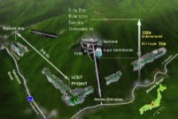

Virgo and LIGO
Virgo and LIGO built new observatories in the 90’s
Virgo
LIGO
Hanford,
Livingston
KAGRA
2018
…and Observed with the initial detectors
2005-2011,
and saw no signals
(and some interesting non-detections)
2
2

Slide 3
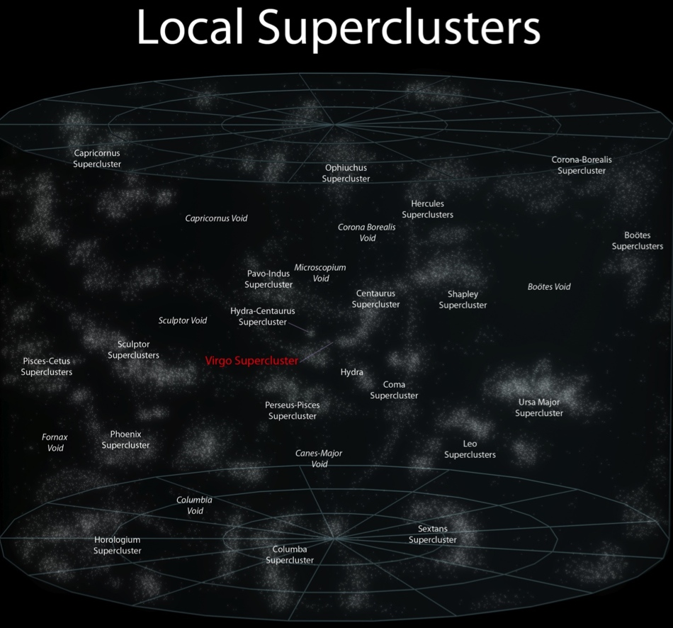
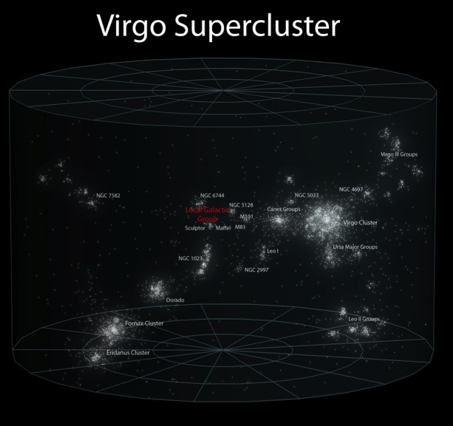
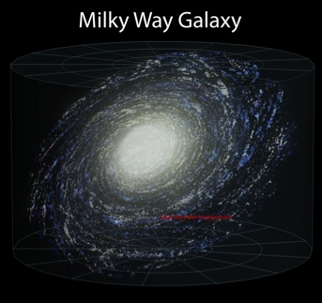
Advanced Detectors: a qualitative difference
While observing with initial detectors, parallel R&D led to better concepts
Design for 10x better sensitivity
  We measure amplitude,
  so signal falls as 1/r
1000x more candidates
Initial Reach
Advanced Reach

Slide 4
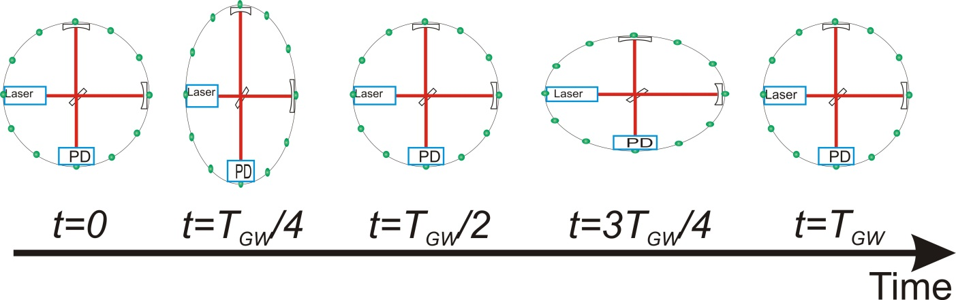
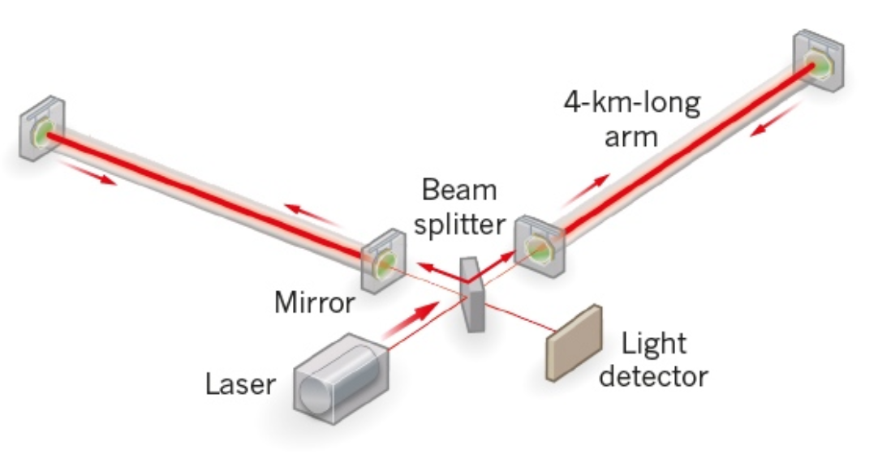
What is our measurement technique?
Enhanced Michelson interferometers
  LIGO, Virgo, and GEO600 use variations
Passing GWs modulate the distance between the end test mass and the beam splitter
The interferometer acts as a transducer, turning GWs into photocurrent proportional to the strain amplitude
Arms are short compared to our GW wavelengths, so longer arms make bigger signals
→ multi-km installations
Arm length limited by
taxpayer noise….
Magnitude of h at Earth:
  Largest signals h ~ 10⁻²¹
  (1 hair / Alpha Centauri)
  For L = 1 m, ΔL= 10⁻²¹ m
  For L = 4km, ΔL= 4x10⁻¹⁸ m

Slide 5
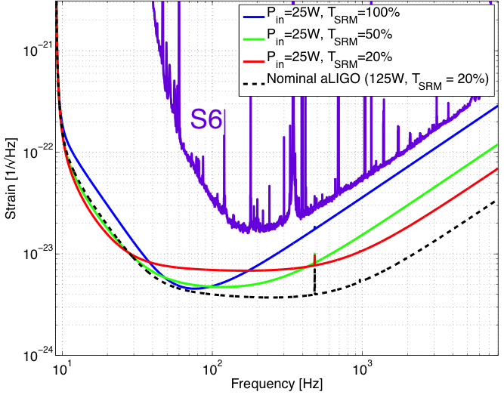
  Measuring ΔL= 4x10⁻¹⁸ m
  Readout
Shot noise – ability to resolve a fringe shift due to a GW (counting statistics)
Zum gegenwärtigen Stand
des Strahlungsproblems,
A. Einstein, 1909
Fringe Resolution at high frequencies improves as as
(laser power)^{1/2}

Slide 6
  Measuring ΔL= 4x10⁻¹⁸ m
  Readout
Shot noise – ability to resolve a fringe shift due to a GW (counting statistics)
Radiation Pressure noise – Point of diminishing returns when buffeting of test mass
by photons increases
low-frequency noise –
use heavy test masses!
‘Standard Quantum Limit’

Slide 7
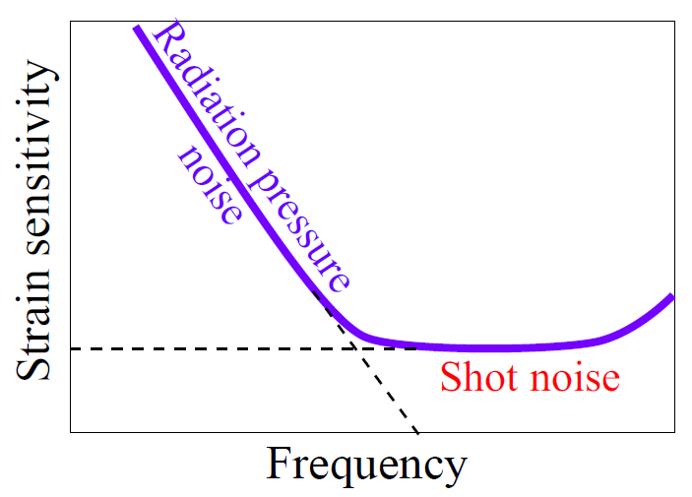
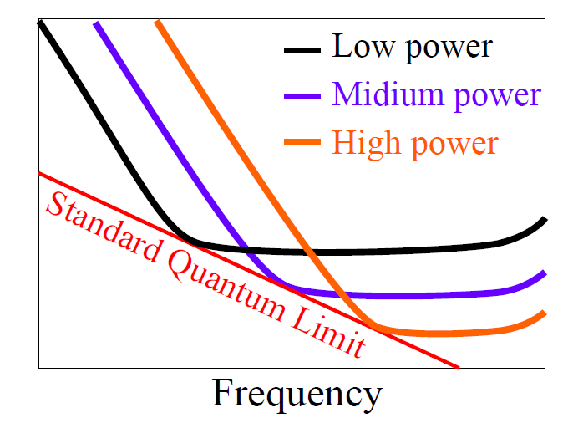
Standard Quantum Limit
For a simple model of the instrument, one can choose the frequency of the best compromise between the two effects
Figures: Miao

Slide 8
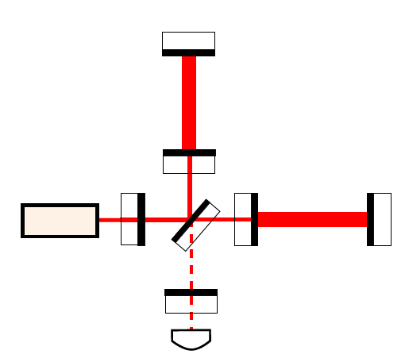
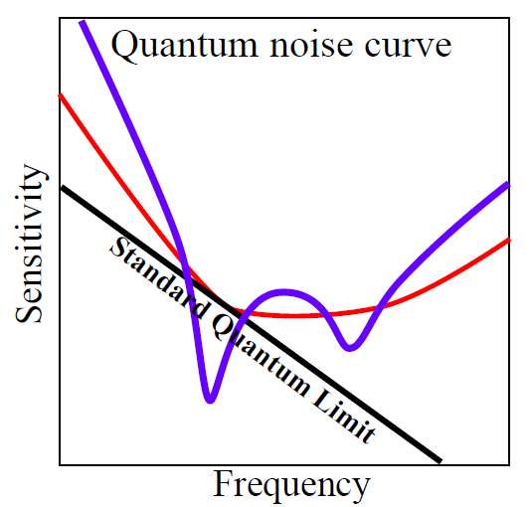



Detuned signal recycling (SR)
In fact, in Advanced LIGO the signal recycling mirror couples phase and amplitude, and there is pondermotive squeezing of the light
Signal recycling
mirror (SRM)
One interpretation: optical spring effect
[1] A. Buonanno and Y. Chen. Signal recycled laser-interferometer gravitational-wave detectors as optical springs, PRD 65, 042001 (2002). Slide: H. Miao
5

Slide 9
  Measuring ΔL= 4x10⁻¹⁸ m
  Readout
Advanced LIGO is expected to operate in this pondermotive regime with its
200W laser, 40 kg test masses
…not yet, though (only see shot noise to date)

Slide 10
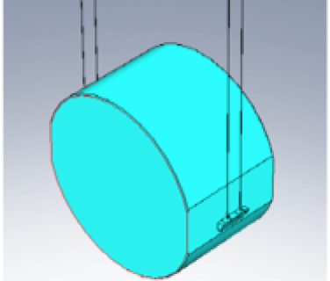
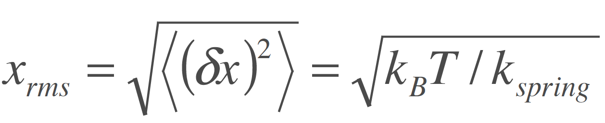
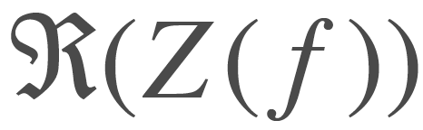
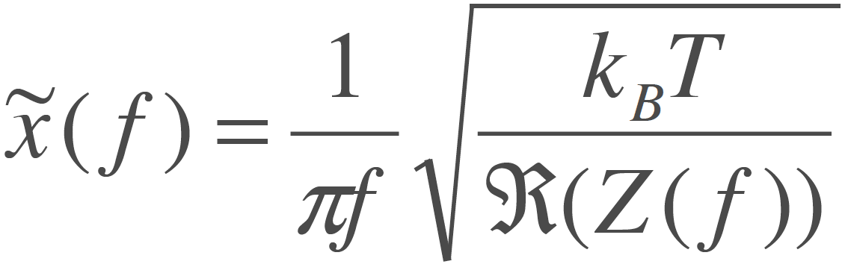
Measuring ΔL= 4x10⁻¹⁸ m
Internal motion
Thermal noise – kT of energy
per mechanical mode
Über die von der molekularkinetischen Theorie
der Wärmegeforderte Bewegung
von in ruhenden Flüssigkeiten suspendierten Teilchen,
A. Einstein, 1905
Simple Harmonic Oscillator:
Distributed in frequency according to real part of impedance

Slide 11
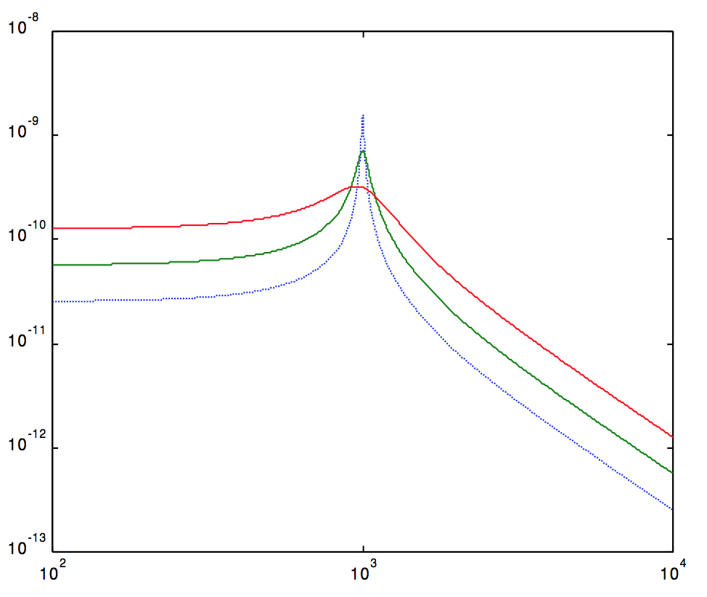
Measuring ΔL= 4x10⁻¹⁸ m
Internal motion
Thermal noise – kT of energy
per mechanical mode
  This is the integral under the curve of motion…
Fluctuation-dissipation theorem gives motion as a function of frequency
Low mechanical loss materials gather this motion into a narrow
peak at resonant frequencies
  Lower noise above and below the peak

Slide 12
Measuring ΔL= 4x10⁻¹⁸ m
Internal motion
In Advanced LIGO, the optical coating is the dominant loss
Fused silica components have losses of order 10⁻⁶ – 10⁻⁸
Sputtered optical coatings have losses of order 10⁻⁴
And the lossy coating is the interface to the laser beam
This is the dominant limit in the critical 10-200 Hz band
A focus of research!

Slide 13
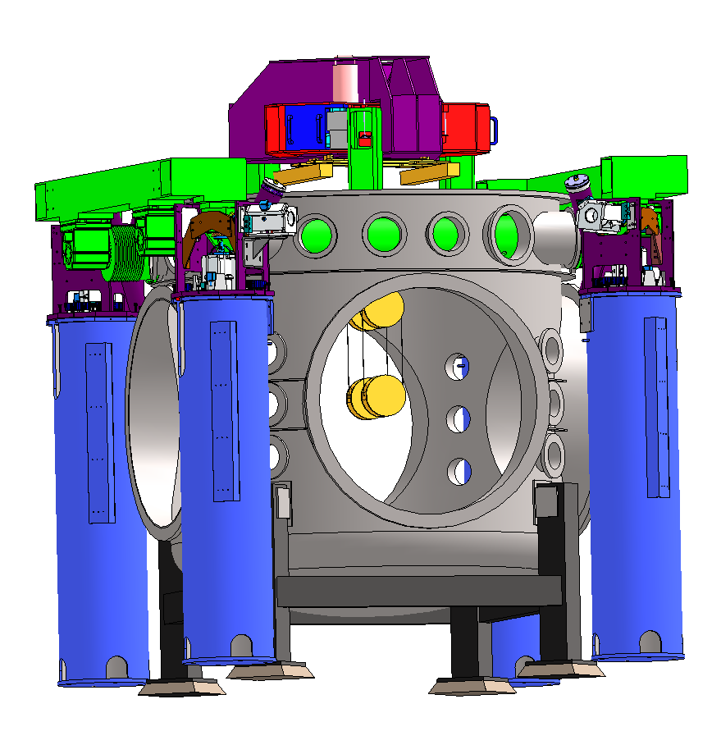
Measuring ΔL= 4x10⁻¹⁸ m
Forces on test mass
Seismic noise – must prevent masking of GWs, enable practical control systems
(did Einstein work on seismic motion…?)
Motion from waves on coasts…and people moving around
GW band: 10 Hz and above – direct effect of masking
Control Band: below 10 Hz – forces needed to hold optics
on resonance and aligned
aLIGO uses active servo-controlled platforms, multiple pendulums

Slide 14
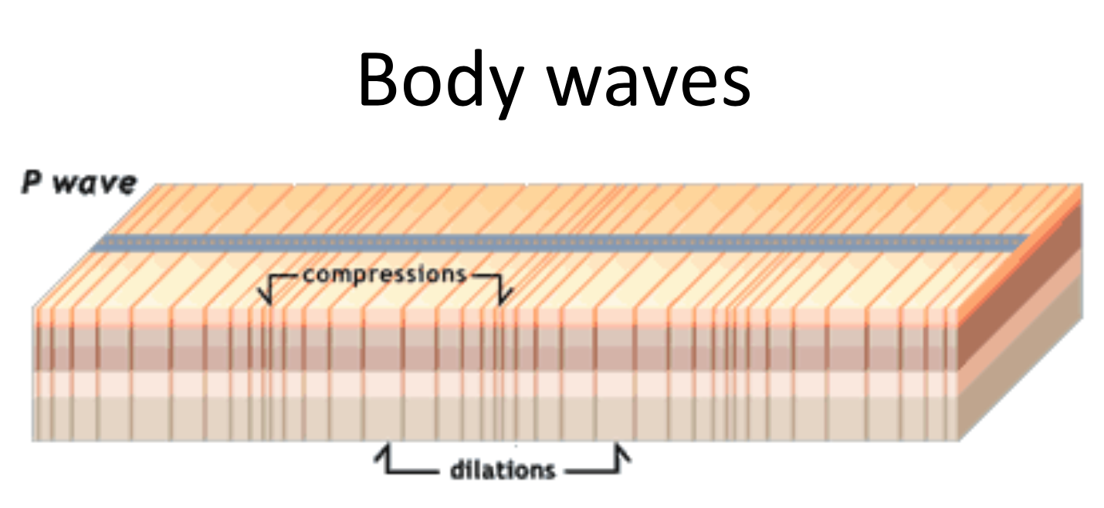
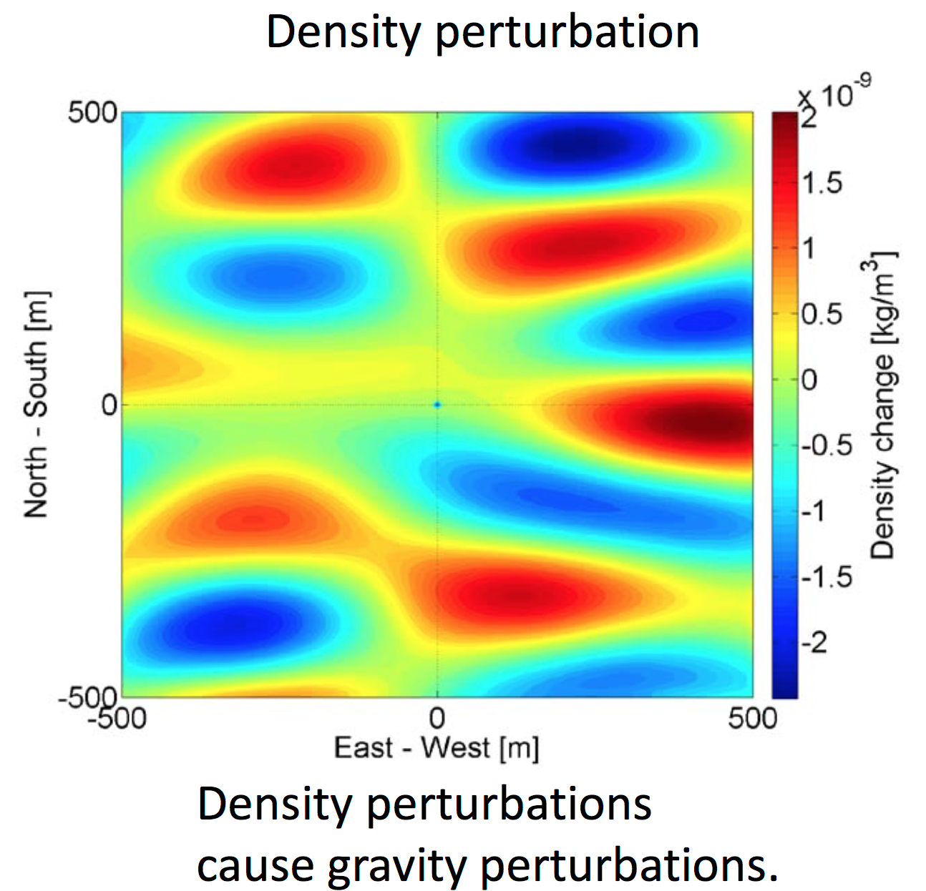
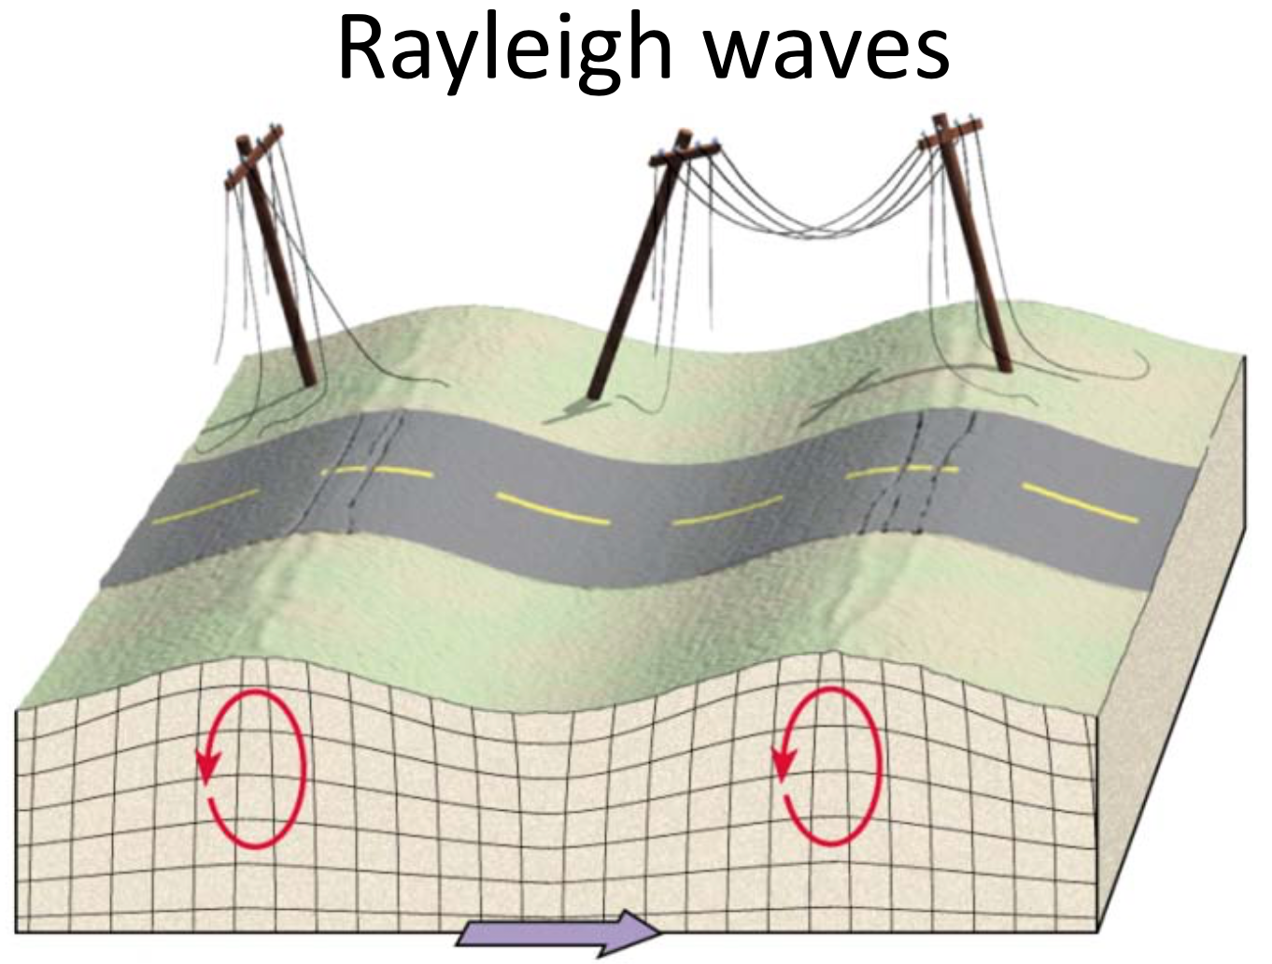
Measuring ΔL= 4x10⁻¹⁸ m
Forces on test mass
Ultimate limit on the lowest frequency detectors on- or under-ground:
Newtownian background – wandering net gravity vector; a limit in the 10-20 Hz band
Images: J. Harms

Slide 15
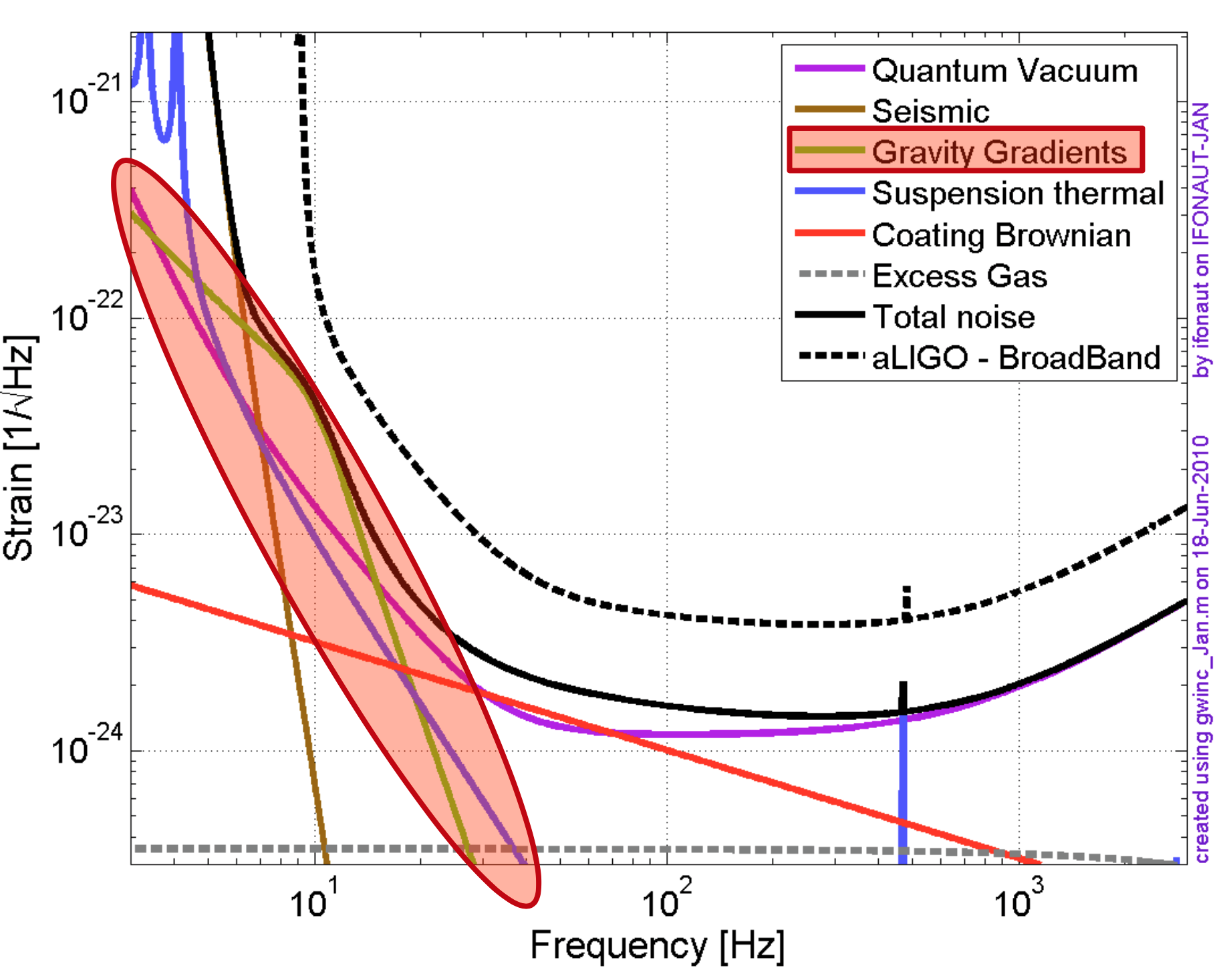
Measuring ΔL= 4x10⁻¹⁸ m
Forces on test mass
Advanced LIGO (and Virgo) expect to be limited by this noise source –
  After all technical noise sources beaten down
  At low optical power (no radiation pressure noise)
  In the 10-30 Hz range
We would love to be limited only by this noise source!
Images: J. Harms

Slide 16
Then there are the technical noise sources….

Slide 17
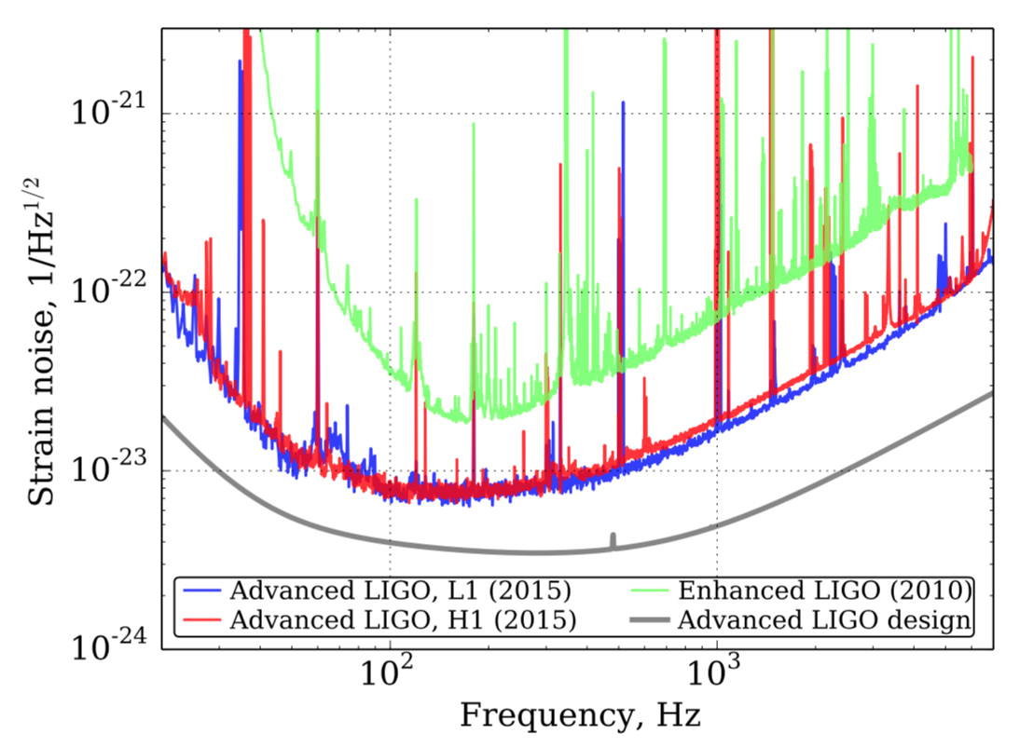
Sensitivity for first Observing run
At ~40 Hz, Factor ~100 improvement
Broadband,
Factor ~3 improvement
Initial LIGO
O1 aLIGO
Design aLIGO

Slide 18
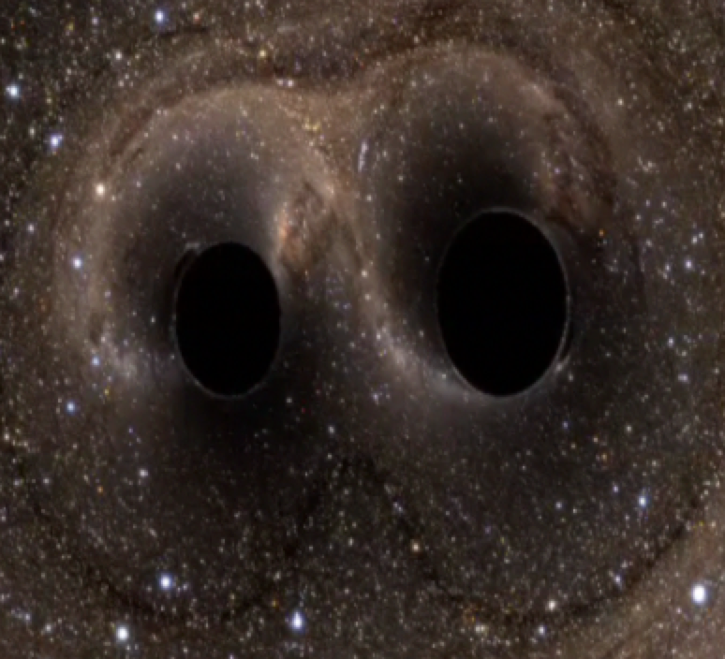
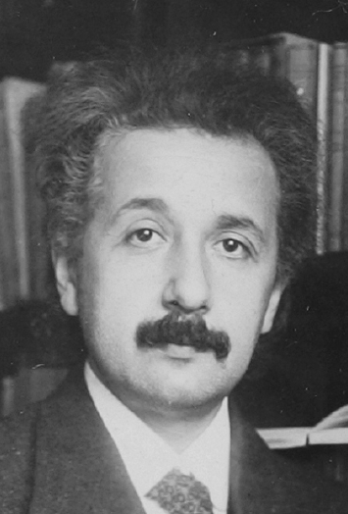
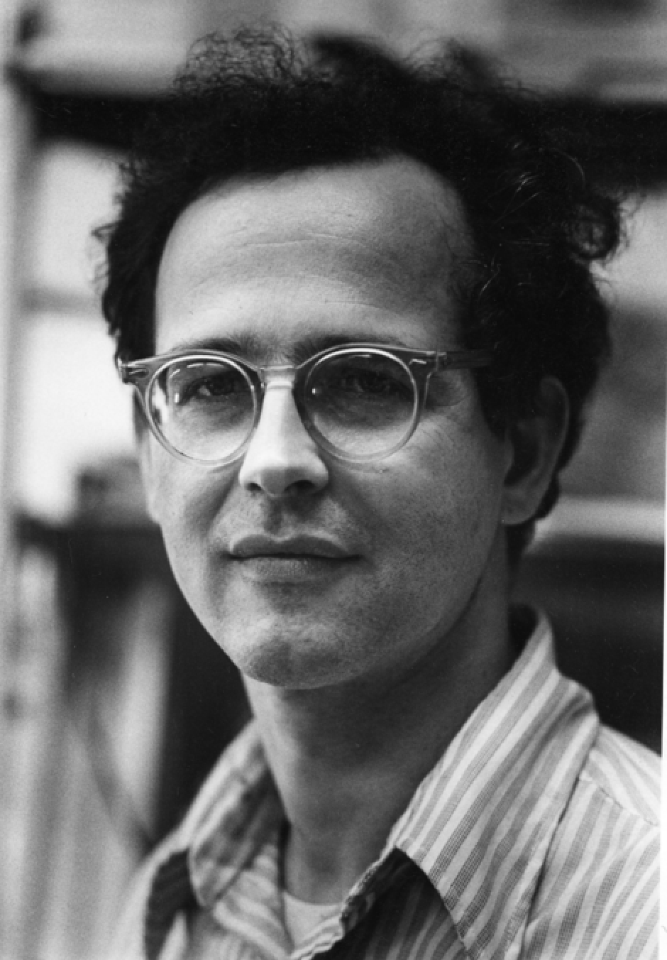
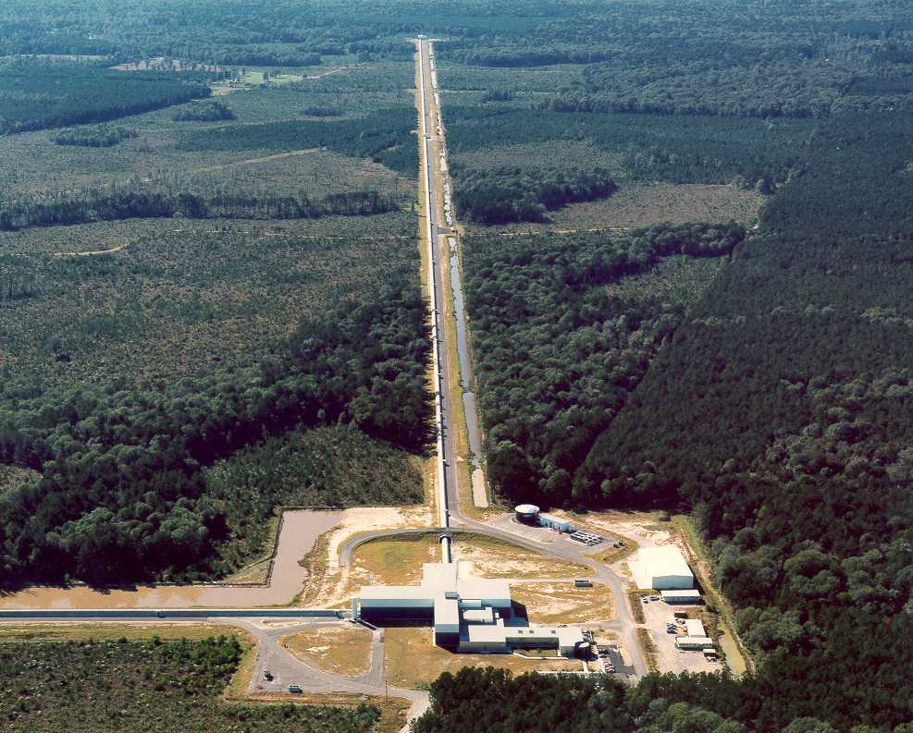
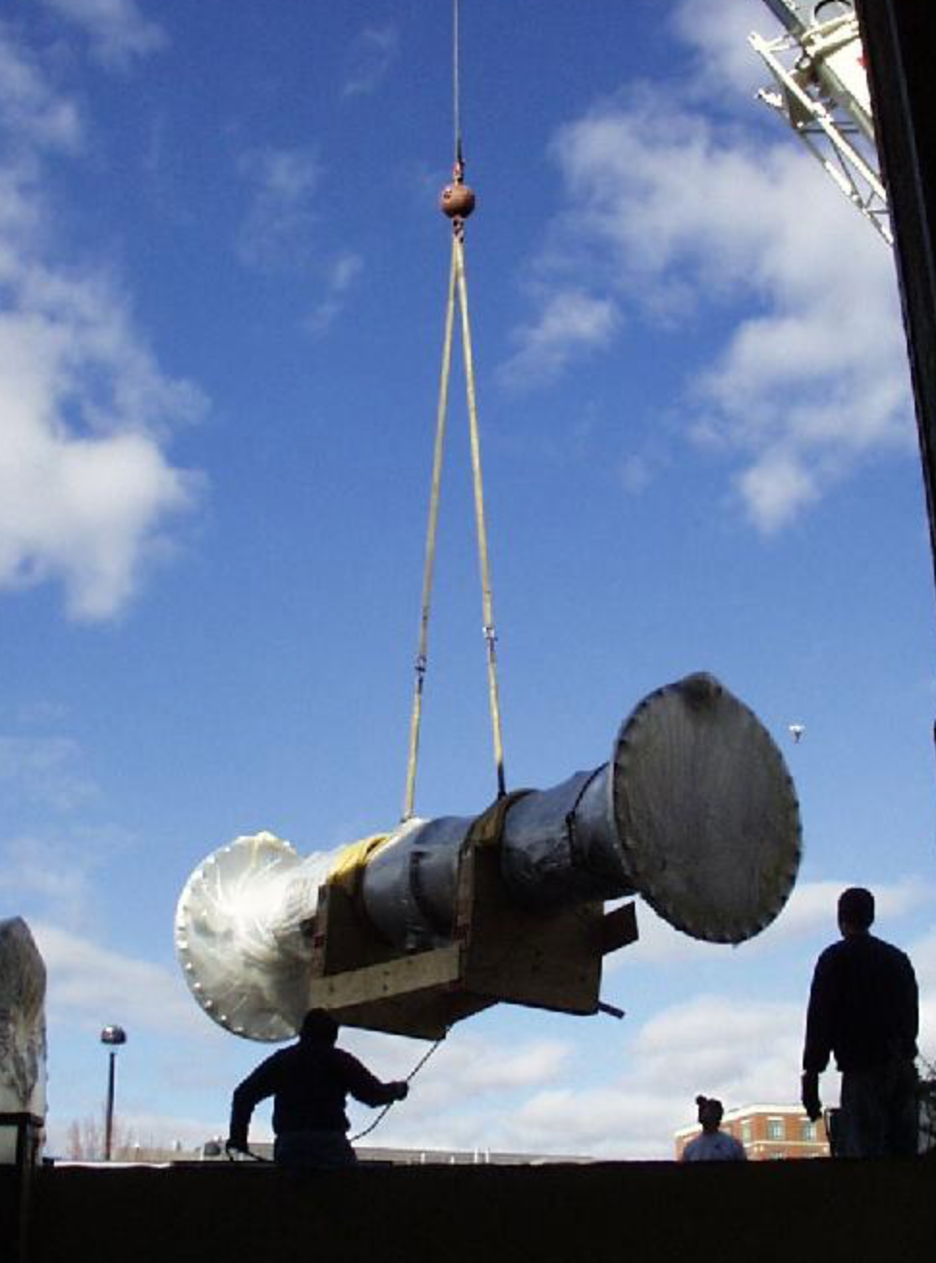
1.3 Billion years after the Black Holes merged..
(and multicellular life started on earth…)
100 years after Einstein predicted gravitational waves…
50 years after Rai Weiss invented the detectors...
20 years after the NSF, MIT, and Caltech Founded LIGO...
10 years after Advanced LIGO got the ok...
6 months after starting detector tuning...
Two days after we started observing...
Notes:
And then...after this 1.3-billion-year history,
Two days after we started observing...

Slide 19
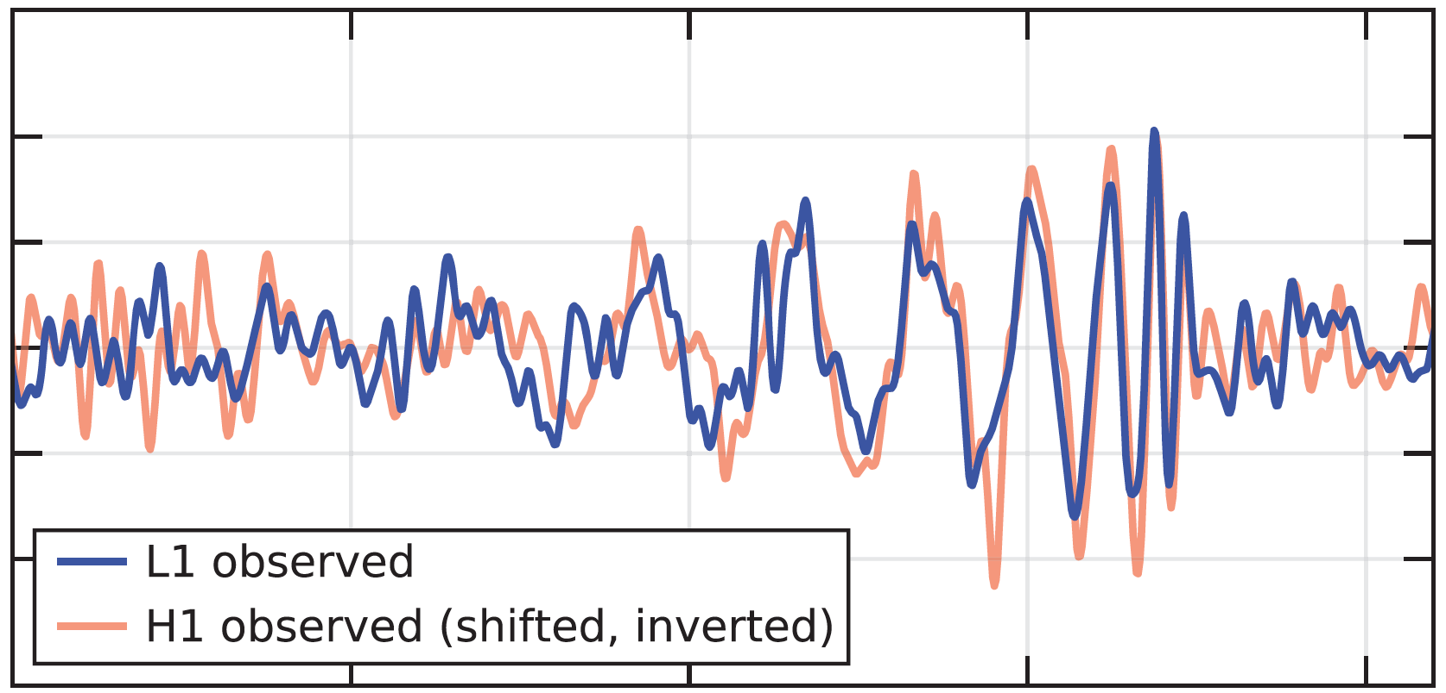
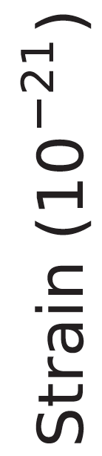
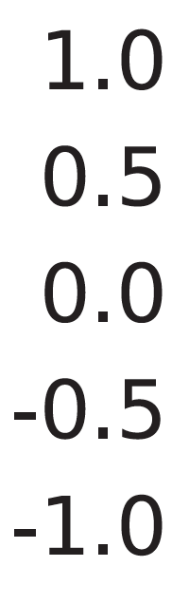
The first signal
On September 14, 2015 at 09:50:45 UTC the two detectors of the
Laser Interferometer Gravitational-Wave Observatory
observed a transient gravitational-wave signal
← 1/10 second →

Slide 20
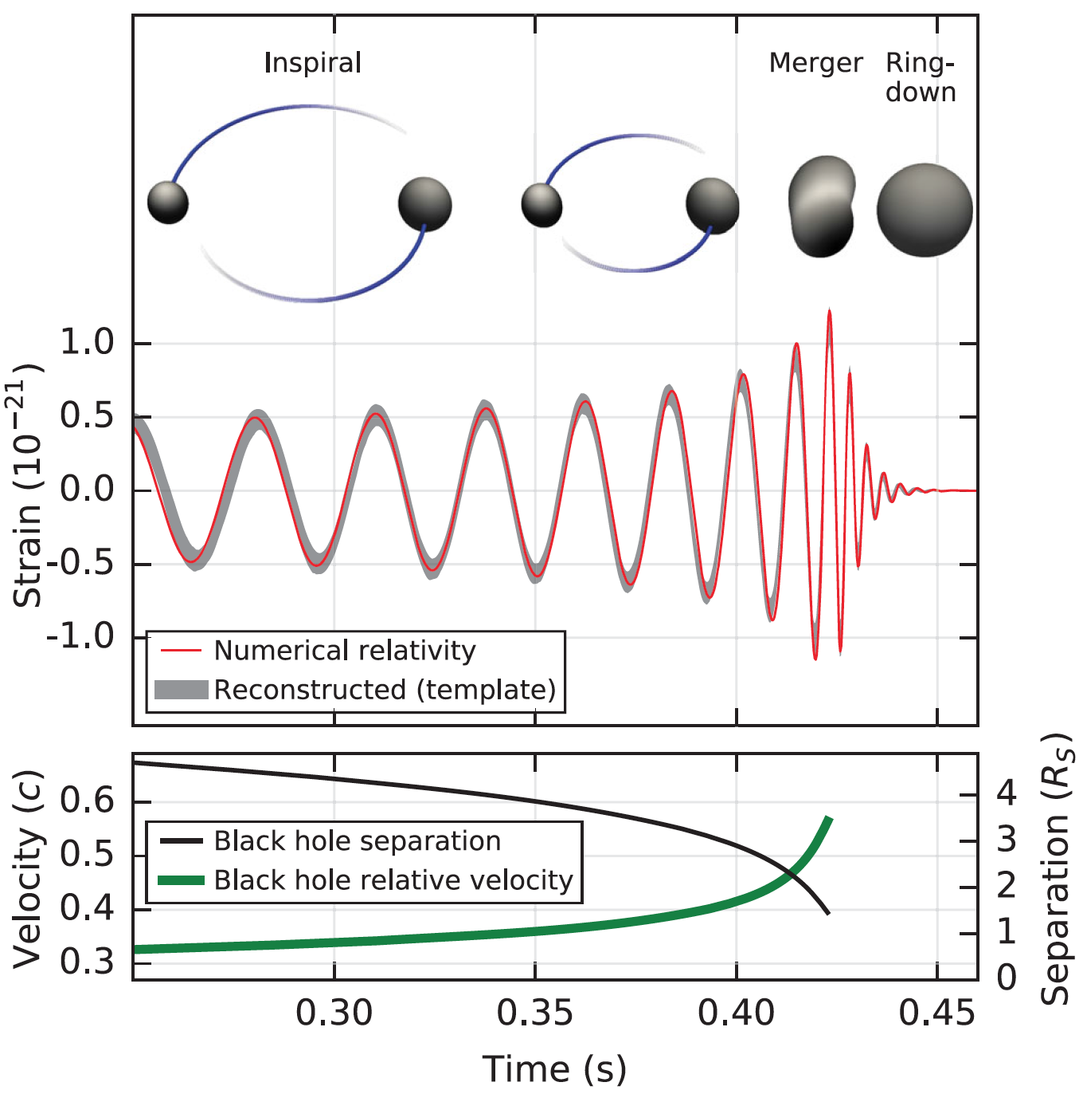
We measure h(t) – think ‘strip chart recorder’
The output of the detector is the (signed) strain as a function of time
Earlier measurements of the pulsar period decay (Taylor/Hulse/Weisberg) measured energy loss from the binary system – a beautiful experiment
  radiation of gravitational waves confirmed to remarkable
  precision for 0pn
LIGO can actually measure the change in distance between our own test masses, due to a passing
space-time ripple
  More ‘direct’ (in some sense)
  Much richer information!

Slide 21
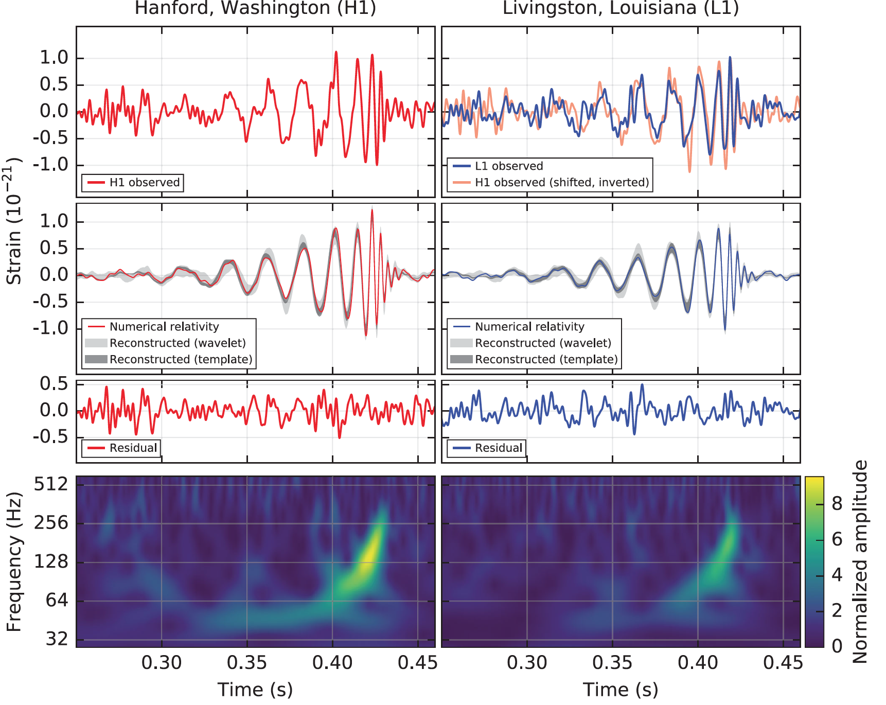
Time trace from Hanford, high- and low-pass filtered to make signal more evident. Signal in-band for ~0.2 secs. Amplitude ~1x10⁻²¹

Slide 22
Time trace from Hanford and Livingston; Hanford inverted (observatory orientation is 180),
and shifted by 7.1 msec
(the observatories are separated by 10 msec time of flight). Source is in an annulus in the Southern hemisphere.

Slide 23
Best fit waveform, assuming Einstein’s GR, using numerical relativity calculations, and putting in the same high/low pass filtering (so no long sinusoidal precursor). Same fit matches both observatories.

Slide 24
Real time-series data,
minus best fit GR waveform:
Shows only noise in residual.
Absolutely astonishing.

Slide 25
Spectrogram of high/low pass filtered data shows characteristic ‘chirp’ form.

Slide 26
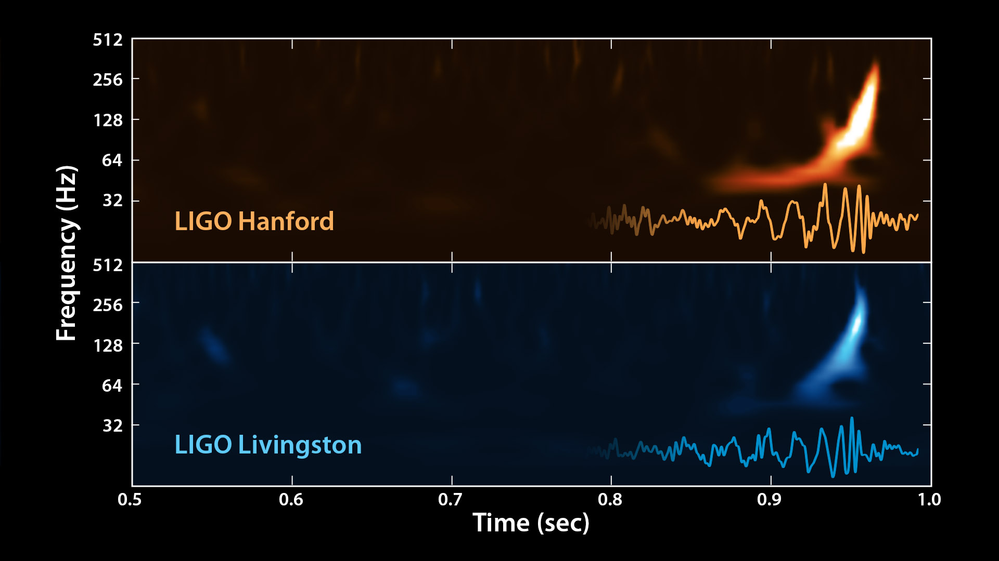

Slide 27
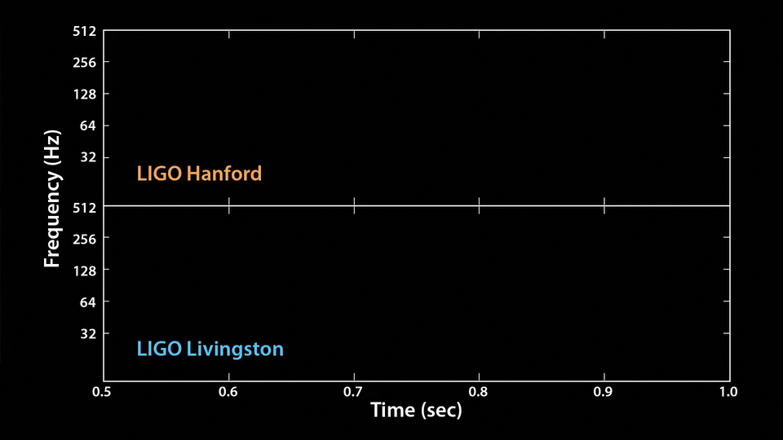

Slide 29
One event…was it real?

Slide 30
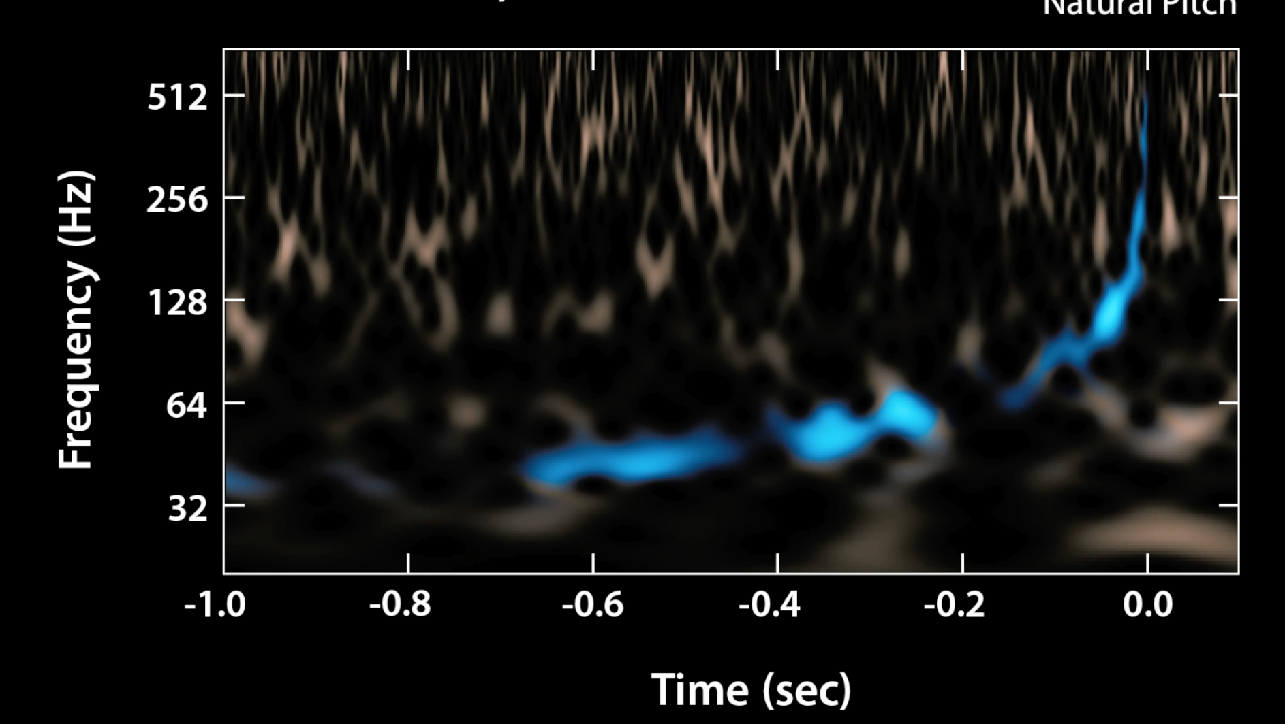
Our second signal, 26 December 2015 – the SNR we thought we would be working with

Slide 31
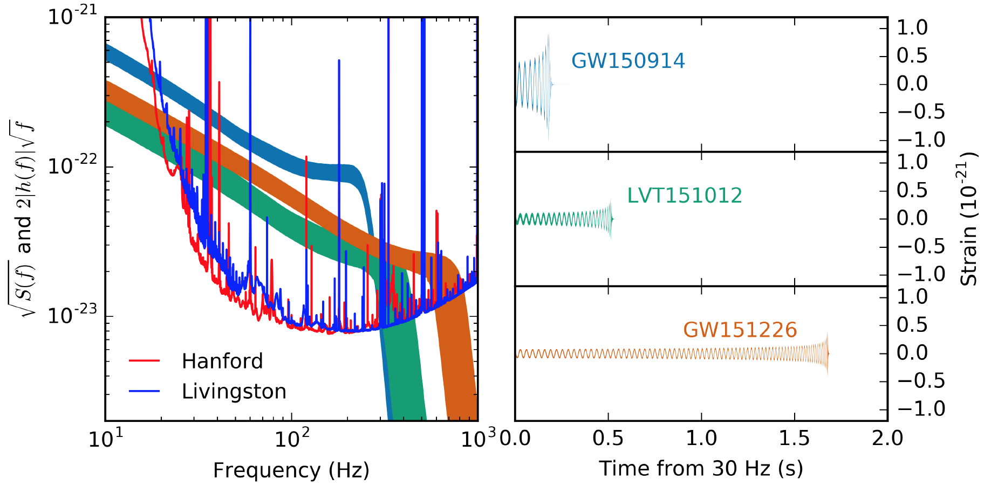
Our 2+1 signals to date

Slide 32
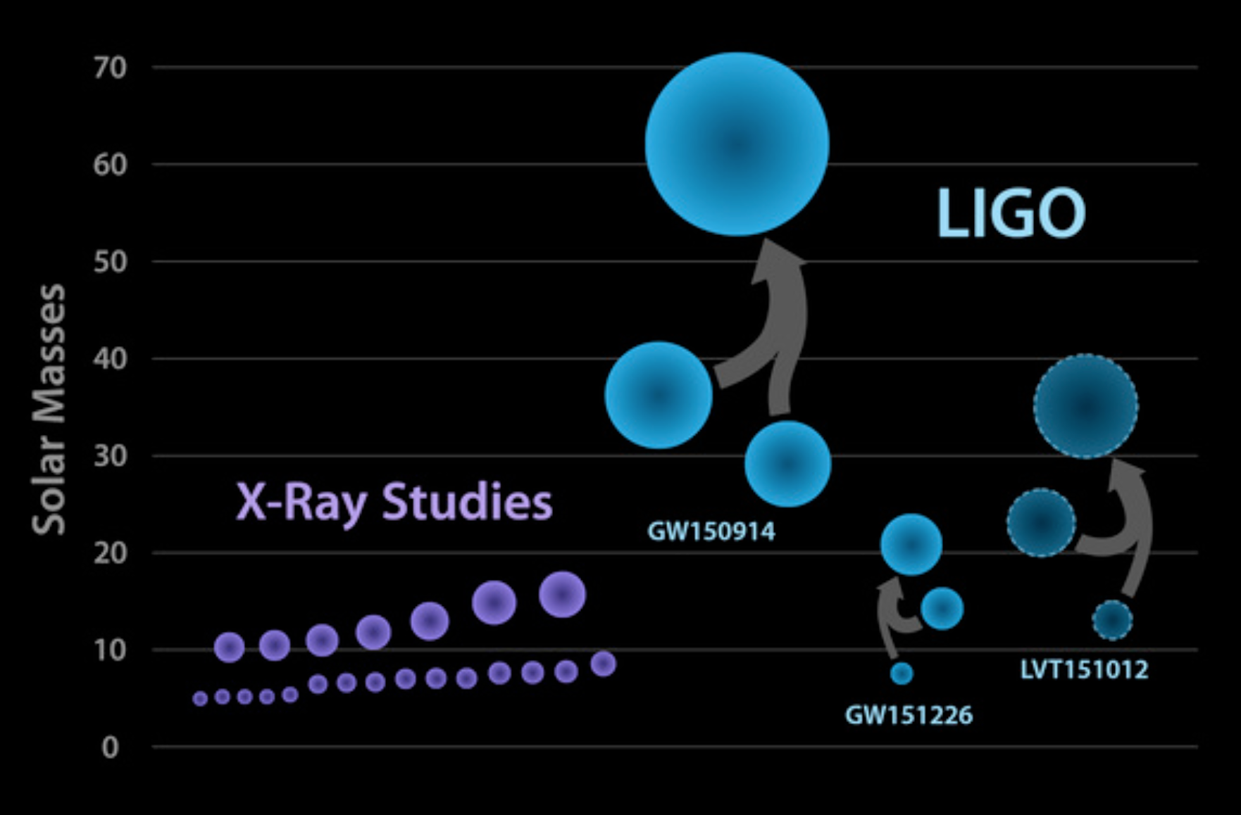
Black holes seen to date

Slide 33
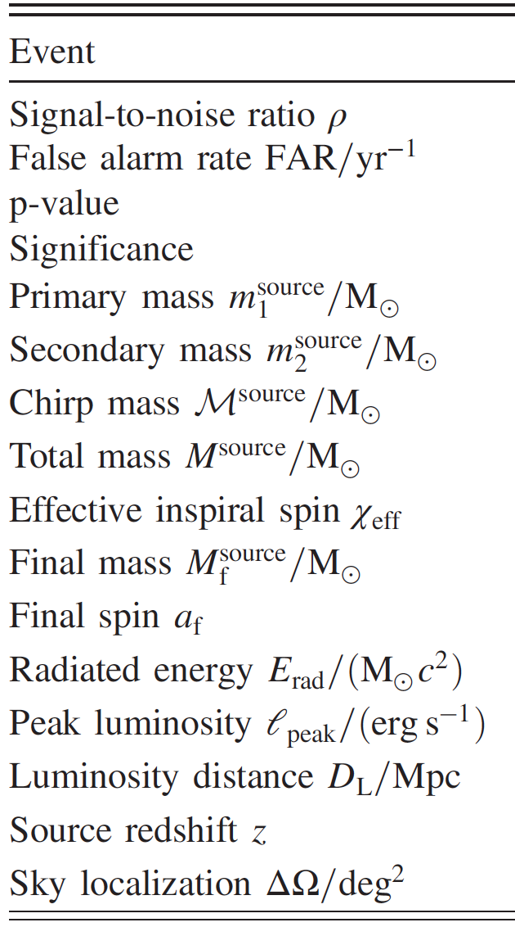
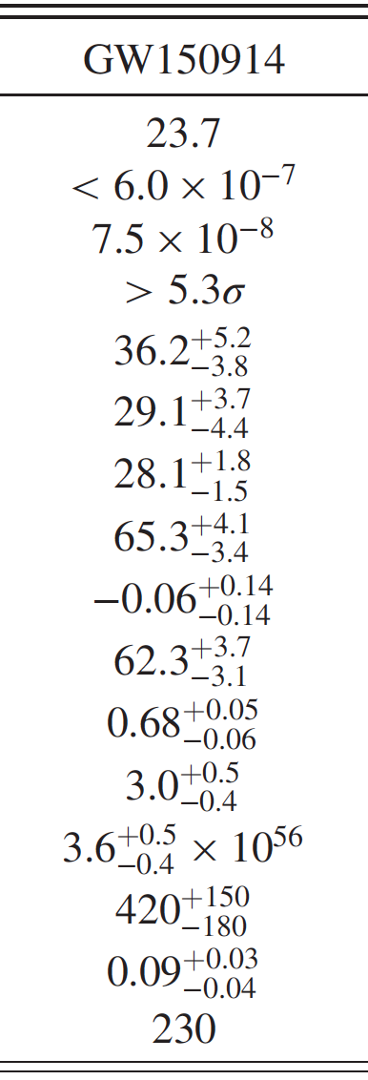
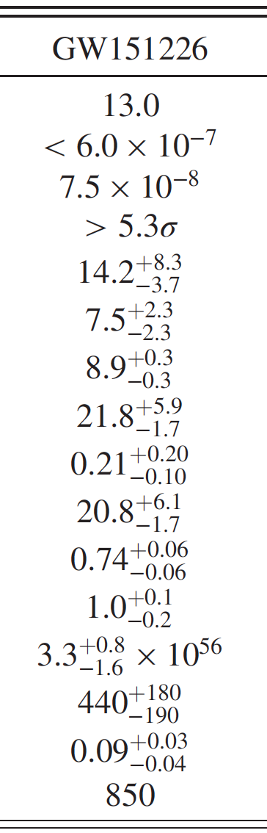
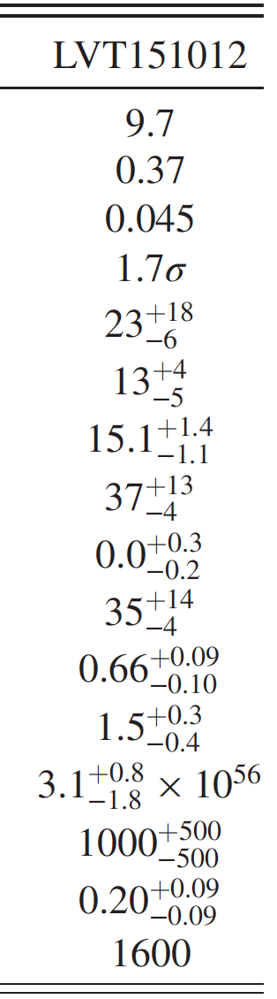
Gravitational-wave astrophysics

Slide 34
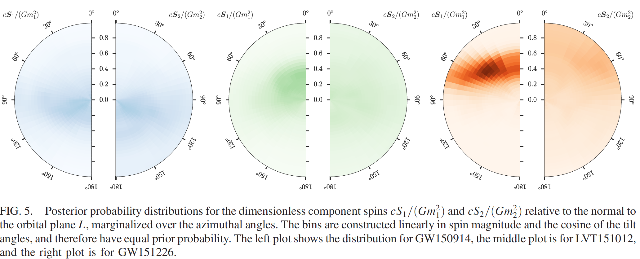
Spins of component BH
Would like to make inferences about origins based on spin
For all but one, no statistical deviation from zero spin (face-on, so not a good measure
For one component of GW151226, spin of 0.2 – so probably not the result of a merger (→ primordial BH?)

Slide 35


The advanced GW detector network
Advanced
Virgo
2016
Advanced
LIGO
Hanford,
Livingston
2015
KAGRA
2018
LIGO-India
2022
35
35

Slide 36
What does the future hold?

Slide 37
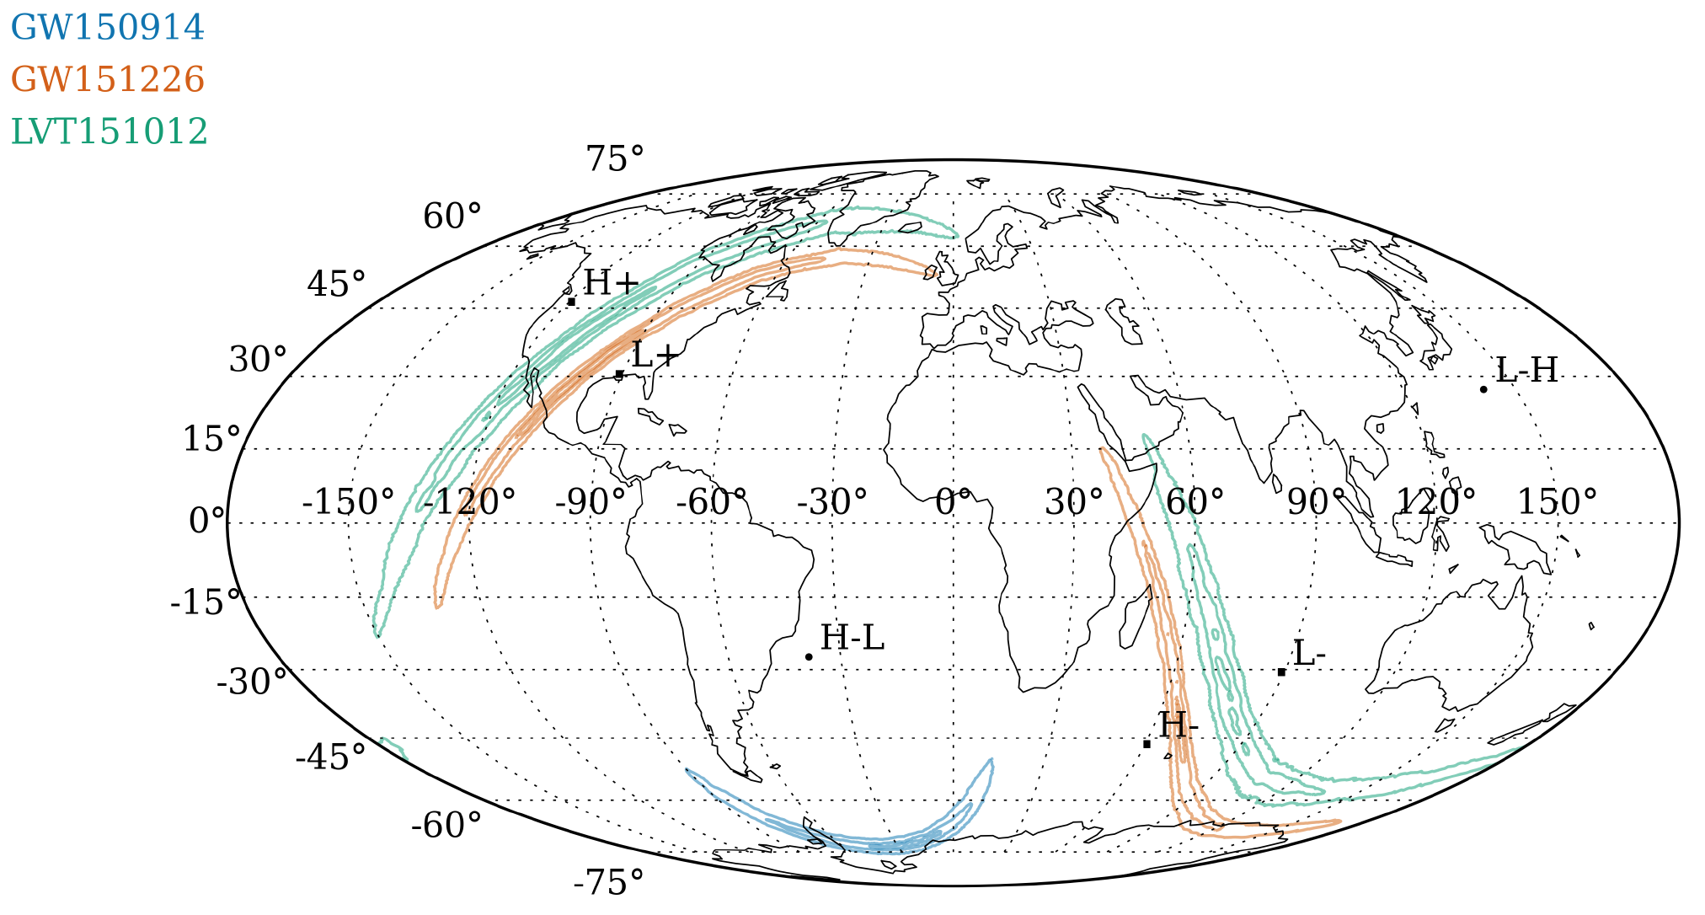
First Detection Sensitivity/configuration:
2 detectors, 1/3 goal sensitivity
~3 signals in 4 months of observation
37
Notes:
P0900125-v8

Slide 38
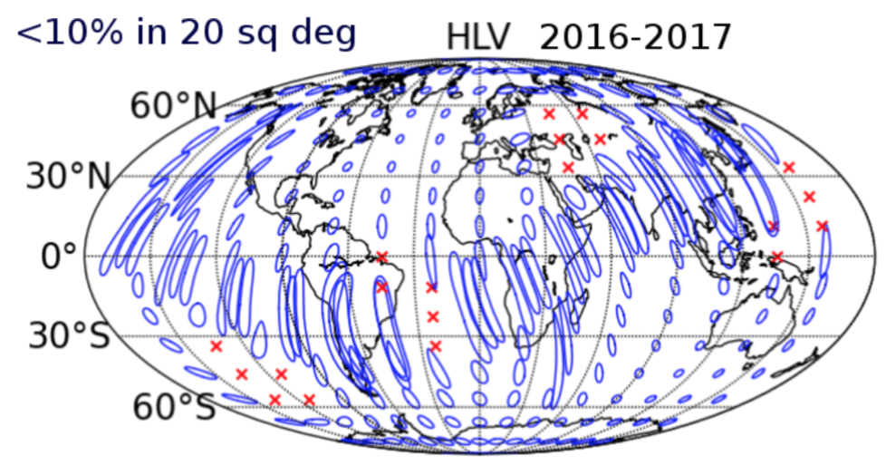
2017 Sensitivity/configuration:
3 detectors (add Virgo), ~1/2 goal sensitivity
~2-3 signals per month of observation
Notes:
P0900125-v8

Slide 39
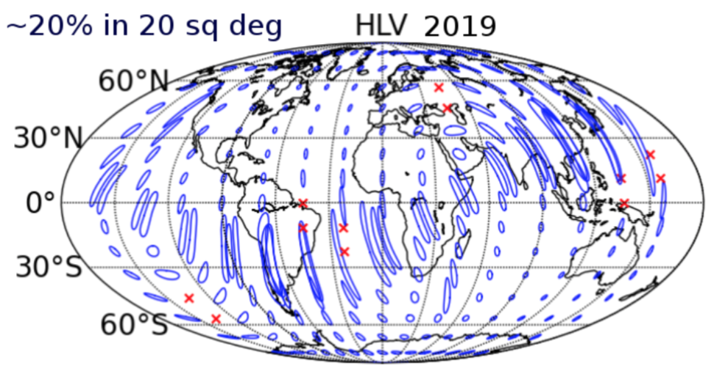
2018-19 Sensitivity/configuration:
3 detectors, full goal sensitivity
~1 signal per day
Notes:
P0900125-v8

Slide 40
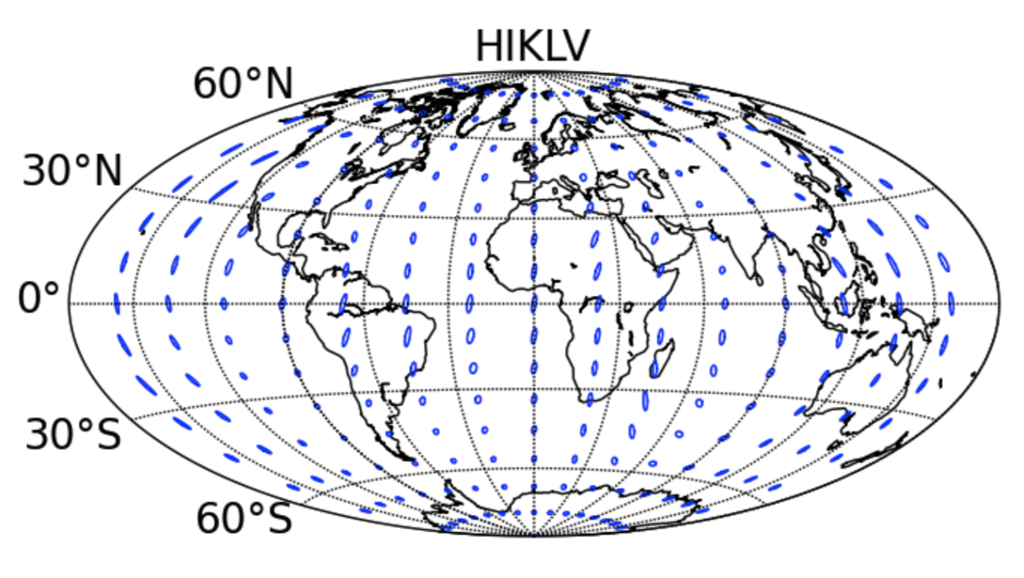
2022 Sensitivity/configuration:
5 detectors (add India and Japan)
far improved source localization
~60% in 10 sq deg
2022
Notes:
P0900125-v8

Slide 41
aLIGO operating at full power
ZUCKER

Slide 42
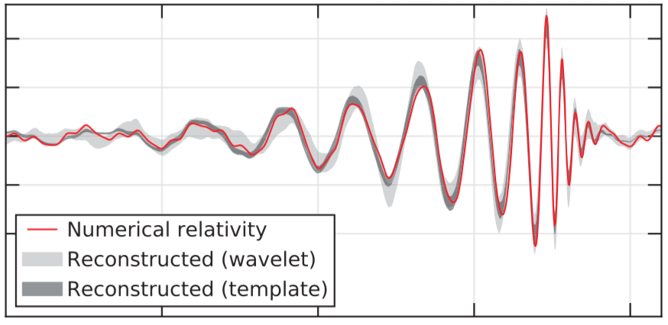
aLIGO with the addition of frequency-dependent squeezing and lowered optical coating thermal noise
A+
BNS reach: 510 Mpc
BBH reach: 3700 Mpc
(z = 1.1)
QNM SNR ~35
(for an event like GW150914)
ZUCKER

Slide 43
A+
An incremental upgrade to aLIGO
leverages existing technology and infrastructure, with
  minimal new investment,
  moderate risk, and
  modest interruption in observing
Target: factor of 1.7* increase in range over aLIGO
About a factor of 5 greater event rate
Stepping stone to future 3G detector technologies
Link to future GW astrophysics and cosmology
Could be observing within < 6.5 years (mid-2022)
  (with FY’19 or earlier funding)
“Scientific breakeven” within 1/2 year of operation
Incremental cost: a small fraction of aLIGO
  Formulating proposal to NSF now
*BBH 20/20 M: 1.64x
*BNS 1.4/1.4 M: 1.85x
ZUCKER

Slide 44
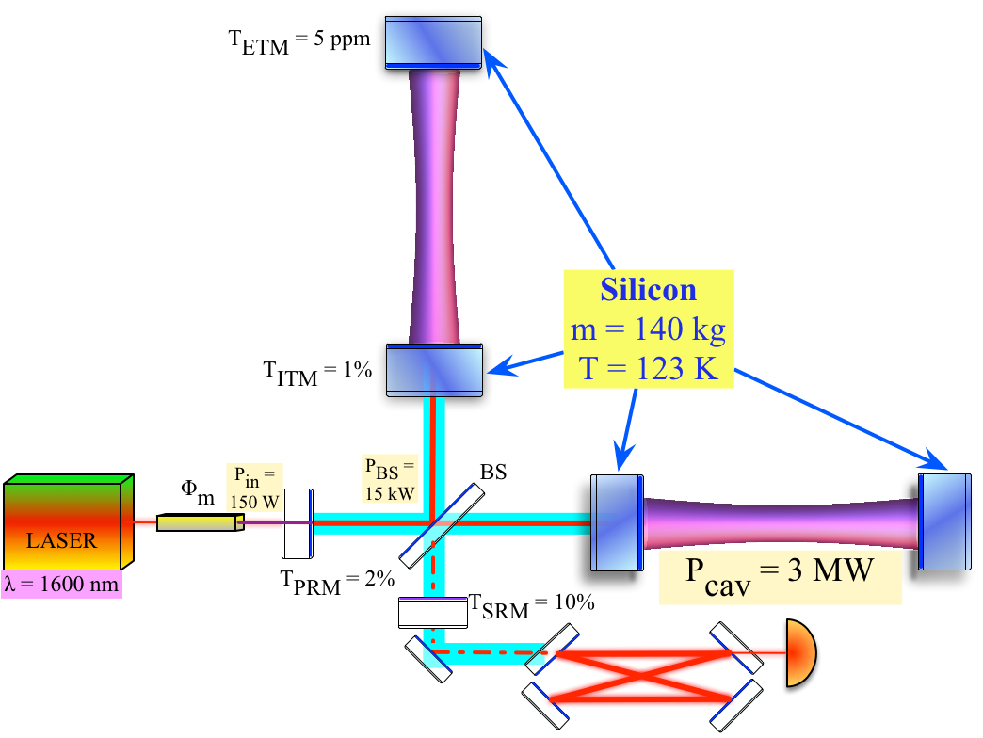
LIGO Voyager: exploit existing facilities
Si optics, > 100 kg
Si or AlGaAs coatings
‘mildly’ Cryogenic
λ~2 µm, 300 W
BNS Range = 740 Mpc
aLIGO
Voyager
BNS R < 800 Mpc
BBH z < 5 (@10 M)
QNM SNR ~80
~$ ½ aLIGO
Refs: https://dcc.ligo.org/LIGO-T1400226, https://dcc.ligo.org/LIGO-T1200031, https://dcc.ligo.org/LIGO-T1200099
ZUCKER

Slide 45
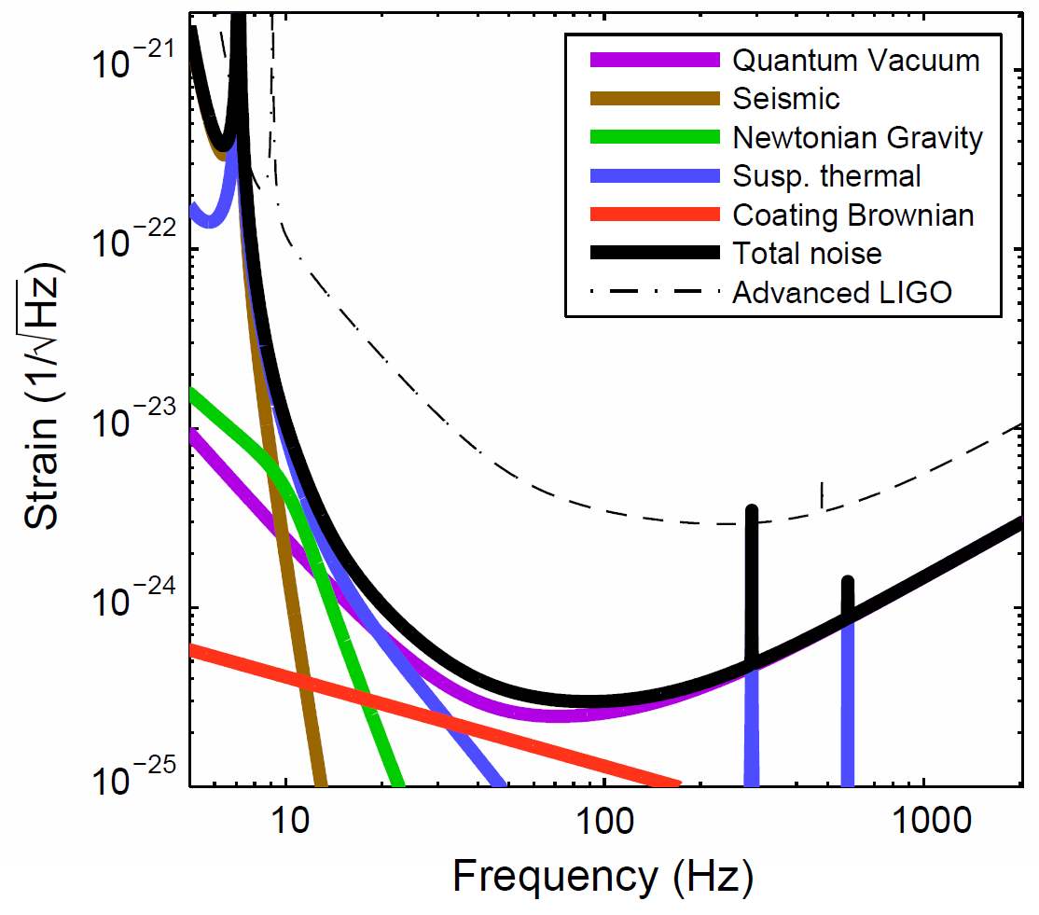
US Concept:
Make Advanced LIGO 10x longer,
10x more sensitive
Signal grows with length – not most noise sources
Thermal noise, radiation pressure, seismic, Newtonian unchanged
Coating thermal noise improves faster than linearly with length
40km surface Observatory ‘toy’ baseline
  can still find sites, earthmoving feasible; costs another limit…
Concept offers sensitivity without new measurement challenges; could start at room temperature, modest laser power, etc.
 | Adv. LIGO | 40 km LIGO
Arm length | 4 km | 40 km
Beam radius | 6.2 cm | 11.6 cm
Measured squeezing | none | 5 dB
Filter cavity length | none | 1 km
Suspension length | 0.6 m | 1 m
Signal recycling mirror trans. | 20% | 10%
Arm cavity circulating power | 775 kW
Arm cavity finesse | 446
Total light storage time | 200 ms | 2 s
Sigg et. al

Slide 46
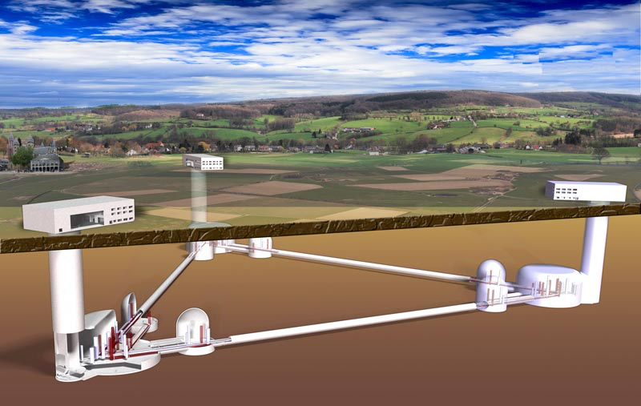
Further Future Improvements: The 3rd generation
European Concept: Einstein Telescope
Significant design study undertaken for both Facility and Instruments
Underground construction proposed to reduce Newtonian Background
  (and be compatible with densely-populated Europe)
Triangle – LISA-like –
with 10km arms
Multiple instruments in a
‘Xylophone’ configuration
  Allows technical challenges
  for low- and high-frequency
  to be separated
Designed to accommodate a
range of detector topologies and
mechanical realizations
  Including squeezing and
  cryogenics

Slide 47

Einstein Telescope, Cosmic Explorer
‘Green field’ multi-generation Observatories ~G$/G€
SNR in QNM ~600
CE
BNS
NSBH
BBH
POP3?
John Miller, T1500491;
P1400147; ET-0106C-10
Sigg et. al

Slide 48
3rd Generation
When could this new wave of ground instruments come into play?
Appears 15 years from t=0 is a feasible baseline
  Initial LIGO: 1989 proposal, and at design sensitivity 2005
  Advanced LIGO: 1999 White Paper, GW150914 in 2015
Modulo funding, could envision…
  Einstein Telescope in the early 2030’s
  Cosmic Explorer in the mid-2030s
Should hope – and strive and plan – to have great instruments ready to ‘catch’ the end phase of binaries seen in LISA (ref. Sesana)
Crucial for all these endeavors: to grow the scientific community planning on exploiting these instruments far beyond the GR/GW enclave
  Costs are like TMT – needs a comparable audience

Slide 49

...and a detector in Space: LISA
Once you are there, vacuum is inexpensive – make very long arms
  Very high signal-to-noise – precision tests of gravitation
Can observe much larger masses
  Galaxies with black holes of a million solar masses coalescing
Analogous to adding Radio Astronomy to Optical Astronomy
AEI Max Planck

Slide 50

LISA
Notion of a space-based interferometric
detector dates from 1974
  Rai Weiss and Peter Bender
Basically a timing measurement
between test masses in space
Take advantage of vacuum in space: make very long arms
  h = ΔL/L ; L can be ~10⁹ m, making ΔL ~10⁻¹² m (not LIGO’s 10⁻¹⁹)
  Also moves best sensitivity to milliHz
  region – explores much more massive
  objects
Triangular configuration
Sums and differences around the triangle
  Allows both polarizations of the
  gravitational waves to be measured
  Provides signals to remove laser
  frequency noise
Earth-trailing orbit provides scan of the sky,
provides sky localization

Slide 51

LISA Pathfinder test mission, now underway: interferometry between two LISA test masses

Slide 52

LISA Sensitivity, with current Pathfinder Performance
A. Petiteau 2016

Slide 53

LISA
ESA-led mission; NASA
minority partner
ESA-NASA discussions
on program elements
EU-US community
(re-)forming joint
collaboration
Phase A imminent;
mission adoption possible
in 2020
Launch date nominally
2034; may bring in to ~2030
…and then great science:
Blue: Simulated signal for inspiral of two 5x10⁵ Black Holes inspiraling at z=5
Red: LISA Pathfinder interferometer performance

Slide 54



Notes:
So, that is my story of a cosmic cataclysmic rendez-vous: from 1.3 billion years ago with black holes coalescing in space when life was just forming on Earth, through the medium our favorite scientist Einstein – who looks in this photo as though he knew exactly how this was going to play out-- , and to a magic moment on September 14th 2015 when all the parts fell together to make this once-in-a-lifetime discovery possible.

