Slide 1
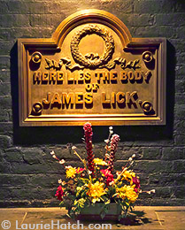

Slide 2
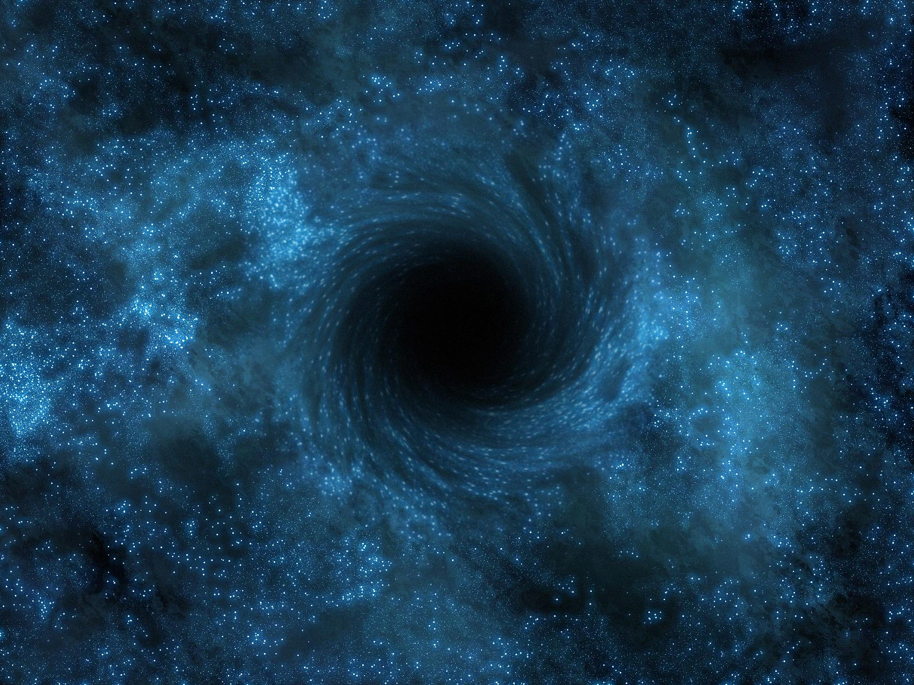

Slide 3
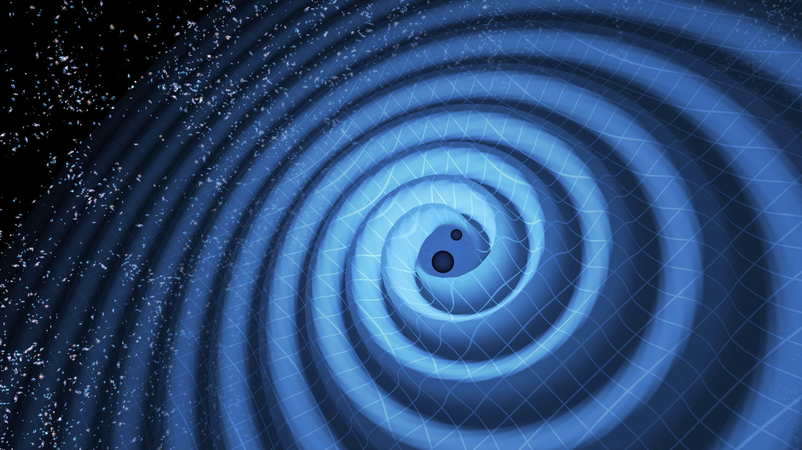

Slide 4
European Space Agency

Slide 5
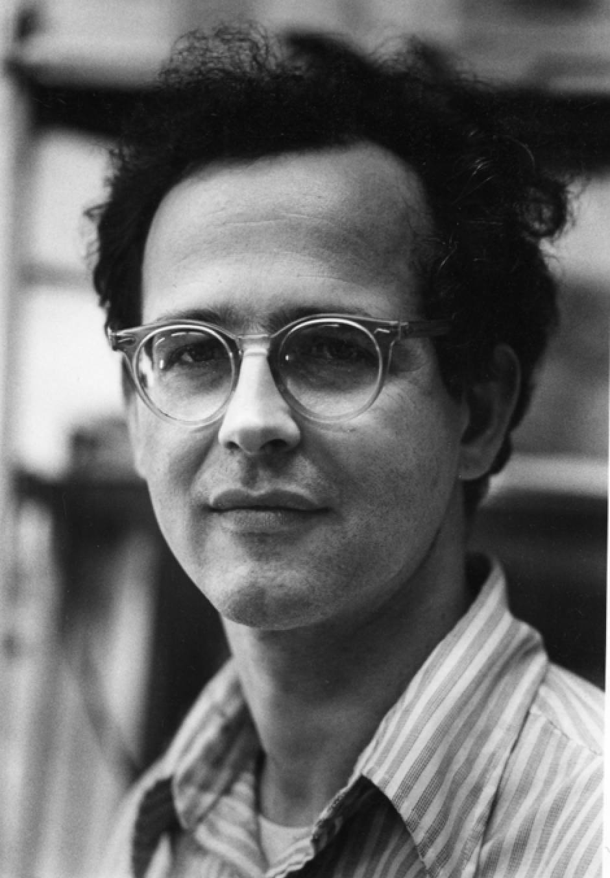
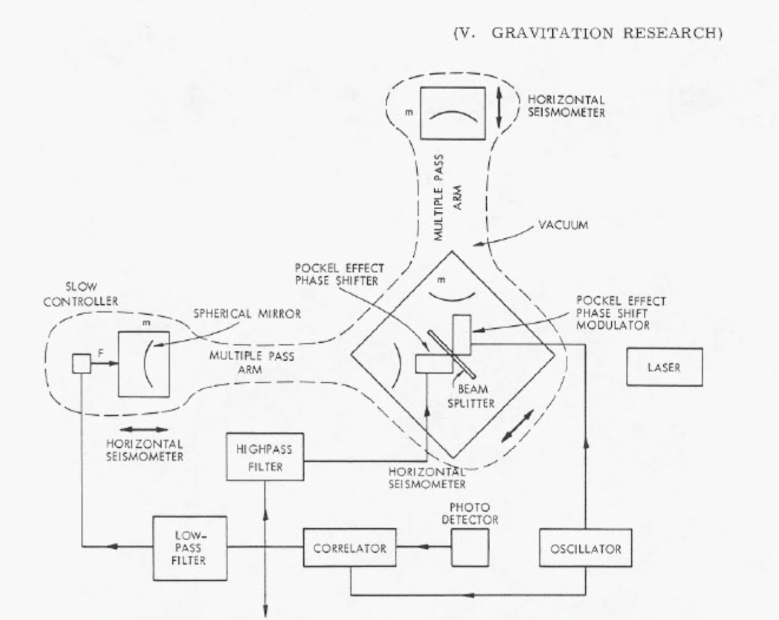
Rai Weiss, circa 1967

Slide 6
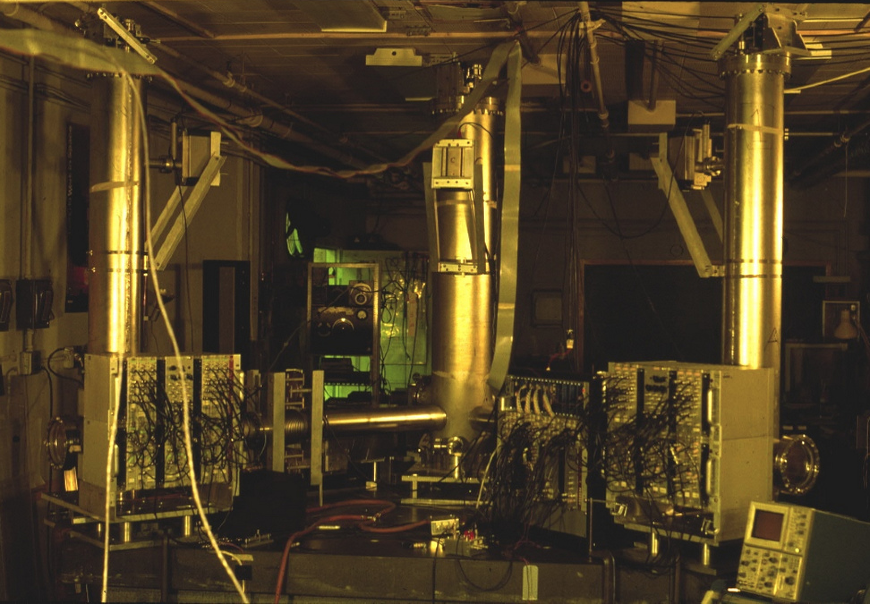
Laser Interferometer Test Rig

Slide 7
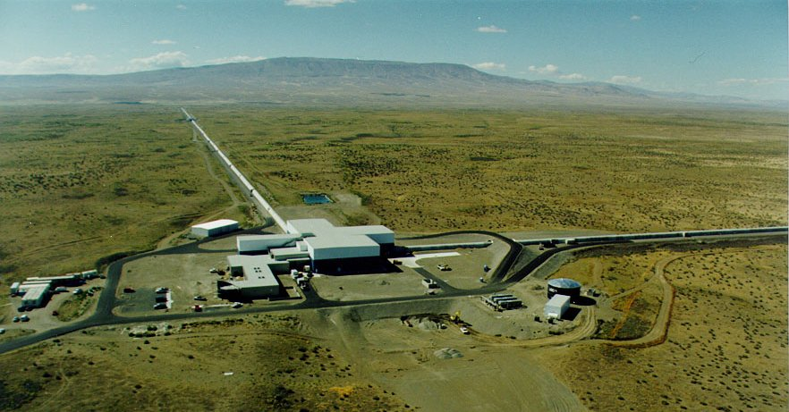
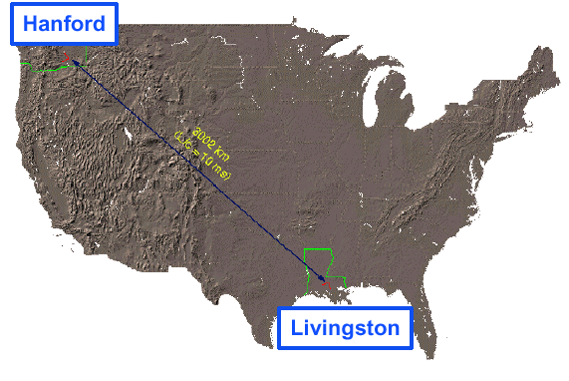
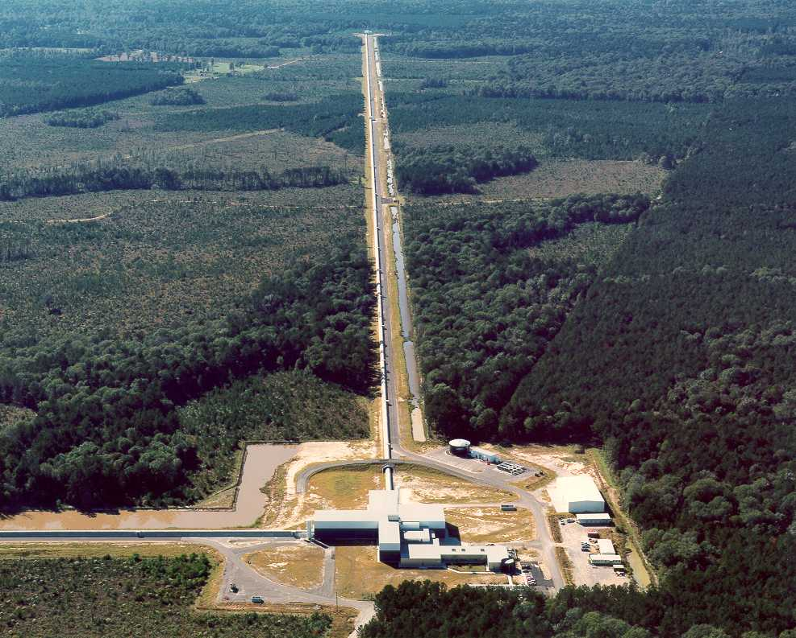
LIGO Laboratory: two Observatories
LIGO Livingston

Slide 10
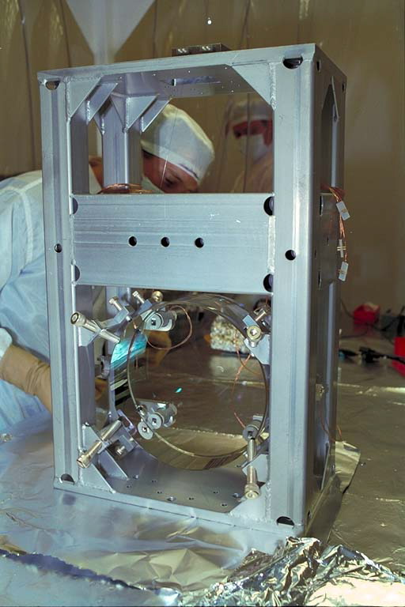
Old LIGO…
Advanced LIGO !

Slide 11
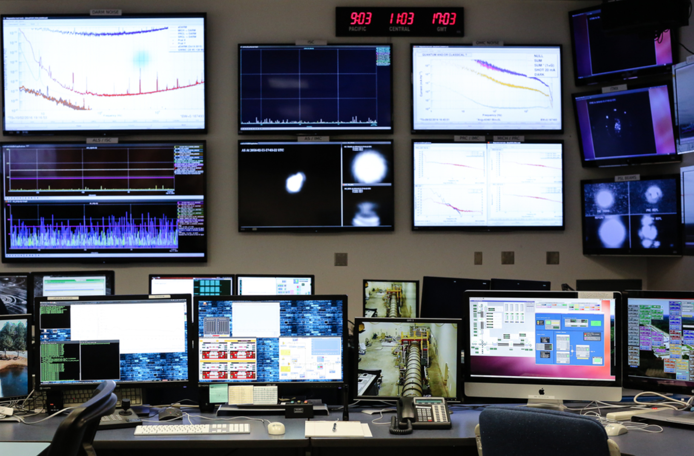
LIGO Control Room

Slide 12
September 14, 2015 at 04:51 CDT:

Slide 13
Notes:
.

Slide 15
L I S A

