Slide 1
P-Cal Periscope Shields Concept
LIGO-D1600453-v5

Slide 2
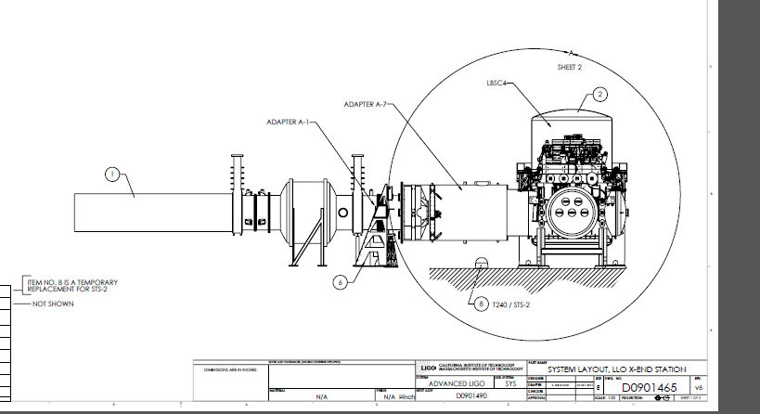
P-Cal Periscope in end station (X end shown)
Refer to aLIGO Systems Layout LLO X-End Station (OR EQUIV) https://dcc.ligo.org/LIGO-D0901465 if more detail required.

Slide 3
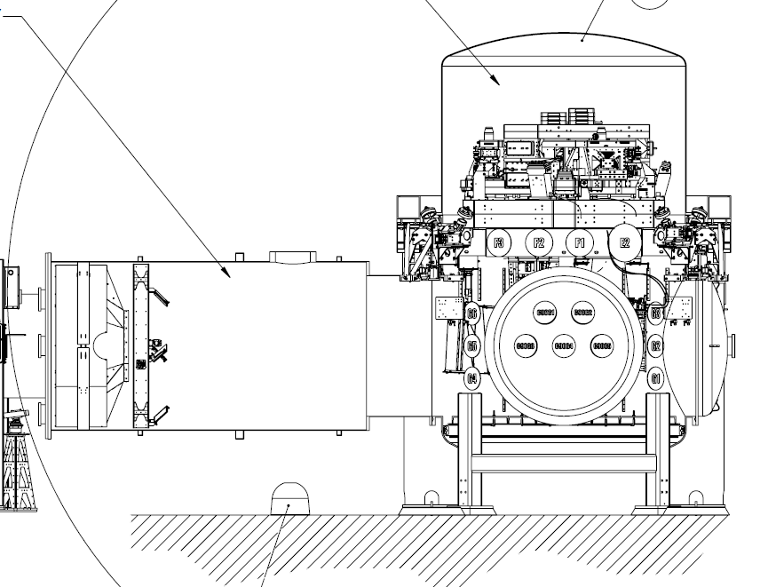
Manifold Cryopump baffle
P-Cal Mirrors
ACB
P-Cal Periscope
ETM
Refer to aLIGO Systems Layout LLO X-End Station (OR EQUIV) https://dcc.ligo.org/LIGO-D0901465 if more detail required.

Slide 4
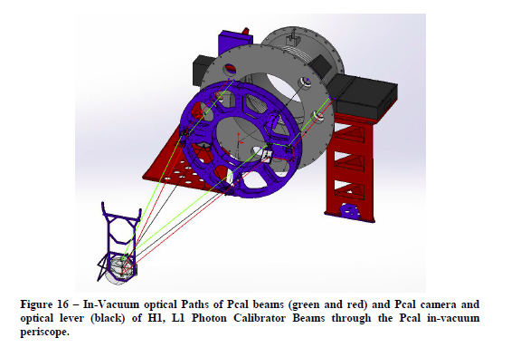
Laser beam (optical path): Also refer to the optical layout in figure 16, page 19 of PCal final design doc: https://dcc.ligo.org/DocDB/0032/T1100068/023/PhotonCalibratorFinalDesign.pdf.

Slide 5
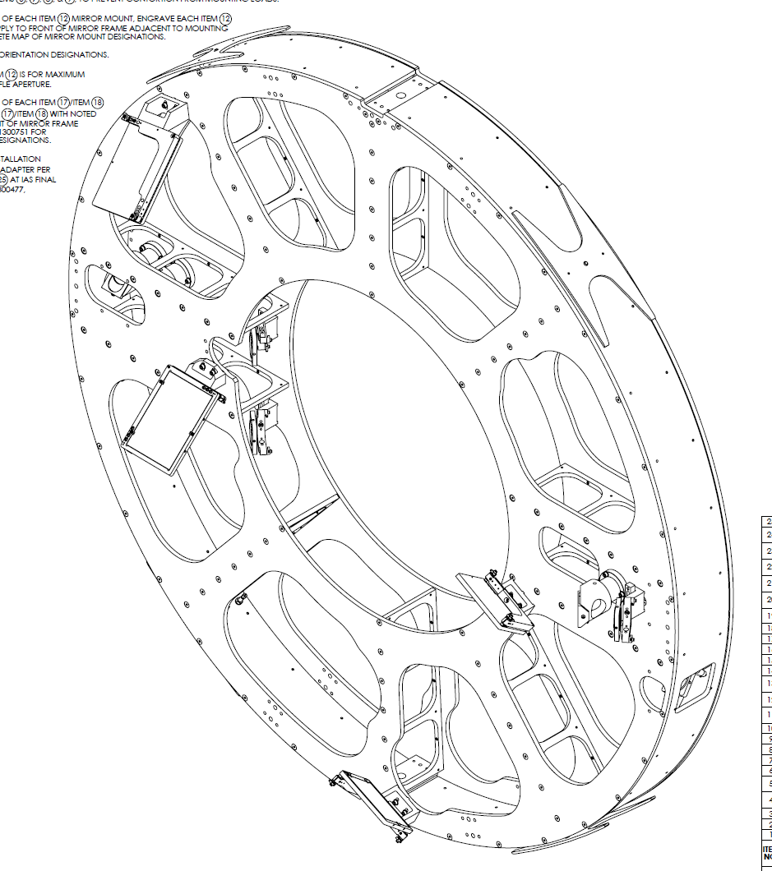
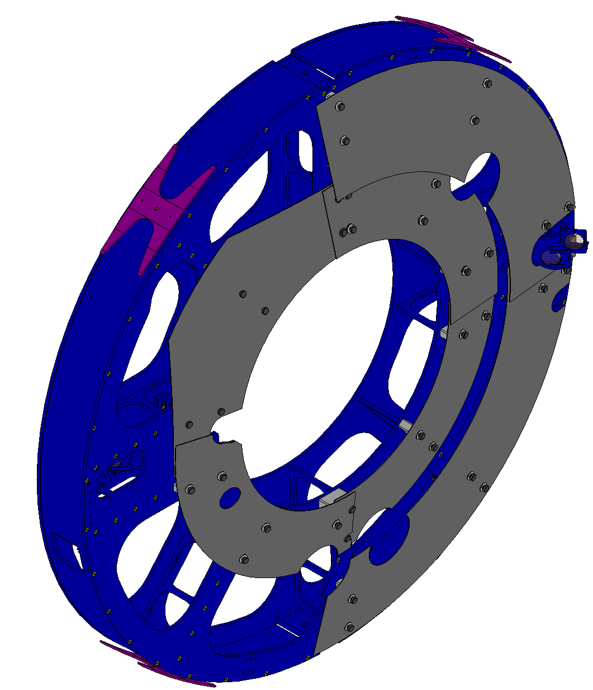
PROPOSED BAFFLES FOR PCAL Periscope:
Modified with SLC Shields (Weight: 250.00 lbs Approx.)
As built (Weight: 222 lbs)
REMOVED PCAL MIRROR MOUNTS ASSY.
4 PL.

Slide 6
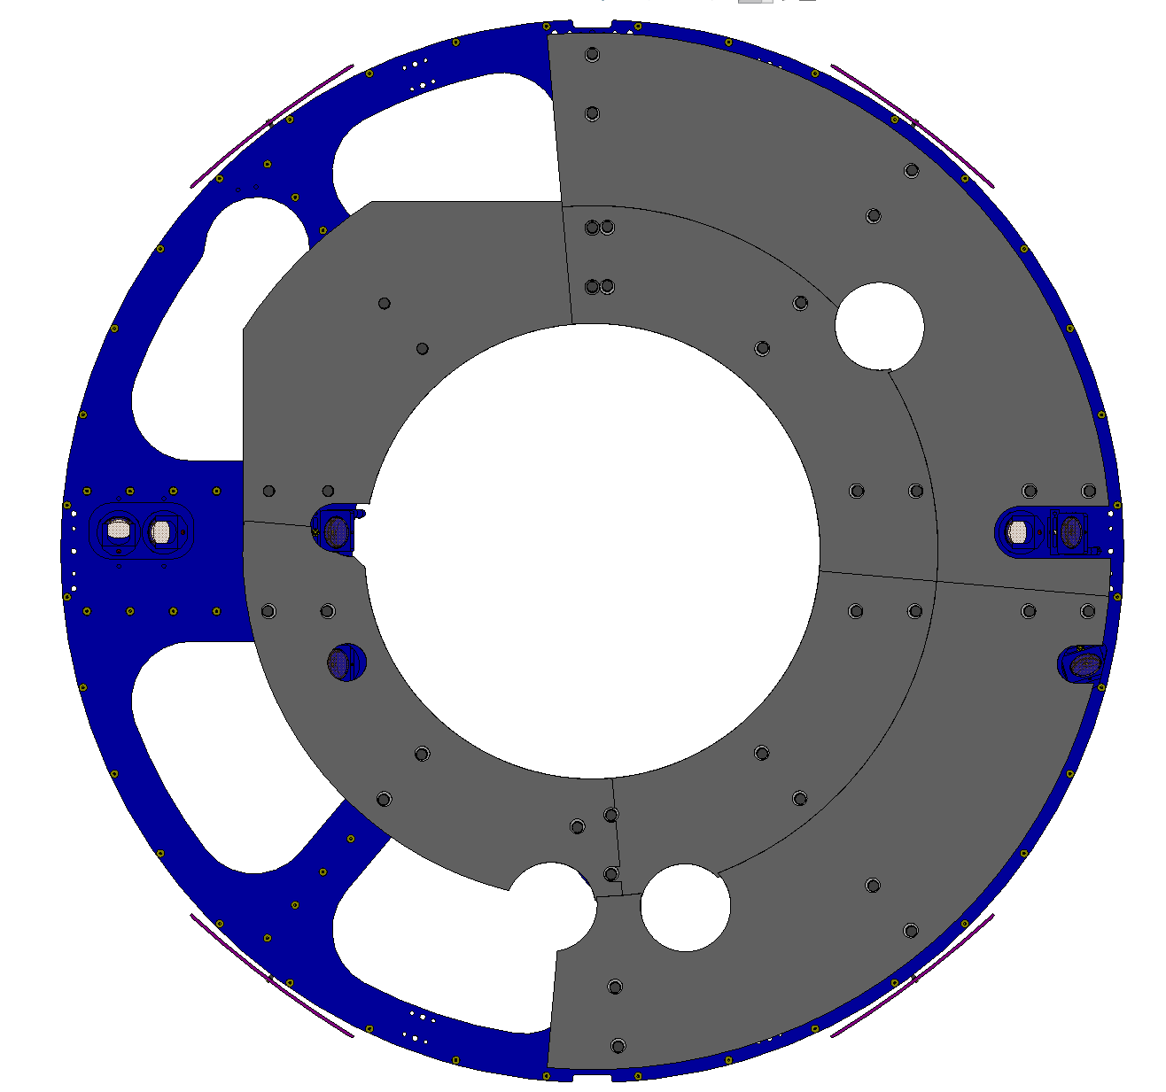
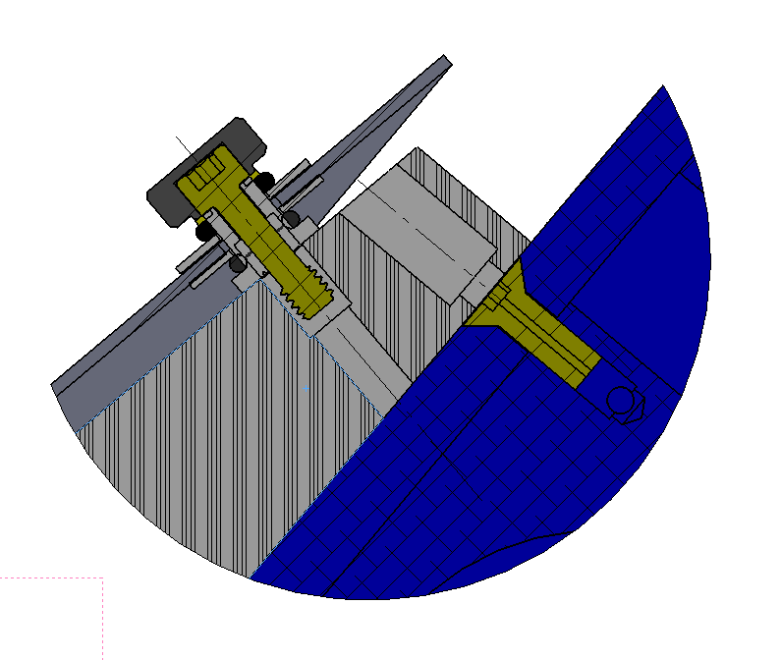
PROPOSED BAFFLES FOR PCAL Periscope:
Outer shields O.D =69.0 in
Qty. 2
SHIELDS PROTRUDE
3 3/16 in
.075 SUPER #8 304 SSTL
Inner shields O.D =46.0 in
Qty. 4
LIGO D1500105-7 (NEW CONFIG.)
QTY. 2 PER WEDGE
QTY. 6 PER PANEL
QTY. 36 TOTAL
A
Radial Clearance
=1.75 in
A
30.31 ID.
(770mm)
10 Deg.
Typ.
EXISTING FLAT HEAD SCREWS
WILL BE REPLACED WITH
1/4-20 SHC SCREWS
QTY/ 3 PER WEDGE
OVERLAPPING PANELS
FOR COMPLETE COVERAGE
SHIELDS ATTACH TO PCAL PERISCOPE
VIA WEDGE
SUPPLIED WITH 1/4-20 HELICOIL TAPPED HOLES
QTY. 16 TOTAL
(10 USED FOR INNER PANELS)
FRONT VIEW
SECTION A-A
(PARTIAL VIEW)

Slide 7
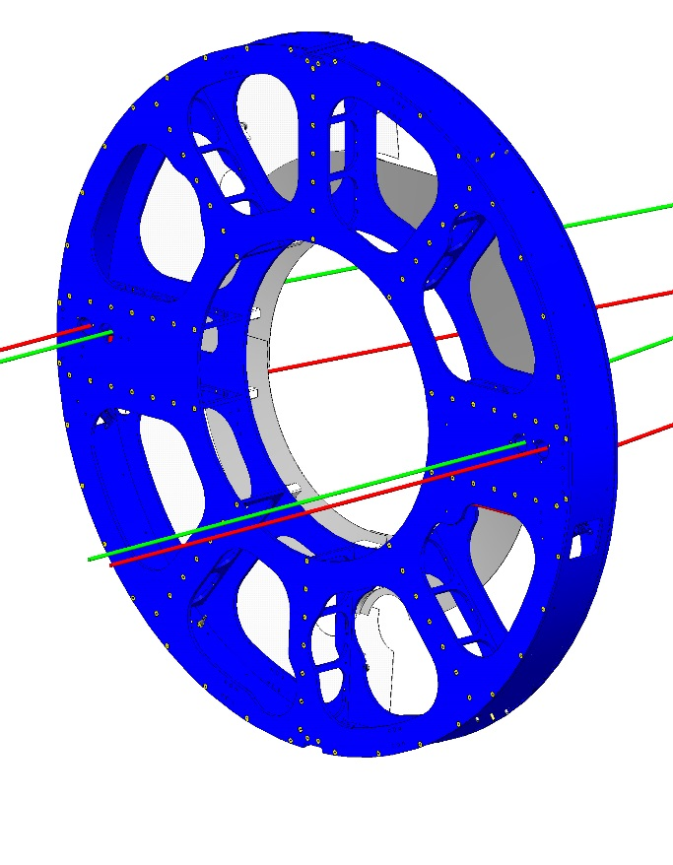
PROPOSED BAFFLES FOR PCAL Periscope:
PCAL BEAMS:
INPUT/OUTPUT BEAMS POSITIONED
AS PER LIGO T1100068
PCAL PERISCOPE, ISO VIEW
(FRONT SIDE)
PCAL PERISCOPE, ISO VIEW
(BACK SIDE)

Slide 8
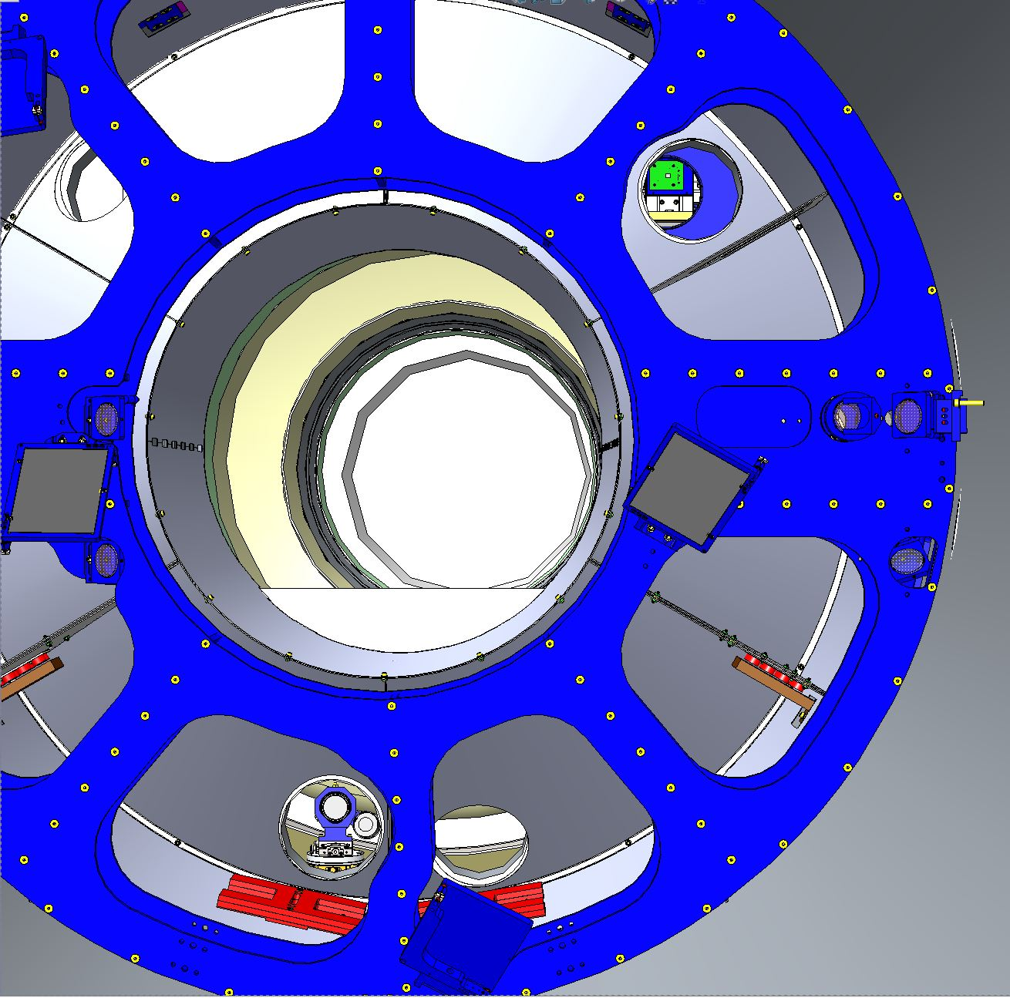
PROPOSED BAFFLES FOR PCAL Periscope:
As built
CAD image extracted from Solidworks of PCAL Periscope as viewed from a camera centered and perpendicular to the HR of ETMy face for a ± 11 deg field of regard (22 full Angle)
Refer to LIGO G1602132

Slide 9
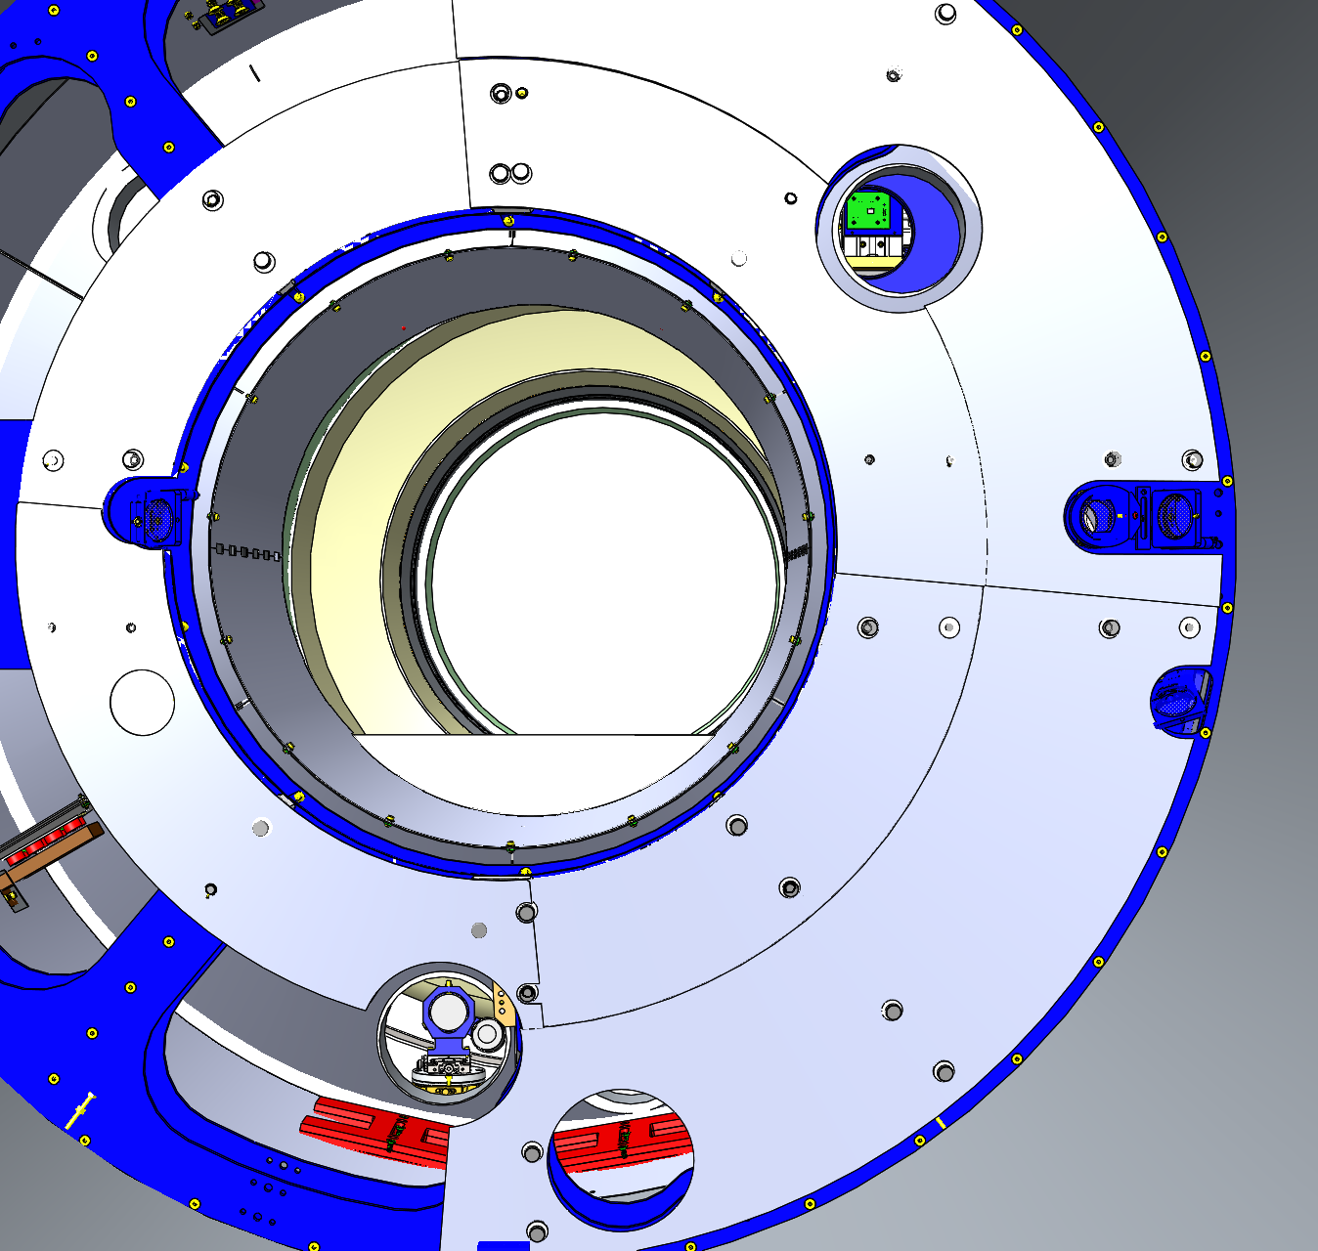
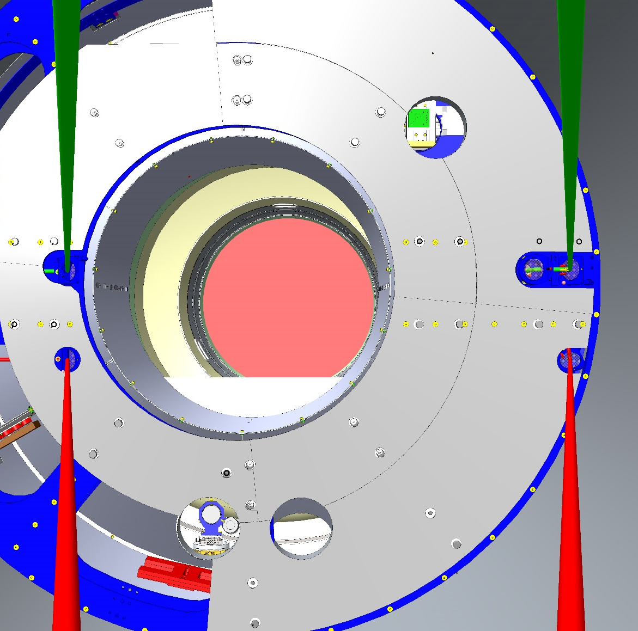
PROPOSED BAFFLES FOR PCAL Periscope:
WAS:
With PCAL shields
IS:
With PCAL shields
CAD image extracted from Solidworks of PCAL Periscope as viewed from a camera centered and perpendicular to the HR of ETMy face for a ± 11 deg field of regard (22 full Angle)
CAD image extracted from Solidworks of PCAL Periscope as viewed from a camera centered and perpendicular to the HR of ETMy face for a ± 11 deg field of regard (22 full Angle)

Slide 10
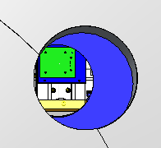
PROPOSED BAFFLES FOR PCAL Periscope:
With PCAL shields
Aperture Size= 2.5in
RCVR PYLON
(oplev enclosure)
OPLEV
CAD image extracted from Solidworks of PCAL Periscope as viewed from a camera centered and perpendicular to the HR of ETMy face for a ± 11 deg field of regard (22 full Angle)
VP4

