Slide 1
Exploring the New Frontier of Gravitational-Wave Astronomy
Fred Raab, for the LIGO Scientific Collaboration and the Virgo Collaboration
TWAS2016
16 Nov 2016
Fred Raab, for the LIGO Scientific Collaboration and the Virgo Collaboration

Slide 2
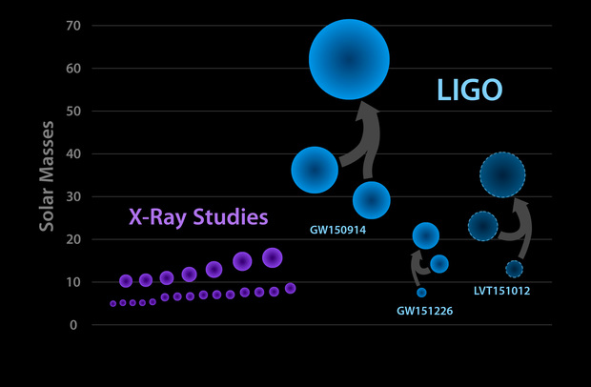
Known Stellar-Mass Black Holes – June 2016
Courtesy Caltech/MIT/LIGO Laboratory

Slide 3
Now what?
These first observations open up access to a vast new frontier for exploration
Initial observations indicate that stellar-mass or “heavy” black hole binaries merge hourly somewhere in the universe
What can these mergers teach us?
How and where have these objects been formed?
Where is the matter?
  No “known” form of matter can explain LIGO’s early discoveries, and they behave like black holes.
  Can we prove that these objects are black holes?
  Where are the neutron stars and how do they behave?

Slide 4
Multi-Messenger Astronomy
These first observations of dynamic extreme spacetimes show us that GR is reasonably accurate in this regime and can be used as a tool for examining and interpreting extreme states of matter.
There are a rich collection of sources still to be examined!

Slide 5

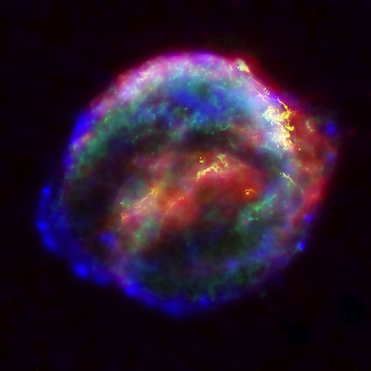

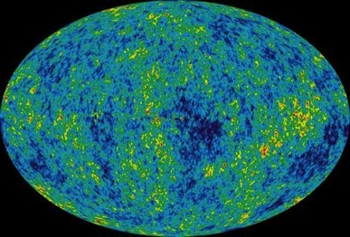
Astrophysical Sources of Gravitational Waves
Coalescing Compact Binary Systems: Neutron Star-NS, Black Hole-NS, BH-BH
- Strong emitters, well-modeled,
- (effectively) transient
Asymmetric Core Collapse Supernovae
- Weak emitters, not well-modeled (‘bursts’), transient
Credit: Chandra X-ray Observatory
Credit: AEI, CCT, LSU
Cosmic Gravitational-wave Background
- Residue of the Big Bang
- Long duration, stochastic background
Spinning neutron stars
- (nearly) monotonic waveform
- Long duration
NASA/WMAP Science Team
Casey Reed, Penn State
Notes:
LIGO is designed to be an observatory, not a one-off proof that GWs exist. What do we look for?
There are number of predicted astrophysical sources of gravitational radiation, and most of them involve cataclysmic events.
Binary systems – NSs and BHs, most likely source, theoretically well understood with known waveforms
Bursts – GW emissions that are not well modeled or understood. These include asymmetrically core collapse supernova, cosmic strings, and perhaps unknown sources
The residual GW background
Continuously emitting sources such as spinning neutron stars, which have a pure monotone emission.

Slide 6
Astrophysical Sources of Gravitational Waves
Coalescing Compact Binary Systems: Neutron Star-NS, Black Hole-NS, BH-BH
- Strong emitters, well-modeled,
- (effectively) transient
Asymmetric Core Collapse Supernovae
- Weak emitters, not well-modeled (‘bursts’), transient
✓
Credit: Chandra X-ray Observatory
Credit: AEI, CCT, LSU
Cosmic Gravitational-wave Background
- Residue of the Big Bang
- Long duration, stochastic background
Spinning neutron stars
- (nearly) monotonic waveform
- Long duration
NASA/WMAP Science Team
Casey Reed, Penn State
Notes:
LIGO is designed to be an observatory, not a one-off proof that GWs exist. What do we look for?
There are number of predicted astrophysical sources of gravitational radiation, and most of them involve cataclysmic events.
Binary systems – NSs and BHs, most likely source, theoretically well understood with known waveforms
Bursts – GW emissions that are not well modeled or understood. These include asymmetrically core collapse supernova, cosmic strings, and perhaps unknown sources
The residual GW background
Continuously emitting sources such as spinning neutron stars, which have a pure monotone emission.

Slide 7
Frequency-Time
Characteristics of GW Sources
time
Ringdowns
Broadband Background
Bursts
frequency
CW (quasi-periodic)
Chirps
Earth’s orbit
Earth’s rotation
frequency
frequency
time
time

Slide 8
The rate of future discovery in gravitational-wave astronomy will be determined by the number and sensitivity of gravitational-wave detectors and the number and skill of GW experimentalists.

Slide 9
Building Out the Terrestrial Gravitational-Wave Network
A greater number of detector facilities around the world improves:
  Sky localization
  Polarization information
  CBC orbital inclination
  CBC Distance information
  CBC precession information
  Network robustness

Slide 10
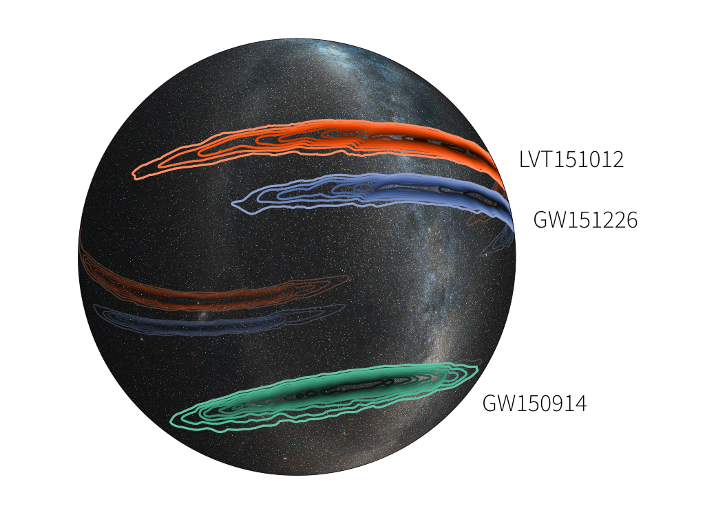
Sky Localization Is Poor With Only Two Detectors
Image credit: LIGO (Leo Singer) /Milky Way image (Axel Mellinger)

Slide 11


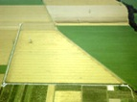

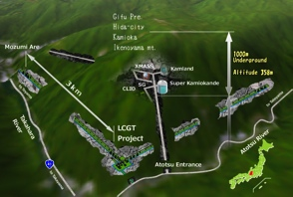



The advanced GW detector network:
2015-2025
Advanced LIGO
Hanford
2015
GEO600 (HF)
2011
KAGRA
>2018
Advanced LIGO
Livingston
2015
Advanced
Virgo
2017
LIGO-India
2024
11
11

Slide 12
LIGO-India Concept
Started as a partnership between LIGO Laboratory and IndIGO collaboration to build an Indian interferometer
  LIGO Lab (with its UK, German and Australian partners) provides components for one Advanced LIGO interferometer (H2) from the Advanced LIGO project
  LIGO Lab provides designs and design assistance for facilities and vacuum system and training for Indian detector team
  India provides the infrastructure (site, roads, building, vacuum system), staff for installation & commissioning, operating costs
LIGO-India would be operated as part of LIGO Global Network to maximize scientific impact
Major enhancement to the global network and to the capabilities for GW astrophysics and Multi-messenger Astronomy

Slide 13
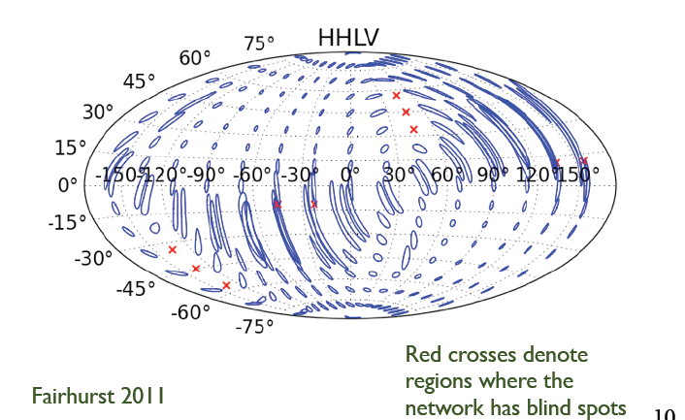
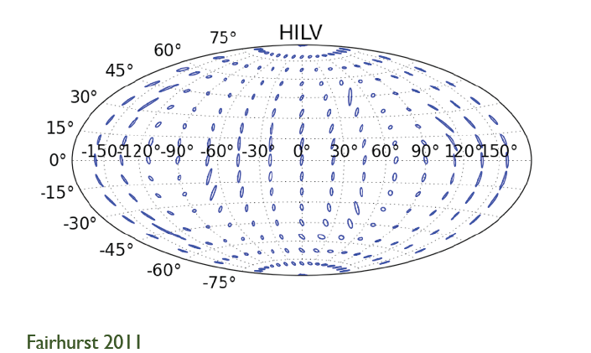
Effect of Adding LIGO-India to the LIGO+Virgo Network
LIGO+Virgo only
With LIGO-India

Slide 14
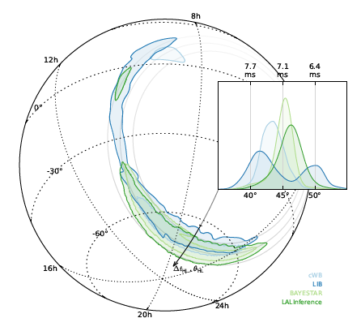
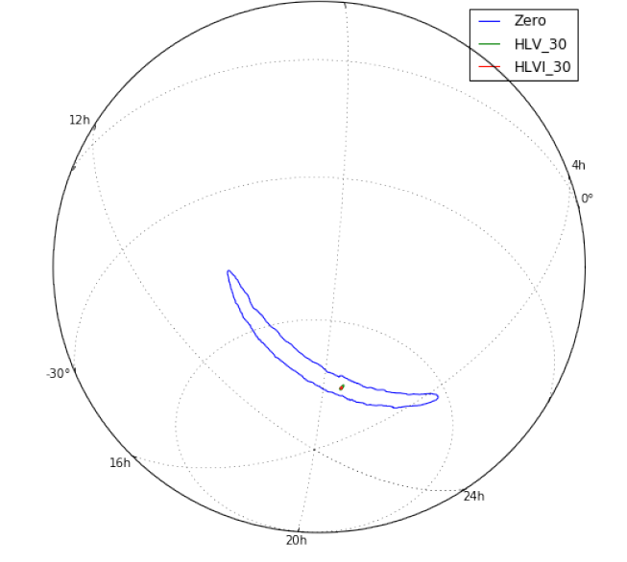
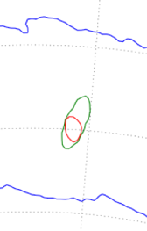
Improved Localization:
LIGO→Virgo→LIGO-India
GW150914: LIGO →LV →LVI
(Preliminary)
GW150914: LIGO only
375° → 9.3° → 7.8°
(99% confidence level)
LSC/Virgo et al. 2016, ApJL
arXiv:1602.08492
LSC/Virgo, L. Singer, S. Gaebel

Slide 15
Sensitivity of Detectors is Determined by Noise and Background
The key to improving detectors is sensitivity which improved by reducing noise and background.
Range is proportional to sensitivity.
Event rate is proportional to volume, which is proportional to range cubed.
Thus a factor of 2 in sensitivity gives a factor of 8 in event rate (nearly an order of magnitude).

Slide 16
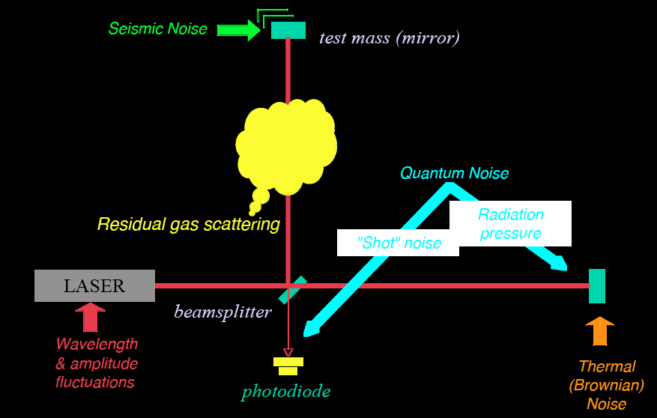
Noise and background cartoon
R. Adhikari

Slide 17
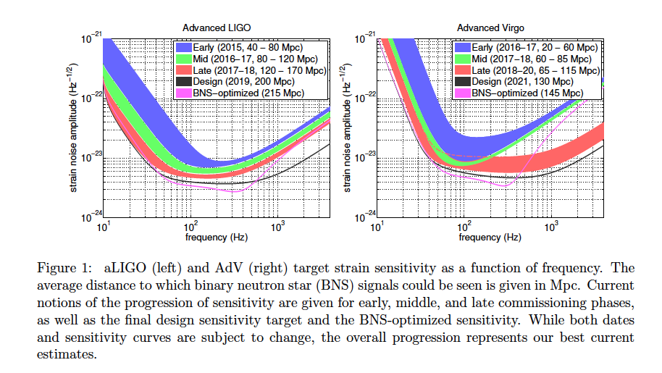
LVC Observing Scenario
(arXiv:1304.0670)

Slide 18
Initial S6 / Advanced O1
Design / A+ Upgrade
https://dcc.ligo.org/public/0113/T1400316/004; https://dcc.ligo.org/LIGO-G1500623
~3 x the sensitivity
made the difference
And we can
go beyond
~3 x to go!

Slide 19
Science drives Requirements
Stellar Evolution at High Red-Shift: Black Holes from the first stars (Population III)
  Reach z > ~10
  At least moderate GW luminosity distance precision
Independent Cosmology and the Dark Energy Equation of State
  Needs precision GW luminosity distance and localization for EM follow-ups (for redshift)
Checking GR in extreme regime
  High SNR needed
  GW luminosity distance and localization not essential

Slide 20
What will it take to improve detectors?
Clever experimental physicists and engineers, capable of solving multi-dimensional problems at the forefront of basic measurement science
Advanced LIGO detectors are complex:
  Approximately 350 high-performance servomechanisms
  Many of these are multiple-input, multiple output
  Sensors and actuators for these are operating at or beyond commercial limits
Developing ways to work around fundamental limitations:
  Quantum nature of light
  Atomic nature of matter
A single example: working around the classical and quantum nature of light

Slide 21
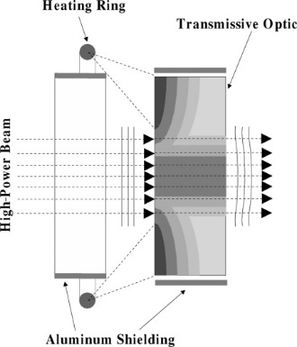
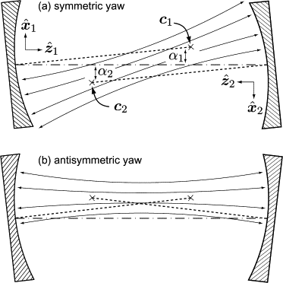
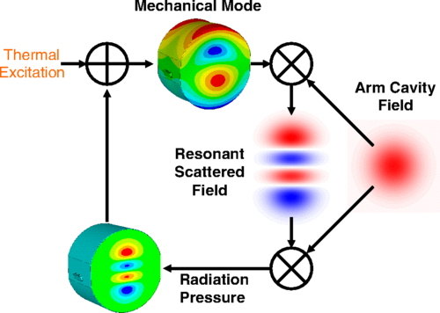
Nothing Is Easy: Classical Challenges to High-Power Operation
Thermal lensing and compensation
Angular radiation pressure
instabilities
Parametric instabilities
M Evans et al (2015) Phys. Rev. Lett. 114, 161102
R Lawrence et al (2004)
Opt Lett 29(22)2635-2637
J Sidles, D Sigg, Phys. Lett. A.
354, 167-172 (2006)

Slide 22
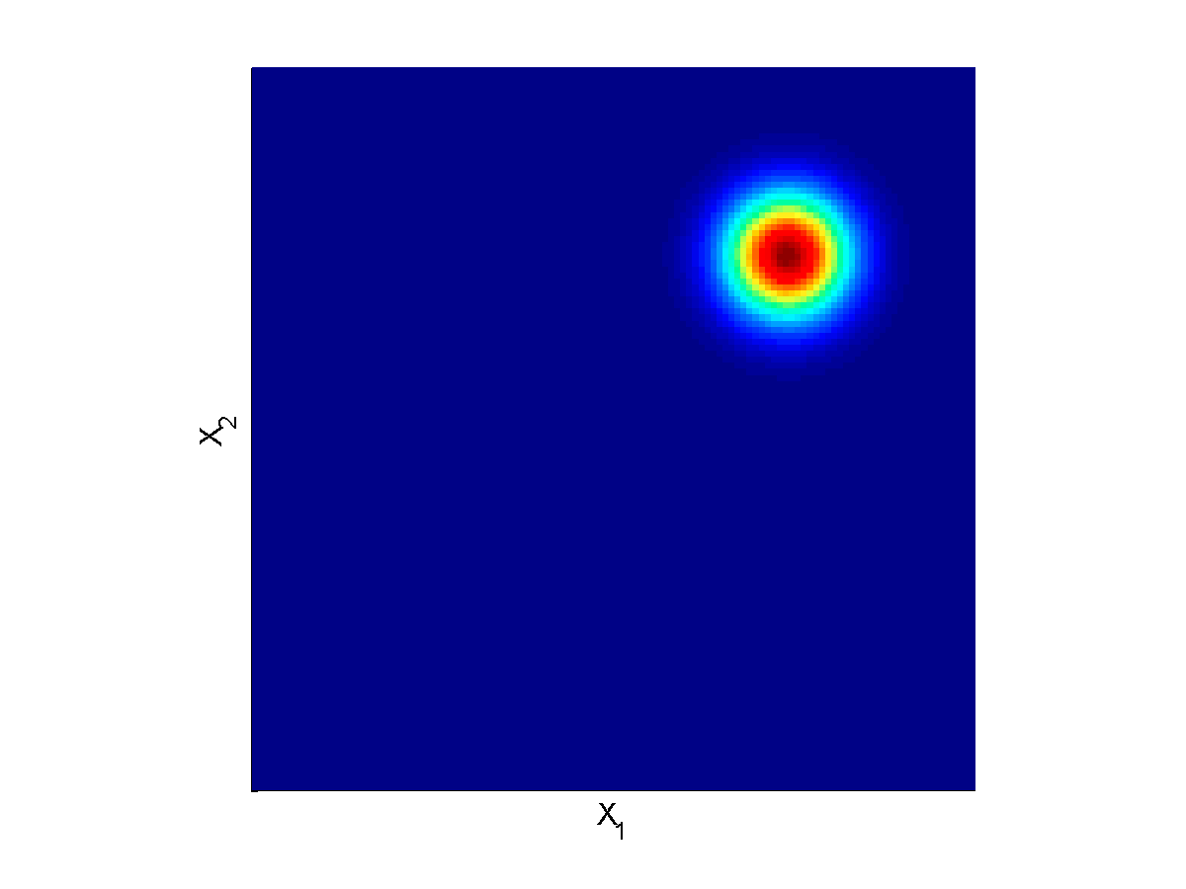
Quantum Noise is Fundamental, Caused by Vacuum Fluctuations
EM Vacuum Fluctuations Cause Shot Noise and Radiation Pressure Noise
Laser
C Caves (1981) Phys. Rev. D 23, 1693

Slide 23
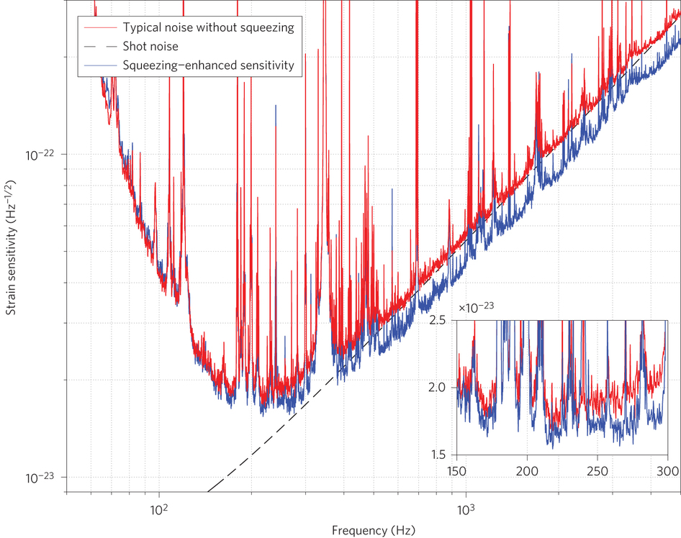
Vacuum squeezing: a partial work-around
Laser
LIGO Scientific Collaboration, Nature Photonics 2013
doi:10.1038/nphoton.2013.177

Slide 24
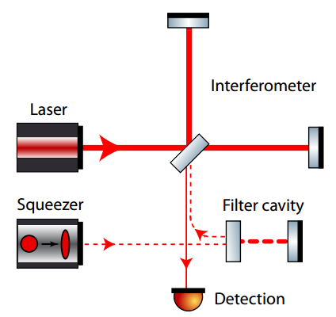
A better work-around: frequency-dependent squeezing
Original idea: J Kimble et al (2001) Phys. Rev. D 65, 022002
Practical designs: T Corbitt et al (2004) Phys. Rev. D 70, 022002
Demonstration in regime applicable to LIGO: E Oelker et al (2016) Phys. Rev. Lett. 116, 041102
M Evans et al, (2013) PRD 88 022002

Slide 25
Advanced LIGO upgrade path
Advanced LIGO is limited by
quantum noise & coating thermal noise
Squeezed vacuum to reduce quantum noise
Options for thermal noise:
  Better coatings
  Cryogenic operation
  Longer arms (new facility)

Slide 26
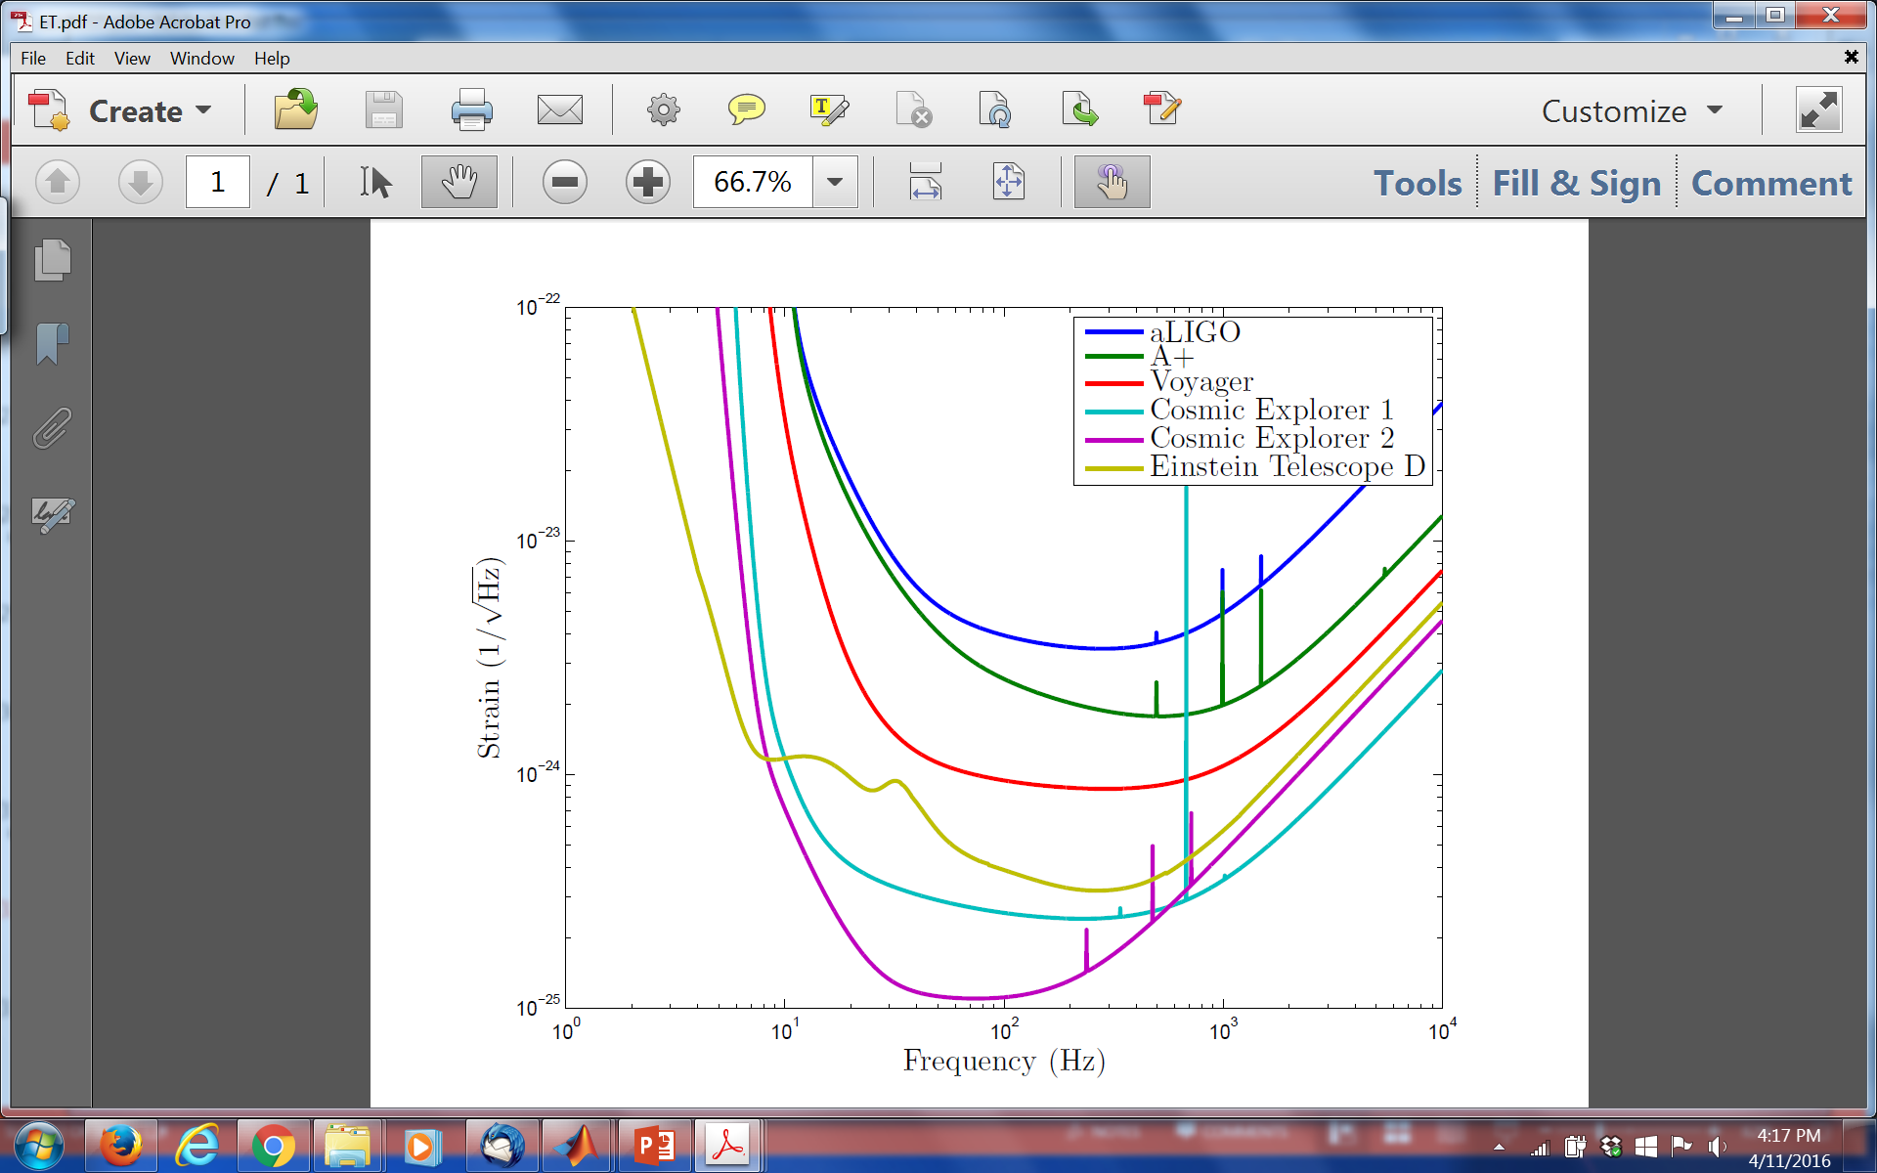
Upgrade possibilities
https://dcc.ligo.org/public/0113/T1400316/004; www.et-gw.eu

Slide 27
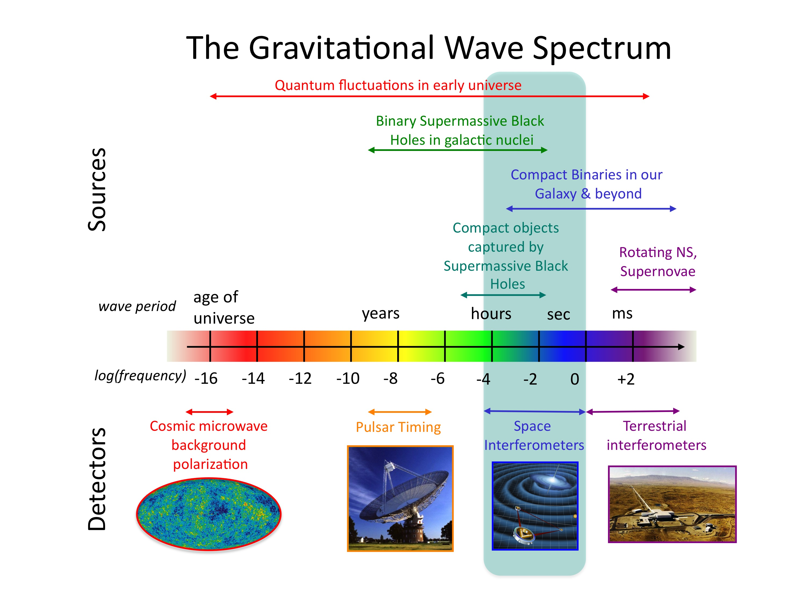
Credit: NASA

Slide 28
Summary
1st observing run of LIGO’s 2nd-generation detectors have initiated Gravitational-Wave Astronomy, opening a vast new frontier for exploration.
An emerging international network of detectors soon will provide more accurate positions of sources to enable EM follow-ups of GW events.
There is still room within the laws of physics to develop more powerful generations of detectors and much physics still to be harvested from their observations.

Slide 29
Extra slides

Slide 30
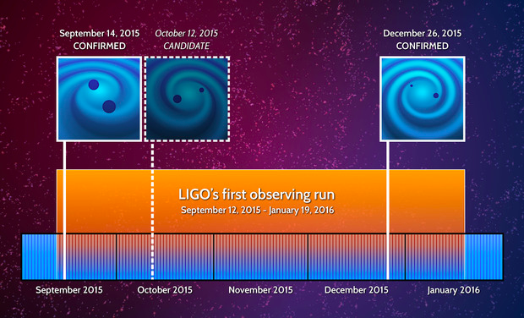
Discovery Timeline – Advanced LIGO’s 1st Observations
Courtesy Caltech/MIT/LIGO Laboratory

Slide 31
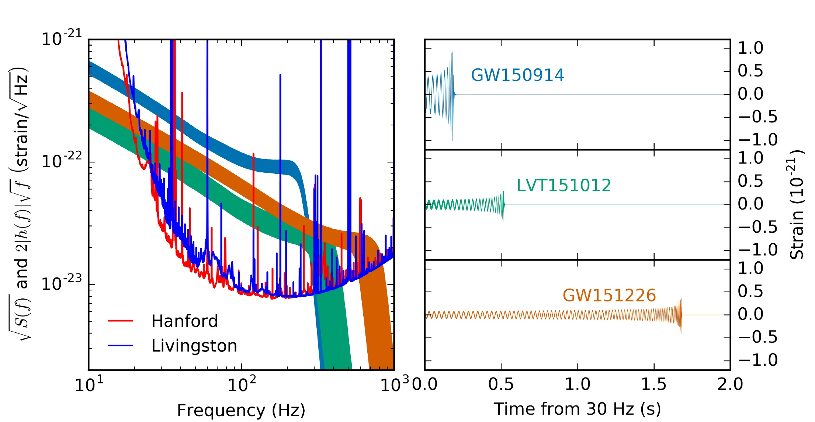
Advanced LIGO’s First Observations
ArViv:1606.04856; see also PRL 116, 241103 (2016) for GW151226.

Slide 32
Principal noise terms
Radiation-Pressure Dominated Background
Shot-Noise Dominated Phase Noise

