Slide 1
Study of Optical Scatterers within Coating Layers of gravitational wave detector Mirrors
L. Glover^{(1,3)}, R. DeSalvo^{(1,3)}, B. Kells⁽²⁾, I. Pinto⁽³⁾
E. Arriaga⁽¹⁾, E. Barragan⁽¹⁾ E. Do⁽¹⁾, C. Fajardo⁽¹⁾, M. Goff⁽¹⁾, J. Patel⁽¹⁾, T. Sadecki⁽²⁾, R. Savage⁽²⁾, E. Villarama⁽¹⁾
1 – Cal State LA 2 – LIGO
3 – Uni. Sannio
Related doc: LIGO-G1600431

Slide 2
Gravitational Wave detectors’ mirror thermal noise
Dielectric coatings on mirrors present an anomalously low quality factor 10⁴-10⁵ as compared to >10⁹ for Q-factor for the fused silica substrate.
This dissipation is responsible for most of the thermal noise of mirrors of all gravitational wave detectors.
Mechanical dissipation in coatings is the single most important limit for the detection range of Gravitational waves
Nobody knows where these losses reside or come from.

Slide 3
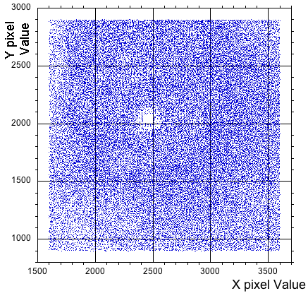
Brief Summary
We analyzed scattering points in photos of Advanced LIGO mirror illuminated by 100 kW stored beams
Hundreds of thousands of progressively weaker scatterers were observed where few were expected, likely extending through the depths of the coating layer stack
Probable locus of the energy losses

Slide 4
Method
Individual scatterers were identified using DAOPHOT an astronomer’s algorithm to identify stars in galaxies
Extract apparent amplitude and position of each scatterer
Subtract the identified “stars” and iterate

Slide 5
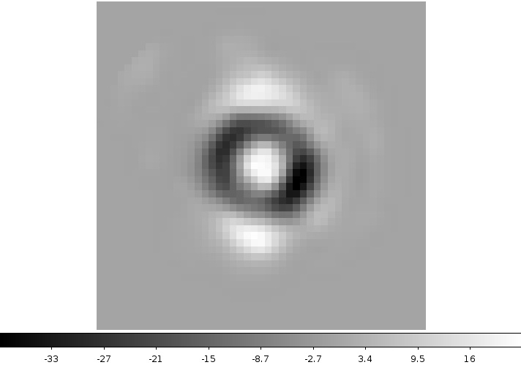
Daophot Mechanism: Point Spread Templates
A point spread template is created from selected sources within the image.
Then it is used to search scatterers
Point Spread Template for an exposure time of 1.25 x 10⁻⁴ s

Slide 6
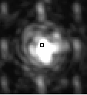
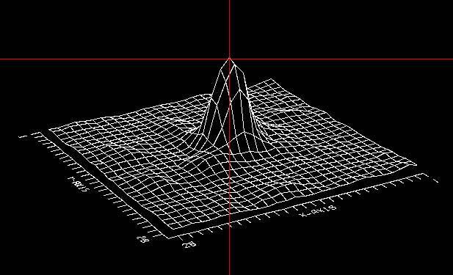
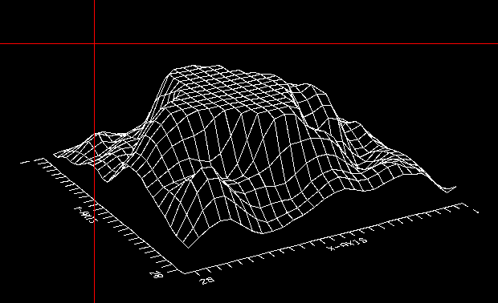
Daophot Mechanism: Problems CCD dynamic range
Good
Badly saturated

Slide 7
Daophot subtraction effectiveness
Pixel amplitude histogram of original Image
100
200
Most pixels restored to “dark” pixel
Residual pixel distribution within 2-3 pixels FWHM
Mostly from saturation effects
Residual pixel amplitude histogram after scatterer extraction
-50
50
Notes:
Note for you, the central pixel does not count because it is just the black background that daophot ignores, but this is log scale, ignoring the central pixel you get 2-3 pixel FWHM

Slide 8
Identifying/subtracting scatterers
Original Photo
Subtracted Photo
Fluffy dirt
ignored
256
100
expanded pixel scale
Dark pixels
256
dots mark the place where scatterers have been excised
“dirt” does not fit template is ignored by daophot and masks out real weaker scatteres

Slide 9
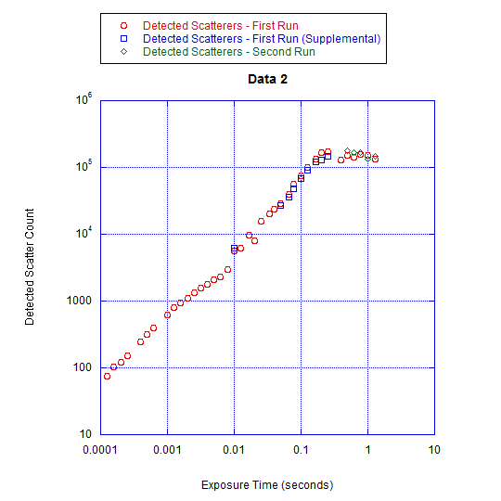
Number of Scatterers vs. Exposure Time
Exposure Scatterers (1st Run)
@ 0.125 ms 76
@ 1 ms exposure 624
@ 400 ms exposure 127,774
100,000
10,000
1,000
100
Scatterer count plateaus due to saturation.
Number increases almost linearly with exposure
Exploring weaker and weaker scatterers
Deeper and deeper in the dielectric coating layers ! !

Slide 10
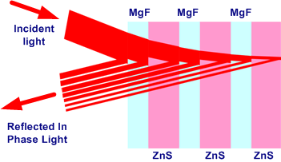
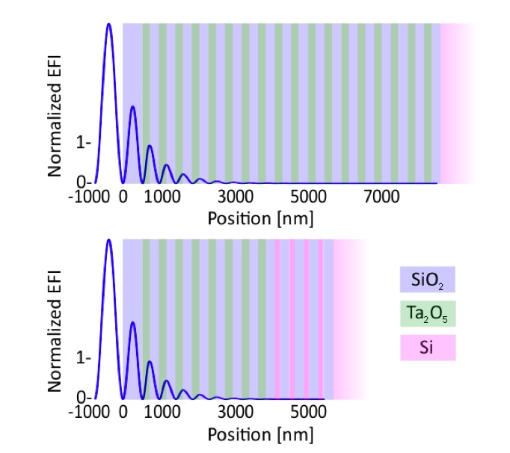
Apparent size: Depth in stack effect
There are two depth attenuation components:
Attenuation of impinging light due to reflections through depth of coating layers
Back-reflection on front layers attenuates Scattered light
Image: Stuart Reid, Iain Martin, 2016
Scattered light detected by CCD
Back reflected scattered light

Slide 11
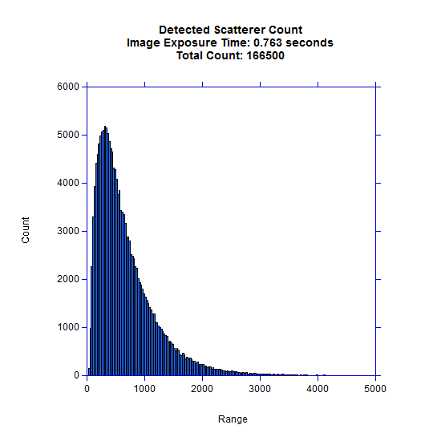
Scatterer light intensity distribution @ Exposure Time = 0.0125 sec
6000
The rapid slope of reconstructed scatterers at low amplitude is compatible with what expected from the reflection curve.
3000
1000
Integrated CCD count
5000

Slide 12
Drop of laser light impedes detection of scatterers below first 2-3 layers 26 layers in each HR coating ~200 scatterers /mm²
How many scatterers
are actually there ?

Slide 13
Origin of scatterers
Virtually no absorption (<0.25 ppm)
Positive or negative density (n) fluctuations
Positive = crystallites, in glasses catalyze crystallization
Negative = large fluctuation of natural voids in glasses
Both have dangling bonds, i.e. double well potentials adsorbing mechanical energy

Slide 14
Ongoing work
Two steps proposed:
Sum coherently lower exposure images from LIGO to mitigate saturation.
Study ad-LIGO witness samples to determine scatterer’s depth distribution through layers and size distribution

Slide 15
Lucky byproduct
Study of image to image “star” position motion for coherent addition of images yielded a metod to independently detect:
Motion of stored beam within mirror
Motion of mirror w.r.t. camera.

Slide 16
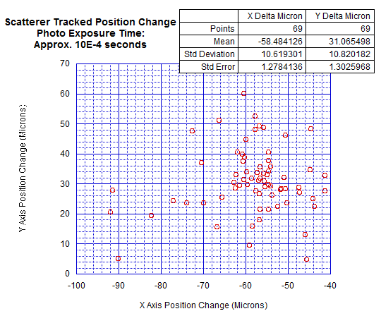
DAOPHOT position resolution
Differential “star” position between two images
The scatter of the points (standard deviation) =
~11µm
positioning error of “daophot”
Calibration 1Pixel = ~80 µm

Slide 17
Detection of mirror motion
Mirror motion
Mirror position resolution ~ 1.3 µm
Calibration 1Pixel = ~80 µm

Slide 18
Depth scatterer exploration
Study a spare witness samples to determine
the scatterer’s depth distribution
the scatterer’s size distribution

Slide 19
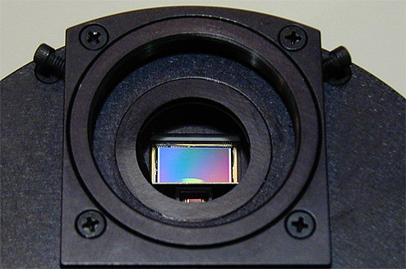
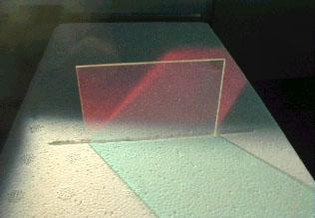
X, Y Axis micropositioning
CCD Camera
3
White light LED
50% Reflector
@ 45°
1
Z Axis piezo focusing
2
Microscope
lens
AdLIGO Multi-Layered Mirror

Slide 20
Grid scan of Mirror
X₁
X₂
…
X_{n}
Raster scan X-Y of microscope frames on mirror surface to identify rough scatterer position
Y₁
Y₂
Defocused
Scatterers
…
Y_{n}

Slide 21
Potential depth resolution
Depth of field 0.6 µm / n
depth resolution of ~ 30 nm/ n achieved from Z-scan
Wide angle-white light illumination allow penetration of many layers
Defocused
Scatterer
Focused
Scatterer
Defocused
Scatterer
Maximum Luminosity
+Z
-Z
Notes:
For your information, n is the refraction index of the material, in Ta2O5 or TiO2 it is between 2.5 and 3

Slide 22
Conclusions 1
A very large population of scatterers was found on aLIGO mirrors under high-power illumination.
They contribute to large angle optical scattering,
if the observed points are the locus of mechanical dissipation, they may explain the anomalous mechanical dissipation observed in sputtered coatings.
The discovery is a good diagnostic tool, perhaps indicating possible ways to reduce the Sensitivity limitation for Gravitational Wave detectors

Slide 23
Conclusions 2
Methods are being developed to monitor
mirror to camera and
beam to mirror
micro-movements
Both can be valuable diagnostic tools at the observatory

