Slide 1
Control system in Gravitational Wave Detectors
引力波
LIGO-G1601928-v1
Koji Arai (新井宏二) – LIGO Laboratory / Caltech
GW mini-school: Beijing Normal University 2016/9/15~18

Slide 2
Introduction ~ Control?
Gravitational wave detection
Laser displacement sensor
Requires linear displacement detection
Control for measurement
Laser interferometer = nonlinear device
Feedback control => linearization

Slide 3
Introduction ~ Control?
What is the feedback control?
  A scheme to monitor and modify output(s) of a system by changing the input(s) depending on the output(s)
Examples
  Shower temperature
  Car driving
  Tight rope walking
Imagine what happens
  If the response is too slow?
  If the response is too fast?
  Air conditioning
  Bike riding
  Inverted bar on a hand

Slide 4
Introduction ~ Control?
Block diagram: Elements of a feedback loop
  Stabilized
  motion
  m or m/Hz^{1/2}
  m or m/Hz^{1/2}
  Disturbance
  Error
  signal
  Sensor
  V or V/Hz^{1/2}
  V/m
  Actuator
  Servo
  Filter
  m/V
  V/V
  Feedback
  signal
  V or V/Hz^{1/2}
  Transducer
  Filter

Slide 5
Introduction ~ Control?
Sensor:
Transducer for displacement-to-voltage conversion
If the sensor is completely linear
(and has or no frequency dependence)
We don’t need feedback control!

Slide 6
Introduction ~ Control?
In reality:
Sensors, laser interferometers in particular, are nonlinear!
Enclose the operating point in the linear region
=> The system recovers linearity
Was the displacement modified by the feedback?
=> Precise knowledge of the control system
for signal reconstruction

Slide 7
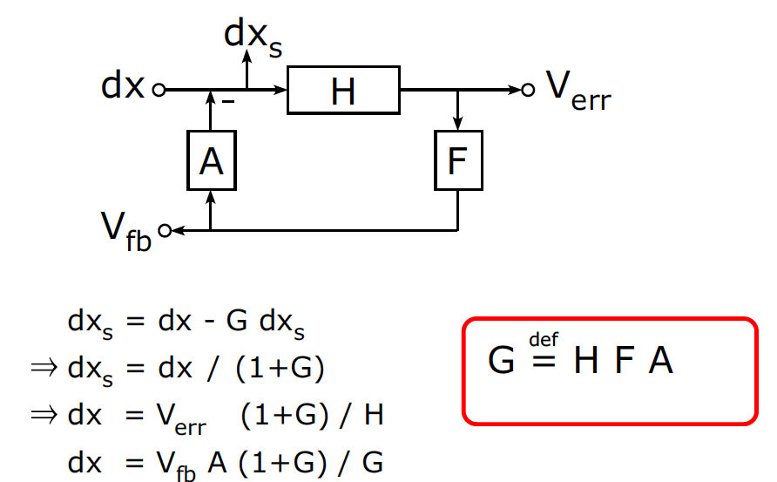
Introduction ~ Control?
Elements of a feedback loop
disturbance
stabilized disturbance
error signal
actuator
sensor
servo filter
feedback
signal
Open loop transfer function

Slide 8
Introduction ~ Control?
When G is small:
disturbance
stabilized disturbance
error signal
actuator
sensor
servo filter
feedback
signal
Open loop transfer function

Slide 9
Introduction ~ Control?
When G is big: e.g. G = 10, 100, or 1000
dx_{s}= dx/(1+G) = 0.09 dx, 0.01 dx, 0.001 dx
dx
V_{err}= dx H /(1+G)
Actuator range
Residual error
vs
Sensor linear range
0.91 dx,
0.99 dx,
0.999 dx
Filter frequency response / loop stability
V_{fb} = G/(1+G) /A dx
= 0.91 dx/A, 0.99 dx/A, 0.999 dx/A

Slide 10
Introduction ~ Control?
When the openloop gain G is >>1, the error signal gets suppressed
“Wow! our sensor signal became smaller!”
  Is our system more sensitive now? => No
  Then, can we still measure gravitational waves
  even if the error signal is almost zero? => Yes

Slide 11
Introduction ~ Control?
Important difference between
  “Feedback control for stabilization”
  and “Feedback control for measurement”
  Feedback control changes the stabilized motion
  but reconstructed Disturbance is not modified by the loop*
  (*if everything is linear)
  Stabilized
  motion
  Disturbance
  Error
  signal
  Sensor
  Actuator
  Servo
  Filter
  Feedback
  signal

Slide 12
Linear systems and their stability

Slide 13
Linear systems and their stability
A deterministic and time-invariant system: H
The system H is LTI (linear & time-invariant) when
We can deal with such a system using Laplace transform
(or almost equivalently Fourier Transform)
H
  System Input
  x(t)
  System Output
  y(t)

Slide 14
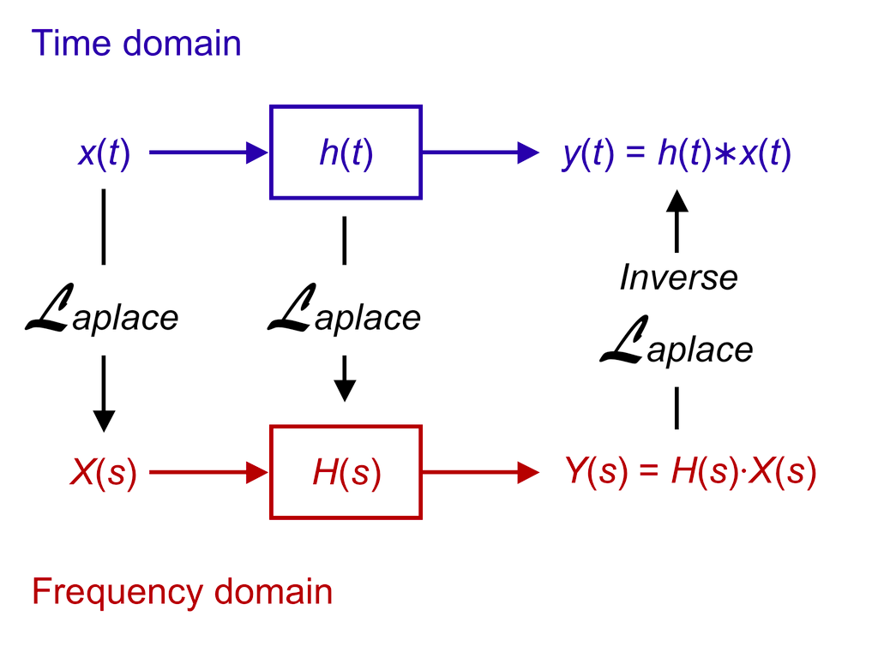
Linear systems and their stability
Time domain vs Laplace (or Fourier) frequency domain
Impulse response
transfer function
http://en.wikipedia.org/wiki/Linear_system
http://en.wikipedia.org/wiki/LTI_system_theory

Slide 15
Linear systems and their stability
It is easy to convert from an ordinary differential equation to a transfer function
e.g. Damped oscillator
  Laplace Transform
  Fourier Transform

Slide 16
Linear systems and their stability
e.g. Damped oscillator
  log-log
  log-lin
Bode diagram

Slide 17
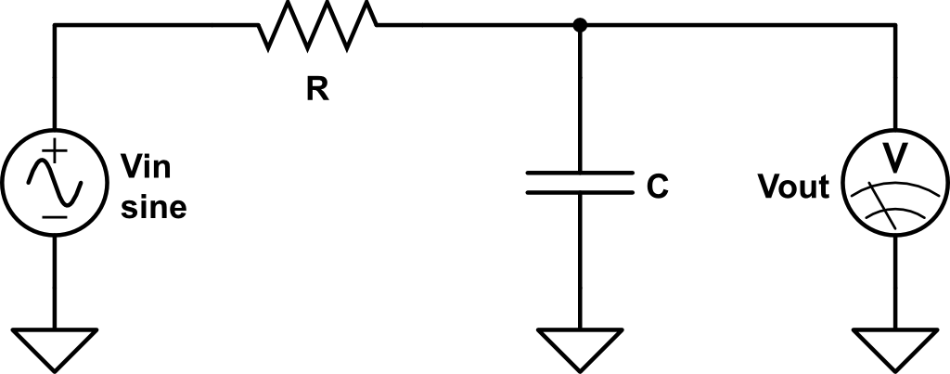
Linear systems and their stability
e.g. RC filter
cut-off freq
w = 1/(R*C)

Slide 18
Linear systems and their stability
In most cases, a system TF can be expressed as:
The roots of the numerator are called as “zeros”
and the roots of the denominator are called as “poles”
Zeros (s_{zi}) and poles (s_{pi}) are
real numbers (single zeros/poles)
or
pairs of complex conjugates (complex zeros/poles)

Slide 19
Linear systems and their stability
Poles rule the stability of the system!
H(s) can be rewritten as
Each term imposes exponential time impulse response
Therefore, if there is ANY pole with
the response of the system diverges

Slide 20
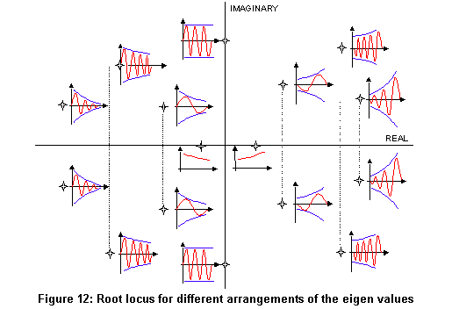
Linear systems and their stability
Poles rule the stability of the system!
  Im(s)
  Unstable
  response
  Re(s)
http://nupet.daelt.ct.utfpr.edu.br/_ontomos/paginas/AMESim4.2.0/demo/Misc/la/SecondOrder/SecondOrder.htm

Slide 21
Linear systems and their stability
Now we eventually came back to this diagram
  dx_{s} = dx/(1+G)
  Open loop TF:
  G = H F A
  Closed loop TF:
  G_{CL} = 1/(1+G)
  dx
Requirement:
All the roots for 1+G should be
in the left hand side of Laplace plane
  (!)

Slide 22
Linear systems and their stability
Remarks
Requirement:
All the roots for 1+G should be in the left hand side of Laplace plane
  This does not mean all H, F, A needs to be stable.
  e.g. Unstable mechanical system A can be stabilized by
  a control loop. (cf. An inverted Rod)
  We usually play with F to tune the result.
  It is awkward to evaluate the stability
  of 1/(1+G) every time.
  There is a way to tell the stability only from G
  Nyquist’s stability criterion
  Open loop TF:
  G = H F A
  Closed loop TF:
  G_{CL} = 1/(1+G)

Slide 23
Linear systems and their stability
Nyquist stability criterion
  Plot openloop gain G in a complex plane (i.e. Nyquist diagram)
  If the locus of G(f) from f=0 to ∞, goes to 0 looking at the point (-1 + 0 i)
  at the left side => Stable
  If the locus sees the point (-1+o i) at the right side => Unstable
  Unity gain frequency f_{UGF} : for |G(f_{UGF})| = 1
  Phase margin θ : θ = Arg(G(f_{UGF}))
  Gain margin g: g = 1/|G(f₀)| where Arg(G(f₀)) = -π

Slide 24
Linear systems and their stability
Phase Margin / Gain Margin in Bode diagram
  Most of the case, a bode diagram of G is enough to see the stability
  Nearly
  unstable
  Unity Gain Freq
  (176kHz)
  Gain Margin
  4.3dB@420kHz
  A rough standard of
  a stable servo loop:
  Phase Margin > 40deg
  Gain Margin > 10dB
  Phase Margin
  48deg
  -180deg

Slide 25
Linear systems and their stability
Building blocks (“zpk” representation)
  Single pole
  Single zero
  A pair of complex poles
  A pair of complex zeros
  Gain

Slide 26
Linear systems and their stability
Relationship between pole/zero locations and w0&Q
To be compared with

Slide 27
Linear systems and their stability

Slide 28
Linear systems and their stability
Summary
  Classical control theory
  Design locations of poles and zeros
  Stability: tuning of open loop transfer function is important

Slide 29
Control system components in GW detectors

Slide 30
Control systems
Elements of a feedback loop (again)
  Sensor
  Actuator
  Servo
  Filter

Slide 31
Interferometer control system
Local control vs global control

Slide 32
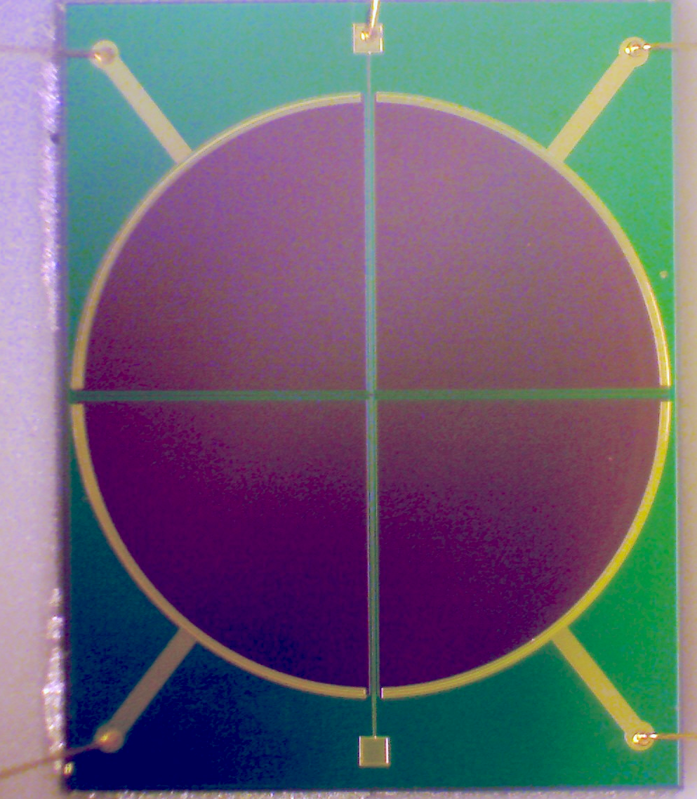
Local Sensors
Shadow sensor (relative displacement sensor)
  aLIGO: Birmingham Optical Sensor
  and Electro-Magnetic actuator (BOSEM)
Linear Variable Differential Transducer
(relative disp. sensor)
Optical Lever (relative angular sensor)
L Carbone, Class. Quantum Grav. 29 (2012) 115005
  A B
  C D
  SUM = A+B+C+D
  X = A–B+C-D
  Y = A+B-C-D

Slide 33
Local Sensors
Accelerometers (Inertial sensor)
  Piezo Accelerometer
  Servo Accelerometer

Slide 34
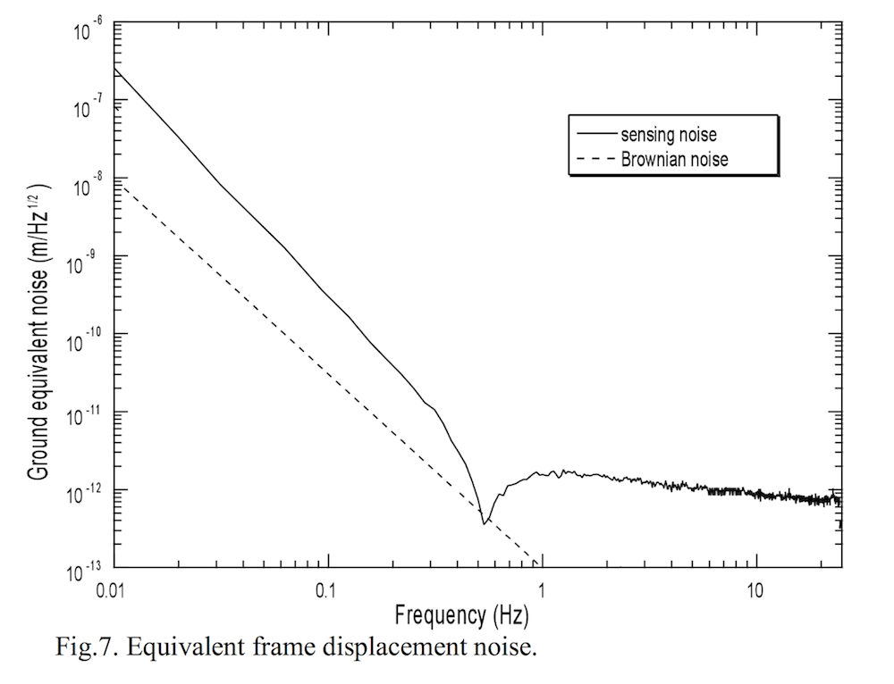
Local Sensors
Servo Accelerometer (Inertial sensor)
  Above the resonant freq: Limited by the sensor noise
  Below the resonant freq:
  Steep rise of the noise as the mass does not move
  in relative to the ground
  => Low resonant freq is beneficial
  1 pm/sqrtHz
  Negative
  spring
  Positive
  spring
A. Bertolini et al, Nuclear Instruments and Methods in Physics Research A 564 (2006) 579–586

Slide 35
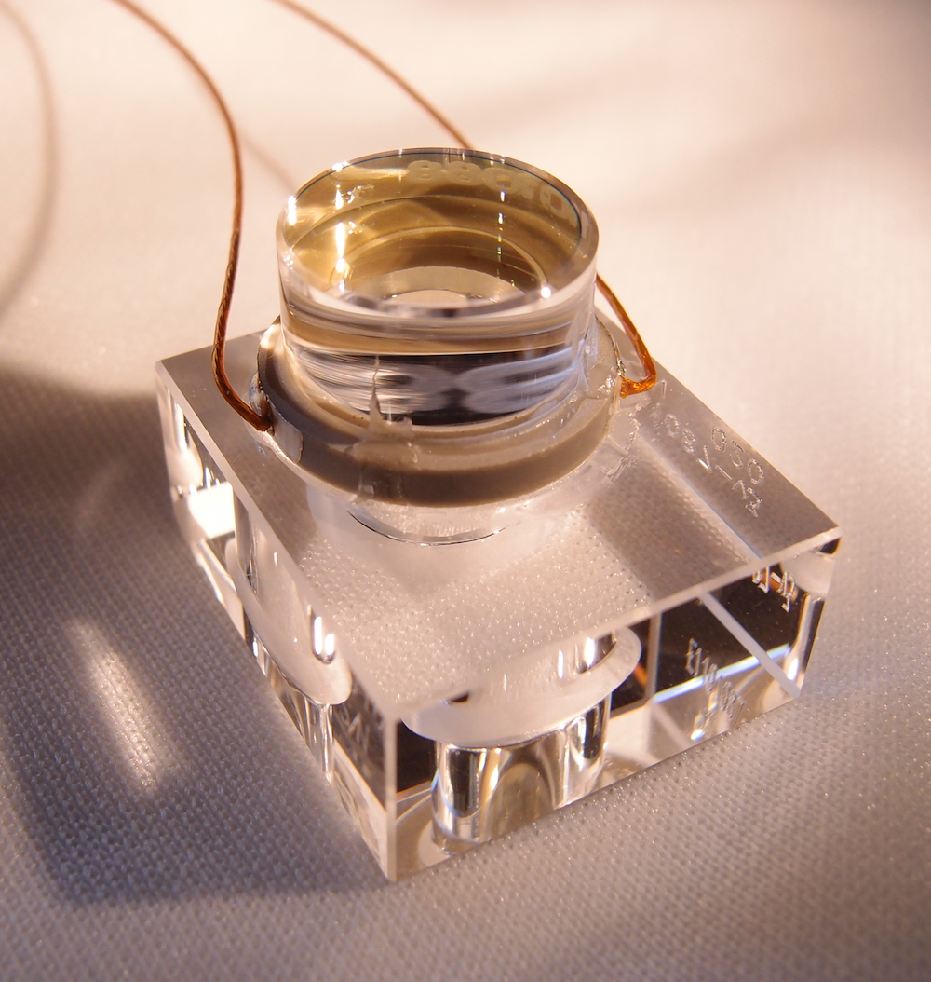
Acutuators
Mechanical actuators
  Coil Magnet actuator
  Electro Static Driver (ESD)
  Piezo (PZT) actuator

Slide 36
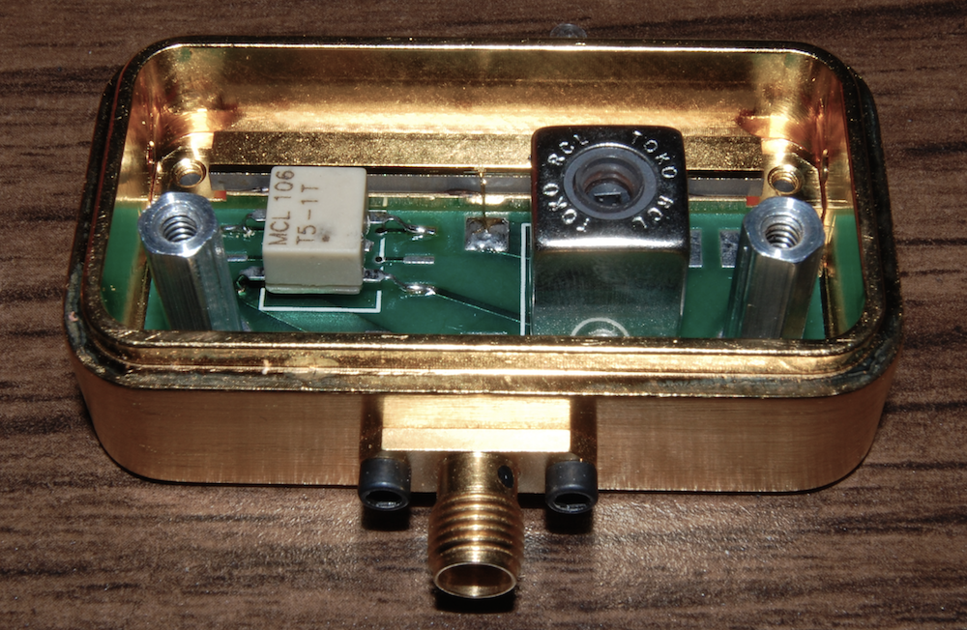
Acutuators
Optical actuators
  Acousto-Optic Modulator
  Electro-Optic Modulator
  Laser Frequency actuator
    Thermal actuator
    Fast piezo actuator
    External EOM
  LiNbO3 crystal

Slide 37
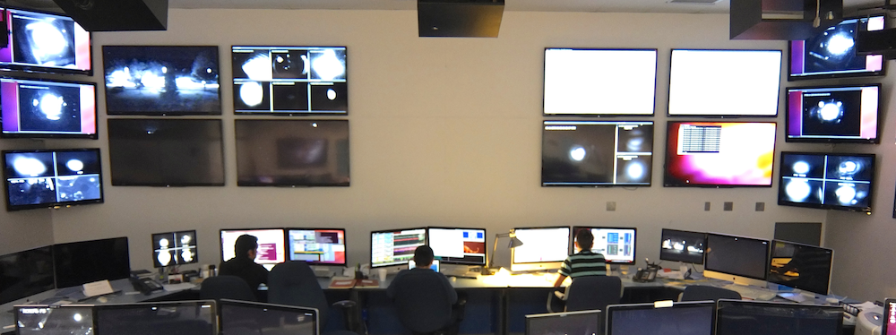
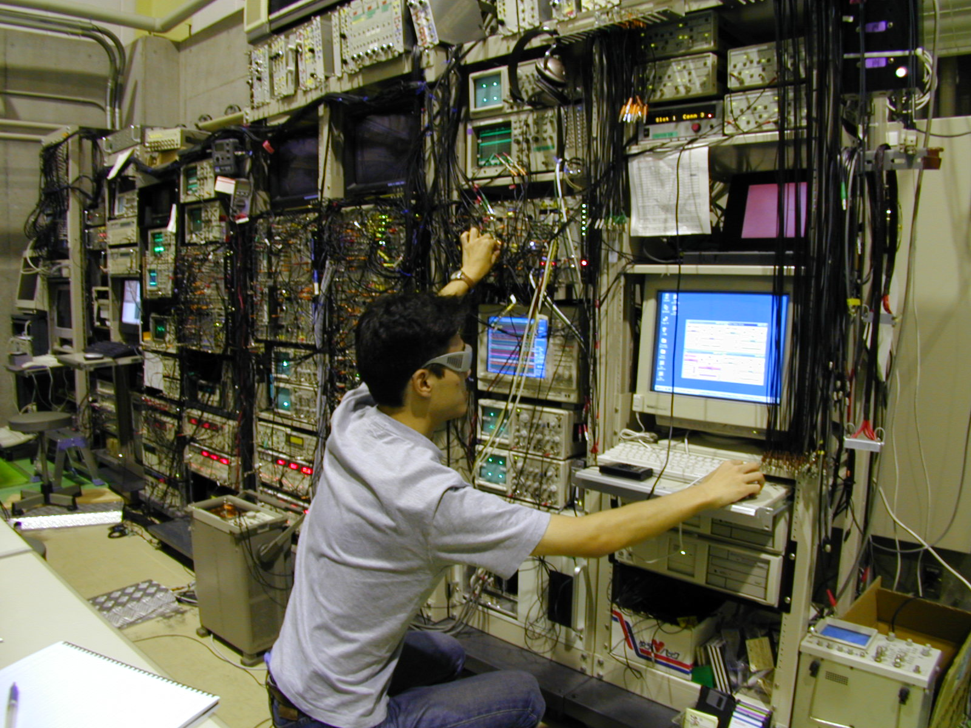
Analog servo vs digital servo
Comparison of the control room in the analog and digital eras
  aLIGO (2014)
  TAMA300 (2001)

