Slide 1



Study of Optical Scatterers within Coating Layers of LIGO Test-Mass Mirrors
Lamar Glover(1,3), Eddy Arriaga(1), Erik Barragan(1), Riccardo DeSalvo(1,3), Eric Do(1), Cameron Fajardo(1), Michael Goff(1), Jignesh Patel(1), Innocenzo Pinto(3), Travis Sadecki(2), Richard Savage(2), Ethan Villarama(1)
1 – Cal State LA
2 – LIGO Hanford
3 – Uni. Sannio
Related doc: LIGO-G1600431

Slide 2
Observation of Optical Scatterers illuminated by LIGO stored beam
Feasibility study of scatterer observation with microscope

Slide 3
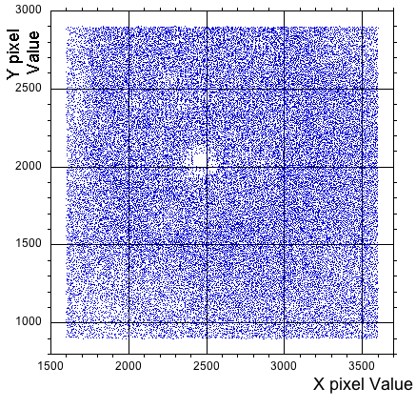
Brief Summary
We are analyzing, at Cal State LA, scattering points detected in beam-illuminated photos of Advanced LIGO mirrors
A large number of scatterers were observed where few were expected, likely extending through the depths of the coating layer stack
Perhaps the problem of scatterers can now be better understood

Slide 4
Method
Individual scatterers were identified using an astronomer’s algorithm for stars in galaxies
Extract apparent amplitude and position of each scatterer
Fit the stored beam position and profile to determine the illumination power on each scatterer.
Track changes in scatterer position and luminosity distribution in order to determine motion amongst test mass, stored beam and camera

Slide 5
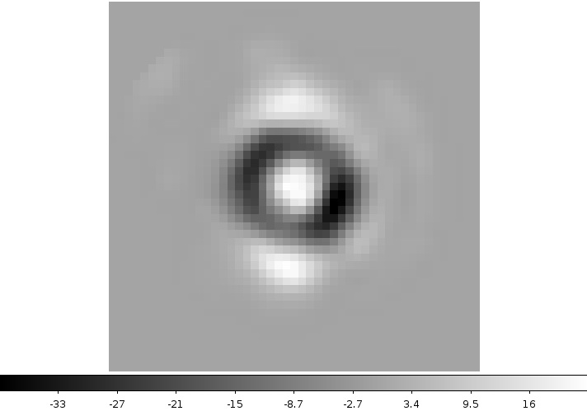
Daophot Mechanism:
Point Spread Templates
“daophot” creates a point spread template from selected sources within the image.
The template is used to search scatterers
Magnitude data is derived for each identified source.
Point Spread Template for an exposure time of 1.25 x 10⁻⁴ s

Slide 6

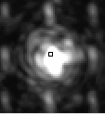
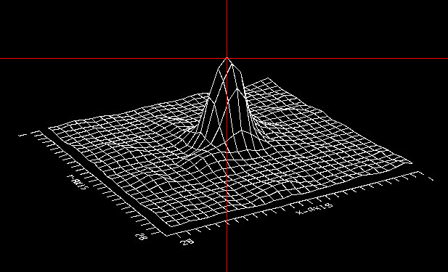
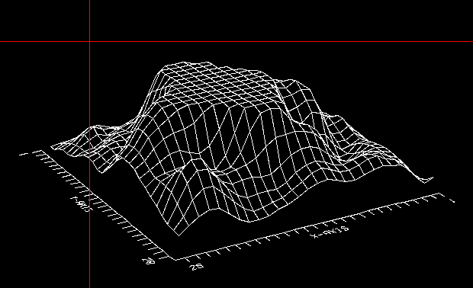
Daophot Mechanism: Problems
Good
Badly saturated

Slide 7
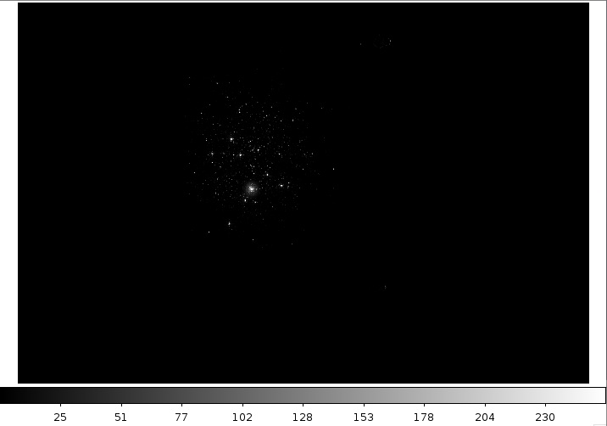
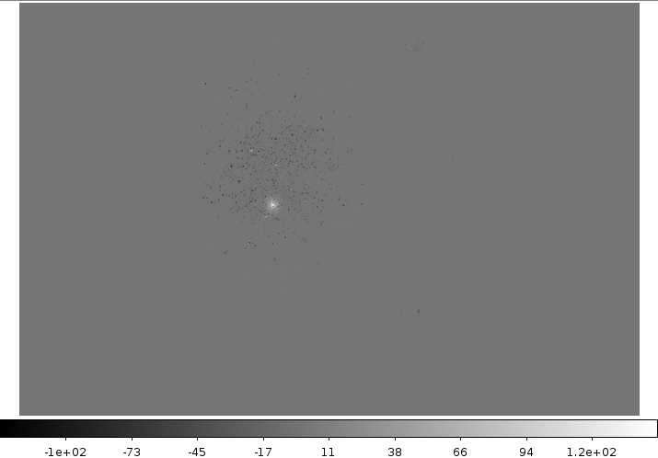
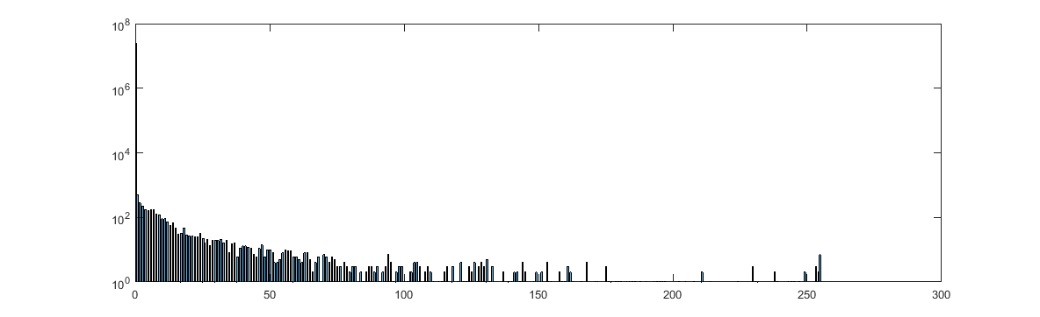
Identifying/subtracting scatterers
Original Photo
Subtracted Photo
Fluffy dirt
ignored
256
100
expanded pixel scale
Dark pixels
256
Black dots mark the place where bright scatterers have been excised
“dirt” does not fit template is ignored by daophot and is less bright

Slide 8
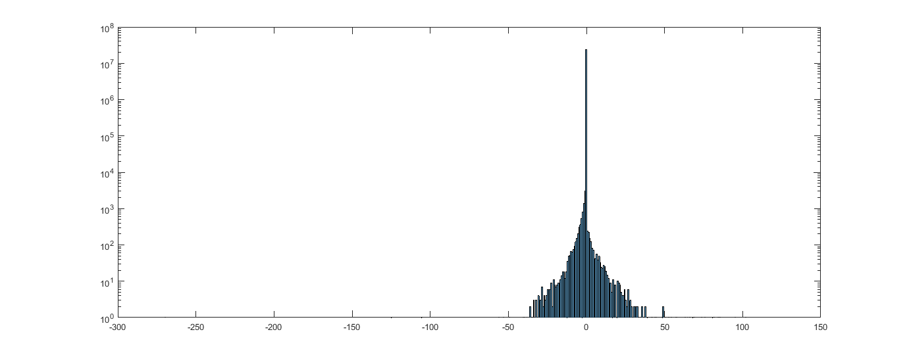
Daophot subtraction effectiveness and magnitudo resolution
Pixel amplitude histogram of original Image
100
200
In a good image, “daophot” is very effective in extracting all scatterers
Width of residuals (2-3 pixels FWHM) illustrates “daophot’s” good resolution
Residual pixel amplitude histogram after scatterer extraction
-50
50
Notes:
Note for you, the central pixel does not count because it is just the black background that daophot ignores, but this is log scale, ignoring the central pixel you get 2-3 pixel FWHM

Slide 9
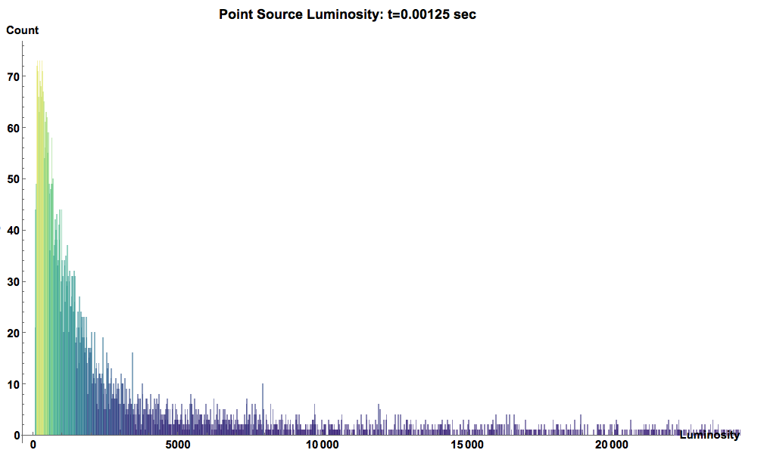
Scatterer light intensity distribution
@ Exposure Time = 0.0125 sec
70
The number of reconstructed scatterers grows rapidly at low amplitude.
40
5000
Integrated count
20000

Slide 10
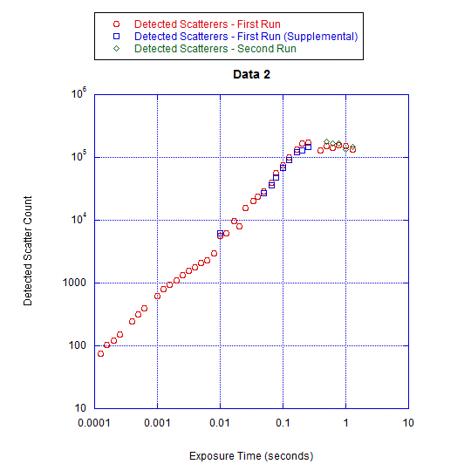
Number of Scatterers vs. Exposure Time
Exposure Scatterers (1st Run)
@ 0.125 ms 76
@ 1 ms exposure 624
  @ 400 ms exposure 127,774
Scatterer count plateaus due to saturation.
Number increases almost linearly with exposure
Exploring smaller scatterers
But also deeper in the dielectric coating layers ! !

Slide 11
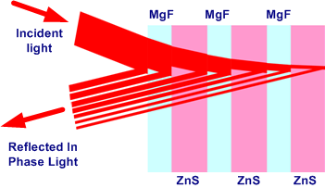
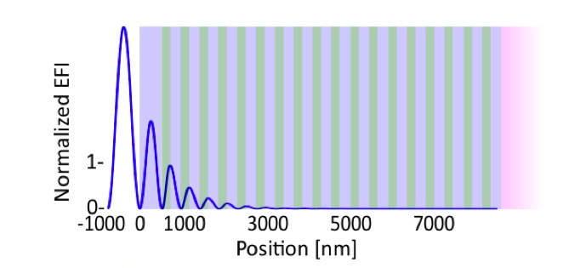
Apparent size: Depth in stack effect
There are two depth attenuation components:
Attenuation of impinging light due to reflections through depth of coating layers
Back-reflection on front layers attenuates Scattered light
Scattered light
detected by CCD
Image: Stuart Reid, Iain Martin, 2016
Back reflected scattered light

Slide 12
Rapid drop of laser light impedes:
Measurement of size of scatterers
Detection of scatterers below first 2-3 layers
Need different exploration method

Slide 13
Ongoing work
Two steps proposed:
Analyze more images from LIGO Hanford/Livingston to mitigate saturation.
Study spare ad-LIGO witness samples to determine scatterer’s depth distribution through layers and size distribution

Slide 14
1st feasibility study
  Idea:
Analyze more low exposure images from LIGO and add them up coherently to mitigate the saturation
  Problems:
Camera moves w.r.t. mirror, scatteters change pixel position
Beam moves w.r.t. mirror, scatterers change luminosity
  Byproduct:
Independent detection of motions of stored beam, camera and/or test mass.

Slide 15
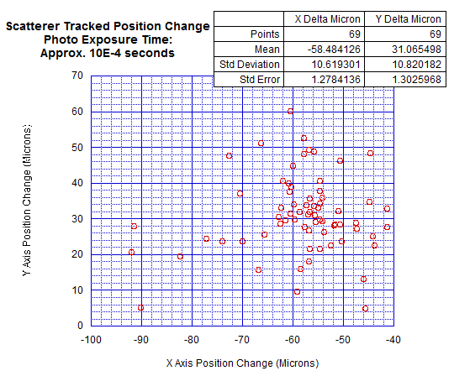
Initial Analysis of Scatterer Motion Tracking
The scatter of the points (standard deviation) =
~11µm
positioning error of “daophot”

Slide 16
Initial Analysis of Scatterer Motion Tracking
The mean offset (-58 ±1.3µm in X 31 ±1.3µm in Y) is attributed to the relative motion of the camera and the test mass.
Calibration 1Pixel = ~80 µm

Slide 17
Luminosity Shifts in Images
Divide an image into two halves with approximately equivalent luminosity
Compare the relative change in luminosity in a subsequent picture
Initial analysis with the only two images of similar time exposures (both approx. 1.3 millisecond)
SPLIT | INITIAL DIFFERENCE | FINAL DIFFERENCE | Luminosity Shift | Apparent Stored Beam Shift
Left compared to Right | Left – Right = -0.0070 | Left – Right = -0.0062 | -0.0008 | 0.02 mm
Bottom compared to Top | Bottom - Top = -0.0278 | Bottom - Top = -0.0550 | 0.0272 | 0.6 mm
VERY PRELIMINARY

Slide 18
Next Steps
Analyze exposure-optimized images from LIGO Hanford or Livingston to:
Mitigate saturation
Extract Test Mass vs. Camera position
Extract Stored Beam vs. Test Mass position

Slide 19
Depth scatterer exploration
Study a spare ad-LIGO witness samples to determine
the scatterer’s depth distribution through the layers
the size distribution

Slide 20
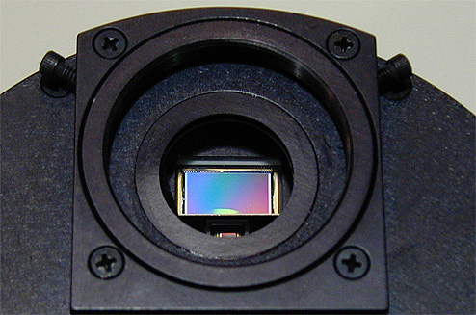
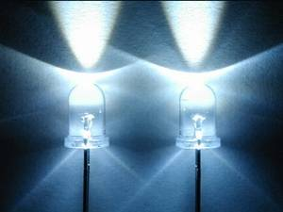
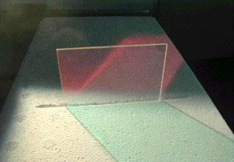
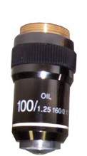
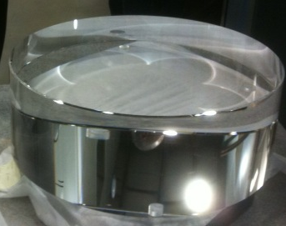
X, Y Axis micropositioning
CCD Camera
3
White light LED
50% Reflector
@ 45°
1
Z Axis piezo focusing
2
Microscope
lens
AdLIGO
Multi-Layered
Mirror

Slide 21

Grid scan of Mirror
X₁
X₂
…
X_{n}
Raster scan X-Y of microscope frames on mirror surface to identify rough scatterer position
Y₁
Y₂
Defocused
Scatterers
…
Y_{n}

Slide 22
Method for Depth determination by Z-focussing
No scatterer present:
  No reflected light
Scatterer present out of f-plane
  Low illumination density
  Defocused scatterer image
Z-zoom with piezo-movement to bring focal plane on scatterer:
  Brighter illumination
  Focused airy disk image
Defocused
Scatterer
Focused
Scatterer
Defocused
Scatterer
Maximum
Brilliance
+Z
-Z

Slide 23
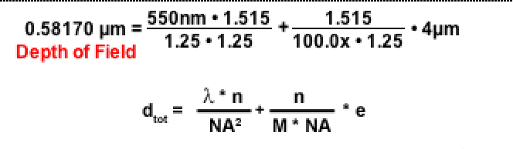
Potential depth resolution
  Depth of field 0.6 µm / n
  Sub-wavelength
  Z-position determination from Z-feedback fit
Defocused
Scatterer
Focused
Scatterer
Defocused
Scatterer
Maximum
Luminosity
+Z
-Z
Nikon lens calculator
http://www.microscopyu.com/tutorials/java/depthoffield/
Notes:
For your information, n is the refraction index of the material, in Ta2O5 or TiO2 it is between 2.5 and 3

Slide 24
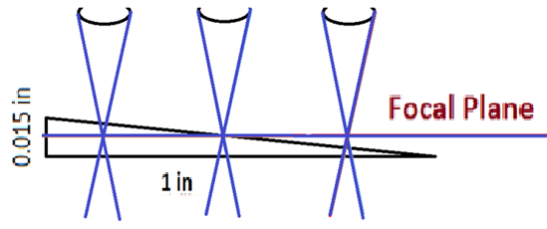
Feasibility Study of Z sensitivity
Use a slightly tilted grating
At 100x magnification, monitor the line sharpness as a function of x position

Slide 25
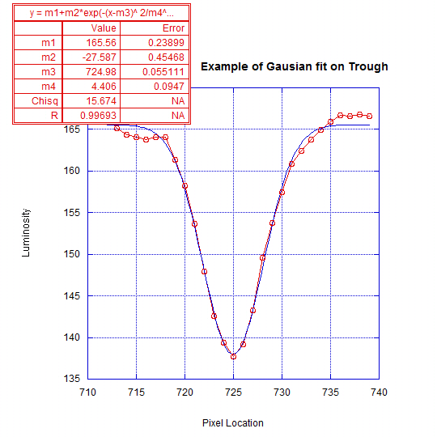
Z Axis Calibration – line widths
Areas with sharp lines are on the focal plane
Blurry areas are either above or below the focal plane
The sharpness is measured by the apparent width of the grating lines in the luminosity graph

Slide 26
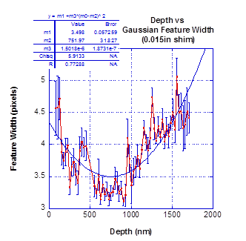
Feasibility Study: Z AxisCalibration
The plotted widths have a minimum at the focal plane
The parabolic fit parameter error gives the depth resolution of the focal plane.
A depth resolution of about 30 nm is observed.

Slide 27
Potentiality
Depth of scatterers in the coating layers can be measured if sufficient contrast is available.
Scatterer “size” can be corrected for the depth attenuation effect
The large angle and wide light spectrum of the light used by the microscope may allow exploration of scatterer distribution deeper than the first 2-3 layers

Slide 28
Next steps
Continue the feasibility study on a aLIGO witness sample mirror using a piezo actuator scanner in the microscope

Slide 29
Conclusions 1
A very large population of scatterers was found on aLIGO mirrors under high-power illumination.
They contribute to large angle optical scattering,
if the observed points are the locus of mechanical dissipation, they may explain the anomalous mechanical dissipation observed in sputtered coatings.
The discovery is a good diagnostic tool, perhaps indicating possible ways to improve the Sensitivity limitation of Gravitational Wave detectors

Slide 30
Conclusions 2
Methods are being developed to monitor
mirror to camera and
beam to mirror micro-movements
Both can be valuable diagnostic tools at the observatory

